Slide 1
Drought Outlook Support Briefing June 2021
Climate Prediction Center/NCEP/NOAA
http://www.cpc.ncep.noaa.gov/products/Drought

Slide 2
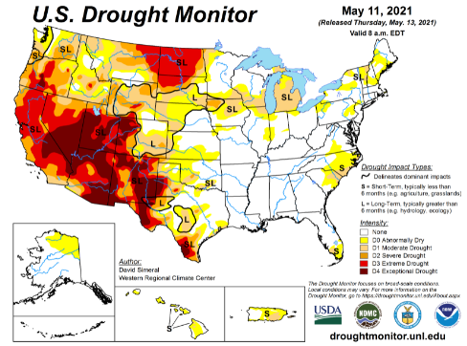
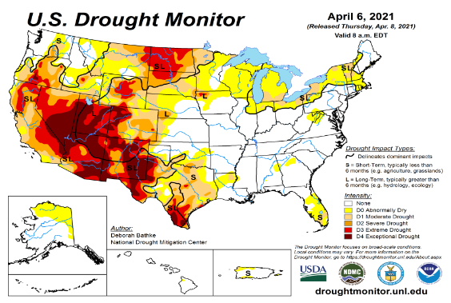
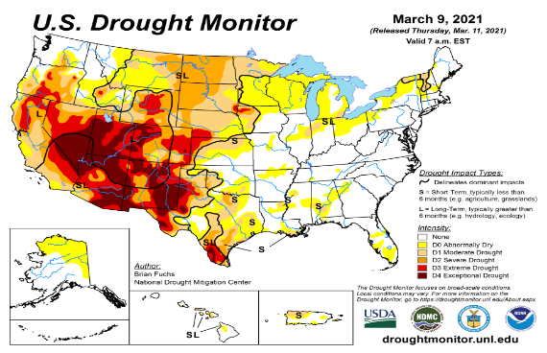
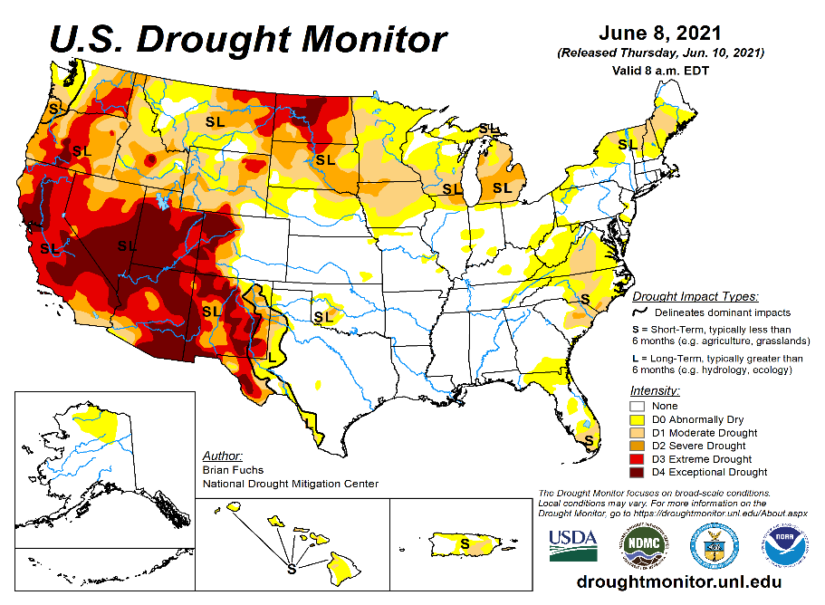
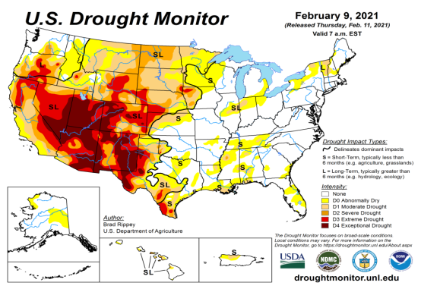
Drought Monitor
Monitoring is important because, unlike US T/P fcsts, for drought forecasts, we have to know where we are, before we can tell where we are going!! Drought forecasts are tendency forecasts.
May
April
Over the last 4-5 months, drought area & severity has overall generally remained about the same. The worse drought conditions are in the border areas of southwest states CA, AZ, NV, UT, CO, and NM. These west regions are part of the long term drought. Improvement has been noted over parts of TX.
The drought OR, WA in the Dakotas, MT, ID, Wyoming, has also either expanded or intensified.
About 50 % of the country is continuing to experience category D1 or worse drought condition (next side!). Most US area under D4 (about 10%) continuously in recent months since 2000?
The Drought in the Northern Great Plains has reached D4 level in some areas. June is the rainiest month of the summer rainy season. Rainfall in the next many weeks or month will decide if this drought area will expand or contract.
March
June
(Recent/Latest)
February
February

Slide 3
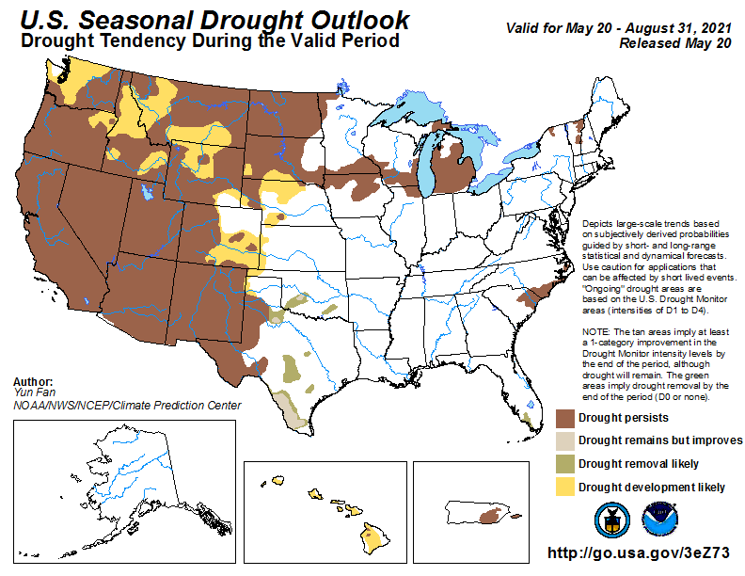
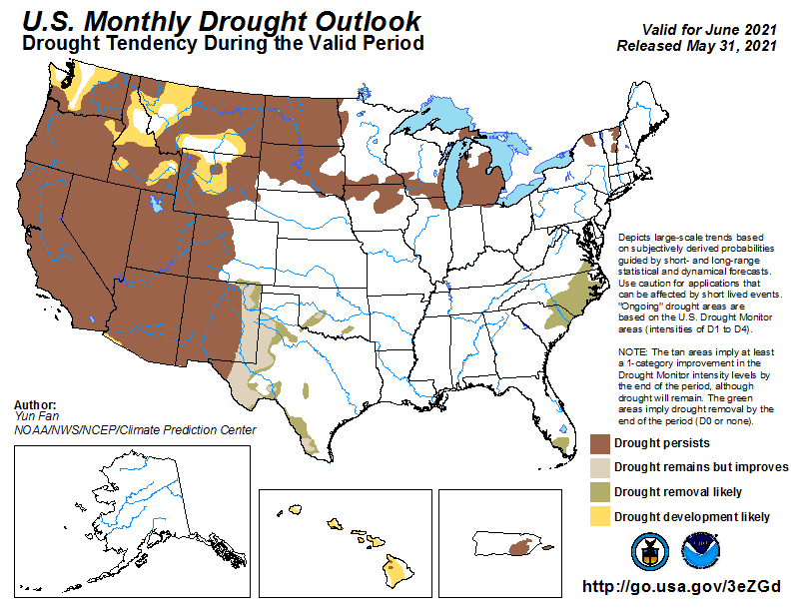
(Prev) Seasonal/Monthly Drought outlooks
(New Seasonal+ Drought Outlook to be released in 2 days!)
(New Monthly Drought Outlook to be released end of this month)
Seasonal Outlook
(Mid May 2021- Aug 2021)
issued 05/20/21
Monthly outlook
(for June 2021)
issued 05/31/21
Similar looking Monthly and seasonal outlooks, except in the northeast!
Also compare West vs East.

Slide 4
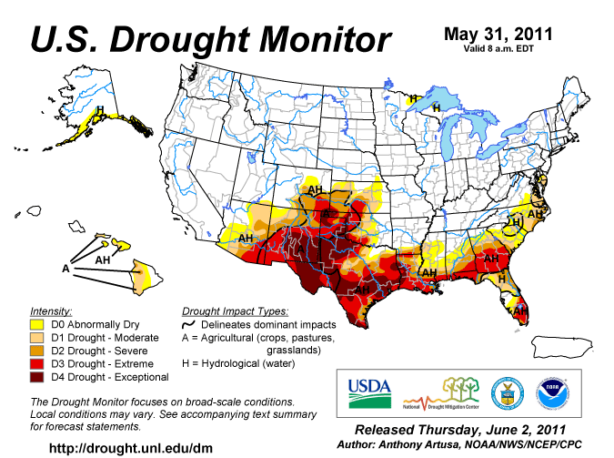
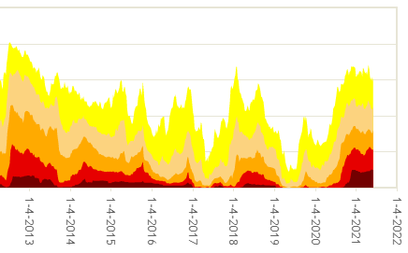
Famous 2011 TX drought
Each drought is different!!
The recent drought has somewhat stagnated ?
50%
Now!
Most area under severe D4 drought for a long time since 2000?

Slide 5
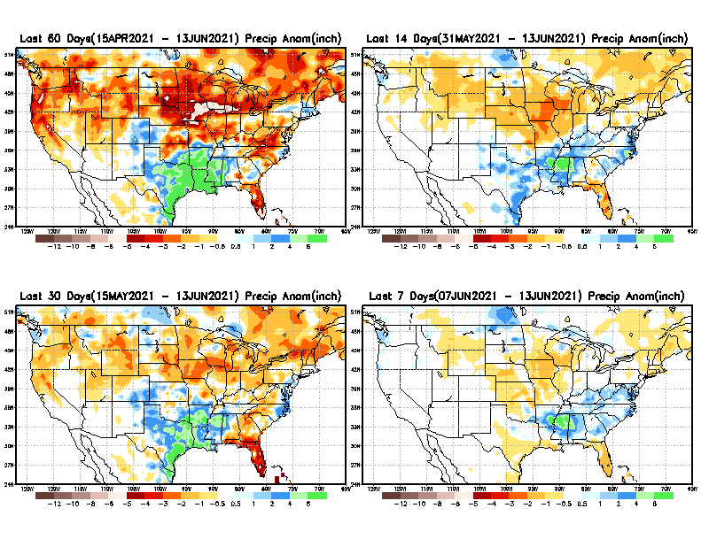
Precipitation ANOM during last 7, 14, 30, & 60 days.
This and next few slides show Precip deficit (excess).
Droughts, for the MOST part, begin and end with precip!! Lately, Temps are becoming (secondarily) important as well.
60 Days
14 Days
30 Days
7 Days
These maps in this and following slides, including a) Total,
b) Anom and
c) Percent of Normal precip. in these and other longer time ranges are now (routinely) daily updated at:
From: Recent Accumulated Precipitation https://www.cpc.ncep.noaa.gov/products/Drought/briefing_prcp.shtml

Slide 6
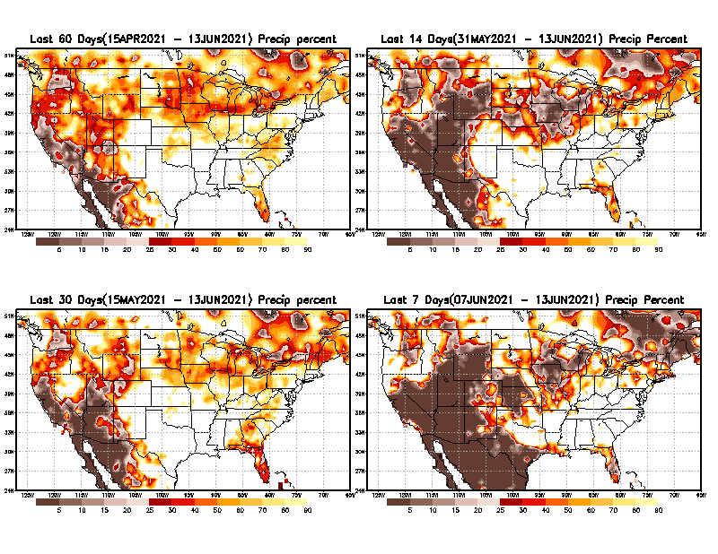
Precipitation Percent during last 7, 14, 30, & 60 days.–Only Deficit Areas shown!! <=90%
60 Days
14 Days
This plot shows only the rainfall deficient regions <= 90% of normal.
-- This shows more clearly possible/likely drought developing region in the future unless there is above normal rainfall in these regions in the future, to offset these shortfalls.
30 days
7 Days
Current/June is the rainiest month of the year for the Northern Great Plains (Montana, Dakotas, see later slides)!!
Southern FL is worrisome!! But upcoming rainy season will help.
From: Recent Accumulated Precipitation https://www.cpc.ncep.noaa.gov/products/Drought/briefing_prcp.shtml

Slide 7
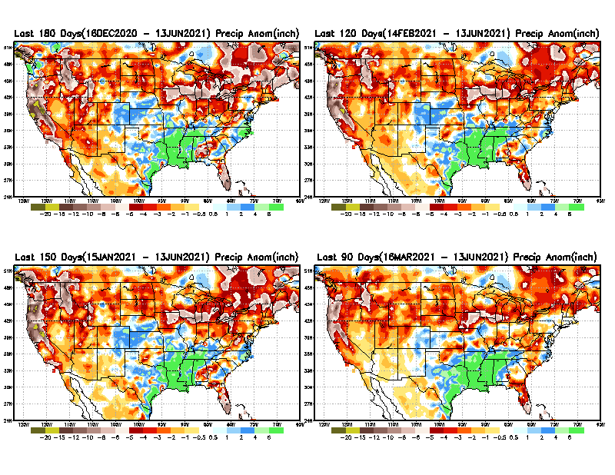
Total precipitation ANOM during last 3, 4, 5, and 6 months.
6 M
4 M
While the Precipitation anomalies deficit may seem large in some regions (compared to others), it is the % of normal precip (next slide) that matters more!!
5 M
3 M
From northeastern IA extending eastward, strong –ve precip anomalies, looks bad, but not so bad in the percent map!!
From: Recent Accumulated Precipitation https://www.cpc.ncep.noaa.gov/products/Drought/briefing_prcp.shtml

Slide 8
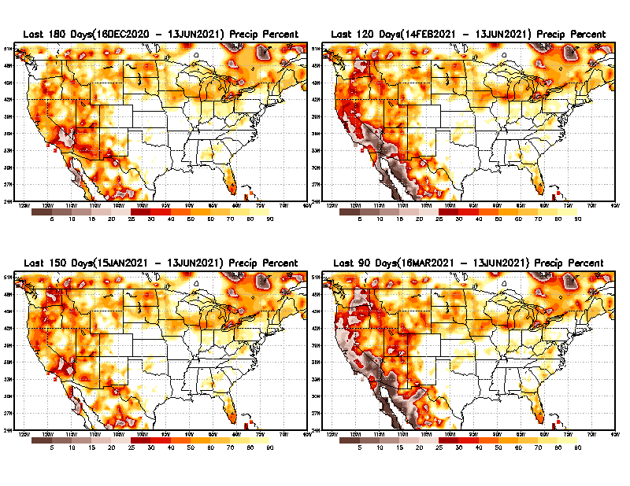
Total precipitation Percent during last 3, 4, 5, and 6 months–Only Deficit Areas!! <=90%
6 M
4 M
In these interim time scale 3-6 months, we need to pay attention to regions, which are dark-brown, red & dark red (<50%).
While accrued precipitation deficits are real & objective,
droughts are subjective declarations!!
5 M
3M
East vs West!
Broad vs Narrow
rainfall season.
In general, West suffers more from frequent and lasting droughts.
With these various rainfall deficits in diff. time ranges, where and how exactly does one declare drought? Other factors (T/SM/E, etc..) do matter, but is cumulative precip. Are deficits/percent_of_normal ultimately more important?

Slide 9
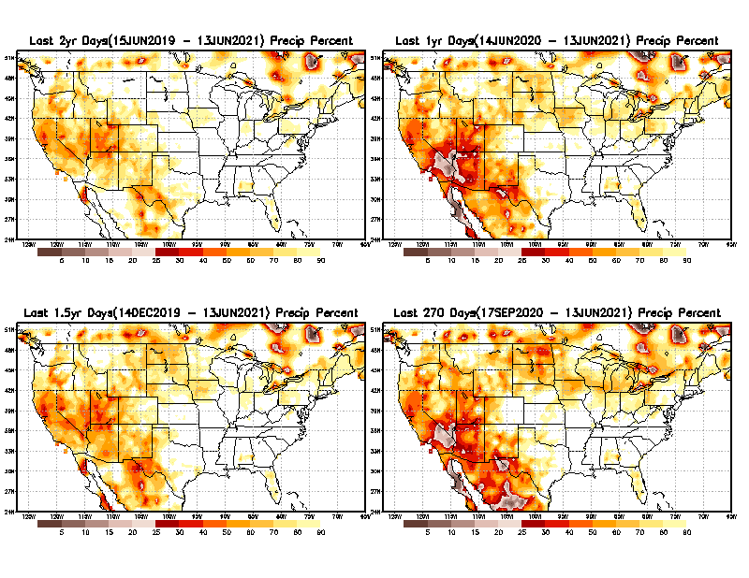
Total precipitation Percent during last 9 months, 1 yr, 1.5yrs, & 2 yrs. .–Only Deficit Areas shown!! <=90%
2 Y
1 Y
Tinderbox areas, where some form of longer term rainfall
deficiencies already, exist !!
-Almost all are in the southwest!, all part of the long term drought
-This & Next slide!!
1.5 Y
9 M
From: Recent Accumulated Precipitation https://www.cpc.ncep.noaa.gov/products/Drought/briefing_prcp.shtml

Slide 10
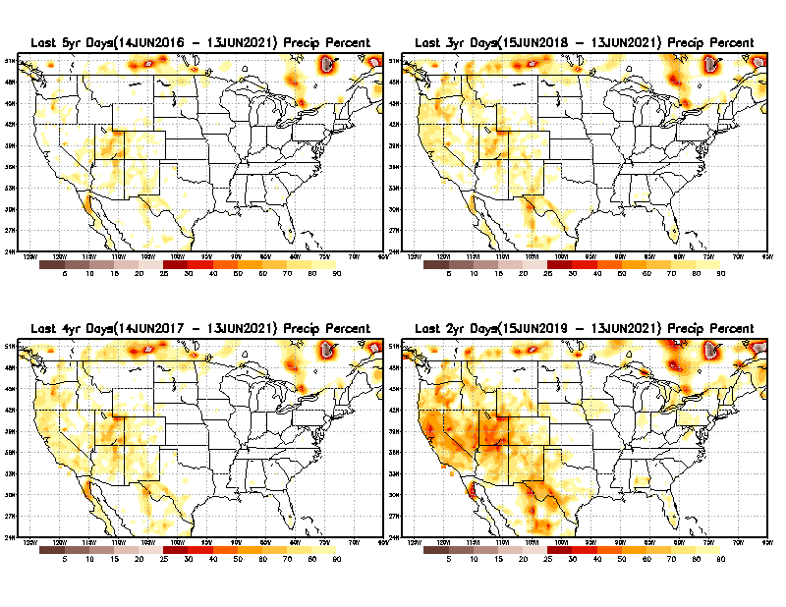
Total precipitation Percent during last 2 yrs, 3 yrs, 4 yrs, & 5 yrs. .–Only Deficit Areas shown!! <=90%
5 Y
3 Y
In these long time ranges (2-5 yrs), there is a general dearth/lack of precipitation in the southwest US. – where the current severe drought ravages!!.
If the La Nina returns later in the year, things will get even worse!!
4 Y
2 Y
Ongoing multiyear drought in the SouthWest!! Getting Worse.
Last few years, each year is a new record for the Fire Season!!
From: Recent Accumulated Precipitation https://www.cpc.ncep.noaa.gov/products/Drought/briefing_prcp.shtml

Slide 11
Rainy (3-month)Season across the US
East vs West!
More darker colors in west/central => narrow rainy season (months)
Overall, more white space in the east => distributed rainfall season (except ~FL).

Slide 12
*********
EAST vs
CTR/WEST
Drought Behavior is loosely tied to rainfall climo!! And the limited rainy season in the west
*********
Adapted from Rich Tinker.

Slide 13
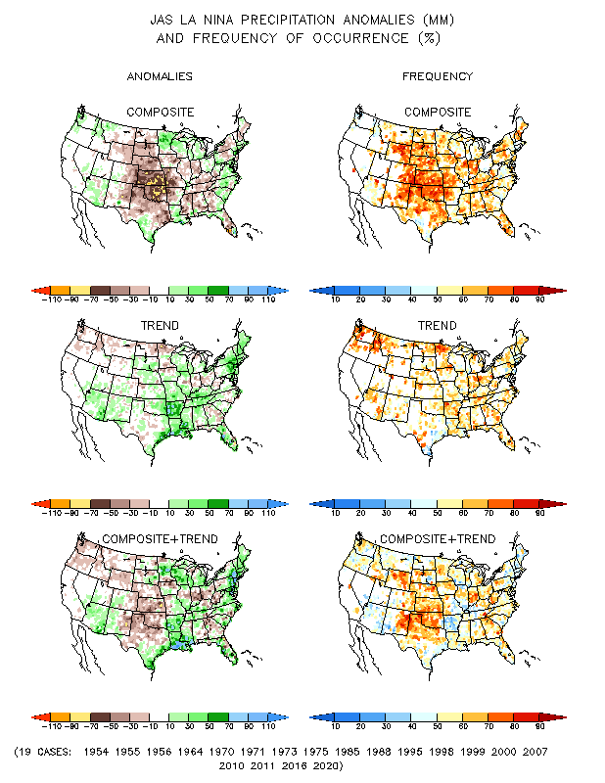
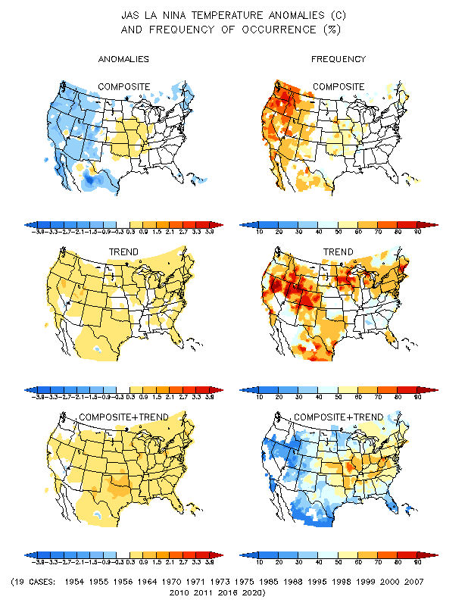
La Nina Precip/Temperature COMPOSITES & Trend map
JAS
P
T
With expected ENSO-neutral conditions, this row is relevant!!

Slide 14
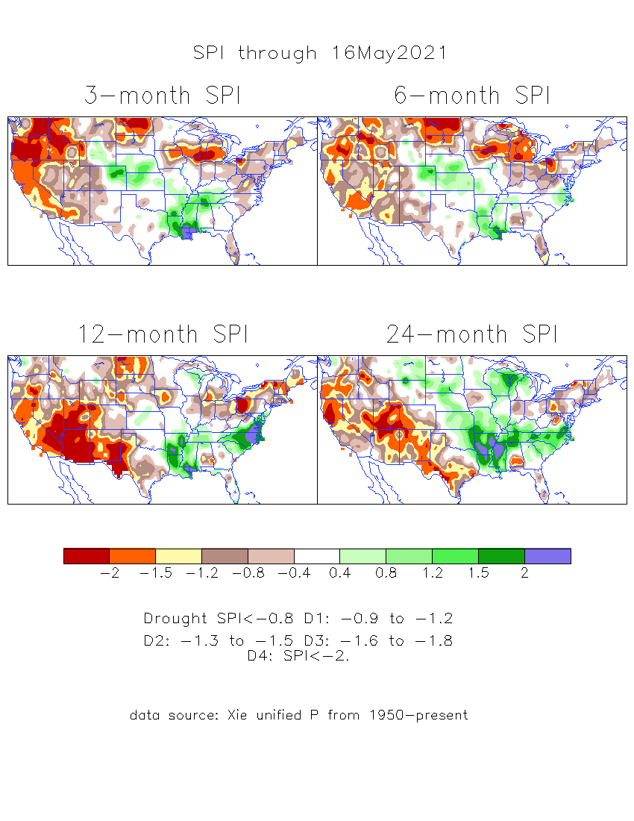
The Standardized Precipitation Index SPI (based on Observed P)
----- Last Month
Very interesting graphic & details for the drought across the US based on the more generalized precip deficit/excess, the Standardized Precipitation Index (SPI).
The dark brown and red colors, indicating standardized precipitation deficits, in the various time periods, approximately correspond to the appropriate short/long term drought monitor regions and their intensities

Slide 15
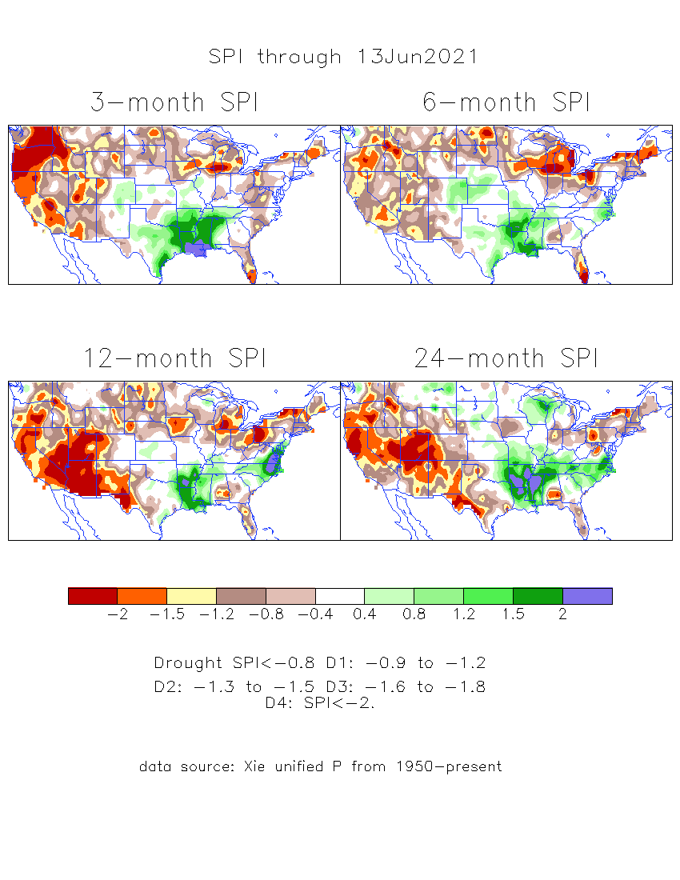
The Standardized Precipitation Index SPI (based on Observed P)
----- NOW
Very interesting graphic & details for the drought across the US based on the more generalized precip deficit/excess, the Standardized Precipitation Index (SPI).
The dark brown and red colors, indicating standardized precipitation deficits, in the various time periods, approximately correspond to the appropriate short/long term drought monitor regions and their intensities
Short
The short term drought has shifted/extended from southwest to northwest. But the long term drought in the southwest remains.
----- NOW
Long
How does one negotiate and reconcile declaring short term vs long term drought when precip. deficiencies patterns differ on many different time scales locally!!
What is the cutoff delineating time between short VS long term drought!!

Slide 16
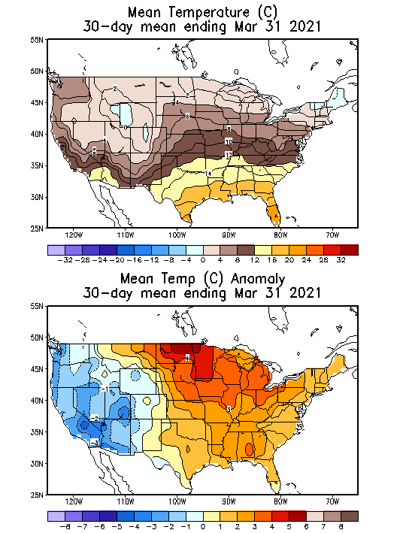
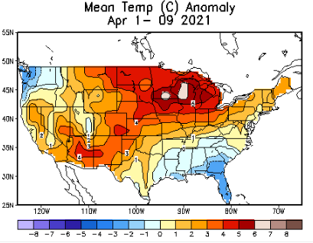
Recent US Temperatures
(MARCH-
Slide shown last month)
Such swings in winter Temperatures
Even in the midst of La Nina!!
From Jan –> Feb -> Mar
Great volatility even during strong ENSO!

Slide 17
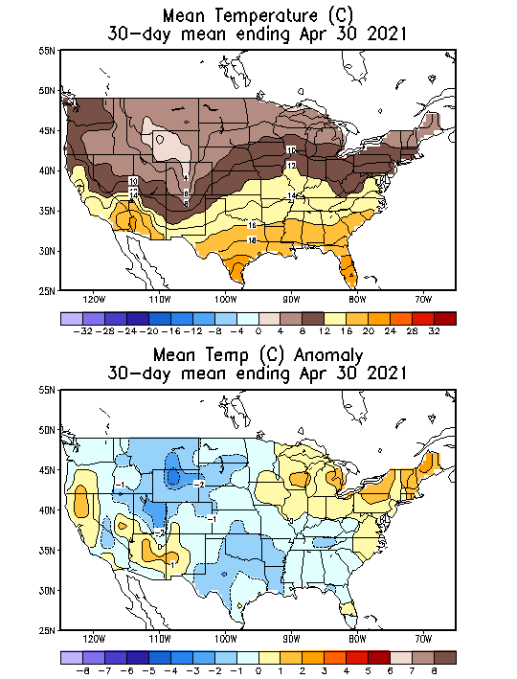
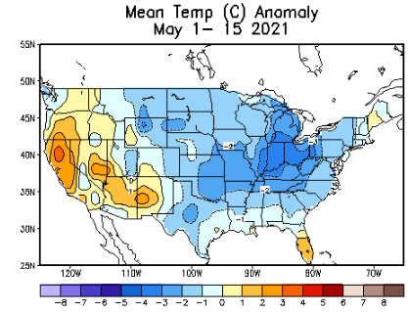
Recent US Temperatures
Such swings in winter Temperatures
Even in the midst of La Nina!!
From Jan –> Feb -> Mar
Now back to cold across much of US! So far!!
So far this month !!
Remember, the TX freeze!!

Slide 18
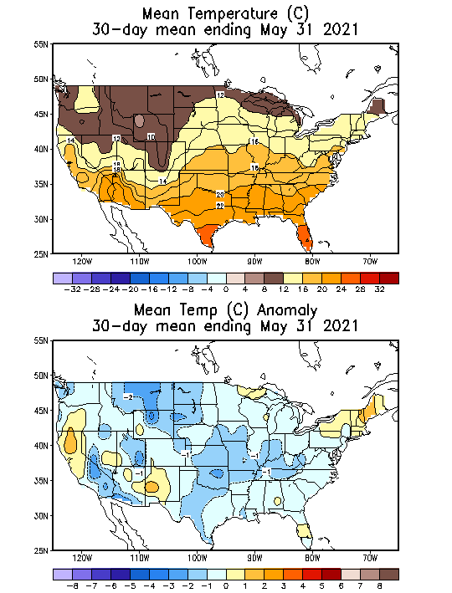
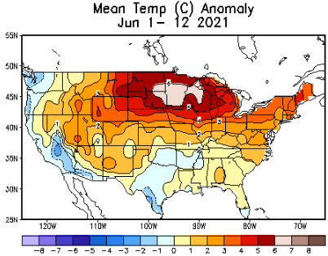
Recent US Temperatures
Such swings in winter Temperatures
Even in the midst of La Nina!!
From Jan –> Feb -> Mar
Now back to cold across much of US! So far!!
So far this month !!
Remember, the TX freeze!!

Slide 19
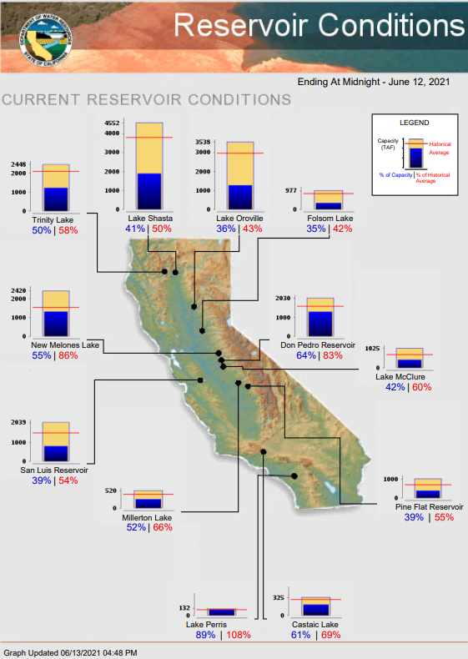
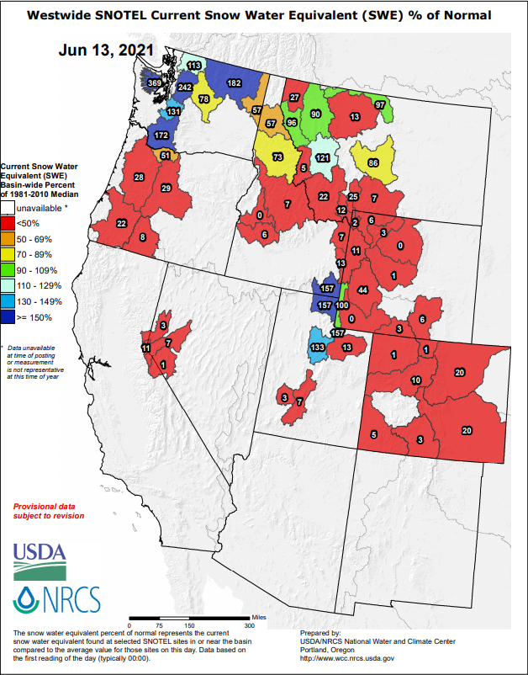
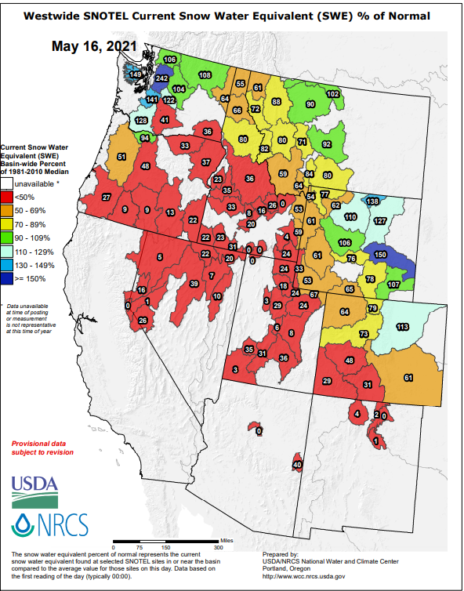
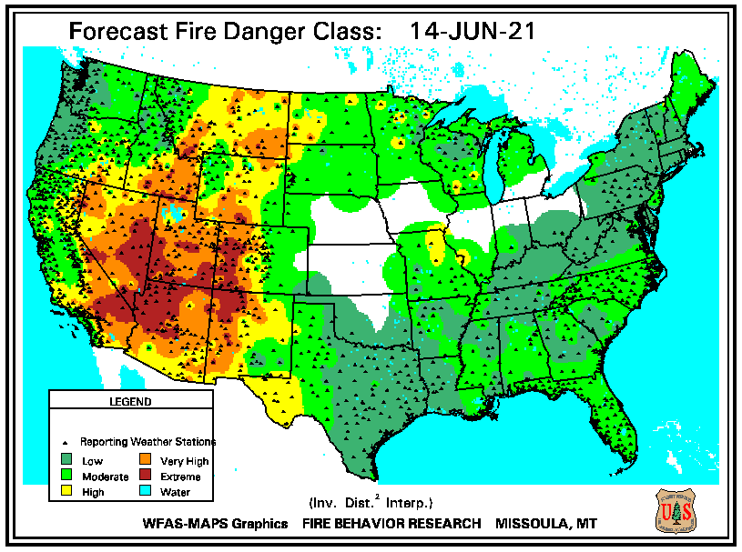
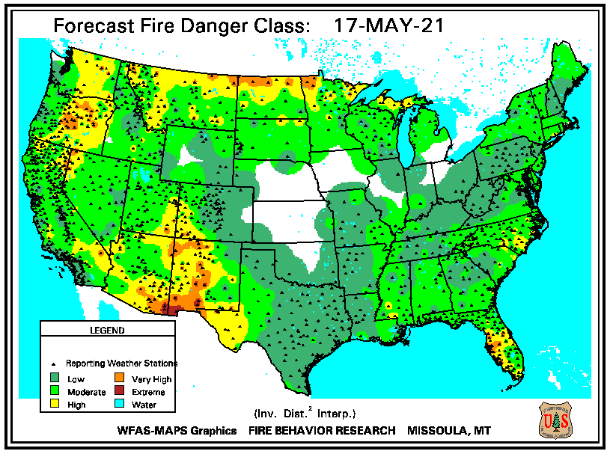
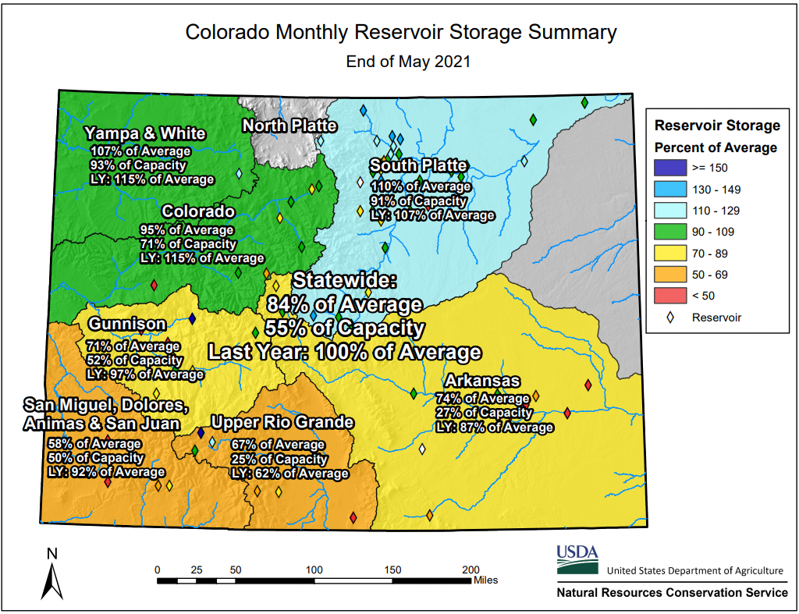
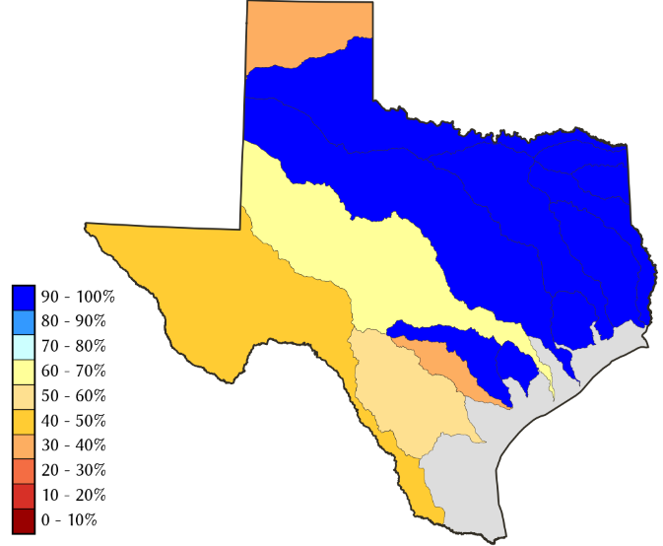
THIS MONTH
1 MONTH ago
https://fsapps.nwcg.gov/
Many CA reservoirs are already low!!
TX
CO
If La Nina continues reappears later this year, it will be a major problem for water in the western states!!!!
ALARM/WARNING!! for this year’s Fire Season for the US West/Southwest states!! (see US Drought Monitor!)
84 %
of AVG!

Slide 20
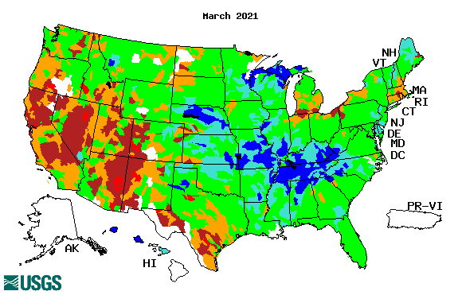
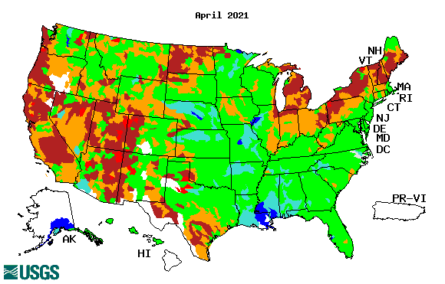
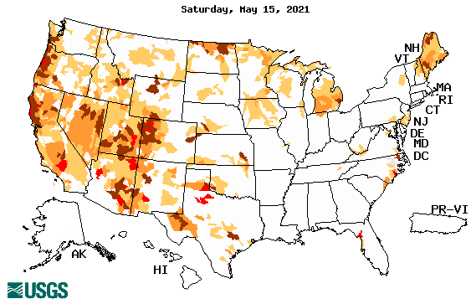
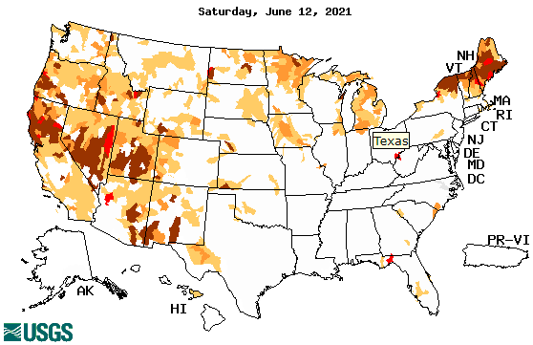
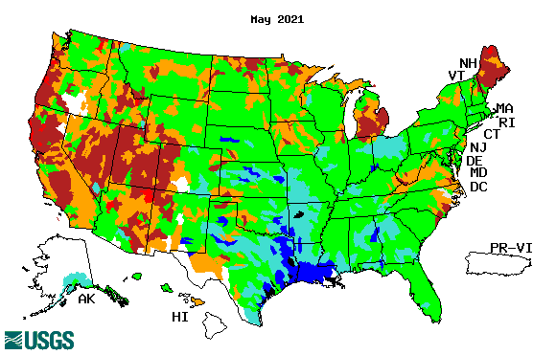
Streamflow (USGS)
Same data source USGS:
Look at the monthly maps for Northeast vs weekly maps in the bottom!!
Map shows only below normal 7-day average streamflow compared to historical streamflow for the day of year.
One month ago (left) &
Now (below)
Streamflow is only a partial indicator, as it is highly managed.
Look along the Pacific coastal states. If sometimes, the various indicators are confusing, go back to % of rainfall deficit maps – to reinforce!!
20

Slide 21
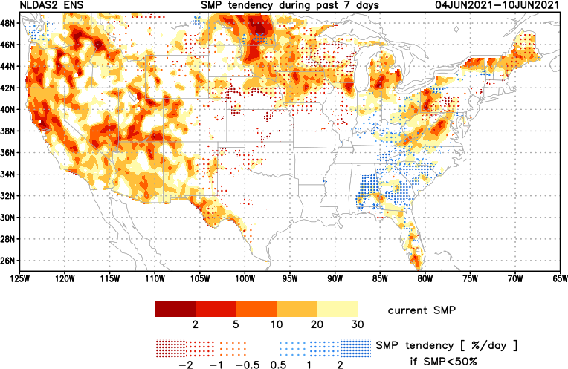
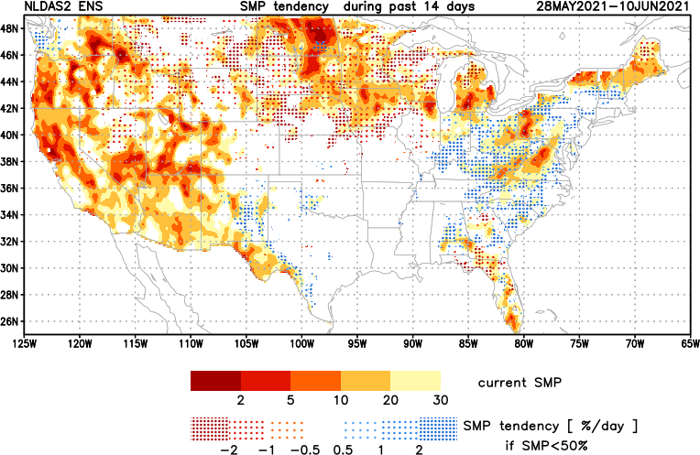
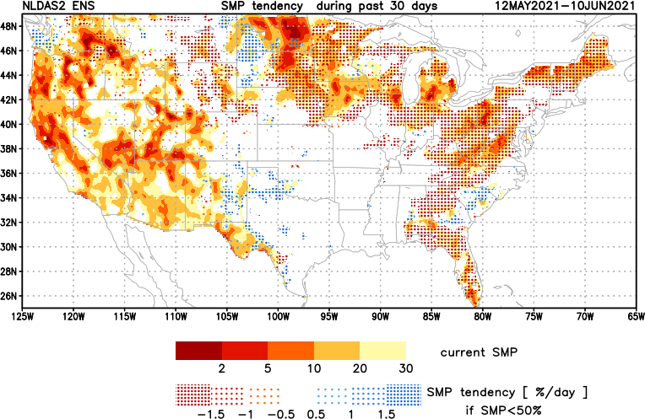
[Now]
NCEP Ensemble mean NLDAS2 models’ Soil Moisture tendency/trend
7 days
14 days
30 days
These NLDAS2 based SM tendency mas are a few days old!! But note the change in the middle part of the country!! Upper Midwest consistently dry!!

Slide 22
EL NIÑO/SOUTHERN OSCILLATION (ENSO)
DIAGNOSTIC DISCUSSION
issued by CLIMATE PREDICTION CENTER/NCEP/NWS and the International Research Institute for Climate and Society
10 June 2021
ENSO Alert System Status: Not Active
Synopsis: ENSO-neutral is favored through the Northern Hemisphere summer (78% chance for the June-August season) and fall (50% chance for the September-November season).

Slide 23
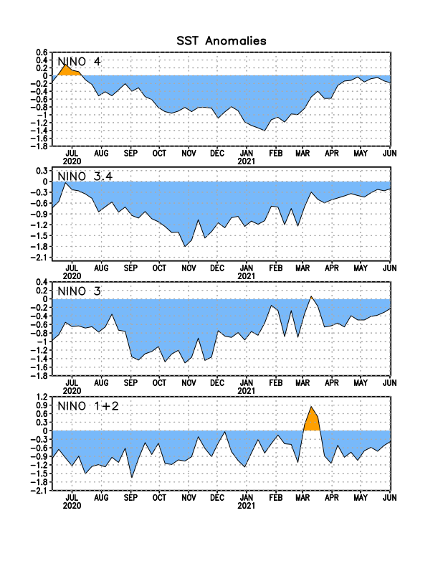
Latest values of SST indices in the various Nino Regions.

Slide 24
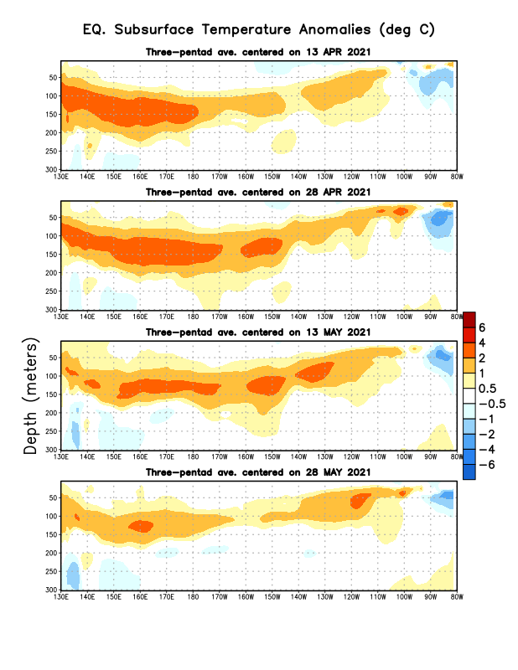
Sub-Surface Temperature Departures in the Equatorial Pacific
The current La Nina conditions has finally ended.
But the million dollar question is: Will there be ENSO neutral conditions in the upcoming season as forecast or ? Look at subsurface conditions!!
Most recent pentad analysis

Slide 25
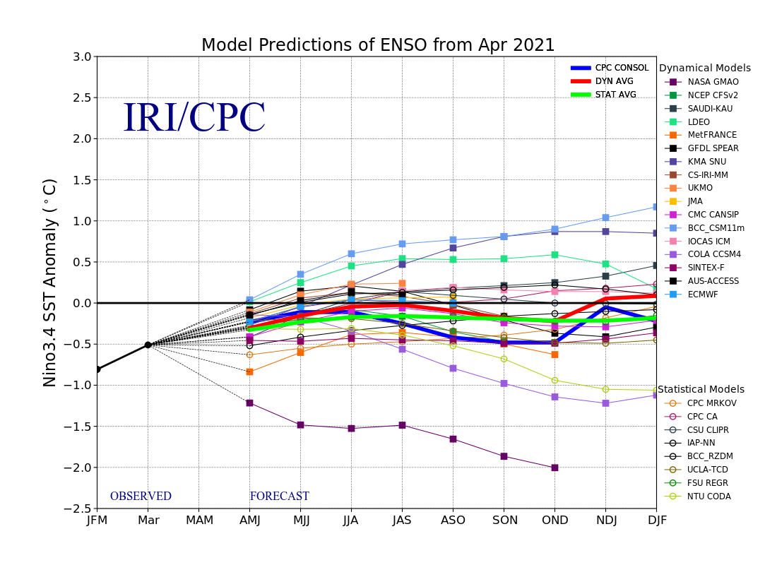
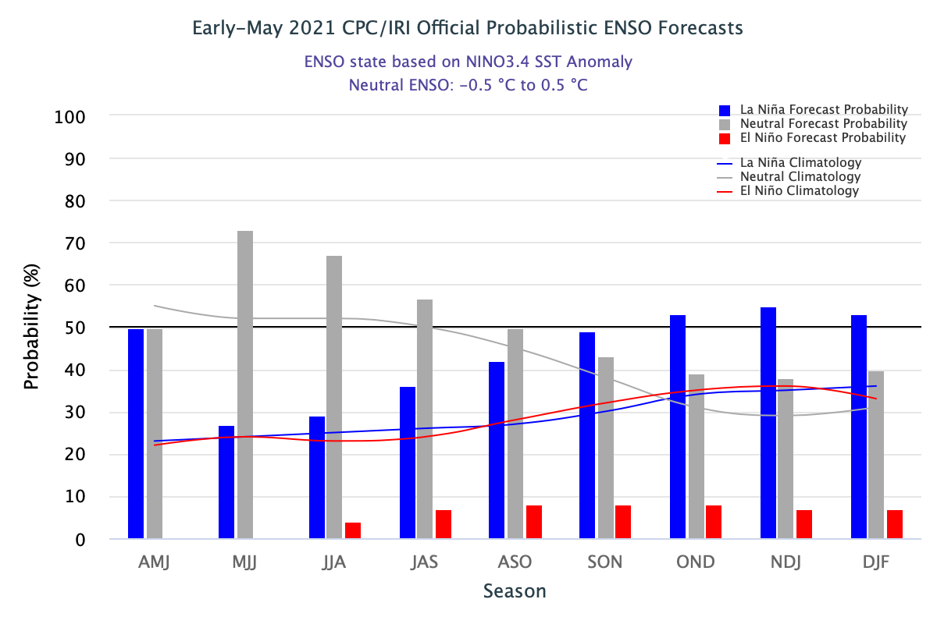
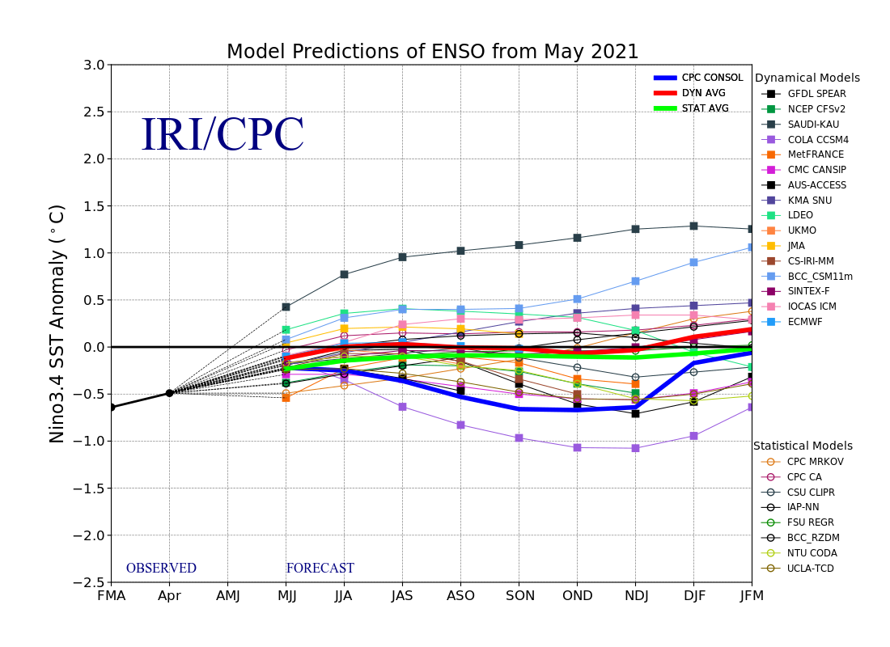
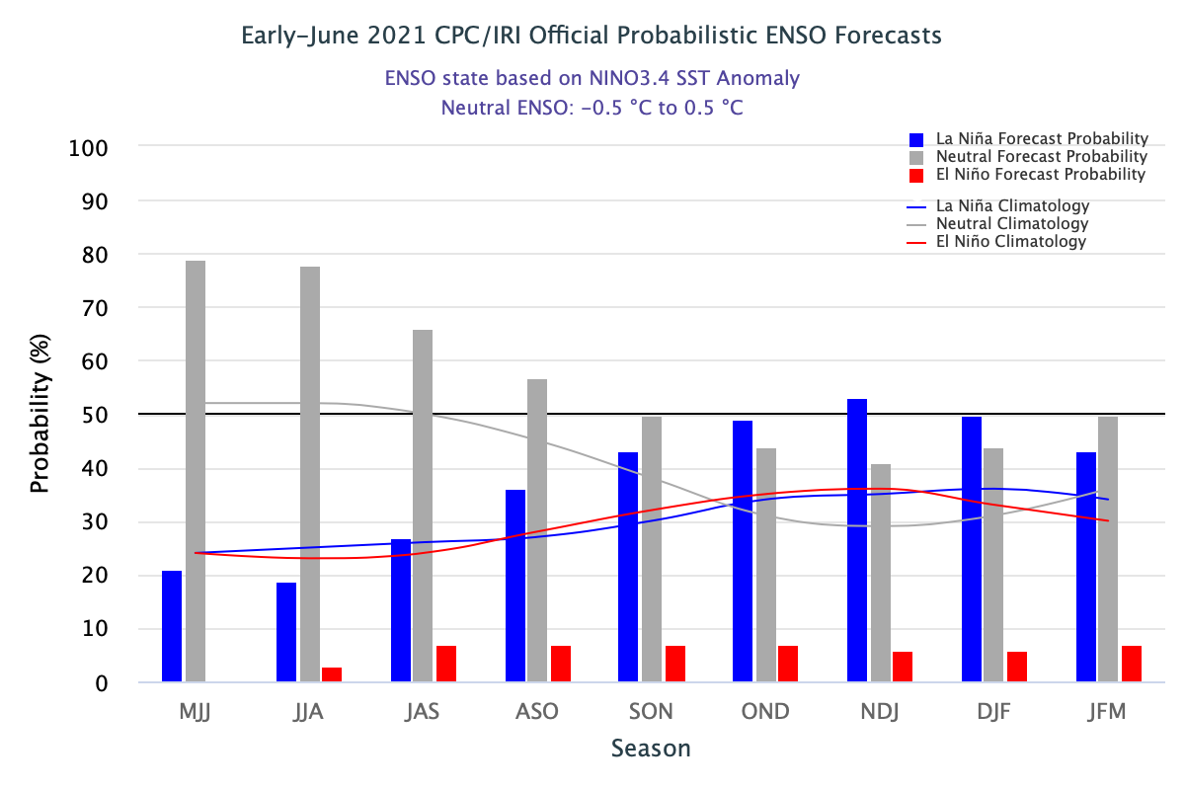
ENSO Forecasts
Early- May CPC/IRI forecast
Early- June CPC/IRI forecast
La Nina is on its way out temporariy? Only to come back later in the year?

Slide 26
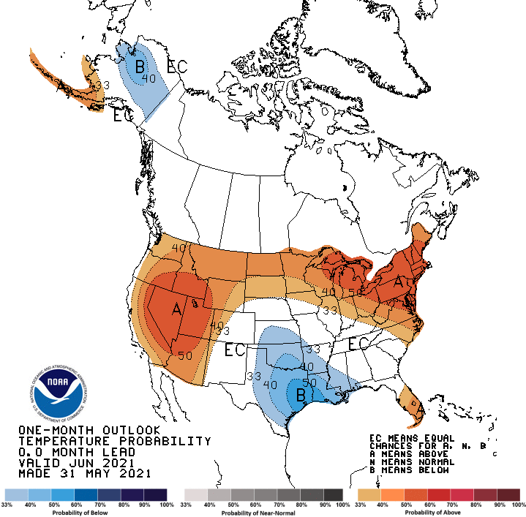
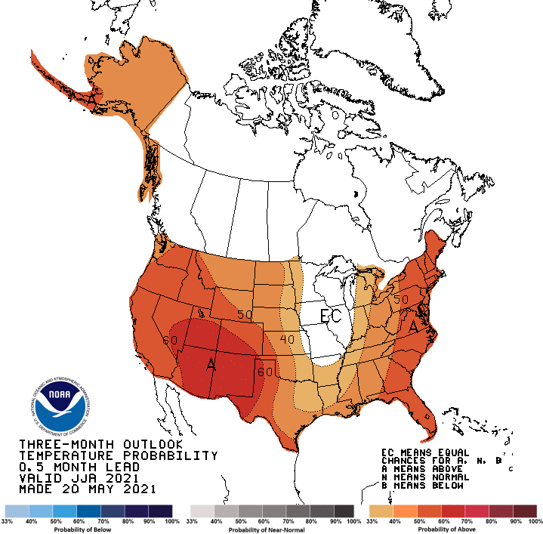
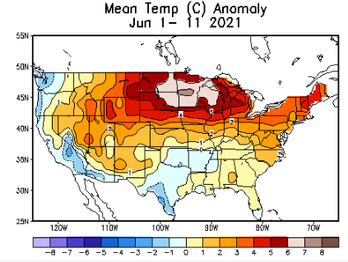
Made
May 31st
Previous (Last Month)
CPC’s official
Temperature OUTLOOK for Monthly (June)/Seasonal (JJA)
Made May 20th
Observed so far this month!! ☺

Slide 27
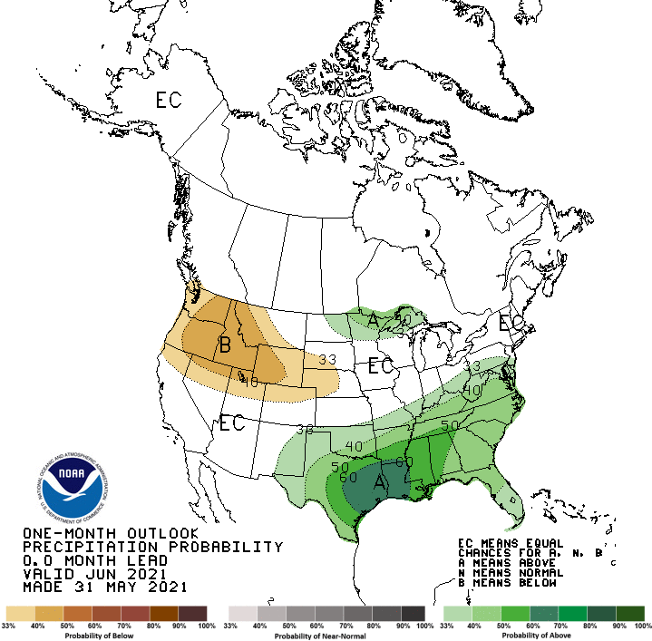
Previous(Last month)
CPC’s official
Precipitation OUTLOOK for Monthly (June)/Seasonal (JJA)
Released May 31st
Released May 20th
Observed so far this month!! ☹
Monthly P/T forecasts verified at mid-month are generally good! Why? ☺
(becoz they are mostly based on GFS’ 2-wk fcsts).
But so far, fcst looks ??

Slide 28
NCEP/WPC Next 7 days QPF Forecast
Actual Precip amounts and region generally varies highly from one model run to next!!
GFS Model Guidance for the
next 16 days.
Looks like the southwest American monsoon is making its entry in NM in about 2/3 weeks. Northern Ohio valley is also forecast to get some rain to help the drought in that region.

Slide 29
From European Center (EC) Precip forecast (made yesterday, 14 June) for next 30 days.

Slide 30
From European Center (EC) Precip forecast (made yesterday, 14 June) for next 30 days.

Slide 33
ECMWF-extended forecast derived VIC model soil moisture percentile forecast
(From Dr. Li Xu) More detail at https://www.cpc.ncep.noaa.gov/products/people/lxu/flashd/flash_prediction.html

Slide 34
NMME T & P Ens.Mean forecasts for
July
Much of the country is fcst to be warm, except in eastern TX & vicinity/ The south/ west is WARM+
JAS
With No ENSO signal!! Less rain in the west where there is drought!
Will the drought expand/redevel-op further in the NW? and in the Northern Great Plains area

Slide 35
Agreement/Disagreement among the various NMME models’ JAS seasonal Precip. Forecast.
??

Slide 36
SPI6 Fcst made from last month(background) compared with this month(foreground, red border)
Why is there so fewer hatched areas in SPI6 fcst from NMME models’ based fcst this month as compared to last month (left 2 columns) ? Fcsts more confident now?
Forecast uncertain in Hatched areas.
Many pieces of hatched areas in the central and mostly in the eastern half of the US – indicating the model’s inability to know the status of drought here.
SPI6 Fcst made from last month
SPI6/SPI12 Fcst made from this month

Slide 37
http://drought.geo.msu.edu/research/forecast/smi.monthly.php
Latest Initial Conditions:
06/01/2021
Predicted Monthly Soil Moisture Percentile
MSU Soil Moisture Percentile forecast NOT available, NOT updated!
CPC’s soil moisture percentile – Leaky bucket Model
The inter quartile range suggest greater uncertainty about the forecast in these shaded regions.

Slide 38
Summary
Current Drought conditions:
Over the last 4-5 months, drought area & severity has overall generally remained about the same. The worse drought conditions are in the border areas of southwest states CA, AZ, NV, UT, CO, and NM. These west regions are part of the long term drought. Improvement has been noted over parts of TX. The drought OR, WA in the Dakotas, MT, ID, Wyoming, has also either expanded or intensified.
About 50 % of the country is continuing to experience category D1 or worse drought condition (next side!). Most US area under D4 (about 10%) continuously in recent months since 2000?
The Drought in the Northern Great Plains has reached D4 level in some areas. June is the rainiest month of the summer rainy season. Rainfall in the next many weeks or month will decide if this drought area will expand or contract. It is unclear how long the narrow eastward extending region of drought from southern Dakota and Iowa will further develop or diminish.
Some/many of California reservoirs levels are below their historical average levels. If a second year La Nina remerge later this year (hope not!) it will worsen the water situation much further! Current drought conditions in the western states is unfortunately a harbinger of probably bad fire season this year also!
Current ENSO status and forecast: ENSO-neutral is favored through the Northern Hemisphere summer (78% chance for the June-August season) and fall (50% chance for the September-November season
Prediction:
With the ENSO neutral conditions during the forecast season, how good will be the model forecasts? Nevertheless, with the forecast above normal temperatures in the west and the continued dry season along the west coast states, the short term drought in the Pacific coastal and adjoining states especially in OR/WA is expected to broaden and get worse.
The long term drought in the south and west is so entrenched, it is likely that those conditions will probably stay the same through the forecast season, especially when the forecast temperatures here are so warm. Each of the last two or three years has seen a new record fire season, and the present and forecast T/P conditions here are likely to contribute to a yet another severe fire season for the region. Water shortages could certainly develop in many of the southwestern states. When the southwest monsoon rainfall begins soon in the next few weeks, there can be some short term relief here, but not for long term drought.
The dryness or precipitation deficit in parts of FL is of some concern in the very immediate short term, but unlikely to develop into a drought by the end of season, as both the upcoming rainfall and hurricane season appear favorable. The dryness in the mid-Atlantic coasts is unlikely to develop into a drought by the end of the forecast season.
The drought in the Northern Great Plains is both short and long term, and is likely to get some relief in some form in the forecast season, as these upcoming months are part of the main rainy season. ***********

Slide 39
Miscellaneous maps

Slide 40
Miscellaneous maps

