Slide 1
Drought Outlook Support Briefing June 2023
Climate Prediction Center/NCEP/NOAA
http://www.cpc.ncep.noaa.gov/products/Drought
Points to ponder:
Often, there is a disconnect between the Short term (S) and Long term (L) drought in regions, and even with the short term (S) drought, the 3-month and 6-month signals are not quite consistent! With Long term (L) drought, it is even more trickier, as it is open ended from 1 year and beyond!!!
Places/regions experiencing Short term drought may (not) be ok in the Long term and vice versa!!
This duality is difficult to reconcile, to convey and even be clearly understood well by the public at large.
Public/Forecaster generally tends to focus more on the Short term Drought (for good reasons!!)
More importantly the very definitions and timescales associated with S/L term droughts and the declarations in the USDM are by themselves subjective!!
The S/L term drought conditions in large parts of California, a year ago, even just a few months ago, has now mostly gone. Many/most reservoirs in CA are at or above their historical averages and even near capacity. However, the two large major reservoirs, Lake Mead and Lake Powell in the CA/AZ/UT border area are at dangerously low levels, thus impacting hydro electric power supply and distribution to nearby states. Even the big snow melt from the record large snow amounts in the region did not help fill these two reservoirs.
It may take a long time for drought to develop, but those conditions can end very quickly! Forecast models are yet to (seasonal) correctly forecast these changes in advance!
Short term vs Long term drought need to be clearly distinguished and shown to the public!!
Subjective(delayed) USDM vs Objective(real time) map! A few days or recent heavy precip can change the USDM a lot!
New objective AI/Deep-Learning based Experimental ODI (objective drought indicator, runs daily) compared with Official USDM (US Drought Monitor, produced weekly by USDM authors).

Slide 2
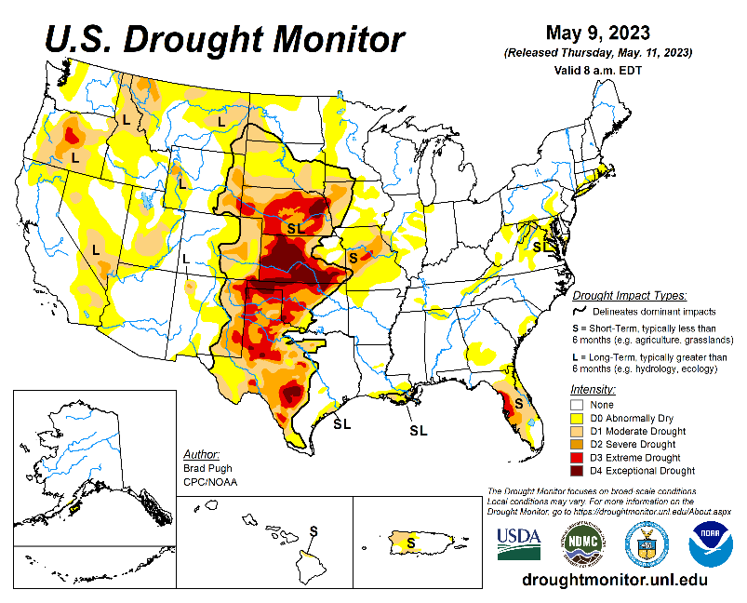
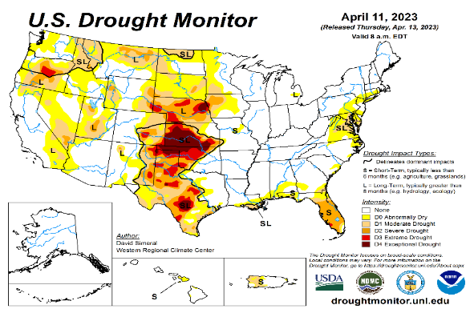
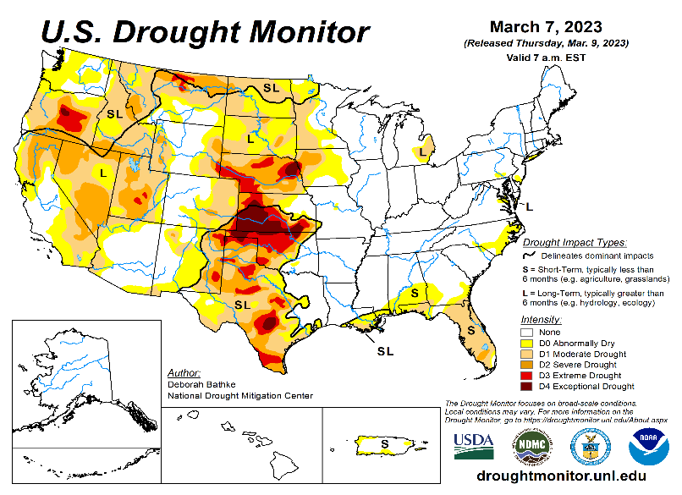
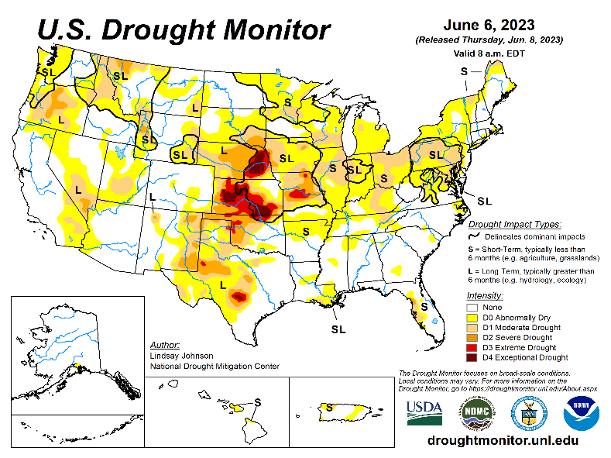
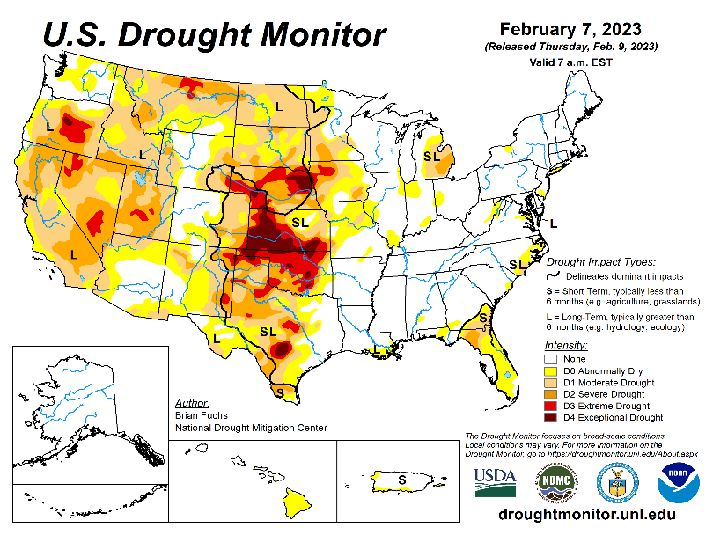
Drought Monitor
Monitoring is important because, unlike US T/P fcsts, for drought forecasts, we have to know where we are, before we can tell where we are going!! Drought forecasts are tendency forecasts.
May
Towards the end of last year 2022, until December or so, severe drought conditions (both short and long term) remained in the west, mild drought conditions expanded in to portions of the eastern half of the US also, covering most of the country with very high % areas of the entire US affected by drought. The situation now is now suddenly and drastically different.
With the start of winter rainy season in CA and the west coast states, the deluge/excess rain over CA and vicinity during the many weeks in winter months wiped out not only the S-term drought but also the L-term drought in most areas. Water levels in most CA reservoirs are now ABOVE their normal levels. However, the water storage levels in the huge Lake Powell and Lake Mead in NV continue to remain historically low, and decade(s) long hydrological drought still lingers. Recharge in to these two reservoirs from subsurface stream flows has been severely impacted.
Across the US, there is a considerable decrease and sudden drop in the areal coverage of all drought categories. Area covered by >D1 category drought is now < 25%.
The subjectively made, weekly once issued official USDM map is not able to keep up with the daily heavy deluge of rains during winter weeks, which can change severe rain deficits to severe excesses, from severe drought to severe floods in just a few days.
The sudden expansion of dry, S-term drought conditions in parts of upper mid-west and northeast has taken on a new dimension.
April
March
June
(Recent/Latest)
February
?

Slide 3
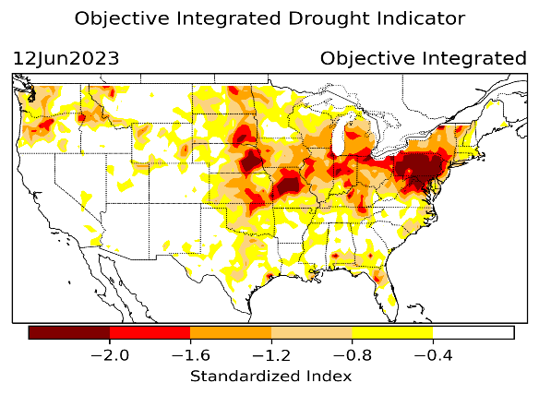
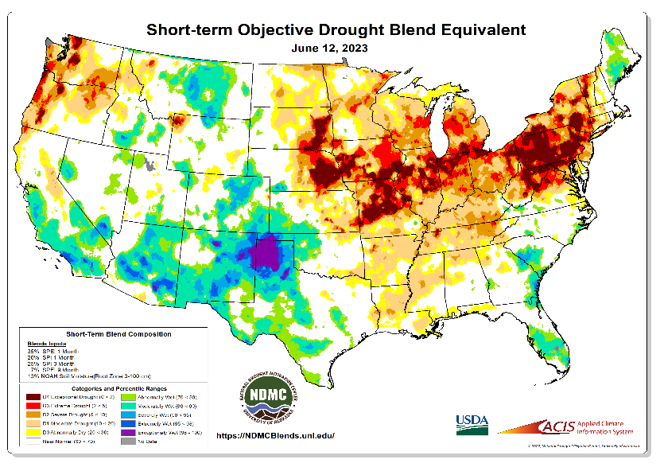
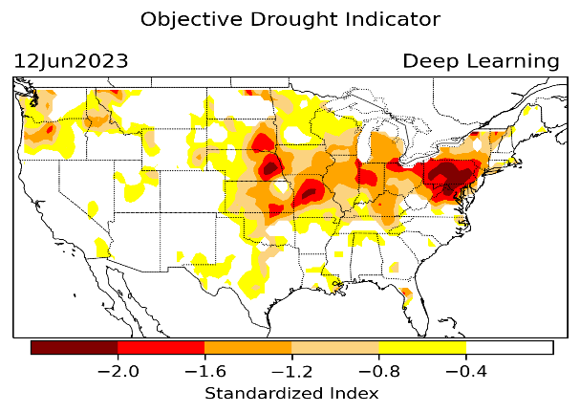
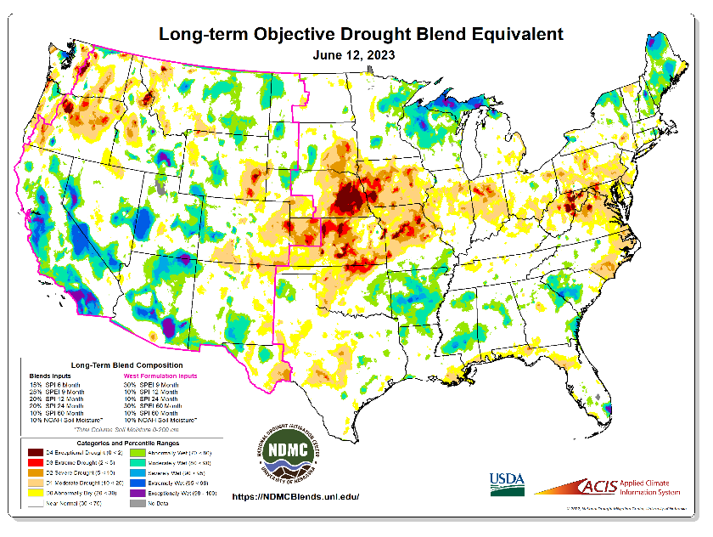
Exptl. Objective Drought Monitor (showing S/term & L/Term separately) from National Drought Mitigation Center (NDMC)
New slide now included in this briefing!
CPC’s own Experimental
Objective Drought Indicator (ODI)
using AI/Deep Learning ! – Updates daily !!
https://www.cpc.ncep.noaa.gov/products/people/lxu/odi/#deep-learning-increment-training
Based on the CPC P/analysis &
VIC (Princeton) NLDAS model assimilation:
Standardize Precipitation index (SPI)
Standardize Precipitation-Evapo –
transpiration index (SPEI)
Evapotranspiration Stress Index (ESI)
Soil Moisture Percentile (SMP)
Standardize Runoff Index (SRI)
-can be split into Short/Long Term Droughts!
https://droughtmonitor.unl.edu/ConditionsOutlooks/CurrentConditions.aspx
Objective &
Runs Daily!
Objectively Integrated
versus Deep Learning
methods.
Both Objective!
Both update daily!
Objective &
Runs Weekly!
On Monday!
Objective &
Runs Daily!
* A manuscript (Xu & Chelliah) is under preparation.
Official USDM (US Drought Monitor)
NOTE : A few days of heavy precip (as recently in CA!) can make big quick changes to the Short and even Long term drought conditions and hence impact the weekly once produced USDM.
???
Subjective &
Runs Weekly!
Objective &
Runs Weekly!
On Monday!
These two maps above, used to be produced at CPC(Rich Tinker!), but recently officially done by NDMC operations!
*Released every Thursday, for conditions as of Tuesday!

Slide 4
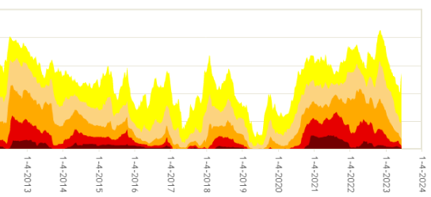
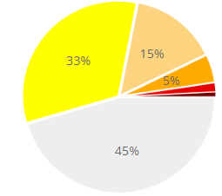
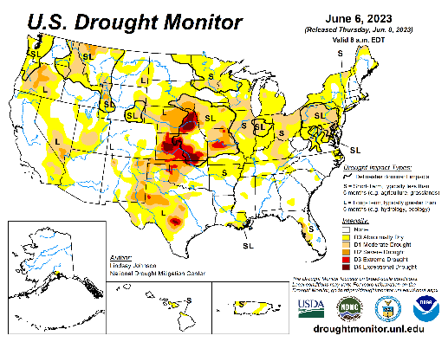
In general, The spatial details of Every drought is different.! Every situation is different!!
Time series since 2000 spilt into 2 (above & below) panels.
Current drought!
In early 2023 (interestingly coincidentally as ten years ago in 2013!) there is such a drastic decrease in the coverage of US drought areas in all categories!! This time, even the many CA reservoirs are well near their historic averages!

Slide 5
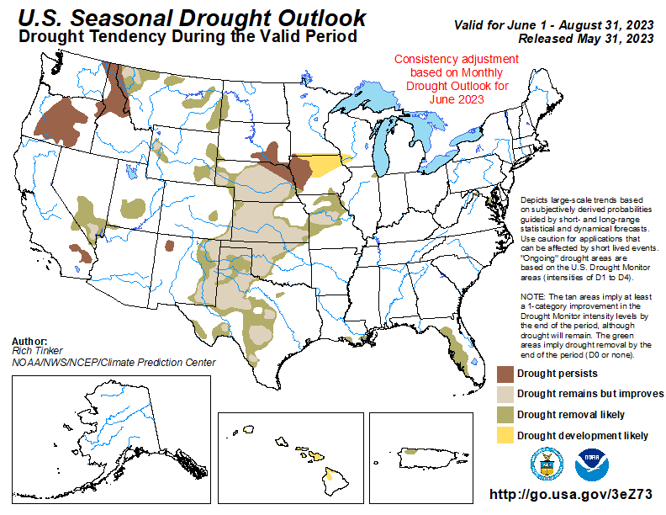
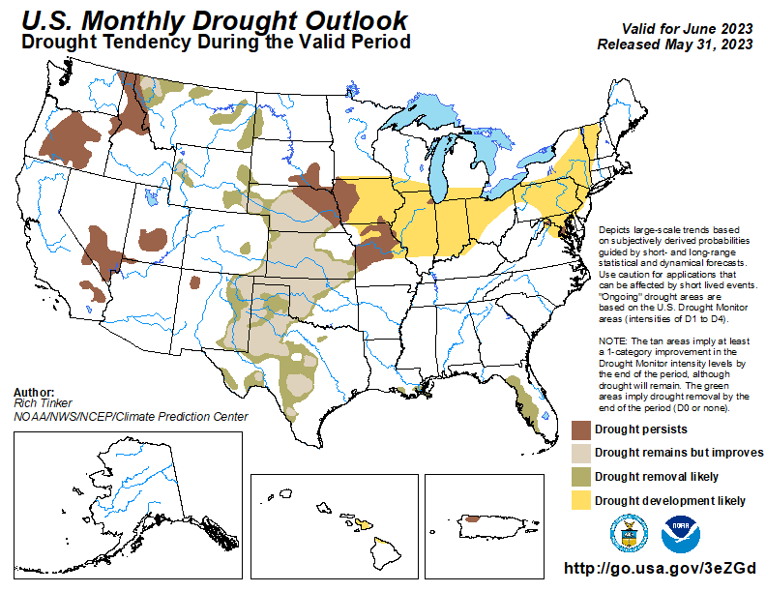
(Previous) Seasonal/Monthly Drought outlooks
New Seasonal+ Drought Outlook(SDO) to be released in 2 days!
(reissued again at end of month for consistency with MDO!)
New Monthly Drought Outlook (MDO) to be released at end of this month)
Updated Seasonal Outlook
( 1 May – 31 Jul 2023)
issued 4/30/23
Monthly outlook (for May 2023)
issued 4/30/23
We said the recent winter rainy season (DJFM) along the west coast states, combined with the weakening/slowly exiting La Nina conditions is likely to improve the overall drought conditions and hence reduce the drought areal coverage in the United States, especially in the west and southwest. But neither the models nor the forecasters expected this kind of quick recovery! BUT Nevada/AZ massive reservoirs/lakes (Mead/Powell) are still extremely low.

Slide 6
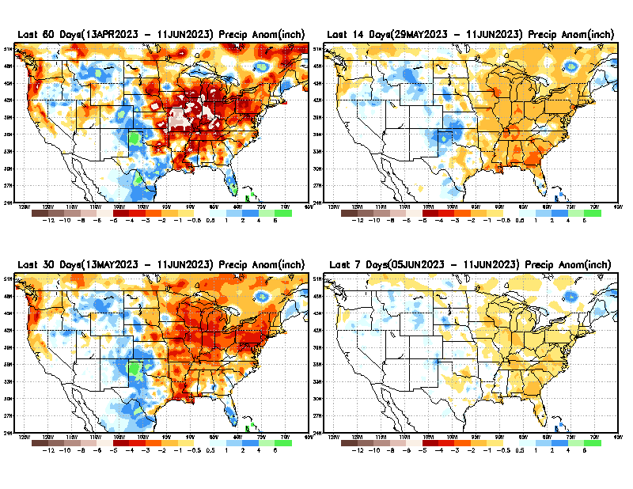
Precipitation ANOM during last 7, 14, 30, & 60 days.
This and next few slides show Precip deficit (excess).
Droughts, for the MOST part, begin and end with precip!! Lately, Temps are becoming (secondarily) important as well.
60 Days
14 Days
30 Days
7 Days
These maps in this and following slides, including a) Total,
b) Anom and
c) Percent of Normal precip. in these and other longer time ranges are now (routinely) daily updated at:
From: Recent Accum./Anom Precipitation https://www.cpc.ncep.noaa.gov/products/Drought/briefing_prcp.shtml

Slide 7
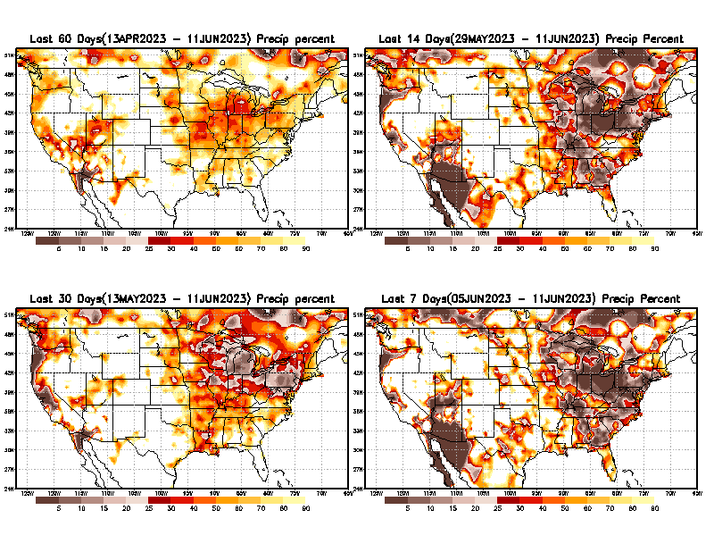
Precipitation Percent (of normal) during last 7, 14, 30, & 60 days - Only Deficit Areas <=90% shown !
60 Days
14 Days
This plot shows only the rainfall deficient regions <= 90% of normal.
-- This shows more clearly possible/likely drought developing region in the future unless there is above normal rainfall in these regions in the future, to offset these shortfalls.
30 days
7 Days
From: Recent Anom/% of normal Precipitation https://www.cpc.ncep.noaa.gov/products/Drought/briefing_prcp.shtml

Slide 8
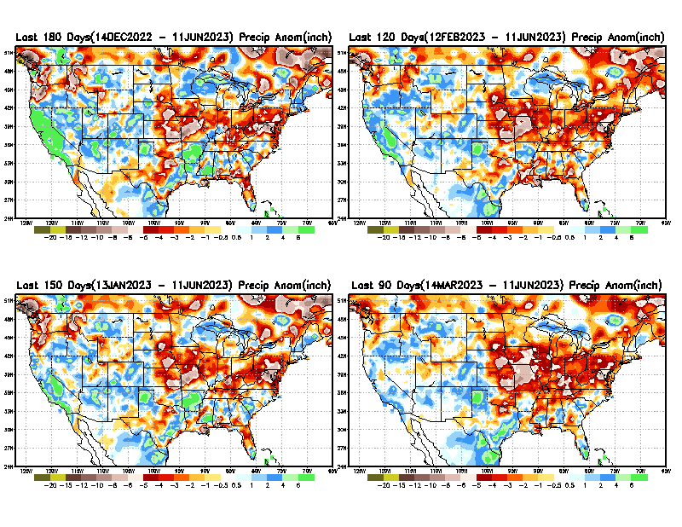
Total precipitation ANOM during last 3, 4, 5, and 6 months.
While the Precipitation anomalies deficit may seem large in some regions (compared to others),
it is the
% of normal precip (next slide) that matters more!!
6 M
4 M
5 M
3 M
From: Recent % of Normal Precipitation https://www.cpc.ncep.noaa.gov/products/Drought/briefing_prcp.shtml

Slide 9
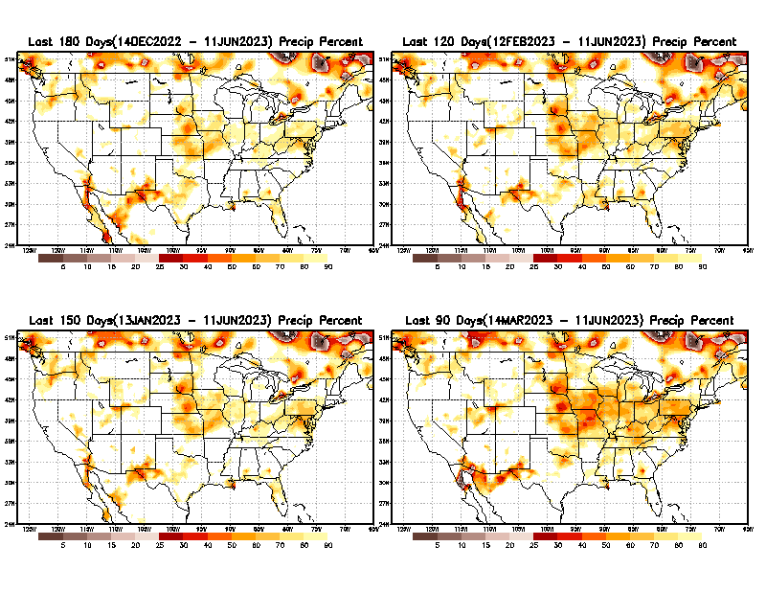
Total precipitation Percent (of normal) during last 3, 4, 5, and 6 months Only Deficit Areas <=90% shown!!
6 M
4 M
In these interim time scale 3-6 months, we need to pay attention to regions, which are dark-brown, red & dark red (<50%).
While accrued precipitation deficits are real & objective,
droughts are subjective declarations!!
5 M
3 M
East vs West!
Broad vs Narrow
rainfall season.
In general, West US suffers more from frequent and lasting droughts. Droughts in East US are less and less lasting!
What about Center ?
More like West than East?
Short term(S) Drought is generally declared when rainfall deficits exist in the 3-6 months time range. {Long term deficits beyond 1 or 2 or more years is Long term L drought! }

Slide 10
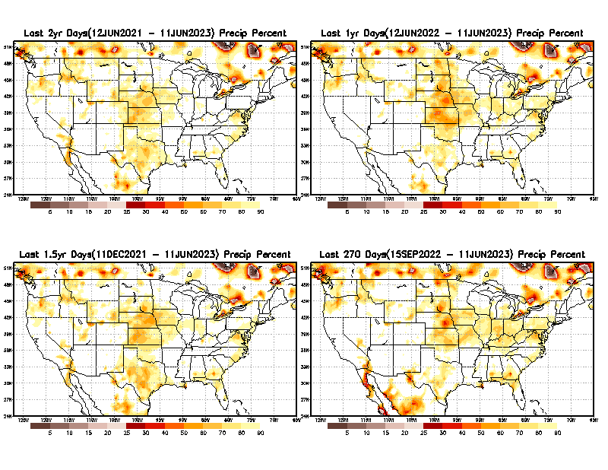
Total precipitation Percent during last 9 months, 1 yr, 1.5yrs, & 2 yrs. .–Only Deficit Areas shown!! <=90%
2 Y
1 Y
1.5 Y
9 M
The character and even location/spatial extent of the short/S and long/L –term droughts are different!!!
From: Recent Accumulated Precipitation https://www.cpc.ncep.noaa.gov/products/Drought/briefing_prcp.shtml

Slide 11
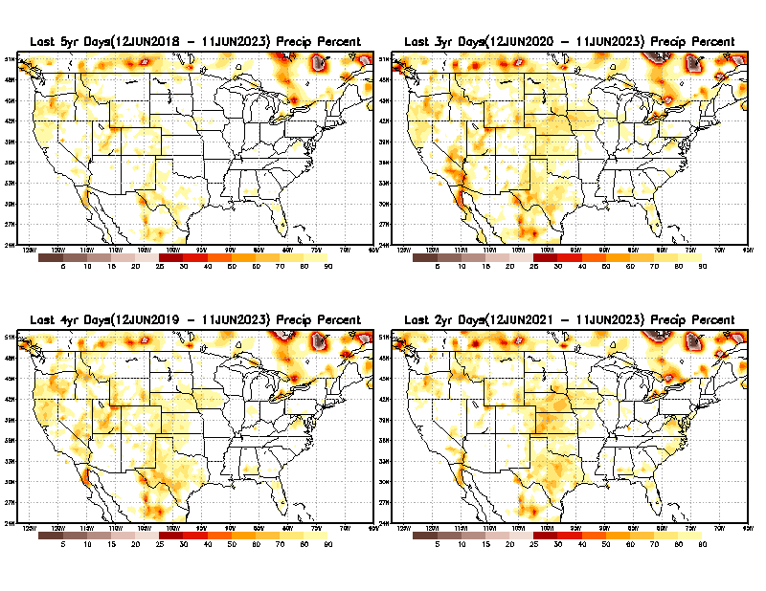
Total precipitation Percent (of normal) during last 2, 3, 4, & 5 yrs. .–Only Deficit Areas <=90% shown !!
5 Y
3 Y
In spite of the recent deluges/floods in California, there still exists a small longer term rainfall deficit in CA and parts of the southwest/ western US.
However, currently, most CA reservoirs are nearing or in excess of their historical averages.
BTW, Not sure if the longer term (20+years) since 2000’s has officially ended! ☺
4 Y
2 Y
From: Recent Accumulated Precipitation https://www.cpc.ncep.noaa.gov/products/Drought/briefing_prcp.shtml

Slide 12
LEAST
Rainy/dry
(3-month) Seasons across the US
MIXED
MOST
East vs West!
More darker colors in west/central => narrow rainy season (months)
Overall, more white space in the east => distributed rainfall season (except ~FL).

Slide 13
June/July/Aug/Sep are imp. rainy months for the southwest.
Florida too!!
This year’s Monsoon ?
*********
EAST vs
CTR/WEST
Drought Behavior is loosely tied to rainfall climo!! And the limited rainy season in the west
*********
Adapted from Rich Tinker.

Slide 14
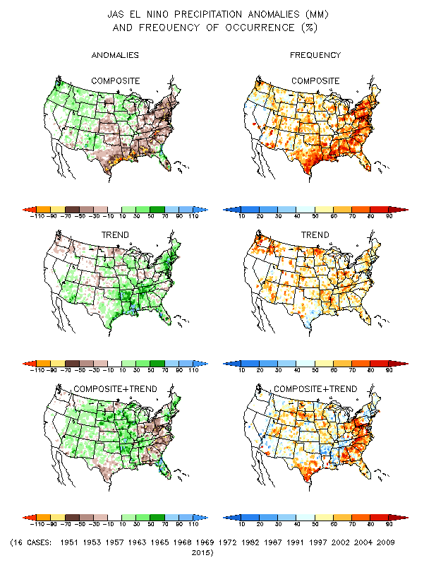
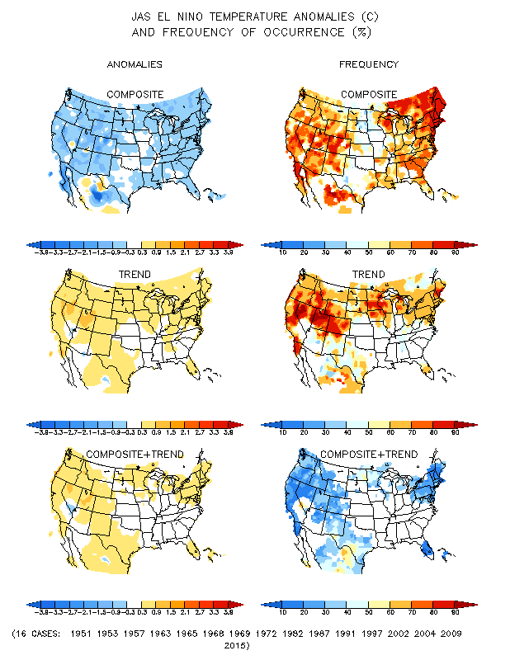
El Nino Precip/Temperature COMPOSITES & Trend map
JAS
P
T
Transitio-ning to
ENSO neutral and then to El NINO conditions
☺

Slide 15
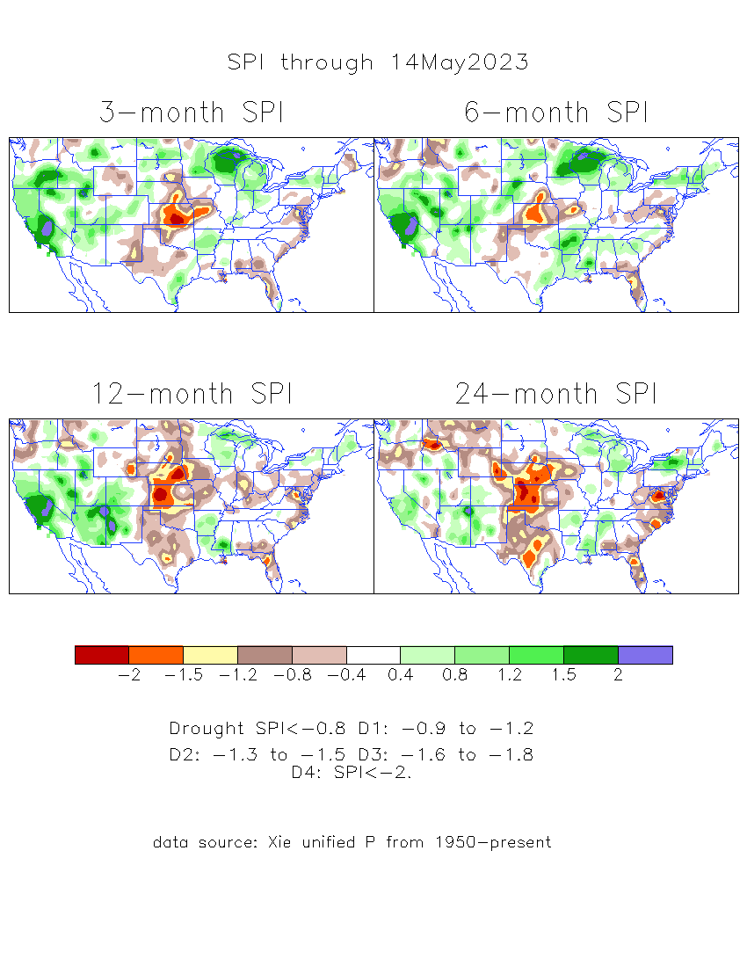
The Standardized Precipitation Index SPI (based on Observed P)
----- Last Month
Very interesting graphic & details for the drought across the US based on the more generalized precip deficit/excess, the Standardized Precipitation Index (SPI).
The dark brown and red colors, indicating standardized precipitation deficits, in the various time periods, approximately correspond to the appropriate short/long term drought monitor regions and their intensities

Slide 16
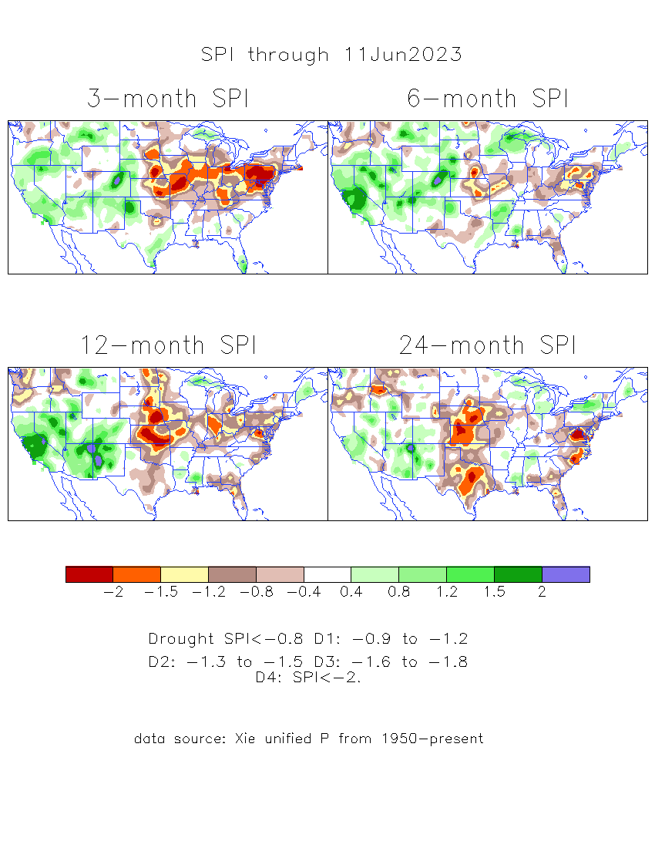
The Standardized Precipitation Index SPI (based on Observed P)
Compare with last month
----- NOW
Very interesting graphic & details for the drought across the US based on the more generalized precip deficit/excess, the Standardized Precipitation Index (SPI).
The dark brown and red colors, indicating standardized precipitation deficits, in the various time periods, approximately correspond to the appropriate short/long term drought monitor regions and their intensities
Short
No S-term drought here! Also big impact on L-term drought in west!
Long
How does one negotiate and reconcile declaring short term vs long term drought when precip. deficiencies patterns differ on many different time scales locally!!
What is the cutoff delineating time between short VS long term drought!! Not so clear!!
At exactly where does drought begin?

Slide 17
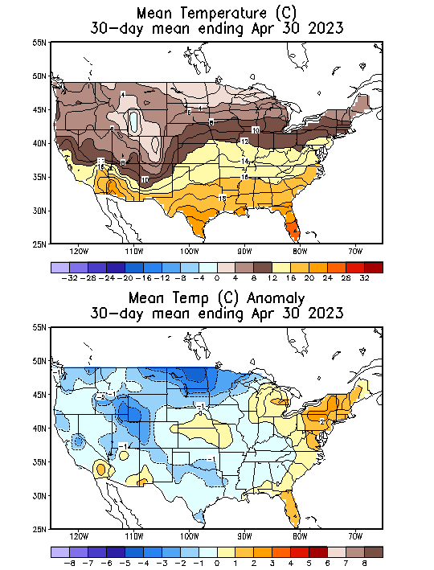
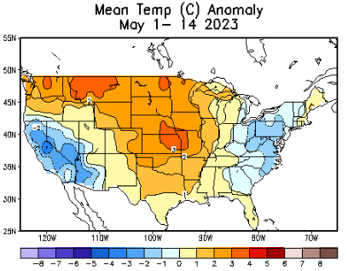
Slide From briefing
Last Month at this time of month!
Recent US Temperatures
.
So far this month !!

Slide 18
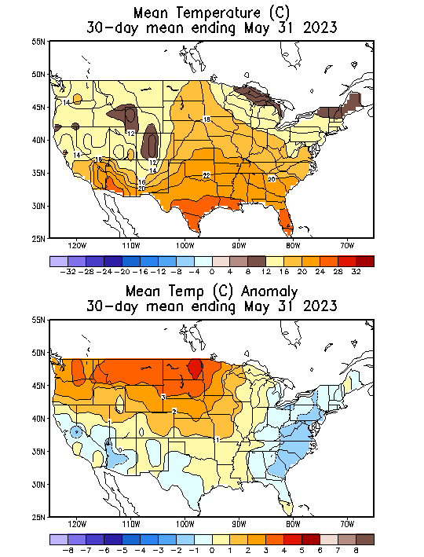
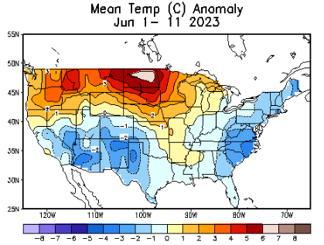
NOW
Recent US Temperatures
.
So far, contrast from last month!
So far this month !!

Slide 19
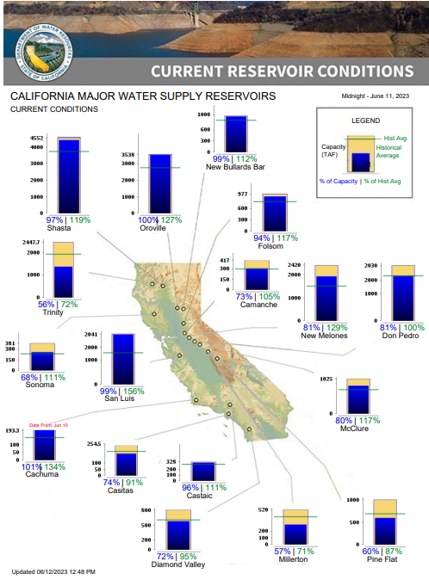
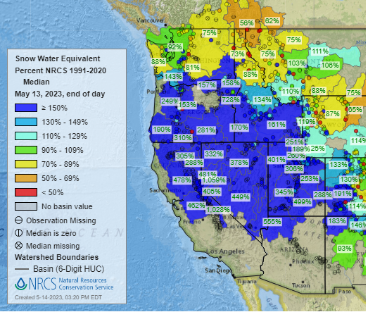
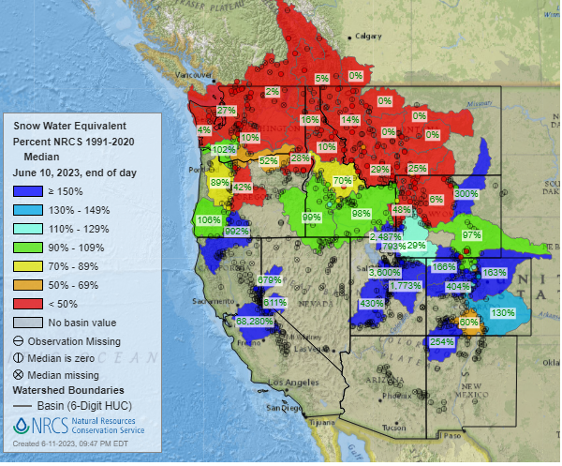
Snow Water Equivalent
% of Capacity
% of Hist. Avg.
of Reservoirs.
Last Month
https://www.nrcs.usda.gov/wps/portal/wcc/home/
Many CA water reservoirs are AT or ABOVE their historical average/ CAPACITY levels ! ☺
This Month
https://www.nohrsc.noaa.gov/interactive/html/map.html?
And all the recent record snow have been melting! ☹, Now from drought to flood ☹
But a very different story for lakes in NV, see next slide! ☹

Slide 20
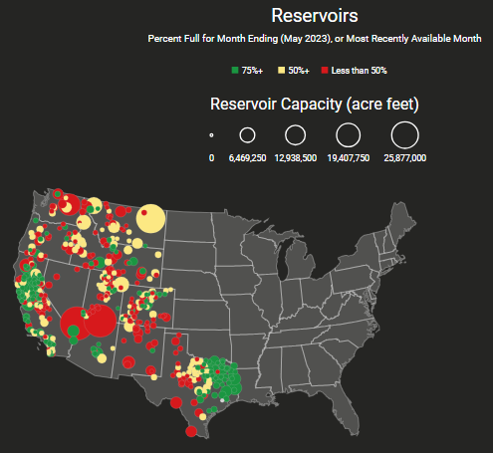
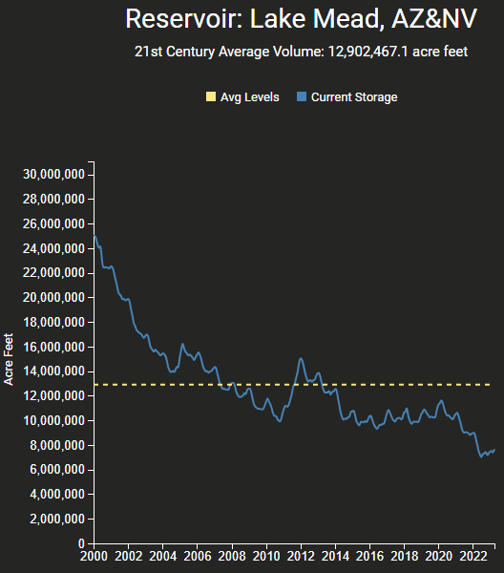
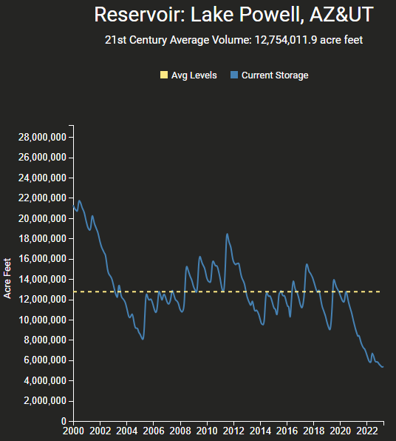
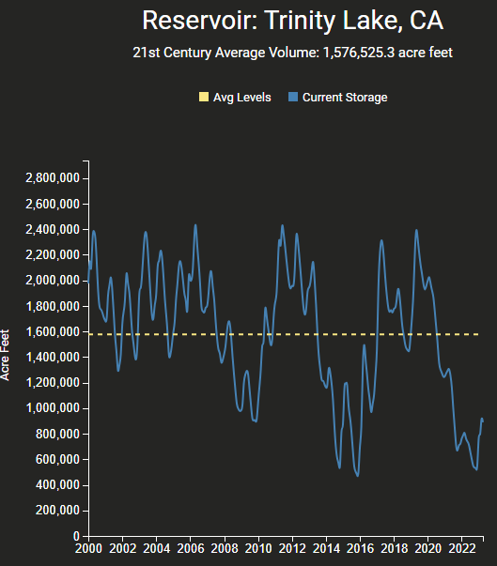
https://www.deanfarr.com/western_water/
https://www.deanfarr.com/western_water/
Hydro Electric power generating turbines STOP operating at the critical 7 million acre feet level
Lakes Mead, Powell in NV/AZ are at historic /dire low levels! ☹ ☹ HUGE consequences for electric power for western states CA/NV/AZ/UT !!

Slide 21
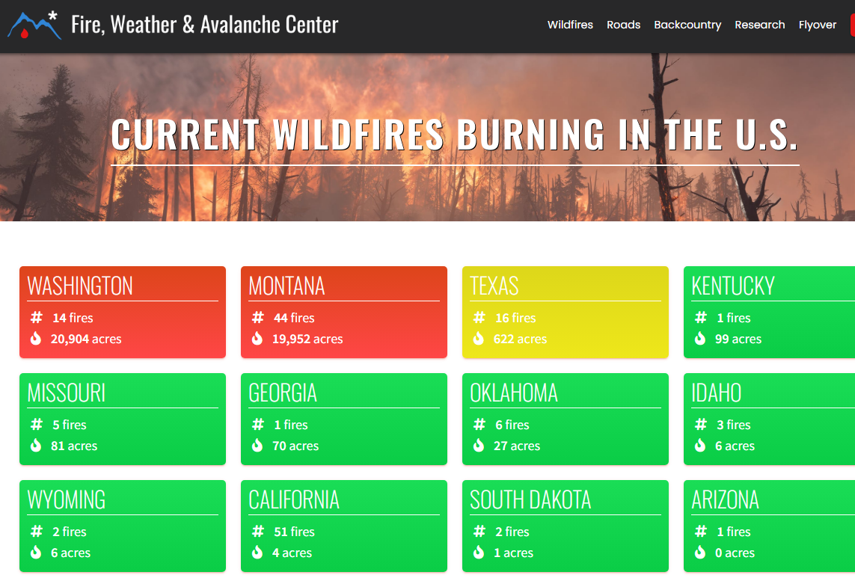
Slide Not shown
THIS MONTH !!
Slide Not shown
THIS MONTH !!
Note: In spite of the ongoing drought, All the fires are gone..
Of course it is getting cold.. ☺
https://www.fireweatheravalanche.org/fire/current-list-of-us-wildfires
(not govt. source! Not sure how good is this data?)

Slide 22
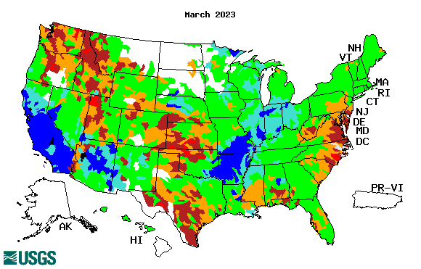
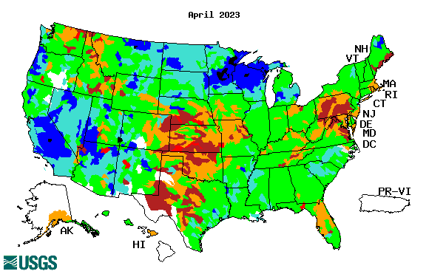
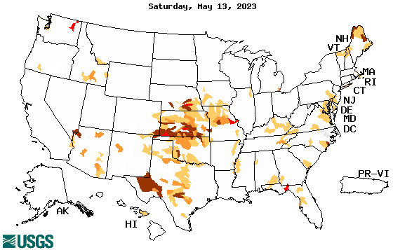
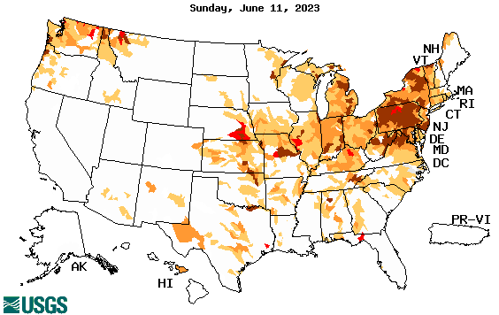
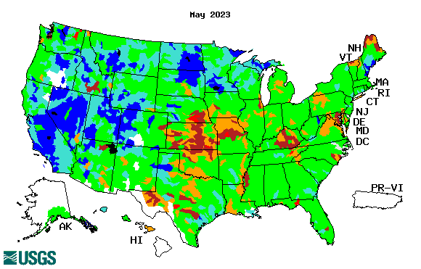
Streamflow (USGS)
Most US east droughts are relatively short lived (as compared to US west). However, if you recall, the drought over the New England states last year was a real surprise!!
Map shows only below normal 7-day average streamflow compared to historical streamflow for the day of year.
One month ago (left) &
Now (below)
Streamflow is only a partial indicator, as sometimes it is highly managed.
If sometimes, the various indicators are confusing, go back to % of rainfall deficit maps – to confirm/reinforce!!
22

Slide 23
EL NIÑO/SOUTHERN OSCILLATION (ENSO)
DIAGNOSTIC DISCUSSION
issued by CLIMATE PREDICTION CENTER/NCEP/NWS and the International Research Institute for Climate and Society
8 June 2023
ENSO Alert System Status: El Niño Advisory
Synopsis: El Niño conditions are present and are expected to gradually strengthen into the Northern Hemisphere winter 2023-24.
CPC’s Oceanic Niño Index (ONI) [3 month running mean of ERSST.v5 SST anomalies in the Niño 3.4 region (5ºN-5ºS, 120º-170ºW)], based on centered 30-year base periods updated every 5 years.

Slide 24
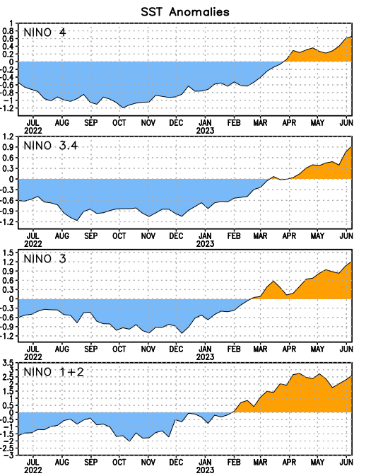
Latest values of SST indices in the various Nino Regions.
Rapidly decreasing Subsurface cold water reserve…

Slide 25
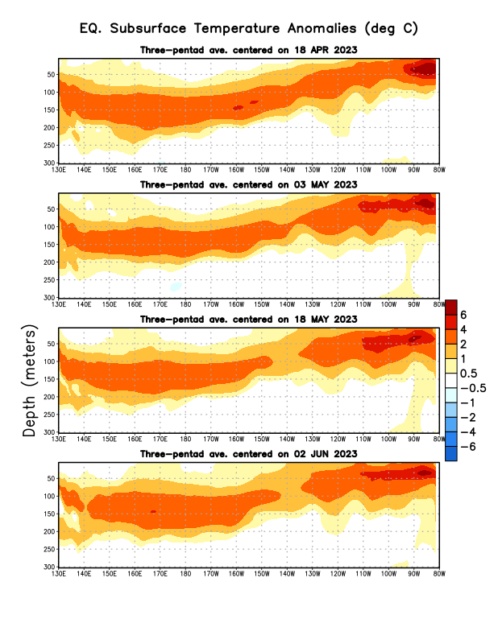
Sub-Surface Temperature Departures in the Equatorial Pacific
All the subsurface water all along the eq. Pacific is warm!
Except in the Nino 3.4 region, here it is not that warm, at least not yet!
Most recent pentad analysis

Slide 26
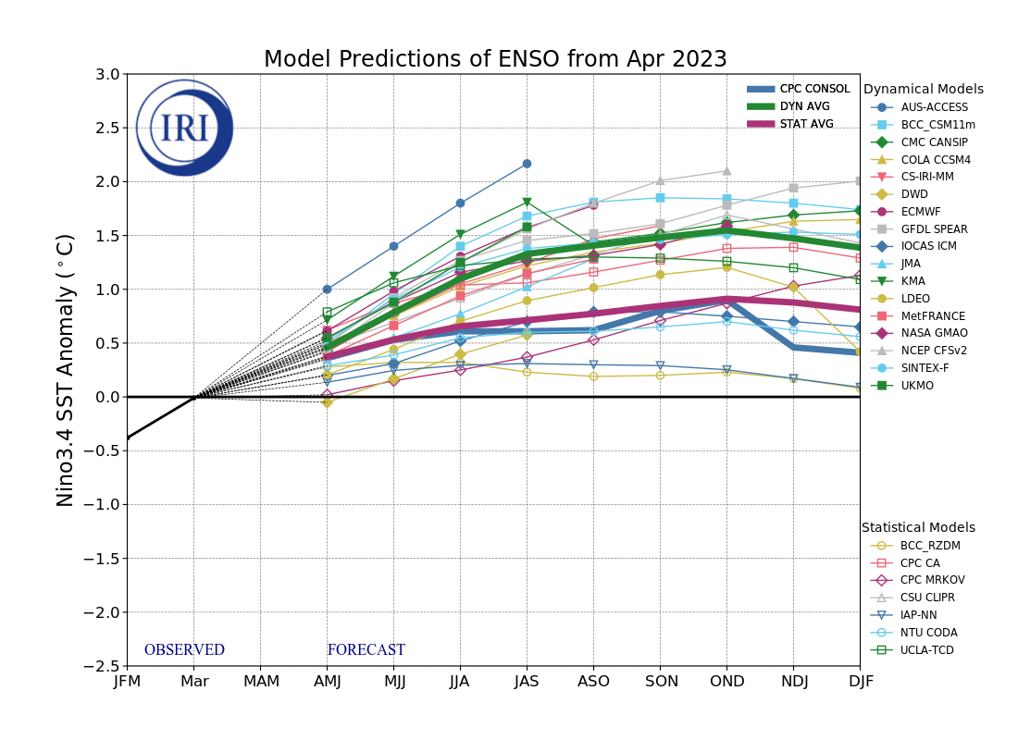
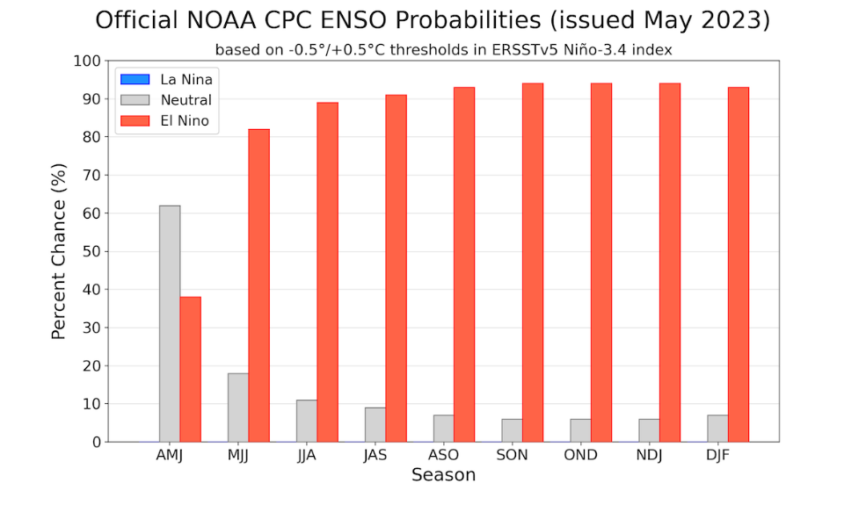
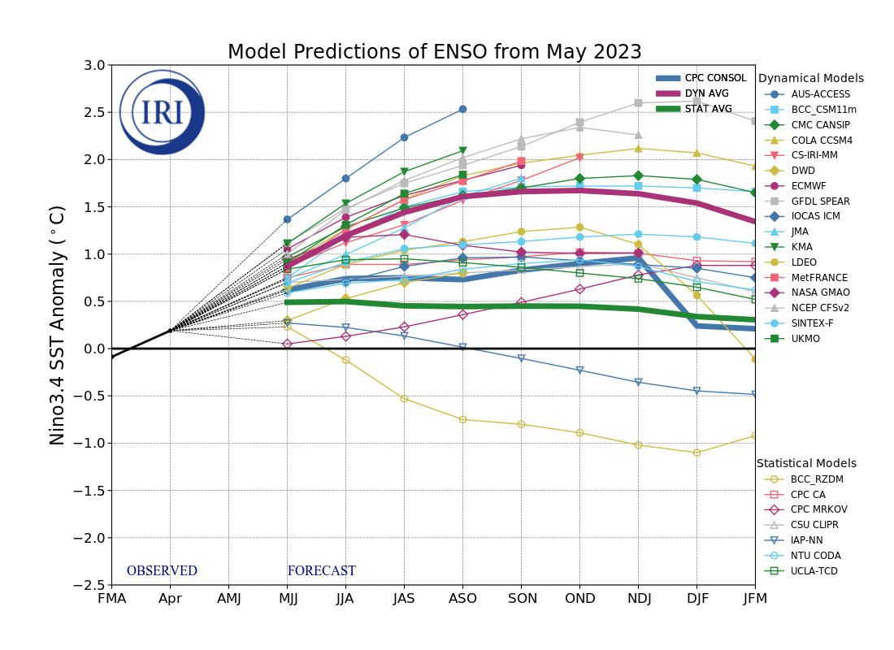
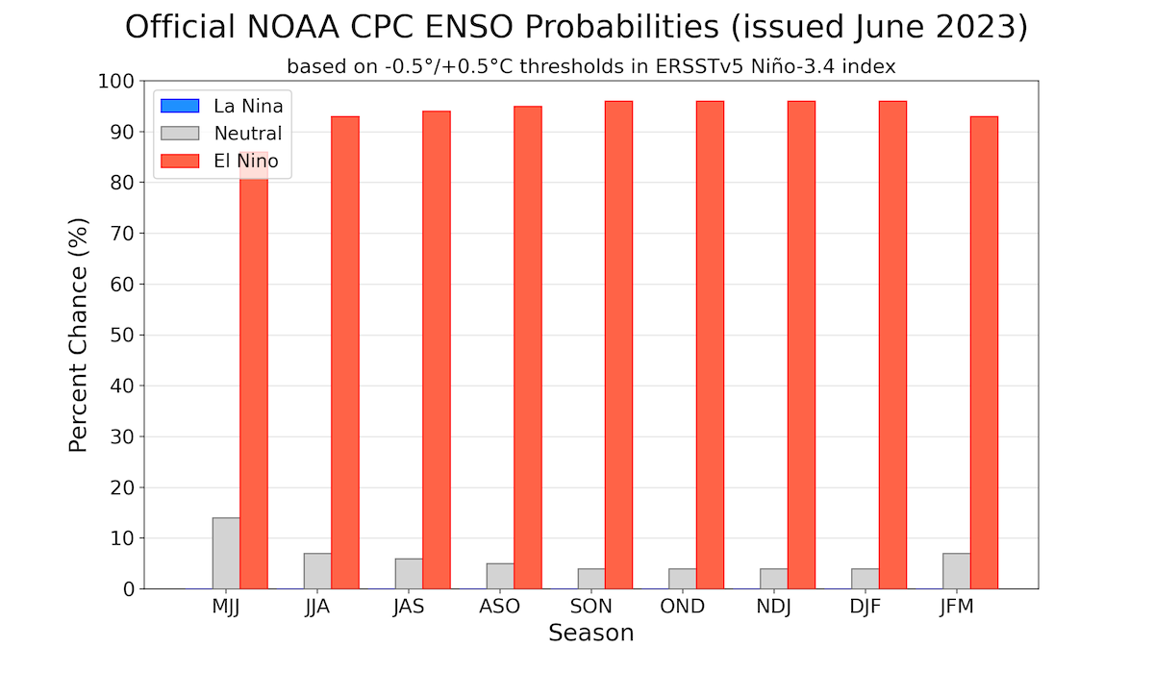
Official ENSO Forecasts
Early-May
Early-June CPC forecast
Both Stat.Avg & CPC-consolidated
are keeping it under 0.5 deg. C ??
90% chance of El Nino during JJA season.

Slide 27
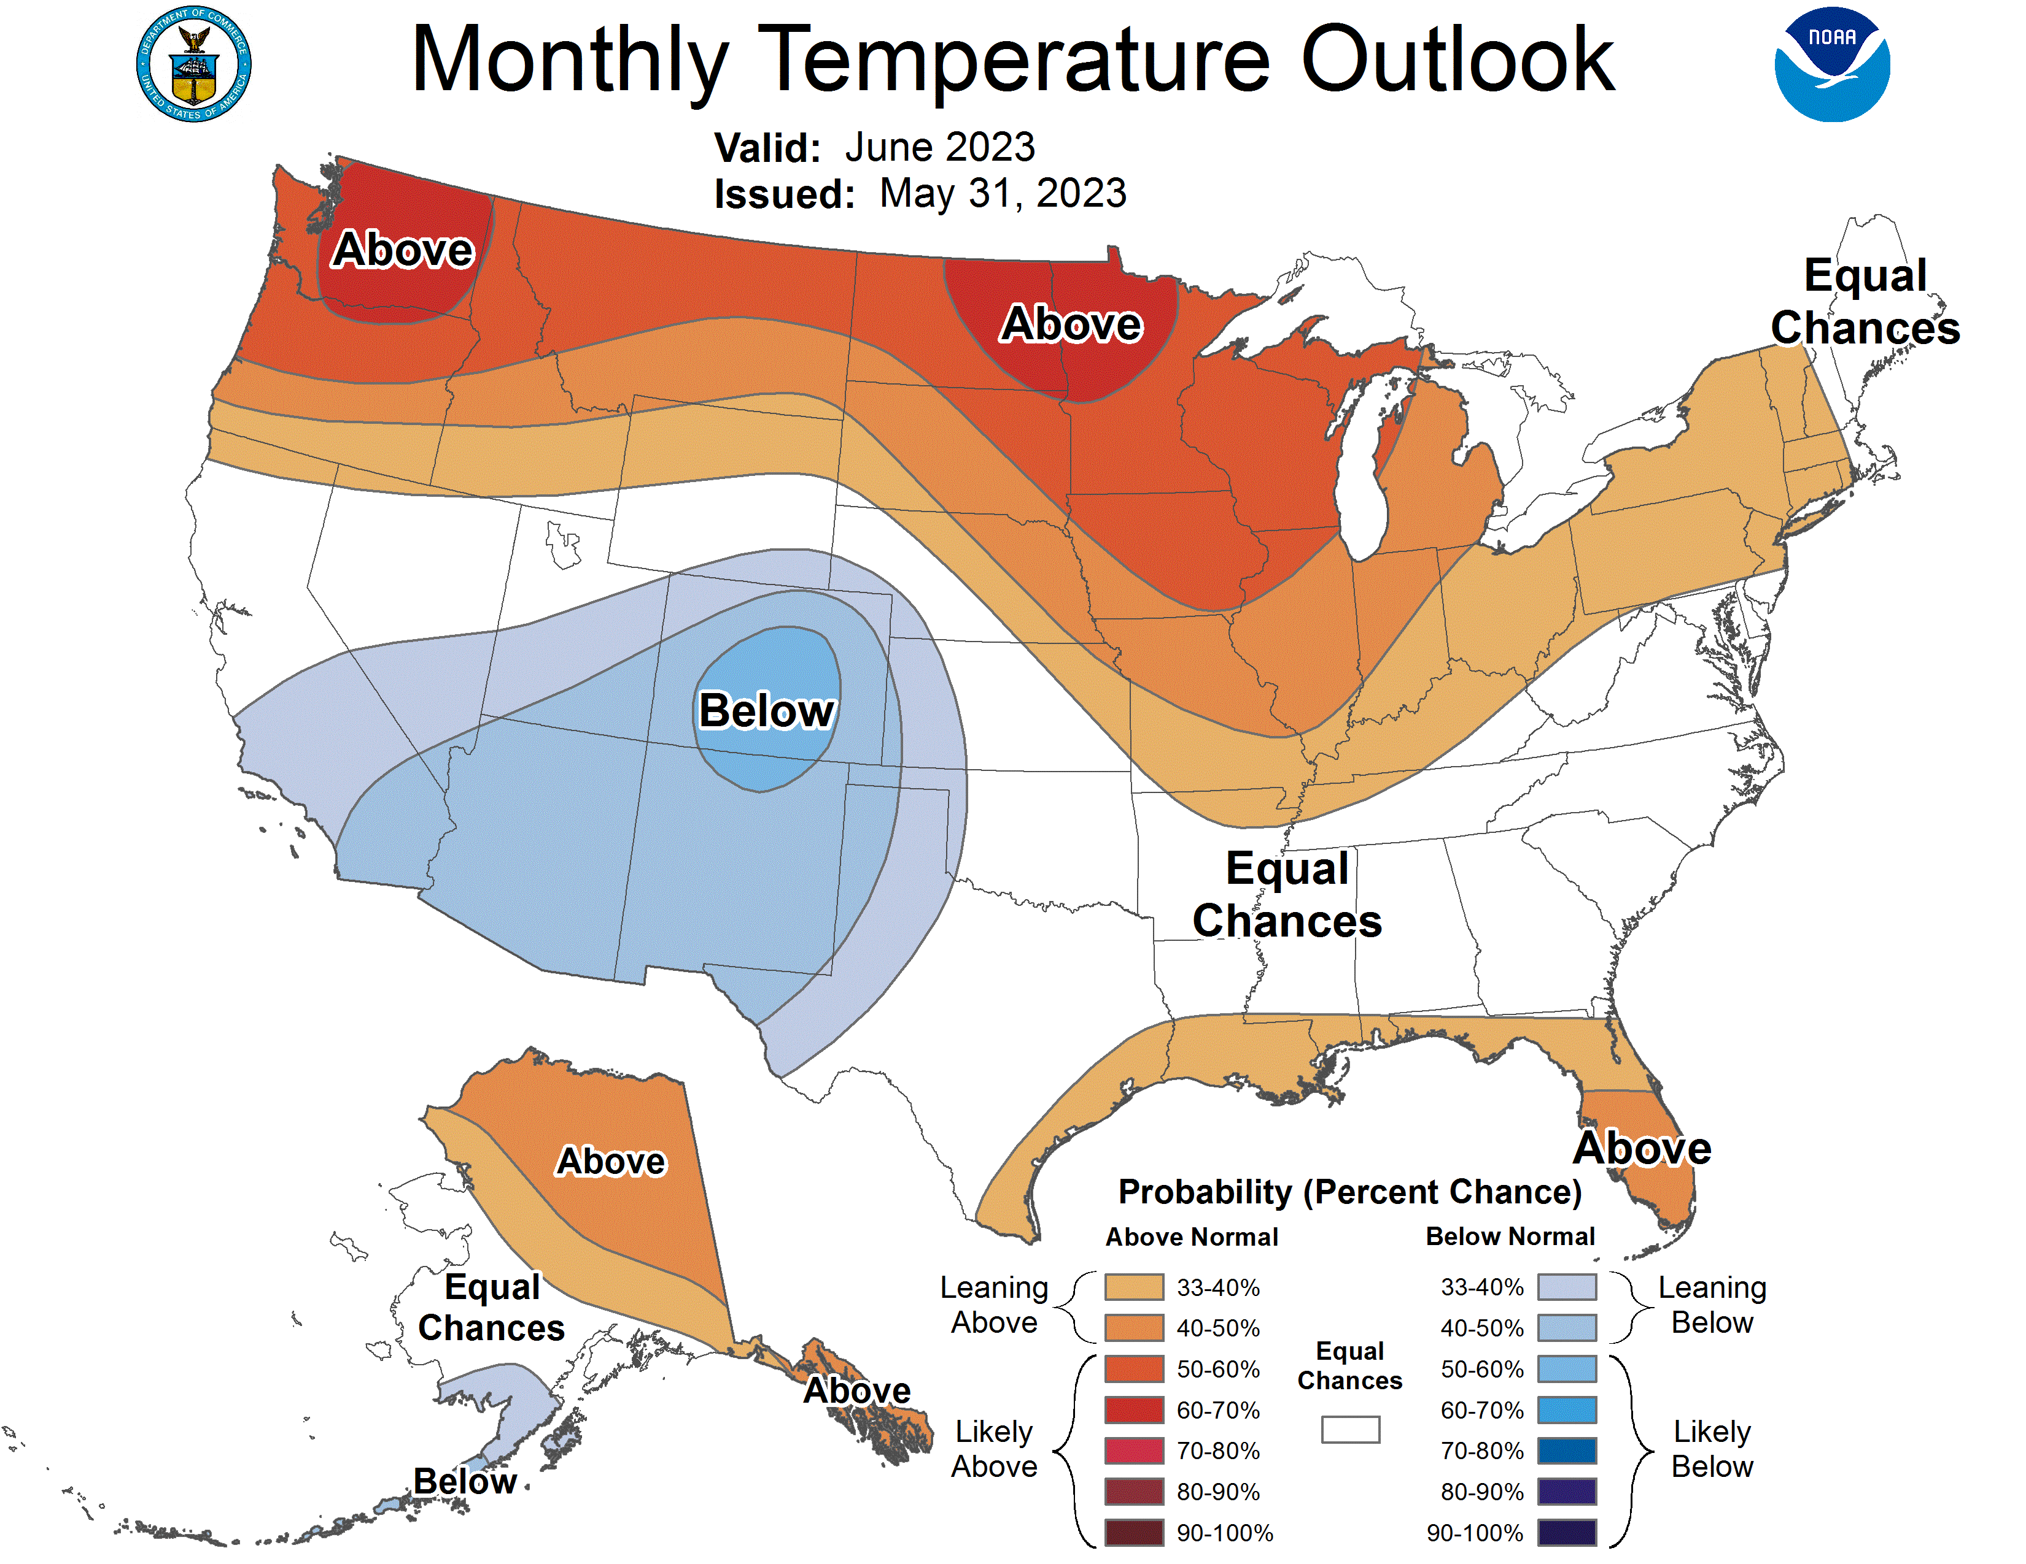
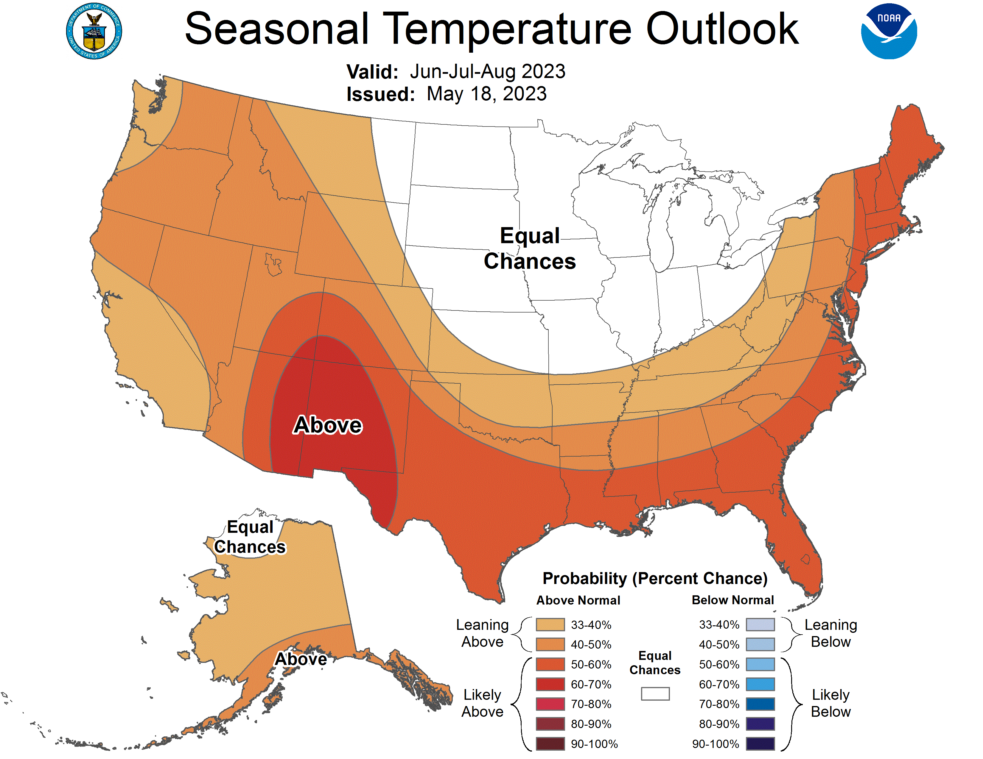
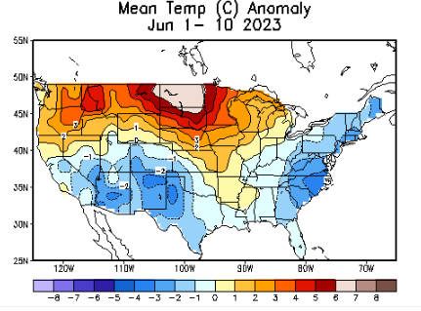
Previous (Last Month’s)
CPC’s official
Temperature OUTLOOK for Monthly (June)/Seasonal (JJA)
Monthly P/T forecasts verified at mid-month are generally good! Becoz of good skill upto 2 wks.
Released Apr 20th
Observed so far this month!! ☺ ☹
E/W

Slide 28
Previous(Last month)
CPC’s official
Precipitation OUTLOOK for Monthly (June)/Seasonal (JJA)
Monthly P/T forecasts verified at mid-month are generally good! (??) Becoz of good skill upto 2 wks.
Released May 18th
Observed so far this month!! ☺ ☹

Slide 29
NCEP/WPC Next 7 days QPF (Quantitative Precipitation Forecast)
GFS Model Guidance for the
next 16 days.
Reg. California, the severe drought conditions, a year ago, a few months ago, has literally turned into a flood situation!

Slide 30
From 3 Models average Precip forecast (made 11/12 June) for next 30 days.
The 3Models are: CFSV2, GEFS, & EC

Slide 31
From 3 Models average Precip forecast (made 11/12 June) for next 30 days.
20
40
May look bad in SW, But not rainy season!!

Slide 32
From 3 Models average Precip forecast (made yesterday 11/12 June) for next 30 days.

Slide 33
Impact of recent winter rains on S/Term drought in the US west coast states!!
From 3 Models average Precip forecast (made yesterday 11/12 June) for next 30 days.

Slide 34
Impact of recent winter rains on L/Term drought in the US west coast states!!
From 3 Models average Precip forecast (made yesterday 11/12 June) for next 30 days.

Slide 35
Week-4 Soil Moisture Percentile (SMP) Fcst based on VIC model forced with ECMWF-extended precipitation forecast!
This month
Now: Based on Yesterday’s IC
While not exactly mapping 1-to-1 with the drought areas, this map is generally connected to the drought areas in some ways, as it is related to soil moisture!!
Above Slide from last month
(From Drs. Li Xu and Yun Fan) More detail at From: https://www.cpc.ncep.noaa.gov/products/people/lxu/flashd/flash_prediction.html#10

Slide 36
NMME* T (left) & P (right) Ens.Mean forecasts for
July
JAS
NMME* : North American Multi Models Ensemble

Slide 37
Agreement/Disagreement among the various NMME models’ JAS seasonal Precip. Forecast.
??

Slide 38
(From NMME) compared with this month(foreground, red border)
Why is there so fewer hatched areas in SPI6 fcst from NMME models’ based fcst this month as compared to last month (left 2 columns) ? Fcsts more confident now?
Forecast uncertain in Hatched areas.
These maps are based on NMME models’ precip forecast uncertainty/certainty (among ensemble members) over the next 3 months
SPI6 Fcst made from last month I.C.
SPI6 & SPI12 Fcst made from this month

Slide 39
http://drought.geo.msu.edu/research/forecast/smi.monthly.php
Predicted Monthly Soil Moisture Percentile
Latest Initial Conditions:
DATA not available !
CPC’s soil moisture percentile – Leaky bucket Model
The inter quartile range suggest greater uncertainty about the forecast in these shaded regions in the ESP based forecast!

Slide 40
BONUS Topic: Discussion continues!! Explanation for the multiyear DROUGHT in the Southwest (CA/AZ/NM/NV/UT/CO & vicinity)!!
More La Nina’s lately ?
More frequent La Ninas lately ?
YES!! The stats in the table below (bottom left) are from the Official CPC ENSO declarations page/table!
Compared to other regions of the globe, the SST warming/trend in the central eq. Pacific (Nino 3.4) is relatively much small. (See Fig. above) – Why is this ?
Does nature try to compensate for the warming else/everywhere by producing more La Ninas in the equatorial Pacific? - Just my observation from data! Let’s check !!!
Since the 1997 monster El Nino (stronger than the famous 1982/83 event), just a quick count of CPC’s Nino 3.4 index++ values for the three month overlapping seasons, (Data at CPC site only available only from 1950!)
(27 years) (47 years) (74 years)
1997-2023 1950-1996 1950-2023
La Nina(DJF) 12 16 28
El Nino(DJF) 8 17 25
La Nina(all 3mos) 119 150 269
El Nino(all 3mos) 77 166 243
(Overlapping 3month seasons)
Look at Ratios of La Ninas (vs El Ninos) in the shorter
recent (27 yr) period vs the longer (47 yr) earlier period!!
Compare the ratios of La Nina to El Nino in the squared boxes.
***Analysis of CPC’s official Nino 3.4 index data over the last 70 years shows that the more frequent La Ninas in recent decades contributed to less rainfall in the southwest (See La Nina precip composites!, slide#13) and hence the ongoing long term drought in the Southwest!! Hence the long term southwest drought is unlikely to go away any time soon***
++ Barnston, Chelliah and Goldenberg (1997):Documentation of a highly ENSO‐related SST region in the equatorial pacific, Atmosphere-Ocean Volume 35, 1997. https://doi.org/10.1080/07055900.1997.9649597
*** The strong/weak annual monsoon rains in the southwest is a minor modulator riding on this bigger/longer-term signal. ***

Slide 41
Summary
Current Drought conditions:
Towards the end of last year 2022, until December or so, severe drought conditions (both short and long term) remained in the west, mild drought conditions expanded in to portions of the eastern half of the US also, covering most of the country with very high % areas of the entire US affected by drought. The situation now is now suddenly and drastically different.
With the start of winter rainy season in CA and the west coast states, the deluge/excess rain over CA and vicinity during the many weeks in winter months wiped out not only the S-term drought but also the L-term drought in most areas. Water levels in most CA reservoirs are now ABOVE their normal levels. However, the water storage levels in the huge Lake Powell and Lake Mead in NV continue to remain historically low, and decade(s) long hydrological drought still lingers. Recharge in to these two reservoirs from subsurface stream flows has been severely impacted.
Across the US, there is a considerable decrease and sudden drop in the areal coverage of all drought categories. Area covered by >D1 category drought is now < 25%.
The sudden expansion of dry, S-term drought conditions in parts of upper mid-west and northeast has taken on a new dimension.
Current ENSO status and forecast: El Niño conditions are present and are expected to gradually strengthen into the Northern Hemisphere winter 2023-24.
Prediction: The transition from the third-year La Nina to an El Nino happened in a great hurry in the tropical equatorial subsurface conditions/temperatures. However, the expected, associated air-sea coupling and its signature in the equatorial Pacific has not caught up, or happened yet. The forecast from dynamical models and the statistical models in the next few months regarding the strength of an upcoming El Nino vary differently. While the dynamical models are more bullish the others are somewhat conservative. It is not clear if during the upcoming forecast JAS season, if the expected air-sea coupling and the tele-connective impacts will actually take place. This forecast season presents a challenge in the context of developing El Nino.
While the models are lately having difficulty in predicting (seasonal time scale) even during this past winter season under established La Nina conditions (look at California deluge!) it will be difficult for the models know to forecast what will happen during the upcoming/how El Nino-ish? forecast season JAS.
The NMME model’s precip guidance in the drought impacted central US states is suggesting slightly above normal precip for July and for the forecast season JAS, which may help the drought in the region.
However, a relatively poor southwest monsoon season is also forecast by the models (after two years in a row of good southwest monsoon season!). This may trigger again a short term drought in parts of the four corner states, especially in AZ/NM/CO, by the end of the JAS season.
The Upper Midwest, IL/IN/MI and central plain states IA/MO and even parts of NE/KS may develop some short term drought particularly more so in the next month(s). The NMME model is not predicting the canonical El Nino impact in the east for various reasons. So it is not clear, if the developing dryness in the aforementioned regions will develop into a full fledged drought by the end of the forecast season JAS. Drought along Atlantic coastal states may not last by end of JAS season. *****

