Slide 1
Drought Outlook Support Briefing June 2024
Climate Prediction Center/NCEP/NOAA
http://www.cpc.ncep.noaa.gov/products/Drought
Points to ponder:
Often, there is a disconnect between the Short term (S) and Long term (L) drought in regions, and even with the short term (S) drought, the 3-month and 6-month signals are not quite consistent! With Long term (L) drought, it is even more trickier, as it is open ended from 6 months-onwards and beyond!!!
Places/regions experiencing Short term drought may (not) be ok in the Long term and vice versa!!
This duality is difficult to reconcile, to convey and even be clearly understood well by the public at large.
Public/Forecaster generally tends to focus more on the Short term Drought (for good reasons!!)
More importantly the very definitions and timescales associated with S/L term droughts and the declarations in the USDM are by themselves subjective!! Short term vs Long term drought need to be clearly distinguished and shown to the public!!
It may take a long time for drought to develop, but those conditions can end very quickly! as it happened in CA after DJF 2023 winter. Forecast models are yet to (seasonal) correctly forecast these changes in advance!
Subjective(delayed) USDM vs Objective(real time) map! A few days of recent heavy precip can change the USDM a lot!
New (last few months):
Towards objective drought monitoring goals, we introduced, a new objective AI/Deep-Learning based Experimental ODI (objective drought indicator, updated daily, Slide # 3) compared with Official USDM (US Drought Monitor, produced weekly by USDM authors).
Towards prediction, we introduce a new section with few slides at the end, consolidating the various exptl. drought outlooks by purely objective methods developed here at CPC! All these in preparation of a broad general push towards Probabilistic Drought outlooks.

Slide 2
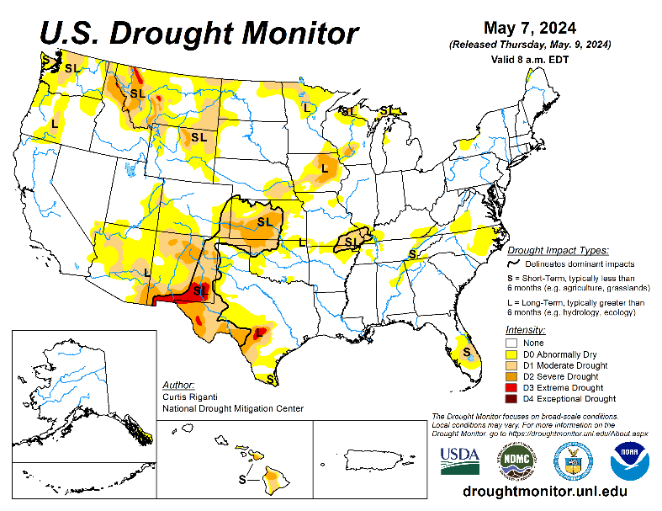
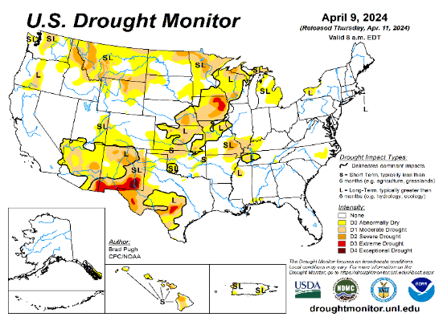
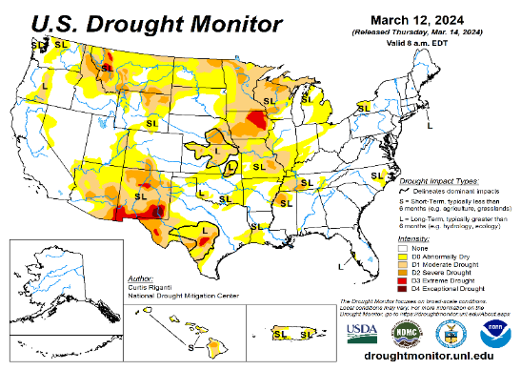
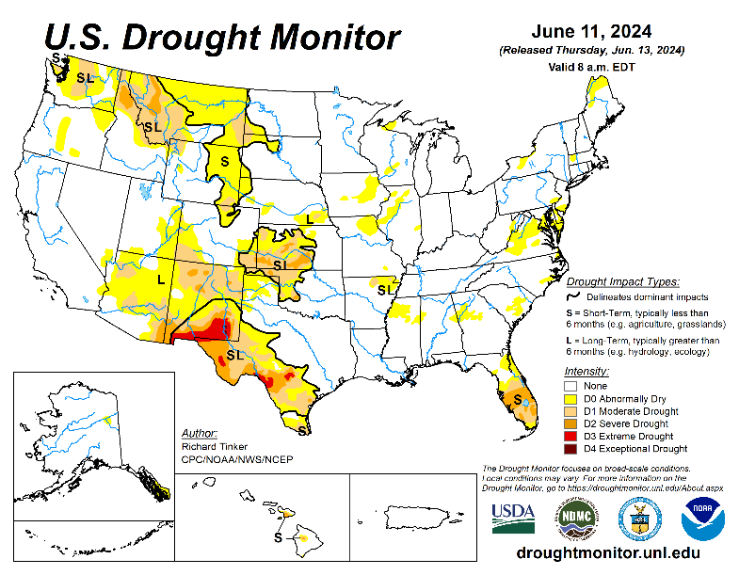
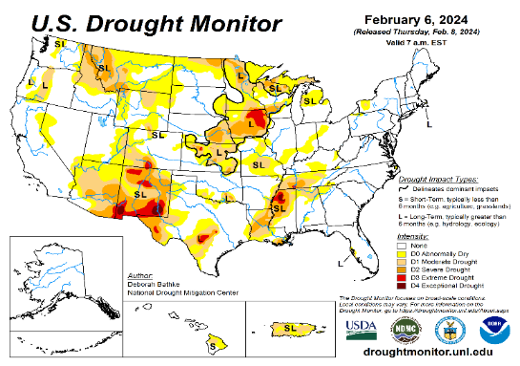
Drought Monitor
Monitoring is important because, unlike US T/P fcsts, for drought forecasts, we have to know where we are, before we can tell where we are going!! Drought forecasts are tendency forecasts as changes from the latest USDM.
May
California has remained drought free for about 18 months now. Above normal rainfall (strangely) during last year’s La Nina winter (2022/23) and (canonically, as expected) during this year’s El Nino winter (2023/24) in California, thus two back to back above normal winter rainfall seasons, have more than compensated for, and totally eliminated the both the Long & Short term drought in the region.
Water levels in almost all CA reservoirs are now at or well above their normal levels. However, the water storage levels in the much bigger lakes, Lake Powell and Lake Mead in NV/AZ still continue to be very low, and have not recovered from the 2+ decade(s) long hydrological drought that existed in the region.
The S/L term drought in the interior Pacific Northwest and in parts of WA, ID & MT is still stubbornly persisting. But drought in MN/IA/WI/ MO/KS is nearly gone, as we had suggested.
We have been suggesting/projecting for the past few months that the overall drought situation across the entire US will be improving slowly and steadily, and it actually happened as suggested. Now a large 71% (3 months ago it was only 54 %) of the lower 48 states is totally drought free. Have we reached the “near bottom” for the % of US areas covered under drought? and will we begin seeing a slow ramp up over the next few/several months? Questions remain about when & the strength of the upcoming La Nina!
The upcoming La Nina, which is generally a poor rainfall period for the US (as compared to El Nino), combined with the hot summer temperatures may begin to slowly increase the US areas under drought.
While CA is totally drought free (ST & LT) large parts of AZ/NM and even western of TX are still under drought due to long term/decadal drought in the SW, as well as the poor SW monsoon this past year (2023). Another possible 2024 poor SW monsoon in AZ/NM and in vicinity might persist or even make the current drought in the region worse.
April
March
June
(Recent/Latest)
February

Slide 3
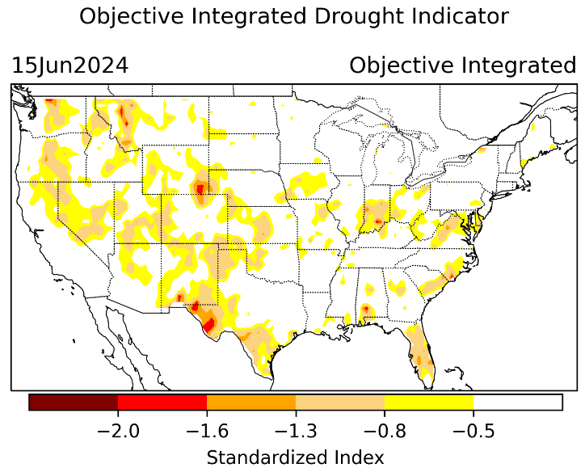
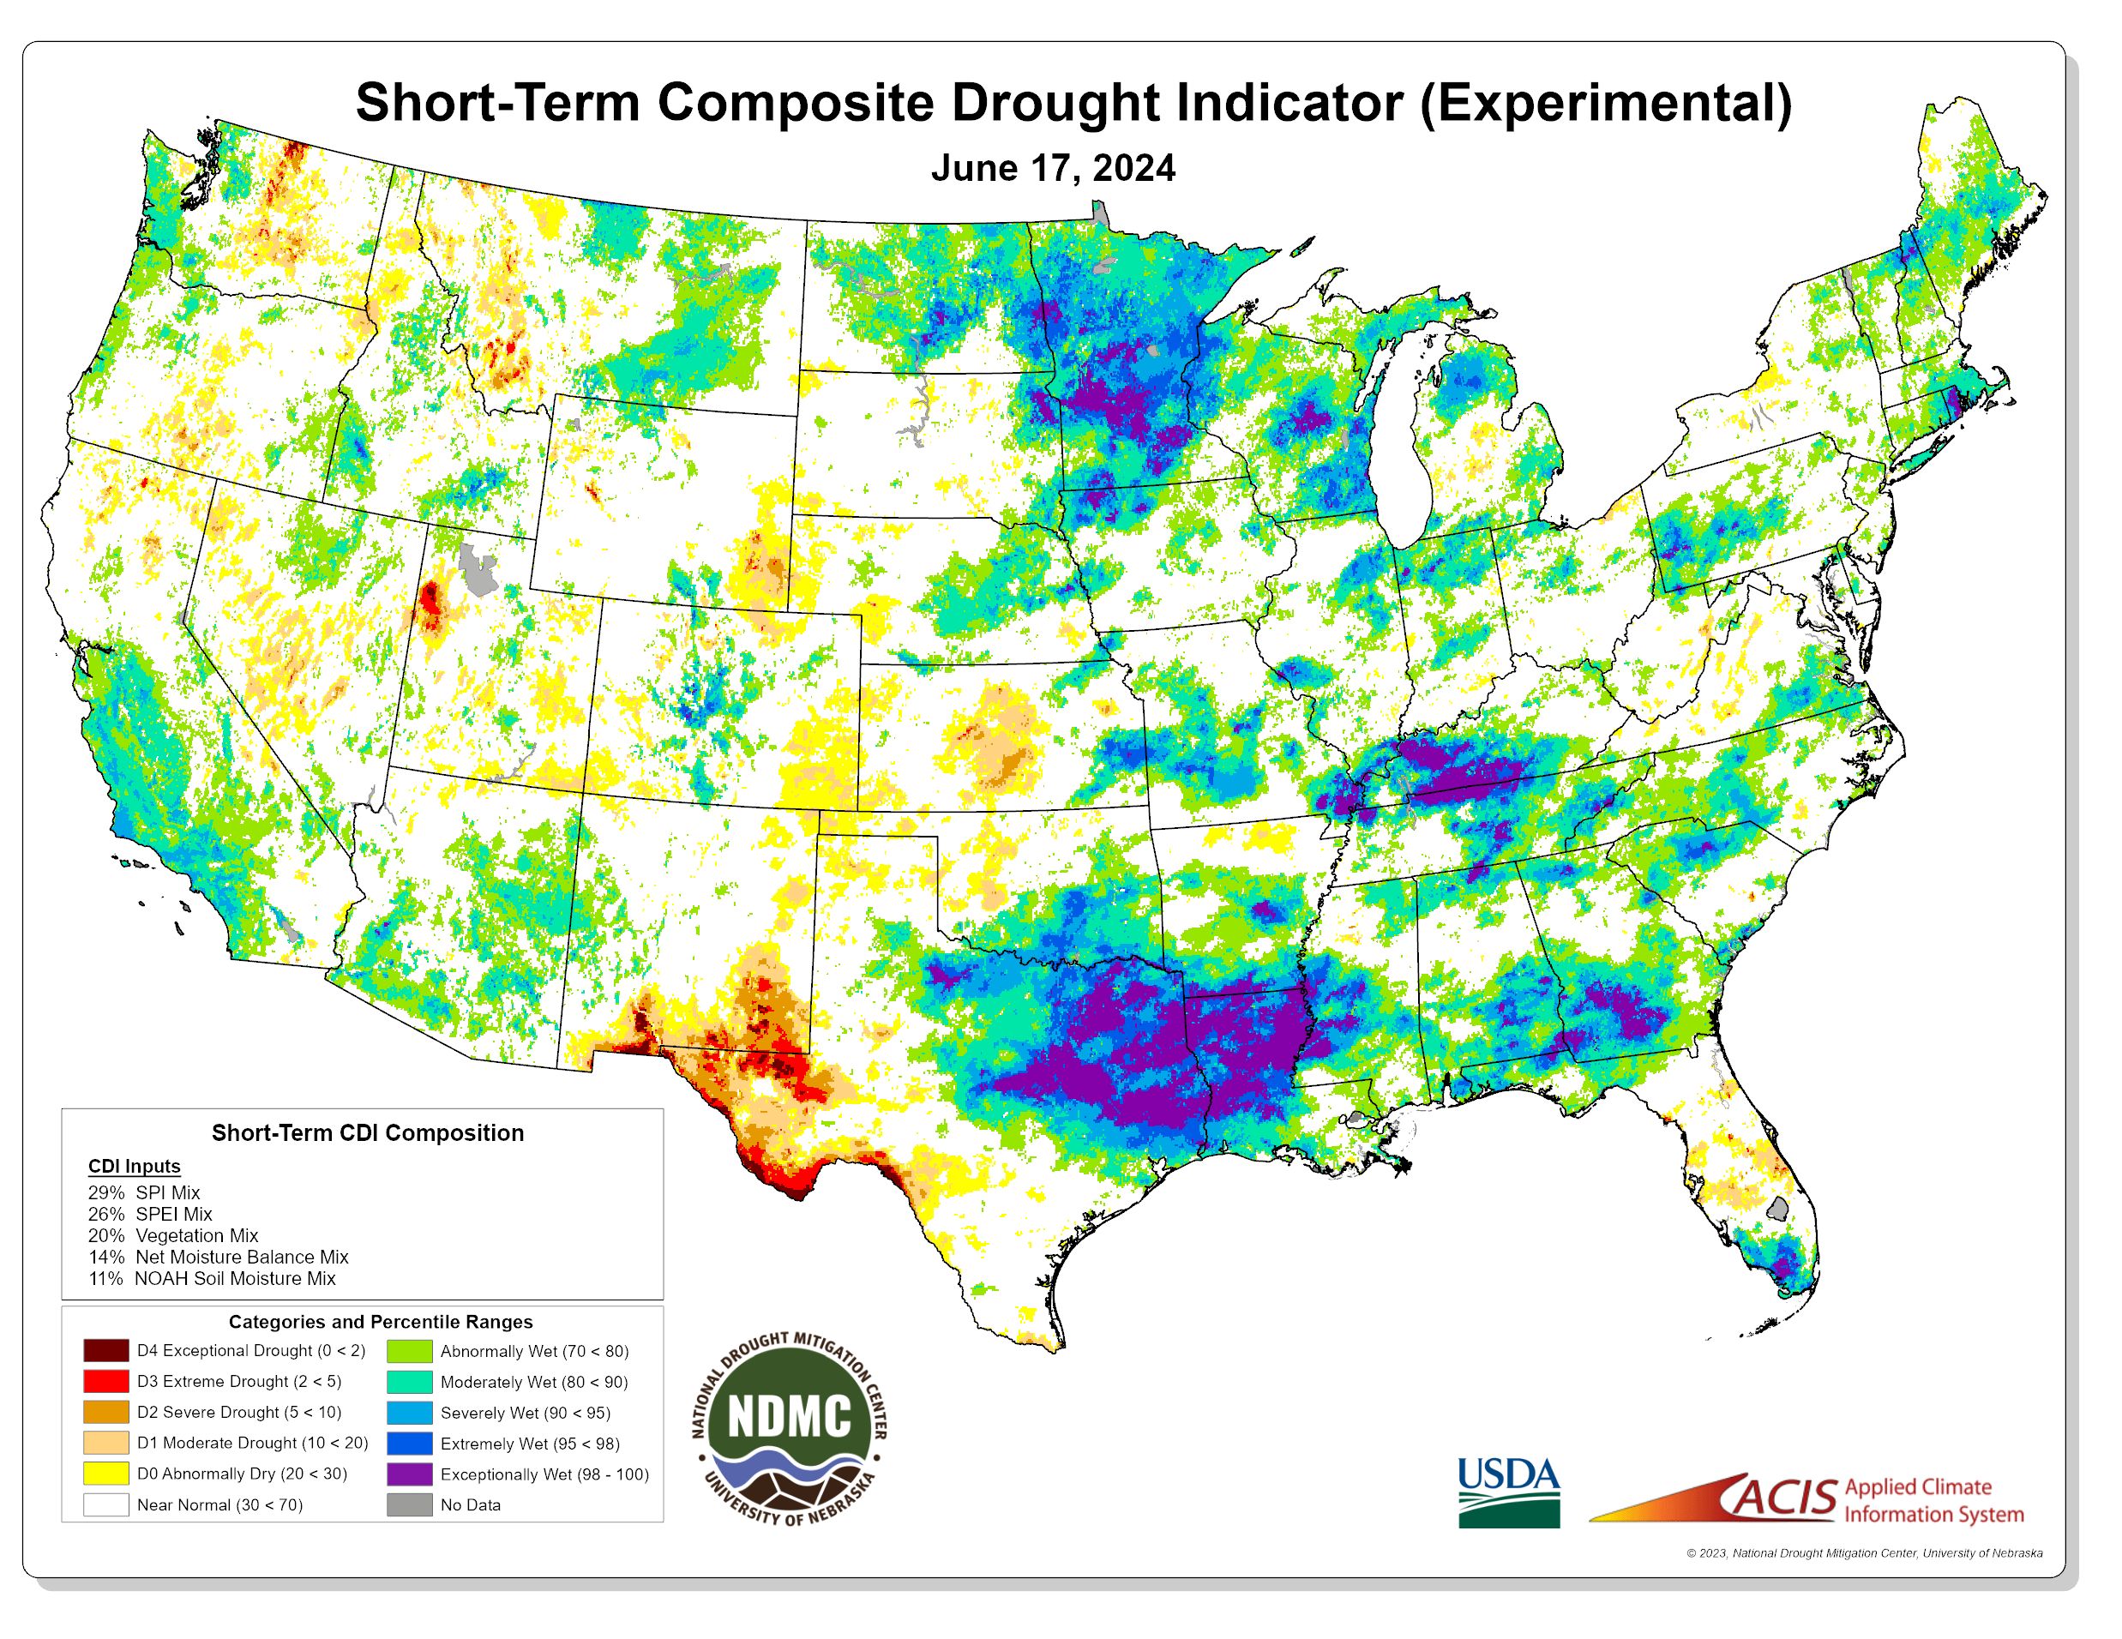
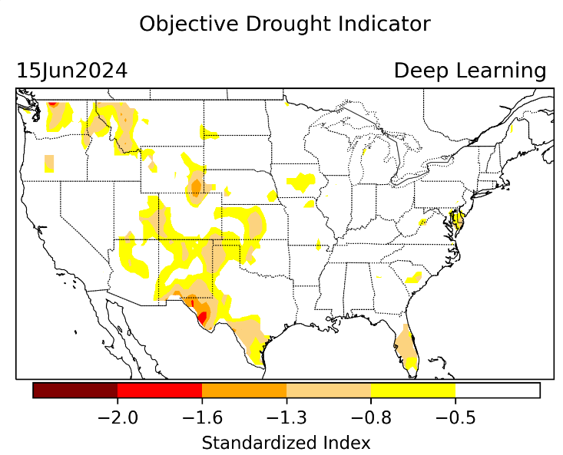
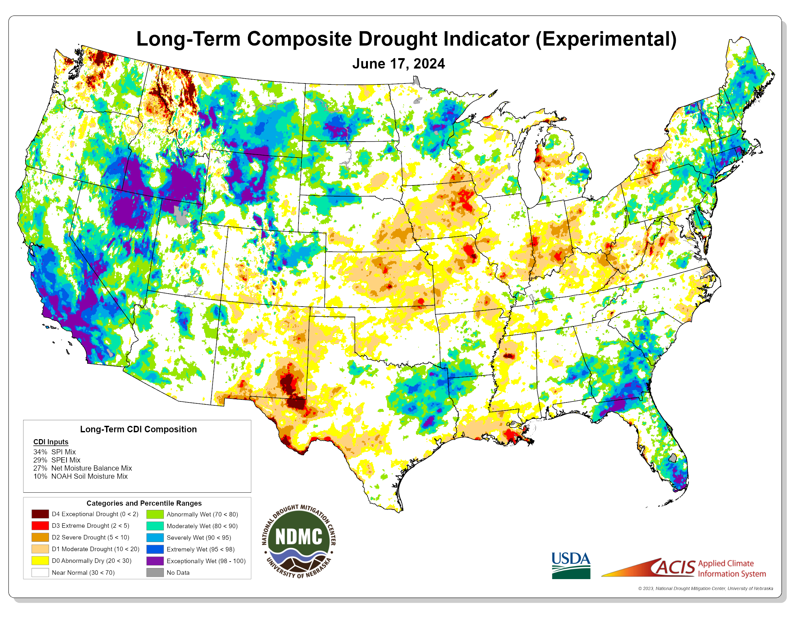
Exptl. Objective Drought Monitor (showing S/term & L/Term separately) from National Drought Mitigation Center (NDMC)
New slide now included recently in this briefing!
CPC’s own Experimental
Objective Drought Indicator (ODI)
using AI/Deep Learning ! – Updates daily !!
https://www.cpc.ncep.noaa.gov/products/people/lxu/odi/#deep-learning-increment-training
Based on the CPC P/analysis &
VIC (Princeton) NLDAS model assimilation:
Standardize Precipitation index (SPI)
Standardize Precipitation-Evapo –
transpiration index (SPEI)
Evapotranspiration Stress Index (ESI)
Soil Moisture Percentile (SMP)
Standardize Runoff Index (SRI)
-can be split into Short/Long Term Droughts!
https://droughtmonitor.unl.edu/ConditionsOutlooks/CurrentConditions.aspx
Objective
& Updates Daily!
Objectively Integrated
versus Deep Learning
Methods ~ gives |||r results. Both Objective!
Both update daily!
Objective, but
Runs Weekly!
On Monday!
Objective
& Updates Daily!
* A manuscript (Xu & Chelliah) is under preparation.
Subjective &
Produced Manually!
Weekly!
Latest Official USDM (US Drought Monitor)
(about a week old!)
Objective, but
Runs Weekly!
On Monday!
These two maps above, used to be produced at CPC(Rich Tinker!), but now recently officially moved to NDMC operations!
*Released every Thursday, for conditions as of Tuesday!

Slide 4
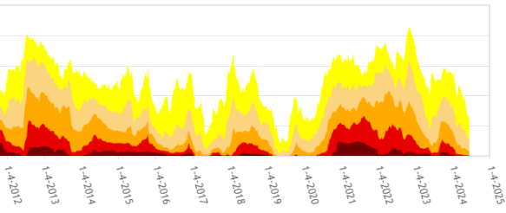
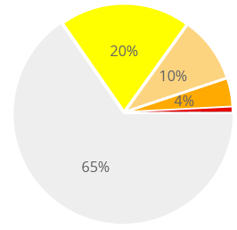
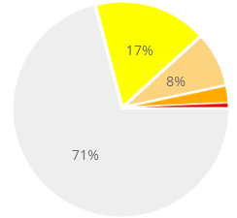
In general, The spatial details of every drought is different.! Every situation is different!!
Time series since 2000 spilt into 2 (above & below) panels.
Last month !
CONUS % Land Area
Last month drought free areas in areas was 65 %. Few months ago it was 54%.
Now it is 71 % excluding D0. Including D0 (just dry!, not drought!) it is 88 %.
We have been indicating, here in this briefing, for the last 4, 5 months that the overall drought covered area will continue to decrease and it has been happening!
Are we now hovering near the lower end of the US land area coverage for drought?
This month !

Slide 5
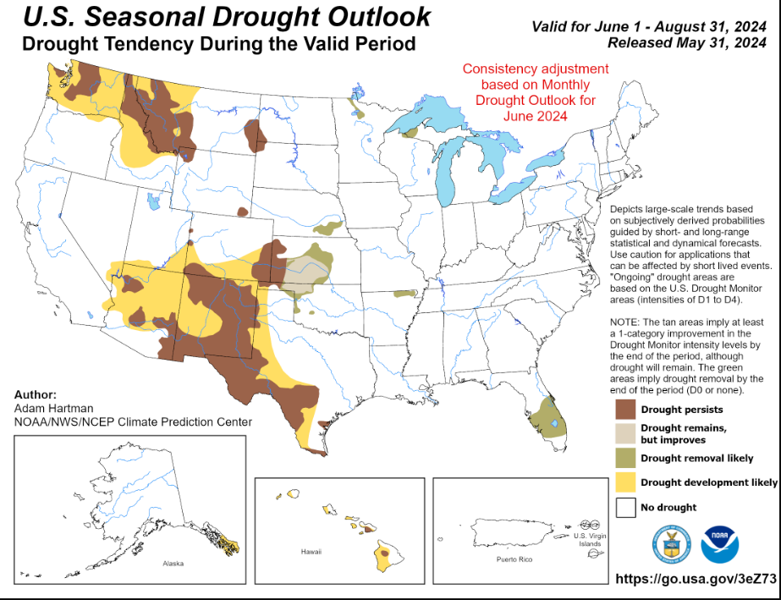
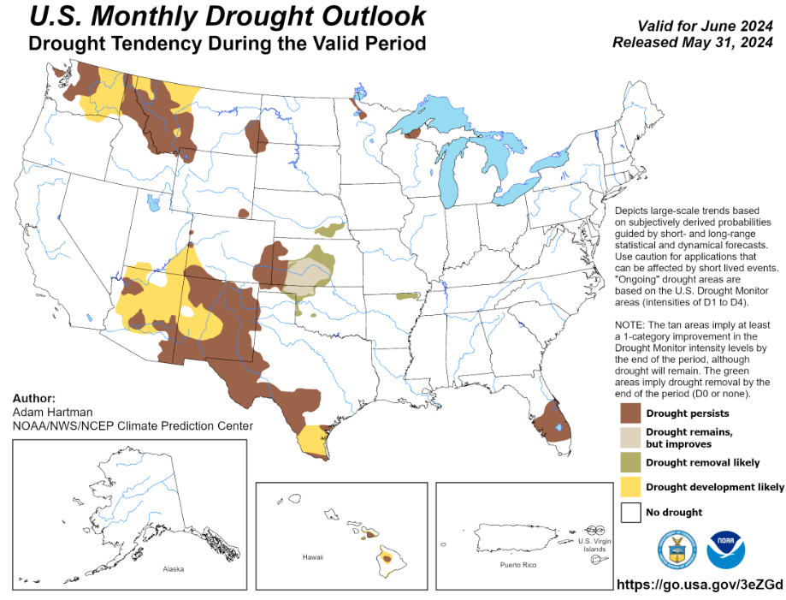
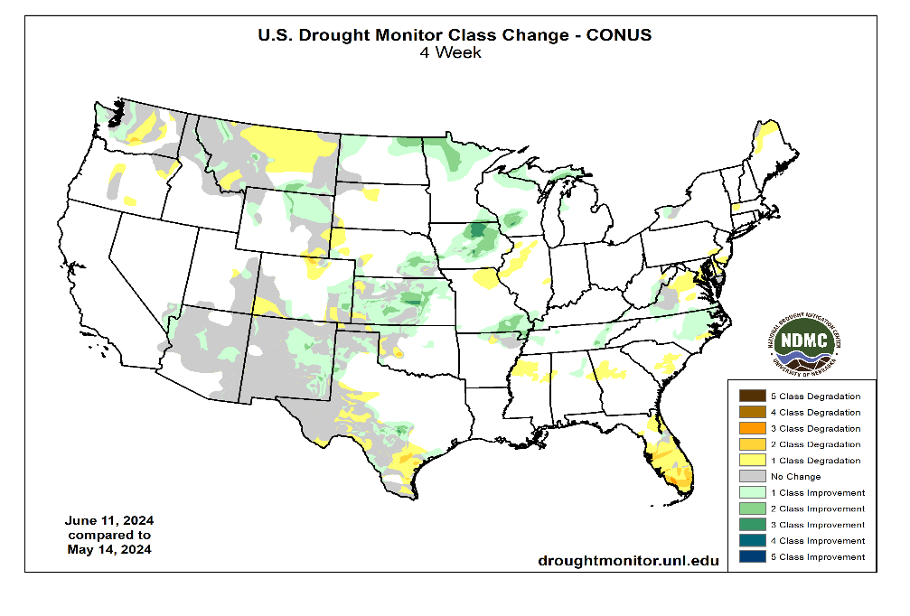
(Previous) Seasonal/Monthly Drought outlooks
New Seasonal+ Drought Outlook(SDO) to be released in 2 days!
(reissued again at end of month for consistency with MDO!)
New Monthly Drought Outlook (MDO) to be released at end of this month)
Updated Seasonal Outlook
( 1 June – 31 Aug 2024)
issued 5/31/24
Monthly outlook (for June 2024)
issued 5/31/24

Slide 6
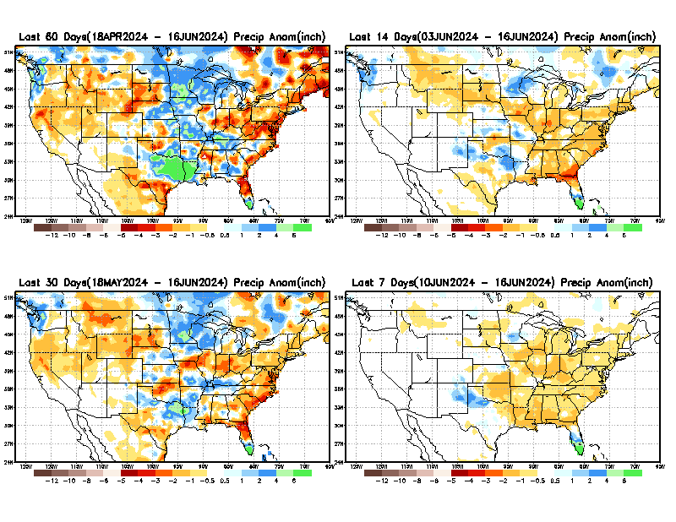
Precipitation ANOM during last 7, 14, 30, & 60 days.
This and next few slides show Precip deficit (excess).
Droughts, for the MOST part, begin and end with precip!! Lately, Temps are becoming (secondarily) important as well.
60 Days
14 Days
30 Days
7 Days
These maps in this and following slides, including a) Total,
b) Anom and
c) Percent of Normal precip. in these and other longer time ranges are now (routinely) daily updated at:
From: Recent Accum./Anom Precipitation https://www.cpc.ncep.noaa.gov/products/Drought/briefing_prcp.shtml

Slide 7
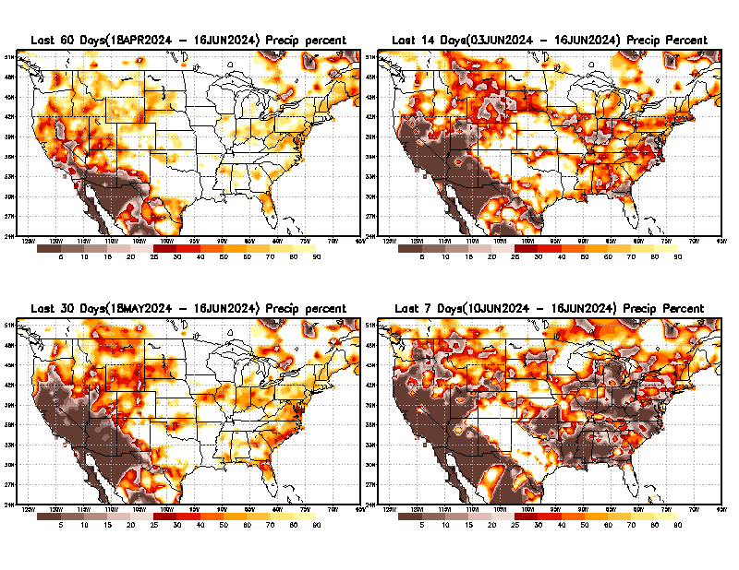
Precipitation Percent (of normal) during last 7, 14, 30, & 60 days - Only Deficit Areas <=90% shown !
60 Days
14 Days
This plot shows only the rainfall deficient regions <= 90% of normal.
-- This shows more clearly possible/likely drought developing region in the future unless there is above normal rainfall in these regions in the future, to offset these shortfalls.
30 days
7 days
From: Recent Anom/% of normal Precipitation https://www.cpc.ncep.noaa.gov/products/Drought/briefing_prcp.shtml

Slide 8
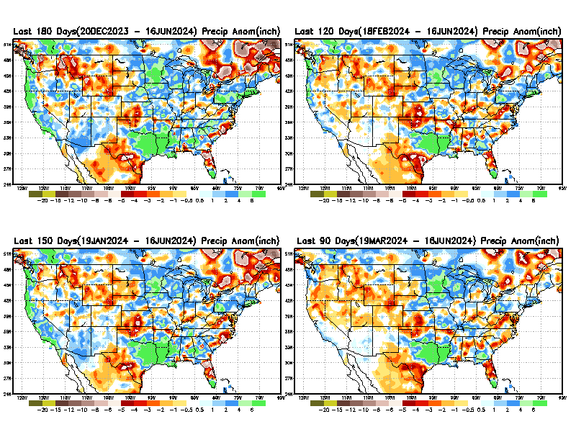
Total precipitation ANOM during last 3, 4, 5, and 6 months.
While the Precipitation anomalies deficit may seem large in some regions (compared to others),
it is the
% of normal precip (next slide) that matters more!!
6 M
4 M
5 M
3 M
From: Recent % of Normal Precipitation https://www.cpc.ncep.noaa.gov/products/Drought/briefing_prcp.shtml

Slide 9
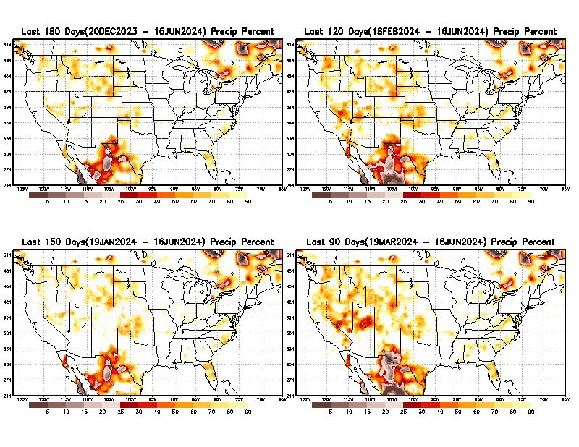
Total precipitation Percent (of normal) during last 3, 4, 5, and 6 months Only Deficit Areas <=90% shown!!
6 M
4 M
In these interim time scale 3-6 months, we need to pay attention to regions, which are dark-brown, red & dark red (<50%).
NOT BAD AT ALL for S/Term Drought
While accrued precipitation deficits are real & objective,
droughts are subjective declarations!!
5 M
3 M
East vs West!
Broad vs Narrow
rainfall season.
In general, West US suffers more from frequent and lasting droughts. Droughts in East US are generally less and less lasting!
What about Center ?
More like West than East?
Short term(S) Drought is generally declared when rainfall deficits exist in the 3-6 months time range. {Long term deficits beyond 1 or 2 or more years is Long term L drought! }

Slide 10
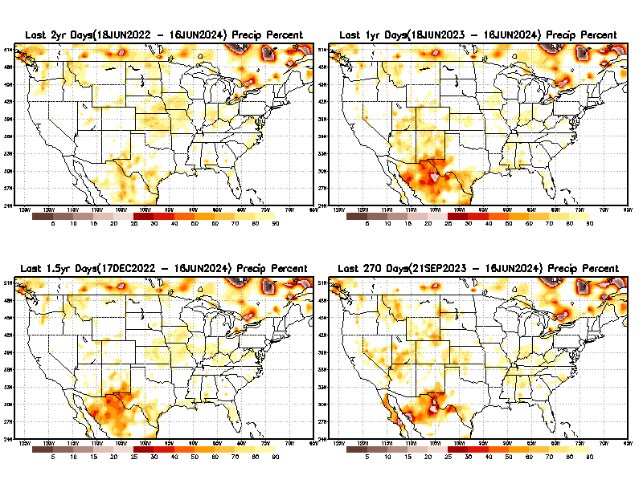
Total precipitation Percent during last 9 months, 1 yr, 1.5yrs, & 2 yrs. .–Only Deficit Areas shown!! <=90%
2 Y
1 Y
1.5 Y
9 M
The character and even location/spatial extent of the short/S and long/L –term droughts are different!!!
From: Recent Accumulated Precipitation https://www.cpc.ncep.noaa.gov/products/Drought/briefing_prcp.shtml

Slide 11
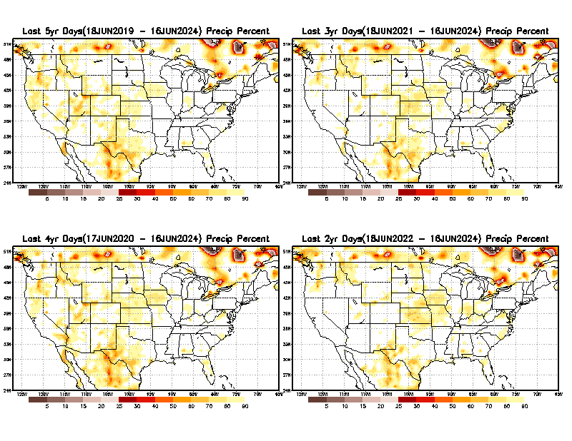
Total precipitation Percent (of normal) during last 2, 3, 4, & 5 yrs. .–Only Deficit Areas <=90% shown !!
5 Y
3 Y
Deficits are not much!
4 Y
2 Y
From: Recent Accumulated Precipitation https://www.cpc.ncep.noaa.gov/products/Drought/briefing_prcp.shtml

Slide 12
LEAST
MIXED
MOST
East vs West!
More darker colors in west/central => narrow rainy season (months)
Overall, more white space in the east => distributed rainfall season (except ~FL).

Slide 13
*********
EAST vs
CTR/WEST
Drought Behavior is loosely tied to rainfall climo!! And the limited rainy season in the west
*********
Adapted from Rich Tinker.

Slide 14
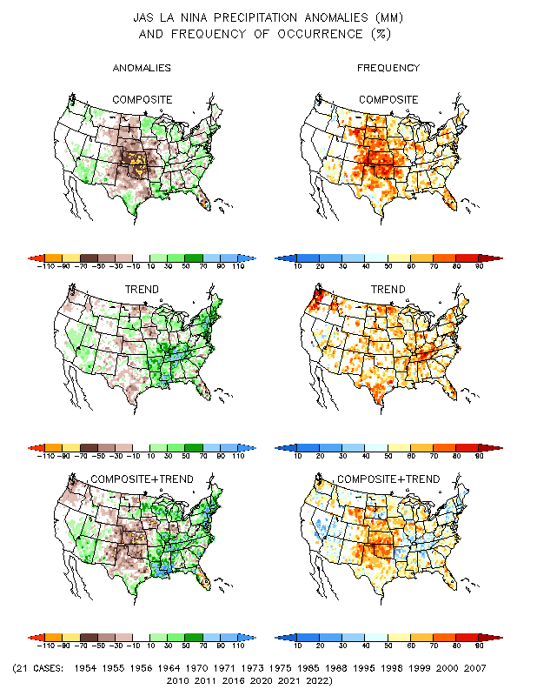
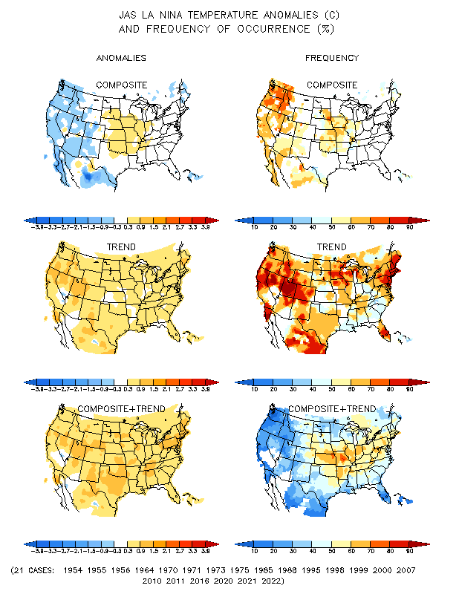
La Nina Precip/Temperature COMPOSITES & Trend map
JAS
P
T
Opposing signals!

Slide 15
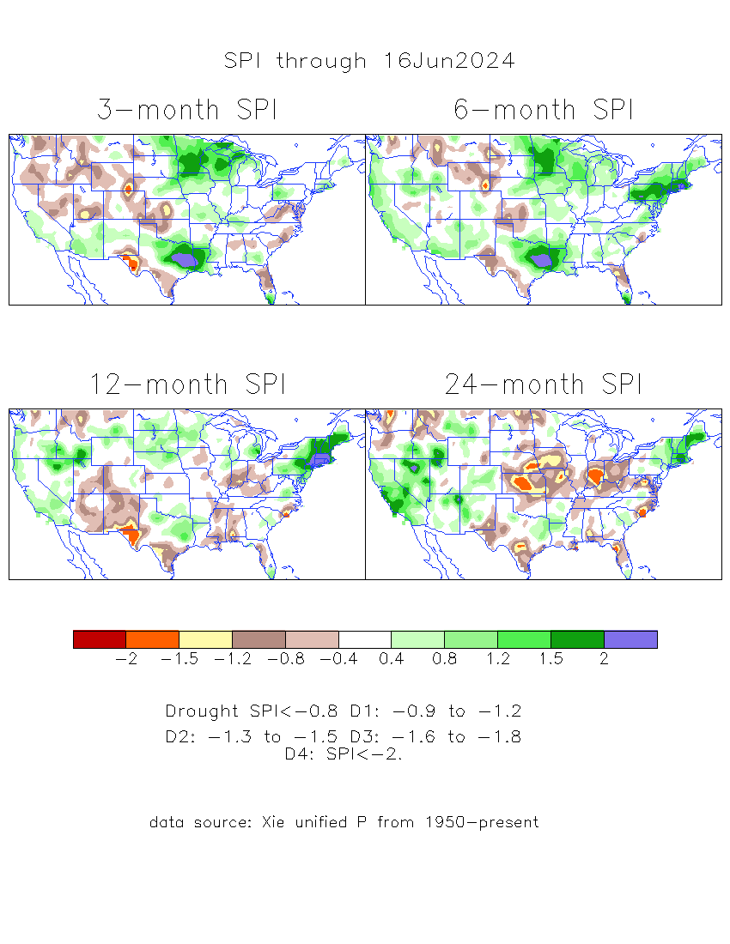
The Standardized Precipitation Index SPI (based on Observed P)
Compare with last month
----- NOW
Very interesting graphic & details for the drought across the US based on the more generalized precip deficit/excess, the Standardized Precipitation Index (SPI).
The dark brown and red colors, indicating standardized precipitation deficits, in the various time periods, approximately correspond to the appropriate short/long term drought monitor regions and their intensities
Short
Long
How does one negotiate and reconcile declaring short term vs long term drought when precip. deficiencies patterns differ on many different time scales locally!!
What is the cutoff delineating time between short VS long term drought!! Not so clear!!
At exactly where, does drought begin?
Only a very small % of US land area is under drought! ☺
Based on this SPI indicator/measure,
The brown areas are various levels of DRY regions!
The yellow/red are more probably drought regions!

Slide 16
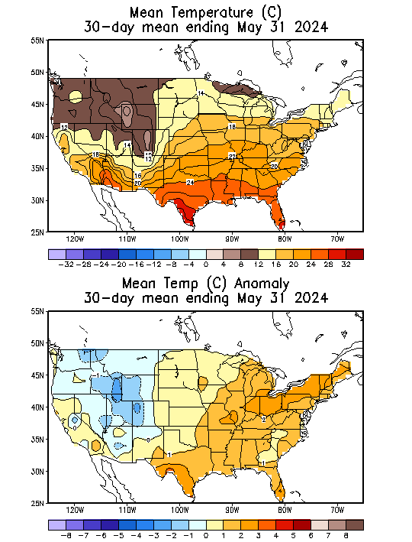
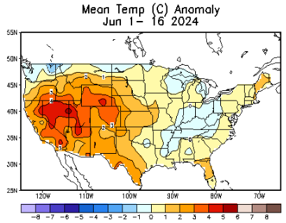
Recent US Temperatures
NOW
.
Last
month !!
So far this month !!

Slide 17
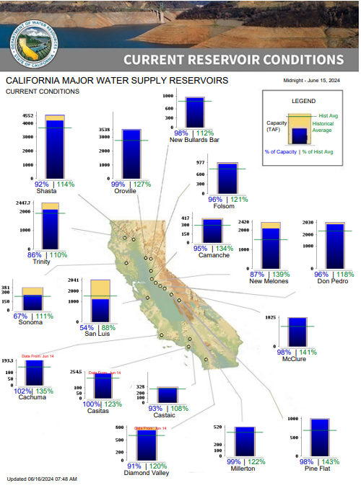
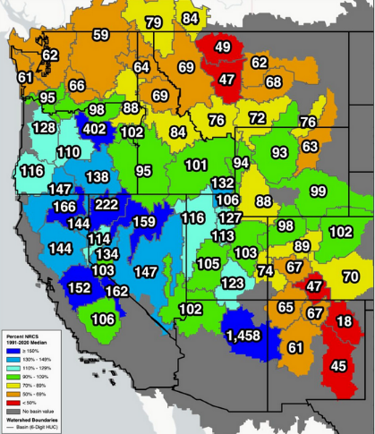
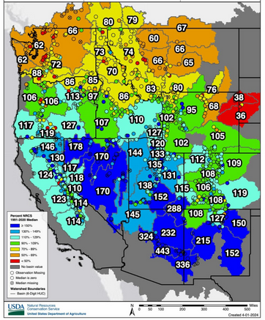
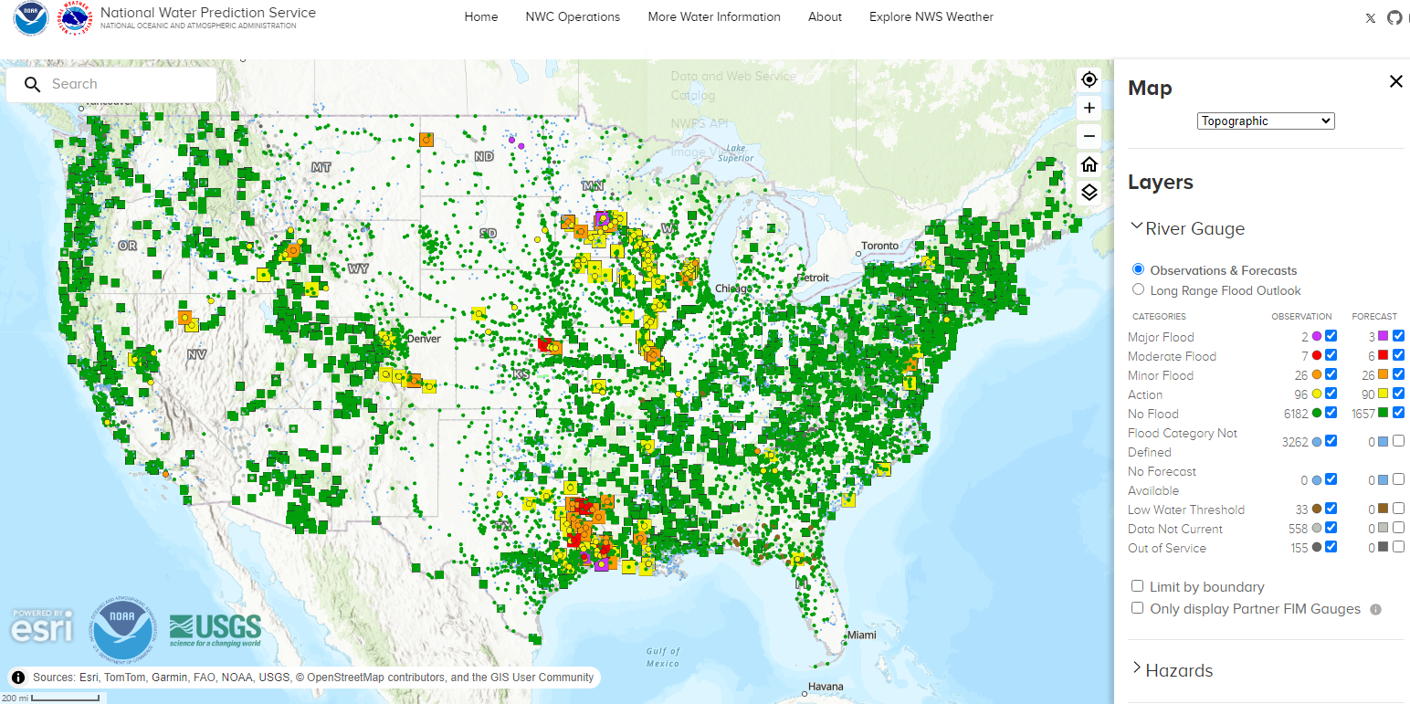
Western US Snow cover
This month versus Last month
% of Capacity
% of Hist. Avg.
of Reservoirs.
5/8
4/3
Water Year
(just started!),
Year-to-date Precipitation:
October 1, 2023 – Dec.17, 2023
https://www.nrcs.usda.gov/wps/portal/wcc/home/
Many CA water reservoirs are AT or ABOVE their historical average/ CAPACITY levels ! ☺
https:/www.nohrsc.noaa.gov/interactive/html/map.html?
Overall, across US, less snow on ground than normal!
WHOEVER thought that the California drought/reservoir-water-levels will turn around in just ONE La NINA winter!!
But a very different story for the big lakes Lake Mead & Lake Powell in NV, see next slide! ☹

Slide 18
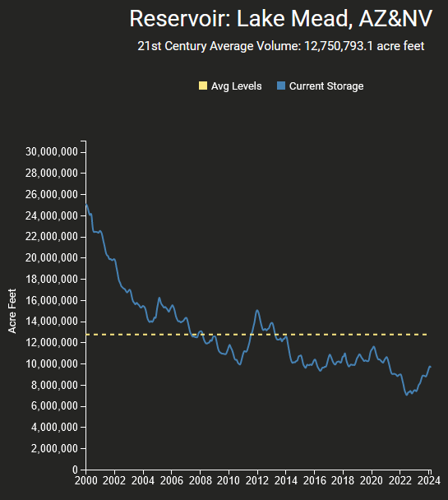
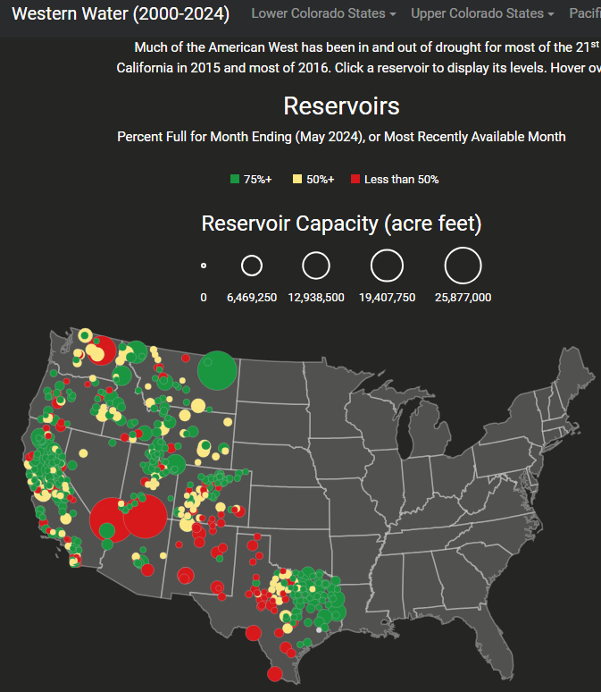
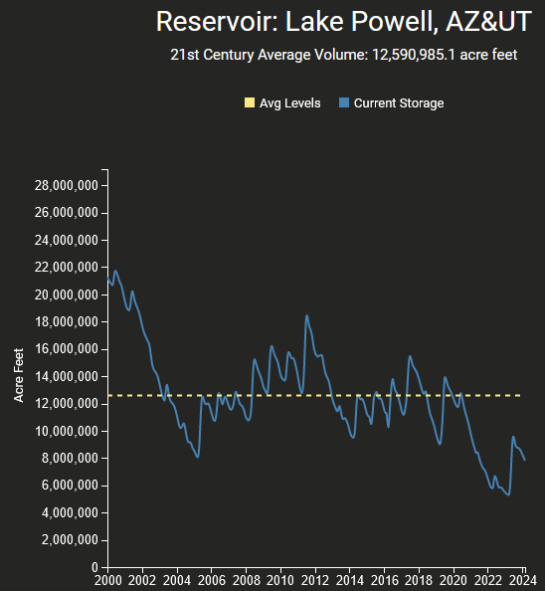
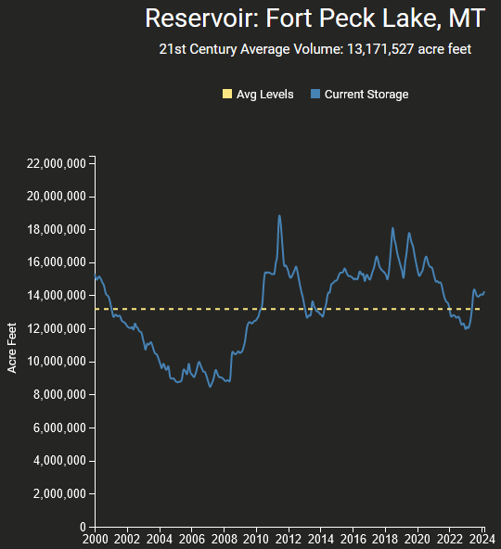
Reservoirs
Percent Full for Month Ending (April 2024), or Most Recently Available Month
Hydro Electric power generating turbines STOP operating at the critical 7 million acre feet level
https://www.deanfarr.com/western_water/
Lakes Mead, Powell in NV/AZ are at low levels! ☹ ☹ HUGE consequences for electric power for western states CA/NV/AZ/UT !! Slowly improving in recent months!

Slide 19
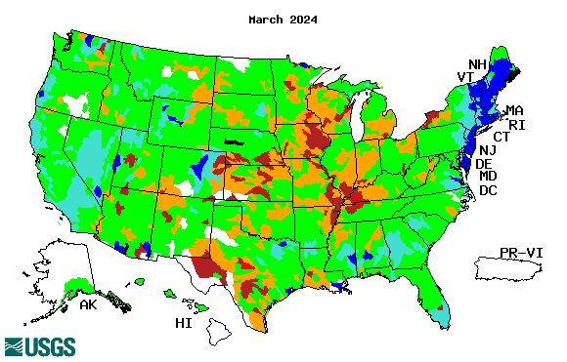
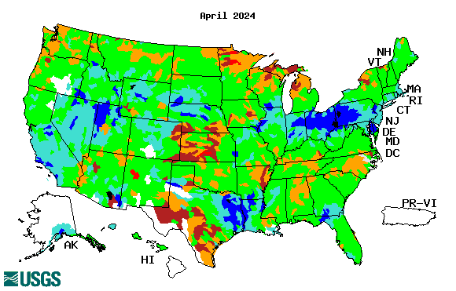
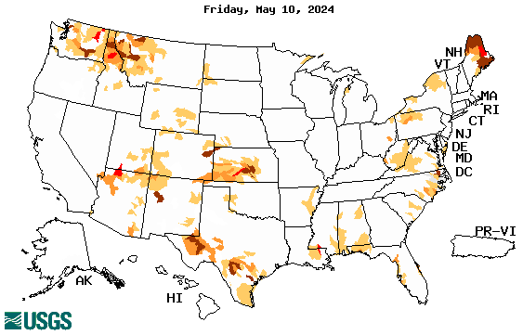
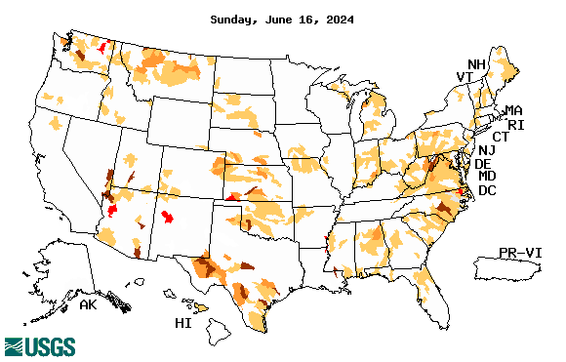
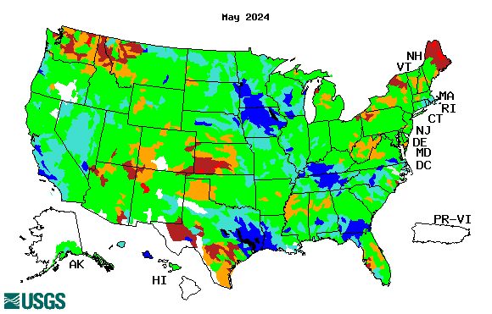
Streamflow (USGS)
Most US east droughts are relatively short lived (as compared to US west).
But in last 2 decades, recently in 2000, 2016, 2020, & 2022, New York and New England experienced historic drought conditions not seen since the 1960s.
Map shows only below normal 7-day average streamflow compared to historical streamflow for the day of year.
One month ago (left) &
Now (below)
Streamflow is only a partial indicator, as sometimes it is highly managed.
If sometimes, the various indicators are confusing, go back to % of rainfall deficit maps – to confirm/reinforce!!
https://waterwatch.usgs.gov/?m=nwc
19

Slide 20
EL NIÑO/SOUTHERN OSCILLATION (ENSO)
DIAGNOSTIC DISCUSSION
issued by CLIMATE PREDICTION CENTER/NCEP/NWS and the International Research Institute for Climate and Society
17 June 2024
ENSO Alert System Status: Final El Niño Advisory/La Niña Watch
Synopsis: ENSO-neutral conditions are present.
La Niña is favored to develop during July-September (65% chance) and persist into the Northern Hemisphere winter 2024-25 (85% chance during November-January).
CPC’s Oceanic Niño Index (ONI) [3 month running mean of ERSST.v5 SST anomalies in the Niño 3.4 region (5ºN-5ºS, 120º-170ºW)], based on centered 30-year base periods updated every 5 years. For historical purposes, periods of below and above normal SSTs are colored in blue and red when the threshold (0.5) is met for a minimum of 5 consecutive 3-month overlapping seasons.

Slide 21
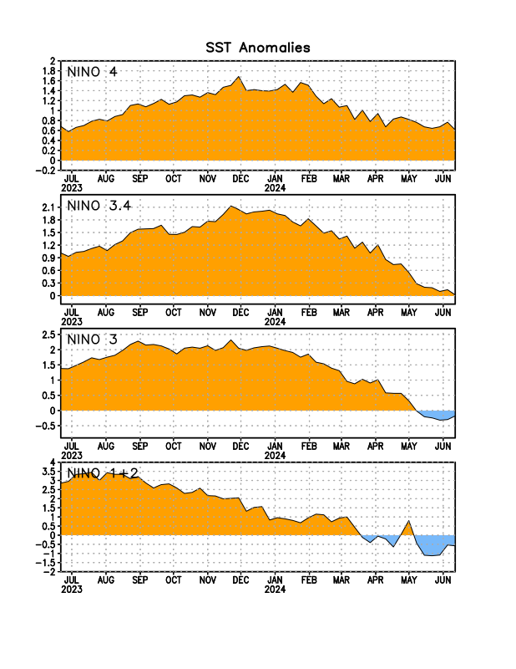
Latest values of SST indices in the various Nino Regions.
The current El Nio came in a hurry after 3 back-to-back La Ninas, and is also going away in a great hurry to make room or ANOTHER La Nina which is on the way!!? ?

Slide 22
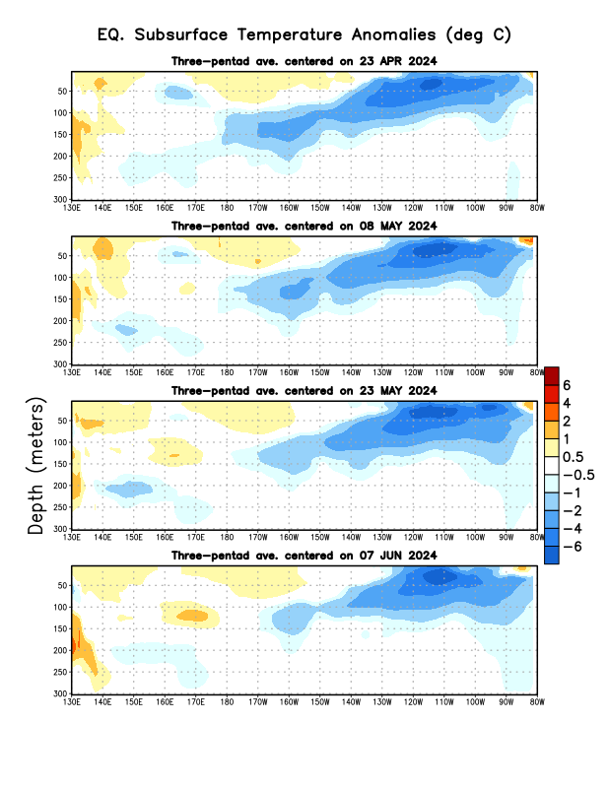
Sub-Surface Temperature Departures in the Equatorial Pacific
Most recent pentad analysis
Is the subsurface cold water content/volume increasing (toward a la Nina event) ?
Or decreasing slightly, lately ???

Slide 23
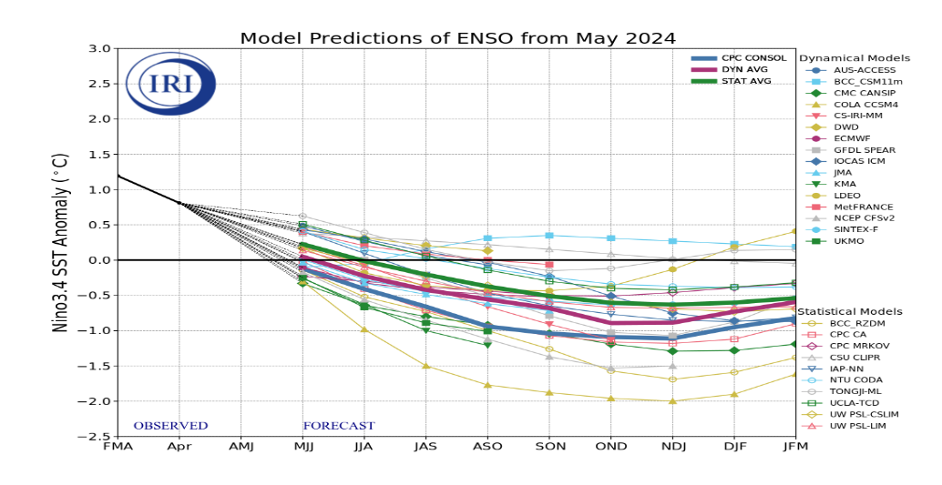
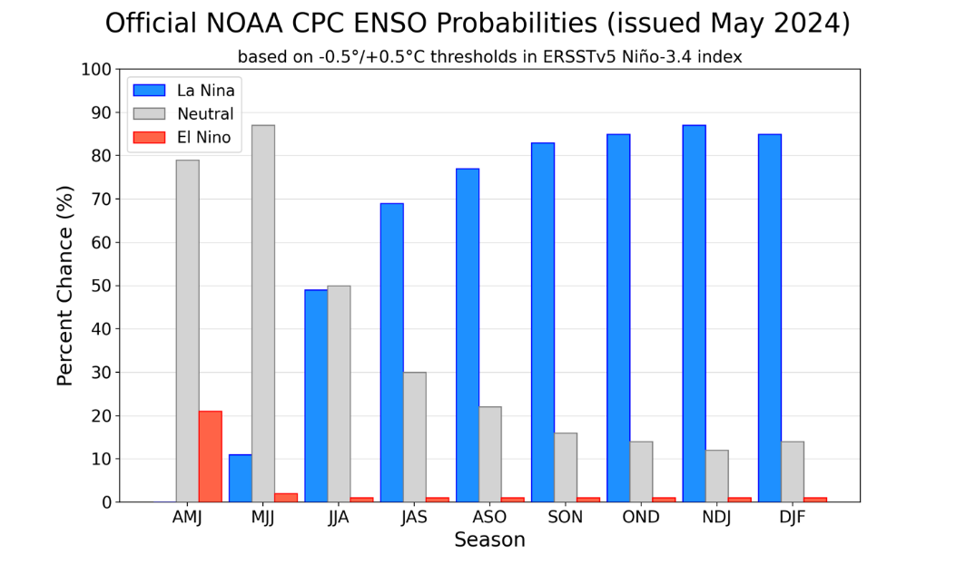
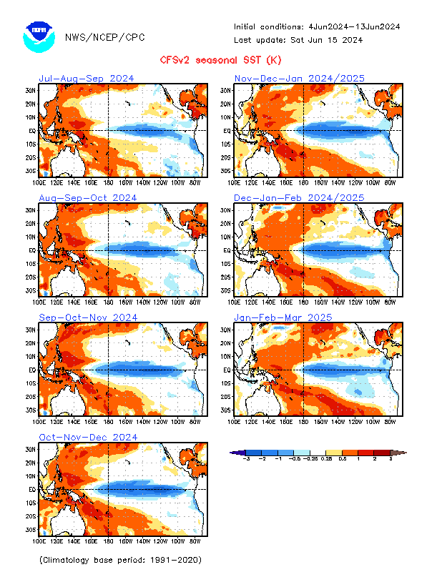
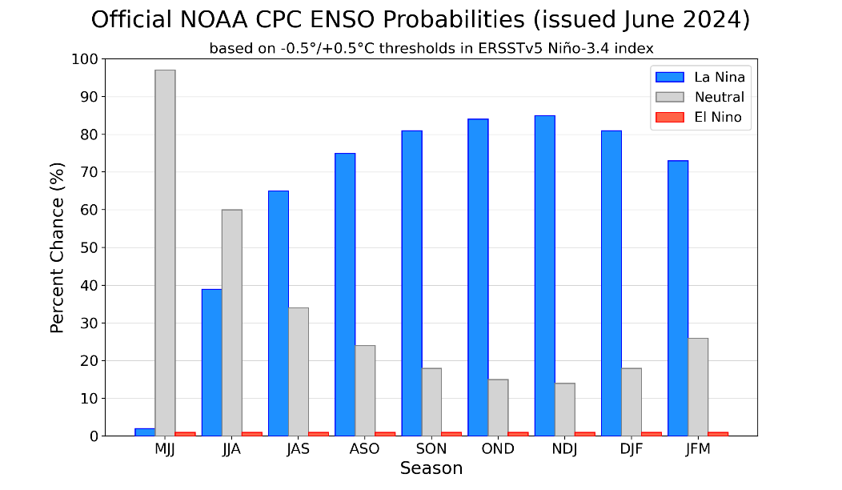
Official ENSO Forecasts
The majority of models indicate ENSO-neutral will persist through July-September 2024. Thereafter, most models indicate a transition to La Niña around August-October 2024.
May CPC/NOAA forecast
A slight pull back from La Nina ??
June CPC/NOAA forecast
https://www.cpc.ncep.noaa.gov/products/people/wwang/cfsv2fcst/images3/PacSSTSeaadj.gif
Latest ensemble membrs (blue!)show are less bullish

Slide 24
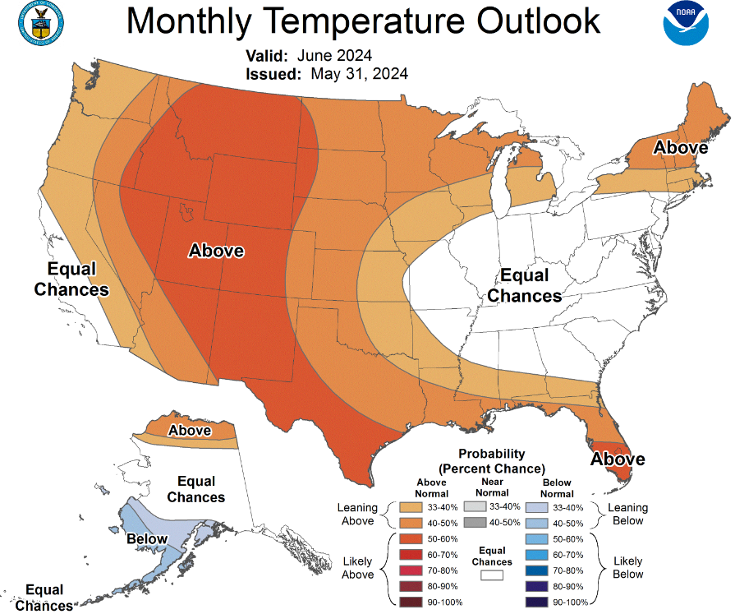
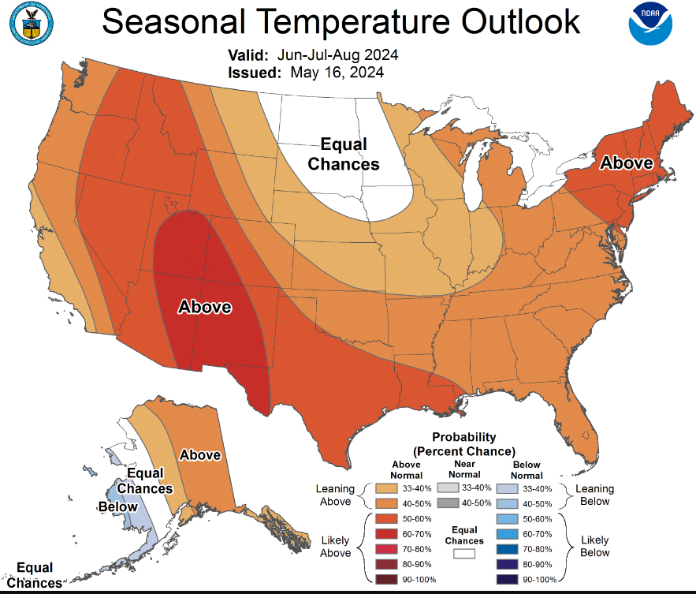
Previous (Last Month’s)
CPC’s official
Temperature OUTLOOK for Monthly (June)/Seasonal (JJA)
Monthly P/T forecasts verified at mid-month are generally good! Becoz of good skill upto 2 wks.
Released May 16th
Observed so far this month!! ☺ ☺ ☺

Slide 25
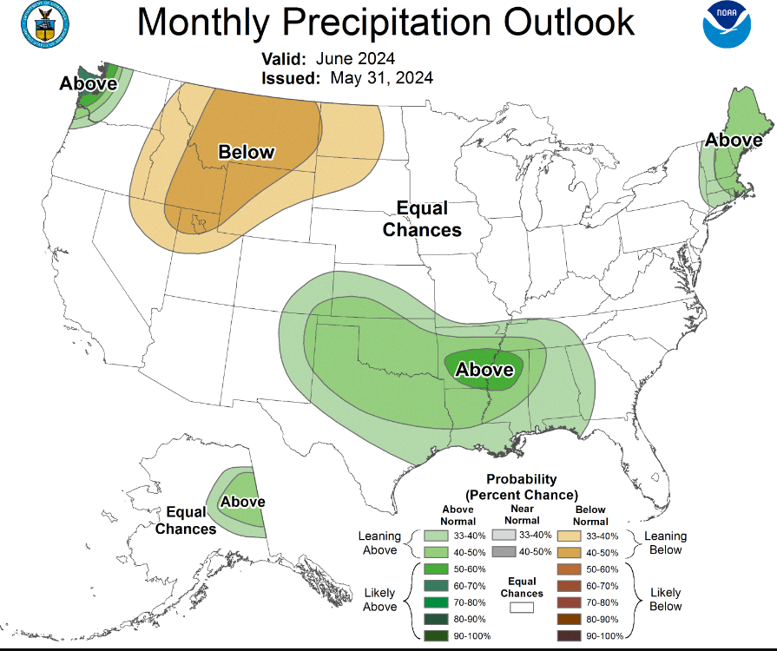
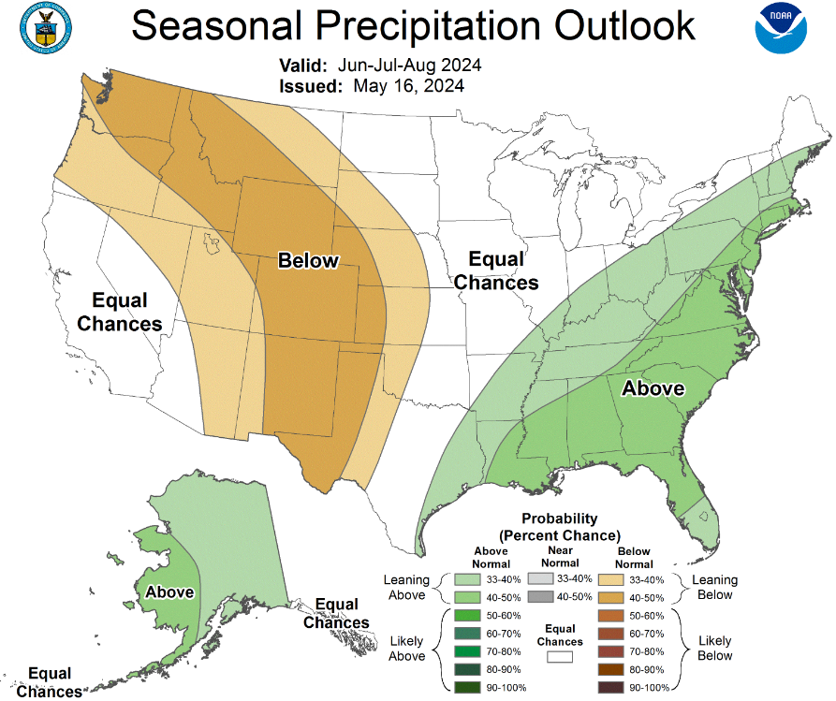
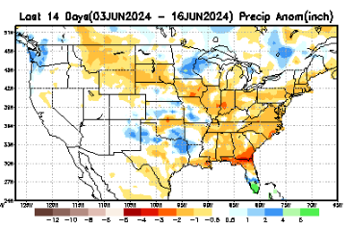
Previous(Last month)
CPC’s official
Precipitation OUTLOOK for Monthly (June)/Seasonal (JJA)
Monthly P/T forecasts verified at mid-month are generally good! (??) Becoz of good skill upto 2 wks.
Released May 16th
Observed so far this month!! ☹ ☹
☹

Slide 26
GEFS
WPC/NCEP’s Next 7 days QPF (Quantitative Precipitation Forecast)
GEFS*/GFS Model Guidance for the next 15 days.
(*new)
GFS

Slide 27
From 3 Models average Precip forecast (made 16 & 17 June) for next 30 days.
The 3 Models are: CFSV2, GEFS, ERA5

Slide 28
From 3 Models average Precip forecast (made 16 & 17 June) for next 30 days.
20
40

Slide 29
Except here, the rest of the country looks good, in terms of rainfall, not just in this short time scale/period, but even up to 5 years, see next maps!
From 3 Models average Precip forecasts (made 16 & 17 June) for next 30 days.

Slide 30
From 3 Models average Precip forecasts (made 16 & 17 June) for next 30 days.

Slide 31
Drought threat does not look bad even in long term! Only in the near short term! All depends on the monsoon this year in the SW.
From 3 Models average Precip forecasts (made yesterday 16 &17 June) for next 30 days.

Slide 32
Even thru’ up to 5 years period, the country as a whole looks good, in terms of good rainfall!!! And lower drought coverage!!
From 3 Models average Precip forecasts (made 16 & 17 June) for next 30 days.

Slide 33
NMME* T (left) & P (right) Ens.Mean forecasts for
July
T
P
JAS
Note this general area of deficient precip forecast during the next 3 months, implying a weakened upcoming SW monsoon! (as was last year!)
More HOT!
NMME* : North American Multi Models Ensemble

Slide 34
Agreement/Disagreement among the various NMME models’ JAS seasonal Precip. Forecast.
??

Slide 35
http://drought.geo.msu.edu/research/forecast/smi.monthly.php
Predicted Monthly Soil Moisture Percentile
Latest Initial Conditions: 6/11/24
DATA not available !
CPC’s soil moisture percentile – Leaky bucket Model
The inter quartile range suggest greater uncertainty about the forecast in these shaded regions in the ESP based forecast!

Slide 36
BONUS Topic: Discussion continues!! Explanation for the multiyear DROUGHT in the Southwest (CA/AZ/NM/NV/UT/CO & vicinity)!!
More La Nina’s lately ?
More frequent La Ninas lately ?
YES!! The stats in the table below (bottom left) are from the Official CPC ENSO declarations page/table!
(SKIP)
slide
Compared to other regions of the globe, the SST warming/trend in the central eq. Pacific (Nino 3.4) is relatively much small. (See Fig. above) – Why is this ?
Does nature try to compensate for the warming else/everywhere by producing more La Ninas in the equatorial Pacific? - Just my observation from data! Let’s check !!!
Since the 1997 monster El Nino (stronger than the famous 1982/83 event), just a quick count of CPC’s Nino 3.4 index++ values for the three month overlapping seasons, (Data at CPC site only available only from 1950!)
(27 years) (47 years) (74 years)
1997-2023 1950-1996 1950-2023
La Nina(DJF) 13 16 29
El Nino(DJF) 9 17 26
La Nina(all 3mos) 119 150 269
El Nino(all 3mos) 85 166 250
(Overlapping 3month seasons)
Look at Ratios of La Ninas (vs El Ninos) in the shorter
recent (27 yr) period vs the longer (47 yr) earlier period!!
Compare the ratios of La Nina to El Nino in the squared boxes.
***Analysis of CPC’s official Nino 3.4 index data over the last 70 years shows that the more frequent La Ninas in recent decades contributed to less rainfall in the southwest (See La Nina precip composites!, slide#13) and hence the ongoing long term drought in the Southwest!! Hence the long term southwest drought is unlikely to go away any time soon***
++ Barnston, Chelliah and Goldenberg (1997):Documentation of a highly ENSO‐related SST region in the equatorial pacific, Atmosphere-Ocean Volume 35, 1997. https://doi.org/10.1080/07055900.1997.9649597
*** The strong/weak annual monsoon rains in the southwest is a minor modulator riding on this bigger/longer-term signal. ***

Slide 37
Summary
Current Drought conditions:
California has remained drought free for about 18 months now. Above normal rainfall (strangely) during last year’s La Nina winter (2022/23) and (canonically, as expected) during this year’s El Nino winter (2023/24) in California, thus two back to back above normal winter rainfall seasons, have more than compensated for, and totally eliminated the both the Long & Short term drought in the region.
Water levels in almost all CA reservoirs are now at or well above their normal levels. However, the water storage levels in the much bigger lakes, Lake Powell and Lake Mead in NV/AZ still continue to be very low, and have not recovered from the 2+ decade(s) long hydrological drought that existed in the region. The S/L term drought in the interior Pacific Northwest and in parts of WA, ID & MT is still stubbornly persisting. But drought in MN/IA/WI/ MO/KS is nearly gone, as we had suggested.
We have been suggesting/projecting for the past few months that the overall drought situation across the entire US will be improving slowly and steadily, and it actually happened as suggested. Now a large 71% (3 months ago it was only 54 %) of the lower 48 states is totally drought free. Have we reached the “near bottom” for the % of US areas covered under drought? and will we begin seeing a slow ramp up over the next few/several months? Questions remain about when & the strength of the upcoming La Nina!
The upcoming La Nina, which is generally a poor rainfall period for the US (as compared to El Nino), combined with the hot summer temperatures may begin to slowly increase the US areas under drought.
While CA is totally drought free (ST & LT) large parts of AZ/NM and even western of TX are still under drought due to long term/decadal drought in the SW, as well as the poor SW monsoon this past year (2023). Another possible 2024 poor SW monsoon in AZ/NM and in vicinity might persist or even make the current drought in the region worse.
Current ENSO status and forecast: ENSO-neutral conditions are present. La Niña is favored to develop during July-September (65% chance) and persist into the N. Hem. winter 2024-25 (85% chance during Nov-Jan).
Prediction: Even this close, during the upcoming JAS forecast season there is still about 1/3 chance that we may will be in ENSO-neutral territory, again very tricky, in terms of possibly expecting any La Nina impacts!. Again, the expected strength of the La Nina during JAS is likely to be weak. Nevertheless, the models are somewhat consistent in predicting certain key precipitation futures across the United States, not to mention the overall above normal warmth across the US.
The models are somewhat unanimous in predicting a huge dry patch and a relatively weak monsoon, again this year, in the southwest, around the AZ/NM/UT/CO four corner states and western TX, and less precip than normal in to areas extending further north along the mountainous Rockies into WY, ID and MT. The existing drought in parts of SD,NE, KS are also particularly vulnerable, and may continue that way without much improvement. Overall, % of US land areas under drought will slightly increase from existing very low levels, mainly due to drought concern in the western/central US states.
The wetness forecast during JAS along the southeast, associated with or combined with the above normal hurricane season, and the rainfall climatology will likely remove any traces of dryness/drought in the region, and by the end of the season, will likely prevent any emergence of drought. This same argument applies to the mid-Atlantic states as well. *****

Slide 38
(Experimental) Objective drought forecast
Support for Seasonal Drought Outlook (SDO)
NMME Standardized Prcp. Index (SPI) forecast
CONUS
AK regions
NMME Standardized Prcp. Evap. Index (SPEI) forecast
NMME_VIC Soil Moisture Percentile (SMP) forecast (experimental )
NMME_VIC Standardized Runoff Index (SRI) forecast (experimental)
Support for Monthly Drought forecast (MDO)/flash drought
Meteorological drought (SPI)
Agricultural drought (SMP)
Hydrological drought (SRI)
Probabilistic drought forecast (in developing)

Slide 39
The North American Multi-Model Ensemble (NMME):
CFSv2
NCAR_CESM1
GFDL_SPEAR
CanCM4i
GEM_NEMO
NASA_GEOS5v2
Quantile-Mapping (BCSD) bias correction and downscaling
The Hatched area: Signal to Noise Ratio SNR < 1
Maximum likelihood to estimate the gamma distribution
Focus on the Meteorological drought
https://www.cpc.ncep.noaa.gov/products/Drought/Figures/SPI/Prediction/ENS_spi3-12_4x3_hatched.jpg

Slide 40
Focus on the Alaska
The same method with CONUS
SPI3 for Short-term drought
SPI12 for Long-term drought
Observation limited
Skills depend on Model performance
https://www.cpc.ncep.noaa.gov/products/Drought/AK/nmme.shtml

Slide 41
Focus on the climatic water balance: P - PET
Replace for the Palmer drought indices
The PET is estimated by Hargreaves (1985), FAO recommendation method without solar radiation, humidity and wind observation
Historical 1991-2020 base period
Rank-based non-parametric standardized indices (SI)
Good for the long-term drought and short-term drought
NMME Multi-Model Ensemble Median (MMEM) Standardized Prcp. Evap. Index (SPEI) Forecast
https://ftp.cpc.ncep.noaa.gov/CPC/li.xu/SDO/spei.html

Slide 42
NMME_VIC Soil Moisture Percentile(SMP) Forecast
Focus on the agricultural drought
NMME forecasted meteorological forcing
Forecast lead 0-9 months
Weather generator to temporal disaggregation
drought time scales from 1 month to 60 months
Total column vertical integration soil moisture
Highest forecast skills
https://ftp.cpc.ncep.noaa.gov/CPC/li.xu/SDO/smp.html

Slide 43
ECMWF-extended forecast driven VIC model soil moisture percentile (SMP) forecast
ECMWF 48r1 version extended forecast, up to 32 days
Best sub-seasonal forecast currently available
Forecasted meteorological Forcing to drive the VIC model
With realistic land initial from the VIC land analysis
Predictability: land initial + sub-seasonal forecast
SMP for agricultural drought
https://www.cpc.ncep.noaa.gov/products/people/lxu/flashd/flash_prediction.html#10

