Slide 1
Drought Outlook Support Briefing (formerly Drought Outlook Discussion) March 2019
Climate Prediction Center/NCEP/NOAA
http://www.cpc.ncep.noaa.gov/products/Drought
Phone: 1-877-680-3341
Pwd: 858747#

Slide 2
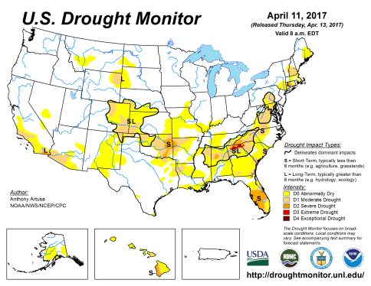
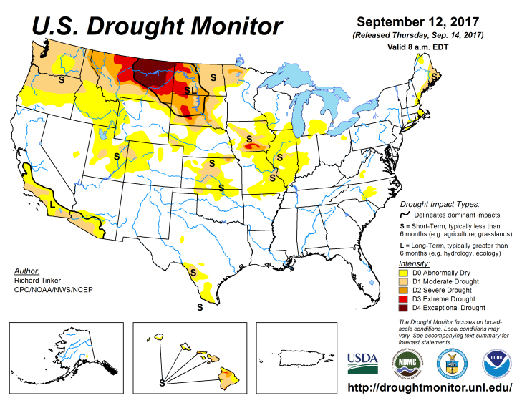
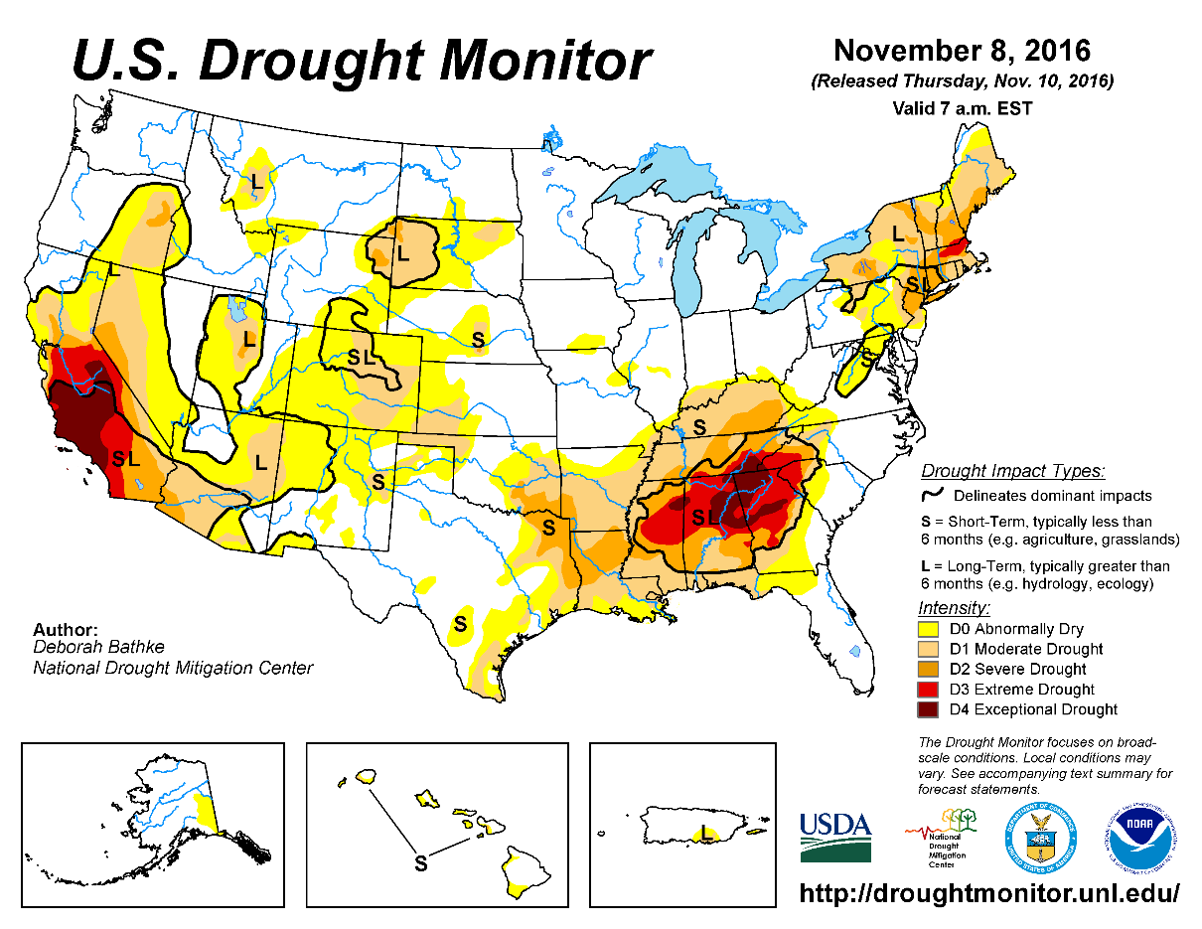
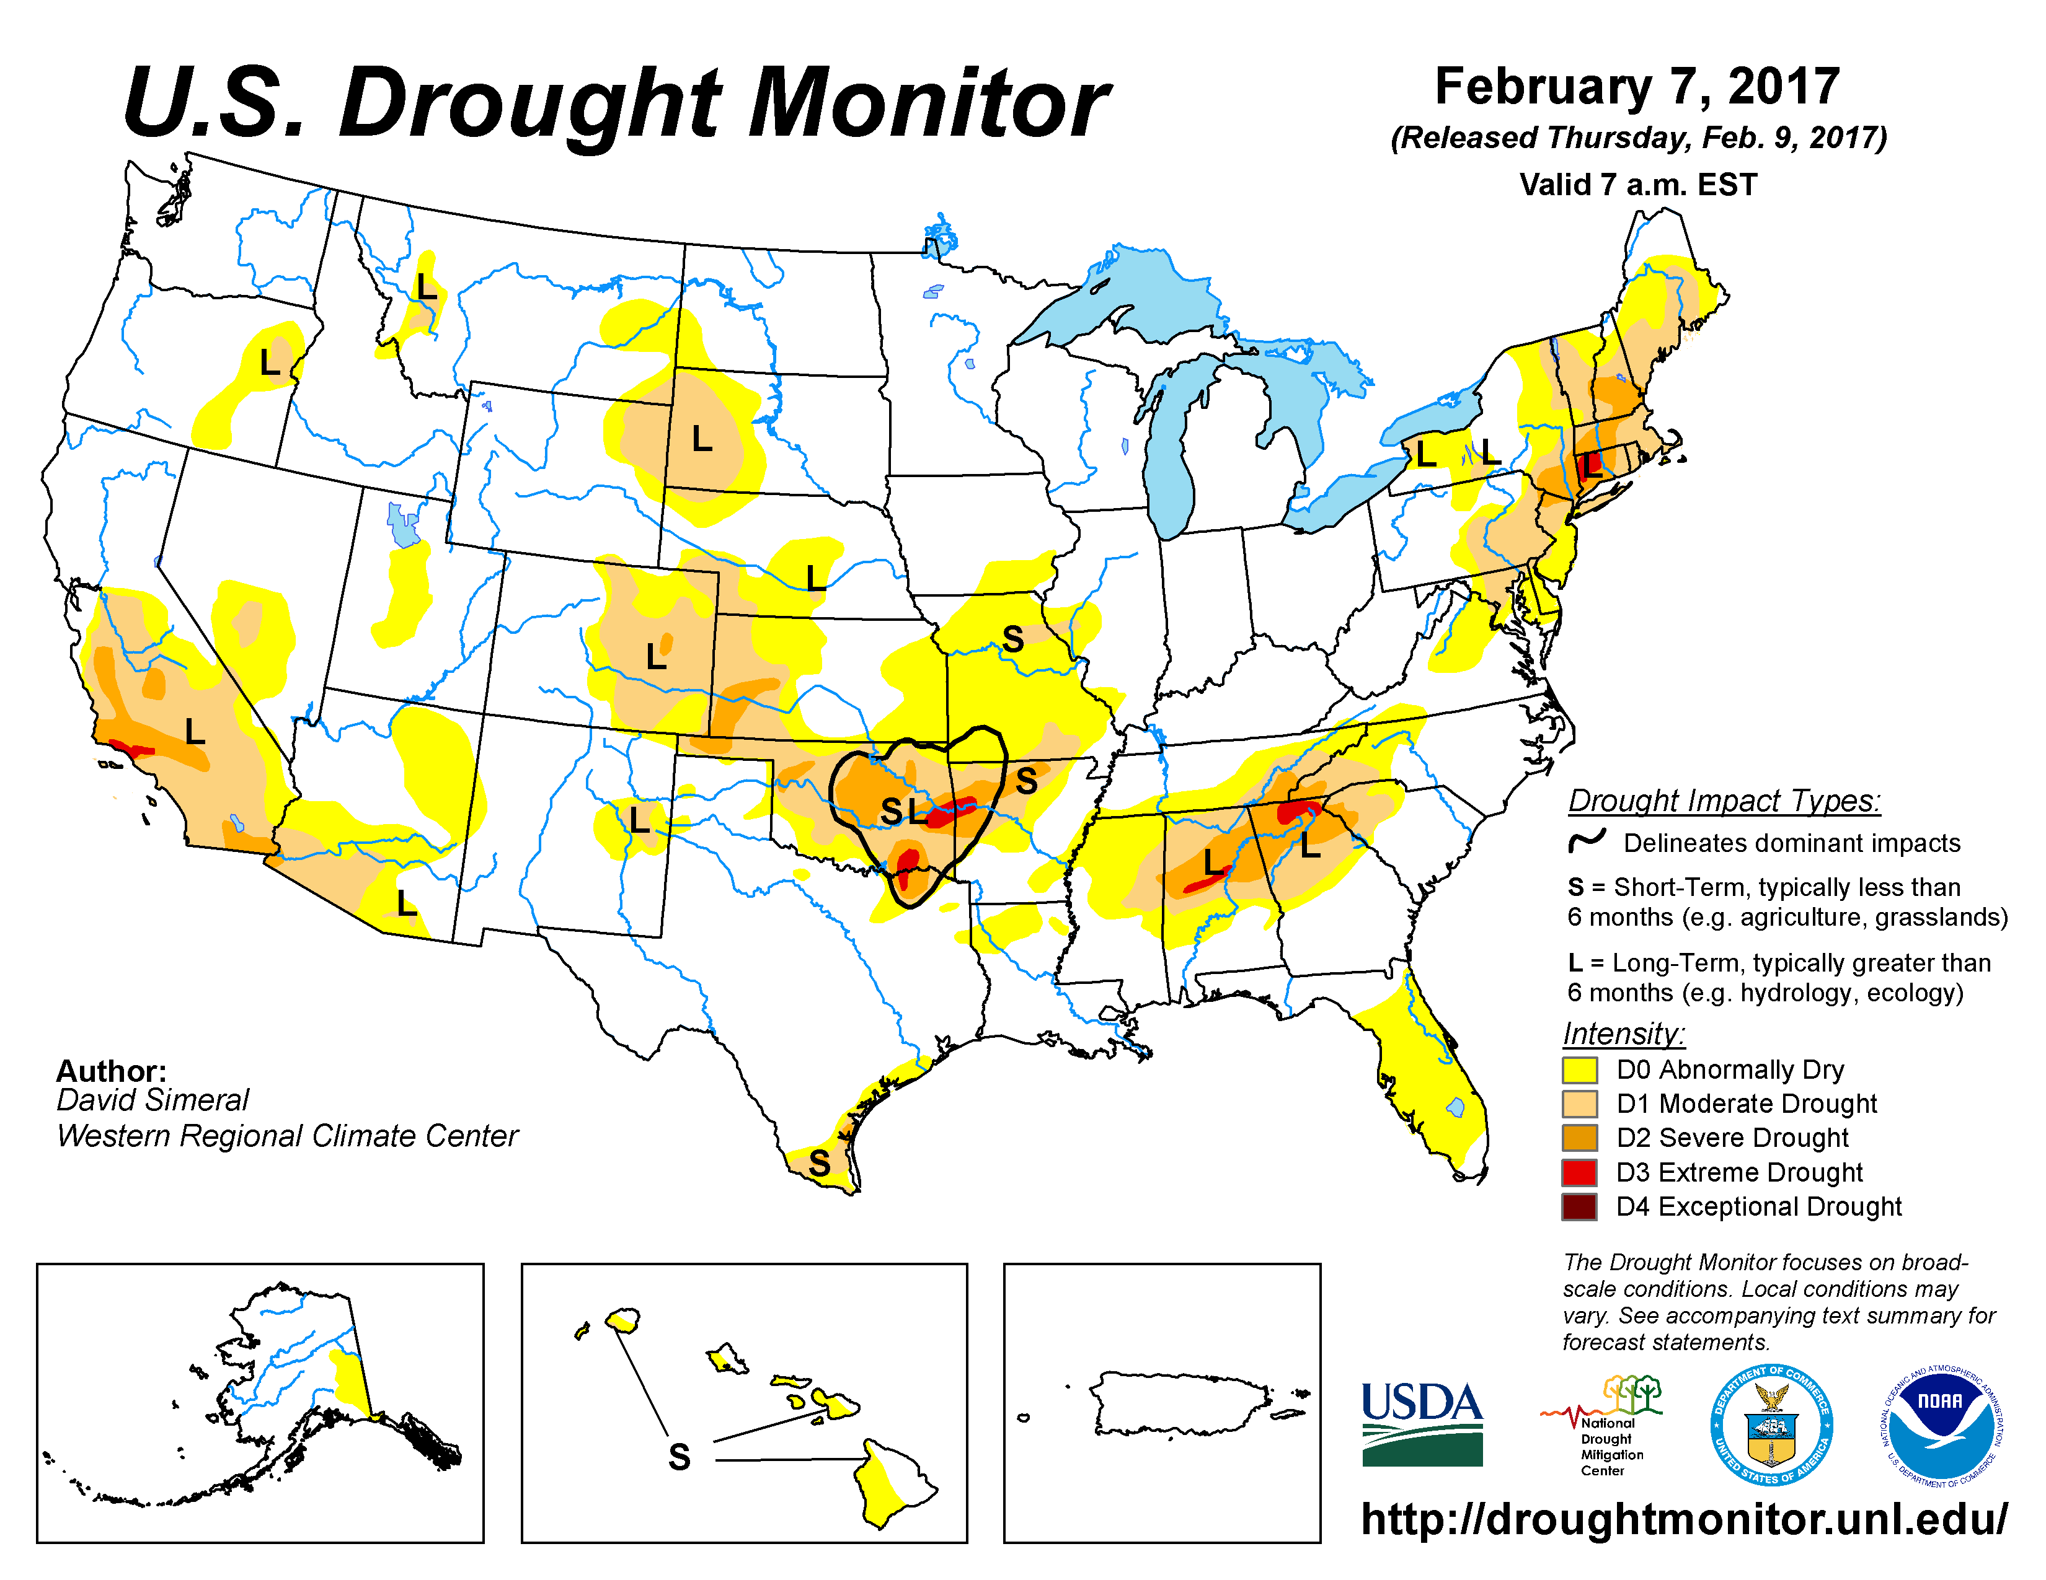
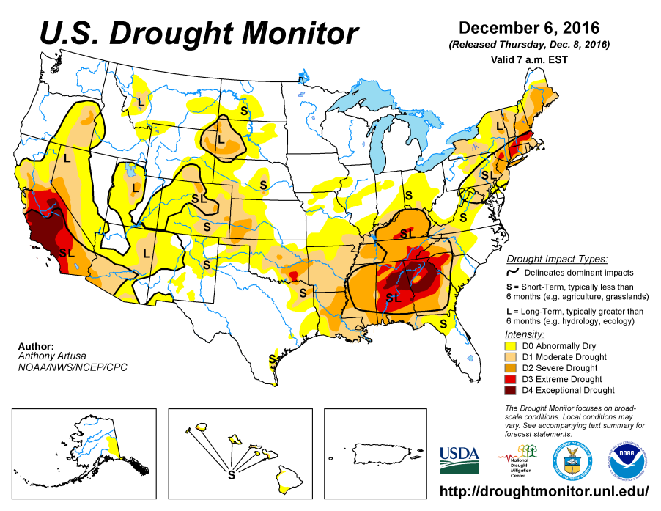
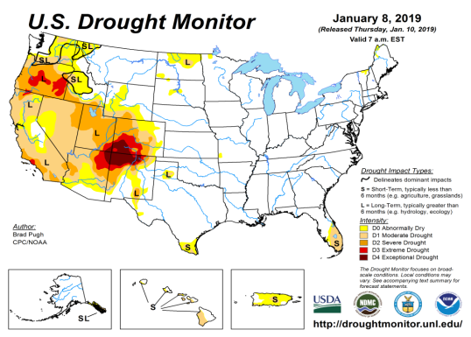
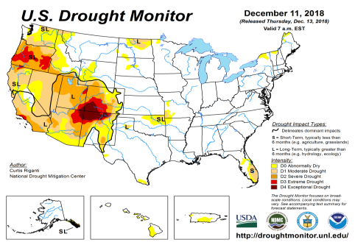
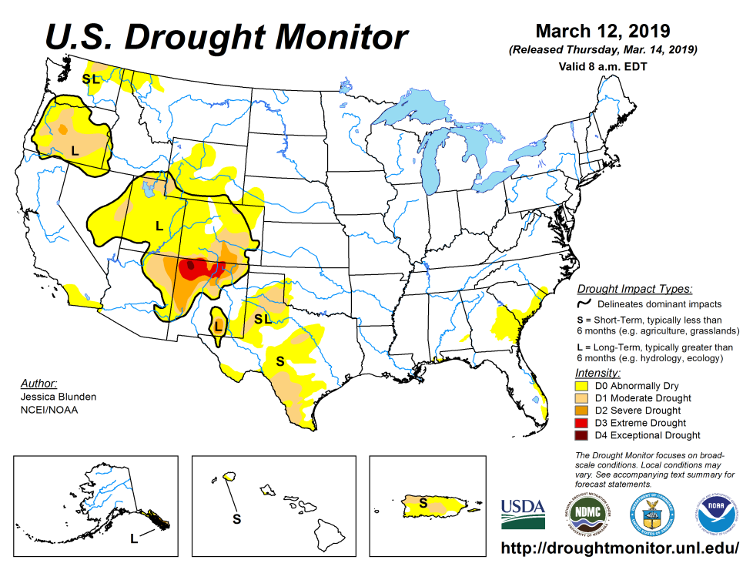
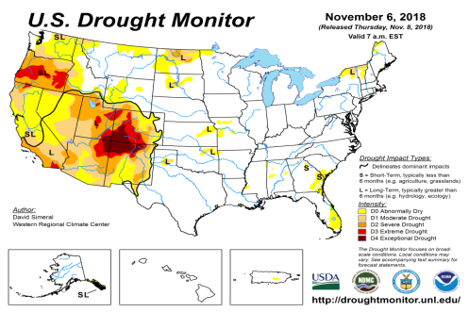
Drought Monitor
The sequence of drought monitor maps, month apart, over the last 5 months, shows the gradual and steady improvement in the drought conditions .
According to the DM:
California for the first time in recent years is almost virtually drought free, as well as Florida, another big state, where drought related impacts are huge.
The eastern two thirds is mostly drought free, but, will it stay way?
February
January
December
Latest/Recent
November

Slide 3
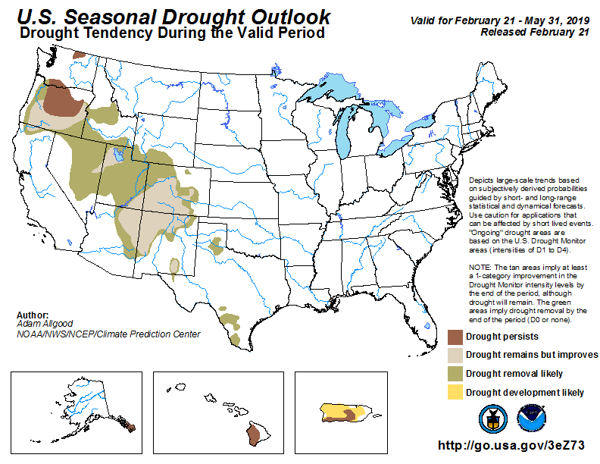
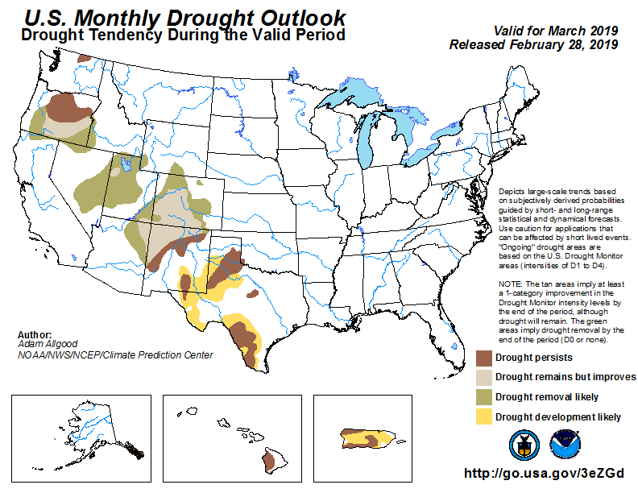
(Prev) Seasonal/Monthly Drought outlooks
(New Seasonal Drought Outlook to be released in 2 days!)
Seasonal Outlook (Mid February 2019 - May 2019)
issued 2/21/19
Monthly outlook
(for March 2019)
issued 2/28/19
General improvement in the drought conditions overall has been forecast by both Monthly and Seasonal Drought Outlooks.

Slide 4
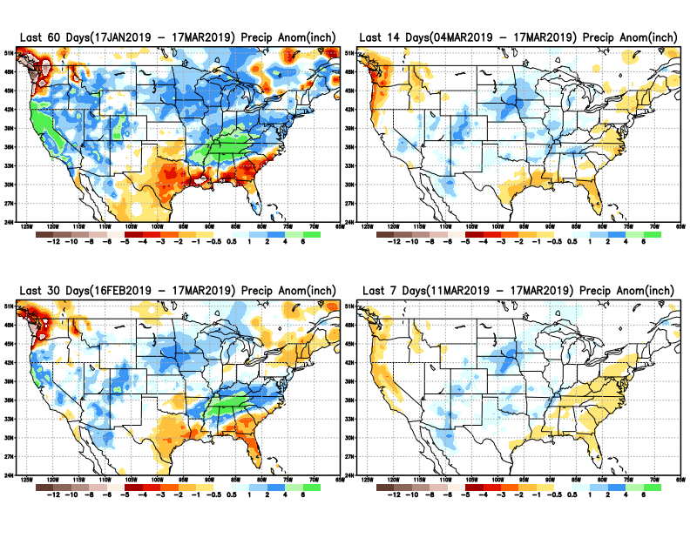
Precipitation ANOM during last 7, 14, 30, & 60 days.
Developing dryness along the Gulf coast and south central TX.
Big deficits in western WA and OR.

Slide 5
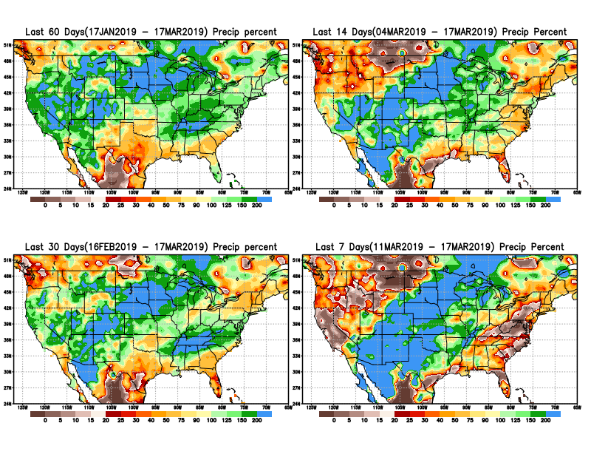
Precipitation Percent during last 7, 14, 30, & 60 days.
NOW !

Slide 6
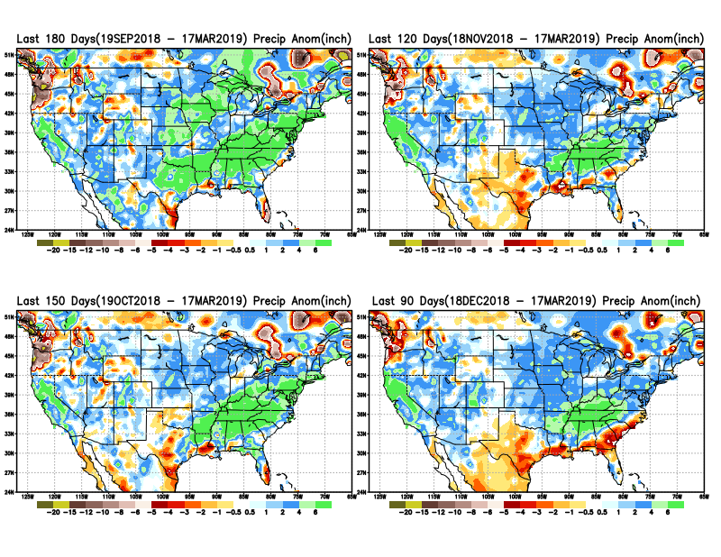
Total precipitation ANOM during last 3, 4, 5, and 6 months.
6 M
4 M
5 M
3 M

Slide 7
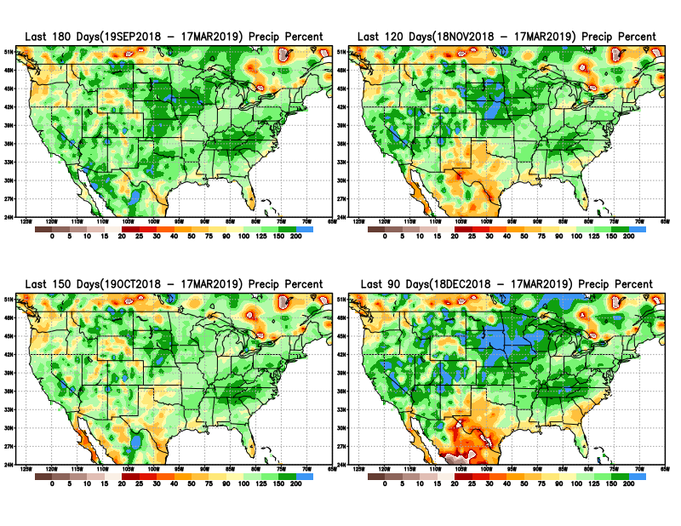
Total precipitation Percent during last 3, 4, 5, and 6 months.
6 M
4 M
5 M
3 M
Need to keep an eye for possible developing drought here and
In general along the Gulf coast.

Slide 8
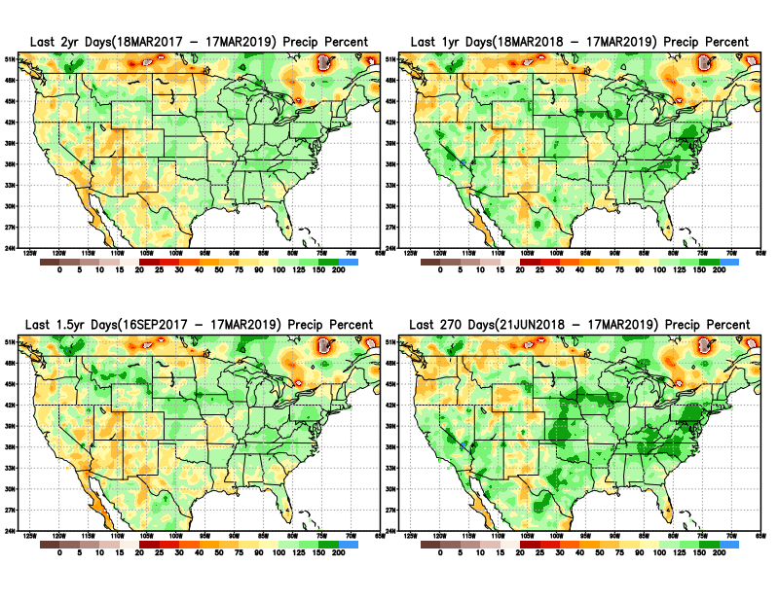
Total precipitation Percent during last 9 months, 1 yr, 1.5yrs, & 2 yrs.
2 Y
1 Y
Rainfall Data issues? Few observations, rugged terrain, interpolation problems!!
Long term rainfall deficits =>1 year still exist in the southwest in site of the recent rains.
1.5 Y
9 M

Slide 9
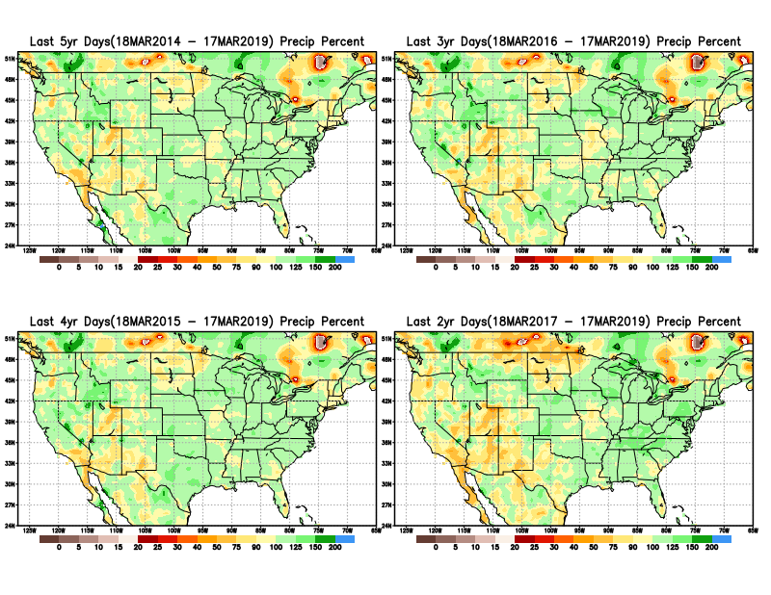
Total precipitation Percent during last 2 yrs, 3 yrs, 4 yrs, & 5 yrs.
5 Y
3 Y
Still longer term rainfall deficit variability in play? Especially in the southwest!
4 Y
2 Y
Quality of data/problem in the Northern High Plains area, especially in interpolation of sparse data in the rugged topography region!

Slide 10
Rainy (3-month)Season across the US

Slide 11
Adapted from Rich Tinker.

Slide 12
Adapted from
Rich Tinker

Slide 13
EL NINO Precip COMPOSITES
DJF
MAM
Next 2-3 months is critical for signs of any developing dryness in the Northern Plains and the southeast Gulf coast – especially with the ongoing El Nino impacts!!

Slide 14
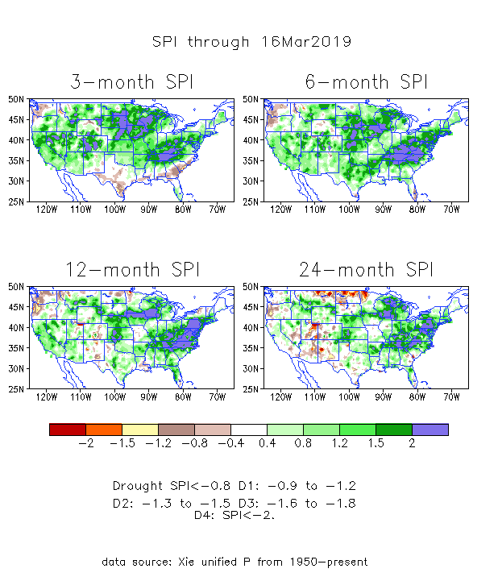
The Standardized Precipitation Index SPI (based on Observed P)
----- NOW
Very interesting graphic & details for the drought across the US based on the more generalized precip deficit/excess, the Standardized Precipitation Index (SPI).
The dark brown and red colors, indicating standardized precipitation deficits, in the various time periods, approximately correspond to the appropriate short/long term drought monitor regions and their intensities
In the short term (~3 mo) dryness is developing along Gulf coast and in southern TX.
In the 6m-9m time scale, drought in OR/WA continues.
In the longer term ~12m-24m and longer, rainfall deficits remain in the AZ/NM/UT/CO states area.

Slide 15
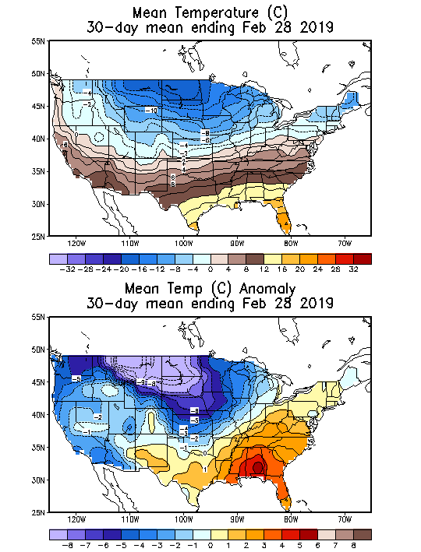
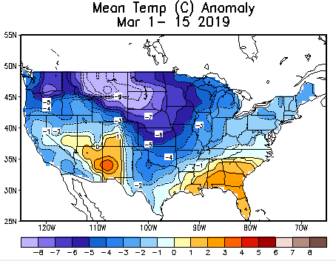
Recent US Temperatures
In December, much of the country has been relatively warmer than normal, particularly the upper Midwest.

Slide 16
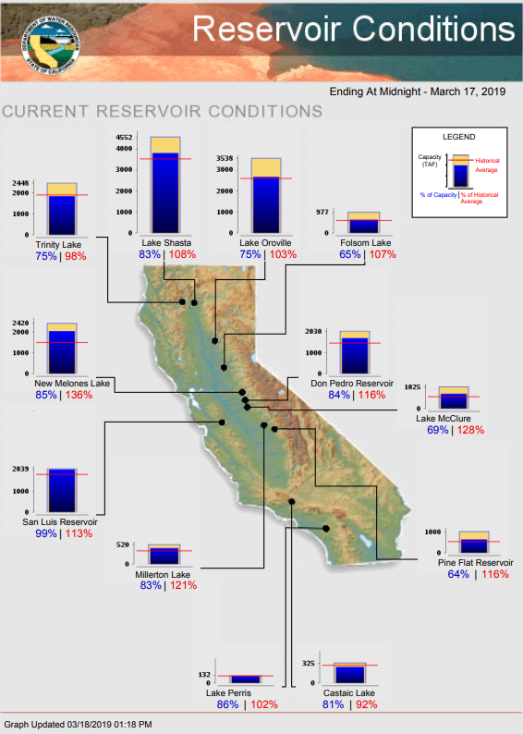
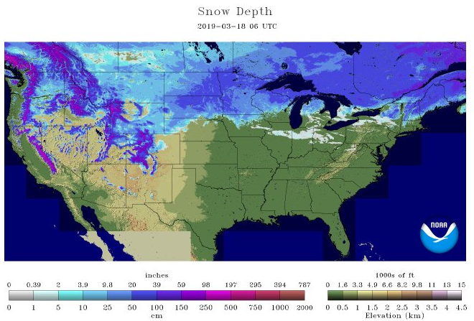
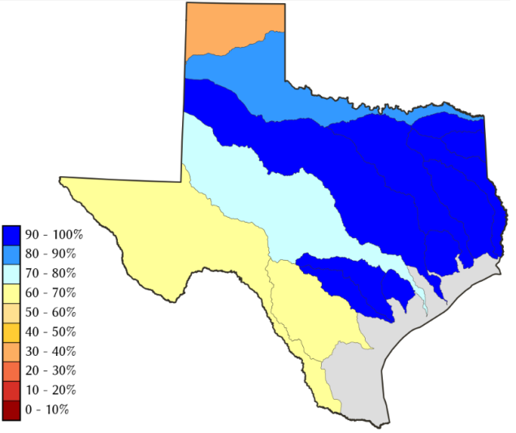
Water Reservoir Levels in some Western/Southern States! And Snow Depth!!
Northern CA reservoirs beginning to show
Weakness, but rainy season coming up!
Reservoir Storage Summary for River Basins
TX
https://fsapps.nwcg.gov/afm/index.php

Slide 17
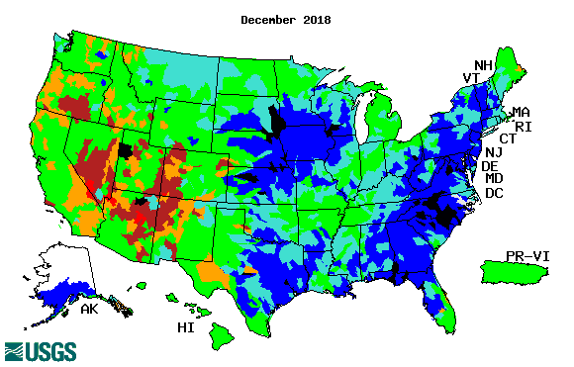
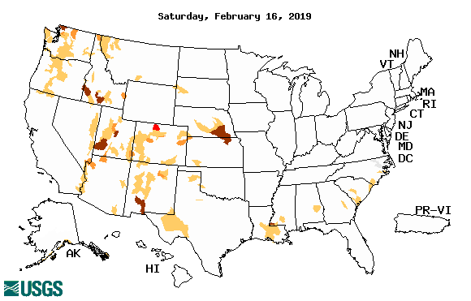
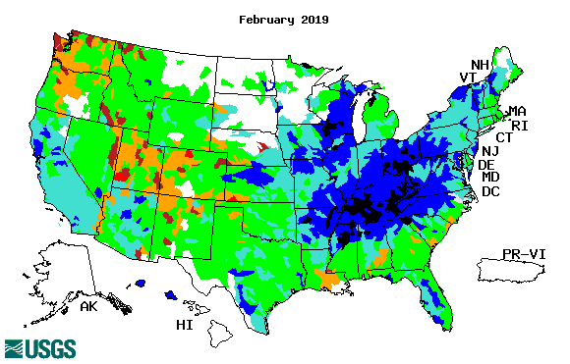
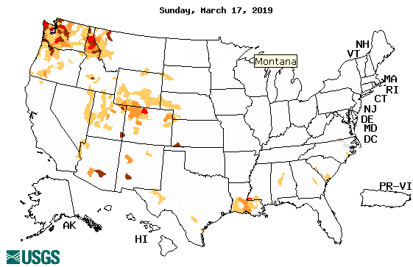
Streamflow (USGS)
Streamflow very good in Texas & eastward.!
Washington and Oregon stream flows slightly worse than last month.
New weakened streamflows along/near Gulf coast in February and in March.
Map shows only below normal 7-day average streamflow compared to historical streamflow for the day of year.
One month ago (left) &
Now (below)
17

Slide 18
EL NIÑO/SOUTHERN OSCILLATION (ENSO)
DIAGNOSTIC DISCUSSION
issued by CLIMATE PREDICTION CENTER/NCEP/NWS and the International Research Institute for Climate and Society
14 March 2019
ENSO Alert System Status: El Nino Advisory
Synopsis: (Now) Weak El Nino conditions are likely to continue through the Northern Hemisphere spring 2019 (~80% chance) and summer (~60% chance) (Last month) Weak El Nino conditions are present and are expected to continue through the Northern Hemisphere spring 2019 ~55% chance.

Slide 19
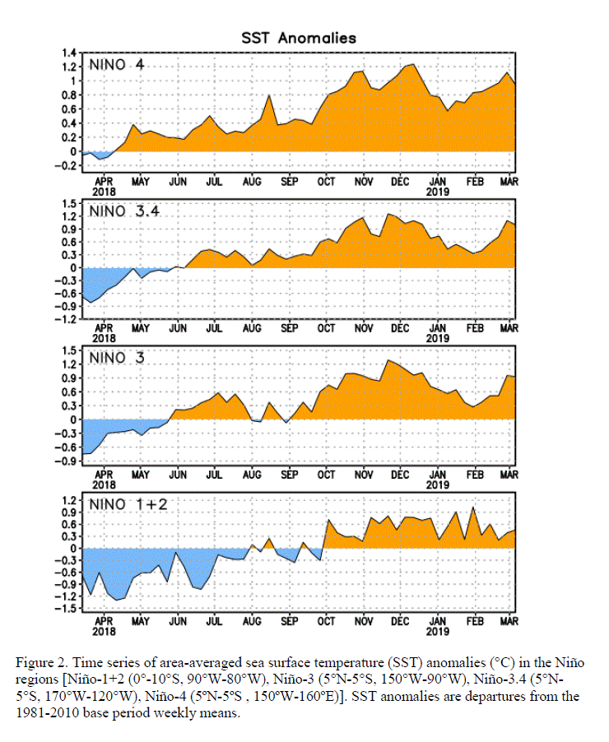
Latest values of SST indices in the various Nino Regions.
The sub surface heat anom continues to stay in the +ve territory! .
?
Relatively short lived!

Slide 20
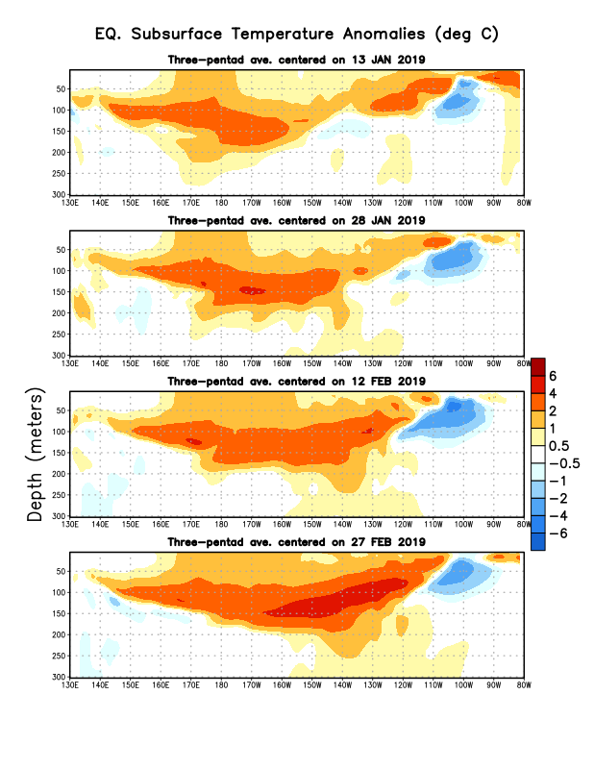
Sub-Surface Temperature Departures in the Equatorial Pacific
Sub surface Temperatures is gradually getting warmer and the colder areas is weakening.
Most recent pentad analysis

Slide 21
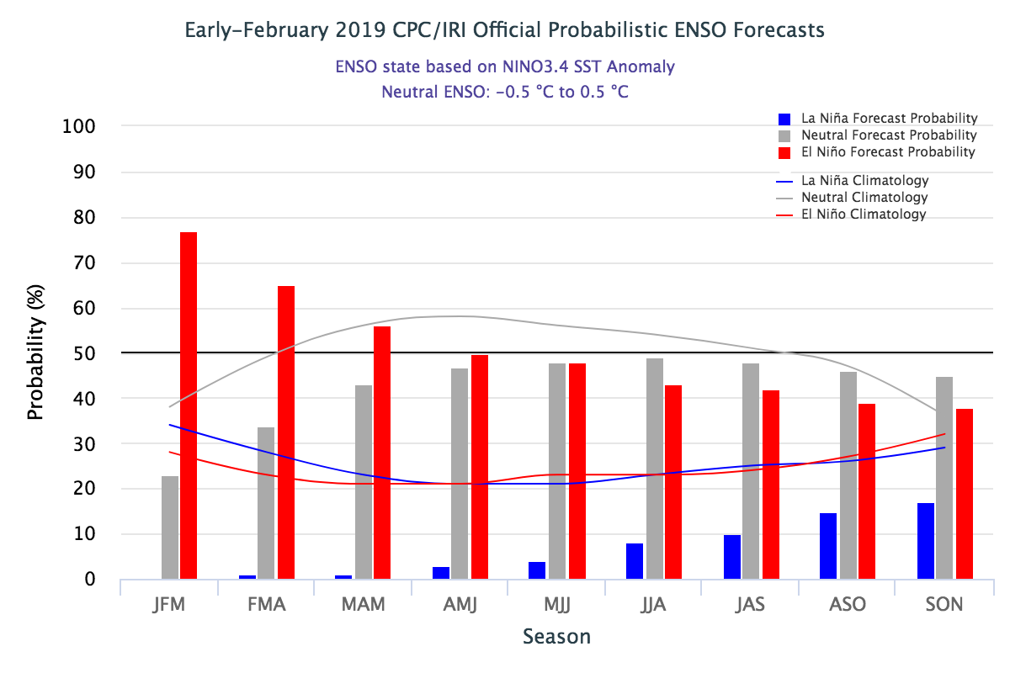
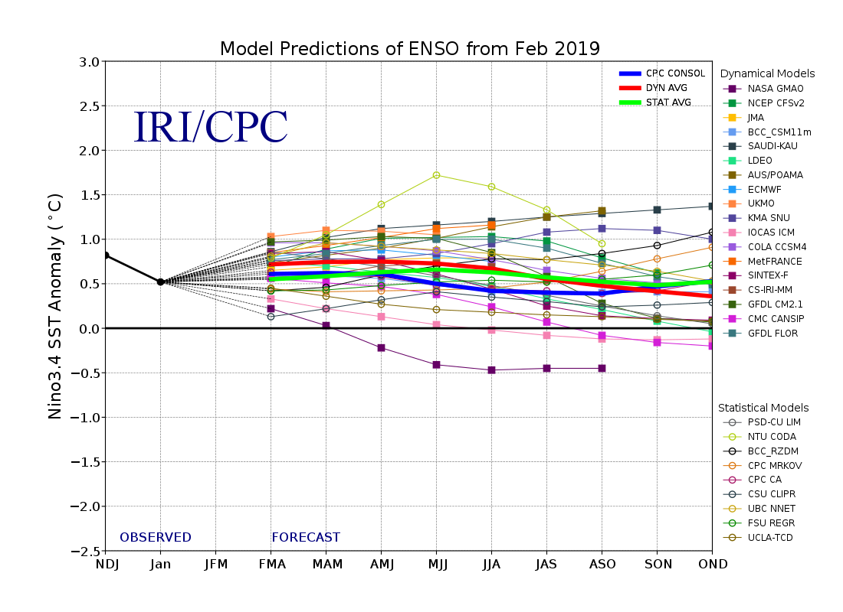
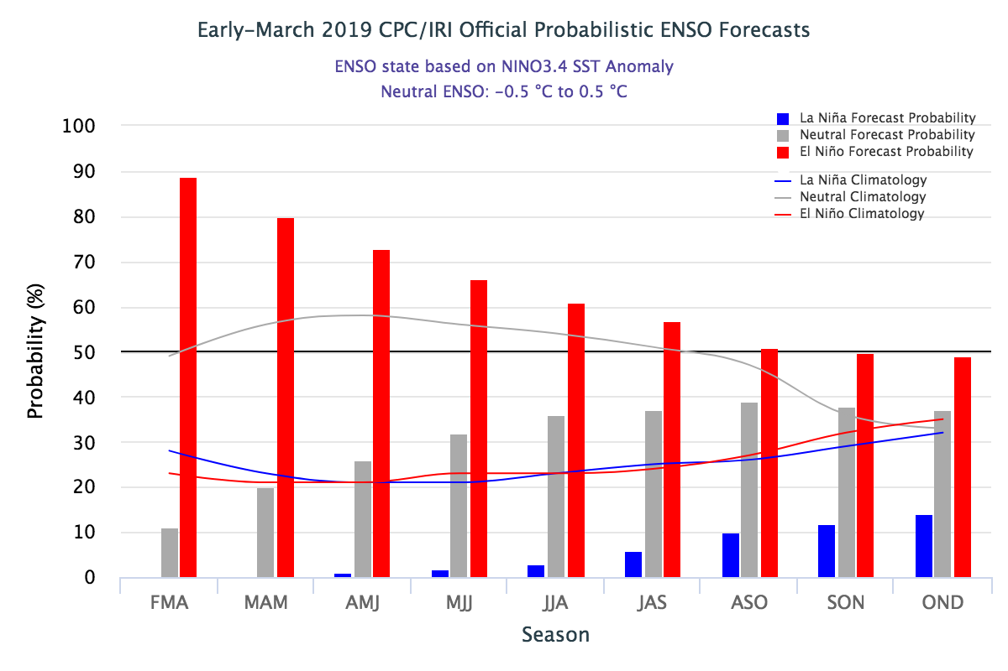
ENSO Forecasts
Early- February CPC/IRI forecast
Early- March CPC/IRI forecast
A renewed kick upward this past month in ElNino continuance probability through Spring.

Slide 22
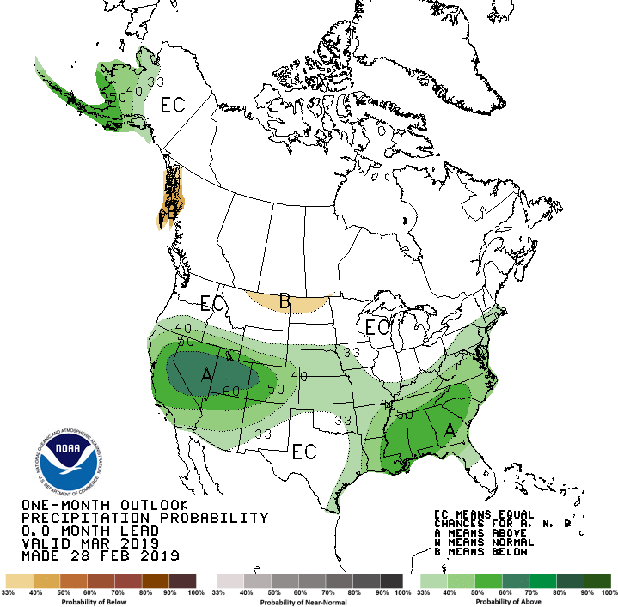
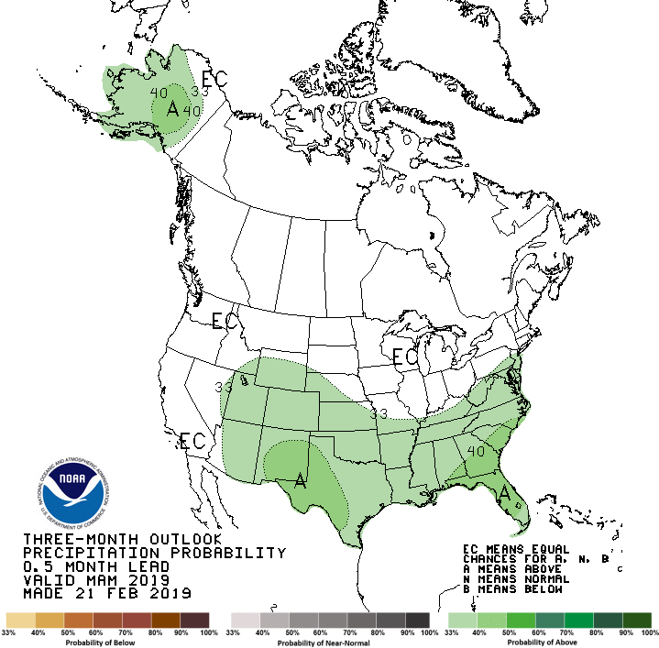
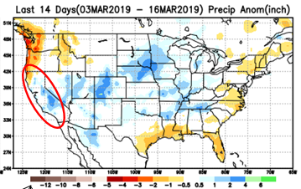
Previous(Last month)
CPC’s official Monthly (Mar)/Seasonal (MAM)
Precipitation outlook
Released Feb 28th
Released Feb 21st
Observed so far this month!!
☺

Slide 23
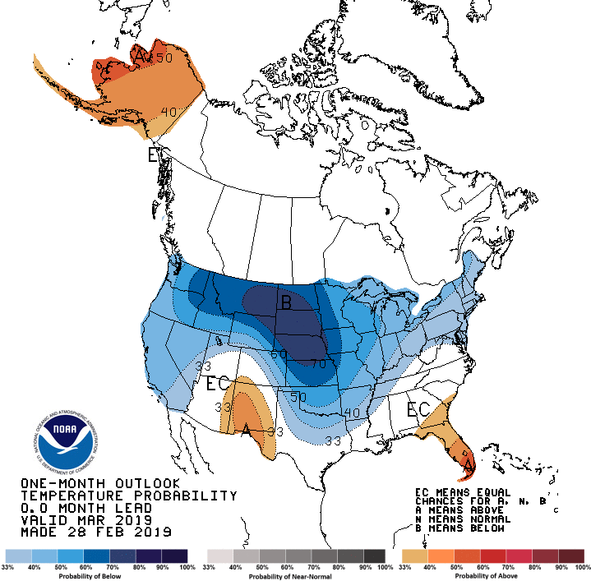
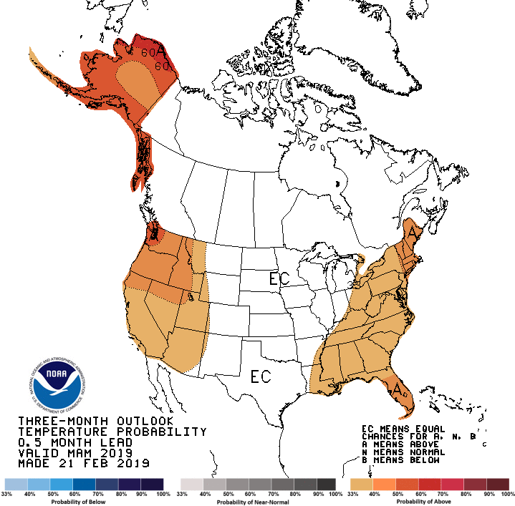
Previous CPC’s official Monthly (Mar)/Seasonal (MAM)
Temperature outlook
Made
Feb 28th
Observed so far this month!! ☺
Made Feb 21st

Slide 24
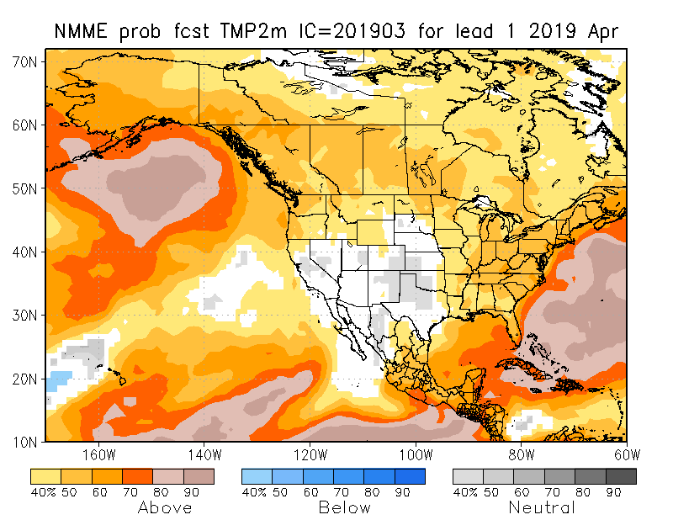
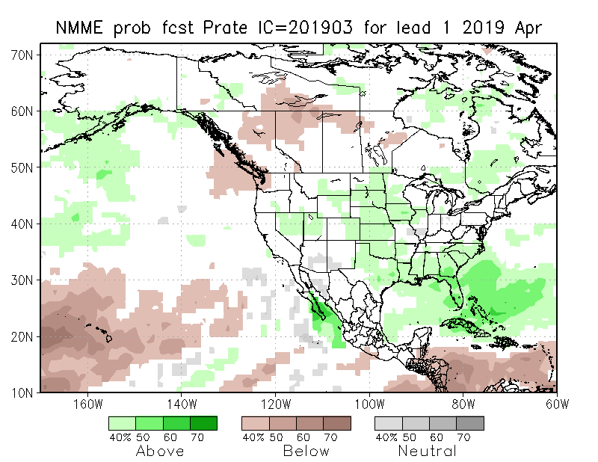
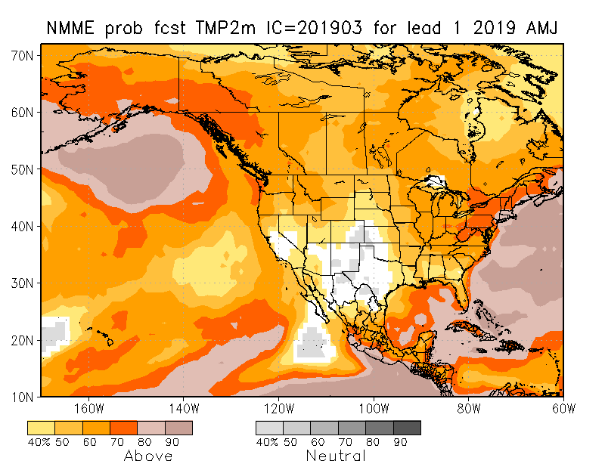
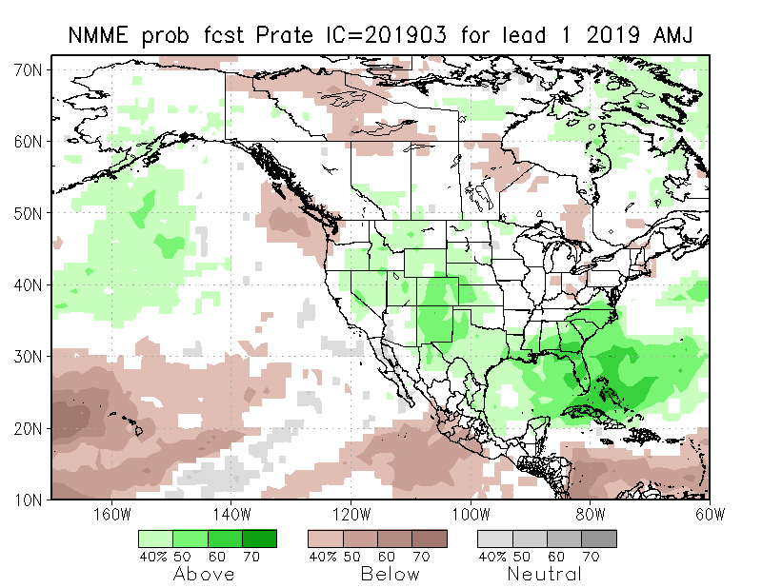
NMME T & P EnsMean forecasts
Apr
AMJ
If verifies will very much help conditions here.
Forecast is based on El Nino conditions!! El Nino is getting more likely through Spring.

Slide 25
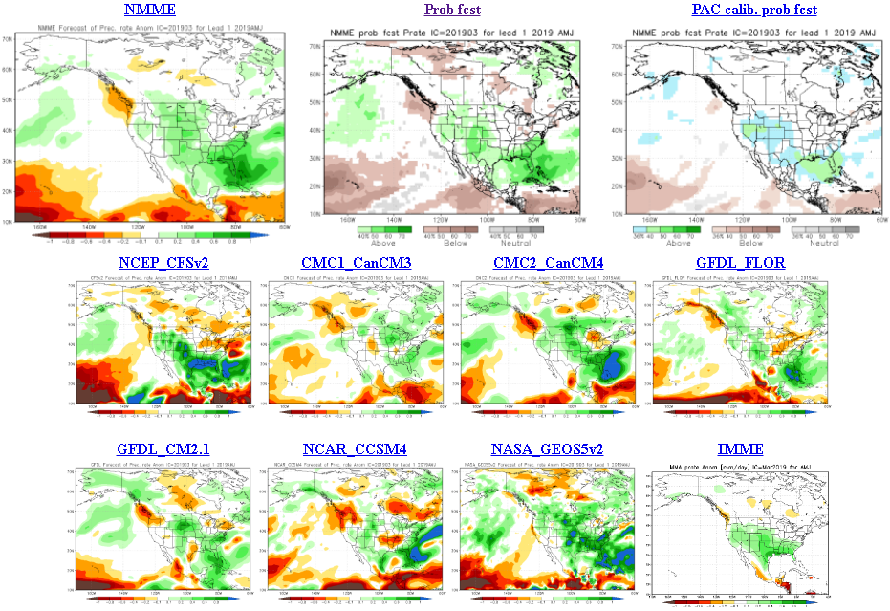
The agreement/uncertainty among the diff. NMME models’ forecasts (middle and bottom panels) for Mar-Apr-May Precipitation!!!
25

Slide 26
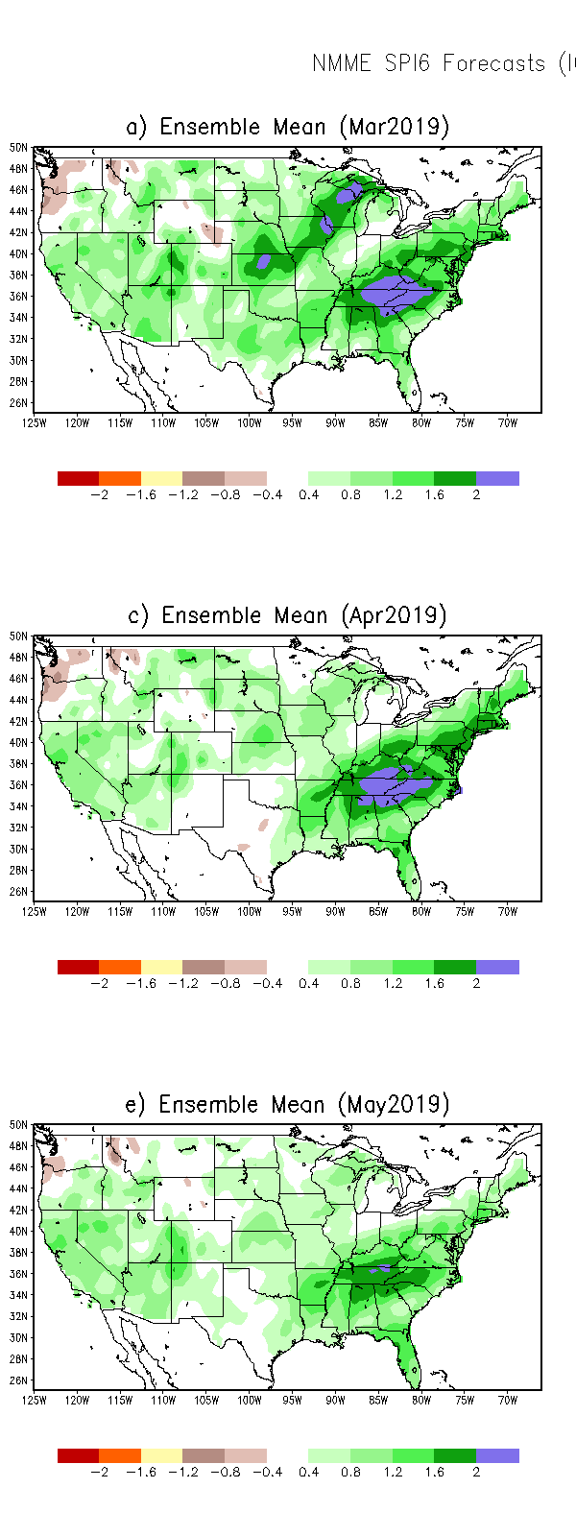
SPI3
SPI6
SPI12
SPI3, SPI6
& SPI12
Forecasts from 6NMME Models
(uses obs. P up to past month, and forecast months’ P from NMME models)
The goodness and skill of these SPI’s forecasts depend directly on the NMME models’ skill in predicting precipitation!!!

Slide 27
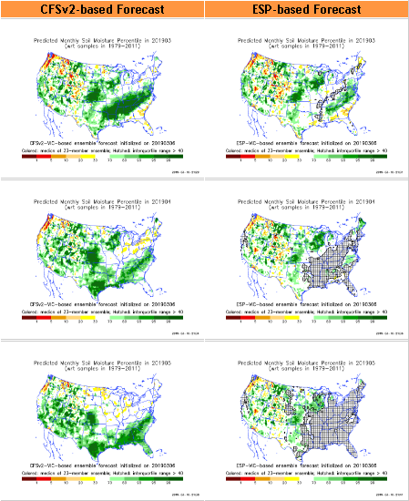
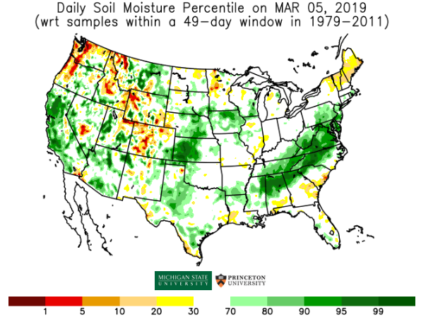
http://drought.geo.msu.edu/research/forecast/smi.monthly.php
Predicted Monthly Soil Moisture Percentile
With Soil Moisture Percentile
Initial Conditions: 3/5/2019
The inter quartile range suggest greater uncertainty about the forecast in these shaded regions.

Slide 28
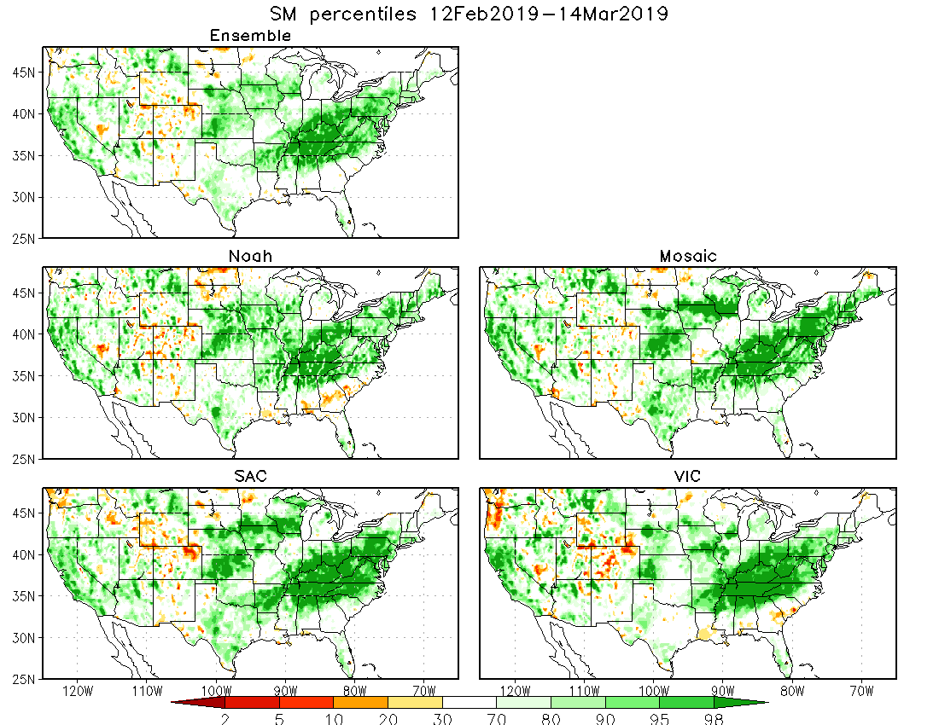
Recent 30 days mean SM percentile.
Developing dryness in the southeast Gulf coast is evident.

Slide 29
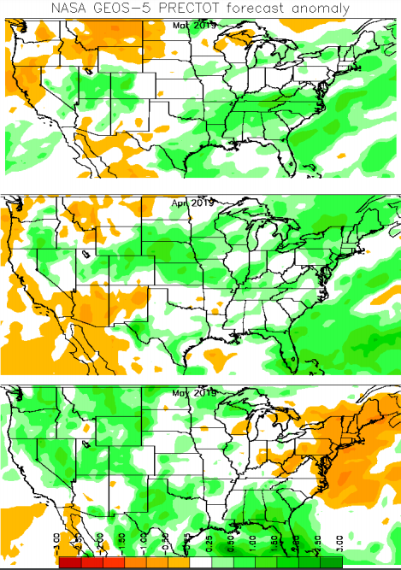
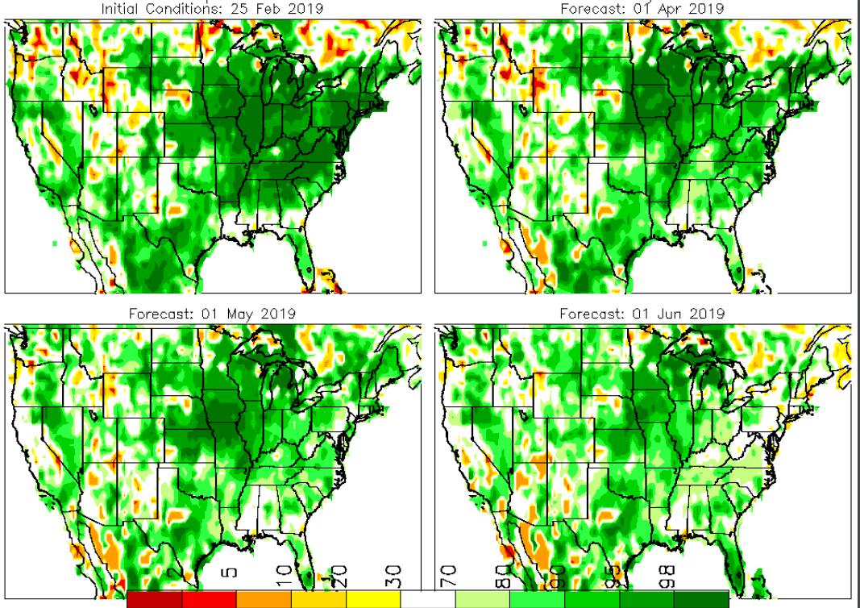
Precipitation
NASA GEOS 5 Model
Precipitation & Soil Moisture Forecast
Mar 2019
Soil Moisture
Apr 2019
IC
3/19
May 2019
4/19
2018
5/19

Slide 30
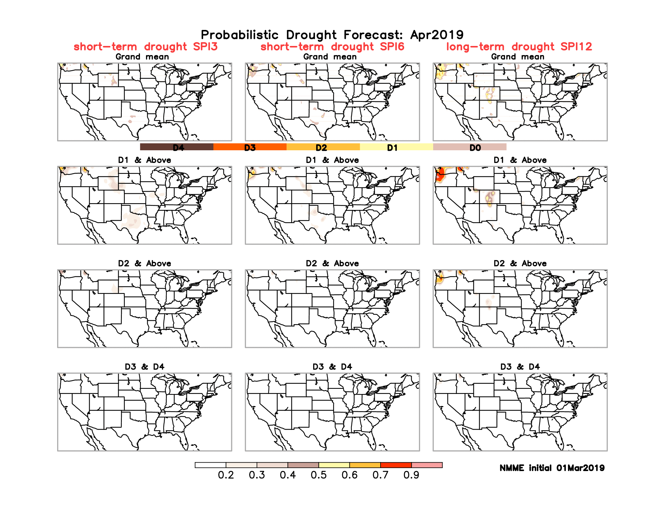
Monthly Drought Tendency in Probability
Based on NMME models’ (dis)agreement in their precip forecasts’ computed SPI!!

Slide 31
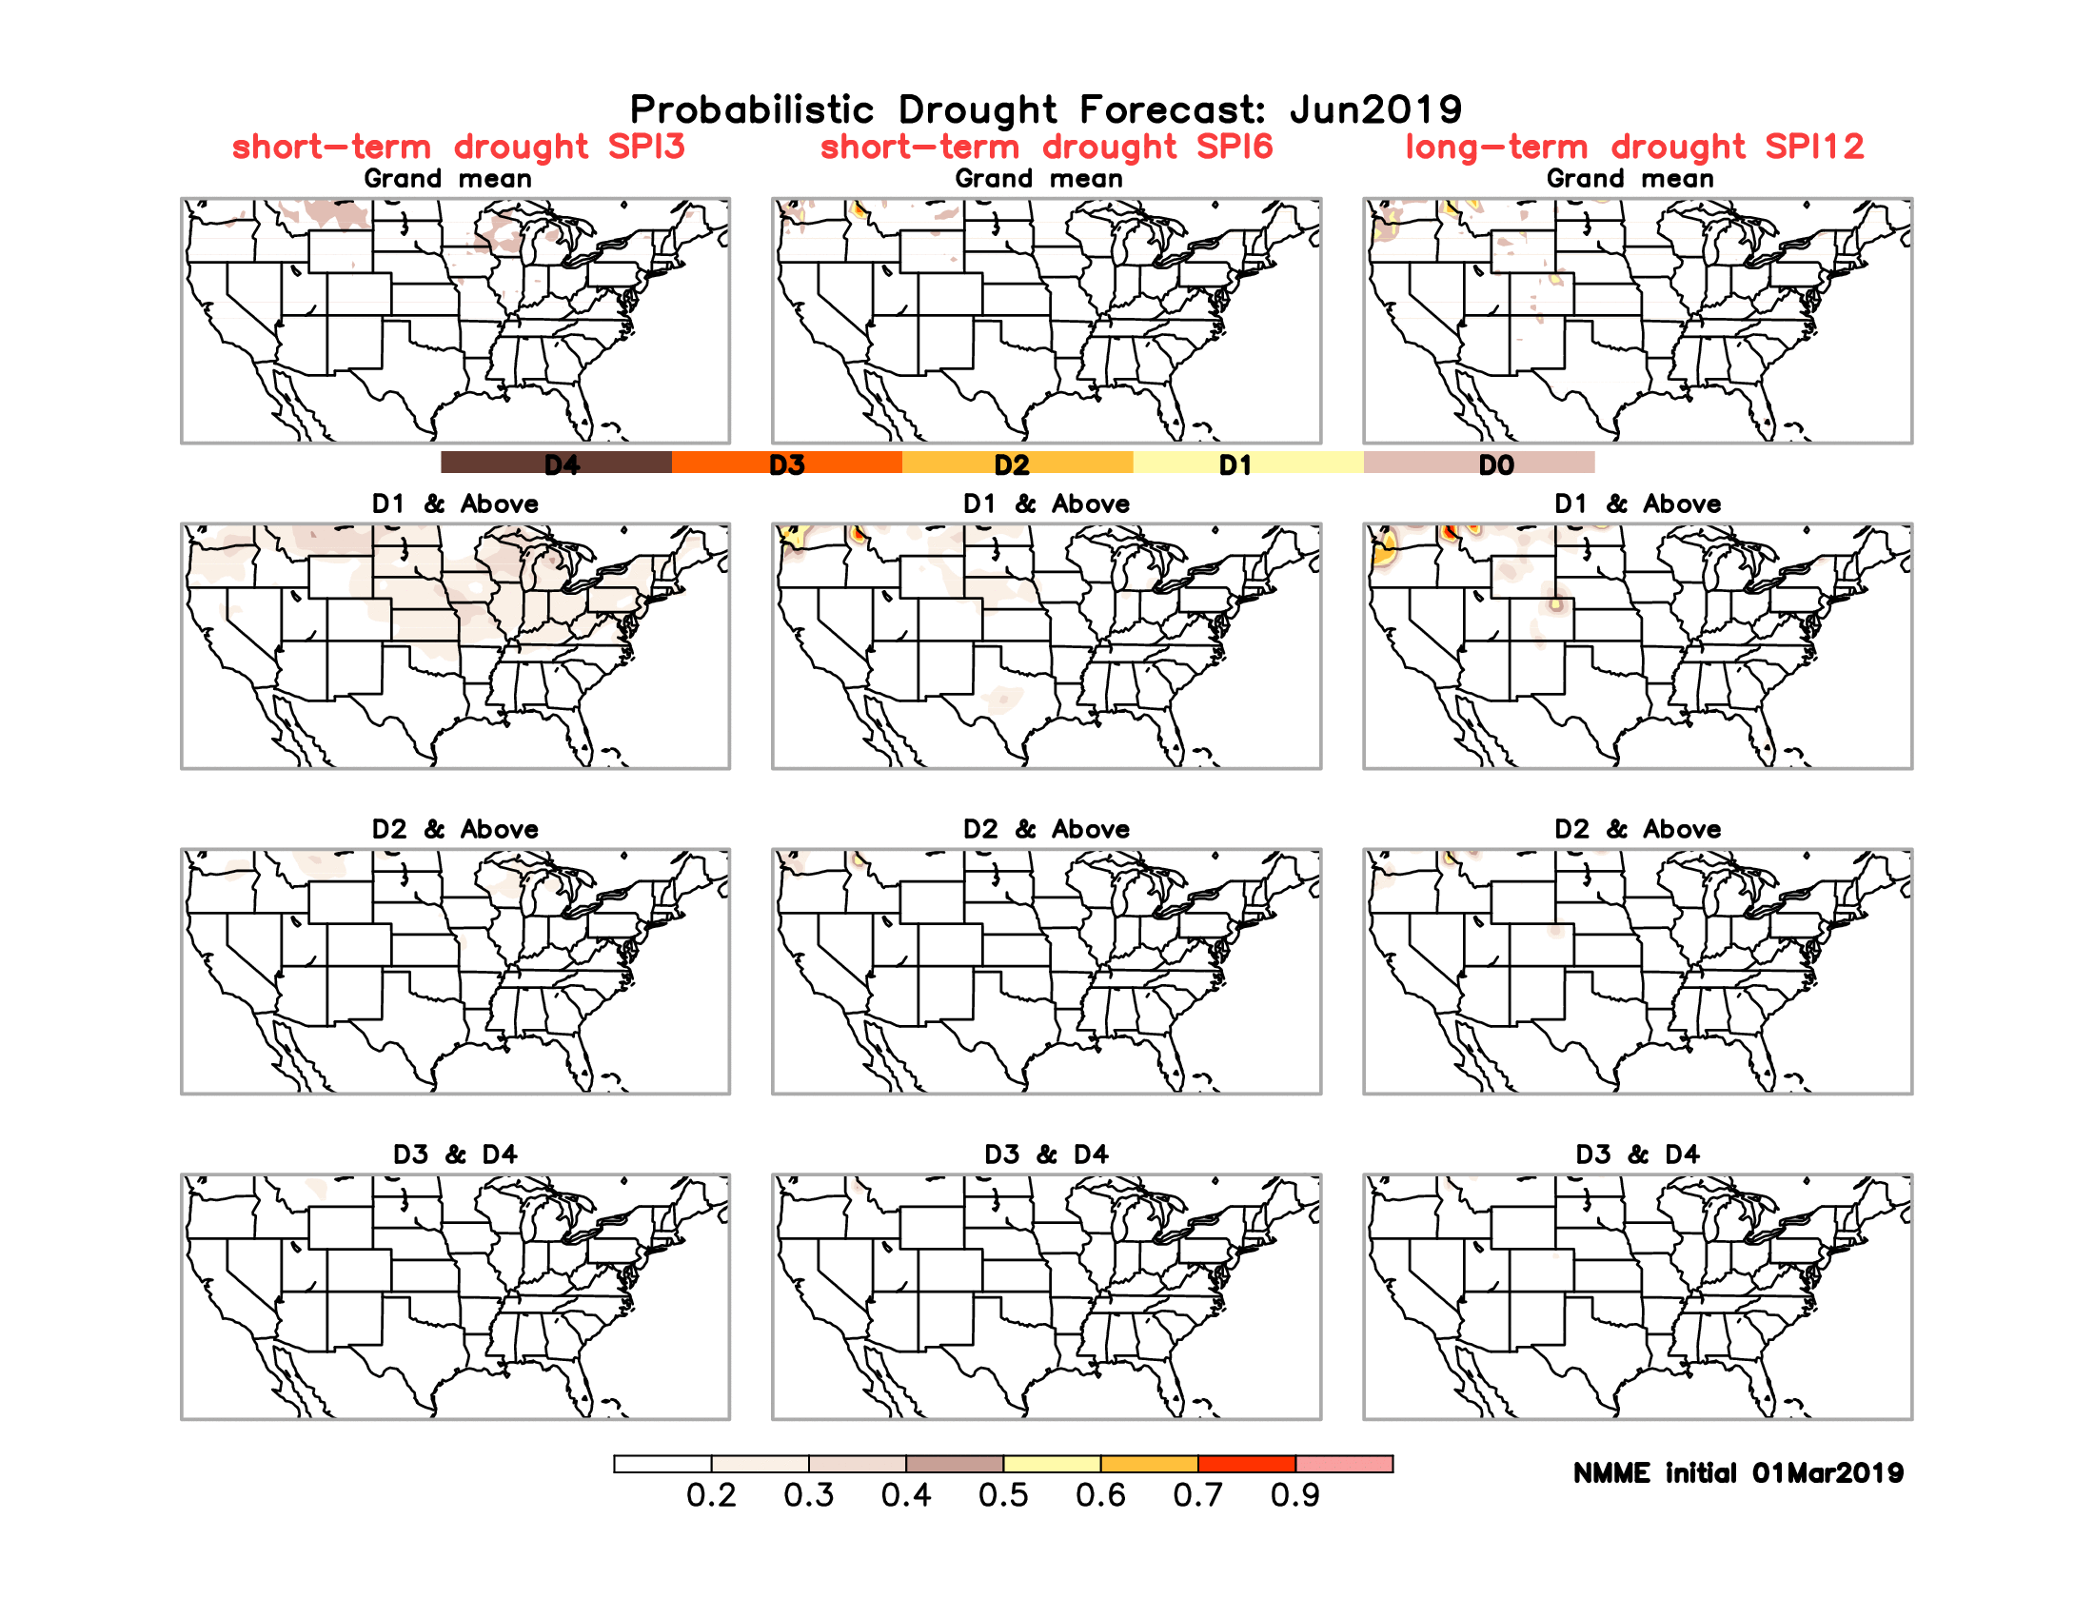
Seasonal Drought Tendency in Probability
Based on NMME models’ (dis)agreement in their precip forecasts’ computed SPI!!

Slide 32
Summary
Current ENSO status and forecast. Weak El Nino conditions are likely to continue through the Northern Hemisphere spring 2019 (~80% chance) and summer (~60% chance)
Current Drought conditions:
According to the Drought Monitor, eastward of Texas, the country is virtually drought free over almost all of the eastern two thirds of the country. But rainfall deficits are beginning to emerge along the Gulf Coast and in large parts of Texas.
Slowly, but steadily the recent winter rains has made a big dent thus leading to marked improvement and even elimination of drought in some areas over the western states and parts of the Southwest.
Compared to previous couple of months, the state reservoirs are more, stream flow has now improved in California and near the four corner states area, but slightly worsened in the far northwest and over parts of Oregon and Washington states. Small pockets of weakness in streamflow are also emerging along/near the Gulf coast, consistent with below normal rainfall in the region over the past 3-4 months.
However, in the 12m-24m and longer time scale, rainfall deficits still remain in around the four states (AZ/NM/UT/CO) corner region.
Prediction:
The main rainfall season is coming to an end along the western states, and the upcoming season’s (A/AMJ) rainfall is important for the Northern Rockies and the Great Plains, West North Central and the Southwest. But the probability of the ongoing weak El Nino to continue in that form through the Spring season, has increased from last month. It is not clear however, if this current weak El Nino conditions, will have any of the expected typical canonical rainfall impacts along the southern states, even though the NMME models are predicting above normal rainfall in these regions.
Overall, short term improvement is expected in the drought conditions over much of the western states especially OR and CA and in the four corner states of AZ/NM/UT/CO region, but the longer term drought is expected to persist but improve. If the expected rains from the ongoing El Nino did not materialize, there exists possibility of drought conditions to emerge along the Gulf coast region, where short term rainfall shortages already exist. Wyoming also has pockets of rainfall deficits, that must be paid attention to. **END***

Slide 33
WPC Next 7 days QPF Forecast
GFS Model Guidance for next 16 days.

Slide 34
Miscellaneous maps

