Slide 1
Drought Outlook Support Briefing March 2020
Climate Prediction Center/NCEP/NOAA
http://www.cpc.ncep.noaa.gov/products/Drought
Phone: 1-877-680-3341
Pwd: 858747#

Slide 2
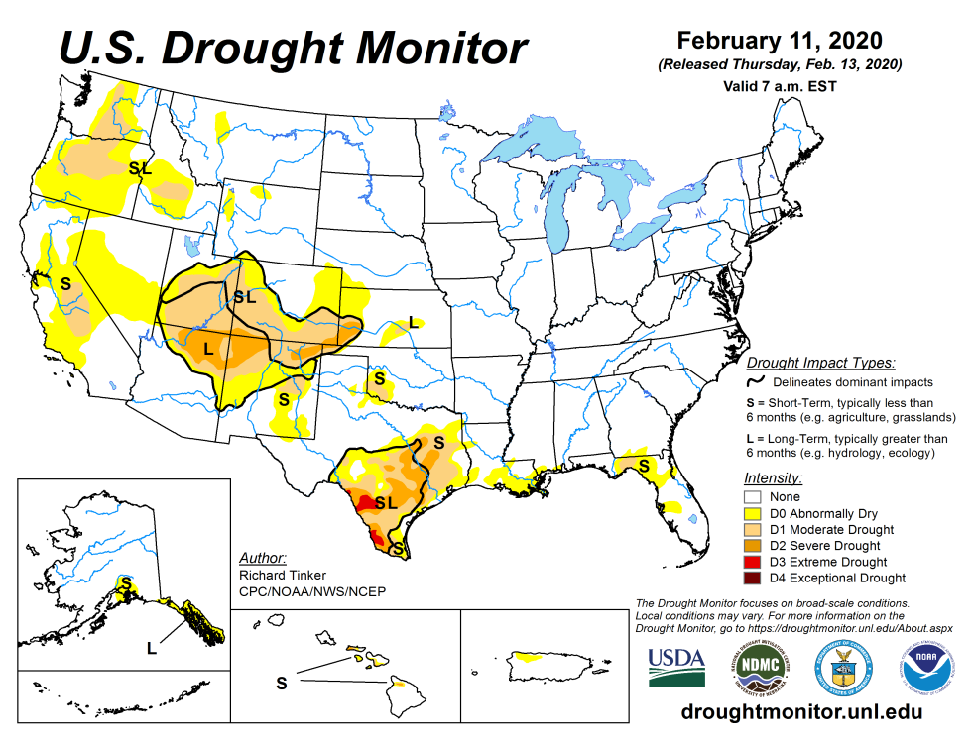
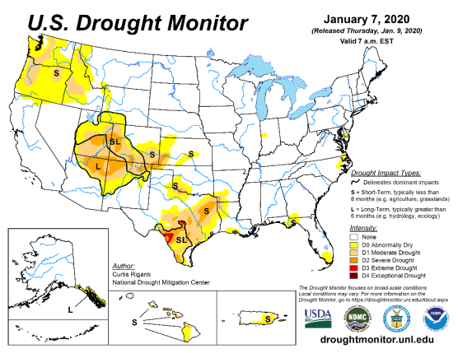
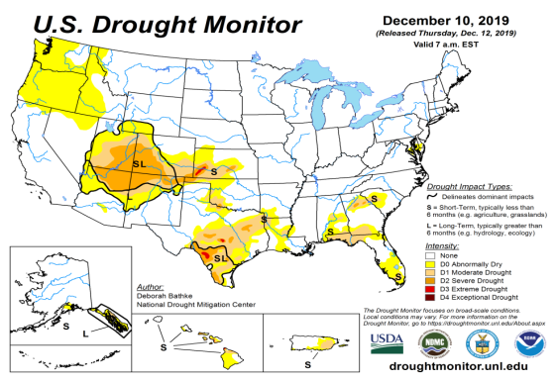
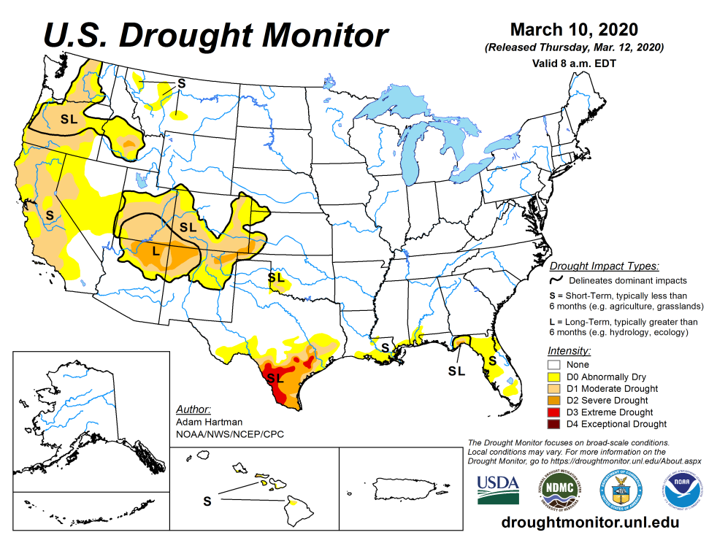
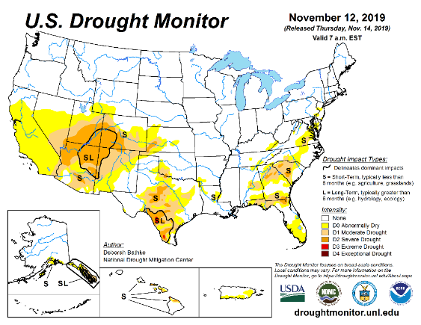
Drought Monitor
February
January
Monitoring is important because, unlike US T/P fcsts, for drought forecasts, we have to know where we are, before we can tell where we are going!!
Drought forecasts are tendency forecasts.
Drought in the southeast, that was present late last year is present in trickles.
The short/long term drought in the four corner states area (AZ/NM/ UT/CO) continues to survive in some form.
Existing and new Drought in CA/OR/WA/NV/ is slowly getting bigger and is expanding. These must be viewed n the context that the rainy winter season has almost ended.
Drought in southern TX has shrunk in size but worsened in intensity.
WEST vs EAST !!!
December
March
(Recent/Latest)
November
February

Slide 3
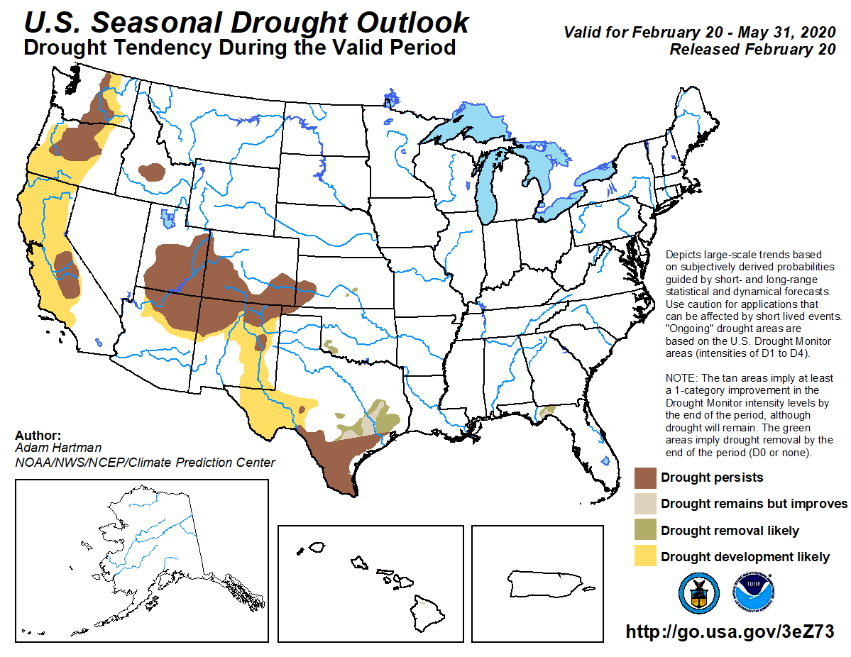
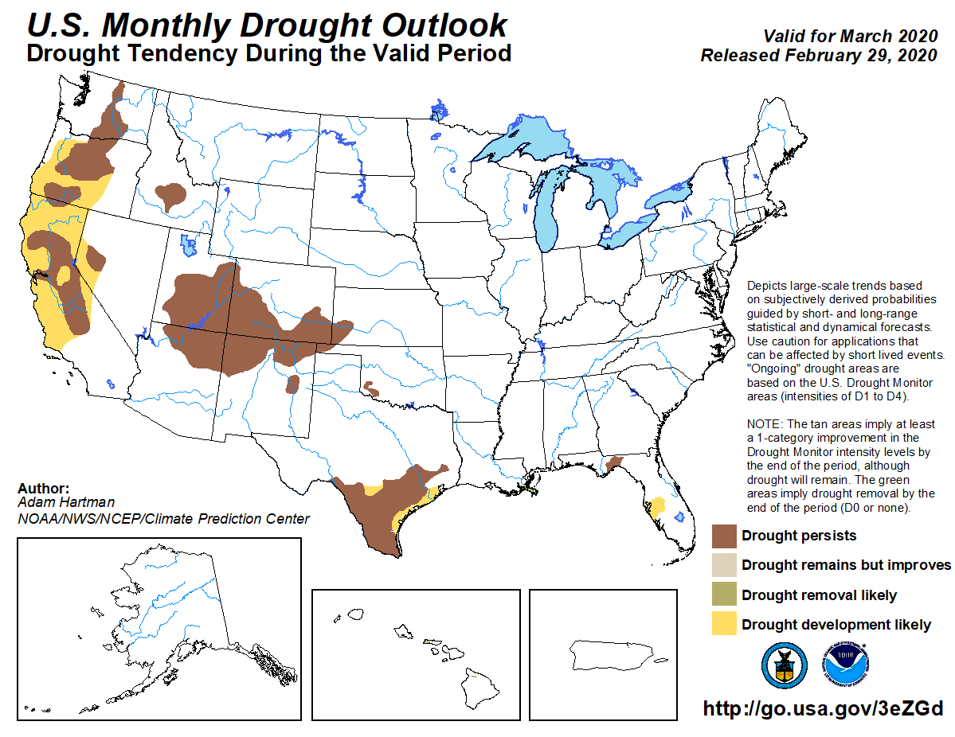
(Prev) Seasonal/Monthly Drought outlooks
(New Seasonal Drought Outlook to be released in 2 days!)
Seasonal Outlook
(Mid Feb 2020- May 2020)
issued 02/20/20
Monthly outlook
(for March 2020)
issued 02/29/20
While the overall aspects of the seasonal drought forecast is yet to be verified, the expansion of the CA drought/dryness into neighboring NV was not forecast in the monthly outlook, a feature which we recommended last month.
This was also true of drought in CA, in the previous month, that was not forecast.

Slide 4
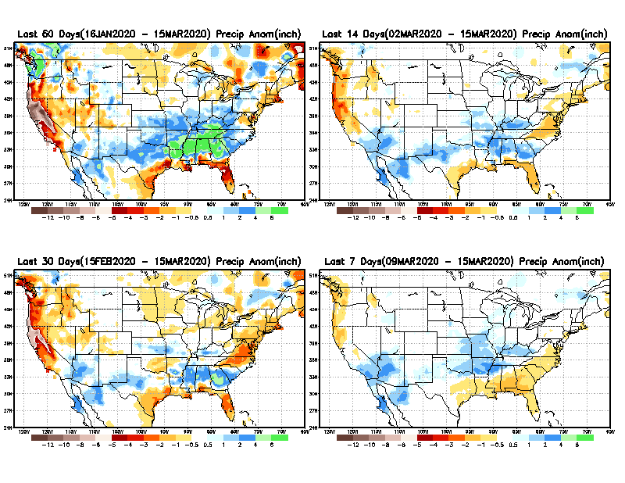
Precipitation ANOM during last 7, 14, 30, & 60 days.
60 Days
14 Days
These maps in this and following slides, including
a) Anom and b) Percent of precip. in these and other longer time ranges. Now daily updated at:
30 Days
7 Days
Alaska will be added here soon!
From: Recent Accumulated Precipitation https://www.cpc.ncep.noaa.gov/products/Drought/briefing_prcp.shtml

Slide 5
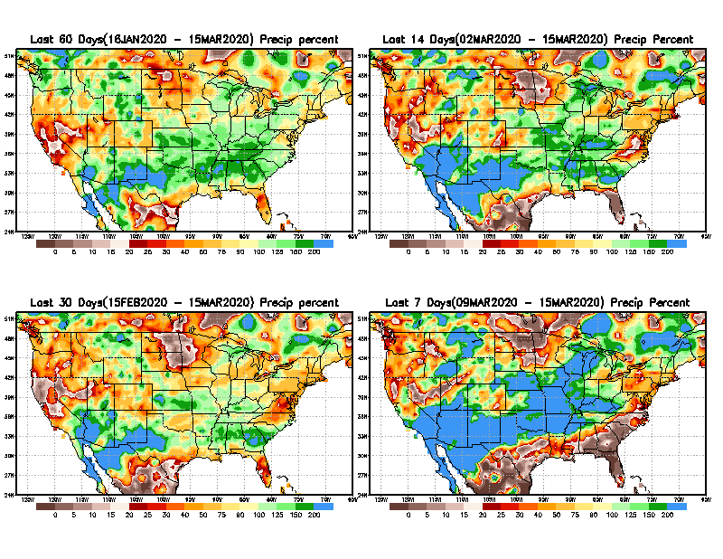
Precipitation Percent during last 7, 14, 30, & 60 days.
60 Days
14 Days
In regions, where the main rainfall season is limited to a few (3-4) months of the year, even one month of large rainfall deficit can be of concern !!
In other regions of relatively broad rainfall months, this need not be a big issue!!
Not yet!
already
30 days
7 Days
already
From: Recent Accumulated Precipitation https://www.cpc.ncep.noaa.gov/products/Drought/briefing_prcp.shtml

Slide 6
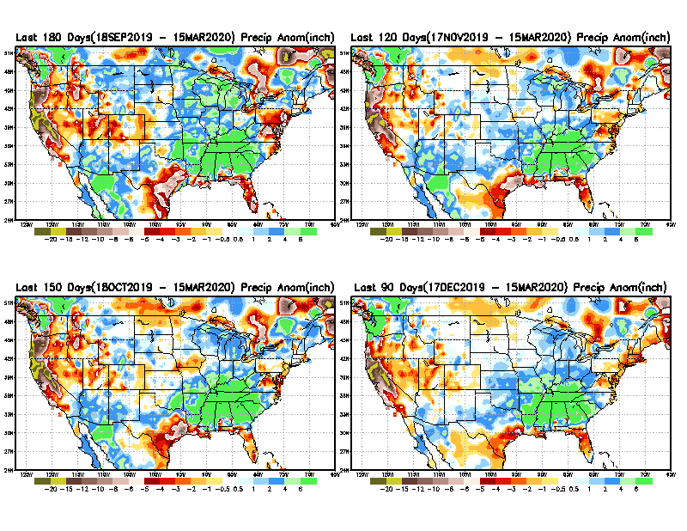
Total precipitation ANOM during last 3, 4, 5, and 6 months.
6 M
4 M
While the Precipitation anomalies deficit may seem large in some regions (compared to others), it is the % of normal precip (next slide) that matters more!!
5 M
3 M
111
From: Recent Accumulated Precipitation https://www.cpc.ncep.noaa.gov/products/Drought/briefing_prcp.shtml

Slide 7
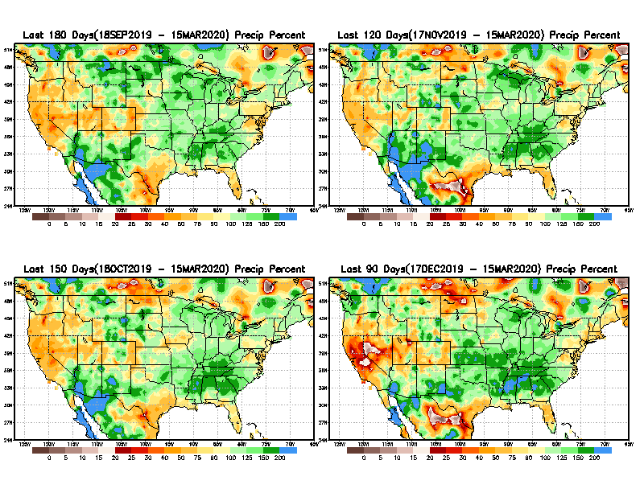
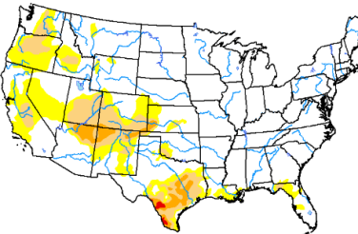
Total precipitation Percent during last 3, 4, 5, and 6 months.
6 M
4 M
In these interim time scale 3-6 months, we need to pay attention to regions, which are dark-red /red & brown (<50%)
5 M
3M
While accrued precipitation deficits are real & objective,
droughts are subjective declarations!!
With these various rainfall deficits in diff. time ranges, where and how exactly does one declare drought? Other factors (T/SM/E, etc..) do matter, but is cumulative precip. deficits ultimately more important?

Slide 8
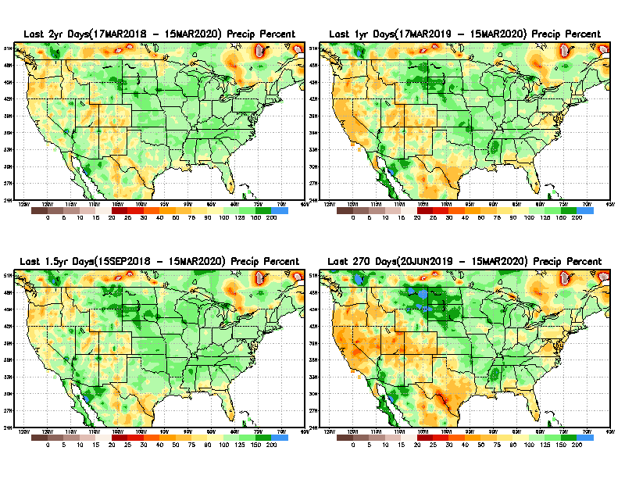
Total precipitation Percent during last 9 months, 1 yr, 1.5yrs, & 2 yrs.
2 Y
1 Y
1.5 Y
9 M
What exactly are the time scales for short(S) and long(L) term drought?
From: Recent Accumulated Precipitation https://www.cpc.ncep.noaa.gov/products/Drought/briefing_prcp.shtml

Slide 9
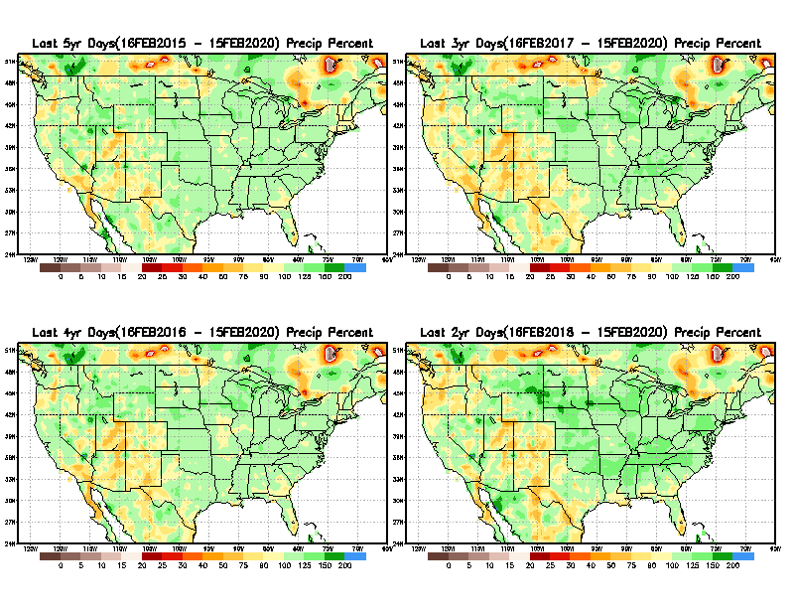
Total precipitation Percent during last 2 yrs, 3 yrs, 4 yrs, & 5 yrs.
5 Y
3 Y
Still longer term rainfall deficit variability in play? Especially in the southwest!
4 Y
2 Y
From: Recent Accumulated Precipitation https://www.cpc.ncep.noaa.gov/products/Drought/briefing_prcp.shtml

Slide 10
Rainy (3-month)Season across the US

Slide 11
EAST vs
CTR/WEST
Behavior in Drought is loosely tied to rainfall climo!!
Adapted from Rich Tinker.

Slide 12
Adapted from
Rich Tinker

Slide 13
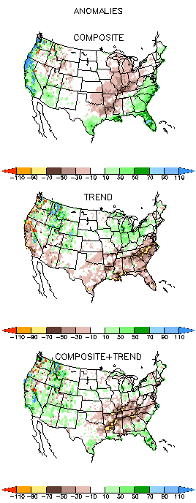
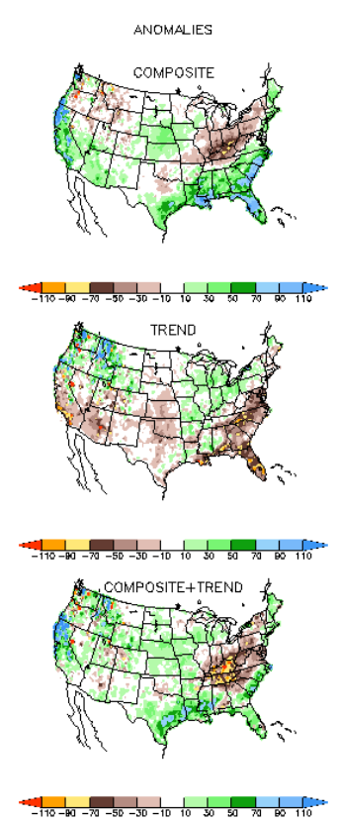
EL NINO Precip COMPOSITES & Trend maps
JFM
FMA
Only this is of relevance to us now due to neutral ENSO status.

Slide 14
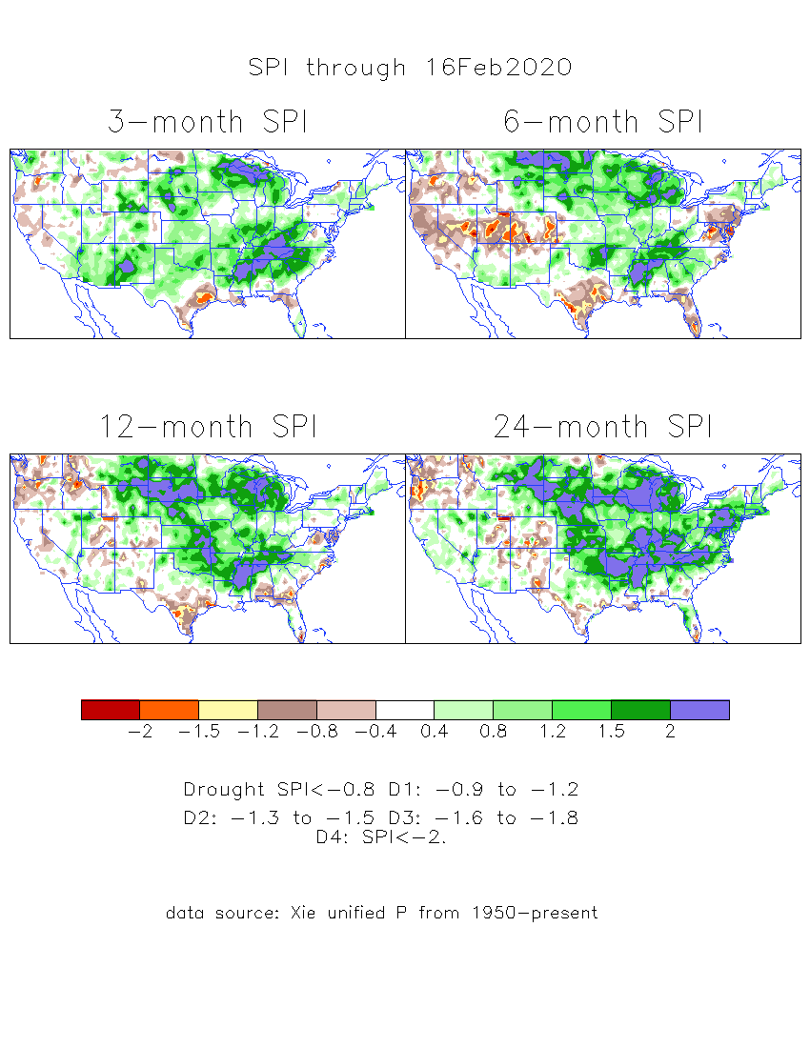
The Standardized Precipitation Index SPI (based on Observed P)
----- Last Month
Very interesting graphic & details for the drought across the US based on the more generalized precip deficit/excess, the Standardized Precipitation Index (SPI).
The dark brown and red colors, indicating standardized precipitation deficits, in the various time periods, approximately correspond to the appropriate short/long term drought monitor regions and their intensities

Slide 15
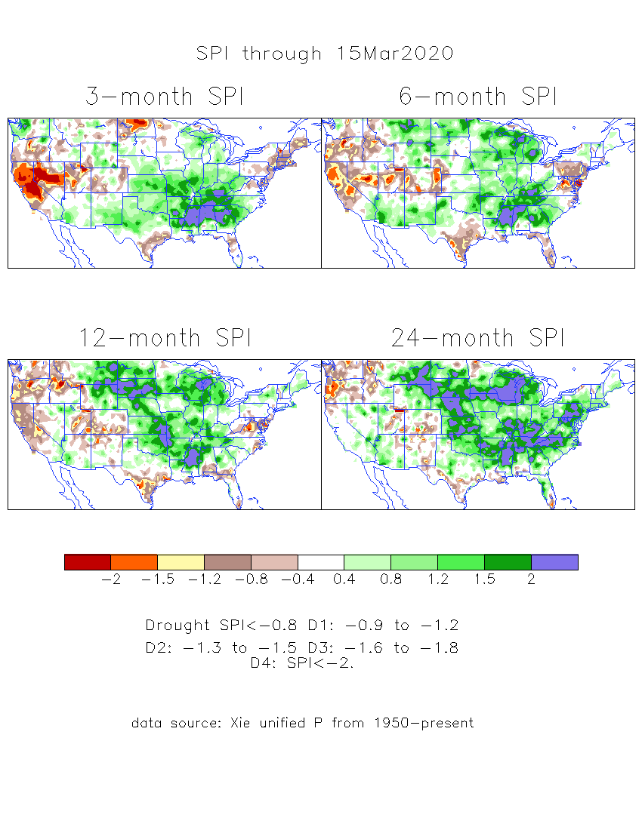
The Standardized Precipitation Index SPI (based on Observed P)
----- NOW
Very interesting graphic & details for the drought across the US based on the more generalized precip deficit/excess, the Standardized Precipitation Index (SPI).
The dark brown and red colors, indicating standardized precipitation deficits, in the various time periods, approximately correspond to the appropriate short/long term drought monitor regions and their intensities
Have to keep an eye on this region!!

Slide 16
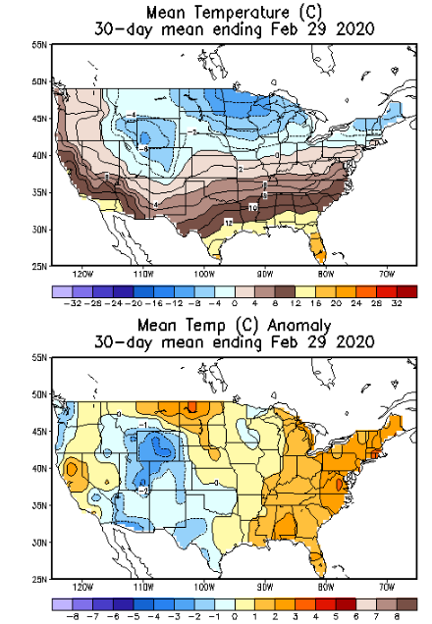
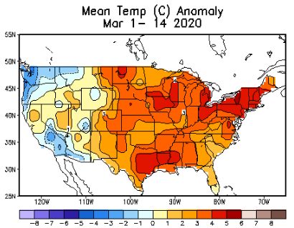
Recent US Temperatures

Slide 17
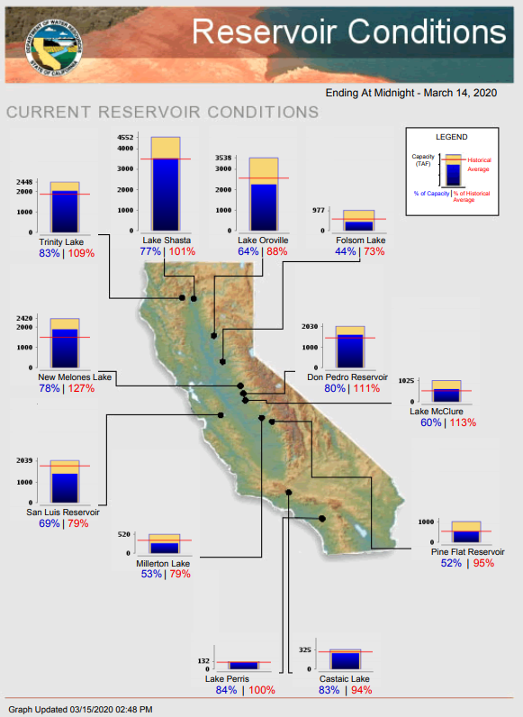
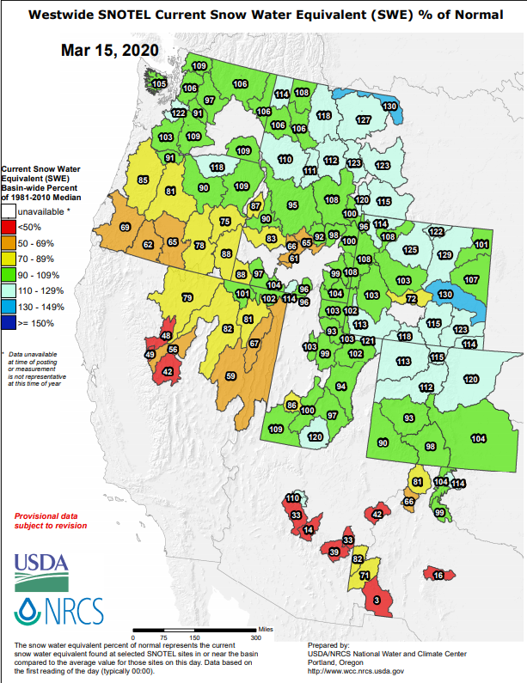
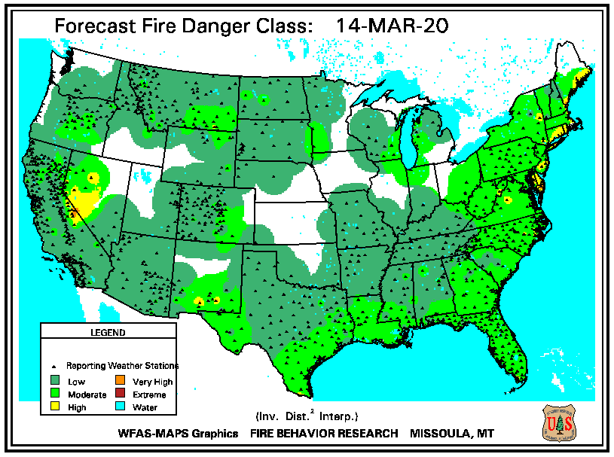
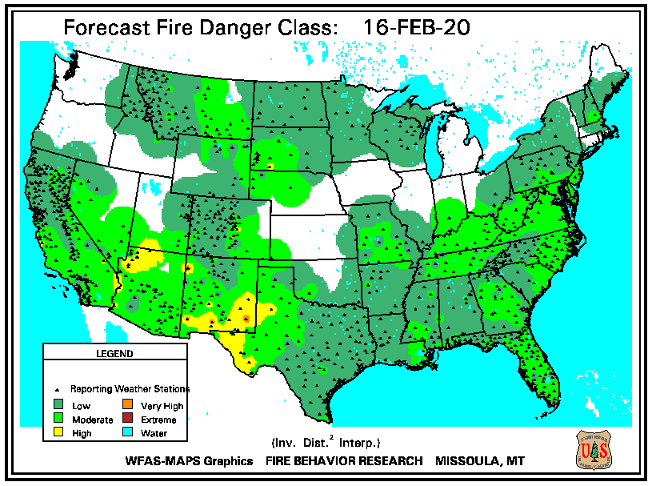
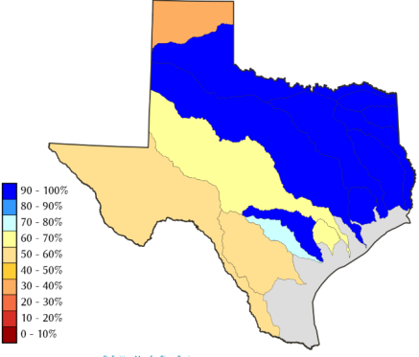
(114%)
(110%)
(94%)
(90%)
https://www.nrcs.usda.gov/wps/portal/wcc/
(136%)
(124%)
(90%)
All California reservoirs levels are BELOW last month’s values!! (shown in parentheses!)
TX
(90%)

Slide 18
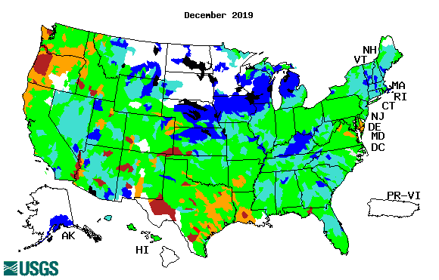
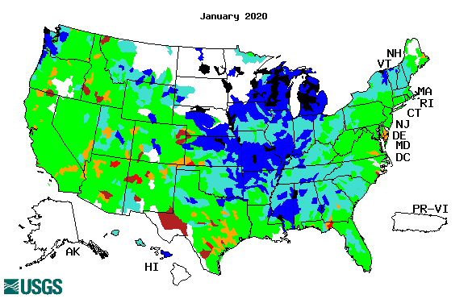
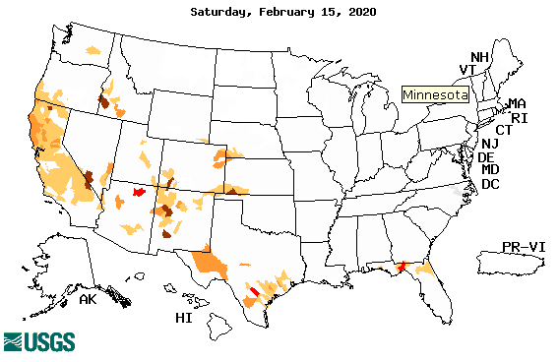
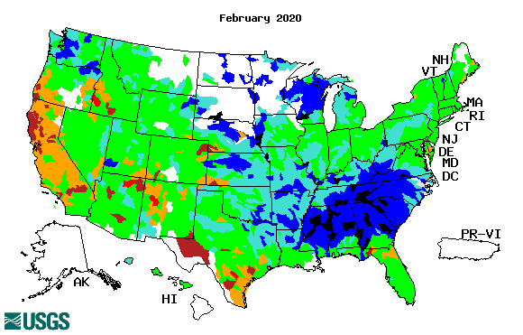
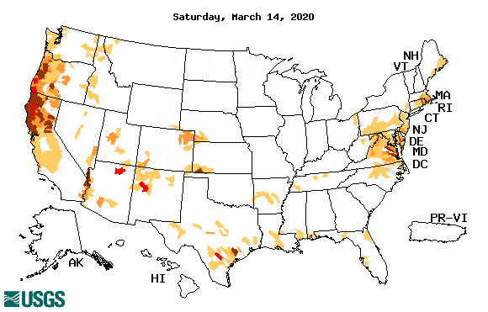
Streamflow (USGS)
Improving conditions in the southwest, getting bad.
Pacific NW much improved now.
Map shows only below normal 7-day average streamflow compared to historical streamflow for the day of year.
One month ago (left) &
Now (below)
18

Slide 19
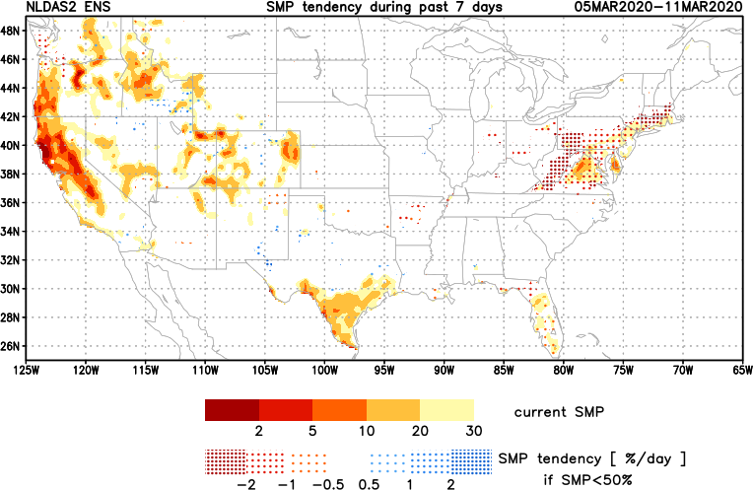
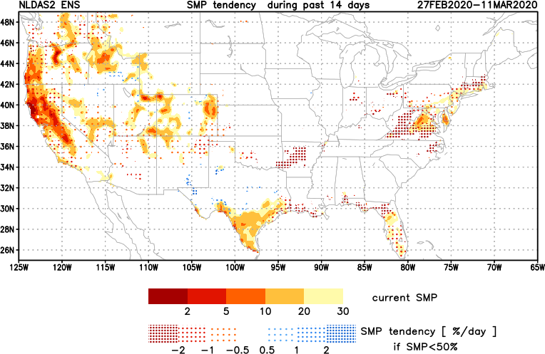
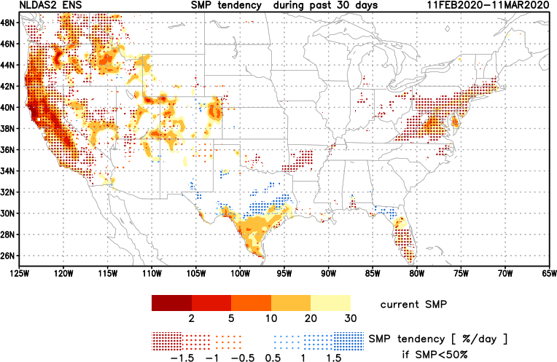
[Now]
NCEP Ensemble mean NLDAS2 models’ Soil Moisture tendency/trend
7 days
14 days
30 days
Drying soil moisture tendency over the last month in the drought affected regions, in the west.

Slide 20
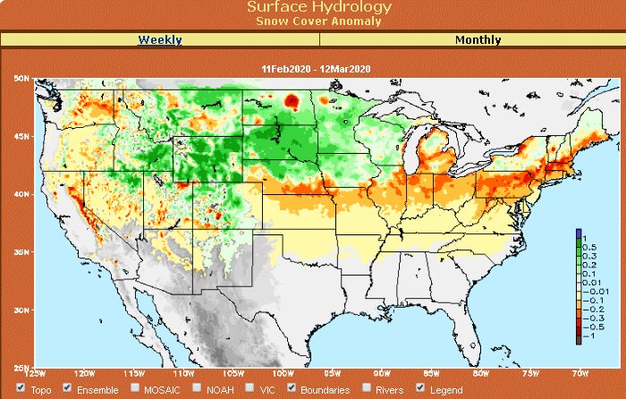
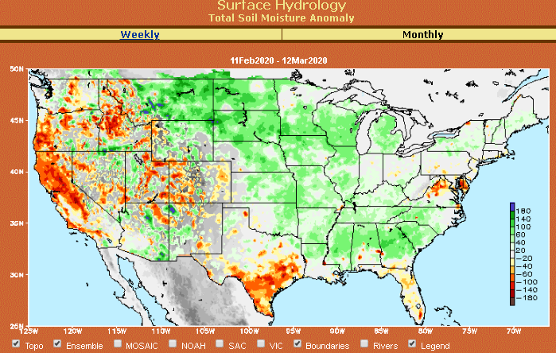
Snow cover & Soil Moisture Anomalies

Slide 21
EL NIÑO/SOUTHERN OSCILLATION (ENSO)
DIAGNOSTIC DISCUSSION
issued by CLIMATE PREDICTION CENTER/NCEP/NWS and the International Research Institute for Climate and Society
13 February 2020
ENSO Alert System Status: Not Active
Synopsis: ENSO-neutral is favored through Northern Hemisphere spring 2020 (~65% chance), continuing through summer 2020 (~55% chance).

Slide 22
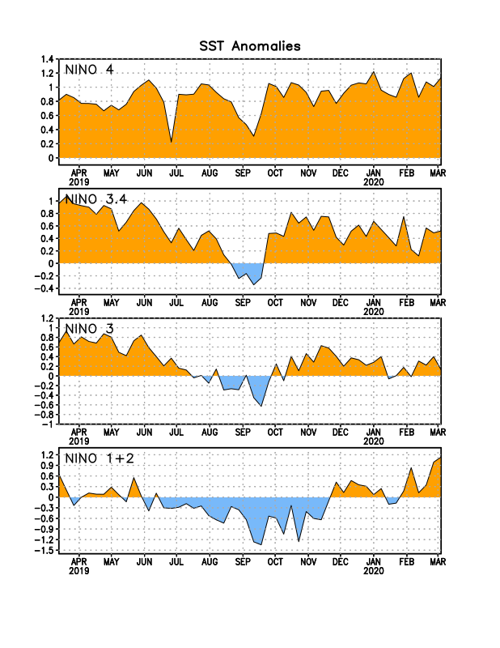
Latest values of SST indices in the various Nino Regions.
Officially in ENSO neutral territory now and for next 3-months. But overall SST anom map looks lot more warm!!

Slide 23
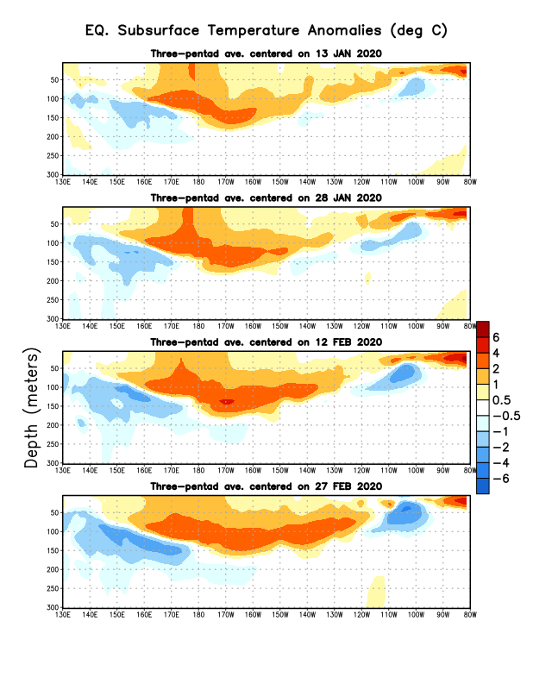
Sub-Surface Temperature Departures in the Equatorial Pacific
Tropical Pacific (Nino 3.4) surface SST in ENSO neutral status vs Subsurface
Most recent pentad analysis

Slide 24
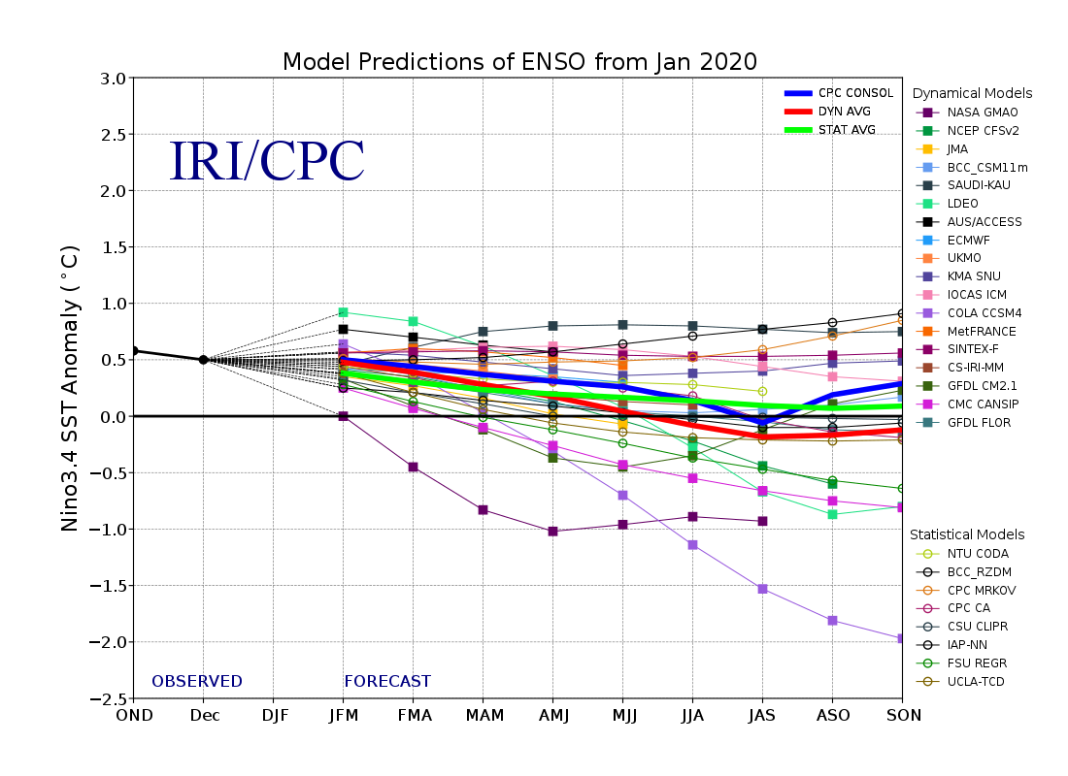
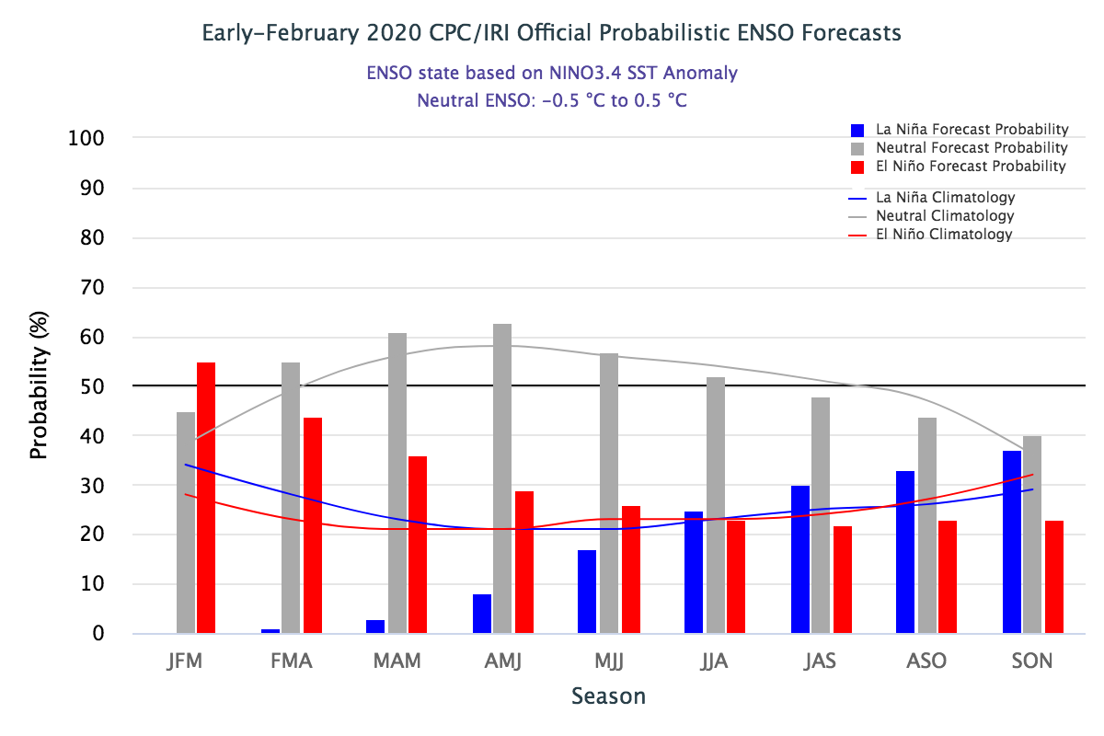
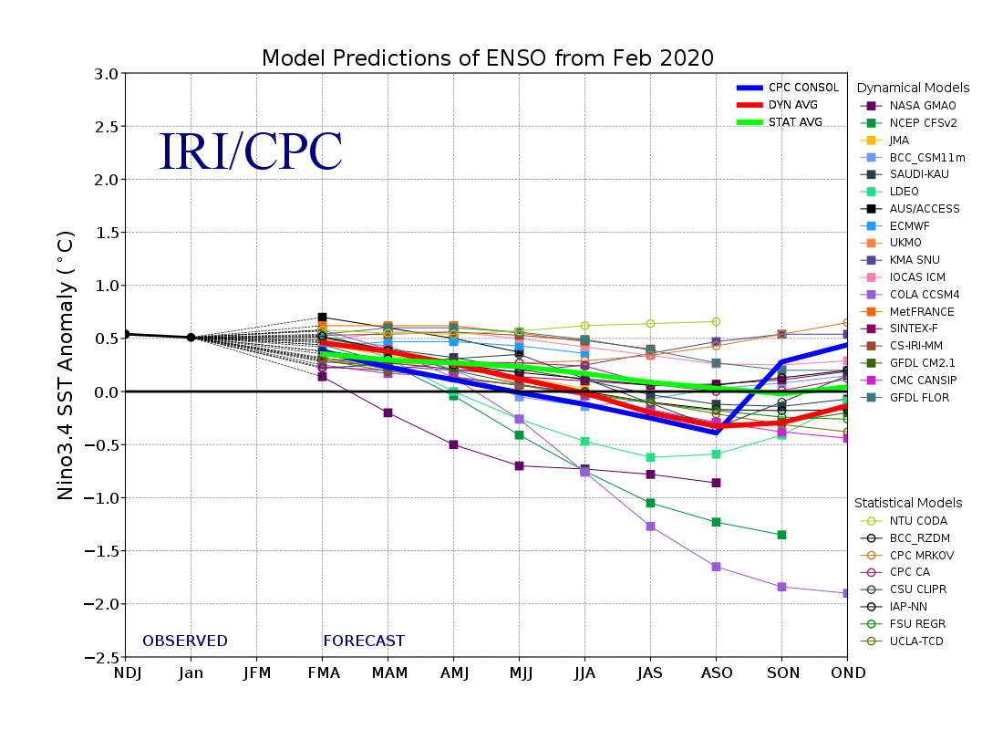
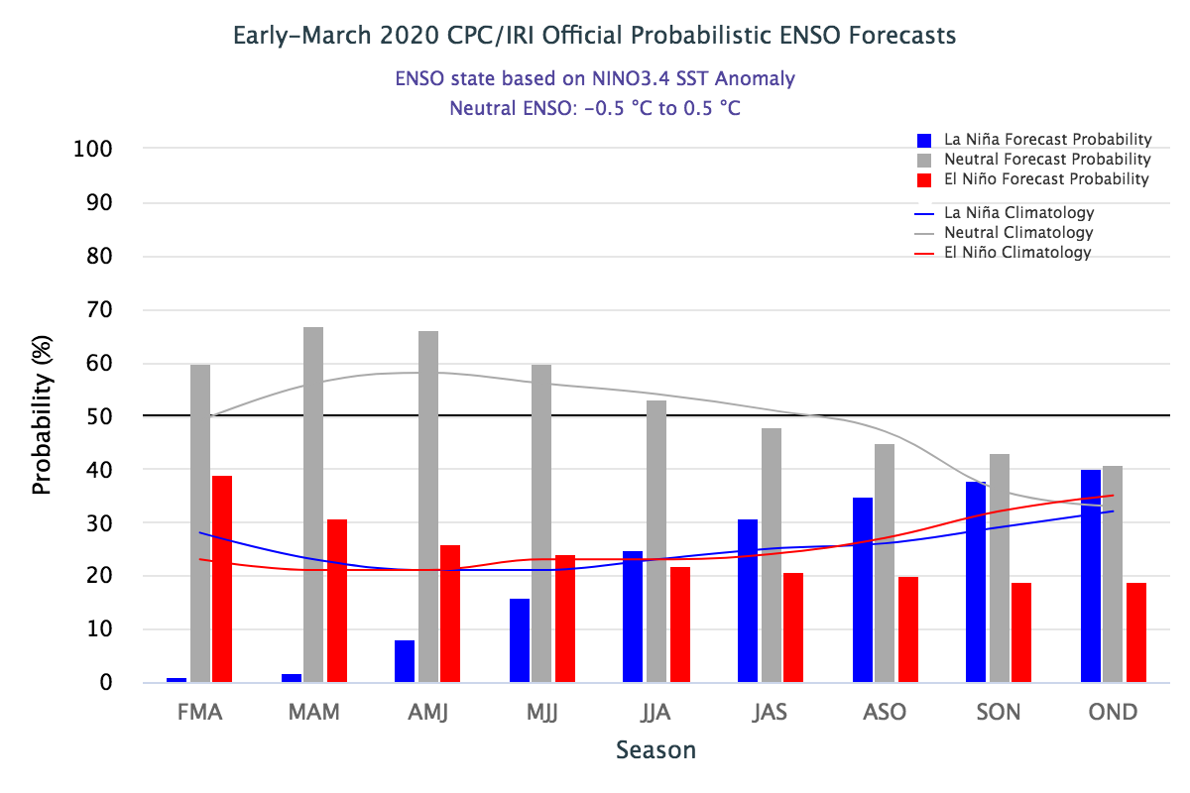
ENSO Forecasts
Early- February CPC/IRI forecast
Early- March CPC/IRI forecast
Pretty flat!! No help here to models for seasonal forecast signature!!

Slide 25
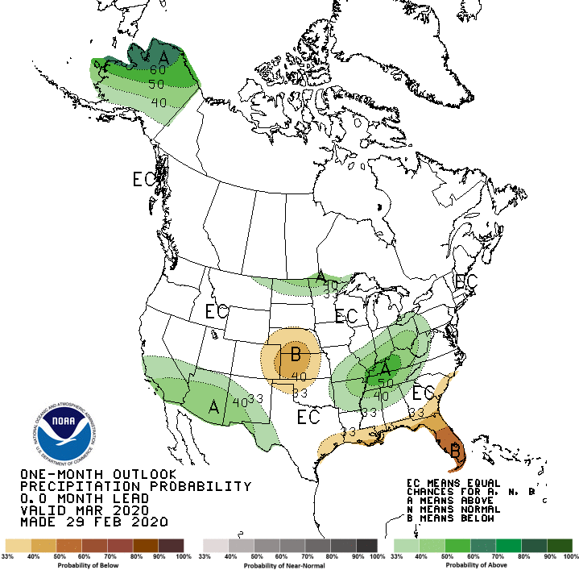
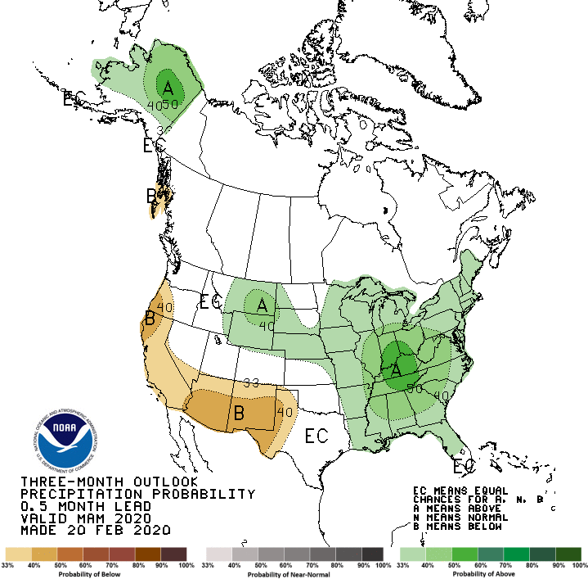
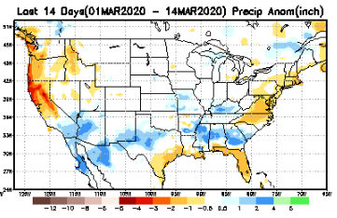
Released Feb 29th
Previous(Last month)
CPC’s official
Precipitation outlook for Monthly (Mar)/Seasonal (MAM)
Released Feb 20th
Observed so far this month!!
Monthly P/T forecasts verified at mid-month are generally good! Why? ☺ (becoz they r mostly based on GFS’ 2-wk fcsts)
Second half month ?
Next slide!

Slide 26
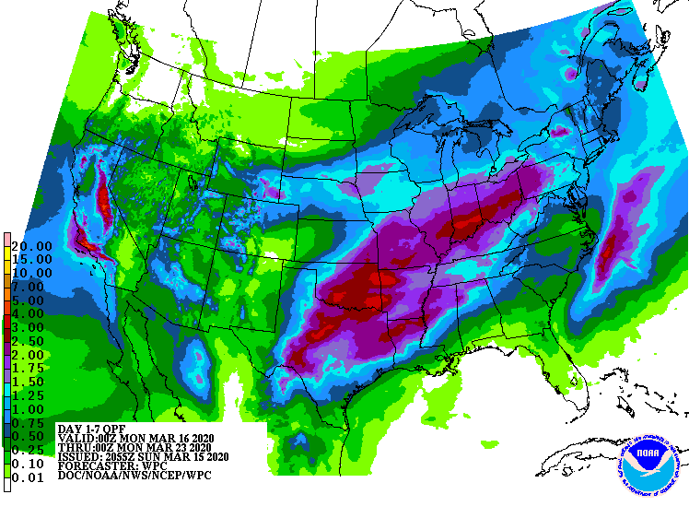
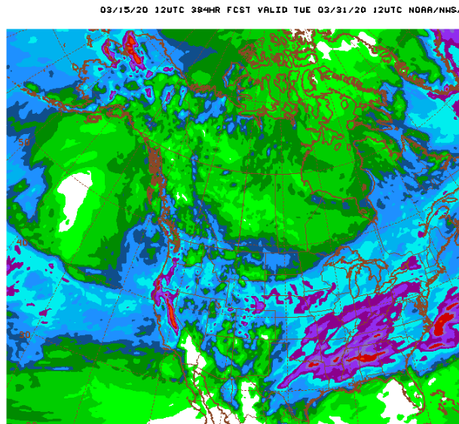
WPC Next 7 days QPF Forecast
GFS Model Guidance for next 16 days.

Slide 27
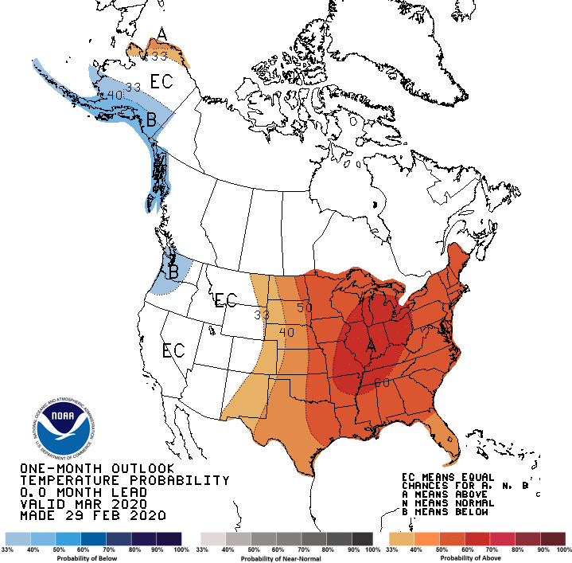
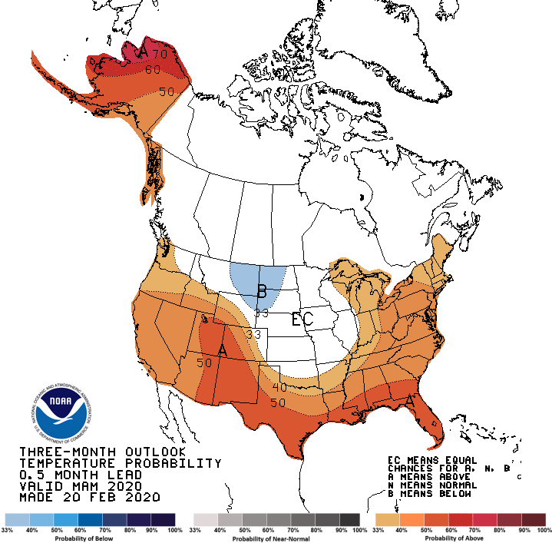
Made
Feb 29th
Previous (Last Month)
CPC’s official
Temperature outlook for Monthly (Feb)/Seasonal (FMA)
Made
Feb 20th
Observed so far this month!! ☺

Slide 28
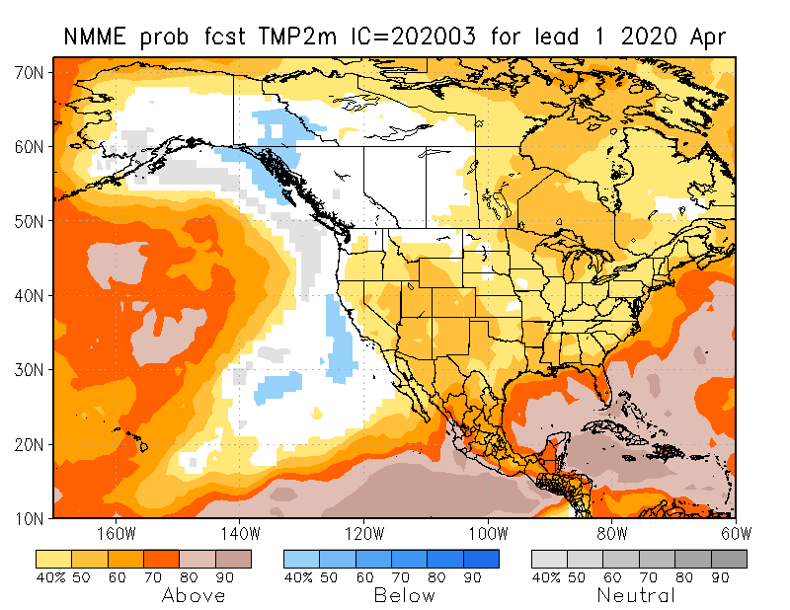
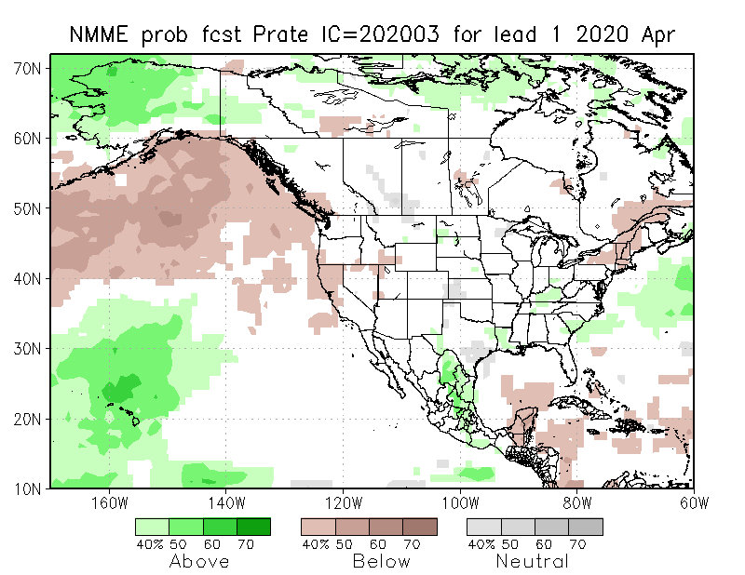
NMME T & P Ens.Mean forecasts
Apr
These warm (red) fcsts for Temp. – are generally made and verify too mostly!!
AMJ
Will these Precip fcsts turn out to be true? Remember the 2017 Spring the Northern Great Plains drought forecast ??

Slide 29
Ageement/Disagreement in the various NMME models’ AMJ seasonal Precip. Forecst.

Slide 30
Forecast uncertain in Hatched areas.

Slide 33
Initial Conditions:
03/03/2020
http://drought.geo.msu.edu/research/forecast/smi.monthly.php
Predicted Monthly Soil Moisture Percentile
Initial Conditions 1 months ago:
02/11/2020
The inter quartile range suggest greater uncertainty about the forecast in these shaded regions.

Slide 34
Summary
Current ENSO status and forecast. ENSO-neutral conditions are present and is favored through Northern Hemisphere spring 2020 (~65% chance), continuing through summer 2020 (~55% chance).
Current Drought conditions:
Drought in the southeast, that was present late last year is only present in bits and pieces. Parts of Florida is experiencing very dry conditions.
The short/long term drought in the four corner states area (AZ/NM/ UT/CO) continues to survive in some form, shape and intensity.
Existing and new Drought in CA/OR/WA/NV/ is slowly getting bigger and is expanding. These must be viewed n the context that the rainy winter season has almost ended.
Drought in southern TX has shrunk in size but worsened in intensity.
Almost all the California reservoirs levels this month are lower than last month’s levels. The rainy winter season is almost over for the region, and the drought here is unlikely to get better.
The dryness/drought here has expanded east into Nevada, according to the DM.
Prediction:
The continued presence and extension of near normal/neutral ENSO conditions in the tropical equatorial Pacific through spring and even summer, is taking away the even little edge and confidence via boundary conditions in the model’s seasonal forecasts of precipitation and temperature over the continental US, especially at this time of the spring season, when the model’s forecast skills are generally at their lowest.
Careful examination of the current precipitation deficiencies on many time scales across the United States and the extent/march of the compact/expanded rainy season in the drought affected and the precipitation deficit regions, will help guide the drought forecasters. These considerations lead us to suggest that the drought in southern Texas will continue to persist. The drought in CA will persist and expand east into NV.
The drought in the four corners region in the west will get continue to persist, due to continued short and long term rainfall deficits in the region. Parts of NV will likely see emergence of new dry/drought regions.
Very small pockets of drought in the southeast may continue to linger, and the FL dryness may worsen in the short term (month) before it gets better by the end of the forecast (AMJ) season, when seasonal rains will begin.
The great Plains, particularly the Dakotas is very tricky, in terms of emerging drought in the AMJ season if the rainy season (AMJJ) is not off to a good start (remember 2017!), where mild deficiencies already exist!!!
*********************

Slide 35
Improve
SDO [FMA’20]
(1/7/20 USDM)
Persist
Develop
Persist
Improve
Improve
Considered Development,
but short-term & ERF wetness,
FMA climo dry
Improve
Persist
ERFs wetness; LLFs = EC;
FMA climo ~ dry (west)
Improve
Persist

Slide 36
Miscellaneous maps

Slide 37
Miscellaneous maps

