Slide 1
Drought Outlook Support Briefing March 2021
Climate Prediction Center/NCEP/NOAA
http://www.cpc.ncep.noaa.gov/products/Drought
Phone: 1-877-680-3341
Pwd: 858747#

Slide 2
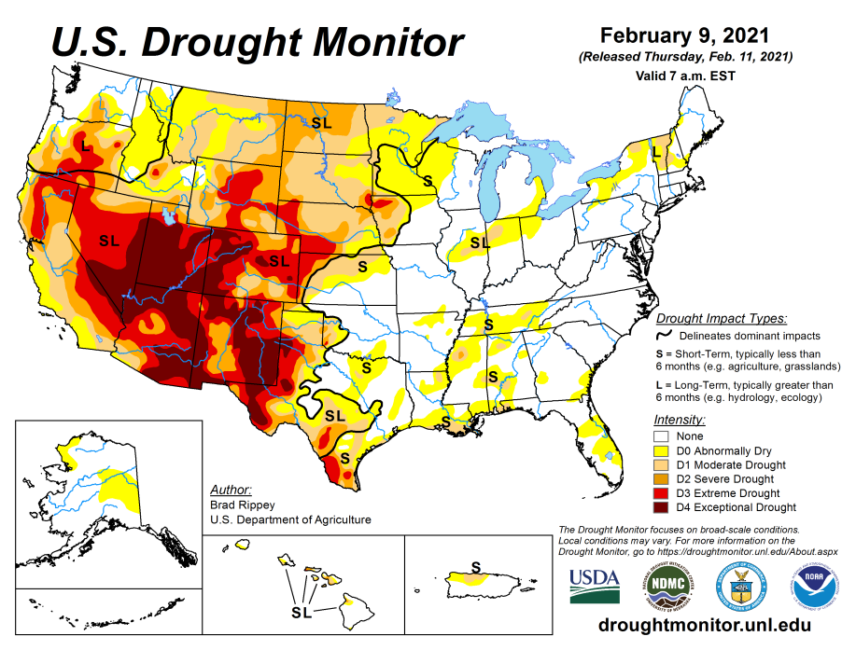
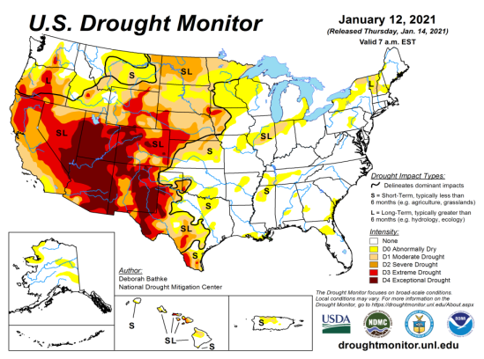
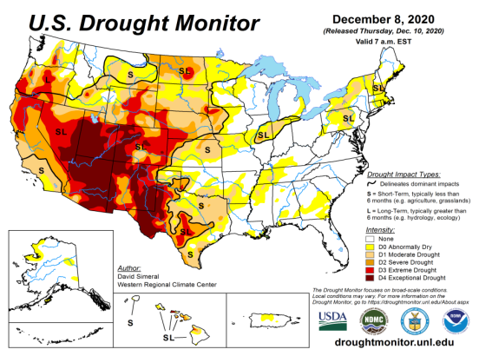
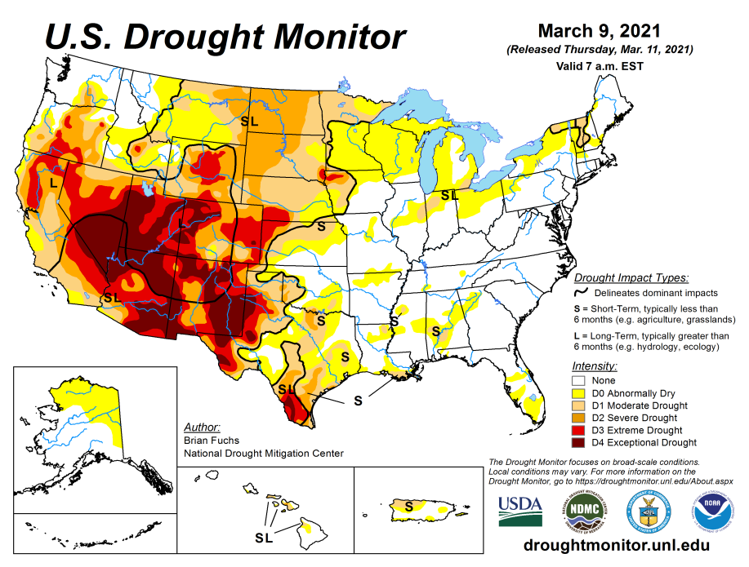
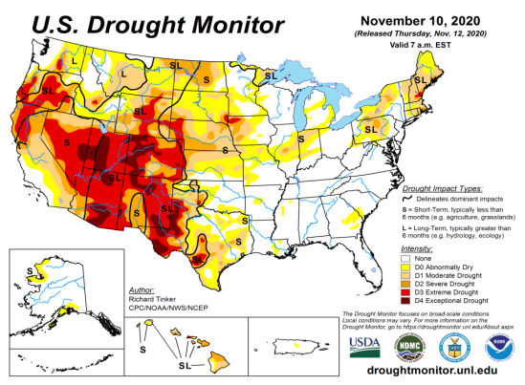
Drought Monitor
Monitoring is important because, unlike US T/P fcsts, for drought forecasts, we have to know where we are, before we can tell where we are going!! Drought forecasts are tendency forecasts.
February
January
Over the last several months, drought area & severity has overall generally just about the same. The worse drought conditions are in the border areas of states AZ, NV, UT, CO, and OR, CA and western TX. These are regions are part of the long term drought.
The drought in the Dakotas, MT, Wyoming, Nebraska, Kansas and vicinity which developed in the last year continues to hang in there. Next months rain crucial!
About 70 % of the country is experiencing category D1 or worse drought condition (next side!)
Is Drought in parts of the New England states trying to make a come back ? Parts of MI/IN/OH/PA ?? Developing dryness in parts of Gulf coast states (see later slides!)
December
March
(Recent/Latest)
November
February

Slide 3
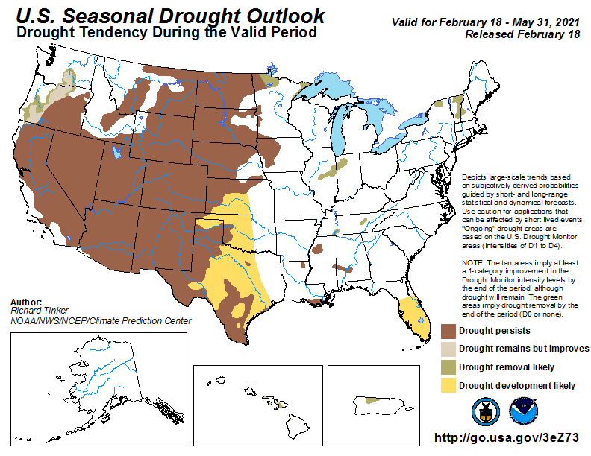
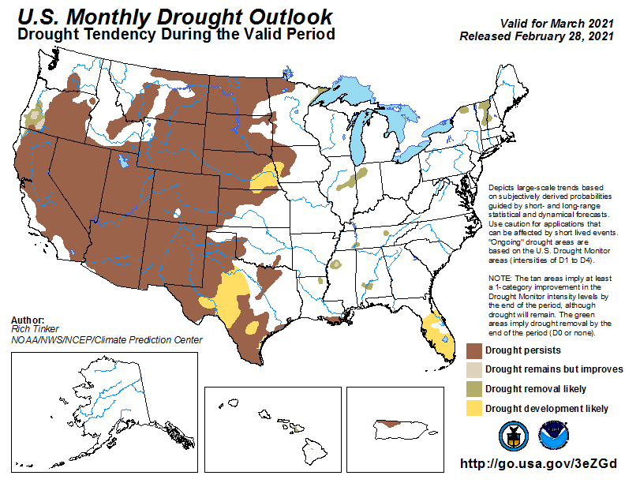
(Prev) Seasonal/Monthly Drought outlooks
(New Seasonal+ Drought Outlook to be released in 2 days!)
(New Monthly Drought Outlook to be released end of this month)
Seasonal Outlook
(Mid Feb 2021- May 2021)
issued 02/18/21
Monthly outlook
(for March 2020)
issued 02/28/21
Similar looking Monthly and seasonal outlooks, except in the southeast. New Drought is expected to emerge in the Southeast, and it is beginning to happen. Will that happen?
The La Nina and the associated below normal precip. across the southwest worsened the drought affected areas in the SW.
We cautioned last month of possibly developing/recurring dryness in the New England states and along OH/PA border and of course Gulf states!

Slide 4
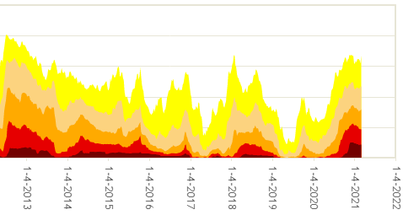
50%
The current % of area extents at D2/D3/D4 drought are approaching the drought during 2013 (the worst since 2000)?

Slide 5
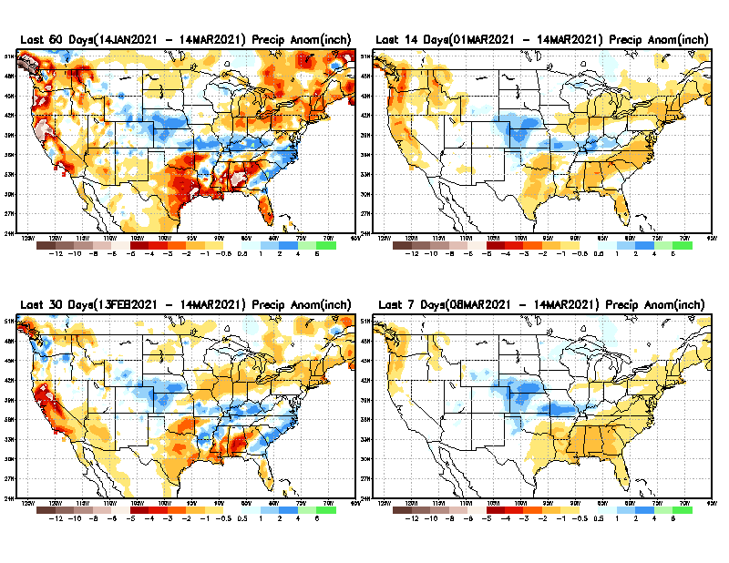
Precipitation ANOM during last 7, 14, 30, & 60 days.
Not much evidence (so far) of Ohio valley excess precip noted during La Nina – It has been a crazy winter of extreme weather so far!! (Also this past year with Hurricanes, West Coast Fires, and now COLD!!!)
60 Days
14 Days
30 Days
7 Days
These maps in this and following slides, including a) Total,
b) Anom and
c) Percent of Normal precip. in these and other longer time ranges are now (routinely) daily updated at:
From: Recent Accumulated Precipitation https://www.cpc.ncep.noaa.gov/products/Drought/briefing_prcp.shtml

Slide 6
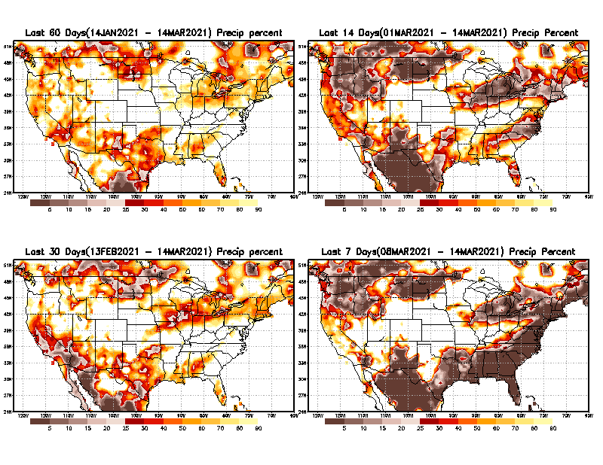
Precipitation Percent during last 7, 14, 30, & 60 days.–Only Deficit Areas!! <=90%
60 Days
14 Days
This plot shows only the rainfall deficient regions <= 90% of normal.
-- This shows more clearly possible/likely drought developing region in the future unless there is above normal rainfall in these regions in the future, to offset these shortfalls.
30 days
7 Days
From: Recent Accumulated Precipitation https://www.cpc.ncep.noaa.gov/products/Drought/briefing_prcp.shtml

Slide 7
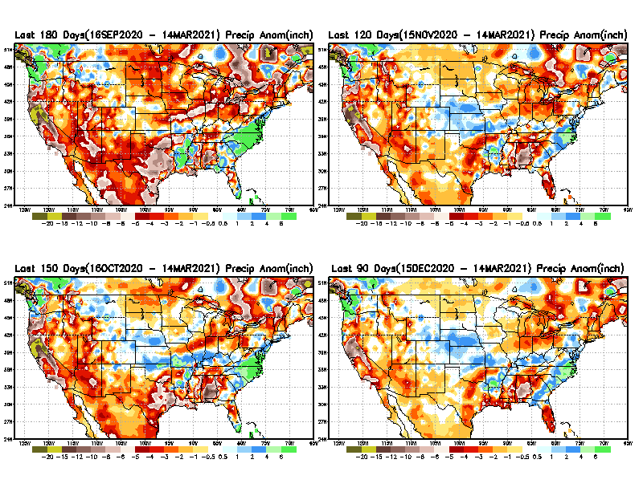
Total precipitation ANOM during last 3, 4, 5, and 6 months.
6 M
4 M
While the Precipitation anomalies deficit may seem large in some regions (compared to others), it is the % of normal precip (next slide) that matters more!!
5 M
3 M
From: Recent Accumulated Precipitation https://www.cpc.ncep.noaa.gov/products/Drought/briefing_prcp.shtml

Slide 8
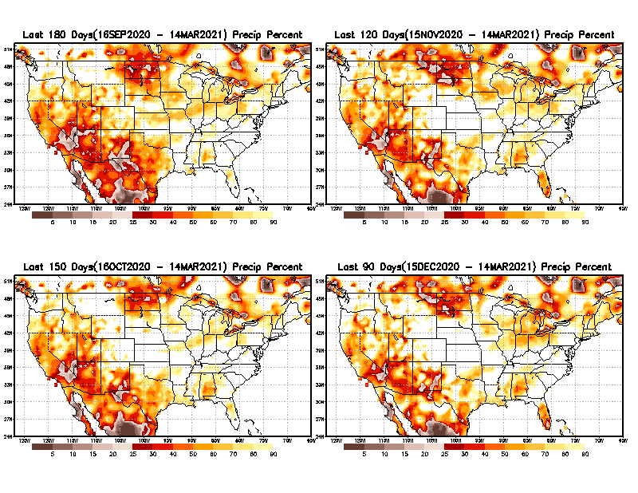
Total precipitation Percent during last 3, 4, 5, and 6 months–Only Deficit Areas!! <=90%
6 M
4 M
In these interim time scale 3-6 months, we need to pay attention to regions, which are dark-brown, red & dark red (<50%).
While accrued precipitation deficits are real & objective,
droughts are subjective declarations!!
5 M
3M
East vs West!
Broad vs Narrow
rainfall season.
In general, West suffers more from frequent and lasting droughts.
With these various rainfall deficits in diff. time ranges, where and how exactly does one declare drought? Other factors (T/SM/E, etc..) do matter, but is cumulative precip. Are deficits/percent_of_normal ultimately more important?

Slide 9
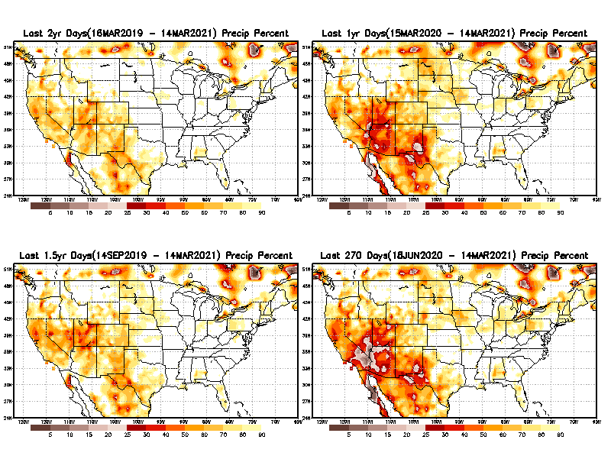
Total precipitation Percent during last 9 months, 1 yr, 1.5yrs, & 2 yrs. .–Only Deficit Areas!! <=90%
2 Y
1 Y
Tinderbox areas, where some form of longer term rainfall
deficiencies already, exist !!
-Almost all are in the southwest!
-This & Next slide!!
1.5 Y
9 M
From: Recent Accumulated Precipitation https://www.cpc.ncep.noaa.gov/products/Drought/briefing_prcp.shtml

Slide 10
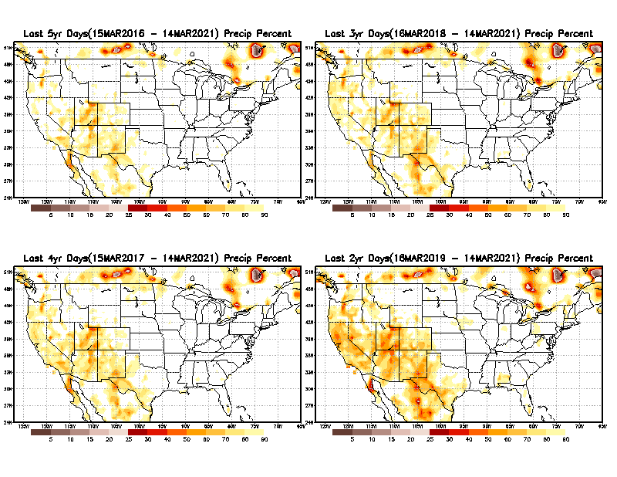
Total precipitation Percent during last 2 yrs, 3 yrs, 4 yrs, & 5 yrs. .–Only Deficit Areas!! <=90%
5 Y
3 Y
In these long time ranges (2-5 yrs), there is a general dearth/lack of precipitation in the southwest US. – where the current severe drought ravages!!. At the end of this current ongoing La Nina the long term situation will get even worse!!
4 Y
2 Y
From: Recent Accumulated Precipitation https://www.cpc.ncep.noaa.gov/products/Drought/briefing_prcp.shtml

Slide 11
Rainy (3-month)Season across the US
East vs West!
More darker colors in west/central => narrow rainy season (months)
Overall, more white space in the east => distributed rainfall season (except ~FL).

Slide 12
*********
EAST vs
CTR/WEST
Drought Behavior is loosely tied to rainfall climo!!
*********
Adapted from Rich Tinker.

Slide 13
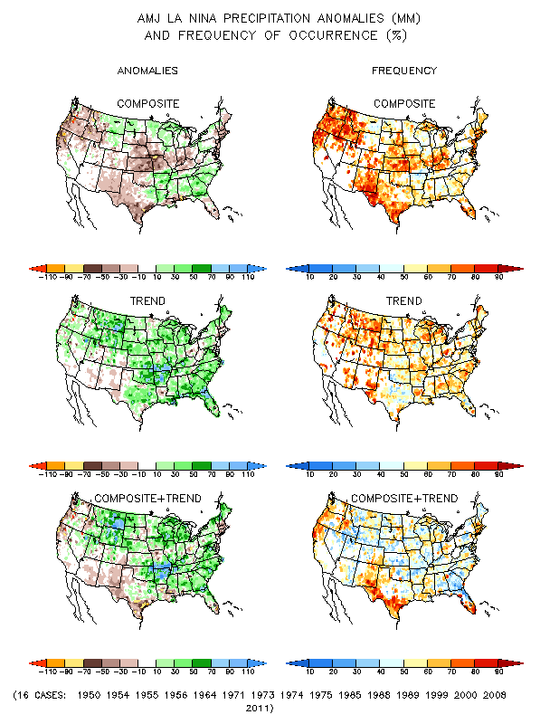
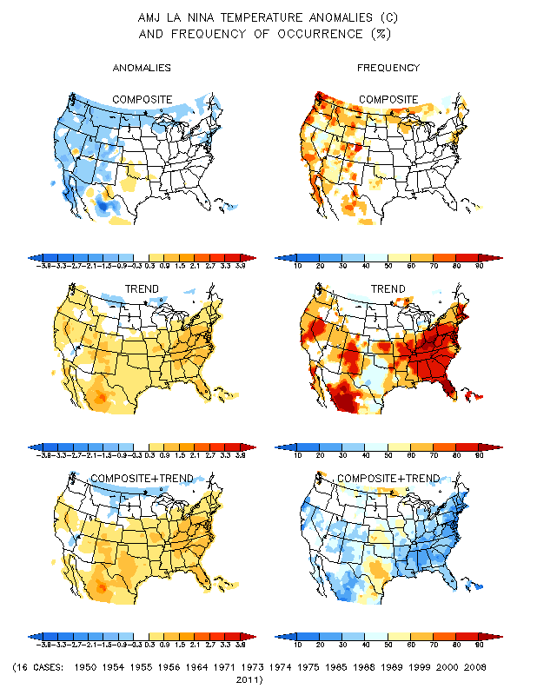
La Nina Precip/Temperature COMPOSITES & Trend map
AMJ
P
T
WET
DRY

Slide 14
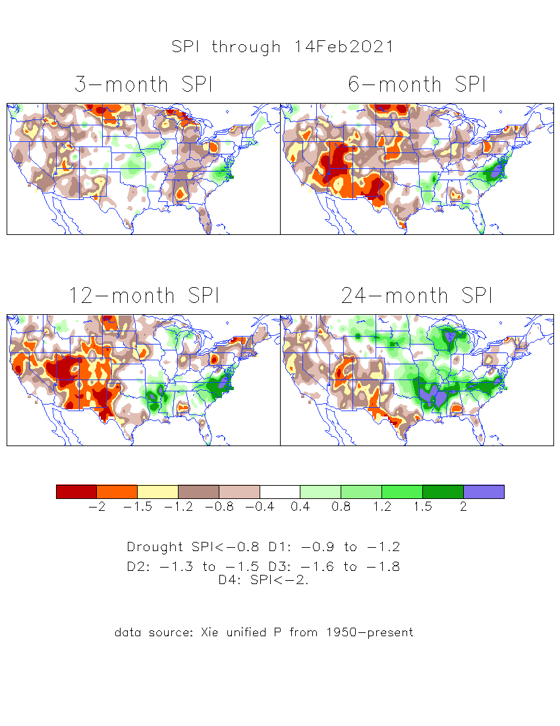
The Standardized Precipitation Index SPI (based on Observed P)
----- Last Month
Very interesting graphic & details for the drought across the US based on the more generalized precip deficit/excess, the Standardized Precipitation Index (SPI).
The dark brown and red colors, indicating standardized precipitation deficits, in the various time periods, approximately correspond to the appropriate short/long term drought monitor regions and their intensities
Short-term situation has gotten slightly better in the west, but long term situation is, and will stay worse -- as we said last month!!

Slide 15
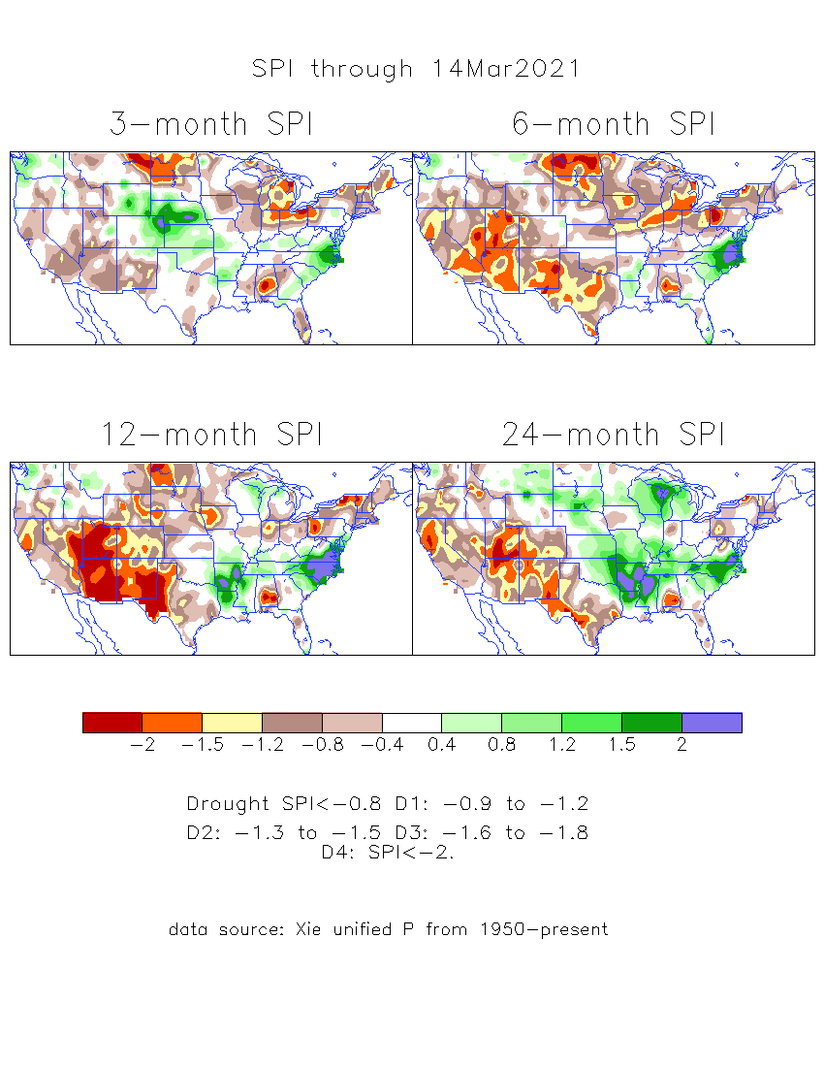
The Standardized Precipitation Index SPI (based on Observed P)
----- NOW
Very interesting graphic & details for the drought across the US based on the more generalized precip deficit/excess, the Standardized Precipitation Index (SPI).
The dark brown and red colors, indicating standardized precipitation deficits, in the various time periods, approximately correspond to the appropriate short/long term drought monitor regions and their intensities
----- NOW
How does one negotiate and reconcile declaring short term vs long term drought when precip. deficiencies patterns differ on many different time scales locally!!
What is the cutoff delineating time between short VS long term drought!!

Slide 16
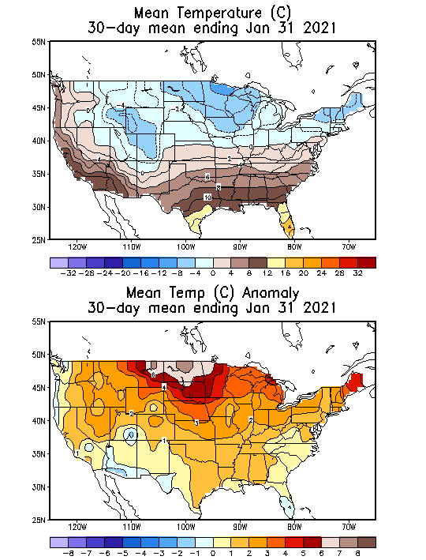
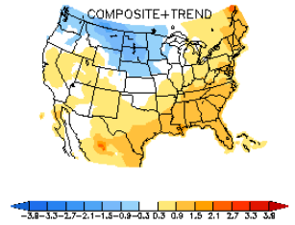
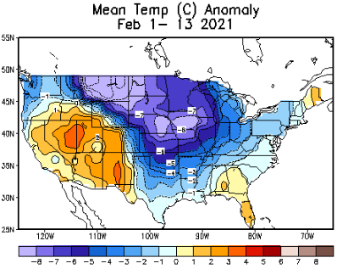
Recent US Temperatures – January
Slide shown in last month’s briefing !
(cf. with this month’s, next slide !!)
Canonical La Nina T - DJF
Last month, observed T anom are opposite of the La Nina Composites!! This month? Not quite La Nina –ish!!

Slide 17
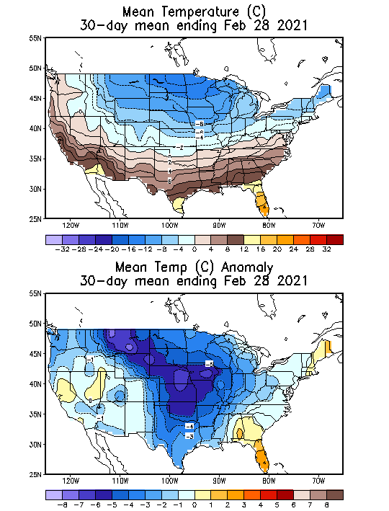
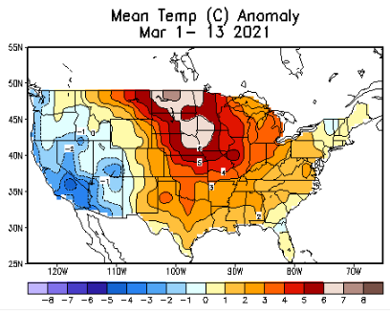
Recent US Temperatures
Such swings in winter Temperatures
Even in the midst of La Nina!!
From Jan –> Feb -> Mar
So far this month !!
Remember, the TX freeze!!

Slide 18
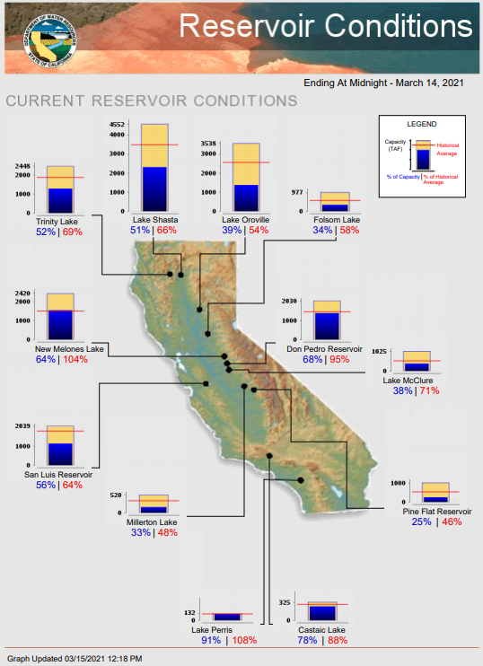
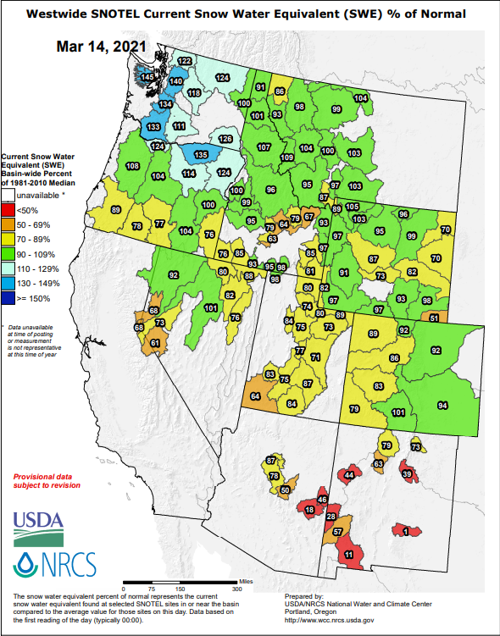
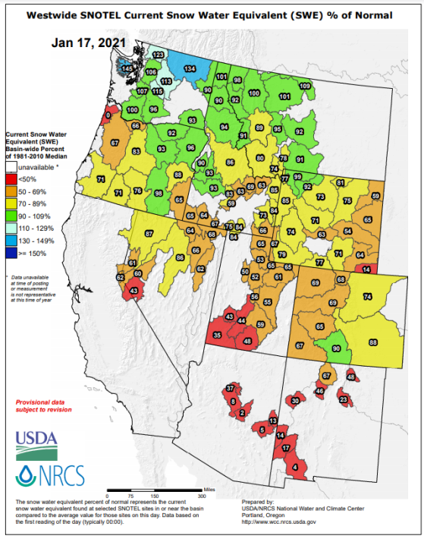
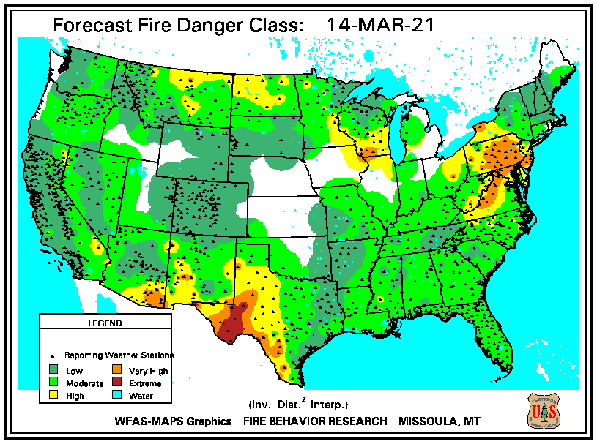
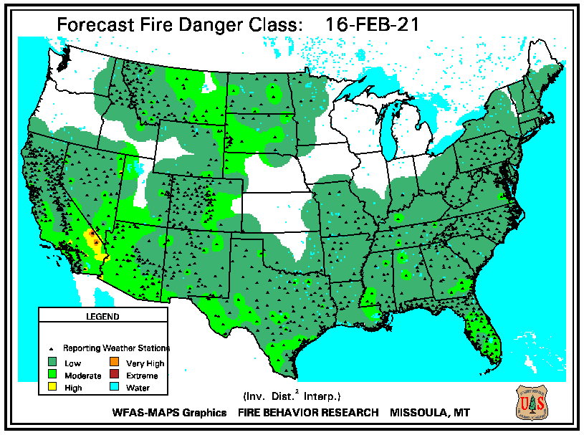
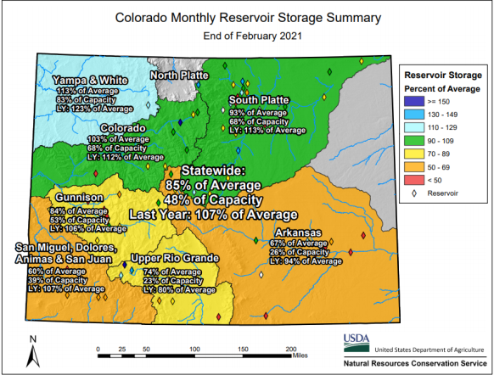
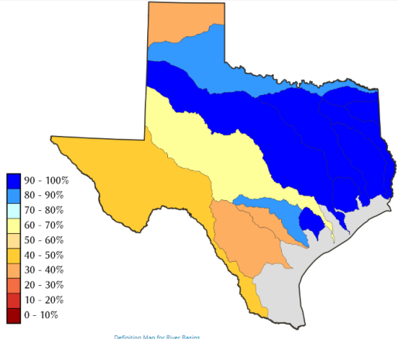
THIS MONTH
2 MONTHs ago
https://fsapps.nwcg.gov/
CO
Many CA reservoirs are at low levels”!!
TX
85 %
of AVG!
Because of La Nina and from conditions even before La Nina, water reservoir levels are low!! If La Nina continues onto second year, this year, it will be a major problem!!

Slide 19
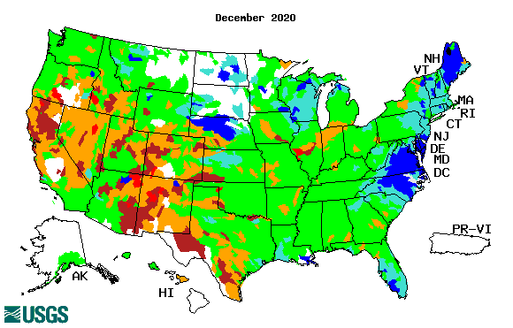
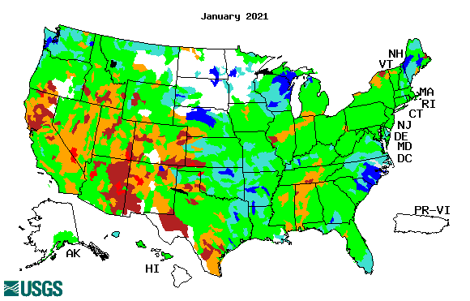
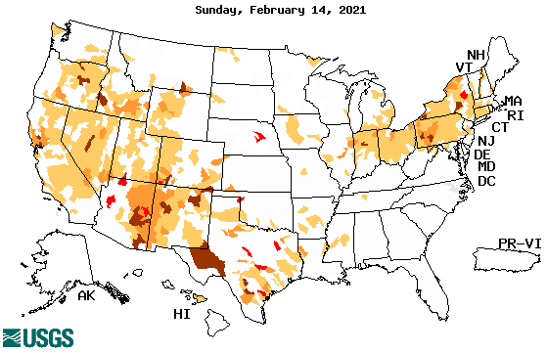
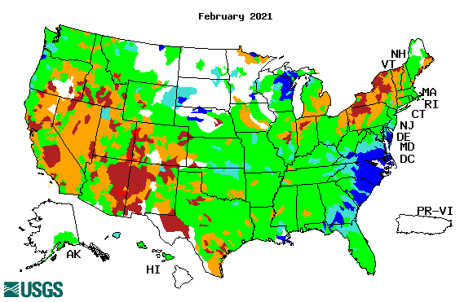
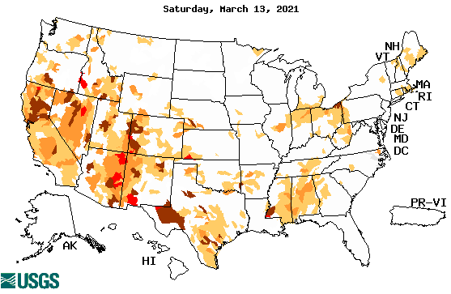
Streamflow (USGS)
Worse conditions in the southwest, in the monsoon region.
Northeast drought considerably improved.
Pacific NW much improved now.
Map shows only below normal 7-day average streamflow compared to historical streamflow for the day of year.
One month ago (left) &
Now (below)
Note:
CA,
TX,
Northeast
Overall, similar streamflow conditions in the south and west . The white areas in maps (left) indicate no data or frozen land.
19

Slide 20
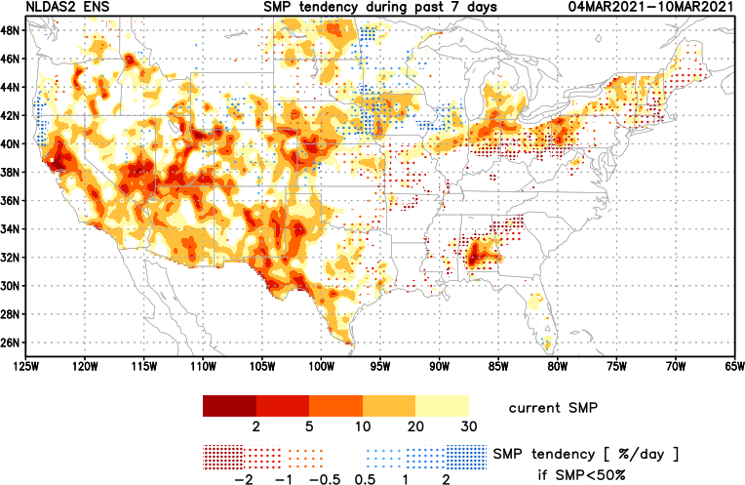
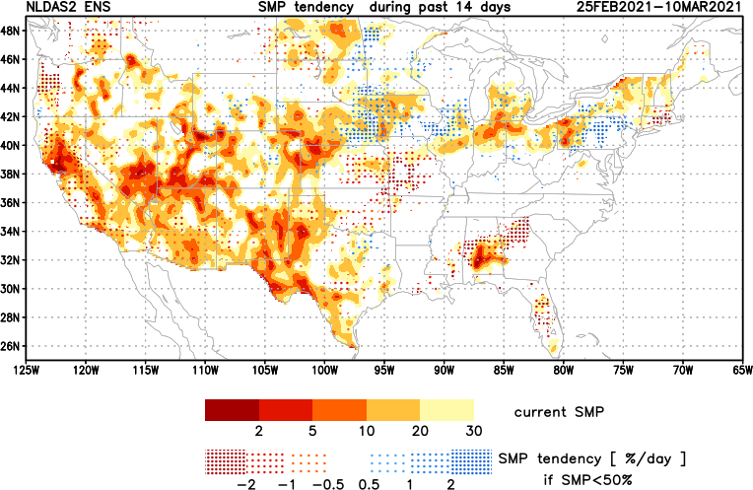
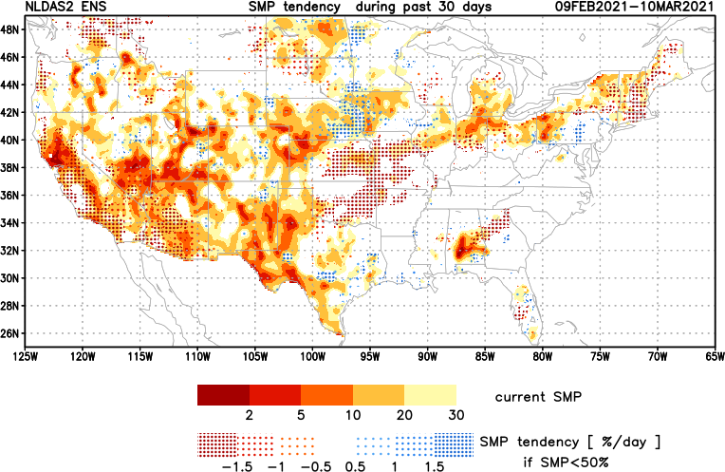
[Now]
NCEP Ensemble mean NLDAS2 models’ Soil Moisture tendency/trend
7 days
14 days
30 days
Western half, mostly straightforward!
MI, OH/PA border region &
Northeastern US – re-emerging drought??

Slide 21
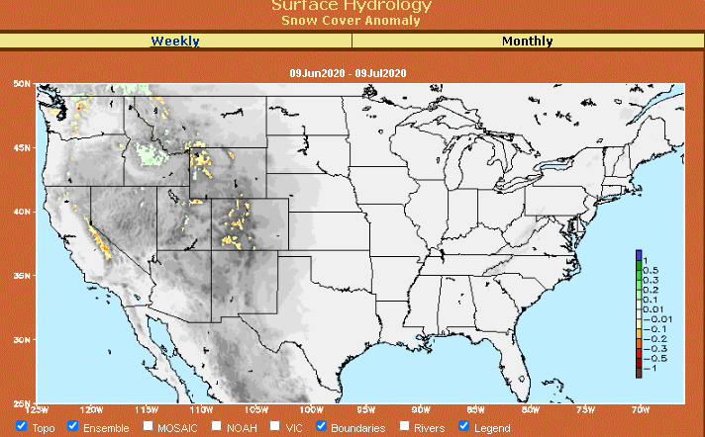
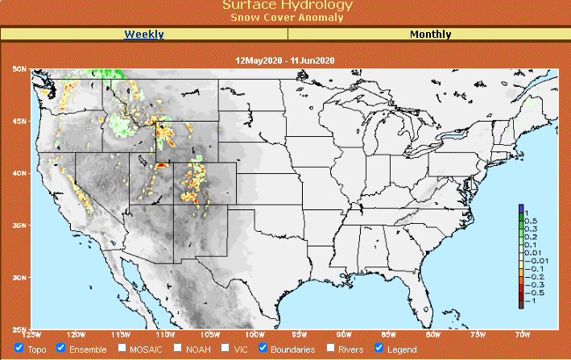
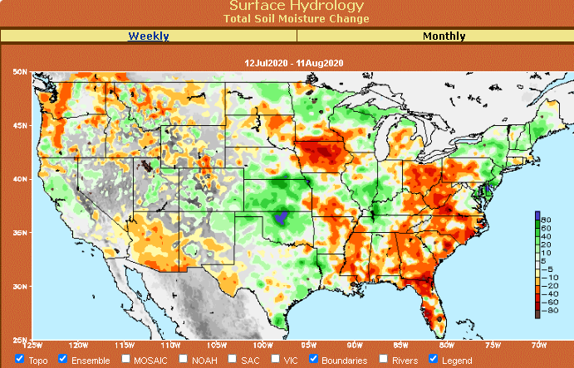
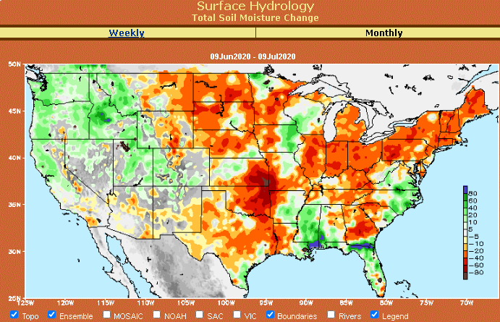
Snow cover & Soil Moisture Anomalies
Snow cover
SLIDE
NOT SHOWN!
Last month ~ this time
Now
Look further for areas of drought development

Slide 22
EL NIÑO/SOUTHERN OSCILLATION (ENSO)
DIAGNOSTIC DISCUSSION
issued by CLIMATE PREDICTION CENTER/NCEP/NWS and the International Research Institute for Climate and Society
11 March 2021
ENSO Alert System Status: La Nina Advisory
Synopsis: There is a ~60% chance of a transition from La Niña to ENSO-Neutral during the Northern Hemisphere spring 2021 (April-June). -------- Forecasting ENSO status during – transition – esp. during - transition months? – generally difficult!!

Slide 23
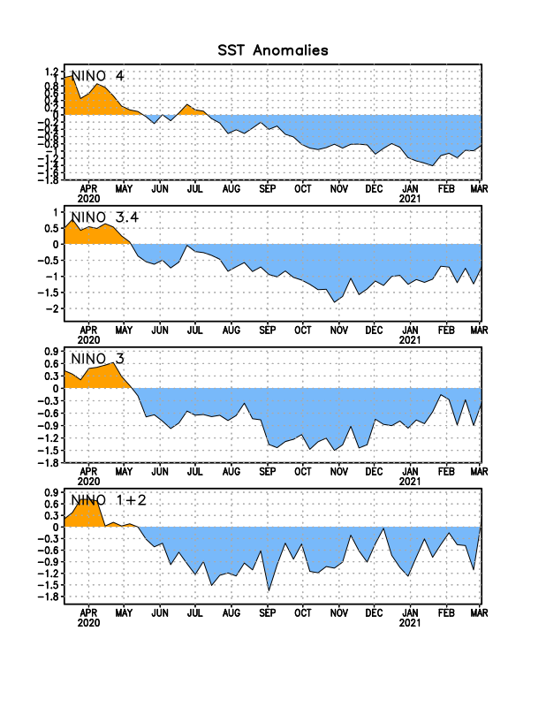
Latest values of SST indices in the various Nino Regions.
This is the most blue! (cold) in all 4 indices (see left) in a while. Subsurface ocean heat anomalies are also cold!!

Slide 24
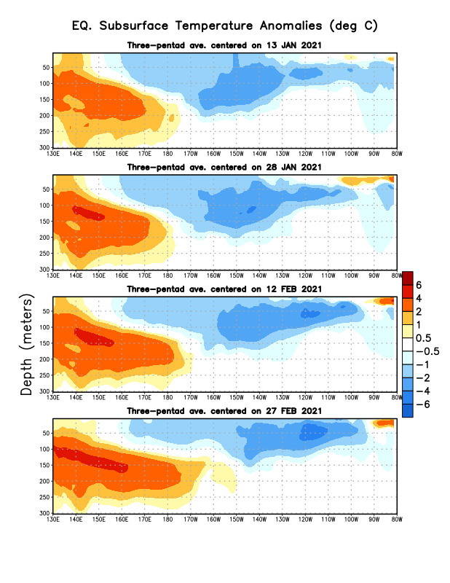
Sub-Surface Temperature Departures in the Equatorial Pacific
Central and eastern tropical SST and subsurface exhibit cold La Nina conditions!!
There really is this tug-of-war between the stubborn sub-surface cold waters in the central/east Eq. Pacific
associated with La Nina and the encroaching warm waters in the deep west Pacific!!
Most recent pentad analysis

Slide 25
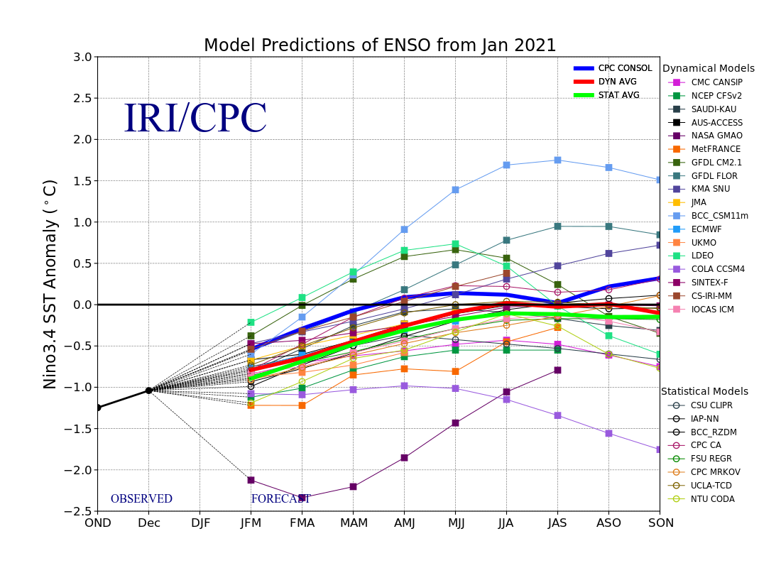
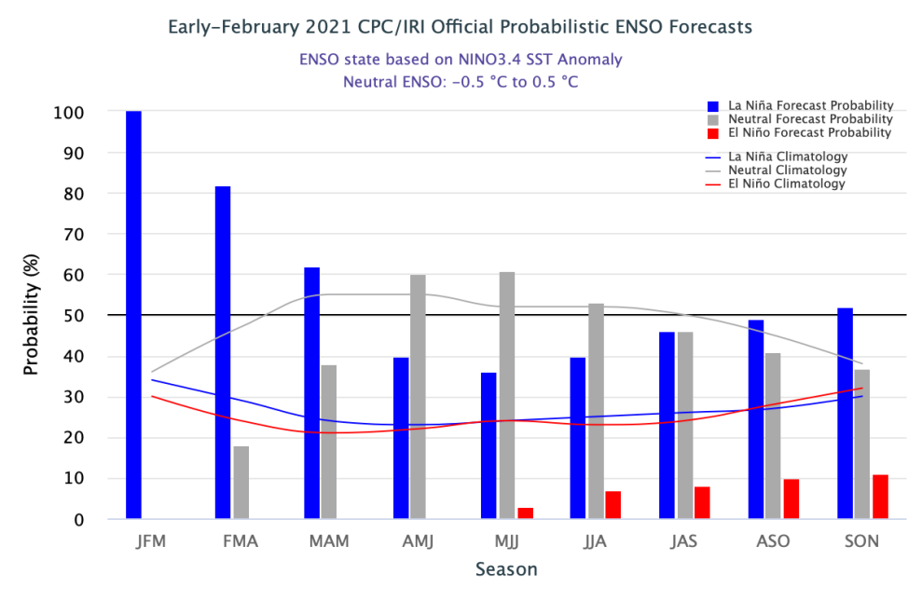
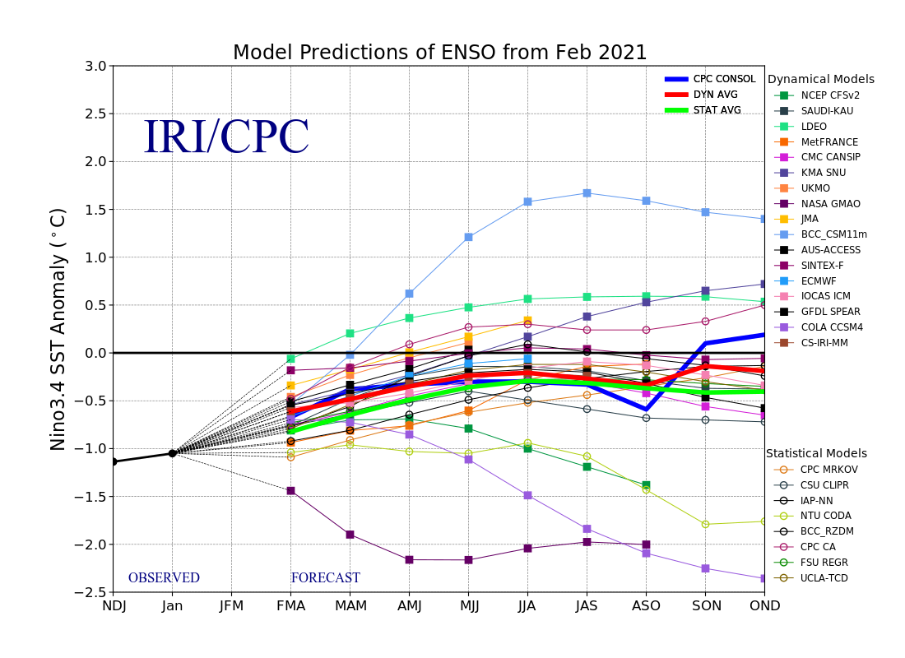
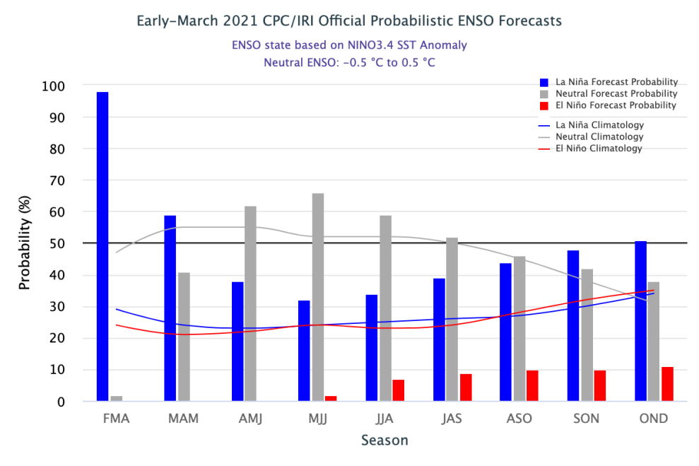
ENSO Forecasts
Early- February CPC/IRI forecast
Early- March CPC/IRI forecast
Is la Nina really on its way out? Or Will it linger in some form? See CPC consolidated above!!
2/3 of all La Ninas are multiyear La Ninas!! ?

Slide 26
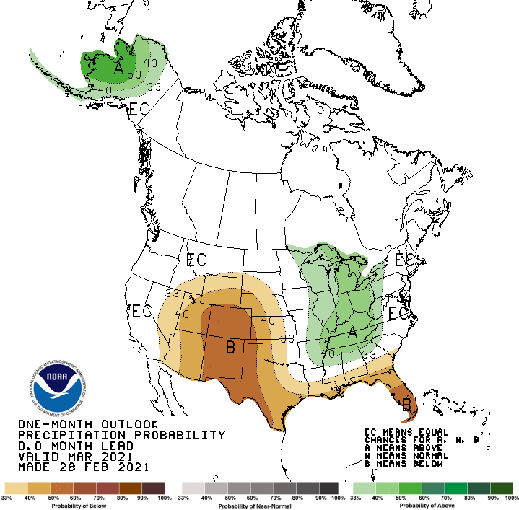
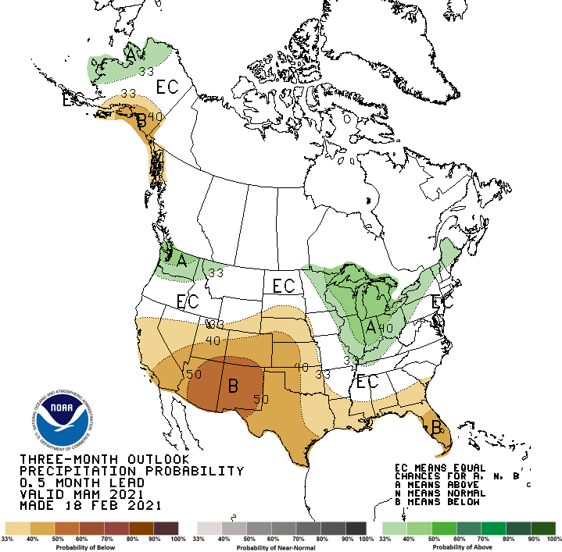
Previous(Last month)
CPC’s official
Precipitation OUTLOOK for Monthly (Mar)/Seasonal (MAM)
Released Feb 28th
Released Feb 18th
Observed so far this month!! ☹
Monthly P/T forecasts verified at mid-month are generally good! Why? ☺ (becoz they r mostly based on GFS’ 2-wk fcsts). We still have many days to go in the month.

Slide 27
NCEP/WPC Next 7 days QPF Forecast
Precip amounts in this region varies highly from one model run to next!!
GFS Model Guidance for the
next 16 days.
Based on this fcst, southern CA, most of FL, and parts of MT & Dakotas – little chance of precip in the short term.
Very little relief in the southwest!

Slide 28
From European Center (EC) Precip forecast (made yesterday, 15 Mar.) for next 30 days.

Slide 29
From European Center (EC) Precip forecast (made yesterday, 15 Mar.) for next 30 days.

Slide 30
Looking back from future (13 Apr) how 60 days and 90 days precip percentile will look, including the 1- month European Center(EC) forecast (made yesterday, 15 Mar) precip amounts.
Possible developing drought in parts of AL/FL in the next month/season? (See also 3-4-5 months precip deficits in this region, earlier slides 7/8 !)
- NOT indicative of long term drought!!

Slide 31
Made
Feb 28th
Previous (Last Month)
CPC’s official
Temperature outlook for Monthly (Mar)/Seasonal (MAM)
Made Jan 21st
Observed so far this month!! ☺

Slide 32
NMME T & P Ens.Mean forecasts
Apr
Much of the country is warm except in the Northwest. The south is WARM+
AMJ
The forecast P pattern is the expected canonical La Nina composite, with dry relative conditions in the
South.

Slide 33
Agreement/Disagreement among the various NMME models’ AMJ seasonal Precip. Forecast.
??
Why is IMME so different from NMME models? What models are in there?
??

Slide 34
SPI6 Fcst made from last month(background) compared with this month(foreground, red border)
Why is there so fewer hatched areas in SPI6 fcst from NMME models’ based fcst this month as compared to last month (left 2 columns) ? Fcsts more confident now?
Forecast uncertain in Hatched areas.
The SPI6 fcsts made last month vs. this month based on NMME models’ precip fcst. suggests continuation of drought in the south and west, in the upper Midwest. Possible total drought removal in the Pacific NW and NE. Possibility of developing dry/drought conditions in the SE by end of fcst season.
SPI6 Fcst made from last month
SPI6 Fcst made from this month

Slide 35
http://drought.geo.msu.edu/research/forecast/smi.monthly.php
Latest Initial Conditions:
03/09/2021
Predicted Monthly Soil Moisture Percentile
MSU stopped updating 06/10/20 ☹
CPC’s soil moisture percentile – Leaky bucket Model
The inter quartile range suggest greater uncertainty about the forecast in these shaded regions.

Slide 36
Summary
Current Drought conditions:
Over the last several months, drought area & severity has overall generally just about the same. The worse drought conditions are in the border areas of states AZ, NV, UT, CO, and OR, CA and western TX. These regions are part of the long term drought.
The drought in the Dakotas, MT, Wyoming, Nebraska, Kansas and vicinity which developed in the last year continues to hang in there. Next months rain crucial!
About 70 % of the country is experiencing category D1 or worse drought condition.
Is Drought in parts of the New England states trying to make a come back ? Parts of MI/IN/OH/PA ?? Developing dryness in parts of Gulf coast states.
Some/many of California reservoirs levels are below their historical average levels. If a second year La Nina remerge later this year (hope not!) it will worsen the water situation much further!
Current ENSO status and forecast:
There is a ~60% chance of a transition from La Niña to ENSO-Neutral during the Northern Hemisphere spring 2021 (April-June) – same La Nina advisory statement from last month!!
Prediction:
ENSO status during - upcoming forecast season April-May-June –is tricky! both in terms of La Nina status and confidence in model forecasts of the associated impacts! - (Historically, the likelihood of a La Nina to continue beyond the first year is high!!)
The observed temperature and precipitation patterns associated with the La Nina, so far, are not quite canonical, except in the southwest with lower rainfall amounts, which has worsened the drought conditions there. Both Short and long term drought conditions in the south and west is expected to persist and not improve!
Drought in the Dakotas (particularly ND), MT, Wyoming, Nebraska, Kansas and vicinity which developed during last year will likely persist through the forecast season – even though the expected rainfall in the upcoming start of the rainy season in these Northern High Plains is critical. New possible short term drought development in eastern WA, ID, western MT!!
Possible drought reemergence in parts of New England states – already dry, forecast high temps, not much help in P forecast!
Mild drought conditions might develop in parts of southeastern states, particularly in parts of AL and FL. Eastern TX, LA? *********************

Slide 37
Miscellaneous maps

Slide 38
Miscellaneous maps

