Slide 1
Drought Outlook Support Briefing March 2022
Climate Prediction Center/NCEP/NOAA
http://www.cpc.ncep.noaa.gov/products/Drought
Points to ponder:
Often, there is a disconnect between the Short term (S) and Long term (L) drought in regions.
Places/regions experiencing Short term drought may (not) be ok in the Long term and vice versa!!
This duality is difficult to reconcile, to convey and even be understood by the public at large.
Public/Forecaster focus tends to be more on the Short term Drought (for good reasons!!)
More importantly the very definitions and timescales associated with S/L term droughts and the declarations in the USDM are by themselves subjective!!

Slide 2
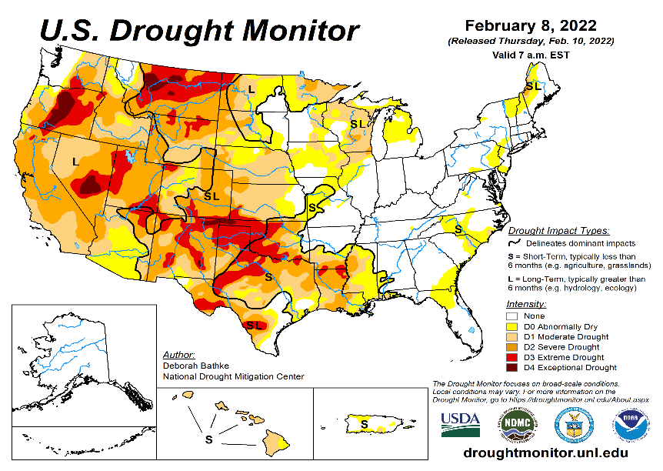
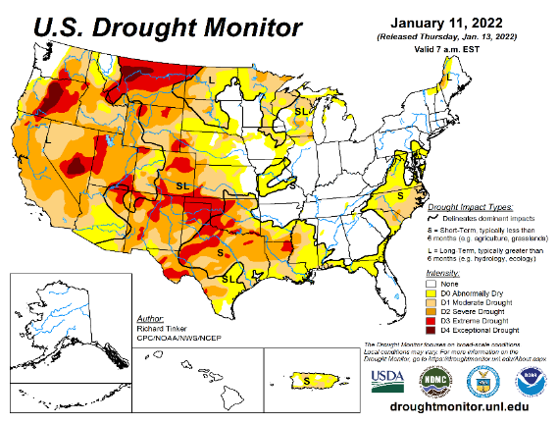
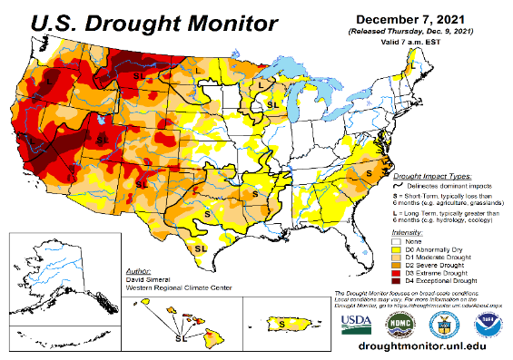
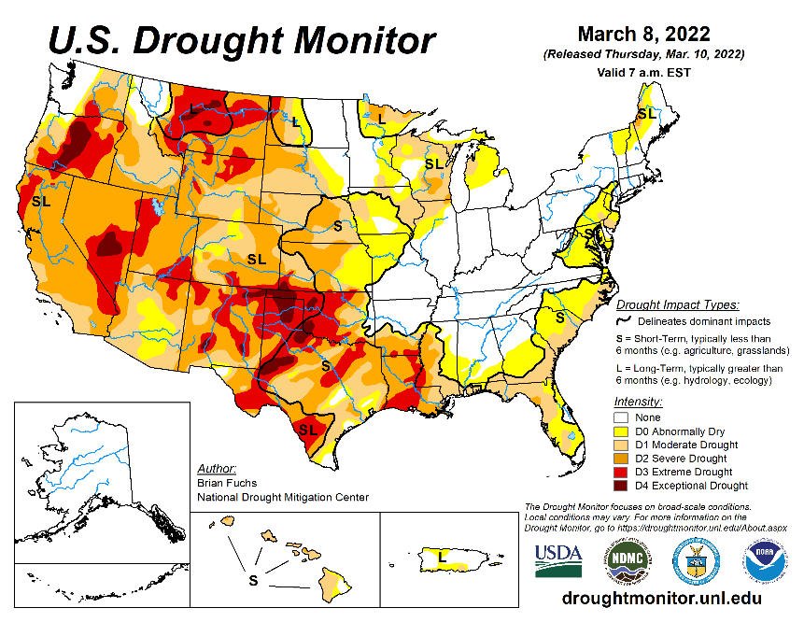
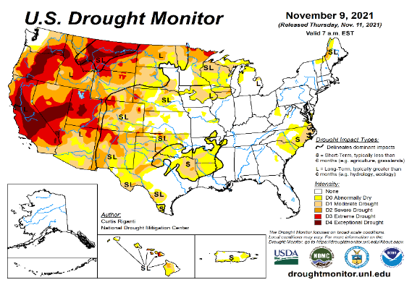
Drought Monitor
Monitoring is important because, unlike US T/P fcsts, for drought forecasts, we have to know where we are, before we can tell where we are going!! Drought forecasts are tendency forecasts.
February
January
Overall, little change in the spatial structure of drought in the south and west this month as compared to last month, except for slightly more severe conditions in some areas.
The slightly temporarily improved drought conditions in the far SW, (CA & vicinity) during January, from the unusual December rains, stayed at those levels, and did not continue to improve further.
Also consistent with the ongoing La Nina (which is on its way out), there has been an increased short term drought conditions along the Gulf coast in the southeast, centered on northern Florida and vicinity.
Most eastern US and east coast droughts (unlike the southern/western US droughts) generally do not last long.
December
March
(Recent/Latest)
November
?

Slide 3
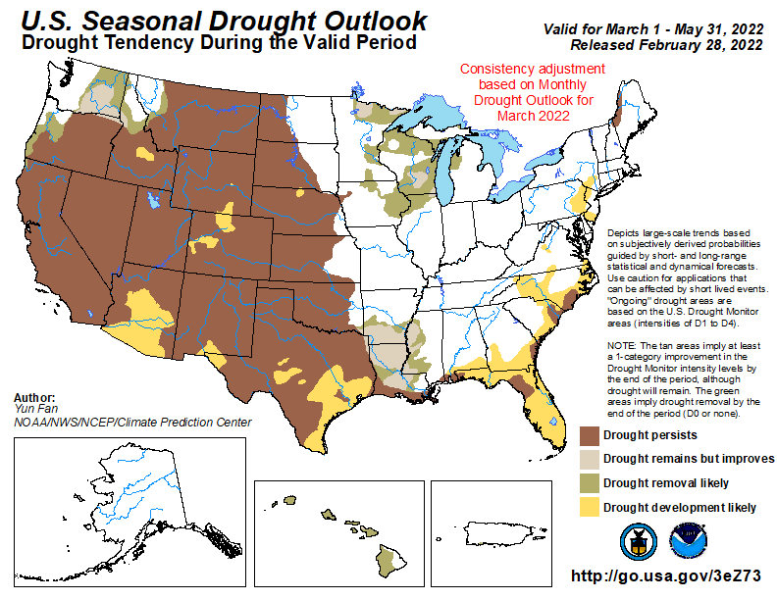
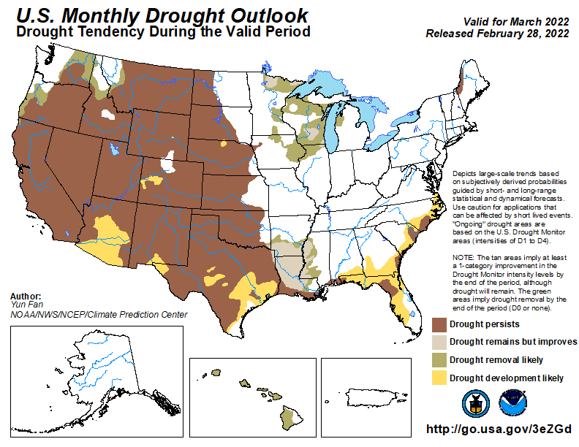
(Previous) Seasonal/Monthly Drought outlooks
New Seasonal+ Drought Outlook to be released in 2 days!
New Monthly Drought Outlook to be released end of this month)
Updated Seasonal Outlook
(1 Feb. 1 - Apr. 30, 2022)
issued 1/31/22
Monthly outlook
(for March 2022)
issued 2/28/22
It is the classic great West versus East drought paradigm !!
US East droughts are different than West droughts!!
This is mainly related to the rainfall climatology! – Of course ENSO impact matters!

Slide 4
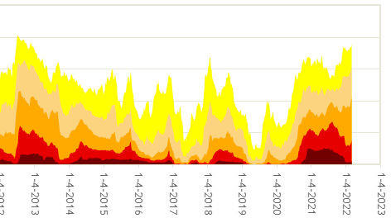
Time series since 2000 spilt into 2 (above & below) panels.
The recent drought has somewhat stagnated ?
Every drought is different.!
Every situation is different!!
D3/D4 areas have decreased.
But, D0/D1/D2 areas increased.
Current drought!
As the La Nina is slowly weakening and is on its way out,
have we seen the worst of the current drought status over the US for now?

Slide 5
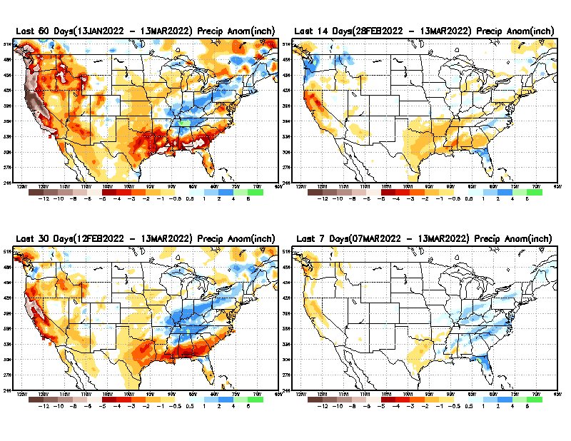
Precipitation ANOM during last 7, 14, 30, & 60 days.
This and next few slides show Precip deficit (excess).
Droughts, for the MOST part, begin and end with precip!! Lately, Temps are becoming (secondarily) important as well.
60 Days
14 Days
30 Day
7 Days
These maps in this and following slides, including a) Total,
b) Anom and
c) Percent of Normal precip. in these and other longer time ranges are now (routinely) daily updated at:
?
From: Recent Accumulated Precipitation https://www.cpc.ncep.noaa.gov/products/Drought/briefing_prcp.shtml

Slide 6
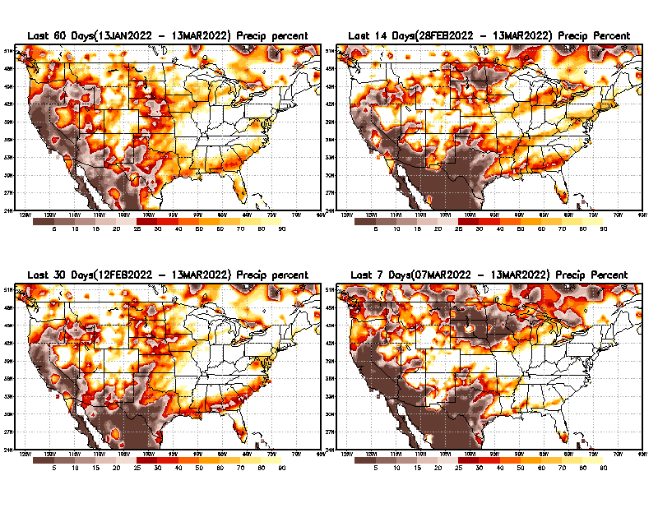
Precipitation Percent (of normal) during last 7, 14, 30, & 60 days - Only Deficit Areas <=90% shown !
60 Days
14 Days
This plot shows only the rainfall deficient regions <= 90% of normal.
-- This shows more clearly possible/likely drought developing region in the future unless there is above normal rainfall in these regions in the future, to offset these shortfalls.
30 days
7 Days
From: Recent Accumulated Precipitation https://www.cpc.ncep.noaa.gov/products/Drought/briefing_prcp.shtml

Slide 7
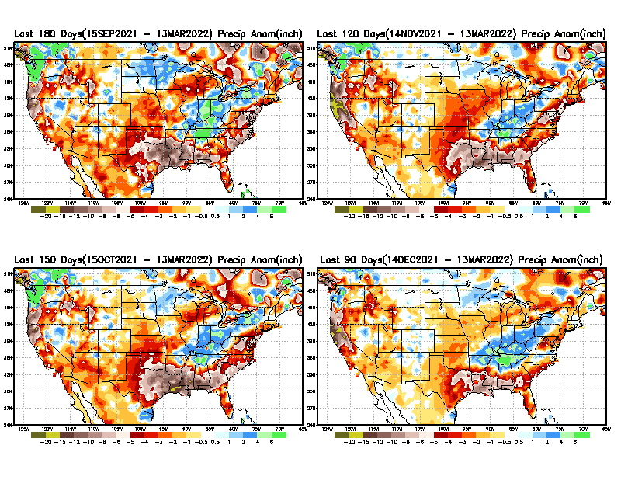
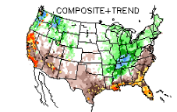
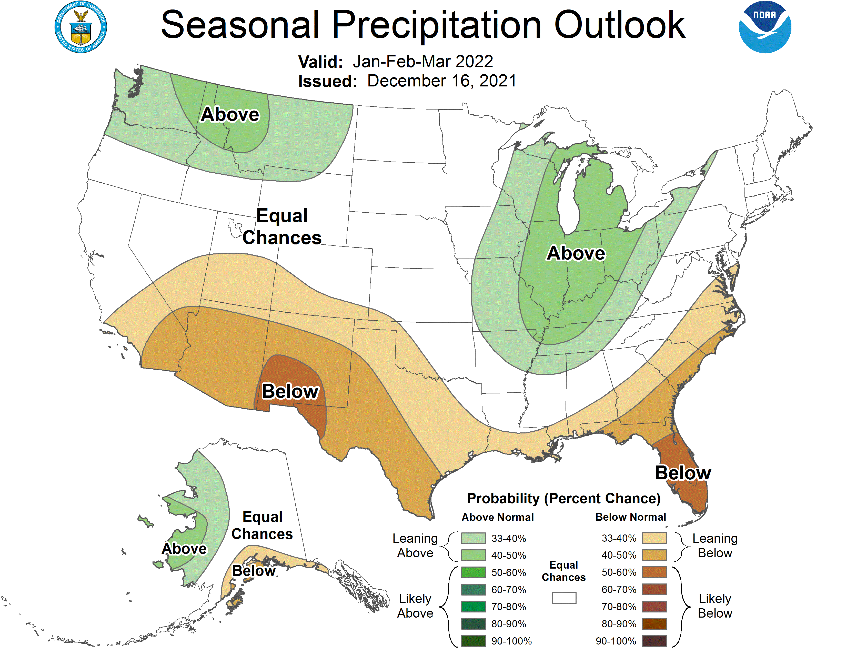
Total precipitation ANOM during last 3, 4, 5, and 6 months.
6 M
4 M
While the Precipitation anomalies deficit may seem large in some regions (compared to others), it is the % of normal precip (next slide) that matters more!!
5 M
3 M
But ~ this happened!!
Typical JFM Precip composite during
La Nina–to be expected!
Fcst
From: Recent Accumulated Precipitation https://www.cpc.ncep.noaa.gov/products/Drought/briefing_prcp.shtml

Slide 8
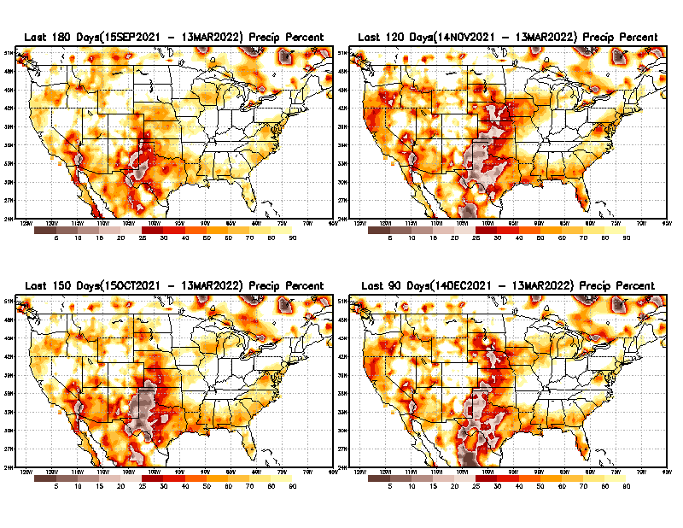
Total precipitation Percent (of normal) during last 3, 4, 5, and 6 months Only Deficit Areas <=90% shown!!
6 M
4 M
In these interim time scale 3-6 months, we need to pay attention to regions, which are dark-brown, red & dark red (<50%).
Not so bad along coast!
in %
While accrued precipitation deficits are real & objective,
droughts are subjective declarations!!
5 M
3M
East vs West!
Broad vs Narrow
rainfall season.
In general, West suffers more from frequent and lasting droughts.
Short term(S) Drought is generally declared when rainfall deficits exist in the 3-6 months time range. { Long term deficits beyond 1 or 2 years is Long term L drought! }

Slide 9
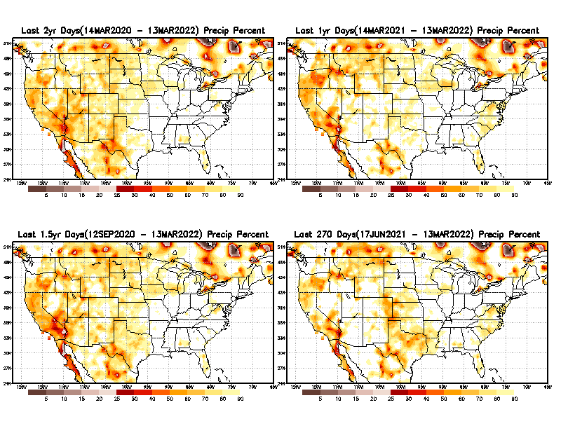
Total precipitation Percent during last 9 months, 1 yr, 1.5yrs, & 2 yrs. .–Only Deficit Areas shown!! <=90%
2 Y
1 Y
Tinderbox areas, where some form of longer term rainfall
deficiencies already, exist !!
-Almost all are in the west!, all part of the long term drought
-This & Next slide!!
1.5 Y
9 M
From: Recent Accumulated Precipitation https://www.cpc.ncep.noaa.gov/products/Drought/briefing_prcp.shtml

Slide 10
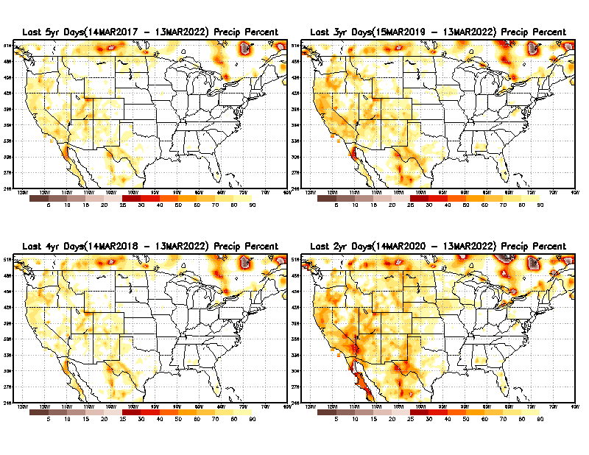
Total precipitation Percent (of normal) during last 2, 3, 4, & 5 yrs. .–Only Deficit Areas <=90% shown !!
5 Y
3 Y
In these long time ranges (2-5 yrs), there is a general dearth/lack of precipitation in the southwest US.
Weather Blog News Today:
A recent study from the University of California, Los Angeles now claims the current drought that started in 2000 for the American Southwest is now the driest 22 years since 800 A.D. Researchers said climate change is to blame. Their proof? Tree rings.
4 Y
2 Y
Ongoing long term drought in the SouthWest!! Exiting La Nina may soon help.
From: Recent Accumulated Precipitation https://www.cpc.ncep.noaa.gov/products/Drought/briefing_prcp.shtml

Slide 11
AMJ:
End of rainy season in w. coast.
Begin of rainy season in northern & central high plains.
East vs West!
More darker colors in west/central => narrow rainy season (months)
Overall, more white space in the east => distributed rainfall season (except ~FL).
Rainy (3-month)Season across the US

Slide 12
For the forecast season MAM, we are rapidly moving away from the rainy winter season in the west!
*********
EAST vs
CTR/WEST
Drought Behavior is loosely tied to rainfall climo!! And the limited rainy season in the west
*********
Adapted from Rich Tinker.

Slide 13
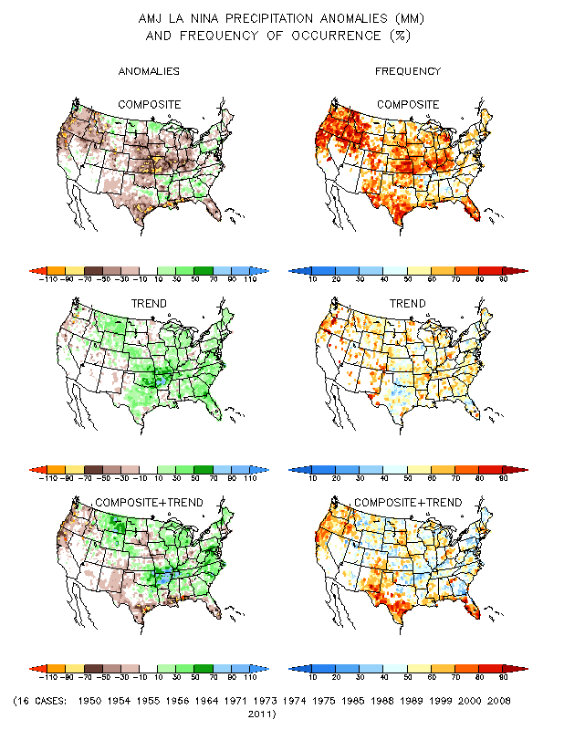
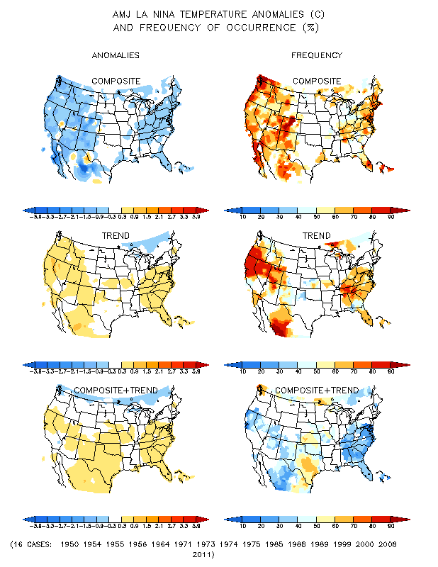
La Nina Precip/Temperature COMPOSITES & Trend map
AMJ
P
T
1
+
1
=
2
Look at frequency along southeast!
Over 70%

Slide 14
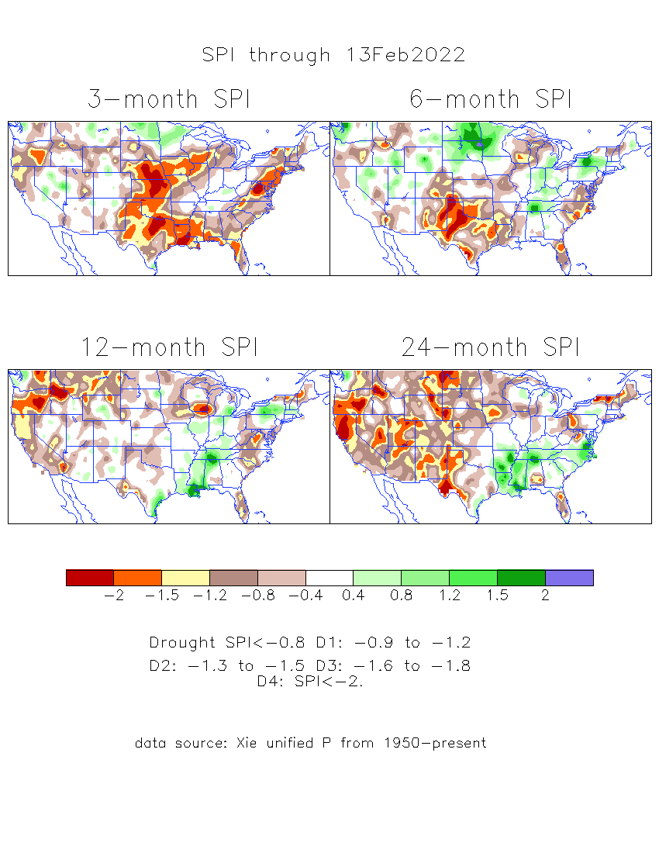
The Standardized Precipitation Index SPI (based on Observed P)
----- Last Month
Very interesting graphic & details for the drought across the US based on the more generalized precip deficit/excess, the Standardized Precipitation Index (SPI).
The dark brown and red colors, indicating standardized precipitation deficits, in the various time periods, approximately correspond to the appropriate short/long term drought monitor regions and their intensities
Don’t let the short term improvement in the southwest fool you!
There is an ongoing long term drought here.

Slide 15
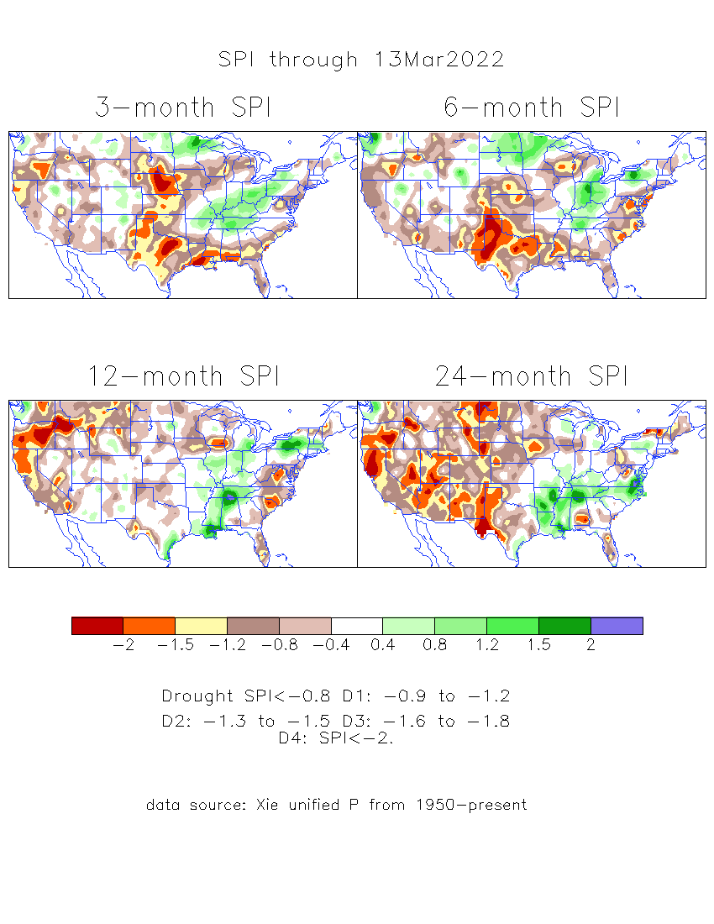
The Standardized Precipitation Index SPI (based on Observed P)
----- NOW
Very interesting graphic & details for the drought across the US based on the more generalized precip deficit/excess, the Standardized Precipitation Index (SPI).
The dark brown and red colors, indicating standardized precipitation deficits, in the various time periods, approximately correspond to the appropriate short/long term drought monitor regions and their intensities
Short
The short term drought has somewhat shifted/extended from southwest to northwest and the northern Plains. But the long term drought in the southwest remains.
Long
How does one negotiate and reconcile declaring short term vs long term drought when precip. deficiencies patterns differ on many different time scales locally!!
What is the cutoff delineating time between short VS long term drought!! Not so clear!!
At exactly where does drought begin?

Slide 16
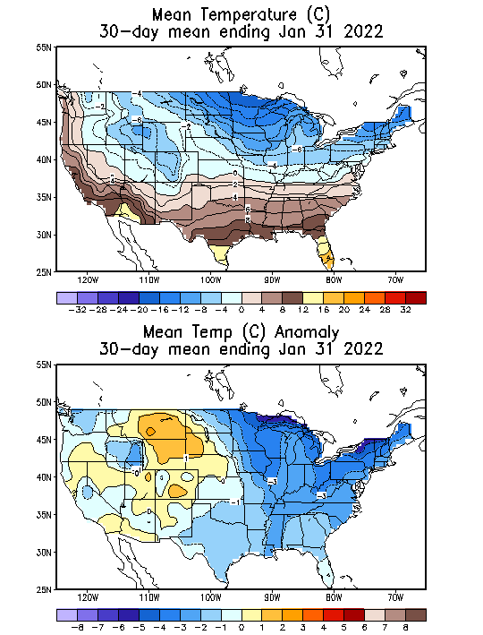
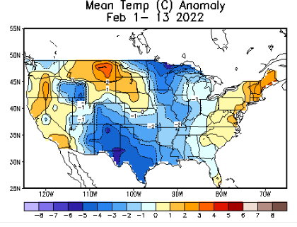
Slide from last month..
-Slide not shown now.
Recent US Temperatures
In spite of the of the La Nina, quite a variability in monthly US Temps. (Focus on maps on bottom left! vs next slide!)
So far this month !!

Slide 17
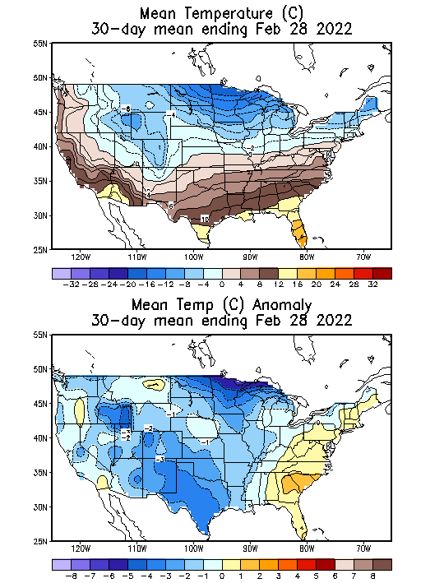
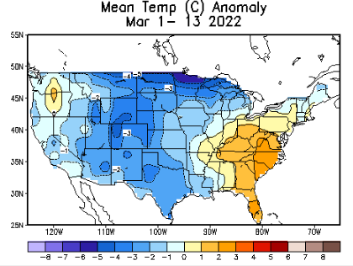
Now..
Recent US Temperatures
So far in March, temps. looking similar to February.
There is a lot more going on than just La Nina!!
So far this month !!

Slide 18
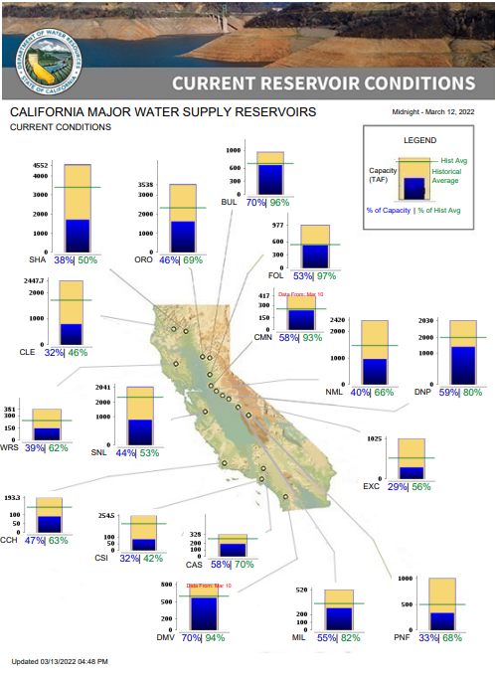
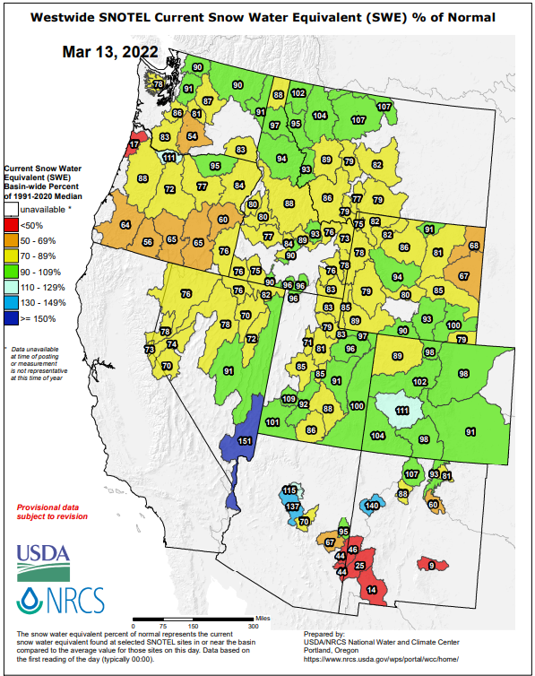
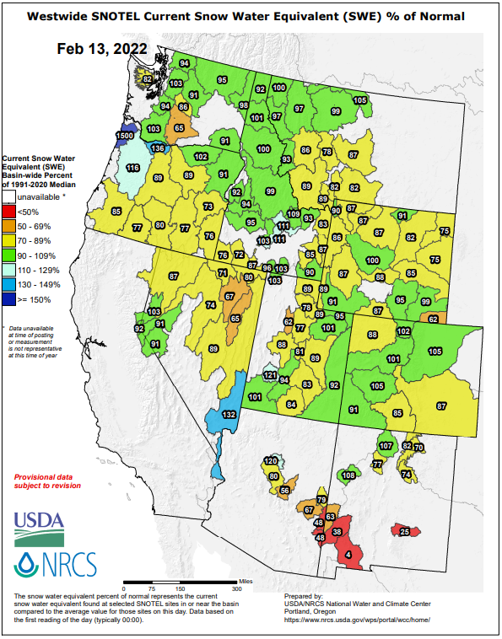
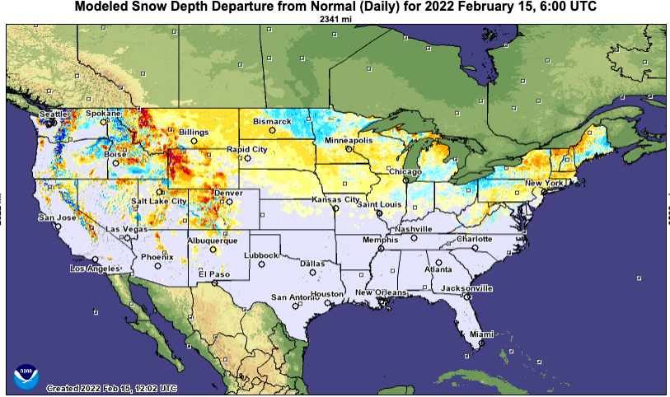
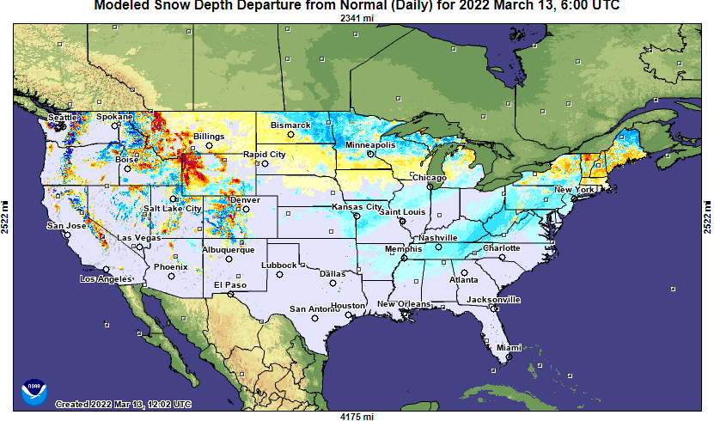
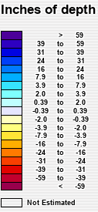
Much of US west snow cover is below median!! See above! cf: prev. month.
Last month
This month
Except for a few, most CA water reservoirs are low!
On going La Nina conditions continue to “not help/improve” the reservoir levels/conditions in northern CA. The winter rainy season is also almost gone, which will not help.

Slide 19
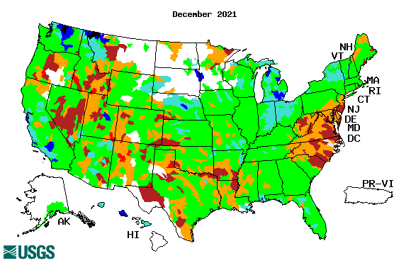
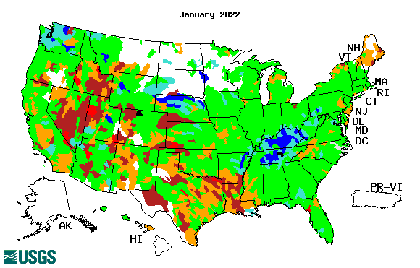
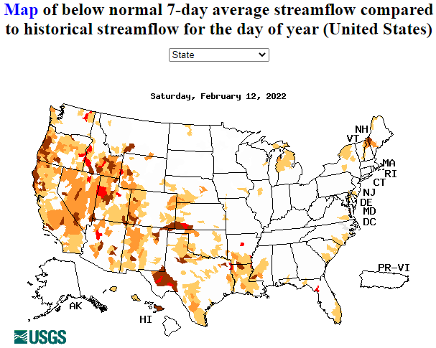
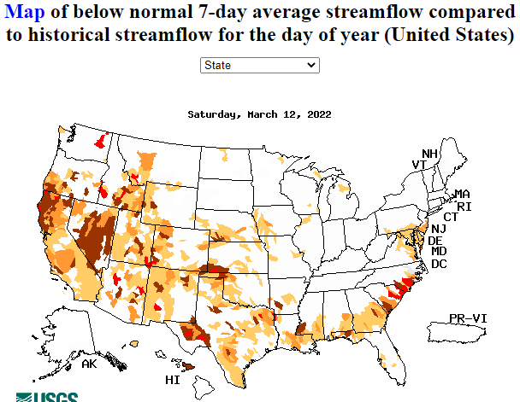
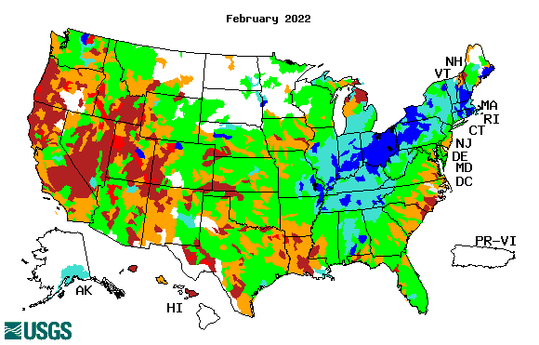
Streamflow (USGS)
Most US east droughts are relatively short lived (as compared to US west). However, if you recall, the drought over the New England states last year was a real surprise!!
Map shows only below normal 7-day average streamflow compared to historical streamflow for the day of year.
One month ago (left) &
Now (below)
Streamflow is only a partial indicator, as it is highly managed.
Look along the Pacific coastal states. If sometimes, the various indicators are confusing, go back to % of rainfall deficit maps – to reinforce!!
19

Slide 20
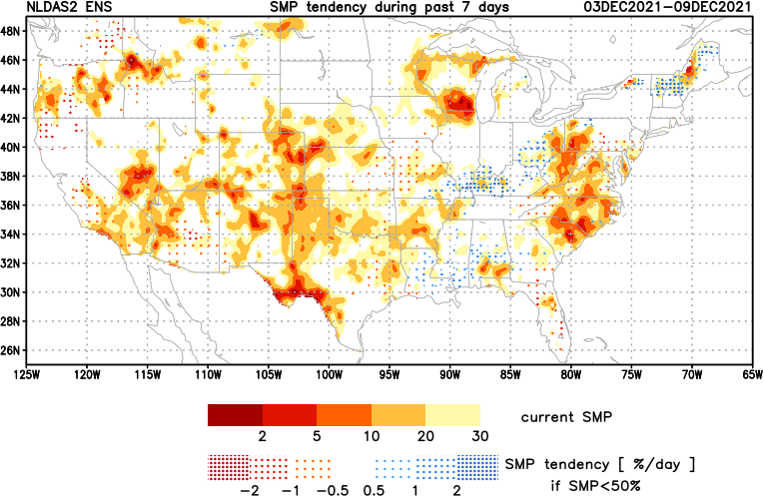
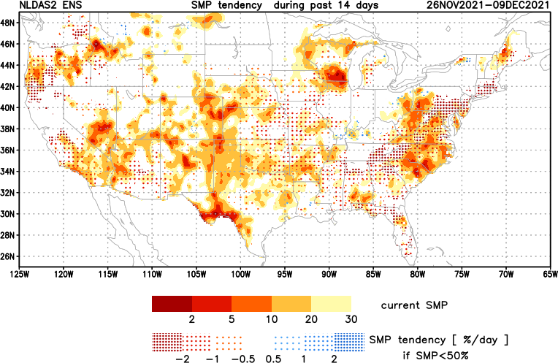
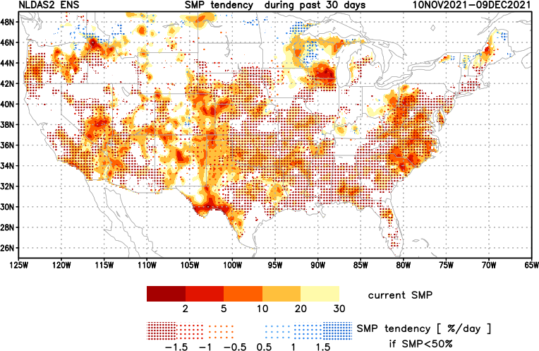
[Slide not shown]
NCEP Ensemble mean NLDAS2 models’ Soil Moisture tendency/trend
7 days
14 days
30 days

Slide 21
EL NIÑO/SOUTHERN OSCILLATION (ENSO)
DIAGNOSTIC DISCUSSION
issued by CLIMATE PREDICTION CENTER/NCEP/NWS and the International Research Institute for Climate and Society
10 March 2022
ENSO Alert System Status:
La Nina Advisory
Synopsis: La Niña is favored to continue into the Northern Hemisphere summer (53% chance during June-August 2022), with a 40-50% chance of La Niña or ENSO-neutral thereafter.
CPC’s Oceanic Niño Index (ONI) [3 month running mean of ERSST.v5 SST anomalies in the Niño 3.4 region (5ºN-5ºS, 120º-170ºW)], based on centered 30-year base periods updated every 5 years.

Slide 22
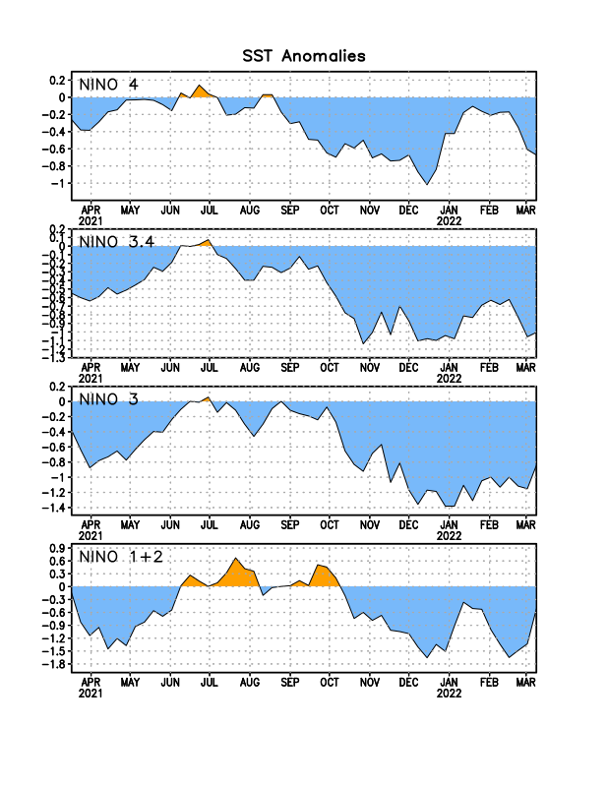
Latest values of SST indices in the various Nino Regions.

Slide 23
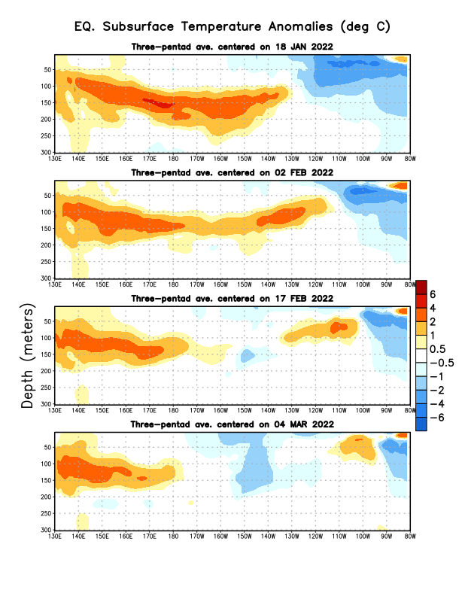
Sub-Surface Temperature Departures in the Equatorial Pacific
The subsurface cold anomalies in east Pacific are slowly weakening and reducing in extent/volume!
Warm waters in the WP/CP that strengthened earlier have recently slowed or pulled back.
Most recent pentad analysis
It is not clear which way, the subsurface waters will go in the next few/many months!!
That’s why the 50/50 chance…

Slide 24
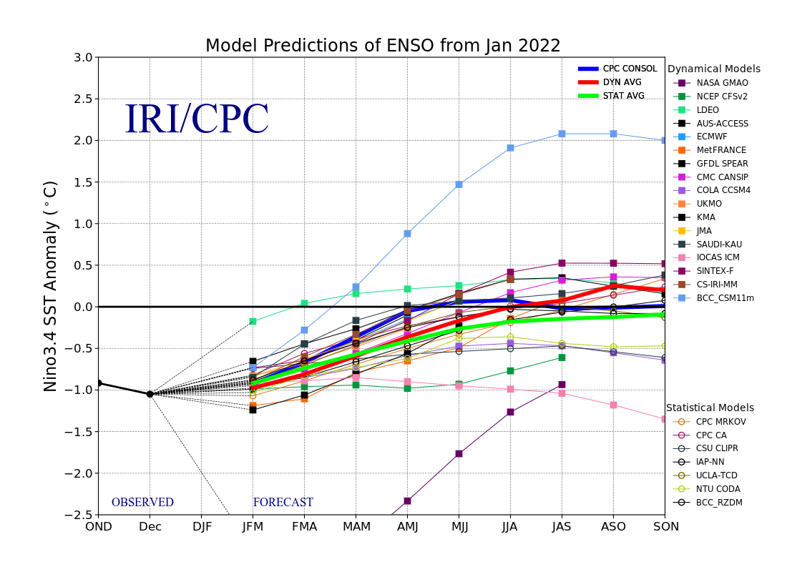
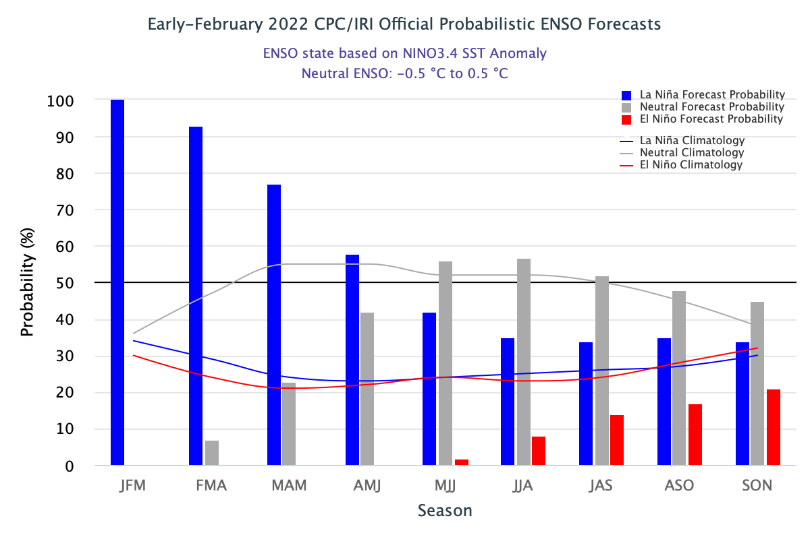
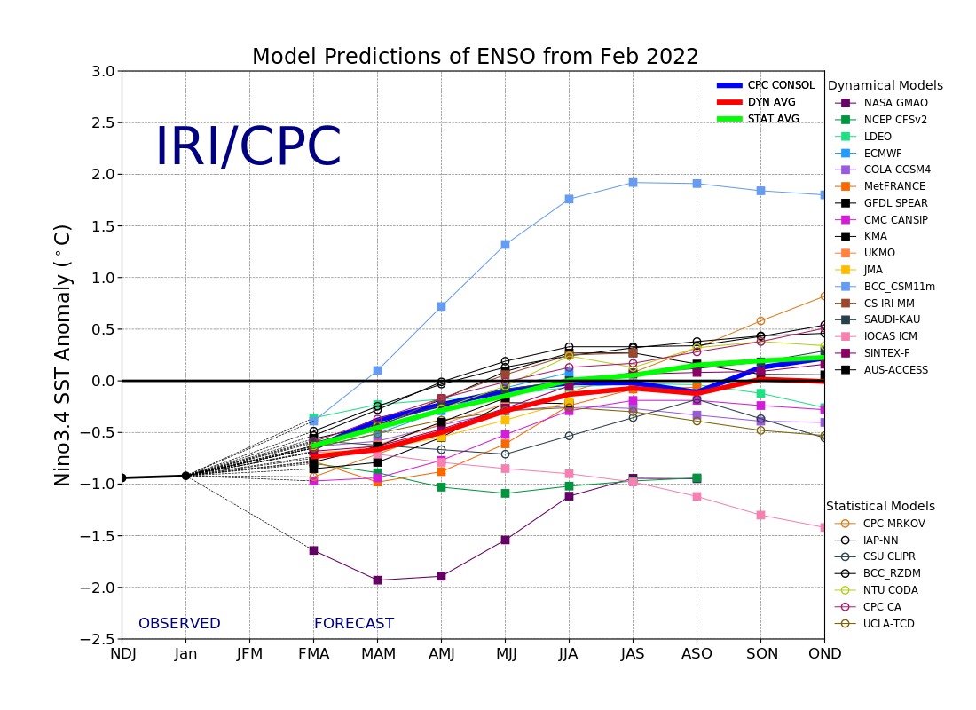
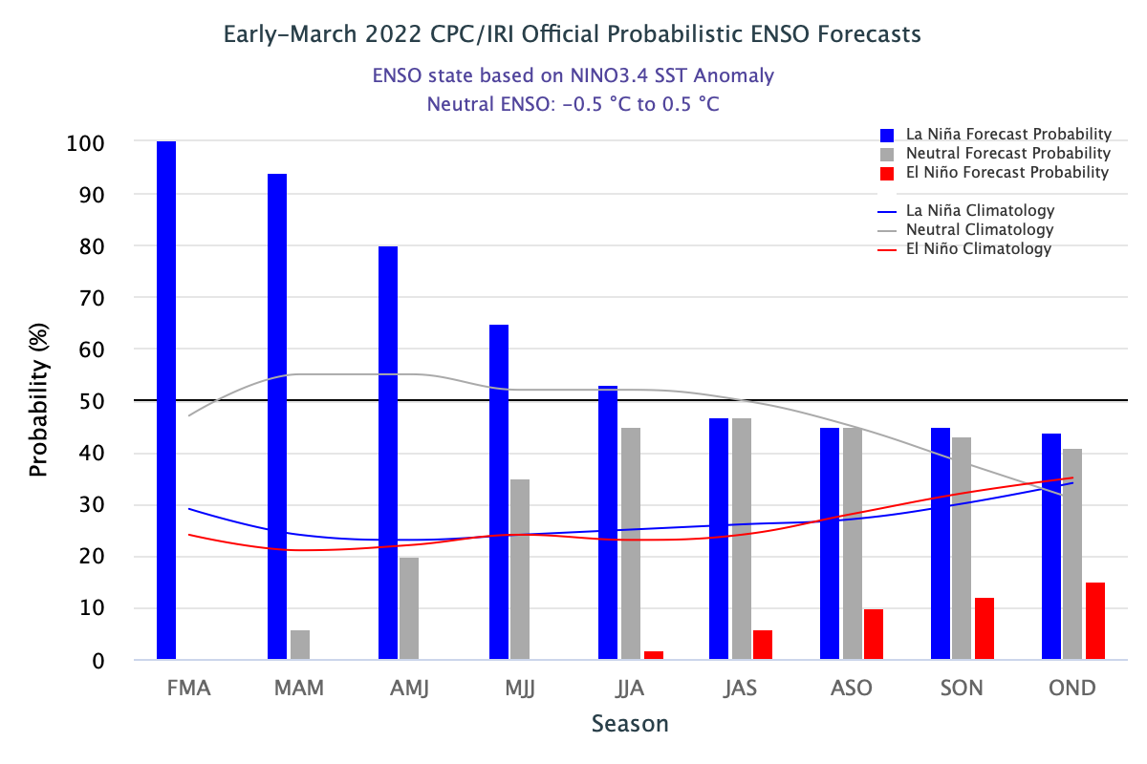
ENSO Forecasts
Early- February CPC/IRI forecast
Early- March CPC/IRI forecast
Dynamical, Statistical, CPC-Consolidated fcsts are coming together!! But still at ~ -0.5C !

Slide 25
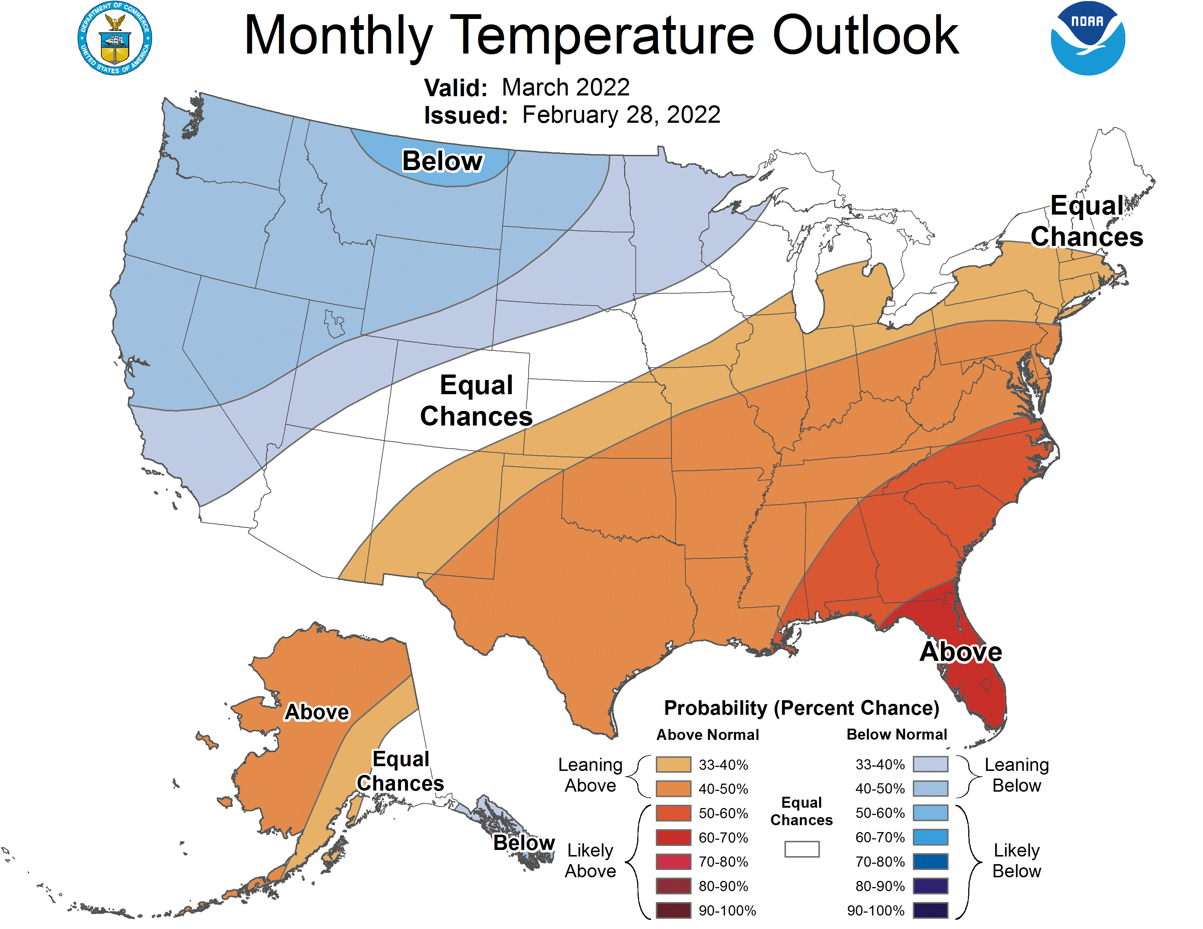
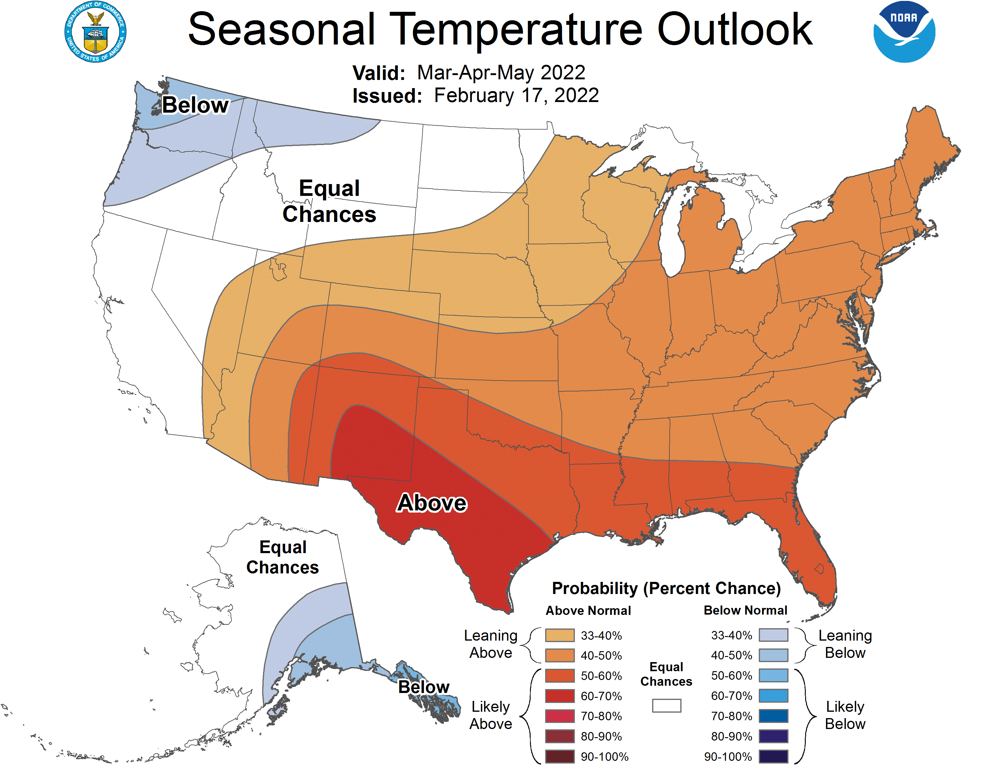
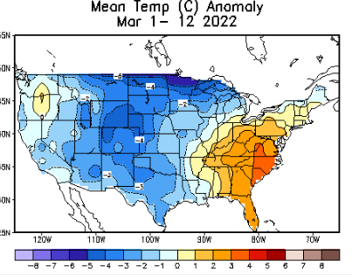
Previous (Last Month’s)
CPC’s official
Temperature OUTLOOK for Monthly (March)/Seasonal (MAM)
Released Jan 20th
Observed so far this month!! ☹

Slide 26
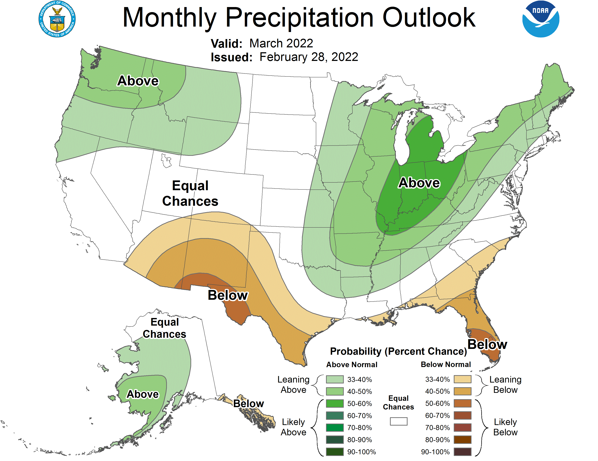
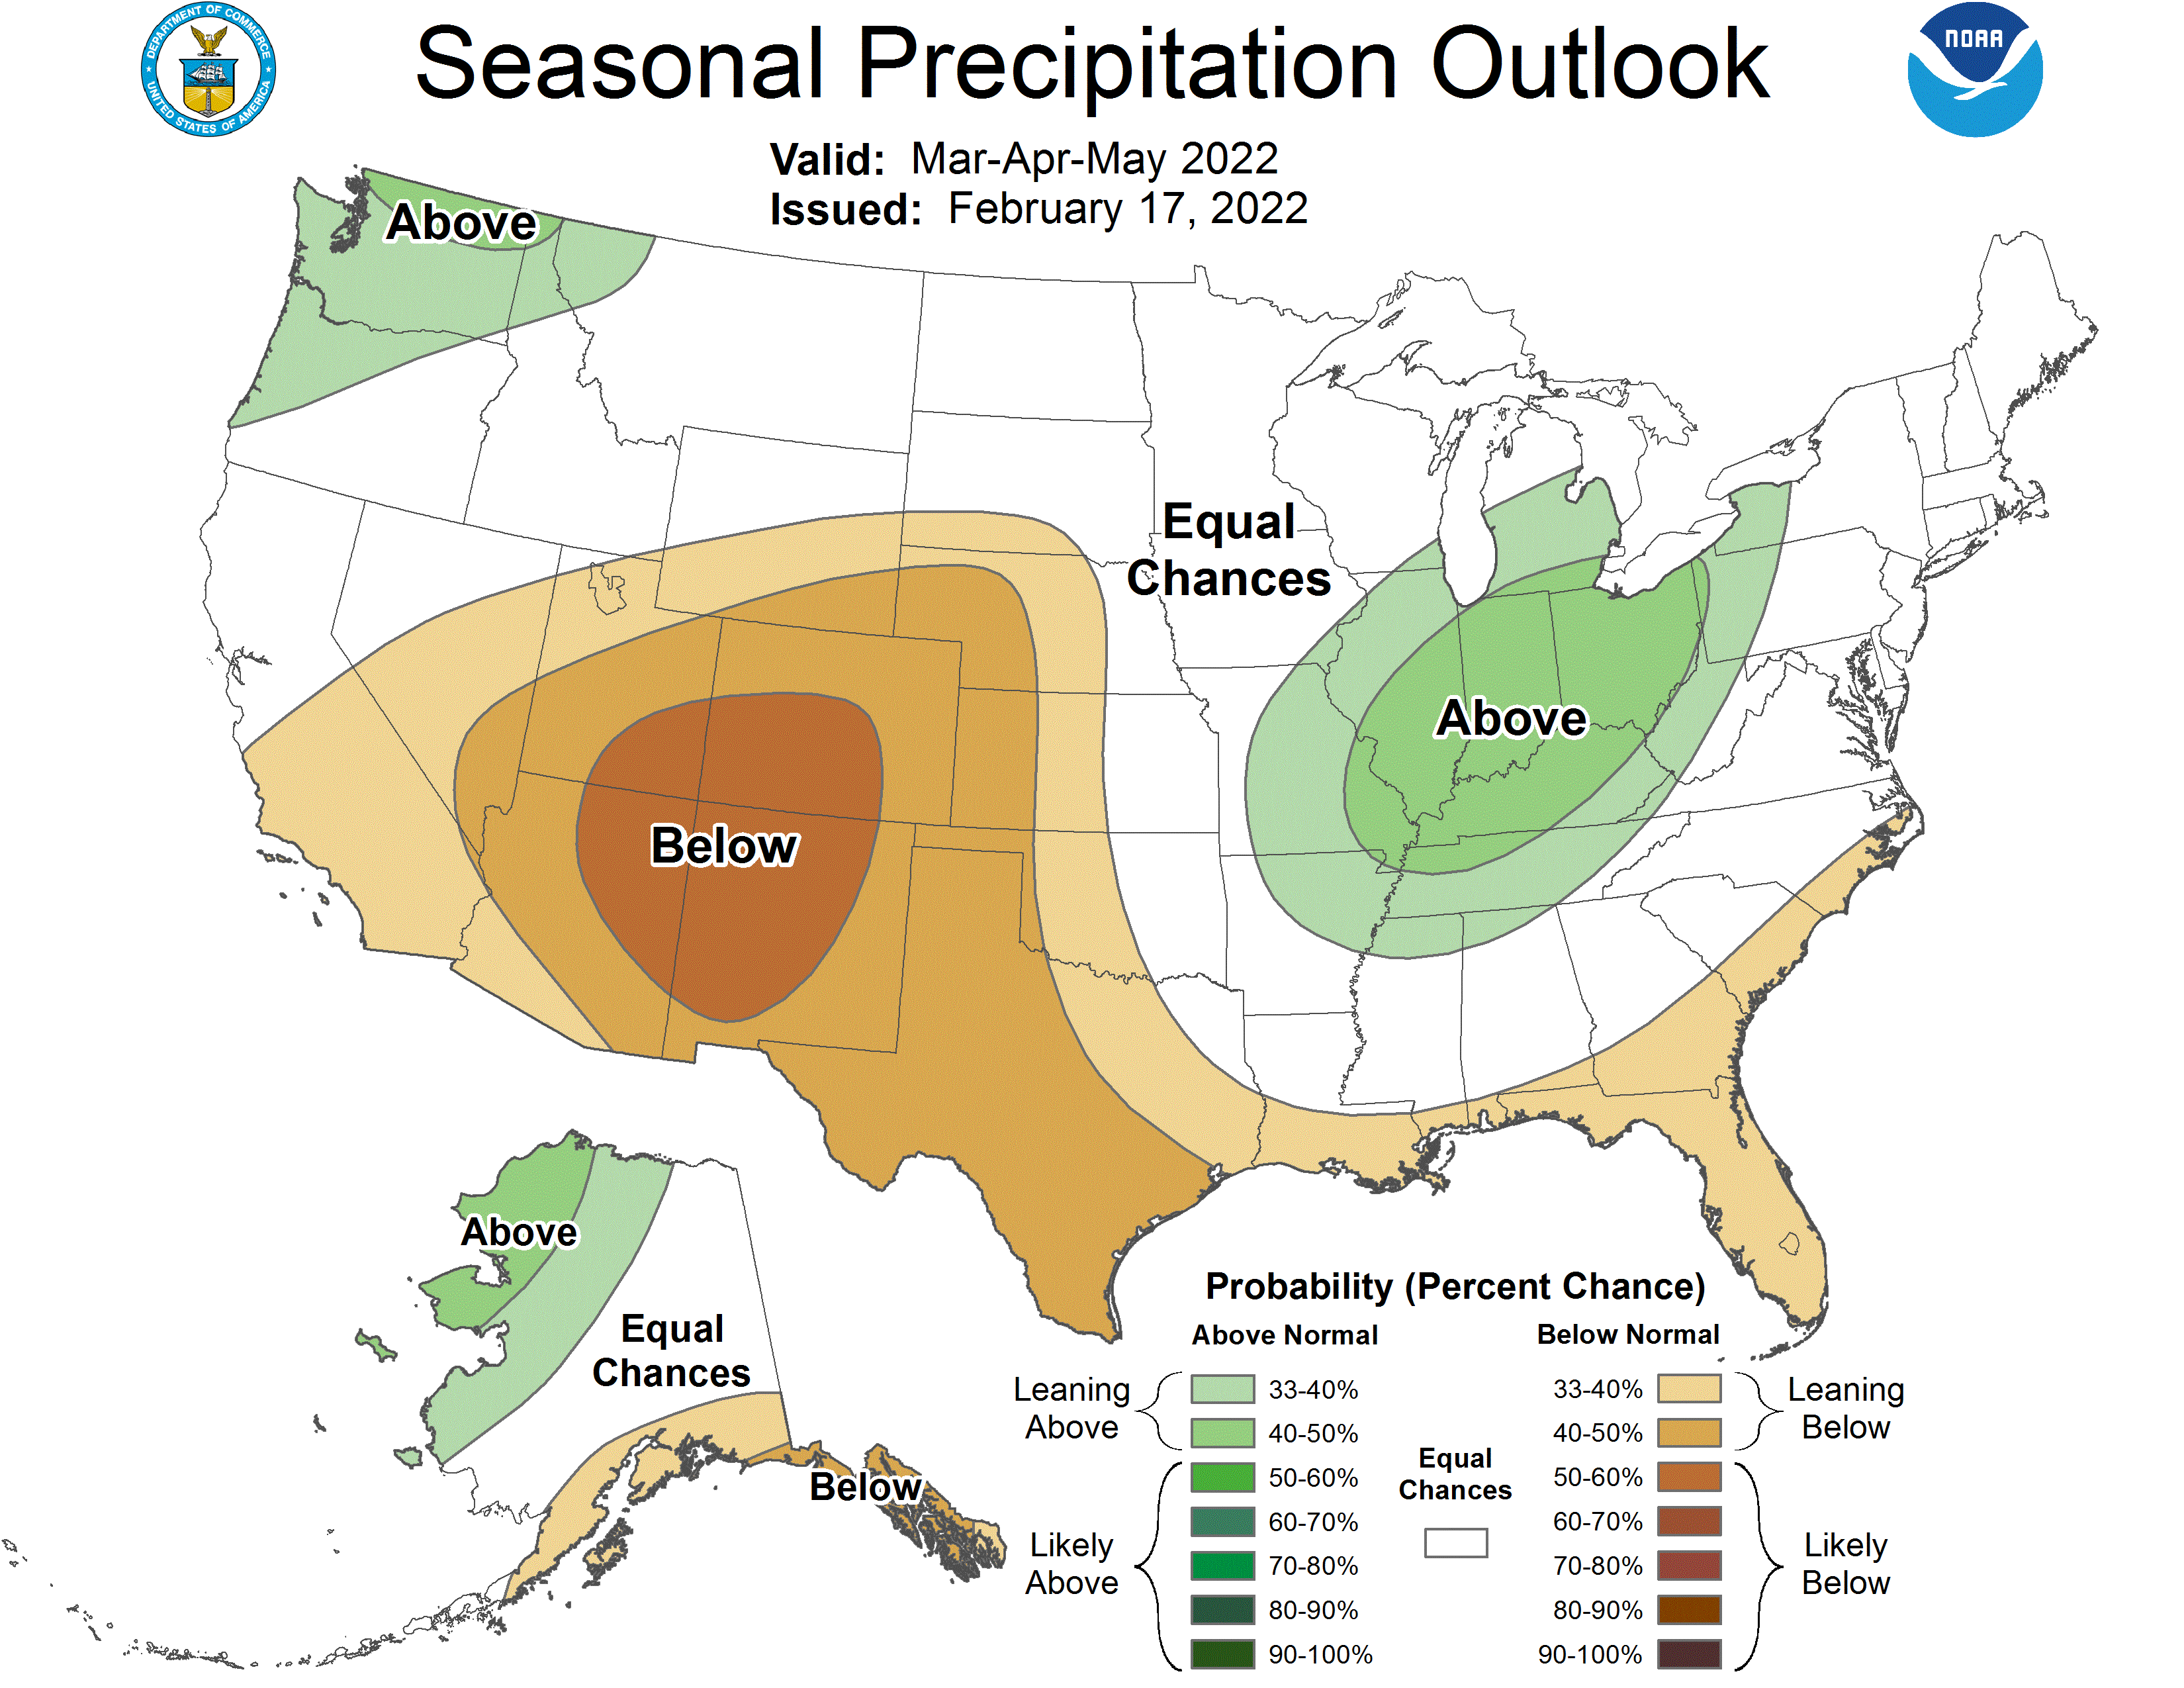
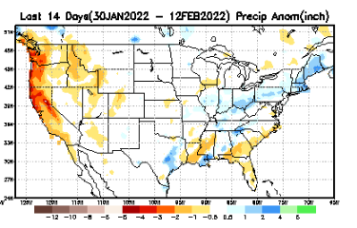
Previous(Last month)
CPC’s official
Precipitation OUTLOOK for Monthly (March)/Seasonal (MAM)
Released Jan 20th
Very similar looking!
Based on La Nina !!!!
Observed so far this month!!
Monthly P/T forecasts verified at mid-month are generally good! Becoz of good skill upto 2 wks.
But so far ☹, esp. along the west !

Slide 27
NCEP/WPC Next 7 days QPF (Quantitative Precipitation Forecast)
GFS Model Guidance for the
next 16 days.

Slide 28
From European Center (EC) Precip forecast (made yesterday, 14 Mar) for next 30 days.

Slide 29
From European Center (EC) Precip forecast (made yesterday, 14 Mar) for next 30 days.
20
40

Slide 32
Week-4 Soil Moisture Percentile (SMP) Fcst based on VIC model forced with ECMWF-extended precipitation forecast!
Now: Yesterday’s IC
??
(From Drs. Li Xu and Yun Fan) More detail at From: https://www.cpc.ncep.noaa.gov/products/people/lxu/flashd/flash_prediction.html

Slide 33
NMME T & P Ens.Mean forecasts for
Apr
AMJ

Slide 34
Agreement/Disagreement among the various NMME models’ AMJ seasonal Precip. Forecast.
??

Slide 35
(From NMME) compared with this month(foreground, red border)
Why is there so fewer hatched areas in SPI6 fcst from NMME models’ based fcst this month as compared to last month (left 2 columns) ? Fcsts more confident now?
Forecast uncertain in Hatched areas.
These maps are based on NMME models’ precip forecast uncertainty/certainty (among ensemble members) over the next 3 months
SPI6 Fcst made from last month
SPI6 & SPI12 Fcst made from this month

Slide 36
Slide not shown!!
http://drought.geo.msu.edu/research/forecast/smi.monthly.php
Latest Initial Conditions:
12/21/2021
Predicted Monthly Soil Moisture Percentile
MSU Soil Moisture Percentile forecast NOT available this month, NOT updated!
CPC’s soil moisture percentile – Leaky bucket Model
The inter quartile range suggest greater uncertainty about the forecast in these shaded regions. Lots of uncertainty regions!! ☹

Slide 37
BONUS Topic: Discussion continues!! Explanation for the multiyear DROUGHT in the Southwest (CA/AZ/NM/NV/UT/CO & vicinity)!!
More La Ninas lately ?
More frequent La Ninas lately ?
YES!! The stats in the table below (bottom left) are from the Official CPC ENSO declarations page/table!
Compared to other regions of the globe, the SST warming/trend in the central eq. Pacific (Nino 3.4) is relatively much small. (See Fig. above) – Why is this ?
Does nature try to compensate for the warming else/everywhere by producing more La Ninas in the central eq. Pacific? - Just my thought ! Let’s check !!!
Since the 1997 monster El Nino (stronger than the famous 1982/83 event), just a quick count of CPC’s Nino 3.4 index++ values for the three month overlapping seasons, (Data at CPC site only available only from 1950!)
(25 years) (47 years)
1997-2021 1950-1996
La Nina(DJF) 10 13
El Nino(DJF) 8 17
La Nina(all 3mos) 101 136
El Nino(all 3mos) 73 158
(Overlapping 3month seasons)
Look at Ratios of La Ninas (vs El Ninos) in the shorter
recent (25 yr) period vs the longer (47 yr) earlier period!!
***Analysis of CPC’s official Nino 3.4 index data over the last 70 years shows that the more frequent La Nina’s in recent decades contributed to less rainfall in the southwest (See La Nina precip composites!, slide#13) and hence the ongoing long term drought in the Southwest!! Hence the long term southwest drought is unlikely to go away any time soon***
++ Barnston, Chelliah and Goldenberg (1997):Documentation of a highly ENSO‐related sst region in the equatorial pacific, Atmosphere-Ocean Volume 35, 1997. https://doi.org/10.1080/07055900.1997.9649597
*** The strong/weak annual monsoon rains in the southwest is just a minor modulator riding on this bigger/long-term signal. ***

Slide 38
Summary
Current Drought conditions:
Overall, little change in the spatial structure of drought in the south and west this month as compared to last month, except for slightly more severe conditions in some areas.
The slightly temporarily improved drought conditions in the far SW, (CA & vicinity) during January, from the unusual December rains, stayed at those levels, and did not continue to improve further.
Except for a few, most California reservoirs are well below their normal levels (at this time of year). This is particularly consequential as the rainy season is coming to an end very soon.
Also consistent with the La Nina (which is on its way out), there has been an increased short term drought conditions along the Gulf coast in the southeast, centered on northern Florida and its vicinity.
Most eastern US and east coast dry conditions sometimes turning into short term droughts (unlike the southern/western US droughts) generally do not last that long.
Current ENSO status and forecast: La Niña is favored to continue into the Northern Hemisphere summer (53% chance during June-August 2022), with a 40-50% chance of La Niña or ENSO-neutral thereafter. ---- If it is ~50/50 for Jun-Aug, what about for the next 2 (Apr-May) months? Weakening to 50/50?
Prediction:
Even as the chance of La Nina has reduced to only ~ 50/50 and is on its way out towards ENSO neutral conditions in the next few months onto summer months, the models and official seasonal forecasts may continue to still predict the same old canonical composite precip patterns across the western southern tier states. But the observed T/P anomalies even during the past peak La Nina conditions in the winter months resembled only weakly similar/like the forecasts or the past La Nina composites. So, now with weakening La Nina conditions and considering we are entering transition spring months (April-May) with inherently weak predictive skill, there will be even more uncertainty in the forecasts.
In spite of these, especially as the winter rainy season is coming to an end along the west coast states, the long term existing drought in the western and southwestern states will continue to stay and persist during AMJ.
AMJ is the beginning of the rainy season in the northern Great Plains and the upper central Plains, and we may expect improvement or even removal of drought in some of these regions.
In the southeastern Gulf/Atlantic coastal states, only weak and short term dryness drought conditions exists now. For the forecast season AMJ, even though the climatology is favorable, the removal of those conditions depends on nature of the departing La Nina conditions. If the La Nina does not depart quickly as expected in the next few months, it may complicate things, and may delay the removal of the dry/drought conditions here, esp. in parts of Florida. *************

