Slide 1
Drought Outlook Support Briefing (formerly Drought Outlook Discussion) May 2018
Climate Prediction Center/NCEP/NOAA
http://www.cpc.ncep.noaa.gov/products/Drought
Phone: 1-877-680-3341
Pwd: 858747#

Slide 2
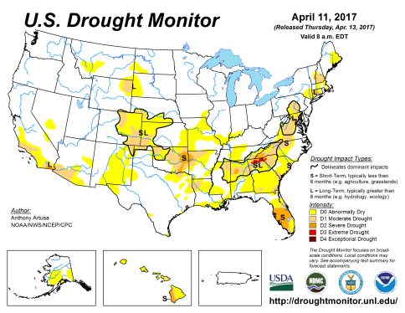
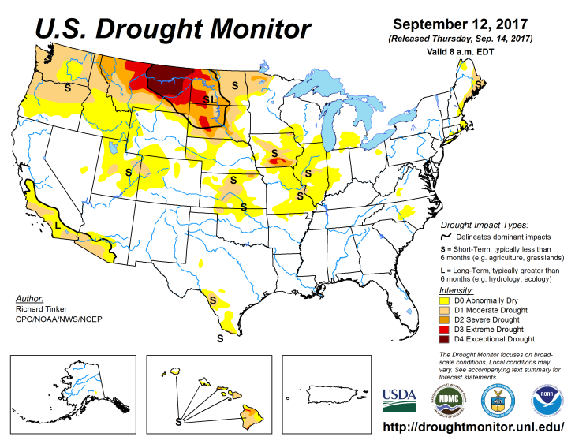
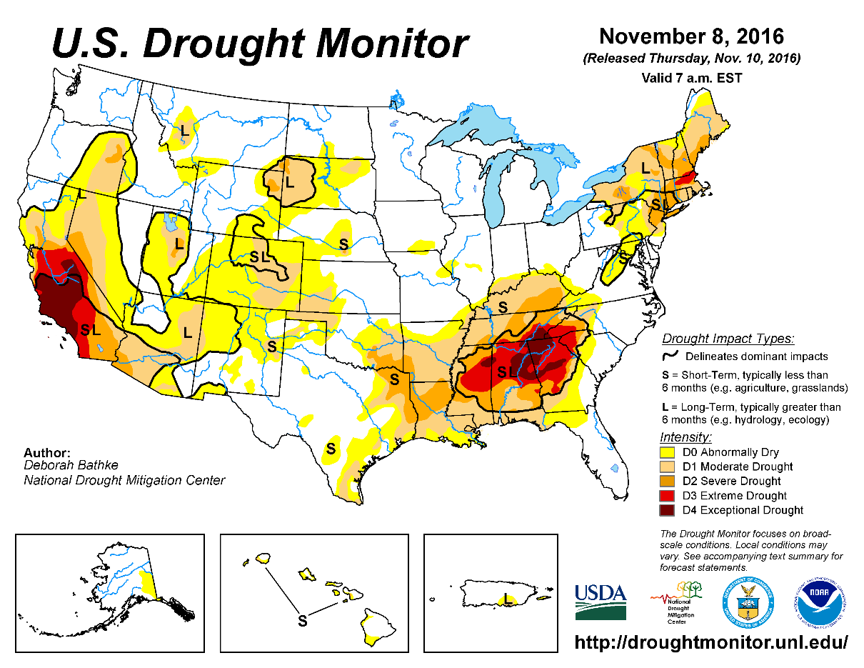
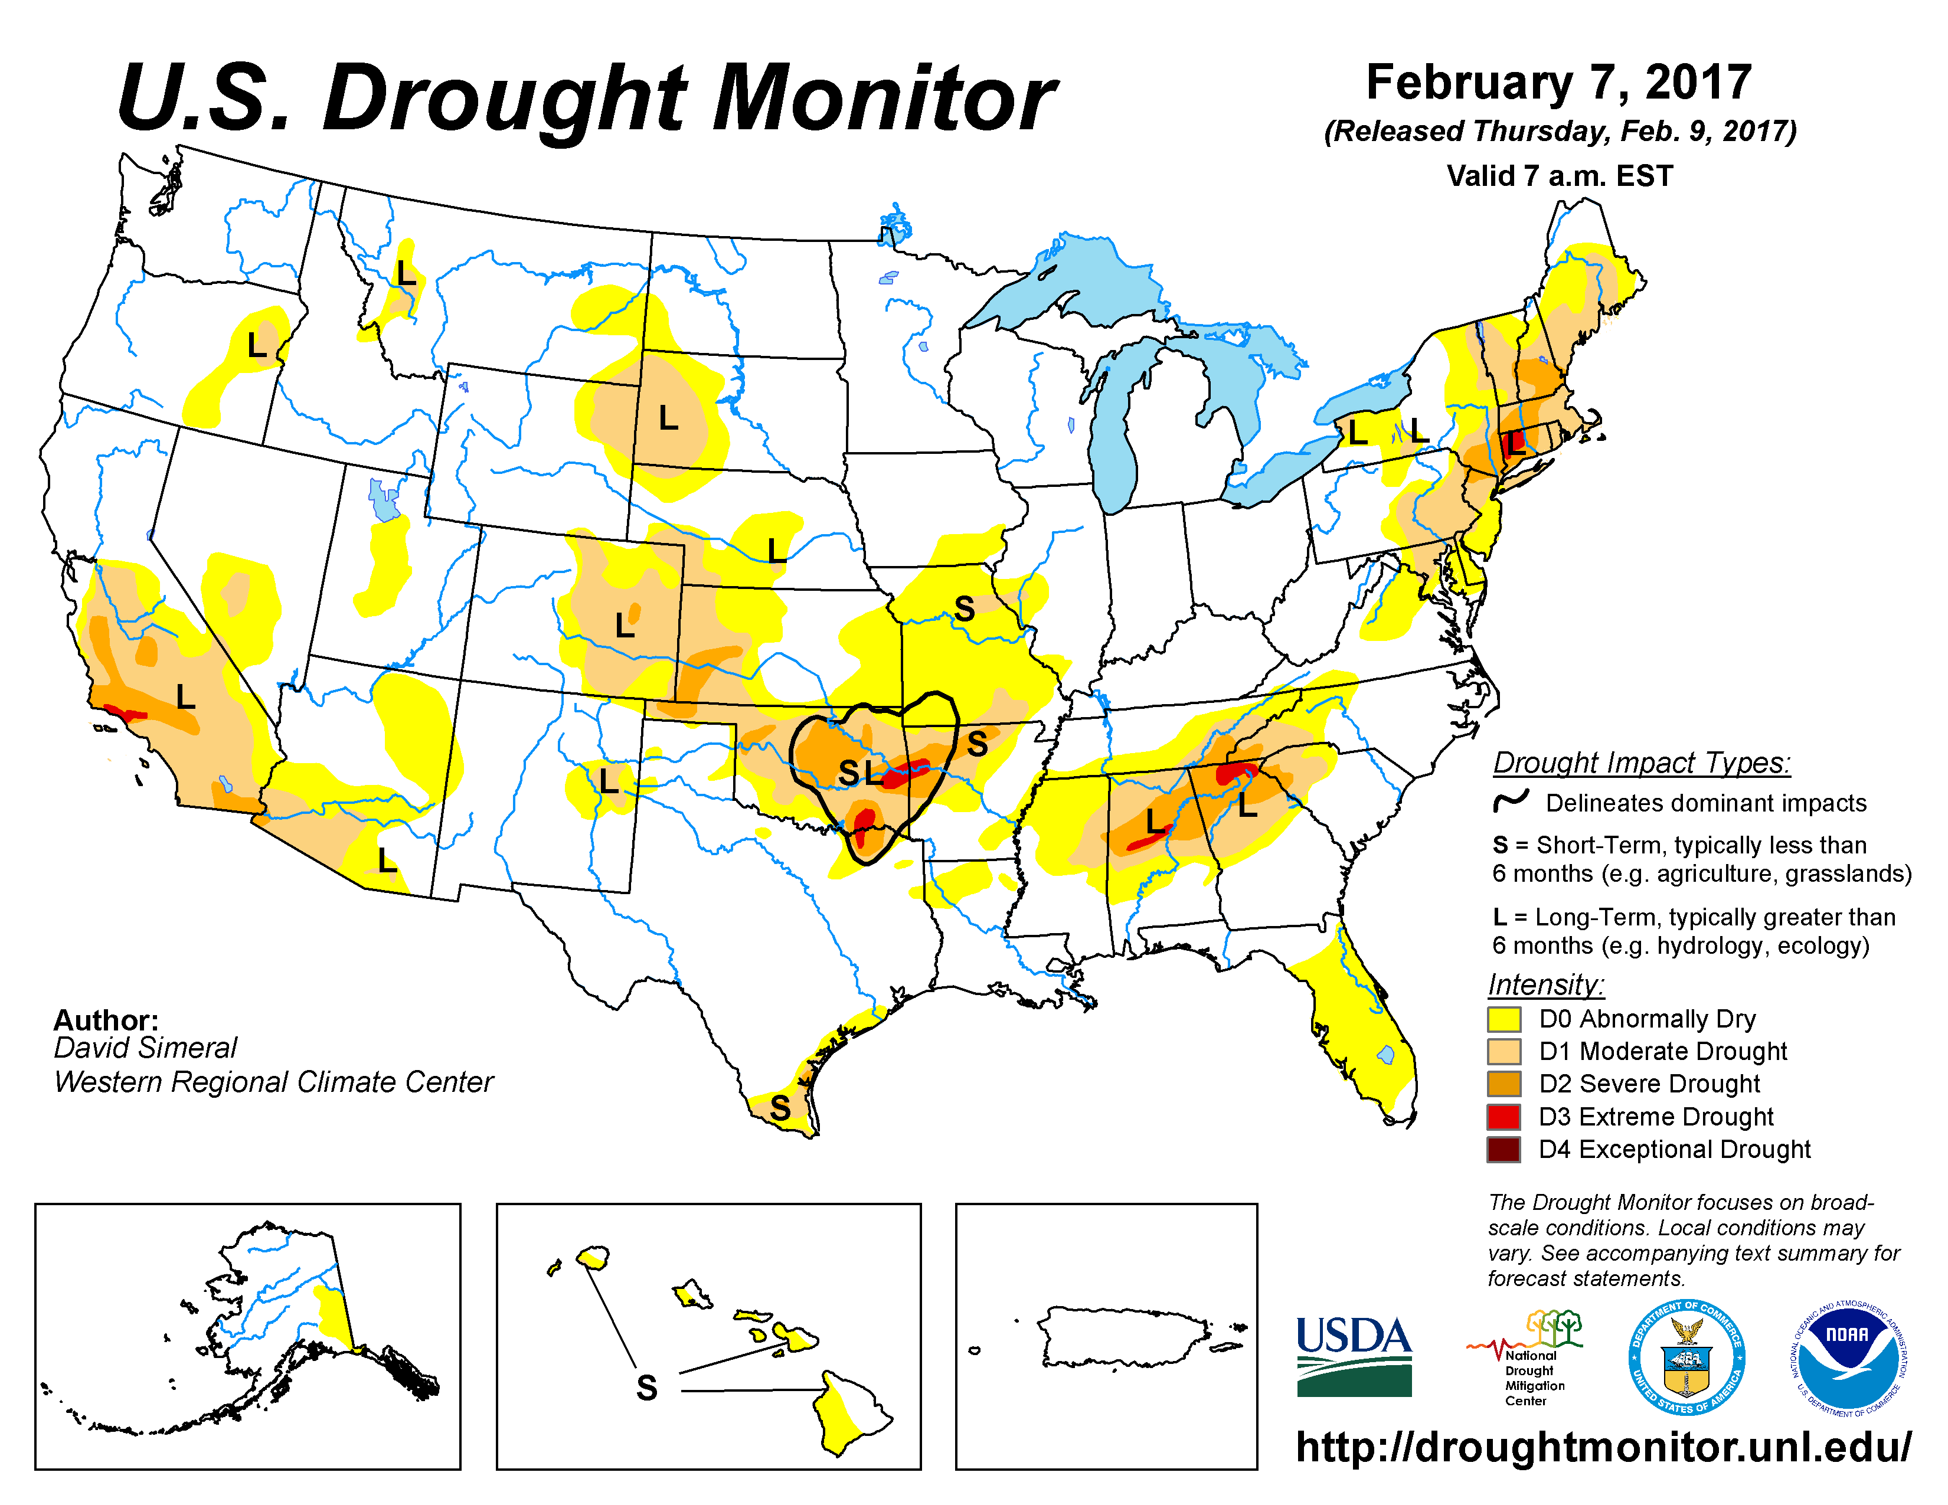
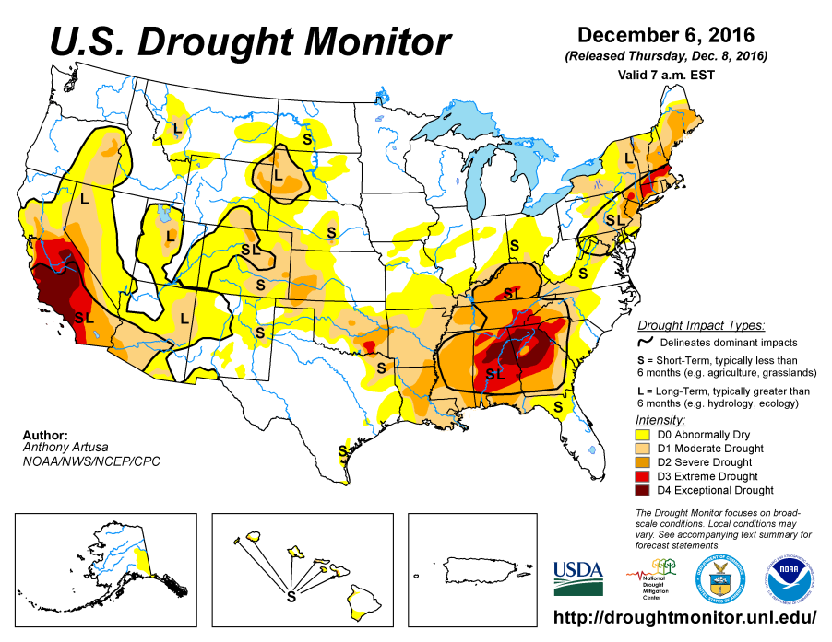
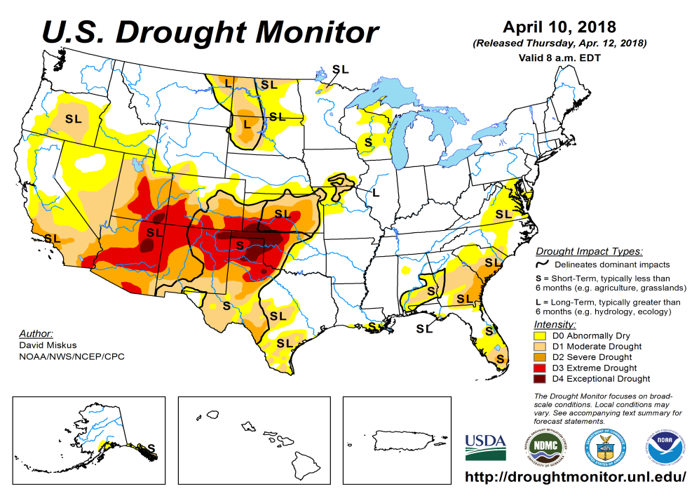
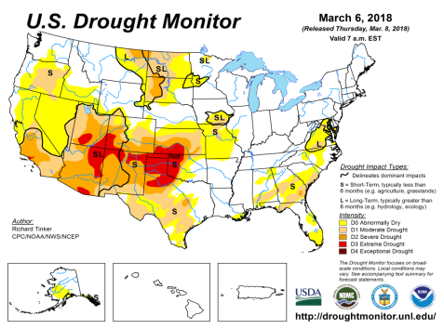
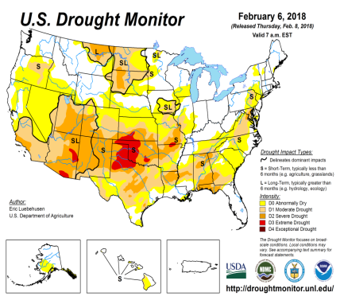
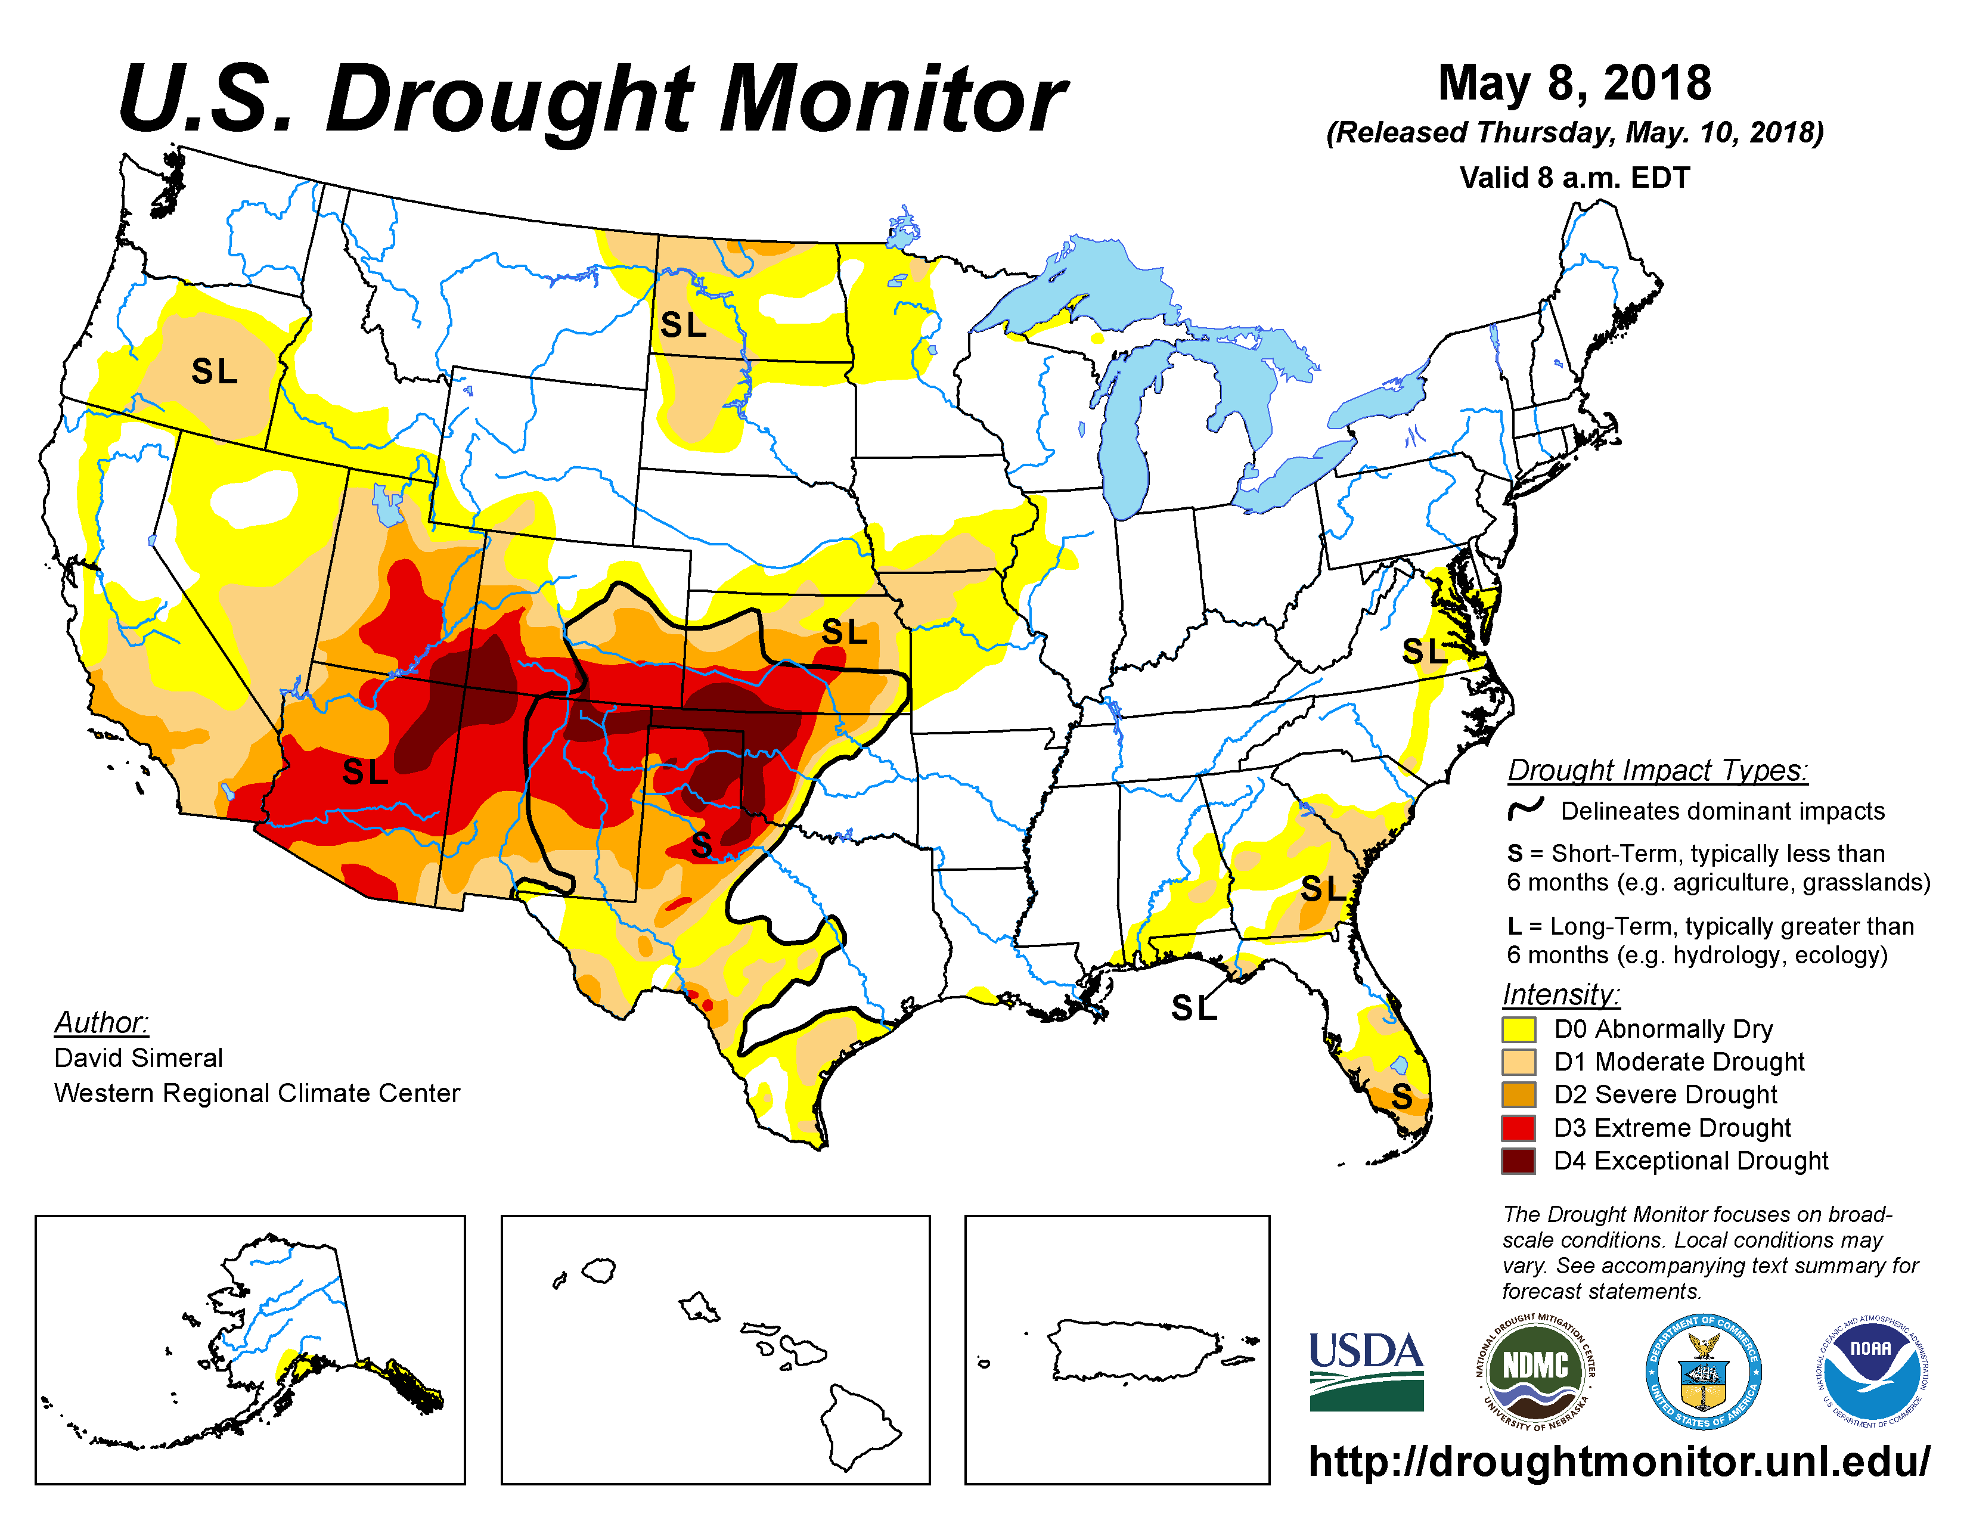
Drought Monitor
Apr
Mar
Previous
Feb
The USDM, while better in terms of spatial coverage compared to few months ago, is however “overall” similar to last month, except worse in certain areas.
Even though ENSO has transitioned from La Nina to neutral conditions, the drought impacts in the south continue to linger, or has even gotten worse in the southwest
Latest/Recent

Slide 3
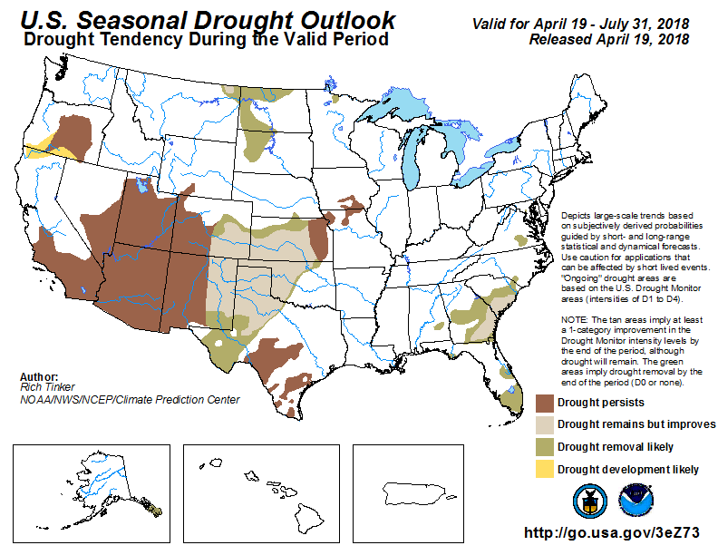
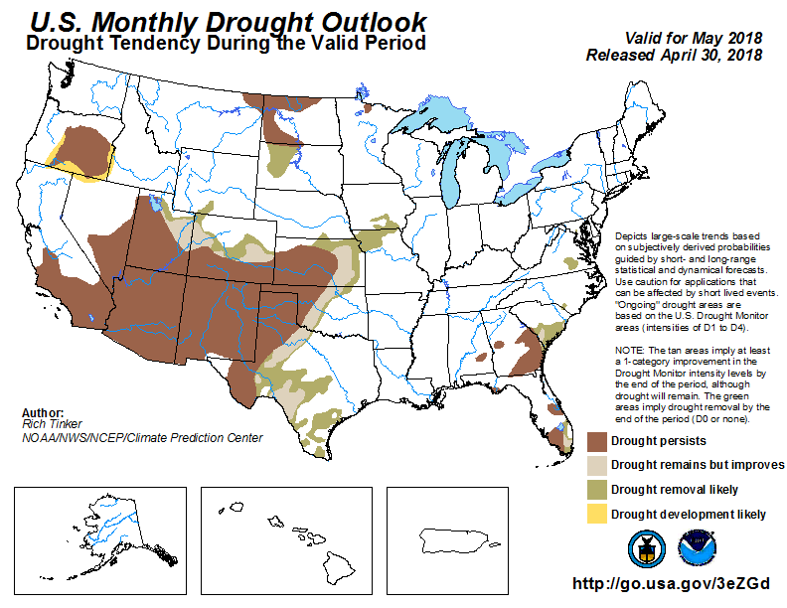
(Prev) Seasonal/Monthly Drought outlooks
Seasonal Outlook (Mid April 2018 - July 2018)
issued 04/19/18
Monthly outlook
(for May 2018)
issued 04/30/18
The monthly outlook has previously called for continued drought conditions and a slightly pessimistic scenario, while the seasonal outlook has called for improvement in the south central part of the country.

Slide 4
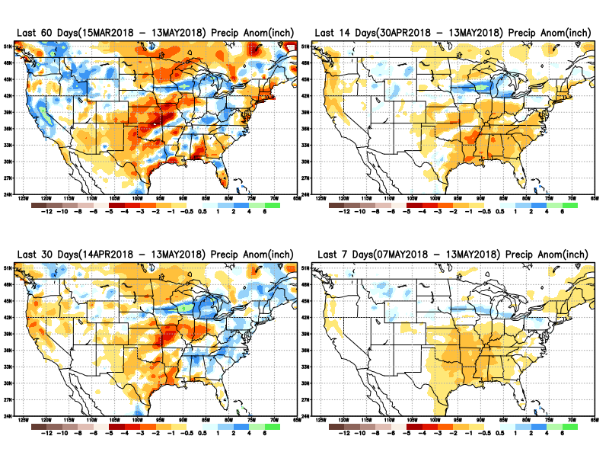
Total precipitation ANOM during last 7, 14, 30, & 60 days.
A general dryness, over the eastern half of the country during the past two weeks.
Rainfall deficit in KS/TN/MO, and northern TX has gotten worse.
Eastern ND and the MN noted last month as beginning to develop some dryness continues to do so!!

Slide 5
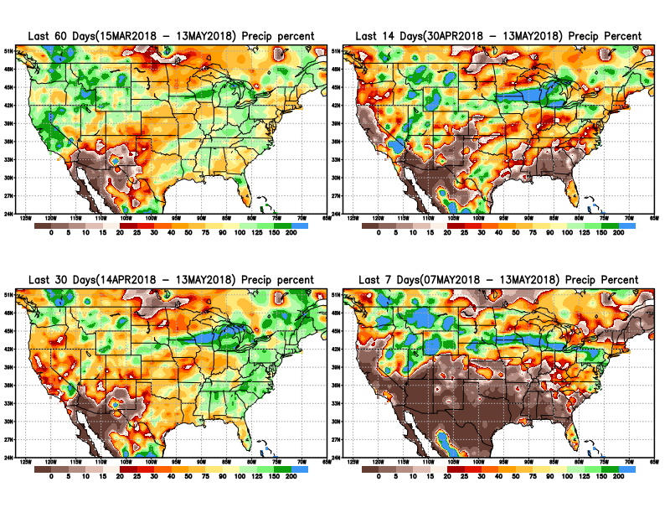
Total precipitation Percent during last 7, 14, 30, & 60 days.
Note percent of precip percent/deficit in around northern TX AZ,NM last 2 months and earlier!!
Also keep an eye on developing dryness Dakotas and MN.

Slide 6
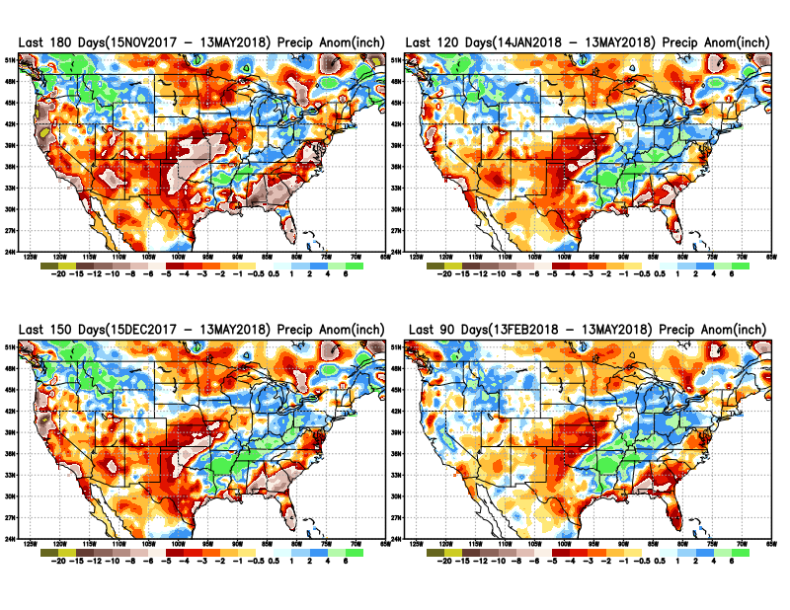
Total precipitation ANOM during last 3, 4, 5, and 6 months.

Slide 7
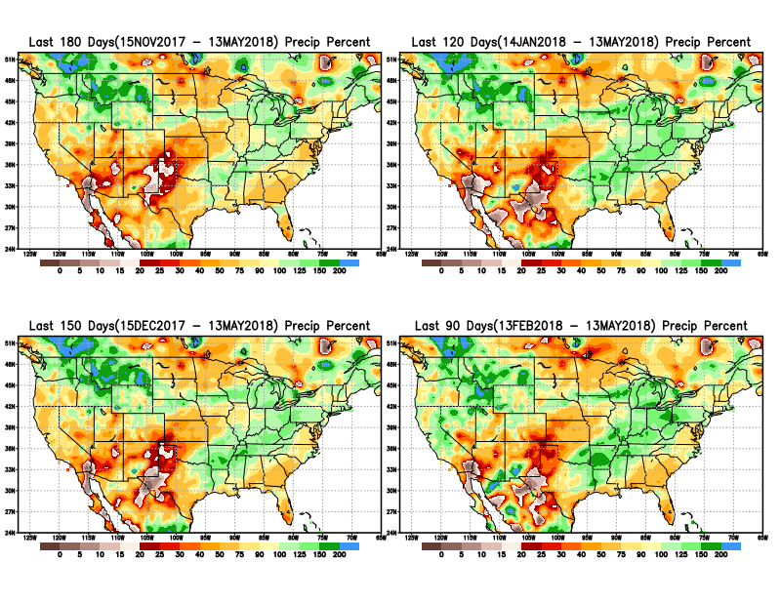
Total precipitation Percent during last 3, 4, 5, and 6 months.
Note Precipitation deficits

Slide 8
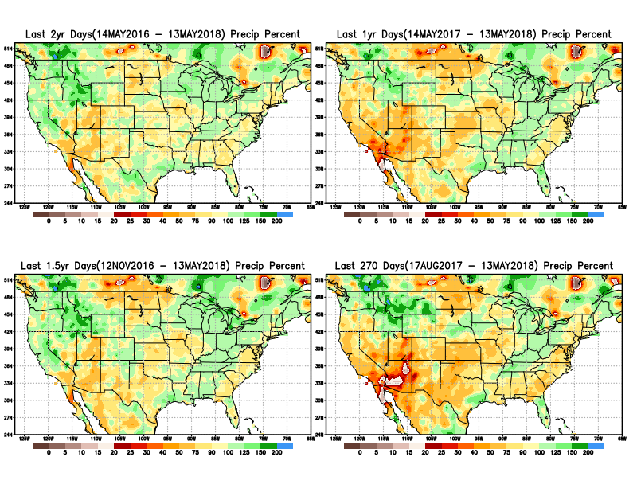
Total precipitation Percent during last 9 months, 1 yr, 1.5yrs, & 2 yrs.
There are many long term rainfall deficit regions in the country, particularly deficits in UT/AZ, southern CA, and parts of NM/CO are long term.

Slide 9
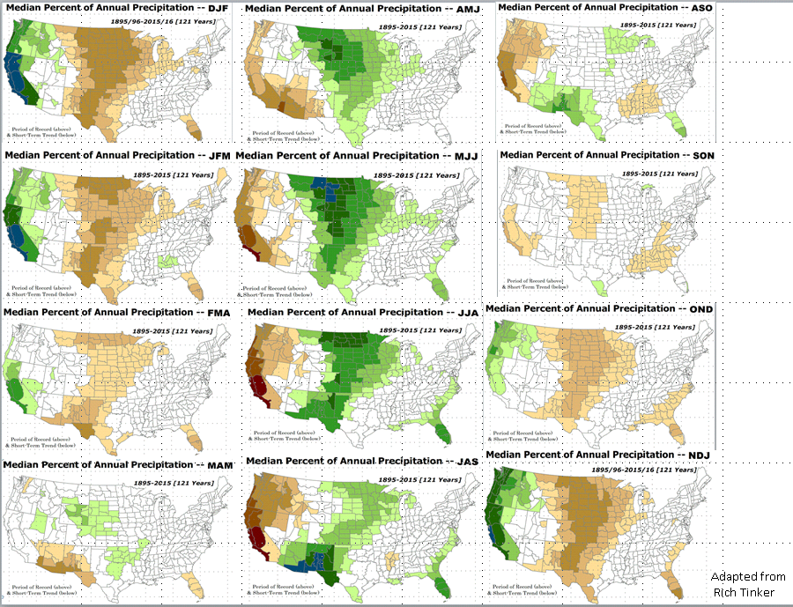
Rainy Season across the US

Slide 10
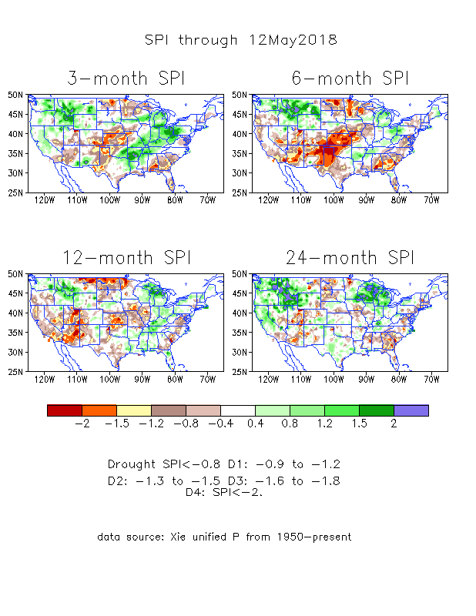
The Standardized Precipitation Index SPI (based on Observed P)
----- NOW
Very interesting graphic & details for the drought across the US based on the more generalized precip deficit/excess, the Standardized Precipitation Index (SPI).
The dark brown and red colors, indicating standardized precipitation deficits, in the various time periods, approximately correspond to the appropriate short/long term drought monitor regions and their intensities

Slide 11
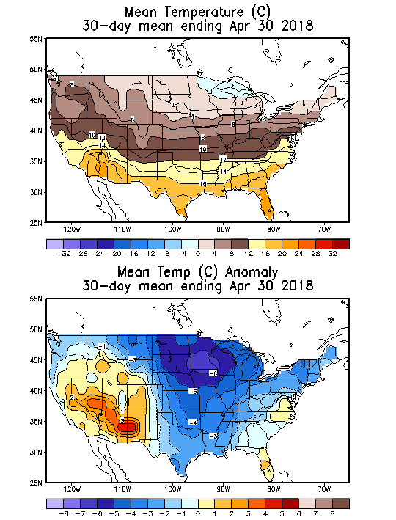
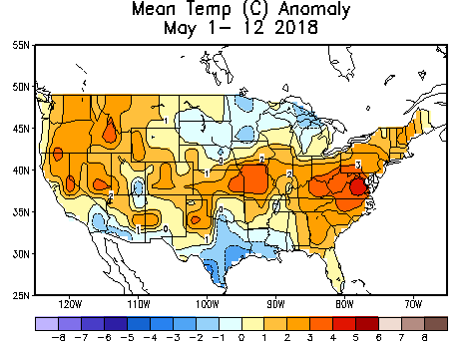
Recent US Temperatures
Overall April Mean T across the US was very cool (especially in the northern central states) across much of the country except in the southwest.
But so far, in May, warmth has retunred over large parts of the country.

Slide 12
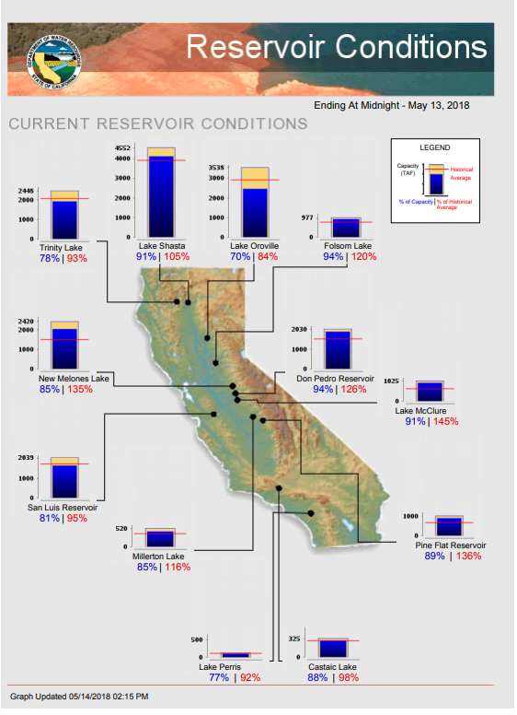
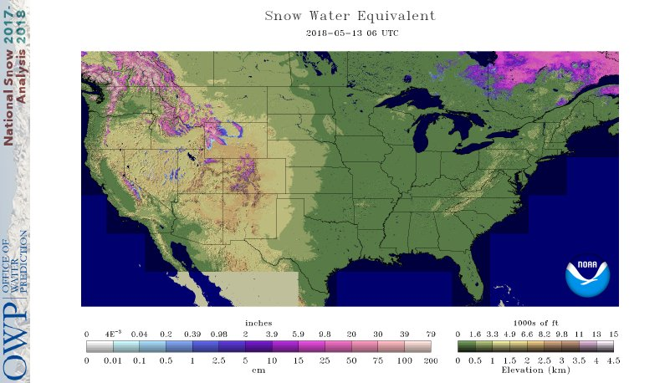
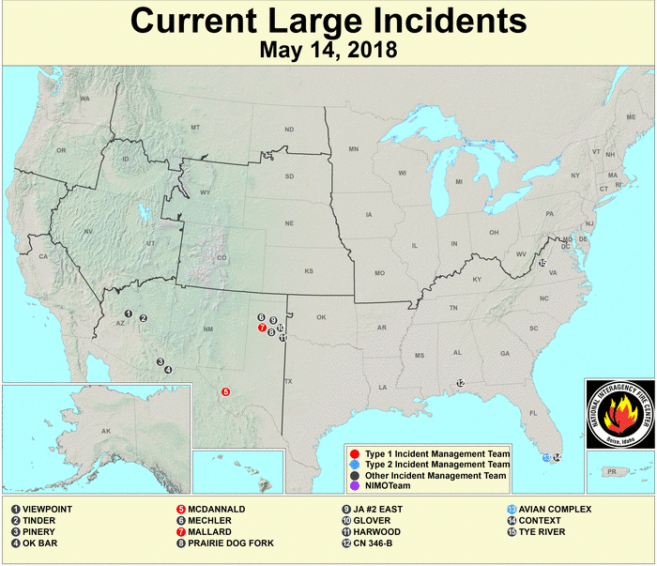
Most of the CA reservoirs continue to be at better than satisfactory levels, except for the Lake Oroville near northern Sierra Nevada. East of central MT all the snow has melted, and there is no snow on the ground.
FIRE
http://cdec.water.ca.gov/cgi-progs/products/rescond.pdf
https://fsapps.nwcg.gov/afm/index.php

Slide 13
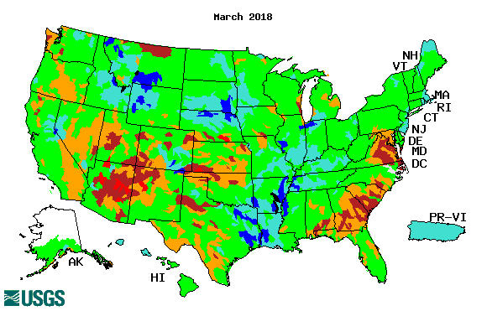
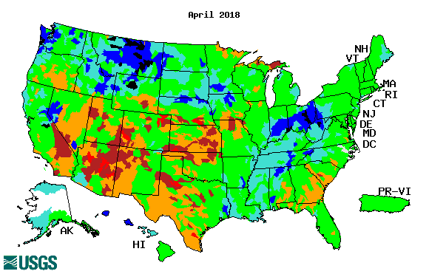
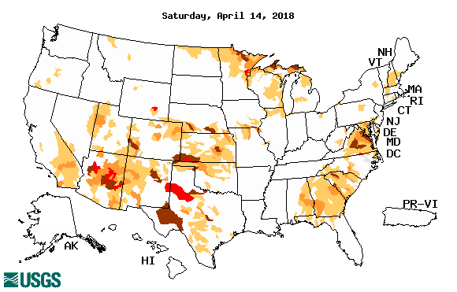
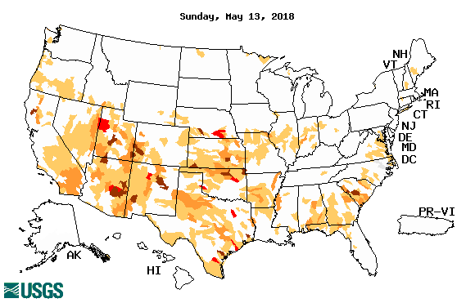
Streamflow (USGS)
The warming temps are melting the frozen ice and snow, which has resulted in increased streamflow in the northern high plains states.
Worsened in south central and south western states, but better in the southeast and along the Atlantic coastal states.
Map shows only below normal 7-day average streamflow compared to historical streamflow for the day of year.
One month ago (left) & Now (below)

Slide 14
EL NIÑO/SOUTHERN OSCILLATION (ENSO)
DIAGNOSTIC DISCUSSION
issued by CLIMATE PREDICTION CENTER/NCEP/NWS and the International Research Institute for Climate and Society
12 May 2018
ENSO Alert System Status: Final La Niña Advisory !!
Synopsis: ENSO-neutral conditions are present.* Equatorial sea surface temperatures (SSTs) are near-to-below average across the east-central and eastern Pacific Ocean. ENSO-neutral is favored through September-November 2018, with the possibility of El Niño nearing 50% by Northern Hemisphere winter 2018-19.

Slide 15
La Nina out, but effects linger?
http://www.cpc.ncep.noaa.gov/products/analysis_monitoring/ensostuff/ensoyears.shtml

Slide 16
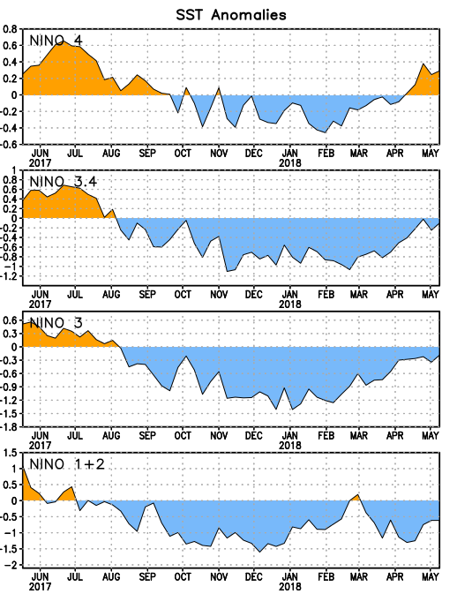
Latest values of SST indices in the various Nino Regions.
The sub surface heat anom is well in the +ve territory! .
Relatively short lived!
Equatorial SST’s are at near to slightly below normal levels in all three ocean basins.

Slide 17
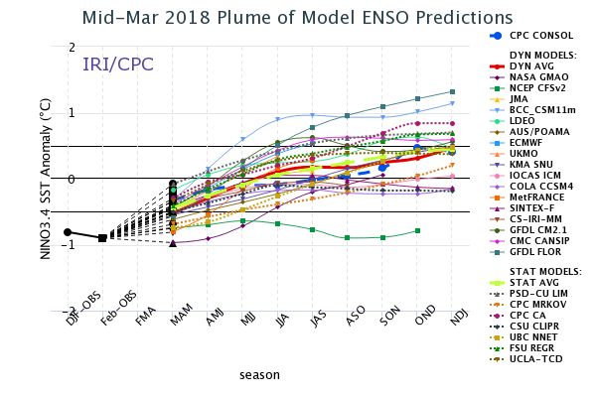
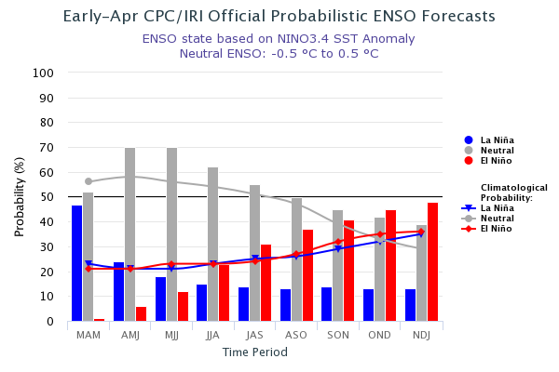
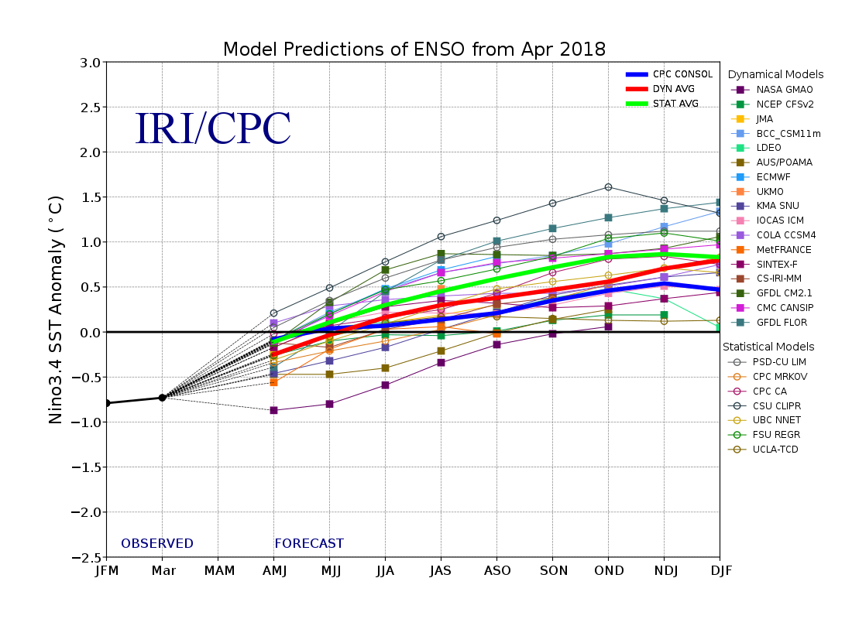
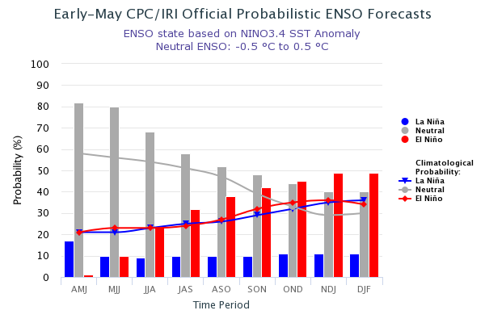
ENSO Forecasts
Early- Apr CPC/IRI forecast
NMME Models’ – Nino 3.4 forecasts
Early- May CPC/IRI forecast
For Next/upcoming winter: Chance of ElNino is Fifty/Fifty!! Until then neutral conditions? Or possibly early El Nino conditions?

Slide 18
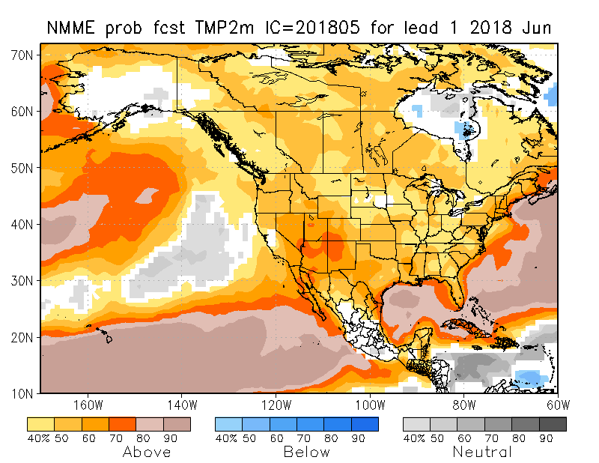
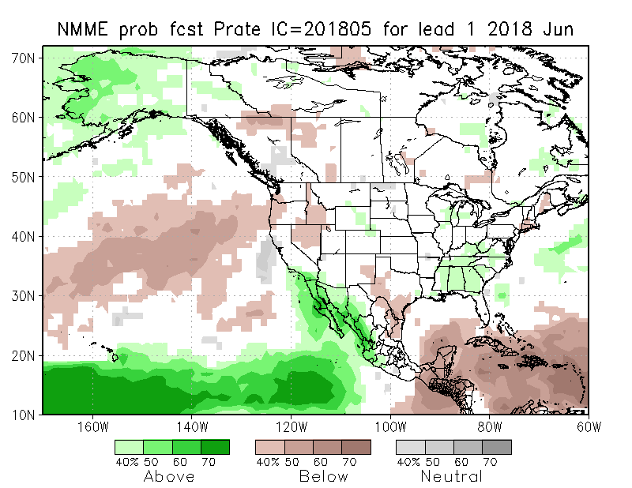
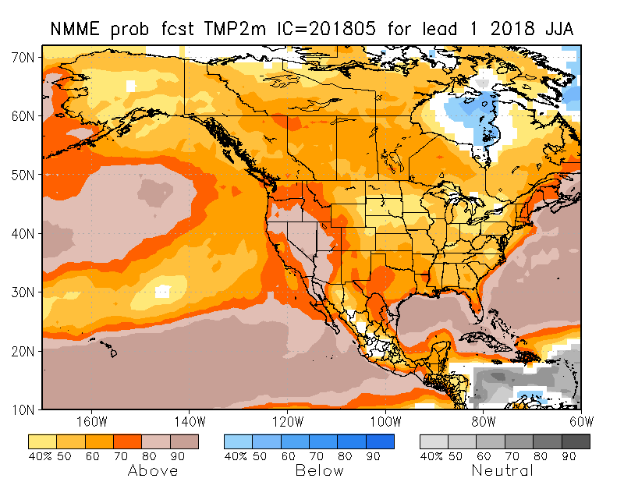
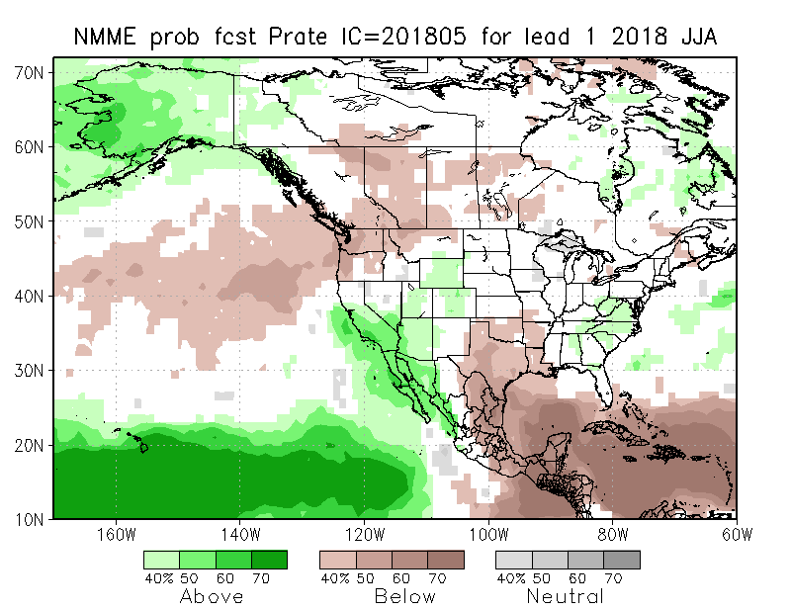
NMME T & P EnsMean forecasts
June
JJA
The La Nina has officially ended and tropical equatorial Pacific is in neutral conditions. T forecasts over US is characterized by general warmth/trend across the country (>80% in the west!). Above normal precip over southern CA and vicinity in summer is very interesting. But ?? (see next slide) where is this coming from?

Slide 19
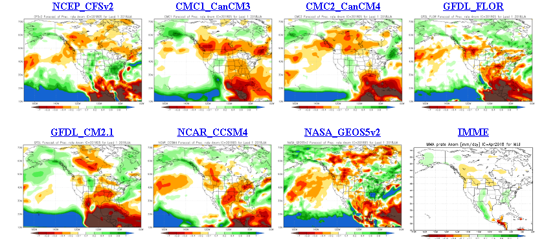
The agreement/uncertainty among the diff. NMME models’ forecasts for June-July-Aug Precipitation!!!
Where is the large probs for above normal precip over southern CA in the previous Ensemble mean NMME coming from?

Slide 20
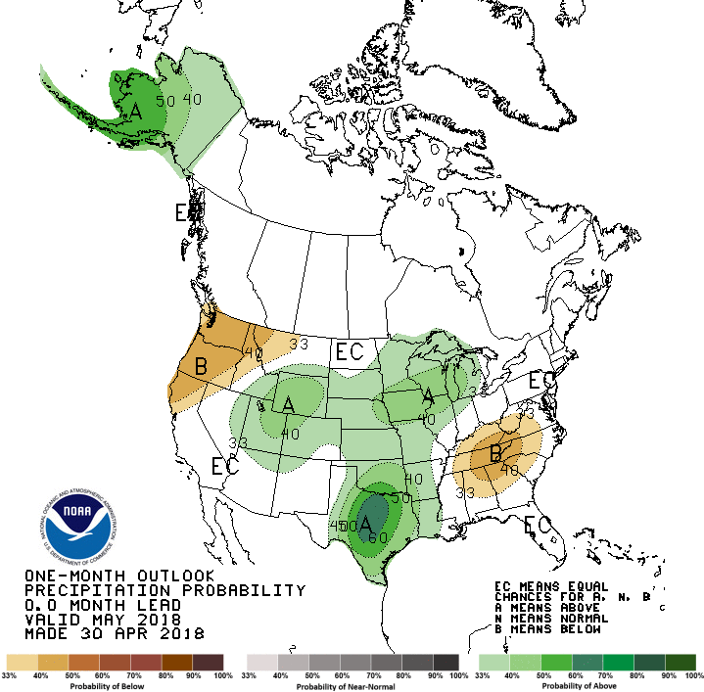
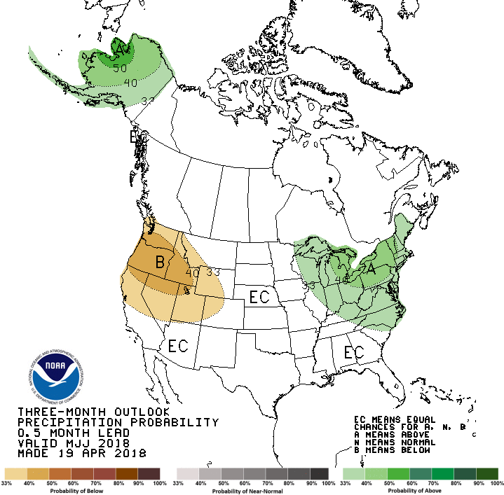
Previous CPC’s official Monthly (May) /Seasonal (MJJ)
Precipitation outlook
Released Apr 30th
Released Apr 19th

Slide 21
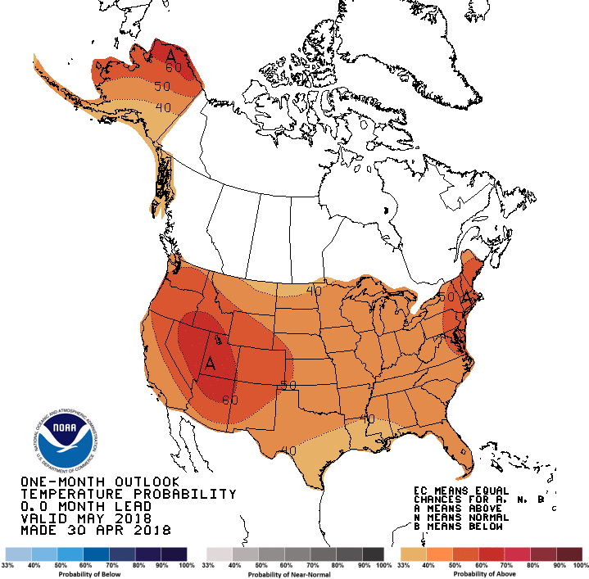
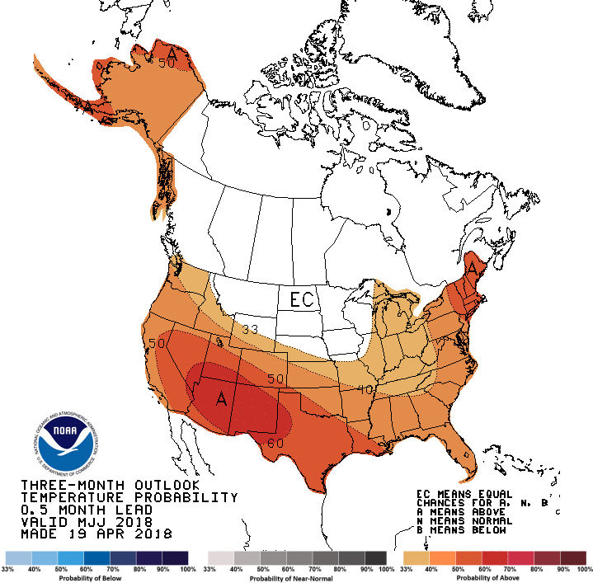
CPC’s official Monthly (May) /Seasonal (MJJ)
Temperature outlook
Made
Apr 30th
Made Apr 19th

Slide 22
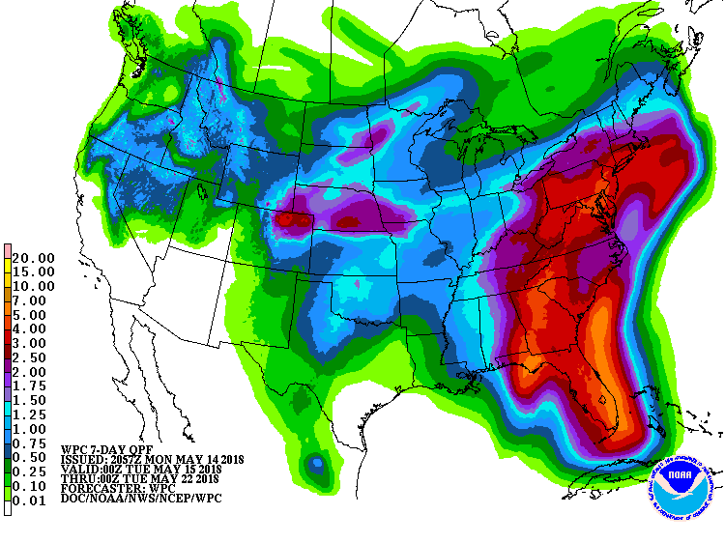
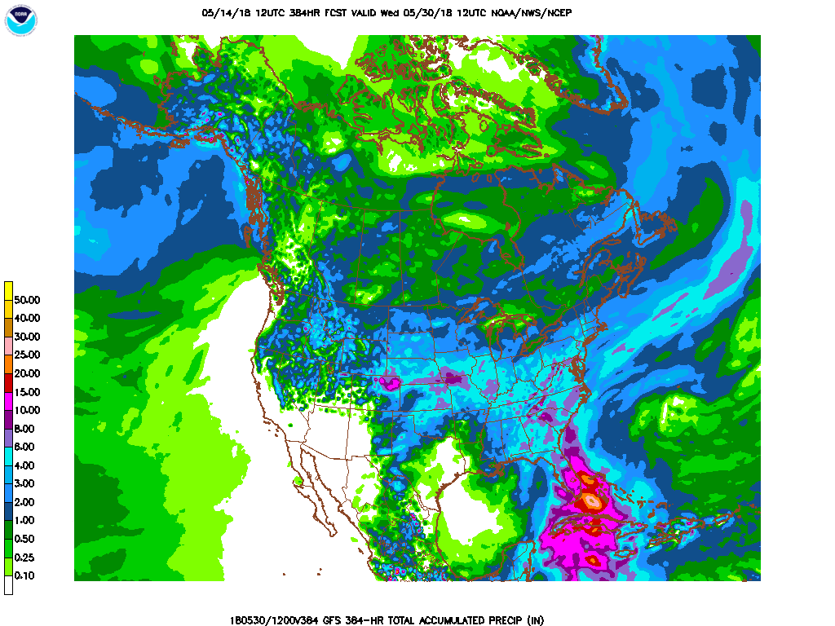
Next 7 days QPF Forecast
In the next 7 days, western OK, eastern TX, western KS, Gulf coast states are expected to receive good rainfall, thus helping the drought situation there.
GFS Model Guidance for next 16 days.
Further reinforcement of precip forecast over the next seven days. Over 5” is expected in western KS.
Not much rain over the southwest. In AZ/NM and far southern CA drought region.

Slide 23
SPI3
SPI6
SPI3 & SPI6
Forecasts from 6NMME Models
(uses obs. P up to past month, and forecast months’ P from NMME models)
The goodness and skill of these SPI’s forecasts depend directly on these models’ skill in predicting precip!!!
In the past these NMME models and their forecasts always did not extend/intensify the Northern plains drought, and ended it repeatedly prematurely!!
The NMME models indicate that by June much of the short term deficit (SPI3), across the US south, may have eased and gone, while the longer term rainfall deficits/drought(SPI6) may continue to improve, but will not go away!

Slide 24
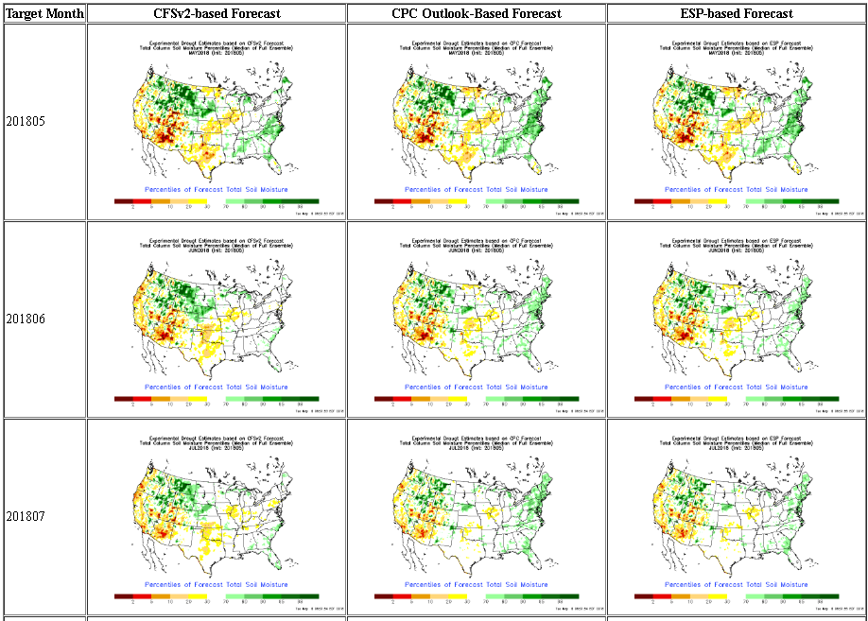
NLDAS Drought Forecast Analysis
The system developed by Princeton University and University of Washington was transitioned to NCEP/EMC as the experimental forecast system.
Forecast using 201805 Initial Condition- Soil Moisture Percentile forecast
Almost always these forecasts generally smoothen and weaken the drought from the levels at IC.
They did the same last year to the 2017 Northern Plains drought.

Slide 25
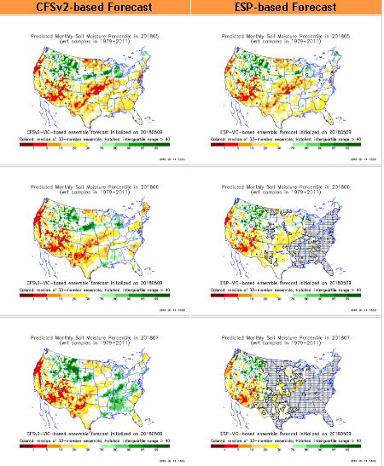
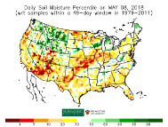
Hydrological Monitoring and Seasonal Forecasting @ MSU (Michigan State University ) NLDAS model
Monthly Soil Moisture Percentile Prediction issued on 201805 with this IC.
http://drought.geo.msu.edu/research/forecast/smi.monthly.php
The inter quartile range suggest greater uncertainty about the forecast in these shaded regions.

Slide 26
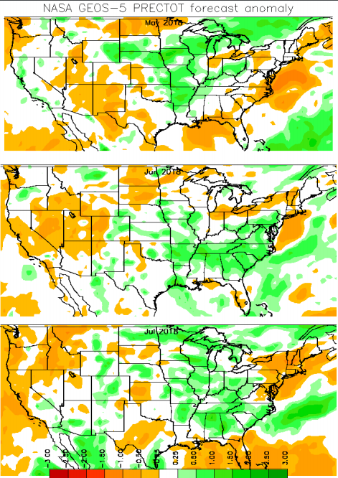
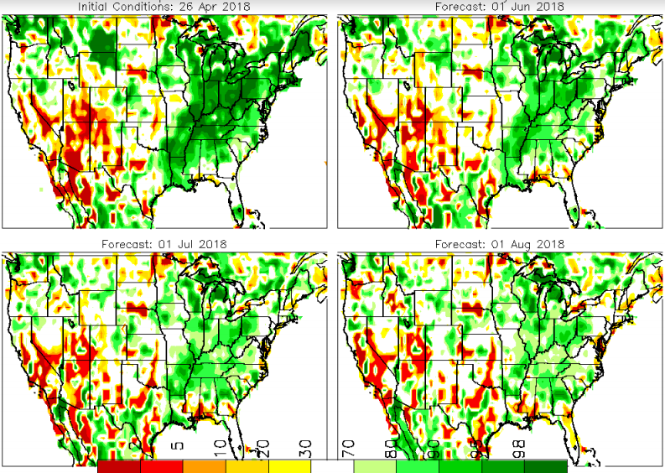
Precip Forecast
NASA GEOS5 Forecasts
May
Soil Moisture Forecast Percentile
Jun
April
Jul
May
Jun

Slide 27
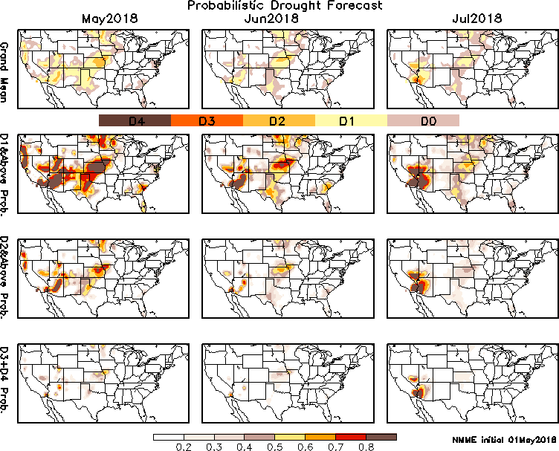
Exptl. Probability Drought Outlook from Kingtse Mo and Li Xu based on NMME ensemble members’ Precip forecast .

Slide 28
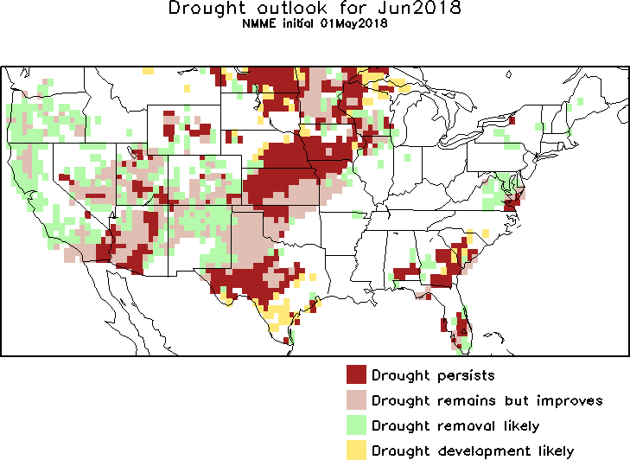
June 2018
JJA 2018
In the official
Drought Outlook Tendency Format!!

Slide 29
Summary
Current ENSO status and forecast. Final La Niña Advisory !! ENSO-neutral conditions are present.*
Equatorial sea surface temperatures (SSTs) are near-to-below average across the east-central and eastern Pacific Ocean. ENSO-neutral is favored through September-November 2018, with the possibility of El Niño nearing 50% (50/50 chance!) by Northern Hemisphere winter 2018-19.
Current Drought conditions:
There are three major areas of drought in the US: The first is the very large area of short/long term drought in the southwest covering southern CA, parts of OR, southern NV, and large parts of UT/AZ/CO/NM/KS/OK and TX extending slightly northeastward into IA/MO, the conditions pretty much unchanged from last month.
The second drought area is the lingering 2017 drought conditions in the Northern Plains states of far eastern MT and the Dakotas, slowly creeping/extending into MN (and WI)?. And the third drought area is the less contiguous small pockets of short/long term drought conditions along the Atlantic coastal states especially in GA and FL.
To the extent the drought along the southern states are probably and partly a consequence of the La Nina, which has just ended, and slowly transitioning to ENSO neutral conditions, maps of observed rainfall accumulations/deficits over time scales ranging from months to a few years, show large areas of longer than La Nina time scale deficits, exist in the southwest.
Prediction:
As the recent La Nina has transitioned to ENSO neutral conditions, such ENSO neutral conditions are expected to be present for the next many months, until winter. This means weak boundary forcing and associated forecast variability/spread. The next few months are luckily a period of seasonal rainfall in the current drought regions from the West north central to the South and Southwest.
So, even a normal upcoming rainfall season will improve the drought conditions here for the seasonal outlook, but the embedded severe long term drought areas will continue to stay under drought, since the accumulated deficits are too large to be made up in a season.
In the very short term however, the GFS forecast rain will definitely help arrest further eastward development in IA/MO, even possibly improve drought conditions in CO/NM/KS/OK/TX. Also, the drought along Atlantic coastal states will probably all be gone in a month.
The Dakotas, MN and northern WI are getting dry, and possibility of drought there likely ***

