Slide 1
Drought Outlook Support Briefing (formerly Drought Outlook Discussion) May 2019
(NOAA news: A near-record low of 2% Drought coverage for the US. ☺ )
Climate Prediction Center/NCEP/NOAA
http://www.cpc.ncep.noaa.gov/products/Drought
Phone: 1-877-680-3341
Pwd: 858747#

Slide 2
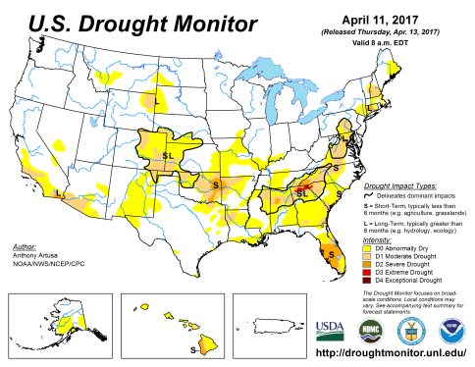
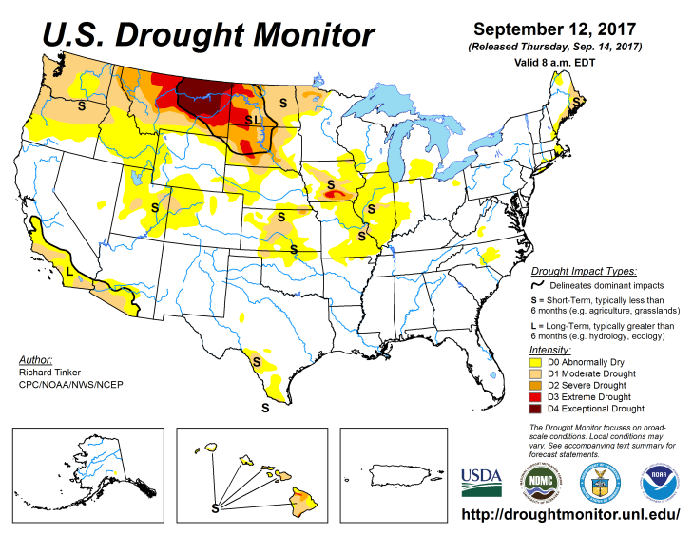
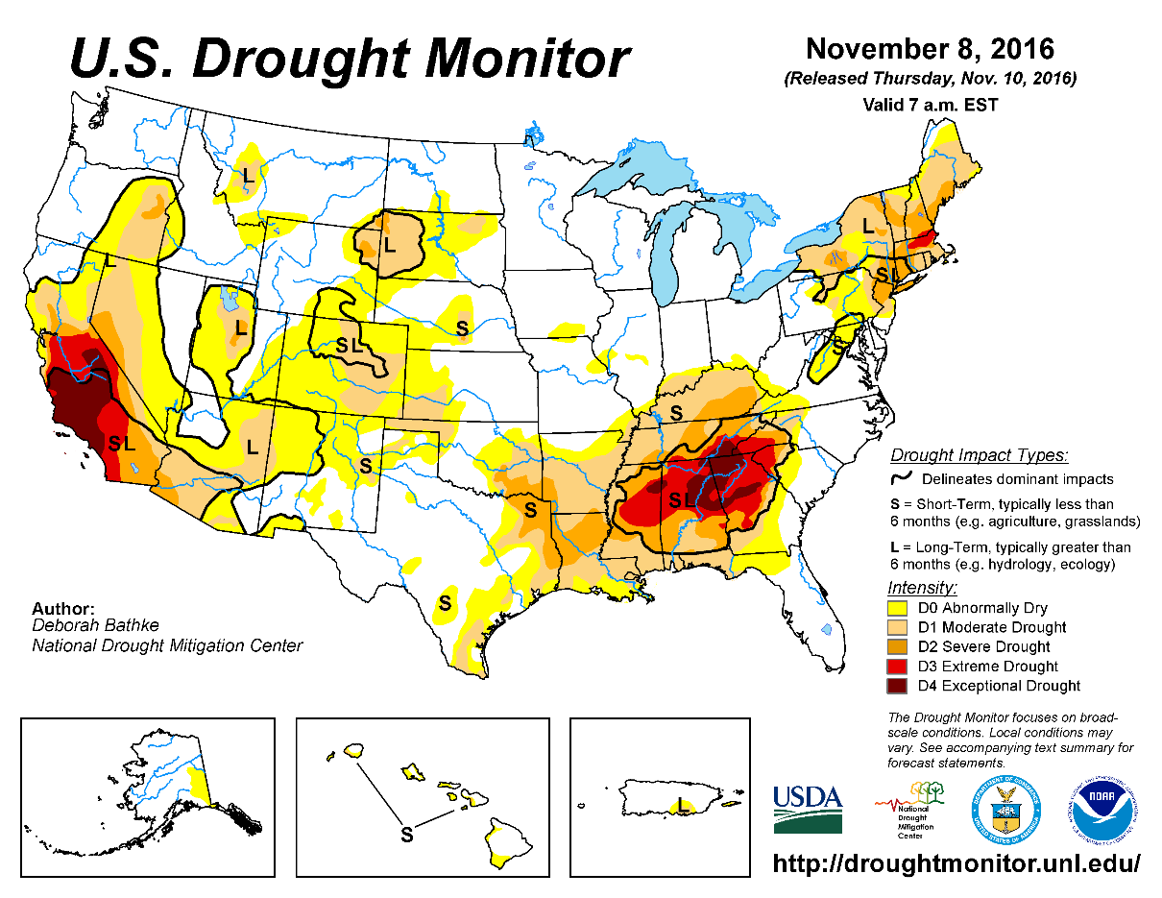
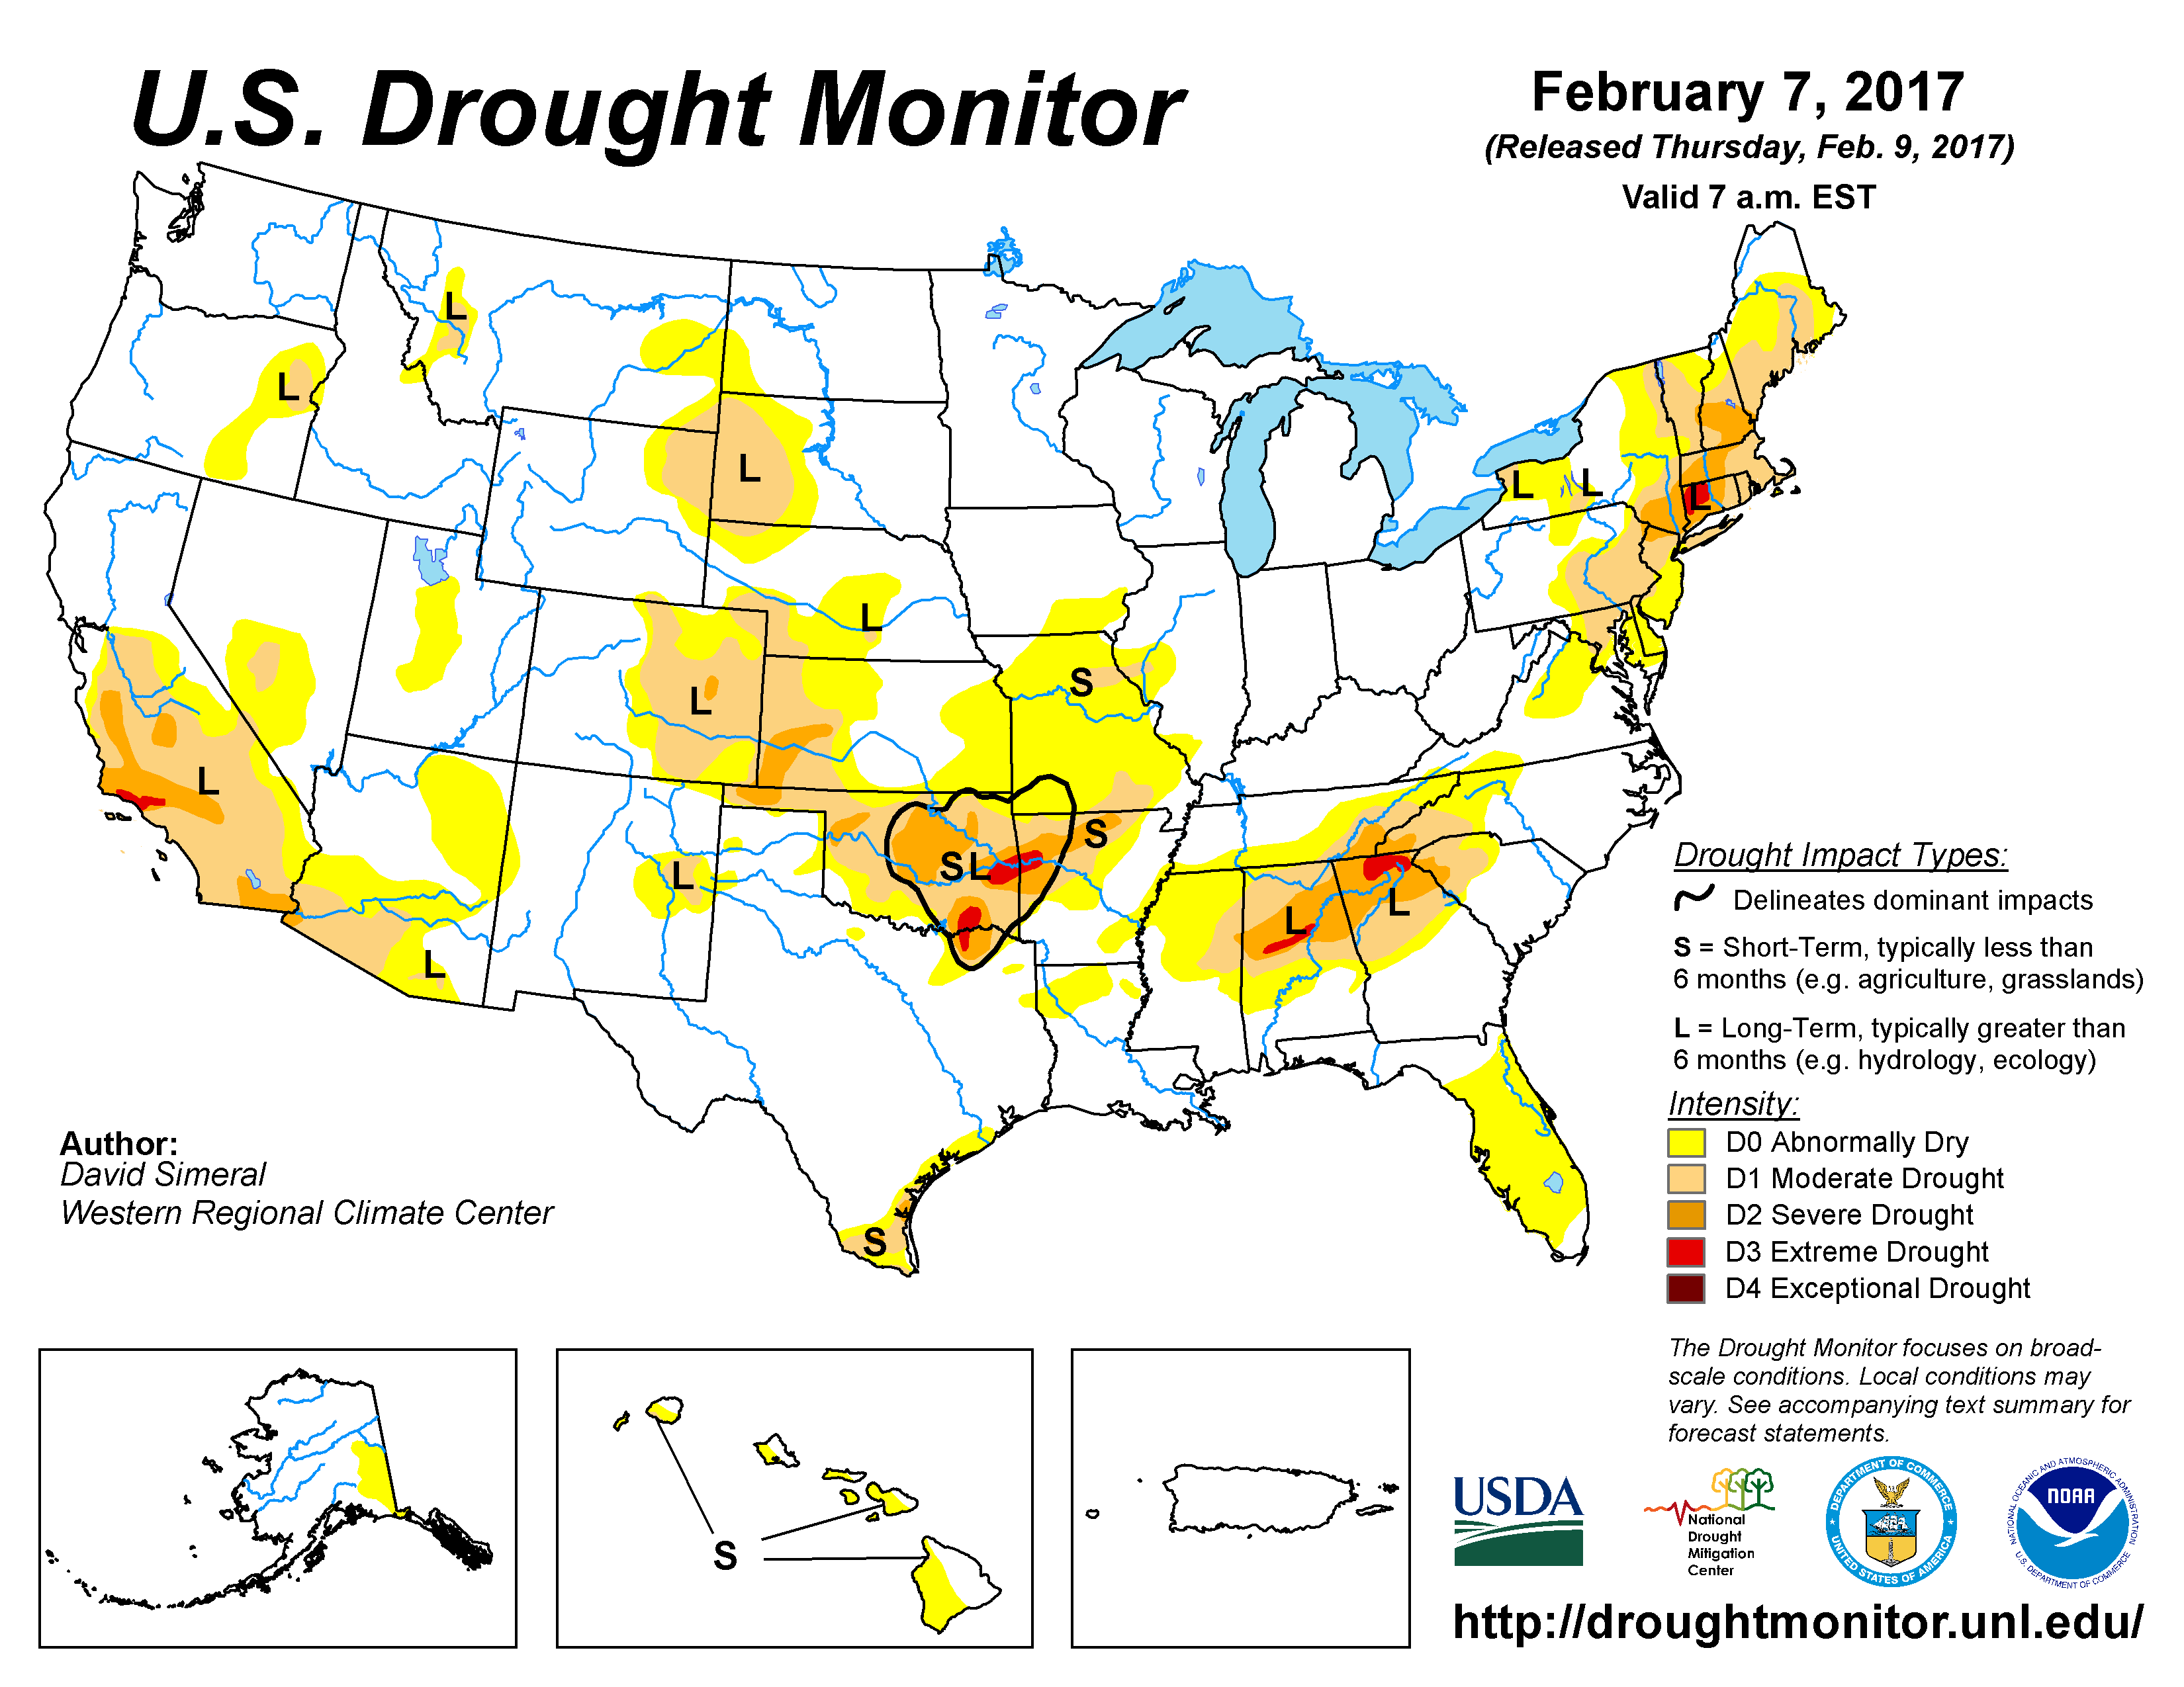
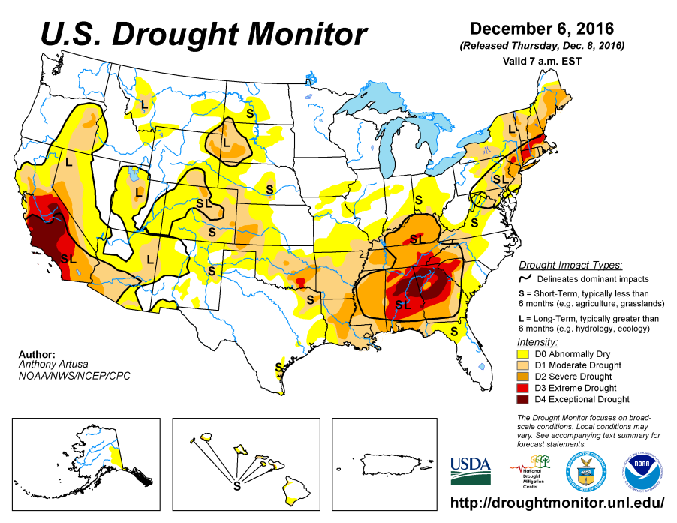
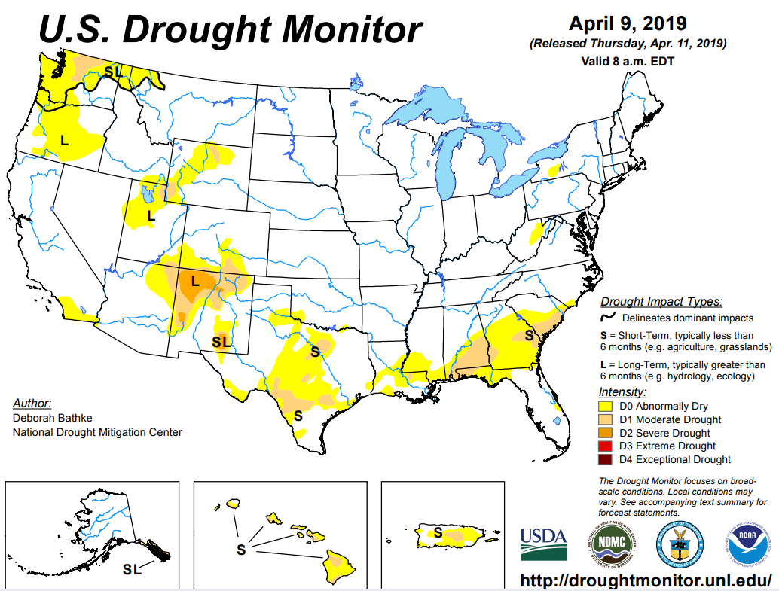
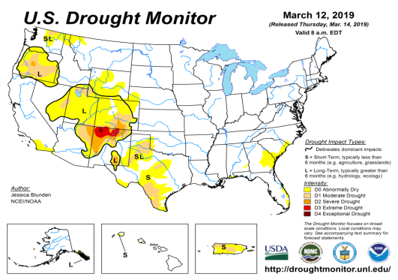
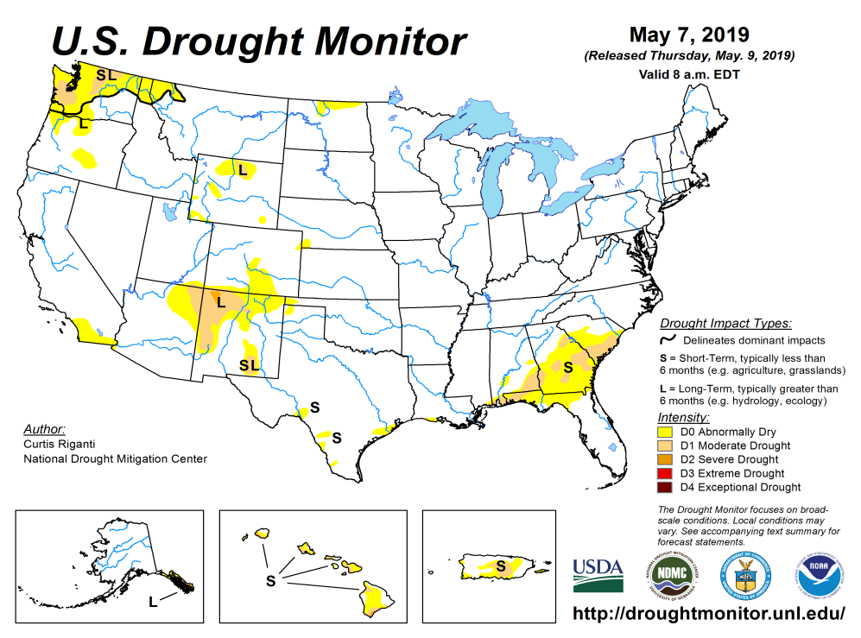
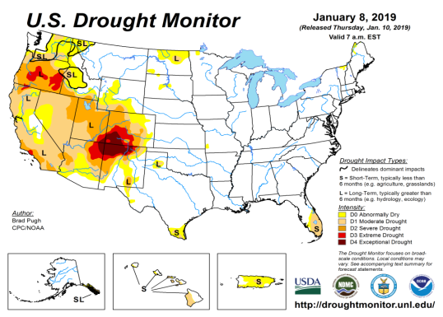
Drought Monitor
The sequence of drought monitor maps, month apart, over the last 5 months, shows the gradual and steady improvement in the drought conditions .
According to the DM, three regions have droughts:
Pacific NW,
around four corner states area in the southwest, and
Southeast.
The recent heavy rains has cleared out the drought in TX, LA and parts of MS.
April
March
February
Recent/Latest
January

Slide 3
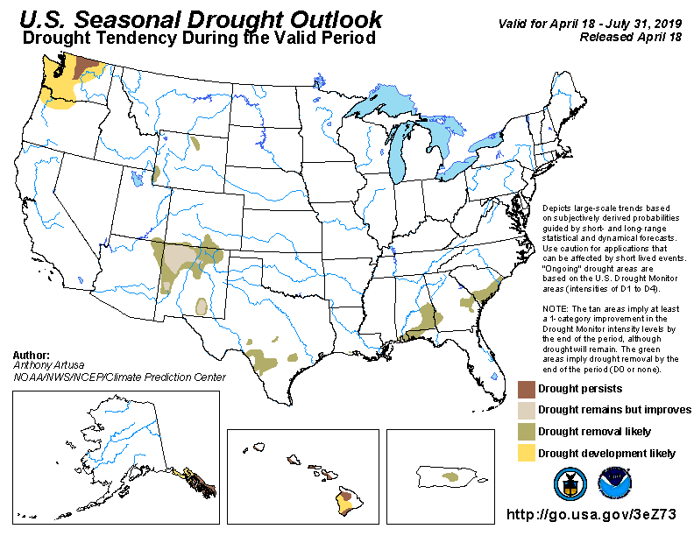
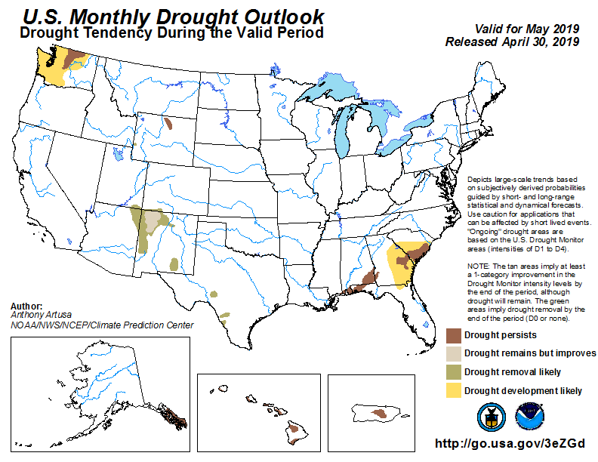
(Prev) Seasonal/Monthly Drought outlooks
(New Seasonal Drought Outlook to be released in 2 days!)
Seasonal Outlook (Mid April 2019 - July 2019)
issued 4/18/19
Monthly outlook
(for May 2019)
issued 4/30/19
General improvement in the southwest is forecast in both monthly and seasonal outlooks.
?

Slide 4
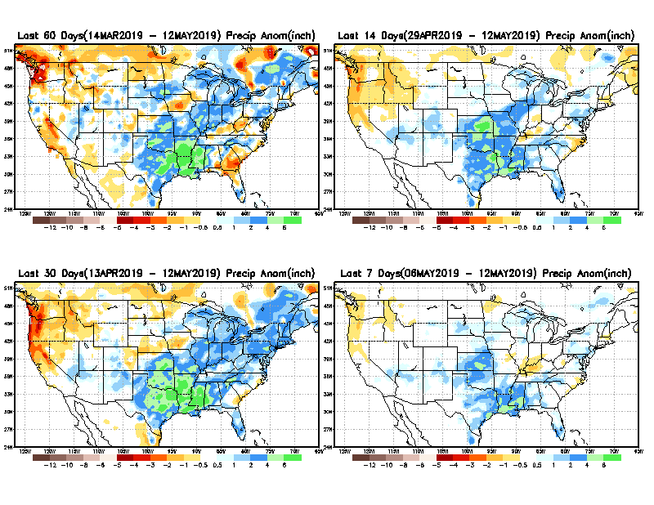
Precipitation ANOM during last 7, 14, 30, & 60 days.
60 Days
14 Days
The recent deluge in TX, LA, OK, MS has more than compensat-ed for the earlier deficits in the region.
30 Days
7 Days

Slide 5
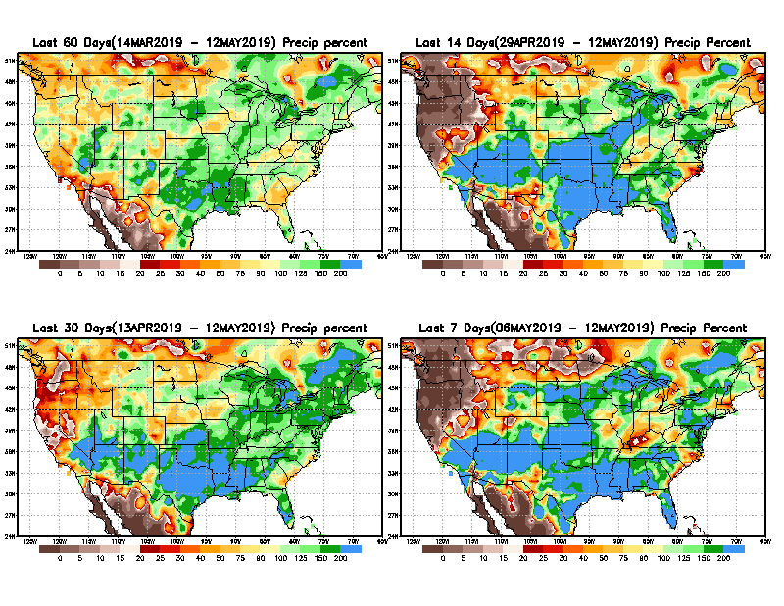
Precipitation Percent during last 7, 14, 30, & 60 days.
60 Days
14 Days
NOW !
Rainy season has ended in the Pacific West/NW.
But it has just begun in the Northern Great Plains and the Southeast.
The Precip forecast/outlook for next month/season is critical for any drought outlook in the Northern Plains.
Recall 2017 !!
30 Days
7 Days

Slide 6
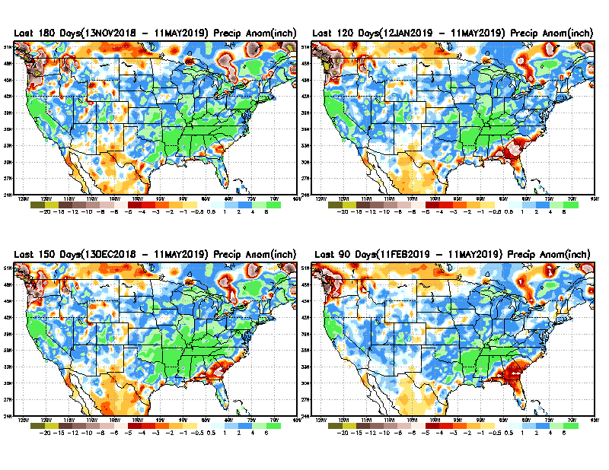
Total precipitation ANOM during last 3, 4, 5, and 6 months.
6 M
4 M
5 M
3 M

Slide 7
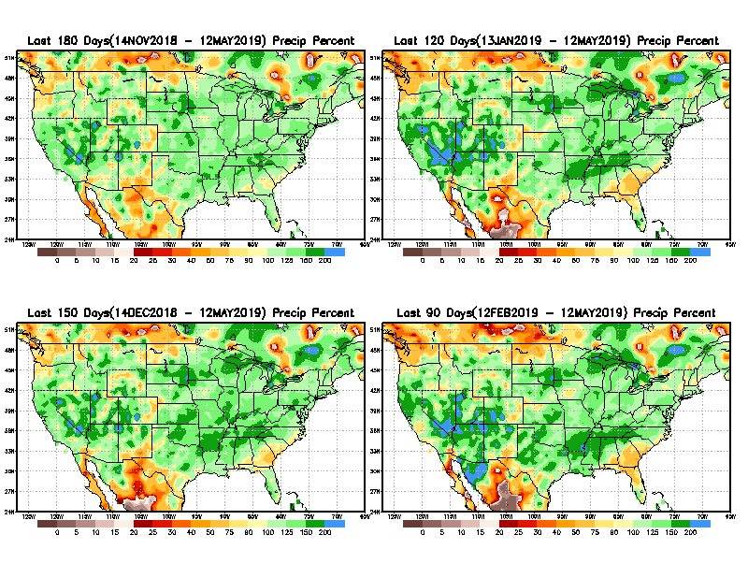
Total precipitation Percent during last 3, 4, 5, and 6 months.
6 M
4 M
Precip. deficits here complicated by data issues!
Recall:
In 2017, the Northern Great Plains Drought here started with similar deficits at about this time.
5 M
3 M
I made this remark last month:
“Need to keep an eye for possible developing drought here and in general along the Gulf coast.”

Slide 8
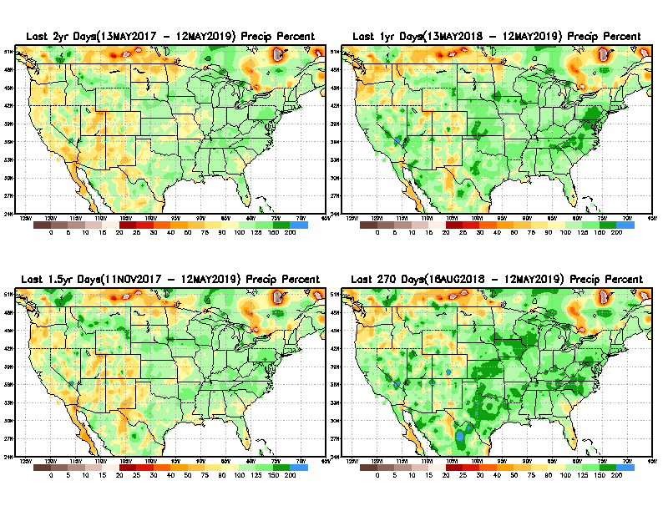
Total precipitation Percent during last 9 months, 1 yr, 1.5yrs, & 2 yrs.
2 Y
1 Y
1. Y
9 M
Long term rainfall deficits >1 year still exist in the southwest.
Does this really matter or not? Since it does not matter much to Drought Monitor!!

Slide 9
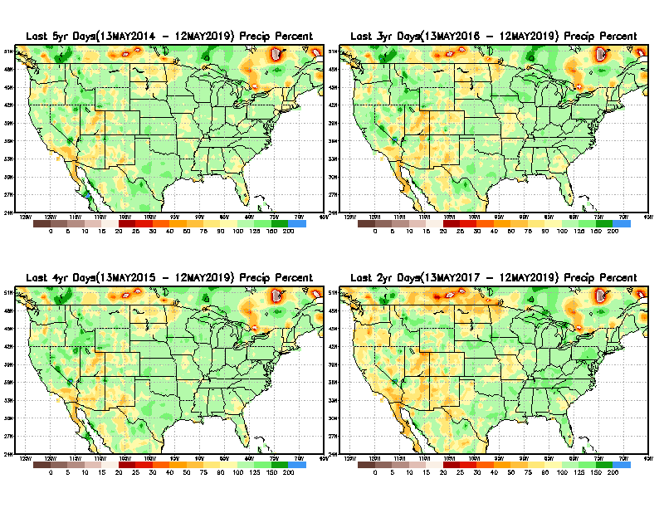
Total precipitation Percent during last 2 yrs, 3 yrs, 4 yrs, & 5 yrs.
5 Y
3 Y
Still longer term rainfall deficit variability in play? Especially in the southwest!
Will these deficits ever go away, OR is these part of the new norm??
4 Y
2 Y

Slide 10
Rainy (3-month)Season across the US

Slide 11
Upcoming rainfall season MJJ in the Northern Plains? Remember 2017!!
Adapted from Rich Tinker.

Slide 12
Adapted from
Rich Tinker

Slide 13
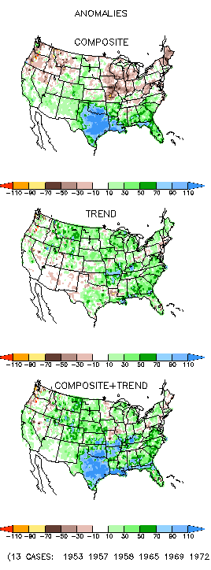
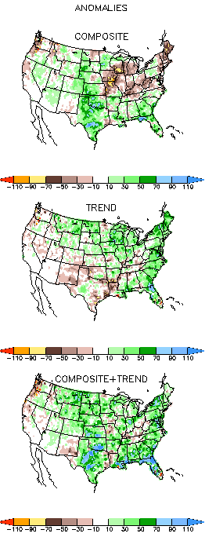
EL NINO Precip COMPOSITES
AMJ
MJJ
Next 2-3 months is critical for signs of any developing dryness in the Northern Plains and the southeast Gulf coast – especially with the ongoing El Nino impacts!!

Slide 14
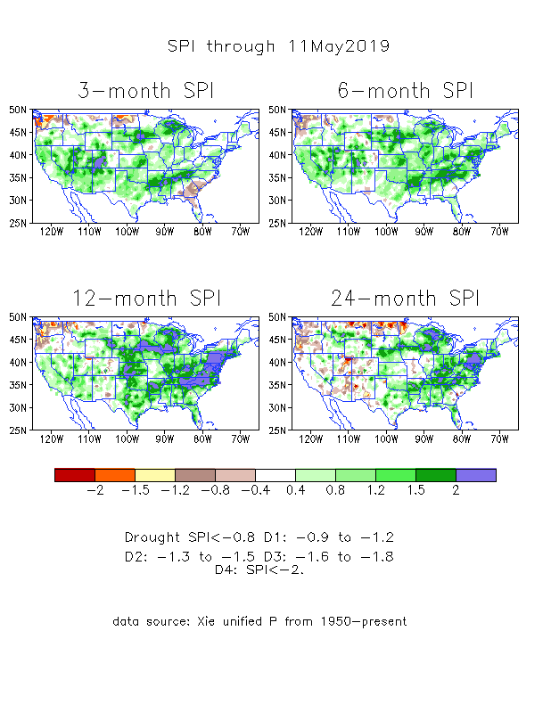
The Standardized Precipitation Index SPI (based on Observed P)
----- NOW
Very interesting graphic & details for the drought across the US based on the more generalized precip deficit/excess, the Standardized Precipitation Index (SPI).
The dark brown and red colors, indicating standardized precipitation deficits, in the various time periods, approximately correspond to the appropriate short/long term drought monitor regions and their intensities
In the short term (~3 mo) dryness still exists in the far southeast, and in he Pacific NW, and in ND.
In the 6m time scale, drought in OR/WA continues.
In the longer term ~12m-24m and longer, rainfall deficits remain in the AZ/NM/UT/CO states area and in Northwest and in the Northern Plains.

Slide 15
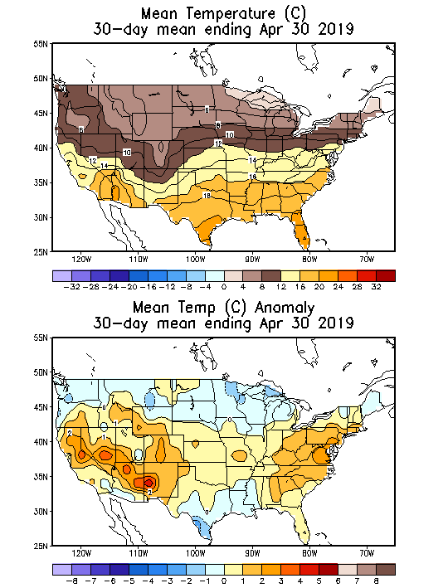
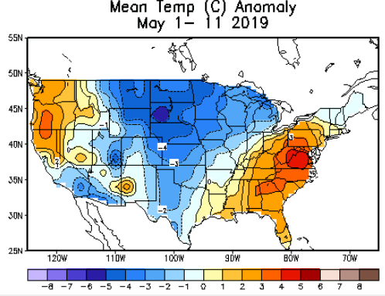
Recent US Temperatures
April was generally warm across the country.
May so far has been unusually cold over the middle two thirds of the country.

Slide 16
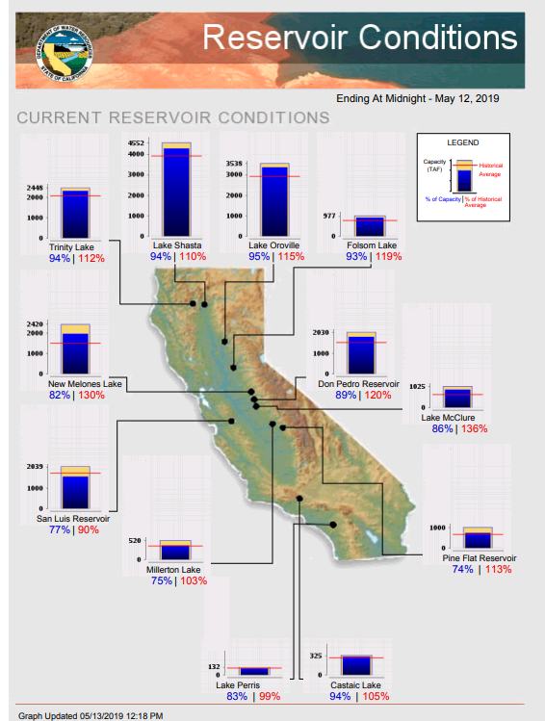
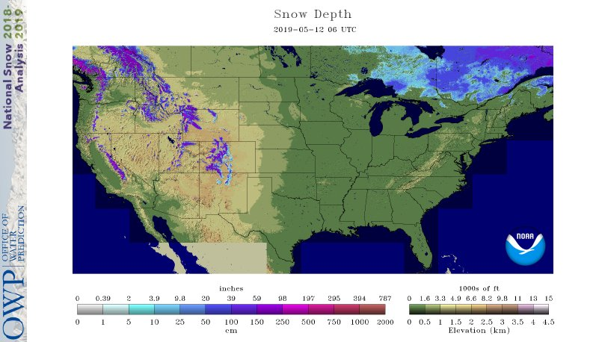
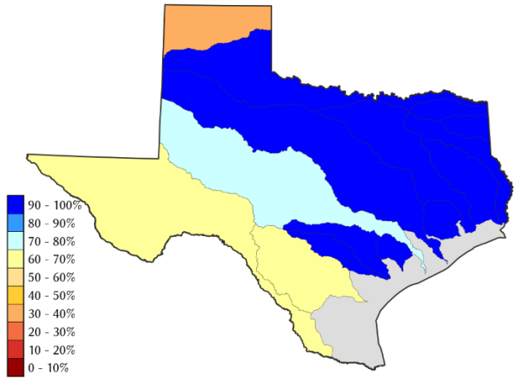
Water Reservoir Levels in some Western/Southern States! And Snow Depth!!
Northern CA reservoirs beginning to show
Weakness, but rainy season coming up!
Except in few high elevations, all snow has melted.
TX
California reservoirs are in good shape.
https://fsapps.nwcg.gov/afm/index.php

Slide 17
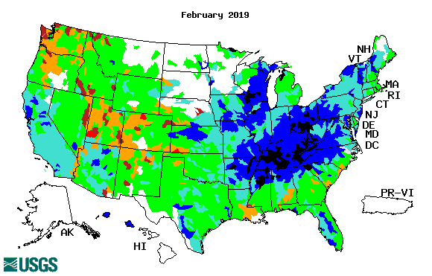
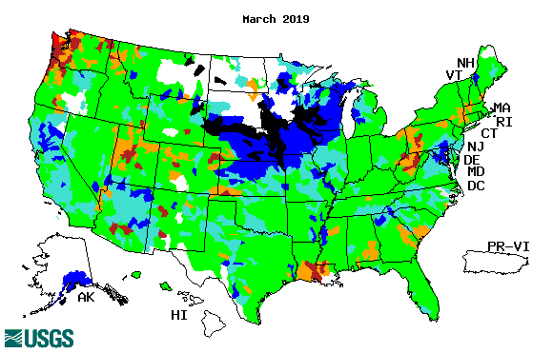
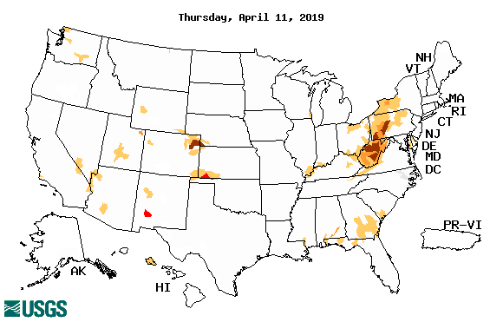
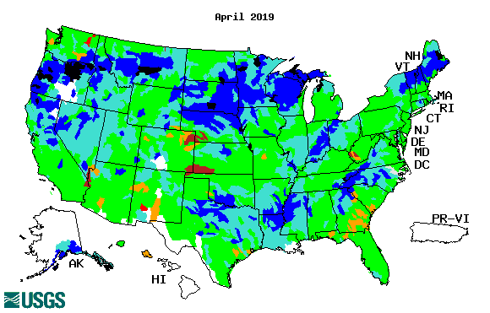
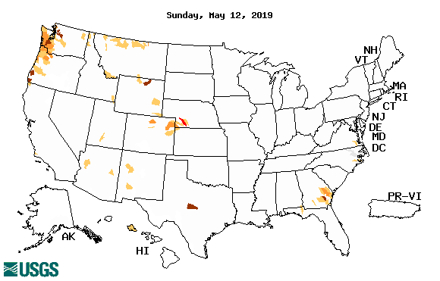
Streamflow (USGS)
Overall, gradual and steady improvement in streamflow conditions across the country, over the last few months.
Pacific Northwest ?
Map shows only below normal 7-day average streamflow compared to historical streamflow for the day of year.
One month ago (left) &
Now (below)
17

Slide 18
EL NIÑO/SOUTHERN OSCILLATION (ENSO)
DIAGNOSTIC DISCUSSION
issued by CLIMATE PREDICTION CENTER/NCEP/NWS and the International Research Institute for Climate and Society
9 May 2019
ENSO Alert System Status: El Nino Advisory
Synopsis: El Niño is likely to continue through the Northern Hemisphere summer 2019 (70% chance) and fall (55-60% chance). Equatorial sea surface temperatures (SSTs) are above average across most of the Pacific Ocean. The pattern of anomalous convection and winds are consistent with El Niño.

Slide 19
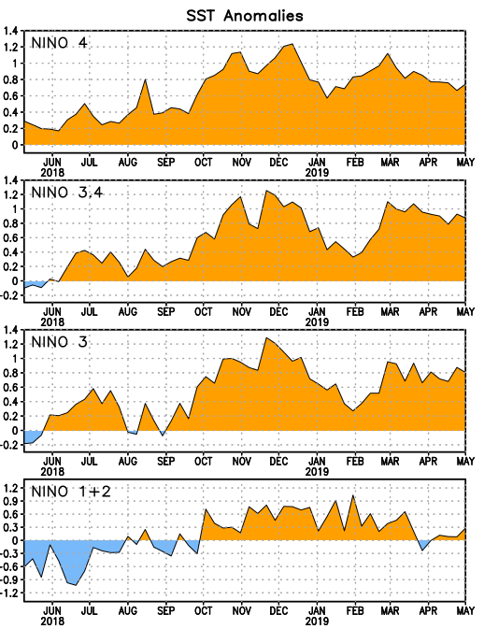
Latest values of SST indices in the various Nino Regions.
The sub surface heat anom has fallen in the last month.
Decreasing!
?
Relatively short lived!

Slide 20
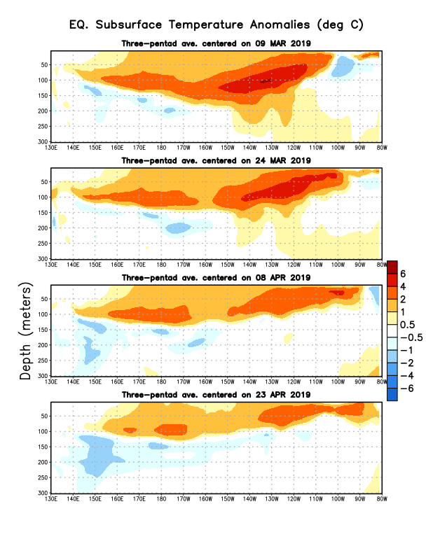
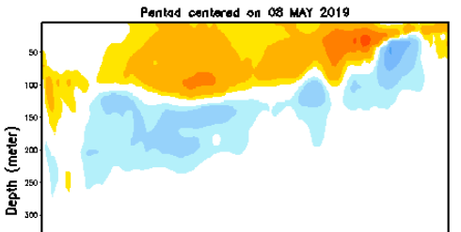
Sub-Surface Temperature Departures in the Equatorial Pacific
Where are we in the EL Nino cycle? Near peak?
The negative anomalies’ extent has increased!!
Will the El Nino strengthen further? Or weaken?
Most recent pentad analysis

Slide 21
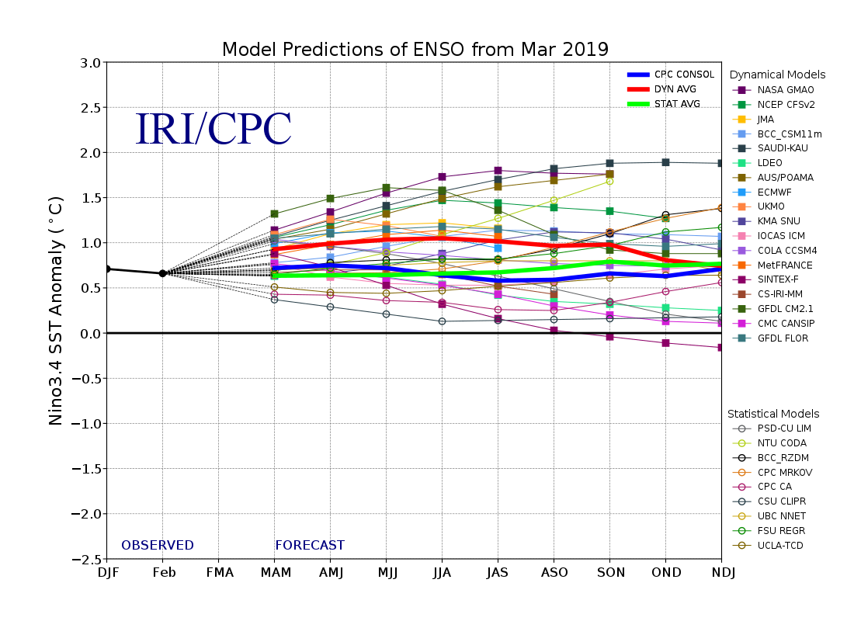
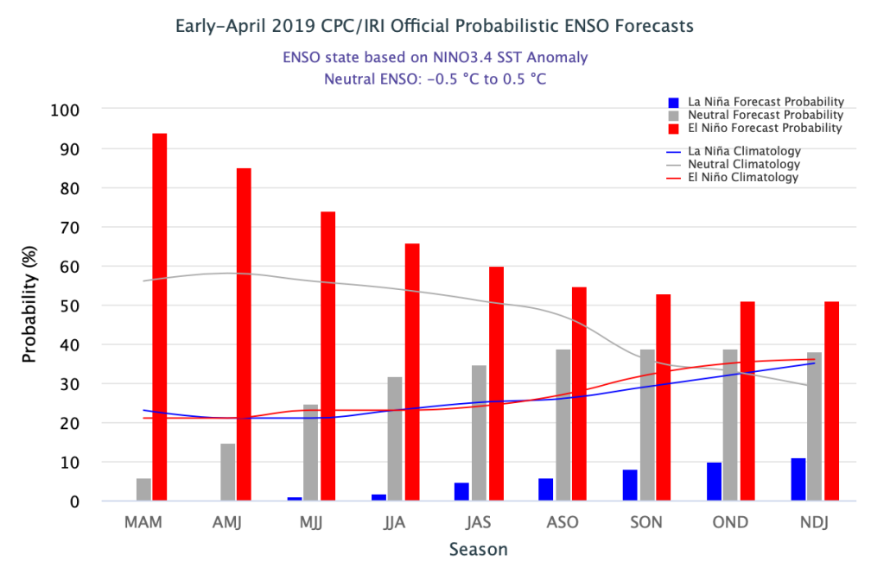
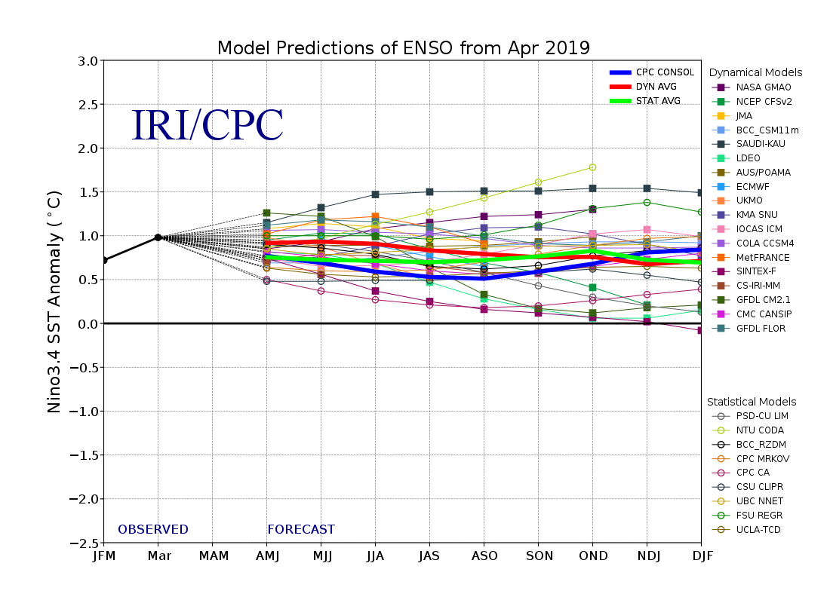
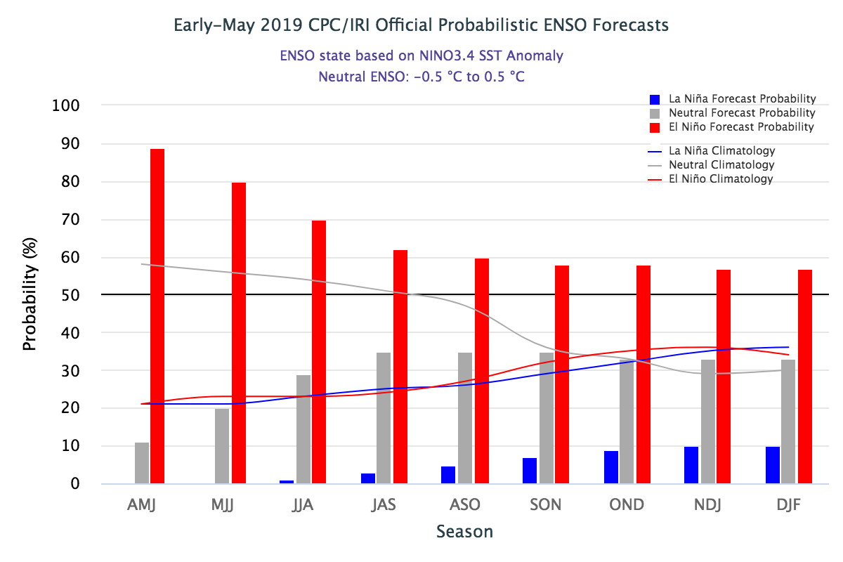
ENSO Forecasts
Early- April CPC/IRI forecast
Early- May CPC/IRI forecast
The models suggest that El Nino in some modest form is expected to remain and continue at least through upcoming winter.

Slide 22
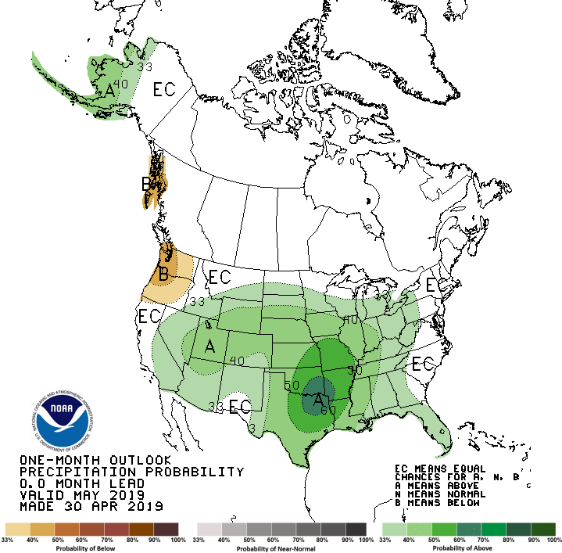
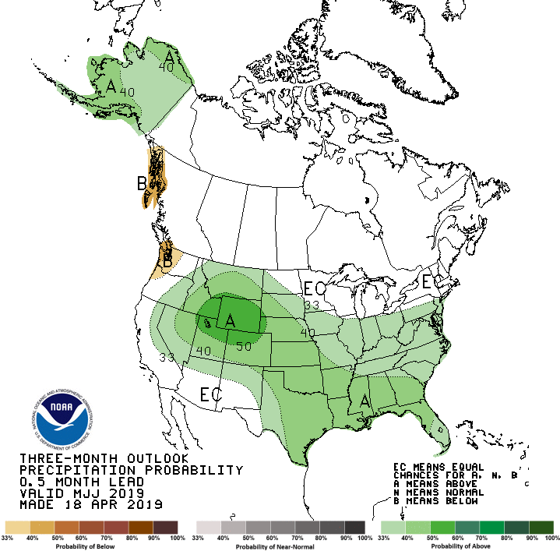
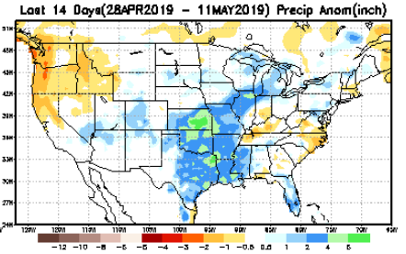
Previous(Last month)
CPC’s official Monthly (May)/Seasonal (MJJ)
Precipitation outlook
Released Apr 30th
Released Apr 18th
Observed so far this month!!
☺

Slide 23
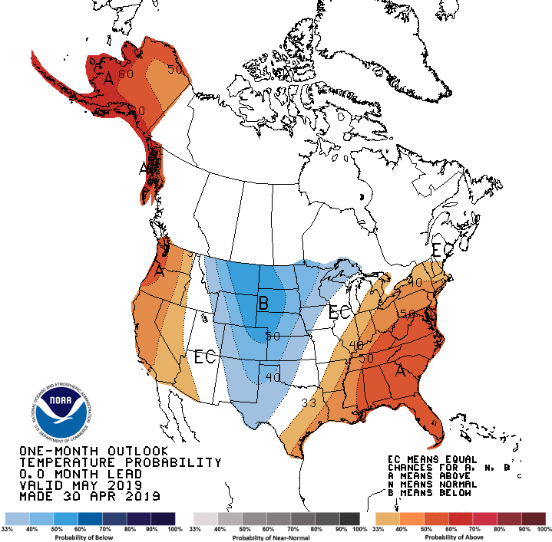
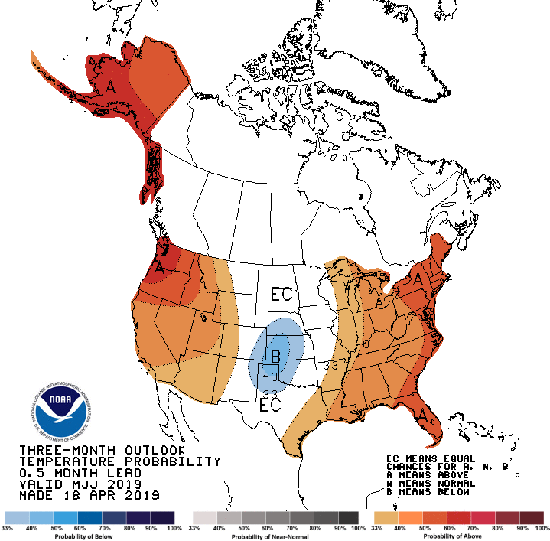
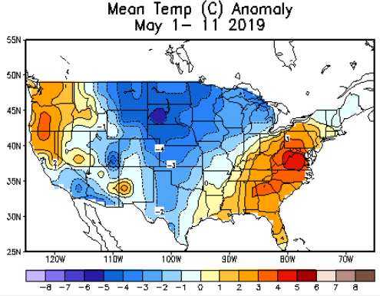
Previous CPC’s official Monthly (May)/Seasonal (MJJ)
Temperature outlook
Made
Apr 30th
Observed so far this month!! ☺
Made Apr 18th

Slide 24
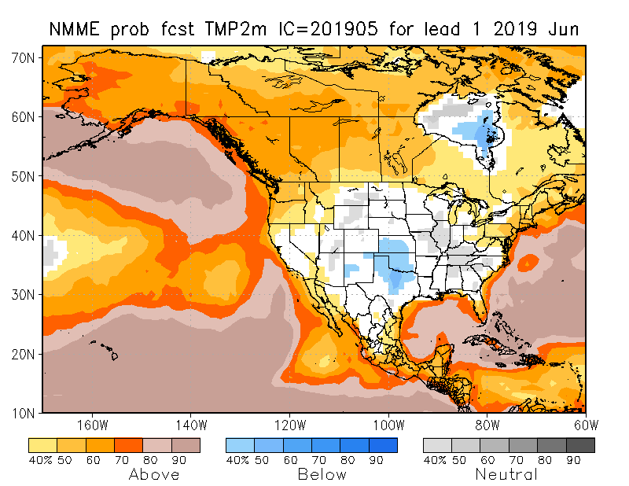
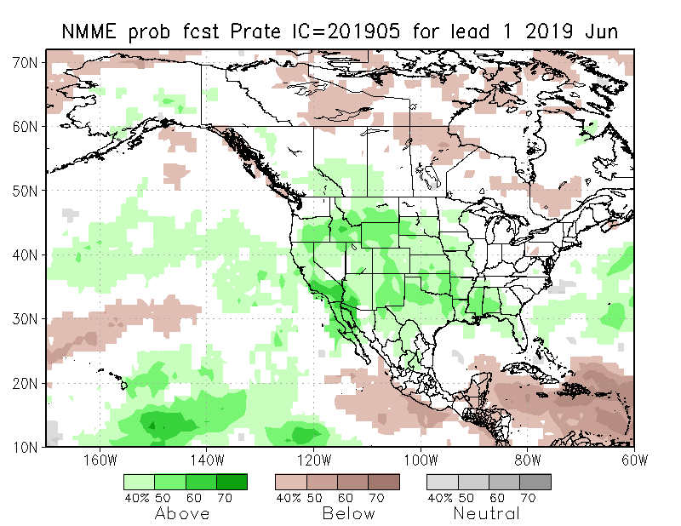
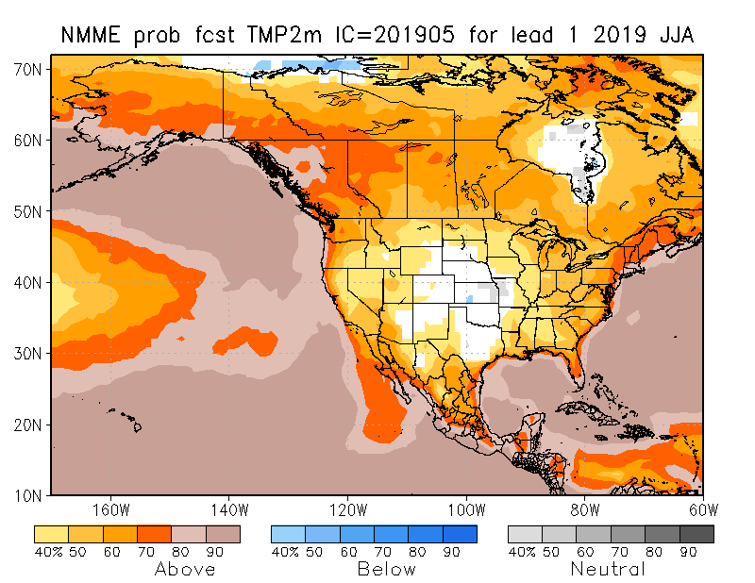
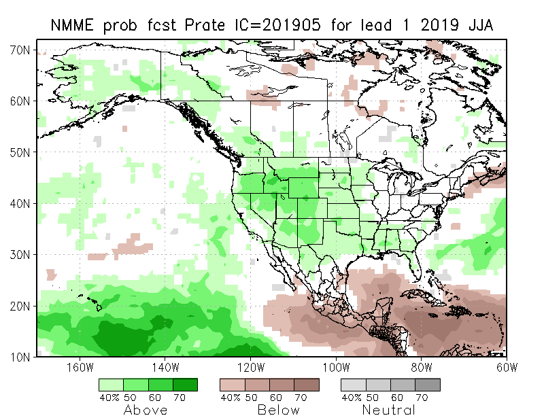
NMME T & P EnsMean forecasts
Jun
JJA
Both monthly and seasonal forecasts call for above normal precip over much of the country.

Slide 25
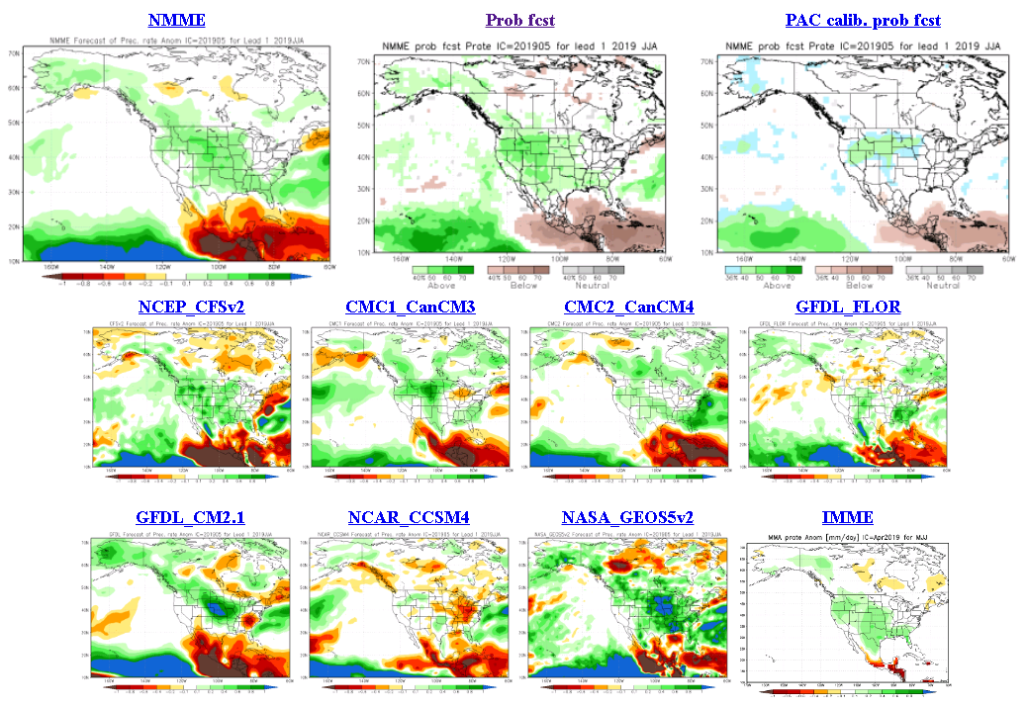
The agreement/uncertainty among the diff. NMME models’ forecasts (middle and bottom panels) for Jun-Jul-Aug Precipitation!!!
25

Slide 26
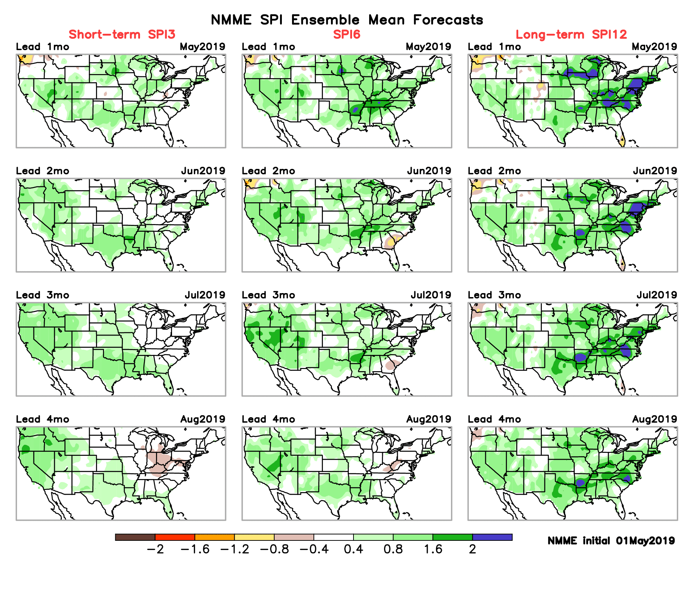
SPI3, SPI6
& SPI12
Forecasts from 6NMME Models
(uses obs. P up to past month, and forecast months’ P from NMME models)
The goodness and skill of these SPI’s forecasts depend directly on the NMME models’ skill in predicting precipitation!!!

Slide 27
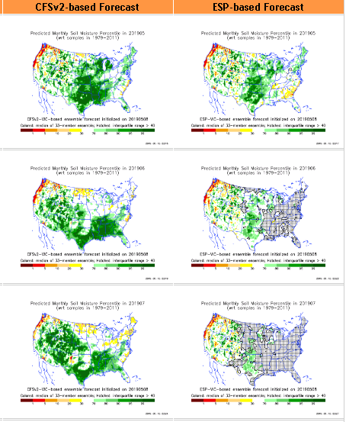
http://drought.geo.msu.edu/research/forecast/smi.monthly.php
Predicted Monthly Soil Moisture Percentile
With Soil Moisture Percentile
Initial Conditions: 4/2/2019
Latest Initial Conditions: 5/7/2019
Before
Recent Rains
Here!!
Things change fast in the east (see above).
But not so in the west! remains in NW.
Northern Plains ? Mild dry/drought?
The inter quartile range suggest greater uncertainty about the forecast in these shaded regions.

Slide 28
Recent 30 days mean SM percentile.
Ensemble mean, SM percentiles looks good even in the Northwest? ? Only VIC model seems realistic !

Slide 29
Precipitation
NASA GEOS 5 Model
Precipitation & Soil Moisture Forecast
May 2019
Soil Moisture
Jun 2019
IC
5/19
Jul 2019
6/19
2018
7/19

Slide 30
Monthly Drought Tendency in Probability
made this month for next month (June)
and season(JJA).
Based on NMME models’ (dis)agreement in their precipitation forecasts’ computed SPI!!

Slide 31
Summary
Current ENSO status and forecast. Weak El Niño is likely to continue through the Northern Hemisphere summer 2019 (70% chance) and fall (55-60% chance).
Current Drought conditions:
A near-record low of only 2% Drought coverage for the US.
According to the DM, only three small areas of drought remain: In the Pacific Northwest in Washington and western MT, in the vicinity of the four corner states in the southwest, and in the far southeast along southern AL, GA and SC. The recent deluge in TX, LA, OK, MS has more than compensated for the earlier deficits in the region and this has removed drought in this region.
Rainy season has ended in the Pacific West/NW. But it has just begun in the Northern Great Plains and Southeast. But rainfall deficits exist in North Dakota, But these deficits might accrue if upcoming month/rainy season is deficient, and may end up in drought (recall 2017!)
California reservoirs are at more than satisfactory levels, and the streamflow conditions across the country has considerably improved for the better over the last three months.
However, in the 12m-24m and even longer time scales, rainfall deficits still remain over large areas in the southwest and west, which is not completely reflected in the drought monitor!
Prediction:
As noted above, the rainfall season has just ended along the west coast, hence the drought along the Pacific Northwest is likely to stay.
But the rainfall season has just started in the Northern Great Plains (MT, Dakotas), and some rainfall deficits already exist in ND. If the upcoming rainy season is deficient here, drought conditions may develop in this region (compare circa 2017!) This region is very tricky, and must be carefully monitored!
Almost all the NMME models and hence the ensemble mean forecast call for a wet upcoming season for much of the US, and there is not a single area of below normal precipitation, which will likely eliminate the small drought area in the southeast US.
Overall, the upcoming season will continue to be likely a season with the lowest percent of coverage for drought across the US, with only the drought in the Pacific Northwest remaining, and the possible elimination of drought in the southeast, at the end of the season. **END***

Slide 32
WPC Next 7 days QPF Forecast
GFS Model Guidance for next 16 days.

Slide 33
Miscellaneous maps

