Slide 1
Drought Outlook Support Briefing May 2020
Climate Prediction Center/NCEP/NOAA
http://www.cpc.ncep.noaa.gov/products/Drought
Phone: 1-877-680-3341
Pwd: 858747#

Slide 2
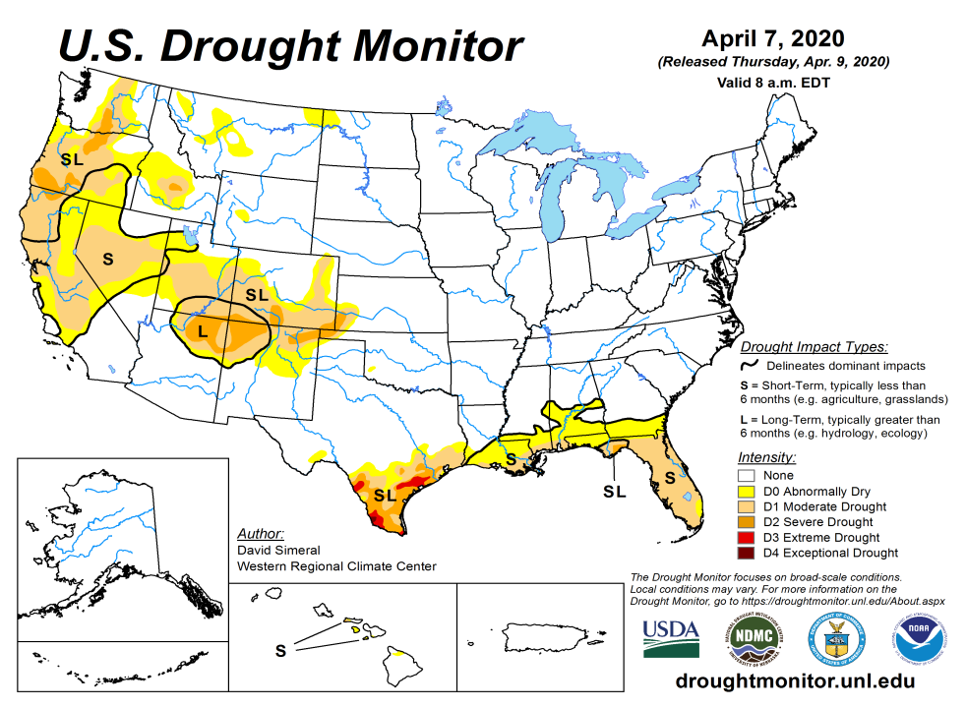
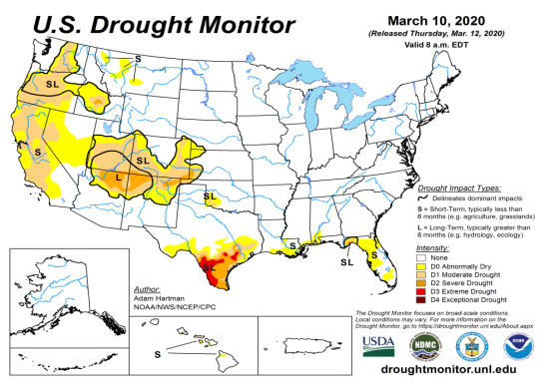
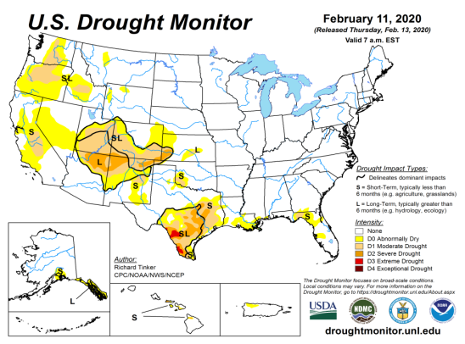
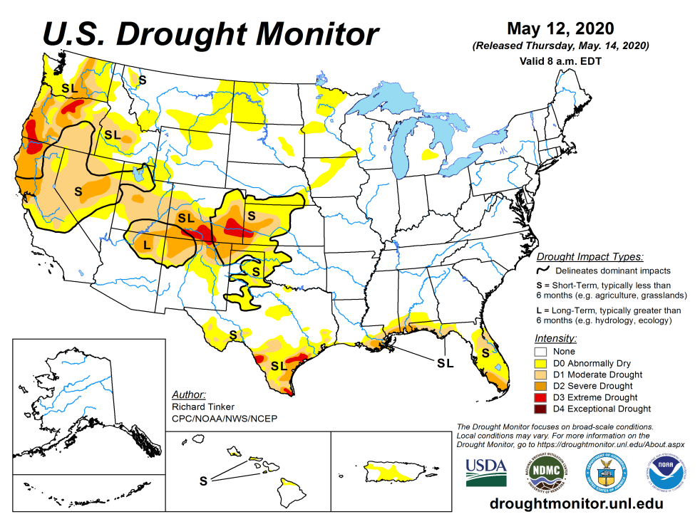
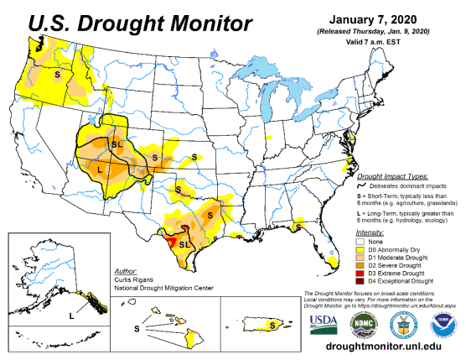
Drought Monitor
April
March
Monitoring is important because, unlike US T/P fcsts, for drought forecasts, we have to know where we are, before we can tell where we are going!!
Drought forecasts are tendency forecasts.
Over the last several months, drought, overall has generally increased in area across the South and the West.
The short/long term drought in the four corner states area (AZ/NM/ UT/CO) and along part of the west coast states continues to present/survive in some form/shape or other.
Existing and new Drought in CA/OR/WA/NV/ is slowly getting bigger and in strength.
Drought in southern TX has slightly shrunk in size, but the new short term drought along the Gulf coast from previous month has lessened.
February
May
(Recent/Latest)
January
February

Slide 3
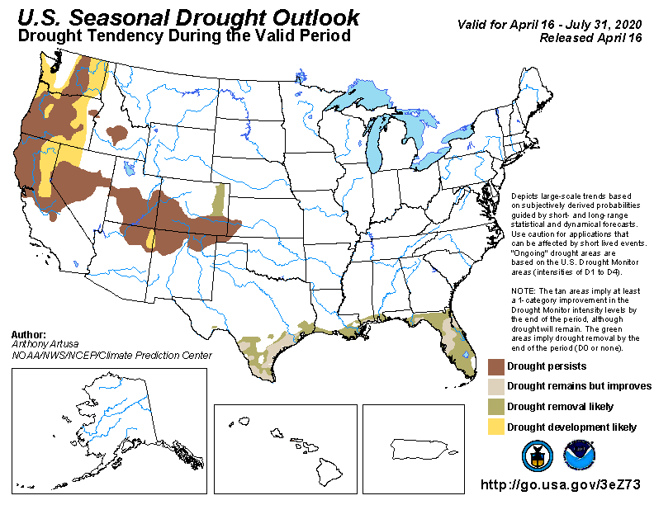
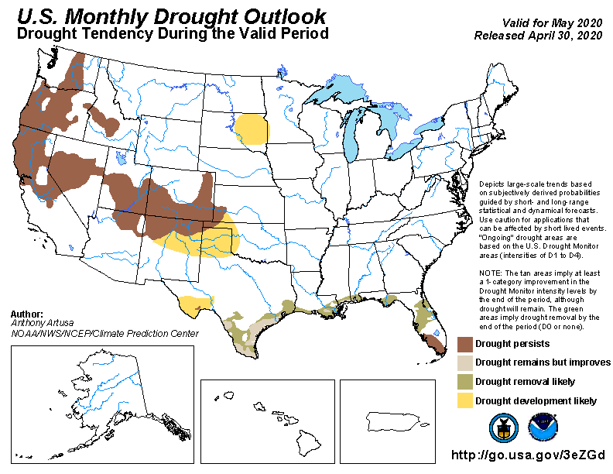
(Prev) Seasonal/Monthly Drought outlooks
(New Seasonal Drought Outlook to be released in 2 days!)
Seasonal Outlook
(Mid April 2020- July 2020)
issued 04/16/20
Monthly outlook
(for May 2020)
issued 04/30/20
Last month in this briefing we recommended:
The drought conditions along the Gulf coast and in Florida will sporadically remain, but will improve across the region in the month of May …
Large parts of the Northern Rockies and the Great Plains, including parts of Dakotas and Montana experienced severe drought in MJJA 2017. Currently low to moderate rainfall/snow/soil moisture shortfalls exist in parts of these states, and is of concern. … Possible emergence of weak dry conditions is likely here …
The drought in the west and the four corners region will continue to persist, due to continued short and long term rainfall deficits in the region.

Slide 4
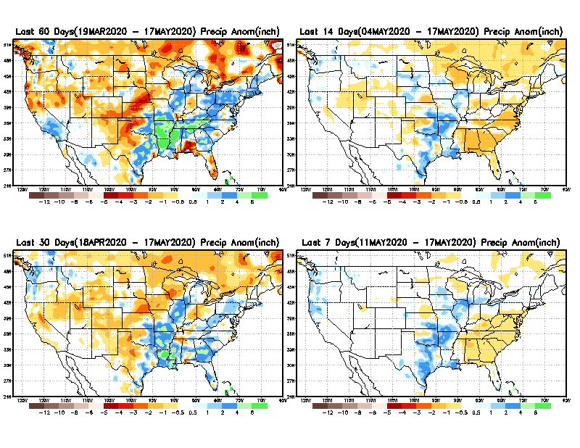
Precipitation ANOM during last 7, 14, 30, & 60 days.
60 Days
14 Days
These maps in this and following slides, including a) Total,
b) Anom and
c) Percent of Normal precip. in these and other longer time ranges are now (routinely) daily updated at:
30 Days
7 Days
Alaska regn. was also added here as separate maps recently.
From: Recent Accumulated Precipitation https://www.cpc.ncep.noaa.gov/products/Drought/briefing_prcp.shtml

Slide 5
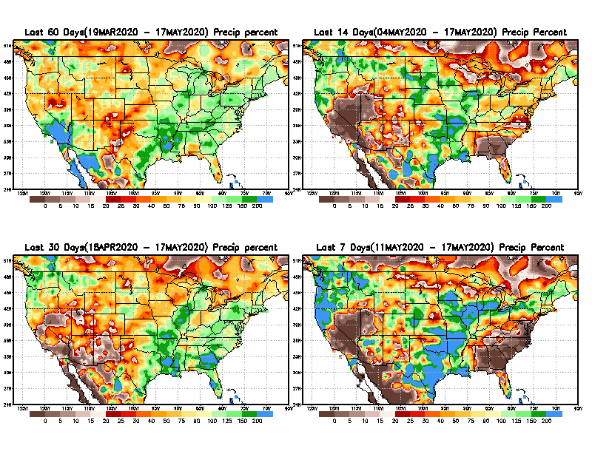
Precipitation Percent during last 7, 14, 30, & 60 days.
60 Days
14 Days
In regions, where the main rainfall season is limited to a few (3-4) months of the year, even one month of large rainfall deficit can be of concern !!
In other regions of relatively broad rainfall months, this need not be a big issue!!
already
30 days
7 Days
This may look bad, may be not!!
From: Recent Accumulated Precipitation https://www.cpc.ncep.noaa.gov/products/Drought/briefing_prcp.shtml

Slide 6
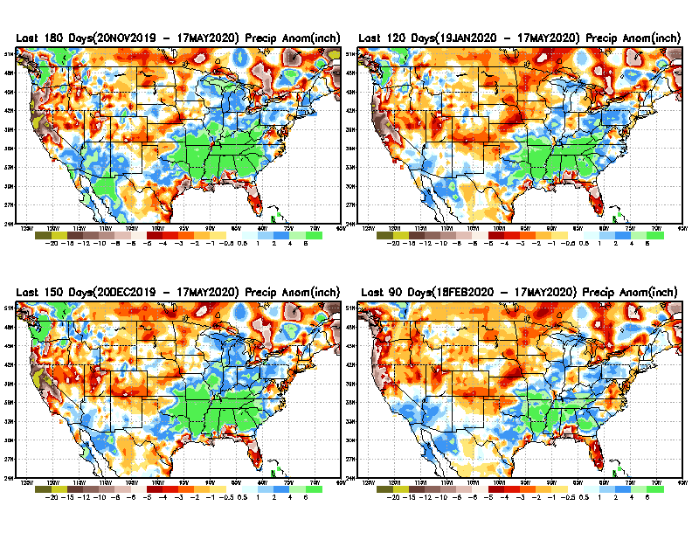
Total precipitation ANOM during last 3, 4, 5, and 6 months.
6 M
4 M
While the Precipitation anomalies deficit may seem large in some regions (compared to others), it is the % of normal precip (next slide) that matters more!!
5 M
3 M
From: Recent Accumulated Precipitation https://www.cpc.ncep.noaa.gov/products/Drought/briefing_prcp.shtml

Slide 7
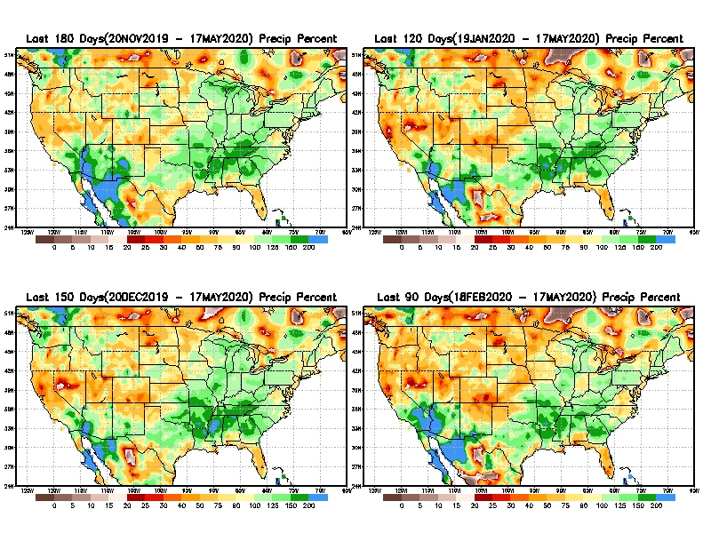
Total precipitation Percent during last 3, 4, 5, and 6 months.
6 M
4 M
In these interim time scale 3-6 months, we need to pay attention to regions, which are dark-brown, red & dark red (<50%).
5 M
3M
While accrued precipitation deficits are real & objective,
droughts are subjective declarations!!
East vs West!
Broad vs Narrow
rainfall season.
With these various rainfall deficits in diff. time ranges, where and how exactly does one declare drought? Other factors (T/SM/E, etc..) do matter, but is cumulative precip. deficits ultimately more important?

Slide 8
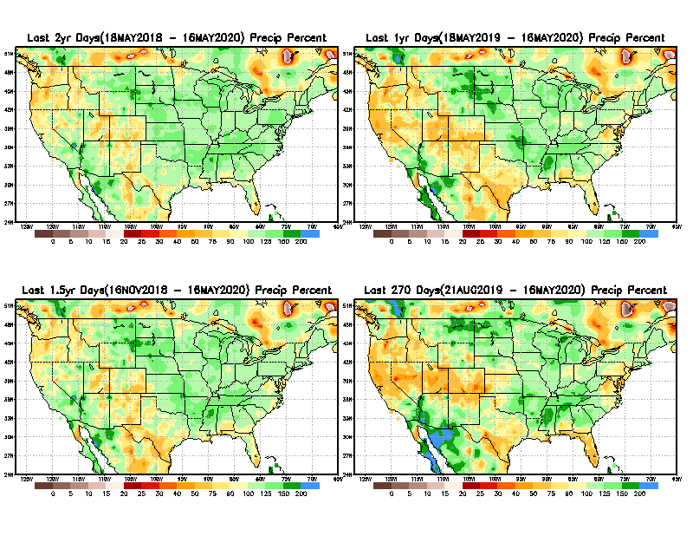
Total precipitation Percent during last 9 months, 1 yr, 1.5yrs, & 2 yrs.
2 Y
1 Y
1.5 Y
9 M
What exactly are the time scales for short(S) and long(L) term drought?
From: Recent Accumulated Precipitation https://www.cpc.ncep.noaa.gov/products/Drought/briefing_prcp.shtml

Slide 9
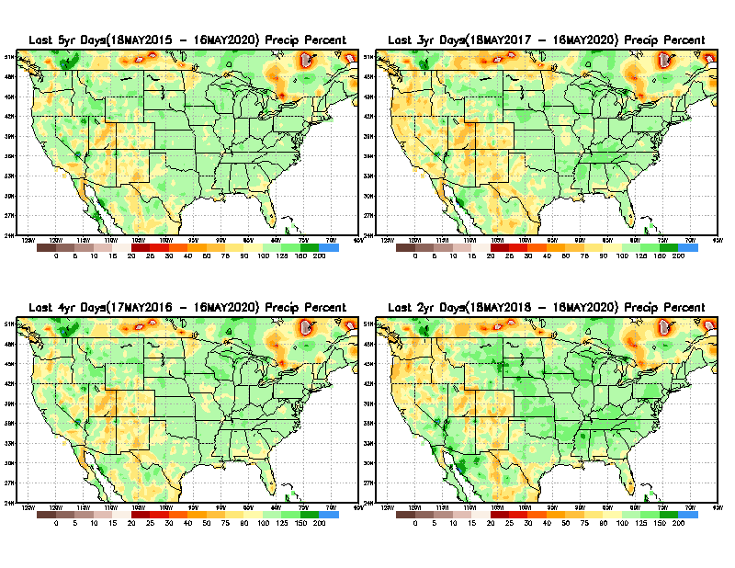
Total precipitation Percent during last 2 yrs, 3 yrs, 4 yrs, & 5 yrs.
5 Y
3 Y
Still longer term rainfall deficit variability in play? Especially in the southwest!
4 Y
2 Y
From: Recent Accumulated Precipitation https://www.cpc.ncep.noaa.gov/products/Drought/briefing_prcp.shtml

Slide 10
Rainy (3-month)Season across the US
East vs West!
Overall, more white space in the east -> distributed rainfall season (except ~FL).

Slide 11
*********
EAST vs
CTR/WEST
Behavior in Drought is loosely tied to rainfall climo!!
*********
Adapted from Rich Tinker.

Slide 12
Adapted from
Rich Tinker

Slide 13
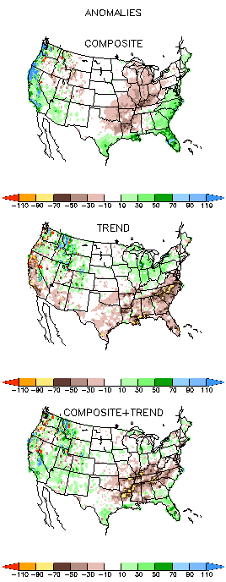
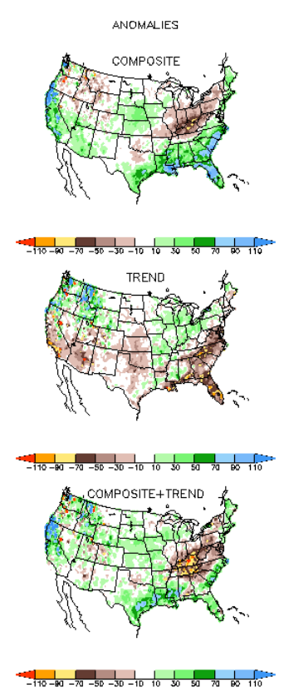
EL NINO Precip COMPOSITES & Trend maps
JFM
FMA
Only this is of relevance to us now due to neutral ENSO status.

Slide 14
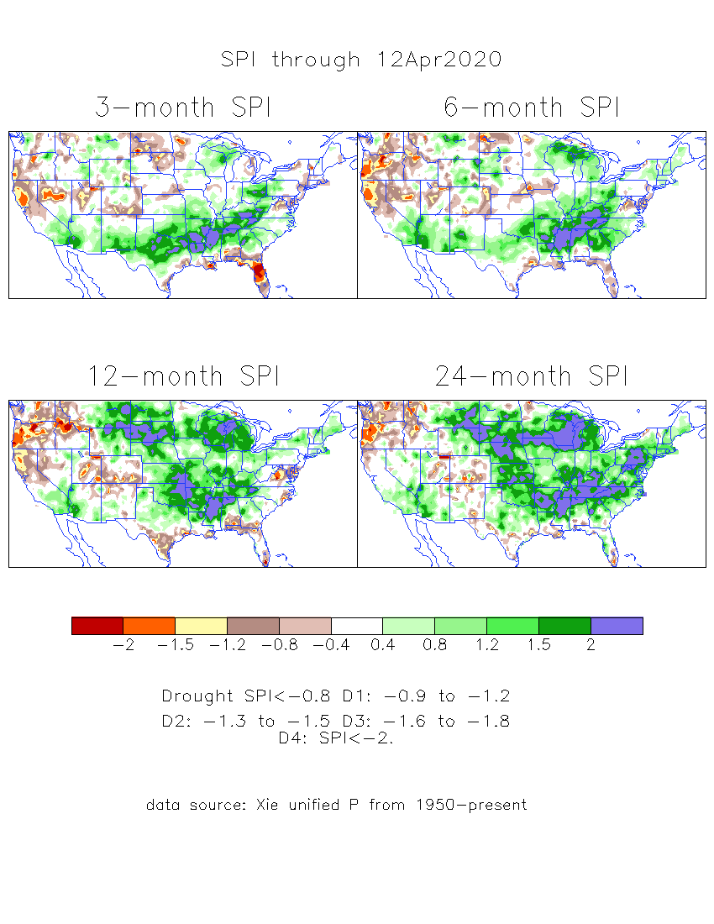
The Standardized Precipitation Index SPI (based on Observed P)
----- Last Month
Very interesting graphic & details for the drought across the US based on the more generalized precip deficit/excess, the Standardized Precipitation Index (SPI).
The dark brown and red colors, indicating standardized precipitation deficits, in the various time periods, approximately correspond to the appropriate short/long term drought monitor regions and their intensities
Have to keep an eye on this region!!
Have to keep an eye on this region!!

Slide 15
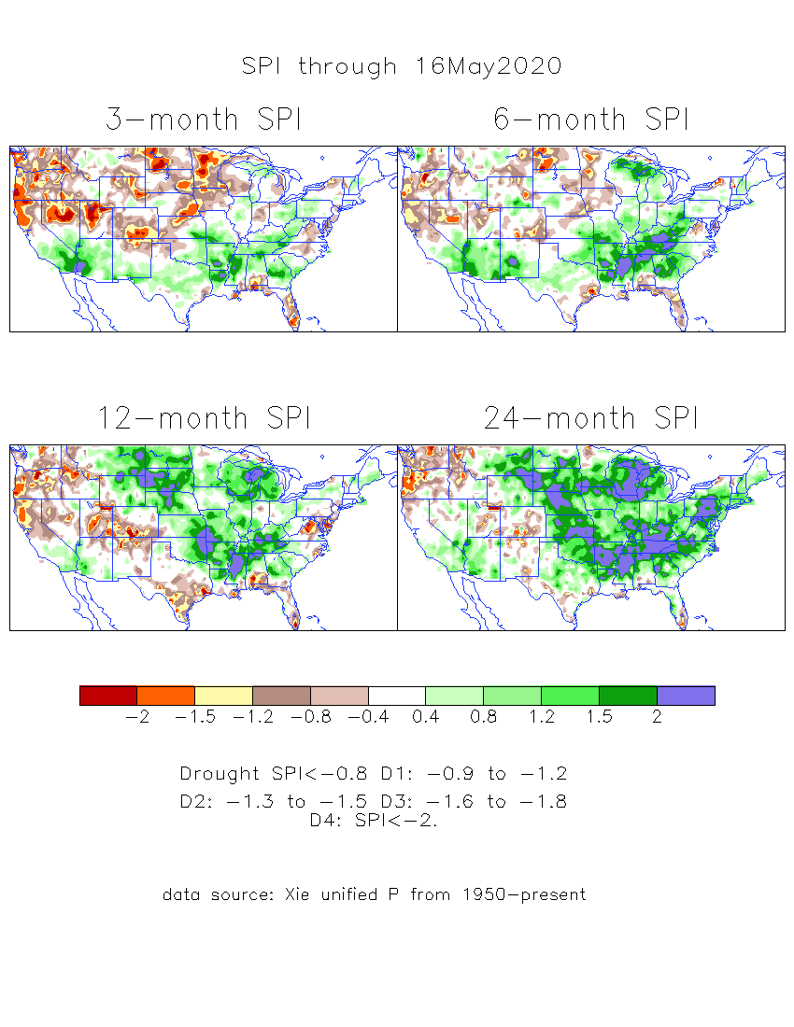
The Standardized Precipitation Index SPI (based on Observed P)
----- NOW
Very interesting graphic & details for the drought across the US based on the more generalized precip deficit/excess, the Standardized Precipitation Index (SPI).
The dark brown and red colors, indicating standardized precipitation deficits, in the various time periods, approximately correspond to the appropriate short/long term drought monitor regions and their intensities
Have to keep an eye on this region!!
How does one negotiate and reconcile declaring short term vs long term drought when precip. deficiencies exist on many different time scales.

Slide 16
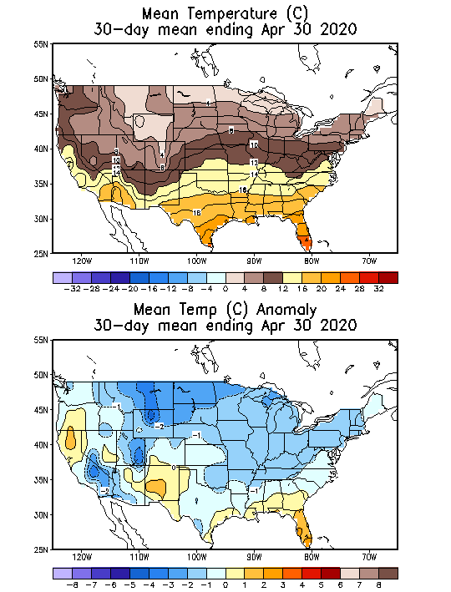
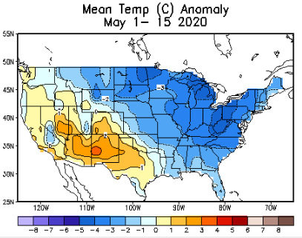
Recent US Temperatures
Overall, the US Temps have been relatively cool (compared to climo) over much of the country, except in the southwest and west, where drought and dryness exist in some form or another.

Slide 17
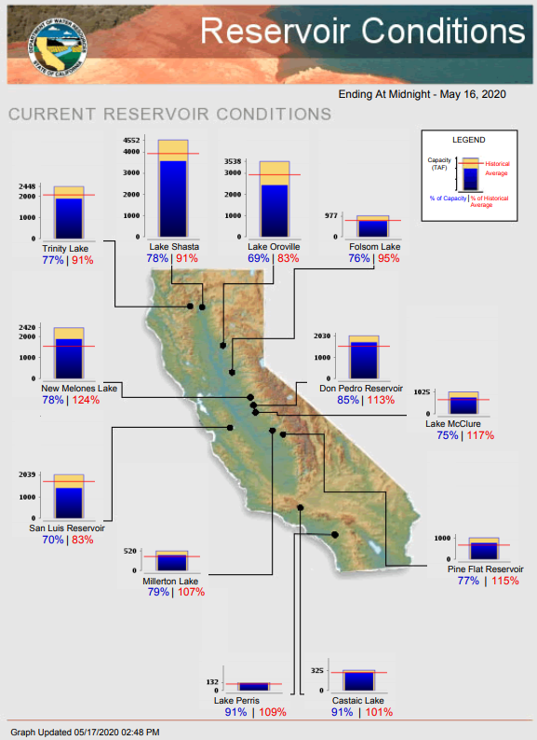
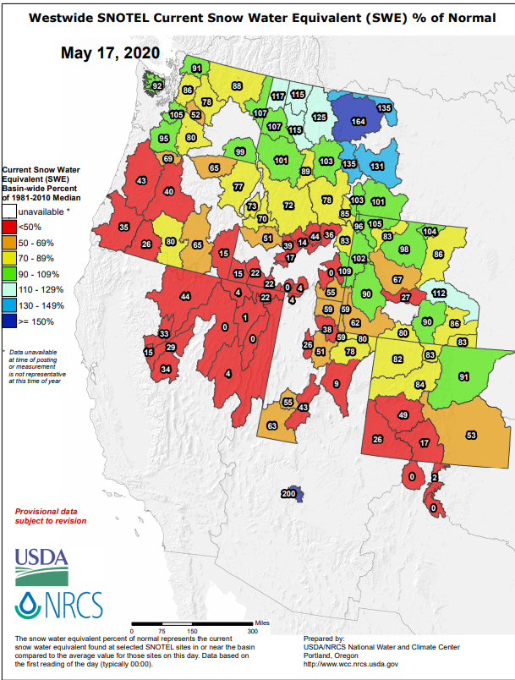
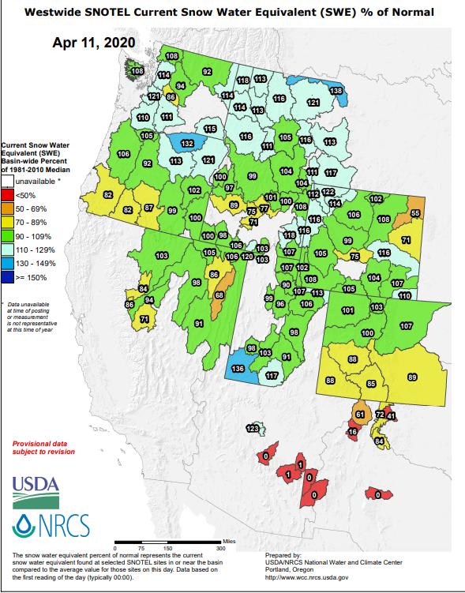
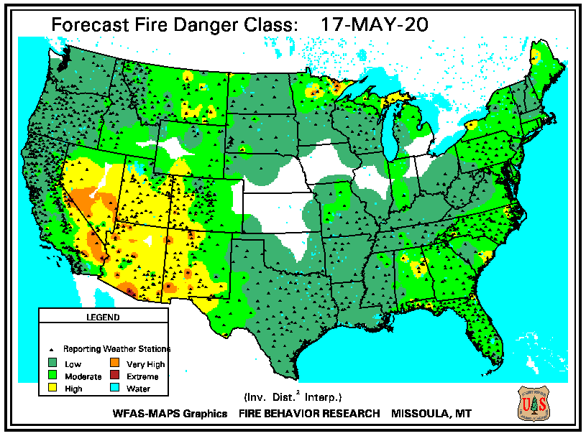
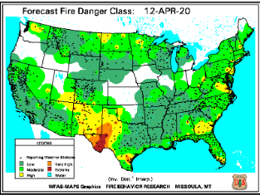
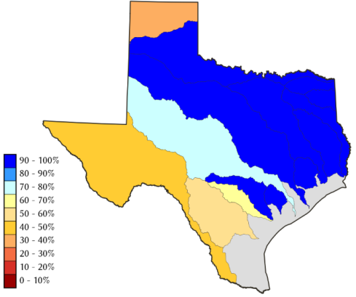
https://www.nrcs.usda.gov/wps/portal/wcc/
TX
Most California reservoirs levels are at slightly below normal levels.

Slide 18
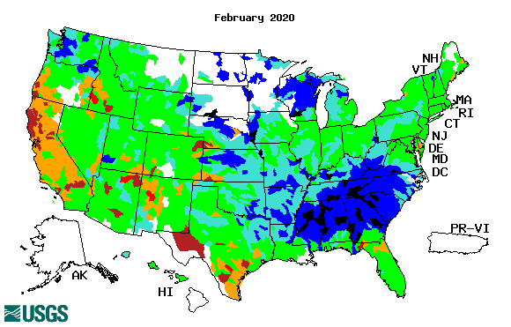
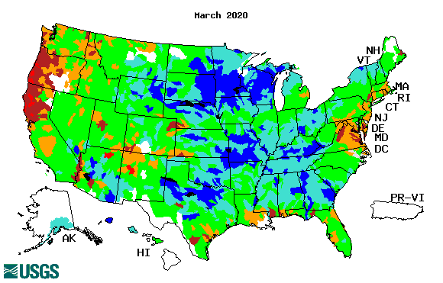
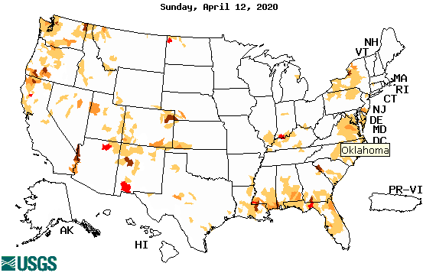
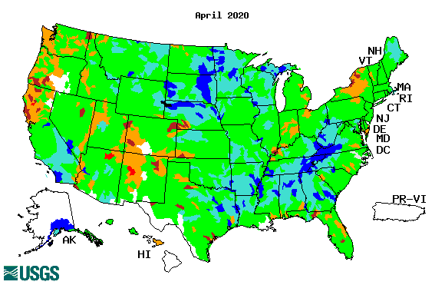
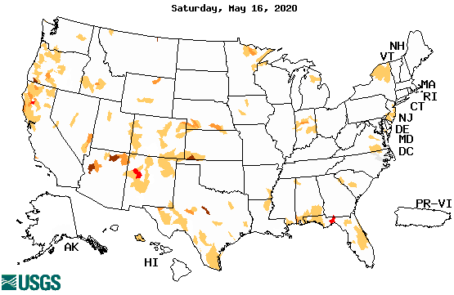
Streamflow (USGS)
Improving conditions in the southwest, getting bad.
Pacific NW much improved now.
Map shows only below normal 7-day average streamflow compared to historical streamflow for the day of year.
compare. Slide 2 USDM.
?
One month ago (left) &
Now (below)
18

Slide 19
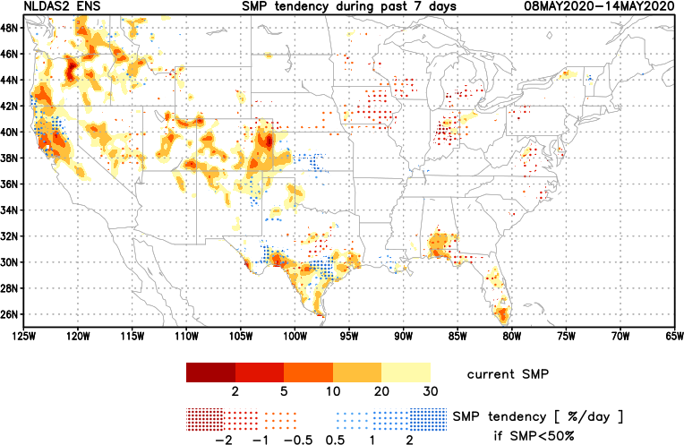
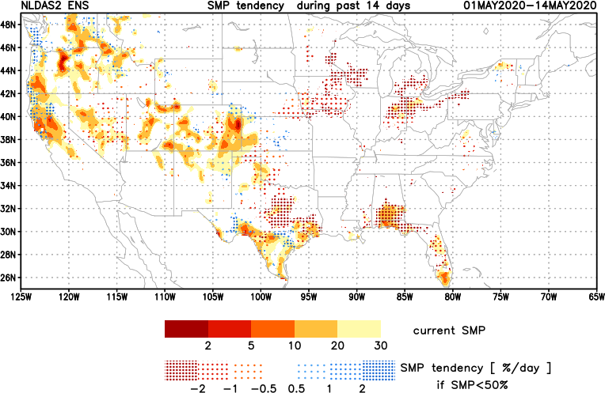
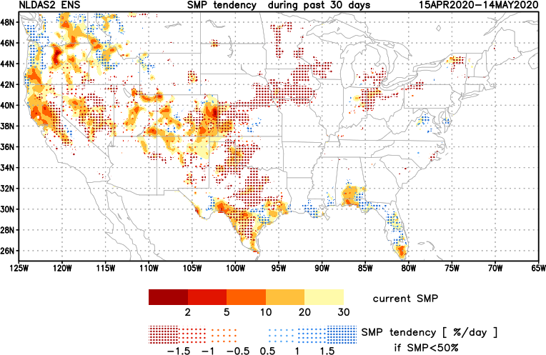
[Now]
NCEP Ensemble mean NLDAS2 models’ Soil Moisture tendency/trend
7 days
14 days
30 days
Overall Moistening tendency in the southeast and far northwest, but generally drying tendency in the southwest and west.

Slide 20
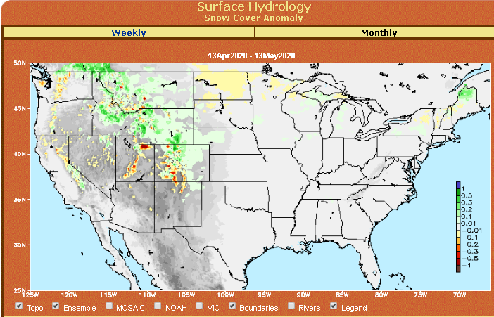
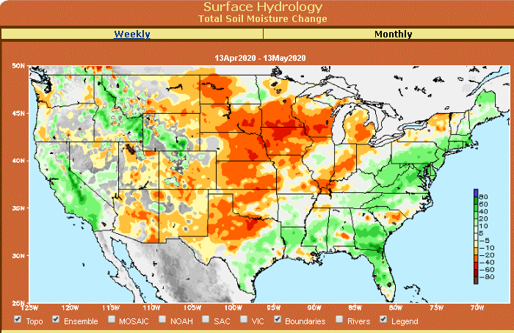
Snow cover & Soil Moisture Anomalies

Slide 21
EL NIÑO/SOUTHERN OSCILLATION (ENSO)
DIAGNOSTIC DISCUSSION
issued by CLIMATE PREDICTION CENTER/NCEP/NWS and the International Research Institute for Climate and Society
14 May 2020
ENSO Alert System Status: Not Active
Synopsis: There is a ~65% chance of ENSO-neutral during Northern Hemisphere summer 2020, with chances decreasing through the autumn (to 45-50%).

Slide 22
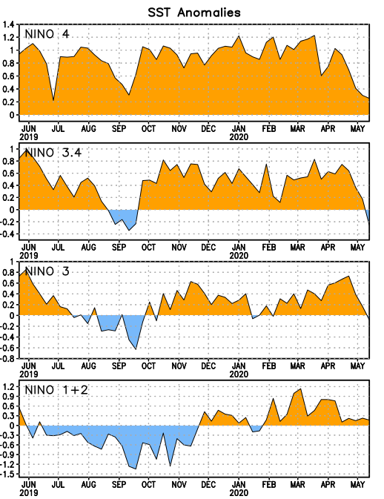
Latest values of SST indices in the various Nino Regions.
Officially in ENSO neutral territory now and for next 3-months. But overall SST anom map looks lot more warm!!

Slide 23
Latest values of SST indices in the various Nino Regions.
Officially in ENSO neutral territory now and for next 3-months. But overall SST anom map looks lot more warm!!

Slide 24
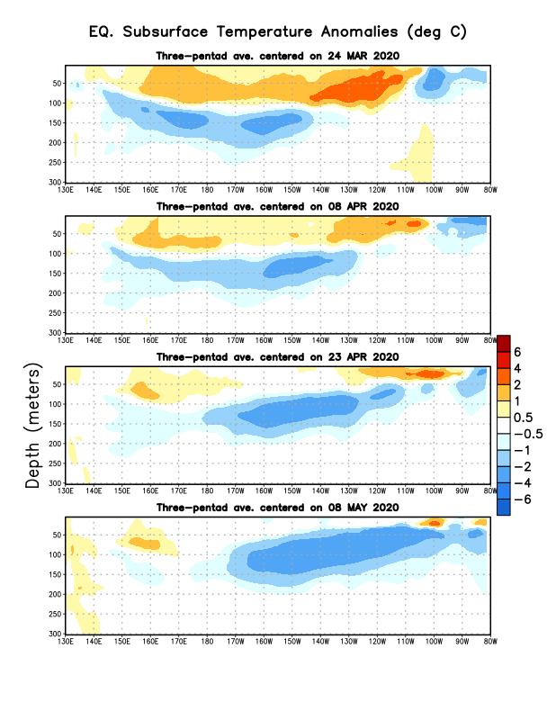
Sub-Surface Temperature Departures in the Equatorial Pacific
Tropical Pacific (Nino 3.4) surface SST in ENSO neutral status vs Subsurface
Most recent pentad analysis

Slide 25
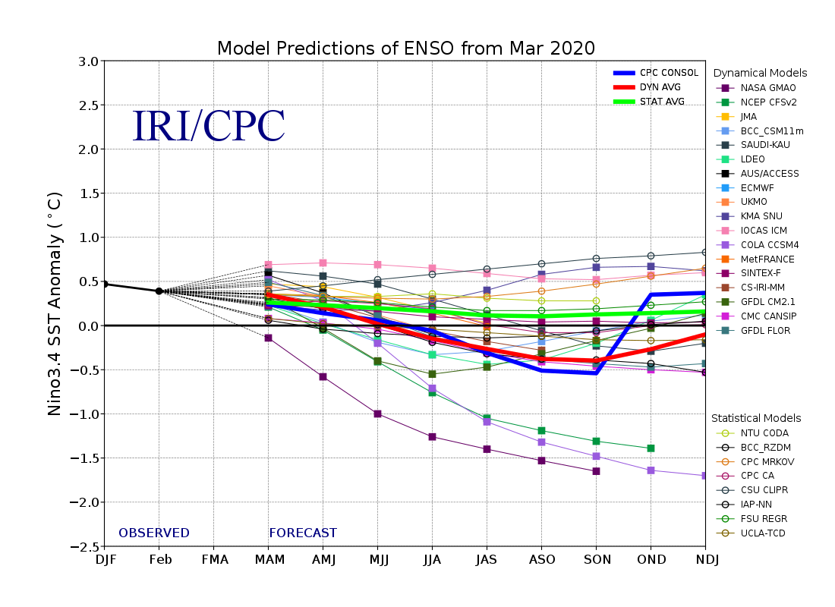
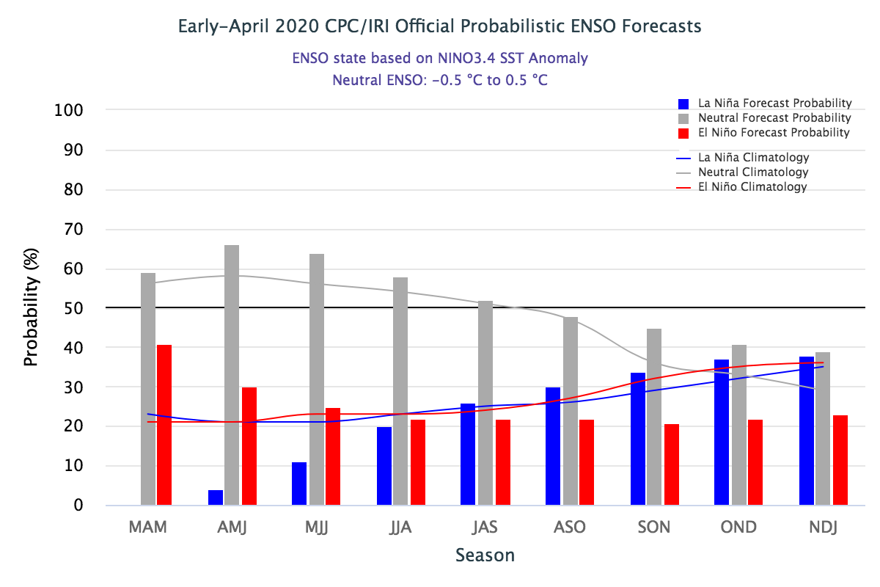
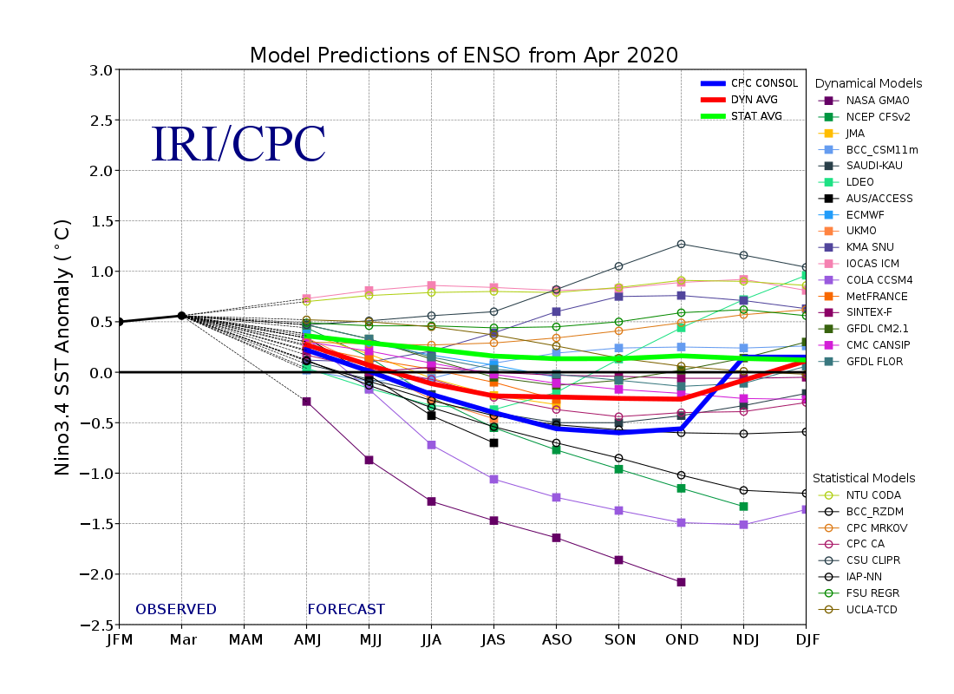
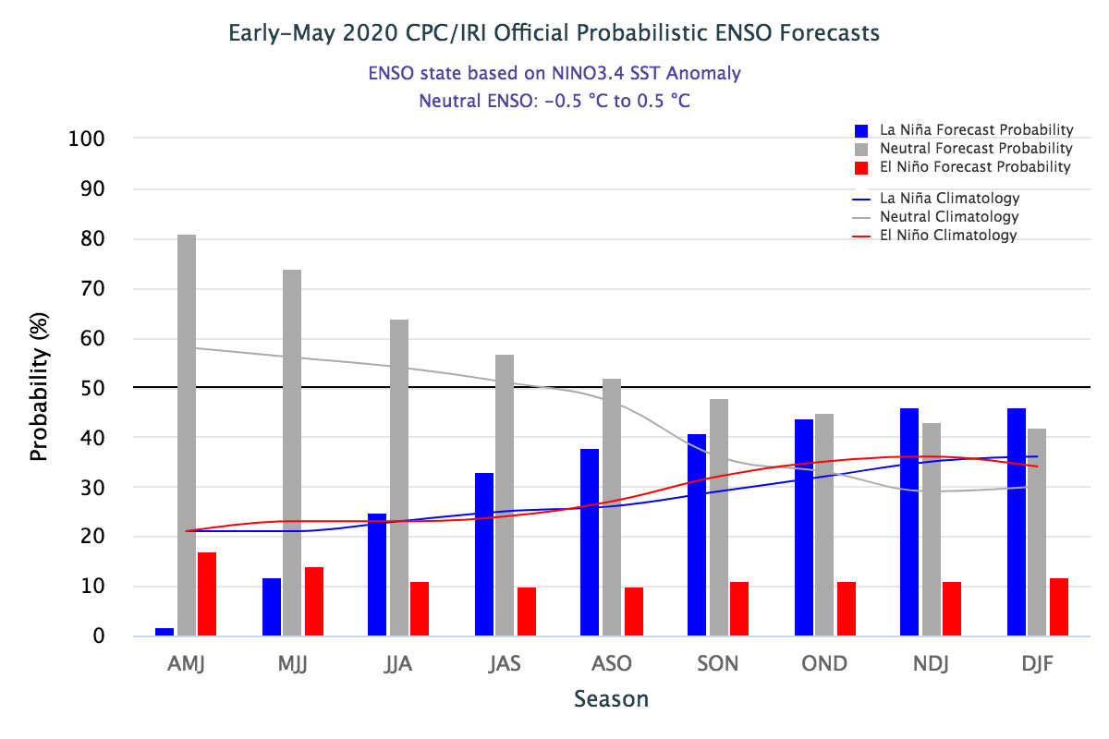
ENSO Forecasts
Early- April CPC/IRI forecast
Onwards to quick increasing probability for La Nina later in the year.
Early- May CPC/IRI forecast
CPC consolidation fcst should stop here..
ENSO Neutral for this forecast season. Not much help here to models for seasonal forecast signal!!

Slide 26
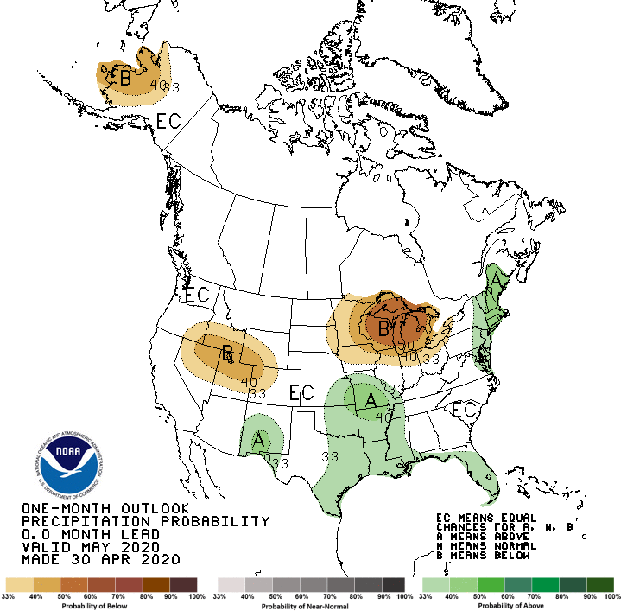
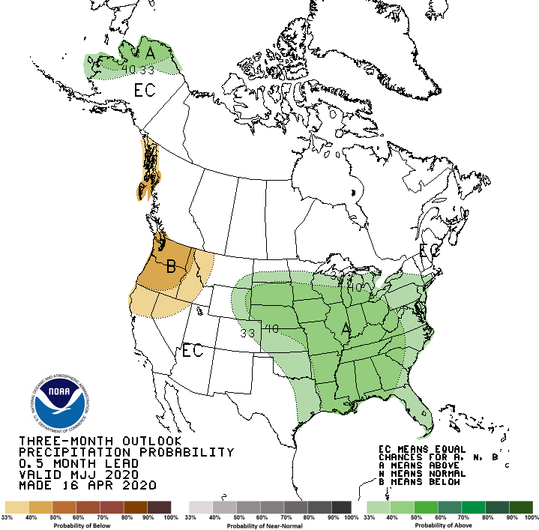
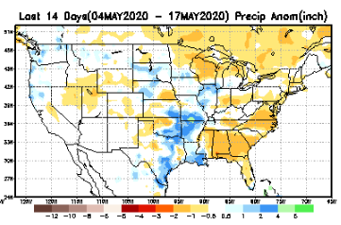
Released Apr 30th
Previous(Last month)
CPC’s official
Precipitation OUTLOOK for Monthly (May)/Seasonal (MJJ)
Released Apr 16th
Observed so far this month!!
Monthly P/T forecasts verified at mid-month are generally good! Why? ☺ (becoz they r mostly based on GFS’ 2-wk fcsts)
But this month, so far ????

Slide 27
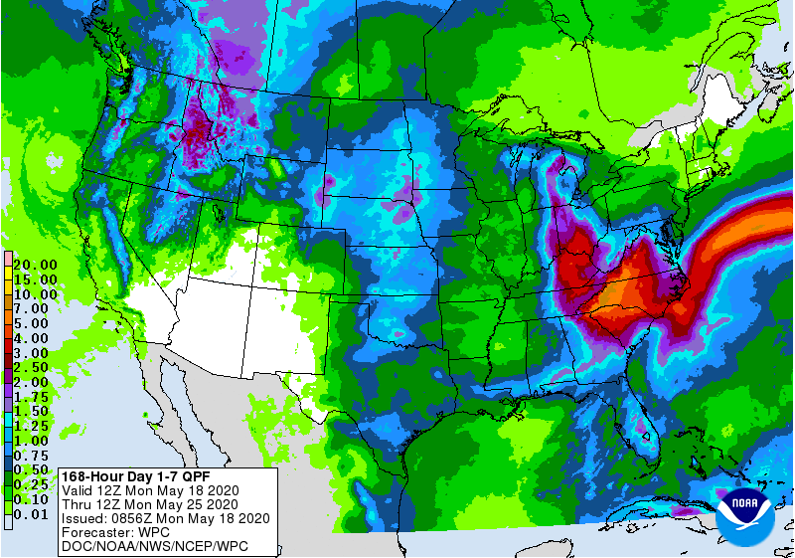
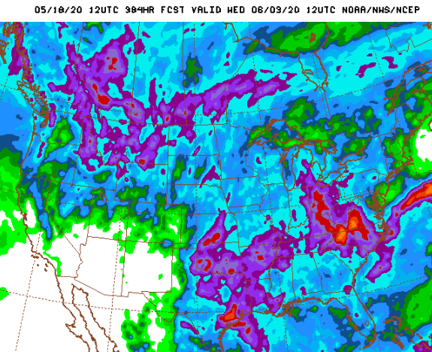
WPC Next 7 days QPF Forecast
Probably flooding in some parts of the SE this week!!
But relative dryness parts of Dakotas Minnesota
GFS Model Guidance for next 16 days.

Slide 28
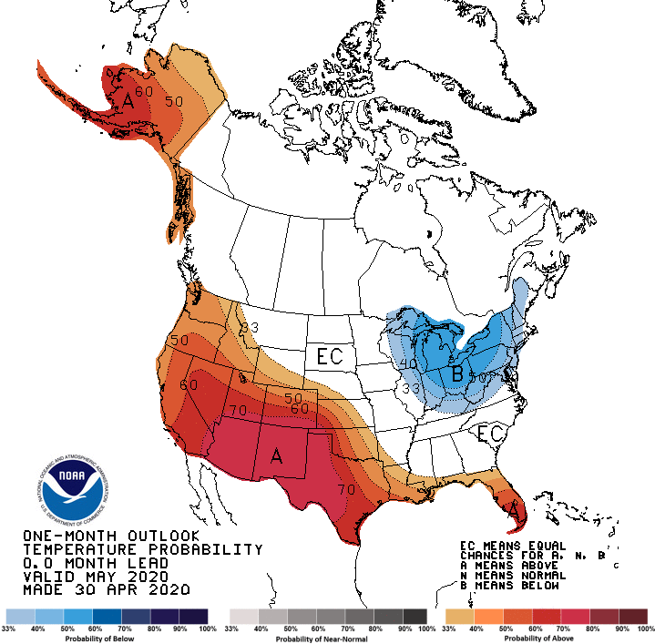
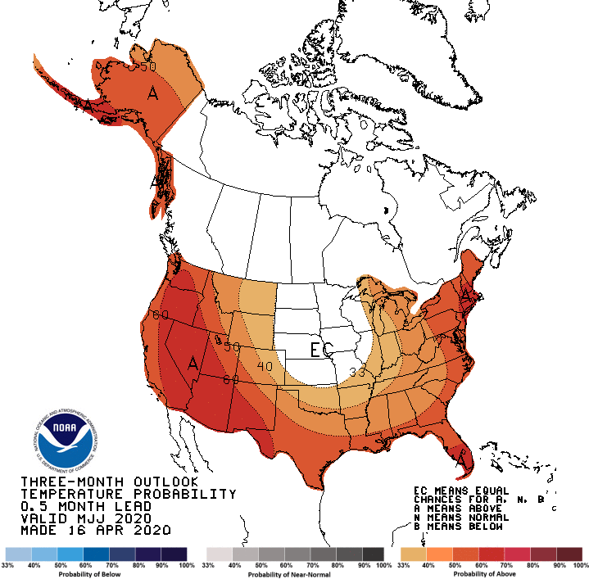
Made
Apr 30th
Previous (Last Month)
CPC’s official
Temperature outlook for Monthly (May)/Seasonal (MJJ)
Made
Apr 16th
Observed so far this month!! ☺

Slide 29
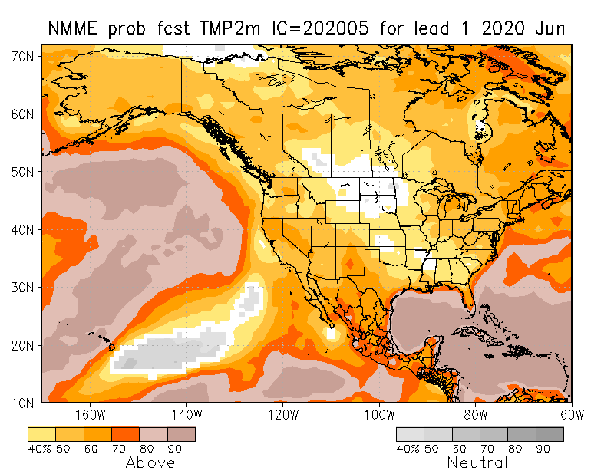
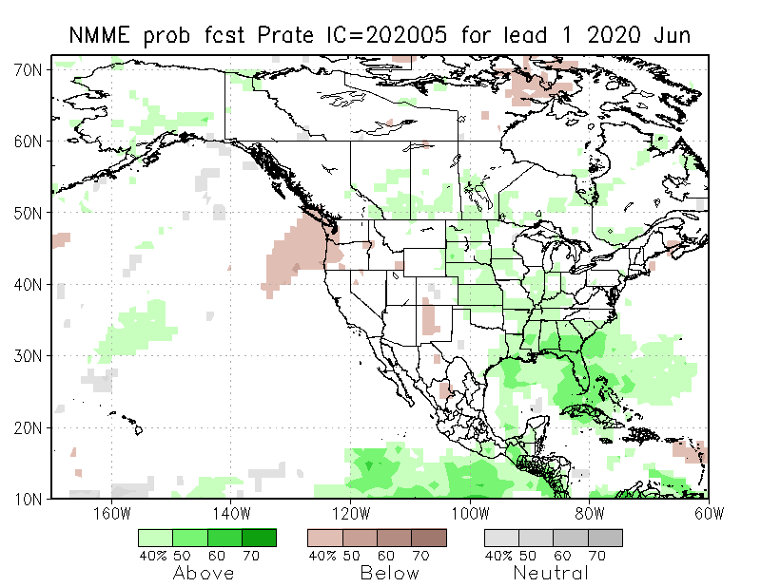
NMME T & P Ens.Mean forecasts
June
These warm (red) fcsts for Temp. – are generally made and verify too mostly!!
JJA
Will these Precip fcsts turn out to be true? Remember the 2017 Spring the Northern Great Plains drought forecast ??

Slide 30
Agreement/Disagreement in the various NMME models’ MJJ seasonal Precip. Forecst.
??

Slide 31
Forecast uncertain in Hatched areas.

Slide 34
Initial Conditions:
05/12/2020
http://drought.geo.msu.edu/research/forecast/smi.monthly.php
Predicted Monthly Soil Moisture Percentile
Initial Conditions 1 months ago:
04/07/2020
The inter quartile range suggest greater uncertainty about the forecast in these shaded regions.

Slide 35
Summary
Current ENSO status and forecast. There is a ~65% chance of ENSO-neutral during Northern Hemisphere summer 2020, with chances decreasing through the autumn (to 45-50%).
Current Drought conditions:
Over the last several months, drought, overall has increased in area across the South and the West.
The short/long term drought in the four corner states area (AZ/NM/ UT/CO) continued to strengthen in CO and extend into Kansas. present/survive/strengthen in some form/shape or other, where long term rainfall deficiencies have been present. Existing and new Drought in CA/OR/WA/NV/ has gotten bigger in area and in strength.
The drought in the southeast along the Gulf coast has either somewhat disappeared or weakened.
Drought in southern TX continues to vacillate, but has slightly decreased in size and intensity.
Much of these were suggested as recommendations from this briefing last month.
The California reservoirs are at somewhat satisfactory levels, but continued dry/drought conditions there, combined with the ending of the rainy winter season will weigh in heavily on these water resources in the upcoming summer and fall months.
Prediction:
The continued presence and forecast of near normal/neutral ENSO conditions in the tropical equatorial Pacific through the rest of spring and summer, is taking away the little edge and confidence via lower Eq. Pacific SST boundary conditions in the model’s seasonal forecasts of precipitation. Also the continued forecast of above normal monthly/seasonal temperatures across the entire US, does not help the drought conditions in the west.
The drought in the west and the four corners region will continue to persist, due to continued short and long term rainfall deficits in the region. Drought along the deep southern Texas coast will be present in some moderate form barring a rainfall impact from a tropical system in the upcoming hurricane season.
Dry to low to moderate drought conditions will continue to emerge in large parts of the Northern Rockies and the Great Plains including parts of Dakotas and Minnesota, where low to moderate rainfall shortfalls exist in parts of these states.
With the upcoming rainfall season, and the expected rainfall in the short and medium term, the drought conditions along the Gulf coast and in Florida will be considerably improved will be pretty much gone in the upcoming month of June and JJA season.
*********************

Slide 36
Improve
SDO [FMA’20]
(1/7/20 USDM)
Persist
Develop
Persist
Improve
Improve
Considered Development,
but short-term & ERF wetness,
FMA climo dry
Improve
Persist
ERFs wetness; LLFs = EC;
FMA climo ~ dry (west)
Improve
Persist

Slide 37
Miscellaneous maps

Slide 38
Miscellaneous maps

