Slide 1
Drought Outlook Support Briefing May 2021
Climate Prediction Center/NCEP/NOAA
http://www.cpc.ncep.noaa.gov/products/Drought

Slide 2
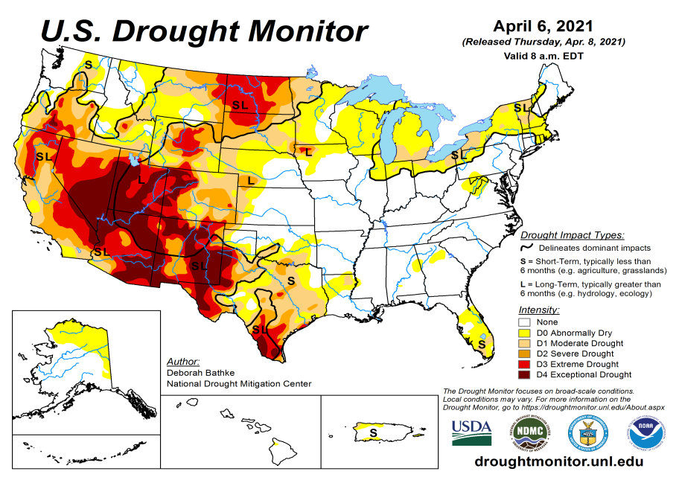
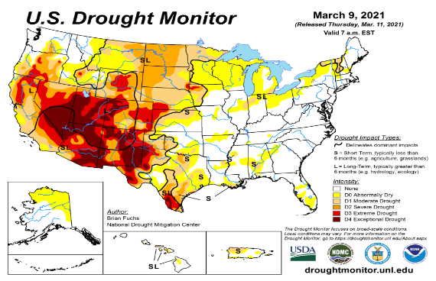
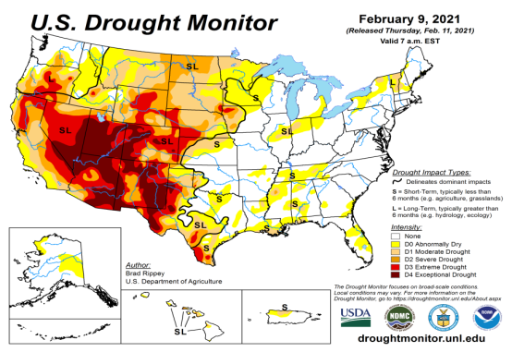
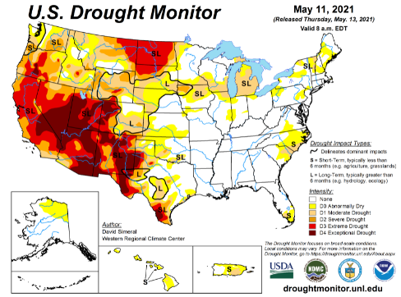
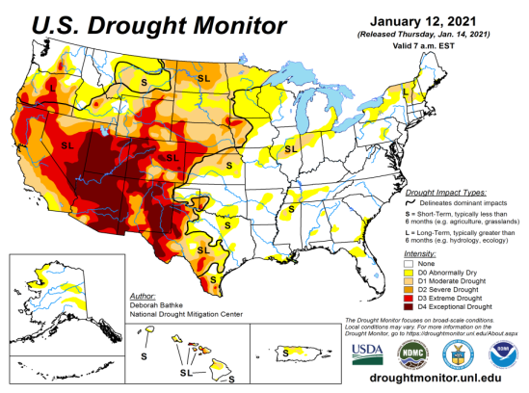
Drought Monitor
Monitoring is important because, unlike US T/P fcsts, for drought forecasts, we have to know where we are, before we can tell where we are going!! Drought forecasts are tendency forecasts.
April
March
Over the last 4-5 months, drought area & severity has overall generally remained about the same. The worse drought conditions are in the border areas of southwest states CA, AZ, NV, UT, CO, and western TX. These are regions are part of the long term drought.
The drought OR, WA in the Dakotas, MT, ID, Wyoming, Nebraska, Kansas and vicinity which developed in the last year continues to hang in there. Next months rain crucial!
About 50 % of the country is continuing to experience category D1 or worse drought condition (next side!). Parts of central/eastern TX did get some relief.
The on/off drought and area extent in the New England states appears to be shrinking. Mild drought along the Carolina border has emerged as forecast.
February
May
(Recent/Latest)
January
February

Slide 3
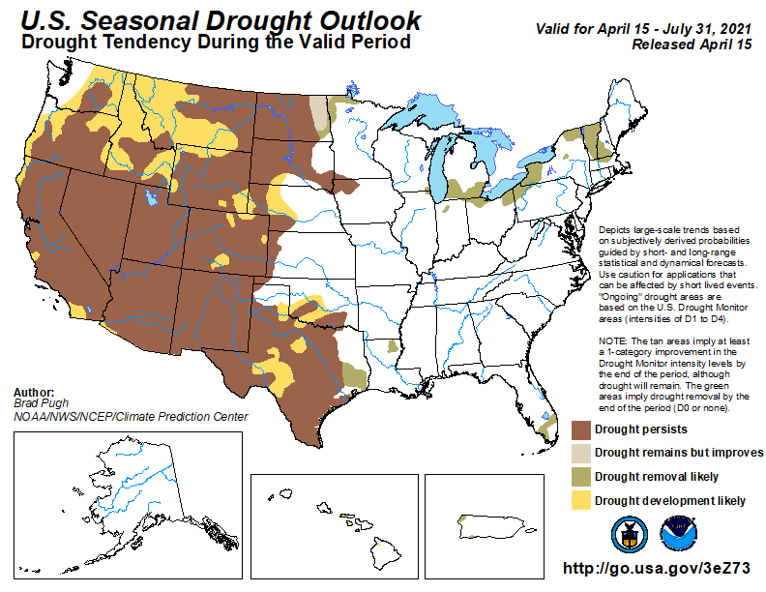
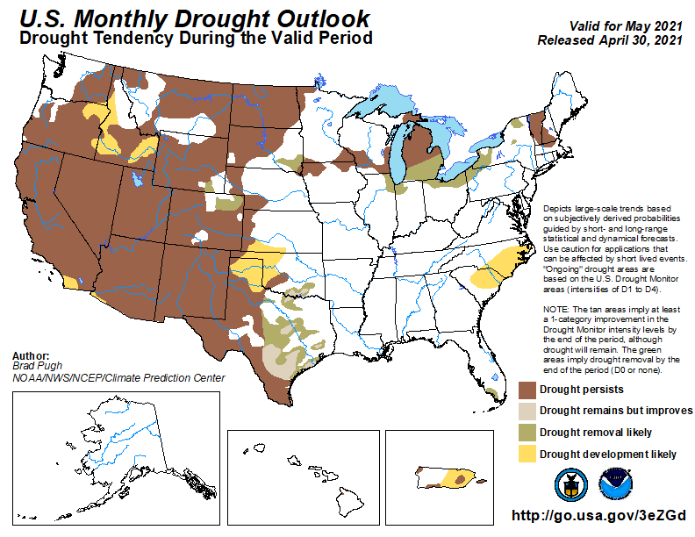
(Prev) Seasonal/Monthly Drought outlooks
(New Seasonal+ Drought Outlook to be released in 2 days!)
(New Monthly Drought Outlook to be released end of this month)
Seasonal Outlook
(Mid Apr 2021- Jul 2021)
issued 04/15/21
Monthly outlook
(for May 2021)
issued 04/30/21
Similar looking Monthly and seasonal outlooks, except in the northeast!
Also compare West vs East.

Slide 4
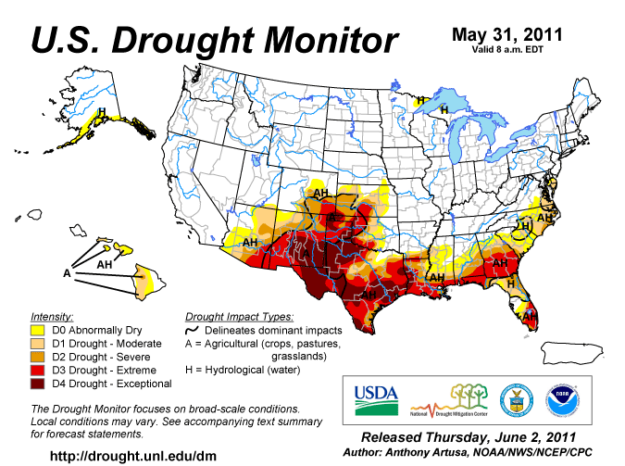
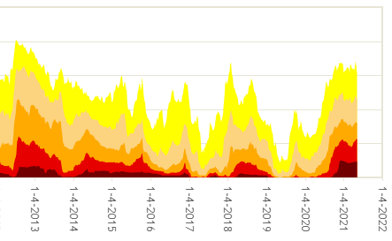
Famous 2011 TX drought
Each drought is different!!
The recent drought has somewhat stagnated ?
50%
Now!

Slide 5
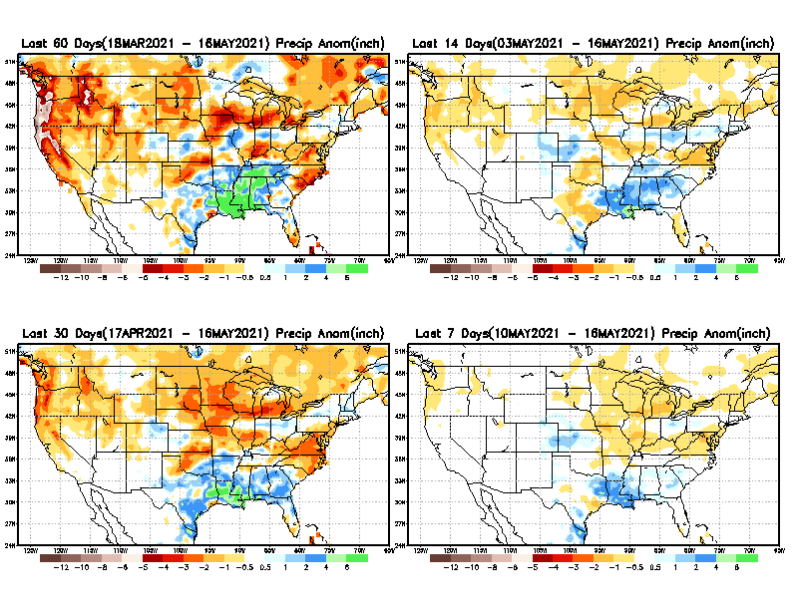
Precipitation ANOM during last 7, 14, 30, & 60 days.
60 Days
14 Days
30 Days
7 Days
These maps in this and following slides, including a) Total,
b) Anom and
c) Percent of Normal precip. in these and other longer time ranges are now (routinely) daily updated at:
From: Recent Accumulated Precipitation https://www.cpc.ncep.noaa.gov/products/Drought/briefing_prcp.shtml

Slide 6
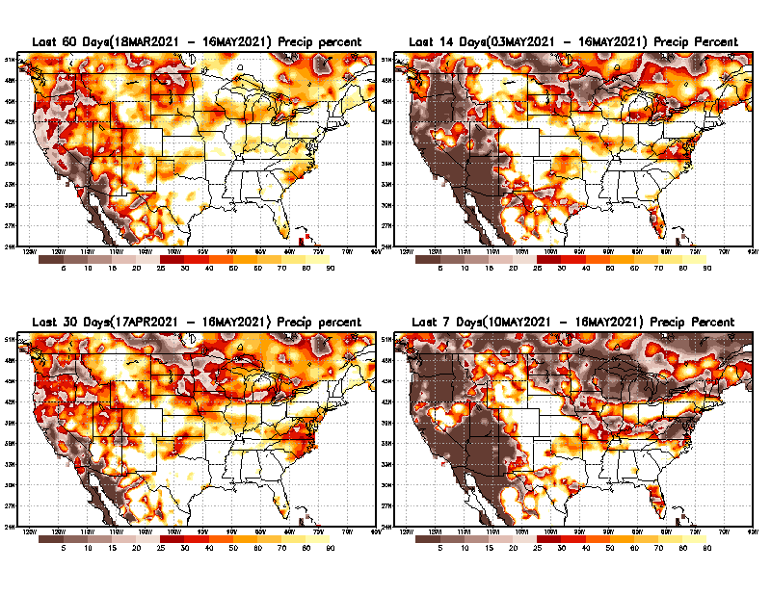
Precipitation Percent during last 7, 14, 30, & 60 days.–Only Deficit Areas shown!! <=90%
60 Days
14 Days
This plot shows only the rainfall deficient regions <= 90% of normal.
-- This shows more clearly possible/likely drought developing region in the future unless there is above normal rainfall in these regions in the future, to offset these shortfalls.
30 days
7 Days
From: Recent Accumulated Precipitation https://www.cpc.ncep.noaa.gov/products/Drought/briefing_prcp.shtml

Slide 7
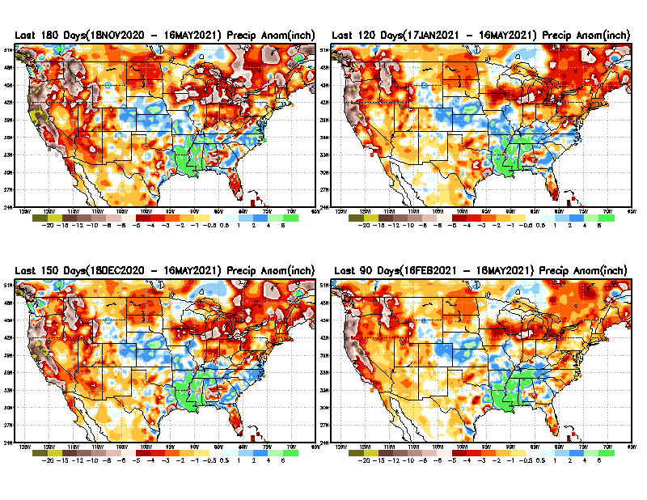
Total precipitation ANOM during last 3, 4, 5, and 6 months.
6 M
4 M
While the Precipitation anomalies deficit may seem large in some regions (compared to others), it is the % of normal precip (next slide) that matters more!!
5 M
3 M
From: Recent Accumulated Precipitation https://www.cpc.ncep.noaa.gov/products/Drought/briefing_prcp.shtml

Slide 8
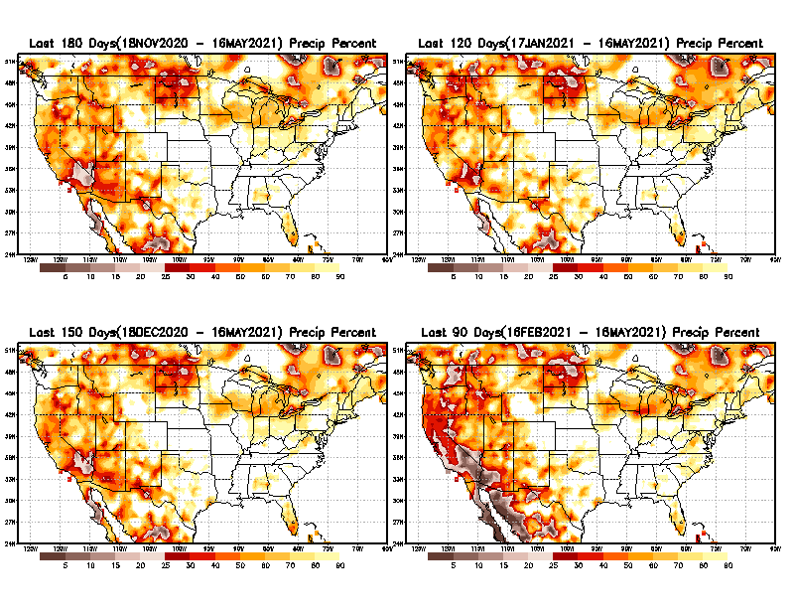
Total precipitation Percent during last 3, 4, 5, and 6 months–Only Deficit Areas!! <=90%
6 M
4 M
In these interim time scale 3-6 months, we need to pay attention to regions, which are dark-brown, red & dark red (<50%).
While accrued precipitation deficits are real & objective,
droughts are subjective declarations!!
5 M
3M
East vs West!
Broad vs Narrow
rainfall season.
In general, West suffers more from frequent and lasting droughts.
With these various rainfall deficits in diff. time ranges, where and how exactly does one declare drought? Other factors (T/SM/E, etc..) do matter, but is cumulative precip. Are deficits/percent_of_normal ultimately more important?

Slide 9
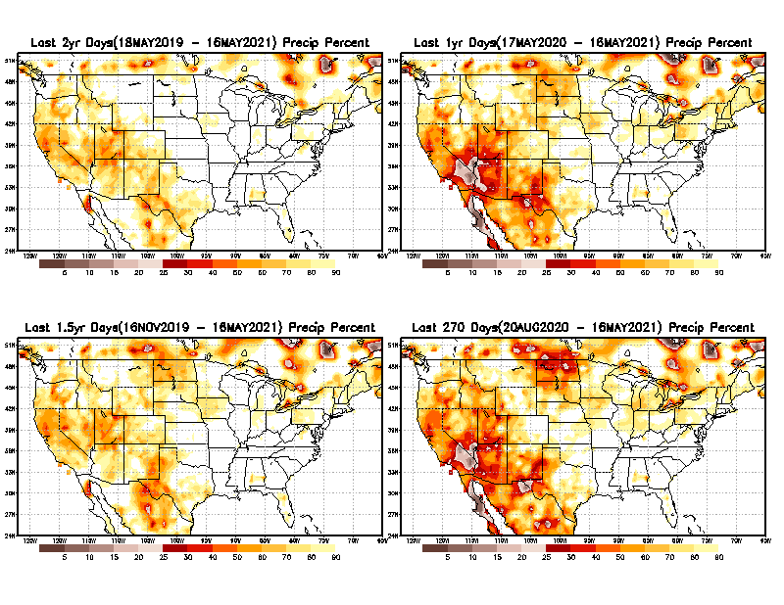
Total precipitation Percent during last 9 months, 1 yr, 1.5yrs, & 2 yrs. .–Only Deficit Areas shown!! <=90%
2 Y
1 Y
Tinderbox areas, where some form of longer term rainfall
deficiencies already, exist !!
-Almost all are in the southwest!
-This & Next slide!!
1.5 Y
9 M
From: Recent Accumulated Precipitation https://www.cpc.ncep.noaa.gov/products/Drought/briefing_prcp.shtml

Slide 10
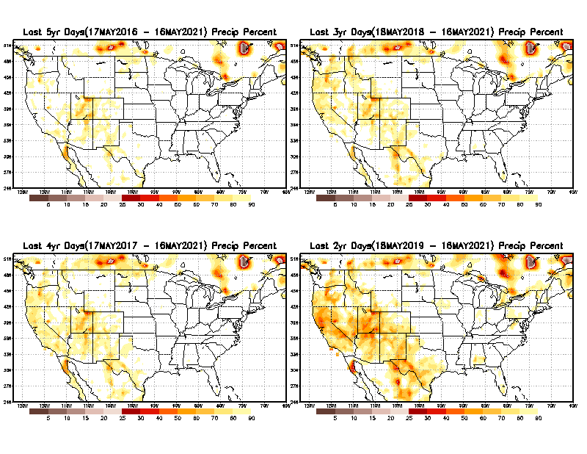
Total precipitation Percent during last 2 yrs, 3 yrs, 4 yrs, & 5 yrs. .–Only Deficit Areas shown!! <=90%
5 Y
3 Y
In these long time ranges (2-5 yrs), there is a general dearth/lack of precipitation in the southwest US. – where the current severe drought ravages!!. At the end of this current ongoing La Nina the long term situation will get even worse!!
4 Y
2 Y
From: Recent Accumulated Precipitation https://www.cpc.ncep.noaa.gov/products/Drought/briefing_prcp.shtml

Slide 11
Rainy (3-month)Season across the US
East vs West!
More darker colors in west/central => narrow rainy season (months)
Overall, more white space in the east => distributed rainfall season (except ~FL).

Slide 12
*********
EAST vs
CTR/WEST
Drought Behavior is loosely tied to rainfall climo!!
*********
Adapted from Rich Tinker.

Slide 13
monthly Climatology difference :
Pclimo_9120 minus Pclimo_8110
(New-Old)

Slide 14
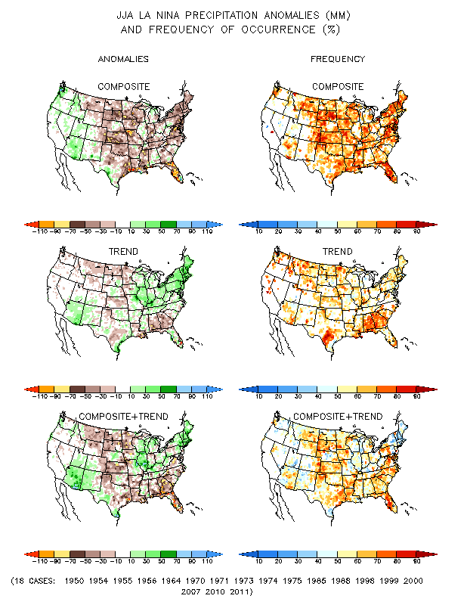
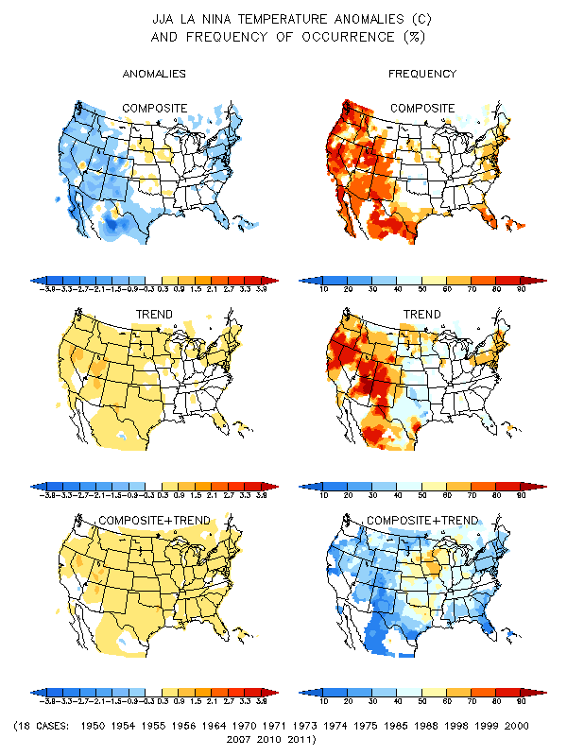
La Nina Precip/Temperature COMPOSITES & Trend map
JJA
P
T
With expected ENSO-neutral conditions, this row is relevant!!

Slide 15
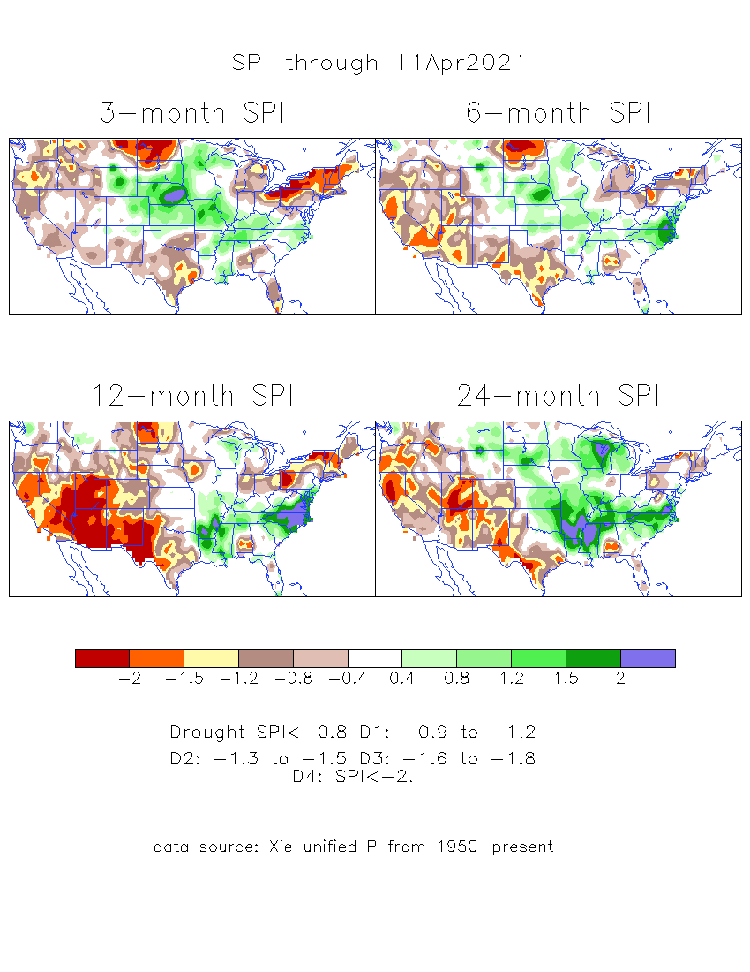
The Standardized Precipitation Index SPI (based on Observed P)
----- Last Month
Very interesting graphic & details for the drought across the US based on the more generalized precip deficit/excess, the Standardized Precipitation Index (SPI).
The dark brown and red colors, indicating standardized precipitation deficits, in the various time periods, approximately correspond to the appropriate short/long term drought monitor regions and their intensities
Short-term situation has gotten slightly better in the west, but long term situation is, and will stay worse -- as we said last month!!

Slide 16
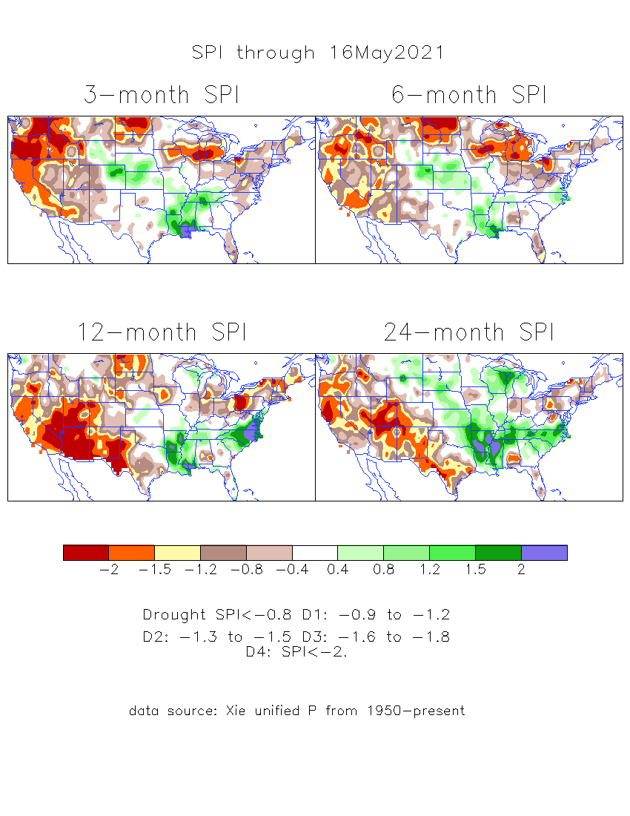
The Standardized Precipitation Index SPI (based on Observed P)
----- NOW
Very interesting graphic & details for the drought across the US based on the more generalized precip deficit/excess, the Standardized Precipitation Index (SPI).
The dark brown and red colors, indicating standardized precipitation deficits, in the various time periods, approximately correspond to the appropriate short/long term drought monitor regions and their intensities
S
The short term drought has shifted/extended from southwest to northwest. But the long term drought in the southwest remains.
----- NOW
L
How does one negotiate and reconcile declaring short term vs long term drought when precip. deficiencies patterns differ on many different time scales locally!!
What is the cutoff delineating time between short VS long term drought!!

Slide 17
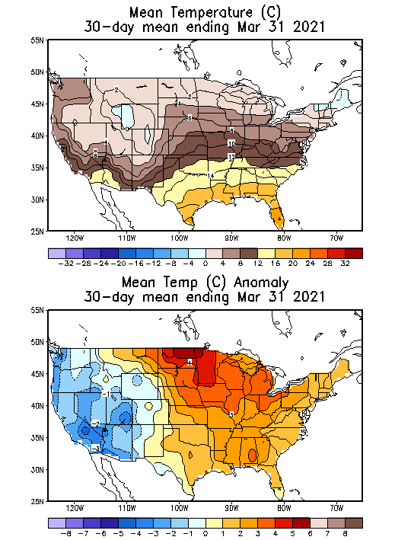
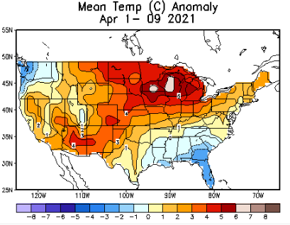
Recent US Temperatures
(MARCH-
Slide shown last month)
Such swings in winter Temperatures
Even in the midst of La Nina!!
From Jan –> Feb -> Mar
Great volatility even during strong ENSO!

Slide 18
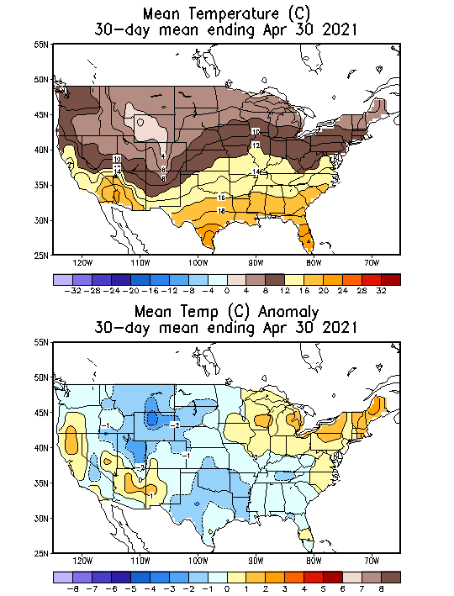
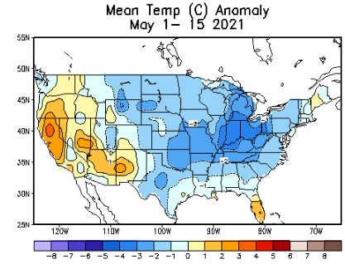
Recent US Temperatures
Such swings in winter Temperatures
Even in the midst of La Nina!!
From Jan –> Feb -> Mar
Now back to cold across much of US! So far!!
So far this month !!
Remember, the TX freeze!!

Slide 19
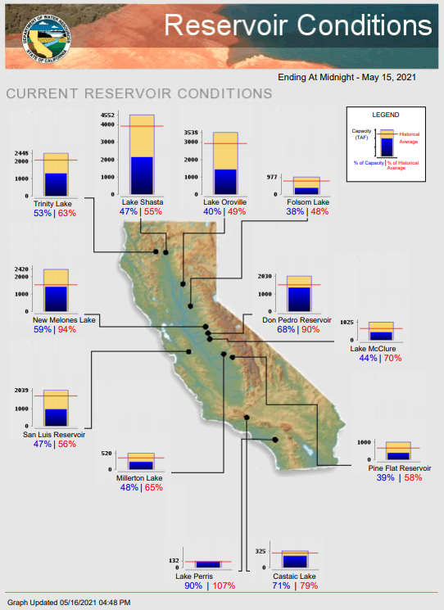
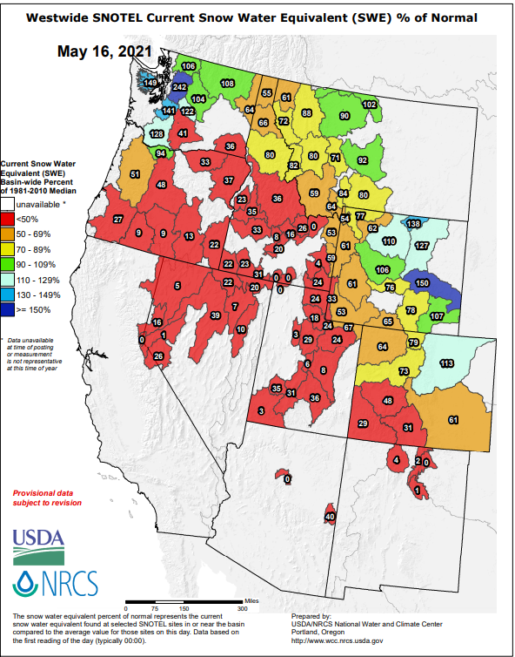
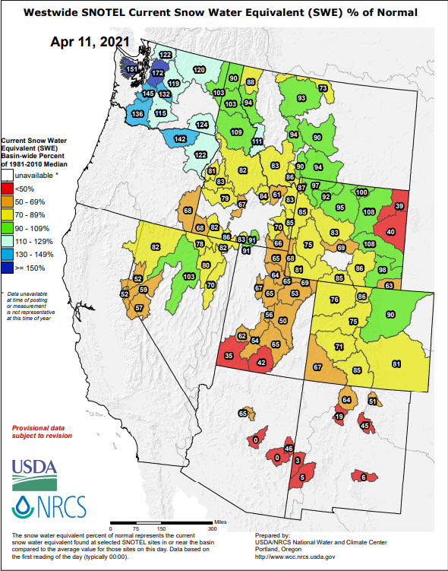
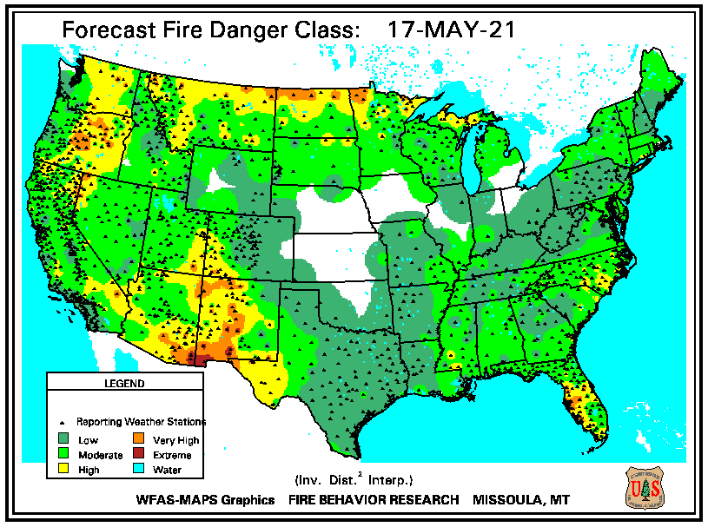
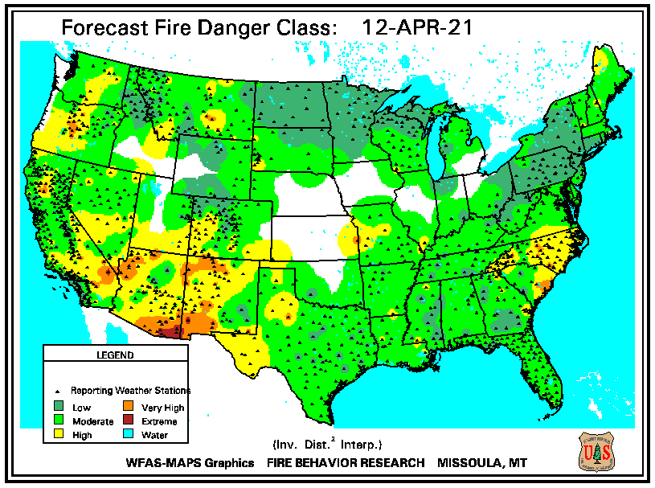
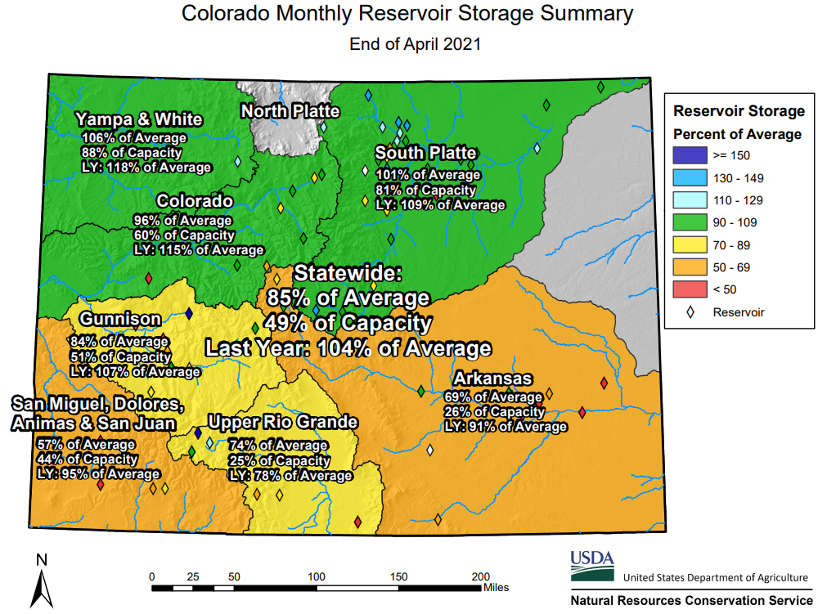
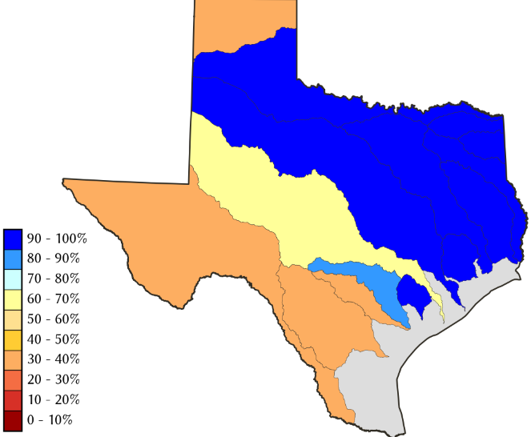
THIS MONTH
1 MONTH ago
https://fsapps.nwcg.gov/
Many CA reservoirs are already low!!
TX
CO
If La Nina continues reappears later this year, it will be a major problem for water in the western states!!!!
ALARM/WARNING!! for this year’s Fire Season for the US West/Southwest states!! (see US Drought Monitor!)
85 %
of AVG!

Slide 20
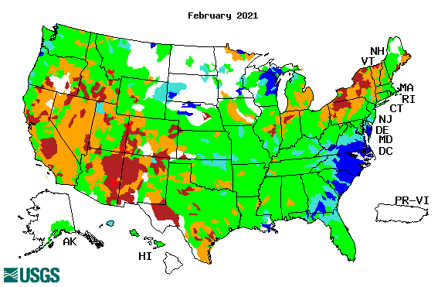
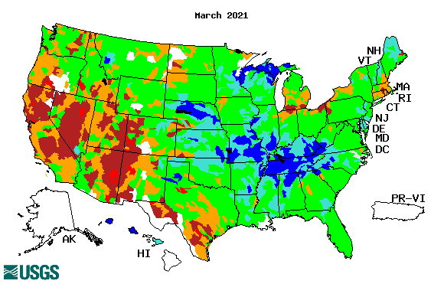
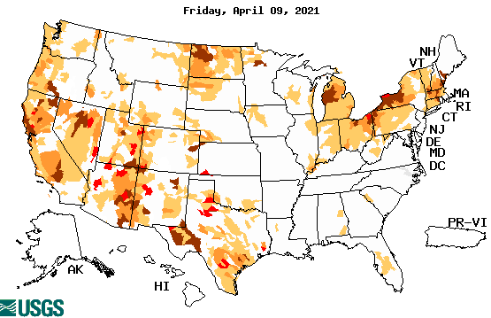
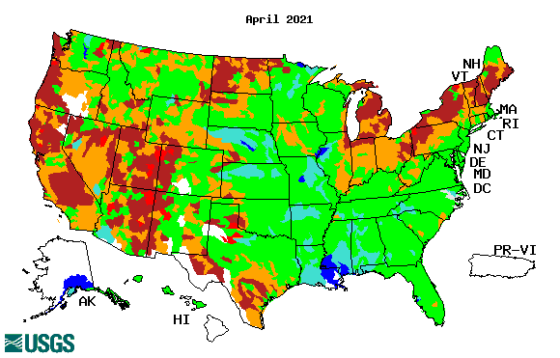
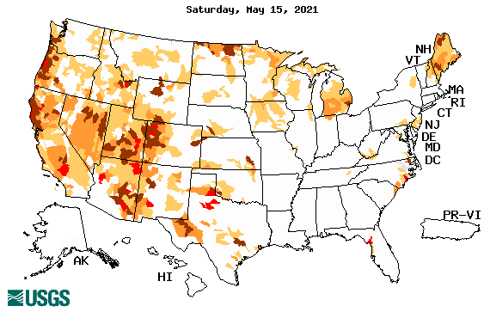
Streamflow (USGS)
Same data source USGS:
Look at the monthly maps for Northeast vs weekly maps in the bottom!!
Map shows only below normal 7-day average streamflow compared to historical streamflow for the day of year.
One month ago (left) &
Now (below)
Look along the Pacific coastal states.
If sometimes, the various indicators are confusing, go back to % of rainfall deficit – to reinforce!!
20

Slide 21
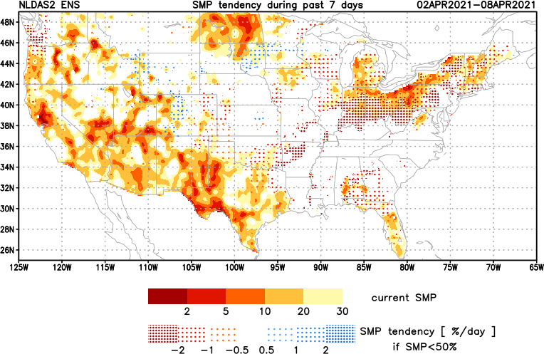
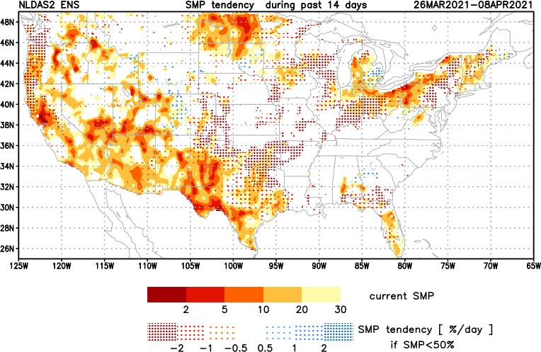
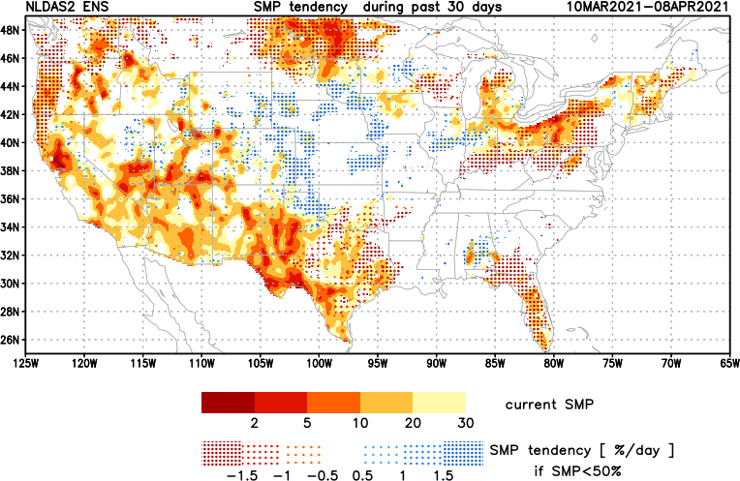
[Now]
NCEP Ensemble mean NLDAS2 models’ Soil Moisture tendency/trend
7 days
14 days
30 days
These NLDAS based SM tendency mas are a few days old!! But note the change in the middle part of the country!! Upper Midwest consistently dry!!

Slide 22
EL NIÑO/SOUTHERN OSCILLATION (ENSO)
DIAGNOSTIC DISCUSSION
issued by CLIMATE PREDICTION CENTER/NCEP/NWS and the International Research Institute for Climate and Society
13 May 2021
ENSO Alert System Status: Final La Nina Advisory
Synopsis: La Niña has ended, with ENSO-neutral likely to continue through the Northern Hemisphere summer (67% chance in June-August 2021) --------

Slide 23
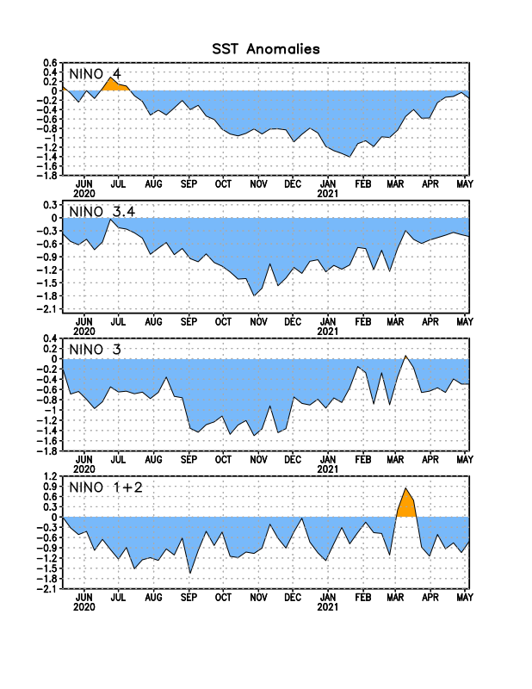
Latest values of SST indices in the various Nino Regions.

Slide 24
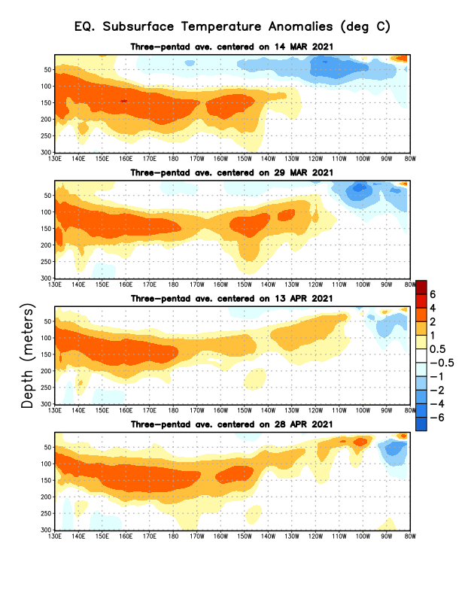
Sub-Surface Temperature Departures in the Equatorial Pacific
The current La Nina conditions has finally ended.
But the million dollar question is: Will there be ENSO neutral conditions in the upcoming season as forecast or ? Look at subsurface conditions!!
Most recent pentad analysis

Slide 25
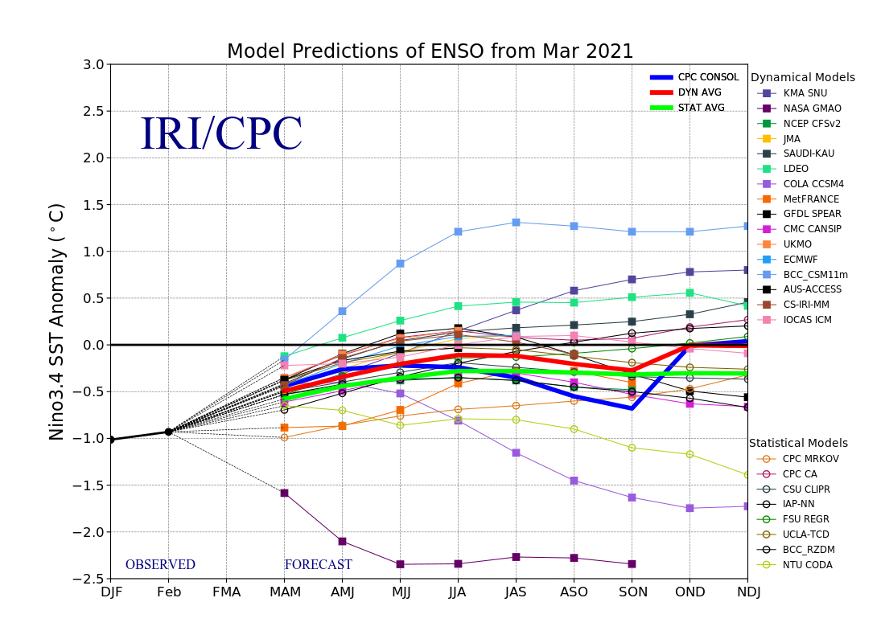
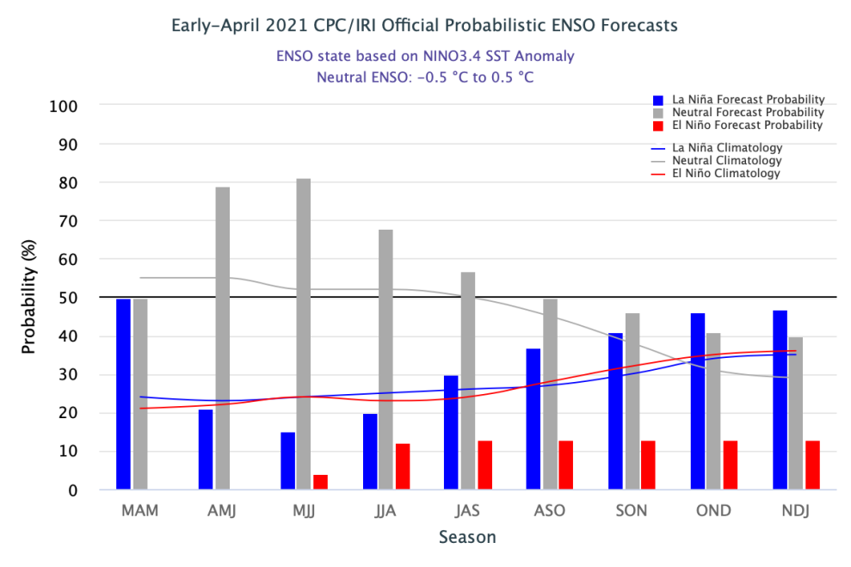
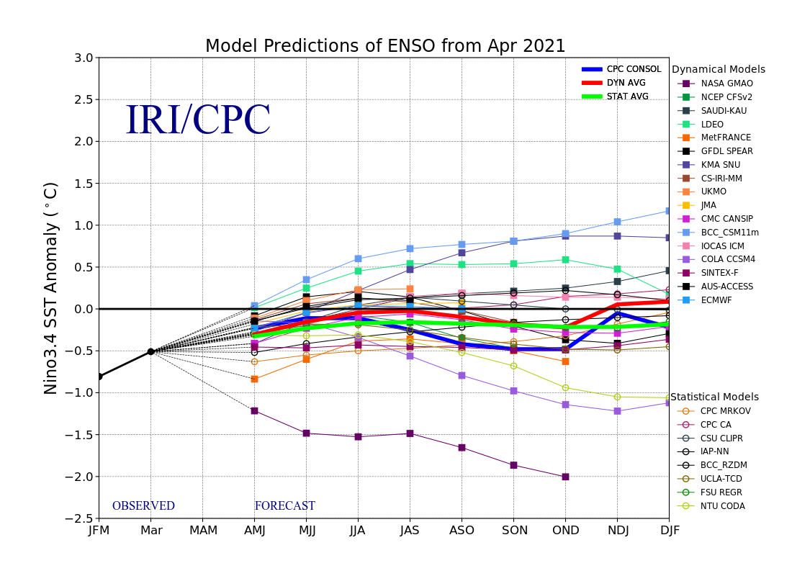
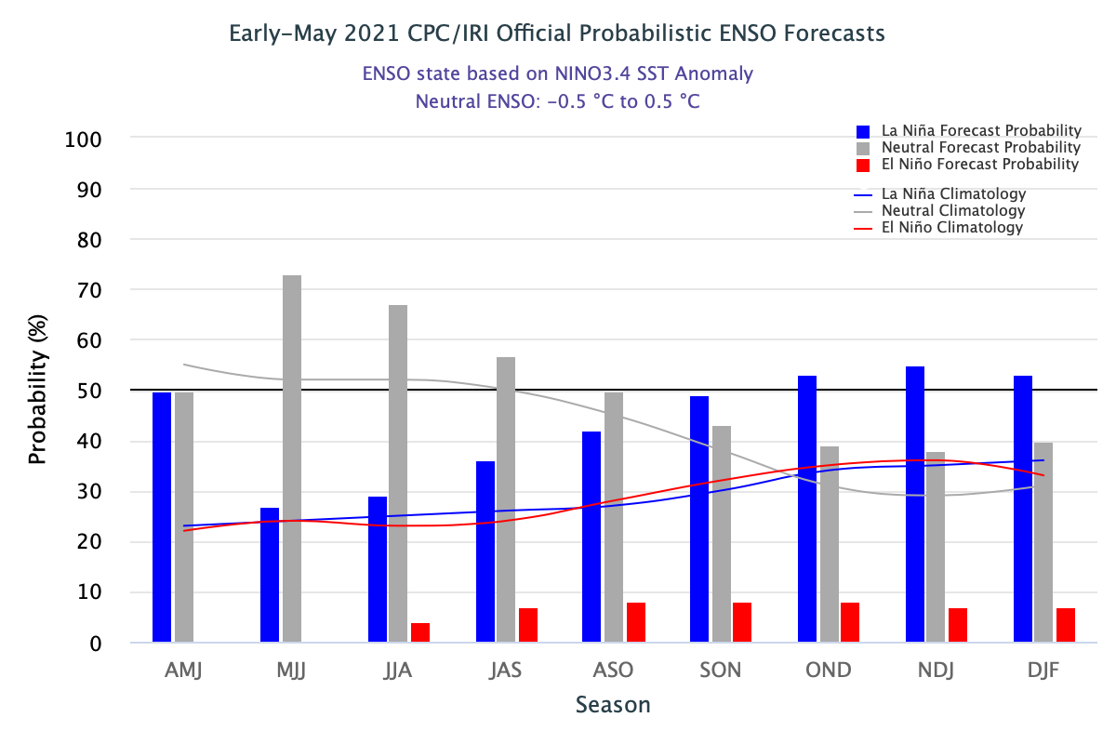
ENSO Forecasts
Early- April CPC/IRI forecast
Early- May CPC/IRI forecast
La Nina is on its way out temporariy? Only to come back later in the year?

Slide 26
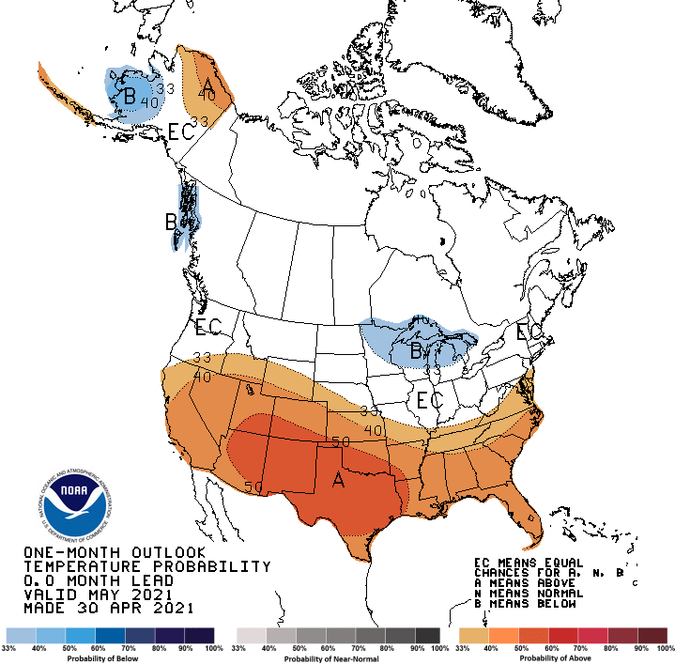
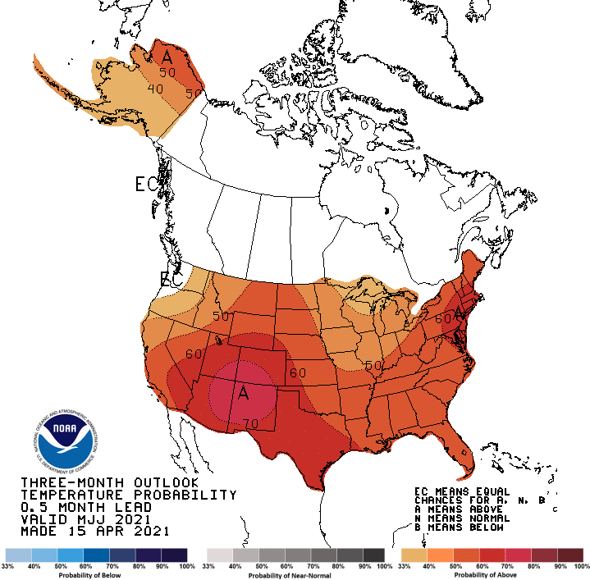
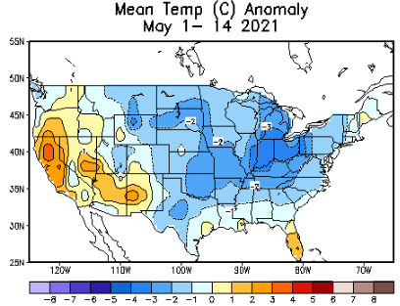
Made
Apr 30th
Previous (Last Month)
CPC’s official
Temperature OUTLOOK for Monthly (May)/Seasonal (MJJ)
Made Apr 15th
Observed so far this month!! ☺

Slide 27
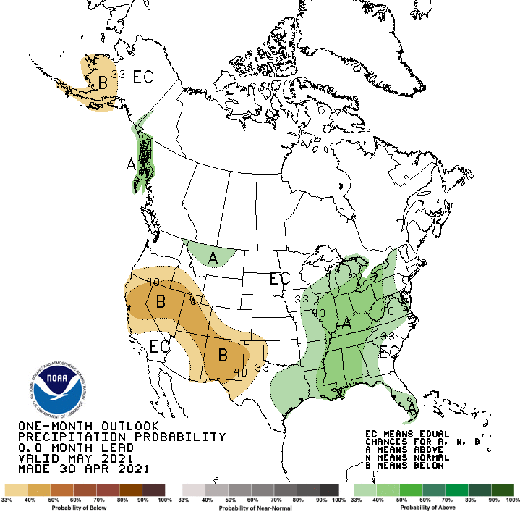
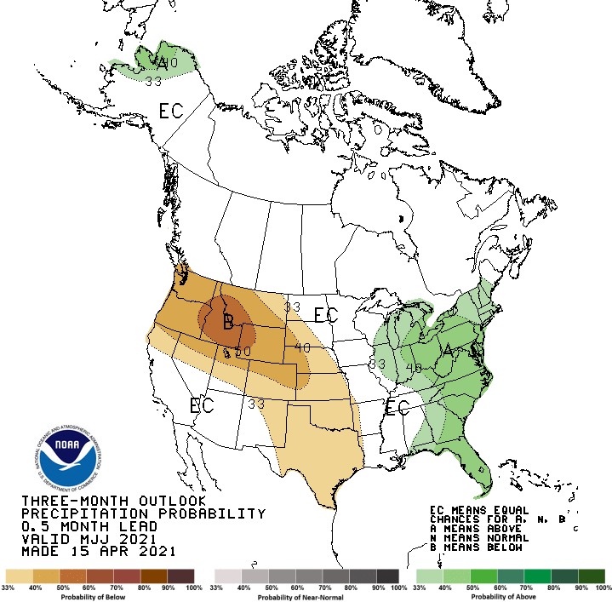
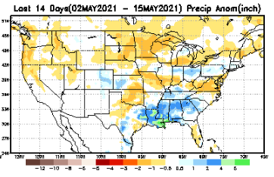
Previous(Last month)
CPC’s official
Precipitation OUTLOOK for Monthly (May)/Seasonal (MJJ)
Released Apr 30th
Released Apr 15th
Observed so far this month!! ☹
Monthly P/T forecasts verified at mid-month are generally good! Why? ☺
(becoz they are mostly based on GFS’ 2-wk fcsts).
But so far, fcst looks ??

Slide 28
NCEP/WPC Next 7 days QPF Forecast
Actual Precip amounts and region generally varies highly from one model run to next!!
GFS Model Guidance for the
next 16 days.
These fcsts soak Central/eastern TX!! – pretty much ending drought there!!?

Slide 29
From European Center (EC) Precip forecast (made yesterday, 17 May) for next 30 days.

Slide 30
From European Center (EC) Precip forecast (made yesterday, 17 May) for next 30 days.

Slide 33
NMME T & P Ens.Mean forecasts for
June
Much of the country is fcst to be warm. The south/ west is WARM+
JJA
With No ENSO signal!! Less rain in the west where there is drought!
Will the drought expand/redevel-op further in the NW?

Slide 34
Agreement/Disagreement among the various NMME models’ JJA seasonal Precip. Forecast.
??

Slide 35
SPI6 Fcst made from last month(background) compared with this month(foreground, red border)
Why is there so fewer hatched areas in SPI6 fcst from NMME models’ based fcst this month as compared to last month (left 2 columns) ? Fcsts more confident now?
Forecast uncertain in Hatched areas.
No change/relief to drought in the south and west! Possible expansion of worsening drought in the Northwest.
SPI6 Fcst made from last month
SPI6 Fcst made from this month

Slide 36
http://drought.geo.msu.edu/research/forecast/smi.monthly.php
Latest Initial Conditions:
05/11/2021
Predicted Monthly Soil Moisture Percentile
MSU stopped updating 06/10/20 ☹
CPC’s soil moisture percentile – Leaky bucket Model
The inter quartile range suggest greater uncertainty about the forecast in these shaded regions.

Slide 37
ECMWF-extended forecast derived VIC model soil moisture percentile forecast
(From Dr. Li Xu) More detail at https://www.cpc.ncep.noaa.gov/products/people/lxu/flashd/flash_prediction.html

Slide 38
Summary
Current Drought conditions:
Over the last 4-5 months, drought area & severity has overall generally remained about the same. The worse drought conditions are in the border areas of southwest states CA, AZ, NV, UT, CO, and western TX. These are regions that are part of the long term drought. The eastern half of the country is nearly drought free.
The drought in OR, WA is continuing to get worse, and the drought in the Dakotas, MT, ID, Wyoming, Nebraska, Kansas and vicinity which developed in the last year continues to hang in there. Next months rain in the Northern Great Plains states during the rainy summer season here is crucial!
About 50 % of the country is continuing to experience category D1 or worse drought condition. Parts of central/eastern TX did get some relief.
The on/off drought and area extent in the New England states appears to be shrinking. Mild drought along the Carolina border has emerged as forecast.
Some/many of California reservoirs levels are below their historical average levels. If a second year La Nina remerge later this year (hope not!) it will worsen the water situation much further! Current drought conditions in the western states is unfortunately a harbinger of probably bad fire season this year also!
Current ENSO status and forecast: La Niña has ended, with ENSO-neutral likely to continue through the Northern Hemisphere summer (67% chance in June-August 2021). (ENSO Caveat): Much of the subsurface ocean waters in the tropical Pacific Ocean are mostly anomalously warm!!
Prediction:
With the likely transition to ENSO neutral conditions during the forecast season, how good will be the model forecasts? Nevertheless, with the forecast above normal temperatures in the west and the beginning of the dry season along the west coast states, the short term drought in the Pacific coastal and adjoining states especially in OR/WA is expected to broaden and get worse. As noted above, this is not helpful for the fire season this year.
The S/L term drought in the south and west is so entrenched, it is likely that those conditions will probably stay the same through the forecast season, especially when the forecast temperatures here are so warm. When the southwest monsoon rainfall begins soon, there can be some short term relief here, but not for long term drought.
The drought in the Northern Great Plains is both short and long term, and is likely to get some relief in some form in the forecast season, as these upcoming months are part of the main rainy season.
The remaining pockets of drought in the northeast, along with the small recently emerged drought in the Carolinas border are likely to go away by the end of forecast season with seasonal rains and a likely near-to-above normal Atlantic hurricane season (neutral ENSO). *********************

Slide 39
Miscellaneous maps

Slide 40
Miscellaneous maps

