Slide 1
Drought Outlook Support Briefing
May 2024
Climate Prediction Center/NCEP/NOAA
http://www.cpc.ncep.noaa.gov/products/Drought
Points to ponder:
Often, there is a disconnect between the Short term (S) and Long term (L) drought in regions, and even with the short term (S) drought, the 3-month and 6-month signals are not quite consistent! With Long term (L) drought, it is even more trickier, as it is open ended from 6 months-onwards and beyond!!!
Places/regions experiencing Short term drought may (not) be ok in the Long term and vice versa!!
This duality is difficult to reconcile, to convey and even be clearly understood well by the public at large.
Public/Forecaster generally tends to focus more on the Short term Drought (for good reasons!!)
More importantly the very definitions and timescales associated with S/L term droughts and the declarations in the USDM are by themselves subjective!! Short term vs Long term drought need to be clearly distinguished and shown to the public!!
It may take a long time for drought to develop, but those conditions can end very quickly! as it happened in CA after DJF 2023 winter. Forecast models are yet to (seasonal) correctly forecast these changes in advance!
Subjective(delayed) USDM vs Objective(real time) map! A few days of recent heavy precip can change the USDM a lot!
New (last few months):
Towards objective drought monitoring goals, we introduced, a new objective AI/Deep-Learning based Experimental ODI (objective drought indicator, updated daily, Slide # 3) compared with Official USDM (US Drought Monitor, produced weekly by USDM authors).
Towards prediction, we introduce a new section with few slides at the end, consolidating the various exptl. drought outlooks by purely objective methods developed here at CPC! All these in preparation of a broad general push towards Probabilistic Drought outlooks.

Slide 2
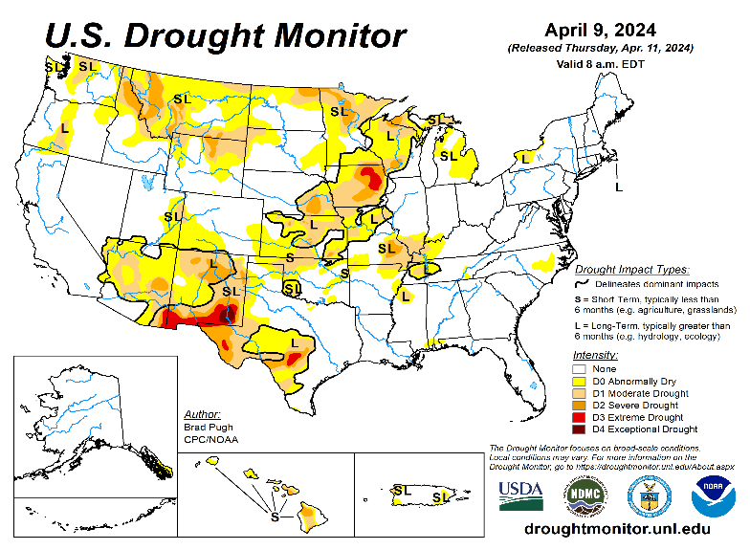
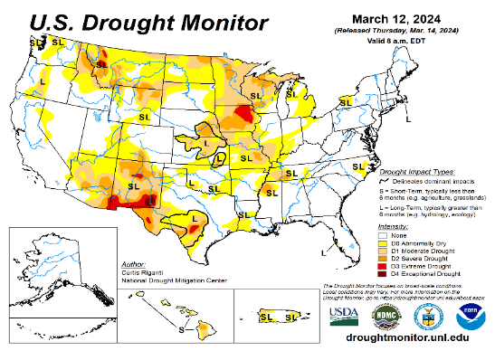
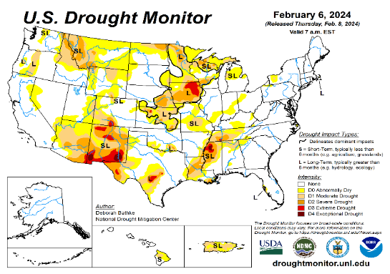
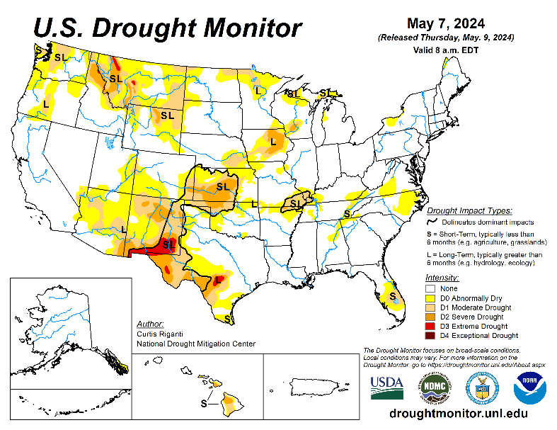
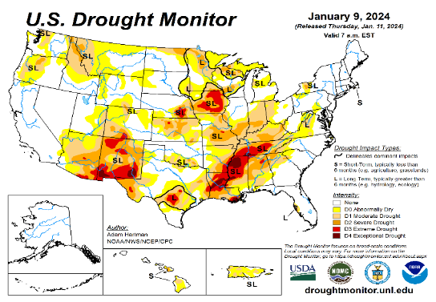
Drought Monitor
Monitoring is important because, unlike US T/P fcsts, for drought forecasts, we have to know where we are, before we can tell where we are going!! Drought forecasts are tendency forecasts as changes from the latest USDM.
April
Above normal rainfall (strangely) during last year’s La Nina winter (2022/23) and (canonically, as expected) during this year’s El Nino winter (2023/24) in California, thus two back to back above normal winter rainfall seasons, has more than compensated for, and totally eliminated the both the Long & Short term drought in the region.
Water levels in almost all CA reservoirs are now at or well above their normal levels. However, the water storage levels in the much bigger lakes, Lake Powell and Lake Mead in NV/AZ still continue to be still very low, and the 2+ decade(s) long hydrological drought still exist here in those two big lakes.
The past ¾ months winter rains in Pacific NW has already improved drought conditions in the region. Also the above normal rains in the Gulf states and vicinity have pretty much eliminated the severe drought in Louisiana and lower Midwest, thus leaving the entire eastern one third of US, up and down the Atlantic coast, drought free.
We have been suggesting/projecting the past few months that the overall drought situation across the entire US will be improving slowly and steadily, and it was happening. Now about 65% (last month 62%) of the lower 48 states is drought free. But drought in western MT/WY persists, while drought in MN/IA/WI/ MO/KS has ameliorated, as we had suggested. Are we hovering near bottom for the % of US areas covered under drought? and will it begin to go up slowly over the next few/several months?
The upcoming La Nina, which is generally a poor rainfall period for the US (as compared to El Nino), combined with the hot summer temperatures may begin to slowly increase the US areas under drought.
While CA is totally drought free (ST & LT) large parts of AZ/NM and even western of TX are still under drought due to long term/decadal drought in the SW, as well as the poor SW monsoon this past year (2023). How is 2024 monsoon season going to be?
March
May
February
(Recent/Latest)
January

Slide 3
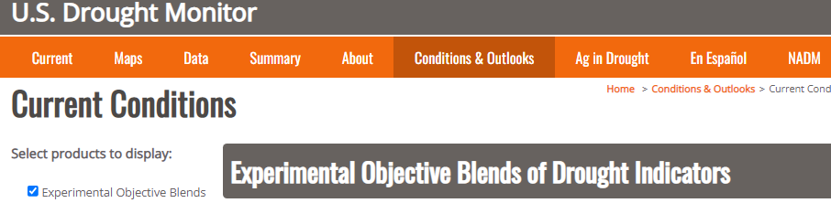
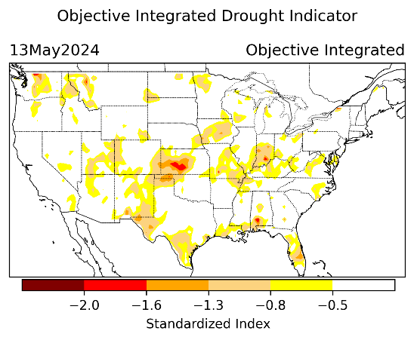
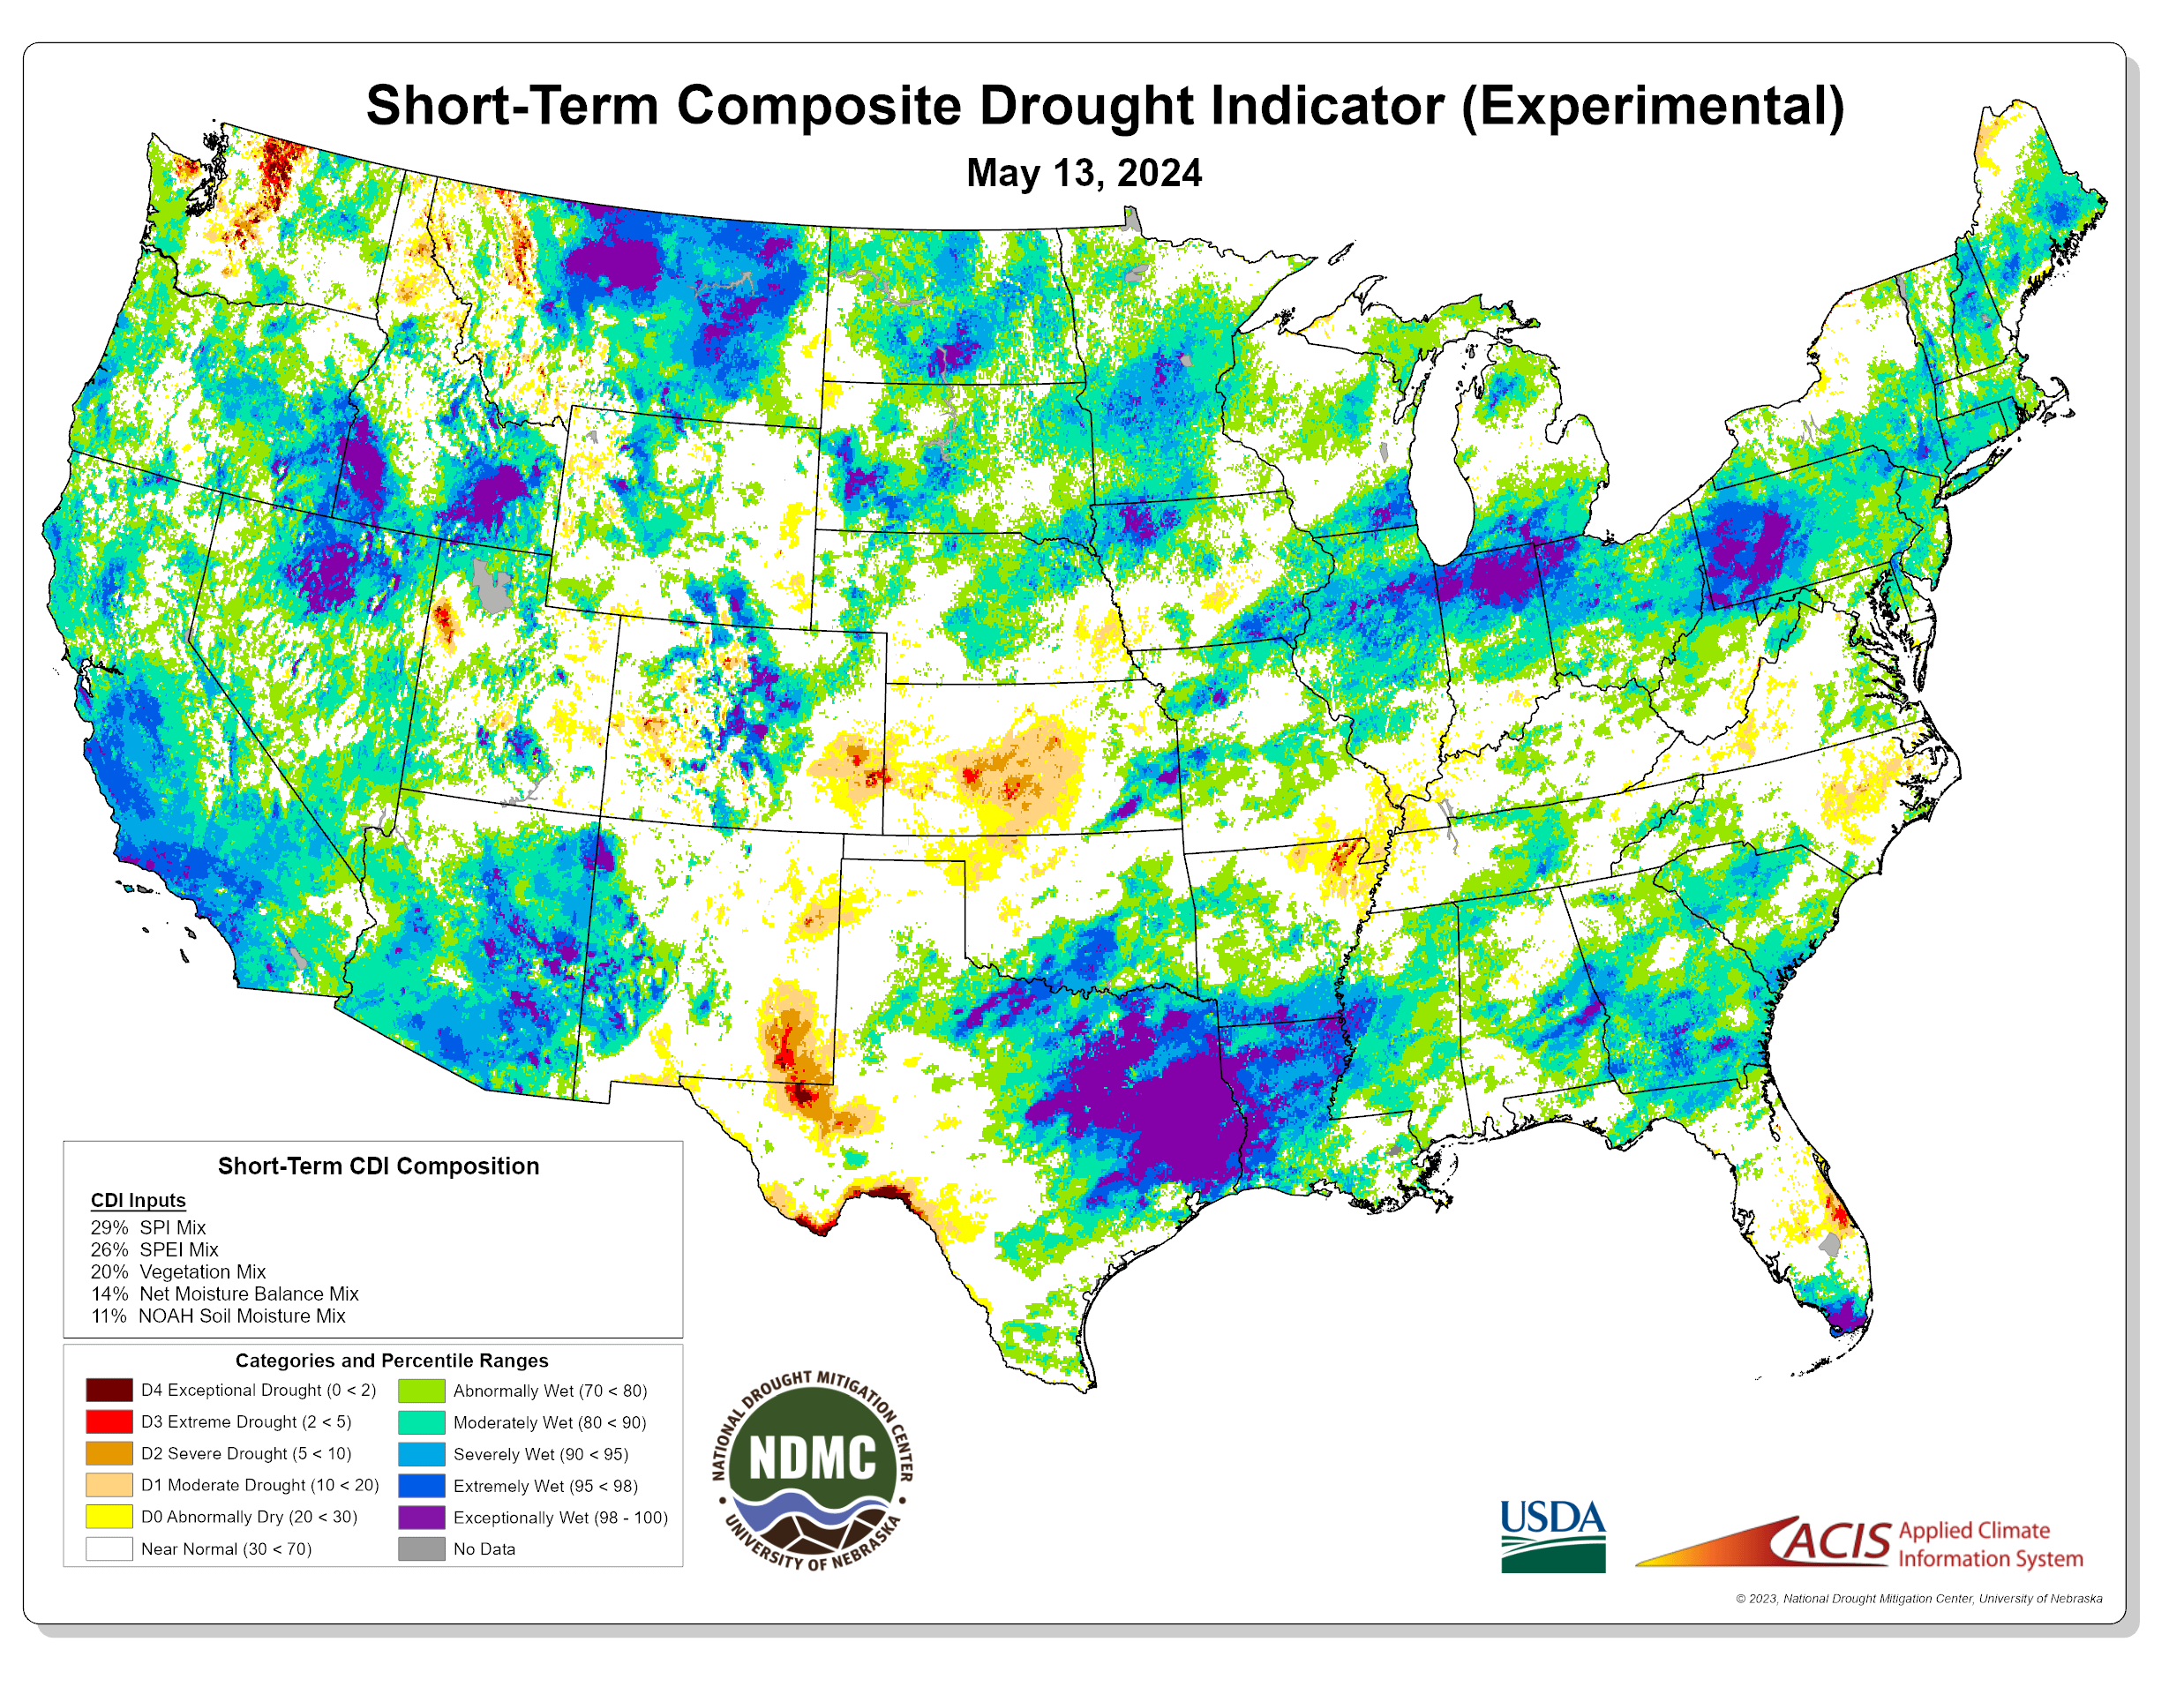
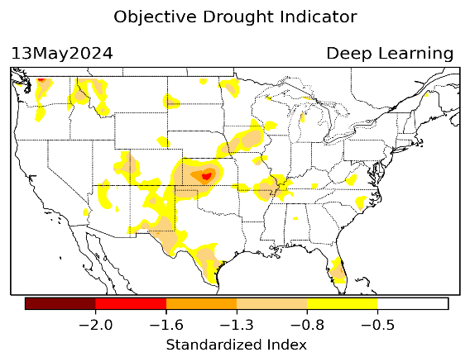
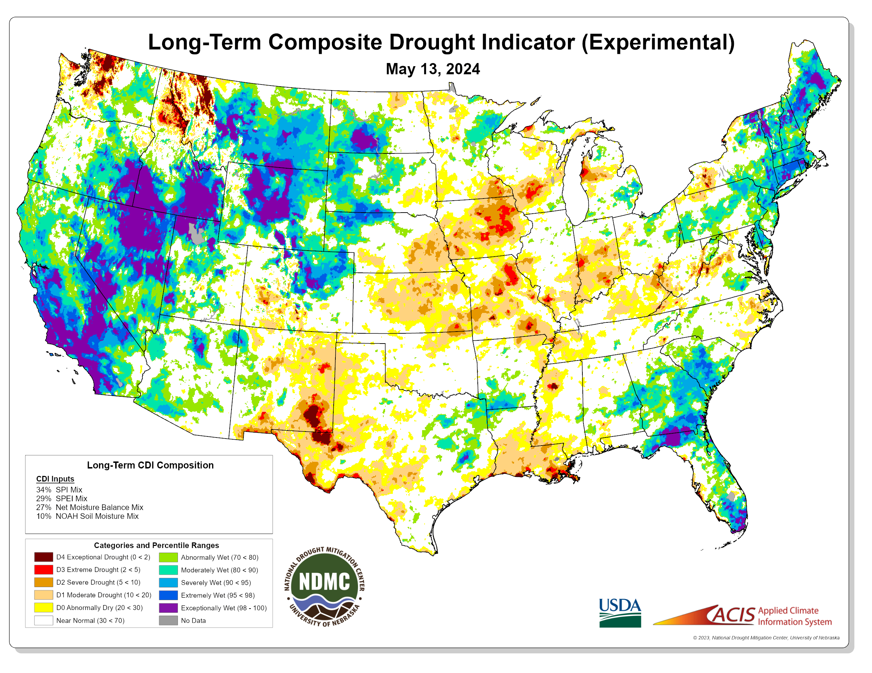
Exptl. Objective Drought Monitor
(showing S/term & L/Term separately) from
National Drought Mitigation Center (NDMC)
New slide now included recently in this briefing!
CPC’s own Experimental
Objective Drought Indicator (ODI)
using AI/Deep Learning ! – Updates daily !!
https://www.cpc.ncep.noaa.gov/products/people/lxu/odi/#deep-learning-increment-training
Based on the CPC P/analysis &
VIC (Princeton) NLDAS model assimilation:
Standardize Precipitation index (SPI)
Standardize Precipitation-Evapo –
transpiration index (SPEI)
Evapotranspiration Stress Index (ESI)
Soil Moisture Percentile (SMP)
Standardize Runoff Index (SRI)
-can be split into Short/Long Term Droughts!
https://droughtmonitor.unl.edu/ConditionsOutlooks/CurrentConditions.aspx
Objective
& Updates Daily!
Objectively Integrated
versus Deep Learning
Methods ~ gives |||r results. Both Objective!
Both update daily!
Objective, but
Runs Weekly!
On Monday!
Objective
& Updates Daily!
* A manuscript (Xu & Chelliah) is under preparation.
Subjective &
Produced Manually!
Weekly!
Latest Official USDM (US Drought Monitor)
(about a week old!)
Objective, but
Runs Weekly!
On Monday!
These two maps above, used to be produced at CPC(Rich Tinker!), but now recently officially moved to NDMC operations!
*Released every Thursday, for conditions as of Tuesday!

Slide 4
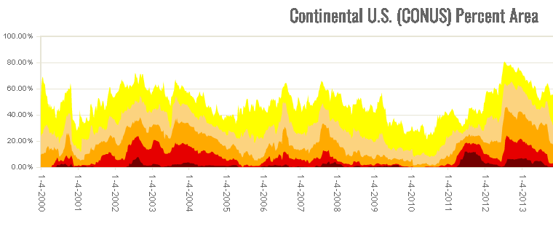
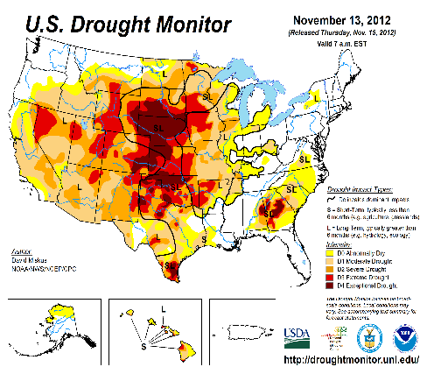

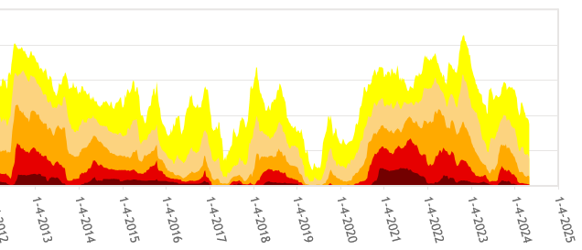

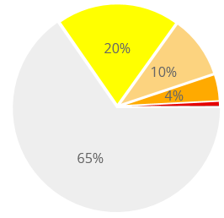

In general, The spatial details of every drought is different.! Every situation is different!!
Time series since 2000 spilt into 2 (above & below) panels.
CONUS % Land Area
Last month drought free areas in areas was 62 %. Few months ago it was 54%.
Now it is 65 % excluding D0. Including D0 (just dry!, not drought!) it is 85 %.
We have been indicating, here in this briefing, for the last 4, 5 months that the overall drought covered area will continue to decrease and it has been happening!
Are we now hovering near the lower end of the US land area coverage for drought?
Current drought!

Slide 5
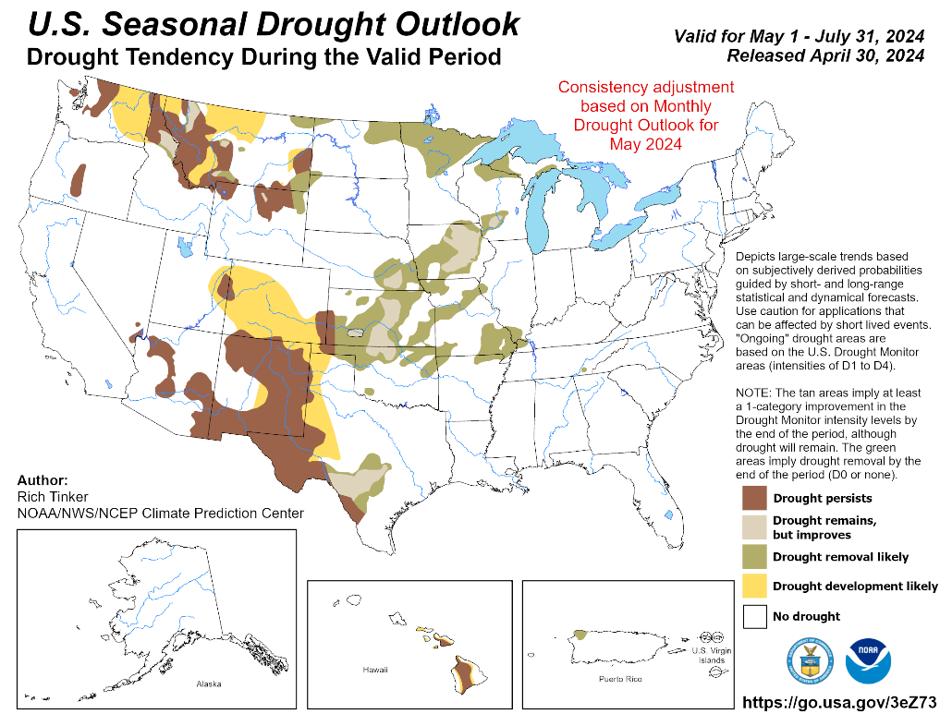
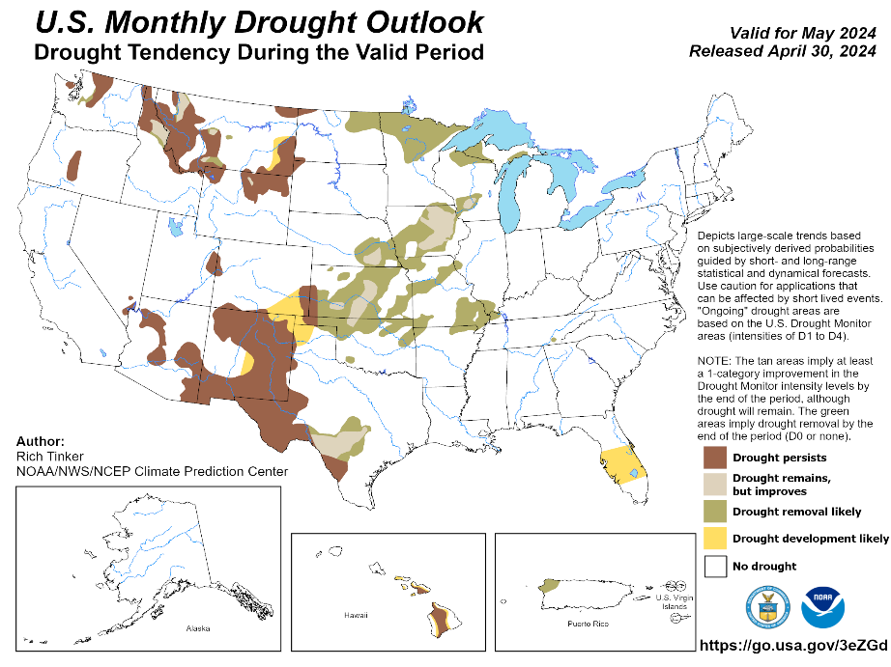
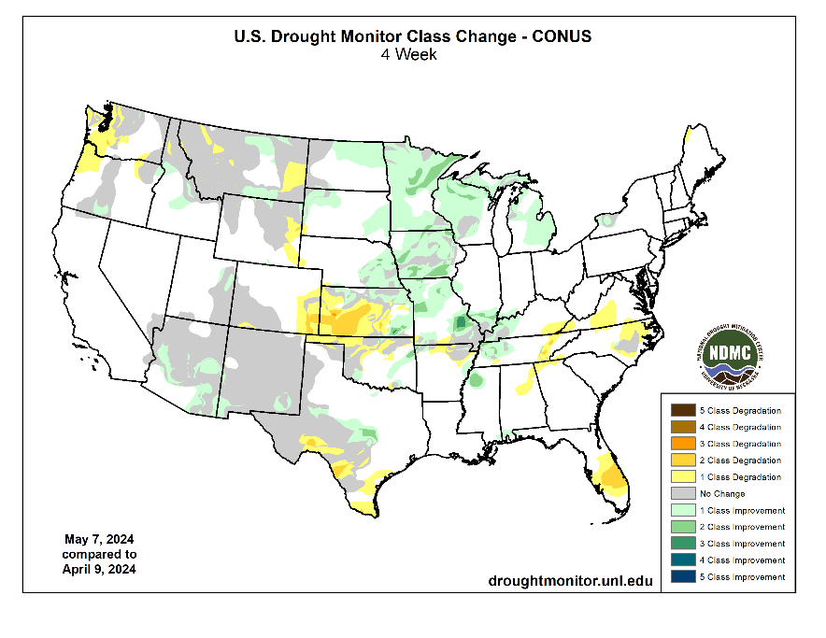
(Previous) Seasonal/Monthly Drought outlooks
New Seasonal+ Drought Outlook(SDO) to be released in 2 days!
(reissued again at end of month for consistency with MDO!)
New Monthly Drought Outlook (MDO) to be released at end of this month)
Updated Seasonal Outlook
( 1 May – 31 Jul 2024)
issued 4/30/24
Monthly outlook (for May 2024)
issued 4/30/24

Slide 6
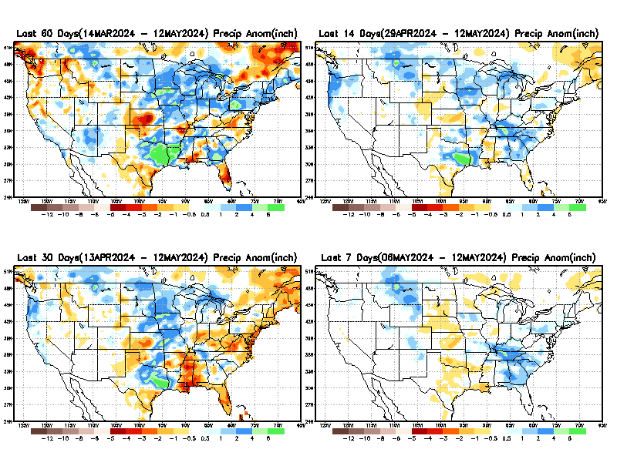
Precipitation ANOM during last 7, 14, 30, & 60 days.
This and next few slides show Precip deficit (excess).
Droughts, for the MOST part, begin and end with precip!! Lately, Temps are becoming (secondarily) important as well.
60 Days
14 Days
30 Days
7 Days
These maps in this and following slides, including a) Total,
b) Anom and
c) Percent of Normal precip. in these and other longer time ranges are now (routinely) daily updated at:
From: Recent Accum./Anom Precipitation https://www.cpc.ncep.noaa.gov/products/Drought/briefing_prcp.shtml

Slide 7
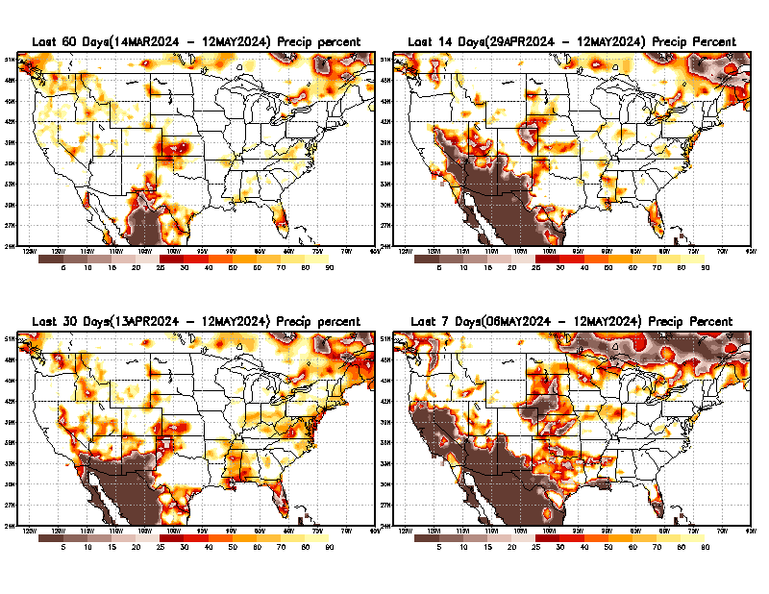
Precipitation Percent (of normal) during last 7, 14, 30, & 60 days - Only Deficit Areas <=90% shown !
60 Days
14 Days
This plot shows only the rainfall deficient regions <= 90% of normal.
-- This shows more clearly possible/likely drought developing region in the future unless there is above normal rainfall in these regions in the future, to offset these shortfalls.
30 days
7 days
From: Recent Anom/% of normal Precipitation https://www.cpc.ncep.noaa.gov/products/Drought/briefing_prcp.shtml

Slide 8
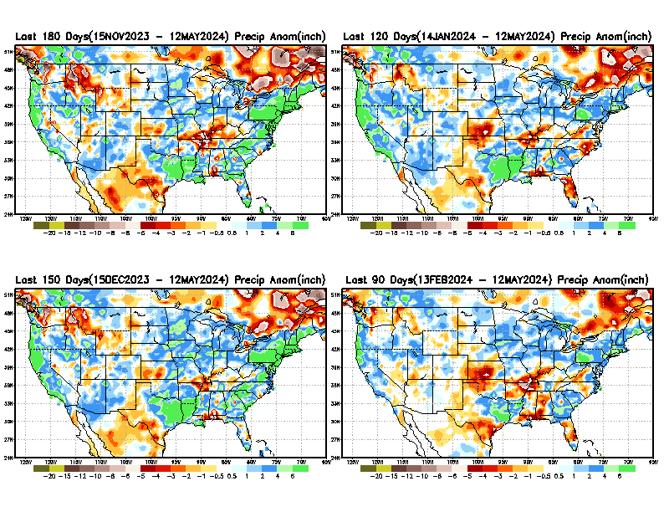
Total precipitation ANOM during last 3, 4, 5, and 6 months.
While the Precipitation anomalies deficit may seem large in some regions (compared to others),
it is the
% of normal precip (next slide) that matters more!!
6 M
4 M
5 M
3 M
From: Recent % of Normal Precipitation https://www.cpc.ncep.noaa.gov/products/Drought/briefing_prcp.shtml

Slide 9
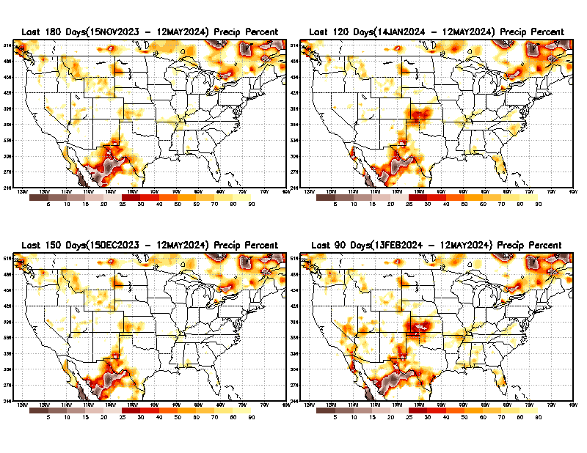
Total precipitation Percent (of normal) during last 3, 4, 5, and 6 months Only Deficit Areas <=90% shown!!
6 M
4 M
In these interim time scale 3-6 months, we need to pay attention to regions, which are dark-brown, red & dark red (<50%).
NOT BAD AT ALL for S/Term Drought
While accrued precipitation deficits are real & objective,
droughts are subjective declarations!!
5 M
3 M
East vs West!
Broad vs Narrow
rainfall season.
In general, West US suffers more from frequent and lasting droughts. Droughts in East US are generally less and less lasting!
What about Center ?
More like West than East?
Short term(S) Drought is generally declared when rainfall deficits exist in the 3-6 months time range. {Long term deficits beyond 1 or 2 or more years is Long term L drought! }

Slide 10
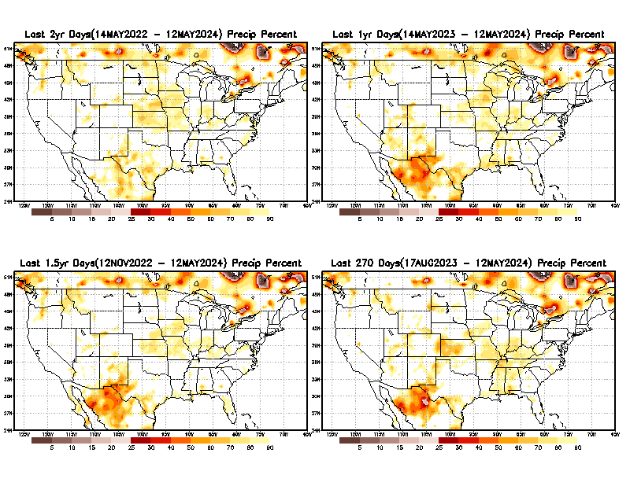
Total precipitation Percent during last 9 months, 1 yr, 1.5yrs, & 2 yrs. .–Only Deficit Areas shown!! <=90%
2 Y
1 Y
1.5 Y
9 M
The character and even location/spatial extent of the short/S and long/L –term droughts are different!!!
From: Recent Accumulated Precipitation https://www.cpc.ncep.noaa.gov/products/Drought/briefing_prcp.shtml

Slide 11
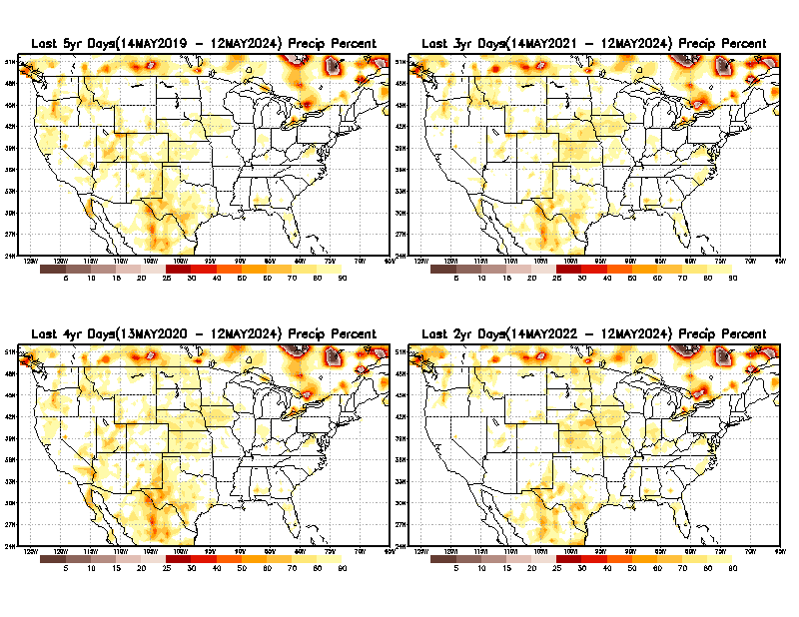
Total precipitation Percent (of normal) during last 2, 3, 4, & 5 yrs. .–Only Deficit Areas <=90% shown !!
5 Y
3 Y
Deficits are not much!
4 Y
2 Y
From: Recent Accumulated Precipitation https://www.cpc.ncep.noaa.gov/products/Drought/briefing_prcp.shtml

Slide 12
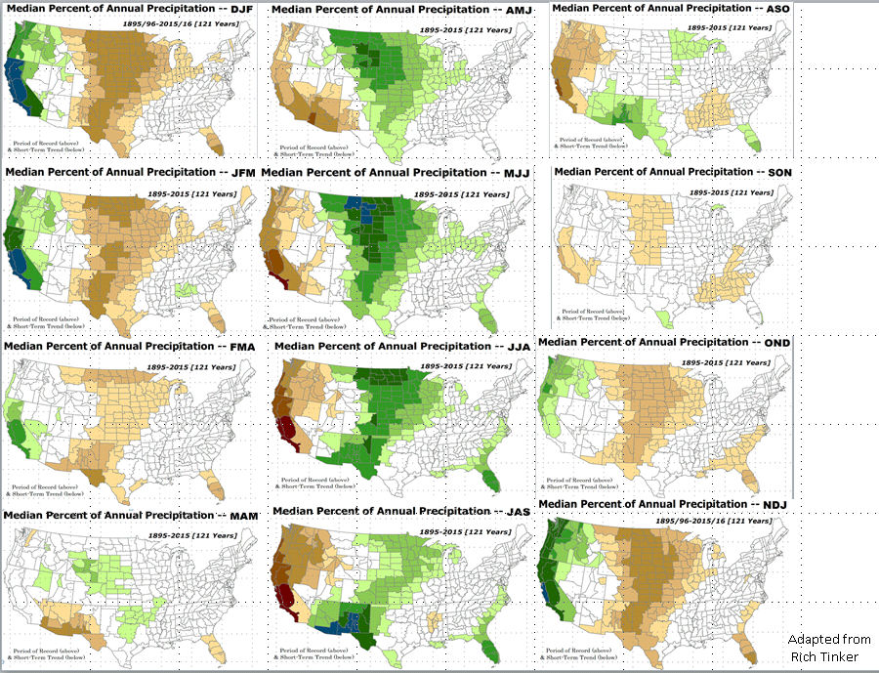

LEAST
MIXED
MOST
East vs West!
More darker colors in west/central => narrow rainy season (months)
Overall, more white space in the east => distributed rainfall season (except ~FL).

Slide 13
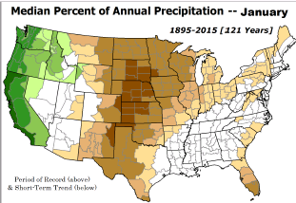
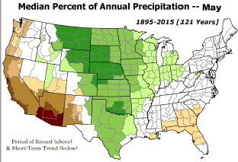
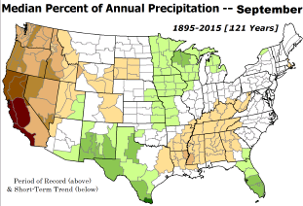
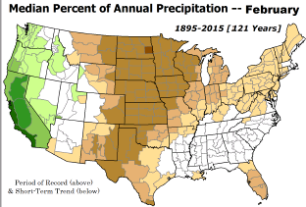
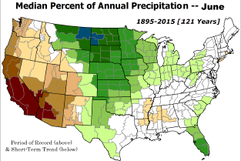
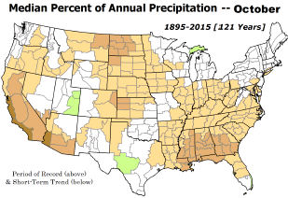

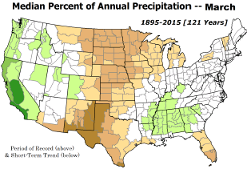
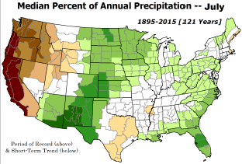
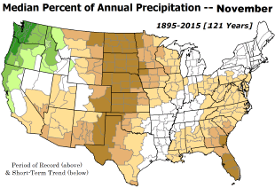
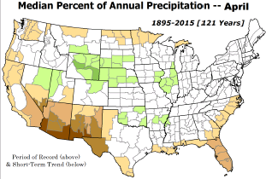
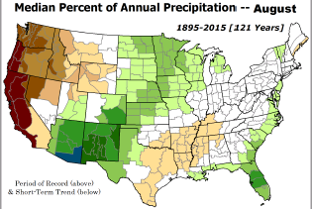
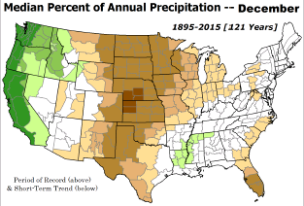
*********
EAST vs
CTR/WEST
Drought Behavior is loosely tied to rainfall climo!! And the limited rainy season in the west
*********
Adapted from Rich Tinker.

Slide 14
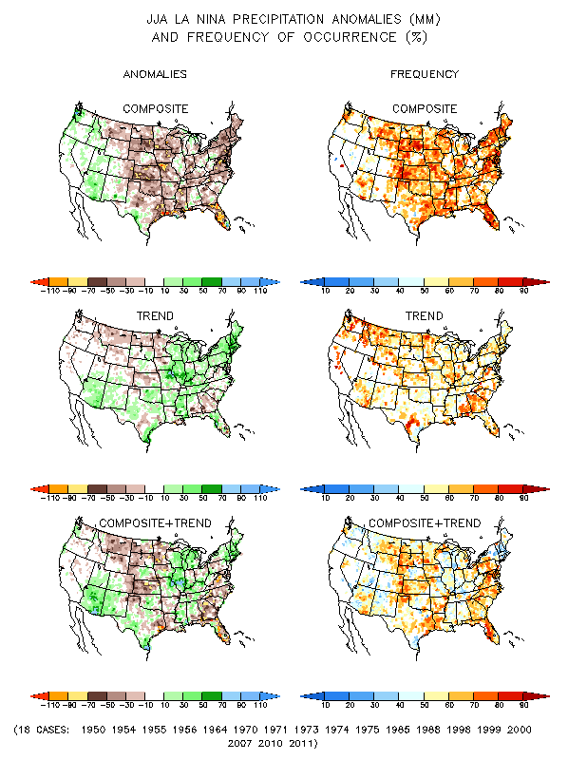
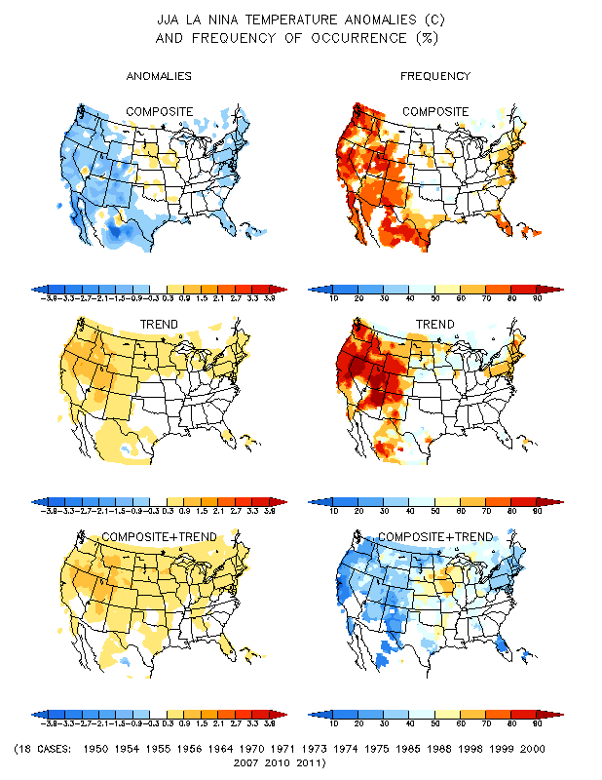
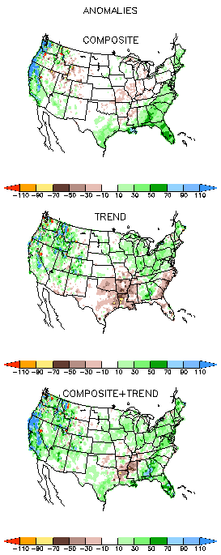
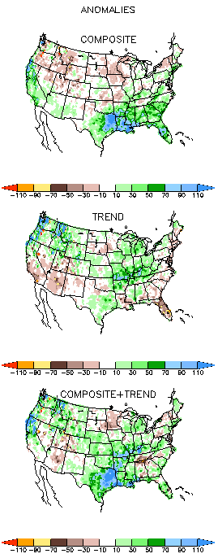
El Nino Precip/Temperature COMPOSITES & Trend map
JJA
P
T
Opposing signals!
These CPC composites do not include recent La Ninas (after 2011! ☹)

Slide 15
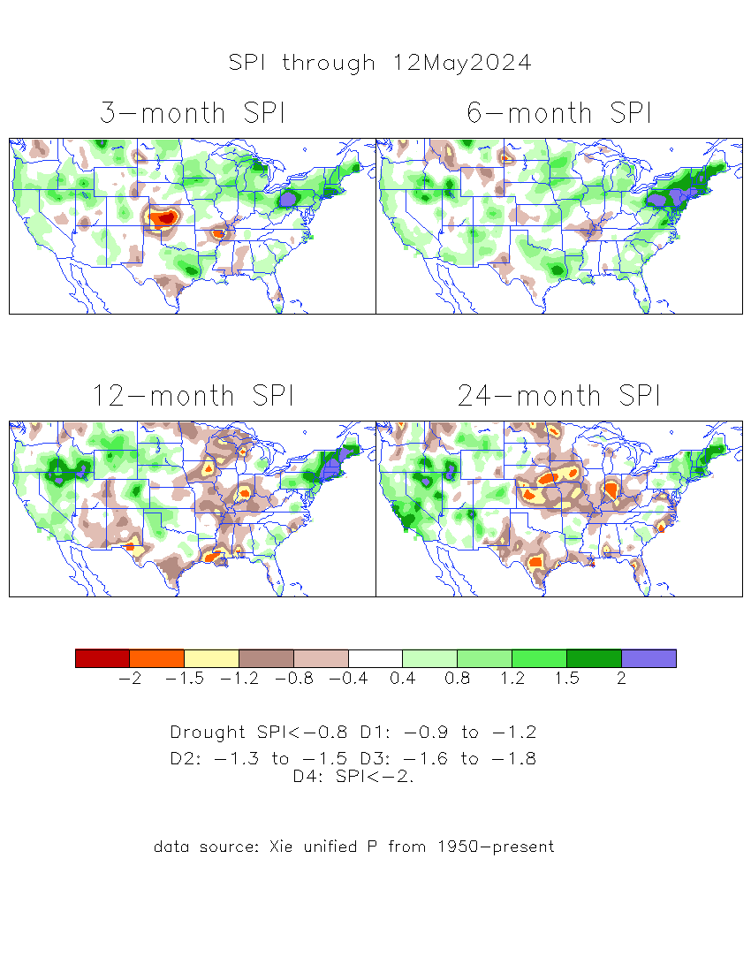
The Standardized Precipitation Index SPI
(based on Observed P)
Compare with last month
----- NOW
Very interesting graphic & details for the drought across the US based on the more generalized precip deficit/excess, the Standardized Precipitation Index (SPI).
The dark brown and red colors, indicating standardized precipitation deficits, in the various time periods, approximately correspond to the appropriate short/long term drought monitor regions and their intensities
Short
Long
How does one negotiate and reconcile declaring short term vs long term drought when precip. deficiencies patterns differ on many different time scales locally!!
What is the cutoff delineating time between short VS long term drought!! Not so clear!!
At exactly where, does drought begin?
Only a very small % of US land area is under drought! ☺
Based on this SPI indicator/measure,
The brown areas are various levels of DRY regions!
The yellow/red are more probably drought regions!

Slide 16
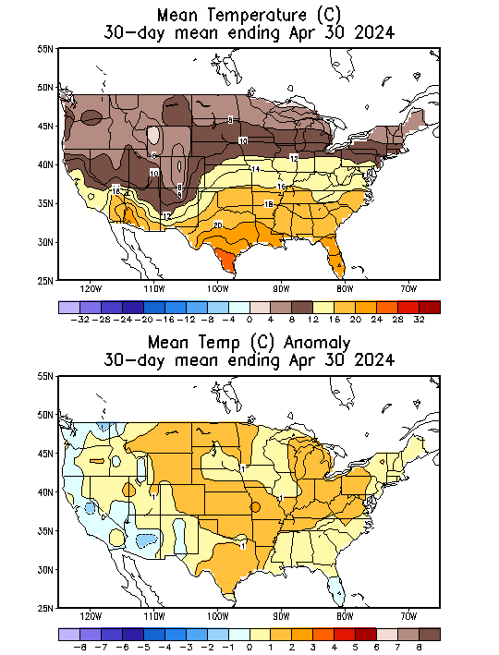
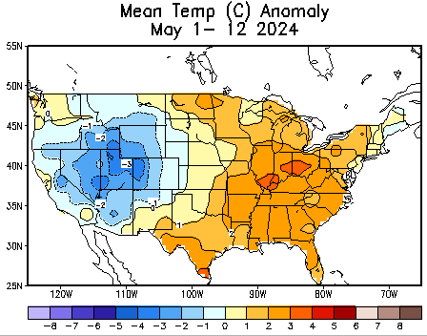
Recent US Temperatures
NOW
So far this month !!
.

Slide 17
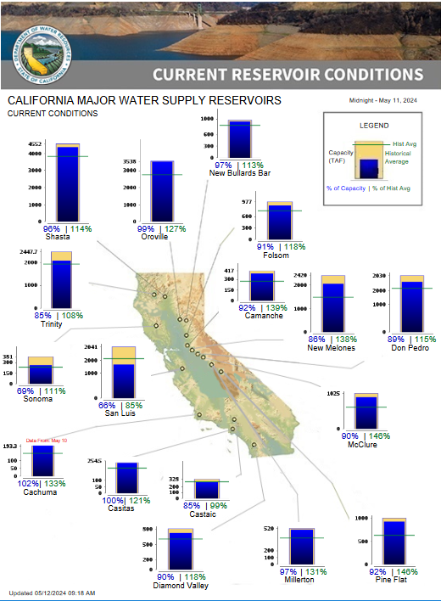
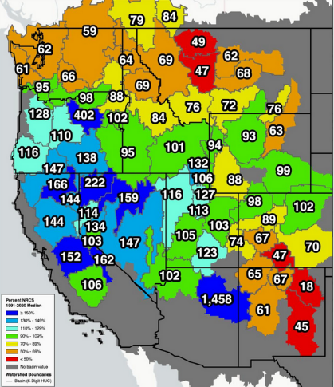
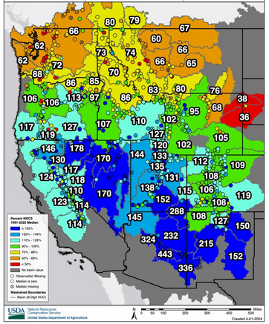

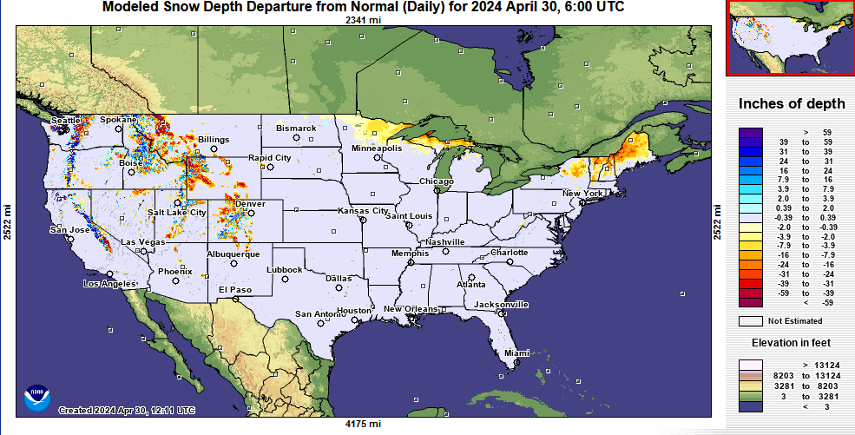

Western US Snow cover
This month versus Last month
% of Capacity
% of Hist. Avg.
of Reservoirs.
5/8
4/3
Water Year
(just started!),
Year-to-date Precipitation:
October 1, 2023 – Dec.17, 2023
https://www.nrcs.usda.gov/wps/portal/wcc/home/
Many CA water reservoirs are AT or ABOVE their historical average/ CAPACITY levels ! ☺
https:/www.nohrsc.noaa.gov/interactive/html/map.html?
Overall, across US, less snow on ground than normal!
WHOEVER thought that the California drought/reservoir-water-levels will turn around in just ONE La NINA winter!!
But a very different story for the big lakes Lake Mead & Lake Powell in NV, see next slide! ☹

Slide 18
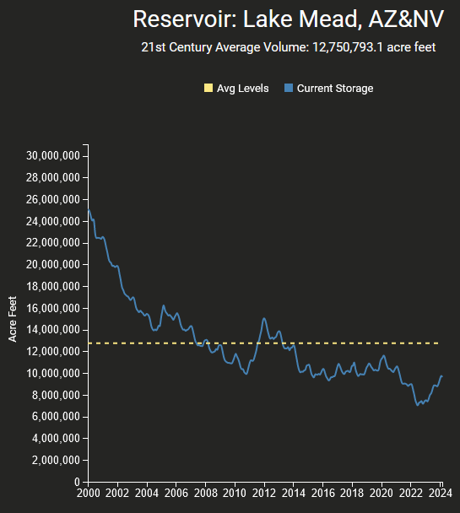
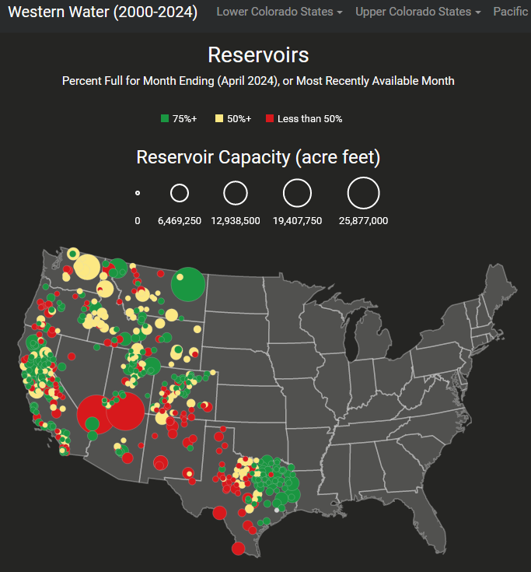
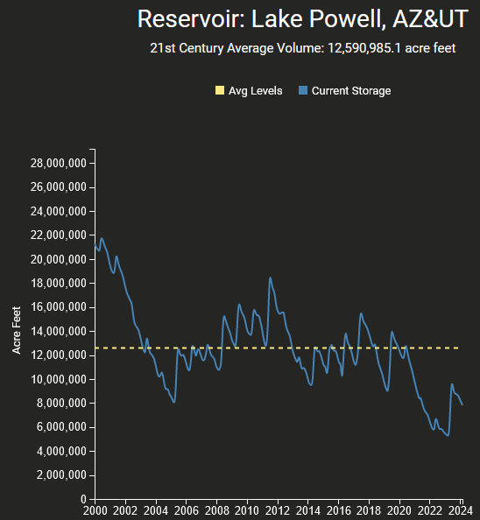

Reservoirs
Percent Full for Month Ending (April 2024), or Most Recently Available Month
Hydro Electric power generating turbines STOP operating at the critical 7 million acre feet level
https://www.deanfarr.com/western_water/
Lakes Mead, Powell in NV/AZ are at low levels! ☹ ☹ HUGE consequences for electric power for western states CA/NV/AZ/UT !!
Only very slight improvement in recent months!

Slide 19







Streamflow (USGS)
Most US east droughts are relatively short lived (as compared to US west).
But in last 2 decades, recently in 2000, 2016, 2020, & 2022, New York and New England experienced historic drought conditions not seen since the 1960s.
Map shows only below normal 7-day average streamflow compared to historical streamflow for the day of year.
One month ago (left) &
Now (below)
Streamflow is only a partial indicator, as sometimes it is highly managed.
If sometimes, the various indicators are confusing, go back to % of rainfall deficit maps – to confirm/reinforce!!
https://waterwatch.usgs.gov/?m=nwc
19

Slide 20

EL NIÑO/SOUTHERN OSCILLATION (ENSO)
DIAGNOSTIC DISCUSSION
issued by
CLIMATE PREDICTION CENTER/NCEP/NWS
and the International Research Institute for Climate and Society
9 May 2024
ENSO Alert System Status: El Niño Advisory/La Niña Watch
Synopsis: El Niño is transitioning toward ENSO-neutral.
Equatorial sea surface temperatures (SSTs) are above average in the western and central Pacific Ocean, and below-average SSTs are emerging in parts of the eastern Pacific Ocean.
A transition from El Niño to ENSO-neutral is likely in in the next month. La Niña may develop in June-August 2024 (49% chance) or July-September (69% chance).
CPC’s Oceanic Niño Index (ONI) [3 month running mean of ERSST.v5 SST anomalies in the Niño 3.4 region (5ºN-5ºS, 120º-170ºW)], based on centered 30-year base periods updated every 5 years. For historical purposes, periods of below and above normal SSTs are colored in blue and red when the threshold (0.5) is met for a minimum of 5 consecutive 3-month overlapping seasons.

Slide 21





Latest values of SST indices in the various Nino Regions.
The current El Nio came in a hurry after 3 back-to-back La Ninas, and is also going away in a great hurry to make room or ANOTHER La Nina which is on the way!!

Slide 22


Sub-Surface Temperature Departures in the Equatorial Pacific
Most recent pentad analysis

Slide 23




Official ENSO Forecasts
April CPC/NOAA forecast
May CPC/NOAA forecast
https://www.cpc.ncep.noaa.gov/products/people/wwang/cfsv2fcst/images3/PacSSTSeaadj.gif
Latest ensemble membrs (blue!)show are less bullish

Slide 24


Previous (Last Month’s)
CPC’s official
Temperature OUTLOOK for Monthly (May)/Seasonal (MJJ)
Monthly P/T forecasts verified at mid-month are generally good! Becoz of good skill upto 2 wks.
Released Apr 18th
Observed so far this month!! ☺

Slide 25



Previous(Last month)
CPC’s official
Precipitation OUTLOOK for
Monthly (May)/Seasonal (MJJ)
Monthly P/T forecasts verified at mid-month are generally good! (??) Becoz of good skill upto 2 wks.
Released Apr 18th
Observed so far this month!! ☺
☹

Slide 26




GEFS
WPC/NCEP’s Next 7 days QPF (Quantitative Precipitation Forecast)
GEFS*/GFS Model Guidance for the next 15 days.
(*new)
GFS

Slide 27

From 2 Models average Precip forecast (made 12 May) for next 30 days.
The 2 Models are: CFSV2, GEFS,

Slide 28

From 2 Models average Precip forecast (made 12 May) for next 30 days.
20
40

Slide 29

Except here, the rest of the country looks good, in terms of rainfall, not just in this short time scale/period, but even up to 5 years, see next maps!
From 2 Models average Precip forecast (made yesterday 12 May) for next 30 days.

Slide 30

2M-6M maps with the least coverage of brown/red(def. rainfall) in a very long time!
From 2 Models average Precip forecast (made yesterday 12 May) for next 30 days.

Slide 31

3M-1year maps with the least coverage of brown/red(def. rainfall) in a very long time!
From 2 Models average Precip forecast (made yesterday 12 May) for next 30 days.

Slide 32

Even thru’ up to 5 years period, the country as a whole looks good, in terms of good rainfall!!! And lower drought coverage!!
From 2 Models average Precip forecast (made yesterday 12 May) for next 30 days.

Slide 33




NMME*
T (left) &
P (right)
Ens.Mean forecasts for
June
T
P
JJA
Note this general area of deficient precip forecast during the next 3 months, implying a weakened upcoming SW monsoon! (as last year!)
More HOT!
NMME* : North American Multi Models Ensemble

Slide 34

Agreement/Disagreement among the various NMME models’ JJA seasonal Precip. Forecast.
??

Slide 35




http://drought.geo.msu.edu/research/forecast/smi.monthly.php
Predicted Monthly Soil Moisture Percentile
Latest Initial Conditions: 5/7/24
DATA not available !
CPC’s soil moisture percentile – Leaky bucket Model
The inter quartile range suggest greater uncertainty about the forecast in these shaded regions in the ESP based forecast!

Slide 36


BONUS Topic: Discussion continues!! Explanation for the multiyear DROUGHT in the Southwest (CA/AZ/NM/NV/UT/CO & vicinity)!!
More La Nina’s lately ?
More frequent La Ninas lately ?
YES!! The stats in the table below (bottom left) are from the Official CPC ENSO declarations page/table!
(SKIP)
slide
Compared to other regions of the globe, the SST warming/trend in the central eq. Pacific (Nino 3.4) is relatively much small. (See Fig. above) – Why is this ?
Does nature try to compensate for the warming else/everywhere by producing more La Ninas in the equatorial Pacific? - Just my observation from data! Let’s check !!!
Since the 1997 monster El Nino (stronger than the famous 1982/83 event), just a quick count of CPC’s Nino 3.4 index++ values for the three month overlapping seasons, (Data at CPC site only available only from 1950!)
(27 years) (47 years) (74 years)
1997-2023 1950-1996 1950-2023
La Nina(DJF) 13 16 29
El Nino(DJF) 9 17 26
La Nina(all 3mos) 119 150 269
El Nino(all 3mos) 85 166 250
(Overlapping 3month seasons)
Look at Ratios of La Ninas (vs El Ninos) in the shorter
recent (27 yr) period vs the longer (47 yr) earlier period!!
Compare the ratios of La Nina to El Nino in the squared boxes.
***Analysis of CPC’s official Nino 3.4 index data over the last 70 years shows that the more frequent La Ninas in recent decades contributed to less rainfall in the southwest (See La Nina precip composites!, slide#13) and hence the ongoing long term drought in the Southwest!! Hence the long term southwest drought is unlikely to go away any time soon***
++ Barnston, Chelliah and Goldenberg (1997):Documentation of a highly ENSO‐related SST region in the equatorial pacific,
Atmosphere-Ocean Volume 35, 1997. https://doi.org/10.1080/07055900.1997.9649597
*** The strong/weak annual monsoon rains in the southwest is a minor modulator riding on this bigger/longer-term signal. ***

Slide 37
Summary
Current Drought conditions:
Above normal rainfall (strangely) during last year’s La Nina winter (2022/23) and (canonically, as expected) during this year’s El Nino winter (2023/24) in California, thus two back to back above normal winter rainfall seasons, has more than compensated for, and totally eliminated the both the Long & Short term drought in the region.
Water levels in almost all CA reservoirs are now at or well above their normal levels. However, the water storage levels in the much bigger lakes, Lake Powell and Lake Mead in NV/AZ still continue to be still very low, and the 2+ decade(s) long hydrological drought still exist here in those two big lakes.
The past ¾ months winter rains in Pacific NW has already improved drought conditions in the region. Also the above normal rains in the Gulf states and vicinity have pretty much eliminated the severe drought in Louisiana and lower Midwest, thus leaving the entire eastern one third of US, up and down the Atlantic coast, drought free.
We have been suggesting/projecting the past few months that the overall drought situation across the entire US will be improving slowly and steadily, and it was happening. Now about 65% (last month 62%) of the lower 48 states is drought free. But drought in western MT/WY persists, while drought in MN/IA/WI/MO/KS has ameliorated, as we had suggested. Are we hovering near bottom for the % of US areas covered under drought? and will it begin to go up slowly over the next few/several months?
While CA is totally drought free large parts of AZ/NM and even western of TX are still under drought due to long term/ decadal drought in the SW, as well as the poor SW monsoon this past year (2023). How is 2024 monsoon season going to be?
For past several months, we have introduced a new AI based, objective, daily updating, exptl. USDM and new set of slides consolidating a few objective drought outlooks, produced experimentally at CPC.
Current ENSO status and forecast: A transition from El Niño to ENSO-neutral is likely in in the next month. La Niña may develop in June-August 2024 (49% chance) or July-September (69% chance).
Prediction: The upcoming JJA forecast season is again going to be very tricky, with the ENSO conditions continuously changing quickly from decaying El-Nino –to- neutral –to- developing La Nina conditions. Just imagine the nature of resultant teleconnections going to be – and how the models are going to handle it, given it is also the transition(Spring!) season, when the models inherently have a difficult in forecast, even in normal conditions!
Assuming by end of JJA fcst season, mild La Nina conditions may exist, and given that US as a whole receives overall less rainfall during La Nina than during normal or El Nino conditions, it is quite possible that the % of US land areas under drought may not decrease any further, and may possibly stay flat and even begin to slowly increase from the current very low levels in the next few months. Any further development/deterioration of drought in the NW US may only be temporary within JJA.
The NMME models have been consistently indicating a poor upcoming monsoon season in the southwest (the four corner states area including AZ/NM/UT/CO), so the existing drought in the region will likely worsen. If this happens, this year 2024 will be the 2nd year the monsoon in the SW will be deficient after being deficient in 2023 also. But considering P climo, and only a weak La Nina presence with an active hurricane season, drought areas may not worsen overall at least through JJA .*

