Slide 1
Drought Outlook Support Briefing (formerly Drought Outlook Discussion) November 2018
Climate Prediction Center/NCEP/NOAA
http://www.cpc.ncep.noaa.gov/products/Drought
Phone: 1-877-680-3341
Pwd: 858747#

Slide 2
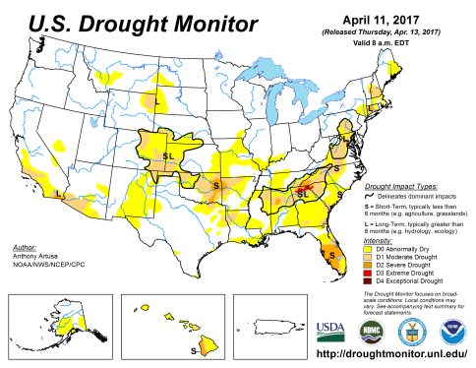
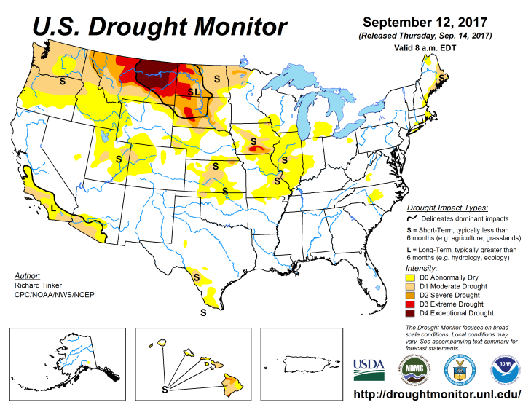
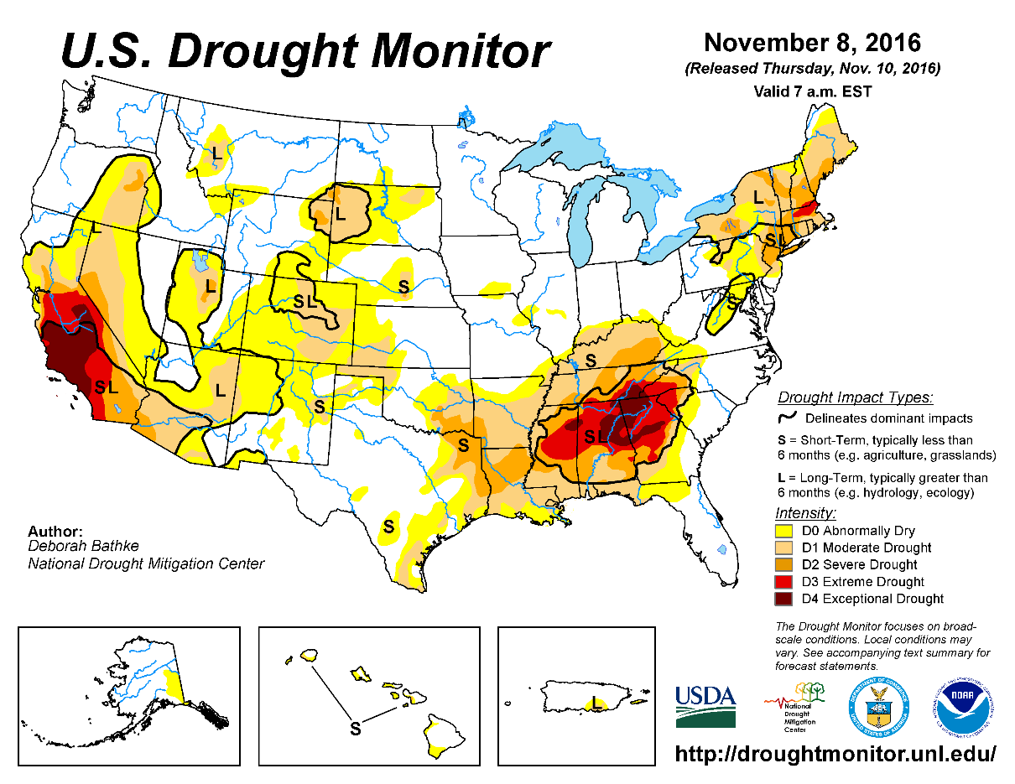
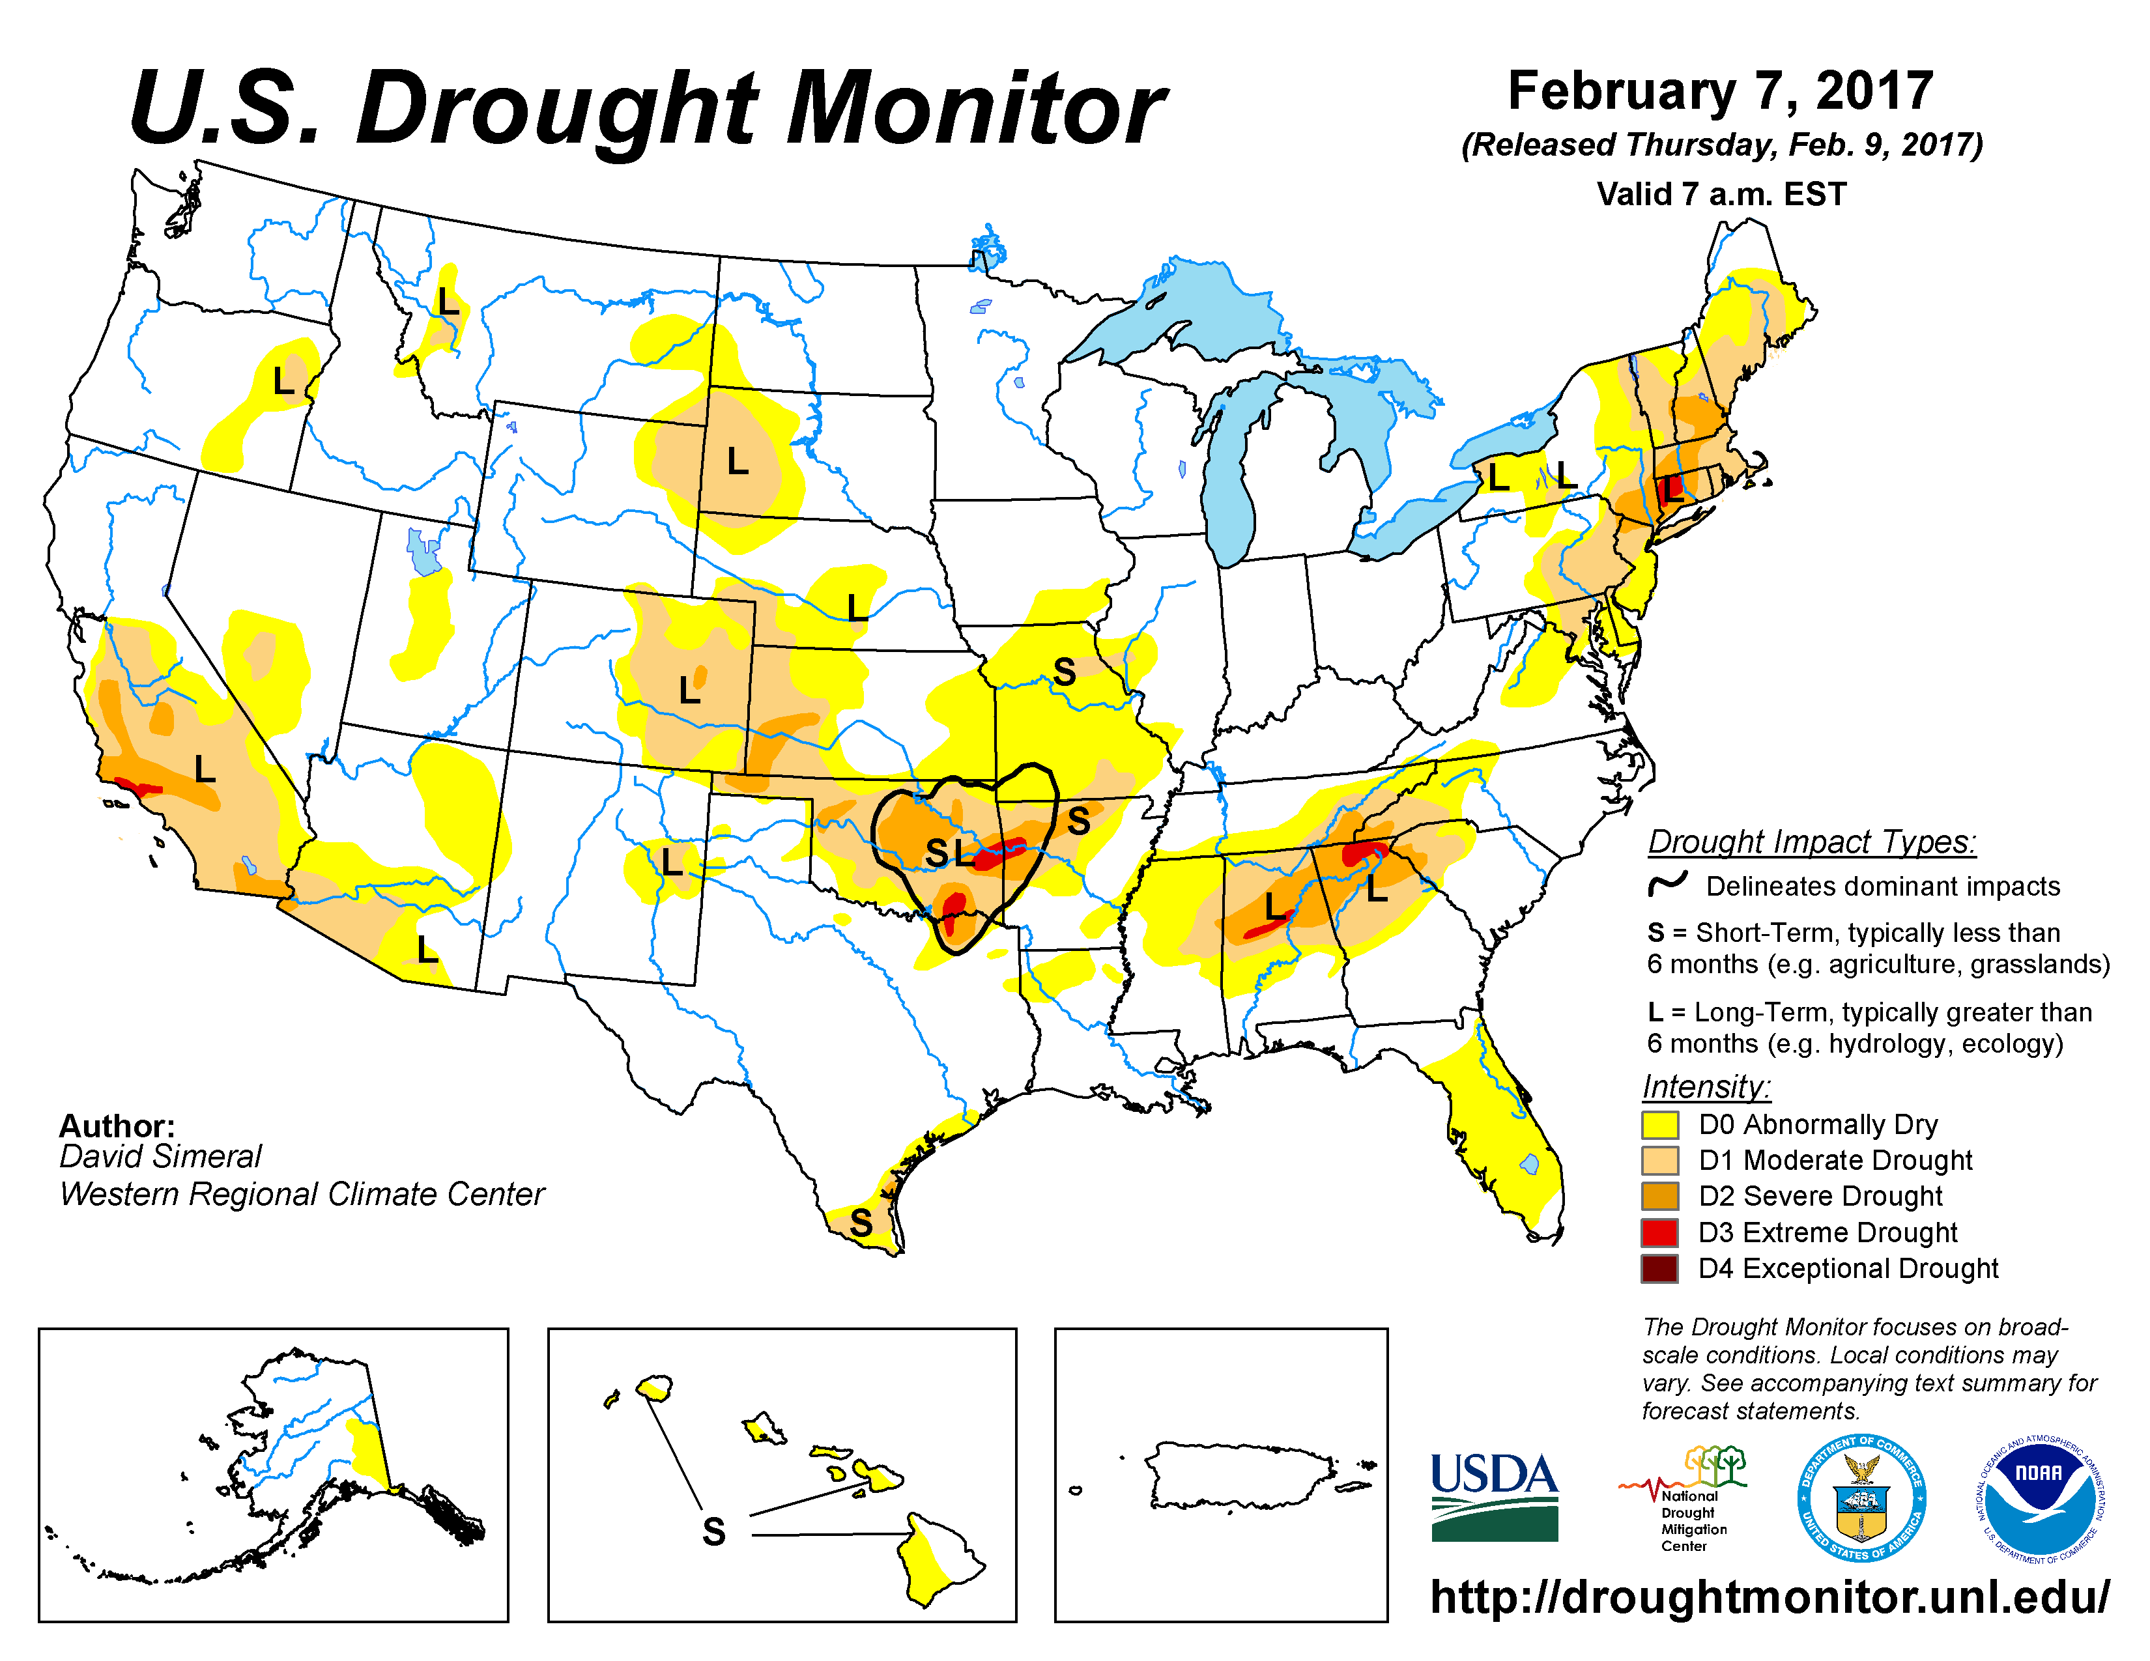
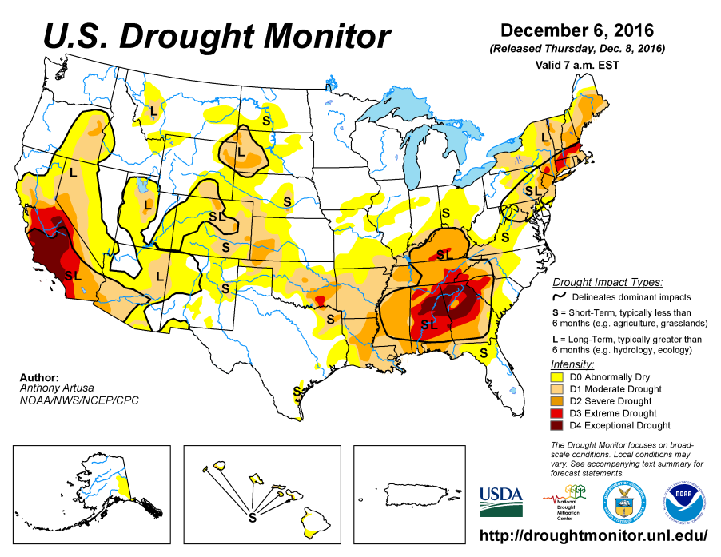
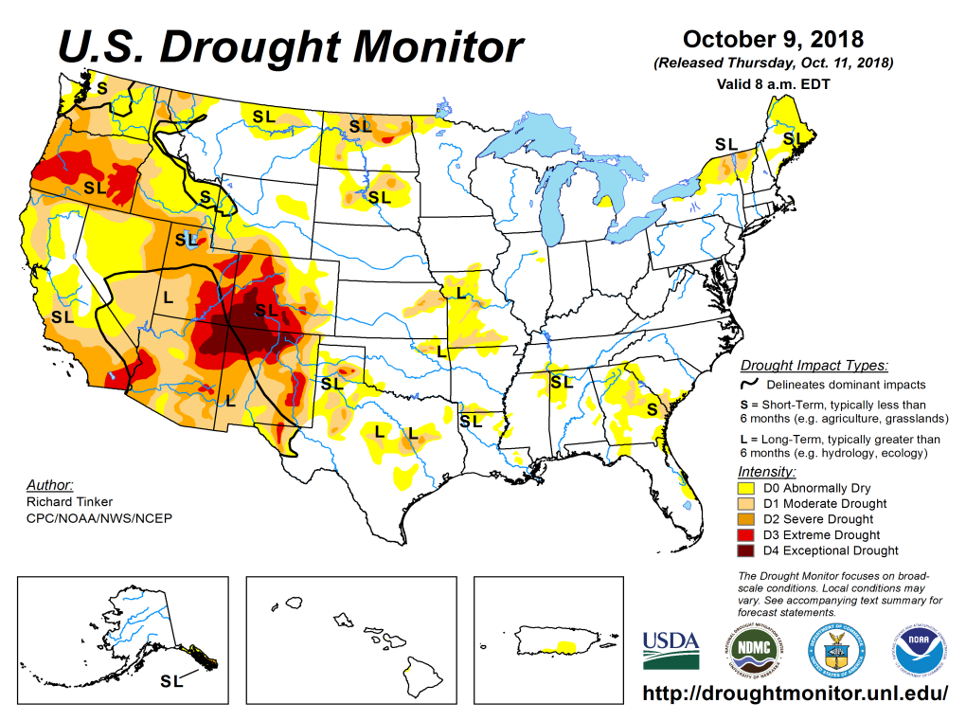
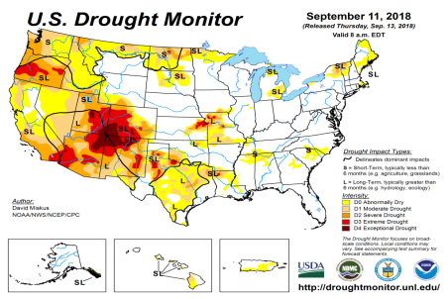
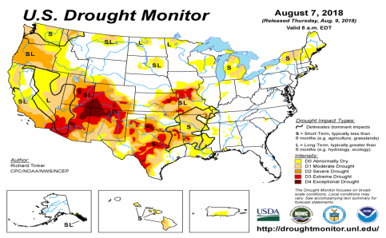
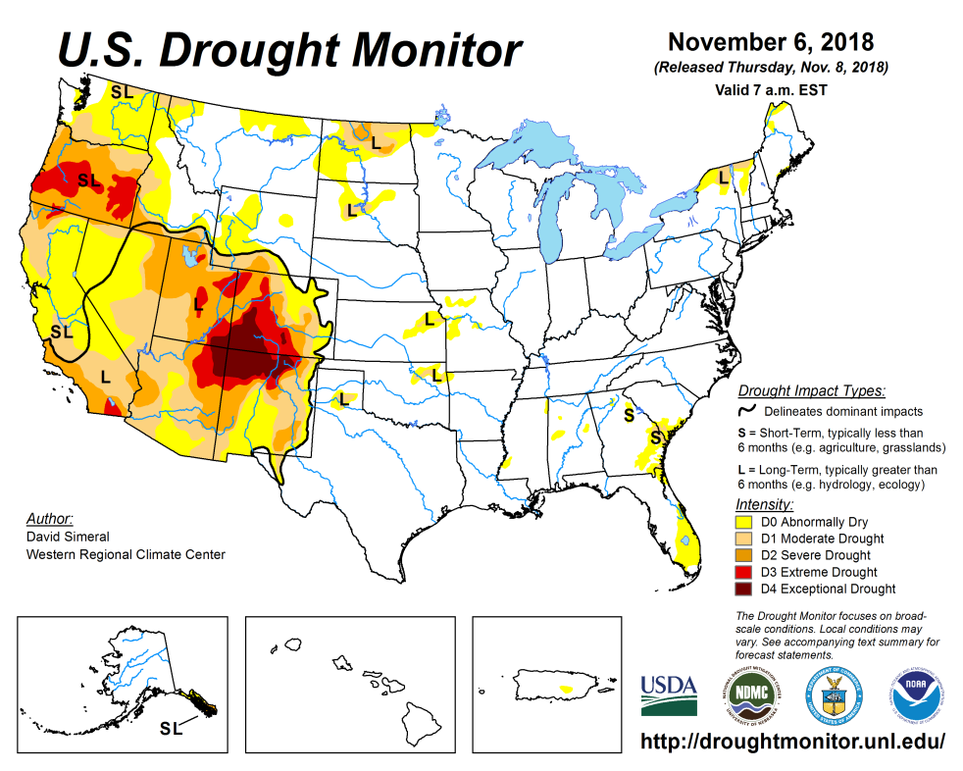
Drought Monitor
October
September
Previous
August
According to the US DM, there is “no drought to speak of” east of, and including, Texas over the eastern two thirds of the country. However, in the southwest, the severe drought in the four corners area in the states of UT/AZ/CO/NM is pretty much stuck there, with not much improvement over the last many seasons.
But drought in Pacific Northwest in OR/WA, that got established in last few months has remained in place.
Latest/Recent

Slide 3
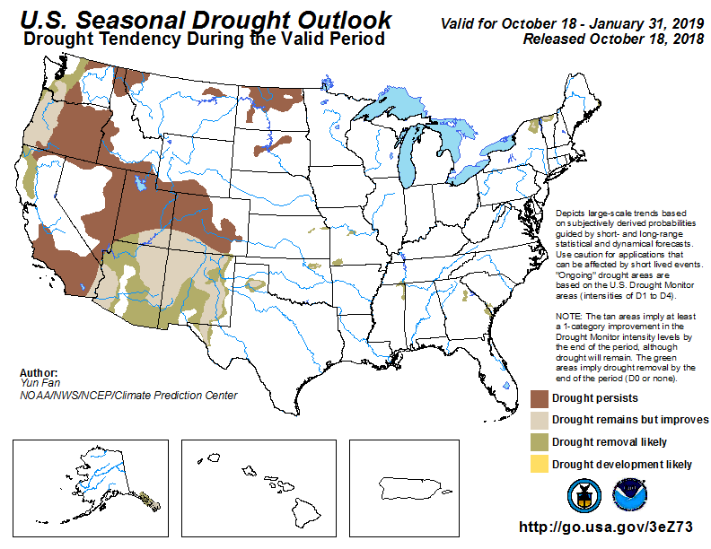
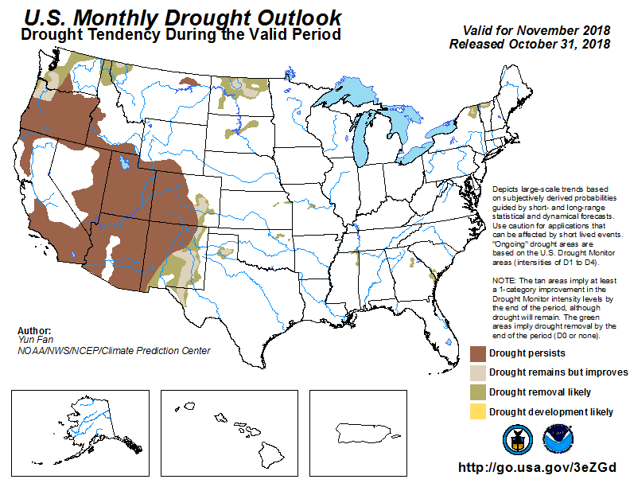
(Prev) Seasonal/Monthly Drought outlooks
Seasonal Outlook (Mid October 2018 - January 2019)
issued 10/18/18
Monthly outlook
(for November 2018)
issued 10/30/18
The four state corners area in the west continues remain in major drought (see previous slide), in spite of the forecast, since rainfall deficits in these regions have lasted longer (later slides!!).

Slide 4
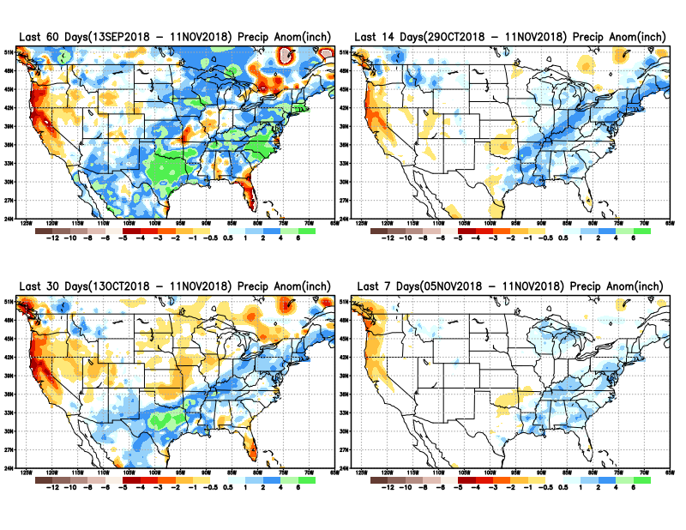
Precipitation ANOM during last 7, 14, 30, & 60 days.
Rainfall, the
East – West
Contrast!!
Overall,
Surplus in the east!
Deficit in
the west!

Slide 5
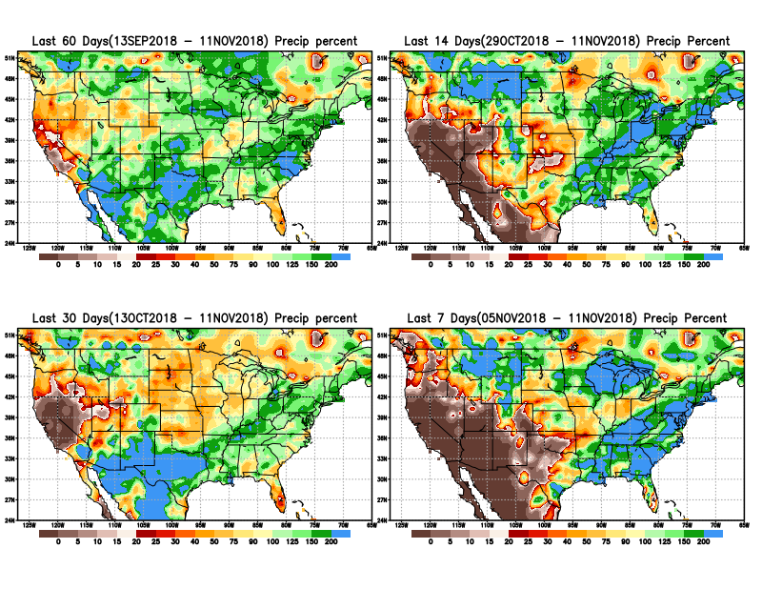
Precipitation Percent during last 7, 14, 30, & 60 days.
NOW !
In these short timescales, overall, the situation is much better in terms of rainfall in the eastern half of the country.
The impact of the relative rainfall shortfall area, greatly matters only with respect to the rainfall season/extent in that region

Slide 6
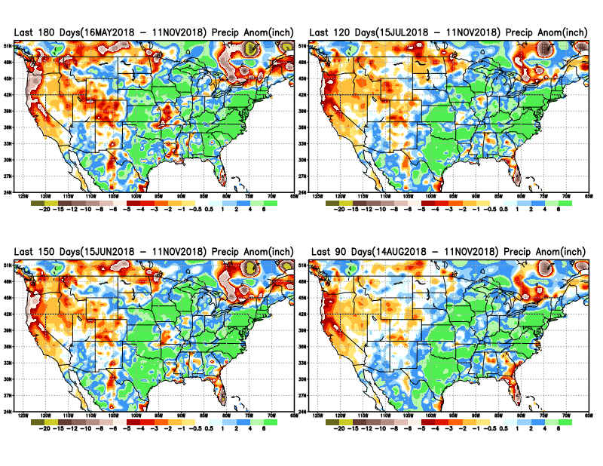
Total precipitation ANOM during last 3, 4, 5, and 6 months.
6 M
4 M
5 M
3 M

Slide 7
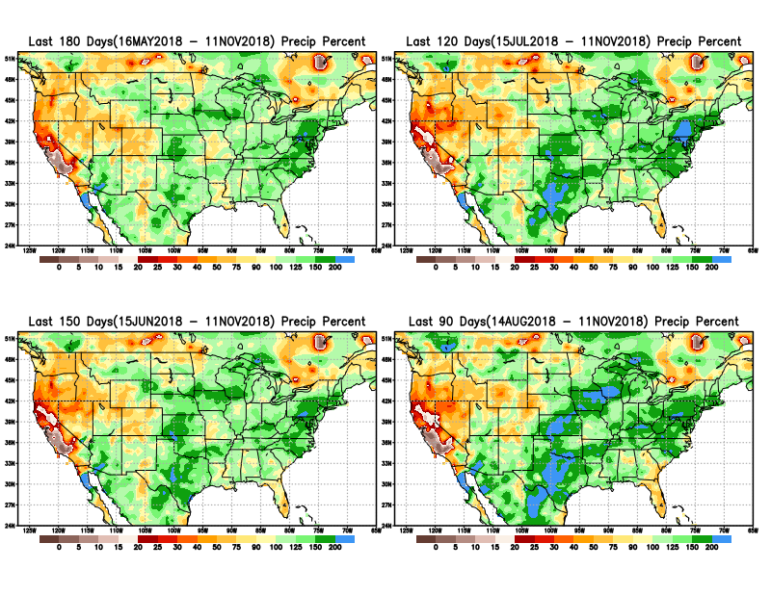
Total precipitation Percent during last 3, 4, 5, and 6 months.
6 M
4 M
5 M
3 M

Slide 8
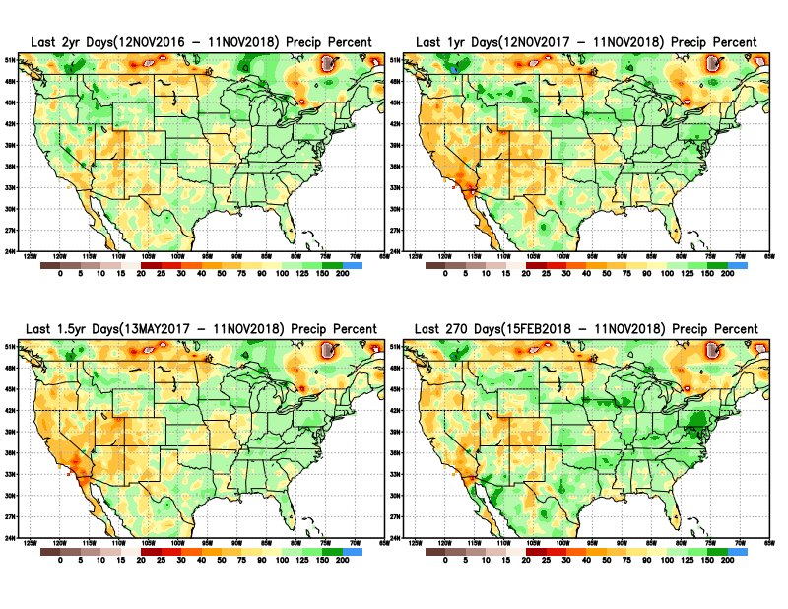
Total precipitation Percent during last 9 months, 1 yr, 1.5yrs, & 2 yrs.
2 Y
1 Y
There are many long term rainfall deficit regions in the country, particularly deficits in UT/AZ, southern CA, and parts of NM/CO are long term – possibly a consequence of the two back to back La Nina’s! and even earlier La Ninas!!
OR
Still longer term variability in play? Especially in the southwest!
1.5 Y
9 M

Slide 9
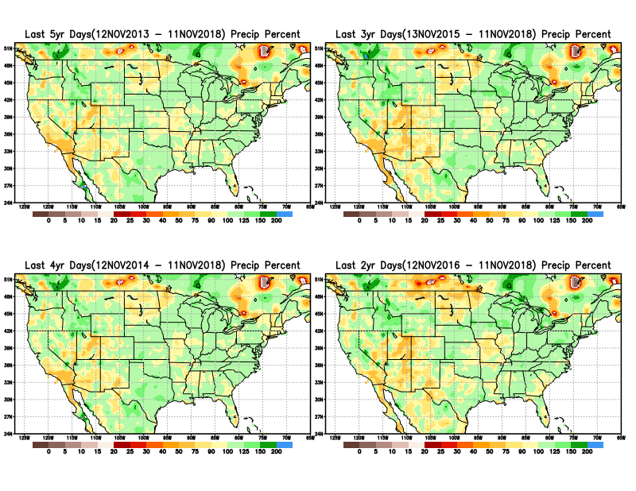
Total precipitation Percent during last 2 yrs, 3 yrs, 4 yrs, & 5 yrs.
5 Y
3 Y
Still longer term rainfall deficit variability in play? Especially in the southwest!
4 Y
2 Y
Quality of data/problem in the Northern High Plains area, especially in interpolation of sparse data in the rugged topography region!

Slide 10
Rainy Season across the US

Slide 11
Upcoming 3-m season’s
Rainy areas!
Adapted from Rich Tinker.

Slide 12
Adapted from
Rich Tinker

Slide 13
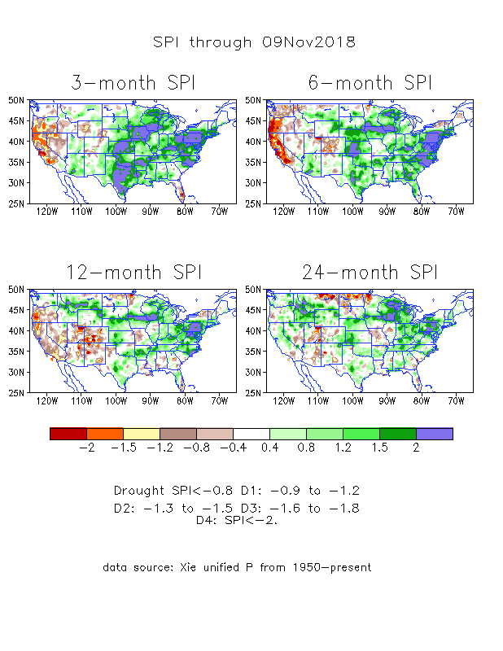
The Standardized Precipitation Index SPI (based on Observed P)
----- NOW
Very interesting graphic & details for the drought across the US based on the more generalized precip deficit/excess, the Standardized Precipitation Index (SPI).
The dark brown and red colors, indicating standardized precipitation deficits, in the various time periods, approximately correspond to the appropriate short/long term drought monitor regions and their intensities
In the short term (~3 mo-6mo), overall the drought looks much improved, except in coastal western states..
In the longer term ~12m and longer, rainfall deficits remain in the Southwest and this season’s rains seems not enough to offset last season’s deficits in the Northern Plains. Note the stronger deficits in the Northern plains! – data issues?

Slide 14
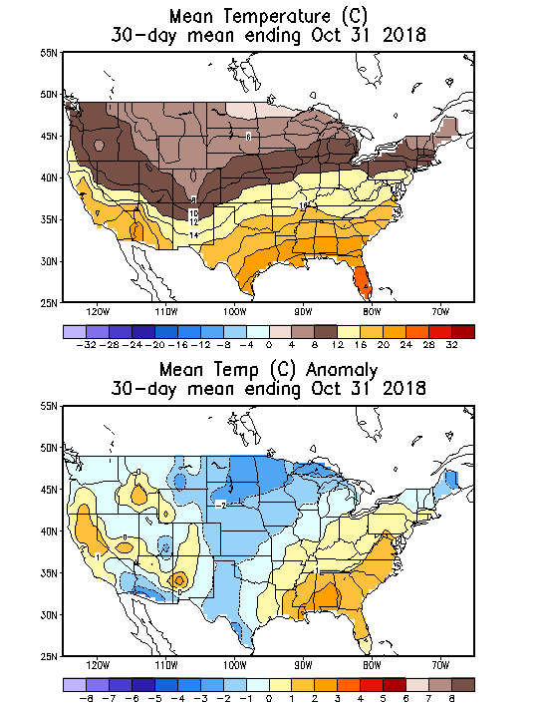
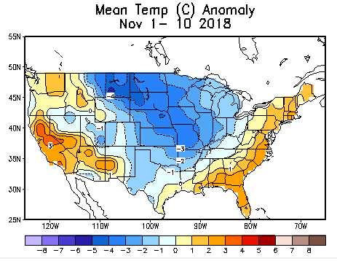
Recent US Temperatures
In October, much of the country has been relatively colder than warmer than normal
November so far is same as October pattern over much of the country.

Slide 15
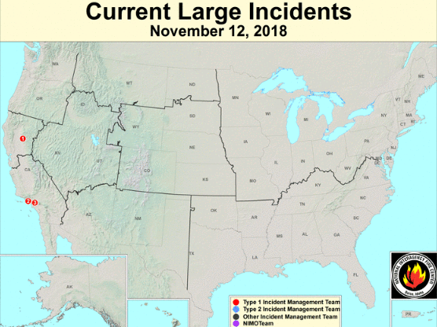
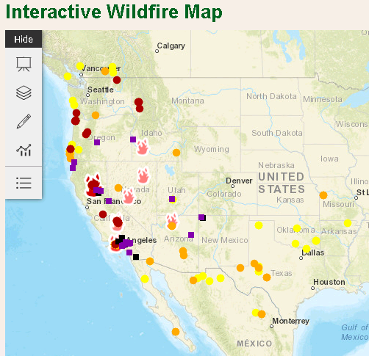
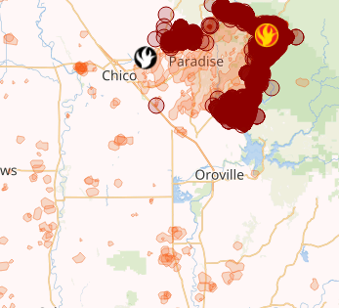
Current Active FIRE
Just when you thought the fire season is over!!
One of the worst, (or probably the worst ?) fire season in CA this year and hence damage/destruction!!
https://fsapps.nwcg.gov/afm/index.php
https://www.fs.fed.us/science-technology/fire/information

Slide 16
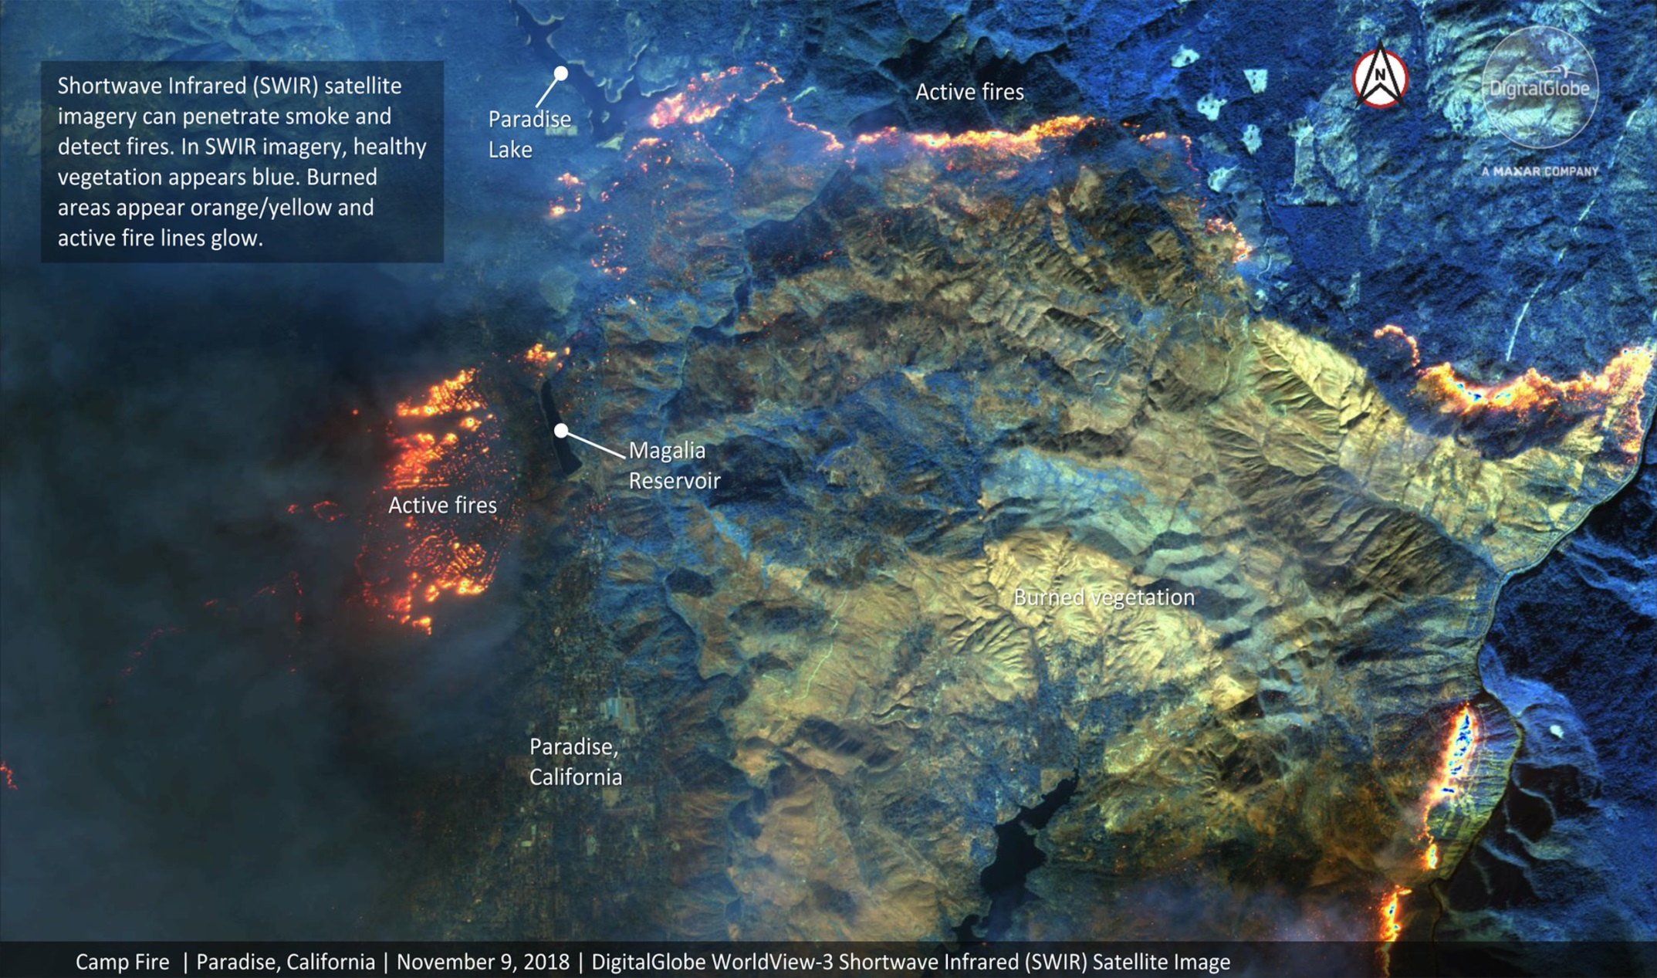
This annotated DigitalGlobe image overlays location information on a view of the deadly Camp Fire in northern California taken Nov. 9, 2018 by the WorldView-3 satellite. Credit: Satellite image ©2018 DigitalGlobe, a Maxar company.

Slide 17
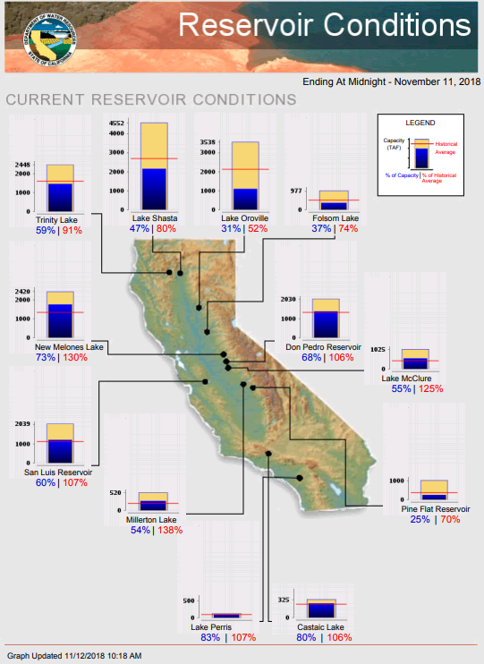
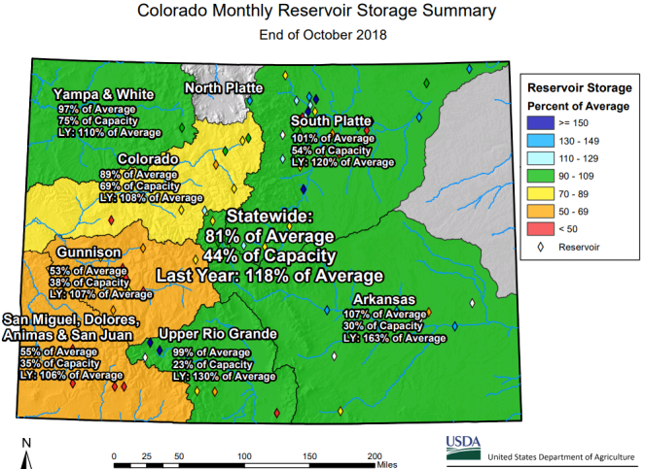
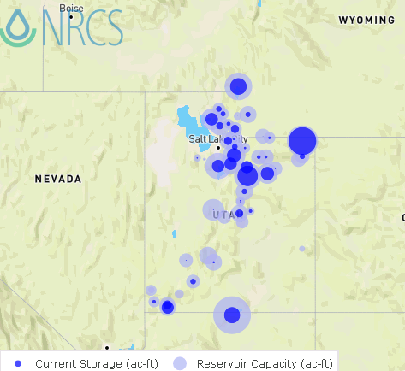
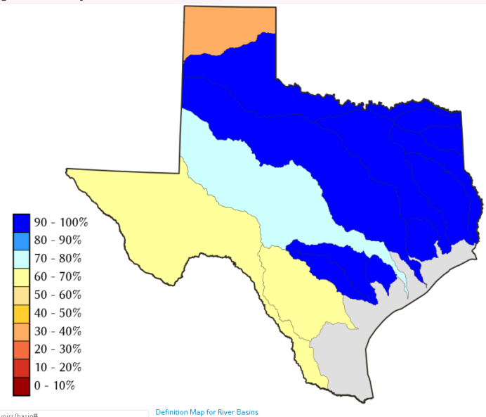
Water Reservoir Levels in some Western/Southern States!
AZ
NM
https://www.climas.arizona.edu/sw-climate/drought/sw-reservoir-volumes -- updated???
Northern CA reservoirs beginning to show
Weakness, but rainy season coming up!
Reservoir Storage Summary for River Basins
TX
2018-11-12
UT
Situation better than last month !
https://fsapps.nwcg.gov/afm/index.php

Slide 18
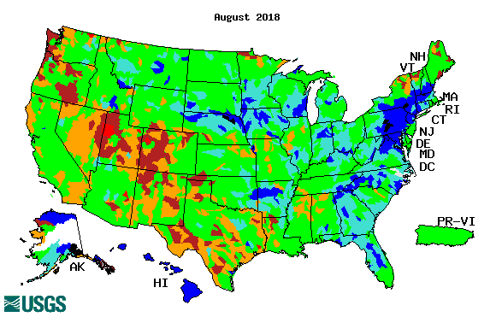
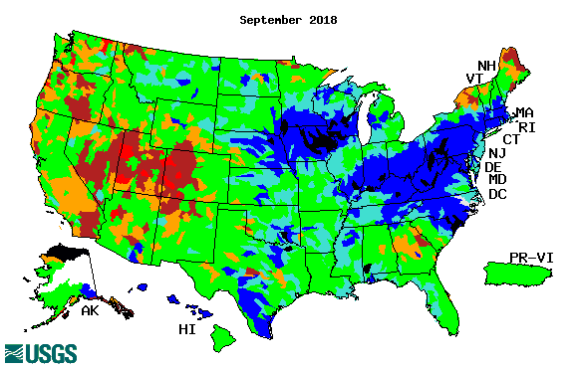
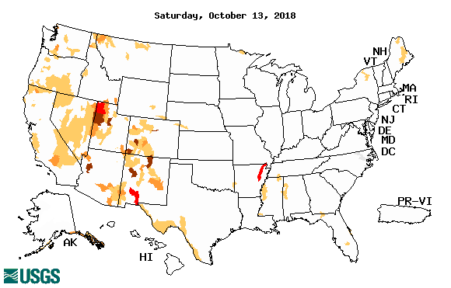
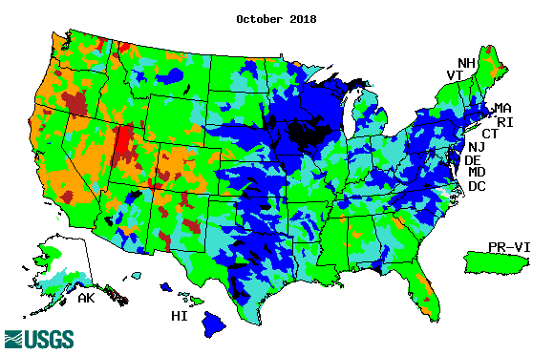
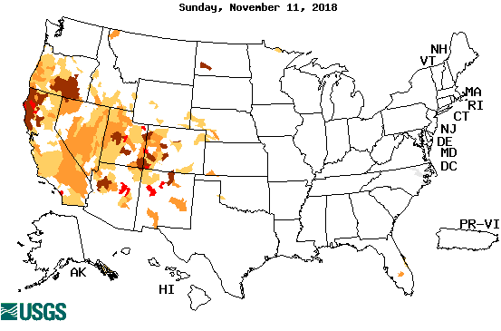
Streamflow (USGS)
Much improvement in Texas.
Lots of rain/streamflow in the east.
Four states corner area in the west – not much improvement!!
Map shows only below normal 7-day average streamflow compared to historical streamflow for the day of year.
One month ago (left) &
Now (below)
Not exactly the same type of maps?
18

Slide 19
EL NIÑO/SOUTHERN OSCILLATION (ENSO)
DIAGNOSTIC DISCUSSION
issued by CLIMATE PREDICTION CENTER/NCEP/NWS and the International Research Institute for Climate and Society
8 November 2018
ENSO Alert System Status: El Nino Watch !!
Synopsis: ENSO-neutral continued during October, despite widespread above-average sea surface temperatures (SSTs) across the equatorial Pacific Ocean. El Niño is expected to form and continue through the Northern Hemisphere winter 2018-19 (~80% chance) and into spring (55-60% chance).

Slide 20
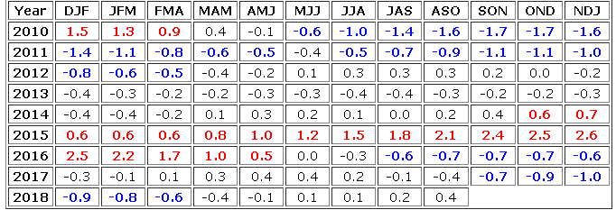
STILL In Neutral Conditions NOW! Expected to turn to
El Nino conditions soon, very soon!
http://www.cpc.ncep.noaa.gov/products/analysis_monitoring/ensostuff/ensoyears.shtml

Slide 21
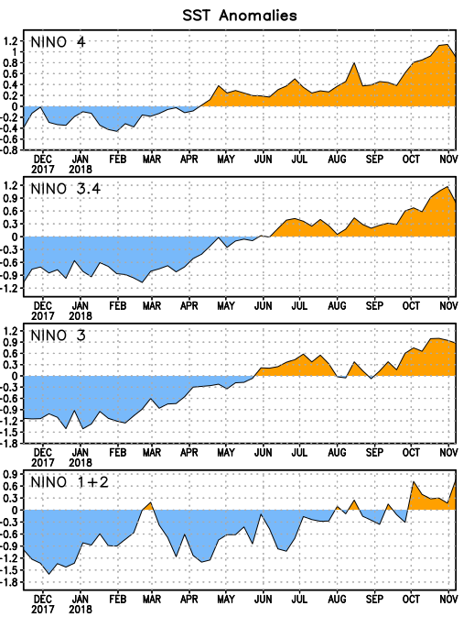
Latest values of SST indices in the various Nino Regions.
The sub surface heat anom continues to stay in the +ve territory! .
Relatively short lived!
Equatorial SST’s are at near to slightly above normal levels in all three ocean basins, except in Nino 4, where it is high!

Slide 22
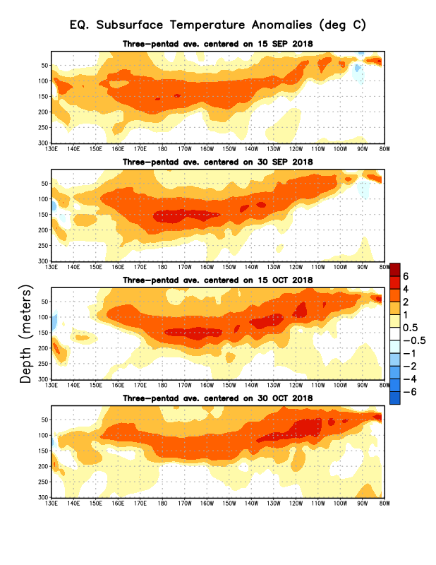
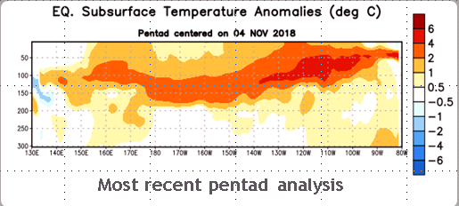
Sub-Surface Temperature Departures in the Equatorial Pacific
Recently, the equatorial sub surface temperatures in the tropical Pacific have increased and expanded into the east Pacific.

Slide 23
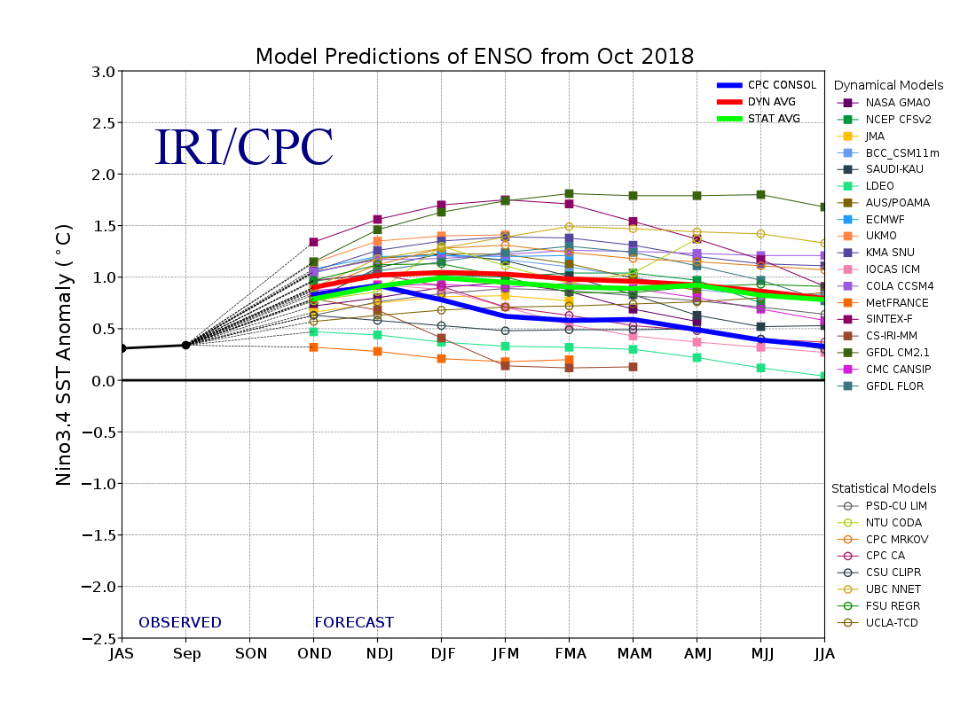
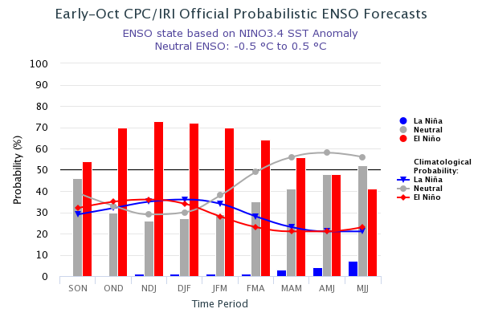
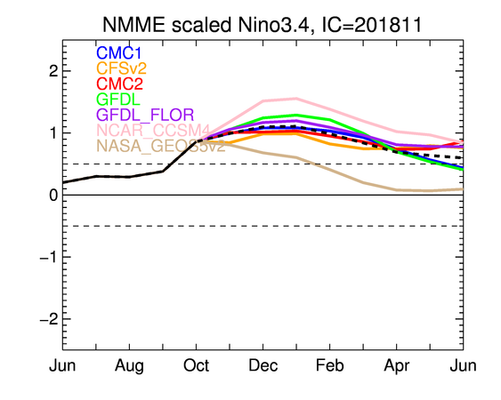
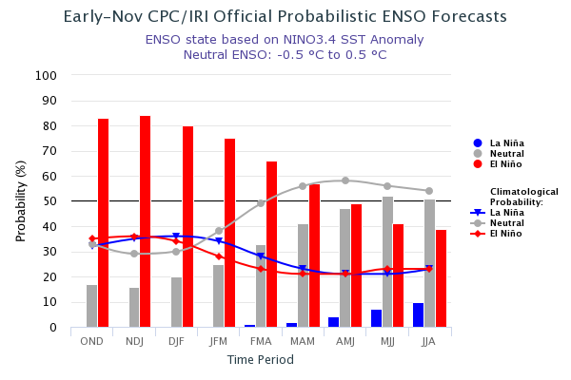
ENSO Forecasts
Early- October CPC/IRI forecast
NMME Models’ – Nino 3.4 forecasts
Early- November CPC/IRI forecast
Neutral conditions. Probability of developing El Nino in Fall/2018 ~ 80 %. – Question?: How long will it last?

Slide 24
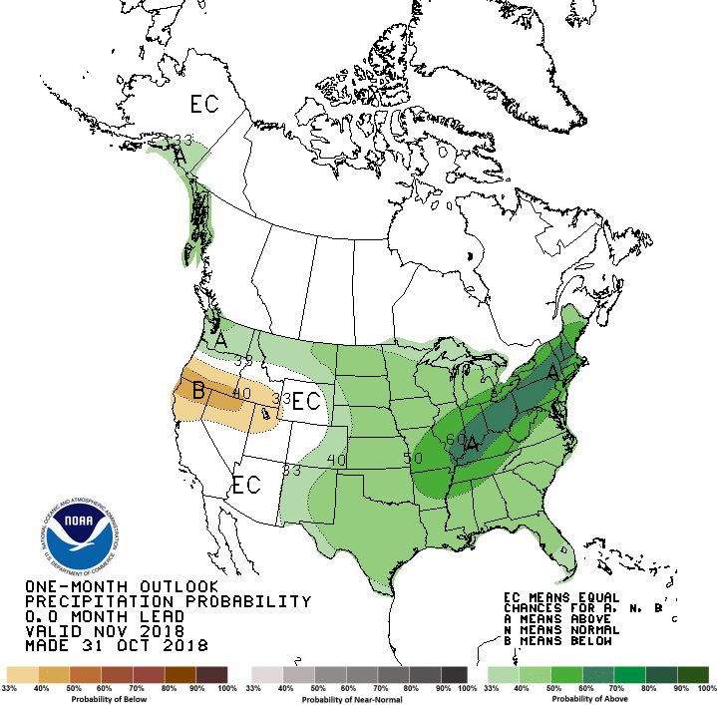
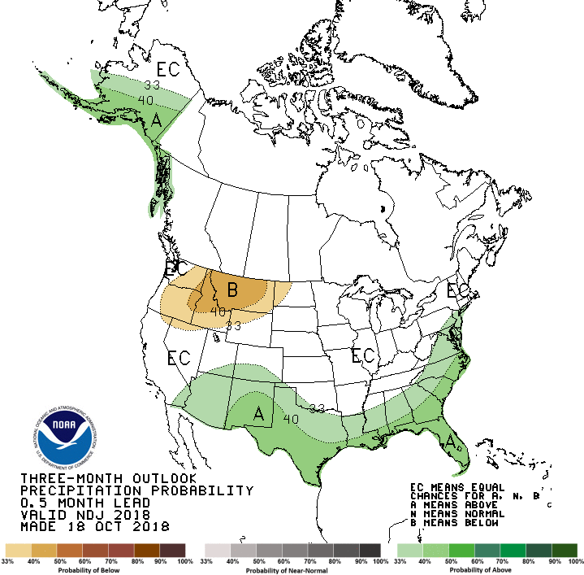
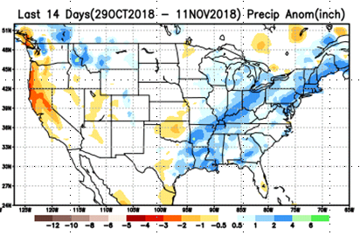
Previous(Last month)
CPC’s official Monthly (Nov)/Seasonal (NDJ)
Precipitation outlook
Released October 31
Released Oct 18th
☺
Observed so far this month!!

Slide 25
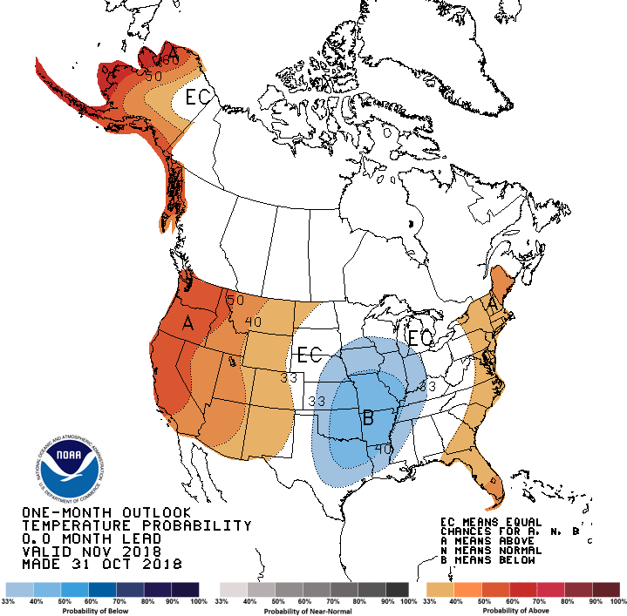
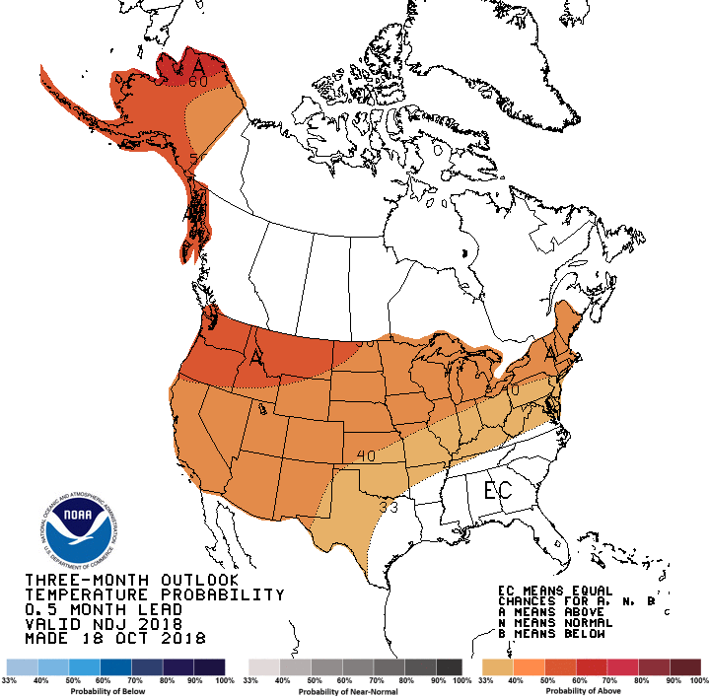
Previous CPC’s official Monthly (Nov)/Seasonal (NDJ)
Temperature outlook
Made
Oct 31th
Observed so far this month!!
Made Oct 18th

Slide 26
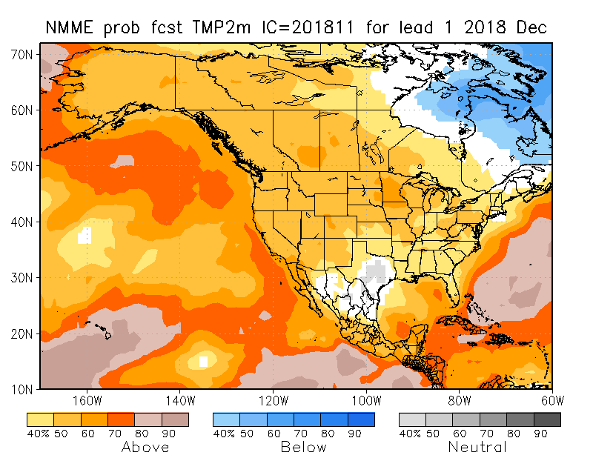
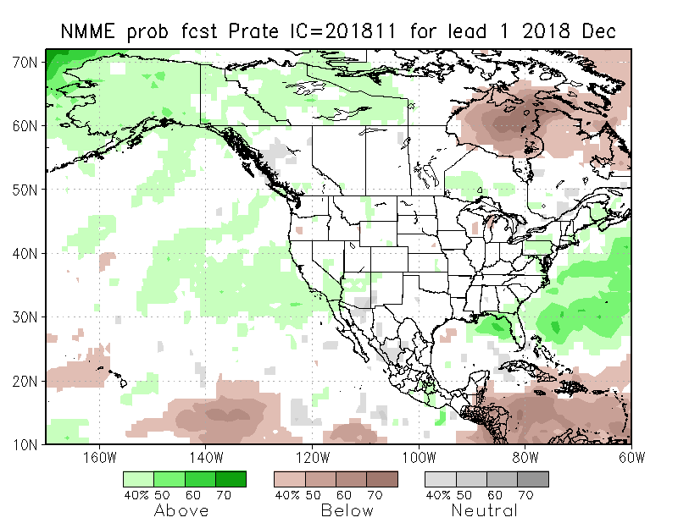
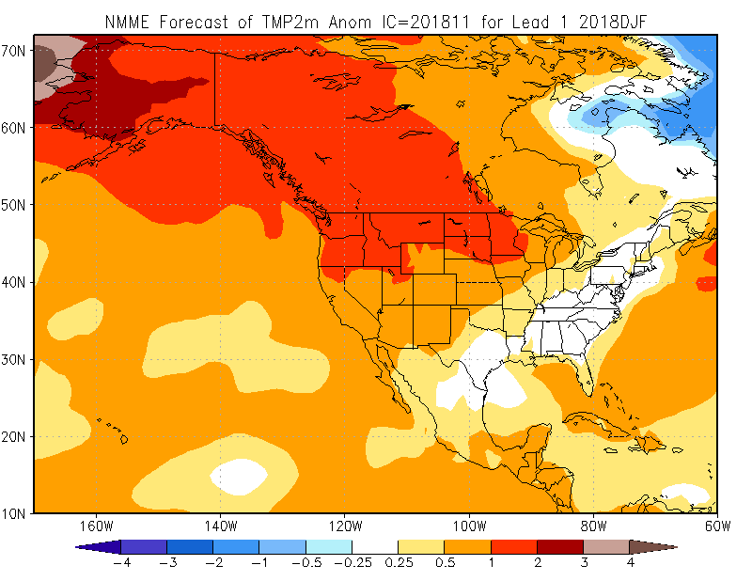
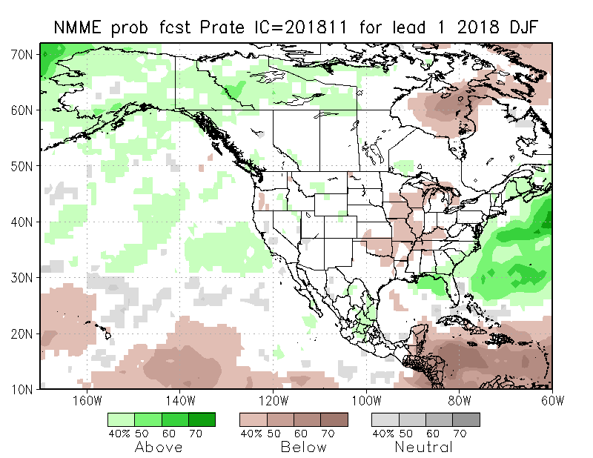
NMME T & P EnsMean forecasts
Dec
DJF
Currently ENSO state is neutral!! Forecast is based on expected developing El Nino conditions!!
Will the expected El Nino conditions during upcoming winter, produce the expected canonical P along west coast/CA???? (Remember 2015/16 strongest El Nino and 2016/2017 La Nina?)

Slide 27
The agreement/uncertainty among the diff. NMME models’ forecasts (middle and bottom panels) for Dec-Jan-Feb Precipitation!!!
27

Slide 28
From 11/12/18 12Z run – showing slow appearance of precip in CA area – but probably not in time to help ongoing active fires!! .
Next 7 days QPF Forecast
GFS Model Guidance for next 16 days.
Southwest and Pacific Northwest are obviously the important areas to watch, both in terms of drought and the upcoming rainy season!!

Slide 29
SPI3
SPI6
SPI12
SPI3, SPI6
& SPI12
Forecasts from 6NMME Models
(uses obs. P up to past month, and forecast months’ P from NMME models)
The goodness and skill of these SPI’s forecasts depend directly on the NMME models’ skill in predicting precipitation!!!
Short vs long term improvement!!

Slide 30
Hydrological Monitoring and Seasonal Forecasting @ MSU (Michigan State University ) NLDAS model
Monthly Soil Moisture Percentile Prediction issued on 201811 with this IC.
http://drought.geo.msu.edu/research/forecast/smi.monthly.php
The inter quartile range suggest greater uncertainty about the forecast in these shaded regions.
The forecast soil moisture situation looks good except in Pacific Northwest! CA!

Slide 31
Precip Forecast
NASA GEOS5 Forecasts
More rain is forecast during December in California, which increases soil moisture. But last month…the model forecast dry conditions in December….
Nov
Soil Moisture Forecast Percentile
Dec
Nov
IC
Jan
Dec
Jan

Slide 32
Monthly Drought Tendency in Probability
(This and next slide!) Exptl. Probability Drought Outlook from Kingtse Mo and Li Xu based on NMME ensemble members’ SPI6 (from precip) forecast – Since it is based on SPI6, longer/term lasting droughts will not be depicted!!

Slide 33
Seasonal Drought Tendency in Probability

Slide 34
Summary
Current ENSO status and forecast. El Nino Watch!! ENSO-neutral continued during October, despite widespread above-average sea surface temperatures (SSTs) across the equatorial Pacific Ocean. El Niño is expected to form and continue through the Northern Hemisphere winter 2018-19 (~80% chance) and into spring (55-60% chance).
Current Drought conditions:
East of Texas, the country is (almost) drought free over the eastern two thirds of the country.
However, the longer term drought in the southwest, in the four corners states area over UT/AZ/CO/NM, continues to persist there, without much improvement.
The short term drought that developed in the Northwest over OR/WA over the last few months, is likely to be impacted in the upcoming winter months.
The short/long term drought in parts of the Northern High Plains has all but vanished, but appears in a muted form.
In spite of these drought declarations, analysis of rainfall received over the last few months, years reveal the exact nature of the varying levels of rainfall deficit in the short/long term drought regions.
Prediction:
Rainfall season(DJF) is coming up for all coastal western states! At present, development of El Nino conditions in the next couple of months appears certain. But, how this developing El Nino will alter/impact this seasonal rainfall pattern in CA, OR, WA and the adjoining states, particularly in the southwest will decide the future of droughts in these regions. The NMME models do not give a clear picture of the expected rainfall for the winter season, in spite of the strong forecast El Nino boundary conditions.
Overall, short term improvement is expected in the drought conditions overmuch of the northwest, south and west in the drought regions. But the longer term drought from longer tem rainfall deficits in these regions is expected to remain! short of an unexpected usual deluge associated with El Nino, which could make a big dent in these longer term rainfall deficits here. The Northern Plains Drought, in some areas of the N/S Dakotas, may continue to exist in a muted form for the season, since the previous rainfall deficits are not completely erased this year. **END***

Slide 35
Miscellaneous maps

