Slide 1
Drought Outlook Support Briefing November 2019
Climate Prediction Center/NCEP/NOAA
http://www.cpc.ncep.noaa.gov/products/Drought
Phone: 1-877-680-3341
Pwd: 858747#

Slide 2
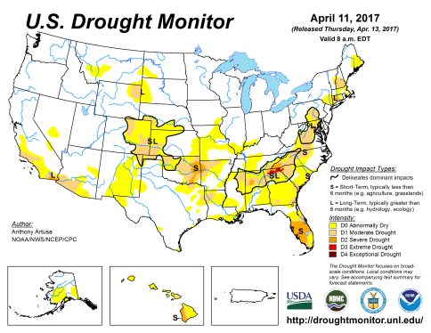
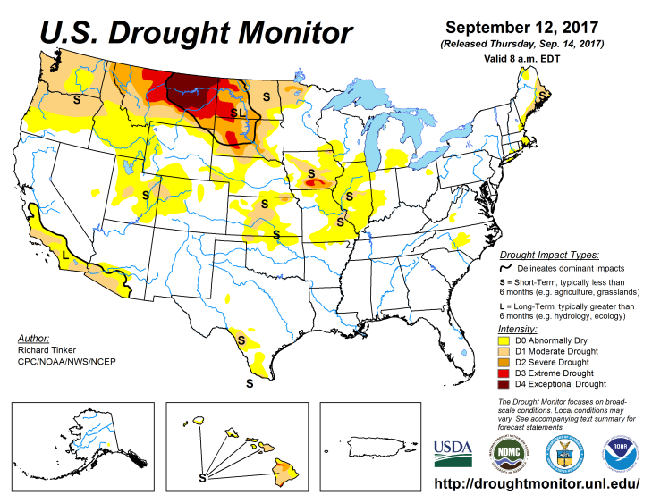
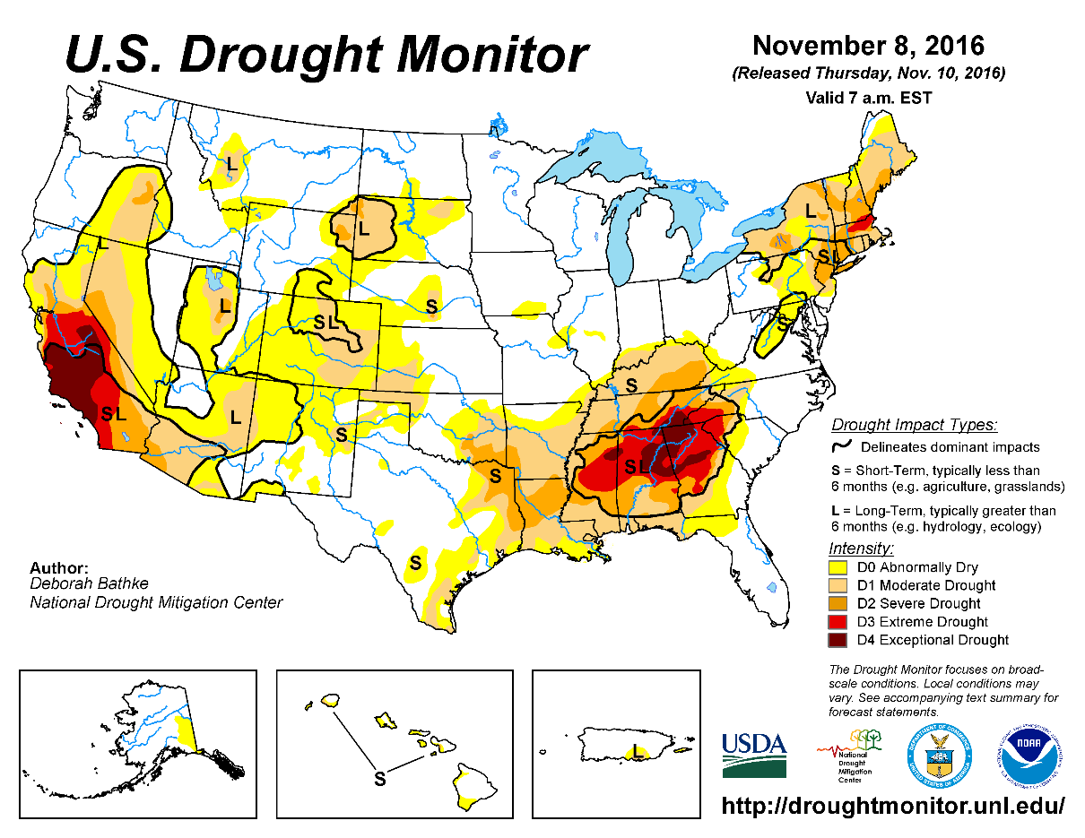
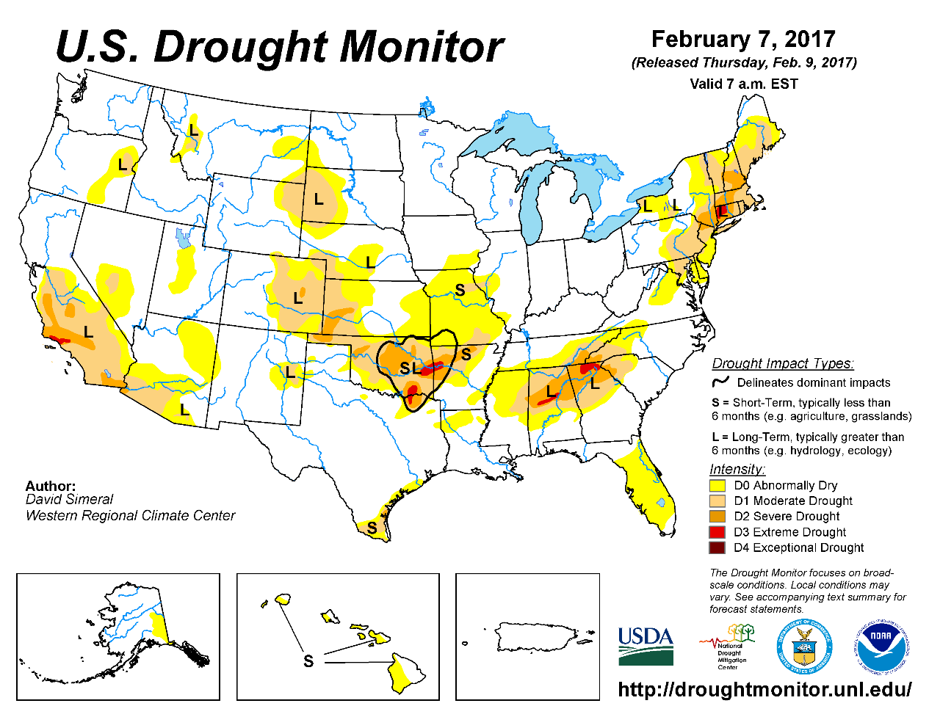
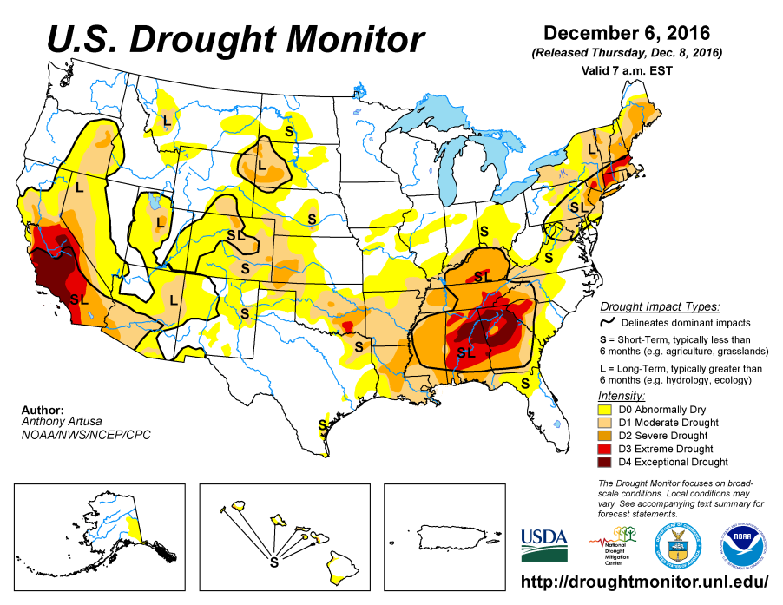
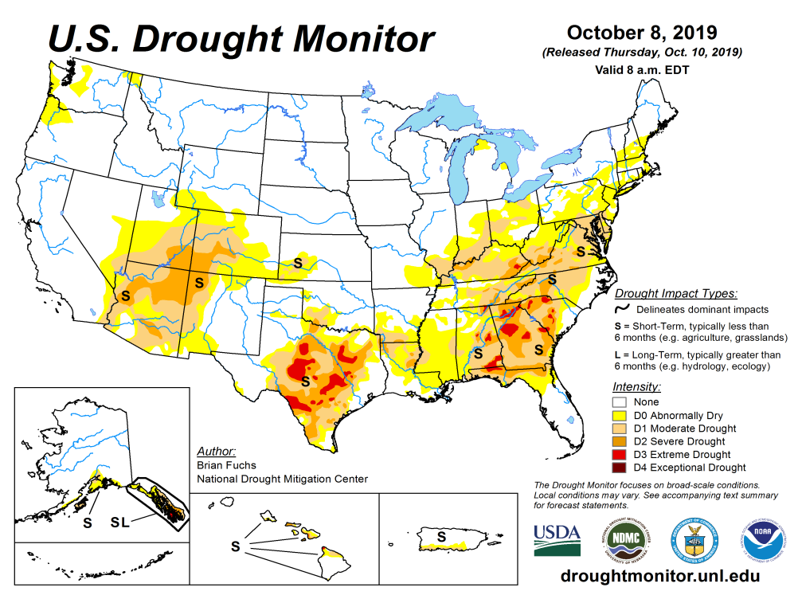
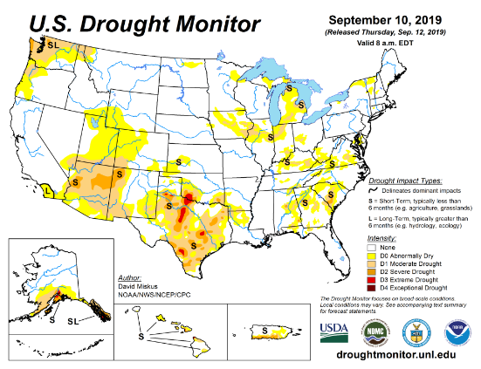
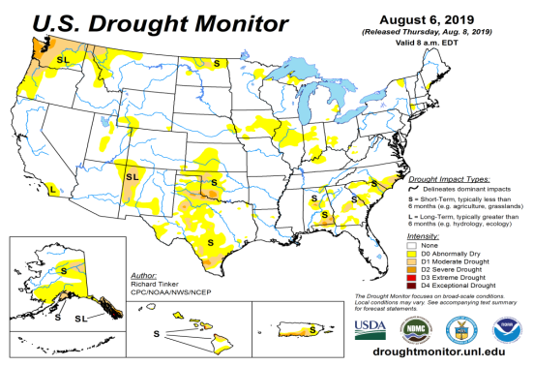
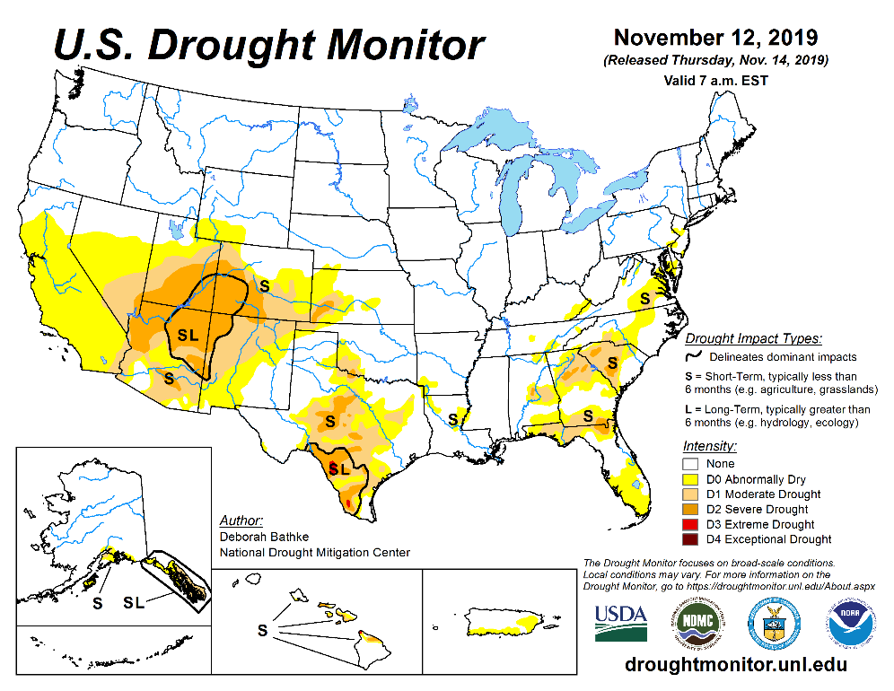
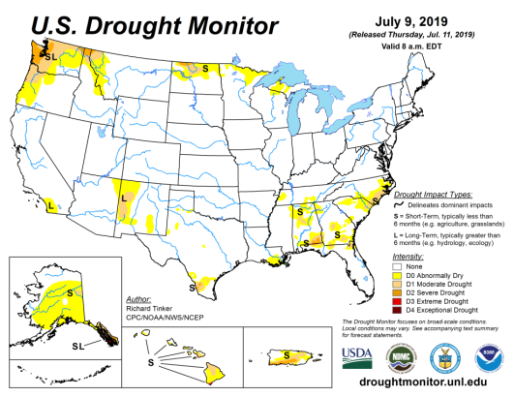
Drought Monitor
October
After reaching a relative minimum in the area of drought coverage across the US in April/May, the drought area has been surging lately.
According to the DM, it is mostly the drought in the southern drought regions vs the drought free northern tier states.
Dryness/Flash drought in the Midwest/ southeast has gotten much better both in areal extent as well as intensity.
And in TX better too..
Southwest is slightly worse, especially around the four corners area.
September
August
Recent/Latest
July
February

Slide 3
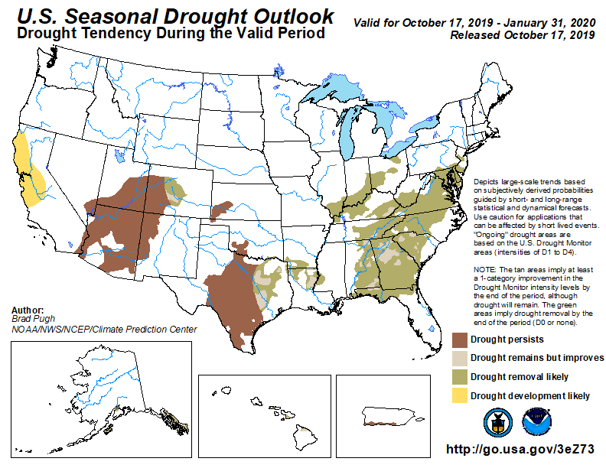
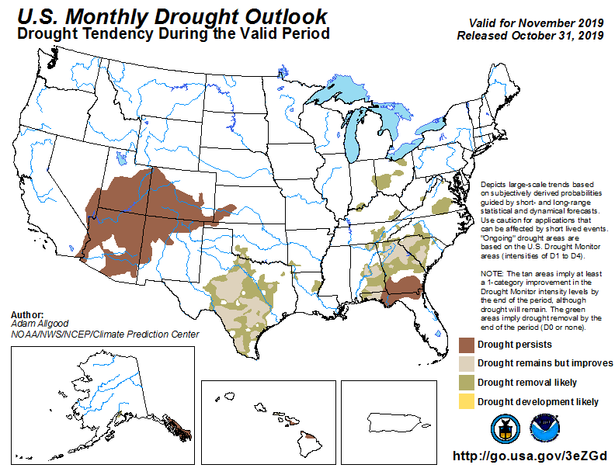
(Prev) Seasonal/Monthly Drought outlooks
(New Seasonal Drought Outlook to be released in 2 days!)
Seasonal Outlook
(Mid Oct 2019- Jan 2020)
issued 10/17/19
Monthly outlook
(for Nov 2019)
issued 10/31/19
Pretty good monthly forecast so far. →

Slide 4
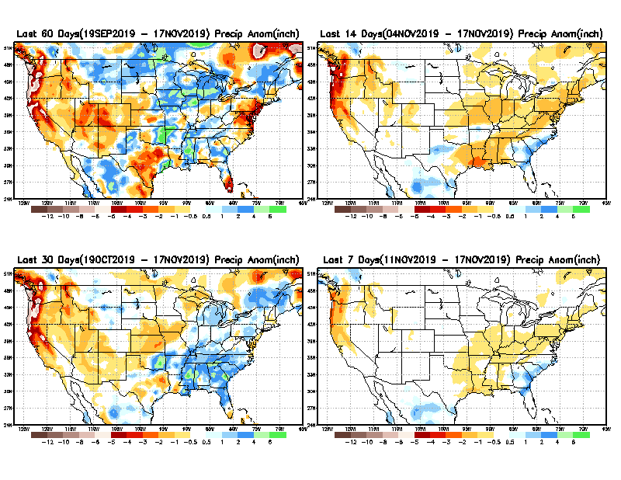
Precipitation ANOM during last 7, 14, 30, & 60 days.
60 Days
14 Days
These maps in this and following slides, including
a) Anom and b) Percent of precip. in these and other longer time ranges. Now daily updated at:
30 Days
7 Days
From: Recent Accumulated Precipitation https://www.cpc.ncep.noaa.gov/products/Drought/briefing_prcp.shtml

Slide 5
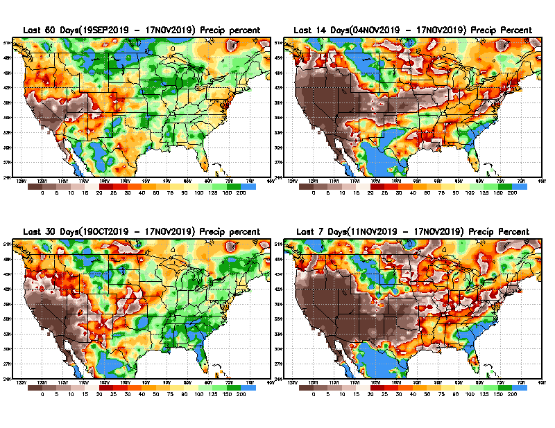
Precipitation Percent during last 7, 14, 30, & 60 days.
60 Days
14 Days
NOW !
Need to keep an eye for month/ season
In regions, where the rainfall season is kinda strictly limited to a few months (say 3-4), even one month of acute rainfall deficit can be of concern !!
In other regions of relatively broad rainfall months, this need not be a big issue!!
30 days
7 Days
From: Recent Accumulated Precipitation https://www.cpc.ncep.noaa.gov/products/Drought/briefing_prcp.shtml

Slide 6
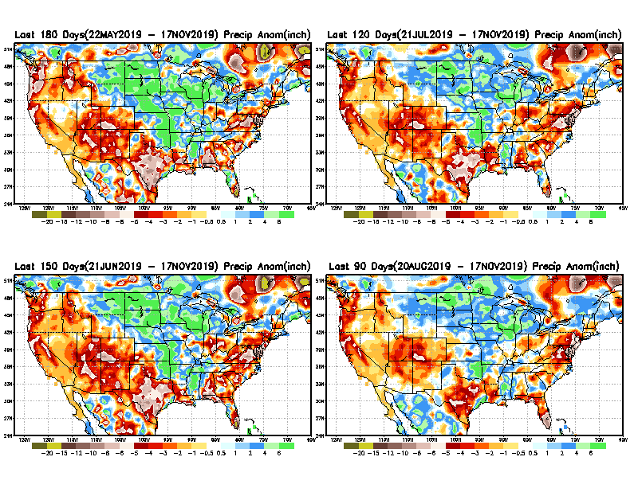
Total precipitation ANOM during last 3, 4, 5, and 6 months.
6 M
4 M
5 M
3 M
While the Precip anomalies deficit may seem large in some regions, it is the % of precip (next slide) that matters more!!
From: Recent Accumulated Precipitation https://www.cpc.ncep.noaa.gov/products/Drought/briefing_prcp.shtml

Slide 7
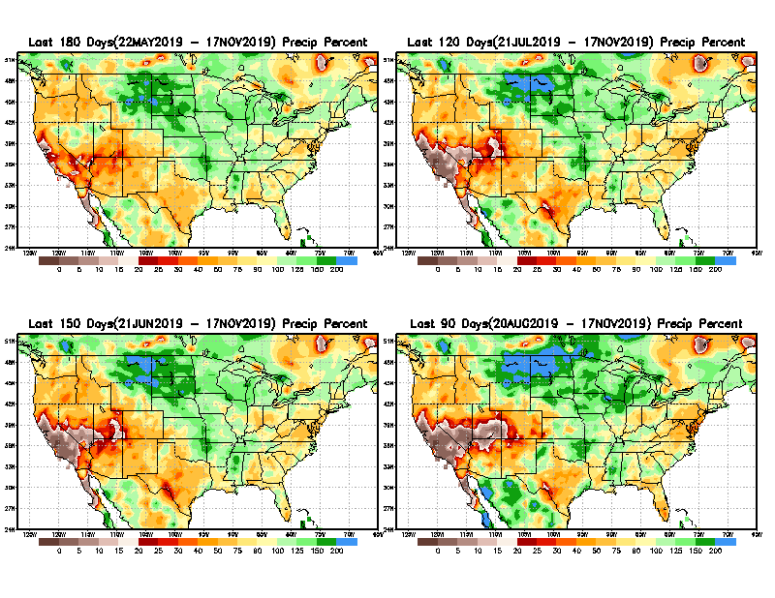
Total precipitation Percent during last 3, 4, 5, and 6 months.
6 M
4 M
In these interim time scale 3-6 months, we need to pay attention to regions, which are red/dark red and brown (<50%)
5 M
3M

Slide 8
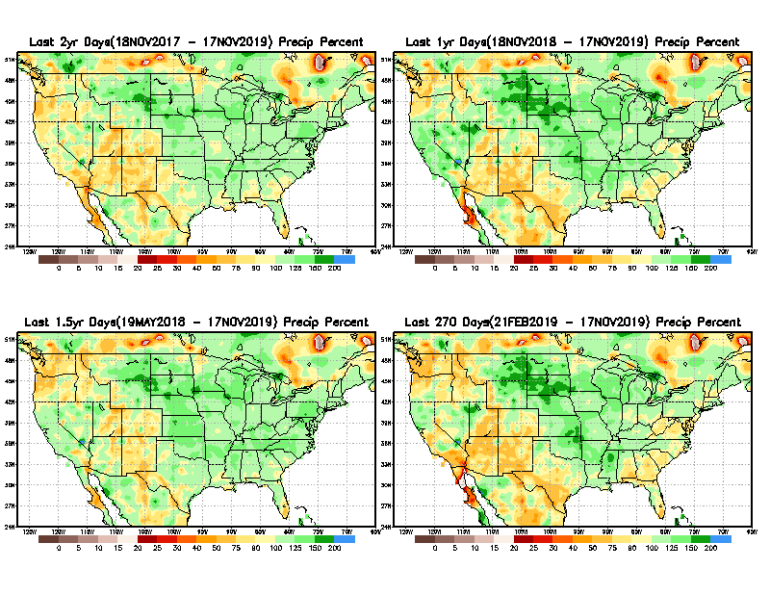
Total precipitation Percent during last 9 months, 1 yr, 1.5yrs, & 2 yrs.
2 Y
1 Y
1.5 Y
9 M
From: Recent Accumulated Precipitation https://www.cpc.ncep.noaa.gov/products/Drought/briefing_prcp.shtml

Slide 9
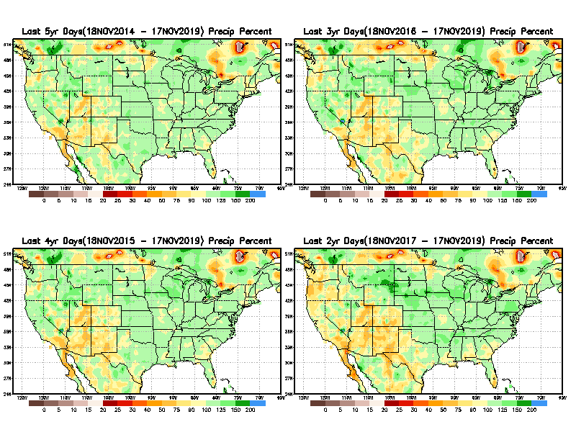
Total precipitation Percent during last 2 yrs, 3 yrs, 4 yrs, & 5 yrs.
5 Y
3 Y
Still longer term rainfall deficit variability in play? Especially in the southwest!
Will these deficits ever go away, OR is these part of the new norm??
Not so bad in the east!!
4 Y
2 Y
From: Recent Accumulated Precipitation https://www.cpc.ncep.noaa.gov/products/Drought/briefing_prcp.shtml

Slide 10
Rainy (3-month)Season across the US

Slide 11
Watch how Southeast contrasts w TX and SW as we move forward to January.
Adapted from Rich Tinker.

Slide 12
Adapted from
Rich Tinker

Slide 13
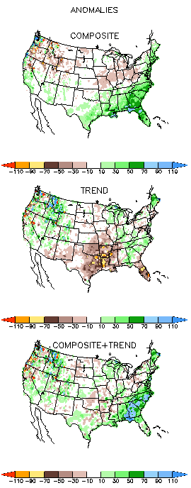
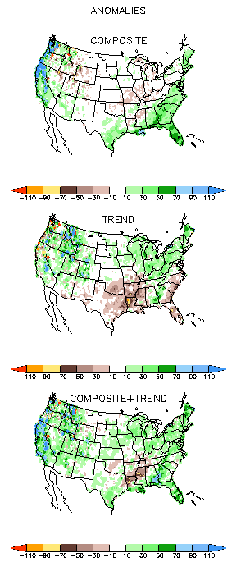
EL NINO Precip COMPOSITES & Trend maps
NDJ
DJF
Only this is of relevance to us now due to neutral ENSO status.

Slide 14
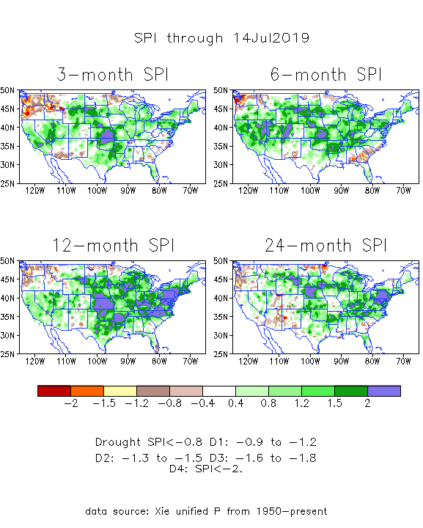
The Standardized Precipitation Index SPI (based on Observed P)
---4 months ago
Very interesting graphic & details for the drought across the US based on the more generalized precip deficit/excess, the Standardized Precipitation Index (SPI).
The dark brown and red colors, indicating standardized precipitation deficits, in the various time periods, approximately correspond to the appropriate short/long term drought monitor regions and their intensities
How quickly the short term drought situation changes!!
Compare these patterns just 2 months ago to current situation now (next slide!)

Slide 15
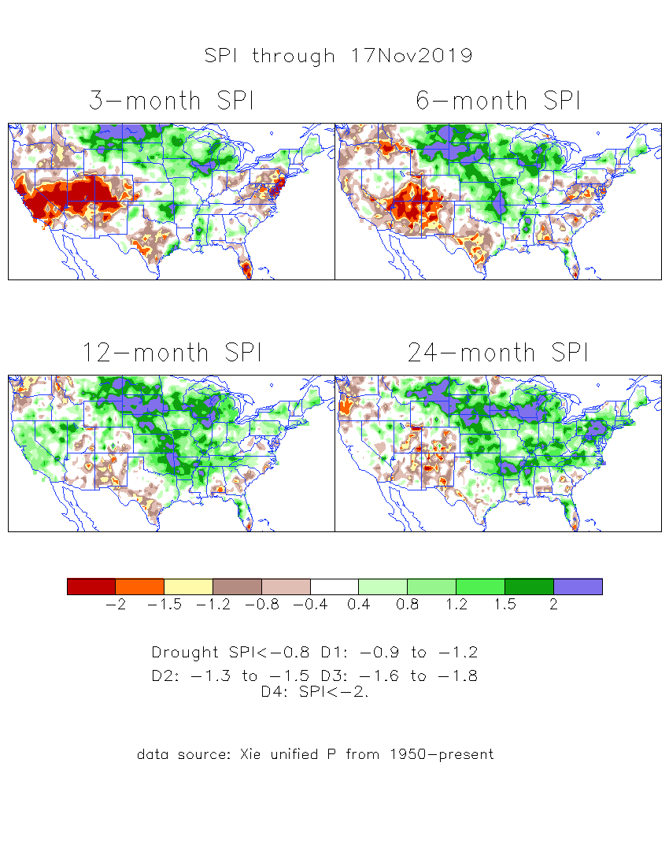
The Standardized Precipitation Index SPI (based on Observed P)
----- NOW
Very interesting graphic & details for the drought across the US based on the more generalized precip deficit/excess, the Standardized Precipitation Index (SPI).
The dark brown and red colors, indicating standardized precipitation deficits, in the various time periods, approximately correspond to the appropriate short/long term drought monitor regions and their intensities
Overall, there is a great deal of similarity between the short/medium and long term SPI patterns,
In the short term, the lack of precip and the cumulative dryness in the TX/southwest has gotten worse.
But improvement is noted in the Pacific NW and southeast.
New area of dryness has emerged in the coastal mid-Atlantic states, and FL.

Slide 16
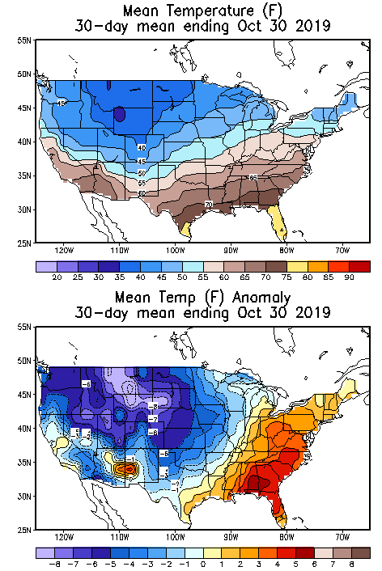
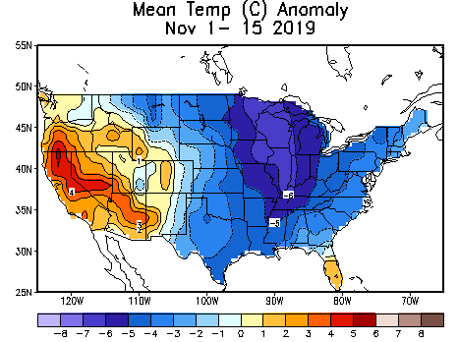
Recent US Temperatures
September US T pattern was mixed with generally warm in the center, south and east, but cool in the west.
October so far much colder in the west, especially in the northern plains

Slide 17
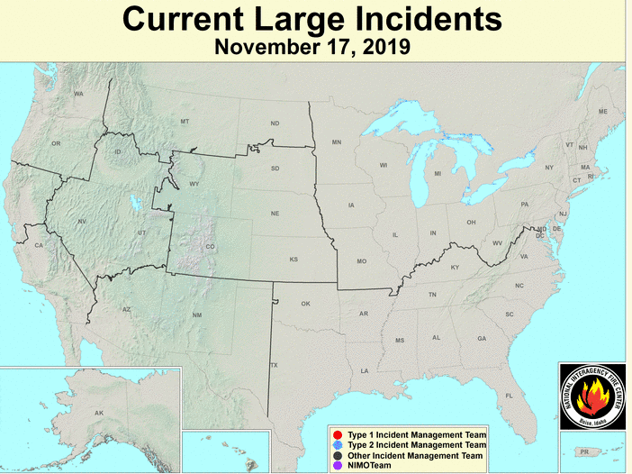
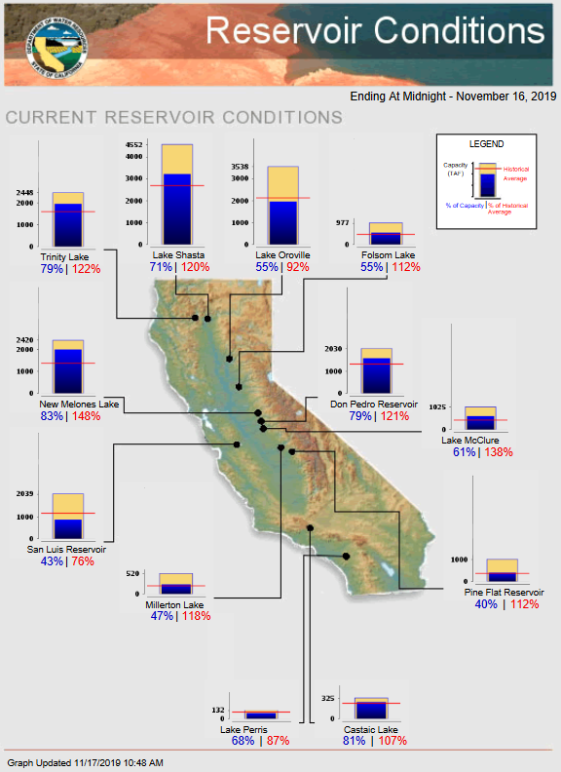
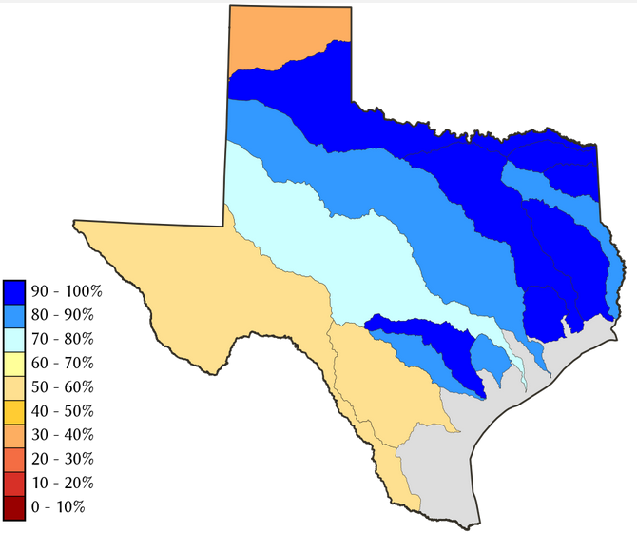
Water Reservoir Levels in some Western/Southern States! !
https://fsapps.nwcg.gov/afm/index.php
No reported major fire incidents so far. (cf. last year!)
Except in few high elevations, all snow has melted.
Northern CA reservoirs beginning to show
Weakness, but rainy season coming up!
COLORADO
End of Oct’2019 water reservoir storages at 109 % of long term average – thanks to snow melt.
(last year: 80% of Average)
TX
California reservoirs are still at or above historic average levels.
https://fsapps.nwcg.gov/afm/index.php

Slide 18
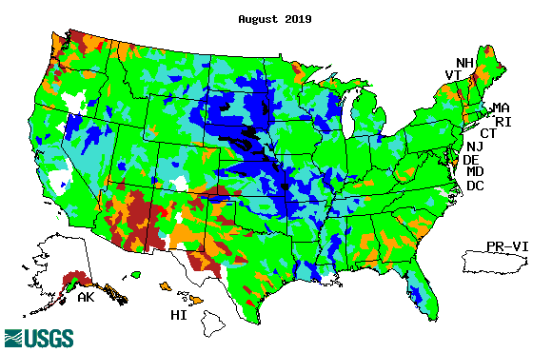
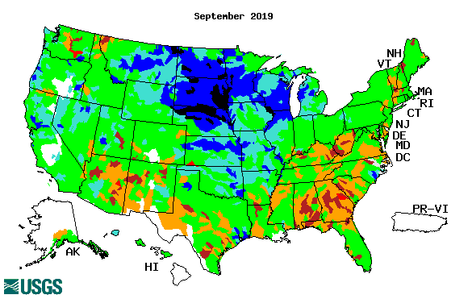
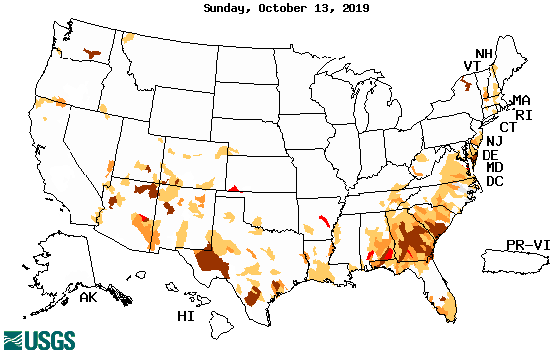
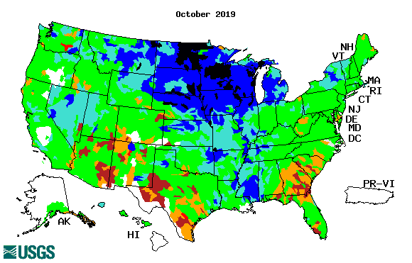
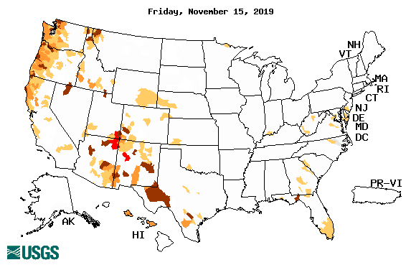
Streamflow (USGS)
Overall, worsened stream flow conditions in the southeast.
Slight improved conditions in the southwest.
Pacific NW much improved now.
Map shows only below normal 7-day average streamflow compared to historical streamflow for the day of year.
One month ago (left) &
Now (below)
18

Slide 19
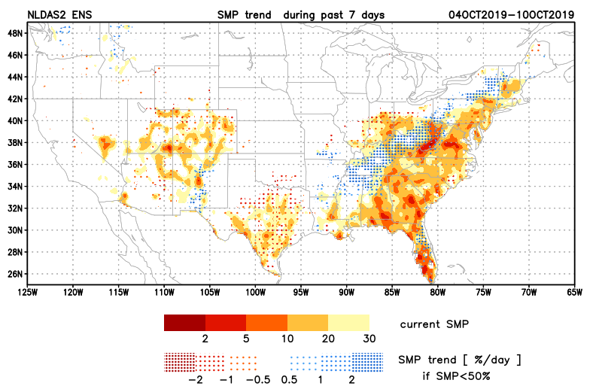
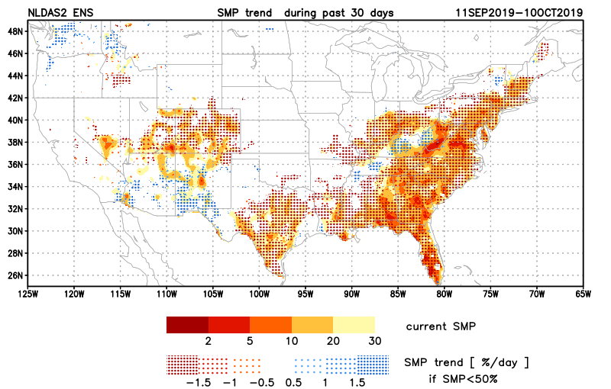
[Last Month]
NCEP Ensemble mean NLDAS2 models’ Soil Moisture tendency/trend
7 days
14 days
Drying soil moisture tendency over the last month in the drought affected regions, especially in the southeast.
30 days

Slide 20
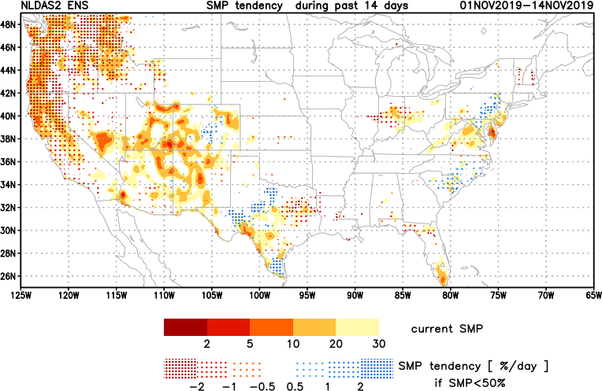
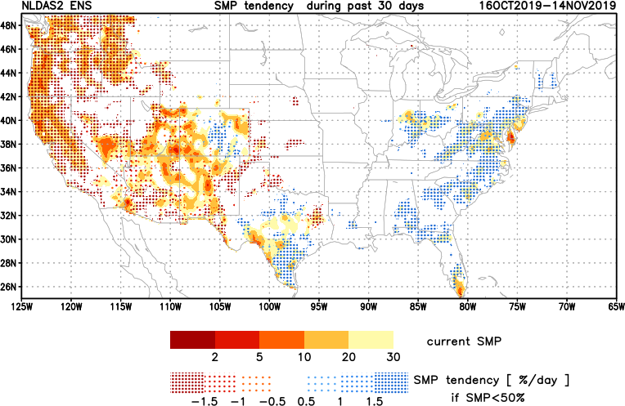
[Now]
NCEP Ensemble mean NLDAS2 models’ Soil Moisture tendency
7 days
14 days
Moistening soil moisture tendency over the last month in the drought affected regions, especially in the southeast – reacting to the rainfall received !
30 days

Slide 21
EL NIÑO/SOUTHERN OSCILLATION (ENSO)
DIAGNOSTIC DISCUSSION
issued by CLIMATE PREDICTION CENTER/NCEP/NWS and the International Research Institute for Climate and Society
14 November 2019
ENSO Alert System Status: Not Active
Synopsis: ENSO-neutral is favored during the Northern Hemisphere winter 2019-20 (~70% chance), continuing through spring 2020 (60 to 65% chance).

Slide 22
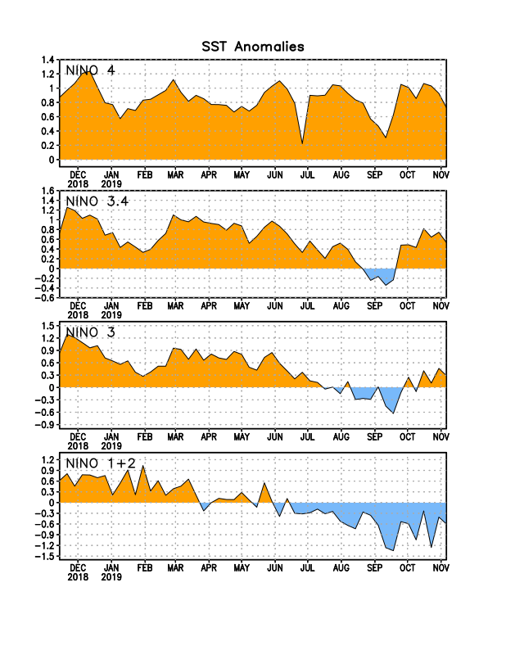
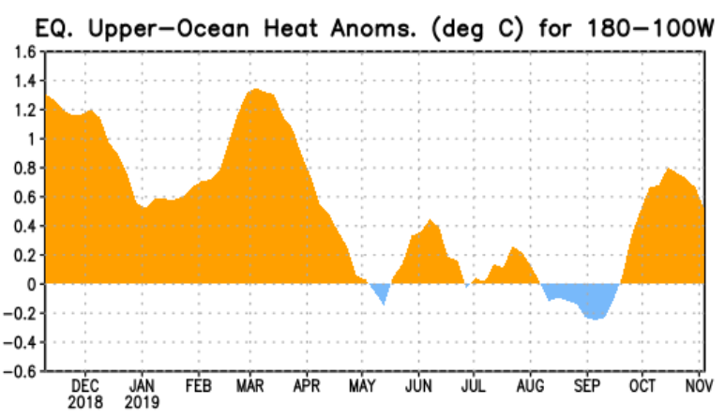
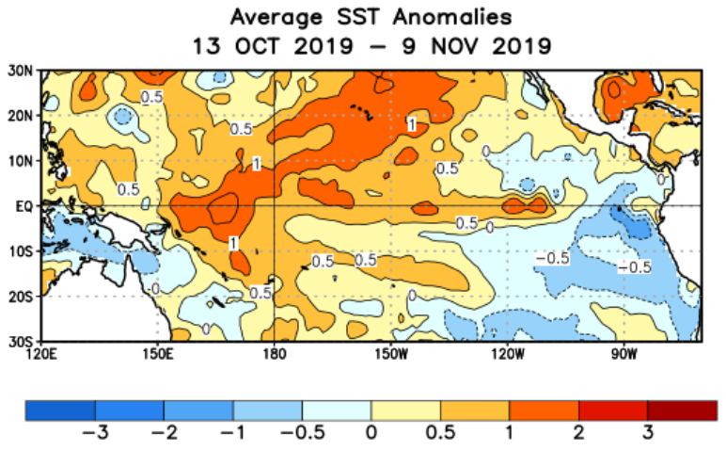
Latest values of SST indices in the various Nino Regions.
The sub surface heat anom has been vascillating for the past few months. Will we be in neutral territory for how long?
?

Slide 23
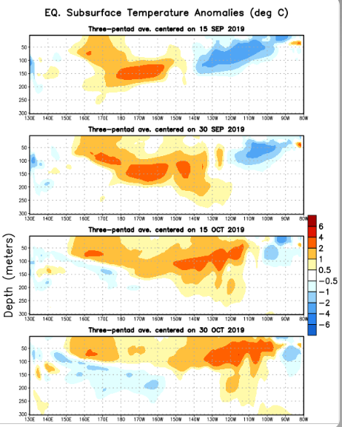
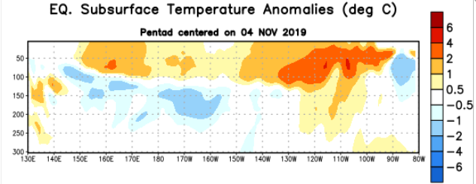
Sub-Surface Temperature Departures in the Equatorial Pacific
Most recent pentad analysis

Slide 24
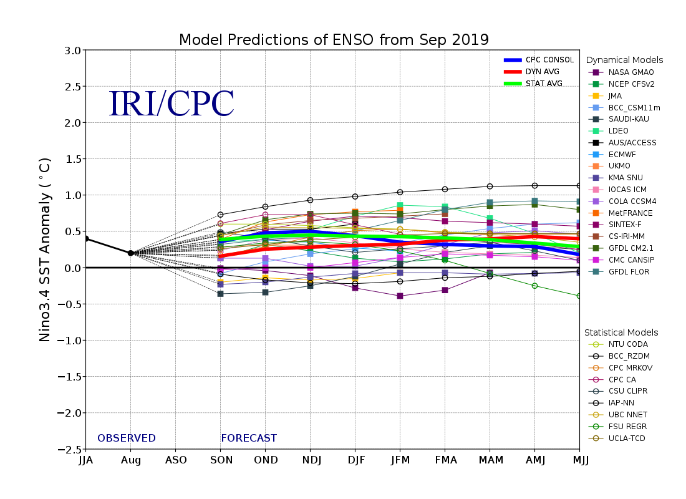
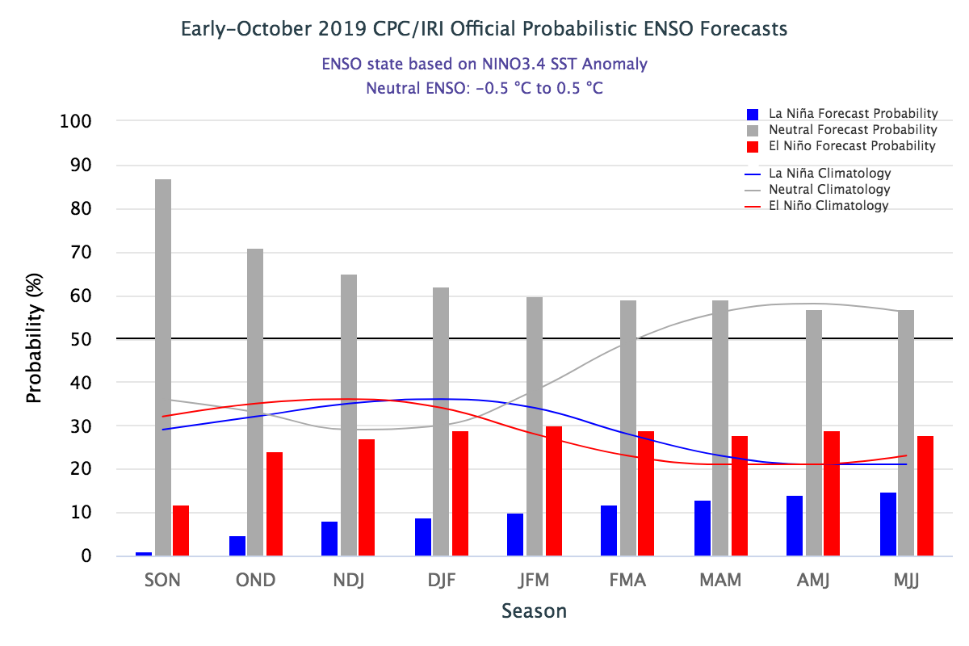
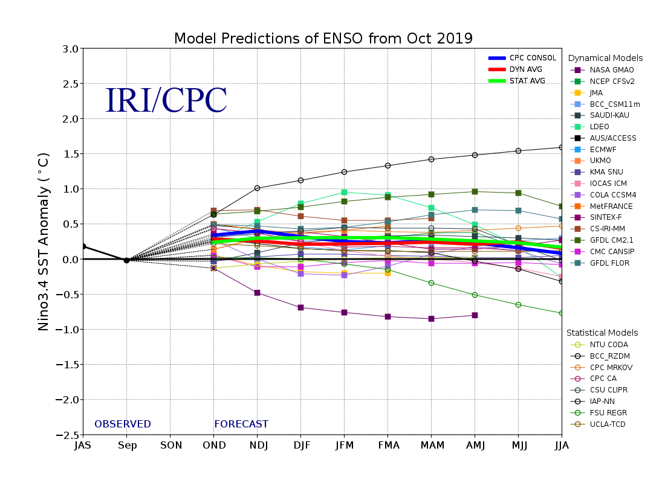
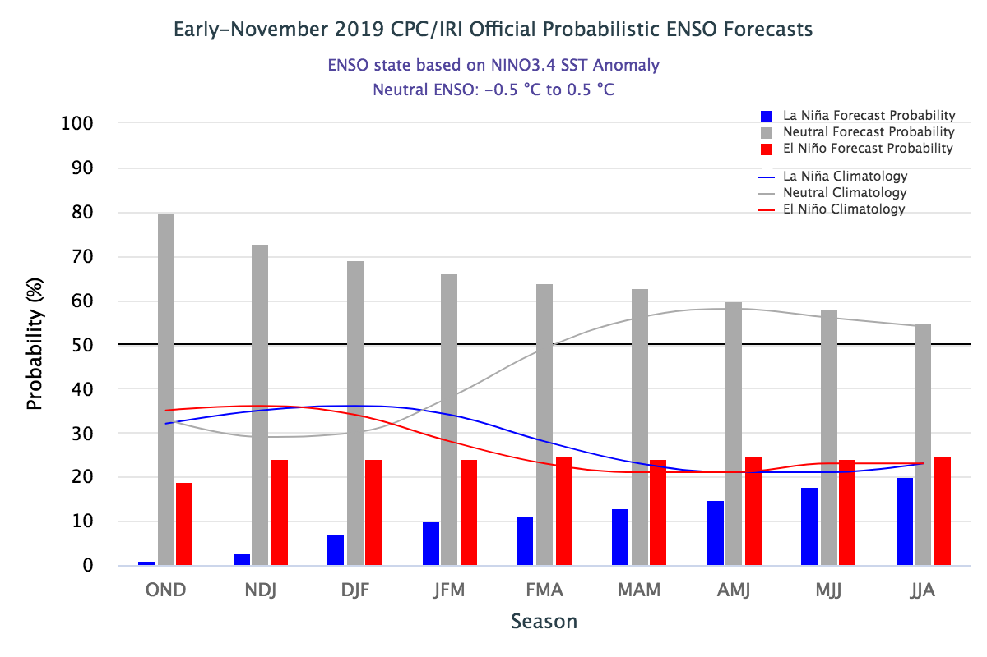
ENSO Forecasts
Early- October CPC/IRI forecast
Early- November CPC/IRI forecast
Neutral for how long? Or a swing to ?

Slide 25
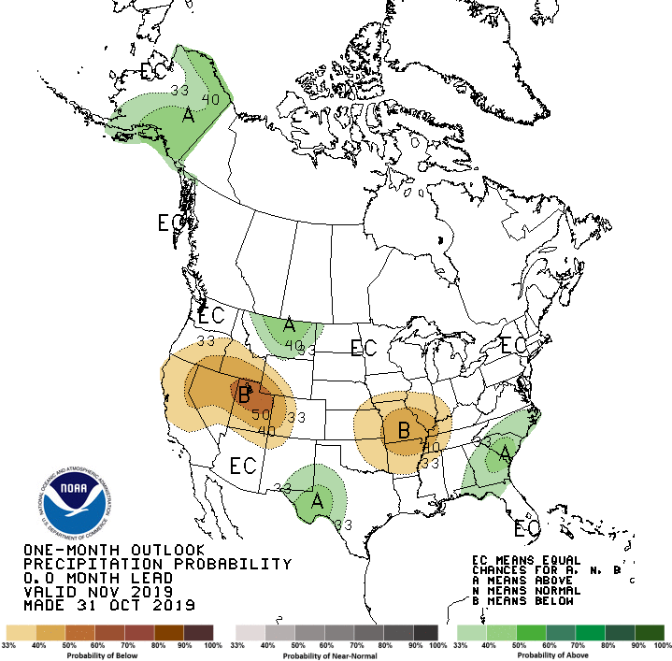
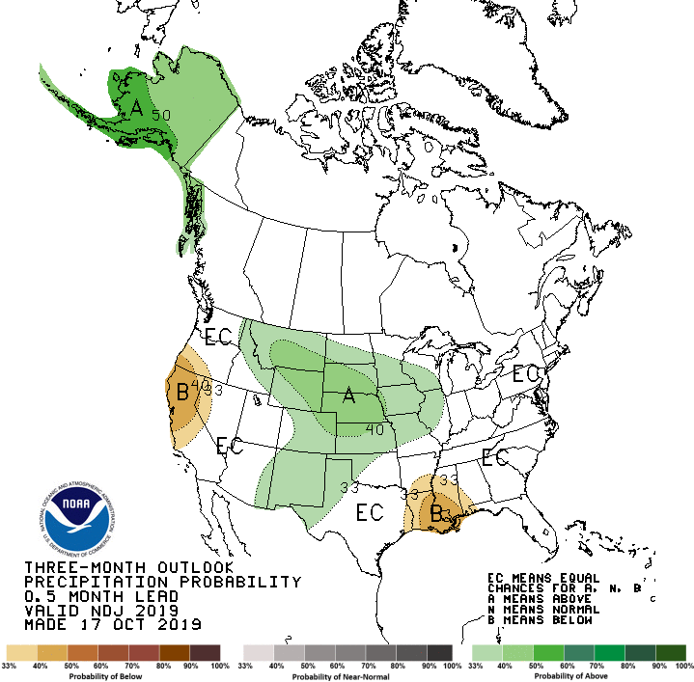
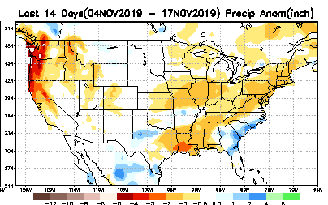
Released Oct 31st
Previous(Last month)
CPC’s official
Precipitation outlook for Monthly (Nov)/Seasonal (NDJ)
Released Oct 17th
Observed so far this month!! ☹
First half of month!
Second half month ?
Next slide!

Slide 26
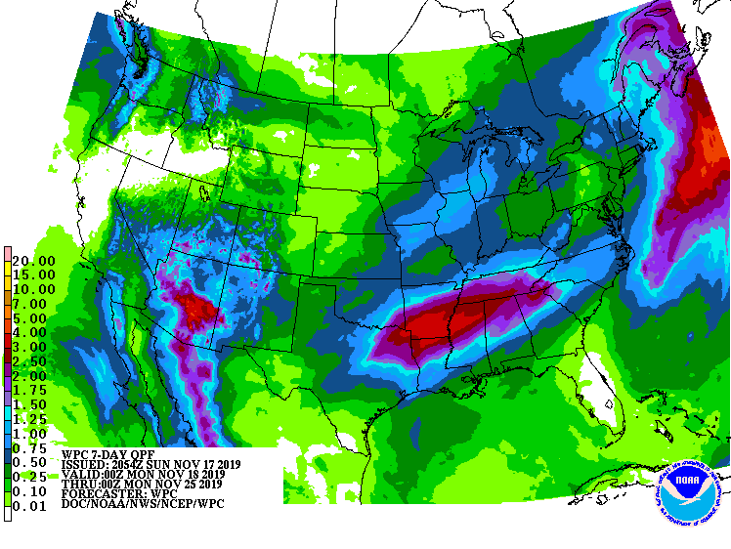
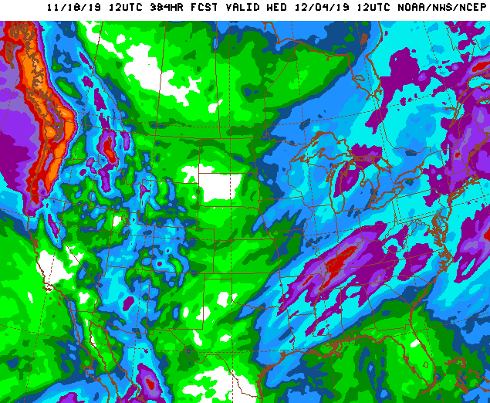
WPC Next 7 days QPF Forecast
GFS Model Guidance for next 16 days.
In the Midwest and southeast, except for FL, southern GA and coastal SC, most other drought affected areas are likely to get a reprieve before the close of the month. Western Texas is likely to not get relief.

Slide 27
Previous (Last Month)
CPC’s official
Temperature outlook for Monthly (Nov)/Seasonal (NDJ)
Made
Oct 31st
Made Oct 17th
Observed so far this month!! ☺

Slide 28
NMME T & P EnsMean forecasts
Dec
DJF
Again back to Red-Dot (warm everywhere!) forecast for Temperature. Both monthly and seasonal forecasts call for above normal temperatures of various extents across the country.
The forecast precipitation patterns are based on ENSO-neutral conditions and so is it reliable?.

Slide 31
Forecast uncertain in Hatched areas.

Slide 32
Forecast from
Initial Conditions:
11/05/2019
http://drought.geo.msu.edu/research/forecast/smi.monthly.php
Predicted Monthly Soil Moisture Percentile
Initial Conditions Last month:
10/01/2019
The inter quartile range suggest greater uncertainty about the forecast in these shaded regions.

Slide 33
Precipitation
NASA GEOS 5 Model
Precipitation & Soil Moisture Forecast
Nov 2019
Soil Moisture
Dec 2019
Nov
2019
I.C.
Jan 2019
Jan
2019
Dec 2019

Slide 34
Summary
Current ENSO status and forecast. ENSO-neutral is favored during the Northern Hemisphere winter 2019-20 (~70% chance), continuing through spring 2020 (60 to 65% chance).
Current Drought conditions:
- After having been near record low in terms of areal coverage for drought affected regions across the US during April/May, the extent of abnormally dryness/drought area coverage has been growing during last few months mostly across the southern US tier states.
The apparent ending of El Nino conditions, and the return of ENSO neutral conditions in the last couple of months, did not help the recent emerging dry conditions in the south. Consequently, the stream flow conditions across the south are generally weaker in the south. The moderate to severe drought in the Pacific Northwest & vicinity has gotten considerably better and almost gone.
The emergence of the flash drought (less rainfall + high T) in the southeast during September/October which was well forecast earlier, has almost gone, due to the above normal rains in the past few weeks. The weak performance of the summer monsoon so far in the southwestern states AZ/NM combined with long term rainfall deficits associated with the back to back La Nina events, has contributed to the continuing drought conditions in the four corner states area comprising AZ/UT/CO/NM and TX. California reservoirs, continue to be at better than historically average levels. CA’s 2019 wildfire season has so far not proven worse than previous devastating years.
Prediction:
Expected presence of near normal ENSO conditions in the tropical equatorial Pacific through upcoming winter season and beyond, is not helping with any confidence in the NMME model’s forecasts for precipitation. However the forecast rains in the very short term may ease the drought conditions in the southeast, except FL, southern parts of GA, SC and Texas affected by drought, where drought may continue in December. Possible drought development in the CO/KS/NE border area is recommended during next month, as well as continued drought conditions to persist in western TX.
In this current ENSO neutral situation, with the gradual return towards moderate rainfall calendar months in the southeast and the main rainy season along CA and the Pacific NW during the upcoming forecast season (Dec-Feb), it is likely keep to prevent from any drought developing here thru the season. However, the drought in the four corners states area (AZ/NM/UT/CO) the existing drought is likely to persist. ------***--------

Slide 35
For ensemble hindcast
Addnl. two slides for Slide 31.
From ECMWF Antje Weisheimer

Slide 36
Estimate the Signal to Noise ratio (SNR) for real-time forecast
assumption:
Signal are independent of noise
Noise are mutually independent
Signal may be correlated
Approximation:
Noise: variance of ensemble member to ensemble mean (spread)
Signal: ensemble mean variance if long-term mean of ensemble close to zero
DelSole et al 2014, GRL; Desole and Tippett (2007)

Slide 37
Miscellaneous maps

Slide 38
Miscellaneous maps

