Slide 1
Drought Outlook Support Briefing November 2021
Climate Prediction Center/NCEP/NOAA
http://www.cpc.ncep.noaa.gov/products/Drought

Slide 2
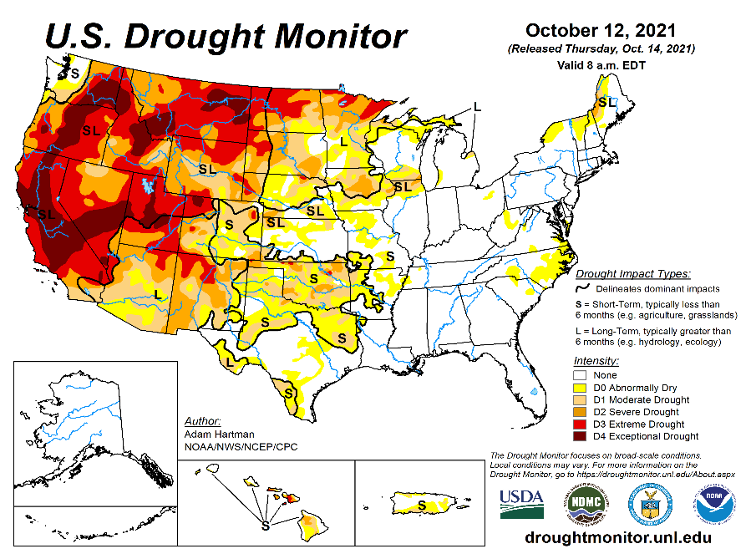
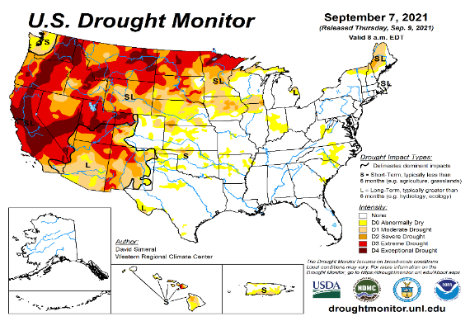
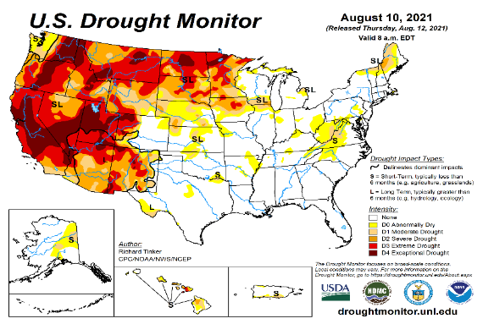
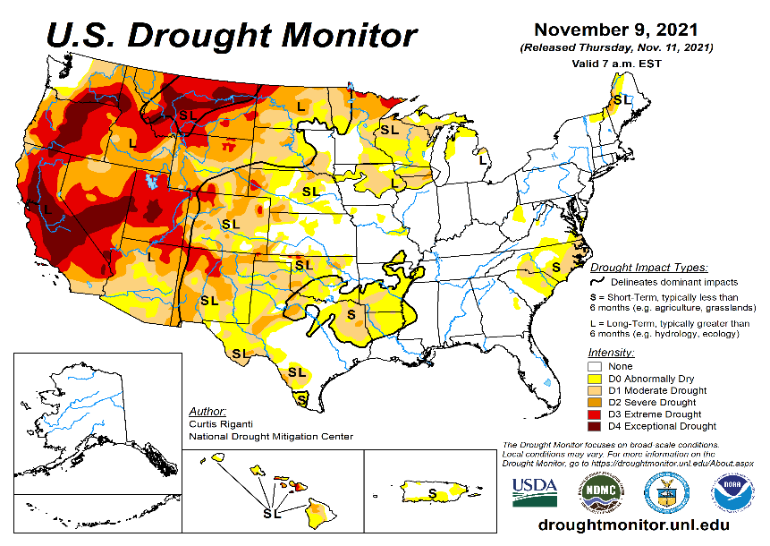
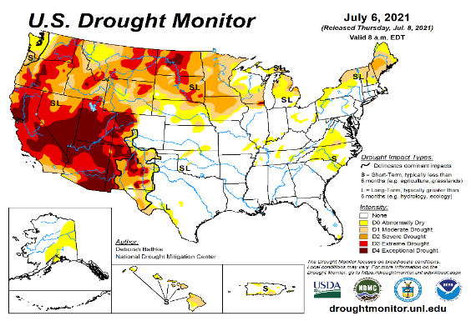
Drought Monitor
Monitoring is important because, unlike US T/P fcsts, for drought forecasts, we have to know where we are, before we can tell where we are going!! Drought forecasts are tendency forecasts.
October
September
Over the last few months, there seems to be gradual eastward expansion of the severe drought in the southwest into southern states into eastern CO, Oklahoma, Texas, and further eastward.
With this, much of all the western and central states of the US, extending from the Canadian border in the north to Mexico in the south, seem to be in some sort of mild to severe drought.
The eastern one third of the United States is almost drought free except for small patches of dryness along the coastal mid Atlantic states and in northwestern Maine.
August
November
(Recent/Latest)
?

Slide 3
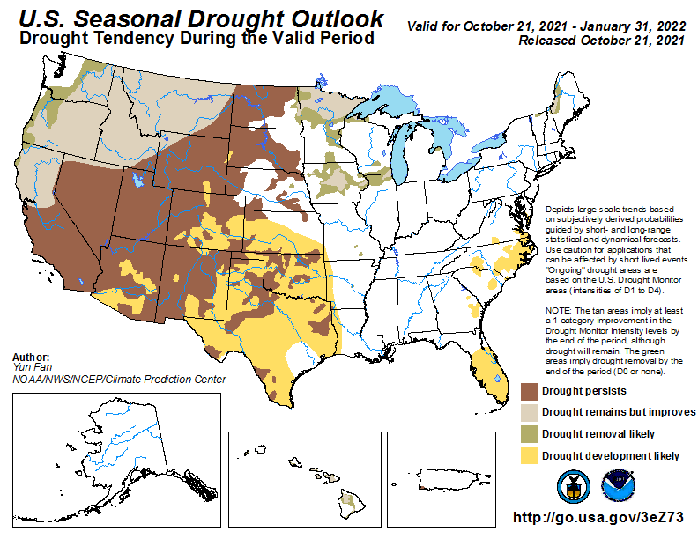
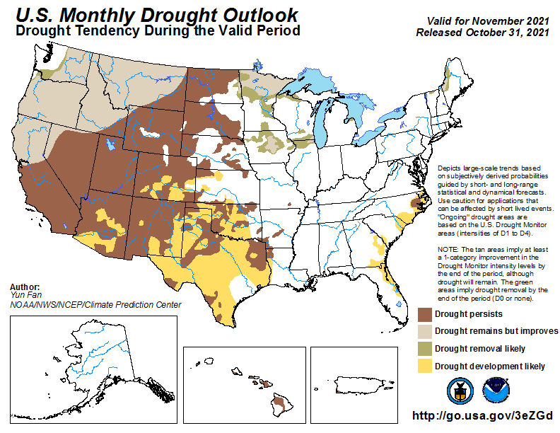
(Previous) Seasonal/Monthly Drought outlooks
New Seasonal+ Drought Outlook to be released in 2 days!
New Monthly Drought Outlook to be released end of this month)
Seasonal Outlook
(21 Oct. 2021- Jan. 2021)
issued 10/21/21
Monthly outlook
(for November 2021)
issued 10/31/21
Almost similar looking monthly and seasonal drought outlooks. Some improvement was expected along the Pacific Northwest due to oncoming rainy season combined with the upcoming La Nina, when dryness is expected in the southwest. Question to consider is will the drought in the south expand eastward? Will Florida develop drought? (See La Nina Precip composites later!, slide #13)

Slide 4
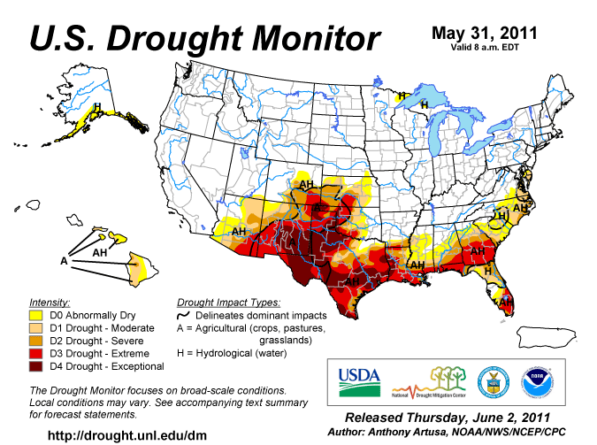
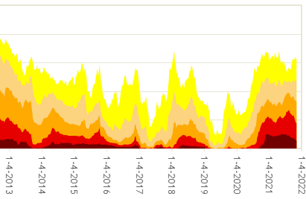
Famous 2011 TX drought
This time series does not tell anything about the distribution of drought areas across the US.
Every drought is different.
See top and bottom map.
The recent drought has somewhat stagnated ?
Current drought!
A slight decrease is seen in the areas covered by D2/3/4 drought areas.
But D0/D1 areas remain high.

Slide 5
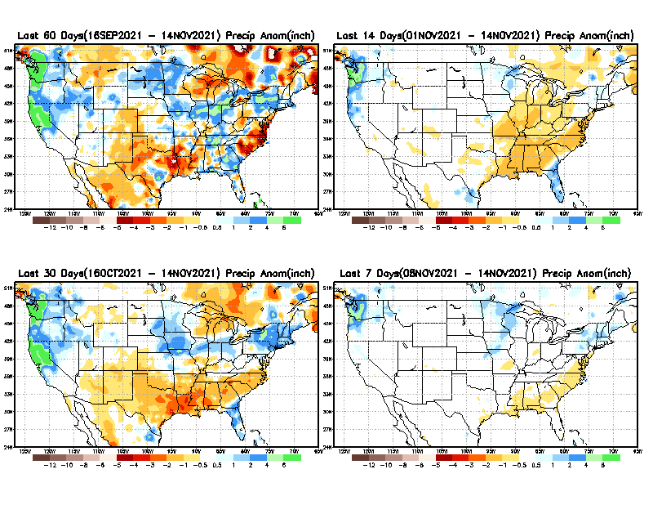
Precipitation ANOM during last 7, 14, 30, & 60 days.
This and next few slides show Precip deficit (excess).
Droughts, for the MOST part, begin and end with precip!! Lately, Temps are becoming (secondarily) important as well.
60 Days
14 Days
?
30 Days
7 Days
These maps in this and following slides, including a) Total,
b) Anom and
c) Percent of Normal precip. in these and other longer time ranges are now (routinely) daily updated at:
?
From: Recent Accumulated Precipitation https://www.cpc.ncep.noaa.gov/products/Drought/briefing_prcp.shtml

Slide 6
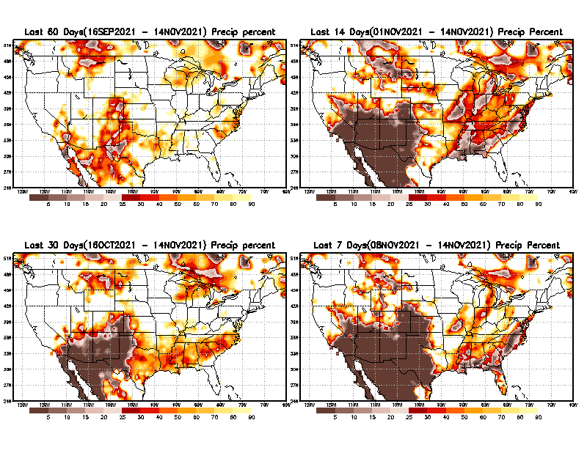
Precipitation Percent (of normal) during last 7, 14, 30, & 60 days - Only Deficit Areas <=90% shown !
60 Days
14 Days
This plot shows only the rainfall deficient regions <= 90% of normal.
-- This shows more clearly possible/likely drought developing region in the future unless there is above normal rainfall in these regions in the future, to offset these shortfalls.
30 days
7 Days
From: Recent Accumulated Precipitation https://www.cpc.ncep.noaa.gov/products/Drought/briefing_prcp.shtml

Slide 7
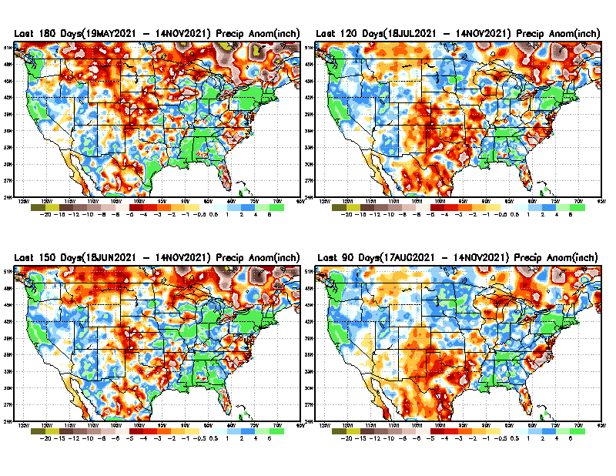
Total precipitation ANOM during last 3, 4, 5, and 6 months.
6 M
4 M
While the Precipitation anomalies deficit may seem large in some regions (compared to others), it is the % of normal precip (next slide) that matters more!!
5 M
3 M
From: Recent Accumulated Precipitation https://www.cpc.ncep.noaa.gov/products/Drought/briefing_prcp.shtml

Slide 8
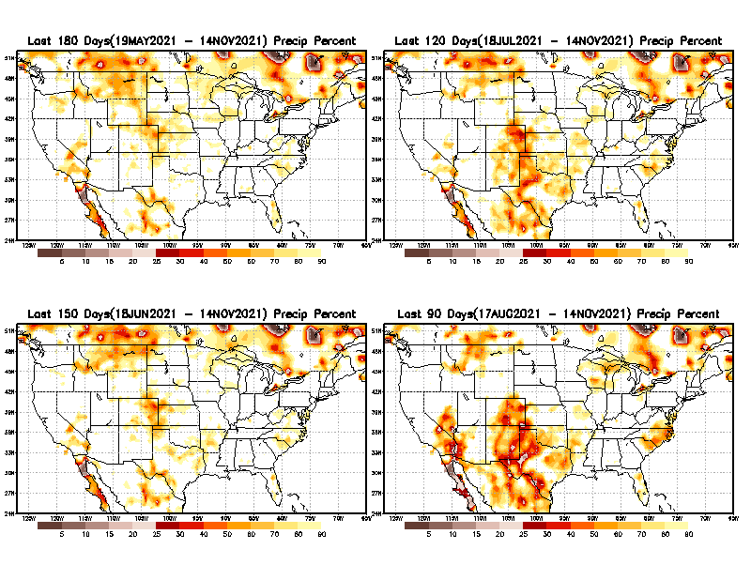
Total precipitation Percent (of normal) during last 3, 4, 5, and 6 months Only Deficit Areas <=90% shown!!
6 M
4 M
In these interim time scale 3-6 months, we need to pay attention to regions, which are dark-brown, red & dark red (<50%).
Not so bad along coast!
in %
While accrued precipitation deficits are real & objective,
droughts are subjective declarations!!
5 M
3M
East vs West!
Broad vs Narrow
rainfall season.
In general, West suffers more from frequent and lasting droughts.
Short term(S) Drought is generally declared when rainfall deficits exist in the 3-6 months time range. { Long term deficits beyond 1 or 2 years is Long term L drought! }

Slide 9
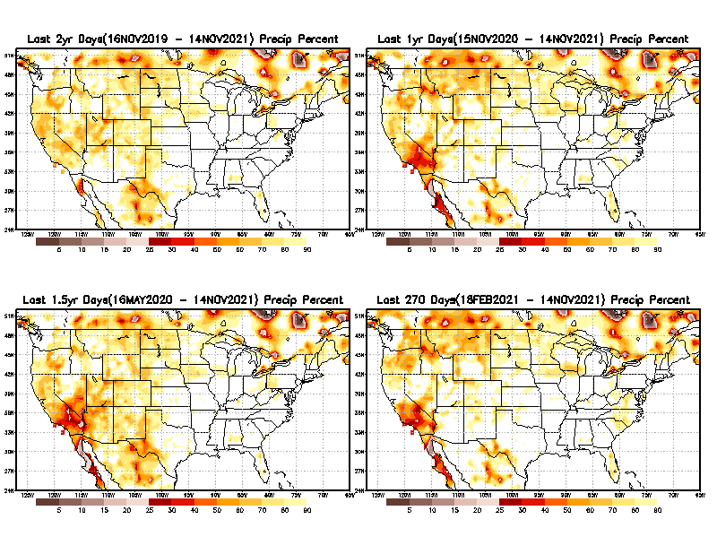
Total precipitation Percent during last 9 months, 1 yr, 1.5yrs, & 2 yrs. .–Only Deficit Areas shown!! <=90%
2 Y
1 Y
Tinderbox areas, where some form of longer term rainfall
deficiencies already, exist !!
-Almost all are in the west!, all part of the long term drought
-This & Next slide!!
9 M
From: Recent Accumulated Precipitation https://www.cpc.ncep.noaa.gov/products/Drought/briefing_prcp.shtml

Slide 10
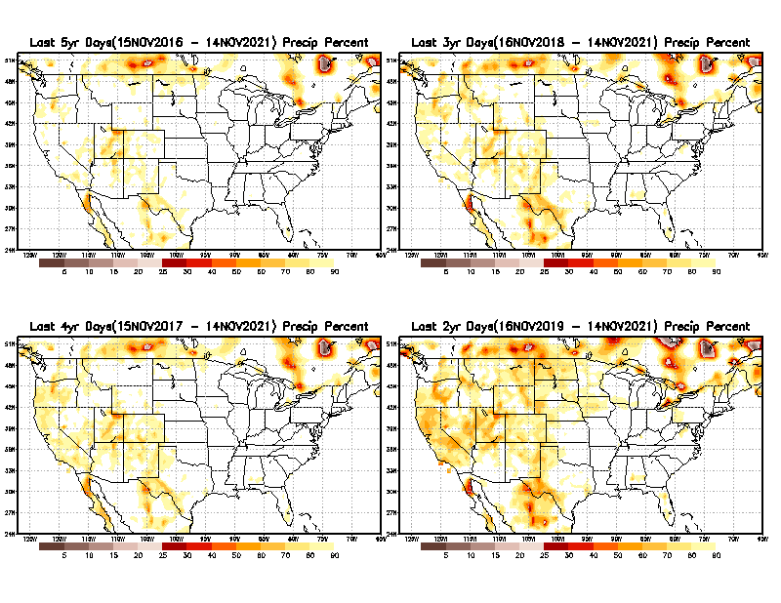
Total precipitation Percent (of normal) during last 2, 3, 4, & 5 yrs. .–Only Deficit Areas <=90% shown !!
5 Y
3 Y
In these long time ranges (2-5 yrs), there is a general dearth/lack of precipitation in the southwest US. – where the current severe drought ravages!!.
4 Y
2 Y
Ongoing multiyear drought in the SouthWest!! Ongoing La Nina will not help.
From: Recent Accumulated Precipitation https://www.cpc.ncep.noaa.gov/products/Drought/briefing_prcp.shtml

Slide 11
Rainy (3-month)Season across the US
NDJ –Large rainfall deficits in the middle of country and SE!
East vs West!
More darker colors in west/central => narrow rainy season (months)
Overall, more white space in the east => distributed rainfall season (except ~FL).

Slide 12
SON season, difficult season for drought forecast? Also transition-ing ENSO?
OCT - Month with the least WHITE & GREEN!
*********
EAST vs
CTR/WEST
Drought Behavior is loosely tied to rainfall climo!! And the limited rainy season in the west
*********
Adapted from Rich Tinker.

Slide 13
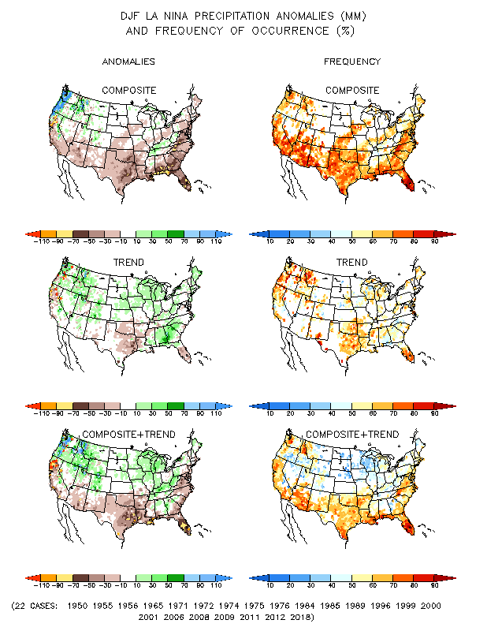
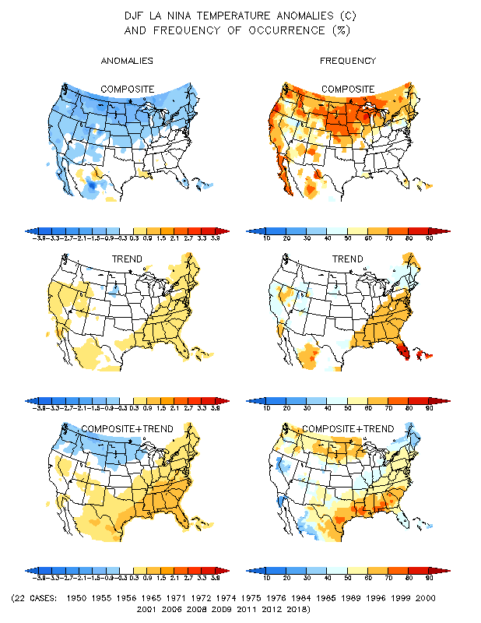
La Nina Precip/Temperature COMPOSITES & Trend map
DJF
P
T

Slide 14
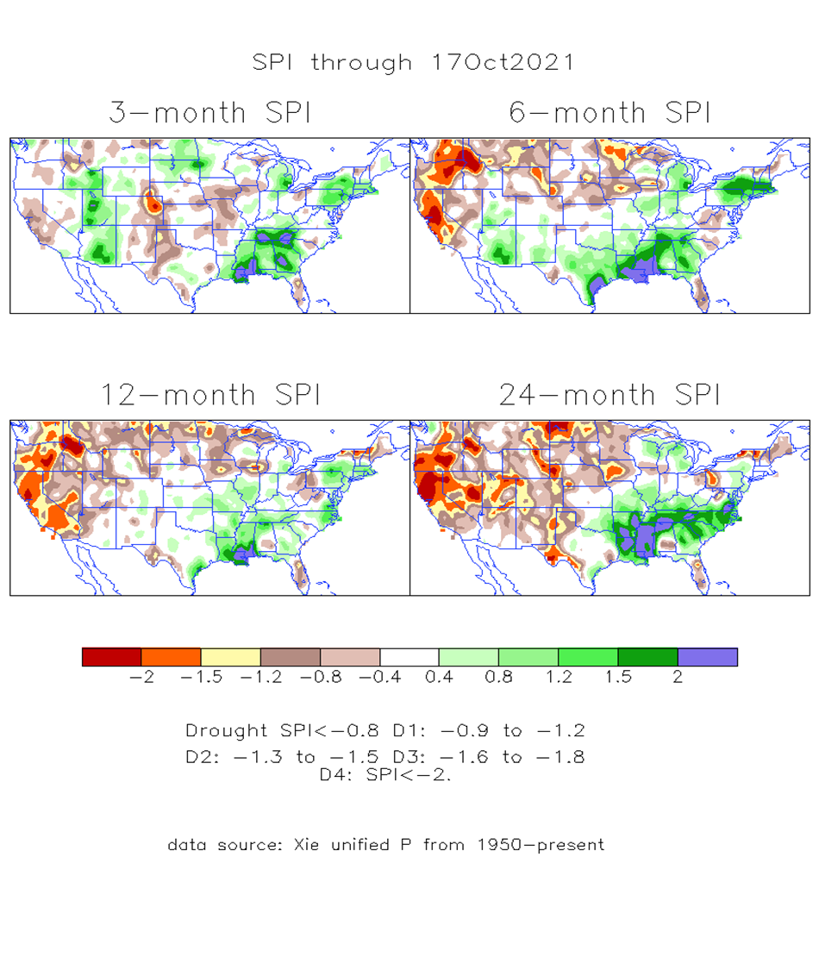
The Standardized Precipitation Index SPI (based on Observed P)
----- Last Month
Very interesting graphic & details for the drought across the US based on the more generalized precip deficit/excess, the Standardized Precipitation Index (SPI).
The dark brown and red colors, indicating standardized precipitation deficits, in the various time periods, approximately correspond to the appropriate short/long term drought monitor regions and their intensities

Slide 15
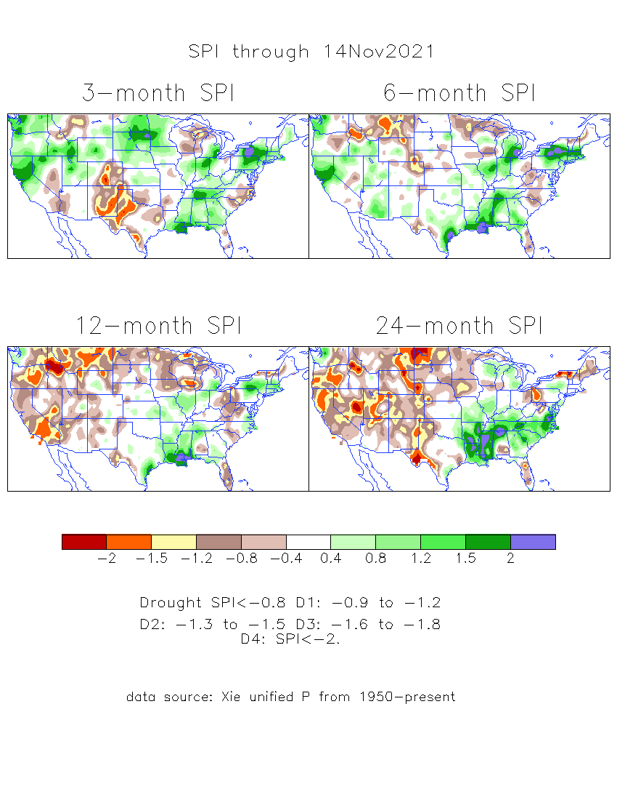
The Standardized Precipitation Index SPI (based on Observed P)
----- NOW
Very interesting graphic & details for the drought across the US based on the more generalized precip deficit/excess, the Standardized Precipitation Index (SPI).
The dark brown and red colors, indicating standardized precipitation deficits, in the various time periods, approximately correspond to the appropriate short/long term drought monitor regions and their intensities
Short
The short term drought has somewhat shifted/extended from southwest to northwest and the northern Plains. But the long term drought in the southwest remains.
----- NOW
Long
How does one negotiate and reconcile declaring short term vs long term drought when precip. deficiencies patterns differ on many different time scales locally!!
What is the cutoff delineating time between short VS long term drought!!
At exactly where does drought begin?

Slide 16
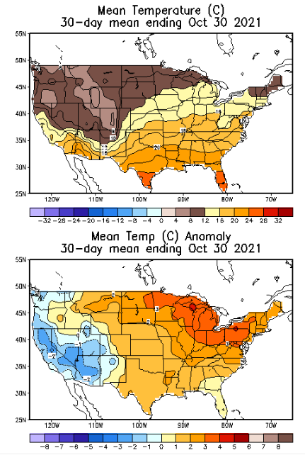
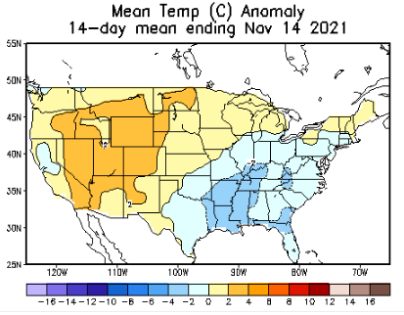
Recent US Temperatures
Almost a east-west flip in the south this month as compared to last month.
So far this month !!

Slide 17
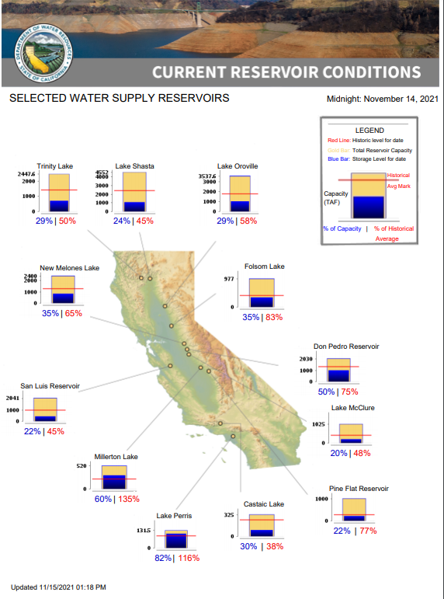
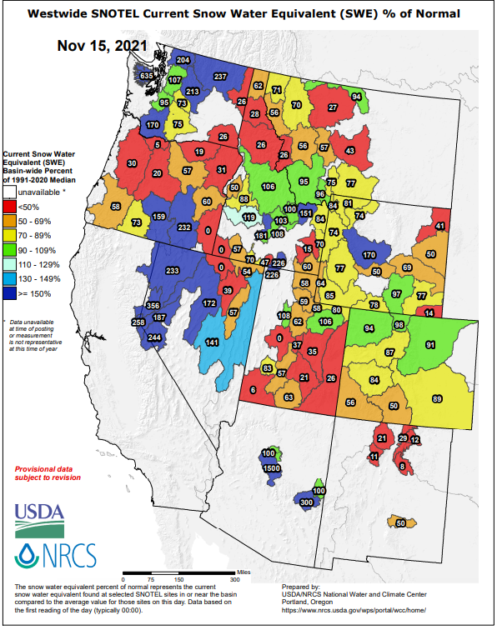
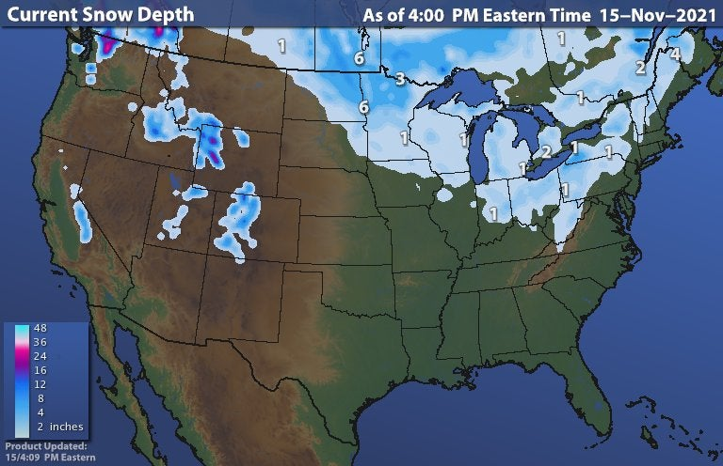
Many CA reservoirs are already low!!
La Nina conditions this upcoming winter will further worsen the water situation in CA and some western states.
https://www.wunderground.com/maps/snow/snow-cover

Slide 18
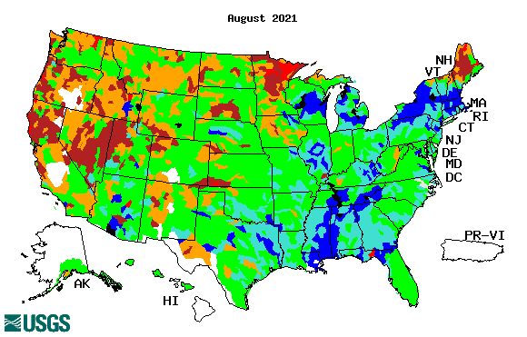
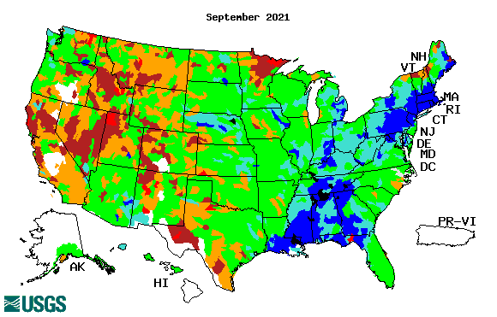
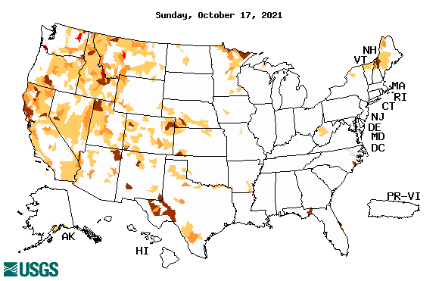
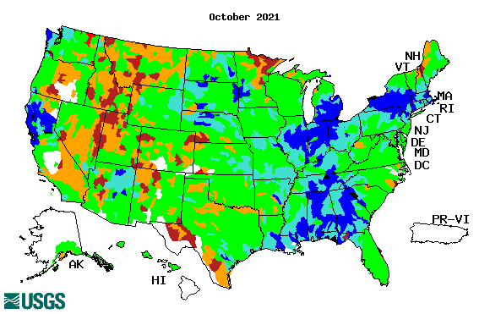
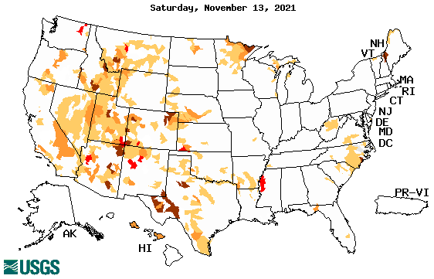
Streamflow (USGS)
Same data source USGS:
Look at the monthly maps for Northeast vs weekly maps in the bottom!!
Map shows only below normal 7-day average streamflow compared to historical streamflow for the day of year.
One month ago (left) &
Now (below)
Streamflow is only a partial indicator, as it is highly managed.
Look along the Pacific coastal states. If sometimes, the various indicators are confusing, go back to % of rainfall deficit maps – to reinforce!!
18

Slide 19
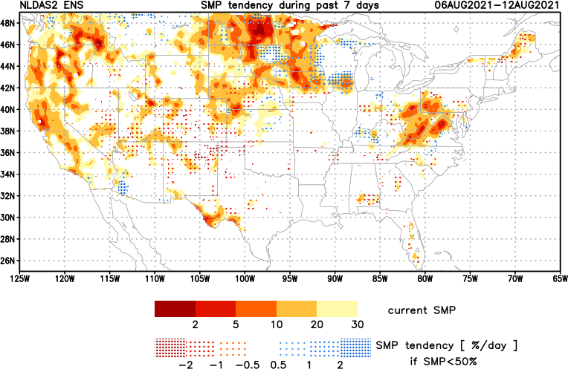
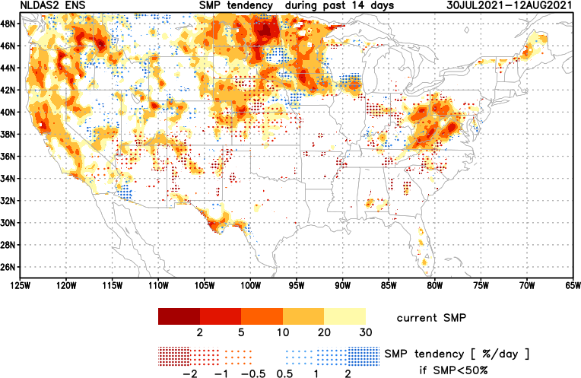
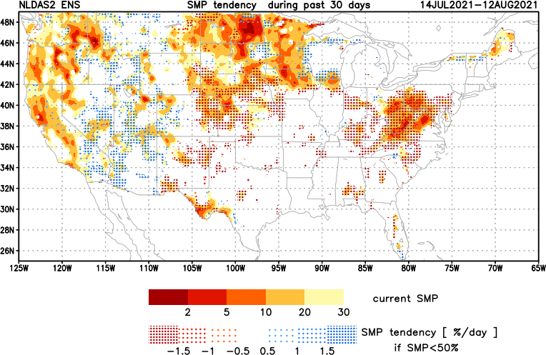
[Slide not shown]
NCEP Ensemble mean NLDAS2 models’ Soil Moisture tendency/trend
7 days
14 days
30 days
These NLDAS2 based SM tendency mas are a few days old!! But note the change in the middle part of the country!! Upper Midwest consistently dry!!
The drying in the mid-Atlantic eastern US states need to keep an eye, but with the approaching Tropical storm FRED, will likely have an impact in the area. Need to watch here. May not be a concern for the season.
+ve SMP (wetness) tendency due to monsoon rains is a temporary relief here and even further north.

Slide 20
EL NIÑO/SOUTHERN OSCILLATION (ENSO)
DIAGNOSTIC DISCUSSION
issued by CLIMATE PREDICTION CENTER/NCEP/NWS and the International Research Institute for Climate and Society
11 November 2021
ENSO Alert System Status: La Nina Advisory
Synopsis: La Niña is likely to continue through the Northern Hemisphere winter 2021-22 (~90% chance) and into spring 2022 (~50% chance during March-May).
CPC’s Oceanic Niño Index (ONI) [3 month running mean of ERSST.v5 SST anomalies in the Niño 3.4 region (5ºN-5ºS, 120º-170ºW)], based on centered 30-year base periods updated every 5 years.

Slide 21
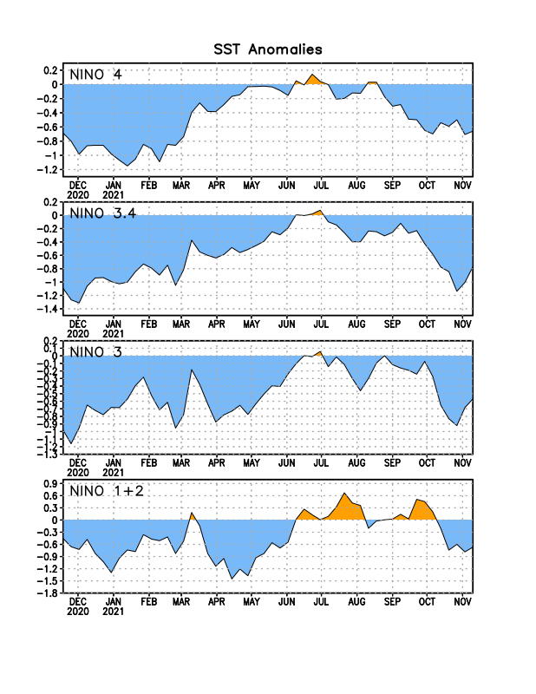
Latest values of SST indices in the various Nino Regions.
A slight expansion of cold water in the surface, but reduction in the depths?

Slide 22
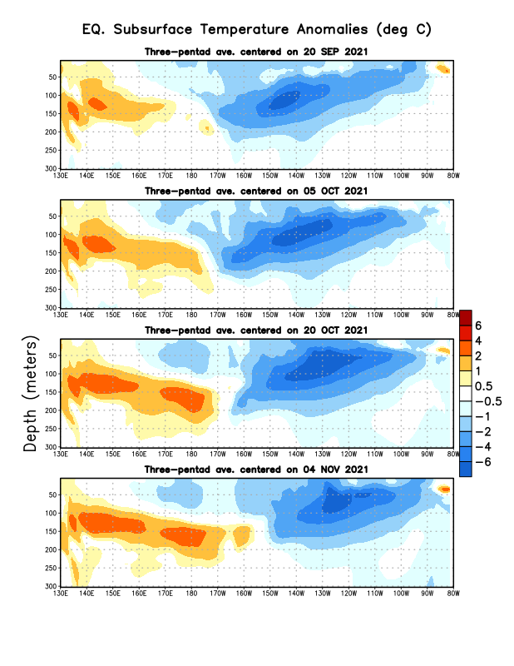
Sub-Surface Temperature Departures in the Equatorial Pacific
The subsurface cold anomalies are strengthening.
Most recent pentad analysis
Will the cooling continue or slow down?

Slide 23
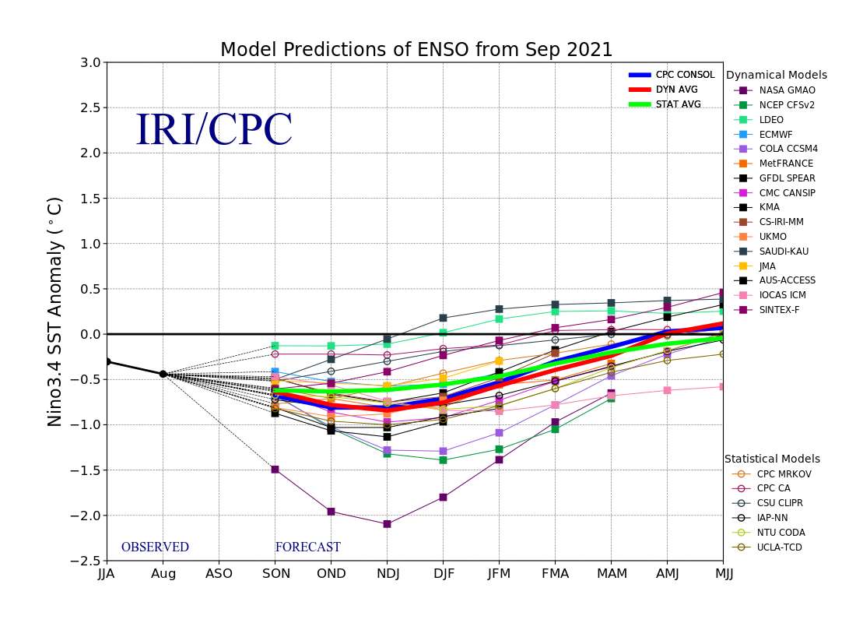
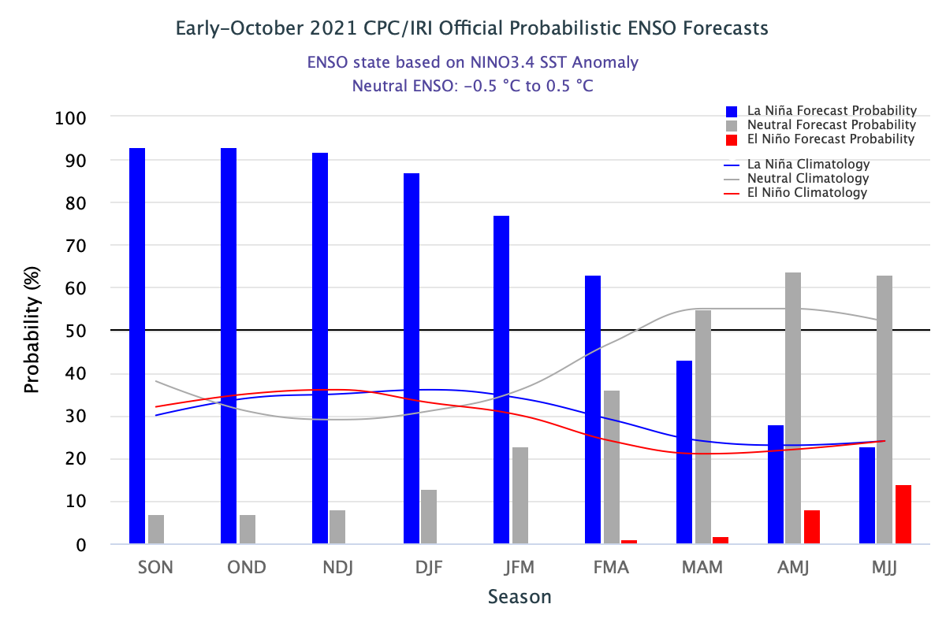
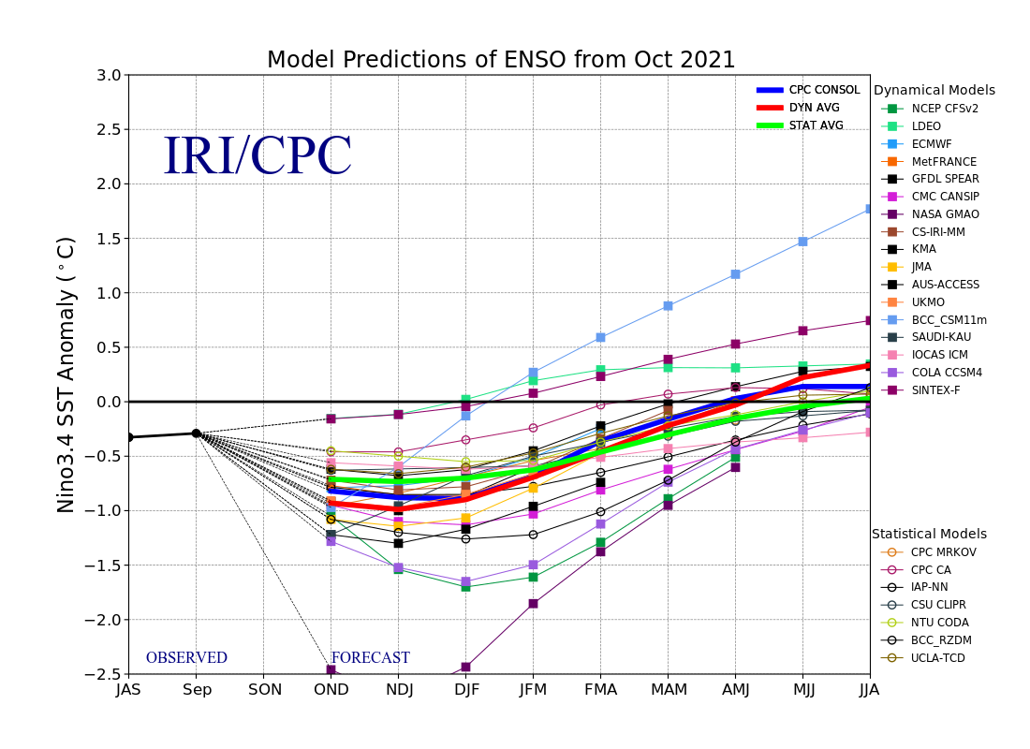
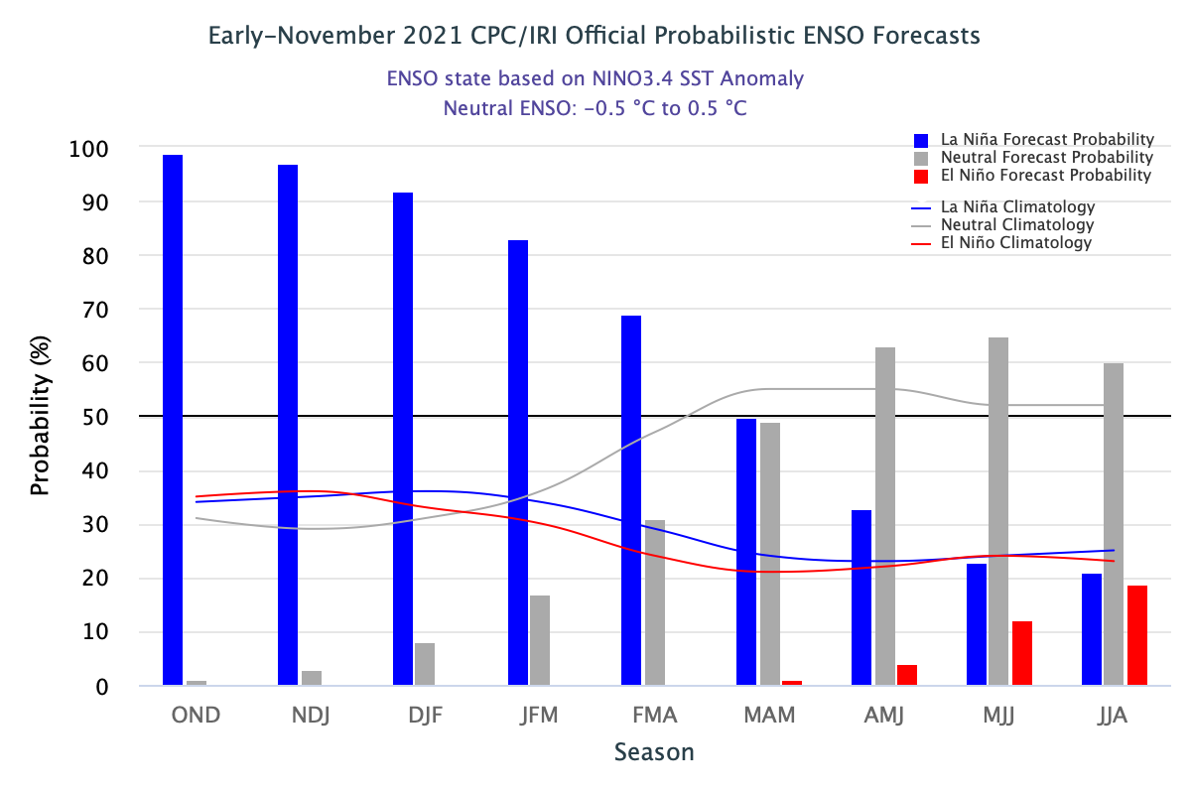
ENSO Forecasts
Early- October CPC/IRI forecast
Early- November CPC/IRI forecast
Dynamical, Statistical, CPC-Consolidated fcsts are coming together!! But still at ~ -0.5C !
Looks like a quick weak La Nina Event during this upcoming winter ONLY!

Slide 24
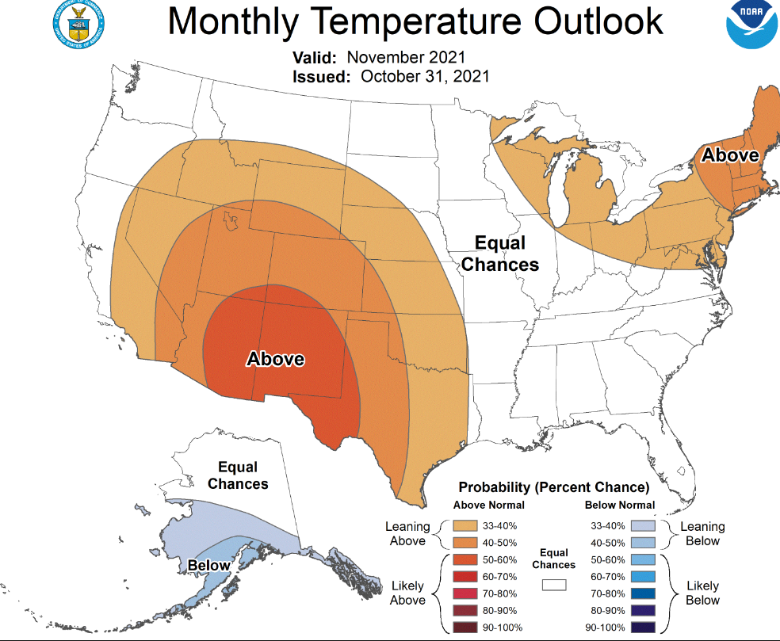
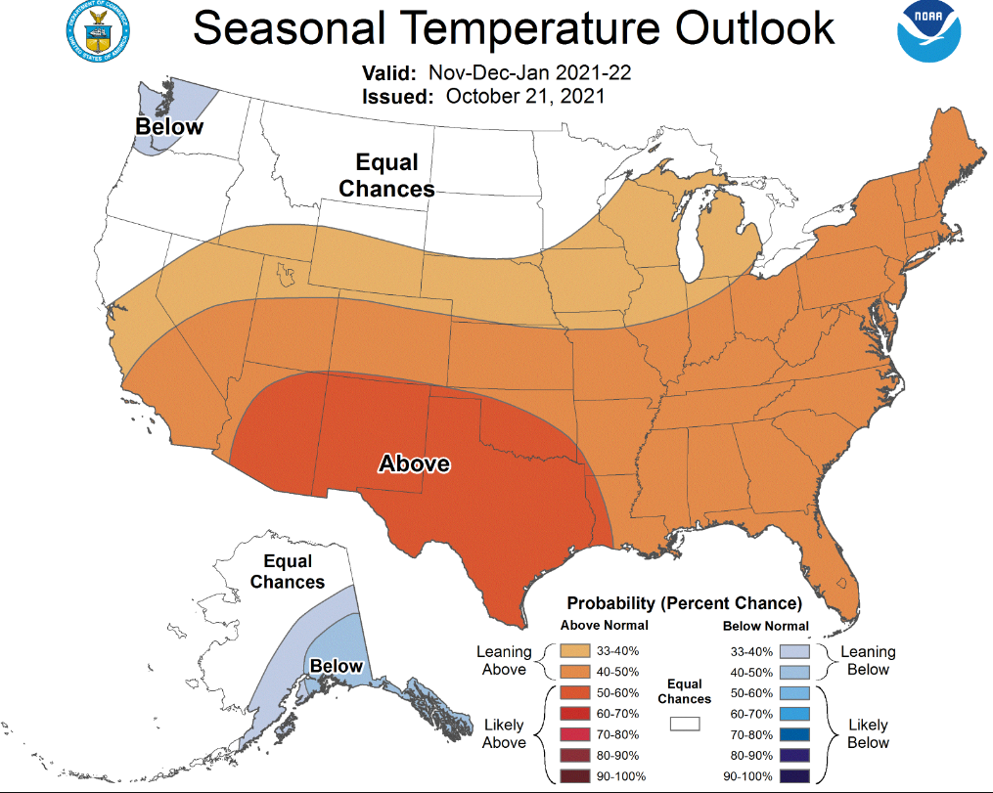
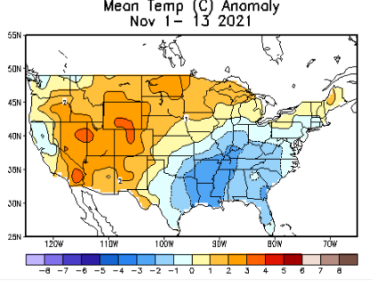
Previous (Last Month)
CPC’s official
Temperature OUTLOOK for Monthly (November)/Seasonal (NDJ)
Released Oct 21st
Observed so far this month!! ☺

Slide 25
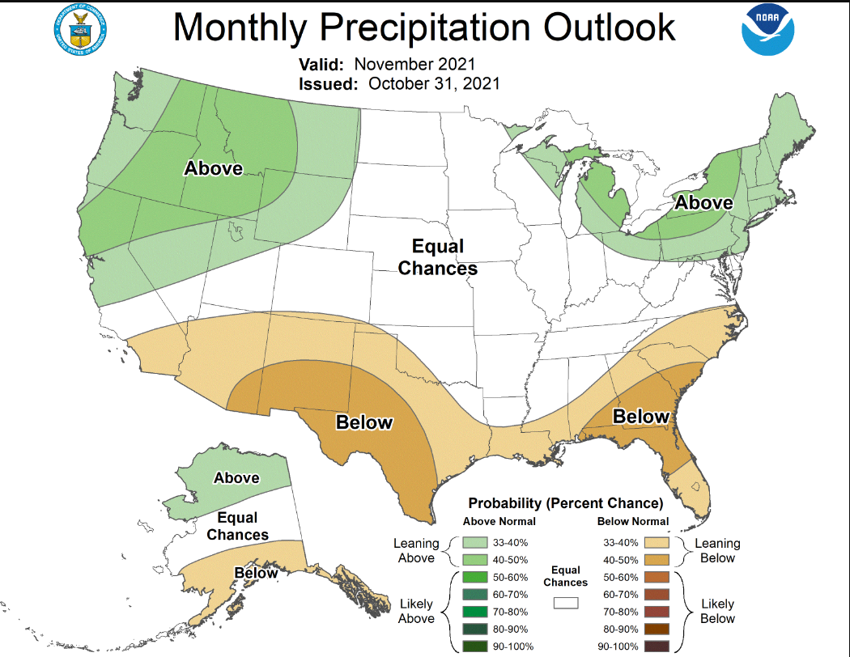
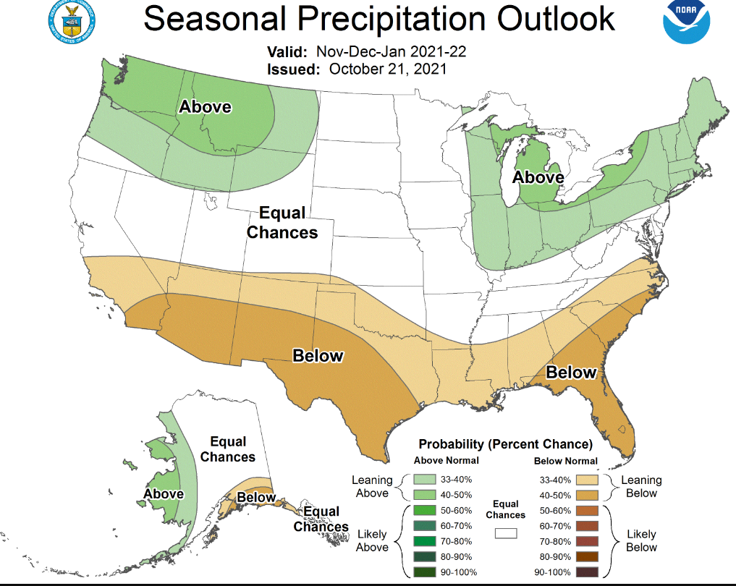
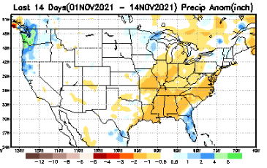
Previous(Last month)
CPC’s official
Precipitation OUTLOOK for Monthly (November)/Seasonal (NDJ)
Released Oct 21st
Very similar looking!
Based on La Nina !!!!
Observed so far this month!! ☹
Monthly P/T forecasts verified at mid-month are generally good! Why?
But so far, fcst looks ☹

Slide 26
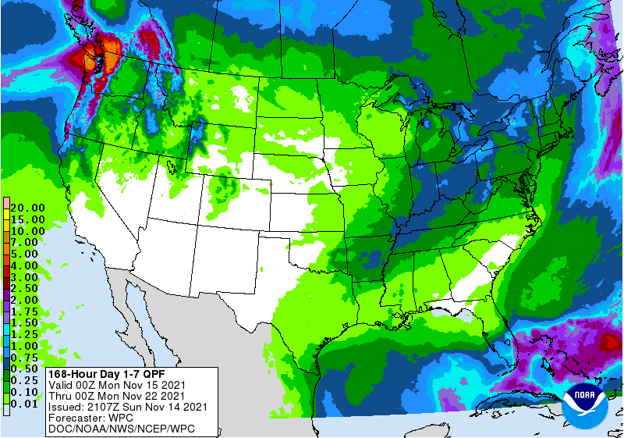
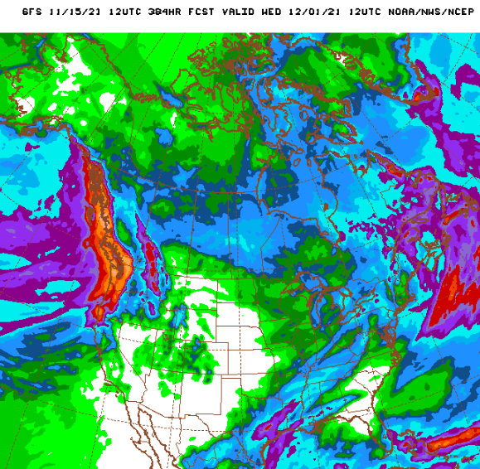
NCEP/WPC Next 7 days QPF (Quantitative Precipitation Forecast)
GFS Model Guidance for the
next 16 days.
Good rainfall is forecast along the Pacific northwest, as well as over northern/central CA. Season starting way too early! ☺
But La Nina is coming!!

Slide 27
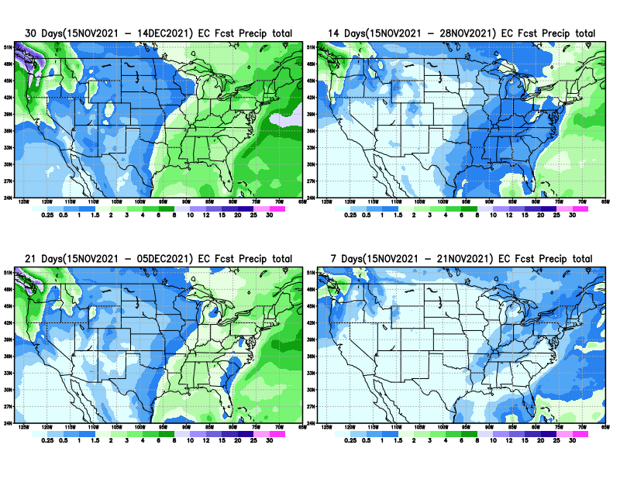
From European Center (EC) Precip forecast (made yesterday, 15 Nov) for next 30 days.

Slide 28
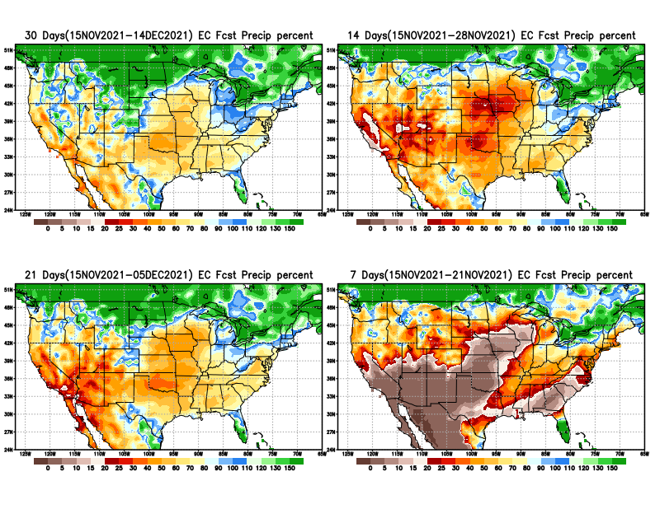
From European Center (EC) Precip forecast (made yesterday, 15 Nov) for next 30 days.
20
40

Slide 29
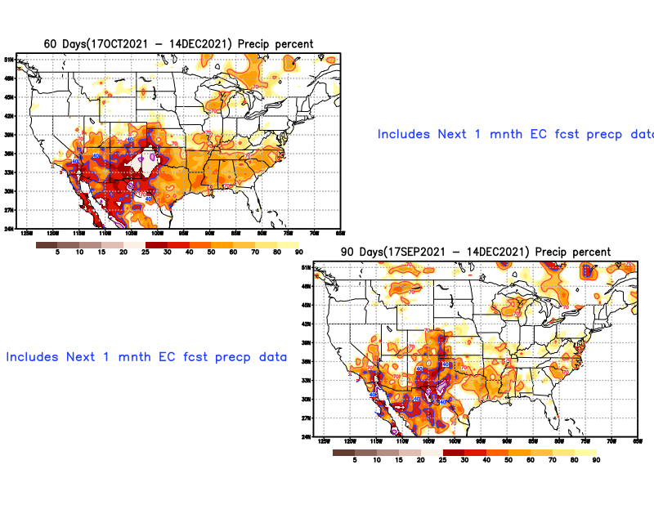

Slide 30
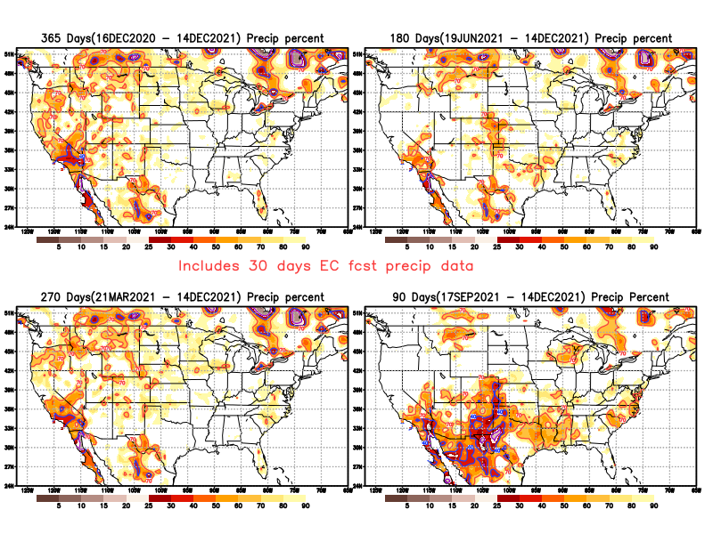

Slide 31
Week-4 Soil Moisture Percentile (SMP) Fcst based on VIC model forced with ECMWF-extended precipitation forecast!
??
(From Drs. Li Xu and Yun Fan) More detail at From: https://www.cpc.ncep.noaa.gov/products/people/lxu/flashd/flash_prediction.html

Slide 32
NMME T & P Ens.Mean forecasts for
Dec
DJF

Slide 33
Agreement/Disagreement among the various NMME models’ DJF seasonal Precip. Forecast.
??

Slide 34
(From NMME) compared with this month(foreground, red border)
Why is there so fewer hatched areas in SPI6 fcst from NMME models’ based fcst this month as compared to last month (left 2 columns) ? Fcsts more confident now?
Forecast uncertain in Hatched areas.
Many pieces of hatched areas in the central and mostly in the eastern half of the US – indicating the model’s inability to know the status of drought here.
Lots of uncertainty regions!! In the middle column!!
SPI6 Fcst made from last month
SPI6/SPI12 Fcst made from this month

Slide 35
http://drought.geo.msu.edu/research/forecast/smi.monthly.php
Latest Initial Conditions:
11/09/2021
Predicted Monthly Soil Moisture Percentile
MSU Soil Moisture Percentile forecast NOT available, NOT updated!
CPC’s soil moisture percentile – Leaky bucket Model
The inter quartile range suggest greater uncertainty about the forecast in these shaded regions. Lots of uncertainty regions!! ☹

Slide 36
Summary
Current Drought conditions:
Over the last few months, there seems to be gradual eastward expansion of the severe drought in the southwest into southern states into eastern CO, Oklahoma, Texas, and further eastward.
With this, much of all the western and central states of the US, extending from the Canadian border in the north to Mexico in the south, seem to be in some sort of mild to severe drought.
The eastern one third of the United States is almost drought free except for small patches of dryness along the coastal mid Atlantic states and in northwestern Maine.
Due to the unusually wet southwest monsoon this year (as compared to the dry one last year) the fire season was not that bad this year in the US western states.
All California reservoirs levels continue to worsen to below their historical average levels. If the forecast warmth/temps and the lack of (seasonal) rainfall continues, things will probably get dire.
Current ENSO status and forecast: La Niña is likely to continue through the Northern Hemisphere winter 2021-22 (~90% chance) and into spring 2022 (~50% chance (50/50 !) during March-May).
Prediction:
La Nina conditions are here now in full force, with anomalously cold waters in almost all of the tropical equatorial Pacific. Even last month, the forecast rainfall patterns for the month and NDJ season very much resembled canonical ENSO patterns, with dry conditions along the southern tier states. With Lina conditions expected to peak In the current forecast DJF season, the same canonical rainfall pattern is expected to be forecast this upcoming DJF season also, as the NMME models’ forecasts suggest now.
If the expected above normal precipitation forecast for the upcoming DJF season in these upper northwestern and part of the northern Great Plains states associated with the emerging La Nina verifies, it will also make an impact on the drought in these regions, even thought drought removal is here is unlikely, except may be along the coastal regions of Washington and Oregon.
The models forecast and there is a strong likelihood that the southern tier states, beginning with southern CA in the west and extending eastward, will likely experience below normal rainfall for the forecast season, due of course to the La Nina. Hence this will likely worsen the already existing drought in the southwestern, southern states, extending eastward in to TX and LA and possibly MS.
The big uncertainty is if new drought will develop in parts of FL. If some sort of mild drought development is forecast here (given the climatology and La Nina at 90% for the DJF season) the confidence in the forecast could be moderate. ******

