Slide 1
Drought Outlook Support Briefing (formerly Drought Outlook Discussion) October 2018
Climate Prediction Center/NCEP/NOAA
http://www.cpc.ncep.noaa.gov/products/Drought
Phone: 1-877-680-3341
Pwd: 858747#

Slide 2
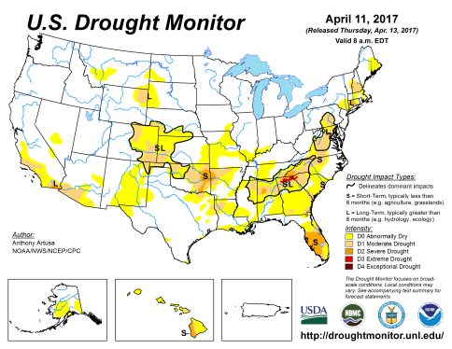
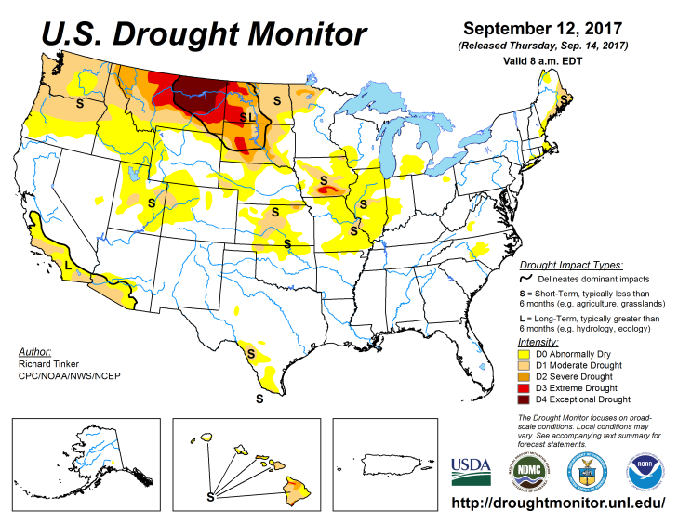
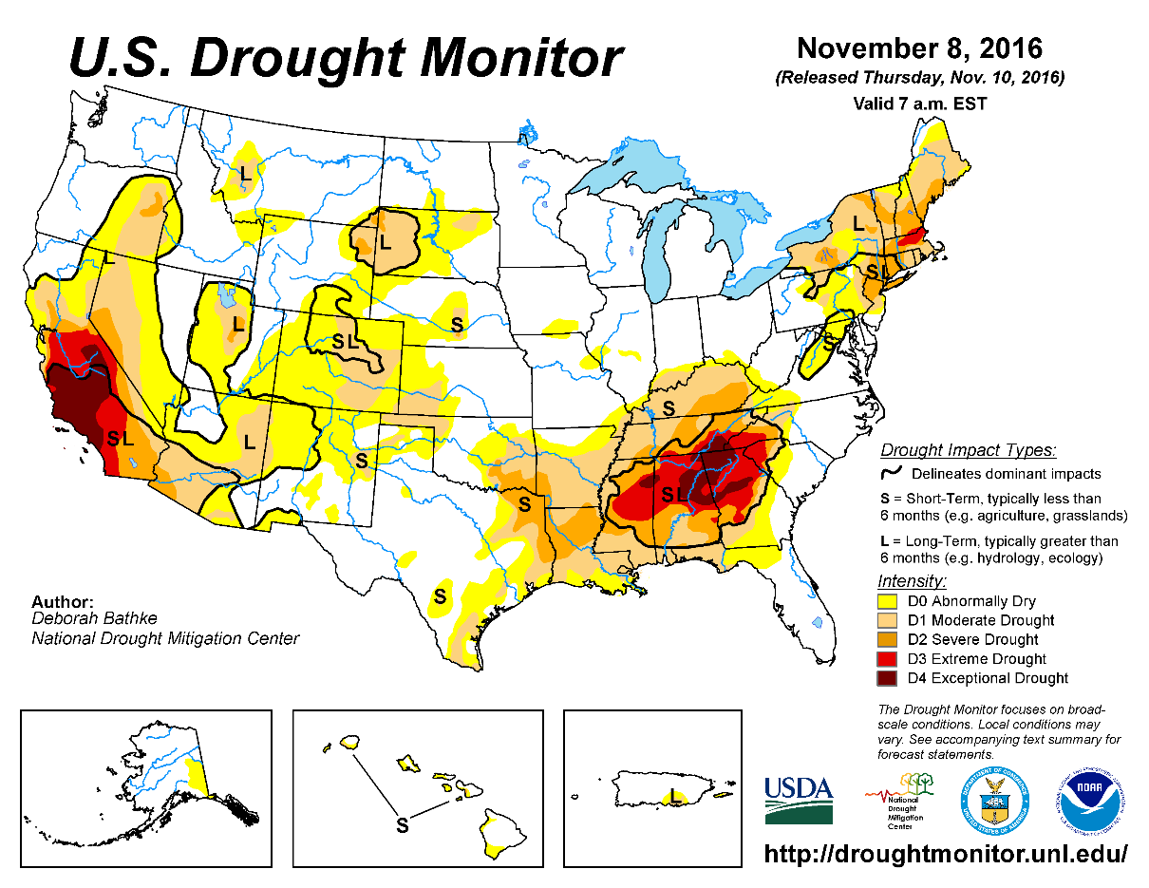
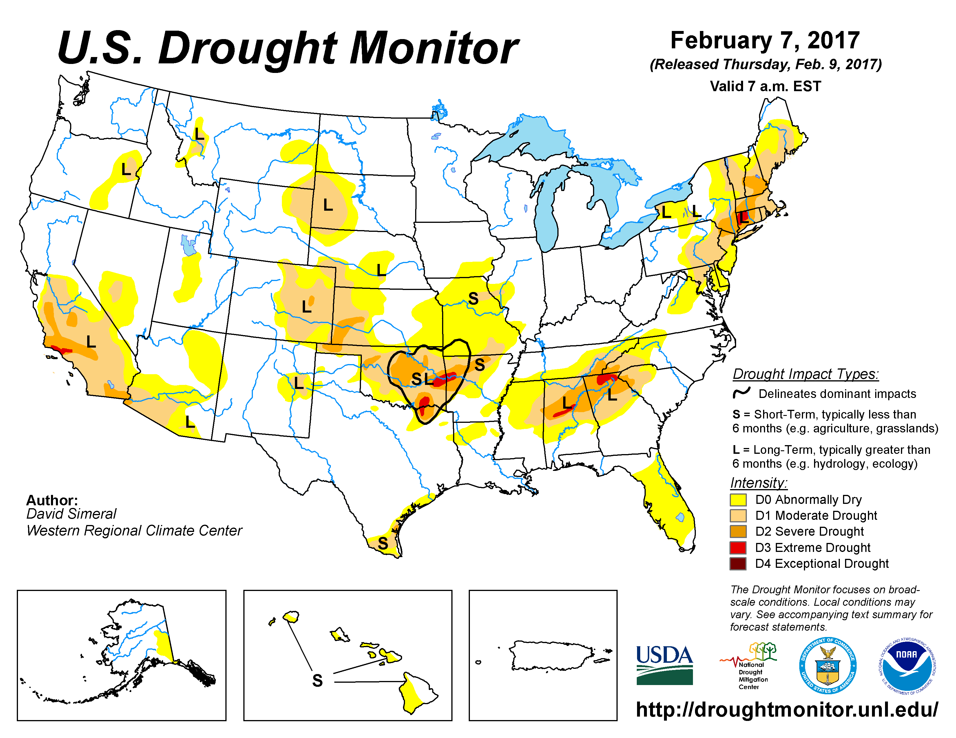
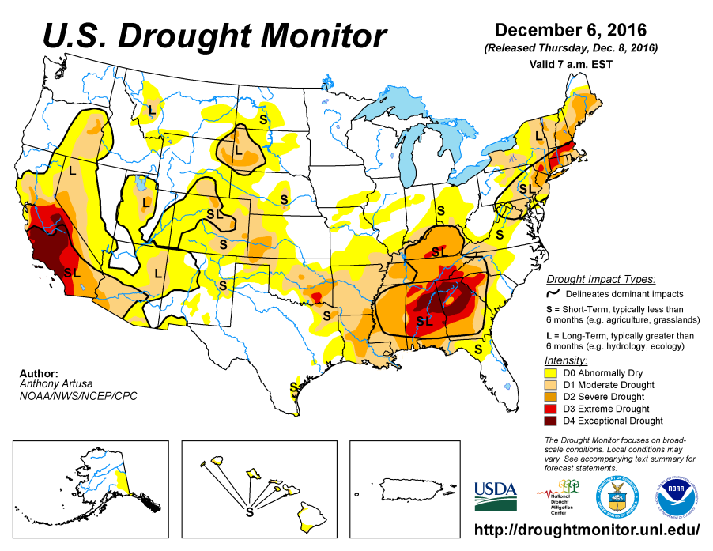
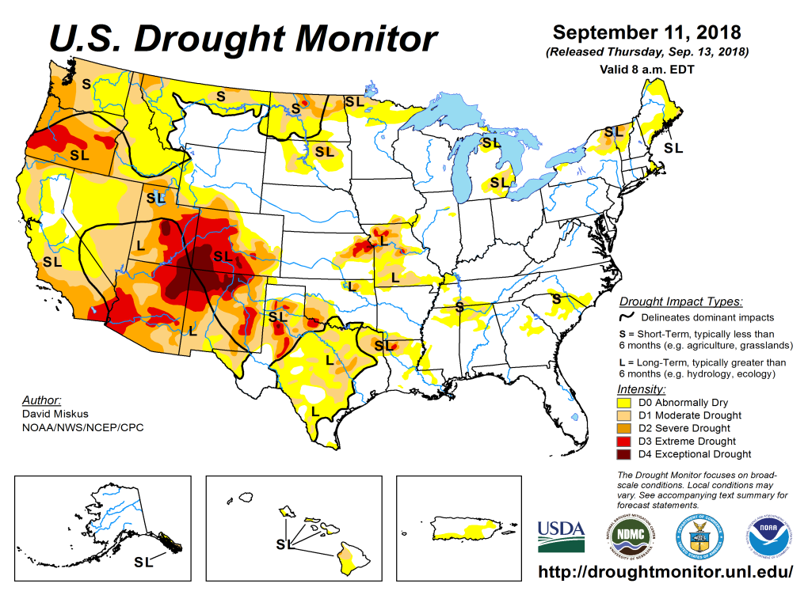
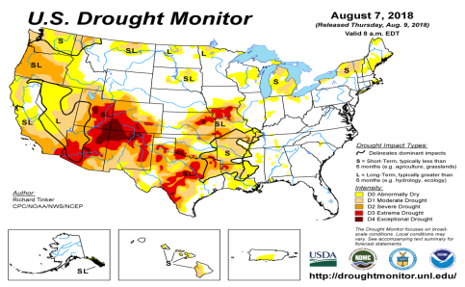
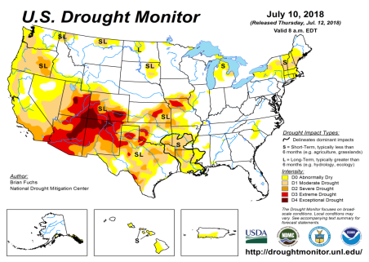
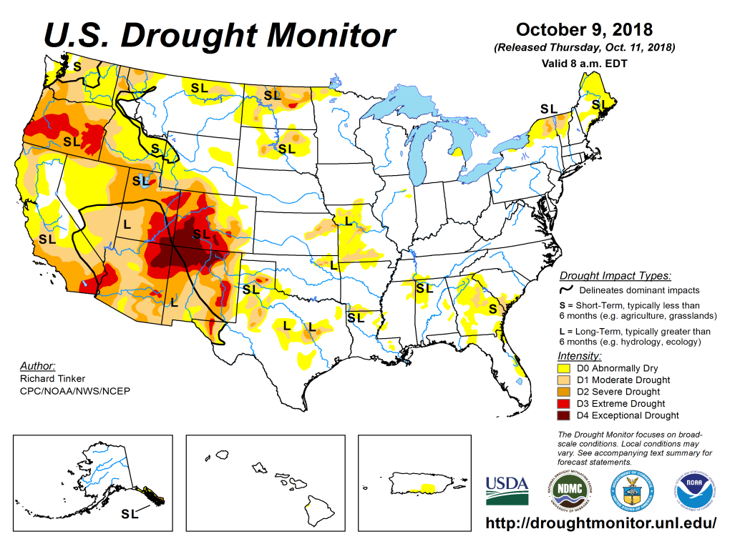
Drought Monitor
September
August
Previous
July
The longstanding drought in the south and west has gotten better in some areas, especially around TX/KS/MO/OK/AR/LA, and in parts of southern CA/AZ/NM. Overall, the eastern two thirds of the country is almost drought free.
But drought in Pacific Northwest in OR/WA and in the Northern Plains states ID/MT/ND has gotten worse. The drought extent/severity in the Northern Plains area has been vacillating back and forth.
Latest/Recent

Slide 3
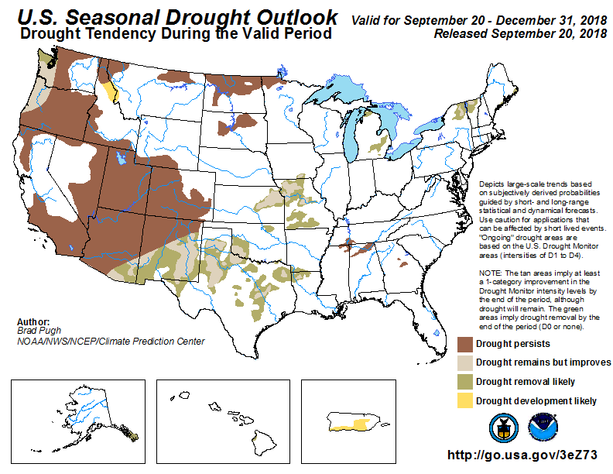
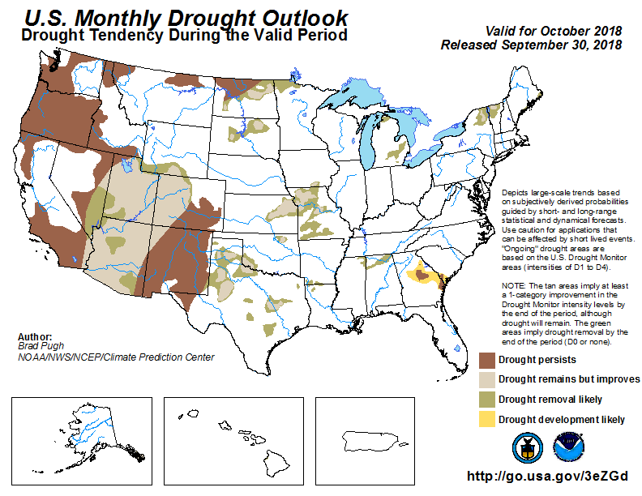
(Prev) Seasonal/Monthly Drought outlooks
Seasonal Outlook (Mid September 2018 - December 2018)
issued 09/20/18
Monthly outlook
(for October 2018)
issued 09/30/18
The four state corners area in the west continues remain in major drought (see previous slide), in spite of the forecast, since rainfall deficits in these regions have lasted longer (later slides!!).

Slide 4
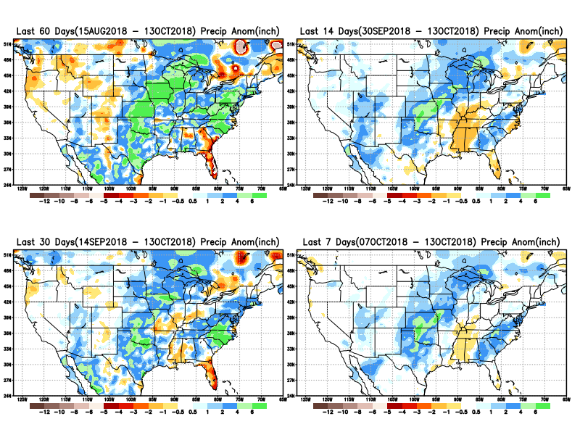
Precipitation ANOM during last 7, 14, 30, & 60 days.
Plenty of rain from hurricanes Florence, Michael in FL/ NC/SC.
Much improvement in TX/OK/KS

Slide 5
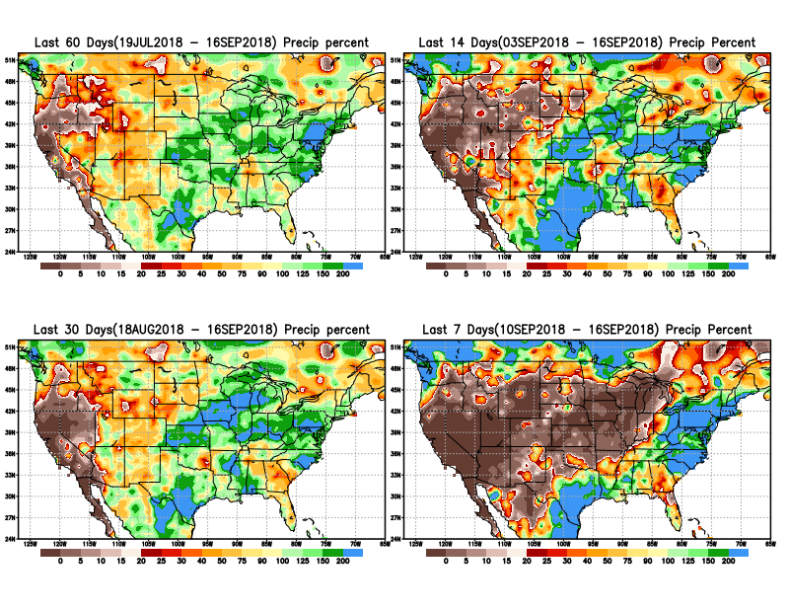
Precipitation Percent during last 7, 14, 30, & 60 days.
LAST MONTH !!
What a difference a month can make!!
This is the dry, fire season in California, and these maps tell us why!
East of CO/NM, in the last one/two months, a good rainfall situation (except a few regions). But west and north of here (NM/CO) relatively less rain.
In the Northeast, in Maine, it is getting dry

Slide 6
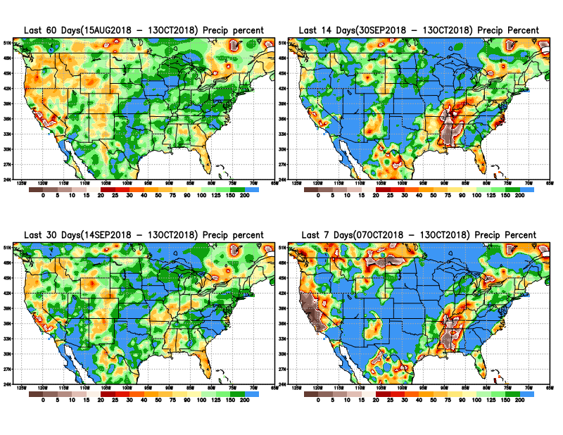
Precipitation Percent during last 7, 14, 30, & 60 days.
NOW !
In these short timescales, overall, the situation is much better in terms of rainfall in the eastern half of the country.
The impact of the relative rainfall shortfall area, greatly matters only with respect to the rainfall season/extent in that region

Slide 7
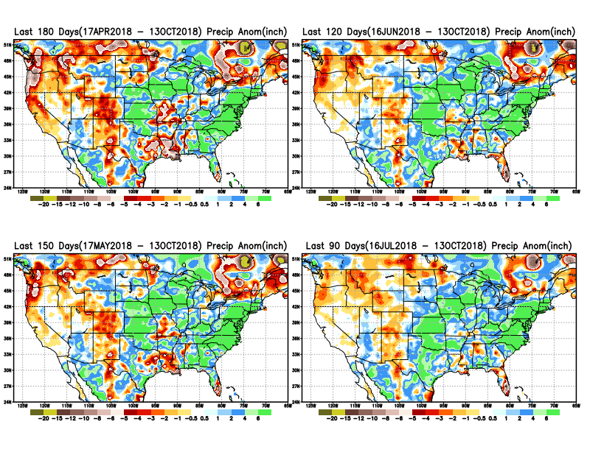
Total precipitation ANOM during last 3, 4, 5, and 6 months.
6 M
4 M
5 M
3 M

Slide 8
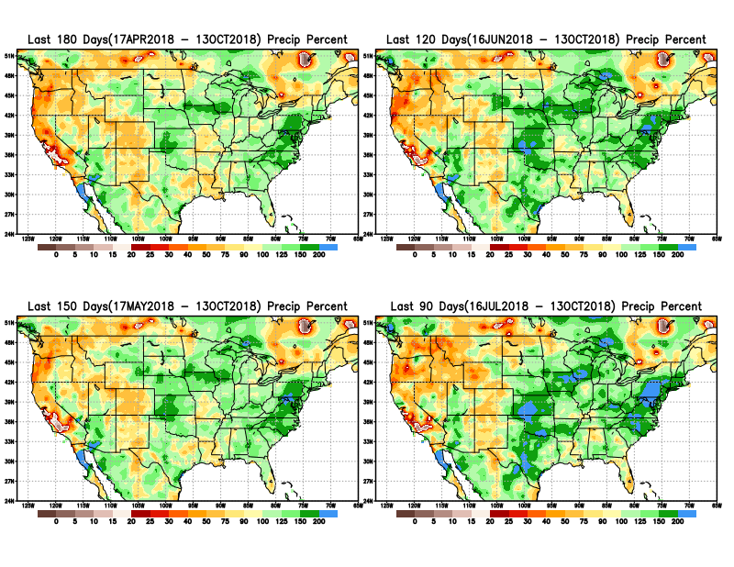
Total precipitation Percent during last 3, 4, 5, and 6 months.
6 M
4 M
5 M
3 M

Slide 9
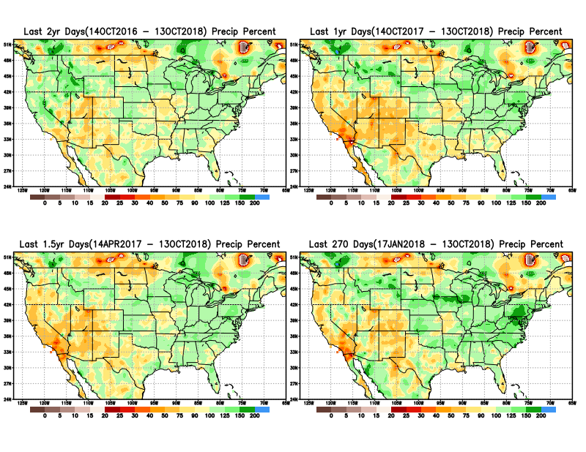
Total precipitation Percent during last 9 months, 1 yr, 1.5yrs, & 2 yrs.
2 Y
1 Y
There are many long term rainfall deficit regions in the country, particularly deficits in UT/AZ, southern CA, and parts of NM/CO are long term – possibly a consequence of the two back to back La Nina’s!
OR
Still longer term variability in play? Especially in the southwest!
1.5 Y
9 M

Slide 10
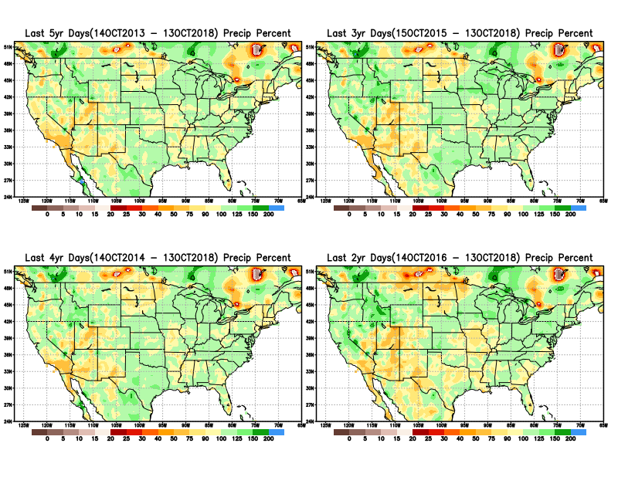
Total precipitation Percent during last 2 yrs, 3 yrs, 4 yrs, & 5 yrs.
5 Y
3 Y
Still longer term variability in play? Especially in the southwest!
4 Y
2 Y

Slide 11
Rainy Season across the US

Slide 12
Upcoming 3-m season’s
Rainy areas!
Adapted from Rich Tinker.

Slide 13
Adapted from
Rich Tinker

Slide 14
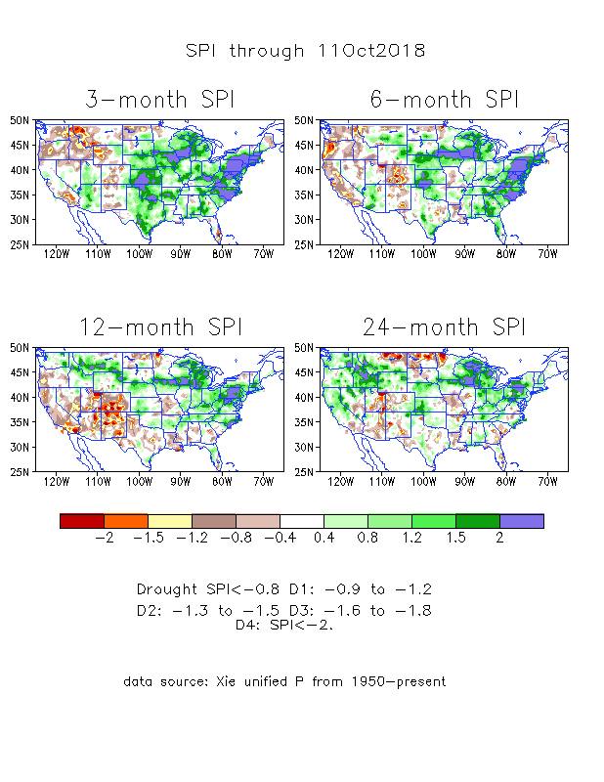
The Standardized Precipitation Index SPI (based on Observed P)
----- NOW
Very interesting graphic & details for the drought across the US based on the more generalized precip deficit/excess, the Standardized Precipitation Index (SPI).
The dark brown and red colors, indicating standardized precipitation deficits, in the various time periods, approximately correspond to the appropriate short/long term drought monitor regions and their intensities
In the short term (~3 mo), overall the drought looks much improved, except in Northwest.
In the longer term ~12m and longer, rainfall deficits remain in the Southwest and this season’s rains seems not enough to offset last season’s deficits in the Northern Plains. Note the stronger deficits in the Northern plains!

Slide 15
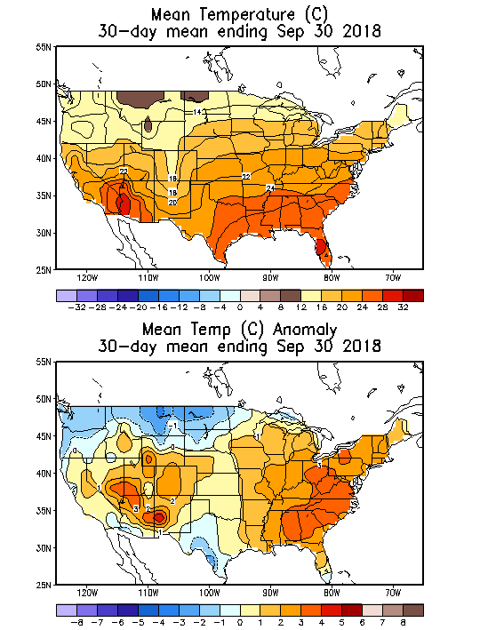
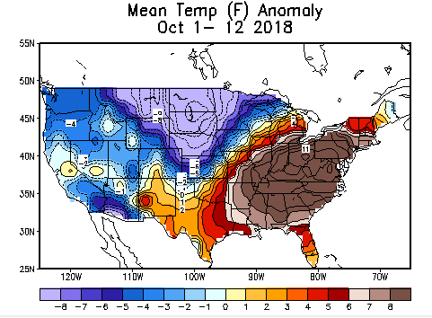
Recent US Temperatures
In September, as the summer has wound down, much of the country has been warmer than normal, except in the far northern and northwestern areas.
October so far is very different than September over much of the country.

Slide 16
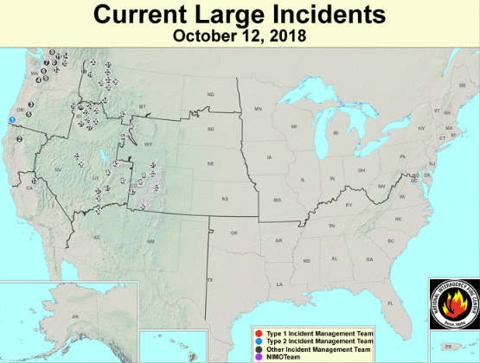
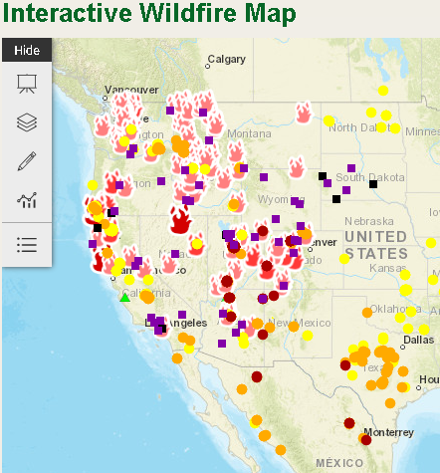
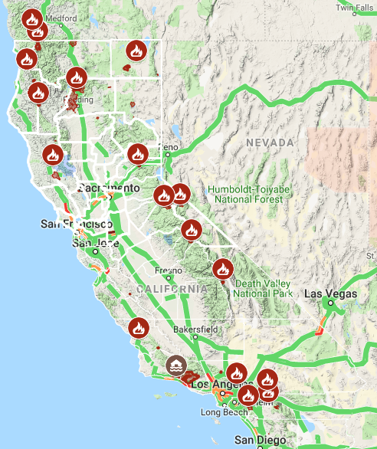
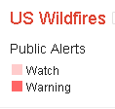
Current Active FIRE
One of the worst, (or probably the worst ?) fire season in CA this year and hence damage/destruction!!
https://fsapps.nwcg.gov/afm/index.php
from Google!
-this morning.
https://www.fs.fed.us/science-technology/fire/information

Slide 17
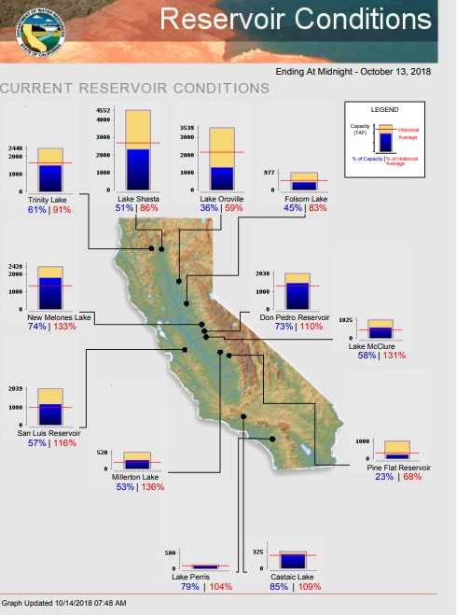
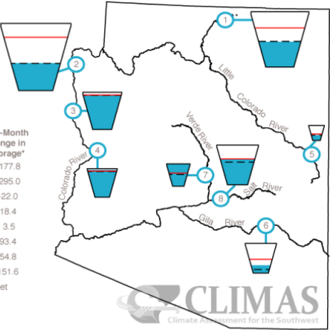
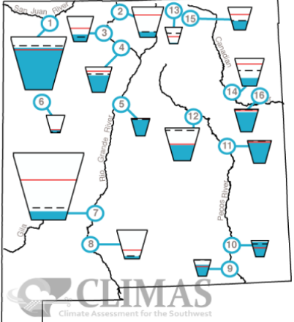
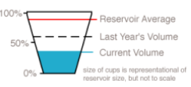
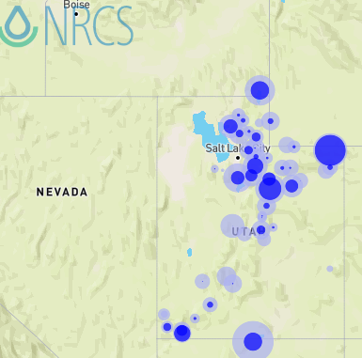
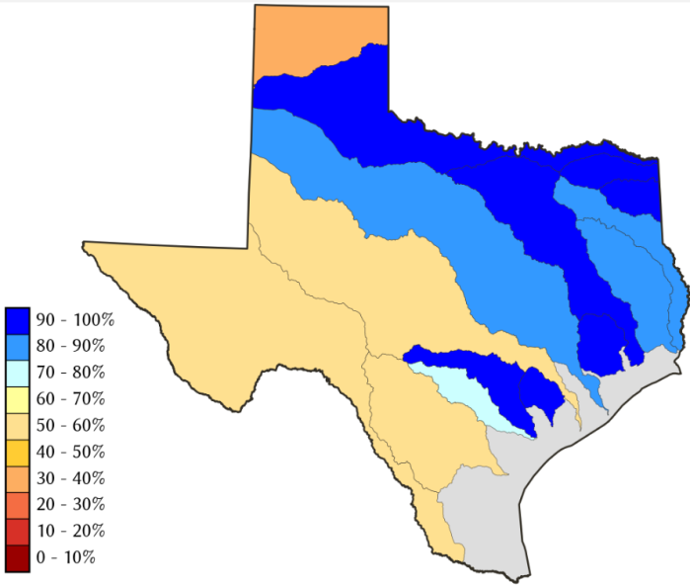
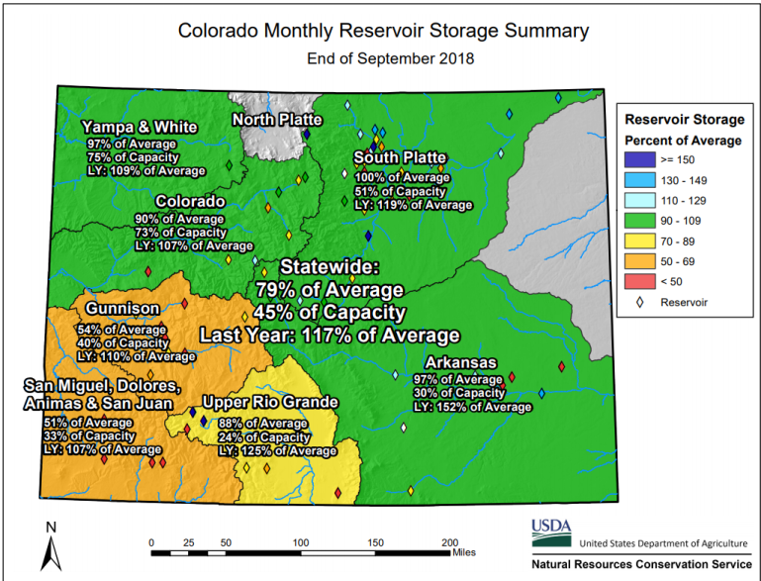
Water Reservoir Levels in some Western/Southern States!
AZ
NM
https://www.climas.arizona.edu/sw-climate/drought/sw-reservoir-volumes -- updated???
Northern CA reservoirs beginning to show
Weakness, but rainy season coming up!
Reservoir Storage Summary for River Basins
TX
2018-10-14
UT
Situation better than last month !
Situation better than last month !
https://fsapps.nwcg.gov/afm/index.php

Slide 18
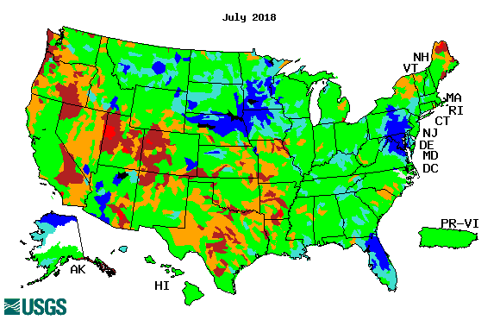
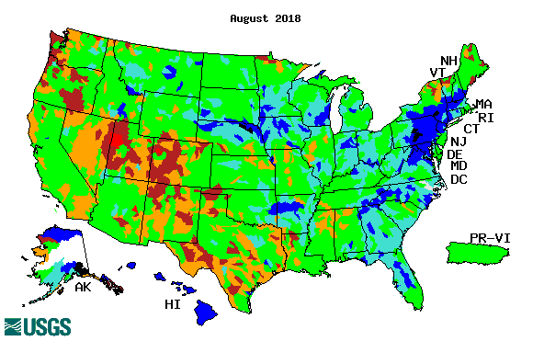
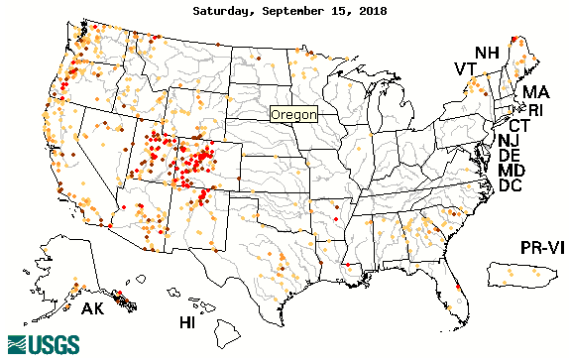
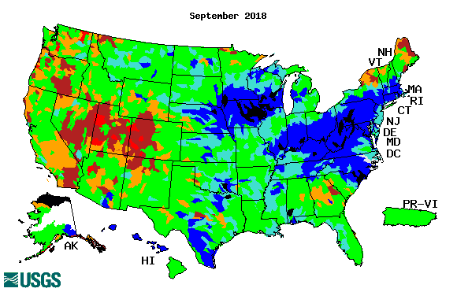
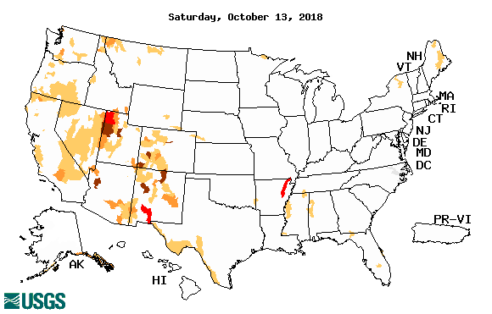
Streamflow (USGS)
Much improvement in Texas.
Lots of rain/streamflow in the east.
Four states corner area in the west – not much improvement!!
Map shows only below normal 7-day average streamflow compared to historical streamflow for the day of year.
One month ago (left) &
Now (below)
Not exactly the same type of maps?
18

Slide 19
EL NIÑO/SOUTHERN OSCILLATION (ENSO)
DIAGNOSTIC DISCUSSION
issued by CLIMATE PREDICTION CENTER/NCEP/NWS and the International Research Institute for Climate and Society
11 October 2018
ENSO Alert System Status: El Nino Watch !!
Synopsis: ENSO-neutral continued during September, but with increasingly more widespread regions of above-average sea surface temperatures (SSTs) across the equatorial Pacific Ocean. Over the last month, all four Niño index values increased, with the latest weekly values in each region near +0.7°C. El Niño is favored to form in the next couple of months and continue through the Northern Hemisphere winter 2018-19 (70-75% chance).

Slide 20
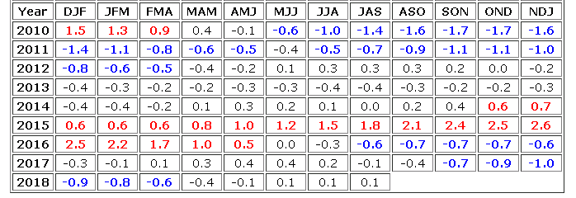
In Neutral Conditions NOW! Expected to turn to
El Nino conditions soon, very soon!
http://www.cpc.ncep.noaa.gov/products/analysis_monitoring/ensostuff/ensoyears.shtml

Slide 21
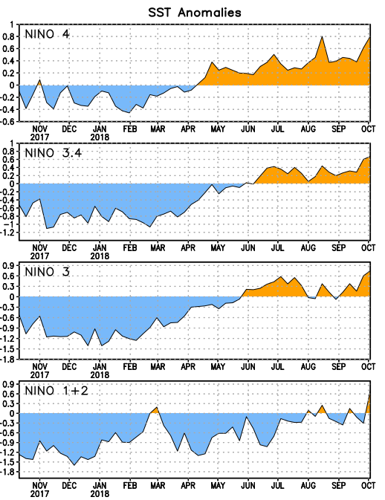
Latest values of SST indices in the various Nino Regions.
The sub surface heat anom continues to stay in the +ve territory! .
Relatively short lived!
Equatorial SST’s are at near to slightly above normal levels in all three ocean basins, except in Nino 4, where it is high!

Slide 22
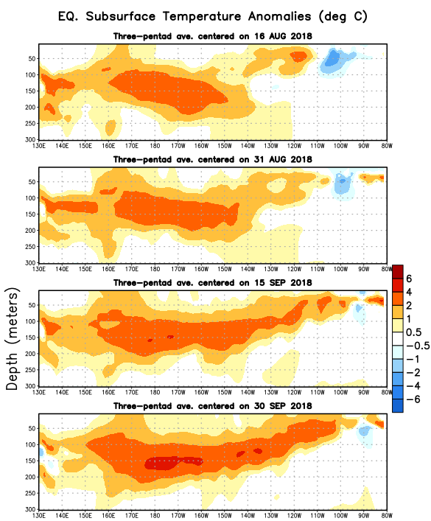
In spite of the relatively weak SST anomalies in recent months, (cf. Nino 3.4 values!) , this is what is happening in sub surface near the equator! Does this mean, still the same probabilities in the upcoming months/seasons for El Nino? Pointing towards a sure El Nino soon?

Slide 23
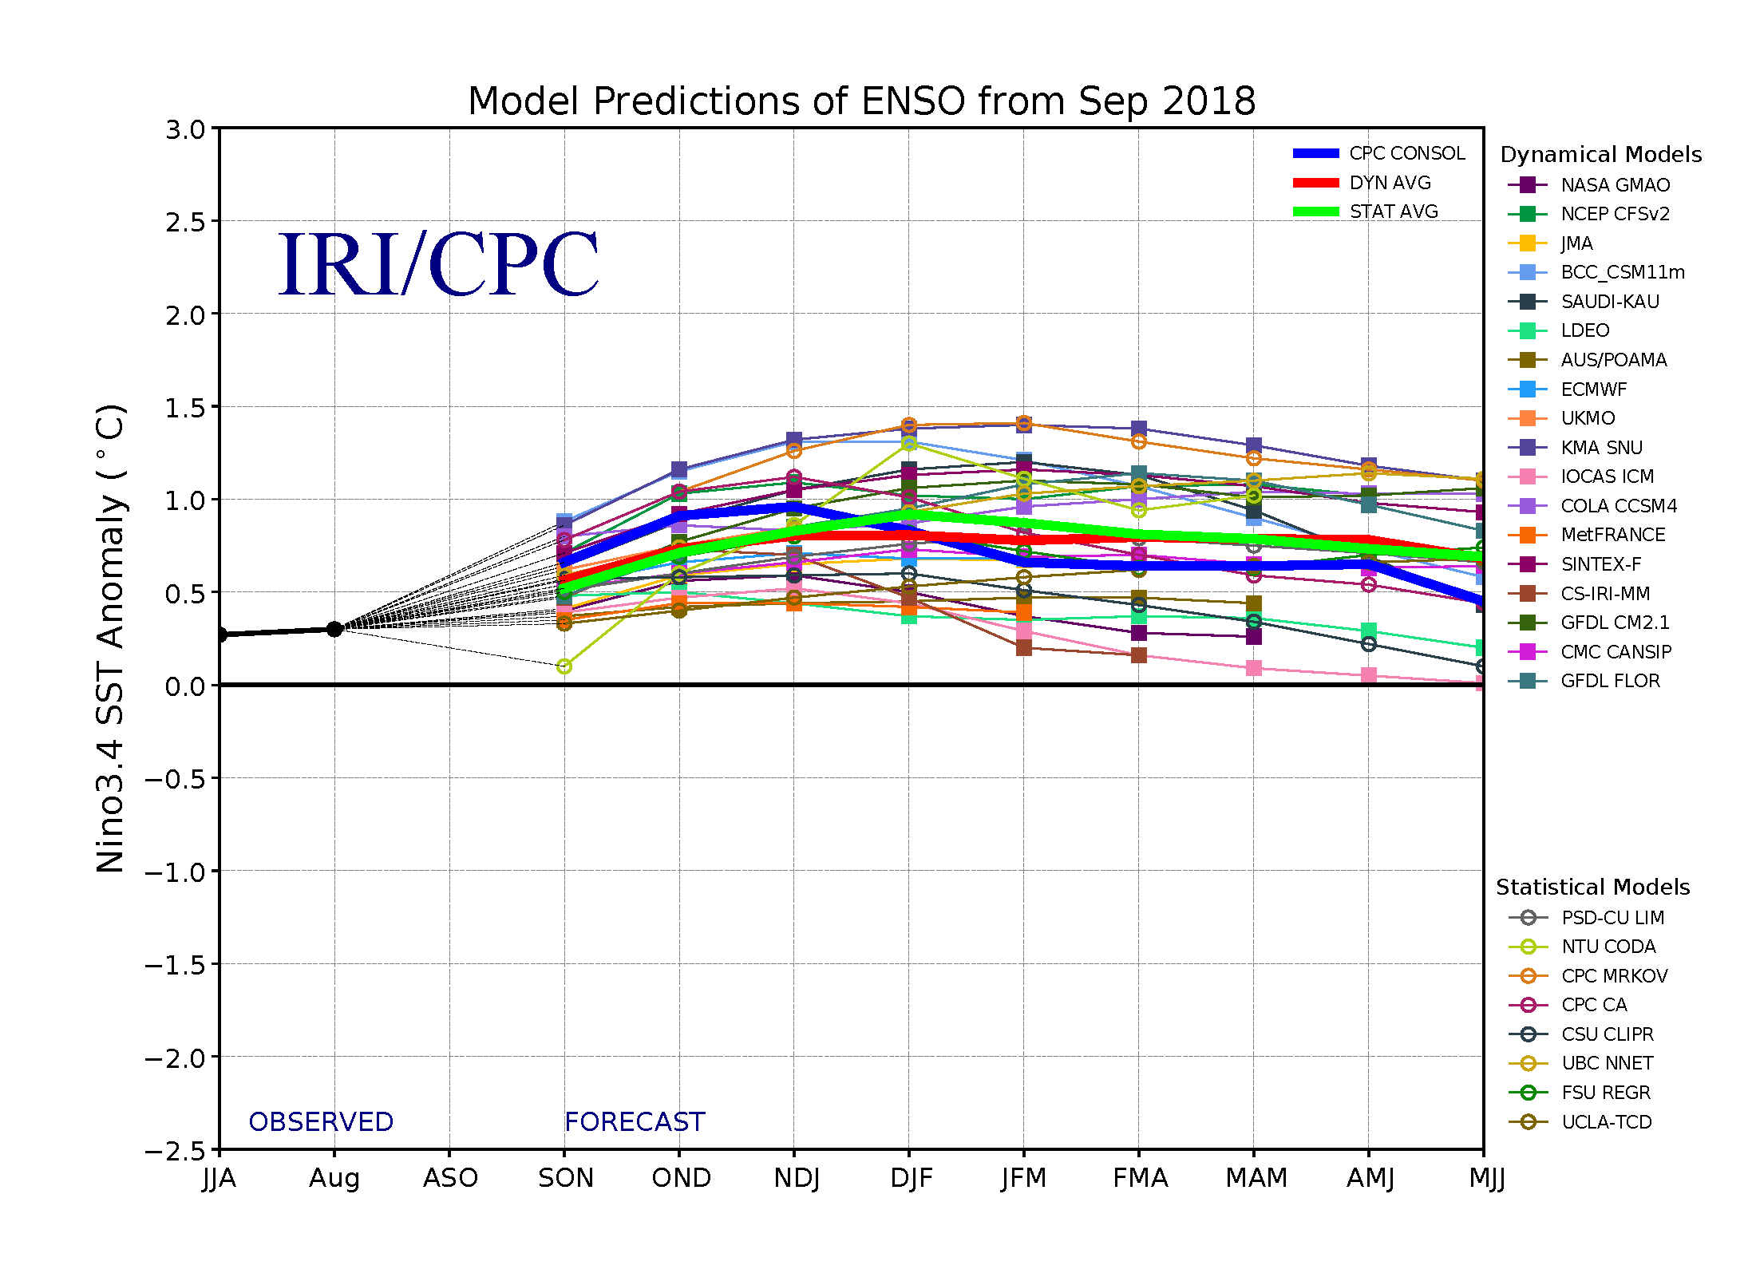
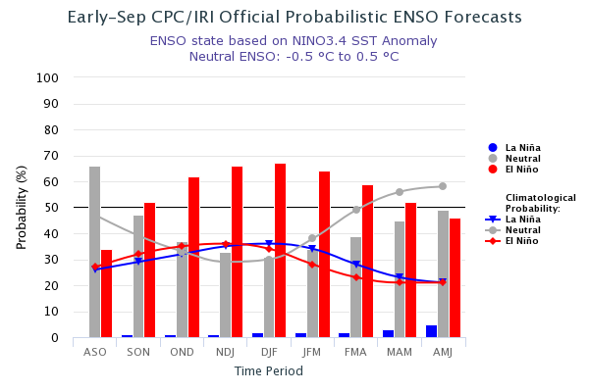
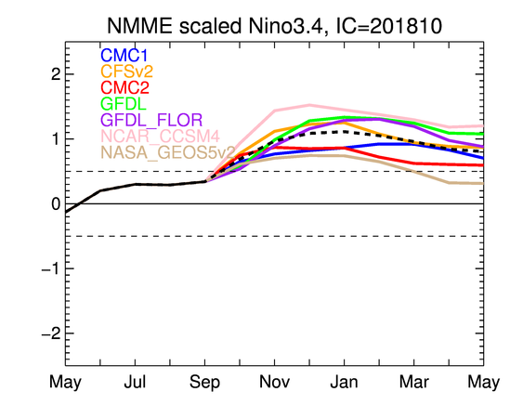
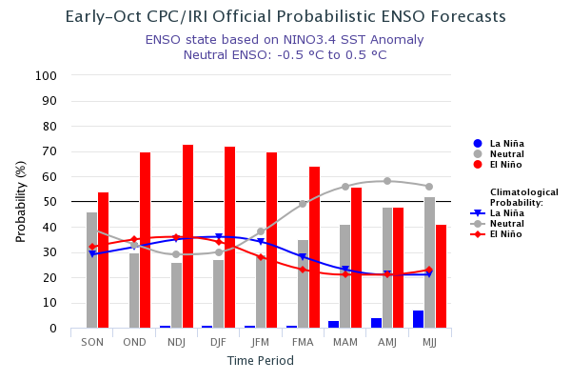
ENSO Forecasts
Early- September CPC/IRI forecast
NMME Models’ – Nino 3.4 forecasts
Early- October CPC/IRI forecast
Neutral conditions. Probability of developing El Nino in Fall/2018 ~ 50-55 %.(in fact, close to 50% than 55%), lower than last month!!

Slide 24
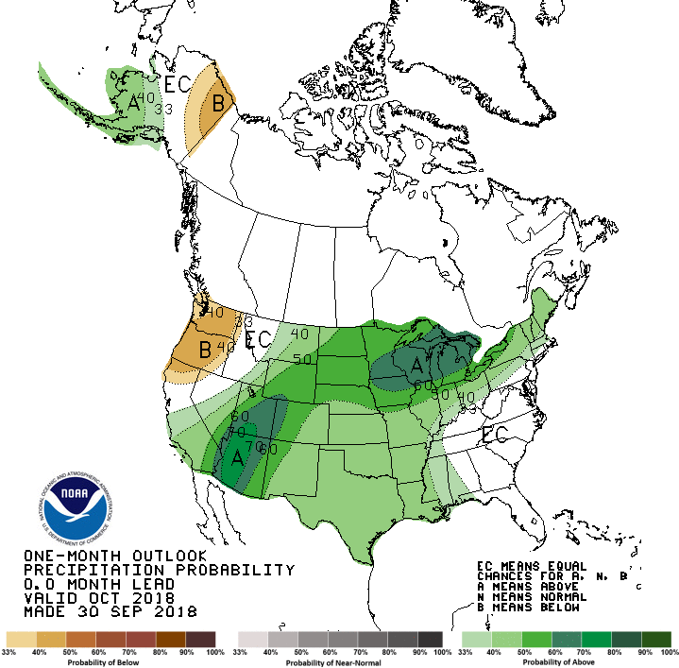
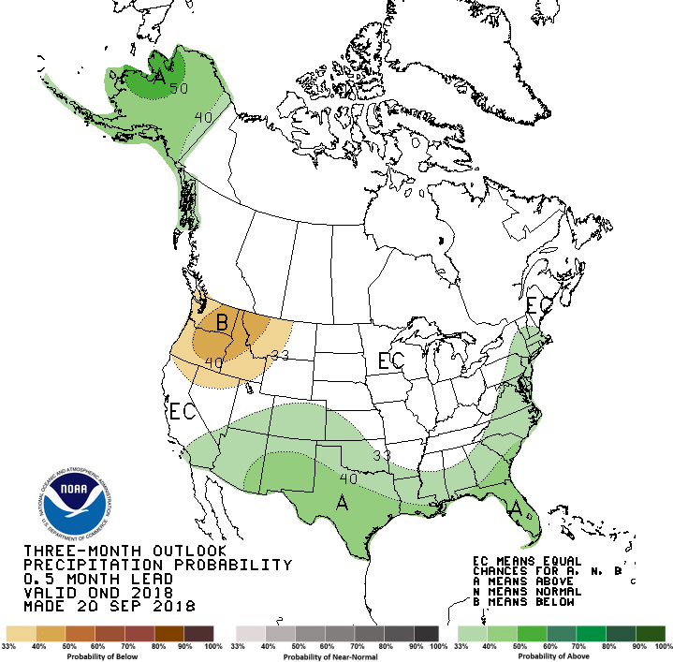
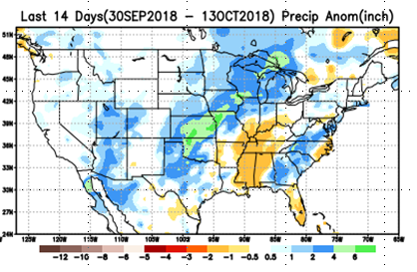
Previous CPC’s official Monthly (Oct)/Seasonal (OND)
Precipitation outlook
Released September 30
Observed so far this month!!
Released Sep 20th

Slide 25
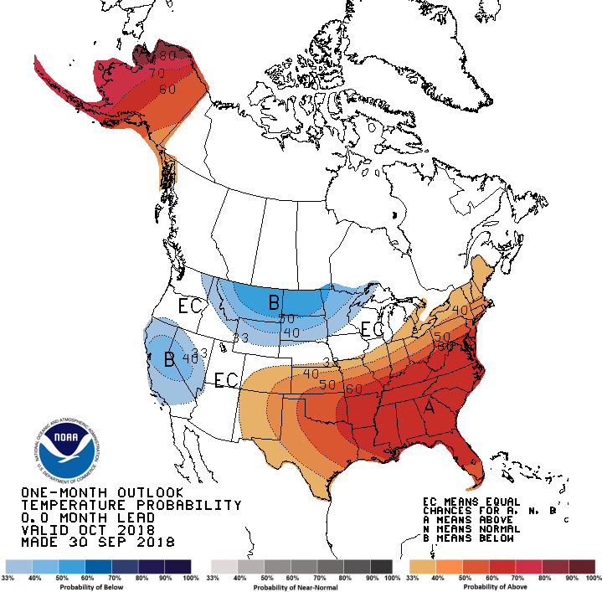
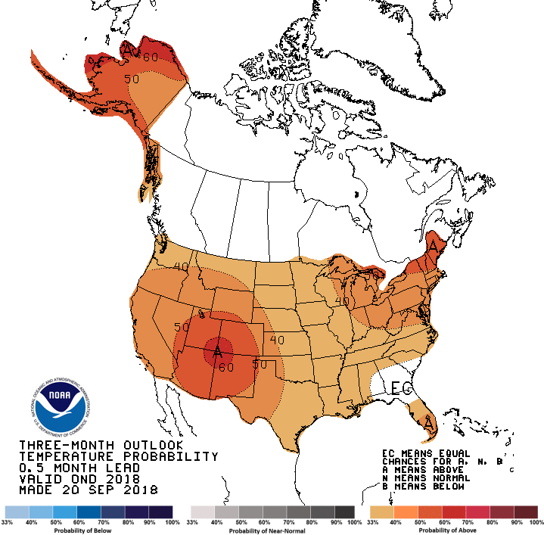
Previous CPC’s official Monthly (Oct)/Seasonal (OND)
Temperature outlook
Made
Sep 30th
Observed so far this month!!
Made Sep 20th

Slide 26
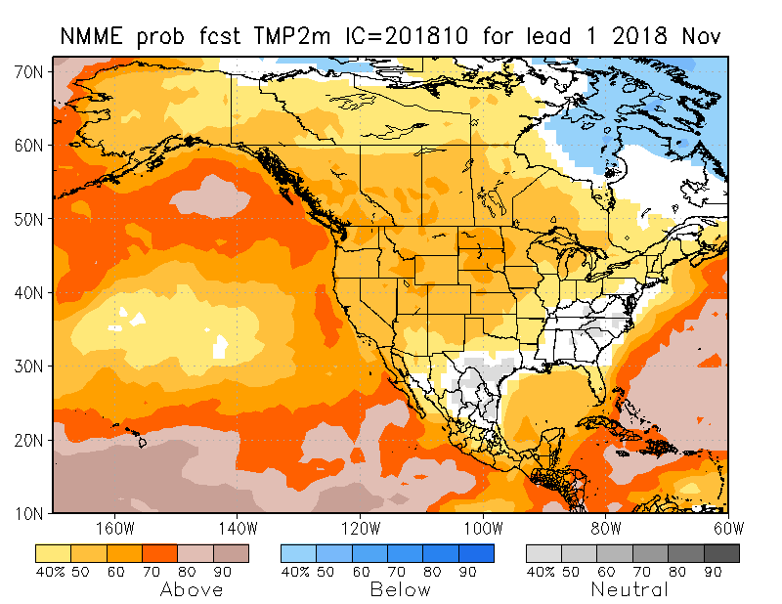
NMME T & P EnsMean forecasts
Nov
NDJ
Current ENSO state is neutral!! Fcst. is based on expected developing El Nino conditions!! Forecast is for somewhat similar looking monthly & seasonal forecasts for both T & P! Warm over the whole country, and slightly wet over the southwest country (except the Pacific NW).

Slide 27
The agreement/uncertainty among the diff. NMME models’ forecasts (middle and bottom panels) for Nov-Dec-Jan Precipitation!!!
27

Slide 28
3 successive runs consistently bringing rain to northwest and northern CA.
Next 7 days QPF Forecast
GFS Model Guidance for next 16 days.
Southwest and Pacific Northwest are obviously the important areas to watch, both in terms of drought and the upcoming rainy season!!

Slide 29
SPI3
SPI6
SPI12
SPI3, SPI6
& SPI12
Forecasts from 6NMME Models
(uses obs. P up to past month, and forecast months’ P from NMME models)
The goodness and skill of these SPI’s forecasts depend directly on the NMME models’ skill in predicting precipitation!!!
Short vs long term improvement!!

Slide 30
Hydrological Monitoring and Seasonal Forecasting @ MSU (Michigan State University ) NLDAS model
Monthly Soil Moisture Percentile Prediction issued on 201810 with this IC.
http://drought.geo.msu.edu/research/forecast/smi.monthly.php
The inter quartile range suggest greater uncertainty about the forecast in these shaded regions.
The forecast soil moisture (how deep!?) situation looks good except in Pacific Northwest! CA?

Slide 31
Precip Forecast
NASA GEOS5 Forecasts
Oct
Soil Moisture Forecast Percentile
Nov
IC
Oct
Dec
Nov
Dec

Slide 32
(This and next slide!) Exptl. Probability Drought Outlook from Kingtse Mo and Li Xu based on NMME ensemble members’ SPI6 (from precip) forecast – Since it is based on SPI6, longer/term lasting droughts will not be depicted!!

Slide 33
Nov2018
NDJ 2018
In the official
Drought Outlook Tendency Format!!
This method however, does not start with the DM as the initial drought conditions! (?)

Slide 34
Summary
Current ENSO status and forecast. ENSO-neutral continued during September, but with increasingly more widespread regions of above-average sea surface temperatures (SSTs) across the equatorial Pacific Ocean. Over the last month, all four Niño index values increased, with the latest weekly values in each region near +0.7°C. El Niño is favored to form in the next couple of months and continue through the Northern Hemisphere winter 2018-19 (70-75% chance).
Current Drought conditions:
The improvement seen from summer 2018 rains impacting the Northern Plains drought (continuing from 2017), that affected eastern Montana, and the North/South Dakotas, did not completely recover from this year’s/season’s(2018 MJJAS) rains. But the drought here is definitely far better now than it was at this time of year last year. The longer term dryness continues (esp. in Dakotas)!
The drought in the four states corner region in the South/Southwest is predominantly, also a consequence of the rainfall deficit associated with the two recent back to back La Ninas and even prior shortfalls. Since last month, short term improvement and short term drought improvement/removal is noted across parts of KS/OK/MO/AR/LA.
Dryness/Drought is expanding/developing in the Pacific Northwest states expanding into ID.
Prediction:
Rainfall season(NDJ) is coming up for all western states and Pacific NorthWest! Under El Nino Watch!! At present, development of El Nino in the next couple of months appears more certain than before. In the next three months, all models indicate slightly above normal rainfall particularly across the South and West, but relative dryness in the upper Northwest.
Overall, short term improvement is expected in the drought conditions overmuch of the south and west. But the longer term drought from longer tem rainfall deficits in these regions is expected to remain! short of an unexpected usual deluge associated with El Nino, which could make a big dent in these longer term rainfall deficits here. The Northern Plains Drought ,in some areas of the N/S Dakotas, may continue to exist in a muted form for the season, since the previous rainfall deficits are not completely erased this year.
Overall, drought persists but improves, is recommended even in the upper Northwest! **END***

Slide 35
Miscellaneous maps

