Slide 1
Drought Outlook Support Briefing October 2019
Climate Prediction Center/NCEP/NOAA
http://www.cpc.ncep.noaa.gov/products/Drought
Phone: 1-877-680-3341
Pwd: 858747#

Slide 2
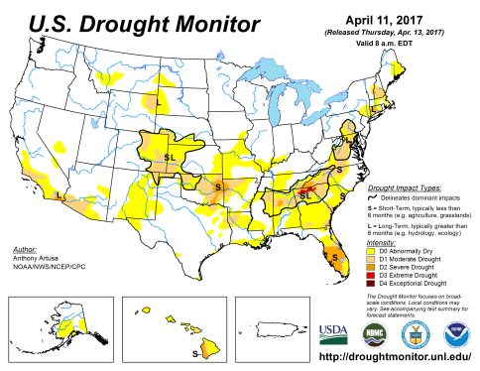
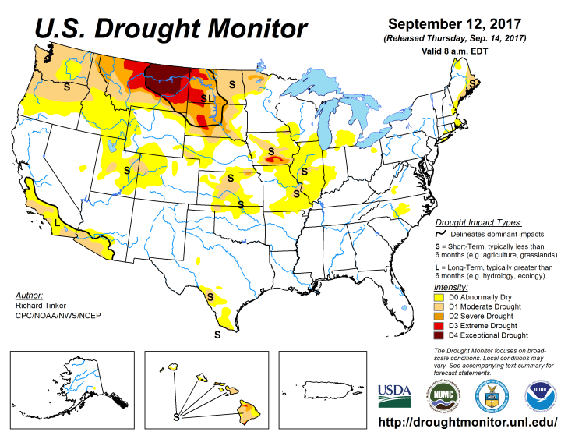
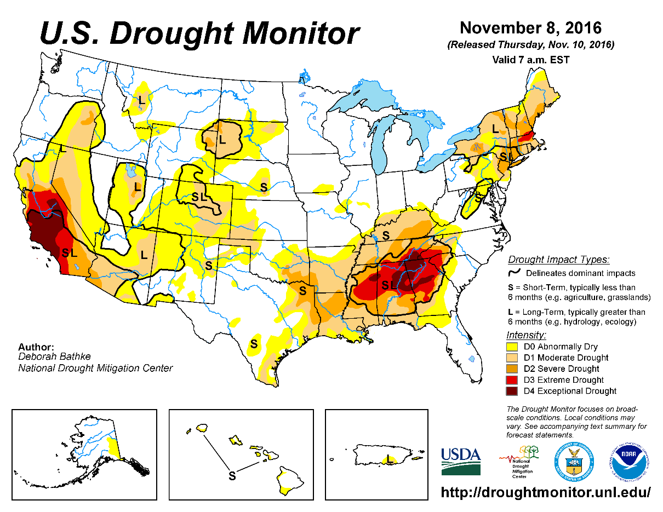
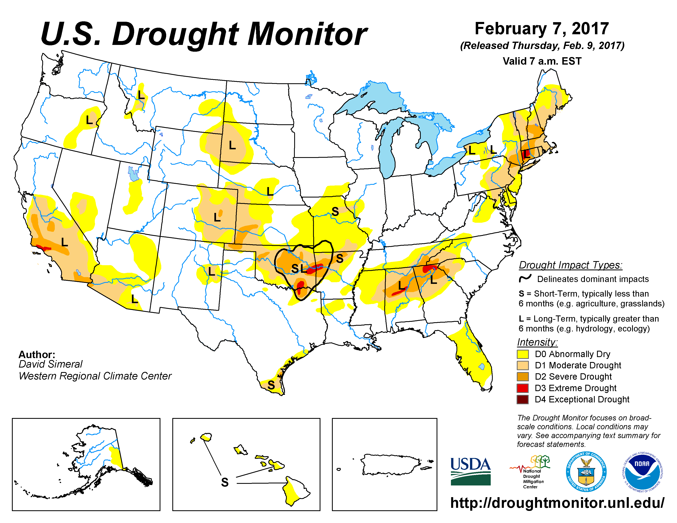
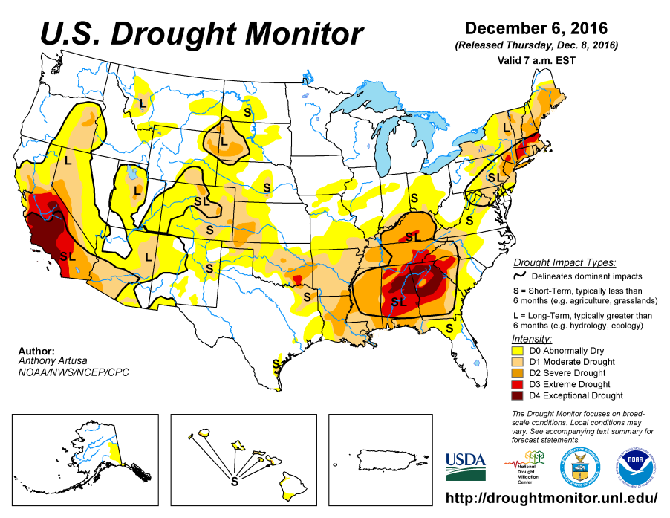
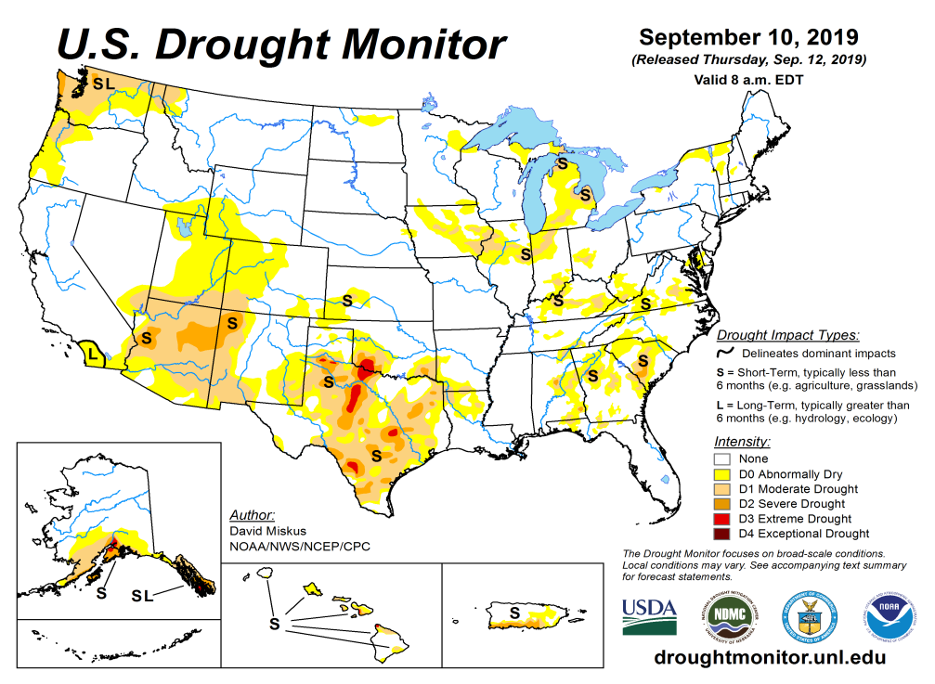
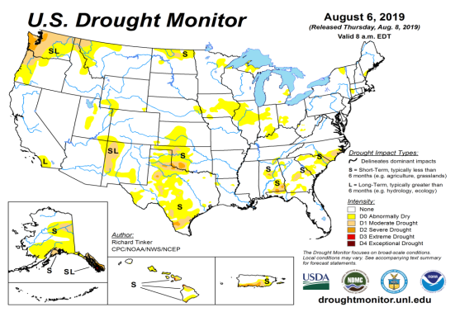
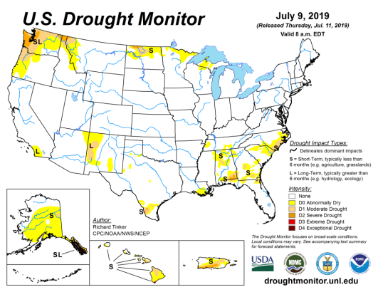
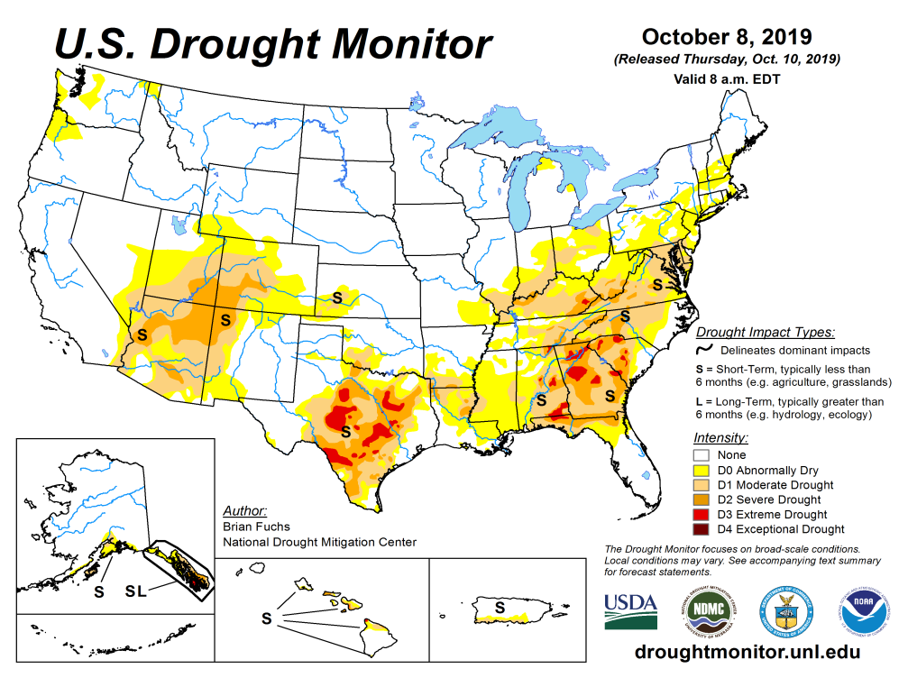
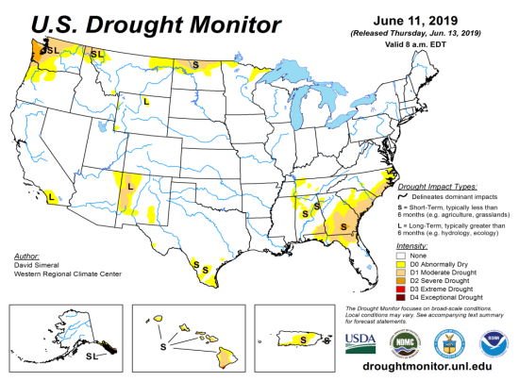
Drought Monitor
September
After reaching a relative minimum in the area of drought coverage across the US has been surging lately.
According to the DM, these regions have droughts:
Dryness/Flash drought in the southeast of various categories covering a large area.
Large parts of TX.
Southwest, especially around the four corners area.
August
July
Recent/Latest
June
February

Slide 3
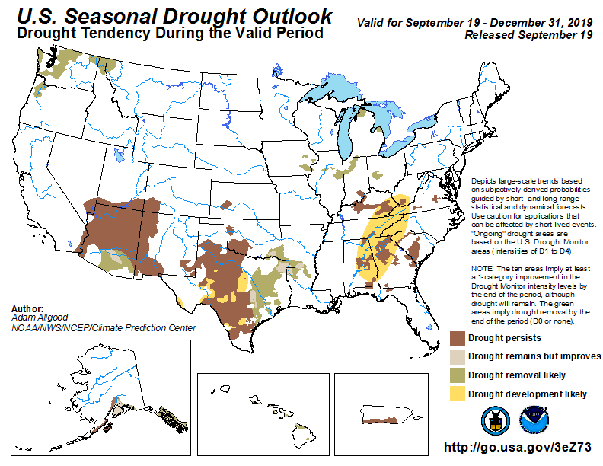
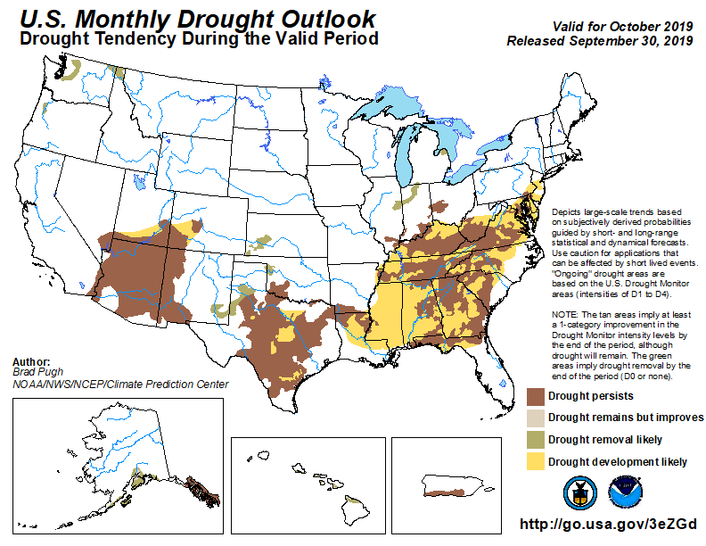
(Prev) Seasonal/Monthly Drought outlooks
(New Seasonal Drought Outlook to be released in 2 days!)
Seasonal Outlook
(Mid Sep 2019- Dec 2019)
issued 9/19/19
Monthly outlook
(for Oct 2019)
issued 9/30/19
Pretty good monthly forecast so far. →

Slide 4
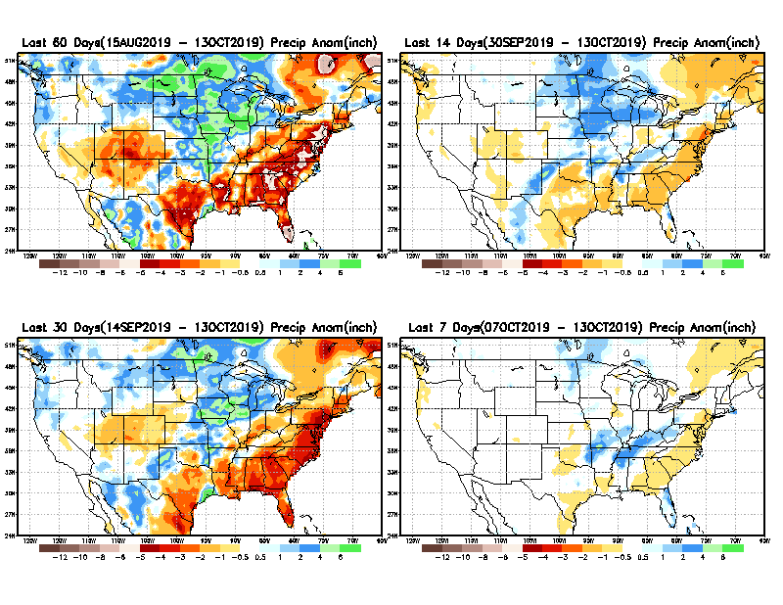
Precipitation ANOM during last 7, 14, 30, & 60 days.
60 Days
14 Days
These maps in this and following slides, including
a) Total,
b) Anom and c) Percent of precip. in these and other longer time ranges are now daily updated at:
30 Days
7 Days
From: Recent Accumulated Precipitation https://www.cpc.ncep.noaa.gov/products/Drought/briefing_prcp.shtml

Slide 5
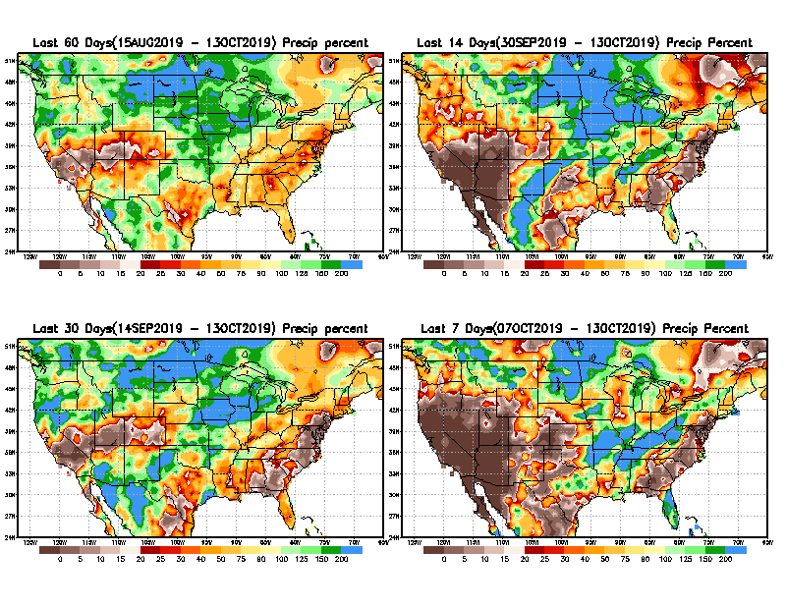
Precipitation Percent during last 7, 14, 30, & 60 days.
60 Days
14 Days
NOW !
30 days
7 Days
From: Recent Accumulated Precipitation https://www.cpc.ncep.noaa.gov/products/Drought/briefing_prcp.shtml

Slide 6
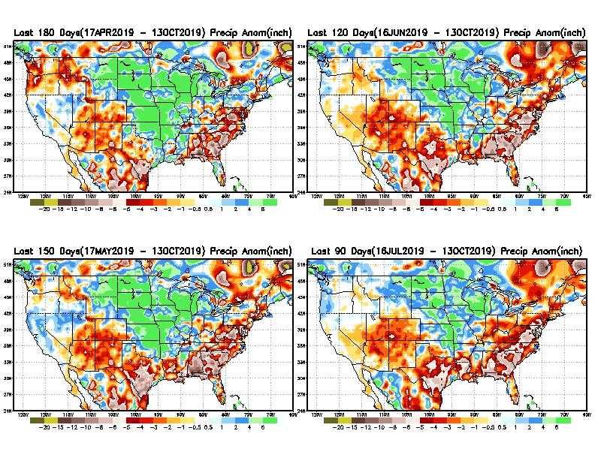
Total precipitation ANOM during last 3, 4, 5, and 6 months.
6 M
4 M
5 M
3 M
From: Recent Accumulated Precipitation https://www.cpc.ncep.noaa.gov/products/Drought/briefing_prcp.shtml

Slide 7
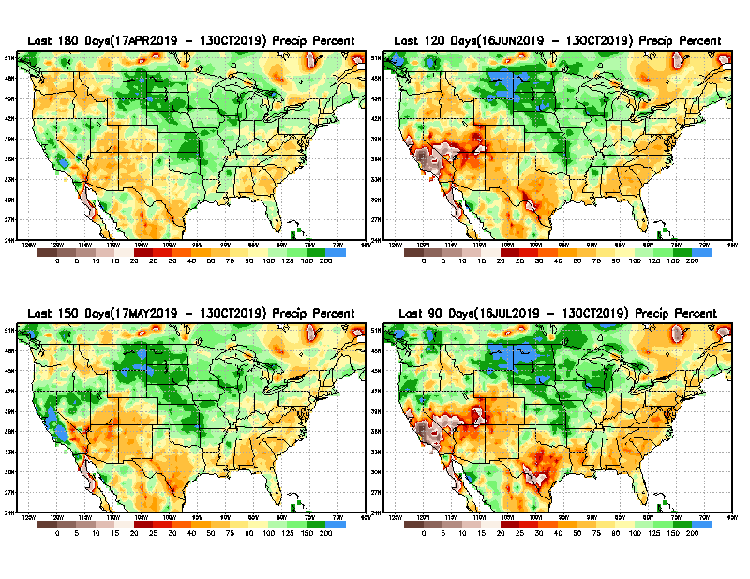
Total precipitation Percent during last 3, 4, 5, and 6 months.
6 M
4 M
In these interim time scale 3-6 months, need to pay attention to regions, which are red/dark red and brown (<50%)
5 M
3M

Slide 8
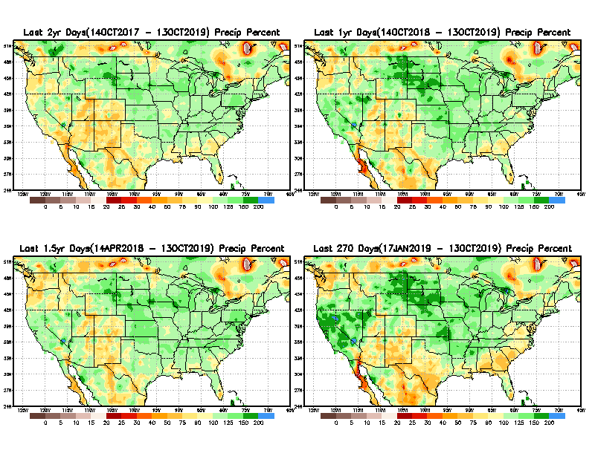
Total precipitation Percent during last 9 months, 1 yr, 1.5yrs, & 2 yrs.
2 Y
1 Y
1.5 Y
9 M
From: Recent Accumulated Precipitation https://www.cpc.ncep.noaa.gov/products/Drought/briefing_prcp.shtml

Slide 9
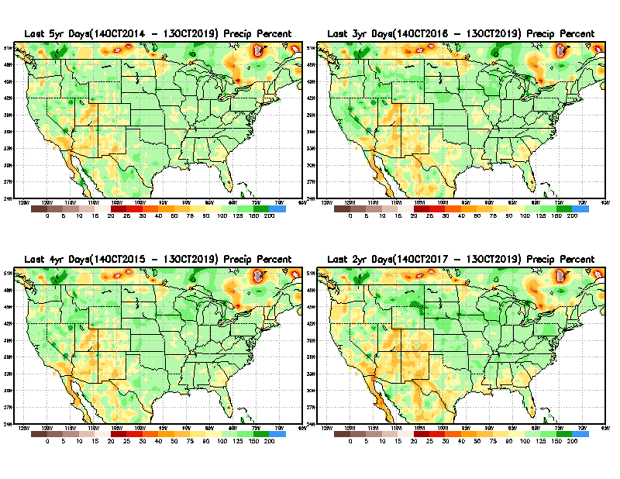
Total precipitation Percent during last 2 yrs, 3 yrs, 4 yrs, & 5 yrs.
5 Y
3 Y
Still longer term rainfall deficit variability in play? Especially in the southwest!
Will these deficits ever go away, OR is these part of the new norm??
Not so bad in the east!!
4 Y
2 Y
From: Recent Accumulated Precipitation https://www.cpc.ncep.noaa.gov/products/Drought/briefing_prcp.shtml

Slide 10
Rainy (3-month)Season across the US

Slide 11
Watch SE, TX and SW as we move forward to January.
Adapted from Rich Tinker.

Slide 12
Adapted from
Rich Tinker

Slide 13
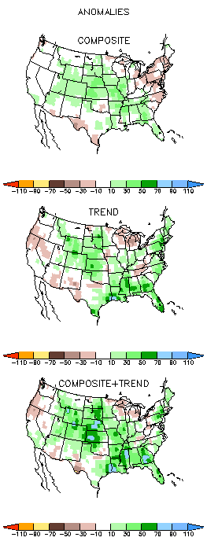
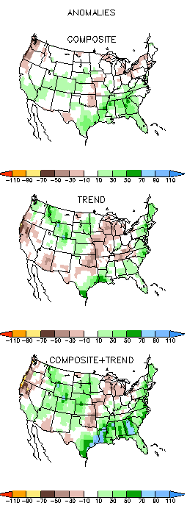
EL NINO Precip COMPOSITES & Trend maps
ASO
SON
Only this is of relevance to us now due to ENSO status.

Slide 14
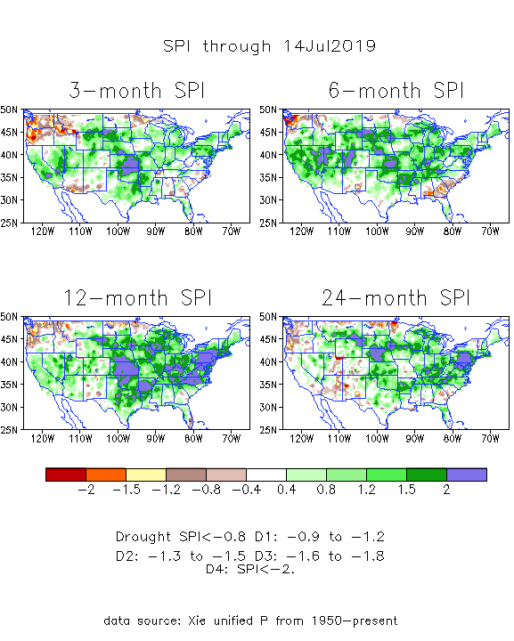
The Standardized Precipitation Index SPI (based on Observed P)
---3 months ago
Very interesting graphic & details for the drought across the US based on the more generalized precip deficit/excess, the Standardized Precipitation Index (SPI).
The dark brown and red colors, indicating standardized precipitation deficits, in the various time periods, approximately correspond to the appropriate short/long term drought monitor regions and their intensities
How quickly the short term drought situation changes!!
Compare these patterns just 2 months ago to current situation now (next slide!)

Slide 15
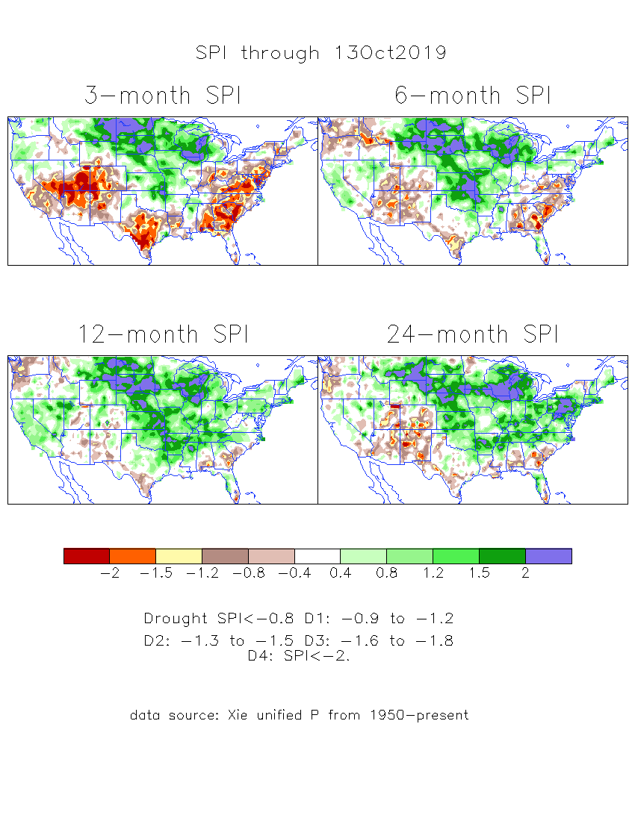
The Standardized Precipitation Index SPI (based on Observed P)
----- NOW
Very interesting graphic & details for the drought across the US based on the more generalized precip deficit/excess, the Standardized Precipitation Index (SPI).
The dark brown and red colors, indicating standardized precipitation deficits, in the various time periods, approximately correspond to the appropriate short/long term drought monitor regions and their intensities
Overall, there is a great deal of similarity between the short/medium and long term SPI patterns,
In the short term, the lack of precip and the cumulative dryness in the TX/southwest has gotten worse.
But improvement is noted in the Pacific NW.
Southeast also has gotten worse.

Slide 16
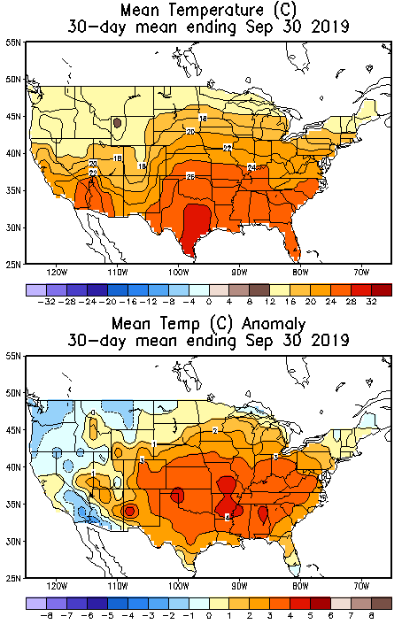
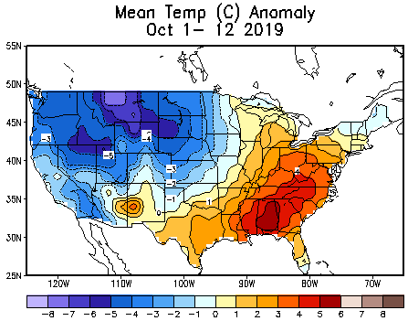
Recent US Temperatures
September US T pattern was mixed with generally warm in the center, south and east, but cool in the west.
October so far much colder in the west, especially in the northern plains

Slide 17
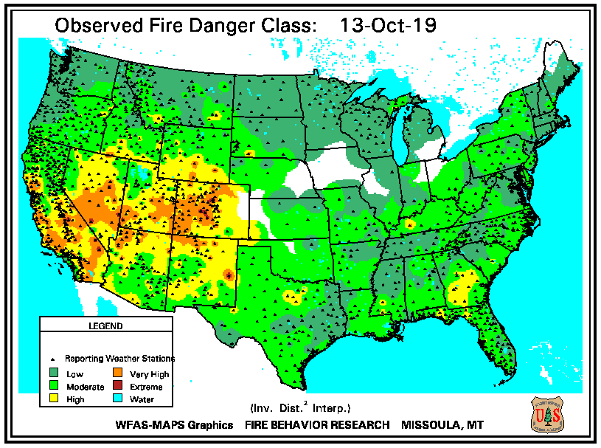
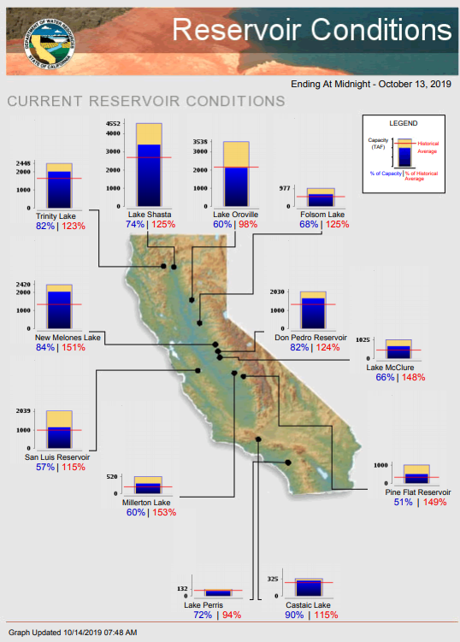
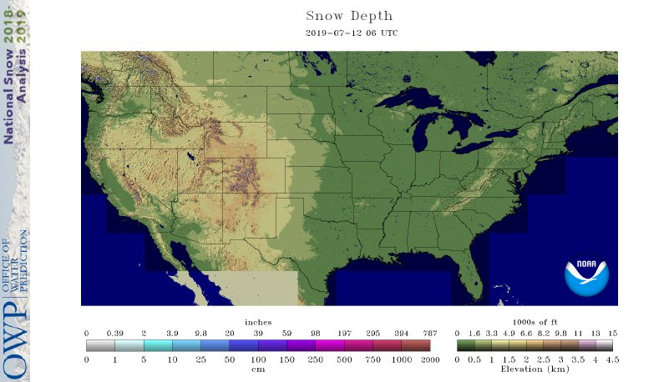
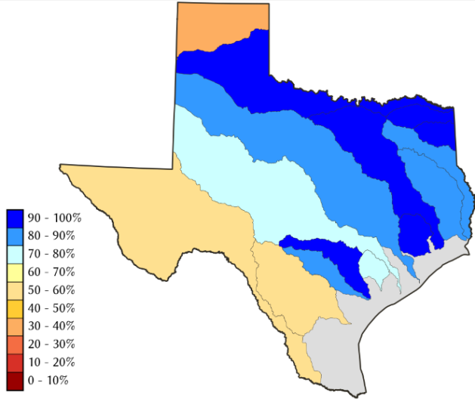
Water Reservoir Levels in some Western/Southern States! !
https://fsapps.nwcg.gov/afm/index.php
No reported major fire incidents so far. (cf. last year!)
Except in few high elevations, all snow has melted.
Northern CA reservoirs beginning to show
Weakness, but rainy season coming up!
COLORADO Sep’2019 water reservoir storages at 121 % of long term average – thanks to snow melt.
(last year: 79% of Average)
TX
In spite of the fire season/ situation in California, its reservoirs are still at or above historic average levels.
https://fsapps.nwcg.gov/afm/index.php

Slide 18
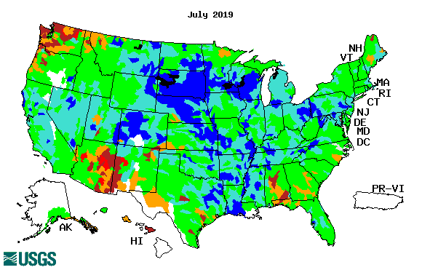
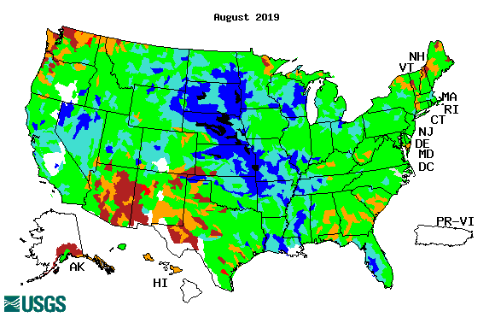
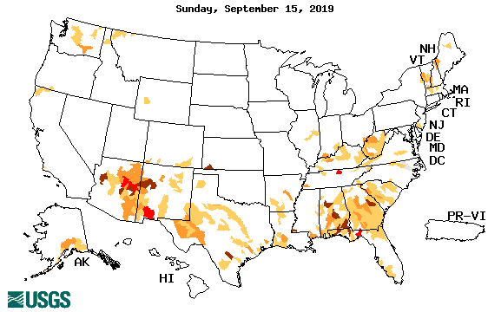
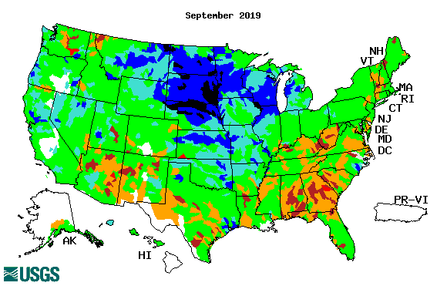
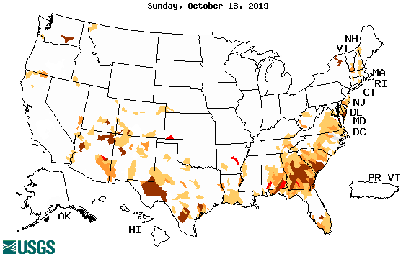
Streamflow (USGS)
Overall, worsened stream flow conditions in the southeast.
Slight improved conditions in the southwest.
Pacific NW much improved now.
Map shows only below normal 7-day average streamflow compared to historical streamflow for the day of year.
One month ago (left) &
Now (below)
18

Slide 19
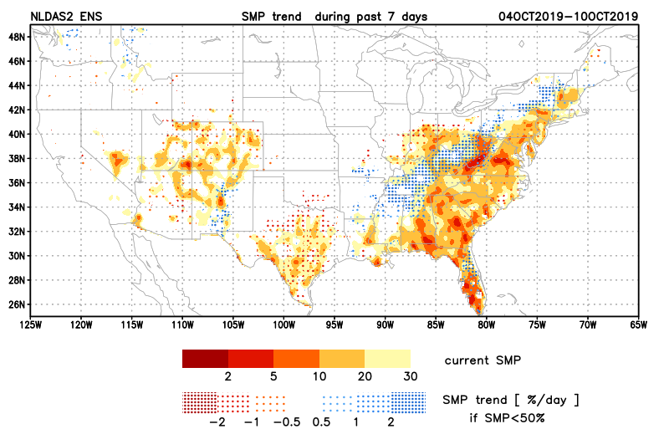
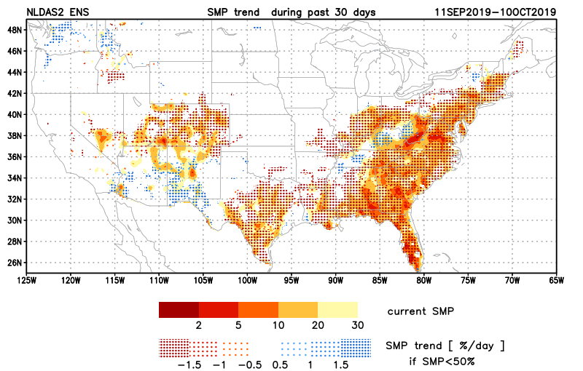
NCEP Ensemble mean NLDAS2 models’ Soil Moisture tendency/trend
7 days
14 days
Drying soil moisture tendency over the last month in the drought affected regions, especially in the southeast.
30 days

Slide 20
EL NIÑO/SOUTHERN OSCILLATION (ENSO)
DIAGNOSTIC DISCUSSION
issued by CLIMATE PREDICTION CENTER/NCEP/NWS and the International Research Institute for Climate and Society
7 October 2019
ENSO Alert System Status: Not Active
Synopsis: ENSO-neutral is favored during the Northern Hemisphere fall 2019 (~85% chance), continuing through spring 2020 (55-60% chance). Near-average sea surface temperatures (SST) were evident in the east-central Pacific Ocean during most of September.

Slide 21
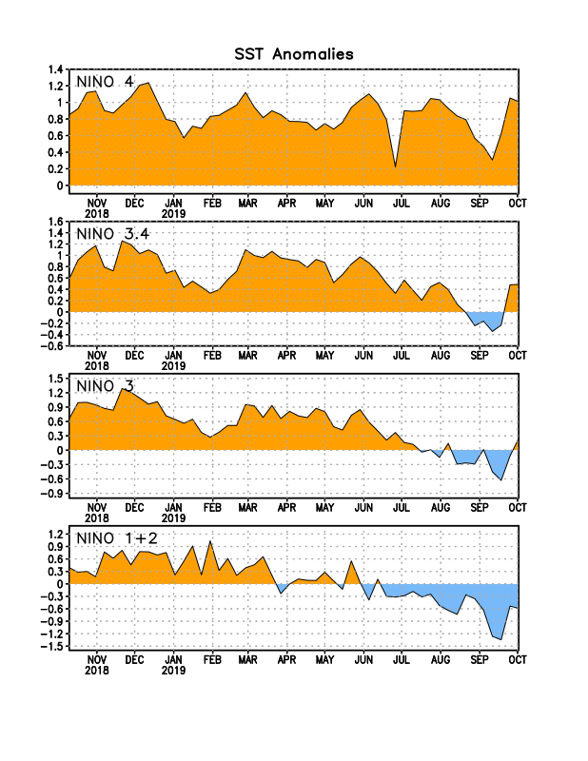
Latest values of SST indices in the various Nino Regions.
The sub surface heat anom has been falling for the past few months. Will we be in neutral territory for how long?
?

Slide 22
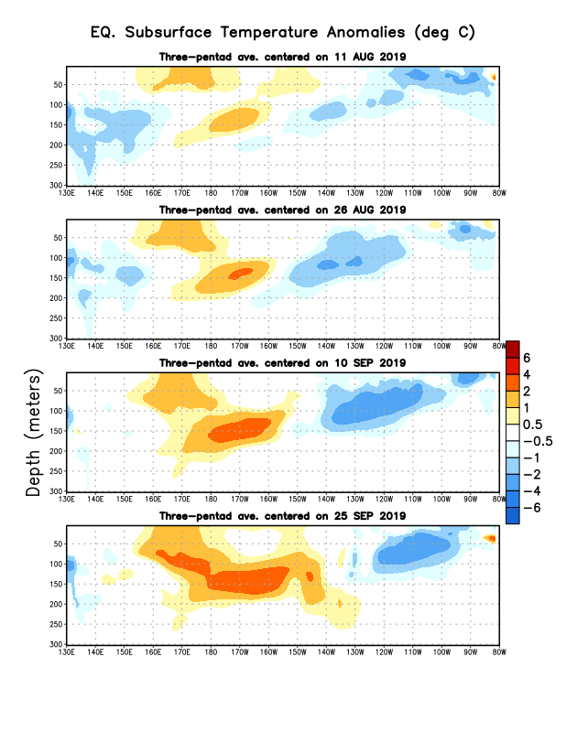
Sub-Surface Temperature Departures in the Equatorial Pacific
Most recent pentad analysis

Slide 23
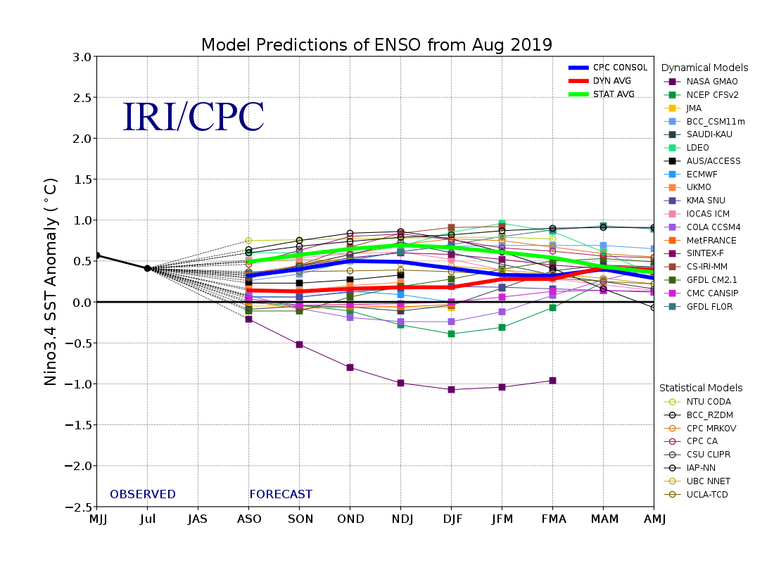
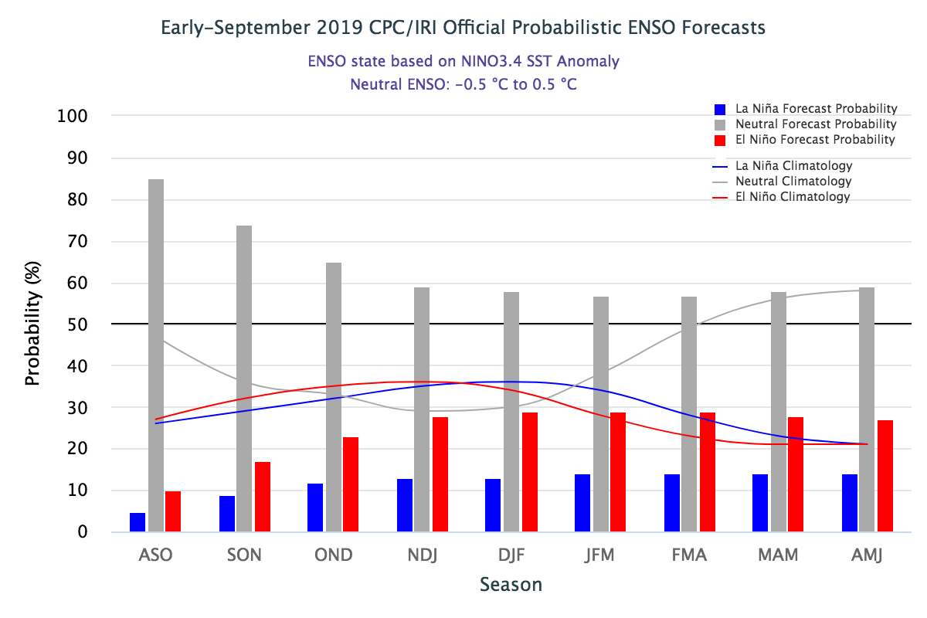
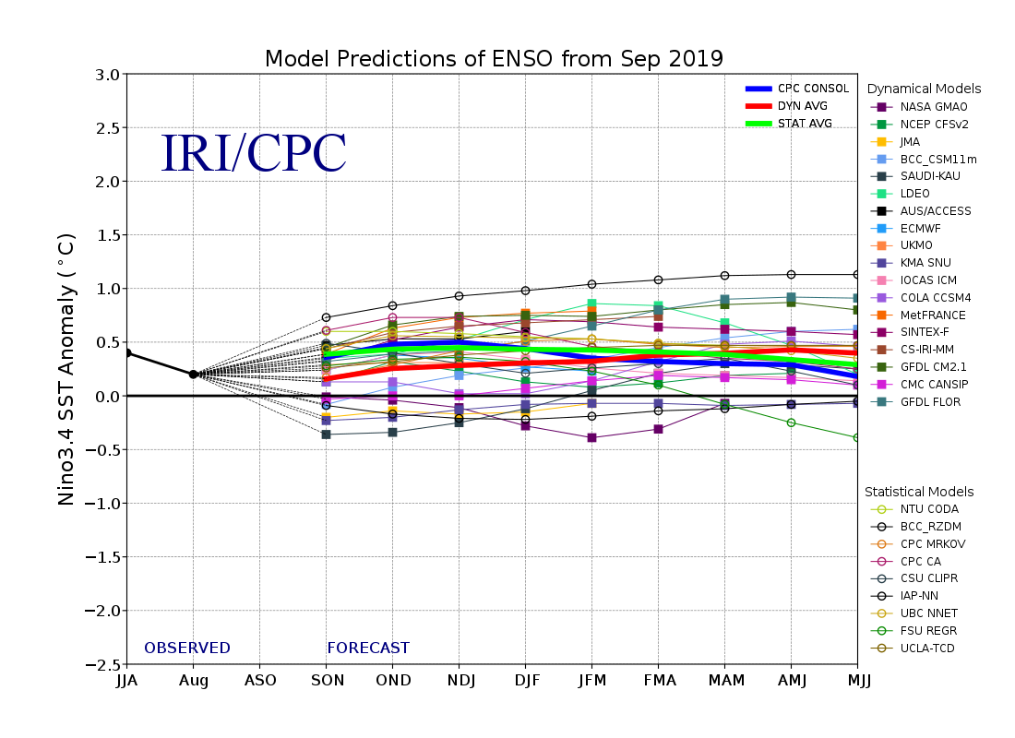
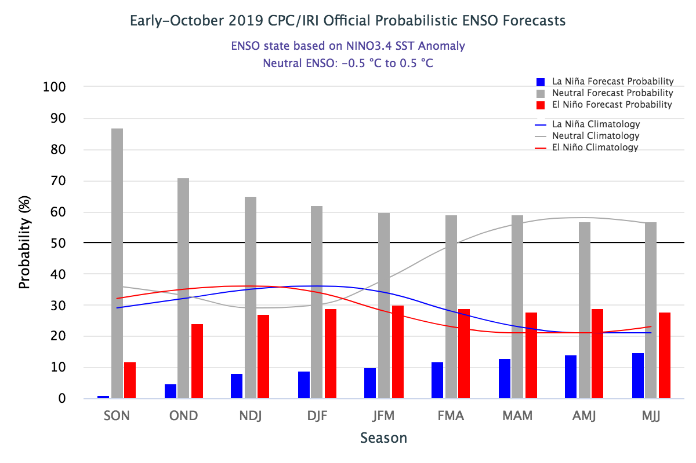
ENSO Forecasts
Early- September CPC/IRI forecast
Early- October CPC/IRI forecast
Neutral for how long? Or a swing to ?

Slide 24
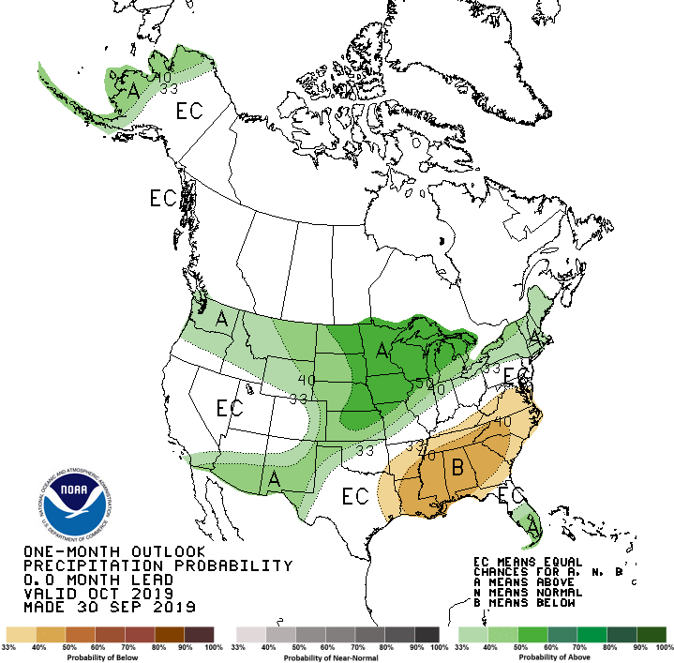
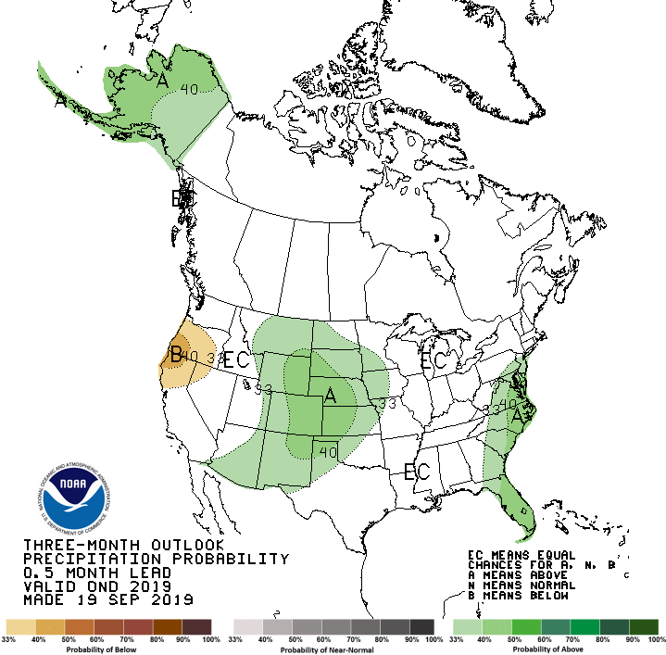
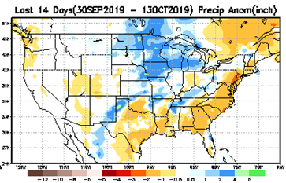
Released Sep 30st
Previous(Last month)
CPC’s official
Precipitation outlook for Monthly (October)/Seasonal (OND)
Released Sep 19th
Observed so far this month!! ☹
First half of month!
Second half month ?
Next slide!

Slide 25
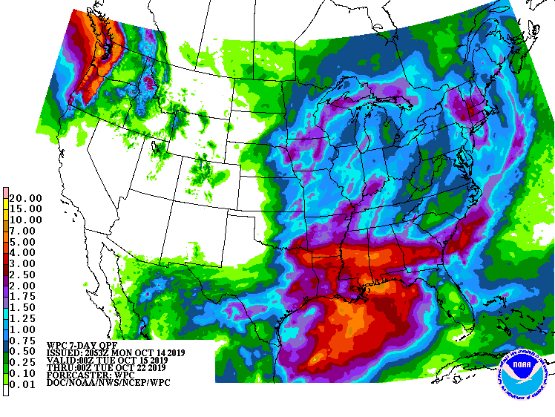
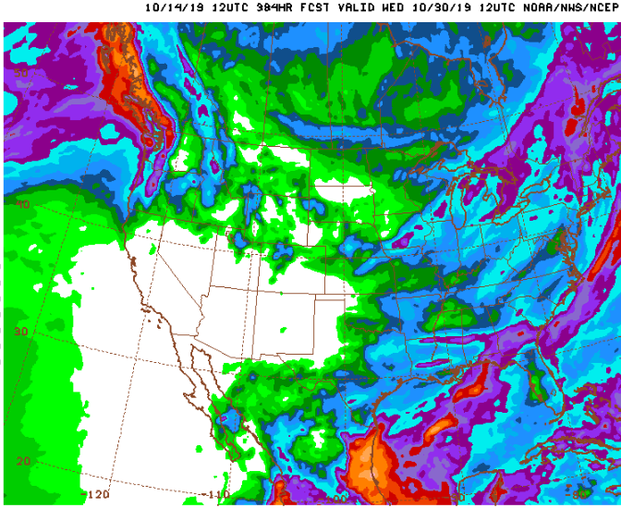
WPC Next 7 days QPF Forecast
GFS Model Guidance for next 16 days.

Slide 26
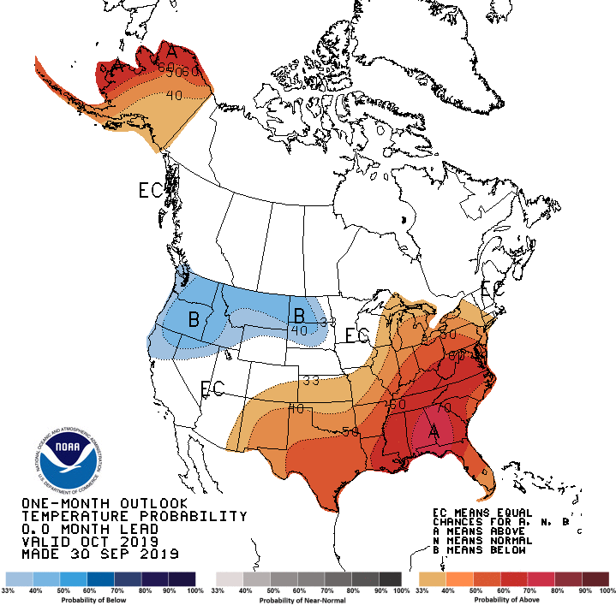
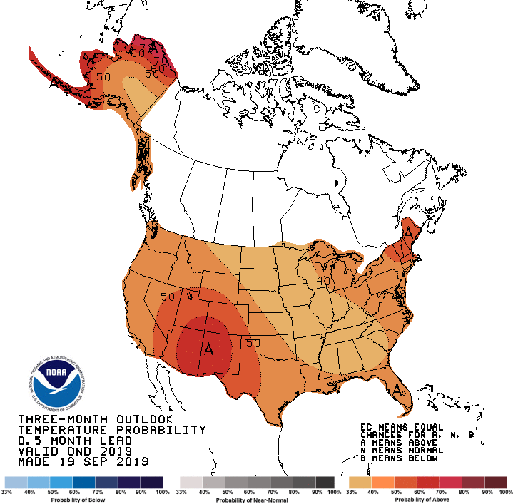
Previous (Last Month)
CPC’s official
Temperature outlook for Monthly (Oct)/Seasonal (OND)
Made
Sep 30th
Made Sep 19th
Observed so far this month!! ☺

Slide 27
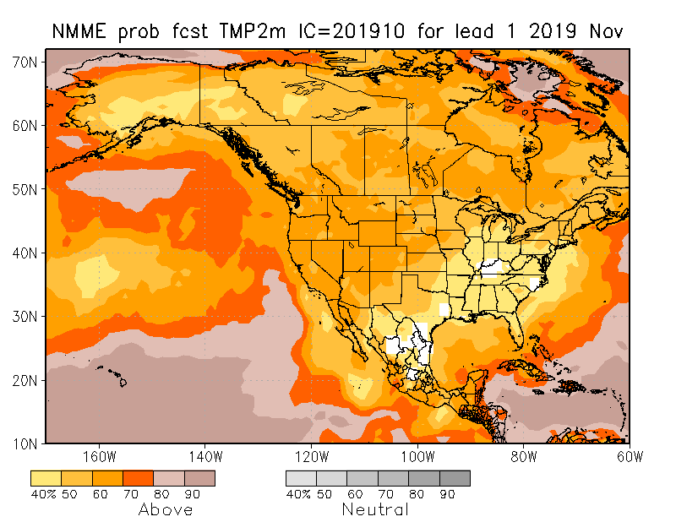
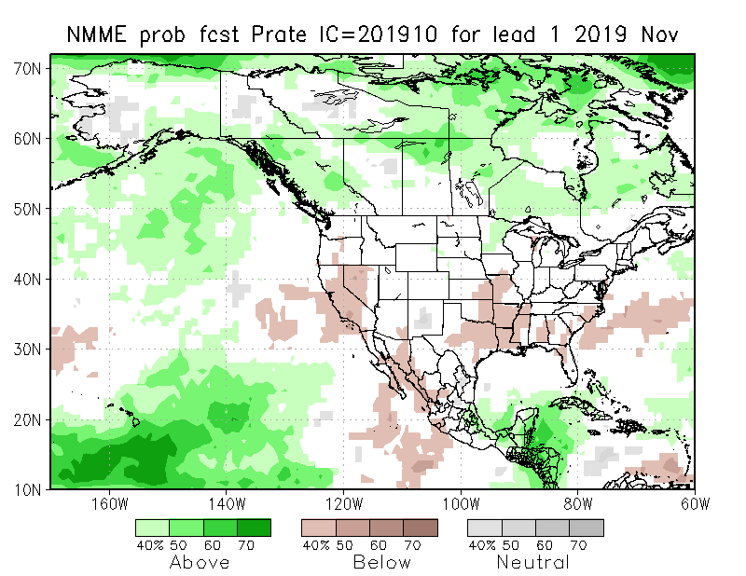
NMME T & P EnsMean forecasts
Nov
NDJ
Back to Red-Dot (warm everywhere!) Forecast for Temperature. Both monthly and seasonal forecasts call for above normal temperatures of various extents across the country.
The forecast precipitation patterns are not anchored to ENSO conditions and so is it reliable?.

Slide 28
The agreement/uncertainty among the diff. NMME models’ forecasts (middle and bottom panels) for Nov-Dec-Jan Precipitation!!!
28

Slide 29
LAST MONTH’s fcst
SPI3, SPI6
& SPI12
Forecasts from 6 NMME Models
(uses obs. P up to past month, and forecast months’ P from NMME models)
?
The goodness and skill of these SPI’s forecasts depend directly on the NMME models’ skill in predicting precipitation!!!

Slide 30
THIS MONTH
SPI3, SPI6
& SPI12
Forecasts from 6 NMME Models
(uses obs. P up to past month, and forecast months’ P from NMME models)
The goodness and skill of these SPI’s forecasts depend directly on the NMME models’ skill in predicting precipitation!!!

Slide 32
http://drought.geo.msu.edu/research/forecast/smi.monthly.php
Predicted Monthly Soil Moisture Percentile
From
Initial Conditions:
10/01/2019
The inter quartile range suggest greater uncertainty about the forecast in these shaded regions.

Slide 33
Precipitation
NASA GEOS 5 Model
Precipitation & Soil Moisture Forecast
Oct 2019
Soil Moisture
Nov 2019
Oct
2019
I.C.
Dec 2019
Dec
2019
Nov 2019

Slide 34
Summary
Current ENSO status and forecast. ENSO-neutral is favored during the Northern Hemisphere fall 2019 (~85% chance), continuing through spring 2020 (55-60% chance). Near-average sea surface temperatures (SST) were evident in the east-central Pacific Ocean during most of September.
Current Drought conditions:
- After having been near record low in terms of areal coverage for drought affected regions across the US during April/May, the extent of abnormally dryness/drought area coverage has been growing during last few months.
The apparent ending of El Nino conditions, and the return of ENSO neutral conditions in the last couple of months, did not help the recent emerging dry conditions in the south. Consequently, the stream flow conditions across the south are weaker this past month than before in the southeast. The moderate to severe drought in the Pacific Northwest & vicinity has gotten considerably better and almost gone.
The emergence of the flash drought (less rainfall + high T) in the southeast during September/October was well forecast. The weak performance of the summer monsoon so far in the southwestern states AZ/NM combined with the remnants of the dryness from previous back to back La Nina events, which really did not go away, has led to dryness in the southwest and contributed to the continued drought like conditions in the four corner states area comprising AZ/UT/CO/NM and TX. California reservoirs, continue to be at better than historically average levels (The El Nino excess rainfall during winter and spring helped!). Fire weather season in California has finally started, but later than it did last year.
Prediction:
Presence of near normal ENSO conditions in the tropical equatorial Pacific, and its near term expected continuation, is not providing any underlying basis or anchor to lower boundary forcing, and hence does not add much confidence to the model’s(NMME) precipitation forecast over the US for the upcoming season.
In this situation, the gradual return towards moderate rainfall calendar months in the southeast during the upcoming forecast season (Nov-Jan), combined with above normal rainfall in the extended range, is likely to lead to the gradual improvement and even possibly the removal of the drought conditions in the southeast.
For approximately the opposite scenario of rainfall conditions in Texas and the southwestern states, the drought in these states is likely to persist and continue through the forecast season.

Slide 35
Miscellaneous maps

Slide 36
Miscellaneous maps

