Slide 1
Drought Outlook Support Briefing October 2020
Climate Prediction Center/NCEP/NOAA
http://www.cpc.ncep.noaa.gov/products/Drought
Phone: 1-877-680-3341
Pwd: 858747#

Slide 2
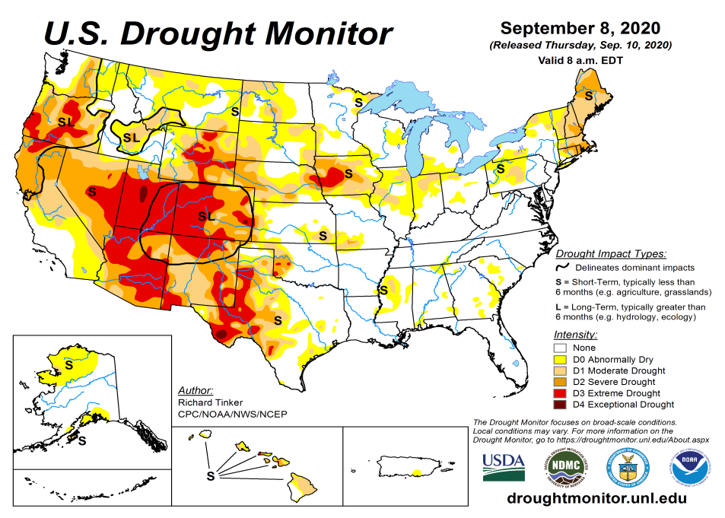
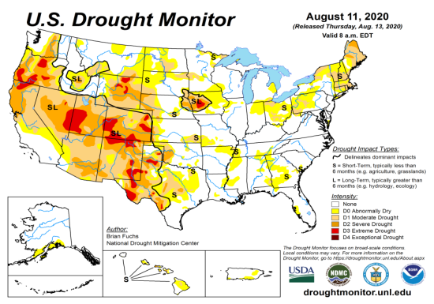
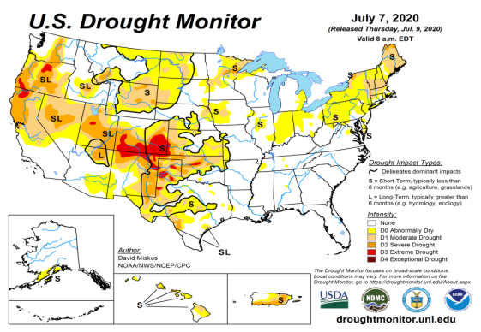
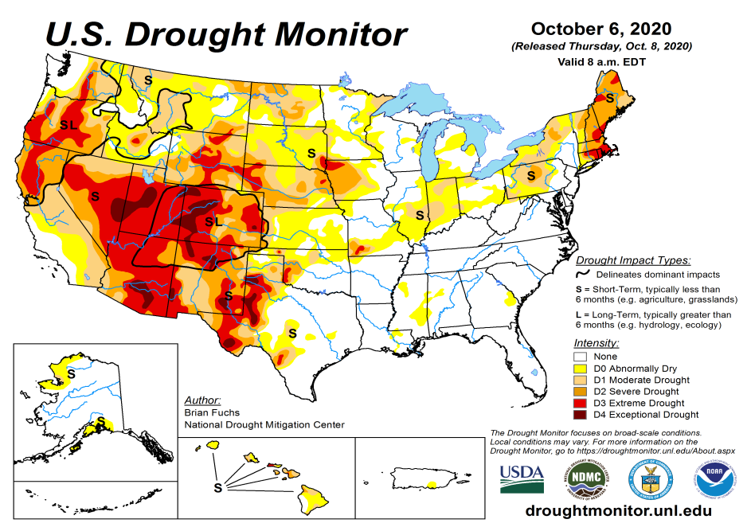
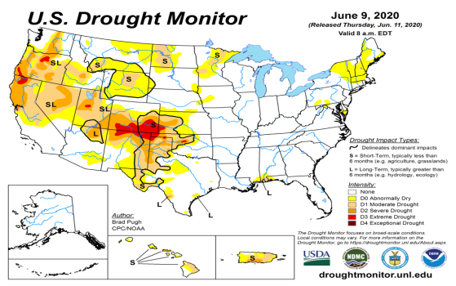
Drought Monitor
Monitoring is important because, unlike US T/P fcsts, for drought forecasts, we have to know where we are, before we can tell where we are going!!
Drought forecasts are tendency forecasts.
September
August
Over the last several months, drought area & severity has overall generally increased across the South West& NW.
Lately, drought has expanded in the western Northern Great plains.
About half of the country is some form of low to severe drought or at least in dry condition.
Drought in the Northeastern states is creeping into parts of NY and PA. The drought in the far NE is extending beyond short term, which is quite unusual for the region.
Recently emerged drought in northern IA and northern Ohio valley states continue..
July
October
(Recent/Latest)
June
February

Slide 3
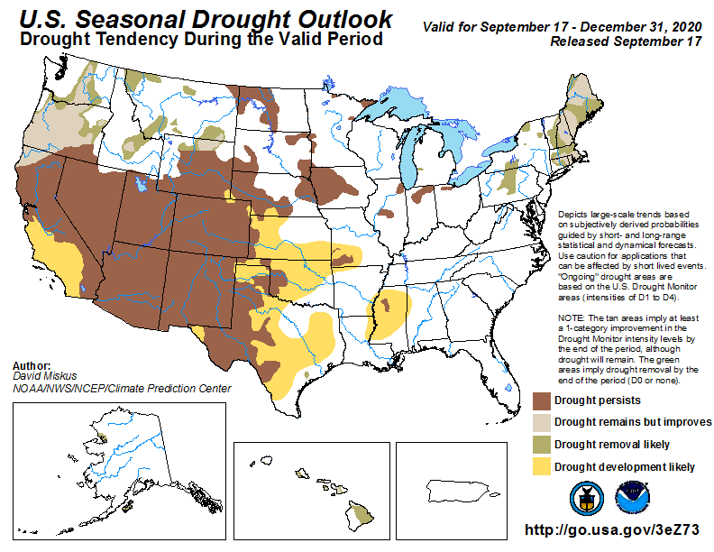
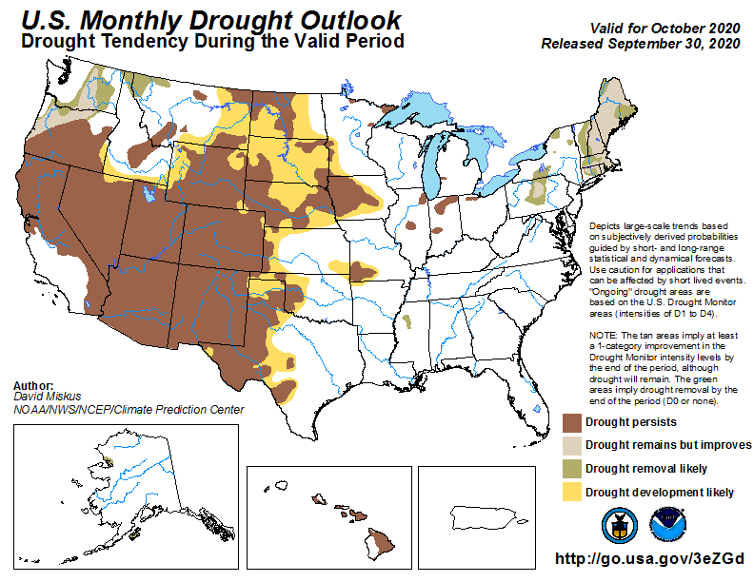
(Prev) Seasonal/Monthly Drought outlooks
(New Seasonal Drought Outlook to be released in 2 days!)
(New Monthly Drought Outlook to be released end of the month)
Seasonal Outlook
(Mid Sep 2020- Dec 2020)
issued 09/17/20
Monthly outlook
(for October 2020)
issued 09/30/20
Much of the western half is in drought. It was not too long ago (~May 2019), the US had almost the lowest coverage of area covered by drought! Approx. < 4% or so. Now it is??
Similar looking Monthly and seasonal outlooks.
Emerging and ongoing La Nina will not help Southern states, due to below normal precip.

Slide 4
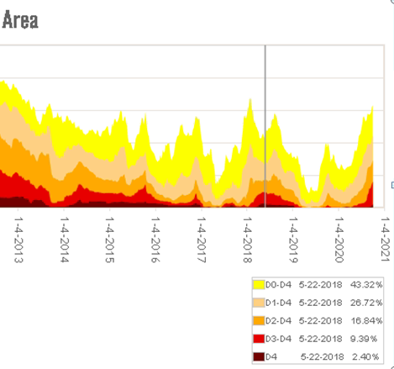

Slide 5
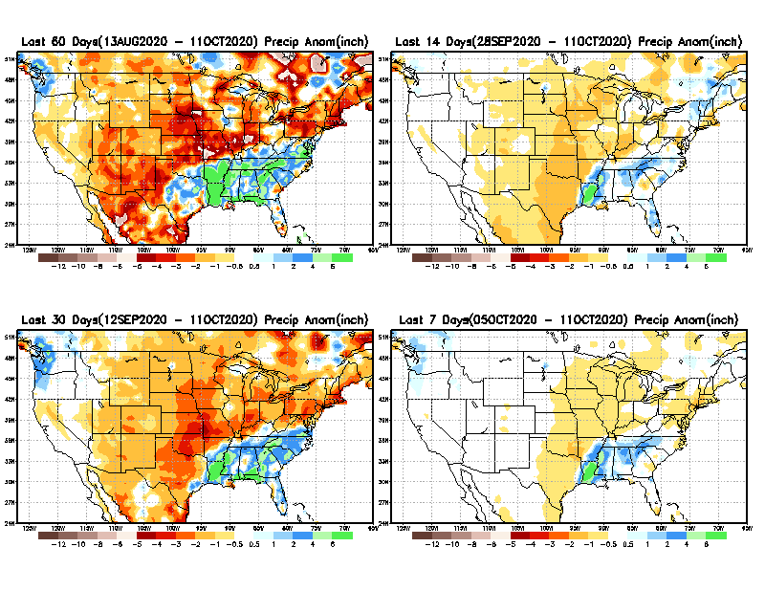
Precipitation ANOM during last 7, 14, 30, & 60 days.
60 Days
14 Days
These maps in this and following slides, including a) Total,
b) Anom and
c) Percent of Normal precip. in these and other longer time ranges are now (routinely) daily updated at:
cf. with USDM
30 Days
7 Days
Alaska regn. was also added here as separate maps recently.
Hur. DELTA
From: Recent Accumulated Precipitation https://www.cpc.ncep.noaa.gov/products/Drought/briefing_prcp.shtml

Slide 6
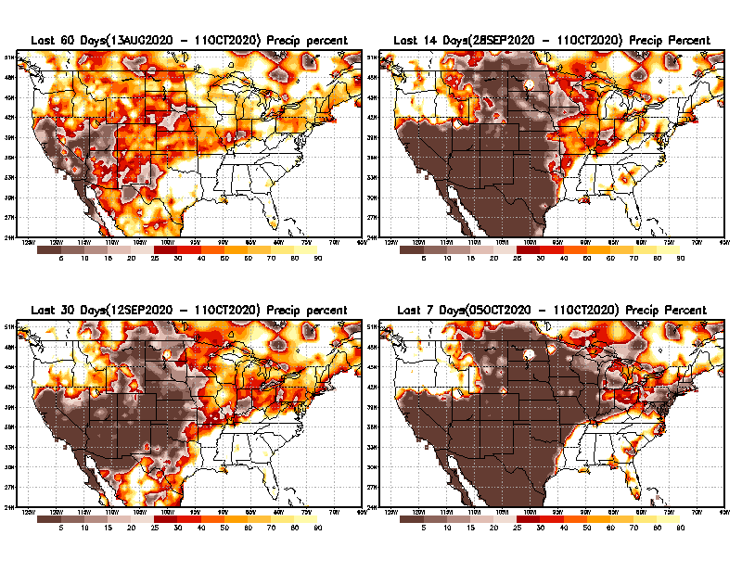
Precipitation Percent during last 7, 14, 30, & 60 days.
60 Days
14 Days
This plot shows only the rainfall deficient regions <= 90% of normal.
-- This shows more clearly possible/likely drought developing region in the future unless there is above normal rainfall in these regions in the future, to offset these shortfalls.
30 days
7 Days
From: Recent Accumulated Precipitation https://www.cpc.ncep.noaa.gov/products/Drought/briefing_prcp.shtml

Slide 7
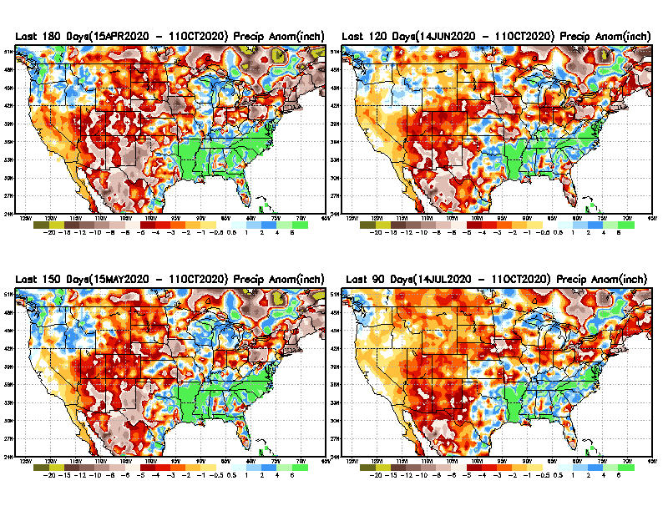
Total precipitation ANOM during last 3, 4, 5, and 6 months.
6 M
4 M
While the Precipitation anomalies deficit may seem large in some regions (compared to others), it is the % of normal precip (next slide) that matters more!!
5 M
3 M
From: Recent Accumulated Precipitation https://www.cpc.ncep.noaa.gov/products/Drought/briefing_prcp.shtml

Slide 8
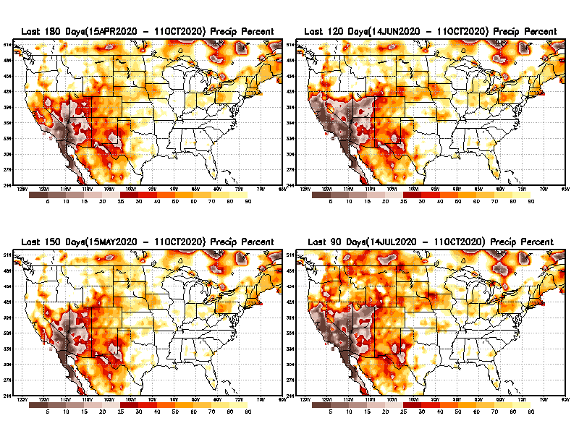
Total precipitation Percent during last 3, 4, 5, and 6 months.
6 M
4 M
In these interim time scale 3-6 months, we need to pay attention to regions, which are dark-brown, red & dark red (<50%).
While accrued precipitation deficits are real & objective,
droughts are subjective declarations!!
5 M
3M
East vs West!
Broad vs Narrow
rainfall season.
In general, West suffers more from frequent and lasting droughts.
With these various rainfall deficits in diff. time ranges, where and how exactly does one declare drought? Other factors (T/SM/E, etc..) do matter, but is cumulative precip. Deficits/percent_of_normal ultimately more important?

Slide 9
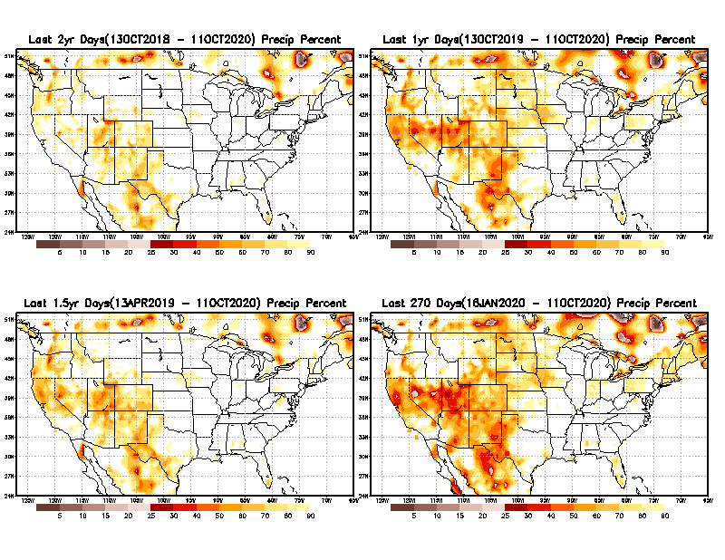
Total precipitation Percent during last 9 months, 1 yr, 1.5yrs, & 2 yrs.
2 Y
1 Y
Tinderbox areas, where some form of longer term rainfall
deficiencies already, exist !!
-Almost all are in the WEST!
-This & Next slide!!
1.5 Y
9 M
These long term P deficits here contribute to & more severe FIRE seasons recently year after year!!
From: Recent Accumulated Precipitation https://www.cpc.ncep.noaa.gov/products/Drought/briefing_prcp.shtml

Slide 10
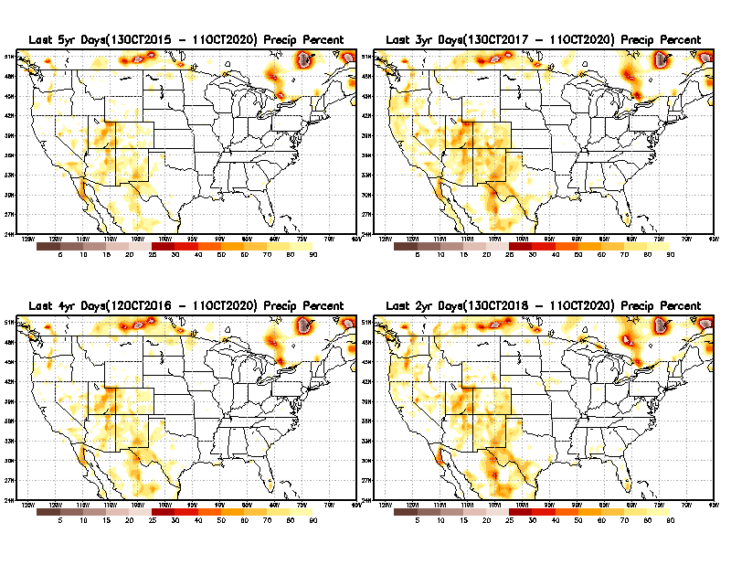
Total precipitation Percent during last 2 yrs, 3 yrs, 4 yrs, & 5 yrs.
5 Y
3 Y
In new format
4 Y
2 Y
In this time range, across the country, there is not any big area where the rainfall is less than 50%.
From: Recent Accumulated Precipitation https://www.cpc.ncep.noaa.gov/products/Drought/briefing_prcp.shtml

Slide 11
Rainy (3-month)Season across the US
East vs West!
More darker colors in regn. central/west => narrow rainy season (months)
Overall, more white space in the east -> distributed rainfall season (except ~FL).

Slide 12
October-least green map!
As if not enough so far, September/October are still climatologically bad months for west coast fire season ☹
*********
EAST vs
CTR/WEST
Behavior in Drought is loosely tied to rainfall climo!!
*********
Adapted from Rich Tinker.

Slide 13
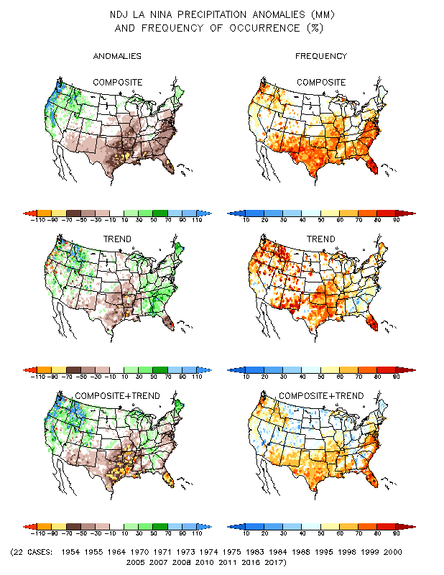
La Nina Precip COMPOSITES & Trend map
JFM
NDJ

Slide 14
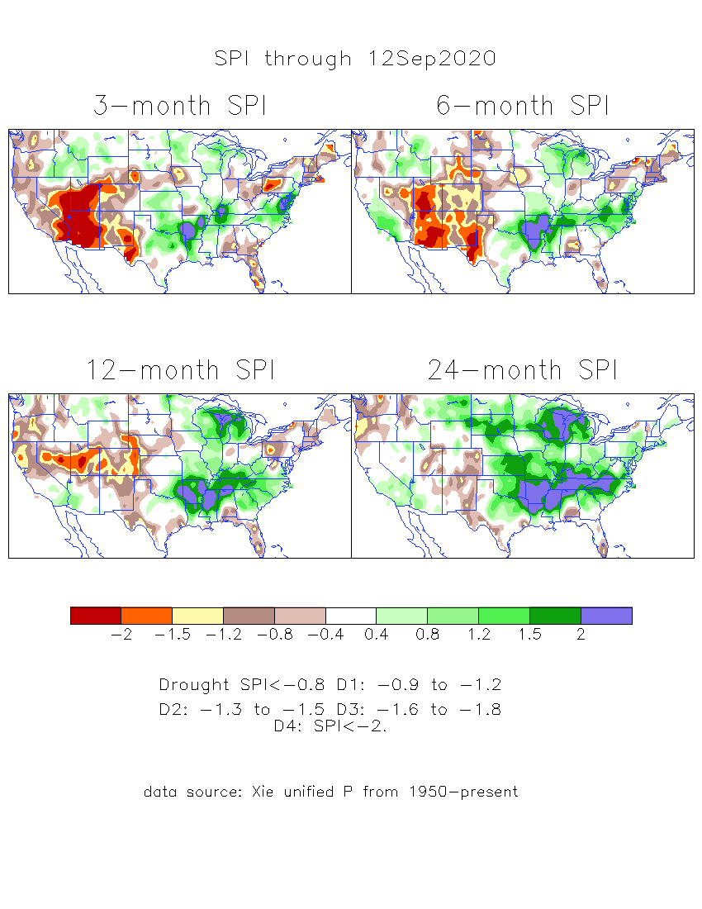
The Standardized Precipitation Index SPI (based on Observed P)
----- Last Month
Very interesting graphic & details for the drought across the US based on the more generalized precip deficit/excess, the Standardized Precipitation Index (SPI).
The dark brown and red colors, indicating standardized precipitation deficits, in the various time periods, approximately correspond to the appropriate short/long term drought monitor regions and their intensities

Slide 15
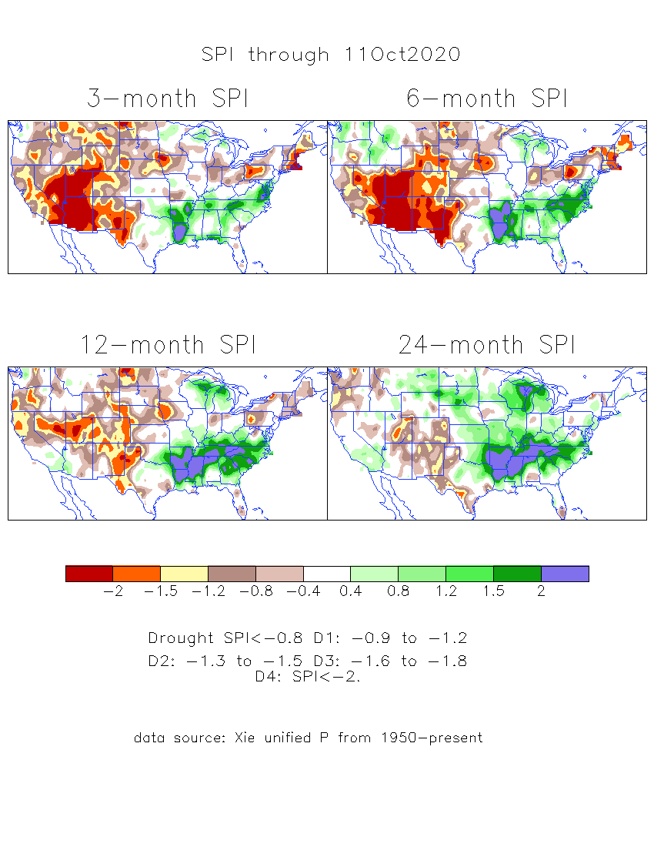
The Standardized Precipitation Index SPI (based on Observed P)
----- NOW
Very interesting graphic & details for the drought across the US based on the more generalized precip deficit/excess, the Standardized Precipitation Index (SPI).
The dark brown and red colors, indicating standardized precipitation deficits, in the various time periods, approximately correspond to the appropriate short/long term drought monitor regions and their intensities
----- NOW
How does one negotiate and reconcile declaring short term vs long term drought when precip. deficiencies patterns differ on many different time scales locally!!
What is the cutoff delineating time between short VS long term drought!!

Slide 16
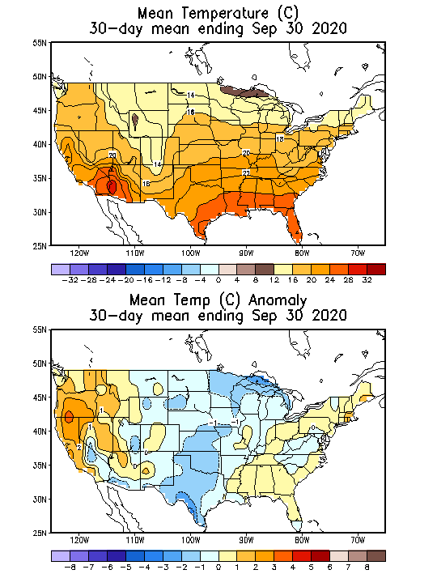
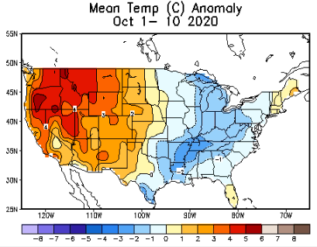
Recent US Temperatures

Slide 17
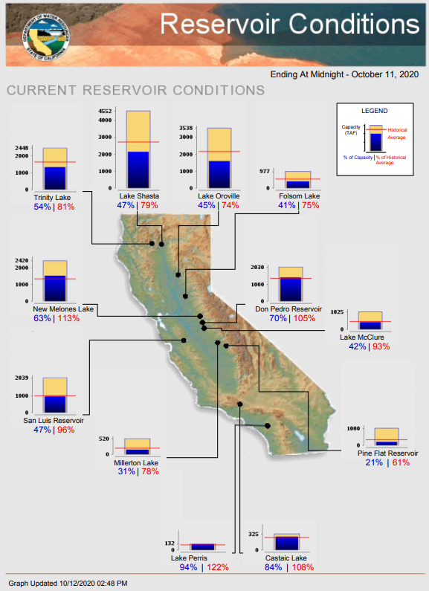
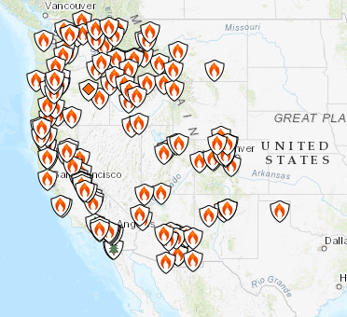
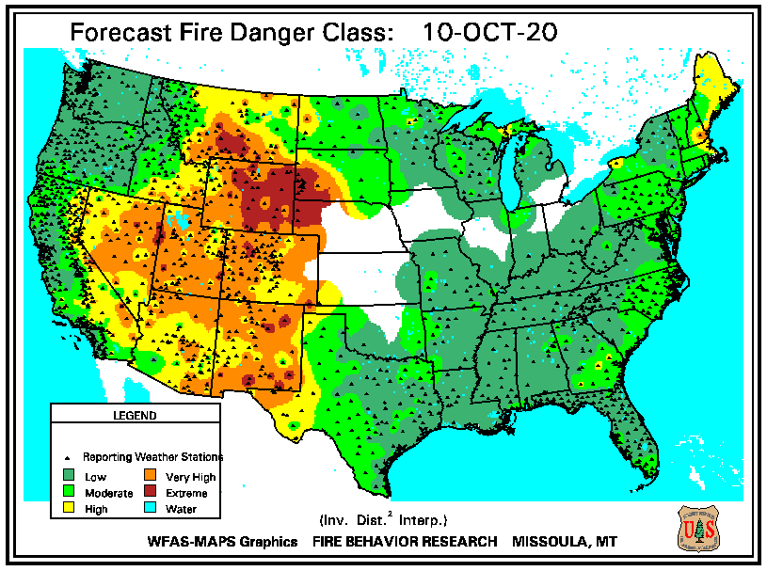
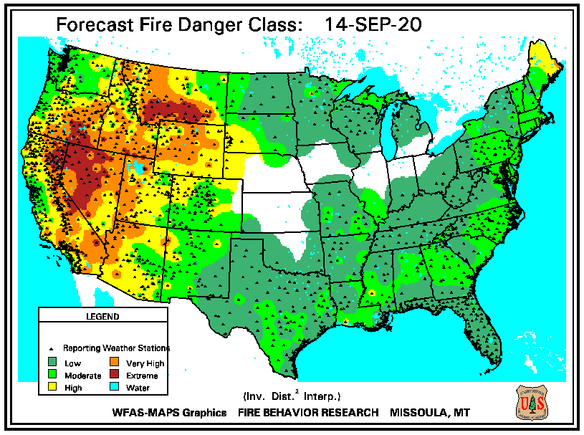
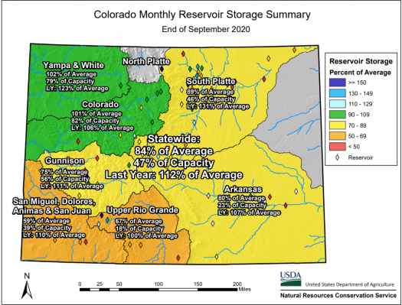
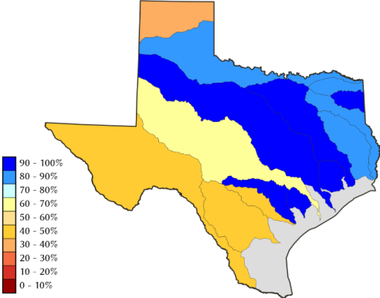
October 12, 2020
Currently, 74 large fires have burned 4.2 million acres in 12 states. To date, 45,517 wildfires have burned 8,073,238 acres
https://fsapps.nwcg.gov/
https://inciweb.nwcg.gov/
THIS MONTH
LAST MONTH
https://inciweb.nwcg.gov/
TX
CO
Some/many of California reservoirs levels are below their historical average levels. La Nina is here atleast thru DJF ☹

Slide 18
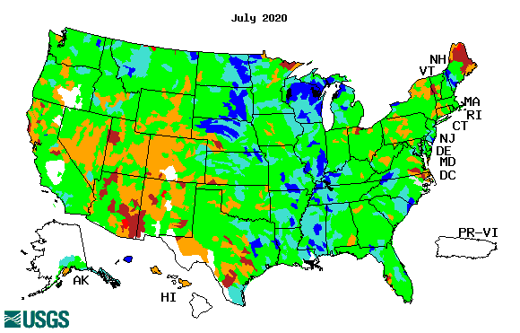
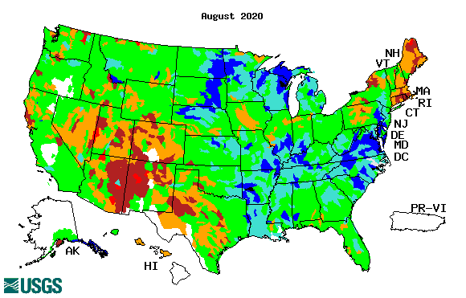
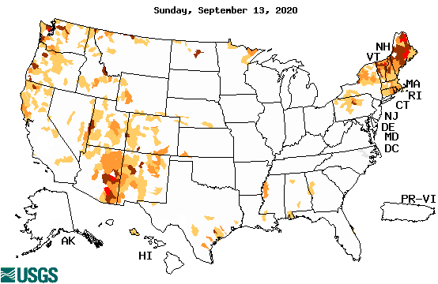
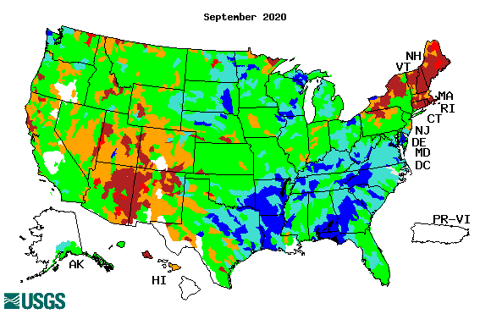
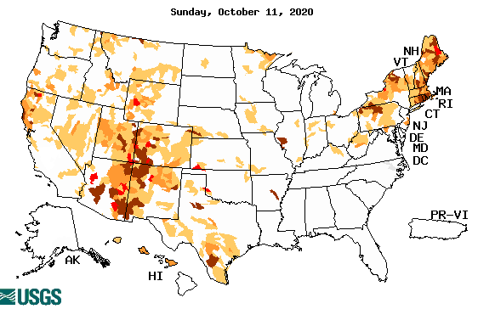
Streamflow (USGS)
Worse conditions in the southwest, in the monsoon region.
Northeast still under drought.
Pacific NW much improved now.
Map shows only below normal 7-day average streamflow compared to historical streamflow for the day of year.
One month ago (left) &
Now (below)
18

Slide 19
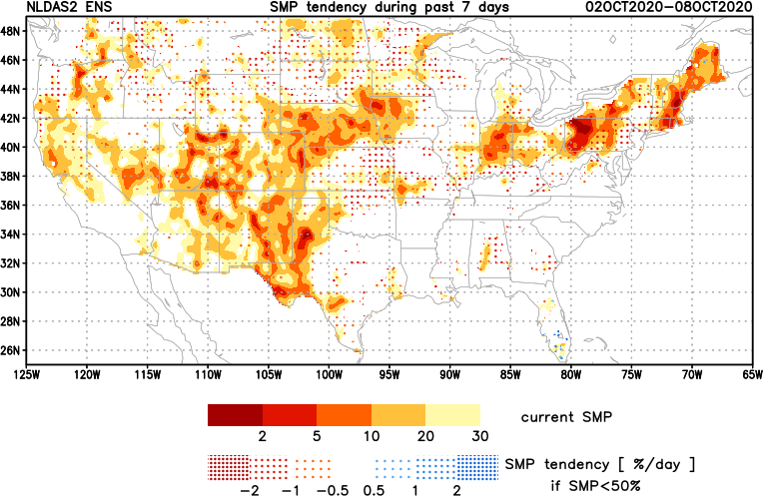
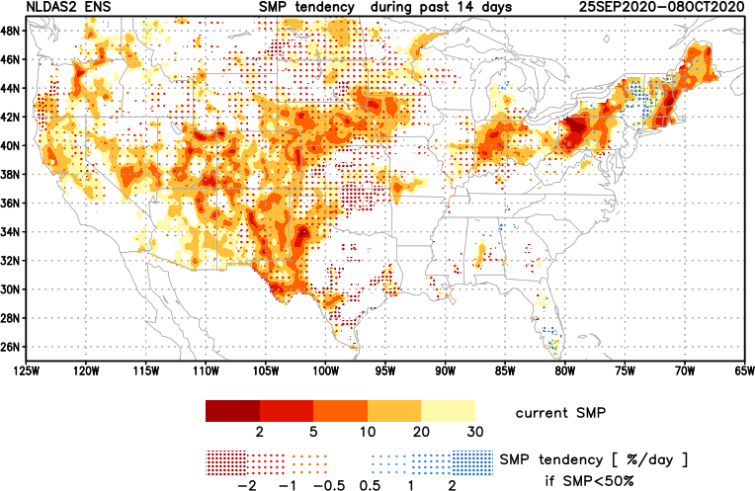
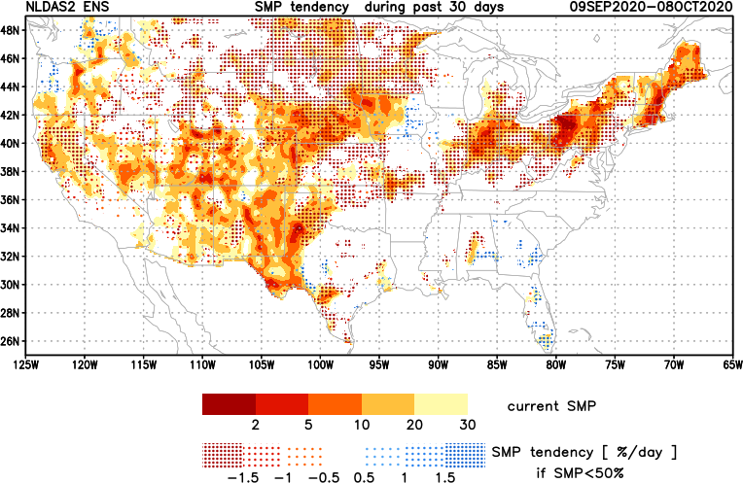
[Now]
NCEP Ensemble mean NLDAS2 models’ Soil Moisture tendency/trend
7 days
14 days
30 days
Overall, during the past month, lots of yellow/red across the country – that is -ve soil moisture tendency – that is drying!
Almost, almost, no areas of blue/moistening..

Slide 20
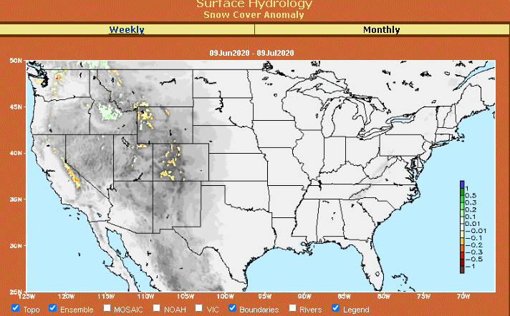
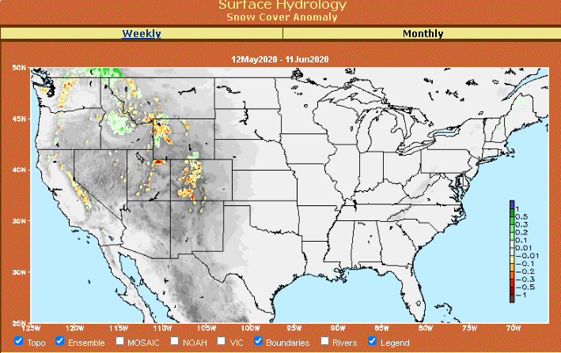
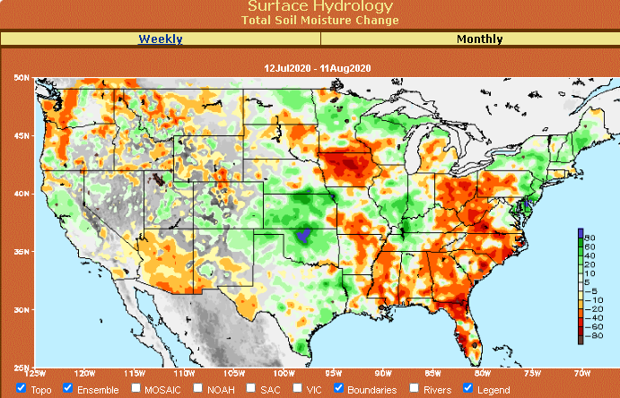
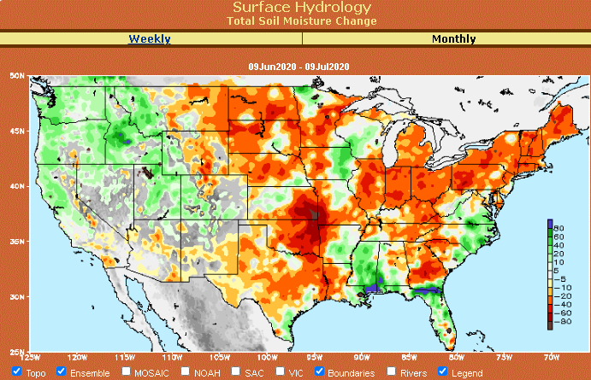
Snow cover & Soil Moisture Anomalies
Snow cover
SLIDE
NOT SHOWN!
Last month ~ this time
Now
Look further for areas of drought development

Slide 21
EL NIÑO/SOUTHERN OSCILLATION (ENSO)
DIAGNOSTIC DISCUSSION
issued by CLIMATE PREDICTION CENTER/NCEP/NWS and the International Research Institute for Climate and Society
8 October 2020
ENSO Alert System Status: La Nina Advisory
Synopsis: La Niña is likely to continue through the Northern Hemisphere winter 2020-21 (~85% chance) and into spring 2021 (~60% chance during February-April).

Slide 22
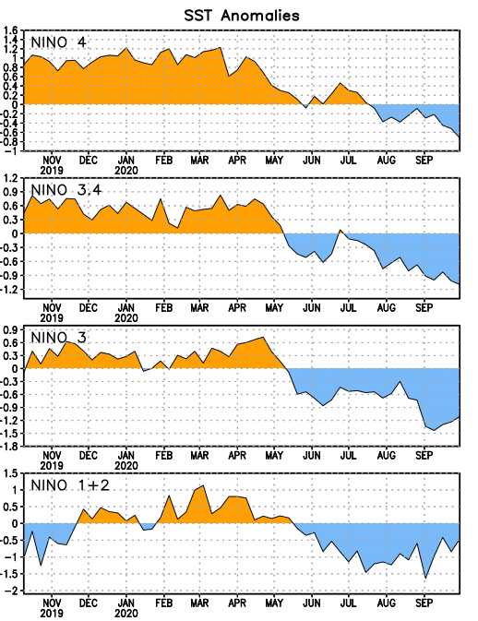
Latest values of SST indices in the various Nino Regions.
This is the most blue! (cold) in all 4 indices (see left) in a while. Subsurface ocean heat anomalies are also cold!!

Slide 23
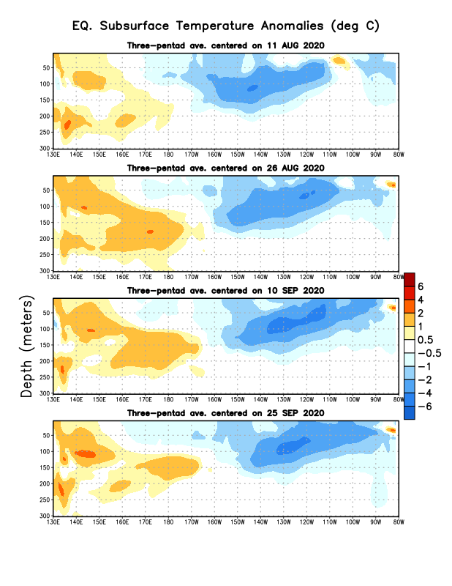
Sub-Surface Temperature Departures in the Equatorial Pacific
Central and eastern tropical SST and subsurface exhibit cold La Nina conditions!! Finally La Nina is officially in place!!
Warm sub-surface cold anomalies is (almost) nowhere in the eastern tropical Pacific ocean.
Most recent pentad analysis

Slide 24
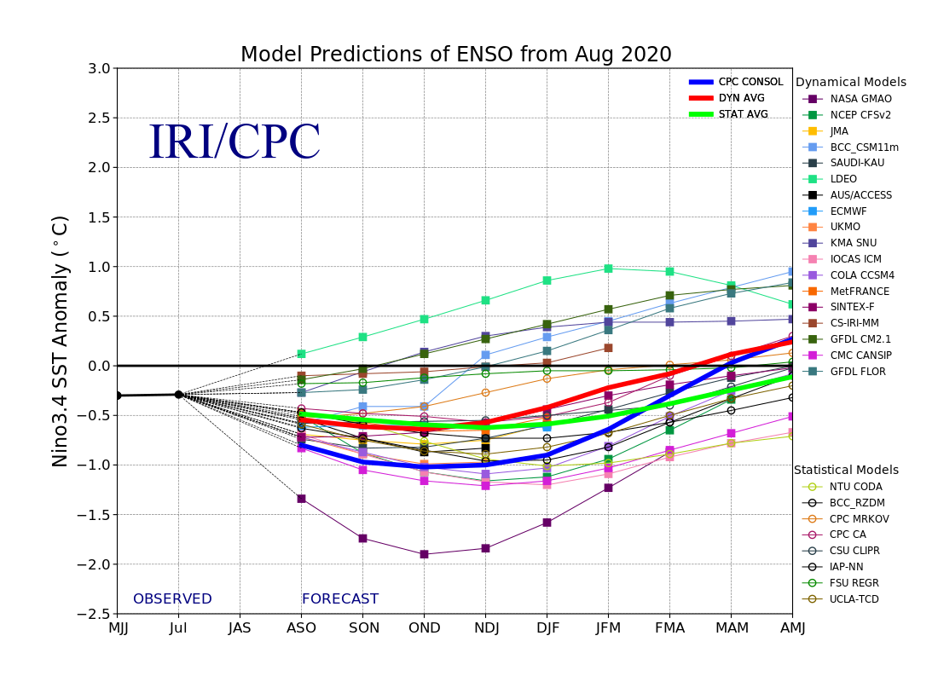
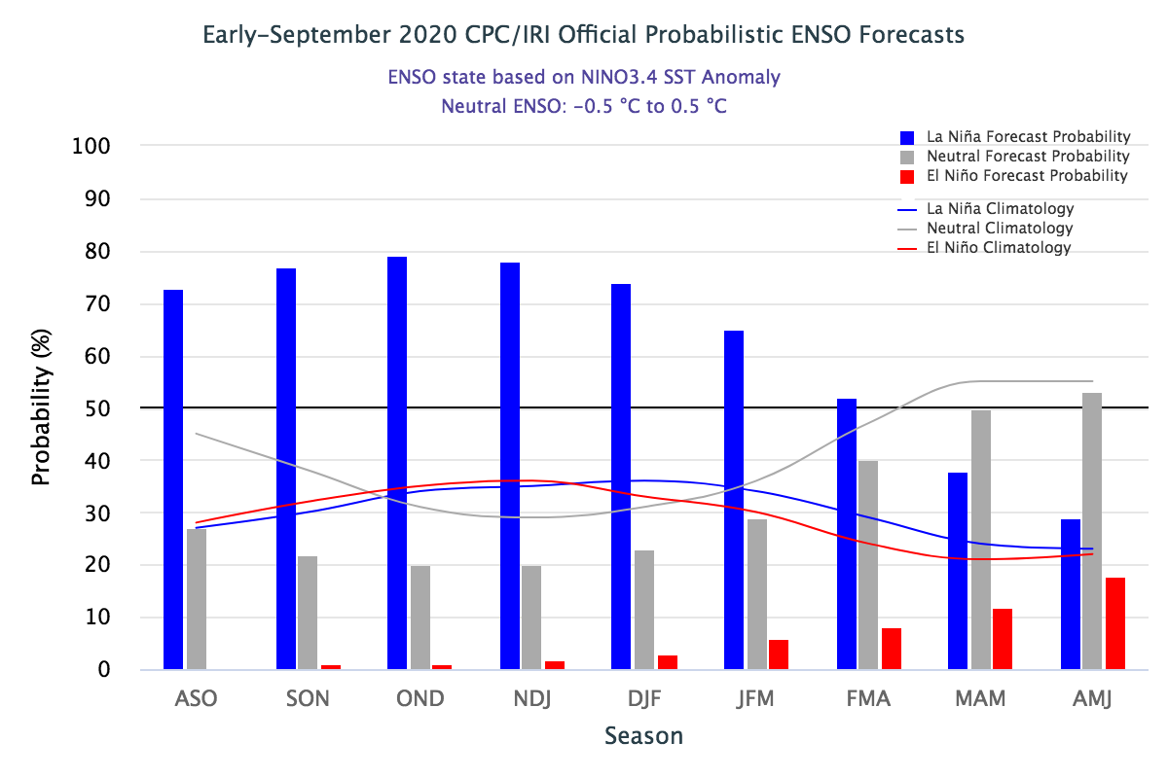
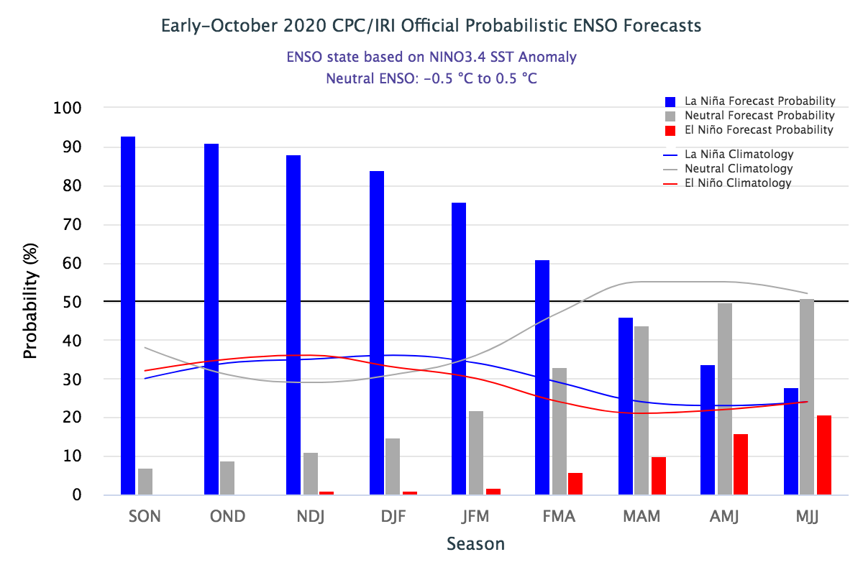
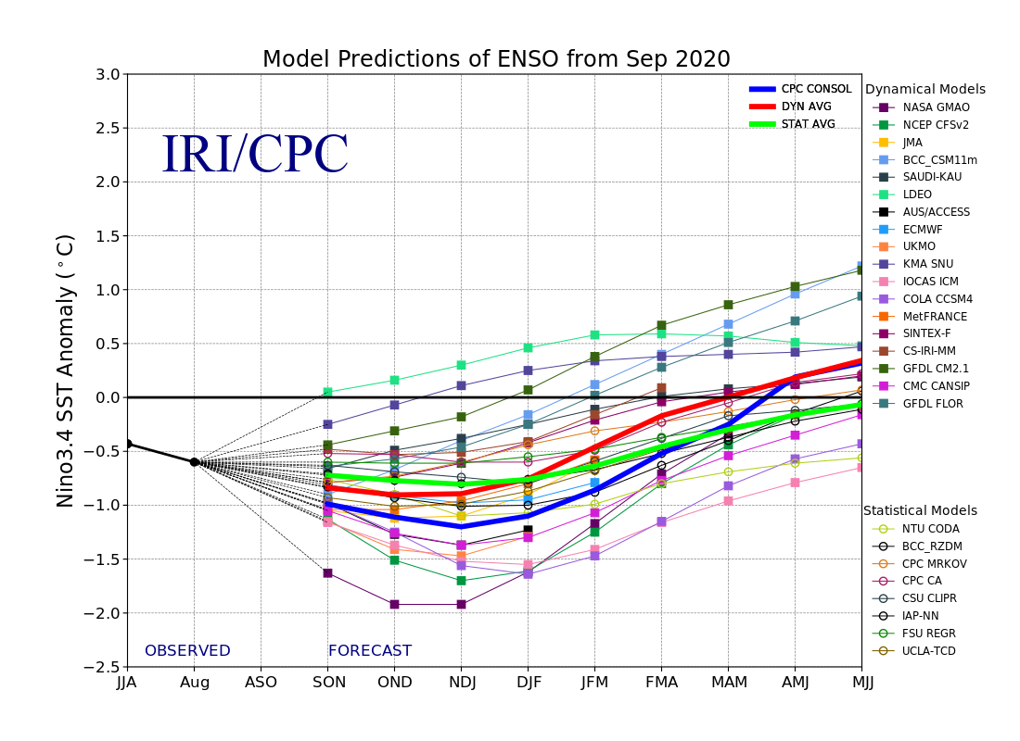
ENSO Forecasts
Early- September CPC/IRI forecast
Early- October CPC/IRI forecast
NDJ < -1 C
The long awaited La Nina is finally here and ongoing! > 90 %
And hopefully the expected Canonical impacts!!

Slide 25
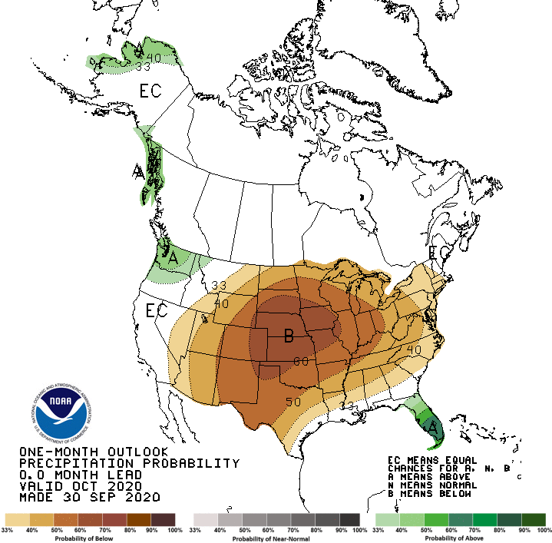
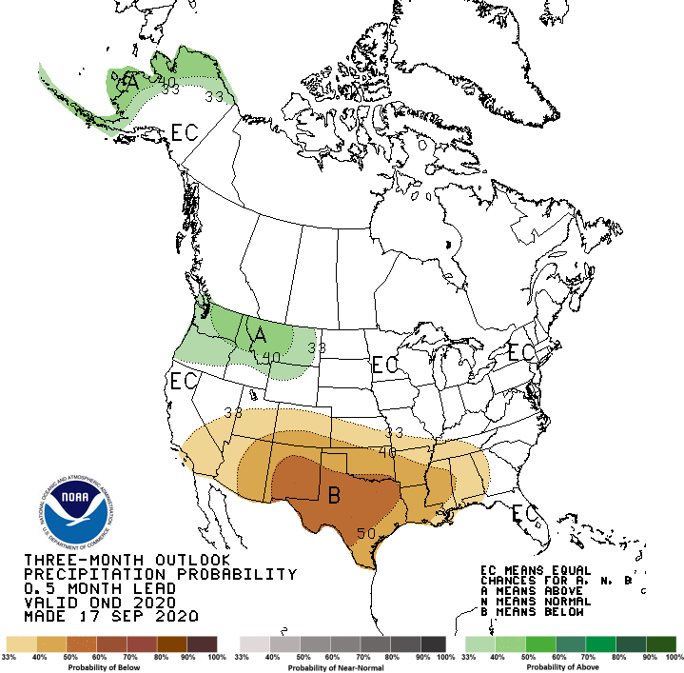
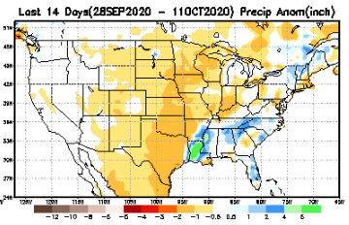
Released Sep 30th
Previous(Last month)
CPC’s official
Precipitation OUTLOOK for Monthly (Oct)/Seasonal (OND)
Released Sep 17th
Observed so far this month!!
Monthly P/T forecasts verified at mid-month are generally good! Why? ☺ (becoz they r mostly based on GFS’ 2-wk fcsts)
But this month, so far ????

Slide 26
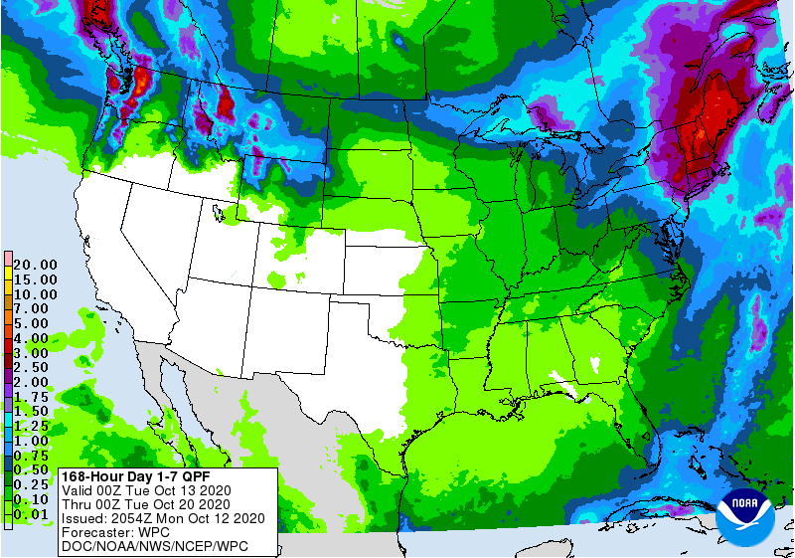
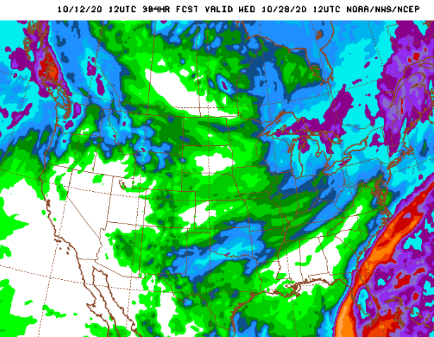
WPC Next 7 days QPF Forecast
GFS Model Guidance for next 16 days.
No rainfall in the short term – where the drought is severe. Much of the US drought is in the West.
Recall the monsoon also failed this year..
Some relief possible in the upper North West and far North East(3-6 “).

Slide 27
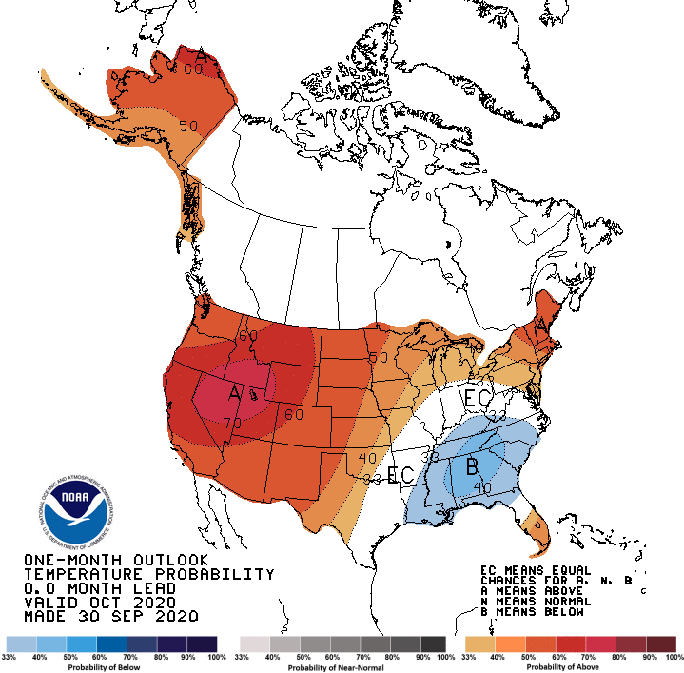
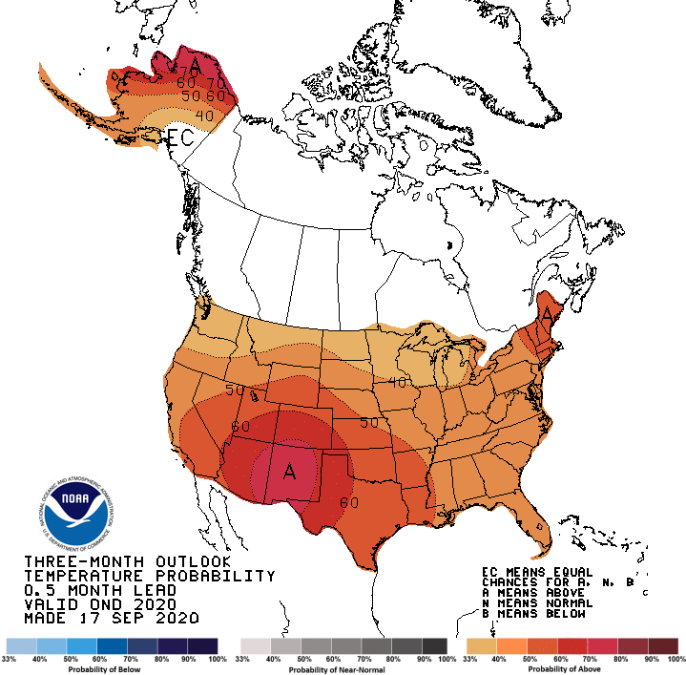
Made
Sep 30th
Previous (Last Month)
CPC’s official
Temperature outlook for Monthly (Oct)/Seasonal (OND)
Made Sep 17th
Observed so far this month!! ☺

Slide 28
NMME T & P Ens.Mean forecasts
Nov
These NMME models always make these red (warmer T) forecasts.
NDJ
The forecast P pattern is the expected canonical La Nina composite, with dry relative conditions in the
South.

Slide 29
Agreement/Disagreement in the various NMME models’ NDJ seasonal Precip. Forecast.
??

Slide 30
SPI6 Fcst made from last month(background) compared with this month(foreground, red border)
Forecast uncertain in Hatched areas.
The SPI6 fcsts made last month vs. this month based on NMME models’ precip fcst. suggests continuation of drought in the south and west, in the upper Midwest, BUT improving conditions in the Pacific NW and ? NE ? There is the possibility of developing dry/drought conditions in the SE by end of fcst season.

Slide 31
Latest Initial Conditions:
10/06/2020
http://drought.geo.msu.edu/research/forecast/smi.monthly.php
Predicted Monthly Soil Moisture Percentile
MSU stopped updating 06/10/20 ☹
Initial Conditions 1 month ago:
09/08/2020
The inter quartile range suggest greater uncertainty about the forecast in these shaded regions.

Slide 32
Summary
Current Drought conditions:
Over the last several months, drought area & severity has overall generally increased across the South West& NW.
Lately, drought has expanded in the western Northern Great plains.
About half of the country is some form of low to severe drought or at least in dry condition.
Drought in the Northeastern states is creeping into parts of NY and PA. The drought in the far NE is extending beyond short term, which is quite unusual for the region.
Recently emerged drought in northern IA and northern Ohio valley states continues.
Some/many of California reservoirs levels are below their historical average levels. It is going to be tough with the above normal Temperature forecast for the region and of course with the La Nina expected to continue through upcoming winter!
Just last May, US had almost the lowest coverage of area covered by drought! approx.< 4% or so. Now more than 50% of the country is under drought!
Current ENSO status and forecast:
La Niña is likely to continue through the Northern Hemisphere winter 2020-21 (~85% chance) and into spring 2021 (~60% chance during February-April).
Prediction:
The long awaited La Nina is now finally here and ongoing with some much needed lower boundary condition, in the form of extensive cold surface and subsurface temperature conditions in the tropical Pacific, so, our confidence in model’s forecasts is increased. The models forecast less than normal rainfall across the southern tier states for the NDJ season. By the end of the forecast season more (than now) of the US could be under some level of drought!
These below normal rainfall conditions combined with higher than normal temperatures will make the drought persist and may even get worse in the upcoming season. The drought in northern CA, NV, UT and western TX will persist may even get worse. But the Pacific Northwest is likely to get better due to seasonal and enhanced precipitation associated with La Nina, and hence some relief from dryness and drought.
The drought conditions in the northeastern states continues to defiantly hang in there against our earlier expectations. The drought conditions here are likely to get slightly better, but drought will remain & continue.
Existing developing dry/drought conditions in NE/IA border, and IN, OH and parts of PA will likely improve.
The seasonal (lack of) rainfall, combined with even less than that normal rainfall conditions (due to La Nina) in Florida and adjacent border SE state areas could develop drought by the end of the NDJ season. *********************

Slide 33
Miscellaneous maps

Slide 34
Miscellaneous maps

