Slide 1
Drought Outlook Support Briefing October 2021
Climate Prediction Center/NCEP/NOAA
http://www.cpc.ncep.noaa.gov/products/Drought

Slide 2
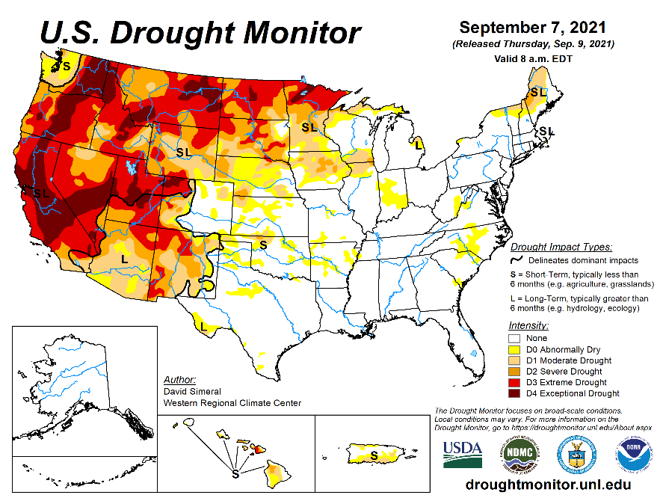
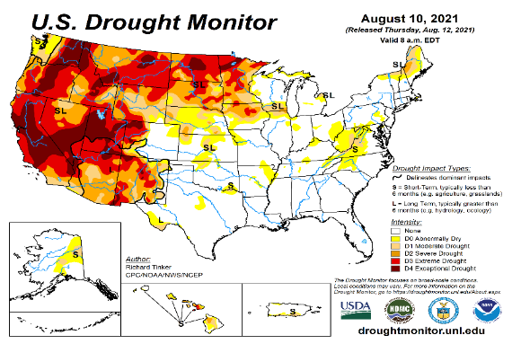
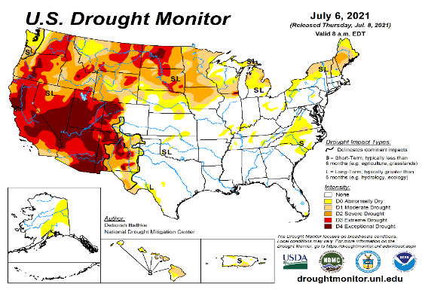
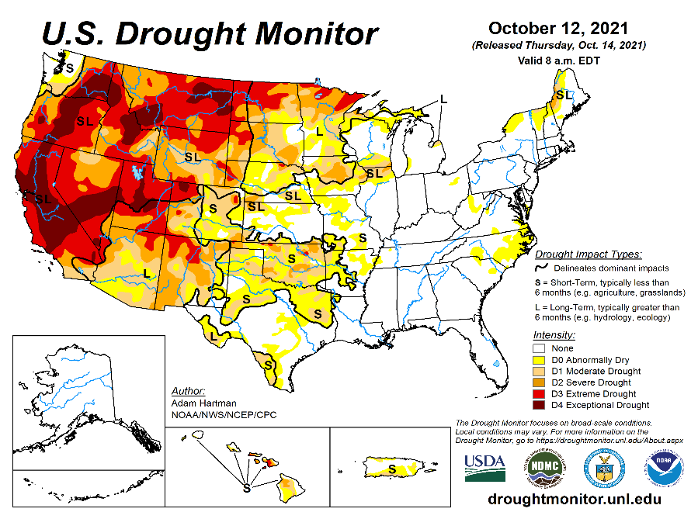
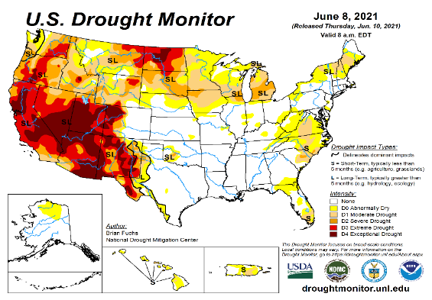
Drought Monitor
Monitoring is important because, unlike US T/P fcsts, for drought forecasts, we have to know where we are, before we can tell where we are going!! Drought forecasts are tendency forecasts.
September
August
Unlike last year, due to the much better SW monsoon rainfall this year, improvement is broadly seen in the short term drought conditions (cf. June/July USDM) now in the four corners states area, NV and vicinity as was also correctly forecast. But Long term drought worries still prevails sporadically across the region due to the ongoing multi year drought in the region.
The fire season has considerably lessened/ended in the southwest, largely due to the monsoon rains.
But conditions have worsened and shifted further west into CA, and northwest into OR, WA, ID, as well as into the Northern Great plains states of MT, the Dakotas and MN. Mild drought has also expanded into NE and IA.
New short term drought (?)(3 vs 6 months ?) development in the South (TX, OK & KS). But climatology and developing La Nina may in fact worsen and extend drought across the South!!
October
(Recent/Latest)
June
?

Slide 3
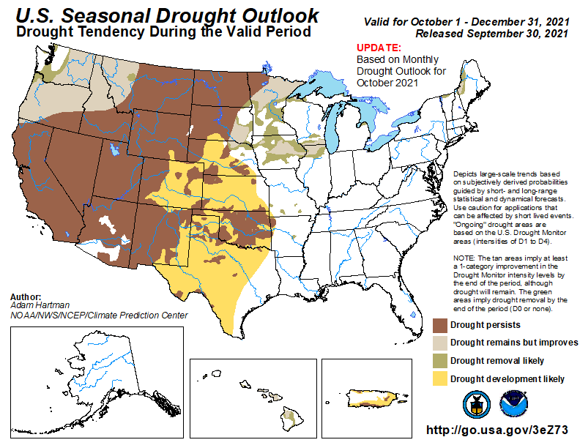
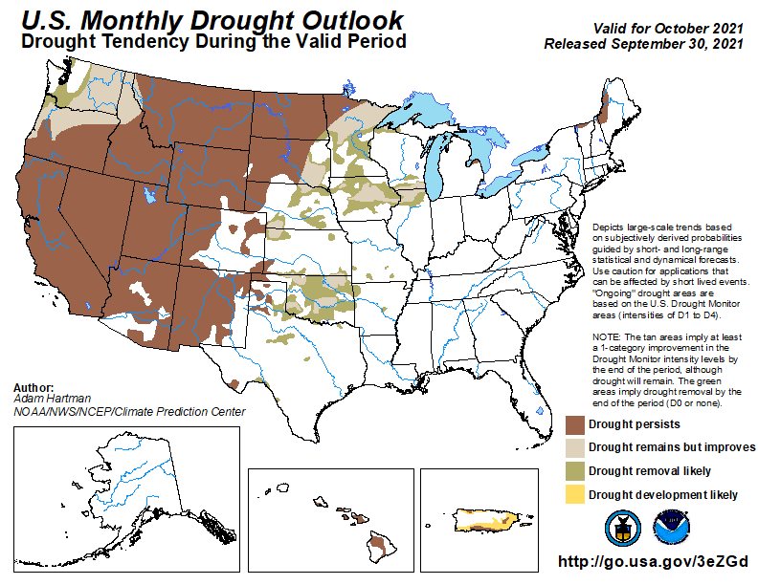
(Previous) Seasonal/Monthly Drought outlooks
New Seasonal+ Drought Outlook to be released in 2 days!
New Monthly Drought Outlook to be released end of this month)
Updated Seasonal Outlook
(Oct. 2021- Dec 2021)
issued 09/30/21
Monthly outlook
(for September 2021)
issued 08/31/21
Why drought development was not forecast last month for October along eastern NM & western TX ? But in the seasonal forecast? Will see later!!!

Slide 4
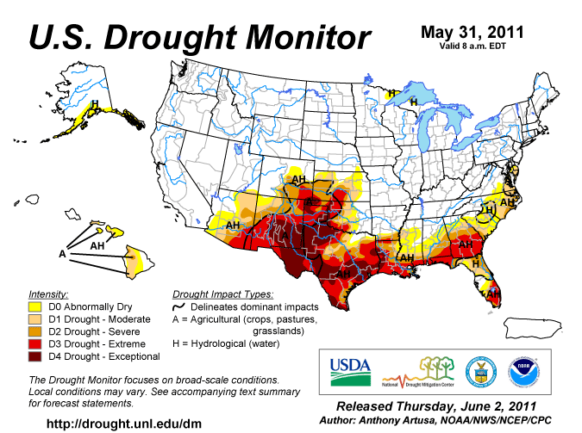
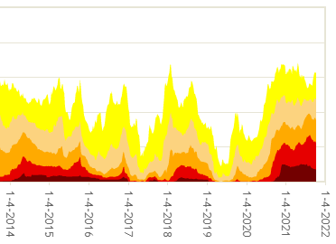
Famous 2011 TX drought
The recent drought has somewhat stagnated ?
Now!
Most area continuously under severe D3/D4 drought for a long time since 2000? (Long Term drought!) West vs East contrast in Drought areas!!

Slide 5
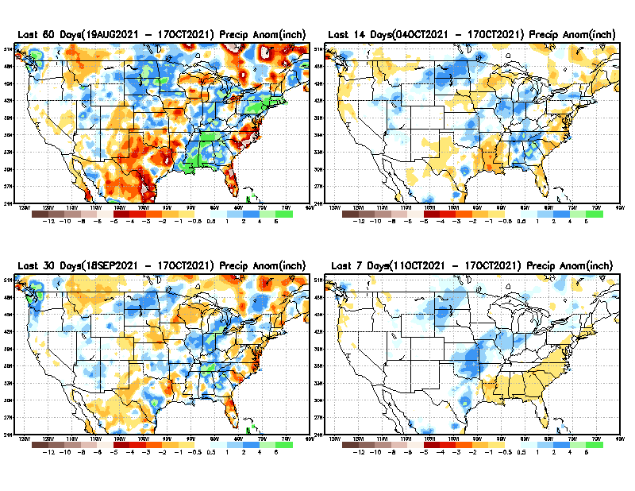
Precipitation ANOM during last 7, 14, 30, & 60 days.
This and next few slides show Precip deficit (excess).
Droughts, for the MOST part, begin and end with precip!! Lately, Temps are becoming (secondarily) important as well.
60 Days
14 Days
?
30 Days
7 Days
These maps in this and following slides, including a) Total,
b) Anom and
c) Percent of Normal precip. in these and other longer time ranges are now (routinely) daily updated at:
?
From: Recent Accumulated Precipitation https://www.cpc.ncep.noaa.gov/products/Drought/briefing_prcp.shtml

Slide 6
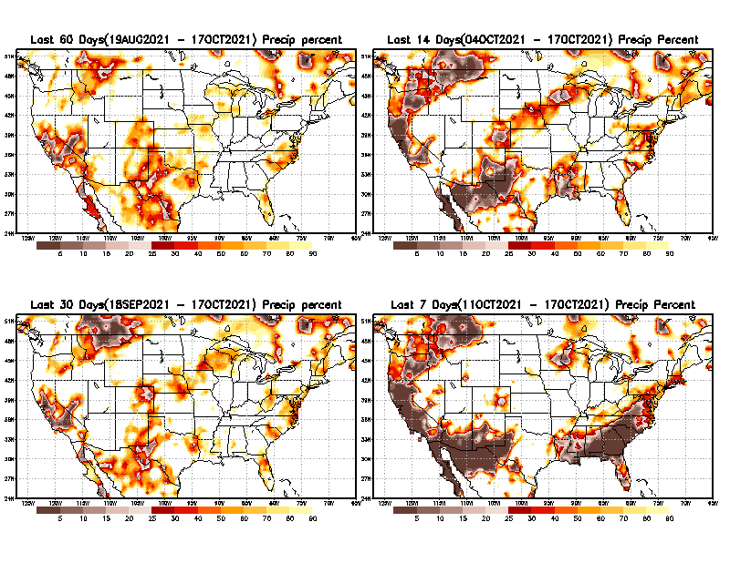
Precipitation Percent (of normal) during last 7, 14, 30, & 60 days - Only Deficit Areas <=90% shown !
60 Days
14 Days
This plot shows only the rainfall deficient regions <= 90% of normal.
-- This shows more clearly possible/likely drought developing region in the future unless there is above normal rainfall in these regions in the future, to offset these shortfalls.
30 days
7 Days
From: Recent Accumulated Precipitation https://www.cpc.ncep.noaa.gov/products/Drought/briefing_prcp.shtml

Slide 7
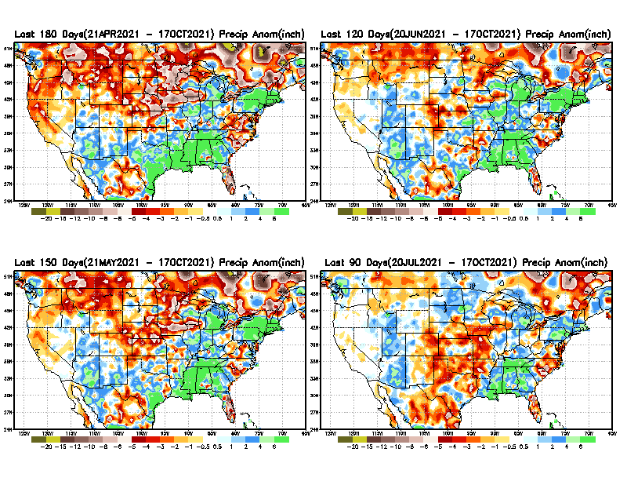
Total precipitation ANOM during last 3, 4, 5, and 6 months.
6 M
4 M
While the Precipitation anomalies deficit may seem large in some regions (compared to others), it is the % of normal precip (next slide) that matters more!!
5 M
3 M
From: Recent Accumulated Precipitation https://www.cpc.ncep.noaa.gov/products/Drought/briefing_prcp.shtml

Slide 8
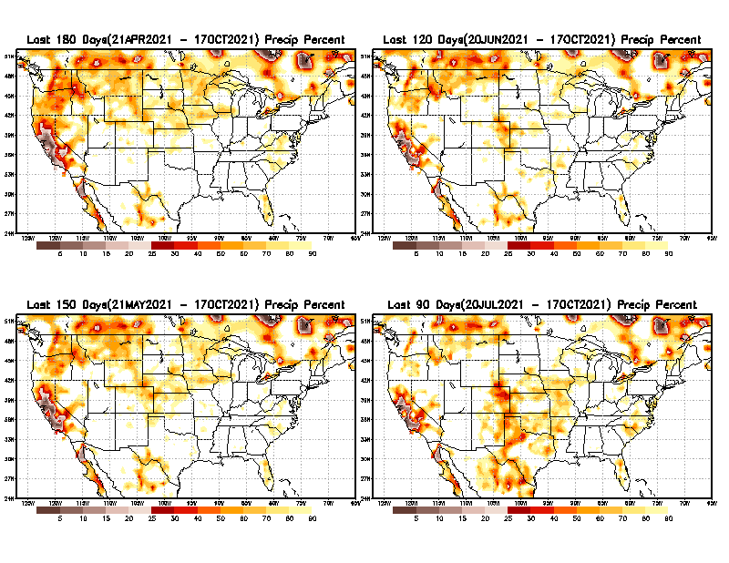
Total precipitation Percent (of normal) during last 3, 4, 5, and 6 months Only Deficit Areas <=90% shown!!
6 M
4 M
In these interim time scale 3-6 months, we need to pay attention to regions, which are dark-brown, red & dark red (<50%).
Not so bad along coast!
in %
While accrued precipitation deficits are real & objective,
droughts are subjective declarations!!
5 M
3M
East vs West!
Broad vs Narrow
rainfall season.
In general, West suffers more from frequent and lasting droughts.
Short term(S) Drought is generally declared when rainfall deficits exist in the 3-6 months time range. { Long term deficits beyond 1 or 2 years is Long term L drought! }

Slide 9
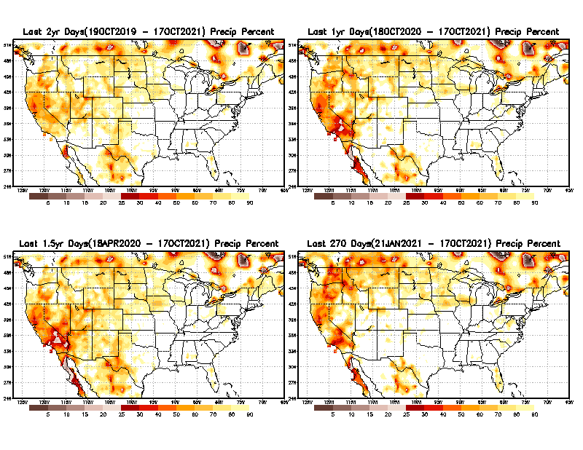
Total precipitation Percent during last 9 months, 1 yr, 1.5yrs, & 2 yrs. .–Only Deficit Areas shown!! <=90%
2 Y
1 Y
Tinderbox areas, where some form of longer term rainfall
deficiencies already, exist !!
-Almost all are in the west!, all part of the long term drought
-This & Next slide!!
1.5 Y
9 M
From: Recent Accumulated Precipitation https://www.cpc.ncep.noaa.gov/products/Drought/briefing_prcp.shtml

Slide 10
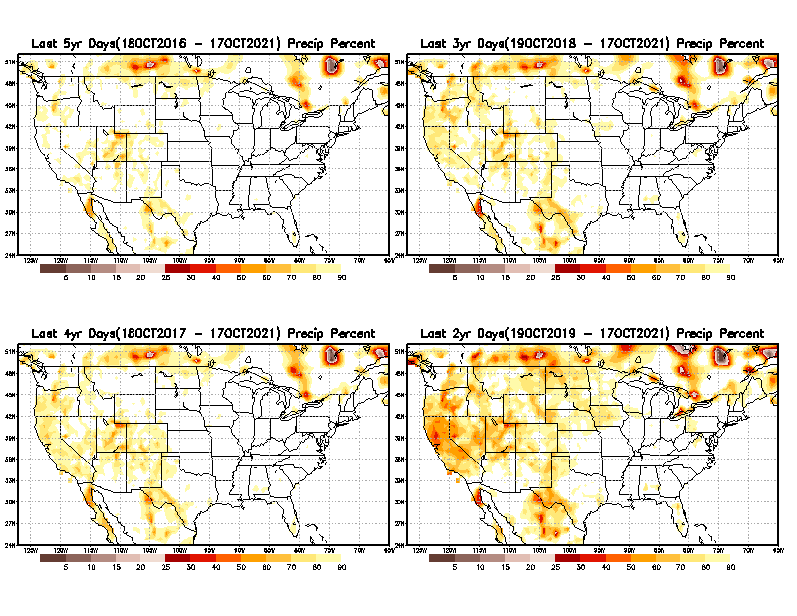
Total precipitation Percent (of normal) during last 2, 3, 4, & 5 yrs. .–Only Deficit Areas <=90% shown !!
5 Y
3 Y
In these long time ranges (2-5 yrs), there is a general dearth/lack of precipitation in the southwest US. – where the current severe drought ravages!!.
If the La Nina returns later in the year, things will get even worse for the southwest!!
4 Y
2 Y
Ongoing multiyear drought in the SouthWest!! Getting Worse.
Last few years, each year is a new record for the Fire Season!!
From: Recent Accumulated Precipitation https://www.cpc.ncep.noaa.gov/products/Drought/briefing_prcp.shtml

Slide 11
Rainy (3-month)Season across the US
NDJ –Large rainfall deficits in the middle of country and SE!
East vs West!
More darker colors in west/central => narrow rainy season (months)
Overall, more white space in the east => distributed rainfall season (except ~FL).

Slide 12
SON season, difficult season for drought forecast? Also transition-ing ENSO?
OCT - Month with the least WHITE & GREEN!
*********
EAST vs
CTR/WEST
Drought Behavior is loosely tied to rainfall climo!! And the limited rainy season in the west
*********
Adapted from Rich Tinker.

Slide 13
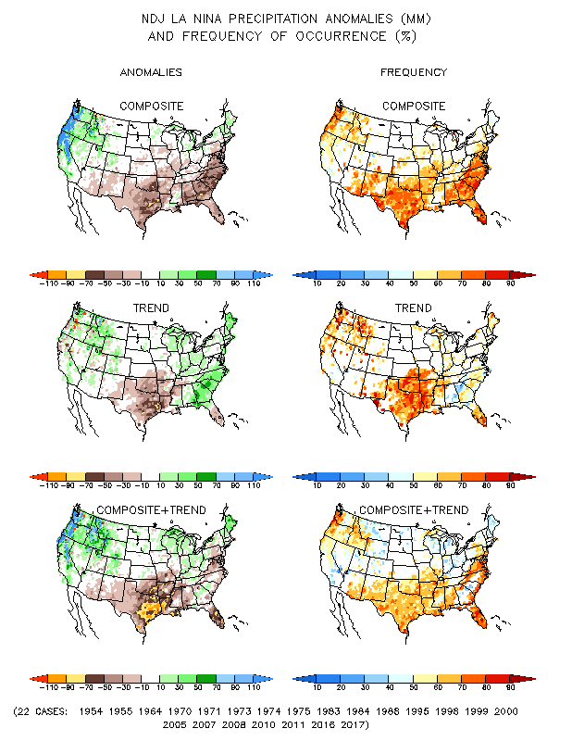
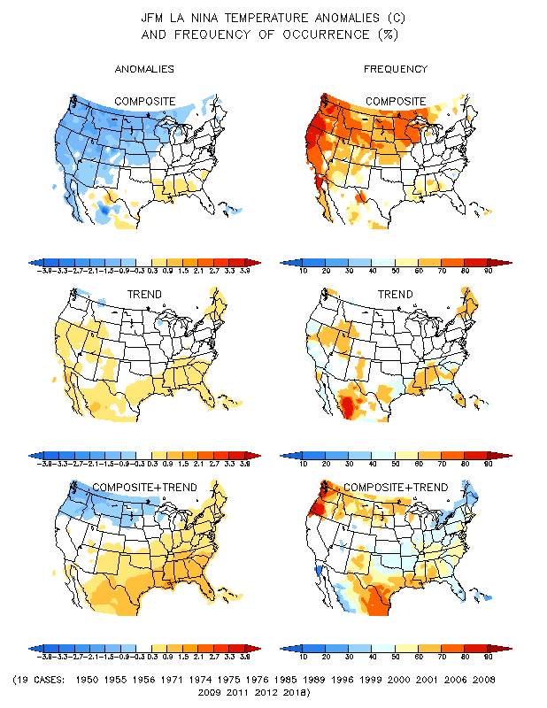
La Nina Precip/Temperature COMPOSITES & Trend map
NDJ
P
T
With expected ENSO-cold conditions, this row is relevant!!

Slide 14
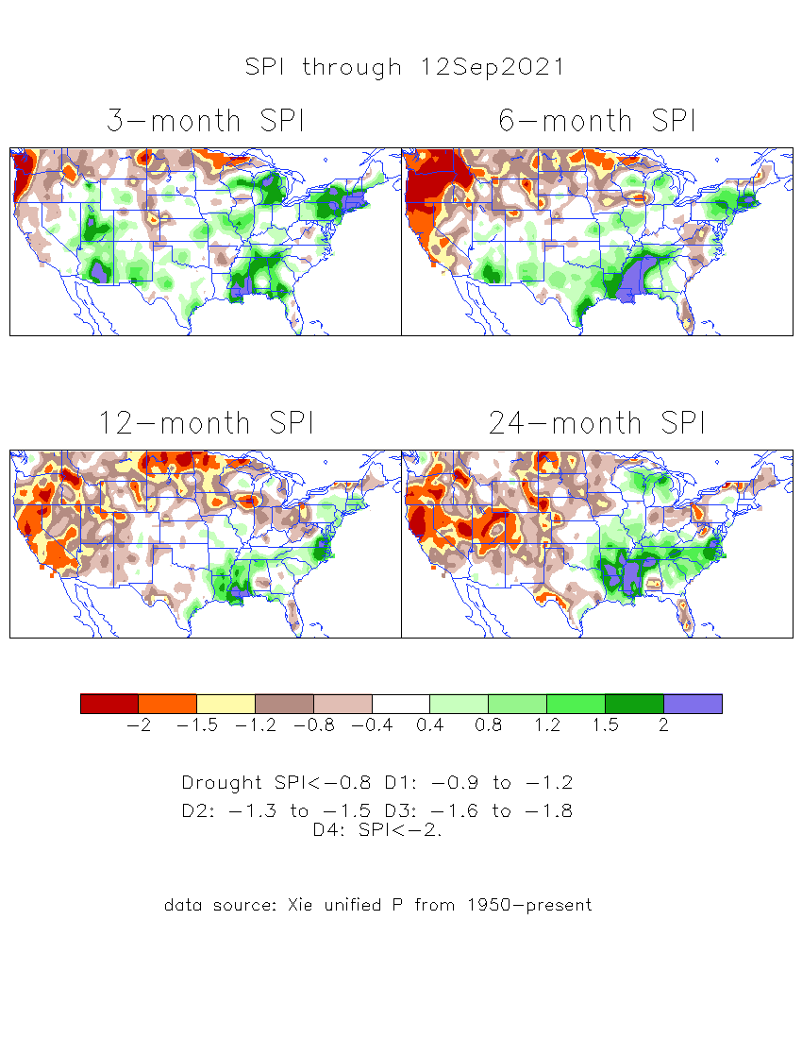
The Standardized Precipitation Index SPI (based on Observed P)
----- Last Month
Very interesting graphic & details for the drought across the US based on the more generalized precip deficit/excess, the Standardized Precipitation Index (SPI).
The dark brown and red colors, indicating standardized precipitation deficits, in the various time periods, approximately correspond to the appropriate short/long term drought monitor regions and their intensities
Why drought development was not forecast last month for October along eastern NM & western TX ?

Slide 15
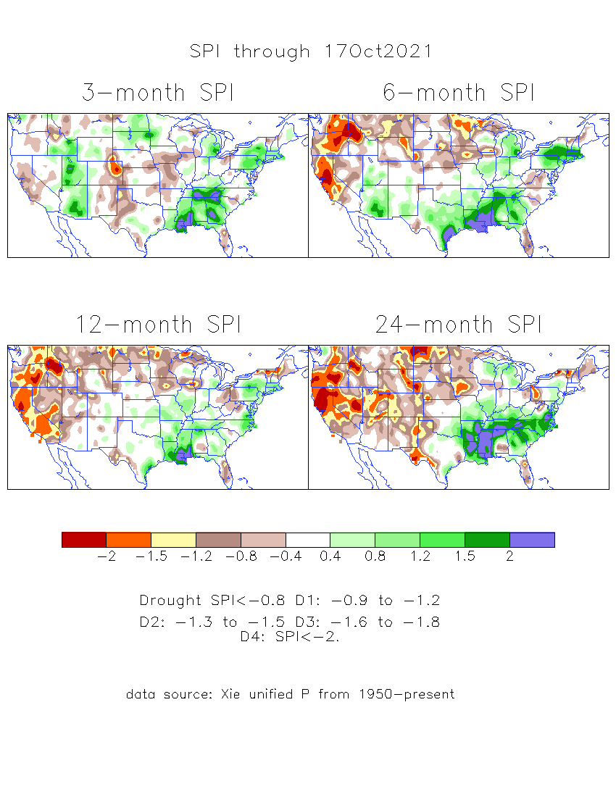
The Standardized Precipitation Index SPI (based on Observed P)
----- NOW
Very interesting graphic & details for the drought across the US based on the more generalized precip deficit/excess, the Standardized Precipitation Index (SPI).
The dark brown and red colors, indicating standardized precipitation deficits, in the various time periods, approximately correspond to the appropriate short/long term drought monitor regions and their intensities
Short
The short term drought has somewhat shifted/extended from southwest to northwest and the northern Plains. But the long term drought in the southwest remains.
----- NOW
Long
How does one negotiate and reconcile declaring short term vs long term drought when precip. deficiencies patterns differ on many different time scales locally!!
What is the cutoff delineating time between short VS long term drought!!
At exactly where does drought begin?

Slide 16
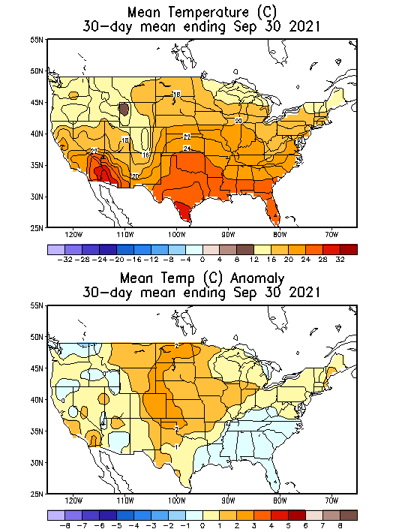
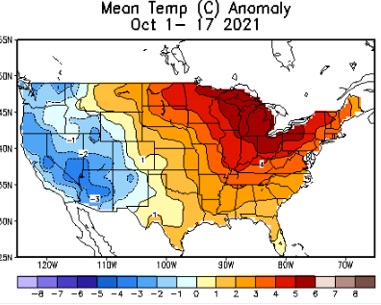
Recent US Temperatures
So far this month !!

Slide 17
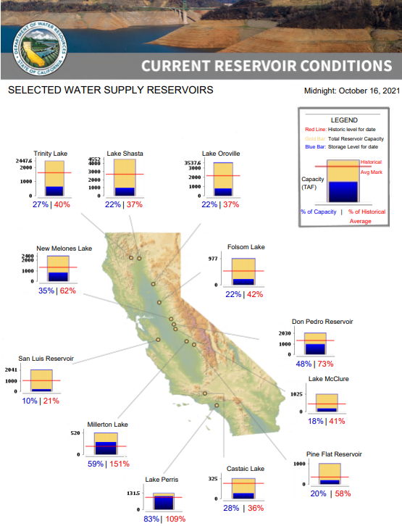
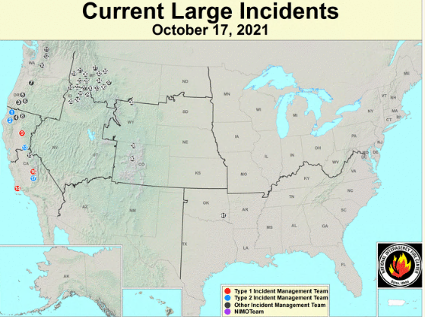
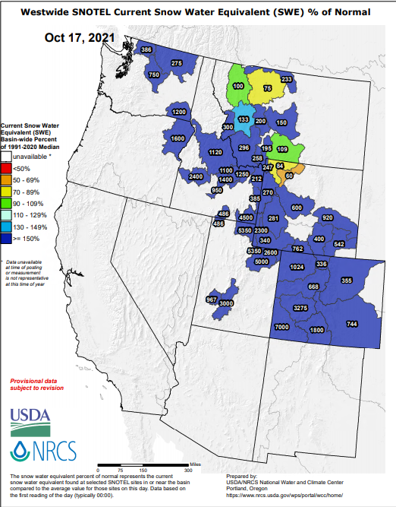
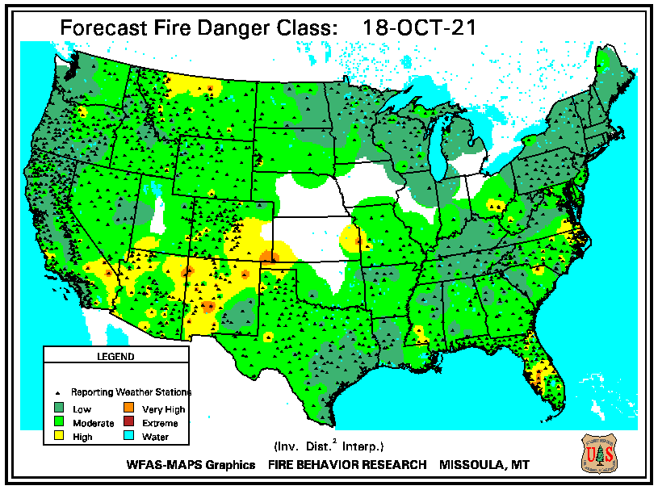
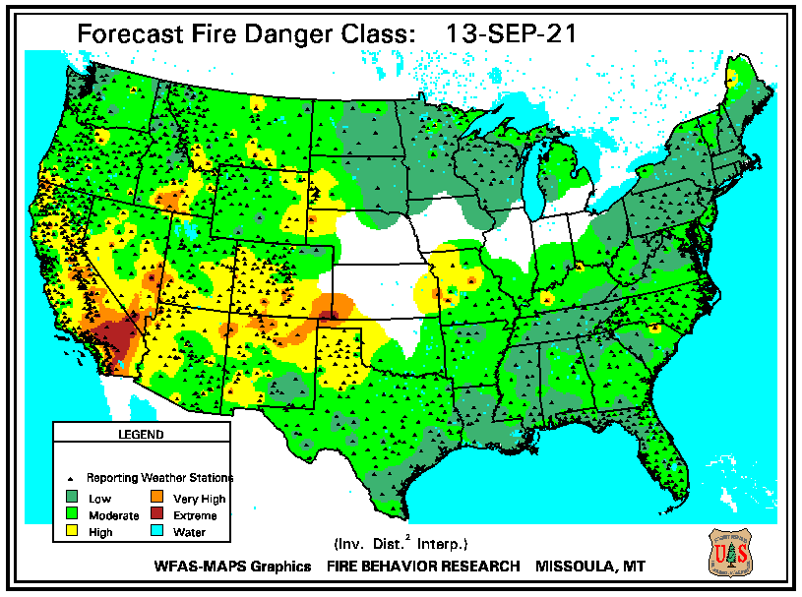
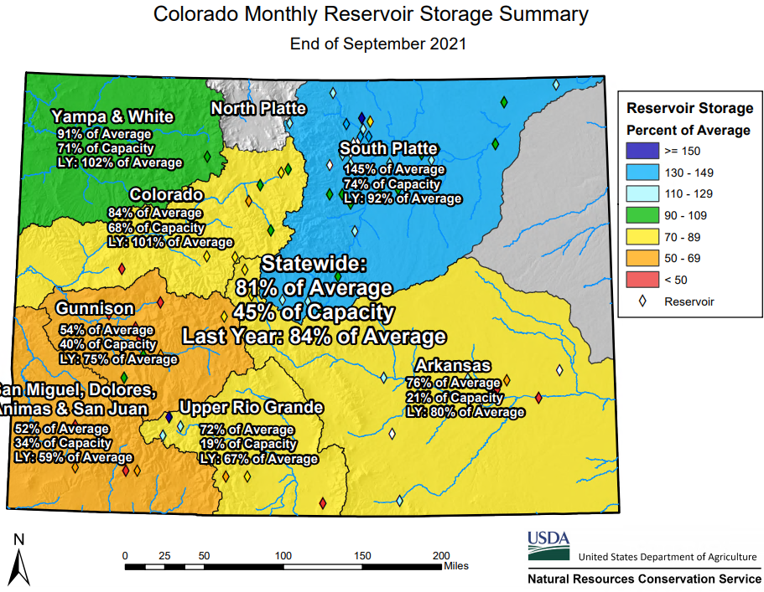
# of Fires NOW in western states
THIS MONTH
Impact of good Monsoon rains!!
OCT
SEP
Many CA reservoirs are already low!!
If canonical rainfall occurs associated with the developing La Nina, it will further worsen the water situation in CA, and the further eastward extension of drought in the South and East.

Slide 18
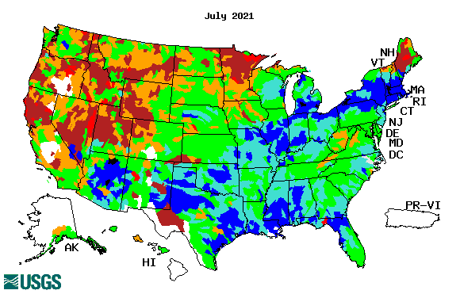
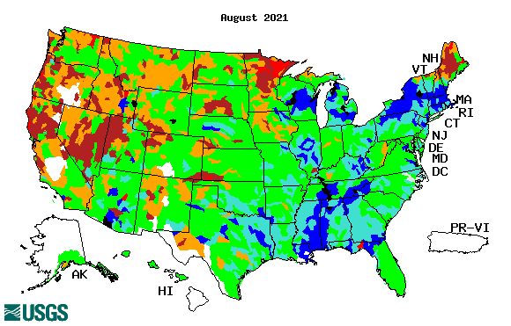
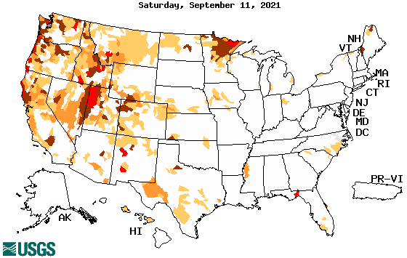
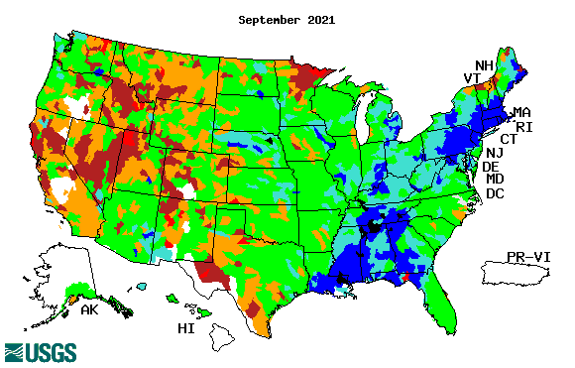
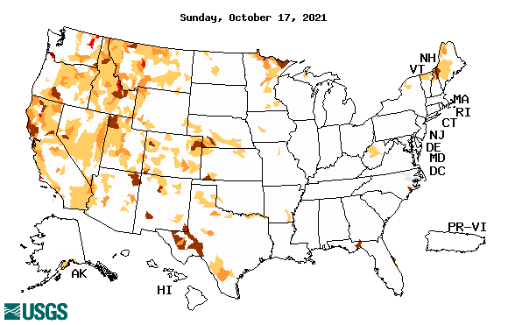
Streamflow (USGS)
Same data source USGS:
Look at the monthly maps for Northeast vs weekly maps in the bottom!!
Map shows only below normal 7-day average streamflow compared to historical streamflow for the day of year.
One month ago (left) &
Now (below)
Streamflow is only a partial indicator, as it is highly managed.
Look along the Pacific coastal states. If sometimes, the various indicators are confusing, go back to % of rainfall deficit maps – to reinforce!!
18

Slide 19
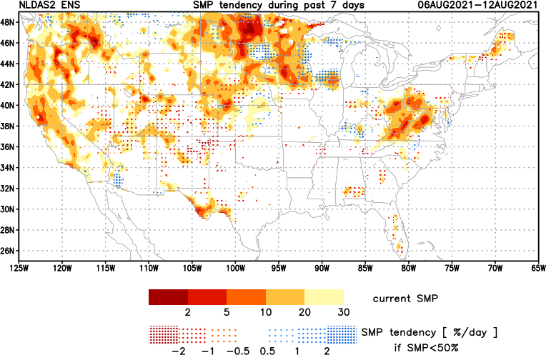
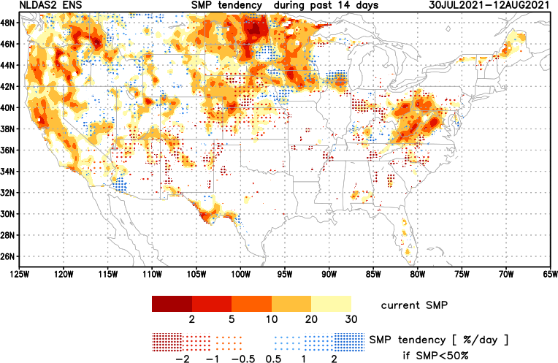
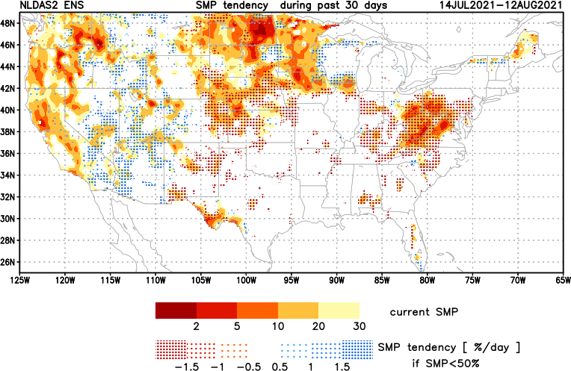
[Now]
NCEP Ensemble mean NLDAS2 models’ Soil Moisture tendency/trend
7 days
14 days
30 days
These NLDAS2 based SM tendency mas are a few days old!! But note the change in the middle part of the country!! Upper Midwest consistently dry!!
The drying in the mid-Atlantic eastern US states need to keep an eye, but with the approaching Tropical storm FRED, will likely have an impact in the area. Need to watch here. May not be a concern for the season.
+ve SMP (wetness) tendency due to monsoon rains is a temporary relief here and even further north.

Slide 20
EL NIÑO/SOUTHERN OSCILLATION (ENSO)
DIAGNOSTIC DISCUSSION
issued by CLIMATE PREDICTION CENTER/NCEP/NWS and the International Research Institute for Climate and Society
14 October 2021
ENSO Alert System Status: La Nina Advisory
Synopsis: La Niña conditions have developed and are expected to continue with an 87% chance of La Niña in December 2021- February 2022.

Slide 21
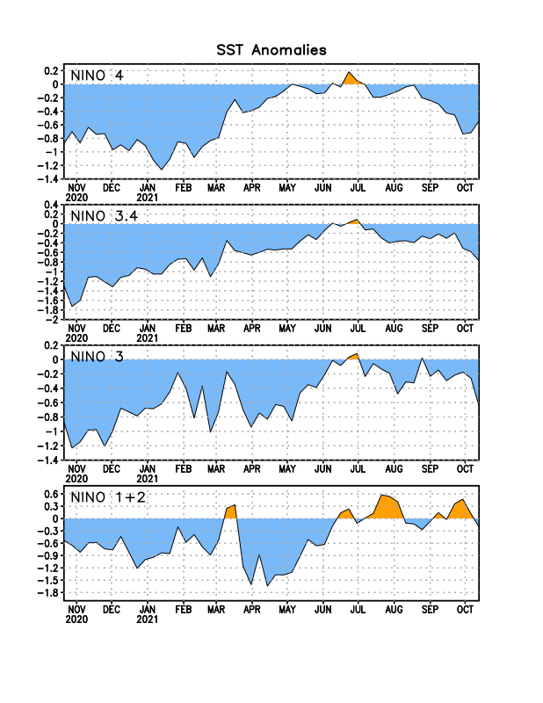
Latest values of SST indices in the various Nino Regions.

Slide 22
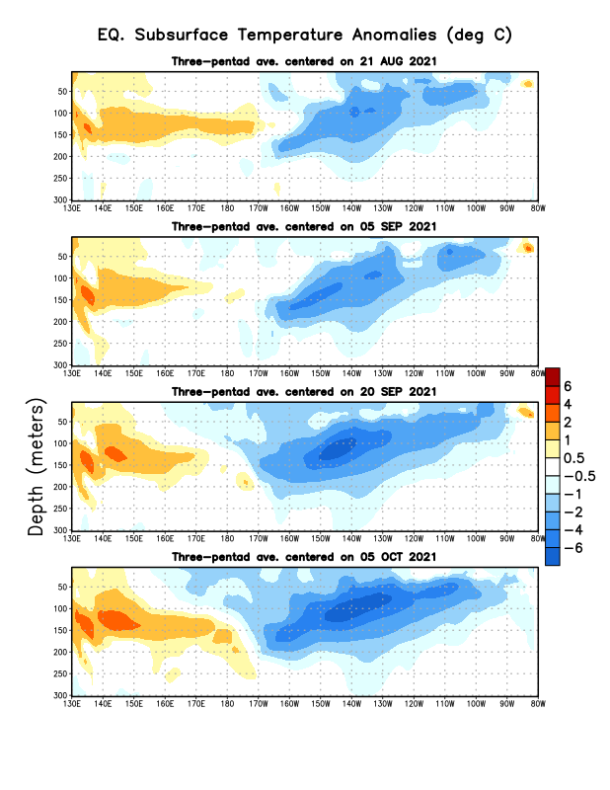
Sub-Surface Temperature Departures in the Equatorial Pacific
The subsurface cold anomalies are strengthening.
Most recent pentad analysis

Slide 23
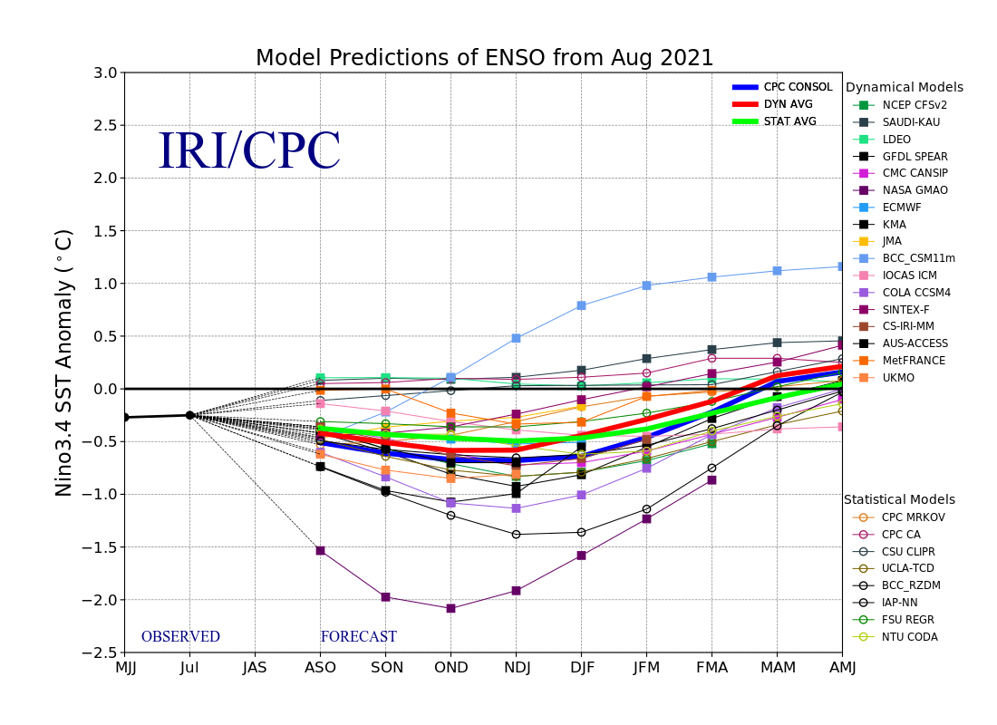
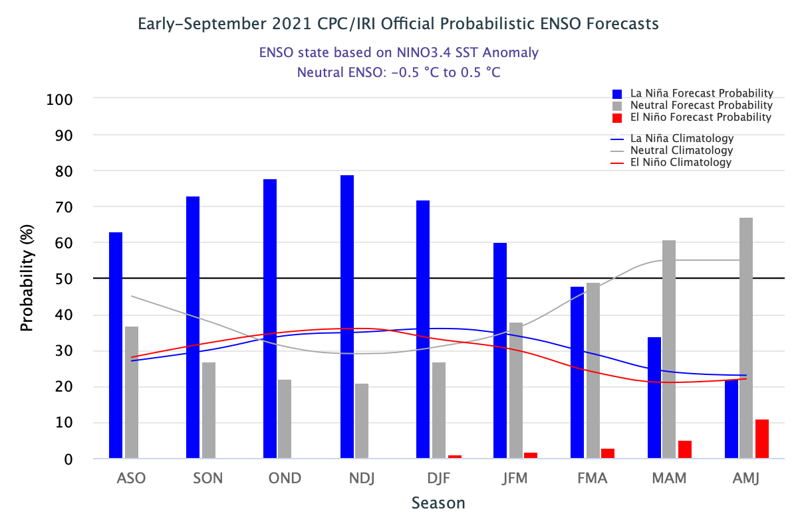
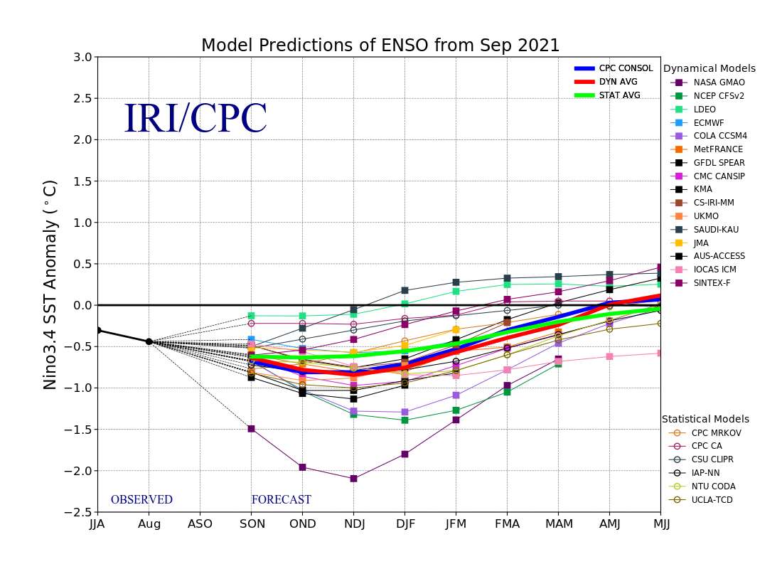
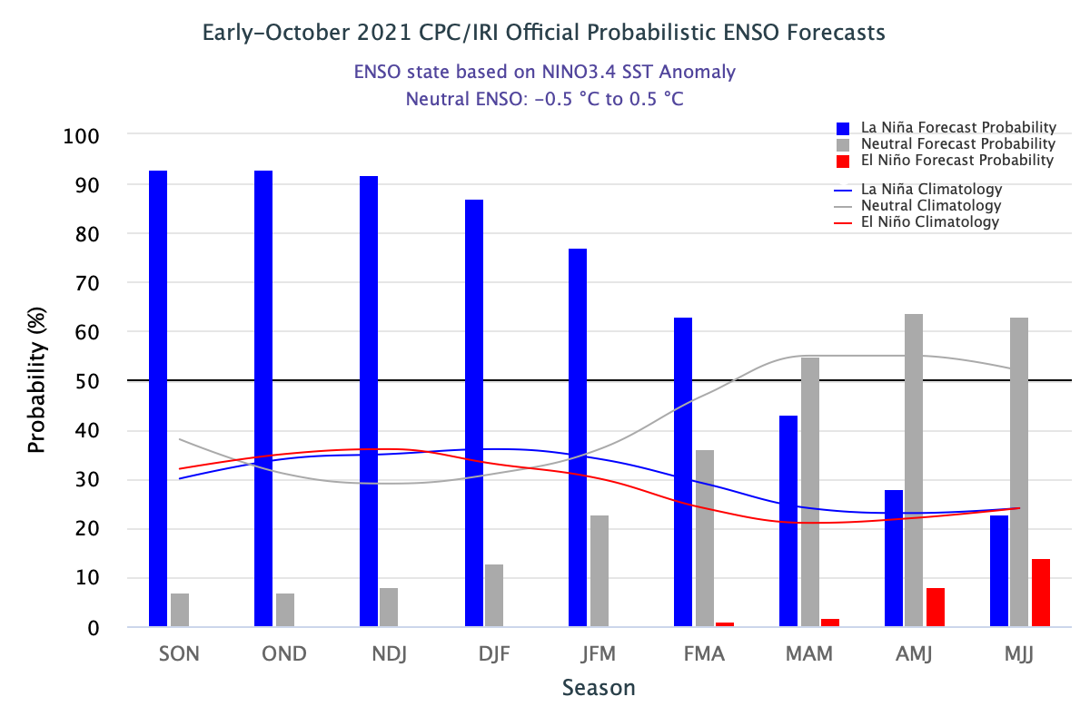
ENSO Forecasts
Early- September CPC/IRI forecast
Early- October CPC/IRI forecast
Dynamical, Statistical, CPC-Consolidated fcsts are coming together!! But still at ~ -0.5C !
Looks like a quick weak La Nina Event during this upcoming winter ONLY!

Slide 24
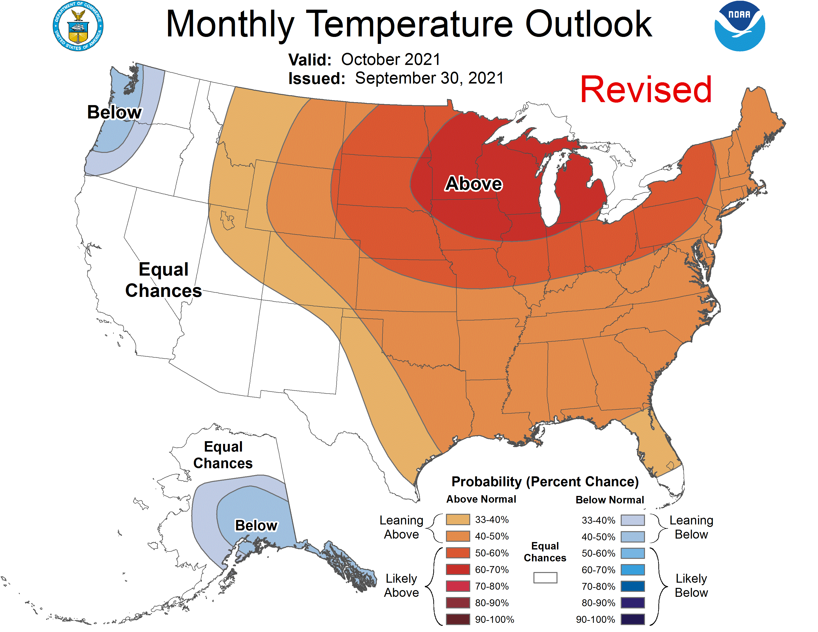
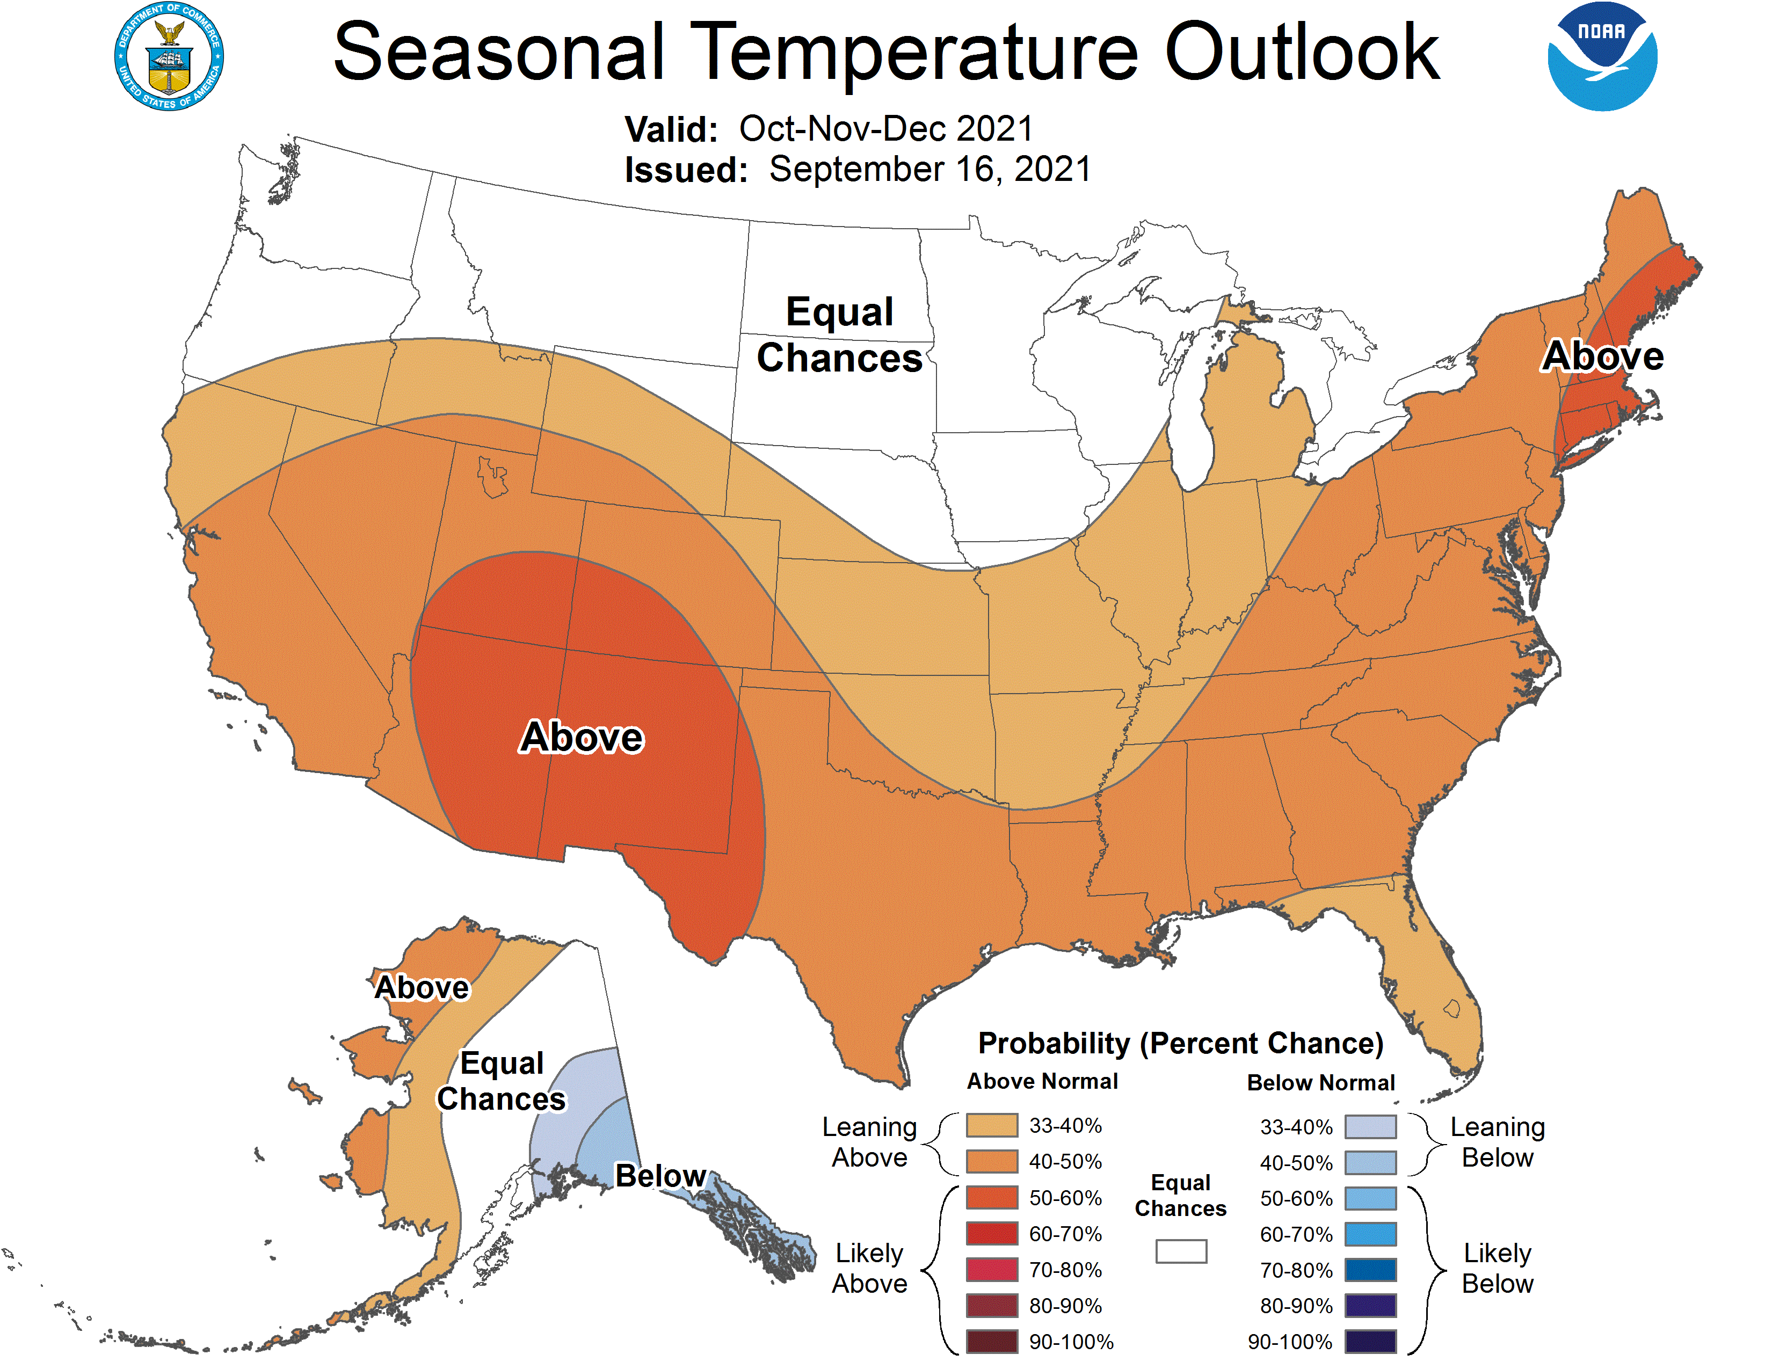
Previous (Last Month)
CPC’s official
Temperature OUTLOOK for Monthly (October)/Seasonal (OND)
Released Sep 16th
Observed so far this month!! ☺

Slide 25
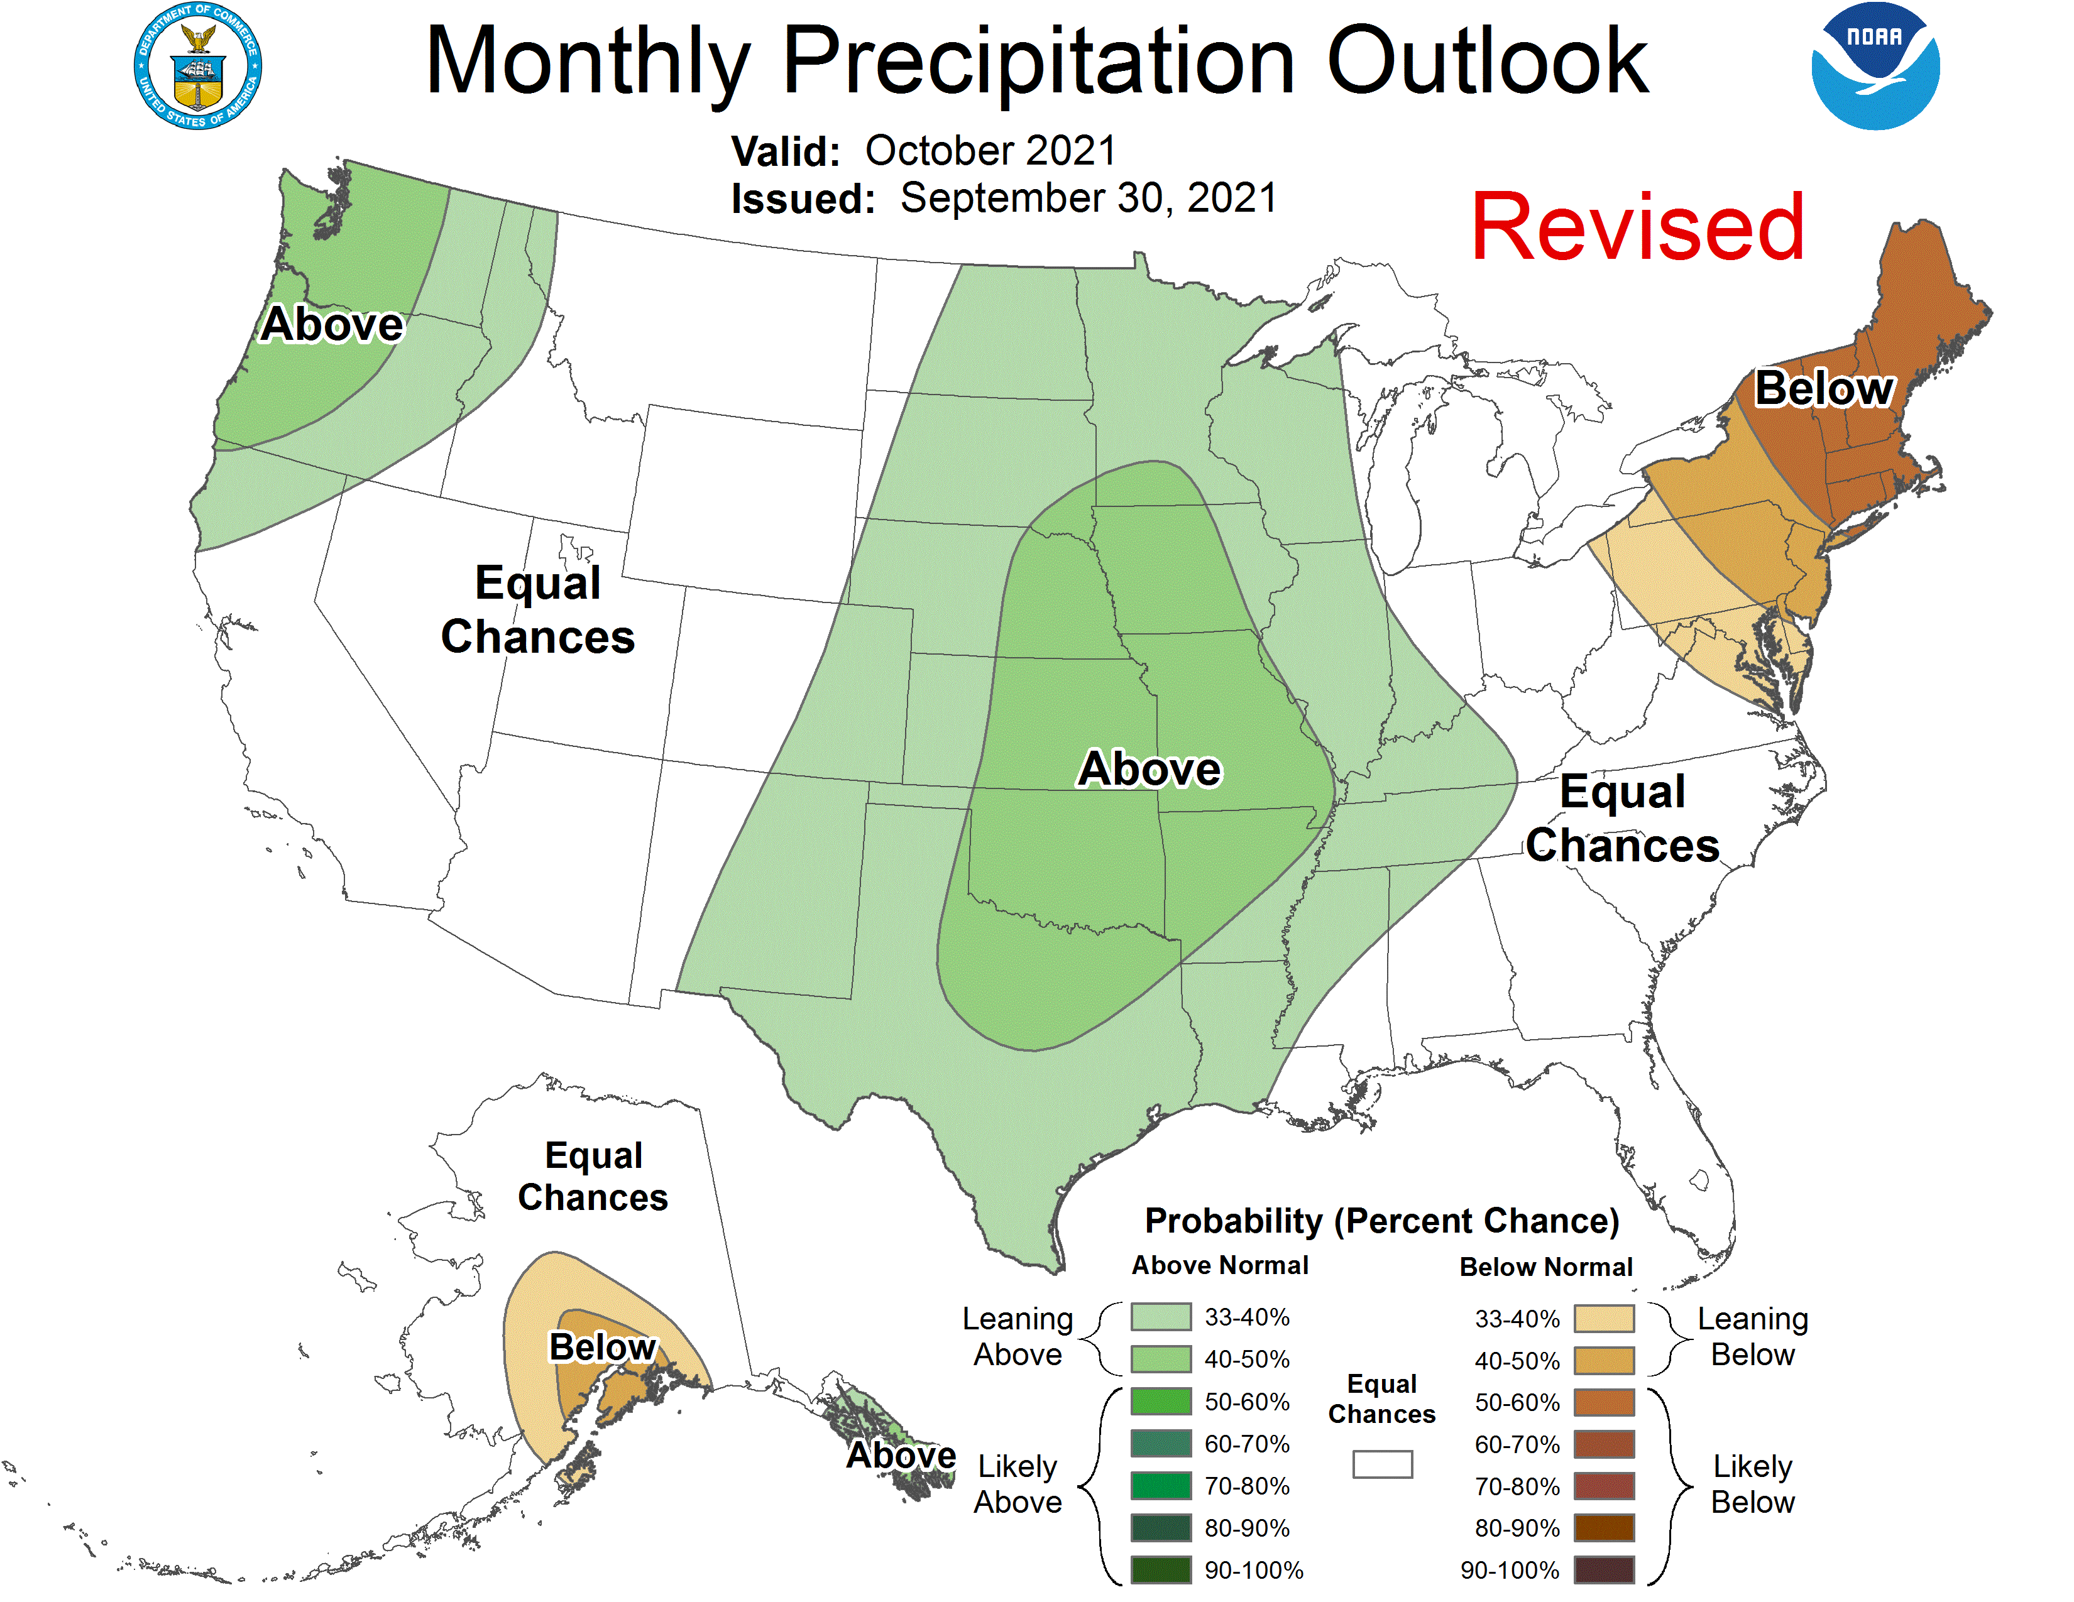
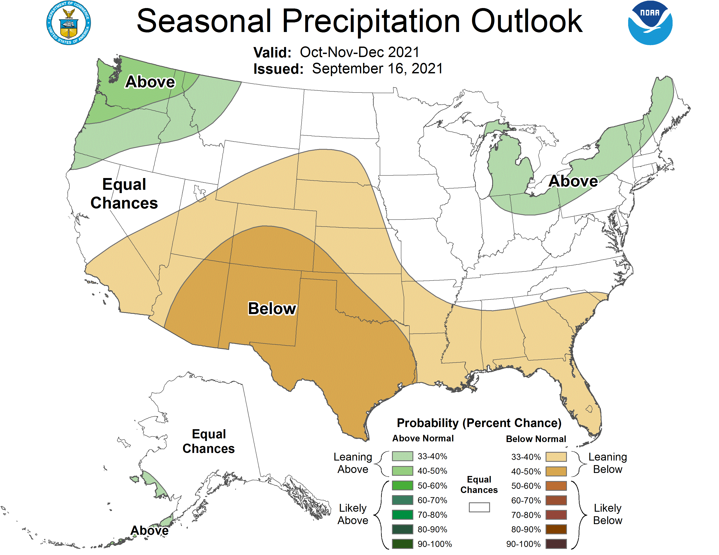
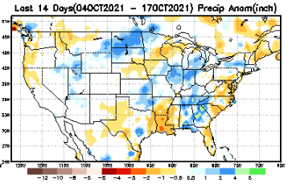
Previous(Last month)
CPC’s official
Precipitation OUTLOOK for Monthly (October)/Seasonal (OND)
Released Sep 16th
Observed so far this month!! ☹
Monthly P/T forecasts verified at mid-month are generally good! Why? ☺
(becoz they are mostly based on GFS’ 2-wk fcsts).
But so far, fcst looks ??

Slide 26
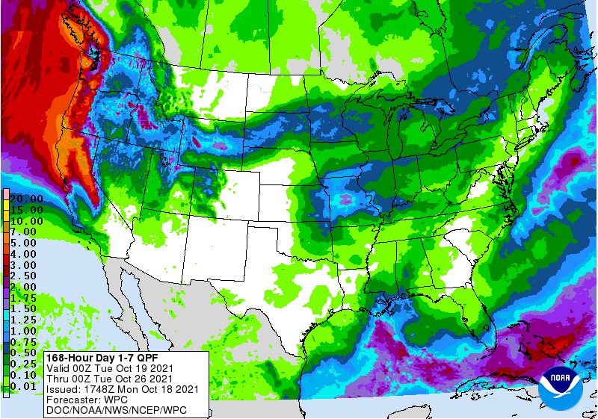
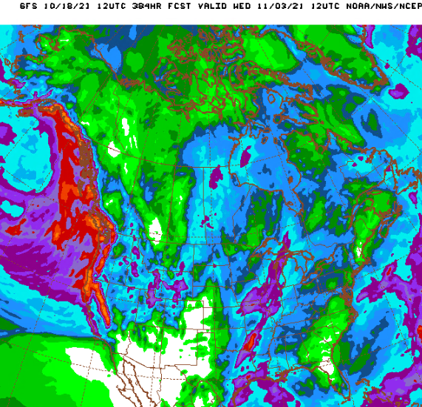
NCEP/WPC Next 7 days QPF Forecast
GFS Model Guidance for the
next 16 days.
Good rainfall is forecast along the Pacific northwest, as well as over northern/central CA. Season starting way too early! ☺
But La Nina is coming!!

Slide 27
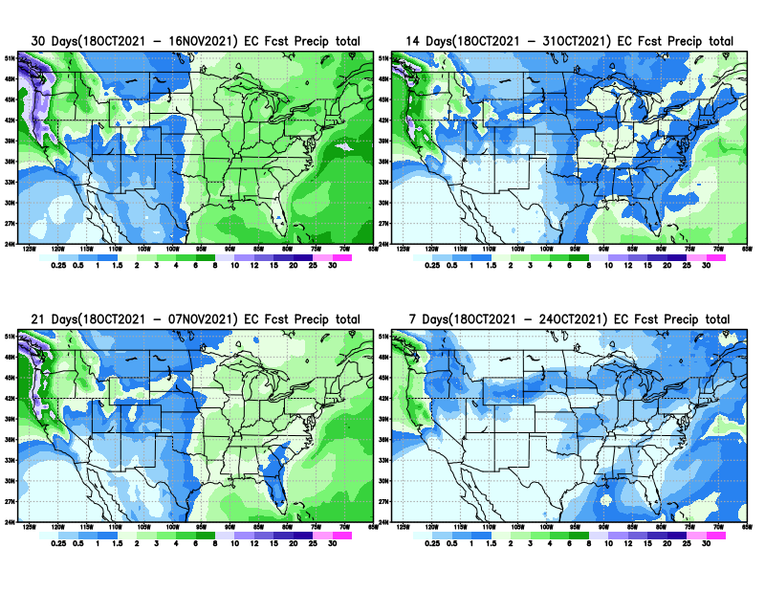
From European Center (EC) Precip forecast (made yesterday, 18 Oct) for next 30 days.

Slide 28
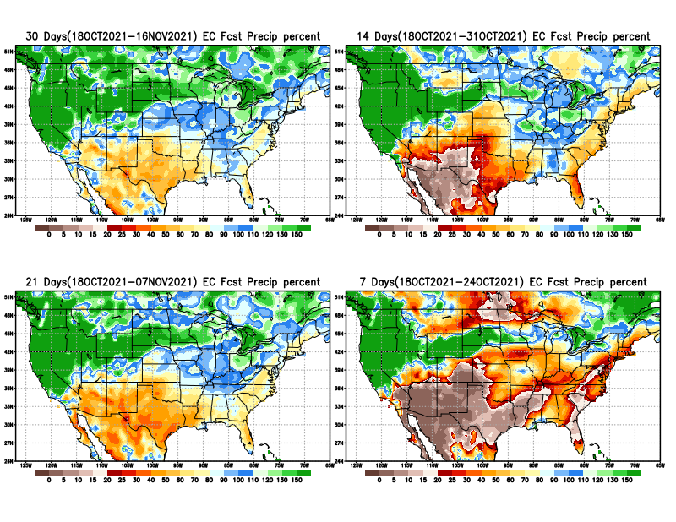
From European Center (EC) Precip forecast (made yesterday, 18 Oct) for next 30 days.
20
40

Slide 29
Watch!!(Recall climo slide earlier!! Possible short term drought development around the dark patches here! (See next slide!)

Slide 30
Watch!!(Recall climo slide earlier!! Possible short term drought development patches here!

Slide 31
Week-4 Soil Moisture Percentile (SMP) Fcst based on VIC model forced with ECMWF-extended precipitation forecast!
??
(From Drs. Li Xu and Yun Fan) More detail at From: https://www.cpc.ncep.noaa.gov/products/people/lxu/flashd/flash_prediction.html

Slide 32
NMME T & P Ens.Mean forecasts for
Nov
NDJ

Slide 33
Agreement/Disagreement among the various NMME models’ NDJ seasonal Precip. Forecast.
??

Slide 34
(From NMME) compared with this month(foreground, red border)
Why is there so fewer hatched areas in SPI6 fcst from NMME models’ based fcst this month as compared to last month (left 2 columns) ? Fcsts more confident now?
Forecast uncertain in Hatched areas.
Many pieces of hatched areas in the central and mostly in the eastern half of the US – indicating the model’s inability to know the status of drought here.
Lots of uncertainty regions!! In the middle column!!
SPI6 Fcst made from last month
SPI6/SPI12 Fcst made from this month

Slide 35
http://drought.geo.msu.edu/research/forecast/smi.monthly.php
Latest Initial Conditions:
10/12/2021
Predicted Monthly Soil Moisture Percentile
MSU Soil Moisture Percentile forecast NOT available, NOT updated!
CPC’s soil moisture percentile – Leaky bucket Model
The inter quartile range suggest greater uncertainty about the forecast in these shaded regions. Lots of uncertainty regions!! ☹

Slide 36
Summary
Current Drought conditions:
Unlike last year, due to the much better SW monsoon rainfall this year, improvement is broadly seen in the short term drought conditions (cf. June/July USDM) now in the four corners states area, NV and vicinity as was also correctly forecast. But Long term drought worries still prevails sporadically across the region due to the ongoing multi year drought in the region.
The fire season has considerably lessened/almost ended in the southwest, largely due to the impressive southwest monsoon rains, that is just ending.
But drought conditions have worsened and shifted further west into CA, and northwest into OR, WA, ID, as well as into the Northern Great plains states of MT, the Dakotas and MN. Mild drought has also expanded into NE and IA.
New short term drought (?)(3 vs 6 months ?) development in the South (TX, OK & KS). But climatology and developing La Nina may in fact worsen and extend drought across the South!!
All California reservoirs levels continue to worsen to below their historical average levels. In the very short term, the situation looks better due to above normal rains, but in the seasonal term If the forecast heat/temps and the lack of (seasonal) rainfall continues, things will probably get dire.
Current ENSO status and forecast: A transition La Niña conditions have developed and are expected to continue with an 87% chance of La Niña in December 2021- February 2022.
Prediction:
La Nina is definitely reemerging, within the upcoming forecast season (NDJ) although the strength of the event is likely to be not strong. Above normal rainfall is forecast in the coming few weeks along the Pacific Northwest including northern and central CA, which will considerably ease and probably remove the short term drought in the region.
If the expected above normal precipitation forecast for the upcoming NDJ season in these upper northwestern and northern Great Plains states, associated with the emerging La Nina verifies, it will also make a big impact on even the long term here in these regions.
The models forecast and there is a strong likelihood that the southern tier states, beginning with southern CA in the west and extending eastward, will likely experience below normal rainfall for the forecast season, due of course to the La Nina. Hence this will likely worsen the already existing drought in the southwestern, southern and even parts of the southeast including Florida by the end of the season. The forecast of above normal temperatures across the United States further contributes to the noted scenario.
The existing above normal wetness in the vicinity of MS/AL will likely be not enough to offset a possible development of mild dry conditions, if the expected La Nina seasonal precipitation impacts occur. Costal region of GA, and the Carolinas are also areas of concern. A much clear picture will emerge next month as/if La Nina impacts show up! ******

