Slide 1
Drought Outlook Support Briefing
March 2024
Climate Prediction Center/NCEP/NOAA
http://www.cpc.ncep.noaa.gov/products/Drought
Points to ponder:
Often, there is a disconnect between the Short term (S) and Long term (L) drought in regions, and even with the short term (S) drought, the 3-month and 6-month signals are not quite consistent! With Long term (L) drought, it is even more trickier, as it is open ended from 6 months-onwards and beyond!!!
Places/regions experiencing Short term drought may (not) be ok in the Long term and vice versa!!
This duality is difficult to reconcile, to convey and even be clearly understood well by the public at large.
Public/Forecaster generally tends to focus more on the Short term Drought (for good reasons!!)
More importantly the very definitions and timescales associated with S/L term droughts and the declarations in the USDM are by themselves subjective!! Short term vs Long term drought need to be clearly distinguished and shown to the public!!
It may take a long time for drought to develop, but those conditions can end very quickly! as it happened in CA after DJF 2023 winter. Forecast models are yet to (seasonal) correctly forecast these changes in advance!
Subjective(delayed) USDM vs Objective(real time) map! A few days of recent heavy precip can change the USDM a lot!
New (last few months):
Towards objective drought monitoring goals, we introduced, a new objective AI/Deep-Learning based Experimental ODI (objective drought indicator, updated daily, Slide # 3) compared with Official USDM (US Drought Monitor, produced weekly by USDM authors).
Towards prediction, we introduce a new section with few slides at the end, consolidating the various exptl. drought outlooks by purely objective methods developed here at CPC! All these in preparation of a broad general push towards Probabilistic Drought outlooks.

Slide 2
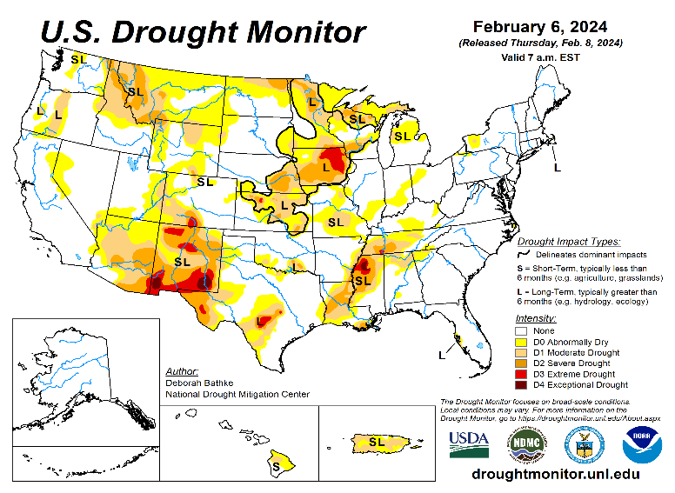
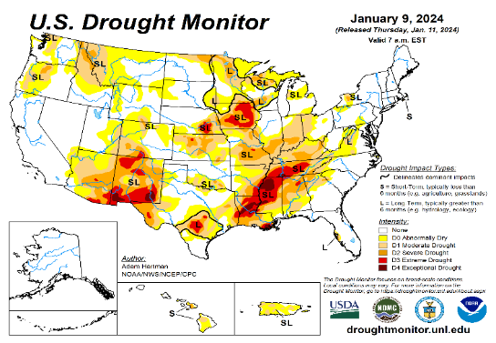
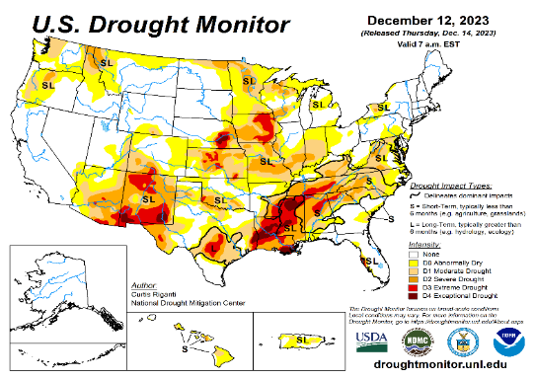
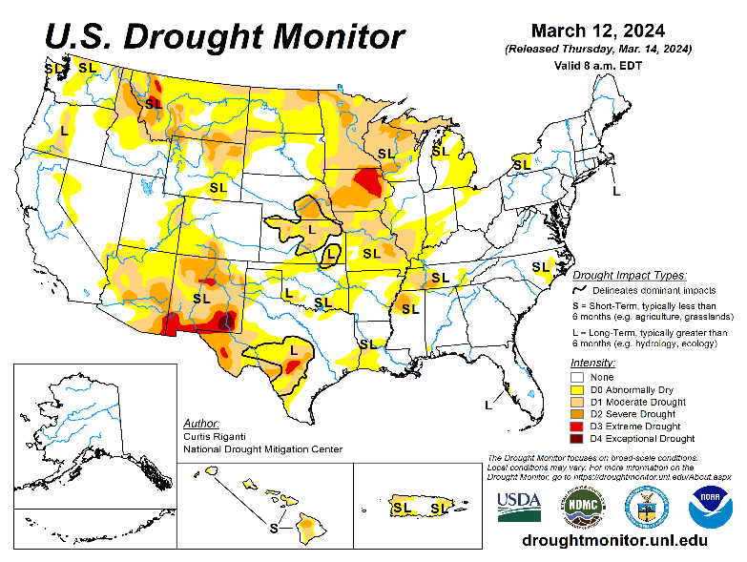
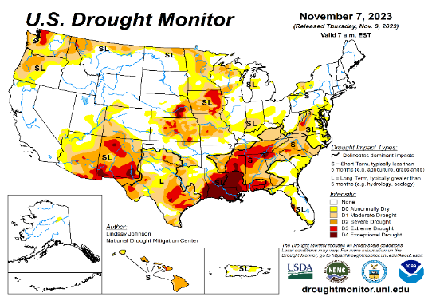
Drought Monitor
Monitoring is important because, unlike US T/P fcsts, for drought forecasts, we have to know where we are, before we can tell where we are going!! Drought forecasts are tendency forecasts.
February
Above normal rainfall (strangely) during last year’s La Nina winter (2022/23) and (canonically, as expected) during this year’s El Nino winter (2023/24) in California, thus two back to back above normal winter rainfall seasons, has more than compensated for, and totally eliminated the both the Long & Short term drought in the region.
Water levels in almost all CA reservoirs are now at or well above their normal levels. However, the water storage levels in the much bigger lakes, Lake Powell and Lake Mead in NV/AZ still continue to be historically low, and the two decade(s) long hydrological drought still exist here.
The past ¾ months winter rains in Pacific NW has already improved drought conditions in the region.
We have been suggesting/projecting the past few months that the overall drought situation will be improving over the entire United States, and it is gradually happening. About 54% of the lower 38 states is totally drought free.
Early in this past 2023/24 winter, severe drought was entrenched in lower Mississippi valley, around LA/MS/AL, which has now completely gone, thanks to El Nino, and also as we had correctly forecast.
The relatively poor SW monsoon this past year(2023) in the southwestern states, and the remnants of the decadal Long-term drought in parts of AZ/NM, from the recent three back-to-back La Nina's has not fully lifted the drought yet in much of these states. If the ENSO situation turns south to another La Nina later this year, it may further add to the rainfall deficits in these southwestern states.
For past couple of months, we have introduced a feature new set of slides consolidating a few objective drought outlooks, produced experimentally at CPC.
January
December
March
(Recent/Latest)
November
Last month we said, “Overall, by the end of the FMA forecast season, slightly more areas of the US will likely be drought free than this month”

Slide 3
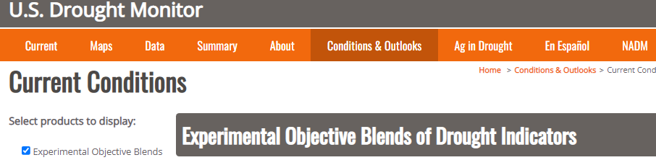
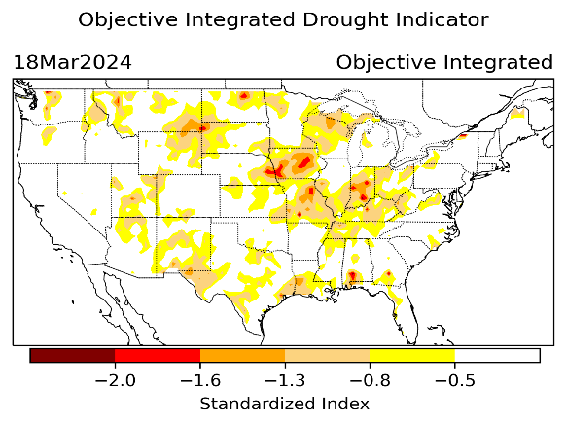
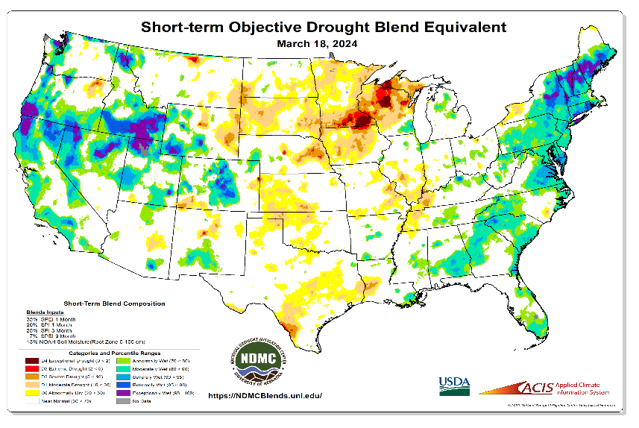
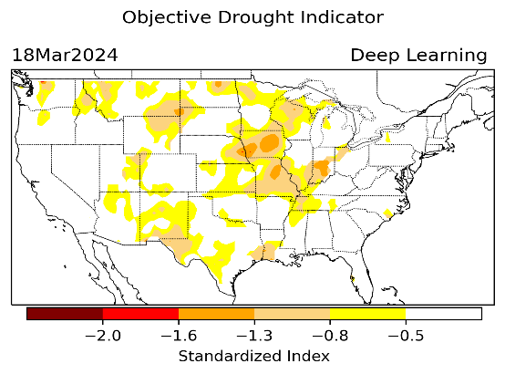
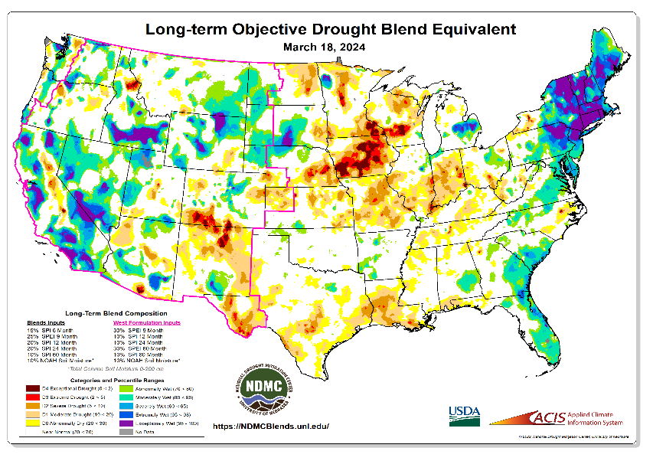
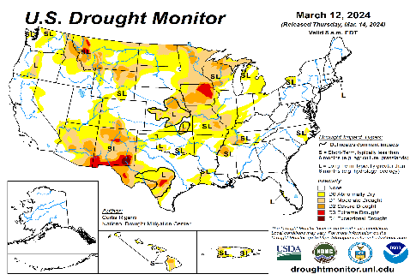
Exptl. Objective Drought Monitor
(showing S/term & L/Term separately) from
National Drought Mitigation Center (NDMC)
New slide now included recently in this briefing!
CPC’s own Experimental
Objective Drought Indicator (ODI)
using AI/Deep Learning ! – Updates daily !!
https://www.cpc.ncep.noaa.gov/products/people/lxu/odi/#deep-learning-increment-training
Based on the CPC P/analysis &
VIC (Princeton) NLDAS model assimilation:
Standardize Precipitation index (SPI)
Standardize Precipitation-Evapo –
transpiration index (SPEI)
Evapotranspiration Stress Index (ESI)
Soil Moisture Percentile (SMP)
Standardize Runoff Index (SRI)
-can be split into Short/Long Term Droughts!
https://droughtmonitor.unl.edu/ConditionsOutlooks/CurrentConditions.aspx
Objective
& Updates Daily!
Objectively Integrated
versus Deep Learning
Methods ~ gives |||r results. Both Objective!
Both update daily!
Objective &
Runs Weekly!
On Monday!
Objective
& Updates Daily!
* A manuscript (Xu & Chelliah) is under preparation.
Subjective &
Produced Manually!
Weekly!
Latest Official USDM (US Drought Monitor)
(about a week old!)
Objective &
Runs Weekly!
On Monday!
These two maps above, used to be produced at CPC(Rich Tinker!), but now recently officially moved to NDMC operations!
*Released every Thursday, for conditions as of Tuesday!

Slide 4
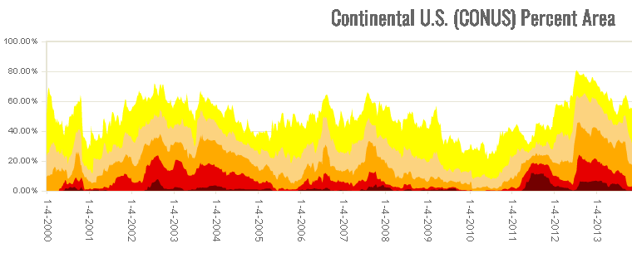
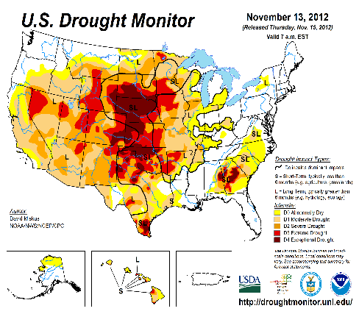

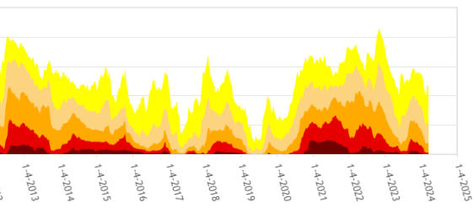

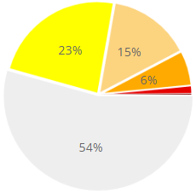
In general, The spatial details of every drought is different.! Every situation is different!!
Time series since 2000 spilt into 2 (above & below) panels.
CONUS % Land Area
Last month drought free areas in areas was 46 %.
Now it is 58%. Definitely the ongoing El Nino has something to do with it. :-)
Current drought!

Slide 5
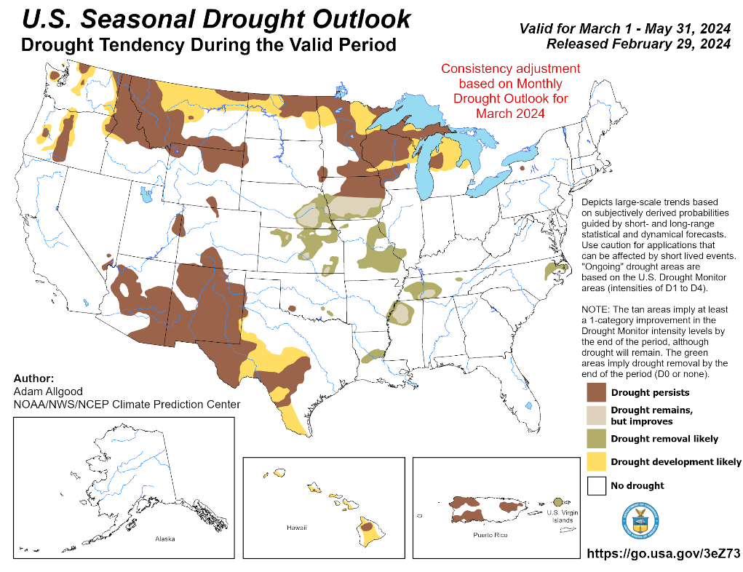
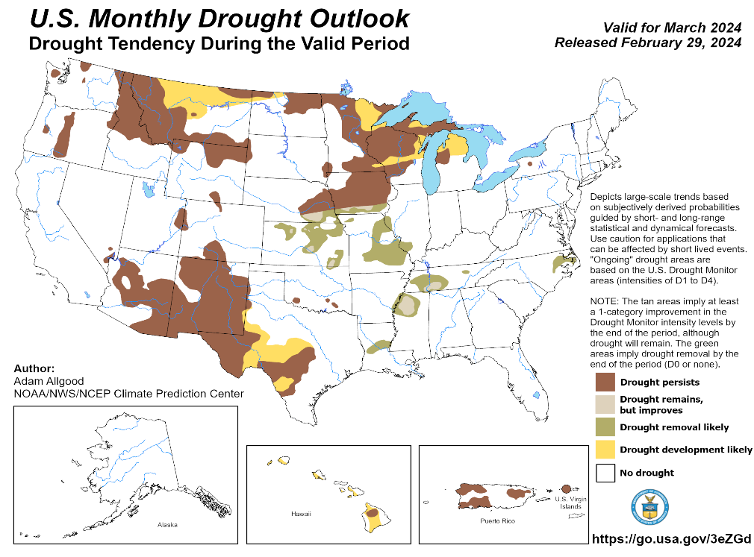
(Previous) Seasonal/Monthly Drought outlooks
New Seasonal+ Drought Outlook(SDO) to be released in 2 days!
(reissued again at end of month for consistency with MDO!)
New Monthly Drought Outlook (MDO) to be released at end of this month)
Updated Seasonal Outlook
( 1 Mar – 31 May 2024)
issued 2/29/24
Monthly outlook (for March 2024)
issued 2/29/24

Slide 6
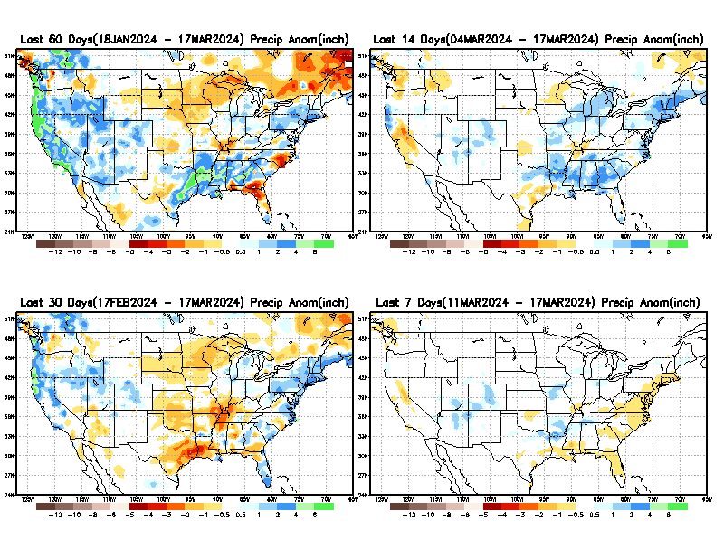
Precipitation ANOM during last 7, 14, 30, & 60 days.
This and next few slides show Precip deficit (excess).
Droughts, for the MOST part, begin and end with precip!! Lately, Temps are becoming (secondarily) important as well.
60 Days
14 Days
30 Days
7 Days
These maps in this and following slides, including a) Total,
b) Anom and
c) Percent of Normal precip. in these and other longer time ranges are now (routinely) daily updated at:
From: Recent Accum./Anom Precipitation https://www.cpc.ncep.noaa.gov/products/Drought/briefing_prcp.shtml

Slide 7
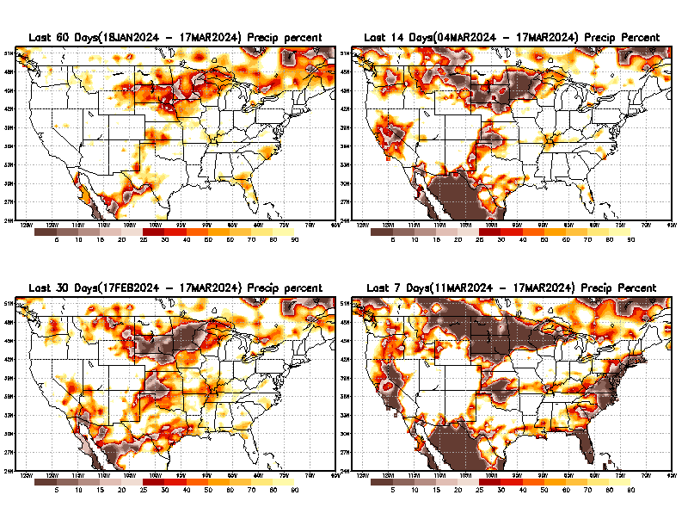
Precipitation Percent (of normal) during last 7, 14, 30, & 60 days - Only Deficit Areas <=90% shown !
60 Days
14 Days
This plot shows only the rainfall deficient regions <= 90% of normal.
-- This shows more clearly possible/likely drought developing region in the future unless there is above normal rainfall in these regions in the future, to offset these shortfalls.
30 days
7 days
From: Recent Anom/% of normal Precipitation https://www.cpc.ncep.noaa.gov/products/Drought/briefing_prcp.shtml

Slide 8
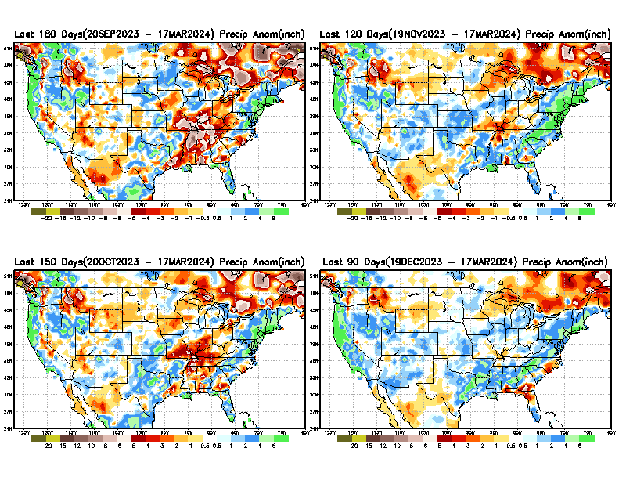
Total precipitation ANOM during last 3, 4, 5, and 6 months.
While the Precipitation anomalies deficit may seem large in some regions (compared to others),
it is the
% of normal precip (next slide) that matters more!!
6 M
4 M
3 M
From: Recent % of Normal Precipitation https://www.cpc.ncep.noaa.gov/products/Drought/briefing_prcp.shtml

Slide 9
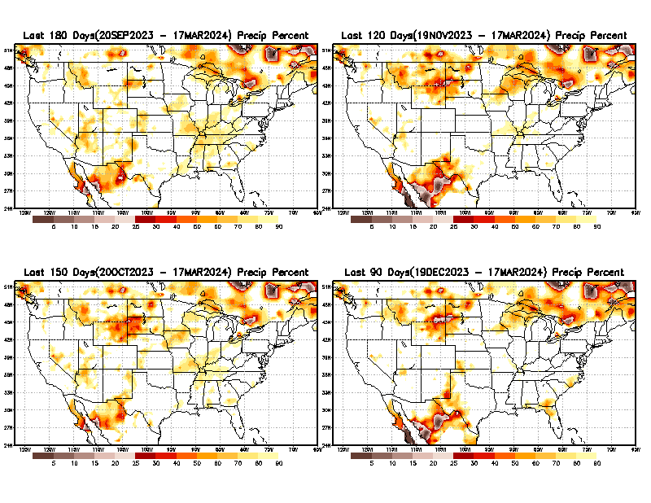
Total precipitation Percent (of normal) during last 3, 4, 5, and 6 months Only Deficit Areas <=90% shown!!
6 M
4 M
In these interim time scale 3-6 months, we need to pay attention to regions, which are dark-brown, red & dark red (<50%).
While accrued precipitation deficits are real & objective,
droughts are subjective declarations!!
5 M
3 M
East vs West!
Broad vs Narrow
rainfall season.
In general, West US suffers more from frequent and lasting droughts. Droughts in East US are less and less lasting!
What about Center ?
More like West than East?
Short term(S) Drought is generally declared when rainfall deficits exist in the 3-6 months time range. {Long term deficits beyond 1 or 2 or more years is Long term L drought! }

Slide 10
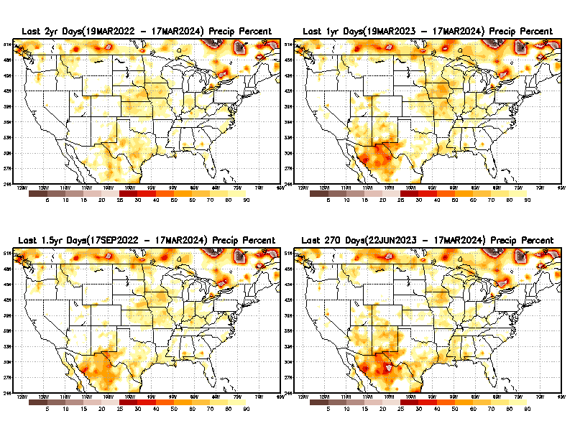
Total precipitation Percent during last 9 months, 1 yr, 1.5yrs, & 2 yrs. .–Only Deficit Areas shown!! <=90%
2 Y
1 Y
1.5 Y
9 M
The character and even location/spatial extent of the short/S and long/L –term droughts are different!!!
From: Recent Accumulated Precipitation https://www.cpc.ncep.noaa.gov/products/Drought/briefing_prcp.shtml

Slide 11
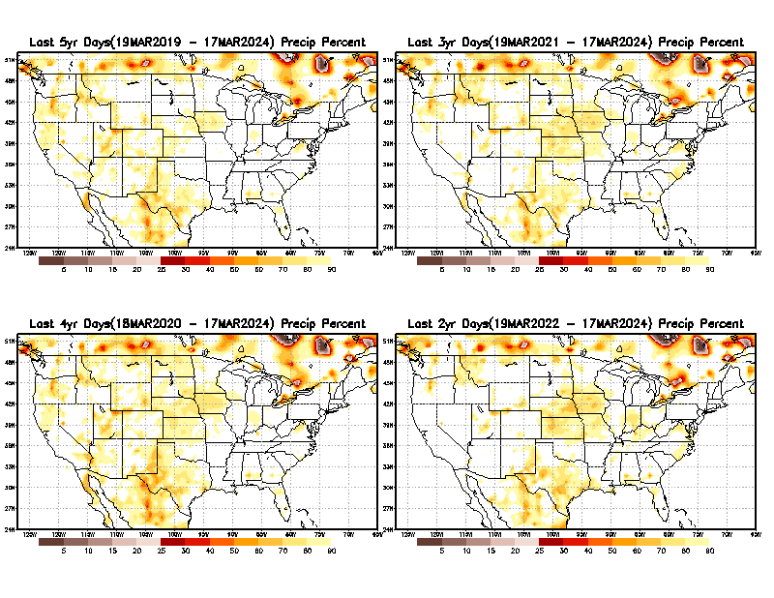
Total precipitation Percent (of normal) during last 2, 3, 4, & 5 yrs. .–Only Deficit Areas <=90% shown !!
5 Y
3 Y
4 Y
2 Y
From: Recent Accumulated Precipitation https://www.cpc.ncep.noaa.gov/products/Drought/briefing_prcp.shtml

Slide 12
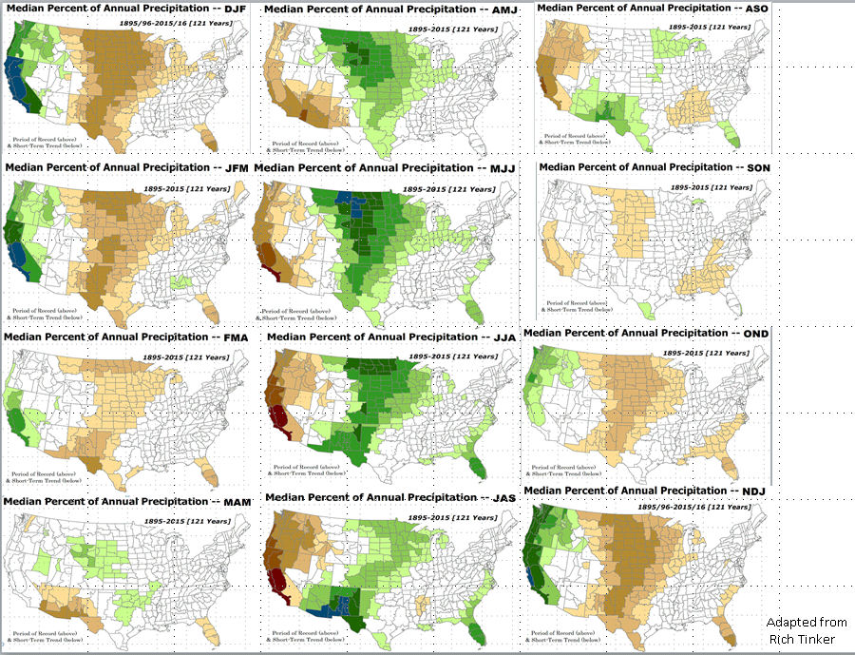

LEAST
MIXED
MOST
East vs West!
More darker colors in west/central => narrow rainy season (months)
Overall, more white space in the east => distributed rainfall season (except ~FL).

Slide 13
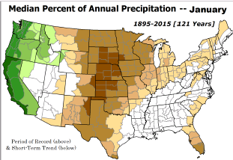
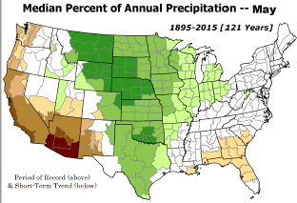
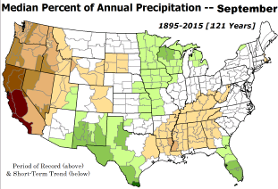
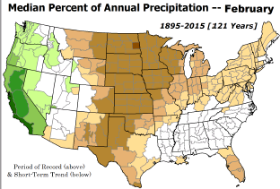
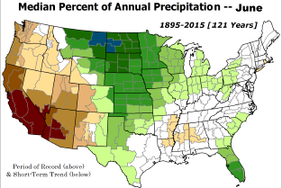
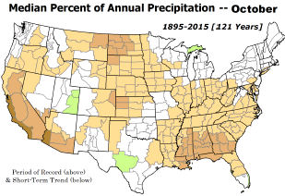

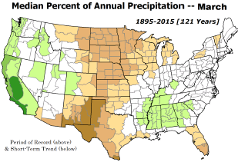
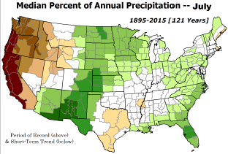
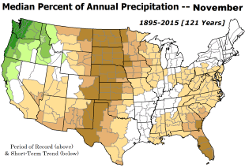
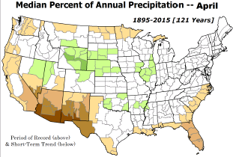
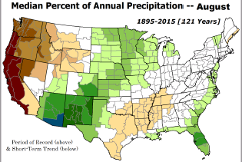
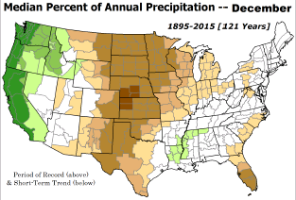
*********
EAST vs
CTR/WEST
Drought Behavior is loosely tied to rainfall climo!! And the limited rainy season in the west
*********
Adapted from Rich Tinker.

Slide 14
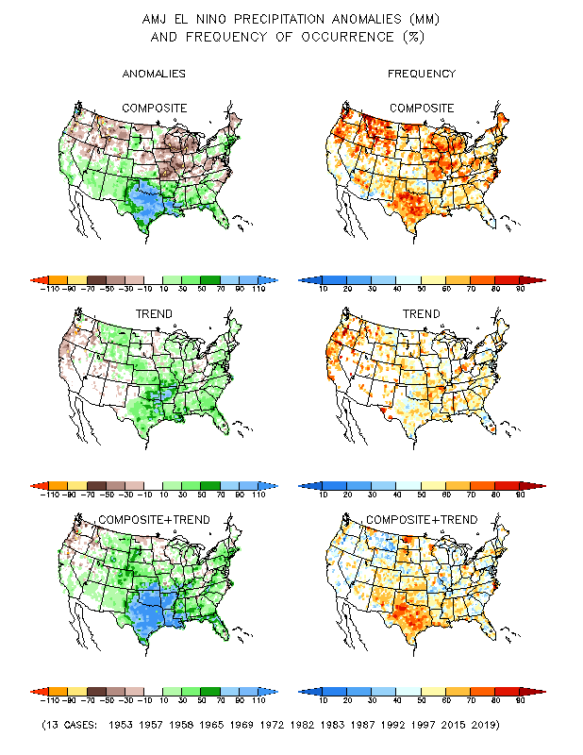
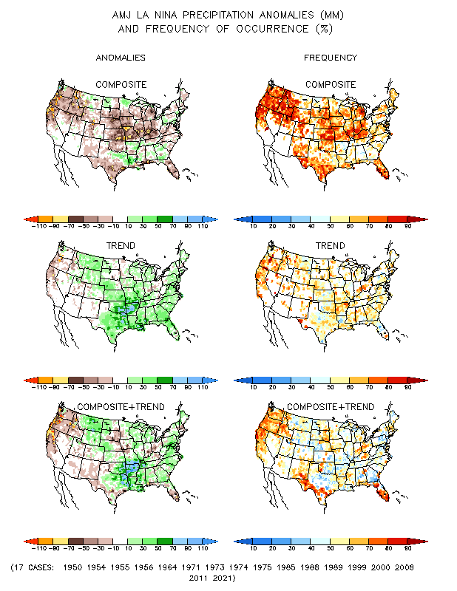
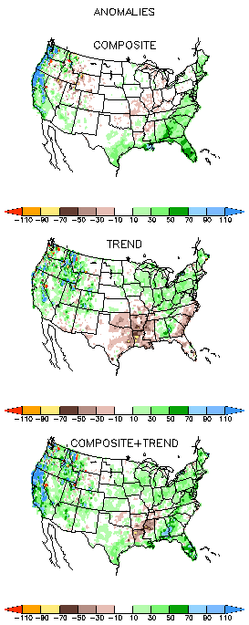
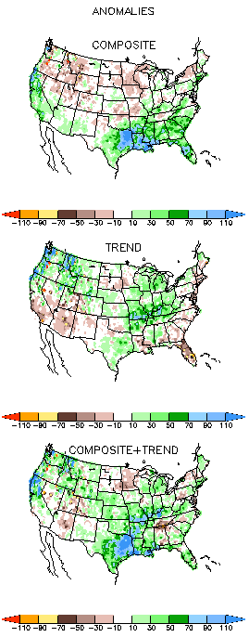
El Nino Precip/Temperature COMPOSITES & Trend map
AMJ
P
P
Opposing signals!
El NINO/Left
La NINA /Right
Southeast US –Above Normal Prcp!
El Nino is weakening, so composites may not hold. Moreover MAM is Spring, an inherently difficult season for forecast!

Slide 15
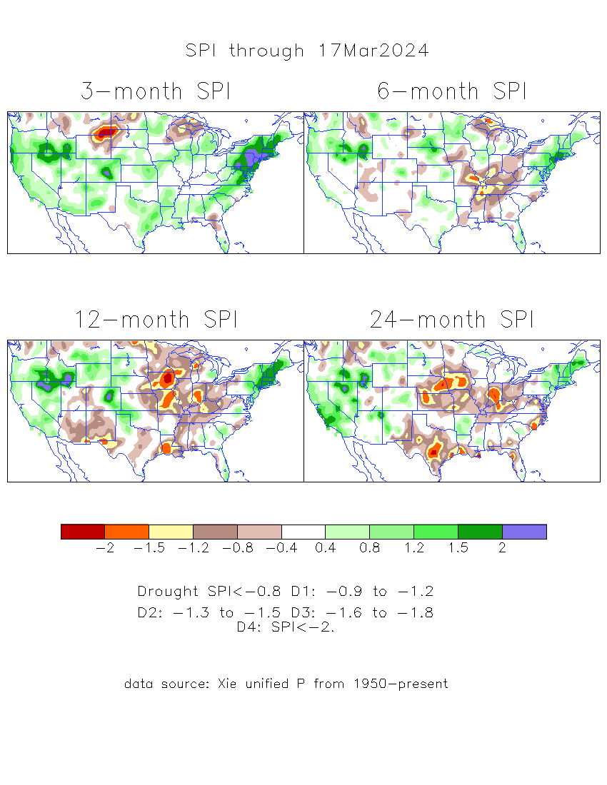
The Standardized Precipitation Index SPI
(based on Observed P)
Compare with last month
----- NOW
Very interesting graphic & details for the drought across the US based on the more generalized precip deficit/excess, the Standardized Precipitation Index (SPI).
The dark brown and red colors, indicating standardized precipitation deficits, in the various time periods, approximately correspond to the appropriate short/long term drought monitor regions and their intensities
Short
Long
How does one negotiate and reconcile declaring short term vs long term drought when precip. deficiencies patterns differ on many different time scales locally!!
What is the cutoff delineating time between short VS long term drought!! Not so clear!!
At exactly where, does drought begin?

Slide 16
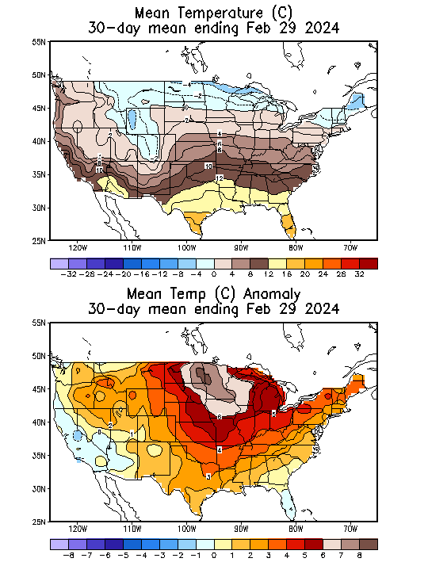
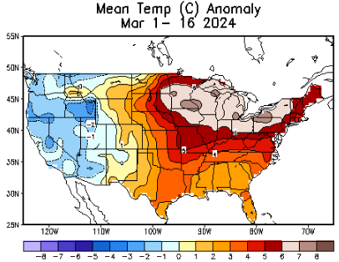
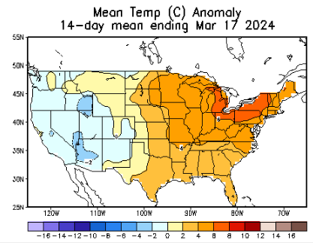
Recent US Temperatures
NOW
So far this month !!
.

Slide 17
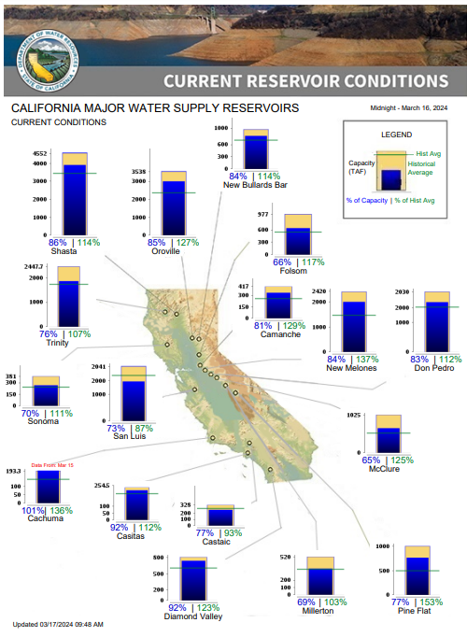
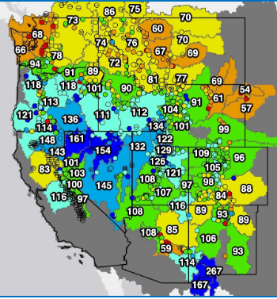
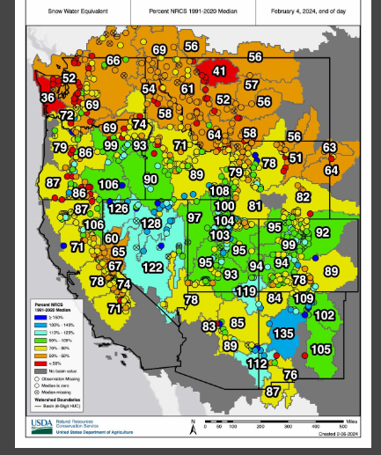

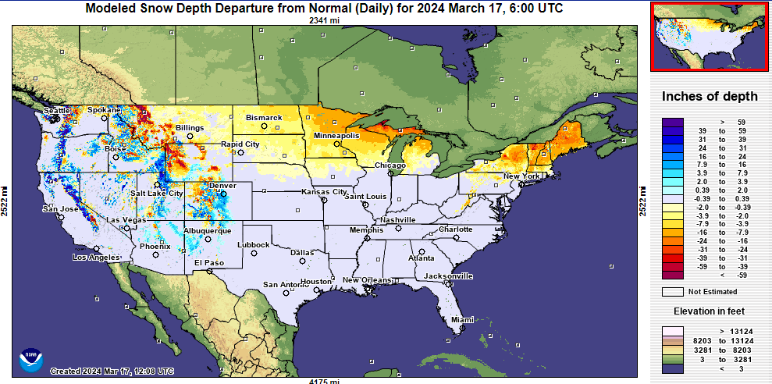

Western US Snow cover
This month (better than) Last month
% of Capacity
% of Hist. Avg.
of Reservoirs.
3/12
Water Year
(just started!),
Year-to-date Precipitation:
October 1, 2023 – Dec.17, 2023
https://www.nrcs.usda.gov/wps/portal/wcc/home/
Many CA water reservoirs are AT or ABOVE their historical average/ CAPACITY levels ! ☺
https:/www.nohrsc.noaa.gov/interactive/html/map.html?
WHOEVER thought that the California drought/reservoir-water-levels will turn around in just ONE La NINA winter!!
But a very different story for the big lakes Lake Mead & Lake Powell in NV, see next slide! ☹

Slide 18
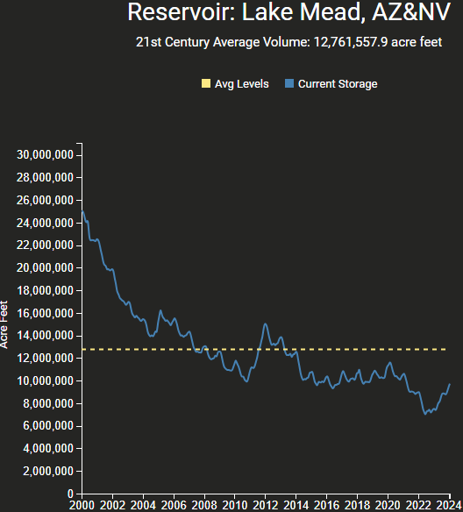
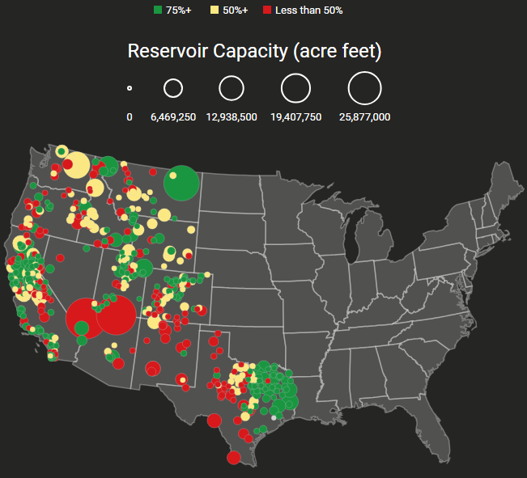


Reservoirs
Percent Full for Month Ending (February 2024), or Most Recently Available Month
Hydro Electric power generating turbines STOP operating at the critical 7 million acre feet level
https://www.deanfarr.com/western_water/
Lakes Mead, Powell in NV/AZ are at historic /dire low levels! ☹ ☹ HUGE consequences for electric power for western states CA/NV/AZ/UT !!
Only very slight improvement in recent months!

Slide 19







Streamflow (USGS)
Most US east droughts are relatively short lived (as compared to US west).
But in last 2 decades, recently in 2000, 2016, 2020, & 2022, New York and New England experienced historic drought conditions not seen since the 1960s.
Map shows only below normal 7-day average streamflow compared to historical streamflow for the day of year.
One month ago (left) &
Now (below)
Streamflow is only a partial indicator, as sometimes it is highly managed.
If sometimes, the various indicators are confusing, go back to % of rainfall deficit maps – to confirm/reinforce!!
https://waterwatch.usgs.gov/?m=nwc
19

Slide 20

EL NIÑO/SOUTHERN OSCILLATION (ENSO)
DIAGNOSTIC DISCUSSION
issued by
CLIMATE PREDICTION CENTER/NCEP/NWS
and the International Research Institute for Climate and Society
14 March 2024
ENSO Alert System Status: El Niño Advisory/La Niña Watch
Synopsis: NOW: A transition from El Niño to ENSO-neutral is likely by April-June 2024 (83% chance), with the odds of La Niña developing by June-August 2024 (62% chance).
CPC’s Oceanic Niño Index (ONI) [3 month unning mean of ERSST.v5 SST anomalies in the Niño 3.4 region (5ºN-5ºS, 120º-170ºW)], based on centered 30-year base periods updated every 5 years. For historical purposes, periods of below and above normal SSTs are colored in blue and red when the threshold (0.5) is met for a minimum of 5 consecutive 3-month overlapping seasons.

Slide 21





Latest values of SST indices in the various Nino Regions.
The current El Nio came in a hurry after 3 back-to-back La Ninas, and is also going away in a great hurry to make room for ANOTHER La Nina which is on the way!!

Slide 22


Sub-Surface Temperature Departures in the Equatorial Pacific
Most recent pentad analysis

Slide 23




Official ENSO Forecasts
February CPC/NOAA forecast
https://www.cpc.ncep.noaa.gov/products/people/wwang/cfsv2fcst/images3/PacSSTSeaadj.gif
March CPC/NOAA forecast
Latest ensemble membrs (blue!)show are less bullish

Slide 24


Previous (Last Month’s)
CPC’s official
Temperature OUTLOOK for Monthly (Mar)/Seasonal (MAM)
Monthly P/T forecasts verified at mid-month are generally good! Becoz of good skill upto 2 wks.
Released Feb 185th
Observed so far this month!! ☺ ☺ ☺

Slide 25



Previous(Last month)
CPC’s official
Precipitation OUTLOOK for
Monthly (Mar)/Seasonal (MAM)
Monthly P/T forecasts verified at mid-month are generally good! (??) Becoz of good skill upto 2 wks.
Released Feb 15th
Observed so far this month!! ☺
☹

Slide 26




GEFS
WPC/NCEP’s Next 7 days QPF (Quantitative Precipitation Forecast)
GEFS*/GFS Model Guidance for the next 15 days.
(*new)
GFS

Slide 27

From 3 Models average Precip forecast (made 17/18 Mar) for next 30 days.
The 3Models are: CFSV2, GEFS, & EC

Slide 28

From 3 Models average Precip forecast (made 17/18 Mar) for next 30 days.
20
40

Slide 29

Except here, the rest of the country looks good, in terms of rainfall, not just in this short time scale/period, but even up to 5 years, see next maps!
From 3 Models average Precip forecast (made yesterday 17/18 Mar) for next 30 days.

Slide 30

2M-6M maps with the least coverage of brown/red(def. rainfall) in a very long time!
From 3 Models average Precip forecast (made yesterday 17/18 Mar) for next 30 days.

Slide 31

3M-1year maps with the least coverage of brown/red(def. rainfall) in a very long time!
From 3 Models average Precip forecast (made yesterday 17/18 Mar) for next 30 days.

Slide 32

Even thru’ up to 5 years period, the country as a whole looks good, in terms of rainfall!!!
From 3 Models average Precip forecast (made yesterday 17/18 Mar) for next 30 days.

Slide 33




NMME*
T (left) &
P (right)
Ens.Mean forecasts for
Apr
T
P
AMJ
NMME* : North American Multi Models Ensemble

Slide 34

Agreement/Disagreement among the various NMME models’ AMJ seasonal Precip. Forecast.
??

Slide 35




http://drought.geo.msu.edu/research/forecast/smi.monthly.php
Predicted Monthly Soil Moisture Percentile
Latest Initial Conditions: 03/05/24
DATA not available !
CPC’s soil moisture percentile – Leaky bucket Model
The inter quartile range suggest greater uncertainty about the forecast in these shaded regions in the ESP based forecast!

Slide 36


BONUS Topic: Discussion continues!! Explanation for the multiyear DROUGHT in the Southwest (CA/AZ/NM/NV/UT/CO & vicinity)!!
More La Nina’s lately ?
More frequent La Ninas lately ?
YES!! The stats in the table below (bottom left) are from the Official CPC ENSO declarations page/table!
(SKIP)
slide
Compared to other regions of the globe, the SST warming/trend in the central eq. Pacific (Nino 3.4) is relatively much small. (See Fig. above) – Why is this ?
Does nature try to compensate for the warming else/everywhere by producing more La Ninas in the equatorial Pacific? - Just my observation from data! Let’s check !!!
Since the 1997 monster El Nino (stronger than the famous 1982/83 event), just a quick count of CPC’s Nino 3.4 index++ values for the three month overlapping seasons, (Data at CPC site only available only from 1950!)
(27 years) (47 years) (74 years)
1997-2023 1950-1996 1950-2023
La Nina(DJF) 13 16 29
El Nino(DJF) 9 17 26
La Nina(all 3mos) 119 150 269
El Nino(all 3mos) 85 166 250
(Overlapping 3month seasons)
Look at Ratios of La Ninas (vs El Ninos) in the shorter
recent (27 yr) period vs the longer (47 yr) earlier period!!
Compare the ratios of La Nina to El Nino in the squared boxes.
***Analysis of CPC’s official Nino 3.4 index data over the last 70 years shows that the more frequent La Ninas in recent decades contributed to less rainfall in the southwest (See La Nina precip composites!, slide#13) and hence the ongoing long term drought in the Southwest!! Hence the long term southwest drought is unlikely to go away any time soon***
++ Barnston, Chelliah and Goldenberg (1997):Documentation of a highly ENSO‐related SST region in the equatorial pacific,
Atmosphere-Ocean Volume 35, 1997. https://doi.org/10.1080/07055900.1997.9649597
*** The strong/weak annual monsoon rains in the southwest is a minor modulator riding on this bigger/longer-term signal. ***

Slide 37
Summary
Current Drought conditions:
Above normal rainfall (strangely) during last year’s La Nina winter (2022/23) and (canonically, as expected) during this year’s El Nino winter (2023/24) in California, thus two back to back above normal winter rainfall seasons, has more than compensated for, and totally eliminated the both the Long & Short term drought in the region.
Water levels in almost all CA reservoirs are now at or well above their normal levels. However, the water storage levels in the much bigger lakes, Lake Powell and Lake Mead in NV/AZ still continue to be historically low, and the two decade(s) long hydrological drought still exist here.
The past ¾ months winter rains in Pacific NW has already improved drought conditions in the region.
We have been suggesting/projecting the past few months that the overall drought situation will be improving over the entire United States, and it is gradually happening. About 54% of the lower 38 states is totally drought free.
Early in this past 2023/24 winter, severe drought was entrenched in lower Mississippi valley, around LA/MS/AL, which has now completely gone, thanks to El Nino, and also as we had correctly forecast.
The relatively poor SW monsoon this past year(2023) in the southwestern states, and the remnants of the decadal Long-term drought in parts of AZ/NM, from the recent three back-to-back La Nina's has not fully lifted the drought yet in much of these states. If the ENSO situation turns south to yet another La Nina later this year as predicted, it may further add to the rainfall deficits in these southwestern states.
Current ENSO status and forecast: A transition from El Niño to ENSO-neutral is likely by April-June 2024 (83% chance), with the odds of La Niña developing by June-August 2024 (62% chance).
Prediction: The upcoming AMJ forecast season is very unique, with the ENSO conditions changing quickly from decaying El-Nino –to- neutral –to- developing La Nina conditions. Just imagine the nature of resultant teleconnections going to be – and how the models are going to handle it, given it is also the transition(Spring!) season, when the models inherently have a difficult in forecast, even in normal conditions!
Nevertheless, with the given forecast rainfall pattern/amounts during the next month or so, except for regions of western TX and vicinity, as well as in southern CA/AZ border regions, extreme dryness/severe drought concerns seem minimal for the rest of the country. In fact, even in the long term (going back 5 years), the overall rainfall situation for the while country seems better than ever.
Even the drought in Iowa, Missouri and Indiana region may get better or improve by the end of the AMJ forecast season. With the upcoming rainy season in northern great plains, and if the NMME forecast verifies, the dry conditions that are spread across here and there at various short time scales will definitely improve.
Overall, by the end of the upcoming AMJ forecast season, drought coverage across the United will likely look very much better than it is now, probably resulting with the very low coverage of drought area. ****

Slide 38
Exptl. objective drought forecast slides

Slide 39
Objective drought forecast
Support for Seasonal Drought Outlook (SDO)
  NMME Standardized Prcp. Index (SPI) forecast
    CONUS
    AK regions
  NMME Standardized Prcp. Evap. Index (SPEI) forecast (new development)
  NMME_VIC Soil Moisture Percentile (SMP) forecast (coming soon)
  NMME_VIC Standardized Runoff Index (SRI) forecast (coming soon)
Support for Monthly Drought forecast (MDO)/flash drought
  Meteorological drought (SPI)
  Agricultural drought (SMP)
  Hydrological drought (SRI)
Towards Probabilistic drought outlook (in development!)
This and following few slides are added new in recent months!

Slide 40

The North American Multi-Model Ensemble (NMME):
  CFSv2,
  NCAR_CCSM4
  GFDL_SPEAR
  CanCM4i
  GEM_NEMO
  NASA_GEOS5v2
Quantile-Mapping (BCSD) bias correction and downscaling
The Hatched area: Signal to Noise Ratio SNR < 1
Maximum likelihood to estimate the gamma distribution
Focus on the Meteorological drought
https://www.cpc.ncep.noaa.gov/products/Drought/Figures/SPI/Prediction/ENS_spi3-12_4x3_hatched.jpg

Slide 41


Focusses on Alaska
The same method as CONUS
Long-term drought
Observation in Alaska is poor!
Skill obviously is dependent on Model performance
https://www.cpc.ncep.noaa.gov/products/Drought/AK/nmme.shtml

Slide 42

NMME Multi-Model Ensemble Median (MMEM)
Standardized Prcp. Evap. Index (SPEI) Forecast
Focusses on the climatic water balance: P - PET
Replace for the Palmer drought indices
The PET is estimated by Hargreaves (1985), FAO recommendation method without solar radiation, humidity and wind observation
Historical 1991-2020 base period
Rank-based non-parametric standardized indices (SI)
Good for the long-term drought and short-term drought
https://ftp.cpc.ncep.noaa.gov/CPC/li.xu/SDO/spei.html

Slide 43

NMME_VIC Soil Moisture Percentile(SMP) Forecast
Focus on the agricultural drought
NMME forecasted meteorological forcing
Forecast lead 0-9 months
Weather generator to temporal disaggregation
drought time scales from 1 month to 60 months
Total column vertical integration soil moisture
Highest forecast skills
https://ftp.cpc.ncep.noaa.gov/CPC/li.xu/SDO/smp.html

Slide 44

ECMWF-extended forecast driven VIC model soil moisture percentile (SMP) forecast
ECMWF 48r1 version extended forecast, up to 32 days
Best sub-seasonal forecast currently available
Forecasted meteorological Forcing to drive the VIC model
With realistic land initial from the VIC land analysis
Predictability: land initial + sub-seasonal forecast
SMP for agricultural drought

Slide 45

ECMWF-extended forecast
driven VIC model Std. Runoff Index(SRI3) forecast
The same EC_VIC model forecast
Focus on the runoff deficiency for hydrological drought
VIC is well prestige for the hydrological forecast
Important for the western US region
Future development

