Slide 1
Drought Outlook Support Briefing (formerly Drought Outlook Discussion) September 2018
Climate Prediction Center/NCEP/NOAA
http://www.cpc.ncep.noaa.gov/products/Drought
Phone: 1-877-680-3341
Pwd: 858747#

Slide 2
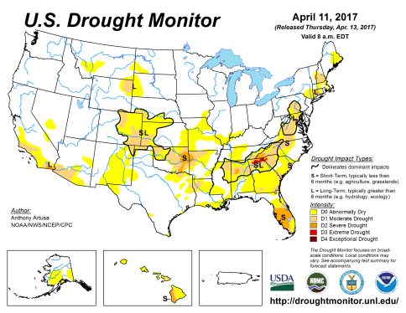
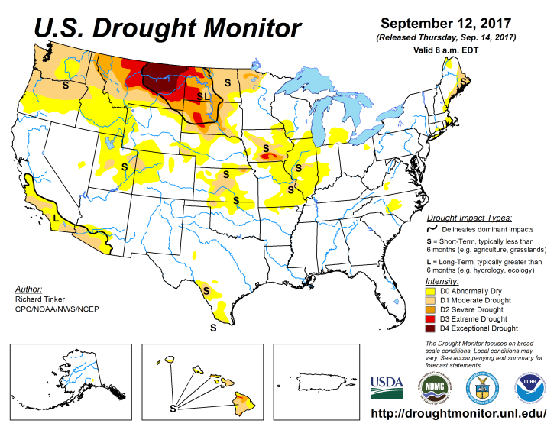
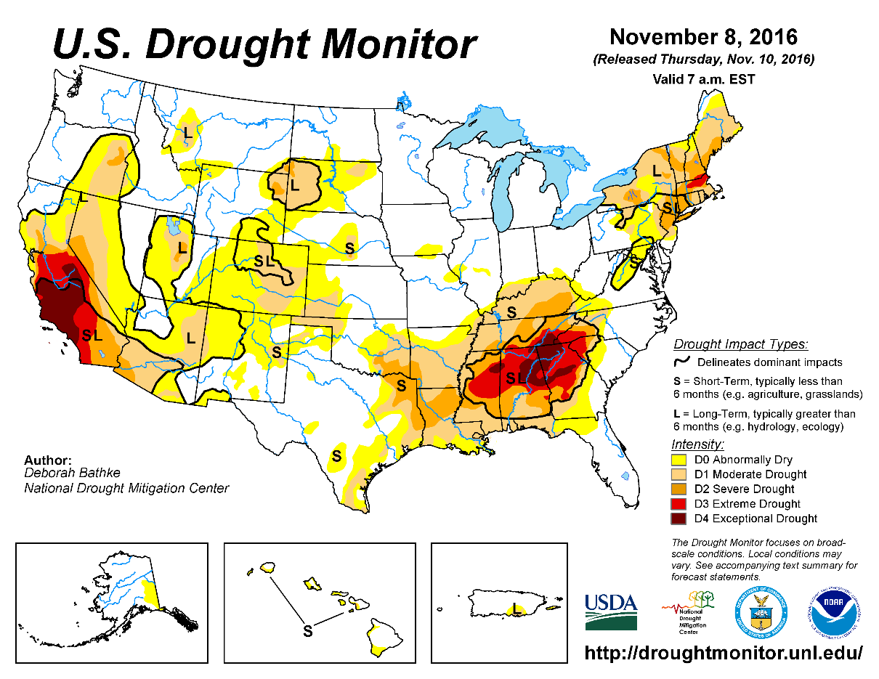
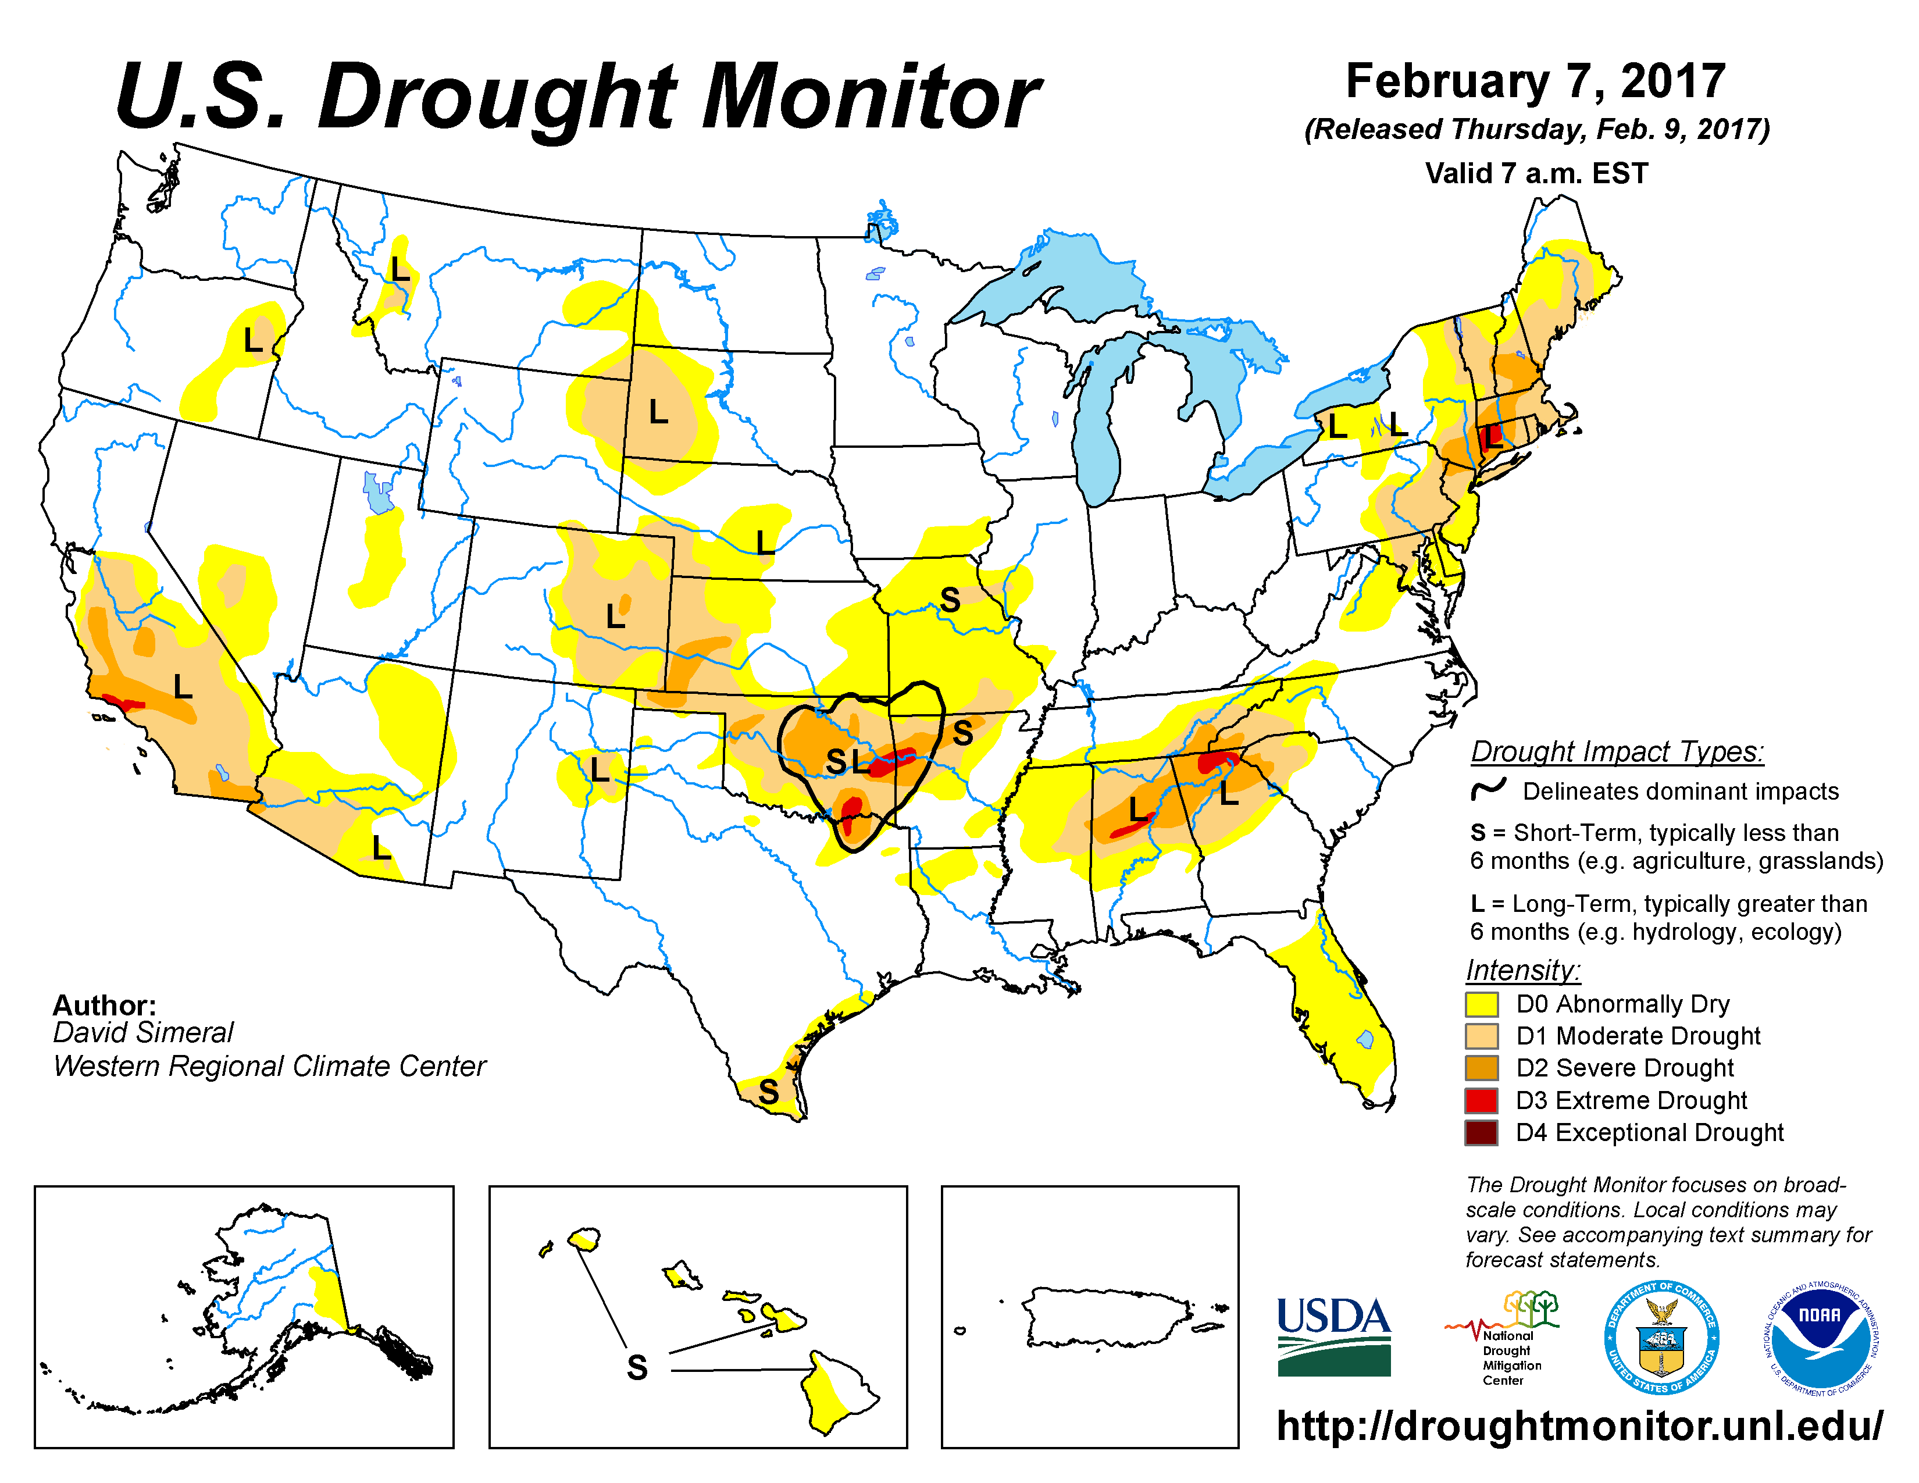
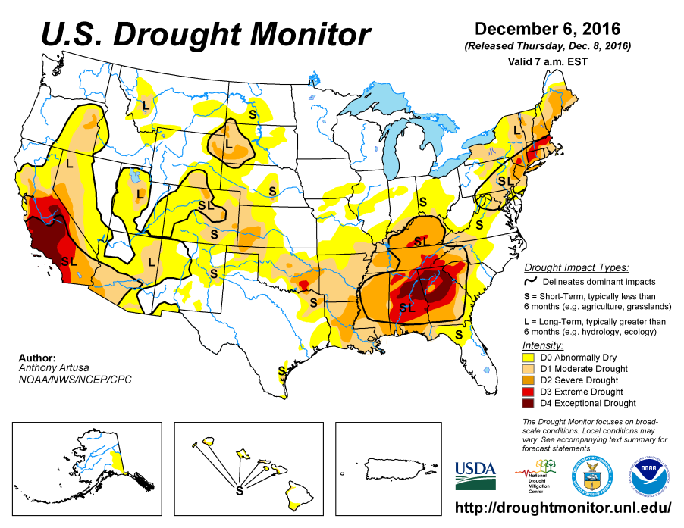
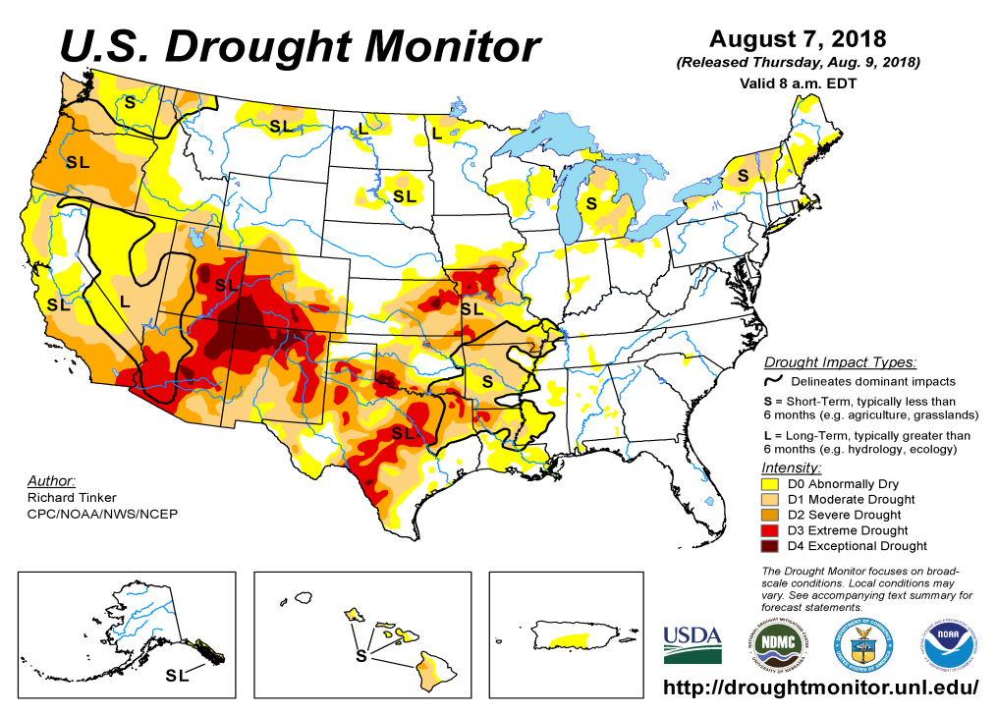
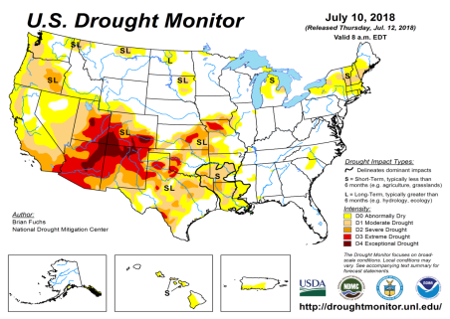
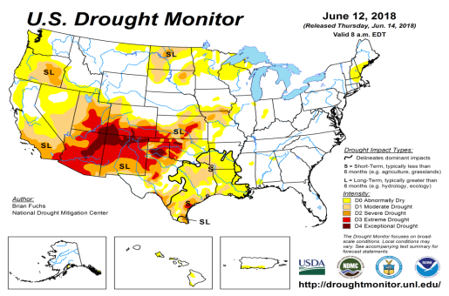
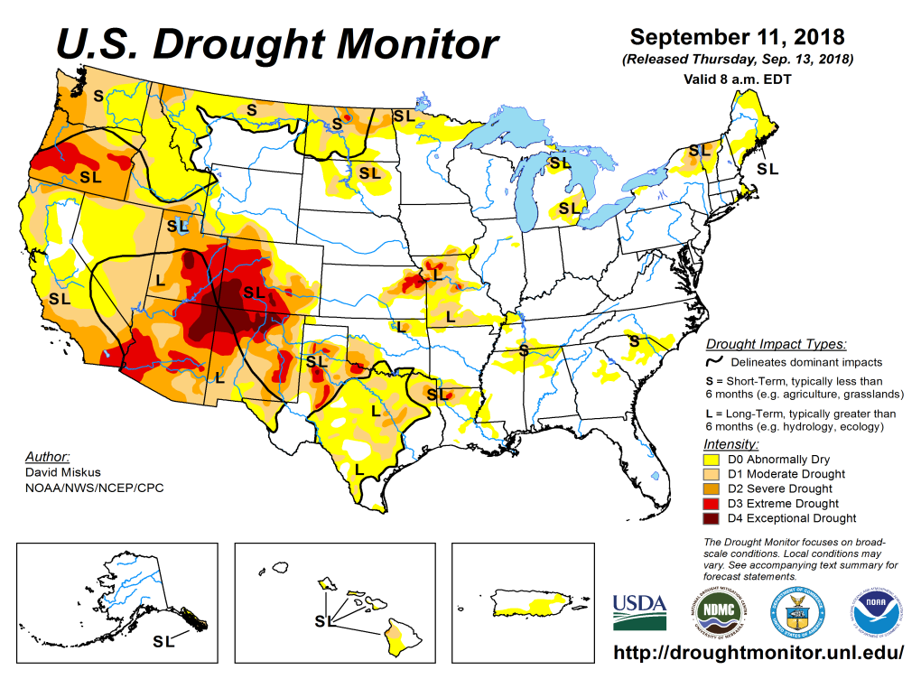
Drought Monitor
August
July
Previous
June
The longstanding drought in the south and west has gotten better in some areas, especially around TX/KS/MO/OK/AR/LA, and in parts of southern AZ/NM.
But drought in Pacific Northwest in OR/WA and in the Northern Plains states ID/MT/ND has gotten worse or has expanded.
Latest/Recent

Slide 3
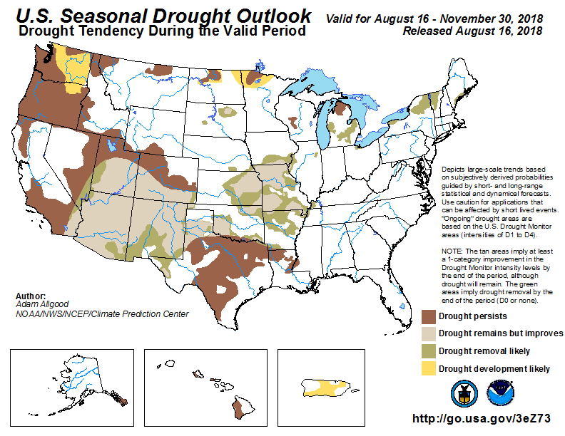
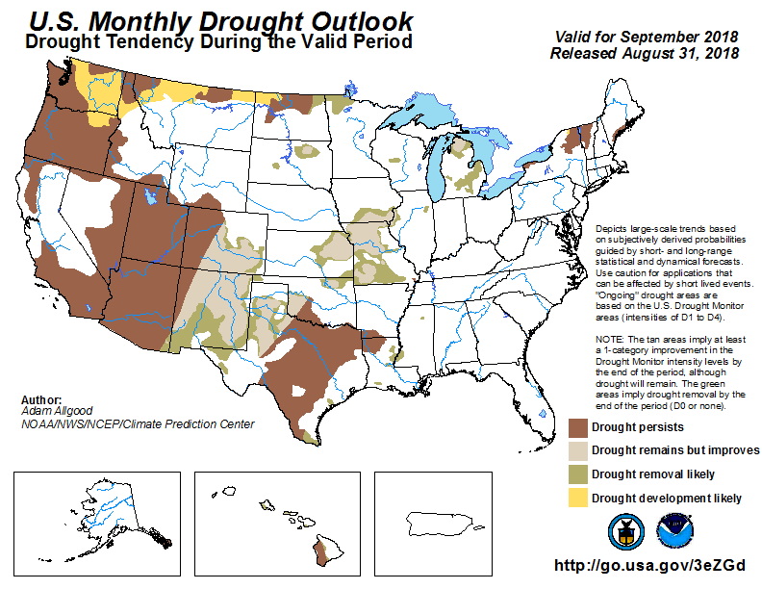
(Prev) Seasonal/Monthly Drought outlooks
Seasonal Outlook (Mid August 2018 - November 2018)
issued 08/16/18
Monthly outlook
(for September 2018)
issued 08/31/18
Comparing with previous slide/points noted therein, much of the forecast outlook features are mostly/right on the mark for the monthly outlook (have to wait on the seasonal outlook!).

Slide 4
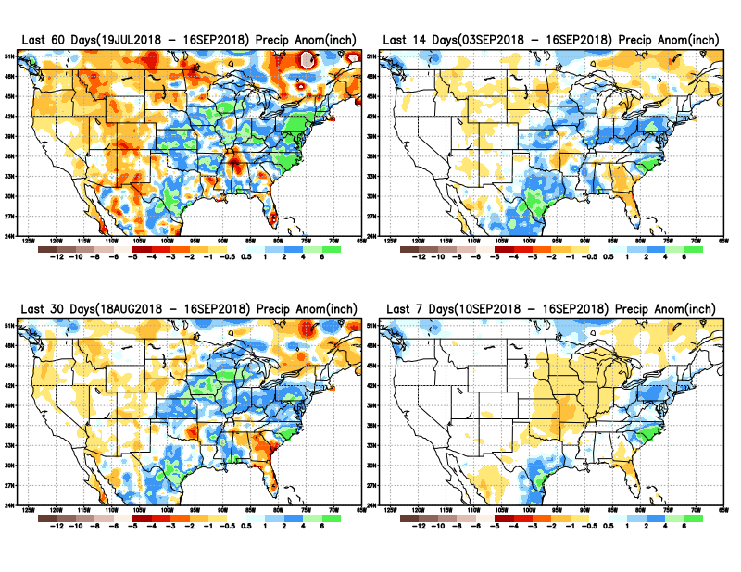
Precipitation ANOM during last 7, 14, 30, & 60 days.
Plenty of rain from Hurricane Florence in the Atlantic coastal states of NC/SC, where it is not needed ☺. (Anom contours only detail deficits (not excess here!)
Recent forecast above normal monsoon rains in the SW did not quite happen.

Slide 5
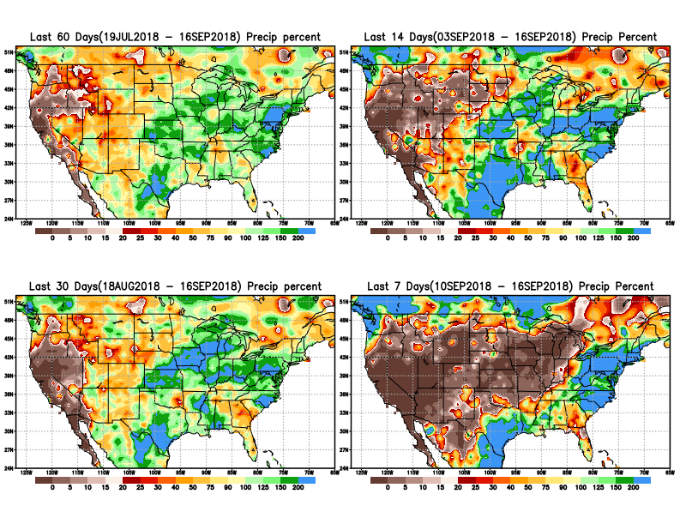
Precipitation Percent during last 7, 14, 30, & 60 days.
This is the dry, fire season in California, and these maps tell us why!
East of CO/NM, in the last one/two months, a good rainfall situation (except a few regions). But west and north of here (NM/CO) relatively less rain.
In the Northeast, in Maine, it is getting dry!

Slide 6
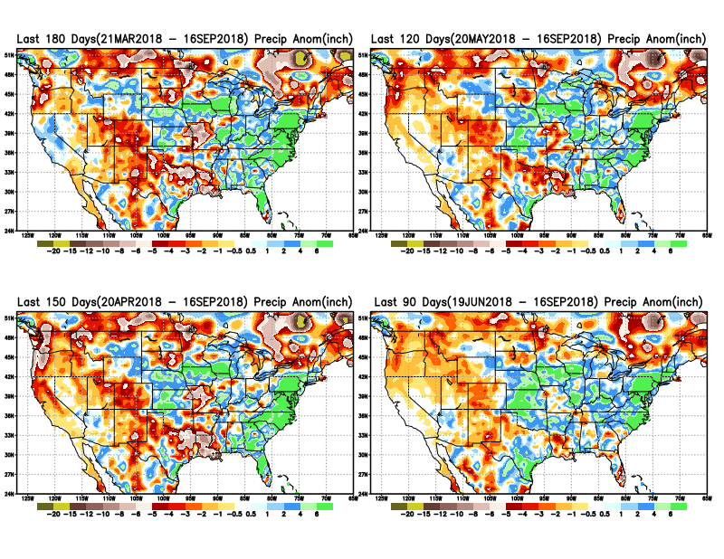
Total precipitation ANOM during last 3, 4, 5, and 6 months.
6 M
4 M
5 M
3 M

Slide 7
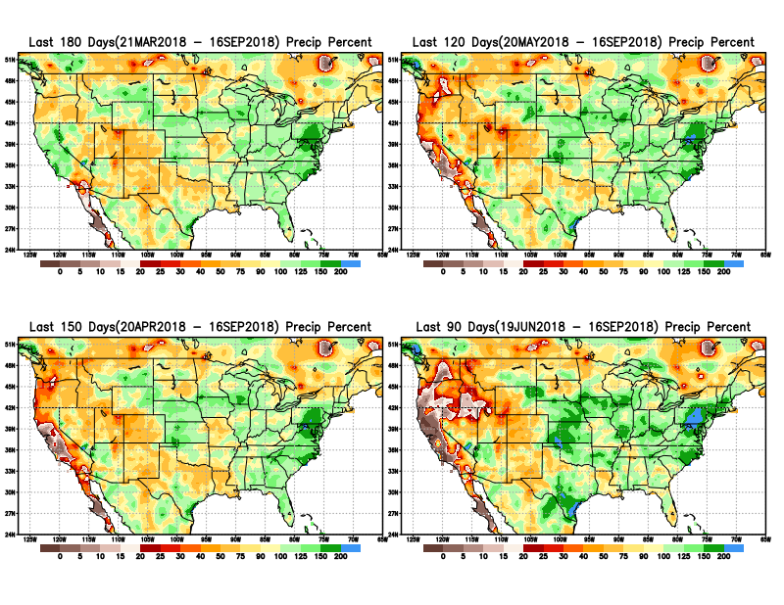
Total precipitation Percent during last 3, 4, 5, and 6 months.
6 M
4 M
5 M
3 M

Slide 8
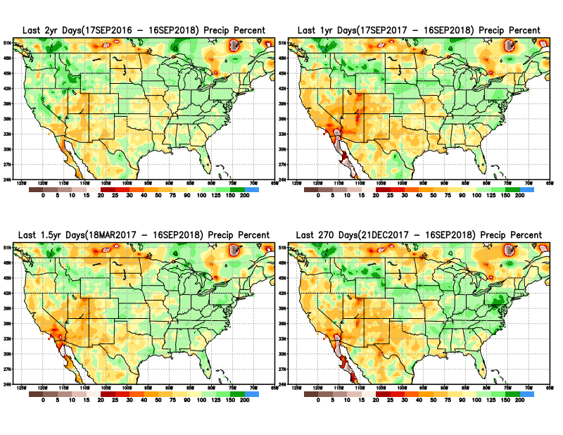
Total precipitation Percent during last 9 months, 1 yr, 1.5yrs, & 2 yrs.
2 Y
1 Y
There are many long term rainfall deficit regions in the country, particularly deficits in UT/AZ, southern CA, and parts of NM/CO are long term – possibly a consequence of the two back to back La Nina’s!
OR
Still longer term variability in play? Especially in the southwest!
1.5 Y
9 M

Slide 9
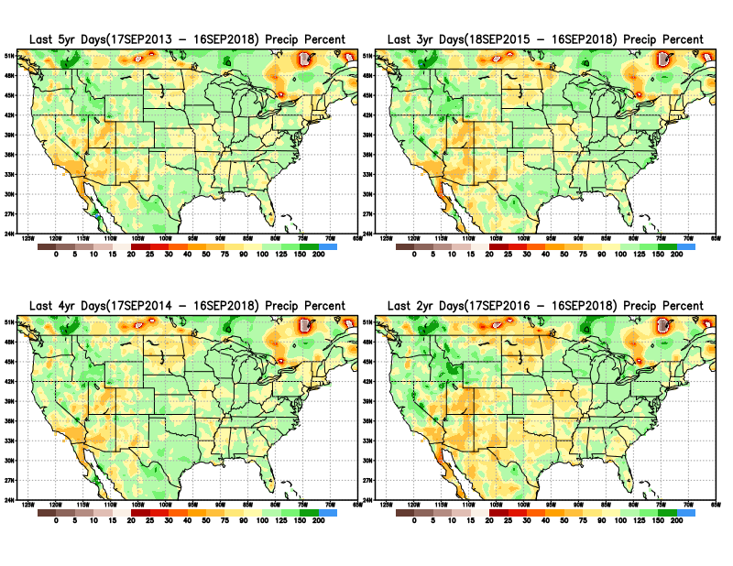
Total precipitation Percent during last 2 yrs, 3 yrs, 4 yrs, & 5 yrs.
5 Y
3 Y
Still longer term variability in play? Especially in the southwest!
4 Y
2 Y

Slide 10
Rainy Season across the US

Slide 11
Upcoming 3-m season’s
Rainy areas!
Adapted from Rich Tinker.

Slide 12
Adapted from
Rich Tinker

Slide 13
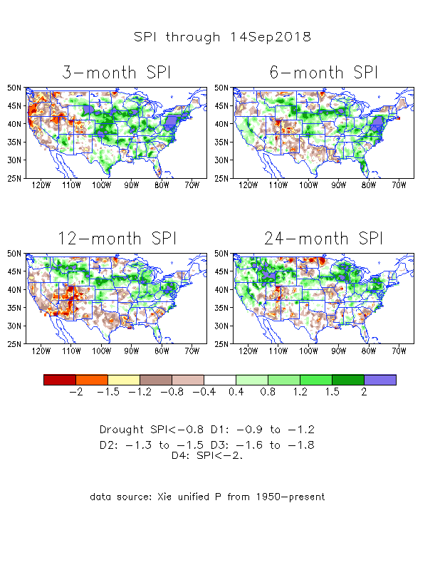
The Standardized Precipitation Index SPI (based on Observed P)
----- NOW
Very interesting graphic & details for the drought across the US based on the more generalized precip deficit/excess, the Standardized Precipitation Index (SPI).
The dark brown and red colors, indicating standardized precipitation deficits, in the various time periods, approximately correspond to the appropriate short/long term drought monitor regions and their intensities
In the short term (~3 mo), overall the drought looks much improved, except in Northwest.
In the longer term ~12m and greater, severe deficits remain in the Southwest and this season’s rains seems not enough to offset last season’s deficits in the Northern Plains.

Slide 14
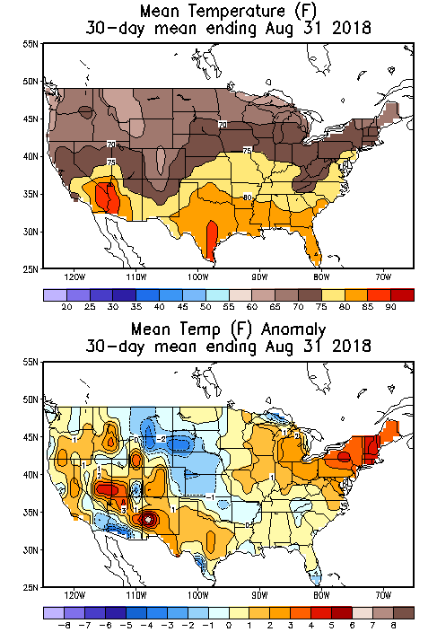
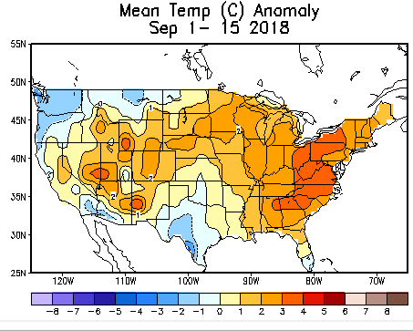
Recent US Temperatures
In August, a pattern with warmth in the west, south and northeast. Relative cool along a northwest to southeast swath.
September so far is somewhat different than August, especially in the middle of the country.

Slide 15
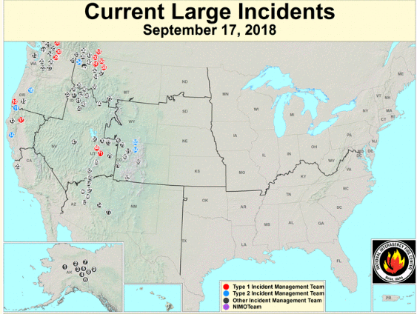
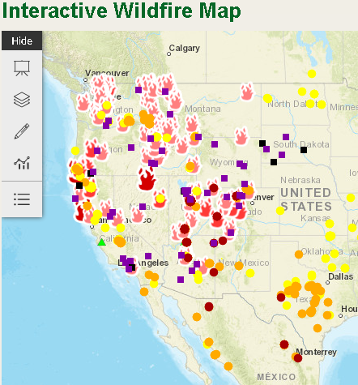
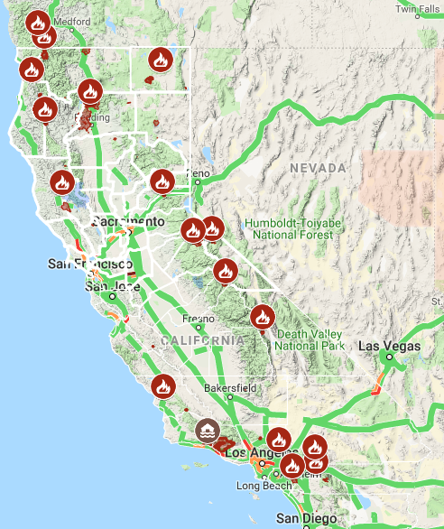
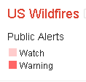
Current Active FIRE
One of the worst, (or probably the worst ?) fire season in CA this year and hence damage/destruction!!
https://fsapps.nwcg.gov/afm/index.php
from Google!
-this morning.
https://www.fs.fed.us/science-technology/fire/information

Slide 16
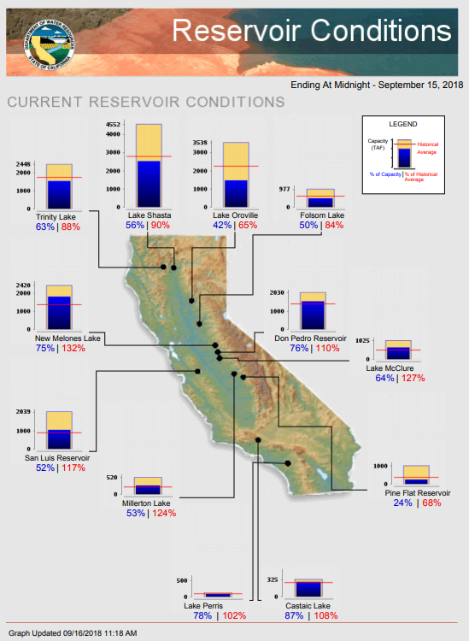
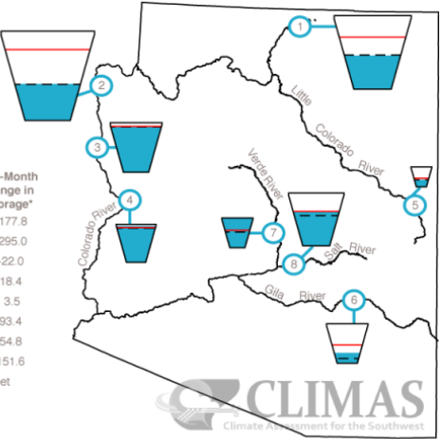
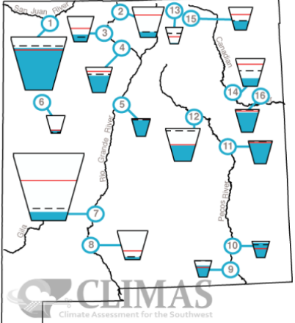
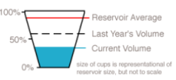
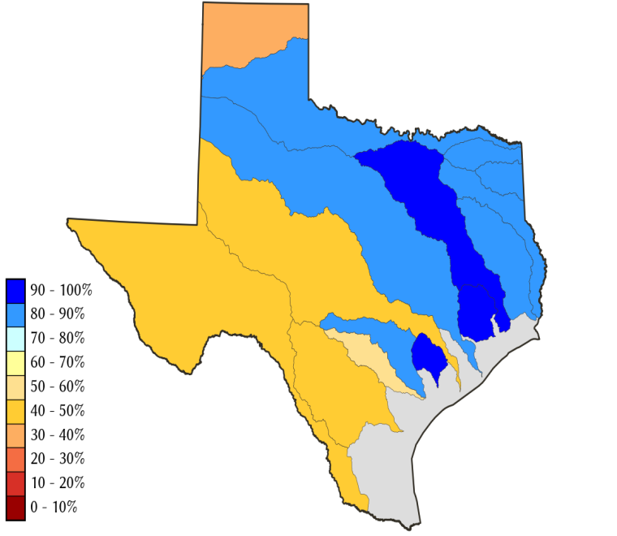
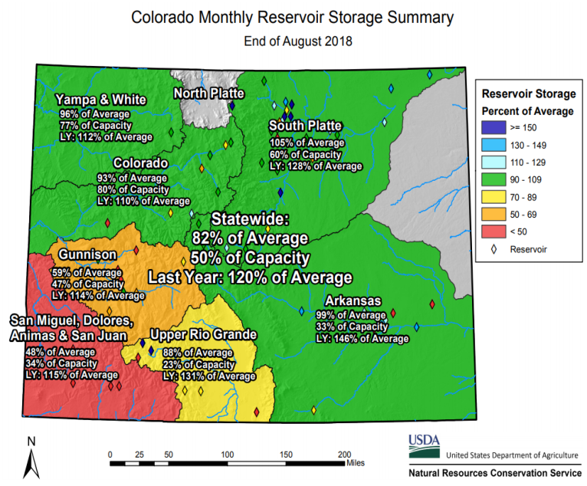
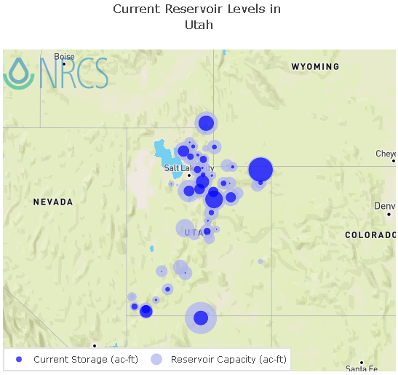
Water Reservoir Levels in some Western/Southern States!
AZ
NM
Northern CA reservoirs beginning to show
weakness
TX
UT
https://fsapps.nwcg.gov/afm/index.php

Slide 17
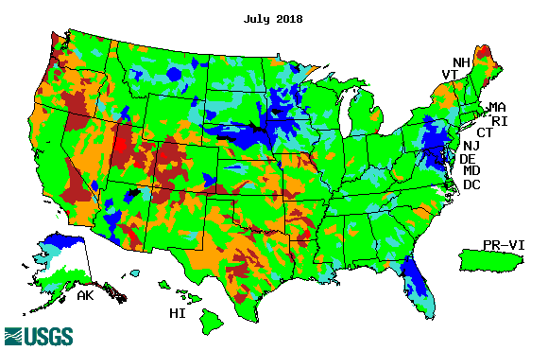
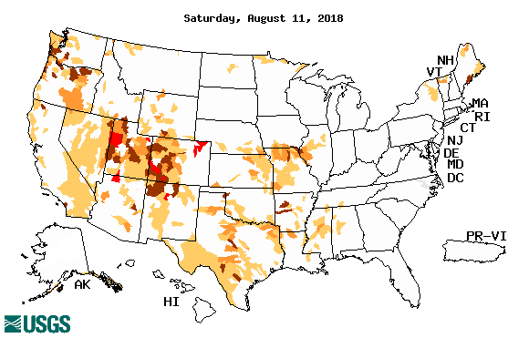
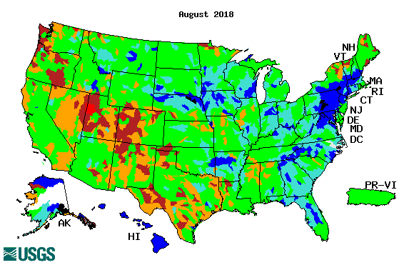
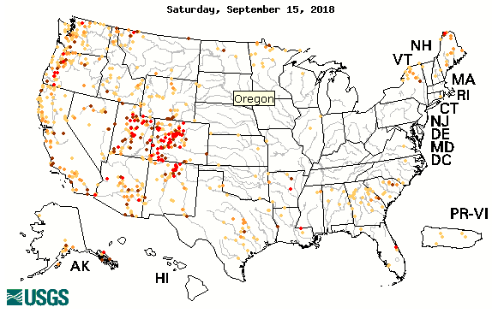
Streamflow (USGS)
Streamflow overall in the South, is slightly better in August (and more in September), than in July.
Same can be said in the Northeast.
In the Northern Plains, conditions relatively similar in both months.
Map shows only below normal 7-day average streamflow compared to historical streamflow for the day of year.
One month ago (left) &
Now (below)
17

Slide 18
EL NIÑO/SOUTHERN OSCILLATION (ENSO)
DIAGNOSTIC DISCUSSION
issued by CLIMATE PREDICTION CENTER/NCEP/NWS and the International Research Institute for Climate and Society
13 September 2018
ENSO Alert System Status: El Nino Watch !!
Synopsis: ENSO-neutral conditions are present. Equatorial sea surface temperatures (SSTs) are near-to-above average across most of the Pacific Ocean. There is a 50-55% chance of El Niño onset during the Northern Hemisphere fall 2018 (September-November), increasing to 65-70% during winter 2018-19.

Slide 19
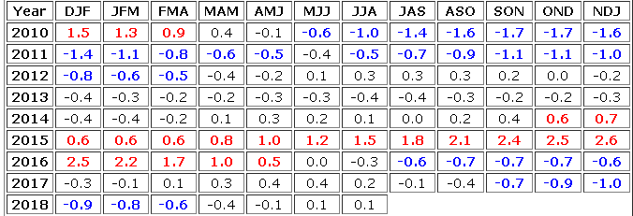
In Neutral Conditions NOW! But for how long?
Trending towards El Nino!!! In Fall / Winter ?
http://www.cpc.ncep.noaa.gov/products/analysis_monitoring/ensostuff/ensoyears.shtml

Slide 20
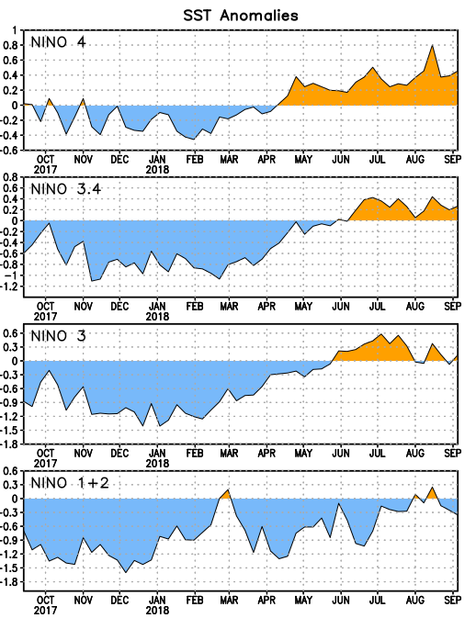
Latest values of SST indices in the various Nino Regions.
The sub surface heat anom continues to stay in the +ve territory! .
Relatively short lived!
Equatorial SST’s are at near to slightly above normal levels in all three ocean basins, except in Nino 4, where it is high!

Slide 21
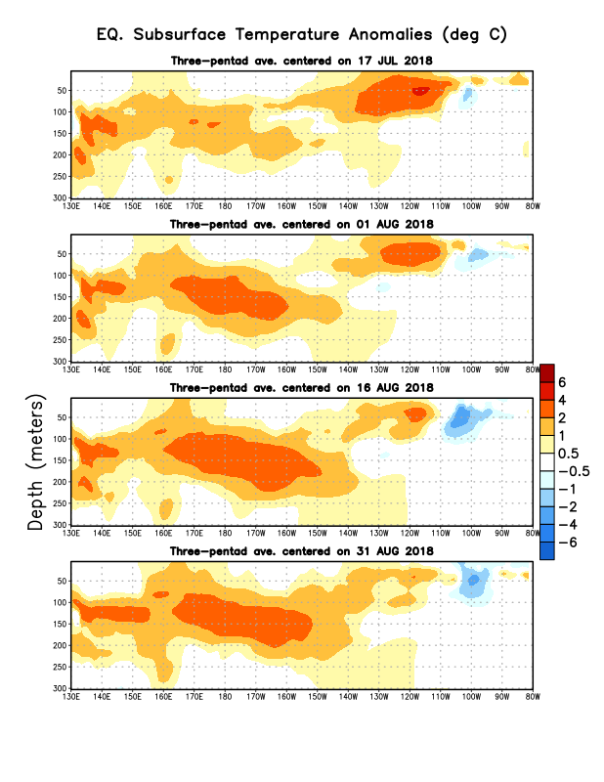
In spite of the recent, relatively weaker SST anomalies, as compared to previous month (previous slide), this is what is happening in sub surface near the equator! Does this mean, still the same probabilities in the upcoming months/seasons for El Nino? Models say:

Slide 22
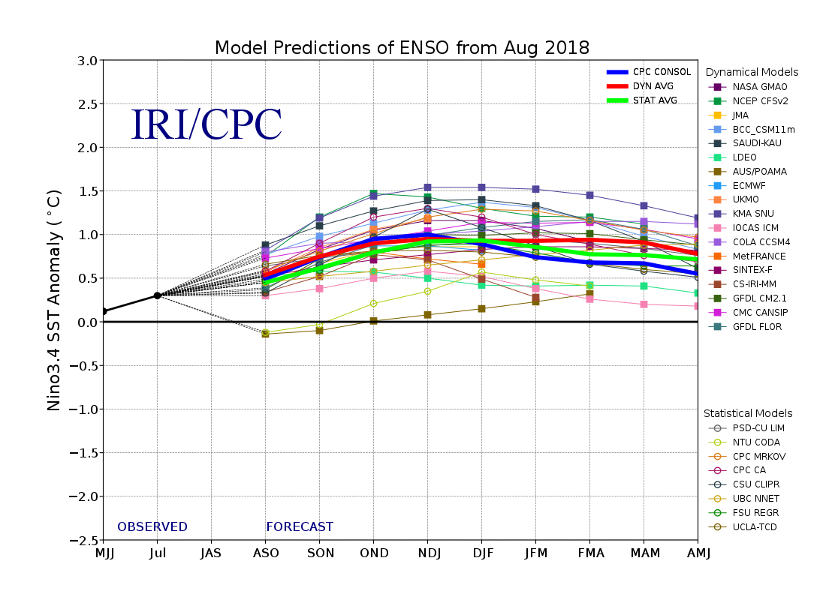
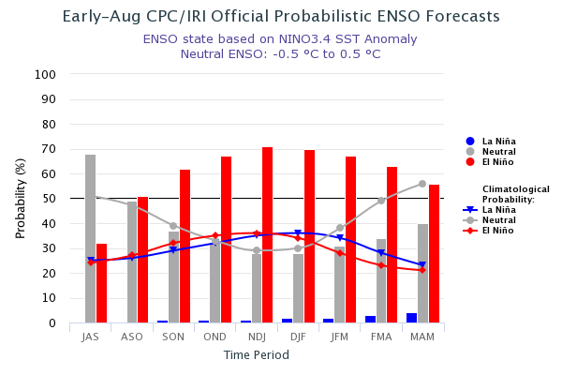
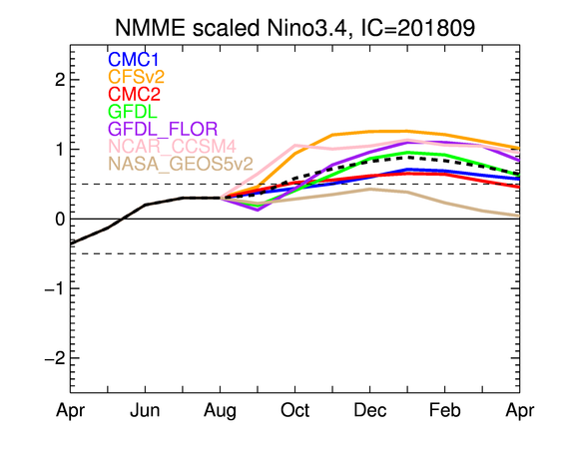
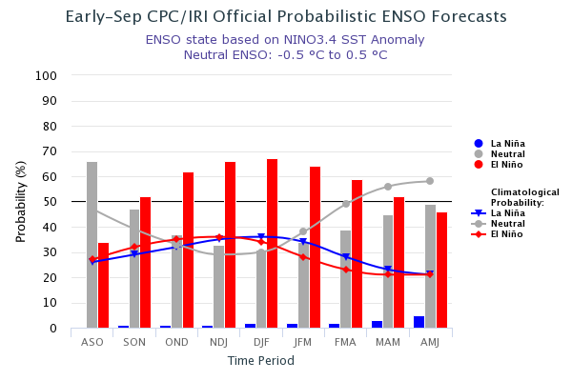
ENSO Forecasts
Early- August CPC/IRI forecast
NMME Models’ – Nino 3.4 forecasts
Early- September CPC/IRI forecast
Neutral conditions. Probability of developing El Nino in Fall/2018 ~ 50-55 %.(in fact, close to 50% than 55%), lower than last month!!

Slide 23
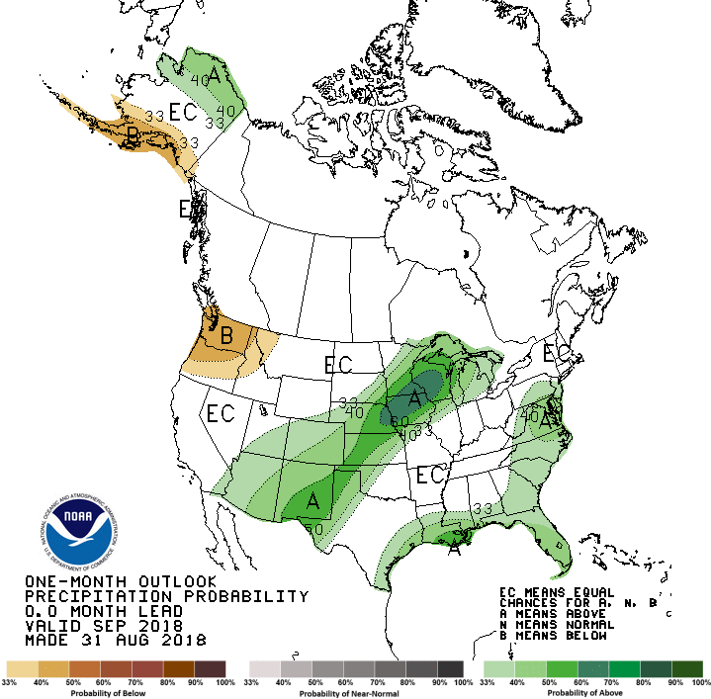
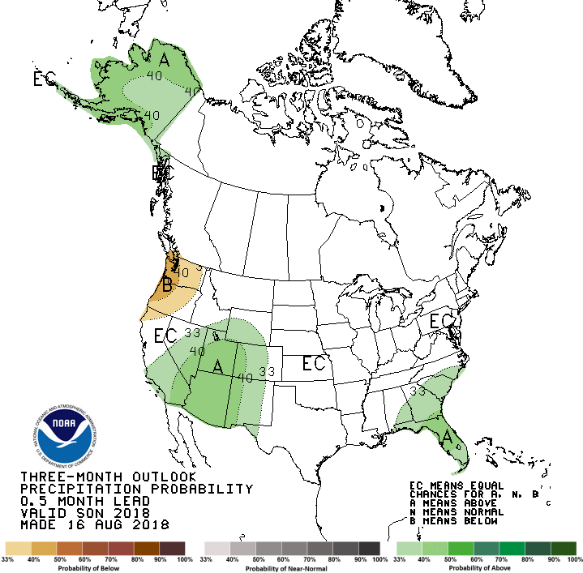
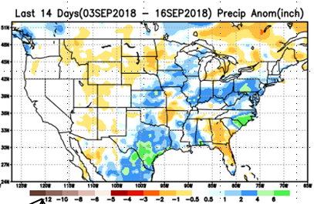
Previous CPC’s official Monthly (Sep)/Seasonal (SON)
Precipitation outlook
Released August 31st
Observed so far this month!!
Released Aug 16th

Slide 24
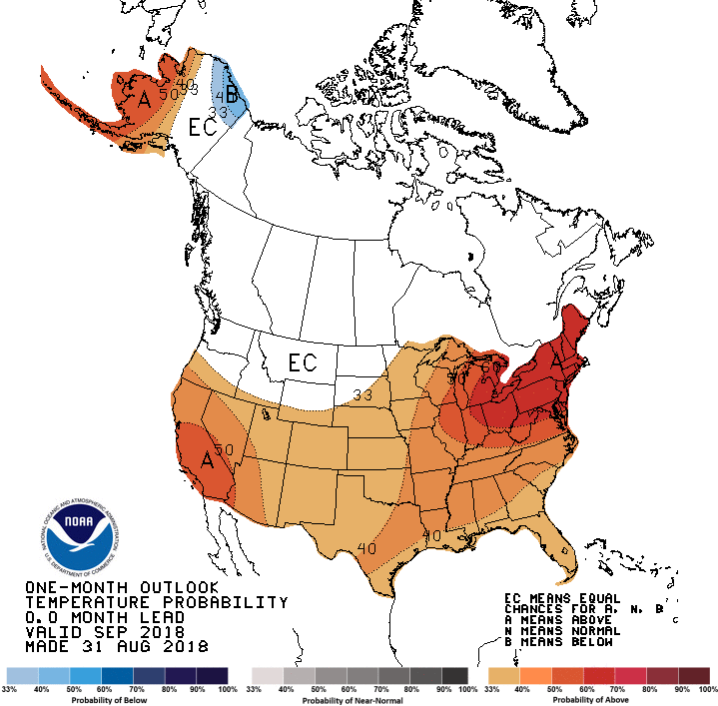
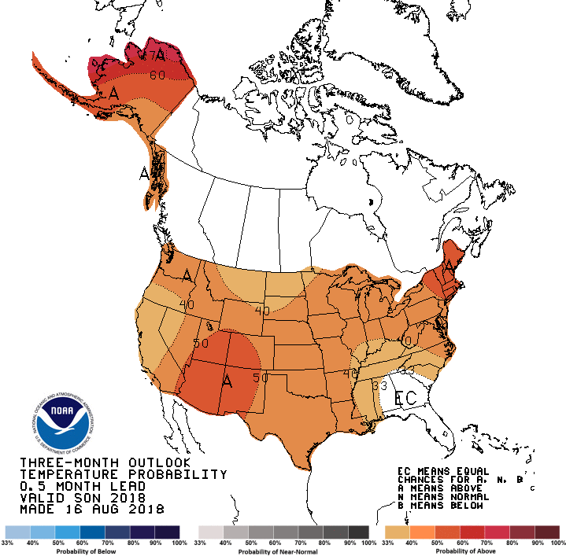
Previous CPC’s official Monthly (Sep)/Seasonal (SON)
Temperature outlook
Made
Aug 31st
Made Aug 16th
Observed so far this month!!

Slide 25
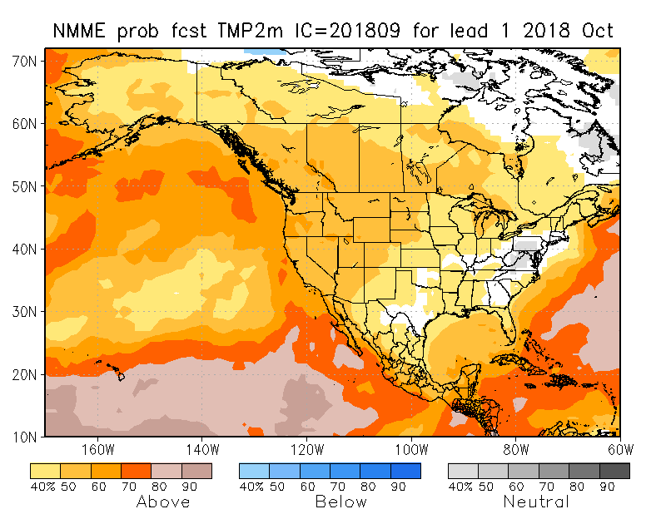
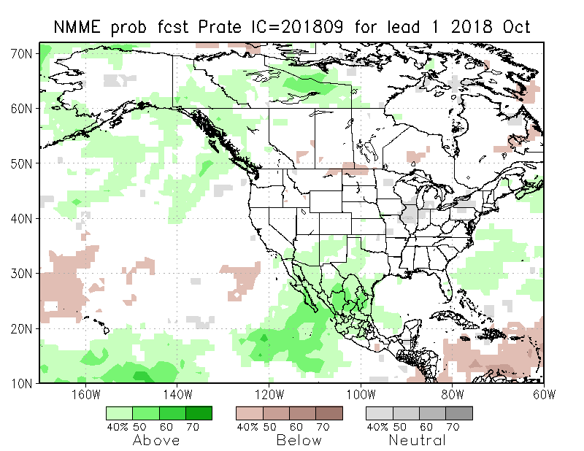
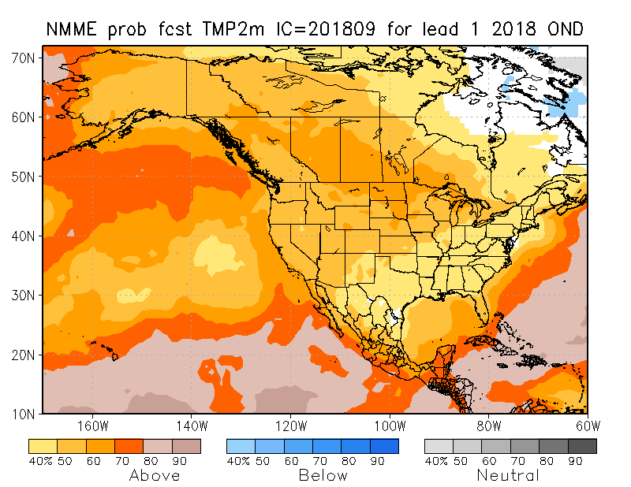
NMME T & P EnsMean forecasts
Oct
OND
Current ENSO state is neutral!! Fcst. is based on expected developing El Nino conditions!! Forecast is for similar looking monthly & seasonal forecasts for both T & P! Warm over the whole country, and slightly wet over the southwest country (except the Pacific NW). Some dryness expected in the Pacific NW states!

Slide 26
Prate ANOM forecast - NMME
26

Slide 27
The agreement/uncertainty among the diff. NMME models’ forecasts (middle and bottom panels) for Oct-Nov-Dec Precipitation!!!
27

Slide 28
Next 7 days QPF Forecast
GFS Model Guidance for next 16 days.
Areas of expected precip in the drought affected regions!
Coastal Northwest, Northern Plains, central/eastern AZ, NM, northwestern TX, KS, OK, MO, Ohio valley

Slide 29
SPI3
SPI6
SPI3 & SPI6
Forecasts from 6NMME Models
(uses obs. P up to past month, and forecast months’ P from NMME models)
The goodness and skill of these SPI’s forecasts depend directly on these NMME models’ skill in predicting precipitation!!!
The NMME models indicate that by October, the short term SPI(3) will all be in the +ve territory, over the monsoon southwest, and even across entire country ☺, but longer term dryness/drought will stay in some areas. What about even longer term deficits ?

Slide 30
SPI3
SPI6
SPI12
SPI3 & SPI6 & SPI12
This from Last Month
Compare with current Maps to see how good these fcst maps are: Are just as good/bas as NMME precip fcsts!!

Slide 31
Hydrological Monitoring and Seasonal Forecasting @ MSU (Michigan State University ) NLDAS model
Monthly Soil Moisture Percentile Prediction issued on 201809 with this IC.
http://drought.geo.msu.edu/research/forecast/smi.monthly.php
The inter quartile range suggest greater uncertainty about the forecast in these shaded regions.

Slide 32
Precip Forecast
NASA GEOS5 Forecasts
Sep
Soil Moisture Forecast Percentile
Oct
IC
Sep
Nov
Oct
Nov

Slide 33
(This and next slide!) Exptl. Probability Drought Outlook from Kingtse Mo and Li Xu based on NMME ensemble members’ SPI6 (from precip) forecast – Since it is based on SPI6, longer/term lasting droughts will not be depicted!!

Slide 34
Oct 2018
In the official
Drought Outlook Tendency Format!!
OND 2018

Slide 35
Summary
Current ENSO status and forecast. ENSO neutral conditions are present! El Nino Watch! There is ~50-55 % chance of El Niño in the Northern Hemisphere fall 2018 (September-November), increasing to ~65-70% during winter 2018-19. These upcoming El Nino probabilities are slightly lower than the numbers from last month.
Current Drought conditions:
The improvement seen in 2018 early/middle summer in the Northern Plains drought continuing from 2017, that affected eastern Montana, and the North/South Dakotas, did not completely recover from this year’s/season’s(2018 MJJAS) rains. The drought continues to persist(even expand slightly) in a weakened form, though not as strong as it was at this time last year. The longer term dryness continues (esp. in Dakotas)!
The much larger and more important South/Southwest drought, which is predominantly, but also a consequence of the rainfall deficit associated with the two recent back to back La Ninas that ended, is undergoing changes in intensity and size. Since last month, short term improvement and short term drought improvement/removal is noted across parts of KS/OK/MO/AR/LA.
Dryness/Drought is expanding/developing in the Pacific Northwest states expanding into ID.
Prediction:
Under El Nino Watch!! At present, development of El Nino in Fall 2018 is at best only marginally better than 50/50 chances! In spite of the tropical Pacific’s surface SST weakness, sub surface Pacific conditions are still reasonably warm and pointing towards El Nino. Models and forecasters continue to predict/expect El Nino conditions to develop in Fall and Winter! Consequently, in the next three months, all models indicate slightly above normal rainfall particularly across the South and West, dryness in the Pacific Northwest. But in upcoming season, seasonal rains will arrive esp. in mid/late November and December all along Pacific western states and adjoining states. Increasing chances of El Nino will definitely help the drought in the south and west, and hence contribute to improving short term improvement, but longer term dryness will persist!
The Northern Plains Drought ,in some areas of the N/S Dakotas, may continue to exist in a muted form for the season, since the previous rainfall deficits are not completely erased this year.
In the Pacific Northwest, the accruing rainfall deficits, below normal rainfall forecast for the season, above normal temperatures may enhance drought conditions there, but late season rainfall will help!
In the east, most regions will likely to be drought free. ***END***

Slide 36
Miscellaneous maps

