Slide 1
Drought Outlook Support Briefing September 2019
Climate Prediction Center/NCEP/NOAA
http://www.cpc.ncep.noaa.gov/products/Drought
Phone: 1-877-680-3341
Pwd: 858747#

Slide 2
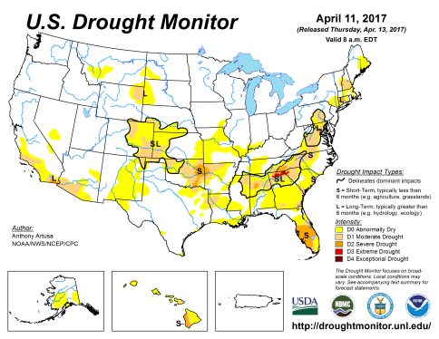
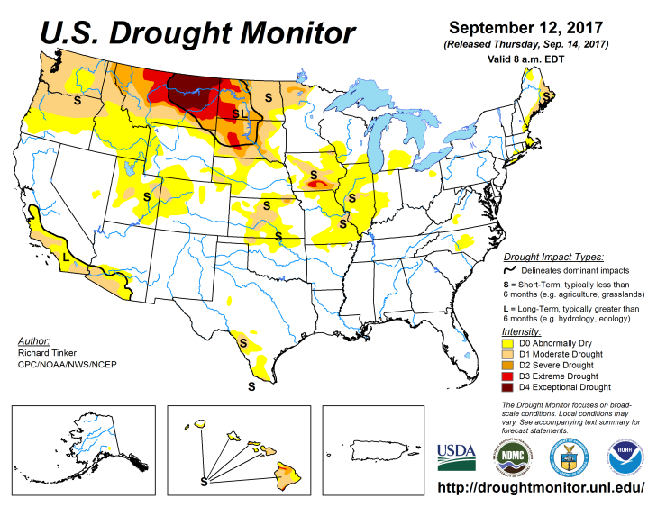
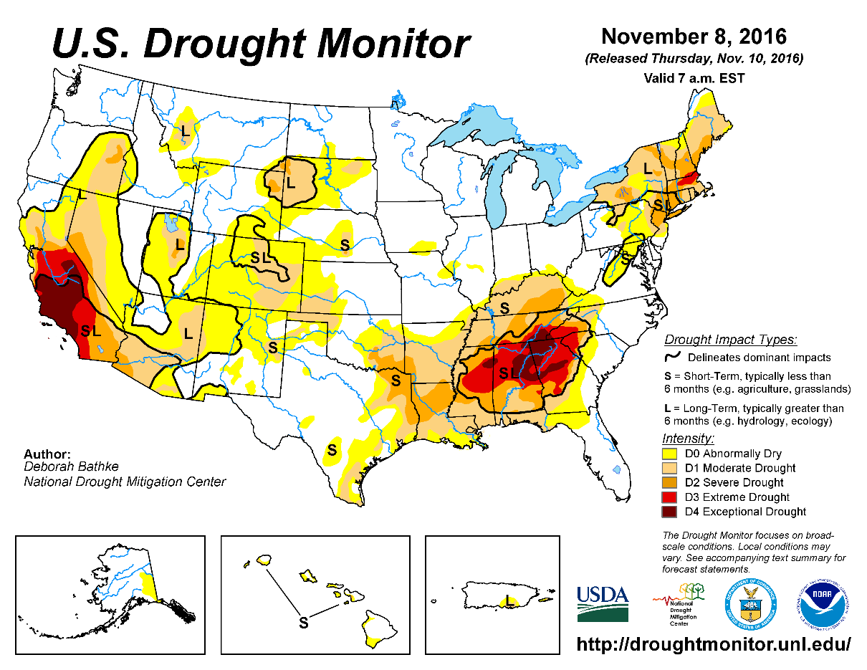
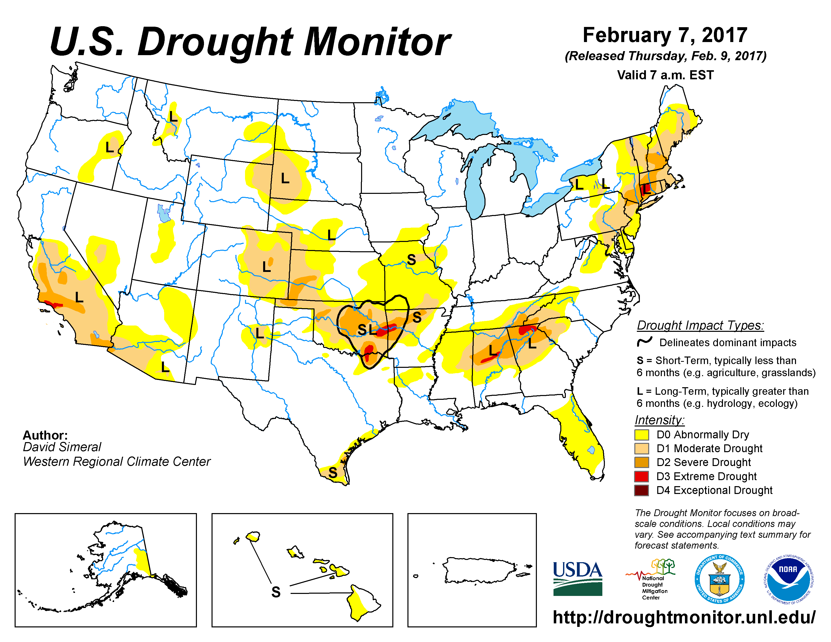
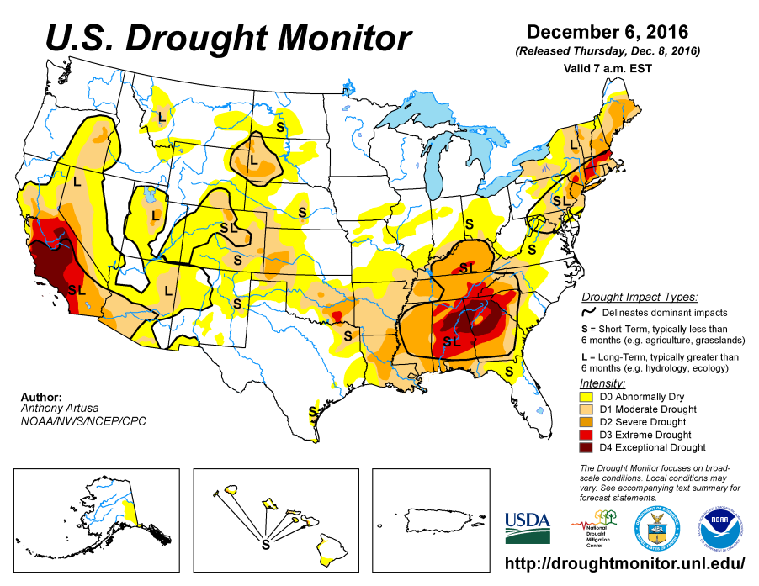
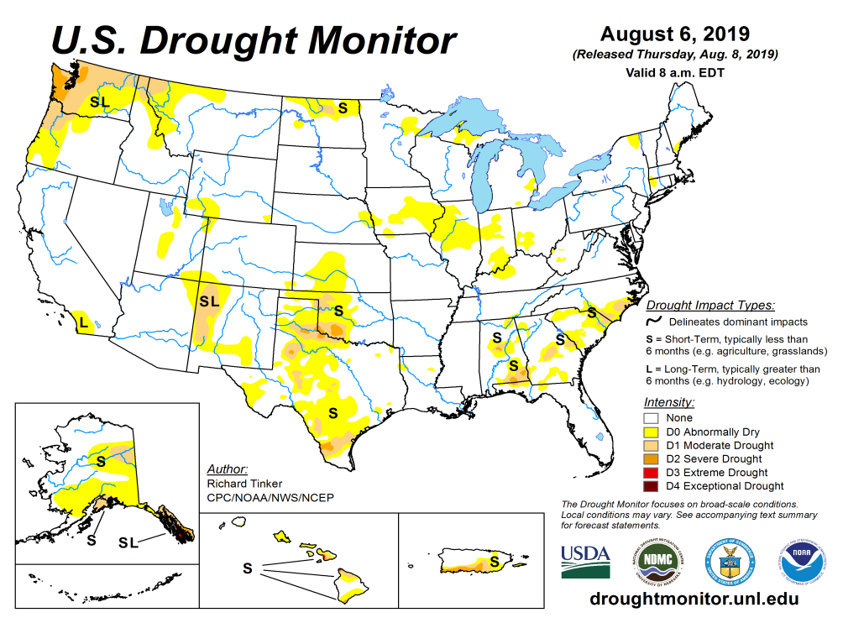
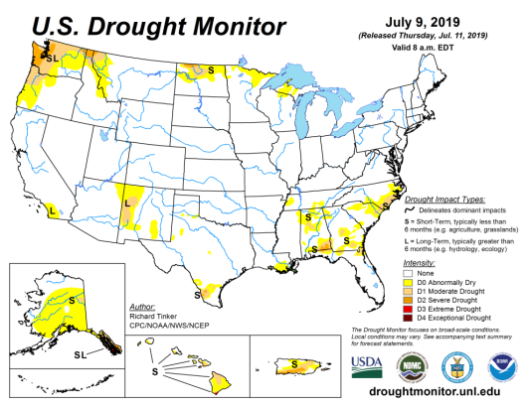
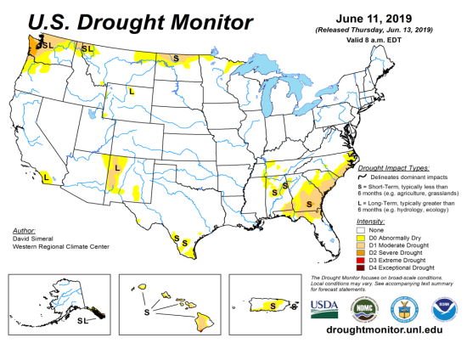
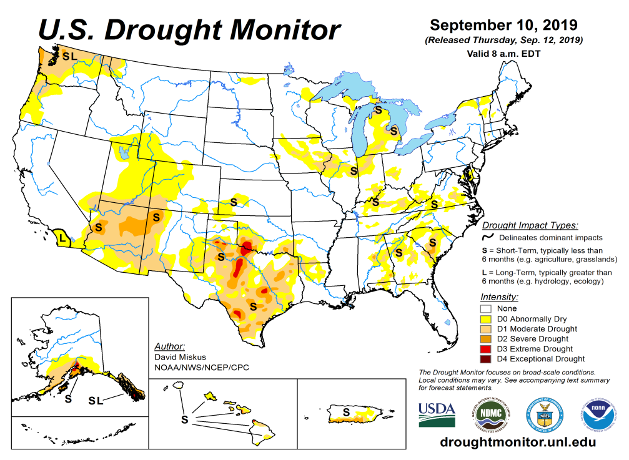
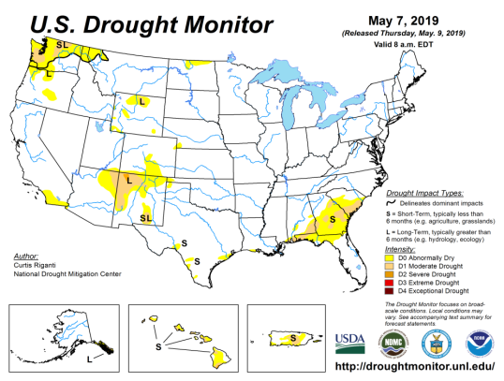
Drought Monitor
August
July
After reaching a relative minimum in the area of drought coverage across the US, it is now slowly beginning to surge.
According to the DM, these regions have droughts:
Pacific NW & nearby regions
Many regions across the south including TX, OK, AZ, NM, UT, CO, and
Small pockets spread across the southeast and upper Midwest.
June
Recent/Latest
May
February

Slide 3
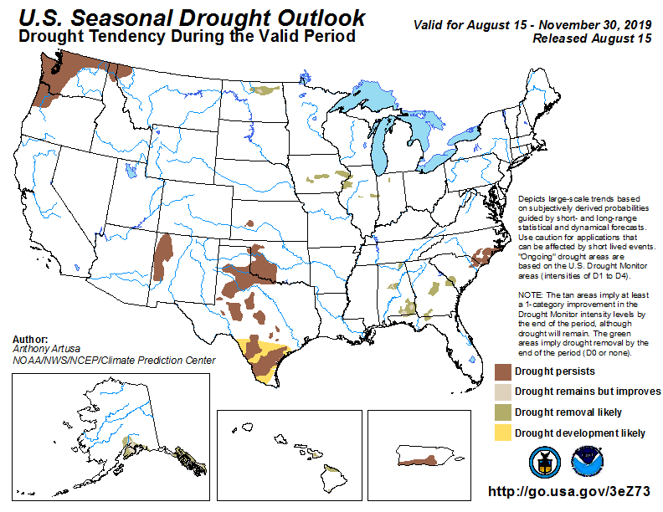
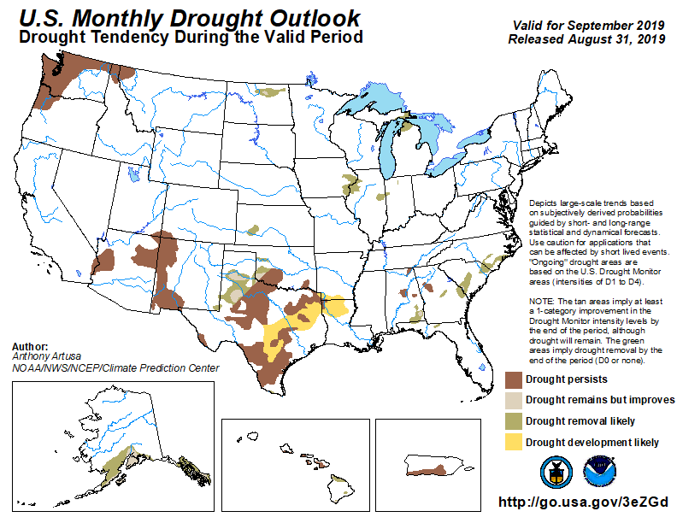
(Prev) Seasonal/Monthly Drought outlooks
(New Seasonal Drought Outlook to be released in 2 days!)
Seasonal Outlook
(Mid Aug 2019- Nov 2019)
issued 8/15/19
Monthly outlook
(for Sep 2019)
issued 8/31/19
The uncertainties in the monthly/seasonal rainfall/temperature outlooks directly impacts these drought outlooks!!

Slide 4
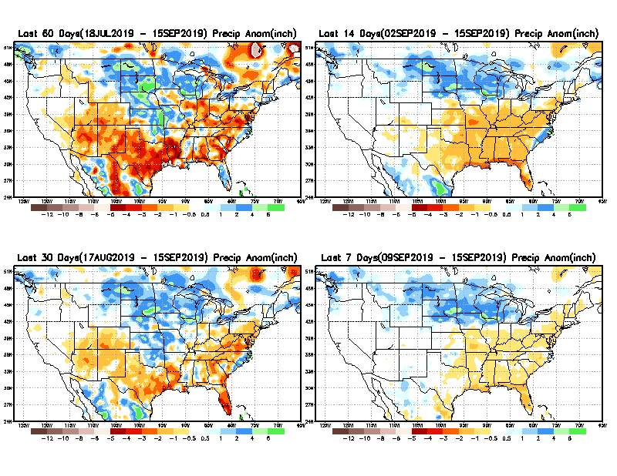
Precipitation ANOM during last 7, 14, 30, & 60 days.
60 Days
14 Days
These maps in this and following slides, including
a) Total,
b) Anom and c) Percent of precip. in these and other longer time ranges are now daily updated at:
30 Days
7 Days
From: Recent Accumulated Precipitation https://www.cpc.ncep.noaa.gov/products/Drought/briefing_prcp.shtml

Slide 5
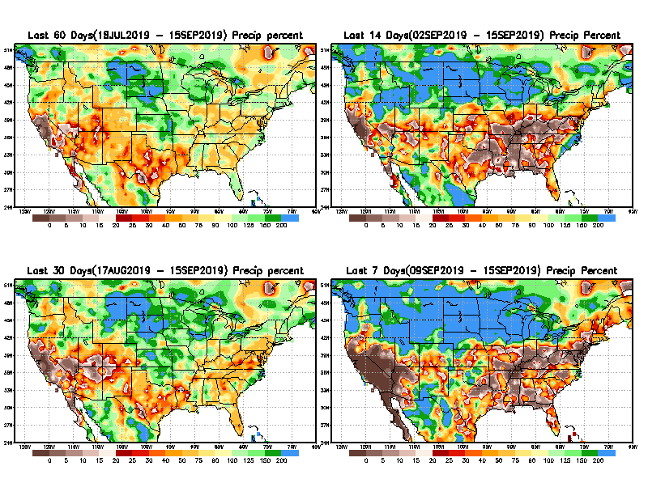
Precipitation Percent during last 7, 14, 30, & 60 days.
60 Days
14 Days
NOW !
30 days
7 Days
From: Recent Accumulated Precipitation https://www.cpc.ncep.noaa.gov/products/Drought/briefing_prcp.shtml

Slide 6
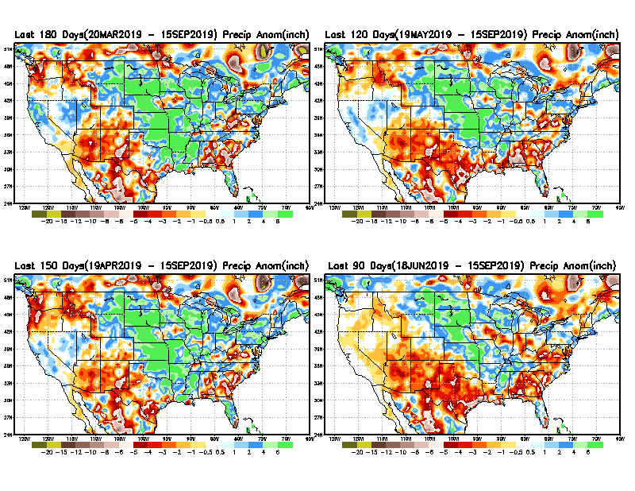
Total precipitation ANOM during last 3, 4, 5, and 6 months.
6 M
4 M
5 M
3 M
From: Recent Accumulated Precipitation https://www.cpc.ncep.noaa.gov/products/Drought/briefing_prcp.shtml

Slide 7
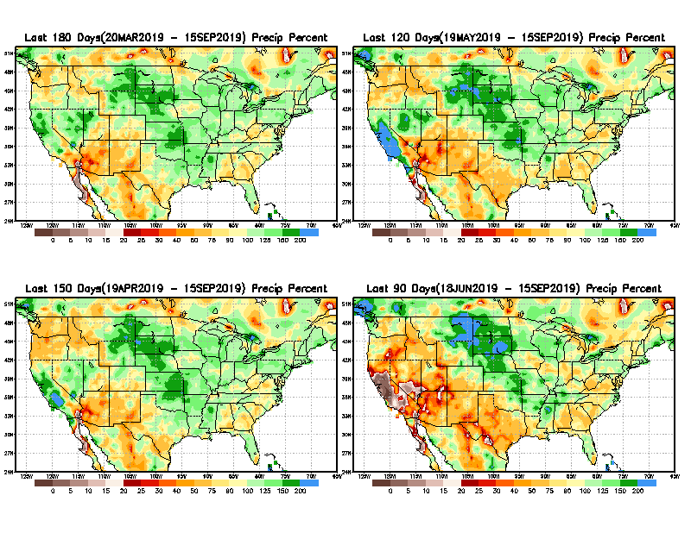
Total precipitation Percent during last 3, 4, 5, and 6 months.
6 M
4 M
Albuquerque NWS office
Forecast above normal JAS 2019 near to slightly above normal in the northern NM area. So far, it is not panning out.
5 M
3M

Slide 8
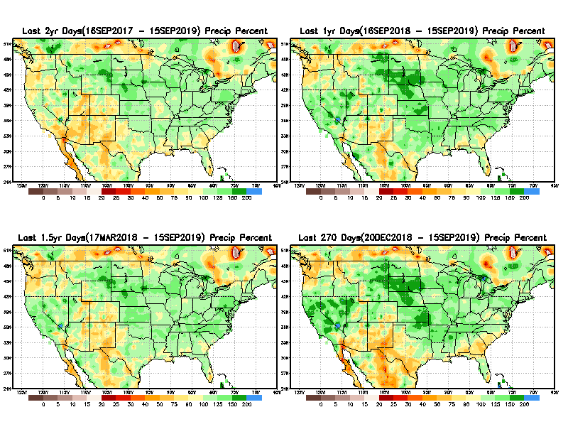
Total precipitation Percent during last 9 months, 1 yr, 1.5yrs, & 2 yrs.
2 Y
1 Y
1.5 Y
9 M
From: Recent Accumulated Precipitation https://www.cpc.ncep.noaa.gov/products/Drought/briefing_prcp.shtml

Slide 9
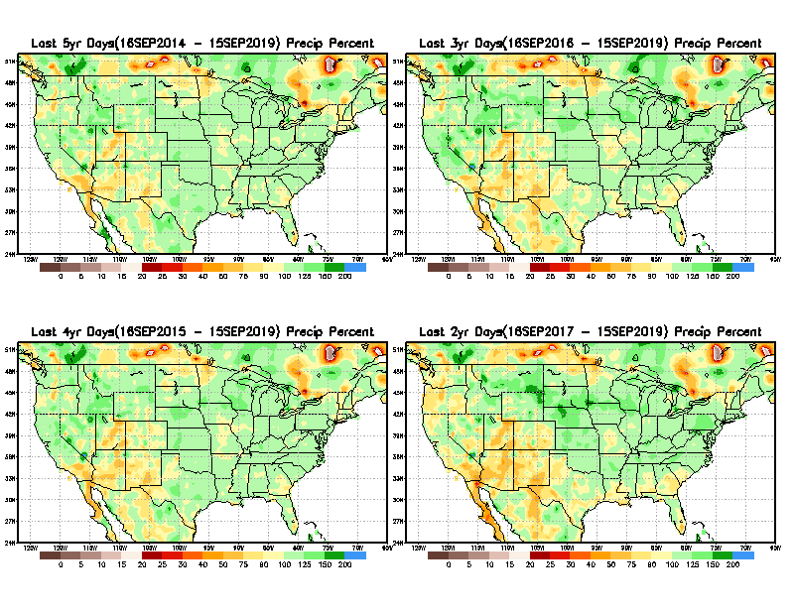
Total precipitation Percent during last 2 yrs, 3 yrs, 4 yrs, & 5 yrs.
5 Y
3 Y
Still longer term rainfall deficit variability in play? Especially in the southwest!
Will these deficits ever go away, OR is these part of the new norm??
4 Y
2 Y
From: Recent Accumulated Precipitation https://www.cpc.ncep.noaa.gov/products/Drought/briefing_prcp.shtml

Slide 10
Rainy (3-month)Season across the US

Slide 11
Adapted from Rich Tinker.

Slide 12
Adapted from
Rich Tinker

Slide 13
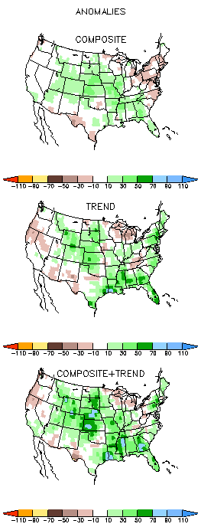
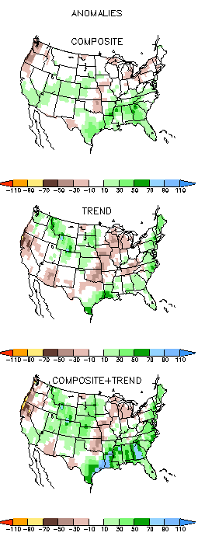
EL NINO Precip COMPOSITES & Trend maps
ASO
SON
Only this is of relevance to us now due to ENSO status.

Slide 14
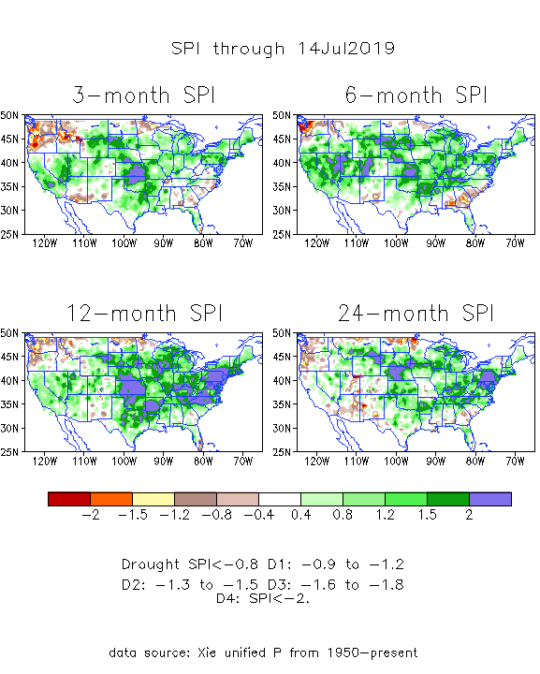
The Standardized Precipitation Index SPI (based on Observed P)
---2 months ago
Very interesting graphic & details for the drought across the US based on the more generalized precip deficit/excess, the Standardized Precipitation Index (SPI).
The dark brown and red colors, indicating standardized precipitation deficits, in the various time periods, approximately correspond to the appropriate short/long term drought monitor regions and their intensities
How quickly the short term drought situation changes!!
Compare these patterns just 2 months ago to current situation now (next slide!)

Slide 15
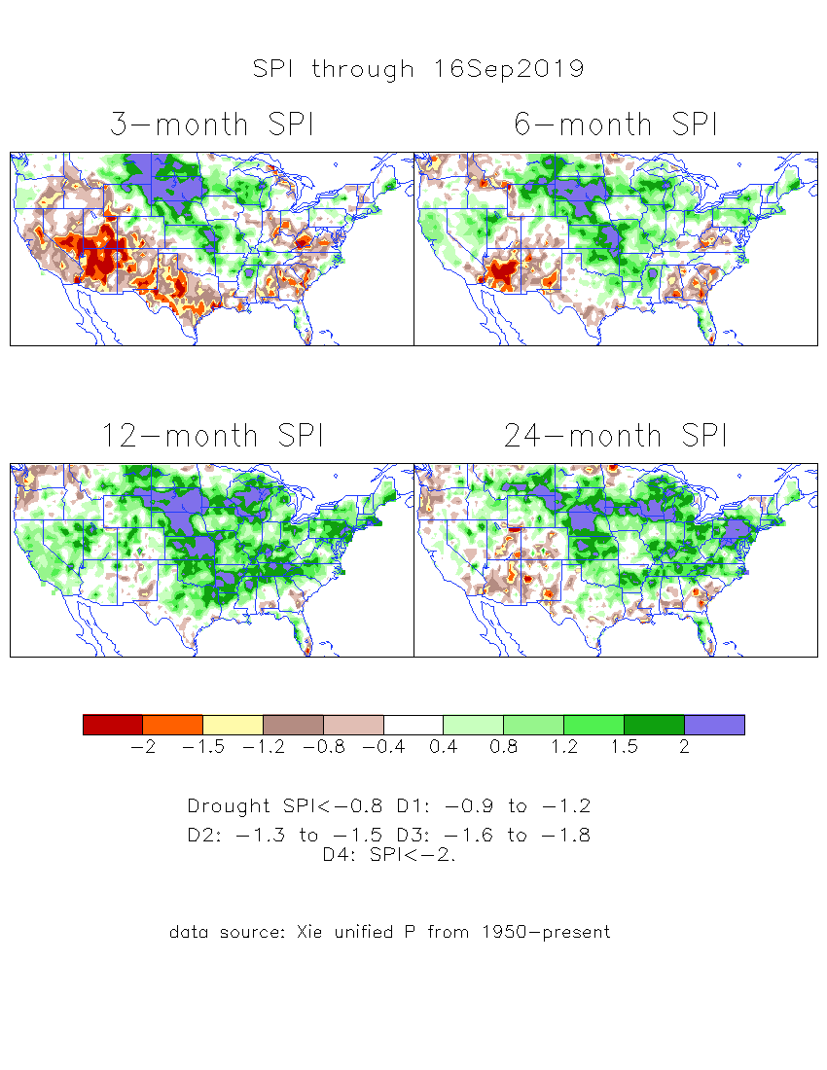
The Standardized Precipitation Index SPI (based on Observed P)
----- NOW
Very interesting graphic & details for the drought across the US based on the more generalized precip deficit/excess, the Standardized Precipitation Index (SPI).
The dark brown and red colors, indicating standardized precipitation deficits, in the various time periods, approximately correspond to the appropriate short/long term drought monitor regions and their intensities
Overall, there is a great deal of similarity between the short/medium and long term SPI patterns,
In the short term, the lack of precip and the cumulative dryness in the TX/southwest has gotten worse.
But improvement is noted in the Pacific NW.

Slide 16
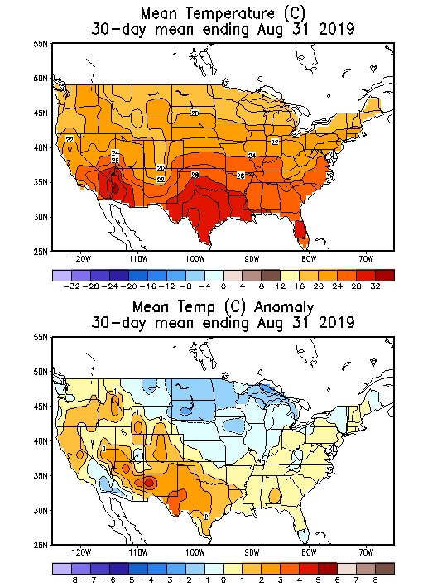
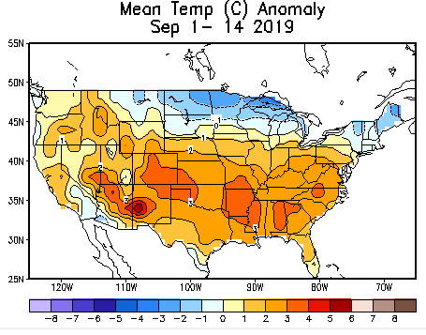
Recent US Temperatures
August US T pattern was mixed with generally warm in the west and mild southeast but cool in the northern Plains and upper Midwest.
September so far is somewhat similar to August.

Slide 17
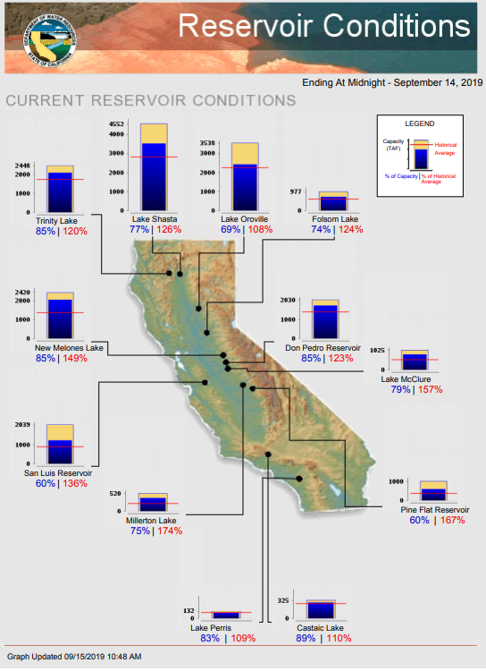
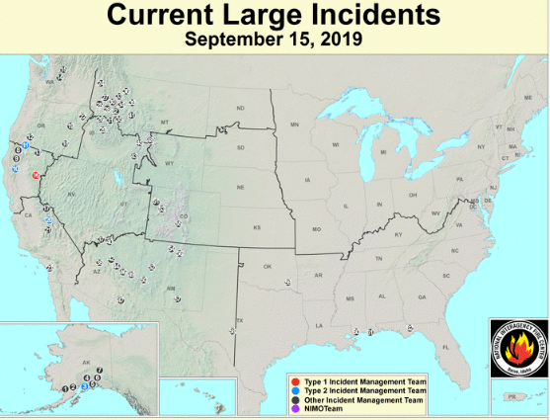
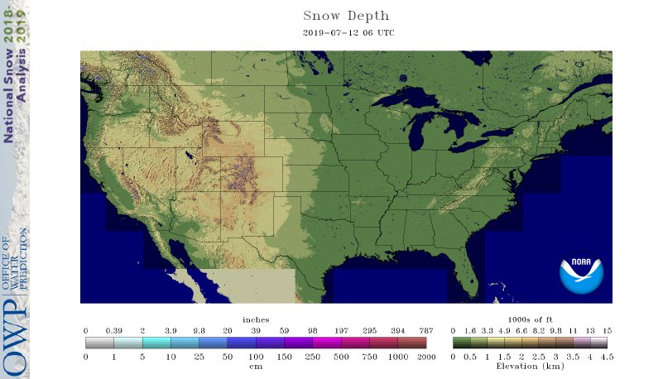
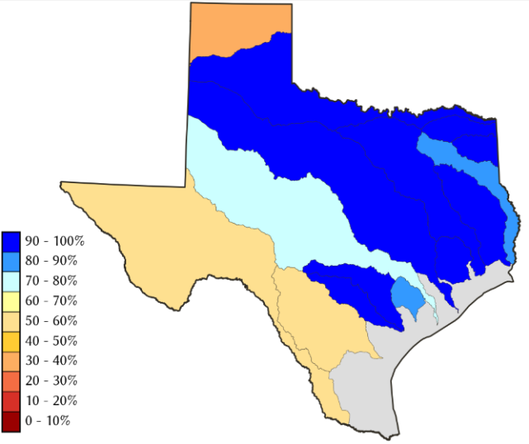
Water Reservoir Levels in some Western/Southern States! !
https://fsapps.nwcg.gov/afm/index.php
No reported major fire incidents so far. (cf. last year!)
Except in few high elevations, all snow has melted.
Northern CA reservoirs beginning to show
Weakness, but rainy season coming up!
COLORADO Aug’2019 water reservoir storages at 116% of long term average – thanks to snow melt.
(last year: 82%)
TX
California reservoirs are at or well above historic average levels.
https://fsapps.nwcg.gov/afm/index.php

Slide 18
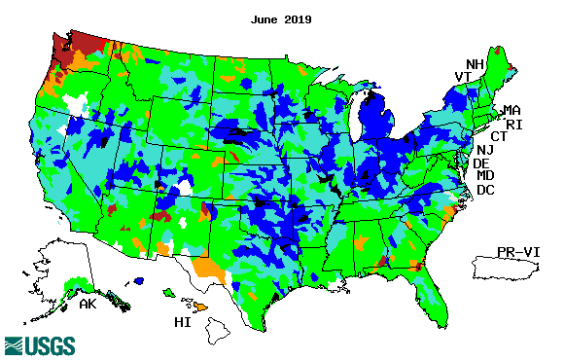
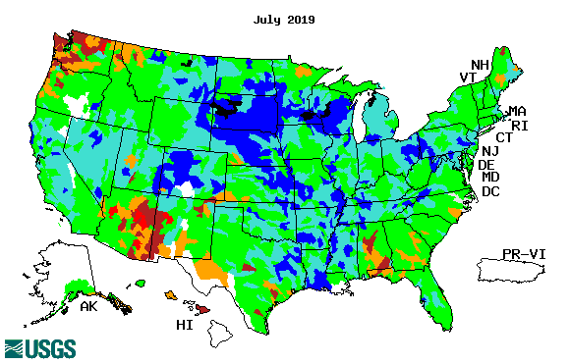
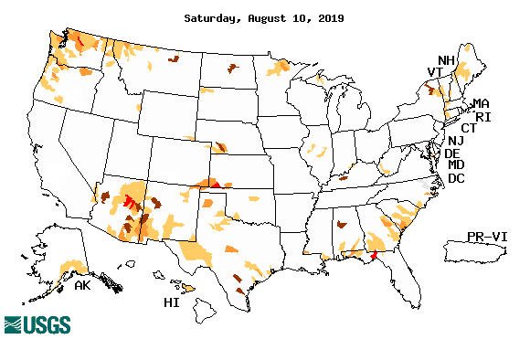
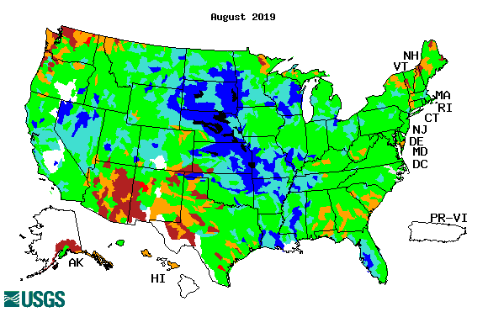
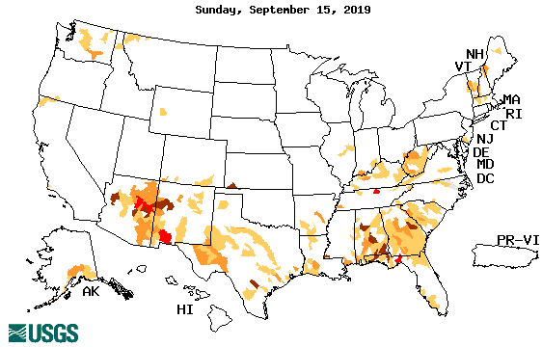
Streamflow (USGS)
Overall, worsened stream flow conditions in the south.
The weak southwest monsoon so far is not helping in AZ/NM and western TX.
Pacific NW is about same as prev. month or may be slightly better.
Map shows only below normal 7-day average streamflow compared to historical streamflow for the day of year.
One month ago (left) &
Now (below)
18

Slide 19
EL NIÑO/SOUTHERN OSCILLATION (ENSO)
DIAGNOSTIC DISCUSSION
issued by CLIMATE PREDICTION CENTER/NCEP/NWS and the International Research Institute for Climate and Society
12 September 2019
ENSO Alert System Status: Not Active
Synopsis: ENSO-neutral conditions are present. ENSO-neutral is favored during the Northern Hemisphere fall 2019 (~75% chance), continuing through spring 2020 (55-60% chance). Equatorial sea surface temperatures (SSTs) are above average across the western Pacific Ocean and are below average in the eastern Pacific. The pattern of anomalous convection and winds are generally consistent with ENSO-neutral.

Slide 20
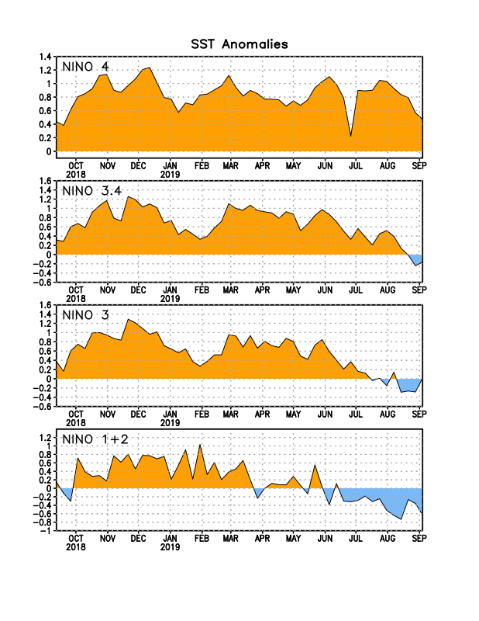
Latest values of SST indices in the various Nino Regions.
The sub surface heat anom has been falling for the past few months.
?
Relatively short lived!

Slide 21
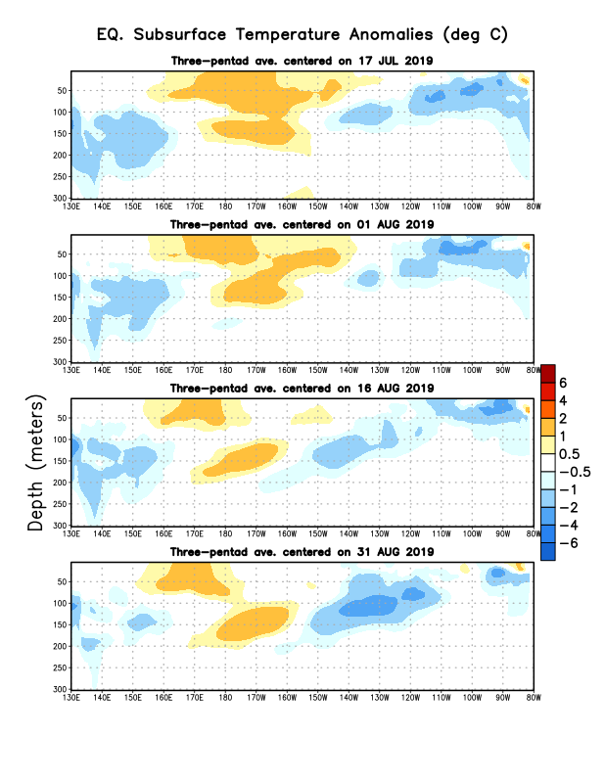
Sub-Surface Temperature Departures in the Equatorial Pacific
Most recent pentad analysis

Slide 22
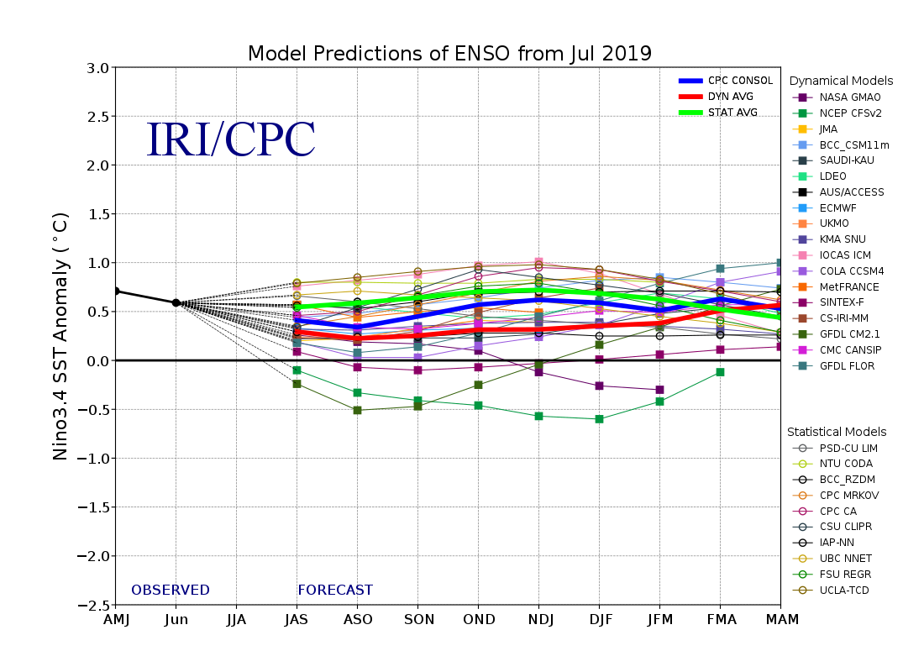
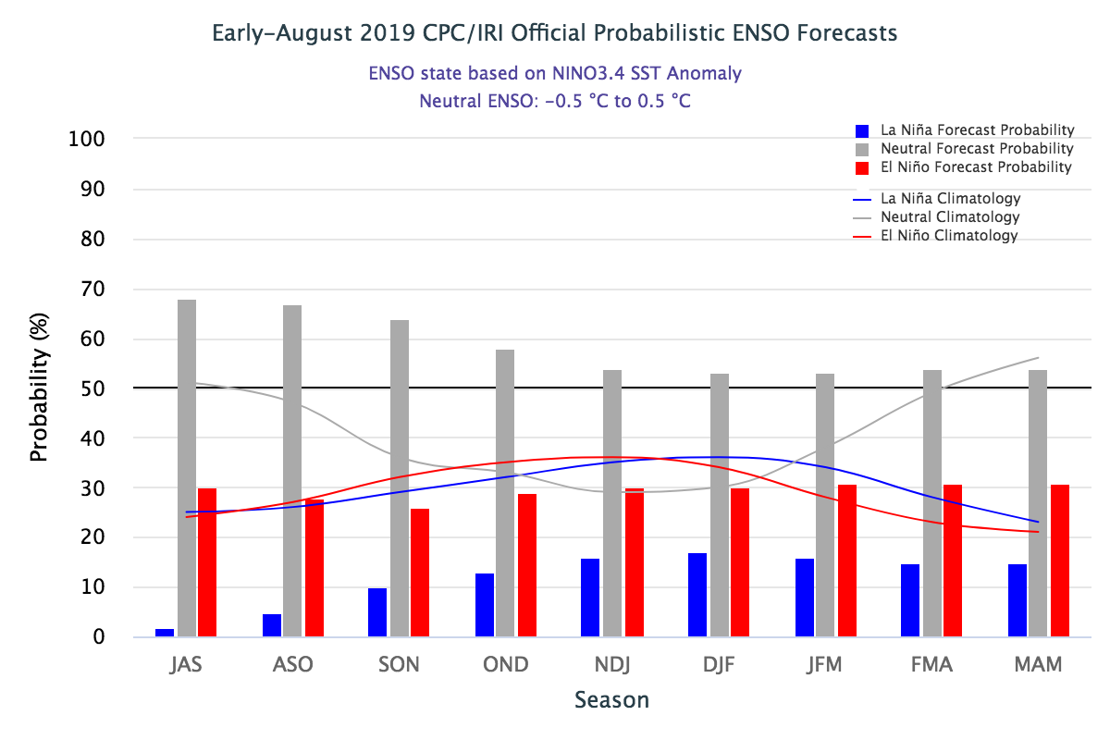
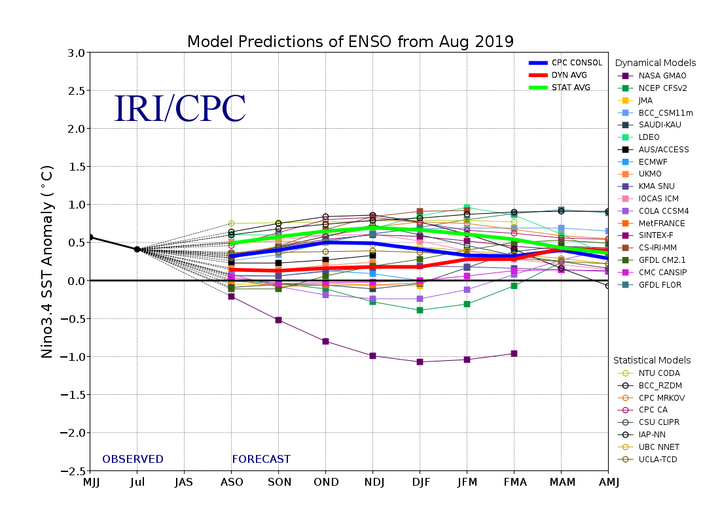
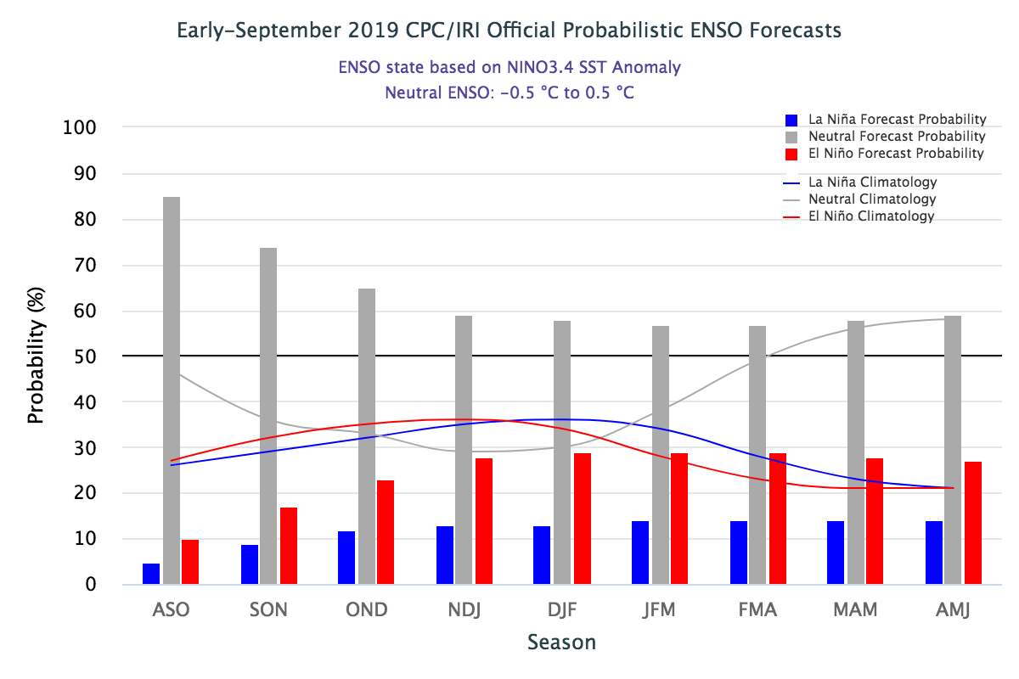
ENSO Forecasts
Early- August CPC/IRI forecast
Early- September CPC/IRI forecast

Slide 23
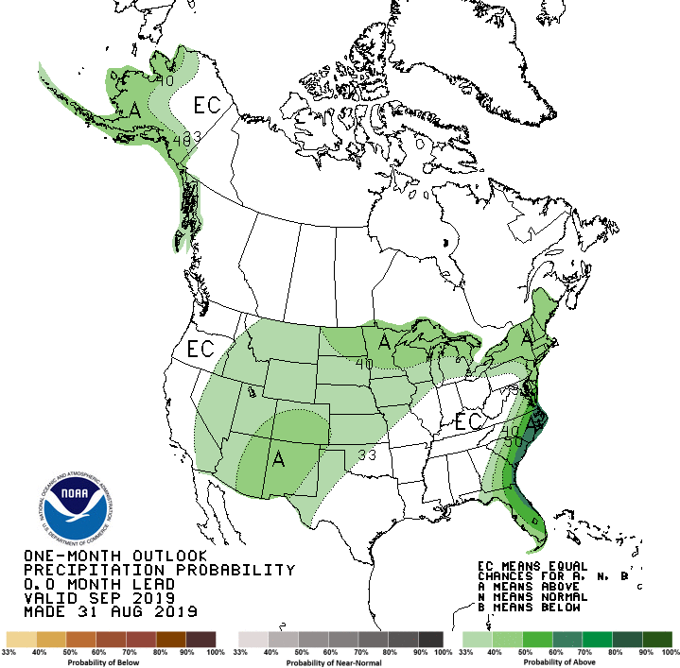
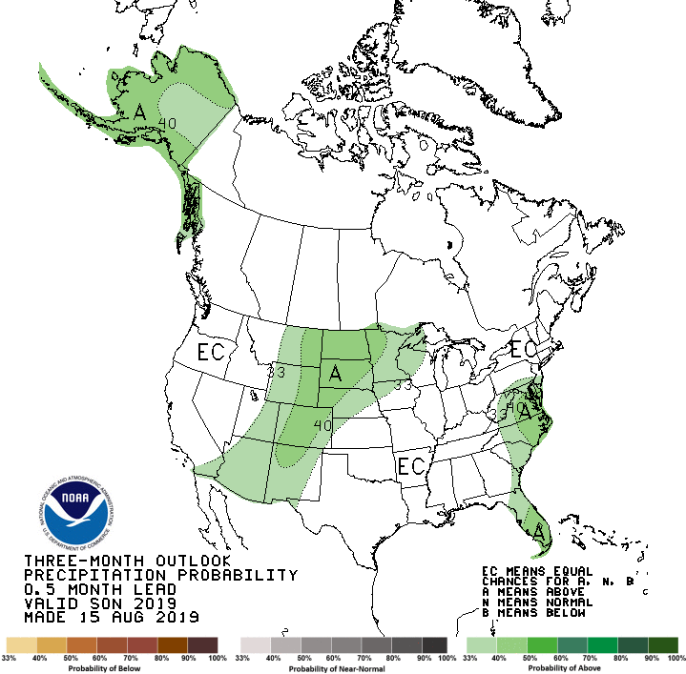
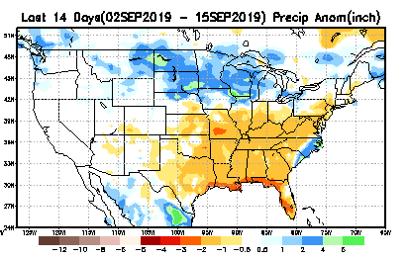
Released Aug 31st
Previous(Last month)
CPC’s official
Precipitation outlook for Monthly (September)/Seasonal (SON)
Released Aug 15th
Observed so far this month!! ☹
?

Slide 24
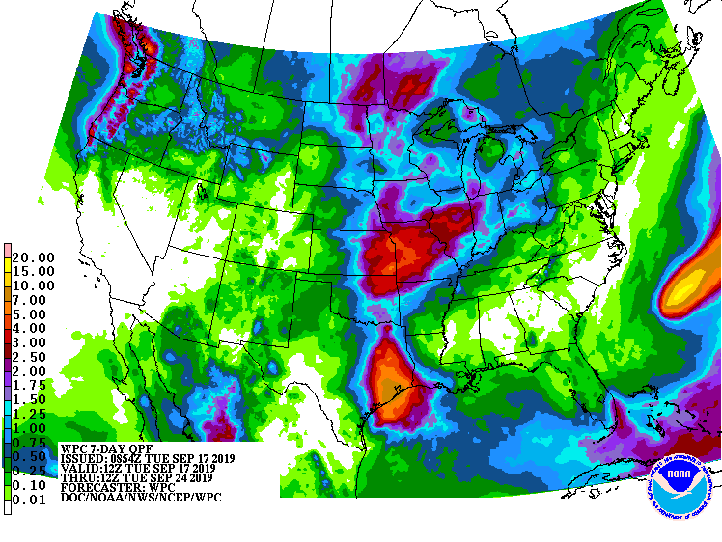
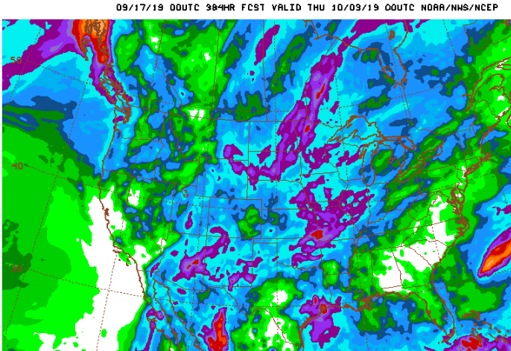
WPC Next 7 days QPF Forecast
GFS Model Guidance for next 16 days.

Slide 25
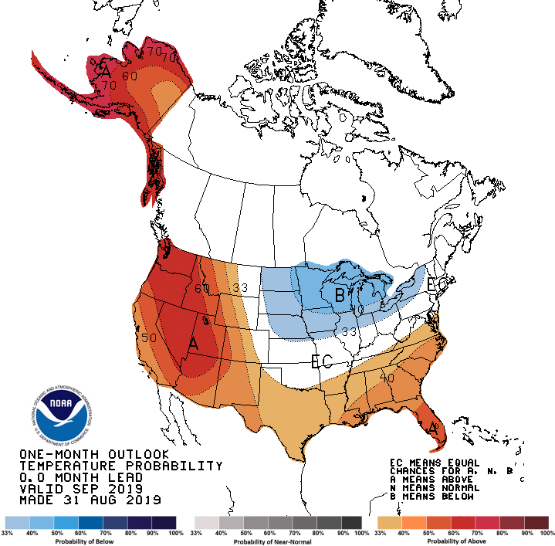
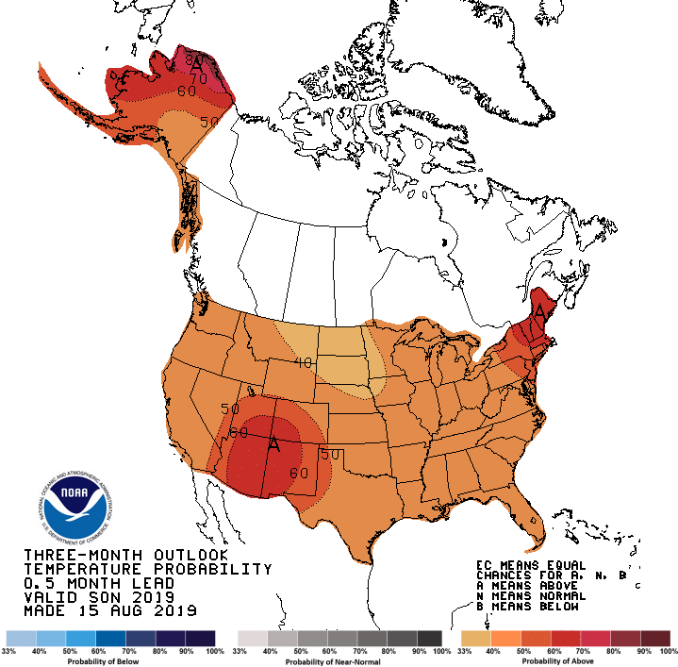
Previous (Last Month)
CPC’s official
Temperature outlook for Monthly (Sep)/Seasonal (SON)
Made
Aug 31st
Made Aug 15th
Observed so far this month!! ☺

Slide 26
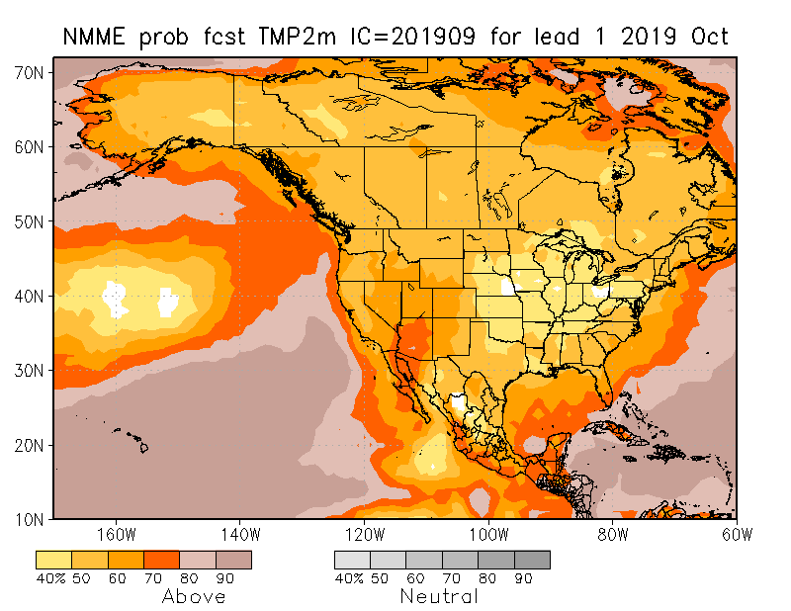
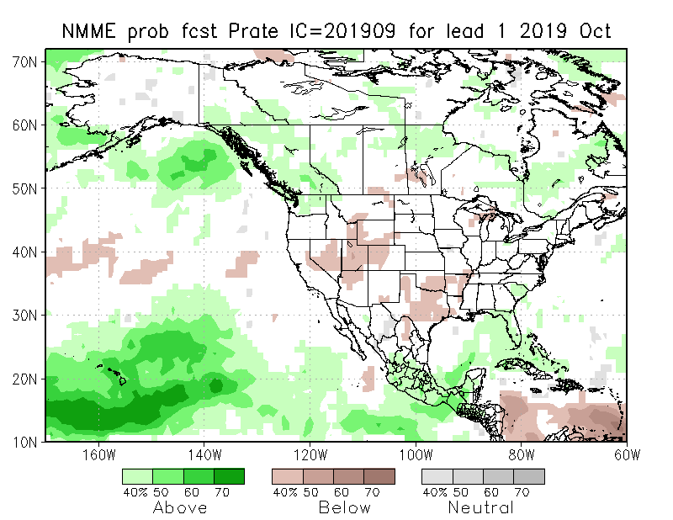
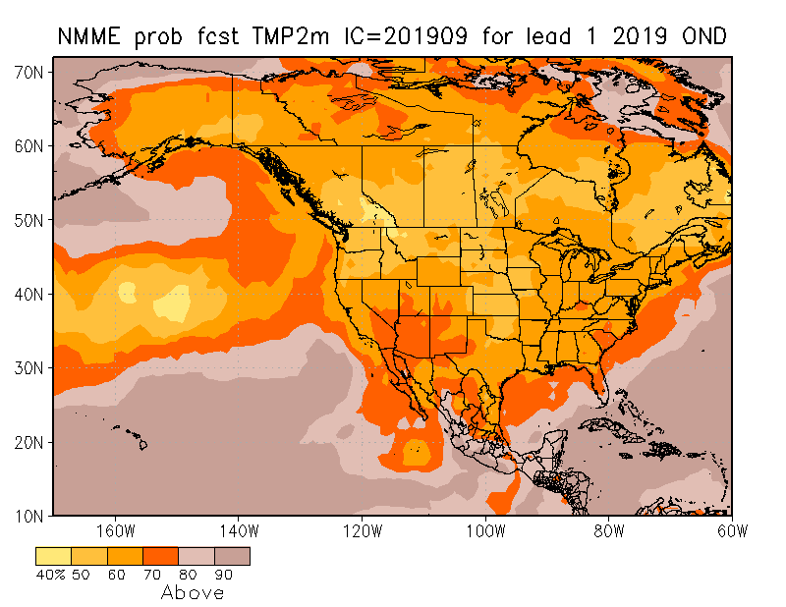
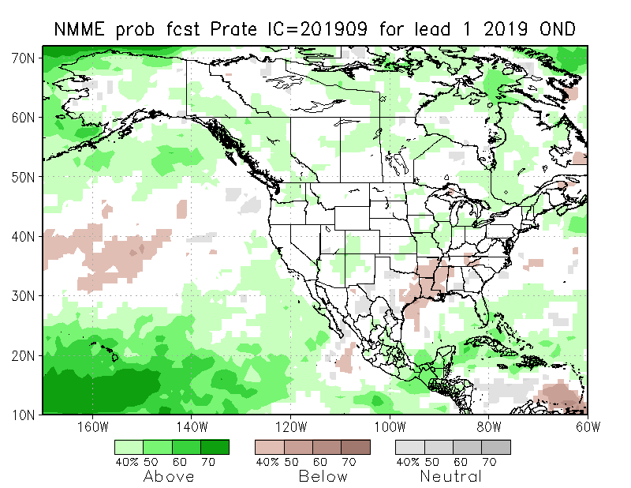
NMME T & P EnsMean forecasts
Sep
SON
Both monthly and seasonal forecasts call for above normal temperatures of various extents across the country. This pattern, is very much the same trend pattern, forecast season after season.
The forecast precipitation patterns are not anchored to ENSO conditions and hence could be suspect.

Slide 27
The agreement/uncertainty among the diff. NMME models’ forecasts (middle and bottom panels) for Oct-Nov-Dec Precipitation!!!
27

Slide 28
SPI3, SPI6
& SPI12
Forecasts from 6 NMME Models
(uses obs. P up to past month, and forecast months’ P from NMME models)
The goodness and skill of these SPI’s forecasts depend directly on the NMME models’ skill in predicting precipitation!!!

Slide 29
http://drought.geo.msu.edu/research/forecast/smi.monthly.php
Predicted Monthly Soil Moisture Percentile
Latest
Initial Conditions:
09/10/2019
The inter quartile range suggest greater uncertainty about the forecast in these shaded regions.

Slide 30
NCEP Ensemble mean NLDAS2 models’ Soil Moisture tendency/trend
7 days
14 days
30 days

Slide 31
Precipitation
NASA GEOS 5 Model
Precipitation & Soil Moisture Forecast
Sep 2019
Soil Moisture
Oct 2019
I.C.
Sep
2019
Nov 2019
Oct
2019
Nov
2019
10/1

Slide 32
Summary
Current ENSO status and forecast. Weak ENSO-neutral conditions are present. ENSO-neutral is favored during the Northern Hemisphere fall 2019 (~75% chance), continuing through spring 2020 (55-60% chance).
Current Drought conditions:
After having been near record low in terms of areal coverage for drought affected regions across the US during April/May, the extent of abnormally dryness/drought area coverage appears to be slowly creeping up during last few months.
The apparent ending of El Nino conditions, and the return of ENSO neutral conditions, did not help the recent emerging dry conditions in the south. Consequently, the stream flow conditions across the south are weaker this past month than before in AZ, NM and western Texas. The moderate to severe drought in the Pacific Northwest & vicinity has gotten slightly better.
The weak performance of the southwest monsoon so far in the southwestern states AZ/NM combined with the remnants of the dryness from previous back to back La Nina events, which really did not go away, has led to dryness in the southwest and contributed to the dryness and the possible re-emergence of drought like conditions in the four corner states area comprising AZ/UT/CO/NM and TX. California reservoirs, continue to be at better than historically average levels (The El Nino excess rainfall during winter and spring helped!). Compared to the devastating fire season at this time last year, the major fire incidents in the state are nearly absent this year.
The above recent short term deficits in the south/west is unfortunately adding to the long-term (>1 year) deficits still remain over large areas in the Southwest and West .
Prediction:
The return to normal conditions, with the apparent ending of El Nino, is not providing any boundary forcing, and it is reflected in the weak precipitation model (NMME) forecast signal over the US for the upcoming season.
The short term dryness in the southeast is getting worse, and whether this will further worsen to develop into a full drought is really tricky, given the rainfall climatology for the upcoming season and the active hurricane season which does not end until November.
The drought along the Pacific Northwest is likely to persist in the monthly time scale, but may considerably improve or completely go away before the forecast season is over, once the rainy season starts here.
The re-emergence of dryness/drought in the southwest/TX is likely to continue and probably get worse.
Drought in Alaska, Hawaii, and Puerto Rico needs to be monitored.

Slide 33
Miscellaneous maps

Slide 34
Miscellaneous maps

