Slide 1
Drought Outlook Support Briefing September 2020
Climate Prediction Center/NCEP/NOAA
http://www.cpc.ncep.noaa.gov/products/Drought
Phone: 1-877-680-3341
Pwd: 858747#

Slide 2
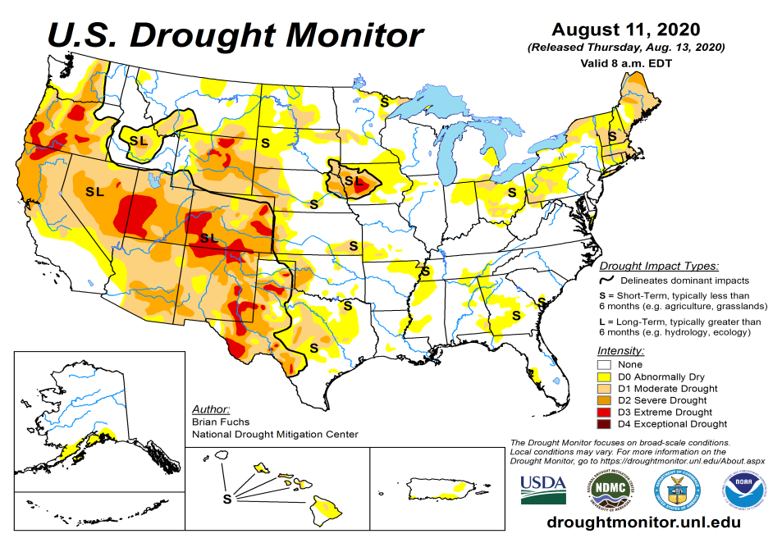
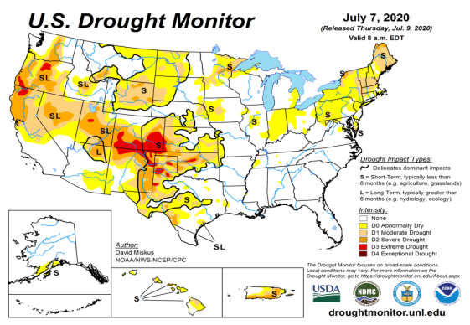
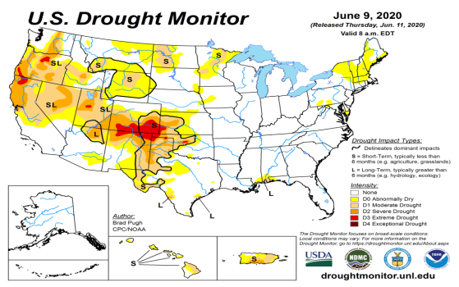
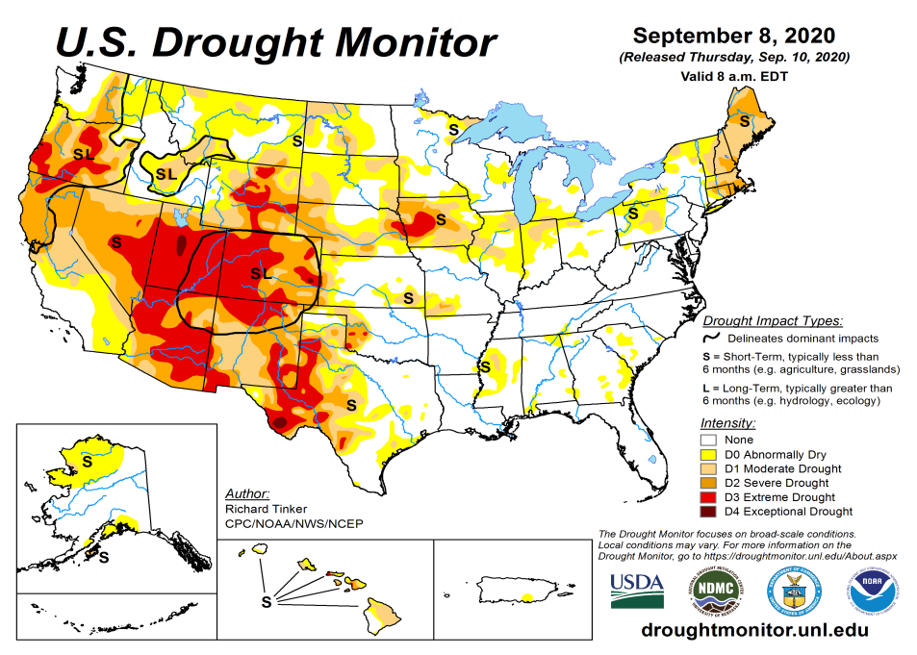
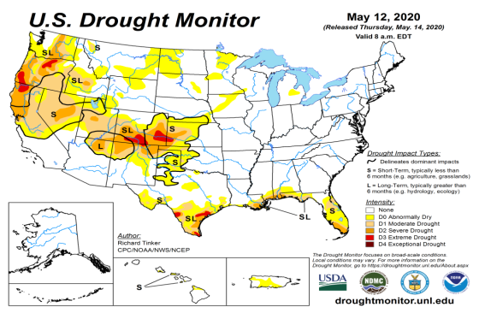
Drought Monitor
Monitoring is important because, unlike US T/P fcsts, for drought forecasts, we have to know where we are, before we can tell where we are going!!
Drought forecasts are tendency forecasts.
August
July
Over the last several months, drought area & severity has overall generally increased across the South West& NW.
The short/long term drought in the four corner states area (AZ/NM/UT/CO), OR, WY CA, NV has vigorously expanded and intensified southward & westward. The weak SW monsoon and emerging La Nina has made conditions worse.
Dryness/Drought in Northern Great Plain states eased but still present.
Recent short-term Drought in the Northeastern states is just not going away completely.
Recently emerged drought in IA and upper Midwestern states continue..
June
September
(Recent/Latest)
May
February

Slide 3
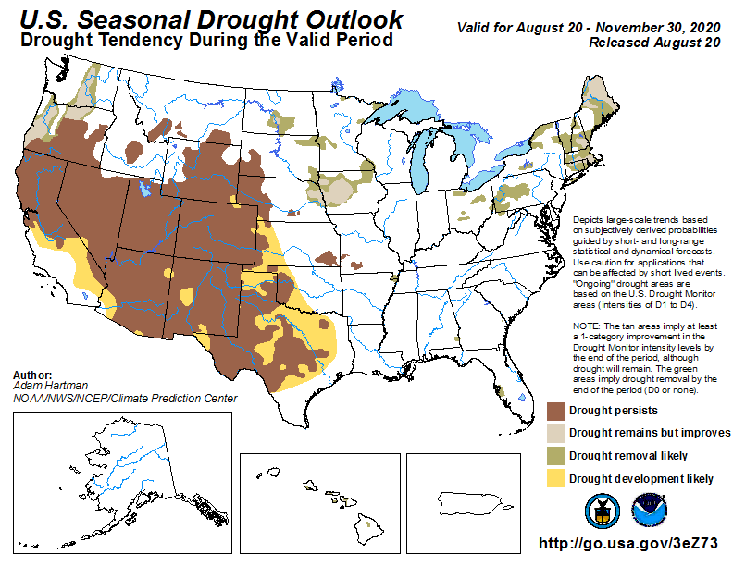
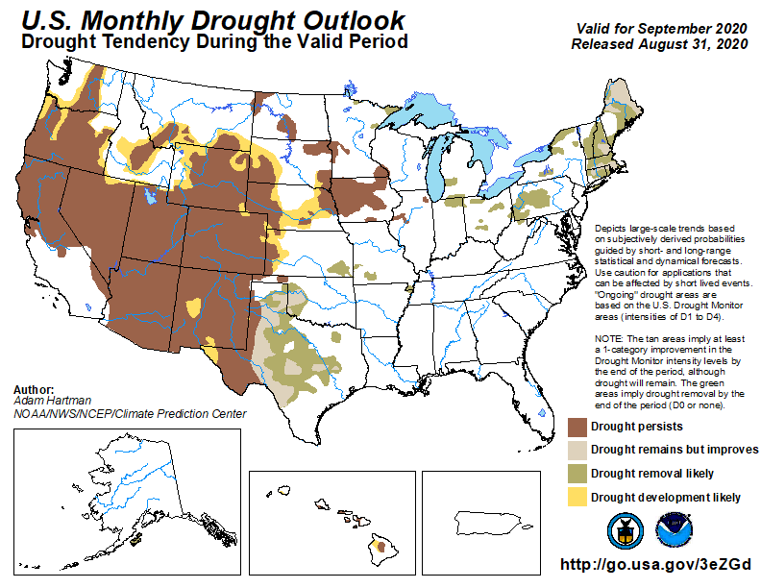
(Prev) Seasonal/Monthly Drought outlooks
(New Seasonal Drought Outlook to be released in 2 days!)
(New Monthly Drought Outlook to be released end of the month)
Seasonal Outlook
(Mid Aug 2020- Nov 2020)
issued 08/20/20
Monthly outlook
(for September 2020)
issued 08/31/20
Much of the western half is in drought. It was not too long ago (~May 2019), the US had almost the lowest coverage of area covered by drought! Approx. < 4% or so.
Similar looking Monthly and seasonal outlooks.
Emerging and ongoing La Nina will not help Southern states, due to below normal precip.

Slide 4
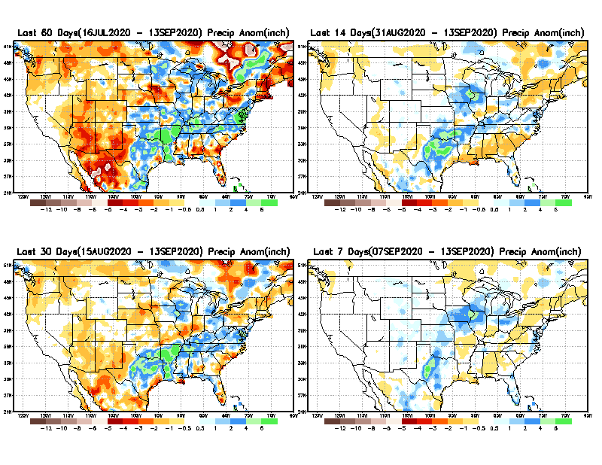
Precipitation ANOM during last 7, 14, 30, & 60 days.
60 Days
14 Days
These maps in this and following slides, including a) Total,
b) Anom and
c) Percent of Normal precip. in these and other longer time ranges are now (routinely) daily updated at:
cf. with USDM
30 Days
7 Days
Alaska regn. was also added here as separate maps recently.
From: Recent Accumulated Precipitation https://www.cpc.ncep.noaa.gov/products/Drought/briefing_prcp.shtml

Slide 5
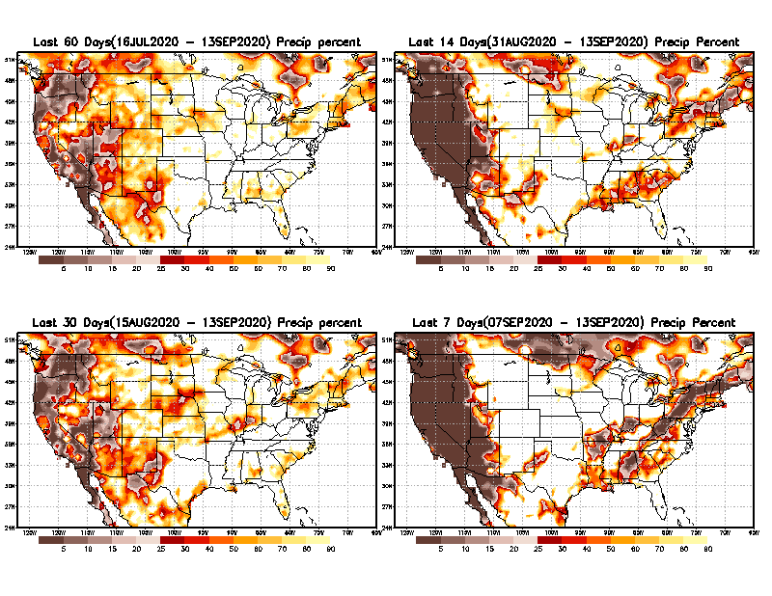
Precipitation Percent during last 7, 14, 30, & 60 days.
60 Days
14 Days
This plot shows only the rainfall deficient regions <= 90% of normal.
-- This shows more clearly possible/likely drought developing region in the future unless there is above normal rainfall in these regions in the future, to offset these shortfalls.
Late/weak monsoon
So far!!
30 days
7 Days
From: Recent Accumulated Precipitation https://www.cpc.ncep.noaa.gov/products/Drought/briefing_prcp.shtml

Slide 6
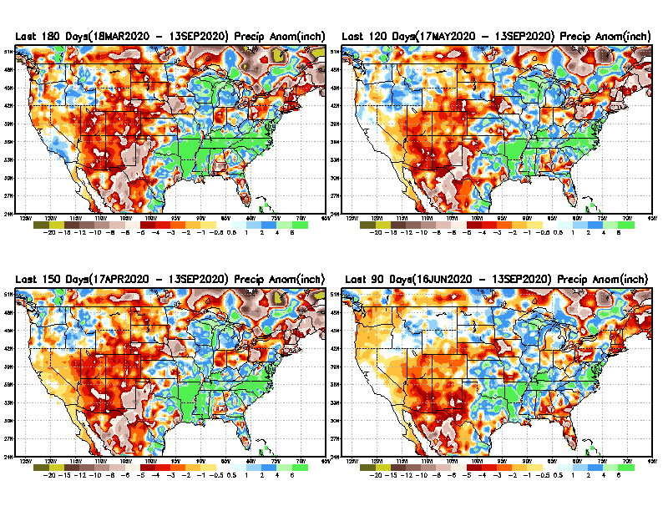
Total precipitation ANOM during last 3, 4, 5, and 6 months.
6 M
4 M
While the Precipitation anomalies deficit may seem large in some regions (compared to others), it is the % of normal precip (next slide) that matters more!!
5 M
3 M
From: Recent Accumulated Precipitation https://www.cpc.ncep.noaa.gov/products/Drought/briefing_prcp.shtml

Slide 7
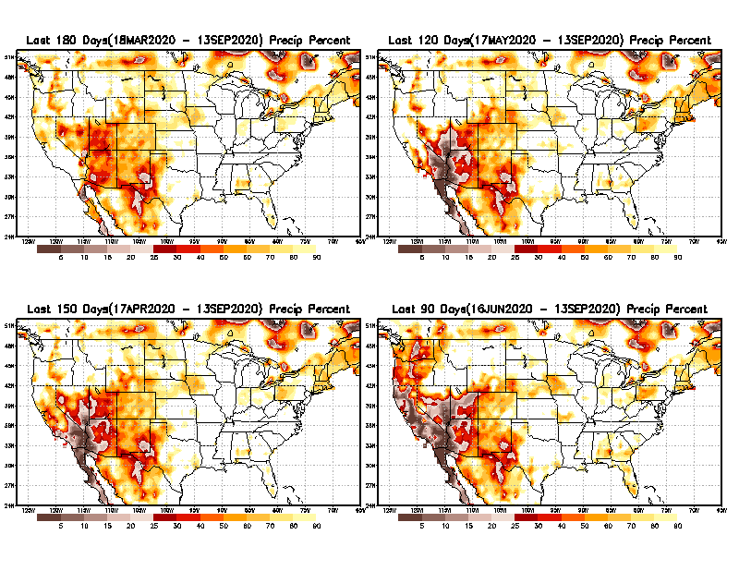
Total precipitation Percent during last 3, 4, 5, and 6 months.
6 M
4 M
In these interim time scale 3-6 months, we need to pay attention to regions, which are dark-brown, red & dark red (<50%).
5 M
3M
While accrued precipitation deficits are real & objective,
droughts are subjective declarations!!
East vs West!
Broad vs Narrow
rainfall season.
With these various rainfall deficits in diff. time ranges, where and how exactly does one declare drought? Other factors (T/SM/E, etc..) do matter, but is cumulative precip. Deficits/percent_of_normal ultimately more important?

Slide 8
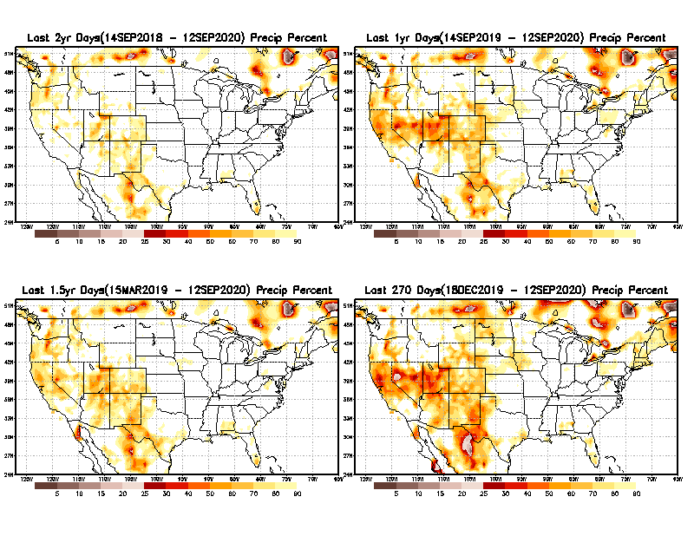
Total precipitation Percent during last 9 months, 1 yr, 1.5yrs, & 2 yrs.
2 Y
1 Y
Tinderbox areas, where some form of longer term rainfall
deficiencies already, exist !!
-Almost all are in the WEST!
1.5 Y
9 M
These long term P deficits here contribute to & more severe FIRE seasons recently year after year!!
From: Recent Accumulated Precipitation https://www.cpc.ncep.noaa.gov/products/Drought/briefing_prcp.shtml

Slide 9
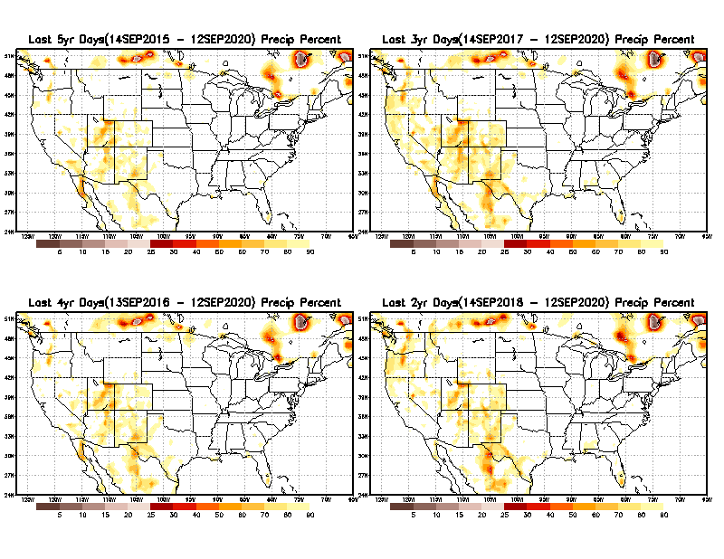
Total precipitation Percent during last 2 yrs, 3 yrs, 4 yrs, & 5 yrs.
5 Y
3 Y
In new format
4 Y
2 Y
In this time range, across the country, there is not any big area where the rainfall is less than 50%.
From: Recent Accumulated Precipitation https://www.cpc.ncep.noaa.gov/products/Drought/briefing_prcp.shtml

Slide 10
Rainy (3-month)Season across the US
East vs West!
More darker colors in regn. central/west => narrow rainy season (months)
Overall, more white space in the east -> distributed rainfall season (except ~FL).

Slide 11
October-least green map!
As if not enough so far, September/October are still climatologically bad months for west coast fire season ☹
*********
EAST vs
CTR/WEST
Behavior in Drought is loosely tied to rainfall climo!!
*********
Adapted from Rich Tinker.

Slide 12
Adapted from
Rich Tinker

Slide 13
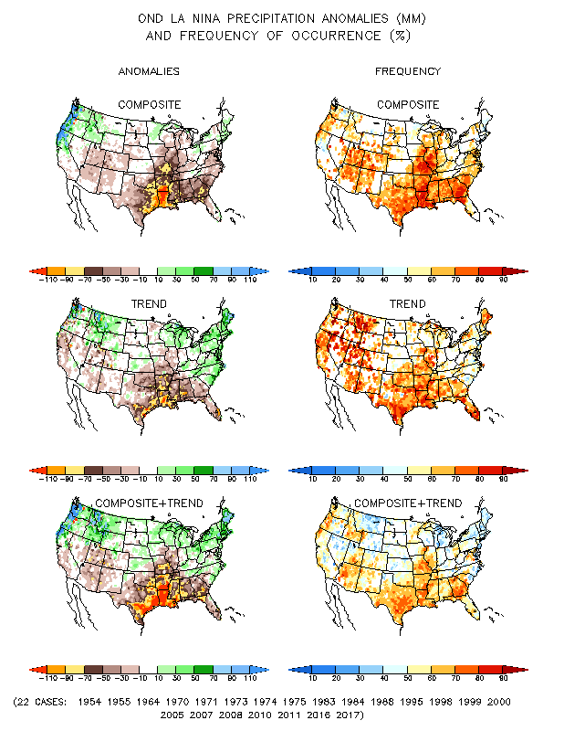
La Nina Precip COMPOSITES & Trend map
JFM
OND

Slide 14
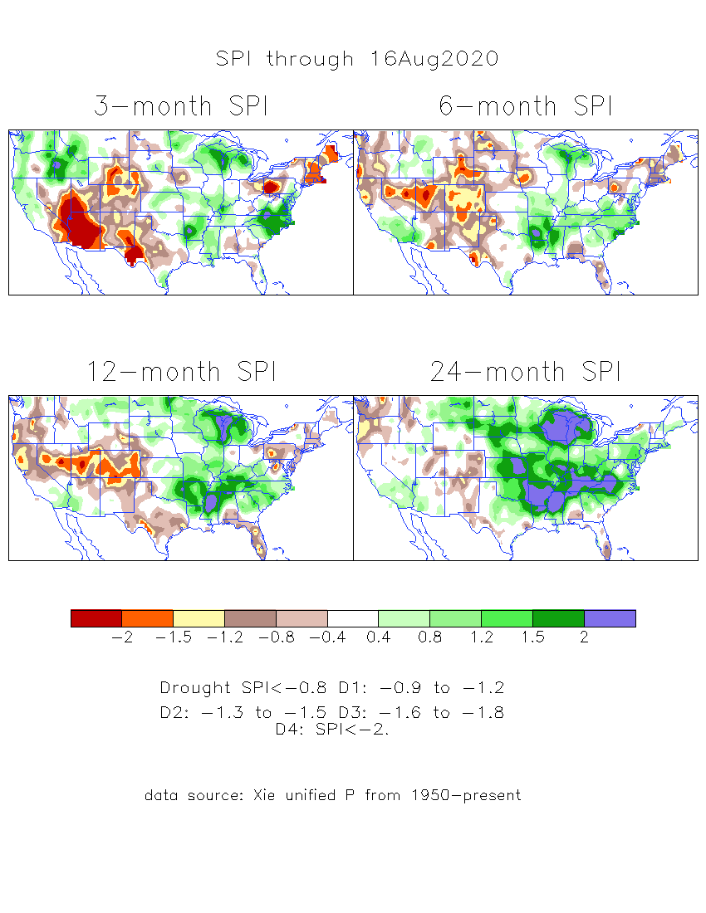
The Standardized Precipitation Index SPI (based on Observed P)
----- Last Month
Very interesting graphic & details for the drought across the US based on the more generalized precip deficit/excess, the Standardized Precipitation Index (SPI).
The dark brown and red colors, indicating standardized precipitation deficits, in the various time periods, approximately correspond to the appropriate short/long term drought monitor regions and their intensities

Slide 15
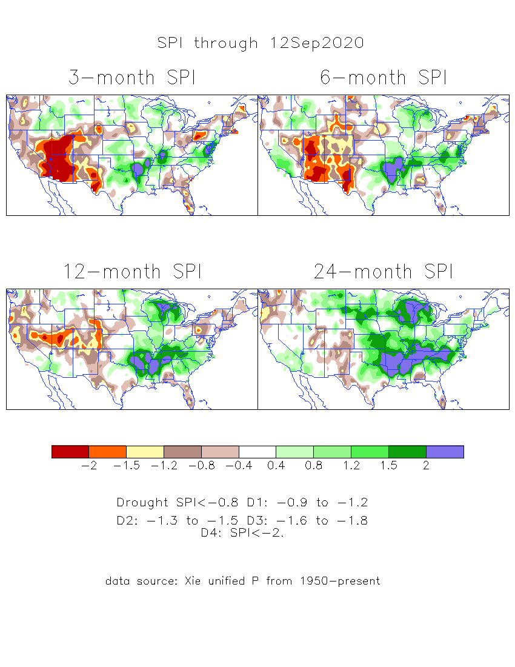
The Standardized Precipitation Index SPI (based on Observed P)
----- NOW
Very interesting graphic & details for the drought across the US based on the more generalized precip deficit/excess, the Standardized Precipitation Index (SPI).
The dark brown and red colors, indicating standardized precipitation deficits, in the various time periods, approximately correspond to the appropriate short/long term drought monitor regions and their intensities
----- NOW
How does one negotiate and reconcile declaring short term vs long term drought when precip. deficiencies patterns differ on many different time scales locally!!
What is the cutoff delineating time between short VS long term drought!!

Slide 16
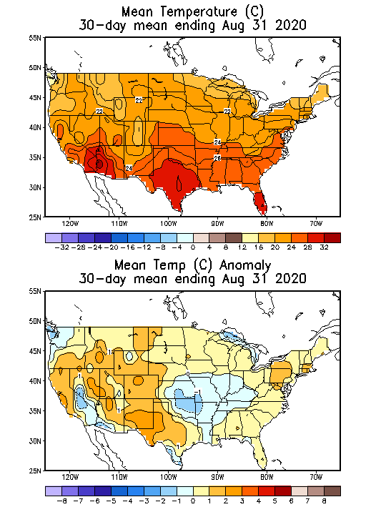
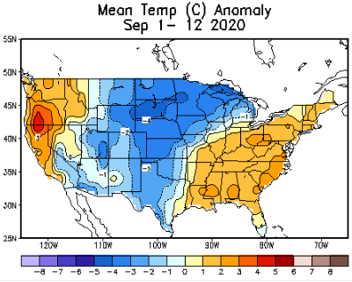
Recent US Temperatures

Slide 17
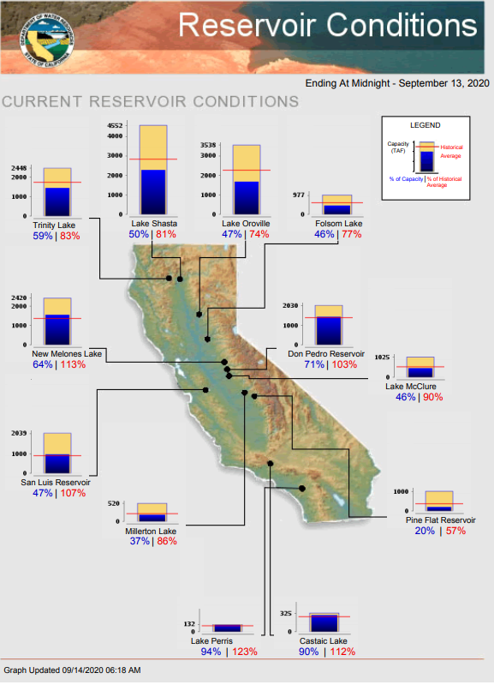
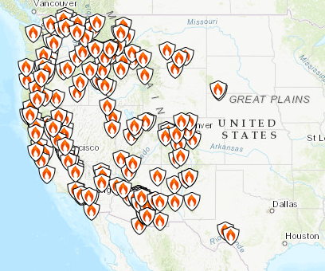
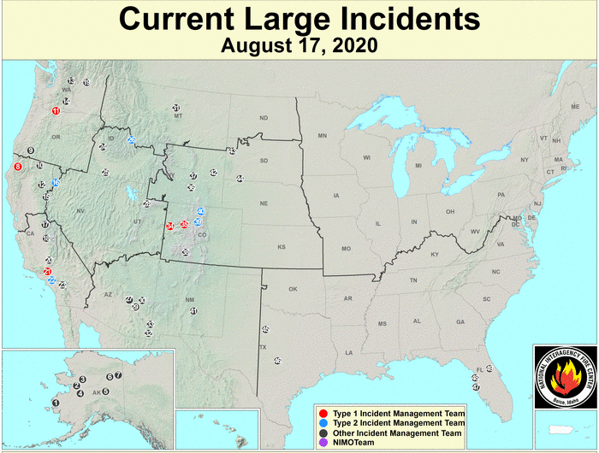
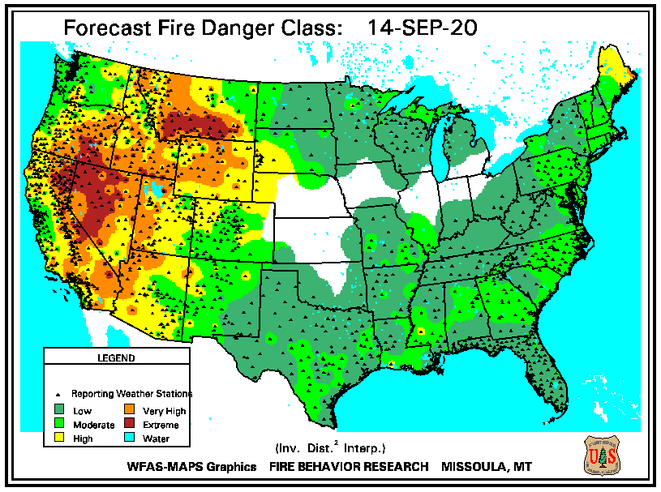
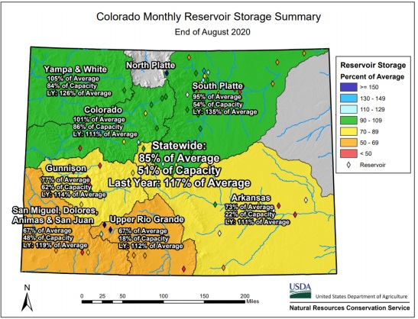
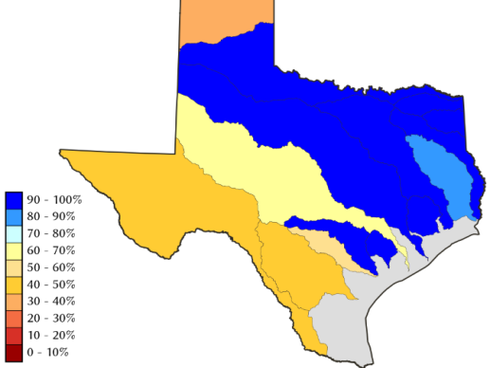
https://fsapps.nwcg.gov/
This is the worst CA fire season ever! –Oct/Nov ?
Many western states (~10) impacted by Ongoing Fire!!
Over 3.5 million acres burnt by fires.
Many (>10 ?) lives lost. Many more missing!!!
Property damage ? Billion $$
https://www.nrcs.usda.gov/wps/portal/wcc/
TX
CO
Some/many of California reservoirs levels are below their historical average levels. La Nina is here atleast thru DJF ☹

Slide 18
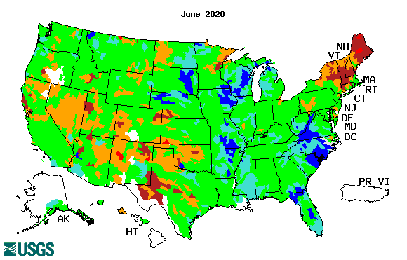
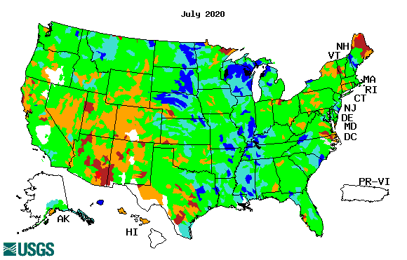
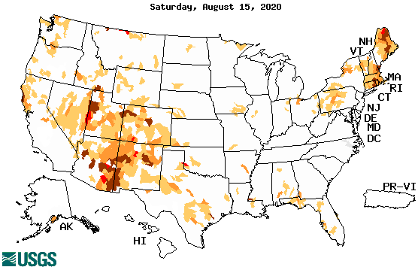
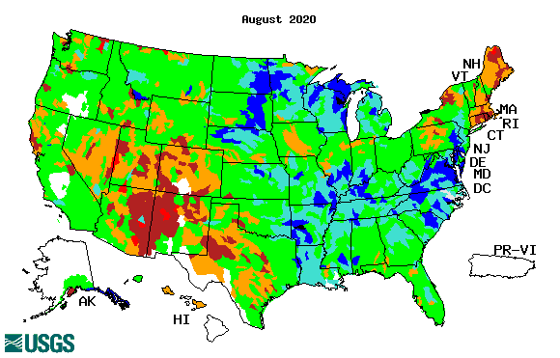
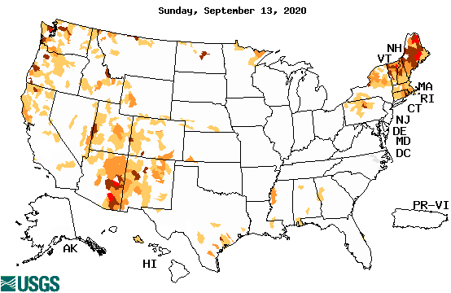
Streamflow (USGS)
Worse conditions in the southwest, in the monsoon region.
Northeast still under drought.
Pacific NW much improved now.
Map shows only below normal 7-day average streamflow compared to historical streamflow for the day of year.
One month ago (left) &
Now (below)
18

Slide 19
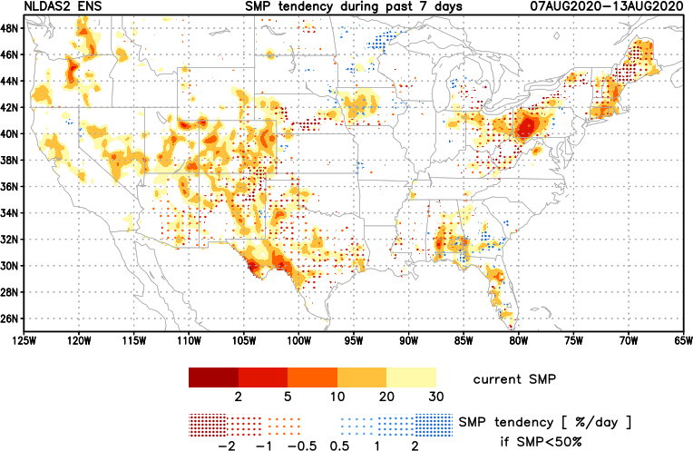
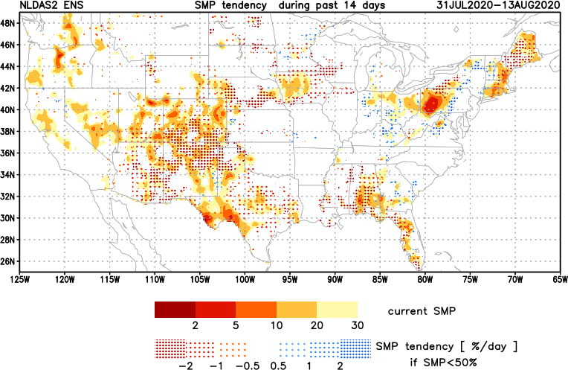
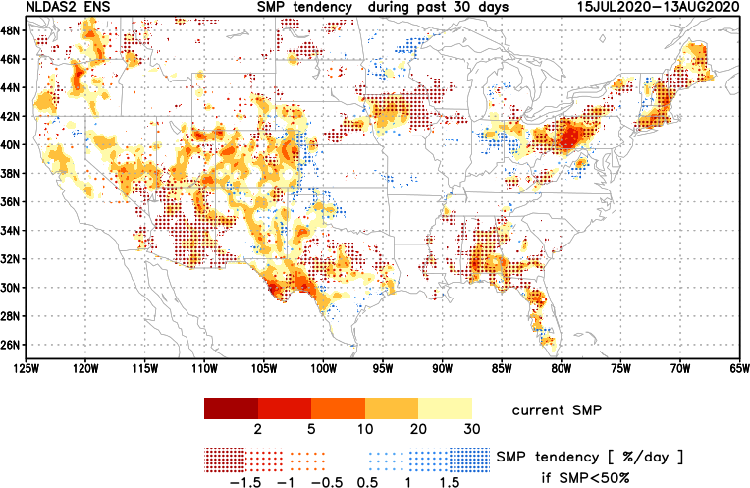
[Now]
NCEP Ensemble mean NLDAS2 models’ Soil Moisture tendency/trend
7 days
14 days
30 days
Overall, during the past month, lots of yellow/red across the country – that is -ve soil moisture tendency – that is drying!

Slide 20
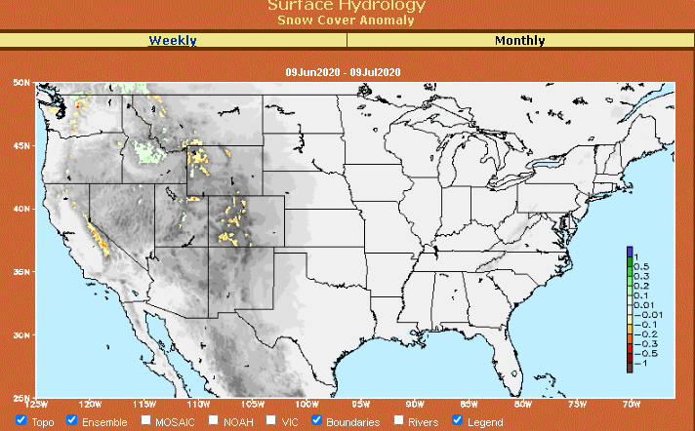
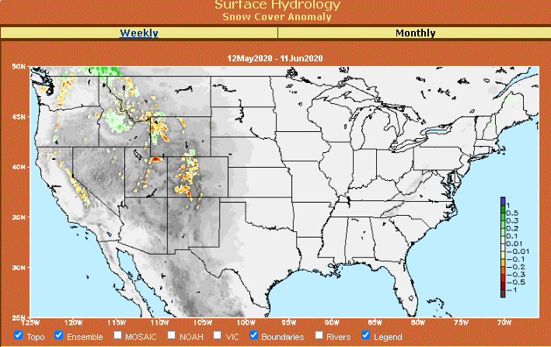
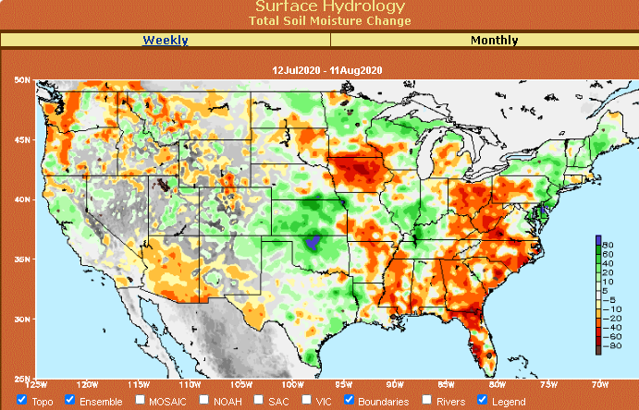
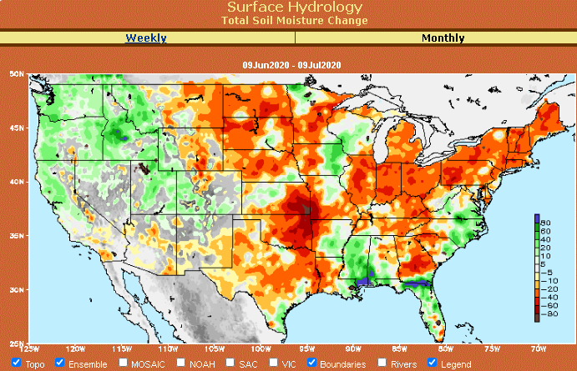
Snow cover & Soil Moisture Anomalies
Snow cover
SLIDE
NOT SHOWN!
Last month ~ this time
Now
Look further for areas of drought development

Slide 21
EL NIÑO/SOUTHERN OSCILLATION (ENSO)
DIAGNOSTIC DISCUSSION
issued by CLIMATE PREDICTION CENTER/NCEP/NWS and the International Research Institute for Climate and Society
10 September 2020
ENSO Alert System Status: La Nina Advisory
Synopsis: La Niña conditions are present and are likely to continue through the Northern Hemisphere winter (~75% chance).

Slide 22
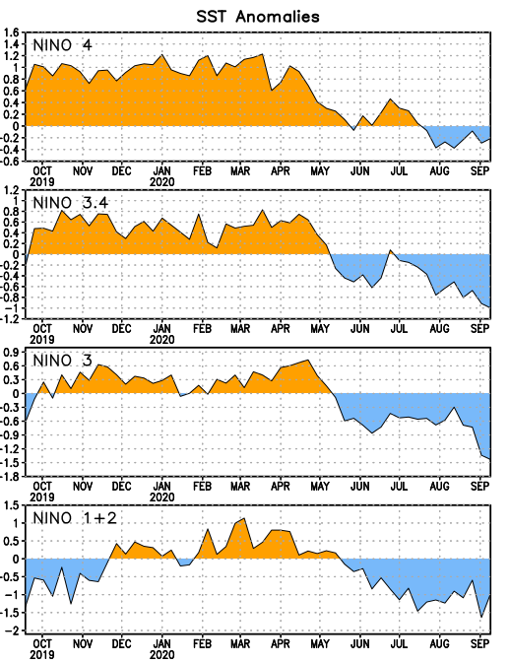
Latest values of SST indices in the various Nino Regions.
This is the most blue! (cold) in all 4 indices (see left) in a while. Subsurface ocean heat anomalies are also cold!!

Slide 23
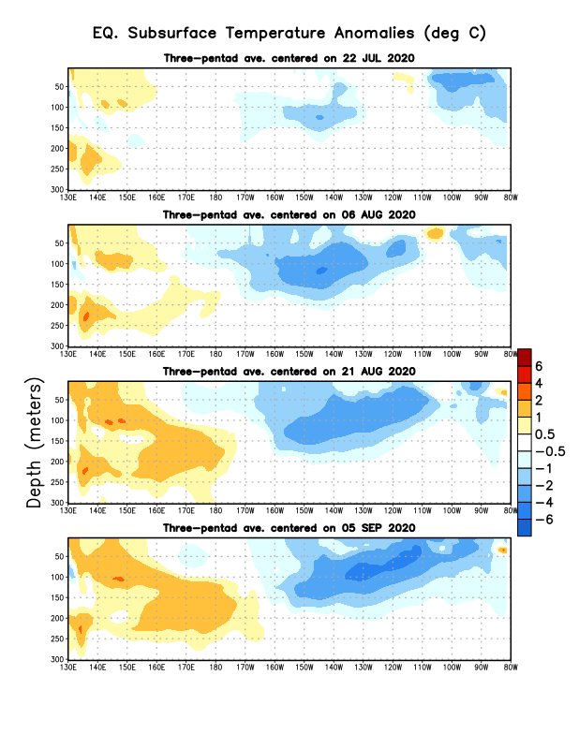
Sub-Surface Temperature Departures in the Equatorial Pacific
Central and eastern tropical SST and subsurface exhibit cold La Nina conditions!! Finally La Nina is officially in place!!
Most recent pentad analysis

Slide 24
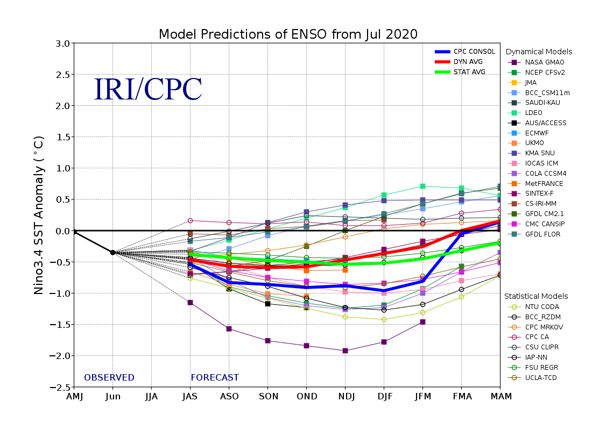
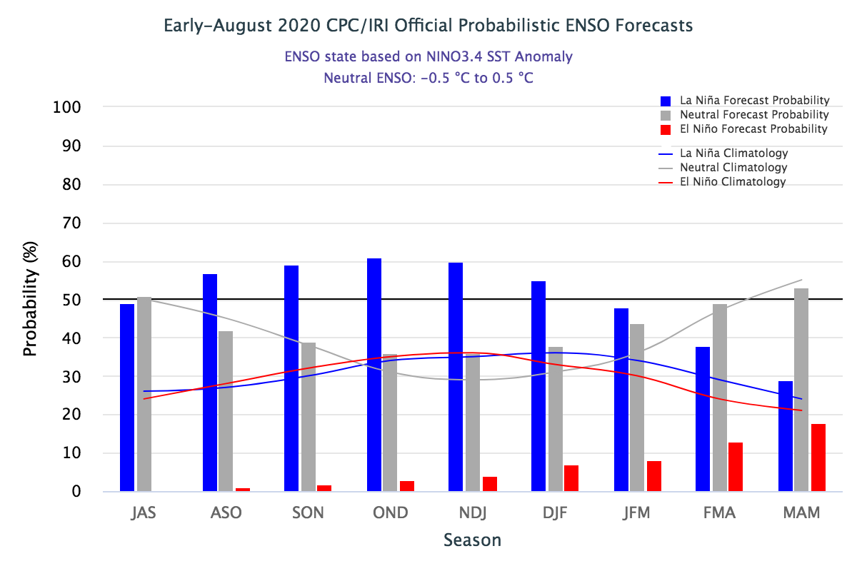
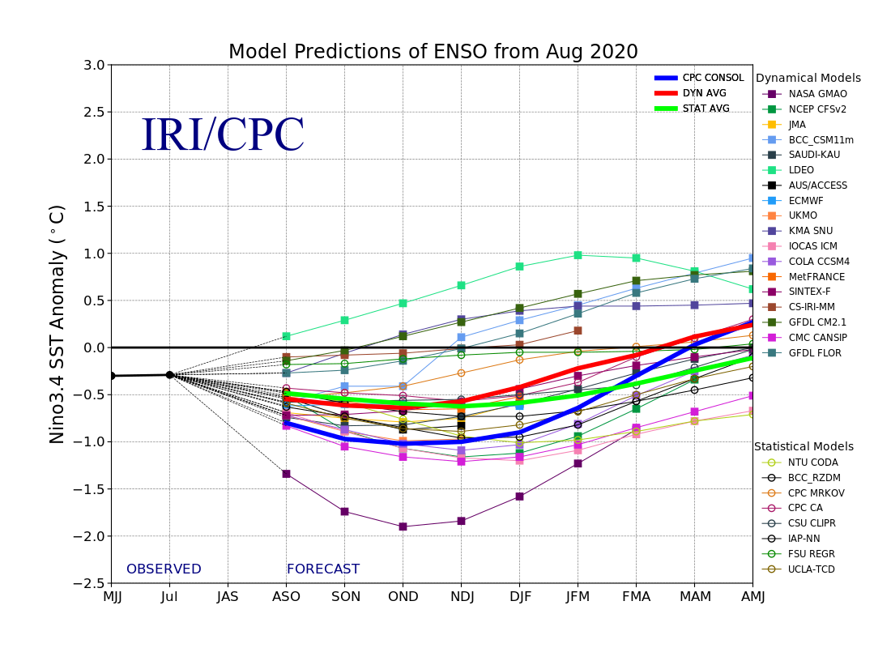
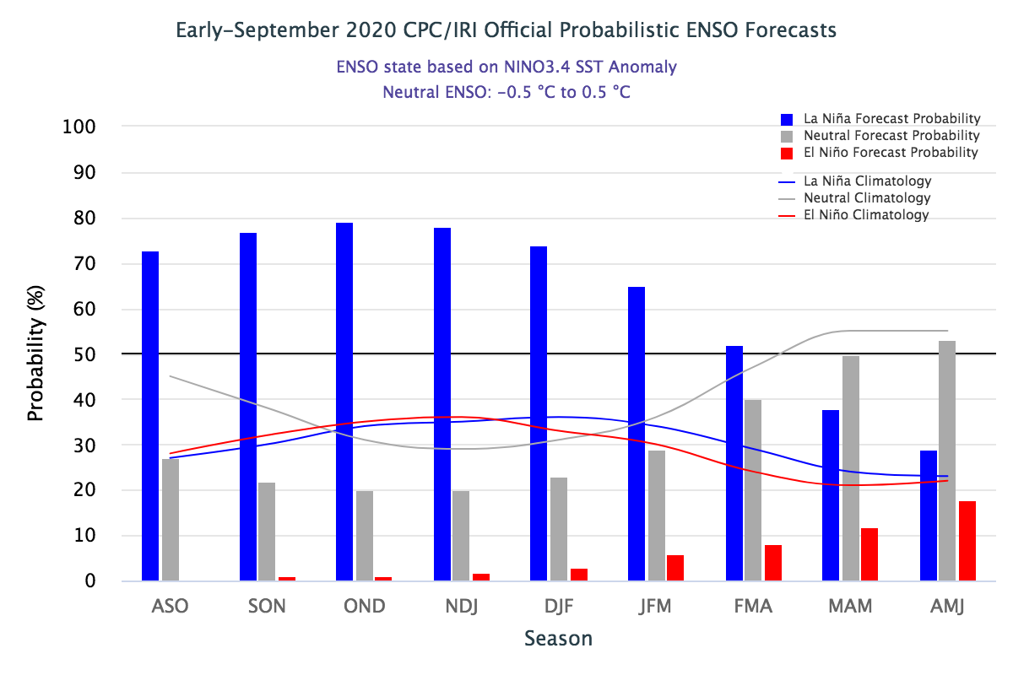
ENSO Forecasts
Early- August CPC/IRI forecast
Early- September CPC/IRI forecast
The long awaited La Nina is finally here!!. 50% to 70%
And hopefully the expected Canonical impacts!!

Slide 25
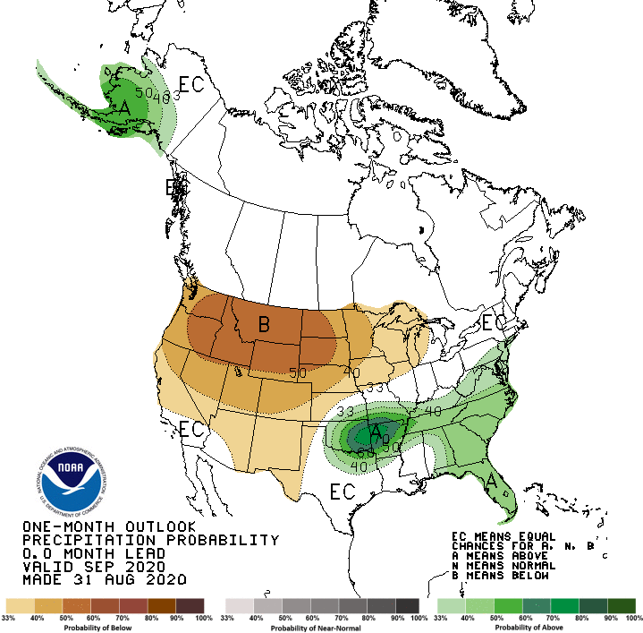
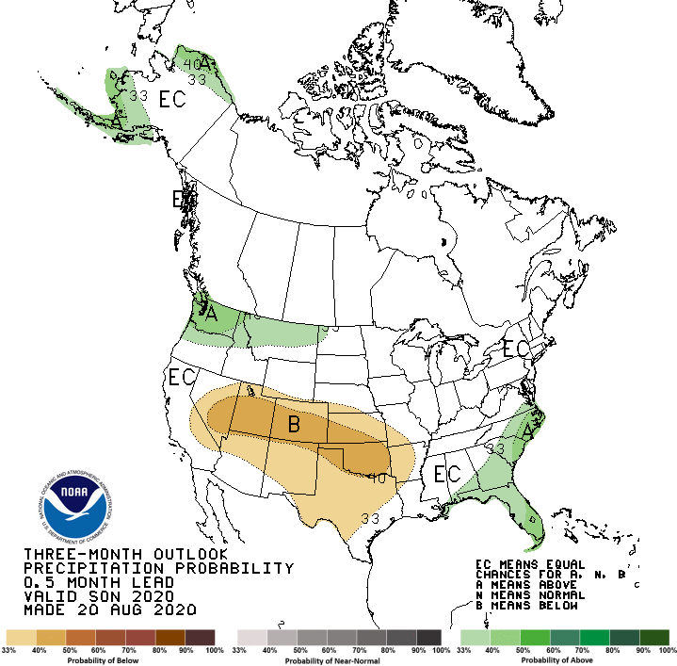
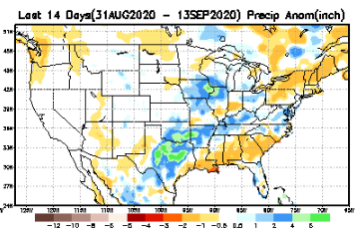
Released Aug 31st
Previous(Last month)
CPC’s official
Precipitation OUTLOOK for Monthly (Sep)/Seasonal (SON)
Released Aug 20th
Observed so far this month!!
Monthly P/T forecasts verified at mid-month are generally good! Why? ☺ (becoz they r mostly based on GFS’ 2-wk fcsts)
But this month, so far ????

Slide 26
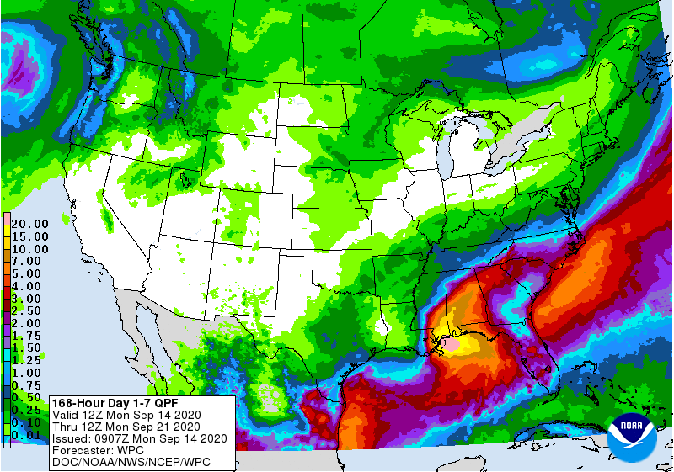
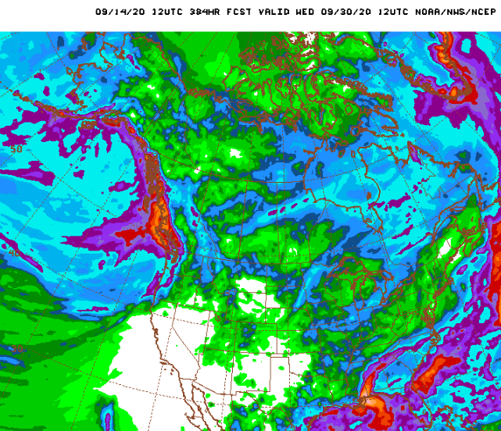
WPC Next 7 days QPF Forecast
Hurricane Sally (Cat 2 ?)
GFS Model Guidance for next 16 days.
Much of the US drought is in the West.
The short term rains may bring Immediate relief to drought/fire in the Pacific Northwest.
Hurricane Sally will take care of some emerging dryness in the southeast.

Slide 27
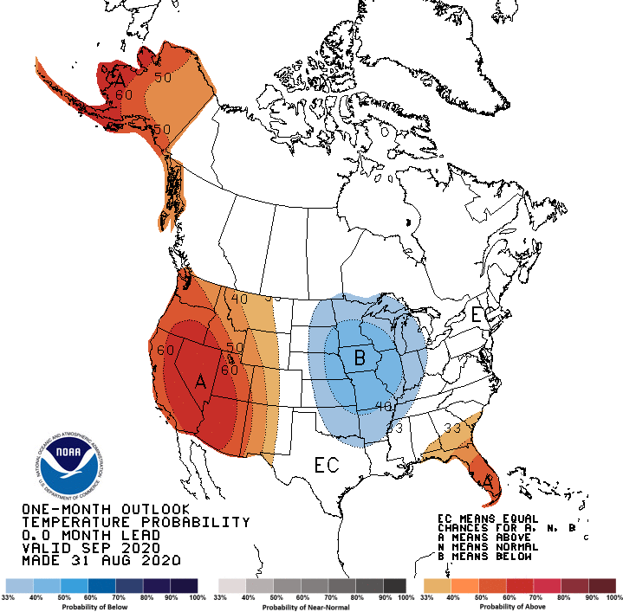
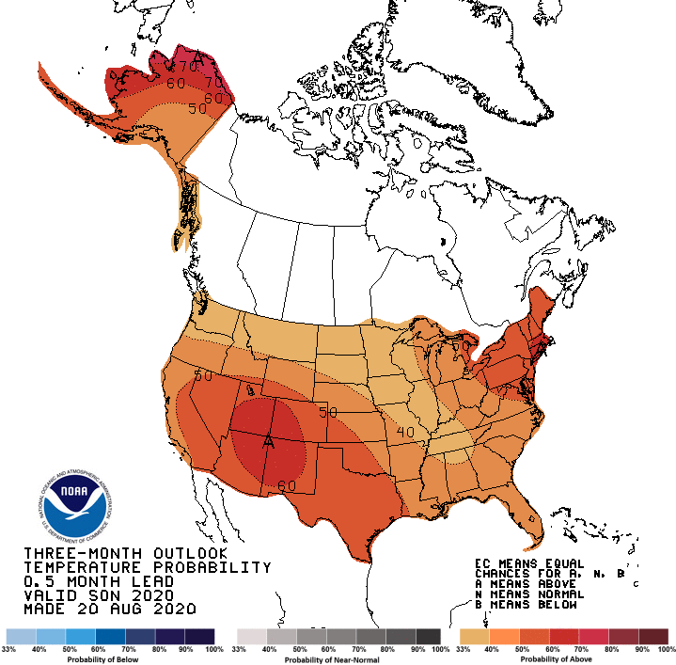
Made
Aug 31th
Previous (Last Month)
CPC’s official
Temperature outlook for Monthly (Sep)/Seasonal (SON)
Made Aug 20th
Observed so far this month!! ☺

Slide 28
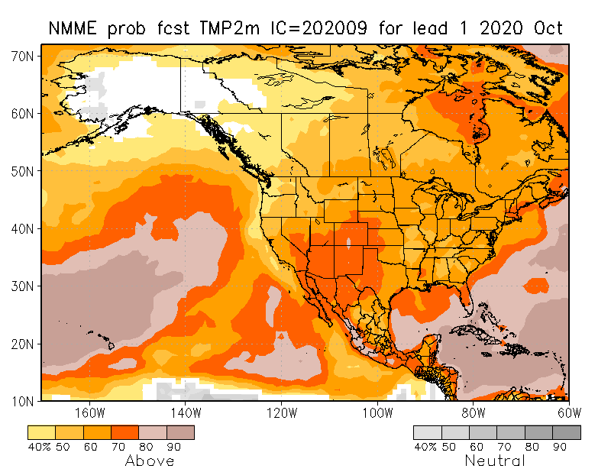
NMME T & P Ens.Mean forecasts
Oct
These NMME models always make these red (warmer T) forecasts.
OND
The forecast P pattern is the expected canonical La Nina composite, with dry relative conditions in the
South.

Slide 29
Agreement/Disagreement in the various NMME models’ SON seasonal Precip. Forecast.
??

Slide 30
Fcst made from last month(background) compared with this month(foreground, red border)
Forecast uncertain in Hatched areas.

Slide 32
Latest Initial Conditions:
09/08/2020
http://drought.geo.msu.edu/research/forecast/smi.monthly.php
Predicted Monthly Soil Moisture Percentile
MSU stopped updating 06/10/20 ☹
Initial Conditions 1 month ago:
08/11/2020
The inter quartile range suggest greater uncertainty about the forecast in these shaded regions.

Slide 33
Summary
Current Drought conditions:
Over the last several months, drought area & severity has overall generally increased across the South West& NW.
The short/long term drought in the four corner states area (AZ/NM/UT/CO), OR, WY, CA, NV has vigorously expanded and intensified southward & westward. The weak SW monsoon so far this year and the emerging and the ongoing La Nina has/is made conditions worse.
Dryness/Drought in Northern Great Plain states has eased but still present/reappearting.
Recent short-term Drought in the Northeastern states is just not going away completely.
Recently emerged drought in IA and upper Midwestern states continue..
Some/many of California reservoirs levels are below their historical average levels. Next rainy season is 3-months away. It is going to be tough with the above normal Temperature forecast for the region and of course with the La Nina expected to continue through upcoming winter!
Just last May, US had almost the lowest coverage of area covered by drought! approx.< 4% or so. Now more than 50% of the country is under drought!
Current ENSO status and forecast:
- La Niña conditions are present and are likely to continue through the Northern Hemisphere winter (~75% chance).
Prediction:
The long awaited La Nina is now finally here with some much needed lower boundary condition, in the form of extensive cold surface and subsurface temperature conditions in the tropical Pacific, so, our confidence in model’s forecasts is increased. The models forecast less than normal rainfall across the southern tier states.
These below normal rainfall conditions combined with the deficient North American monsoon in the southwest in and around the four corners states and vicinity combined with high temperatures will make the drought persist and even get worse in the upcoming season. The short/long tem drought in northern CA, NV, UT and western TX will persist may even get worse (how bad can it be?). But Pacific Northwest is likely to get some seasonal and enhanced precipitation associated with La Nina, and hence some relief from dryness and drought.
The remaining dry/drought conditions in the northeastern states continues to defiantly hang in there against our earlier expectations and forecasts. It is likely to persist there in some ameliorated form.
Existing developing dry/drought conditions in NE/IA border, and IN, OH and parts of PA will likely improve.
- The short term rain, especially from Sally and the active hurricane season, is likely to keep the SE drought free.
*********************

Slide 34
Miscellaneous maps

Slide 35
Miscellaneous maps

