Slide 1
Drought Outlook Support Briefing September 2021
Climate Prediction Center/NCEP/NOAA
http://www.cpc.ncep.noaa.gov/products/Drought

Slide 2
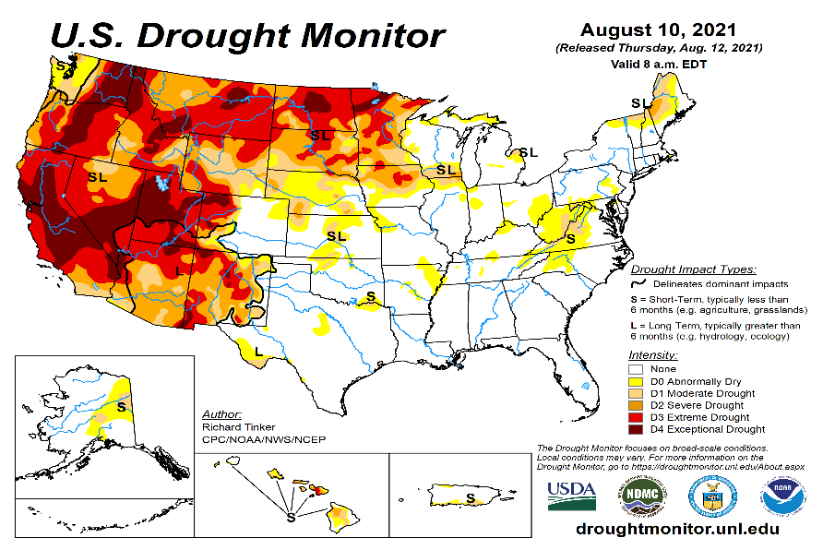
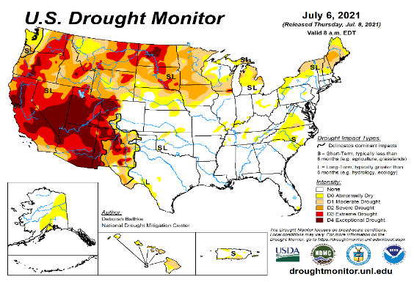
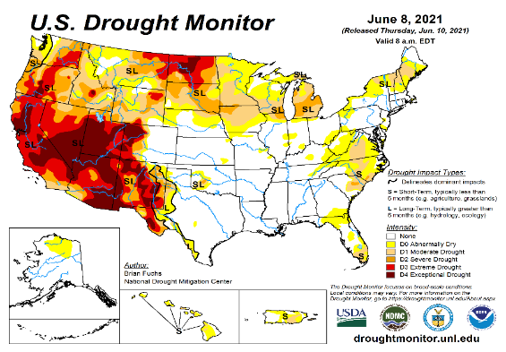
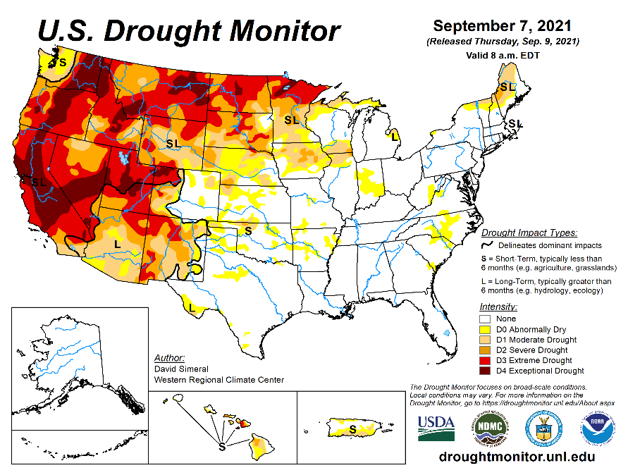
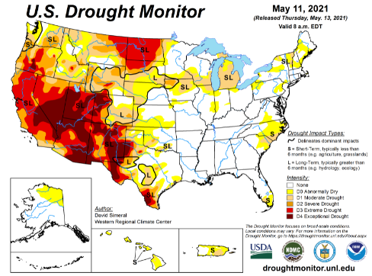
Drought Monitor
Monitoring is important because, unlike US T/P fcsts, for drought forecasts, we have to know where we are, before we can tell where we are going!! Drought forecasts are tendency forecasts.
August
Unlike last year, due to the much better SW monsoon rainfall this year, improvement is broadly seen in the short term drought conditions (cf. June/July USDM) now around the four corners states area, NV and vicinity as was also correctly forecast.
This short term improvement slightly lessens the extreme Fire potential (going forward in the year, compared to last year!)in the region. But Long term drought worries still prevails sporadically across the region due to the ongoing multi year drought in the region.
But conditions have worsened and shifted further west into CA, and northwest into OR and WA and ID, as well as into the Northern Great plains states of MT, the Dakotas and MN. Mild drought has also expanded into NE and IA.
US Drought areas under D3/D4 categories near max since 2000?
June
September
(Recent/Latest)
August
May

Slide 3
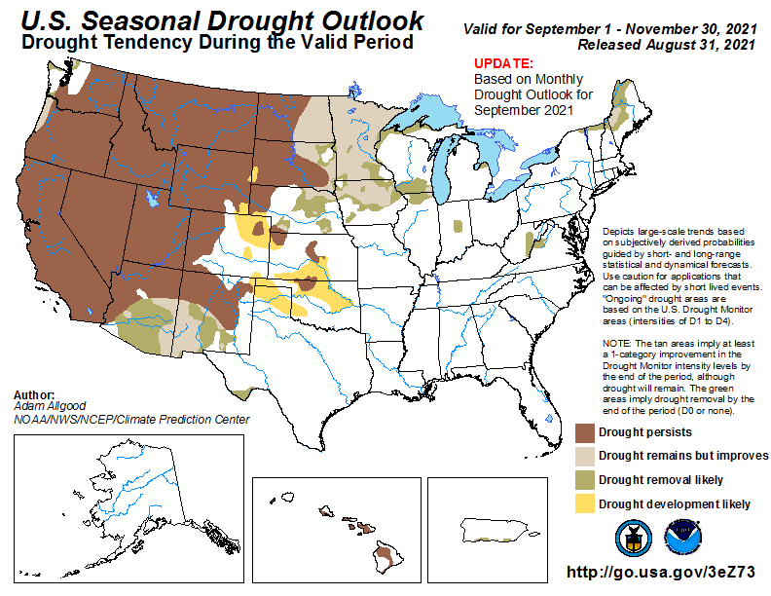
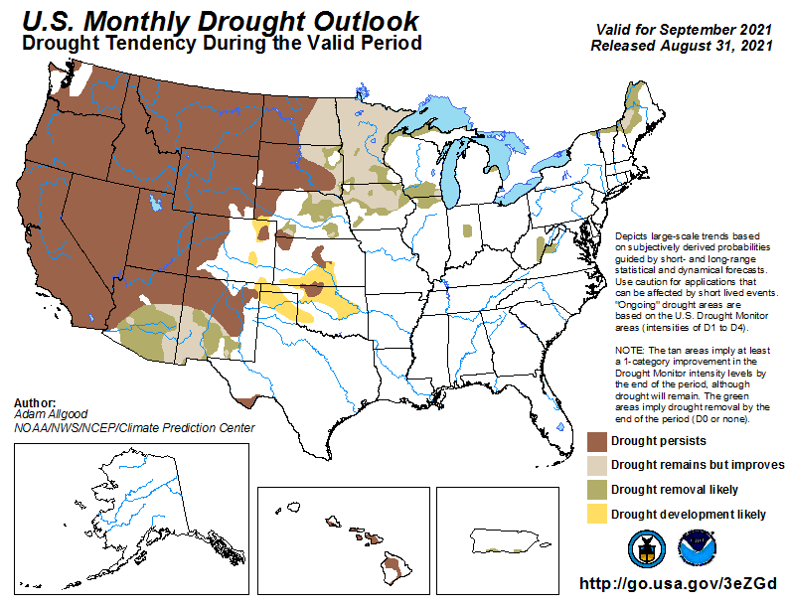
(Previous) Seasonal/Monthly Drought outlooks
New Seasonal+ Drought Outlook to be released in 2 days!
New Monthly Drought Outlook to be released end of this month)
Updated Seasonal Outlook (LOOKS almost SAME as MONTHLY)
(Sep. 2021- Nov. 2021)
issued 08/31/21
Monthly outlook
(for September 2021)
issued 08/31/21
Beginning this month, we show here (above) a new updated seasonal drought outlook(SDO) than the mid month SDO issued earlier in the middle of last month, to project/keep consistency between the MDO for the next month and SDO for the next 3-month season. It looks from these maps, that they both are almost the same.!!

Slide 4
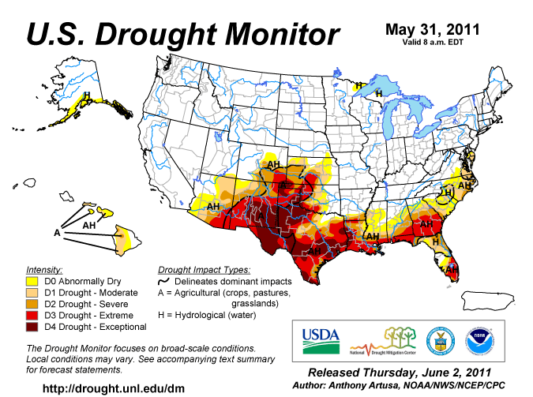
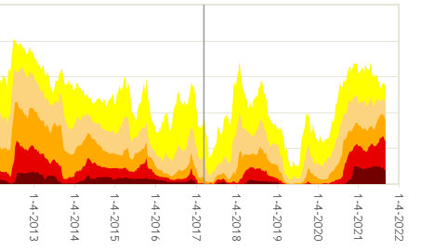
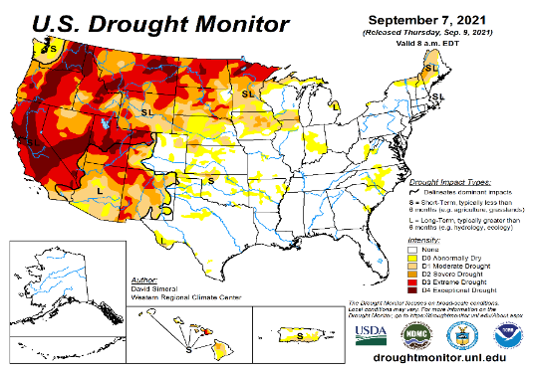
Famous 2011 TX drought
Just as no two ENSO events are the same,
no two drought events are he same!
The recent drought has somewhat stagnated ?
50%
Now!
Most area continuously under severe D3/D4 drought for a long time since 2000? (Long Term drought!) West vs East contrast in Drought areas!!

Slide 5
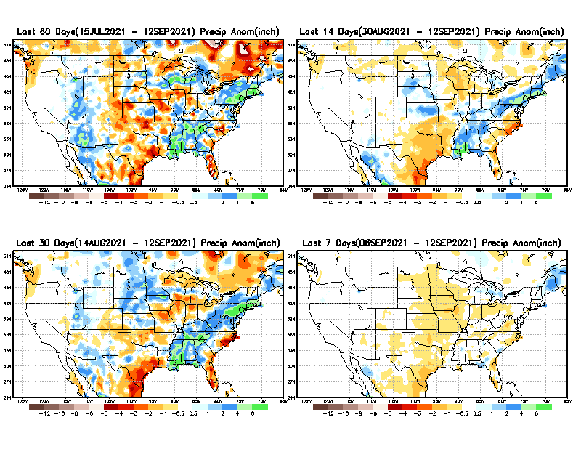
Precipitation ANOM during last 7, 14, 30, & 60 days.
This and next few slides show Precip deficit (excess).
Droughts, for the MOST part, begin and end with precip!! Lately, Temps are becoming (secondarily) important as well.
60 Days
14 Days
?
30 Days
7 Days
These maps in this and following slides, including a) Total,
b) Anom and
c) Percent of Normal precip. in these and other longer time ranges are now (routinely) daily updated at:
?
From: Recent Accumulated Precipitation https://www.cpc.ncep.noaa.gov/products/Drought/briefing_prcp.shtml

Slide 6
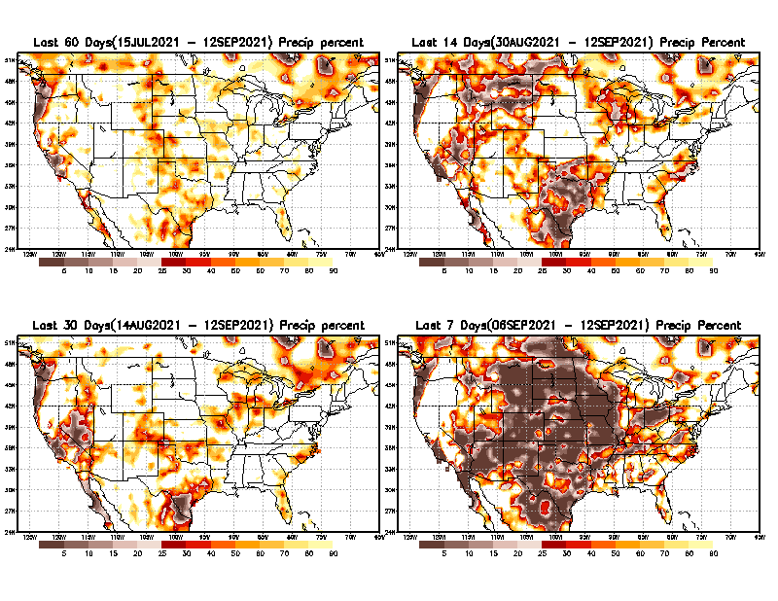
Precipitation Percent (of normal) during last 7, 14, 30, & 60 days - Only Deficit Areas <=90% shown !
60 Days
14 Days
☺
This plot shows only the rainfall deficient regions <= 90% of normal.
-- This shows more clearly possible/likely drought developing region in the future unless there is above normal rainfall in these regions in the future, to offset these shortfalls.
Not so bad !
30 days
7 Days
From: Recent Accumulated Precipitation https://www.cpc.ncep.noaa.gov/products/Drought/briefing_prcp.shtml

Slide 7
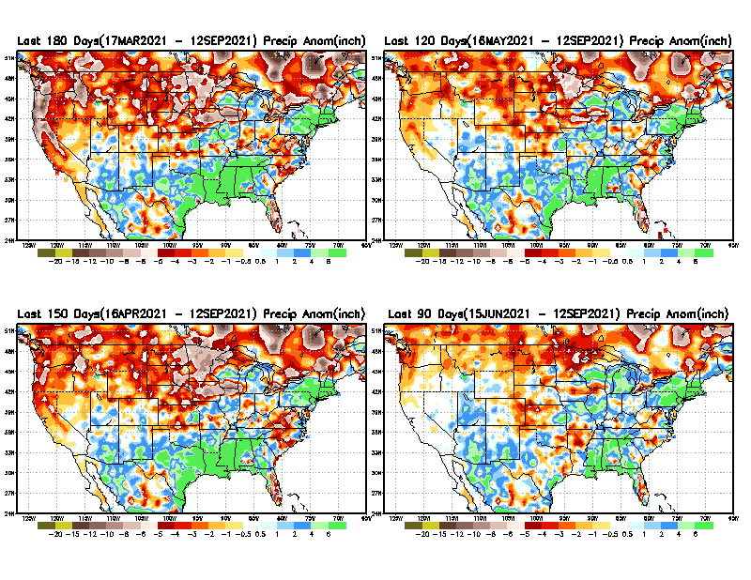
Total precipitation ANOM during last 3, 4, 5, and 6 months.
6 M
4 M
While the Precipitation anomalies deficit may seem large in some regions (compared to others), it is the % of normal precip (next slide) that matters more!!
5 M
3 M
From: Recent Accumulated Precipitation https://www.cpc.ncep.noaa.gov/products/Drought/briefing_prcp.shtml

Slide 8
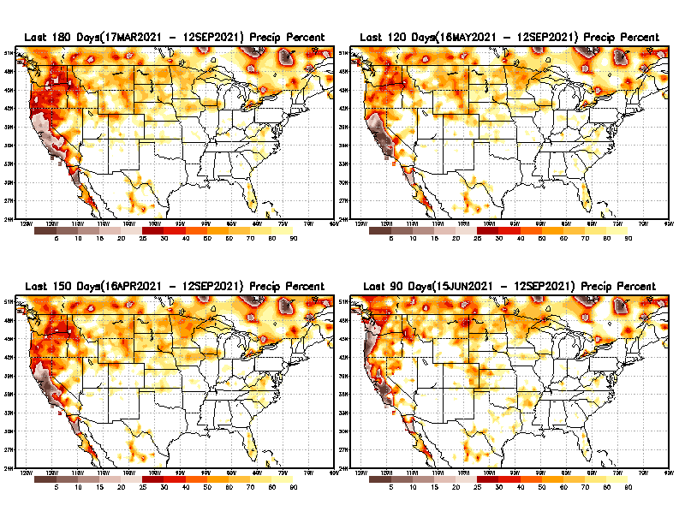
Total precipitation Percent (of normal) during last 3, 4, 5, and 6 months Only Deficit Areas <=90% shown!!
6 M
4 M
In these interim time scale 3-6 months, we need to pay attention to regions, which are dark-brown, red & dark red (<50%).
Not so bad along coast!
in %
While accrued precipitation deficits are real & objective,
droughts are subjective declarations!!
5 M
3M
☺
East vs West!
Broad vs Narrow
rainfall season.
In general, West suffers more from frequent and lasting droughts.
With these various rainfall deficits in diff. time ranges, where and how exactly does one declare drought? Other factors (T/SM/E, etc..) do matter, but is cumulative precip. Are deficits/percent_of_normal ultimately more important?

Slide 9
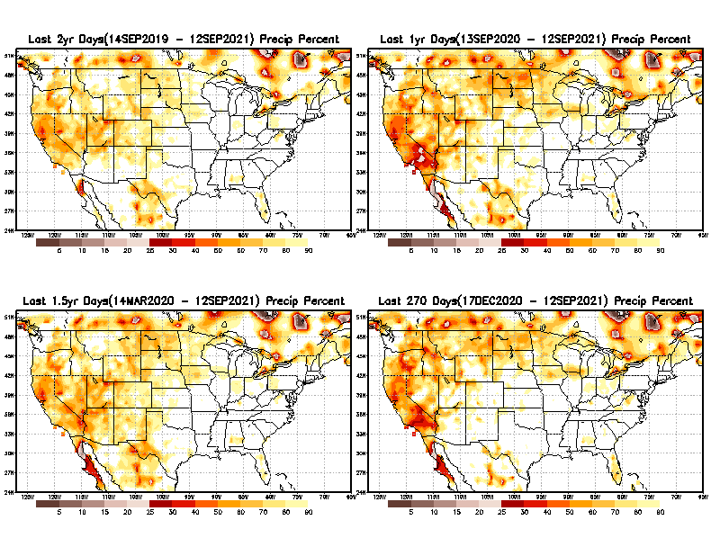
Total precipitation Percent during last 9 months, 1 yr, 1.5yrs, & 2 yrs. .–Only Deficit Areas shown!! <=90%
2 Y
1 Y
Tinderbox areas, where some form of longer term rainfall
deficiencies already, exist !!
-Almost all are in the west!, all part of the long term drought
-This & Next slide!!
1.5 Y
9 M
From: Recent Accumulated Precipitation https://www.cpc.ncep.noaa.gov/products/Drought/briefing_prcp.shtml

Slide 10
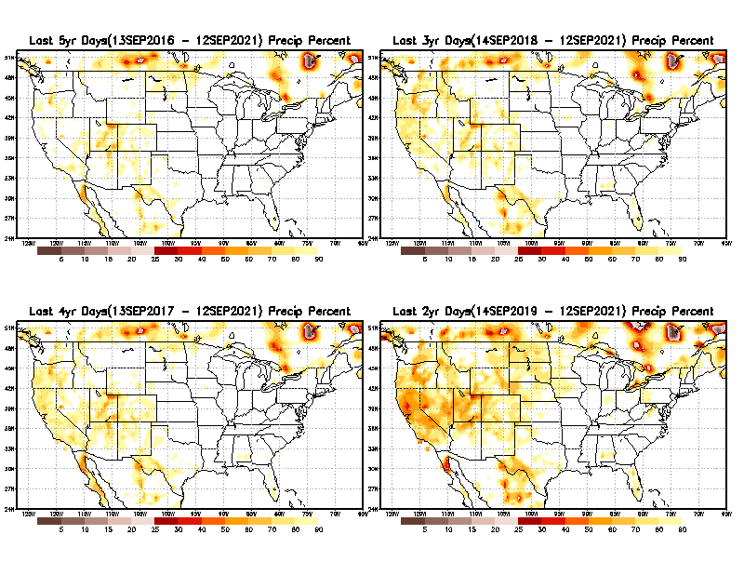
Total precipitation Percent (of normal) during last 2, 3, 4, & 5 yrs. .–Only Deficit Areas <=90% shown !!
5 Y
3 Y
In these long time ranges (2-5 yrs), there is a general dearth/lack of precipitation in the southwest US. – where the current severe drought ravages!!.
If the La Nina returns later in the year, things will get even worse for the southwest!!
4 Y
2 Y
Ongoing multiyear drought in the SouthWest!! Getting Worse.
Last few years, each year is a new record for the Fire Season!!
From: Recent Accumulated Precipitation https://www.cpc.ncep.noaa.gov/products/Drought/briefing_prcp.shtml

Slide 11
Rainy (3-month)Season across the US
SON - Least rainfall season of the year for the US? – No Green??
East vs West!
More darker colors in west/central => narrow rainy season (months)
Overall, more white space in the east => distributed rainfall season (except ~FL).

Slide 12
SON season, difficult season for drought forecast? Also transition-ing ENSO?
OCT - Month with the least WHITE & GREEN!
*********
EAST vs
CTR/WEST
Drought Behavior is loosely tied to rainfall climo!! And the limited rainy season in the west
*********
Adapted from Rich Tinker.

Slide 13
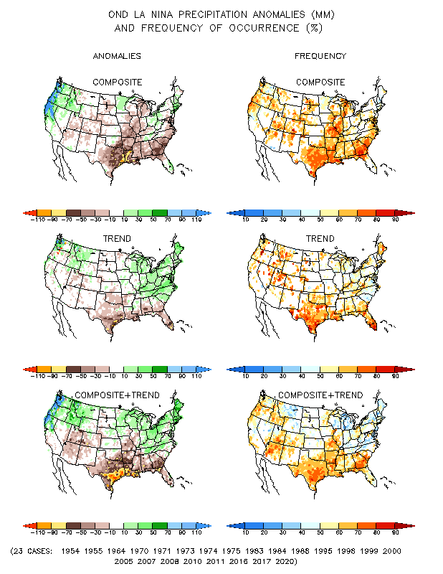
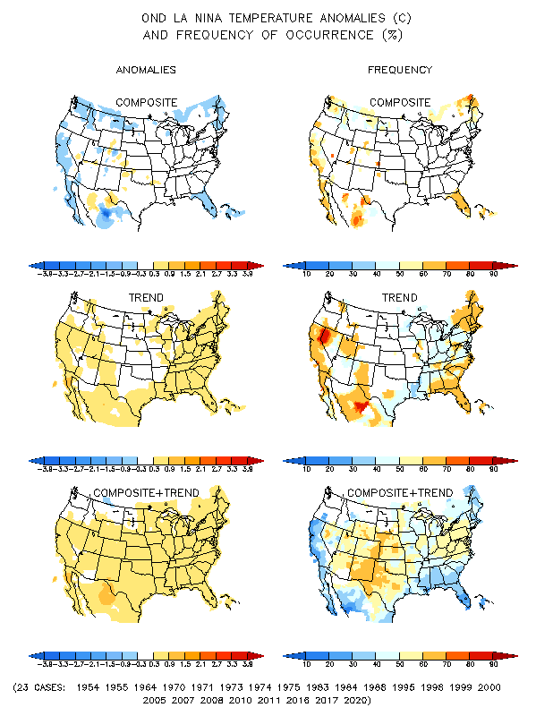
La Nina Precip/Temperature COMPOSITES & Trend map
OND
P
T
With expected ENSO-cold conditions, this row is relevant!!

Slide 14
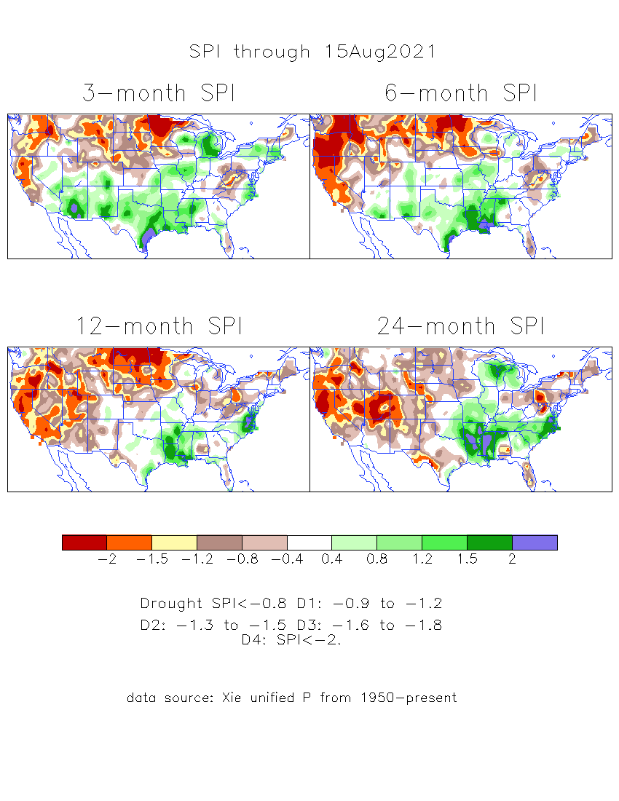
The Standardized Precipitation Index SPI (based on Observed P)
----- Last Month
Very interesting graphic & details for the drought across the US based on the more generalized precip deficit/excess, the Standardized Precipitation Index (SPI).
The dark brown and red colors, indicating standardized precipitation deficits, in the various time periods, approximately correspond to the appropriate short/long term drought monitor regions and their intensities

Slide 15
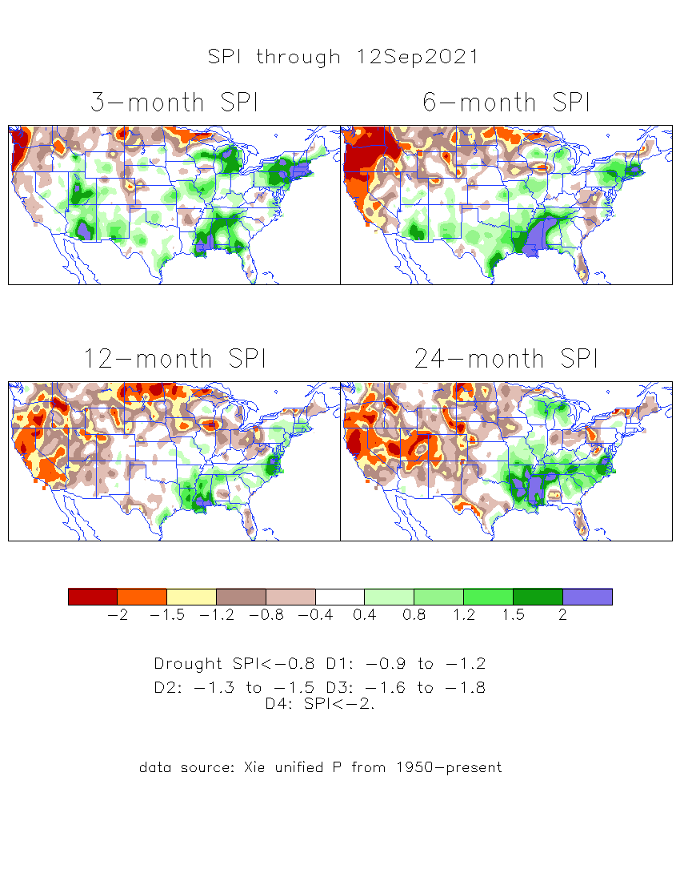
The Standardized Precipitation Index SPI (based on Observed P)
----- NOW
Very interesting graphic & details for the drought across the US based on the more generalized precip deficit/excess, the Standardized Precipitation Index (SPI).
The dark brown and red colors, indicating standardized precipitation deficits, in the various time periods, approximately correspond to the appropriate short/long term drought monitor regions and their intensities
Short
The short term drought has somewhat shifted/extended from southwest to northwest and the northern Plains. But the long term drought in the southwest remains.
----- NOW
Long
How does one negotiate and reconcile declaring short term vs long term drought when precip. deficiencies patterns differ on many different time scales locally!!
What is the cutoff delineating time between short VS long term drought!!
At exactly where does drought begin?

Slide 16
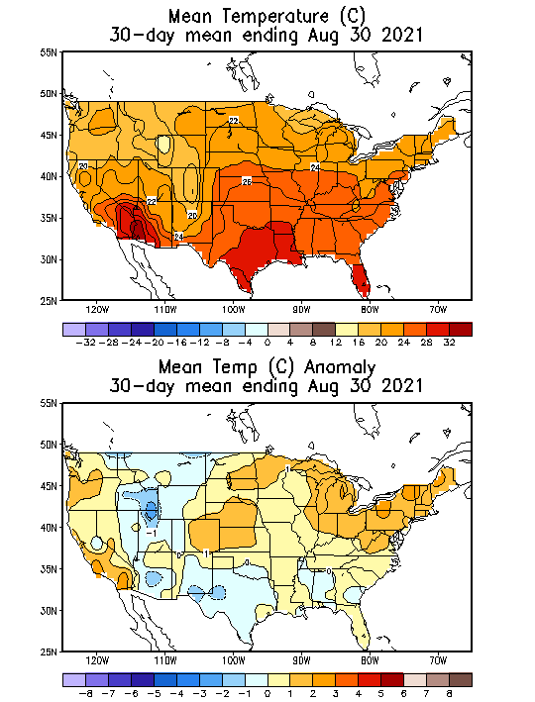
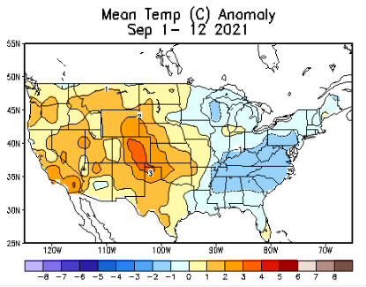
Recent US Temperatures
Such swings in winter Temperatures
Even in the midst of La Nina!!
From Mar->Apr –> May -> Jun
So far this month !!
Remember, the TX freeze!!

Slide 17
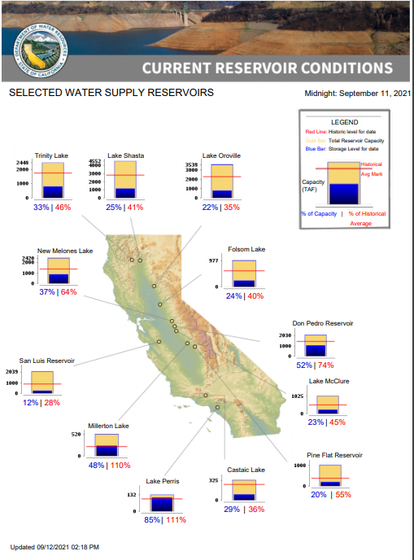
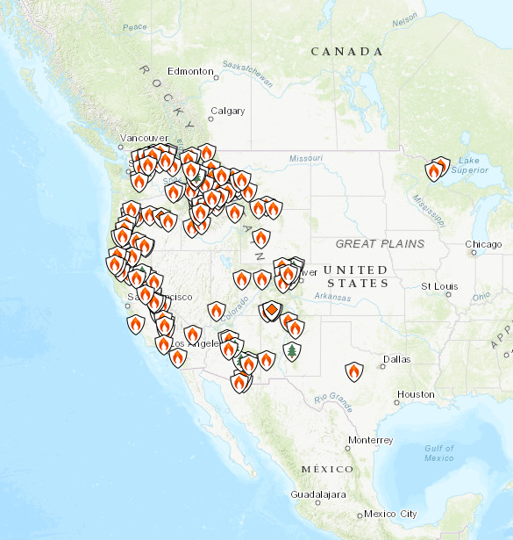
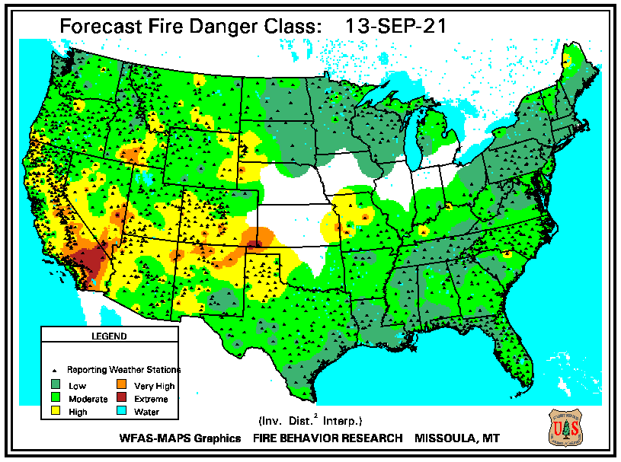
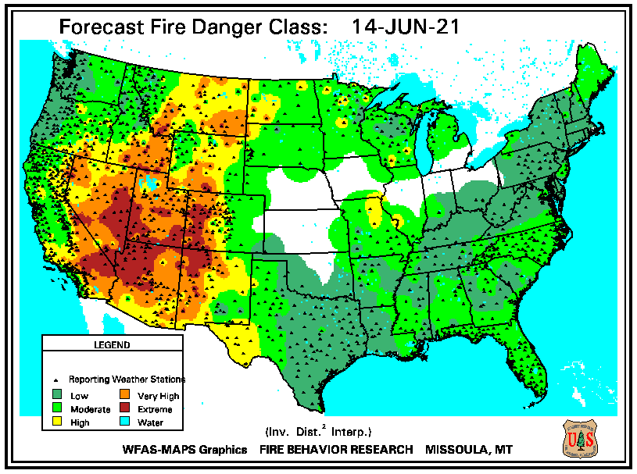
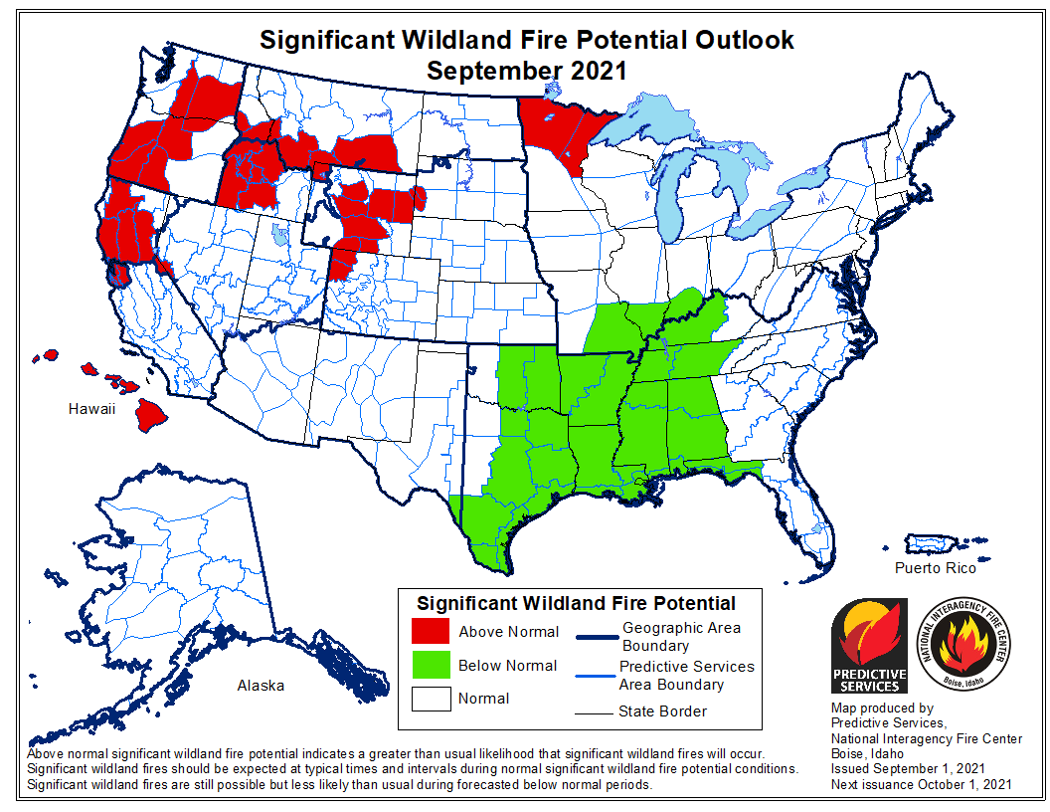
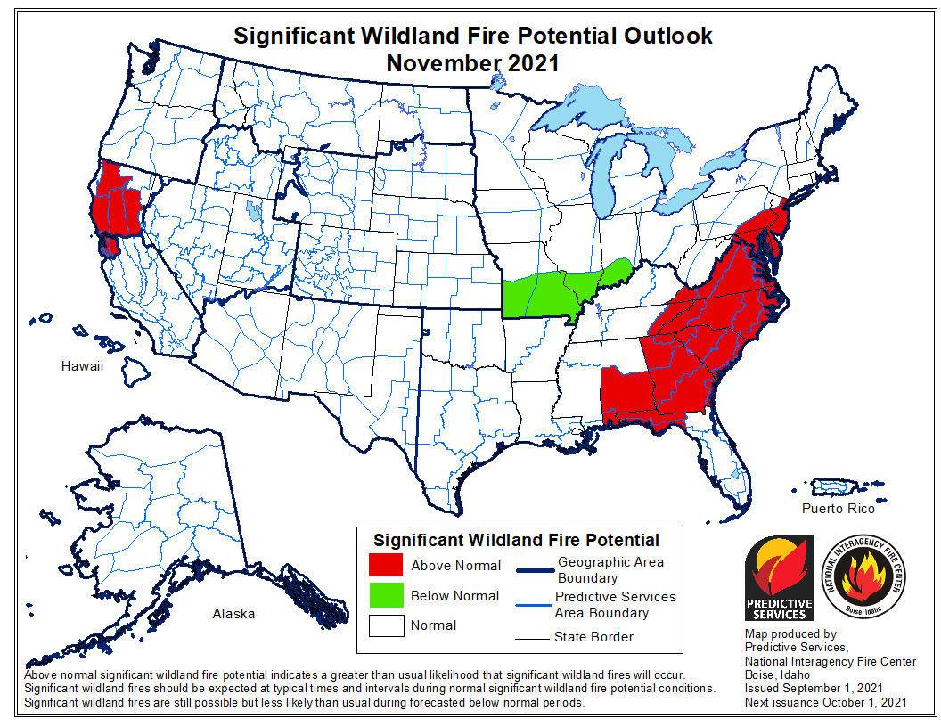
THIS MONTH
# of Fires NOW in western states
Impact of good Monsoon rains!!
SEP
JUN
NIFC’s Fire Potential Outlook for Sep/Oct/Nov
Many CA reservoirs are already low!!
If La Nina continues reappears later this year, (which looks more and more likely) it will be a major problem for water in the western coastal states!

Slide 18
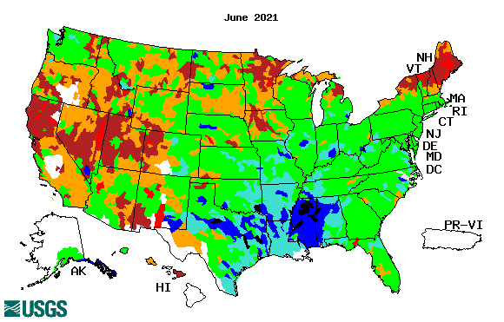
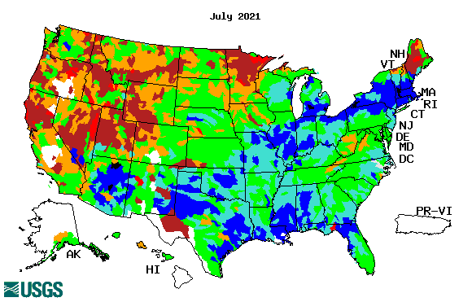
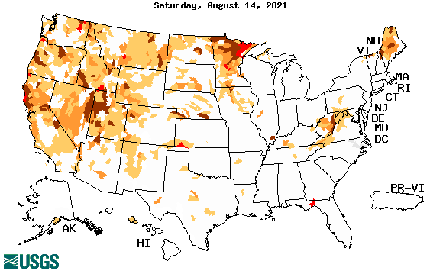
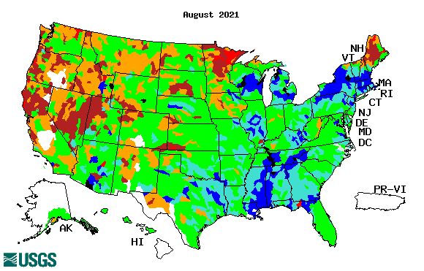
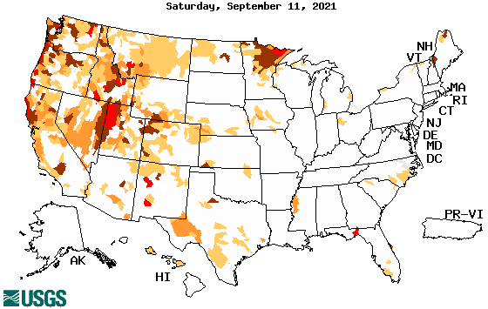
Streamflow (USGS)
Same data source USGS:
Look at the monthly maps for Northeast vs weekly maps in the bottom!!
Map shows only below normal 7-day average streamflow compared to historical streamflow for the day of year.
One month ago (left) &
Now (below)
Streamflow is only a partial indicator, as it is highly managed.
Look along the Pacific coastal states. If sometimes, the various indicators are confusing, go back to % of rainfall deficit maps – to reinforce!!
18

Slide 19
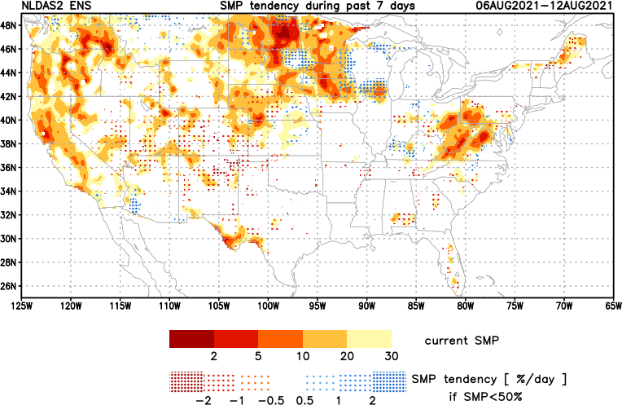
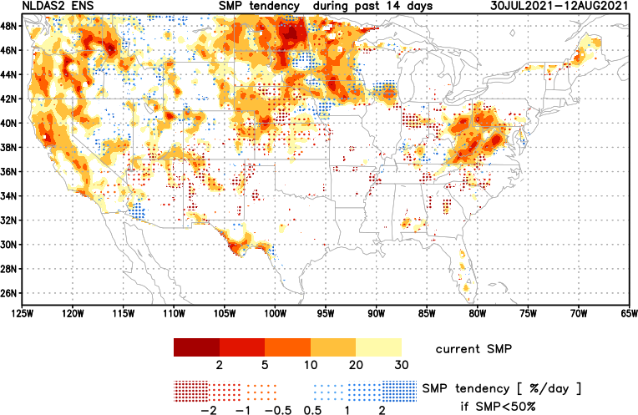
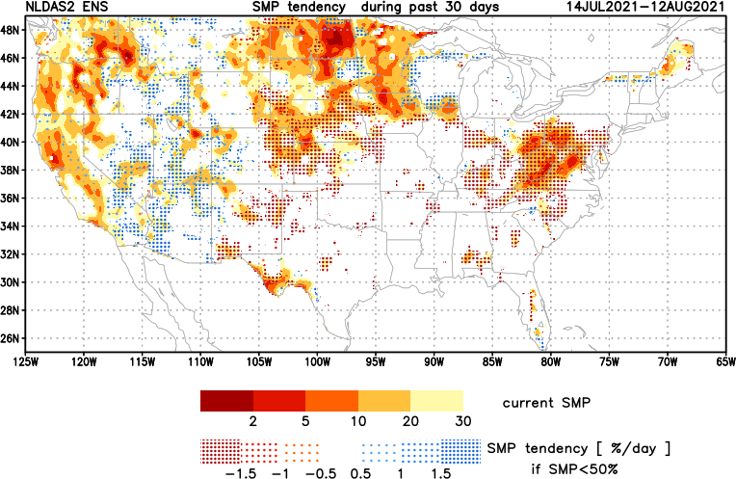
[Now]
NCEP Ensemble mean NLDAS2 models’ Soil Moisture tendency/trend
7 days
14 days
30 days
These NLDAS2 based SM tendency mas are a few days old!! But note the change in the middle part of the country!! Upper Midwest consistently dry!!
The drying in the mid-Atlantic eastern US states need to keep an eye, but with the approaching Tropical storm FRED, will likely have an impact in the area. Need to watch here. May not be a concern for the season.
+ve SMP (wetness) tendency due to monsoon rains is a temporary relief here and even further north.

Slide 20
EL NIÑO/SOUTHERN OSCILLATION (ENSO)
DIAGNOSTIC DISCUSSION
issued by CLIMATE PREDICTION CENTER/NCEP/NWS and the International Research Institute for Climate and Society
9 September 2021
ENSO Alert System Status: La Nina Watch
Synopsis: A transition from ENSO-neutral to La Niña is favored in the next couple of months, with a 70-80% chance of La Niña during the Northern Hemisphere winter 2021-22.

Slide 21
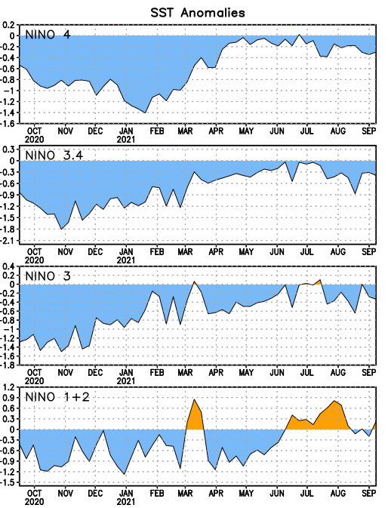
Latest values of SST indices in the various Nino Regions.

Slide 22
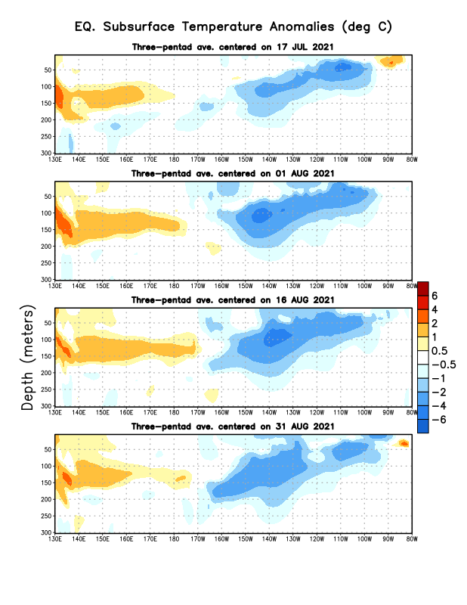
Sub-Surface Temperature Departures in the Equatorial Pacific
Will these cold subsurface anomalies strengthen further into a mature cold event to show up at sea surface?
Most recent pentad analysis

Slide 23
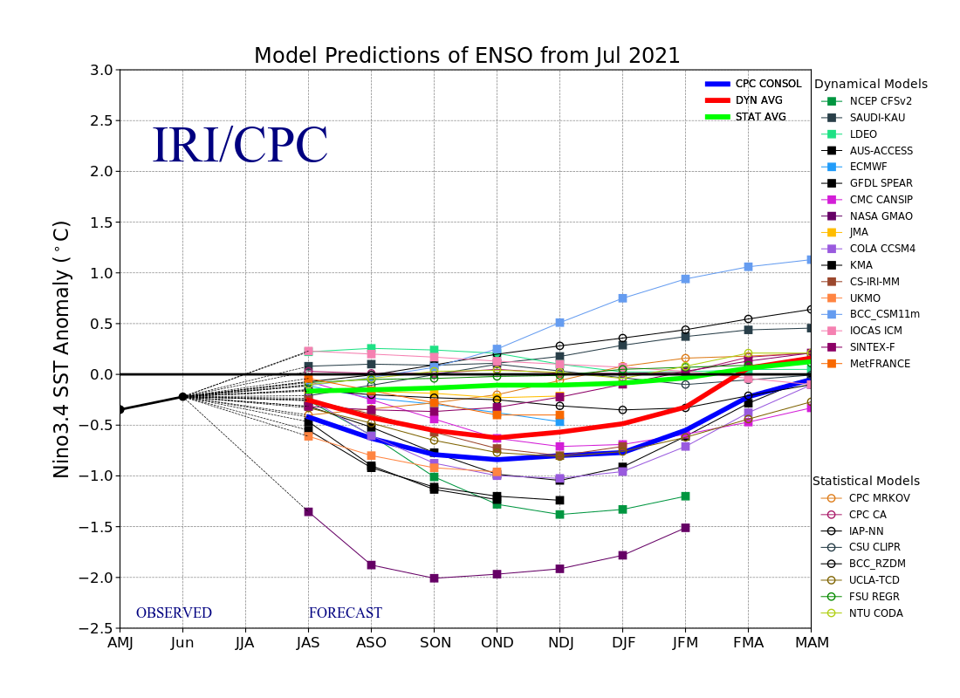
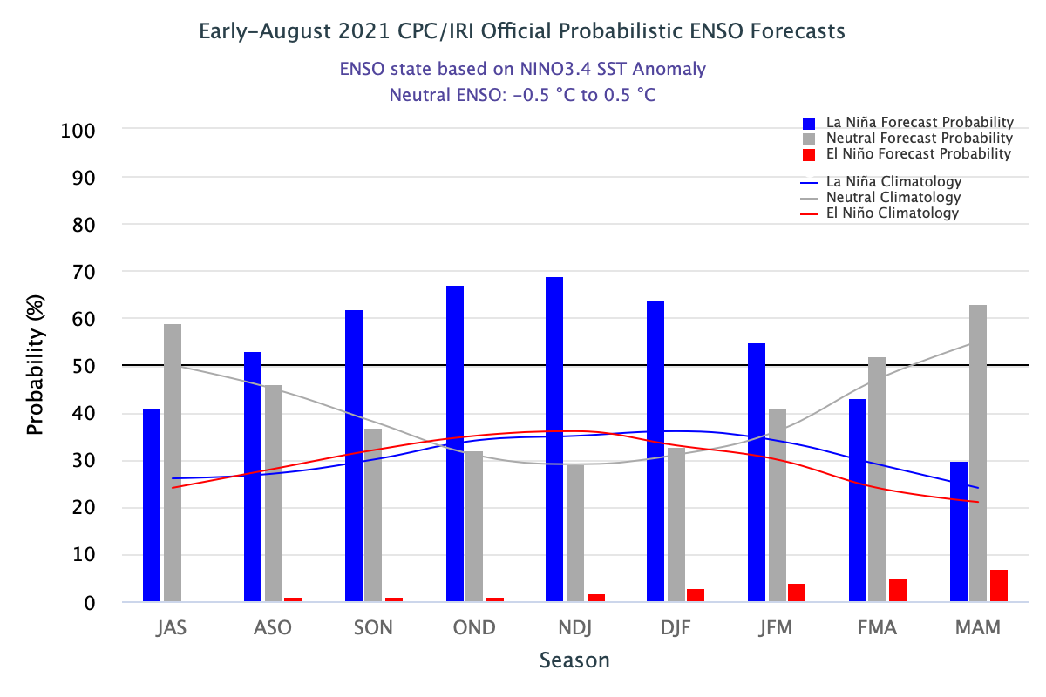
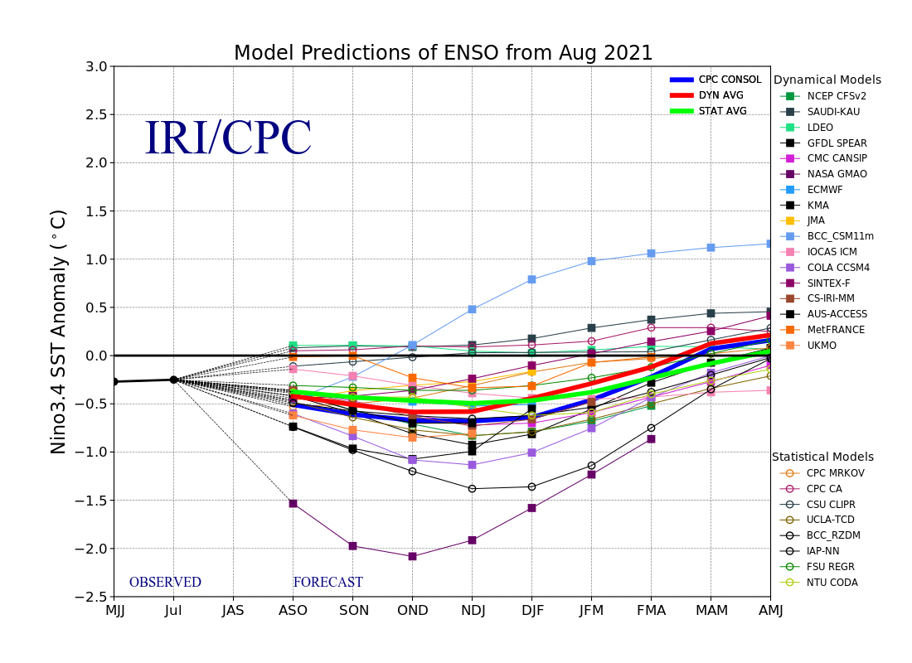
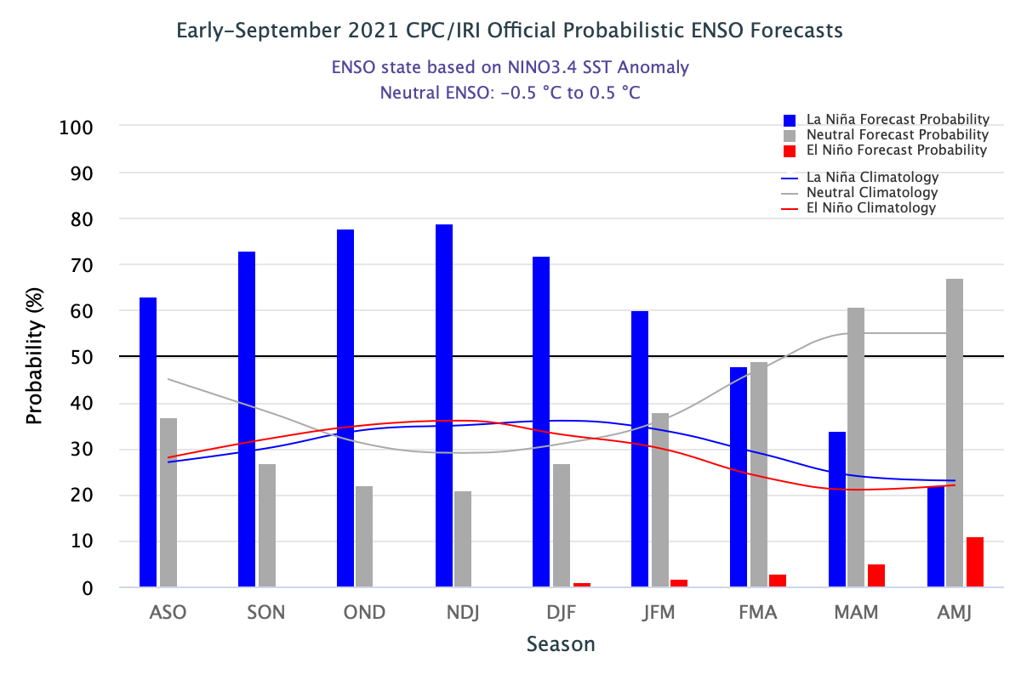
ENSO Forecasts
Early- August CPC/IRI forecast
Early- September CPC/IRI forecast
Dynamical, Statistical, CPC-Consolidated fcsts are coming together!! But still at ~ -0.5C !
Looks like a quick weak La Nina Event during this upcoming winter ONLY? But still there is spread!!

Slide 24
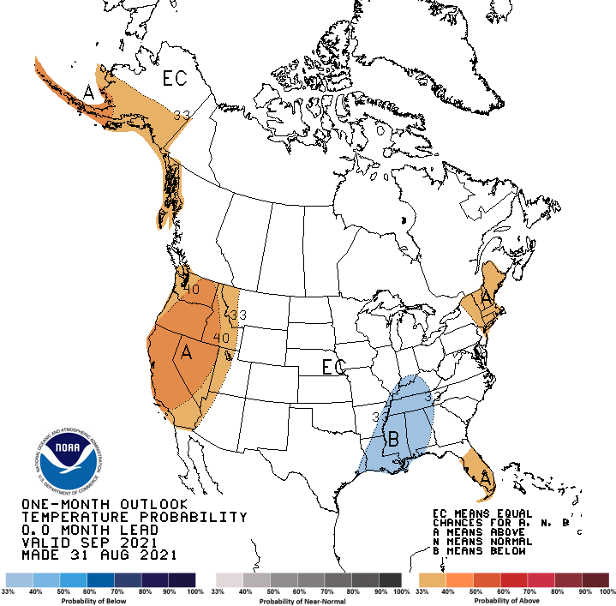
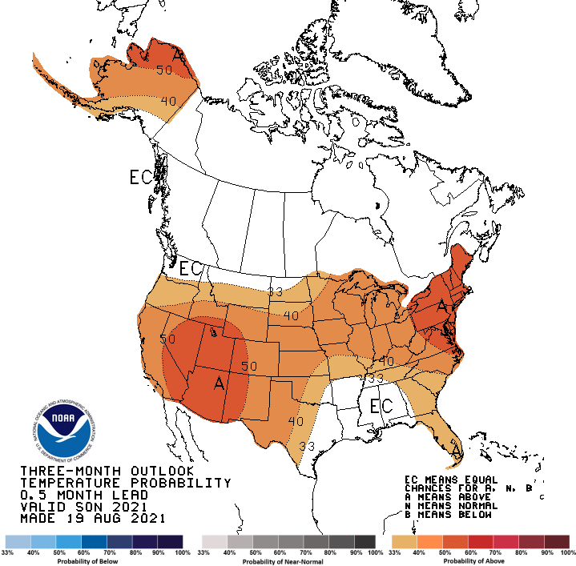
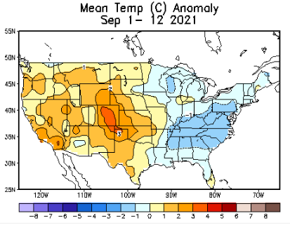
Previous (Last Month)
CPC’s official
Temperature OUTLOOK for Monthly (September)/Seasonal (SON)
Made
Aug 31st
Made Aug 19th
The continued warm temperatures forecast (and observed also) in the US West and North are not going to help ease the drought there.
Observed so far this month!! ☺

Slide 25
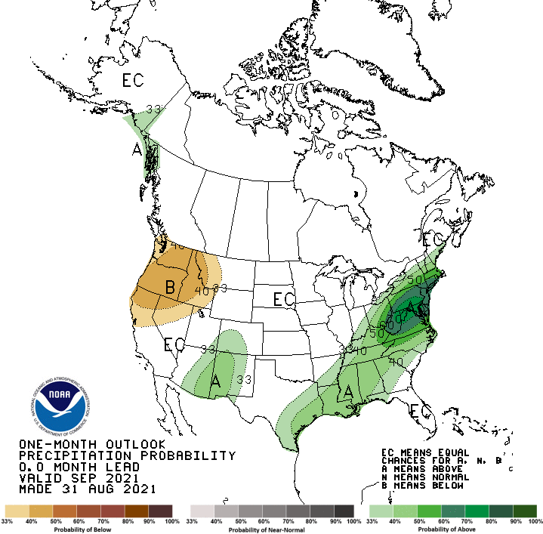
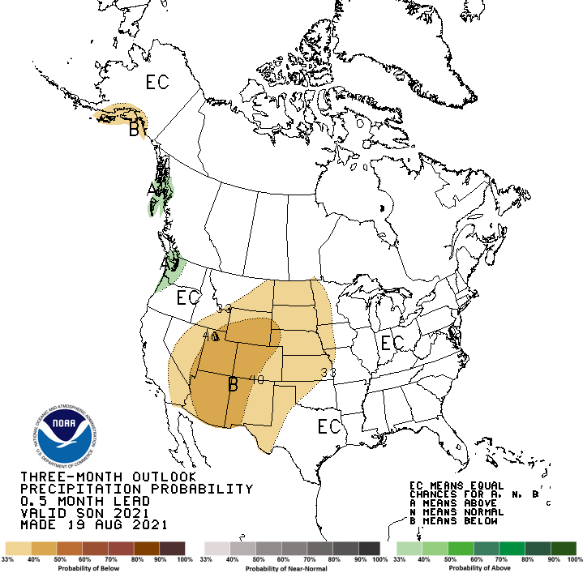
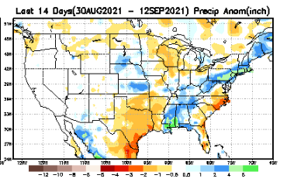
Previous(Last month)
CPC’s official
Precipitation OUTLOOK for Monthly (September)/Seasonal (SON)
Released Aug 31th
Released Aug 19th
Observed so far this month!! ☹
Monthly P/T forecasts verified at mid-month are generally good! Why? ☺
(becoz they are mostly based on GFS’ 2-wk fcsts).
But so far, fcst looks ??

Slide 26
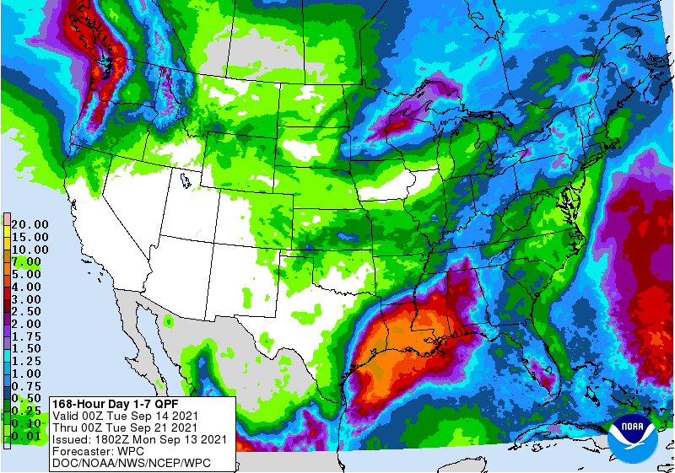
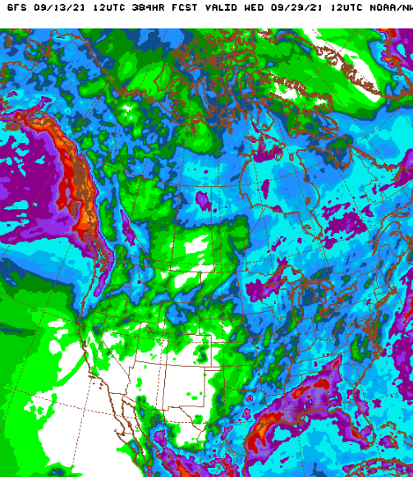
NCEP/WPC Next 7 days QPF Forecast
Actual Precip amounts and region generally varies highly from one model run to next!!
TS Nicholas
GFS Model Guidance for the
next 16 days.
The only good thing happening in the West is at least the Monsoon this year did not fail as it did last year. The rainy season along the Pacific coastal states starts in December1

Slide 27
From European Center (EC) Precip forecast (made yesterday, 13 Sep) for next 30 days.

Slide 28
From European Center (EC) Precip forecast (made yesterday, 13 Sep) for next 30 days.
20
40

Slide 29
Watch!!(Recall climo slide earlier!! Possible short term drought development patches here!
(See next slide!)

Slide 30
Watch!!(Recall climo slide earlier!! Possible short term drought development patches here!

Slide 31
Week-4 Soil Moisture Percentile (SMP) Fcst based on VIC model forced with ECMWF-extended precipitation forecast!
??
(From Drs. Li Xu and Yun Fan) More detail at From: https://www.cpc.ncep.noaa.gov/products/people/lxu/flashd/flash_prediction.html

Slide 32
NMME T & P Ens.Mean forecasts for
Oct
OND

Slide 33
Agreement/Disagreement among the various NMME models’ OND seasonal Precip. Forecast.
??

Slide 34
(From NMME) compared with this month(foreground, red border)
Why is there so fewer hatched areas in SPI6 fcst from NMME models’ based fcst this month as compared to last month (left 2 columns) ? Fcsts more confident now?
Forecast uncertain in Hatched areas.
Many pieces of hatched areas in the central and mostly in the eastern half of the US – indicating the model’s inability to know the status of drought here.
Lots of uncertainty regions!! In the middle column!!
SPI6 Fcst made from last month
SPI6/SPI12 Fcst made from this month

Slide 35
http://drought.geo.msu.edu/research/forecast/smi.monthly.php
Latest Initial Conditions:
09/07/2021
Predicted Monthly Soil Moisture Percentile
MSU Soil Moisture Percentile forecast NOT available, NOT updated!
CPC’s soil moisture percentile – Leaky bucket Model
The inter quartile range suggest greater uncertainty about the forecast in these shaded regions. Lots of uncertainty regions!! ☹

Slide 36
Summary
Current Drought conditions:
Unlike last year, due to the much better SW monsoon rainfall this year, improvement is broadly seen in the short term drought conditions (cf. June/July USDM) now around the four corners states area, NV and vicinity as was also correctly forecast.
This short term improvement slightly lessens the extreme Fire potential (going forward in the year, compared to last year!)in the region. But Long term drought worries still prevails sporadically across the region due to the ongoing multi year drought in the region.
But conditions have worsened and shifted further west into CA, and northwest into OR and WA and ID, as well as into the Northern Great plains states of MT, the Dakotas and MN. Mild drought has also expanded into NE and IA. US Drought areas under D3/D4 categories near max since 2000?
All California reservoirs levels continue to worsen to below their historical average levels. If the forecast heat/temps and the lack of (seasonal) rainfall continues, things will probably get dire.
The fire season in the US western states is already well underway, and is much worse earlier this year, as compared to the same time last year (a record year!), but the better SW monsoon this year has somewhat helped the situation here. Going forward the fire potential outlooks issued for Sep-Oct-Nov does not look dire as last year, due to good monsoon.
Current ENSO status and forecast: A transition from ENSO-neutral to La Niña is favored in the next couple of months, with a 70-80% chance of La Niña during the Northern Hemisphere winter 2021-22.
Prediction:
The odds of La Nina reemerging soon, within the upcoming forecast season (OND) continues to increase during winter, although the event is likely to be of a borderline/minor strength one. Nevertheless, with the continued forecast of above normal temperatures in the US west and the continued dry season along the west coast states until winter (rainfall season), the short term drought in the Pacific coastal and adjoining states especially in CA, OR, WA is expected to broaden and get worse,
In spite of the better SW monsoon rainfall in AZ/NM/UT/CO and vicinity, the long term drought in the south and west is still entrenched. Water shortages could first further worsen in California, before the seasonal winter rains start in late November and early December. Drought conditions in the Northern Great Plains states has worsened, and with the summer rainfall season coming soon to a close, it is unlikely the current drought conditions there will likely persist,
The large swath of the central part of the country, from the Dakotas running south, is a difficult area of concern in terms of drought persistence, development or decay.
SON/OND is a difficult season to forecast, both in terms of rainfall climatology (relatively dry!) and drought, that too especially in the context of developing La Nina conditions. The mild dry conditions (% rainfall wise) in the mid Atlantic states need not be of concern, at least through the rest of active hurricane season through November. ***********

Slide 37
Miscellaneous maps

Slide 38
Miscellaneous maps

