Slide 1
Drought Outlook Support Briefing
September 2022
Climate Prediction Center/NCEP/NOAA
http://www.cpc.ncep.noaa.gov/products/Drought
Points to ponder:
Often, there is a disconnect between the Short term (S) and Long term (L) drought in regions, and even for, with the short term drought, the 3-month and 6-month signals are not quite consistent!
Places/regions experiencing Short term drought may (not) be ok in the Long term and vice versa!!
This duality is difficult to reconcile, to convey and even be understood by the public at large.
Public/Forecaster tends to focus more on the Short term Drought (for good reasons!!)
More importantly the very definitions and timescales associated with S/L term droughts and the declarations in the USDM are by themselves subjective!!
The Southwest monsoon is pretty active, this year too! But the monsoon season is soon coming to an end.
The 2022 Atlantic hurricane season, is not yet active, as forecast!(ACE is now ~29 (vs climo ~64 for today!)) –--- all 6 past (2016-2021) North Atlantic Hurricane seasons have been above normal! (longest on record!)
Because of the S/W monsoon, the Short Term drought scenario in the South/west has changed considerably!

Slide 2
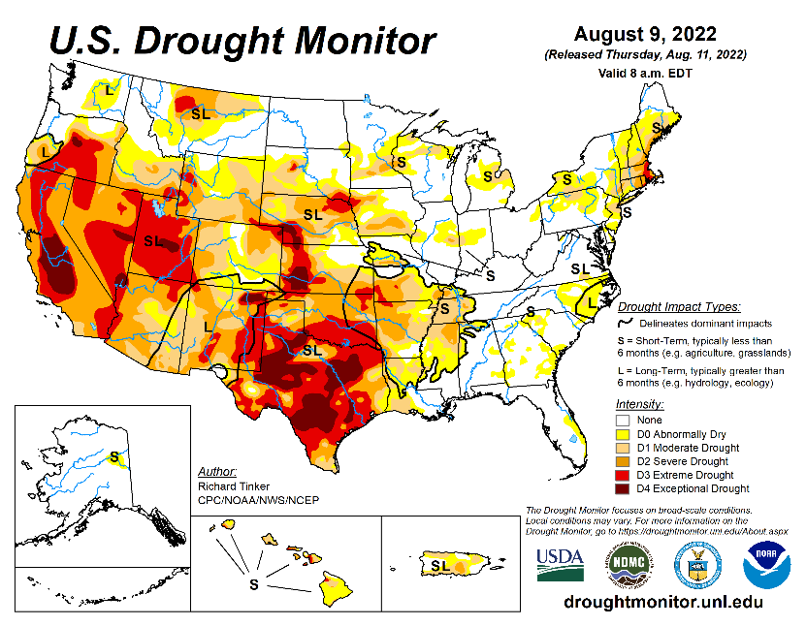
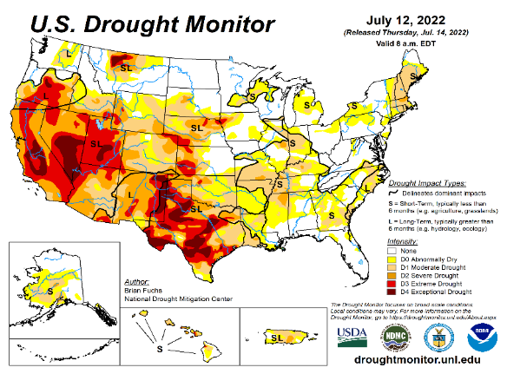
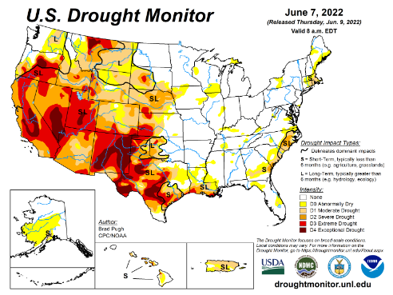
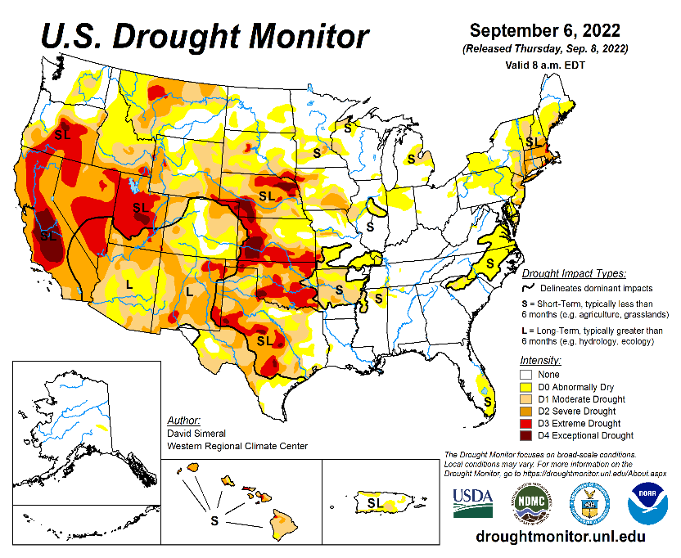
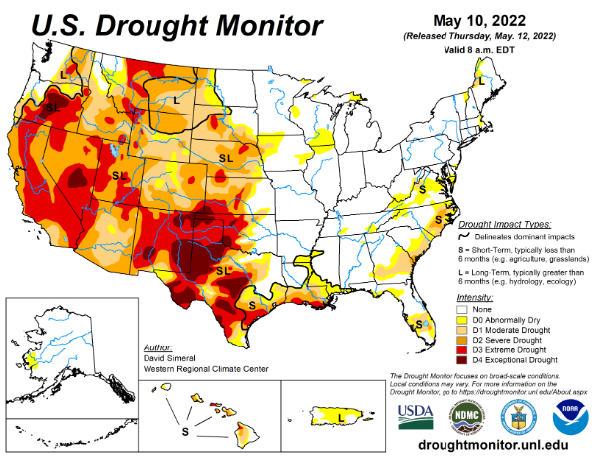
Drought Monitor
Monitoring is important because, unlike US T/P fcsts, for drought forecasts, we have to know where we are, before we can tell where we are going!! Drought forecasts are tendency forecasts.
August
July
It used to be that for many months, the classic East-West dipole pattern with drought in the US west half, and (almost) no drought in the US east half, has somewhat been in place.
But lately, in summer months, short term drought kept wavering (emerging and going away), across parts of the Midwest, and along the Atlantic coastal areas. Also, lately, dryness has developed in many coastal northeastern/New England states.
Some short term (2-3 months) dryness has developed in eastern MT, and in parts of the Dakotas, NE/KS/OK.
The southwest monsoon impacting the 4-corner states (AZ/NM/UT/CO) area and western TX has been very active this year also (as was last year) for the most part, which considerably improved the ST drought situation in the general region. But long term drought (decade+) still remain for the general south western states.
This is not the rainfall season for CA/WA/OR and hence the drought situation here remained basically unchanged. Overall, with the continued presence of La Nina for the third year in a row, as we have been warning, seems to have generally kept the overall LT Drought category areas in the southwestern states.
June
September
(Recent/Latest)
May
?

Slide 3
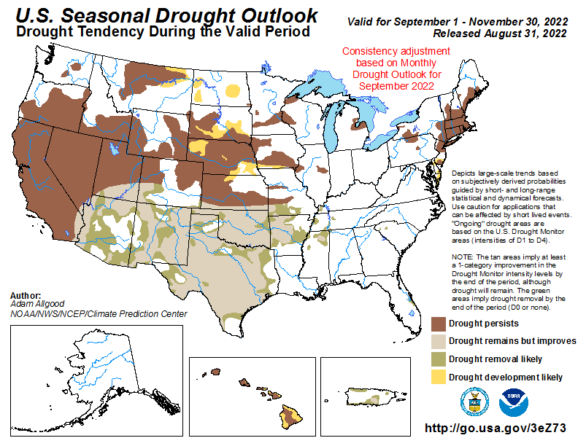
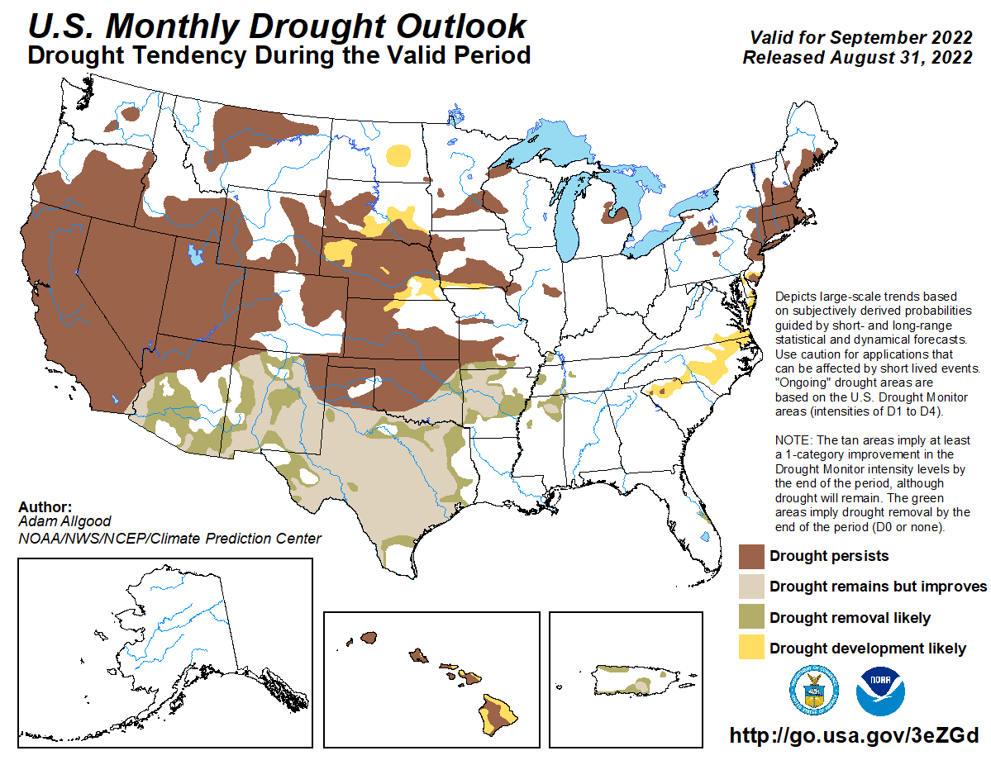
(Previous) Seasonal/Monthly Drought outlooks
New Seasonal+ Drought Outlook to be released in 2 days!
New Monthly Drought Outlook to be released end of this month)
Updated Seasonal Outlook
(1 Sep – 30 Nov 2022)
issued 8/31/22
Monthly outlook (for September 2022)
issued 8/31/22
It is the classic great West versus East drought paradigm !!
US East droughts are different than West droughts!!
This is mainly related to the rainfall climatology! – Of course ENSO impact matters!

Slide 4
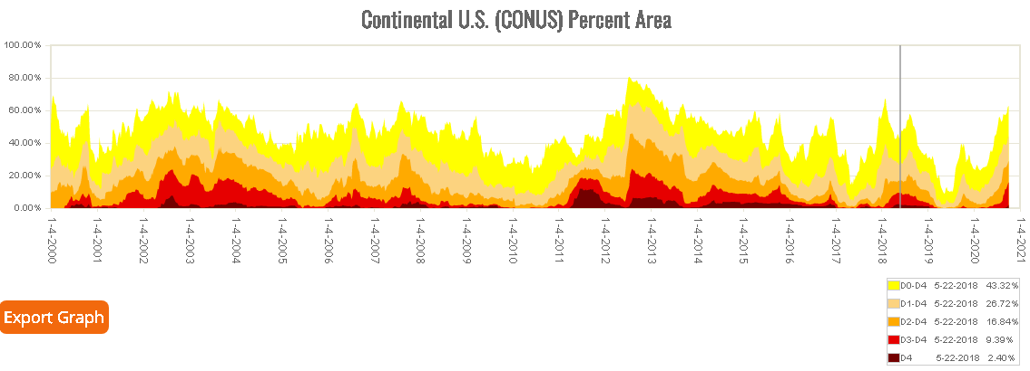
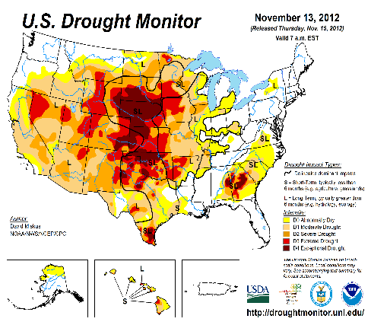

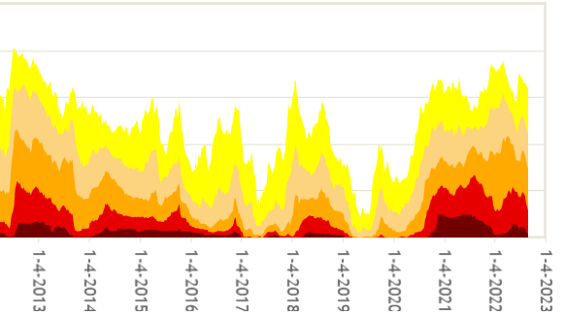


Time series since 2000 spilt into 2 (above & below) panels.
The spatial details of
Every drought is different.!
Every situation is different!!
Current drought!
Now: All five drought categories’ (D0-D4) US land area have come down slightly from recent highs, made possible mainly by the strong southwest monsoon rainfall this calendar year also. But with the monsoon season gradually coming to an end, what will happen? Esp. with the ongoing La Nina!!

Slide 5
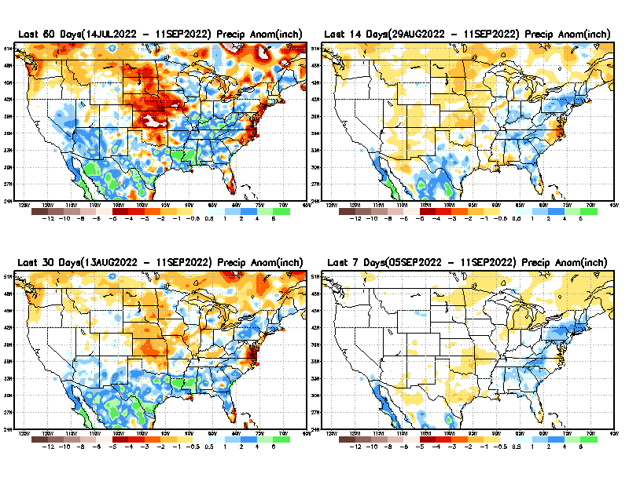
Precipitation ANOM during last 7, 14, 30, & 60 days.
This and next few slides show Precip deficit (excess).
Droughts, for the MOST part, begin and end with precip!! Lately, Temps are becoming (secondarily) important as well.
60 Days
14 Days
30 Day
7 Days
These maps in this and following slides, including a) Total,
b) Anom and
c) Percent of Normal precip. in these and other longer time ranges are now (routinely) daily updated at:
?
So far, a very good active SW monsoon, bringing considerable relief to the short term drought in the SW region! ☺. But long term drought? The two good monsoons in a row, is making a big dent in the short term drought! But is it also making an impact to the long term drought? How long is “long term”, really?
From: Recent Accumulated Precipitation https://www.cpc.ncep.noaa.gov/products/Drought/briefing_prcp.shtml

Slide 6
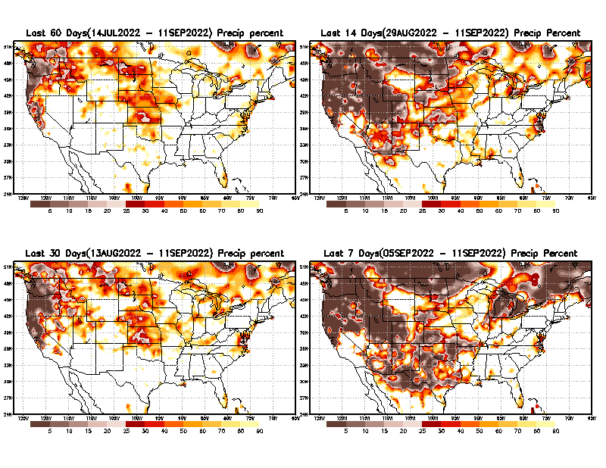
Precipitation Percent (of normal) during last 7, 14, 30, & 60 days - Only Deficit Areas <=90% shown !
60 Days
14 Days
This plot shows only the rainfall deficient regions <= 90% of normal.
-- This shows more clearly possible/likely drought developing region in the future unless there is above normal rainfall in these regions in the future, to offset these shortfalls.
30 days
7 Days
From: Recent Accumulated Precipitation https://www.cpc.ncep.noaa.gov/products/Drought/briefing_prcp.shtml

Slide 7
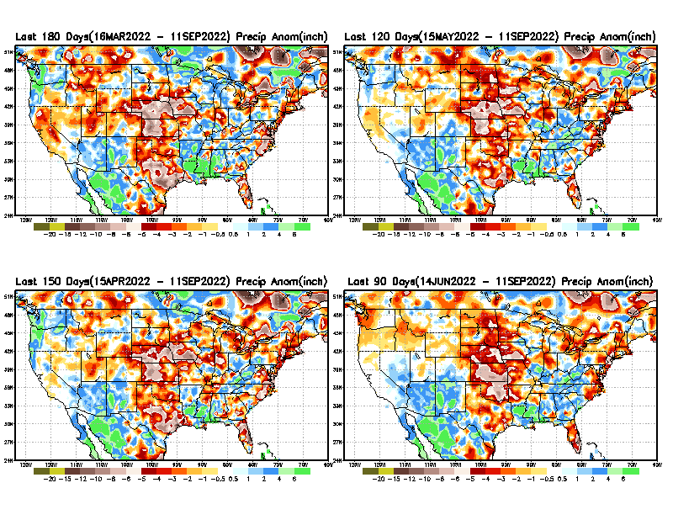
Total precipitation ANOM during last 3, 4, 5, and 6 months.
While the Precipitation anomalies deficit may seem large in some regions (compared to others), it is the % of normal precip (next slide) that matters more!!
6 M
4 M
5 M
3 M
From: Recent Accumulated Precipitation https://www.cpc.ncep.noaa.gov/products/Drought/briefing_prcp.shtml

Slide 8
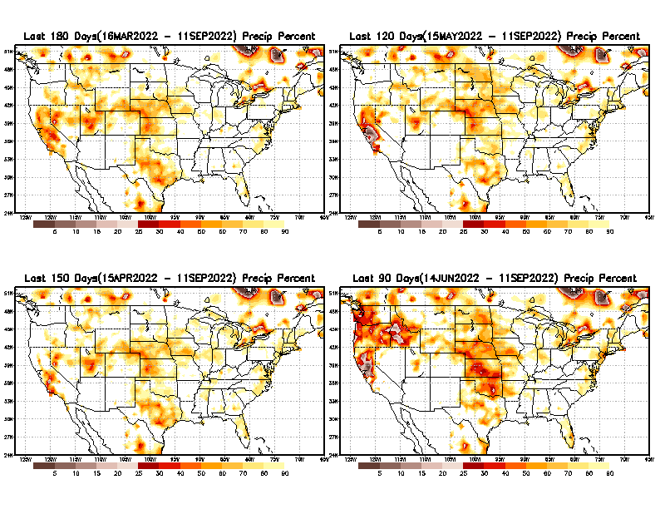
Total precipitation Percent (of normal) during last 3, 4, 5, and 6 months Only Deficit Areas <=90% shown!!
6 M
4 M
In these interim time scale 3-6 months, we need to pay attention to regions, which are dark-brown, red & dark red (<50%).
While accrued precipitation deficits are real & objective,
droughts are subjective declarations!!
5 M
3M
East vs West!
Broad vs Narrow
rainfall season.
In general, West suffers more from frequent and lasting droughts.
Short term(S) Drought is generally declared when rainfall deficits exist in the 3-6 months time range. {Long term deficits beyond 1 or 2 or more years is Long term L drought! }

Slide 9
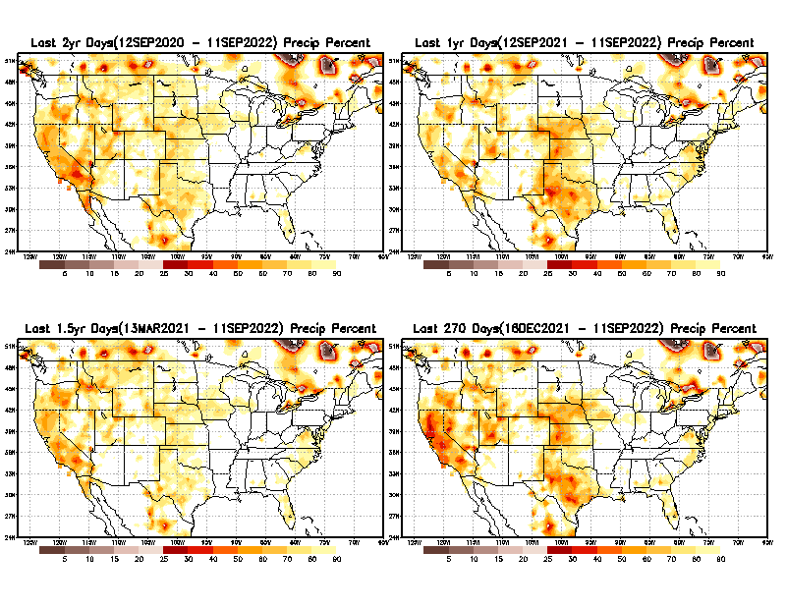
Total precipitation Percent during last 9 months, 1 yr, 1.5yrs, & 2 yrs. .–Only Deficit Areas shown!! <=90%
2 Y
1 Y
Tinderbox areas, where some form of longer term rainfall
deficiencies already, exist !!
-Almost all are in the west!, all part of the long term drought
-This & Next slide!!
1.5 Y
9 M
The character and even location/spatial extent of the short/S and long/L –term droughts are different!!!
From: Recent Accumulated Precipitation https://www.cpc.ncep.noaa.gov/products/Drought/briefing_prcp.shtml

Slide 10
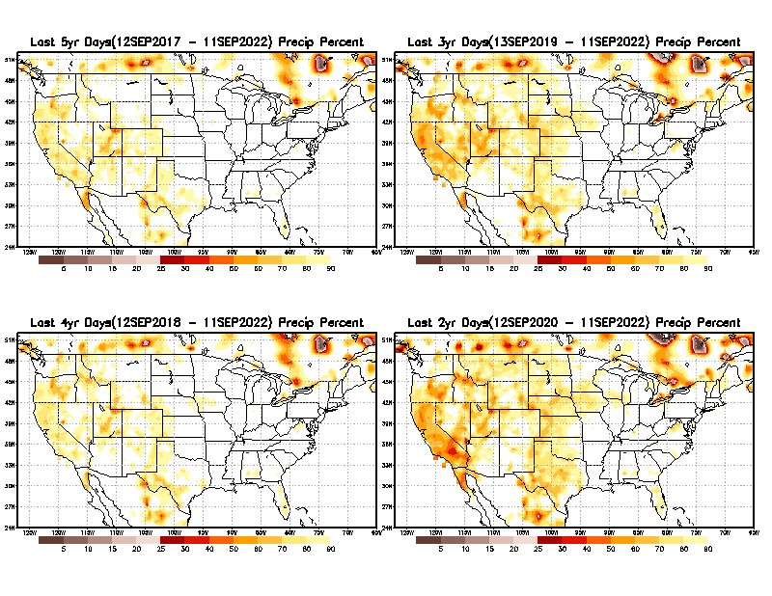
Total precipitation Percent (of normal) during last 2, 3, 4, & 5 yrs. .–Only Deficit Areas <=90% shown !!
5 Y
3 Y
In these long time ranges (2-5 yrs), there is a general dearth/lack of precipitation in the southwest US.
Recent Weather Blog News:
A recent study from the University of California, Los Angeles now claims the current drought that started in 2000 for the American Southwest is now the driest 22 years since 800 A.D. Researchers said climate change is to blame. Their proof? Tree rings!
4 Y
2 Y
Ongoing long term drought in the South West!! 3rd year La Nina(?) will make it worse!!.
From: Recent Accumulated Precipitation https://www.cpc.ncep.noaa.gov/products/Drought/briefing_prcp.shtml

Slide 11
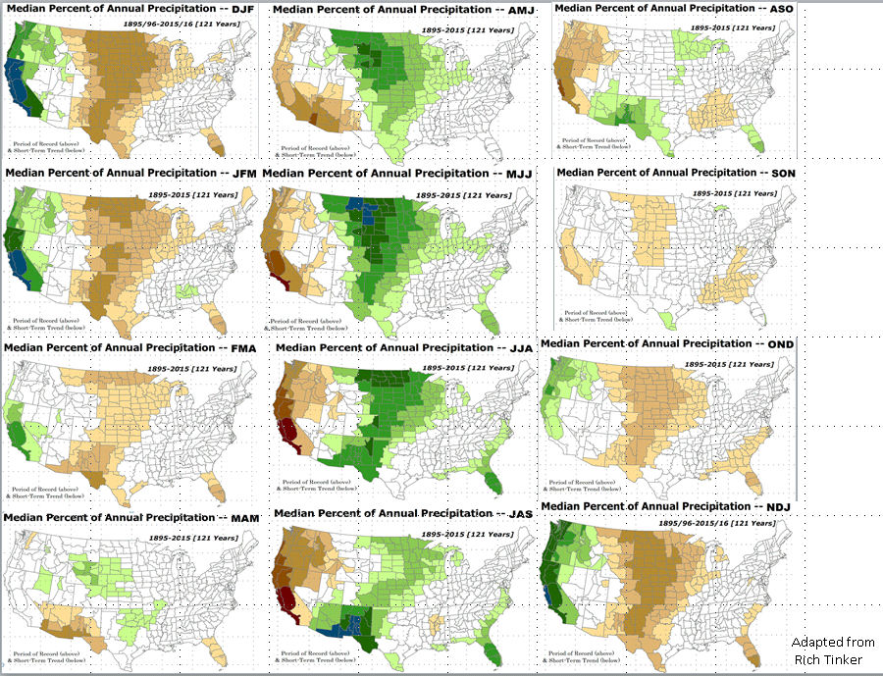

SON:
The season with the least/almost no green in this 3-month percentile map!! But not much dark /brown areas also!!
East vs West!
More darker colors in west/central => narrow rainy season (months)
Overall, more white space in the east => distributed rainfall season (except ~FL).
Rainy (3-month)Season across the US

Slide 12
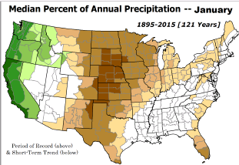
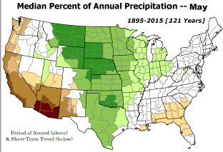
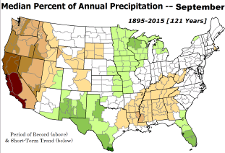
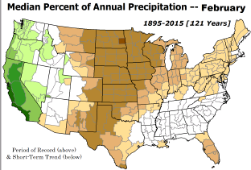
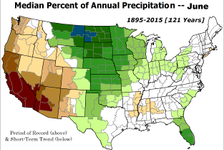
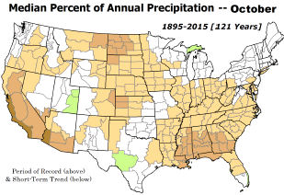

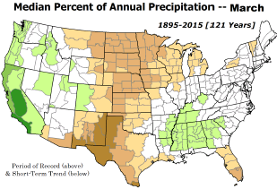
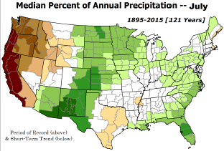
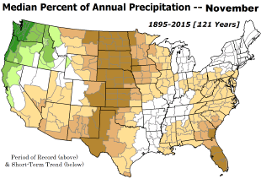
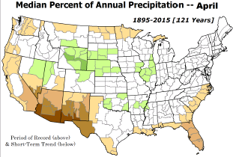
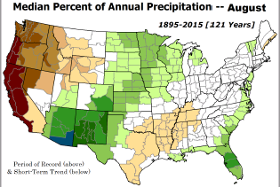
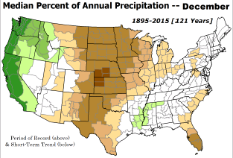
With the monsoon ending, October is the driest of all months in the US. However, by November/ December, early winter rainfall may begin to show up along the Pacific west coast states.
*********
EAST vs
CTR/WEST
Drought Behavior is loosely tied to rainfall climo!! And the limited rainy season in the west
*********
Adapted from Rich Tinker.

Slide 13
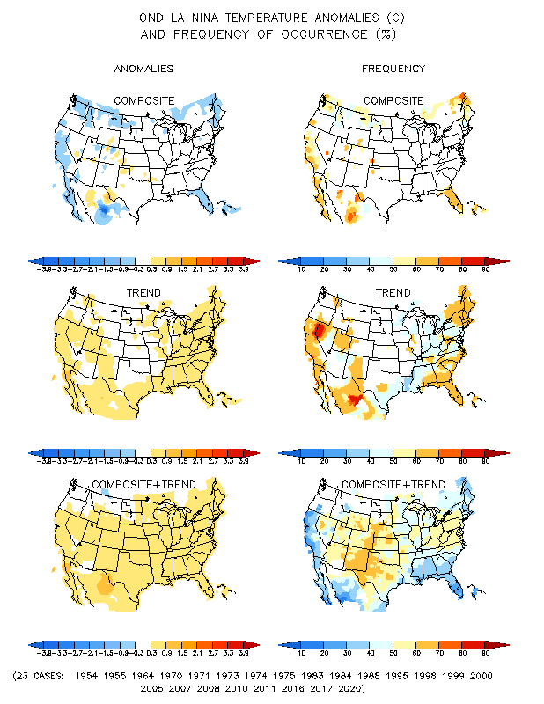
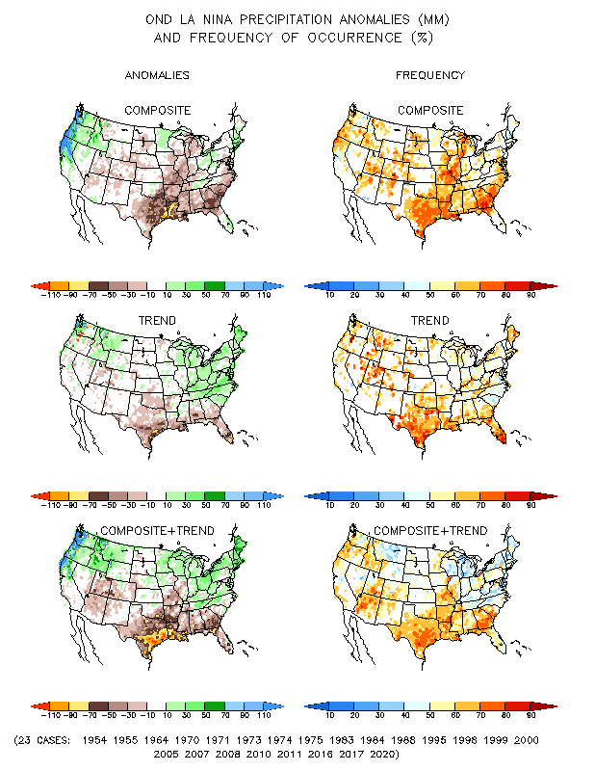
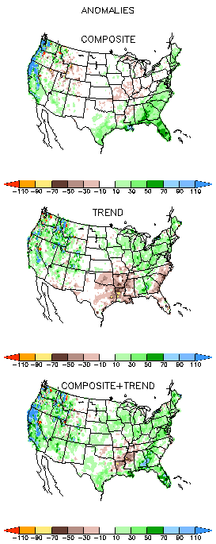
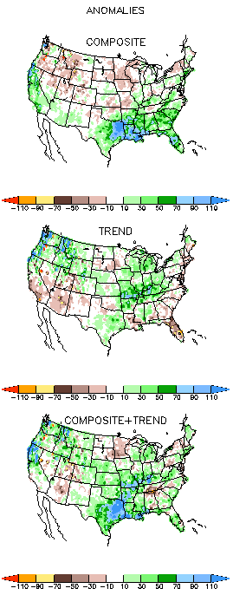
La Nina Precip/Temperature COMPOSITES & Trend map
OND
P
T

Slide 14
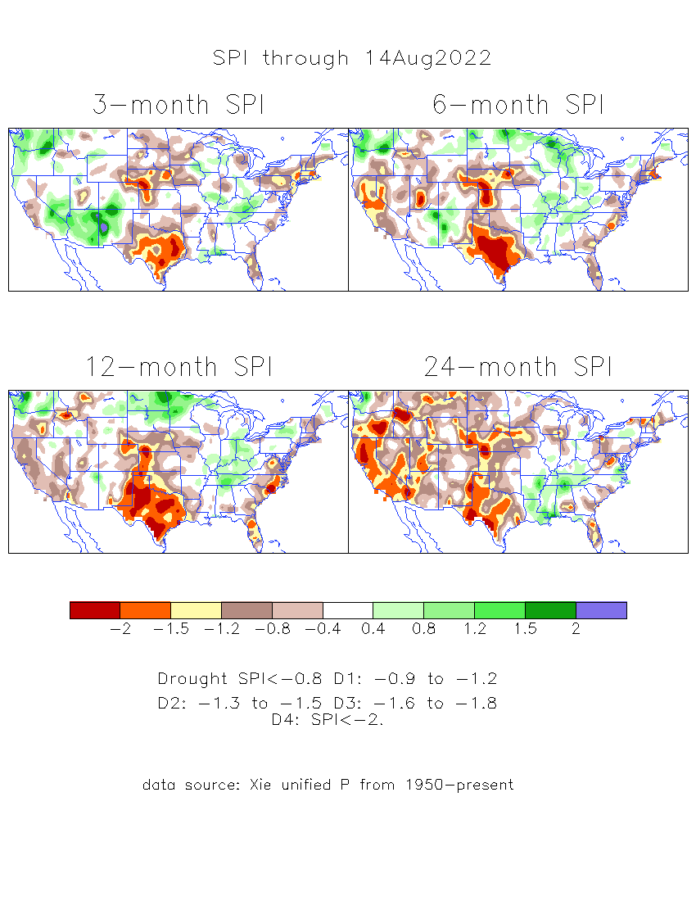
The Standardized Precipitation Index SPI
(based on Observed P)
----- Last Month
Very interesting graphic & details for the drought across the US based on the more generalized precip deficit/excess, the Standardized Precipitation Index (SPI).
The dark brown and red colors, indicating standardized precipitation deficits, in the various time periods, approximately correspond to the appropriate short/long term drought monitor regions and their intensities

Slide 15
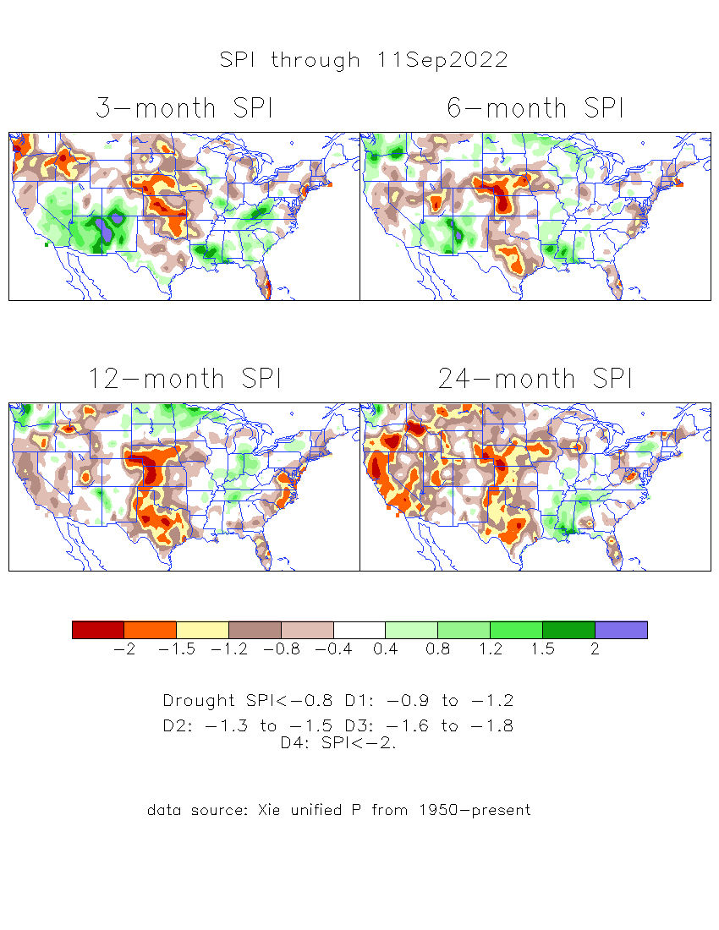
The Standardized Precipitation Index SPI
(based on Observed P)
----- NOW
Very interesting graphic & details for the drought across the US based on the more generalized precip deficit/excess, the Standardized Precipitation Index (SPI).
The dark brown and red colors, indicating standardized precipitation deficits, in the various time periods, approximately correspond to the appropriate short/long term drought monitor regions and their intensities
Short
The short term drought in the southwest is showing mixed signals between 3/6 months SPI ! But the long term drought in the southwest remains.
Long
How does one negotiate and reconcile declaring short term vs long term drought when precip. deficiencies patterns differ on many different time scales locally!!
What is the cutoff delineating time between short VS long term drought!! Not so clear!!
At exactly where does drought begin?
Almost no short term drought in most of the 4- corner states area in the SW?

Slide 16
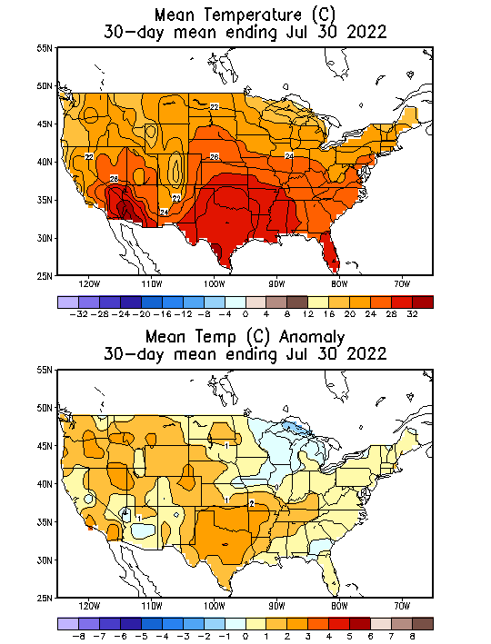
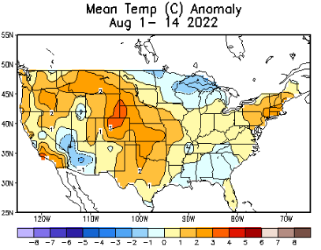
Slide from last month..
To compare with now!
Recent US Temperatures
So far in April, temps. across much of the northern 2/3rd of country is cold, warm along south and northeast. Lot different than last month/March!
There is a lot more going on than just La Nina!!
So far this month !!

Slide 17
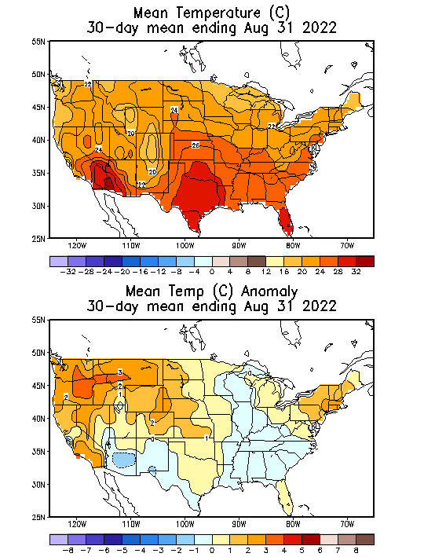
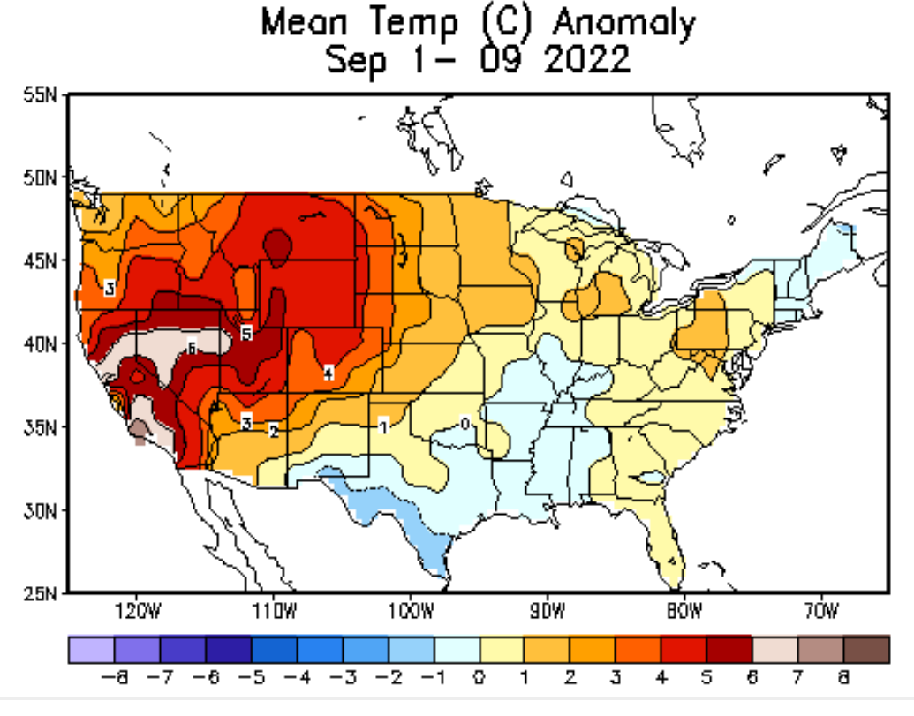
Now
Recent US Temperatures
There is a lot more going on than just La Nina!! These current very warm temperatures across the US and in much of the globe (heard Europe news lately?) is definitely something else and scary!
So far this month !!

Slide 18
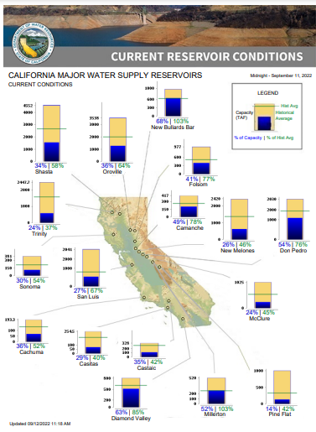
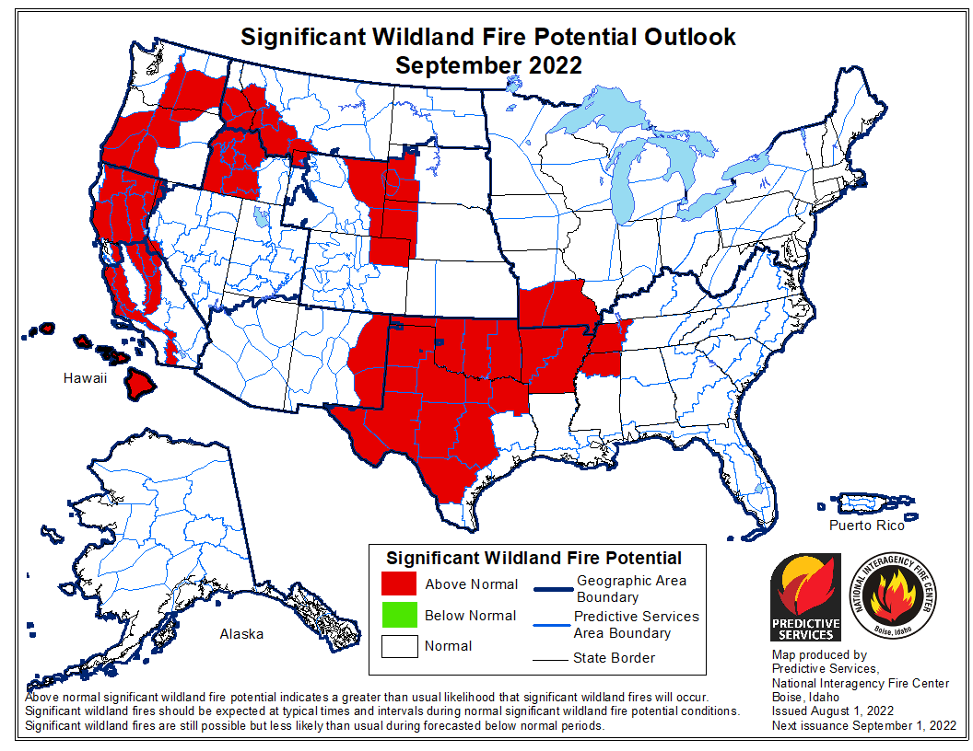
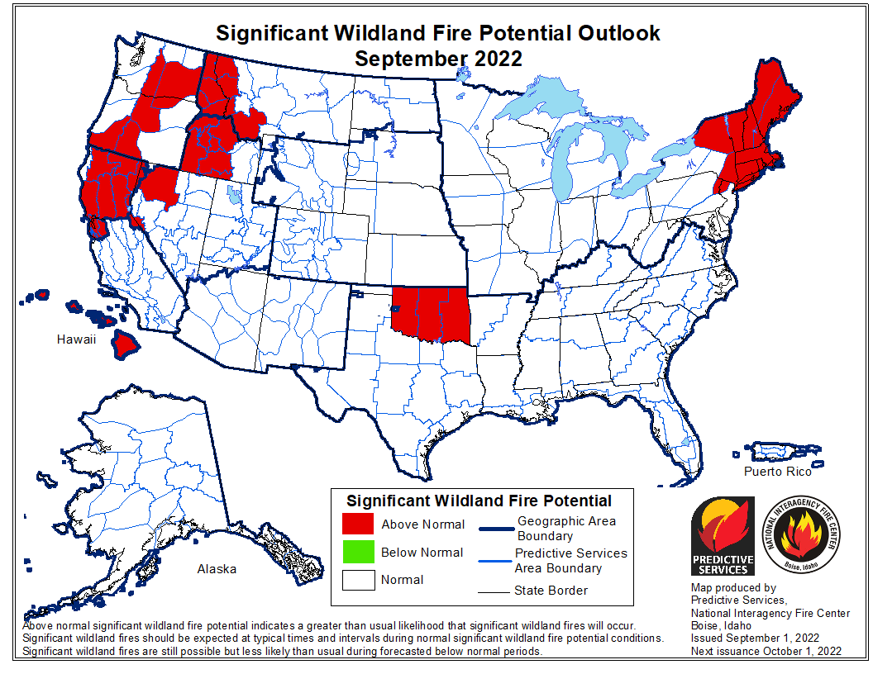
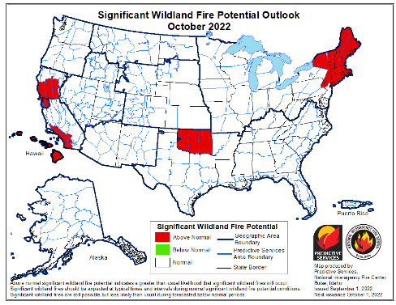
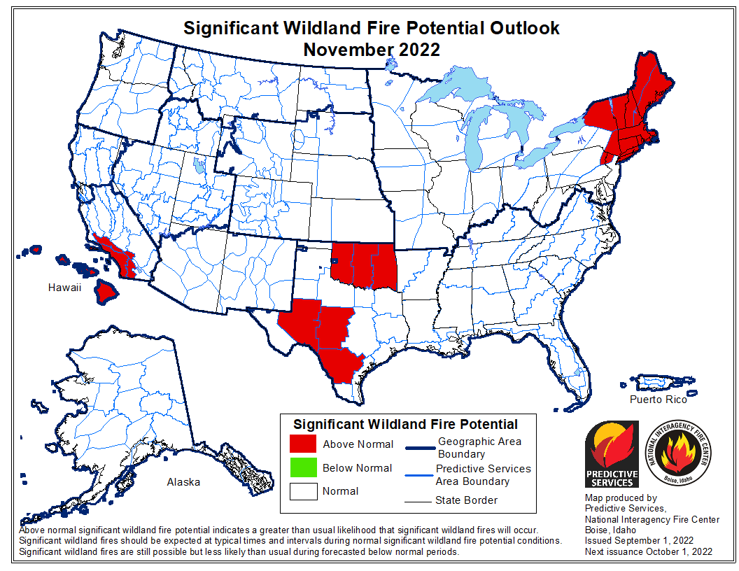
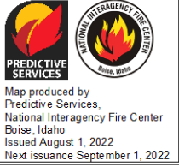
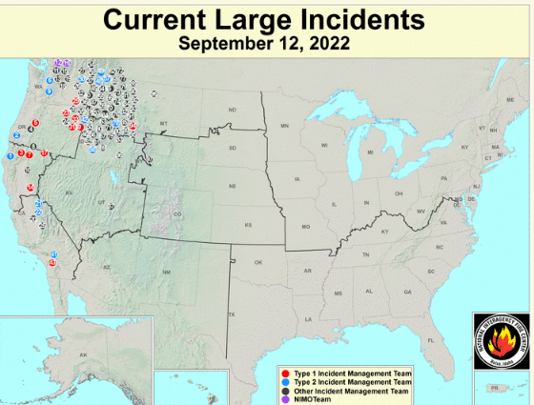
Fire Potential Outlook
old/SEP
new/SEP
% of Capacity
% of Hist. Avg.
of Reservoirs.
new/OCT
new/NOV
Most major fires are now in/near the northwestern states and in northern CA.
Most CA water reservoirs are drastically low!
Third year of La Nina, this coming winter, will make drought conditions even worse for CA!!!

Slide 19
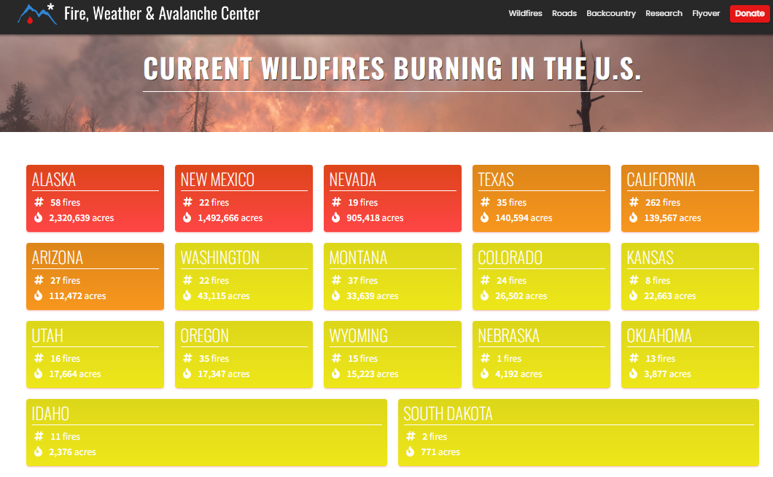
Last month ….
LAST MONTH !!
https://www.fireweatheravalanche.org/fire/current-list-of-us-wildfires
(not govt. source! AZ in brown, NM in red? NV is green? how good is this data?)
Compare California last month VS this month!

Slide 20
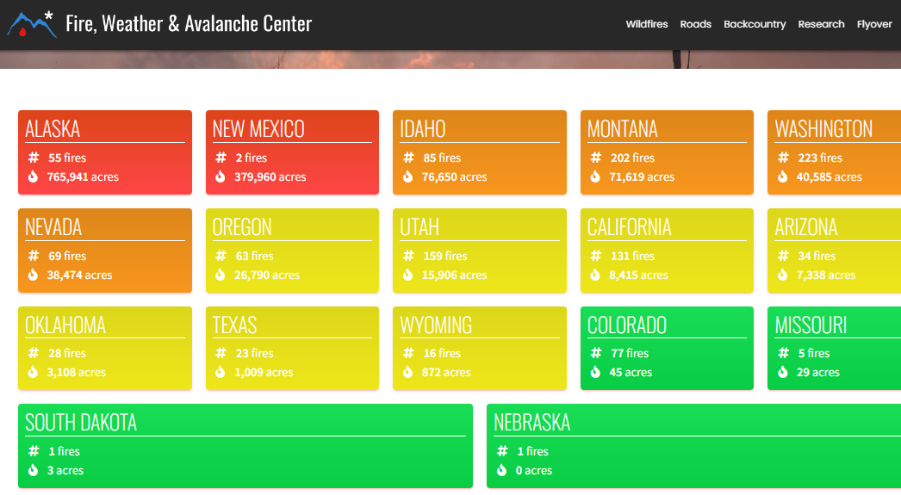
Note: All these are in the center-western US!
THIS MONTH !!
https://www.fireweatheravalanche.org/fire/current-list-of-us-wildfires
(not govt. source! Not sure how good is this data?)

Slide 21
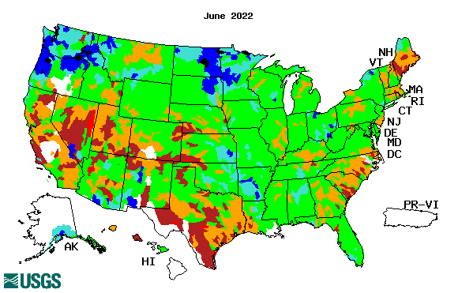
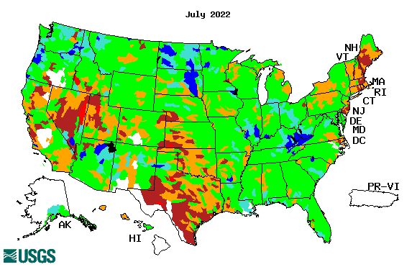





Streamflow (USGS)
Most US east droughts are relatively short lived (as compared to US west). However, if you recall, the drought over the New England states last year was a real surprise!!
Map shows only below normal 7-day average streamflow compared to historical streamflow for the day of year.
One month ago (left) &
Now (below)
Streamflow is only a partial indicator, as it is highly managed.
If sometimes, the various indicators are confusing, go back to % of rainfall deficit maps – to reinforce!!
21

Slide 22

EL NIÑO/SOUTHERN OSCILLATION (ENSO)
DIAGNOSTIC DISCUSSION
issued by
CLIMATE PREDICTION CENTER/NCEP/NWS
and the International Research Institute for Climate and Society
8 September 2022
ENSO Alert System Status:
La Nina Advisory
Synopsis: La Niña is favored to continue through Northern Hemisphere winter 2022-23, with a 91% chance in September-November, decreasing to a 54% chance in January-March 2023.
CPC’s Oceanic Niño Index (ONI) [3 month running mean of ERSST.v5 SST anomalies in the Niño 3.4 region (5ºN-5ºS, 120º-170ºW)], based on centered 30-year base periods updated every 5 years.
???

Slide 23




Latest values of SST indices in the various Nino Regions.
Yo Yo!

Slide 24


Sub-Surface Temperature Departures in the Equatorial Pacific
This tug of war beneath the surface in the equatorial Pacific, between the warm water to the west and the cold water to the east has been going on for the past few months. Looks like the cold begun to dominate the central and east Pacific, while the warmth has stalled in the west.
Most recent pentad analysis

Slide 25




ENSO Forecasts
Early- August CPC/IRI forecast
Early- September CPC/IRI forecast
How forecasts change so fast!
The odds of La Nina for the next few months suddenly changes so FAST and for the upcoming winter are …. about 60%!

Slide 26



Previous (Last Month’s)
CPC’s official
Temperature OUTLOOK for Monthly (Sep)/Seasonal (SON)
N/S
Released Aug 18th
Observed so far this month!! ☺
E/W

Slide 27



Previous(Last month)
CPC’s official
Precipitation OUTLOOK for
Monthly (Sep)/Seasonal (SON)
Released Aug 18th
Monthly P/T forecasts verified at mid-month are generally good! Becoz of good skill upto 2 wks.
Monsoon precip above normal so far ! ☺
Observed so far this month!! ☺

Slide 28



NCEP/WPC Next 7 days QPF (Quantitative Precipitation Forecast)
GFS Model Guidance for the
next 16 days.
Southwest monsoon rainfall continues to kick hard for 2/3 more weeks!
JAS

Slide 29

From European Center (EC) Precip forecast (made yesterday, 12 Sep) for next 30 days.

Slide 30

From European Center (EC) Precip forecast (made yesterday, 12 Sep) for next 30 days.
20
40

Slide 31

From European Center (EC) Precip forecast (made yesterday, 12 Sep) for next 30 days.

Slide 32

From European Center (EC) Precip forecast (made yesterday, 12 Sep) for next 30 days.

Slide 33

Week-4 Soil Moisture Percentile (SMP) Fcst based on VIC model forced with ECMWF-extended precipitation forecast!
Now: Yesterday’s IC
While not exactly mapping 1-to-1 with the drought areas, this map is generally connected to the drought areas in some ways, as it is related to soil moisture!!
(From Drs. Li Xu and Yun Fan) More detail at From: https://www.cpc.ncep.noaa.gov/products/people/lxu/flashd/flash_prediction.html#10

Slide 34




NMME
T (left) &
P (right)
Ens.Mean forecasts for
Oct
OND

Slide 35

Agreement/Disagreement among the various NMME models’ OND seasonal Precip. Forecast.
??

Slide 36


(From NMME) compared with this month(foreground, red border)
Why is there so fewer hatched areas in SPI6 fcst from NMME models’ based fcst this month as compared to last month (left 2 columns) ? Fcsts more confident now?
Forecast uncertain in Hatched areas.
These maps are based on NMME models’ precip forecast uncertainty/certainty (among ensemble members) over the next 3 months
SPI6 Fcst made from last month
SPI6 & SPI12 Fcst made from this month

Slide 37




May skip this slide !!
http://drought.geo.msu.edu/research/forecast/smi.monthly.php
Latest Initial Conditions:
9/06/2022
Predicted Monthly Soil Moisture Percentile
CPC’s soil moisture percentile – Leaky bucket Model
The inter quartile range suggest greater uncertainty about the forecast in these shaded regions. LOTs of uncertainty regions!! ☹

Slide 38


BONUS Topic: Discussion continues!! Explanation for the multiyear DROUGHT in the Southwest (CA/AZ/NM/NV/UT/CO & vicinity)!!
More La Nina’s lately ?
More frequent La Ninas lately ?
YES!! The stats in the table below (bottom left) are from the Official CPC ENSO declarations page/table!
Compared to other regions of the globe, the SST warming/trend in the central eq. Pacific (Nino 3.4) is relatively much small. (See Fig. above) – Why is this ?
Does nature try to compensate for the warming else/everywhere by producing more La Ninas in the equatorial Pacific? - Just my observation from data! Let’s check !!!
Since the 1997 monster El Nino (stronger than the famous 1982/83 event), just a quick count of CPC’s Nino 3.4 index++ values for the three month overlapping seasons, (Data at CPC site only available only from 1950!)
(26 years) (47 years) (73 years)
1997-2022 1950-1996 1950-2022
La Nina(DJF) 12 16 28
El Nino(DJF) 9 17 26
La Nina(all 3mos) 113 150 263
El Nino(all 3mos) 77 166 243
(Overlapping 3month seasons)
Look at Ratios of La Ninas (vs El Ninos) in the shorter
recent (26 yr) period vs the longer (47 yr) earlier period!!
Compare the ratios of La Nina to El Nio in the squared boxes.
And imagine what if the rest of 2022 remain in La Nina column?
***Analysis of CPC’s official Nino 3.4 index data over the last 70 years shows that the more frequent La Nina’s in recent decades contributed to less rainfall in the southwest (See La Nina precip composites!, slide#13) and hence the ongoing long term drought in the Southwest!! Hence the long term southwest drought is unlikely to go away any time soon***
++ Barnston, Chelliah and Goldenberg (1997):Documentation of a highly ENSO‐related SST region in the equatorial pacific,
Atmosphere-Ocean Volume 35, 1997. https://doi.org/10.1080/07055900.1997.9649597
*** The strong/weak annual monsoon rains in the southwest is just a minor modulator riding on this bigger/long-term signal. ***

Slide 39
Summary
Current Drought conditions:
For many months, the classic East-West dipole pattern with drought in the US west half, and (almost) no drought in the US east half, has somewhat been in place.
But lately, in summer months, short term drought kept wavering (emerging and going away), across parts of the Midwest, and along the narrow Atlantic coastal states areas. Also, lately, dryness has developed in many coastal northeastern/New England states. Some short term (2-3 months) dryness has emerged in eastern MT, parts of the Dakotas, and NE/KS/OK.
The southwest monsoon impacting the 4-corner states (AZ/NM/UT/CO) area and western TX has been very active this year also (as was last year), which considerably improved the ST drought situation for the most part in the general region. But LT drought (decade+) still linger for the general south western states.
This is not the rainfall season for CA/WA/OR and hence the drought situation here remained basically unchanged. Overall, with the continued presence of La Nina for the third year in a row, as we have been warning, seems to have generally kept the overall LT Drought category areas in parts of these states as well. CA reservoir levels continue to be worrisome, and the winter rainy season is still at least a couple of months away.
Current ENSO status and forecast: La Nina is favored to continue through Northern Hemisphere winter 2022-23, with a 91% chance in September-November, decreasing to a 54% chance in January-March 2023.
Prediction:
  The third year La Nina is firmly in place through the forecast season (OND). The highly active (for the second year) Southwest summer monsoon in the south western states is slowly coming to an end. The North Atlantic Hurricane season, expected to be above normal(as forecast), is at below normal (ACE-accumulated cyclone energy) levels so far. These are the underlying conditions, that the upcoming Drought Forecast season forecast (OND) depends on.
  The active SW monsoon has already made a big dent in the short term drought in the region, and is even making a slight dent in the long term drought. Hence we expect to see improvement in the ST drought situation, but the LT drought will continue to stay. Same is the situation in CA/OR/WA, until the rainy season begins in late November and December. Continued above normal temperatures forecast for the season in the region does not help.
  Short term rainfall in the next couple of weeks from the active monsoon in NV/UT,AZ/NM and even ID/WY may contain further dryness development in these regions, and may even help the short term drought here. Also, the ST forecast rain in FL, may ease dryness for the month, but probably not for the season (see next point!).
  The dryness in the northeast may also go away from the short term trains. The on going La Nina, the associated ENSO rainfall composites and the NMME forecast, make it highly likely that many parts of the Gulf coastal states may develop some form of short term temporary dryness before the end of the forecast season OND. *****

