Slide 1
Drought Outlook Support Briefing September 2023
Climate Prediction Center/NCEP/NOAA
http://www.cpc.ncep.noaa.gov/products/Drought
Points to ponder:
Often, there is a disconnect between the Short term (S) and Long term (L) drought in regions, and even with the short term (S) drought, the 3-month and 6-month signals are not quite consistent! With Long term (L) drought, it is even more trickier, as it is open ended from 1 year and beyond!!!
Places/regions experiencing Short term drought may (not) be ok in the Long term and vice versa!!
This duality is difficult to reconcile, to convey and even be clearly understood well by the public at large.
Public/Forecaster generally tends to focus more on the Short term Drought (for good reasons!!)
More importantly the very definitions and timescales associated with S/L term droughts and the declarations in the USDM are by themselves subjective!! Short term vs Long term drought need to be clearly distinguished and shown to the public!!
It may take a long time for drought to develop, but those conditions can end very quickly! as it happened in CA after DJF 2023 winter. Forecast models are yet to (seasonal) correctly forecast these changes in advance!
Subjective(delayed) USDM vs Objective(real time) map! A few days of recent heavy precip can change the USDM a lot!
New:
A few months ago, towards drought monitoring, we introduced, a new objective AI/Deep-Learning based Experimental ODI (objective drought indicator, runs daily, Slide # 3) compared with Official USDM (US Drought Monitor, produced weekly by USDM authors).
From this month onwards, towards prediction, we introduce a new section with few slides at the end, consolidating the various exptl. drought outlooks by purely objective methods developed here at CPC! This is in preparation of a broad general push towards Probabilistic outlooks.

Slide 2
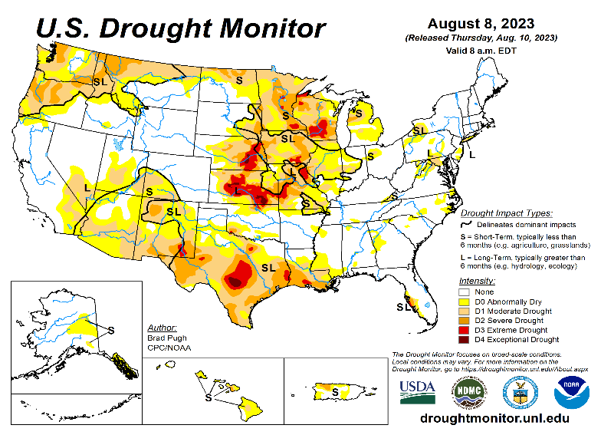
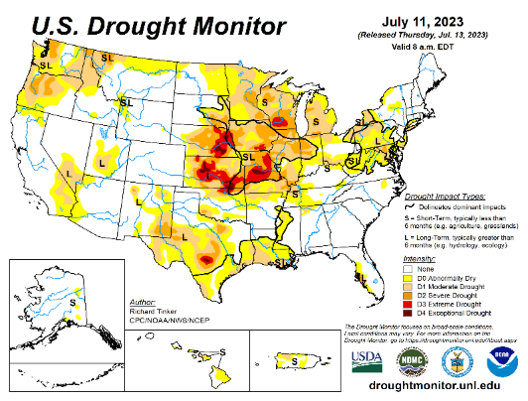
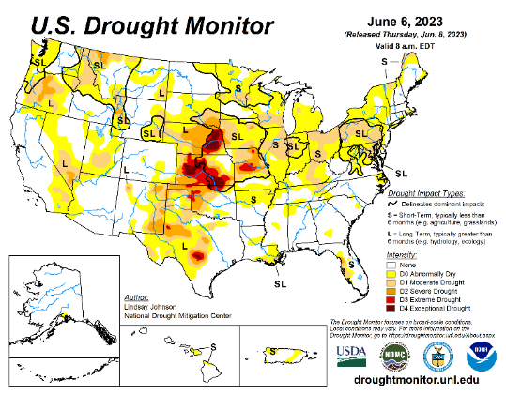
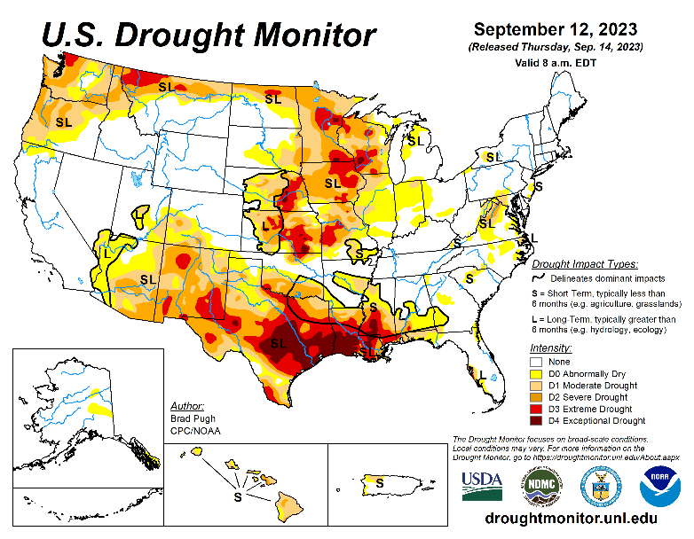
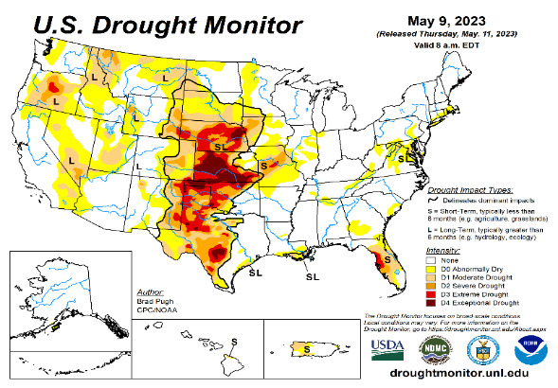
Drought Monitor
Monitoring is important because, unlike US T/P fcsts, for drought forecasts, we have to know where we are, before we can tell where we are going!! Drought forecasts are tendency forecasts.
August
Towards the end of last year 2022, until December or so, severe drought conditions (both short and long term) remained in the west, mild drought conditions expanded in to portions of the eastern half of the US also, covering most of the country with very high % areas of the entire US affected by drought. The situation now is now drastically different due to the extraordinary winter season precipitation.
The past winter/early spring rainy season in CA and the west coast states, wiped out not only the S-term drought but also the L-term drought in most areas. Water levels in almost all CA reservoirs are now ABOVE their normal levels. However, the water storage levels in the huge Lakes Powell and Lake Mead in NV continue to be historically low, & decade(s) long hydrological drought still lingers..
S/L term droughts still remain in parts of northwestern states of WA/OR/ID/MT/ND/SD. Severe drought is entrenched in eastern and central areas of MN/WI/NE/KS/MO. Moderate/Severe drought in now entrenched in MN/WI/IA/IL/IN.
The relatively poor monsoon this year in the southwestern states has created short term drought conditions in AZ/NM and in parts of NV/UT/CO. Severe drought is fully established in most of TX, LA/MS
In spite of all these areas of drought noted above, about 50 % of the country drought free! And the remainder 50 % of the lower 48 states is in some kind of dryness/drought!
Recently we introduced and show here, an exptl. version of an Objective US Drought Indicator based on AI/deep-data methods, that runs daily at CPC.
We introduce in this month’s briefing a new set of slides consolidating a few objective drought outlooks, produced experimentally at CPC.
July
June
September
(Recent/Latest)
May
?

Slide 3
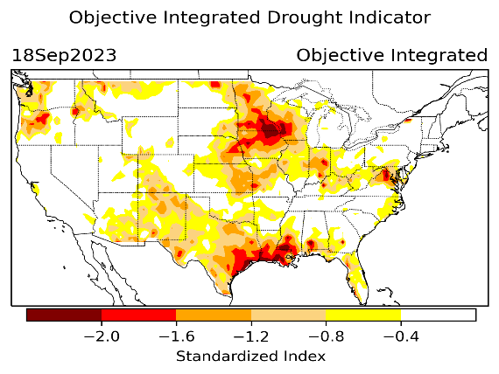
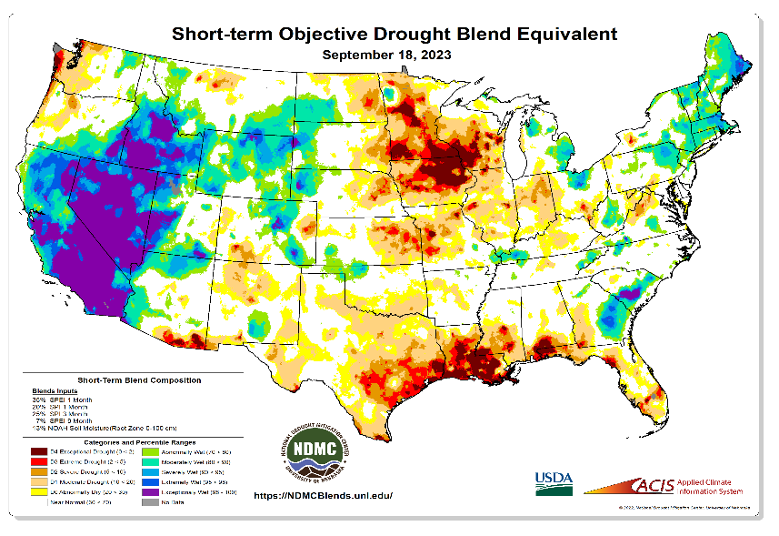
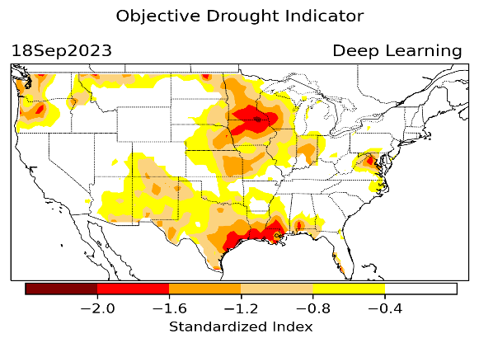
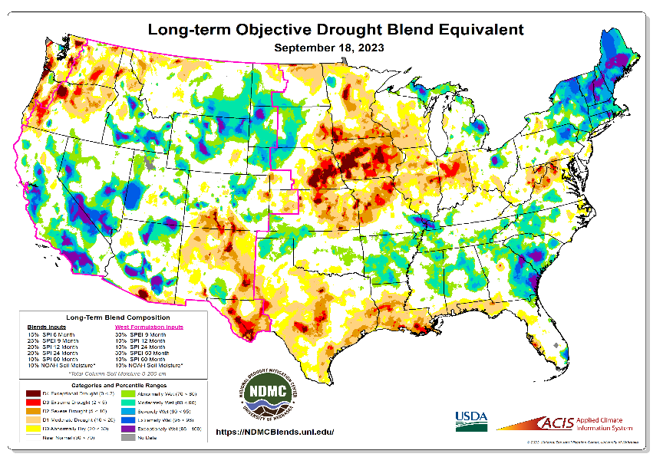
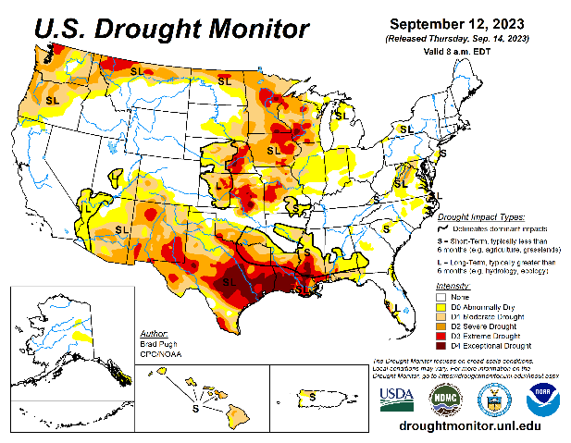
Exptl. Objective Drought Monitor (showing S/term & L/Term separately) from National Drought Mitigation Center (NDMC)
New slide now included recently in this briefing!
CPC’s own Experimental
Objective Drought Indicator (ODI)
using AI/Deep Learning ! – Updates daily !!
https://www.cpc.ncep.noaa.gov/products/people/lxu/odi/#deep-learning-increment-training
Based on the CPC P/analysis &
VIC (Princeton) NLDAS model assimilation:
Standardize Precipitation index (SPI)
Standardize Precipitation-Evapo –
transpiration index (SPEI)
Evapotranspiration Stress Index (ESI)
Soil Moisture Percentile (SMP)
Standardize Runoff Index (SRI)
-can be split into Short/Long Term Droughts!
https://droughtmonitor.unl.edu/ConditionsOutlooks/CurrentConditions.aspx
Objective &
Runs Daily!
Objectively Integrated
versus Deep Learning
methods. ~ gives |||r results.
Both Objective!
Both update daily!
Objective &
Runs Weekly!
On Monday!
Objective &
Runs Daily!
* A manuscript (Xu & Chelliah) is under preparation.
Latest Official USDM (US Drought Monitor)
Subjective &
Produced Manually!
Weekly!
Objective &
Runs Weekly!
On Monday!
These two maps above, used to be produced at CPC(Rich Tinker!), but recently officially done by NDMC operations!
*Released every Thursday, for conditions as of Tuesday!

Slide 4
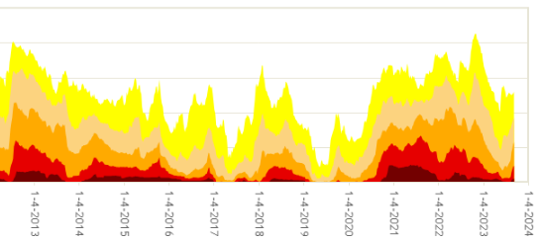
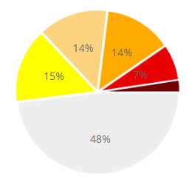
In general, The spatial details of every drought is different.! Every situation is different!!
Time series since 2000 spilt into 2 (above & below) panels.
CONUS % Land Area
Current drought!
Now, about 50 % of the country is drought free! About 50 % of the lower 48 states in some kind of dryness/drought!
As we enter the next few months(OND), will the drought areas likely increase ?? Why I say that?? In spite of possible coastal flooding in many Atlantic coastal states this weekend!
Potential for Flash Drough (temporary!) development during next month in Ohio valley!

Slide 5
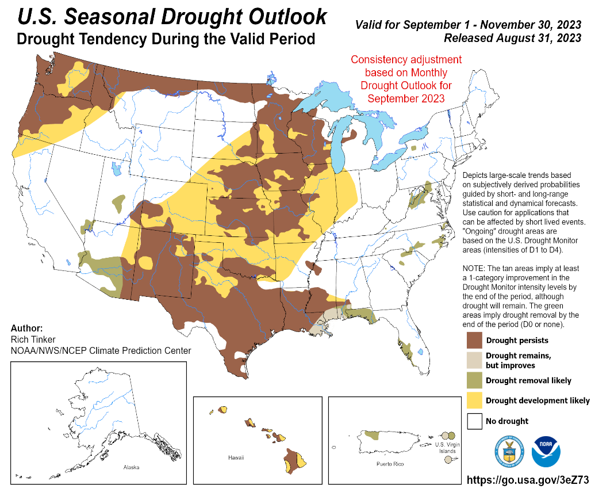
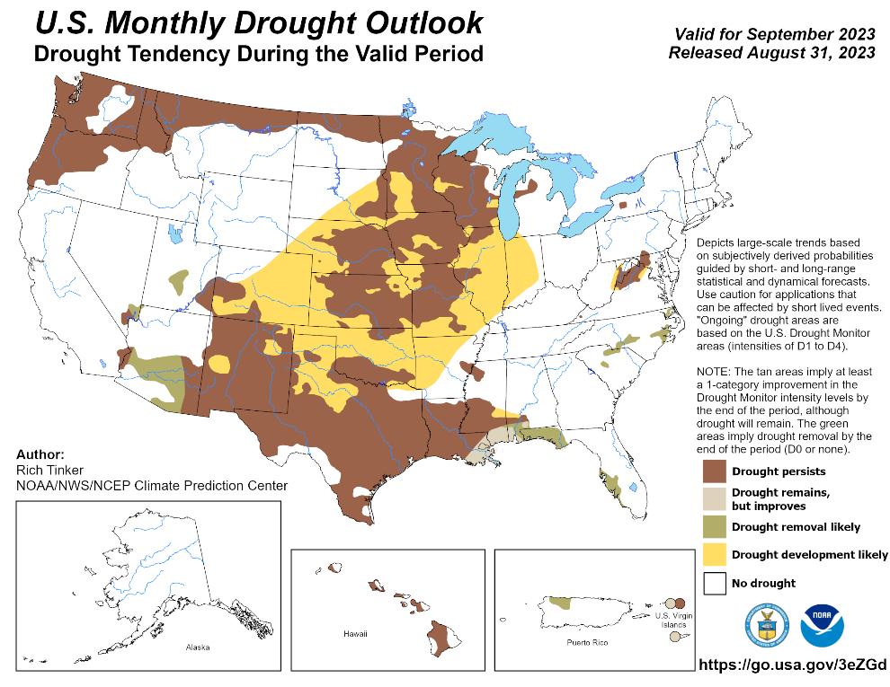
(Previous) Seasonal/Monthly Drought outlooks
New Seasonal+ Drought Outlook(SDO) to be released in 2 days!
(reissued again at end of month for consistency with MDO!)
New Monthly Drought Outlook (MDO) to be released at end of this month)
Updated Seasonal Outlook
( 1 Sep – 30 Nov 2023)
issued 8/31/23
Monthly outlook (for Setmber 2023)
issued 8/31/23
After the relatively recently introduced consistency adjustment, both the Monthly & Seasonal Drought Outlooks look almost the same! ☺ ☺

Slide 6
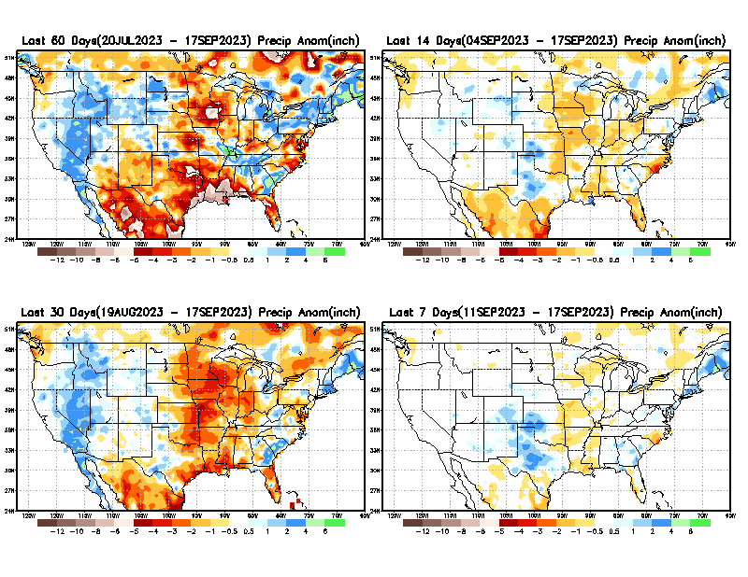
Precipitation ANOM during last 7, 14, 30, & 60 days.
This and next few slides show Precip deficit (excess).
Droughts, for the MOST part, begin and end with precip!! Lately, Temps are becoming (secondarily) important as well.
60 Days
14 Days
Weak monsoon so far this year!
30 Days
7 Days
These maps in this and following slides, including a) Total,
b) Anom and
c) Percent of Normal precip. in these and other longer time ranges are now (routinely) daily updated at:
From: Recent Accum./Anom Precipitation https://www.cpc.ncep.noaa.gov/products/Drought/briefing_prcp.shtml

Slide 7
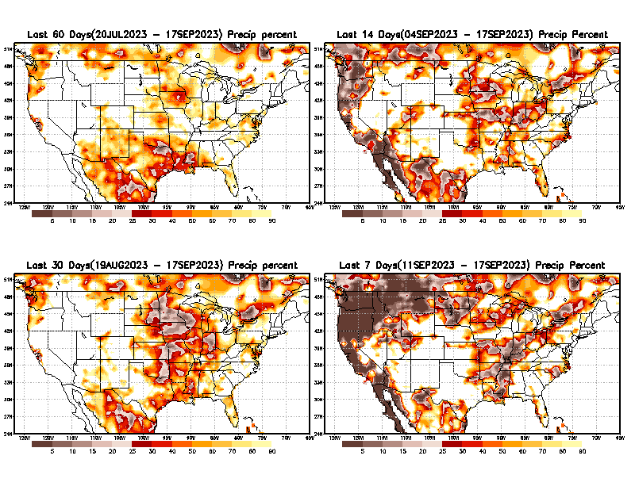
Precipitation Percent (of normal) during last 7, 14, 30, & 60 days - Only Deficit Areas <=90% shown !
60 Days
14 Days
This plot shows only the rainfall deficient regions <= 90% of normal.
-- This shows more clearly possible/likely drought developing region in the future unless there is above normal rainfall in these regions in the future, to offset these shortfalls.
30 days
7 days
From: Recent Anom/% of normal Precipitation https://www.cpc.ncep.noaa.gov/products/Drought/briefing_prcp.shtml

Slide 8
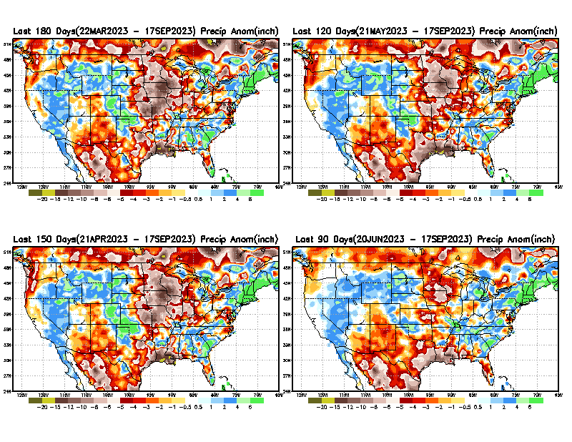
Total precipitation ANOM during last 3, 4, 5, and 6 months.
While the Precipitation anomalies deficit may seem large in some regions (compared to others),
it is the
% of normal precip (next slide) that matters more!!
6 M
4 M
5 M
3 M
From: Recent % of Normal Precipitation https://www.cpc.ncep.noaa.gov/products/Drought/briefing_prcp.shtml

Slide 9
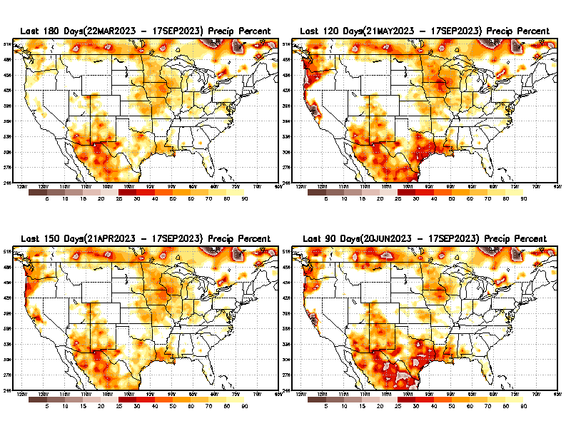
Total precipitation Percent (of normal) during last 3, 4, 5, and 6 months Only Deficit Areas <=90% shown!!
6 M
4 M
In these interim time scale 3-6 months, we need to pay attention to regions, which are dark-brown, red & dark red (<50%).
While accrued precipitation deficits are real & objective,
droughts are subjective declarations!!
5 M
3 M
East vs West!
Broad vs Narrow
rainfall season.
In general, West US suffers more from frequent and lasting droughts. Droughts in East US are less and less lasting!
What about Center ?
More like West than East?
Short term(S) Drought is generally declared when rainfall deficits exist in the 3-6 months time range. {Long term deficits beyond 1 or 2 or more years is Long term L drought! }

Slide 10
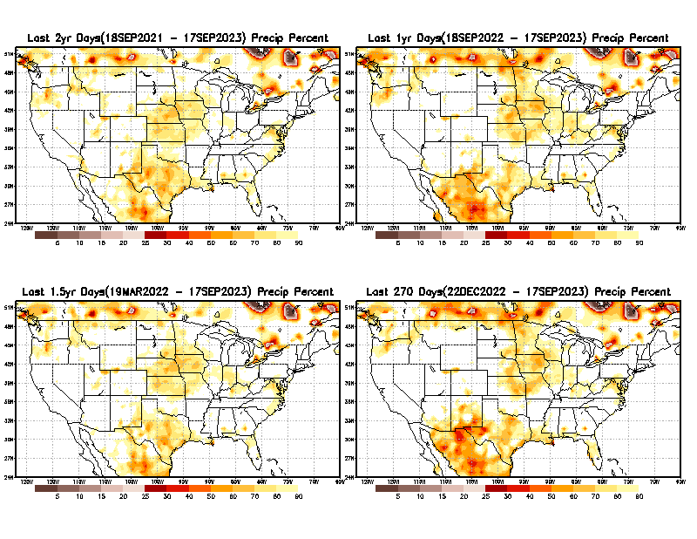
Total precipitation Percent during last 9 months, 1 yr, 1.5yrs, & 2 yrs. .–Only Deficit Areas shown!! <=90%
2 Y
1 Y
1.5 Y
9 M
The character and even location/spatial extent of the short/S and long/L –term droughts are different!!!
From: Recent Accumulated Precipitation https://www.cpc.ncep.noaa.gov/products/Drought/briefing_prcp.shtml

Slide 11
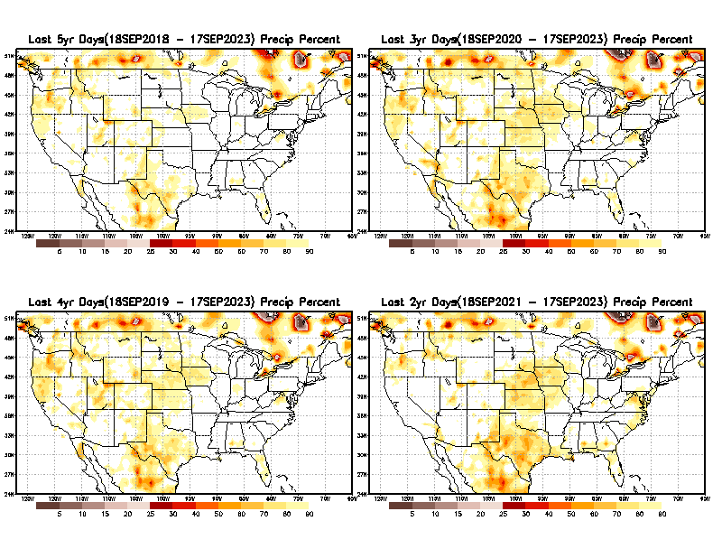
Total precipitation Percent (of normal) during last 2, 3, 4, & 5 yrs. .–Only Deficit Areas <=90% shown !!
5 Y
3 Y
In spite of the recent deluges/floods in California, there still exists a small longer term rainfall deficit in CA and parts of the southwest/ western US.
However, currently, most CA reservoirs are nearing or in excess of their historical averages.
BTW, Not sure if the longer term (20+years) since 2000’s has officially ended! ☺
4 Y
2 Y
From: Recent Accumulated Precipitation https://www.cpc.ncep.noaa.gov/products/Drought/briefing_prcp.shtml

Slide 12
LEAST
Rainy/dry
(3-month) Seasons across the US
MIXED
MOST
East vs West!
More darker colors in west/central => narrow rainy season (months)
Overall, more white space in the east => distributed rainfall season (except ~FL).

Slide 13
October is relatively dry month of the year for the US!
Least green in map.
*********
EAST vs
CTR/WEST
Drought Behavior is loosely tied to rainfall climo!! And the limited rainy season in the west
*********
Adapted from Rich Tinker.

Slide 14
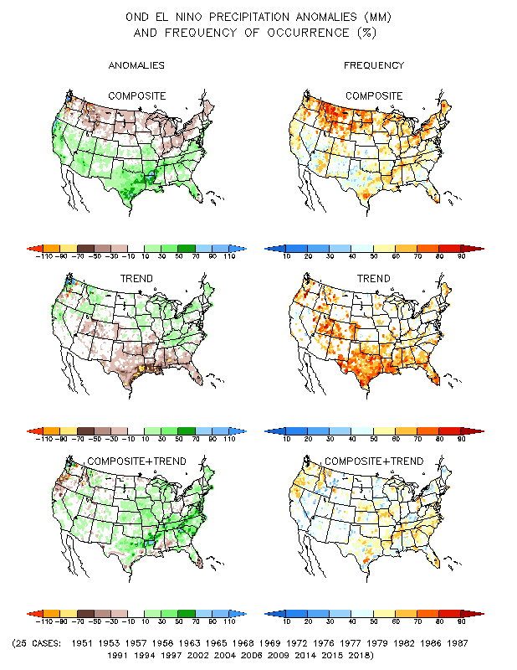
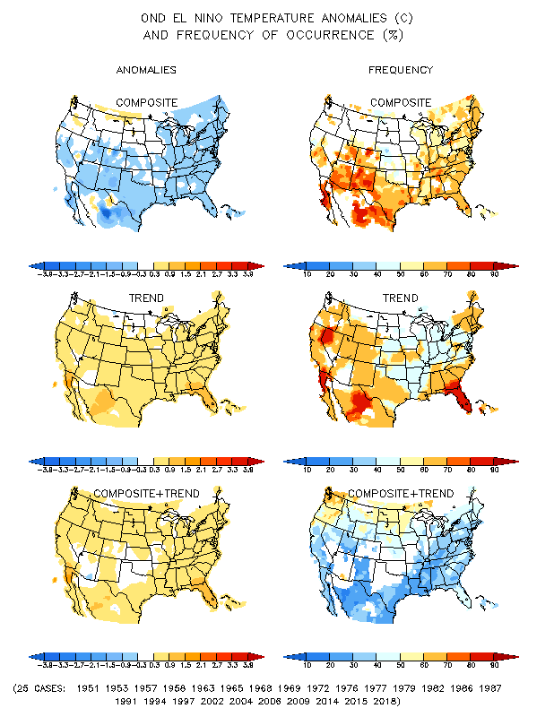
El Nino Precip/Temperature COMPOSITES & Trend map
OND
P
T
Full
El NINO conditions !
Opposing signals!
The Occurrence frequency is WEAK!

Slide 15
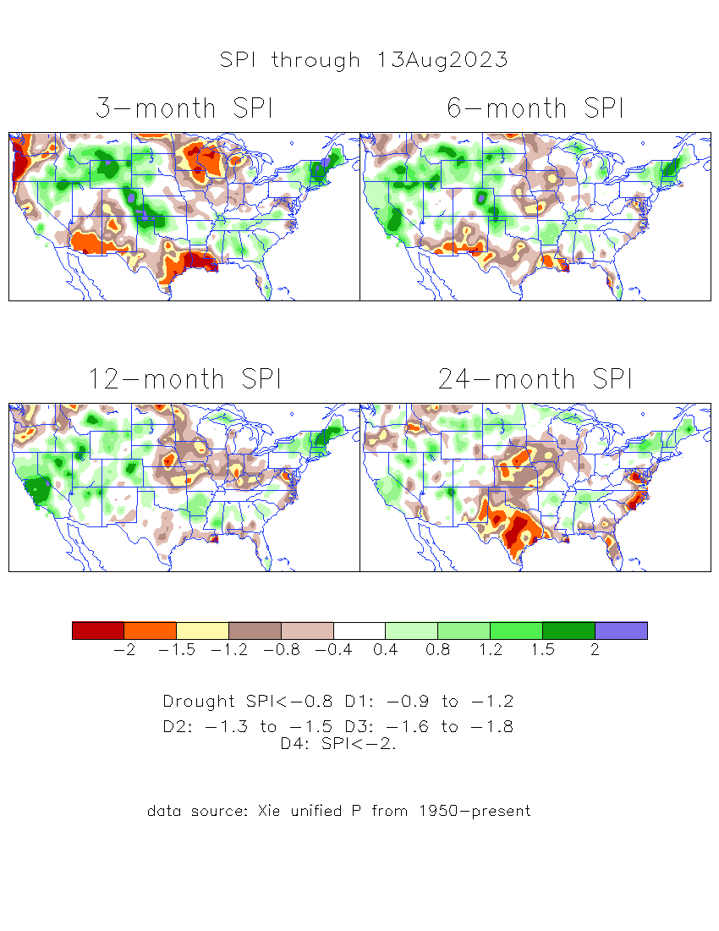
The Standardized Precipitation Index SPI (based on Observed P)
----- Last Month
Very interesting graphic & details for the drought across the US based on the more generalized precip deficit/excess, the Standardized Precipitation Index (SPI).
The dark brown and red colors, indicating standardized precipitation deficits, in the various time periods, approximately correspond to the appropriate short/long term drought monitor regions and their intensities

Slide 16
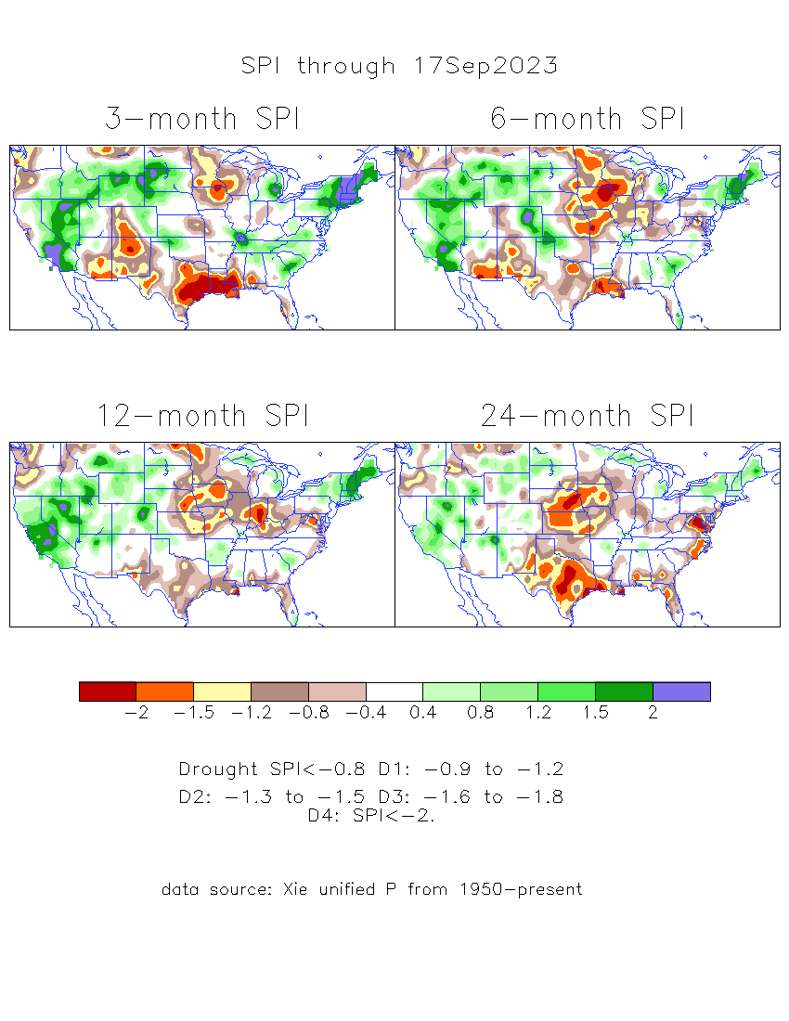
The Standardized Precipitation Index SPI (based on Observed P)
Compare with last month
----- NOW
Very interesting graphic & details for the drought across the US based on the more generalized precip deficit/excess, the Standardized Precipitation Index (SPI).
The dark brown and red colors, indicating standardized precipitation deficits, in the various time periods, approximately correspond to the appropriate short/long term drought monitor regions and their intensities
Short
Long
How does one negotiate and reconcile declaring short term vs long term drought when precip. deficiencies patterns differ on many different time scales locally!!
What is the cutoff delineating time between short VS long term drought!! Not so clear!!
At exactly where, does drought begin?

Slide 17
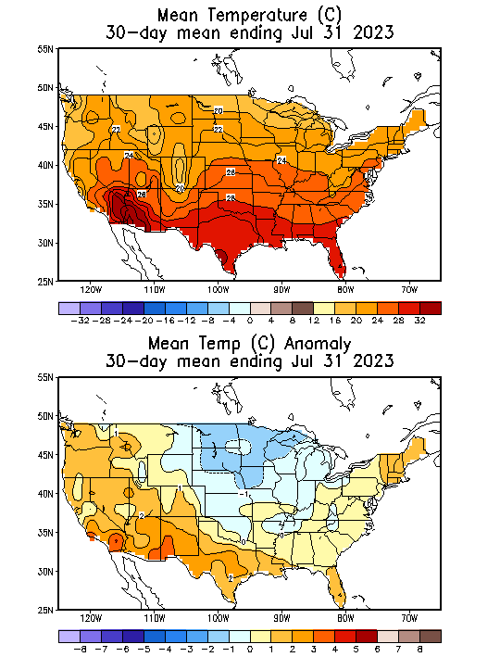
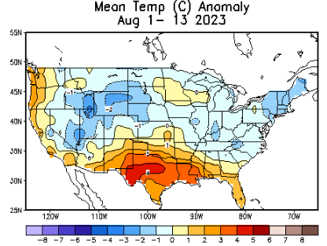
Slide From Last Month’s Briefing!
Recent US Temperatures
.
So far this month !!

Slide 18
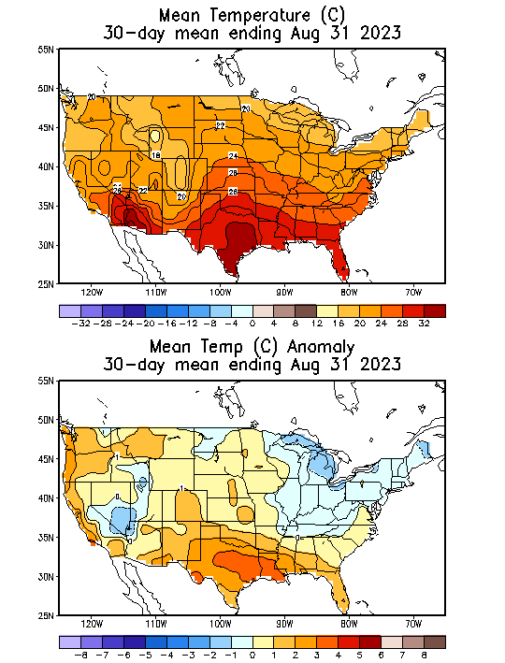
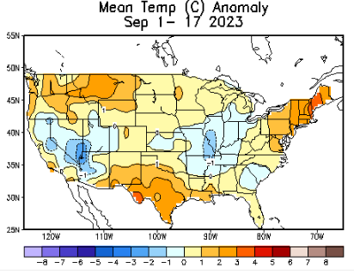
NOW
Recent US Temperatures
.
So far this month !!

Slide 19
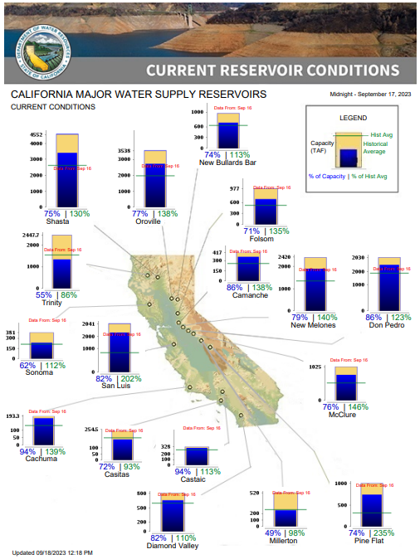
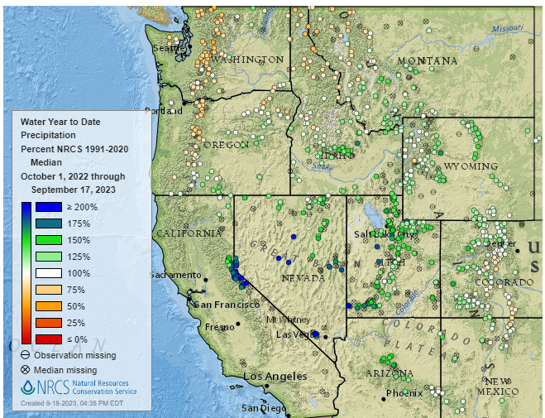
% of Capacity
% of Hist. Avg.
of Reservoirs.
Water Year, Year-to-date Precipitation:
October 1, 2022 – Sep.17, 2023
https://www.nrcs.usda.gov/wps/portal/wcc/home/
Many CA water reservoirs are AT or ABOVE their historical average/ CAPACITY levels ! ☺
https://www.nohrsc.noaa.gov/interactive/html/map.html?
https://cdec.water.ca.gov/cgi-progs/products/rescond.pdf
WHOEVER though that the California drought/reservoir-water-levels will turn around in just ONE winter!!
But a very different story for the big lakes Lake Mead & Lake Powell in NV, see next slide! ☹

Slide 20
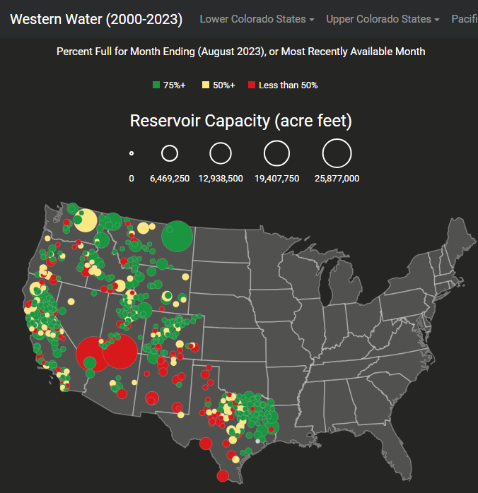
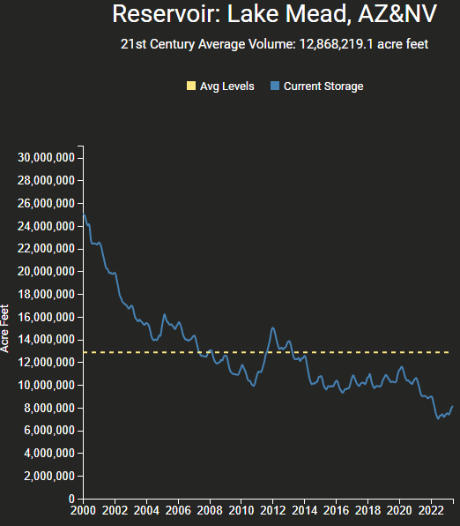
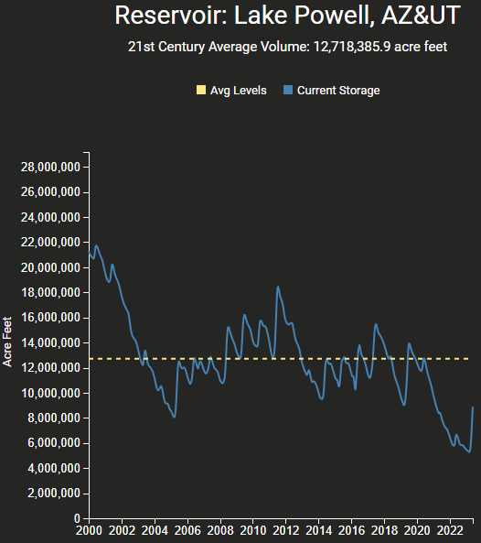
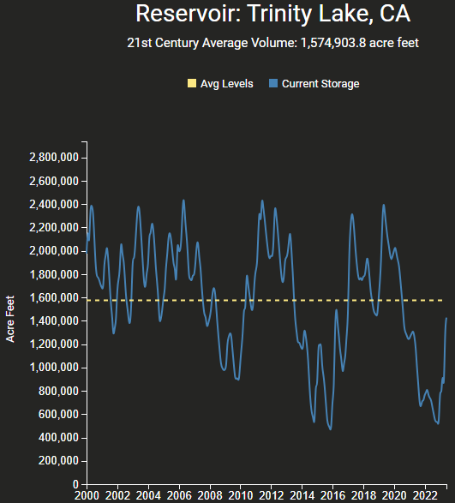
https://www.deanfarr.com/western_water/
https://www.deanfarr.com/western_water/
Hydro Electric power generating turbines STOP operating at the critical 7 million acre feet level
Lakes Mead, Powell in NV/AZ are at historic /dire low levels! ☹ ☹ HUGE consequences for electric power for western states CA/NV/AZ/UT !!
Only very slight improvement in recent months!

Slide 21
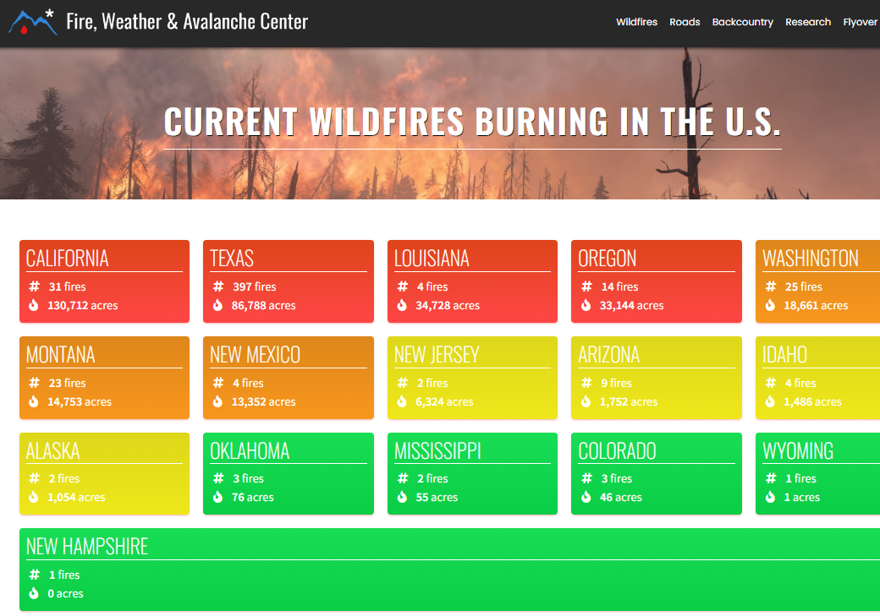
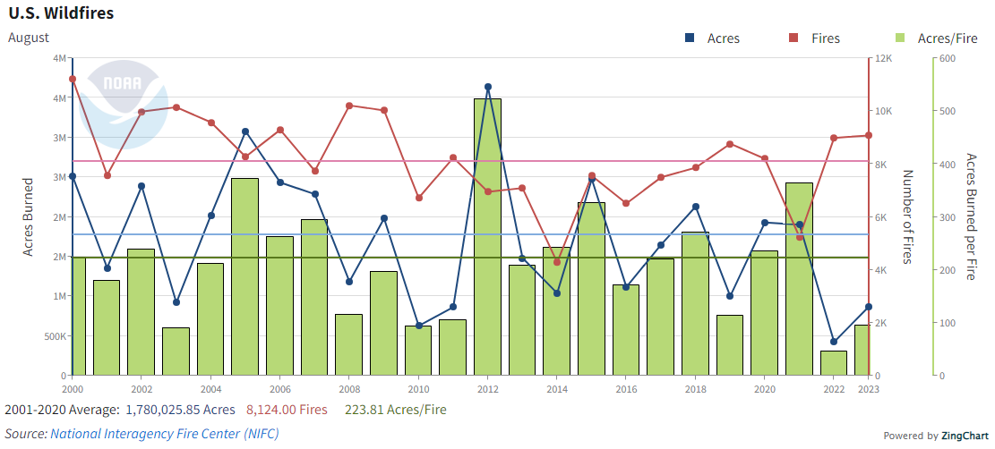
https://www.fireweatheravalanche.org/fire/current-list-of-us-wildfires
(not govt. source! Not sure how good is this data?)
The National Interagency Fire Center statistics show that, as of Aug. 28, 2023, there have been 38,831 fires this year that have burned 1.96 million acres.
This is significantly below the 10-year average (2013-2022) of 40,512 fires and the average acreage of 5.06 million acres.
{Text and Graph do not match! ☺ But 2023 acres burnt is low for sure !!} ☺ ☺

Slide 22
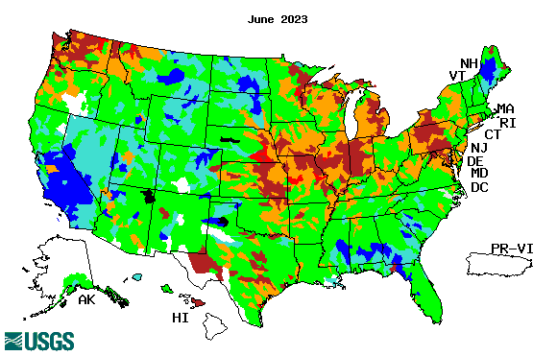
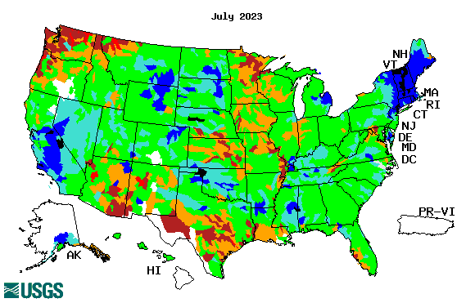
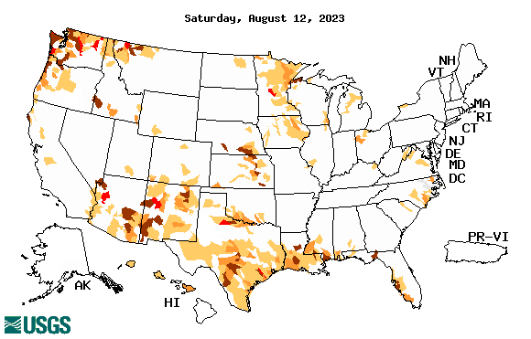
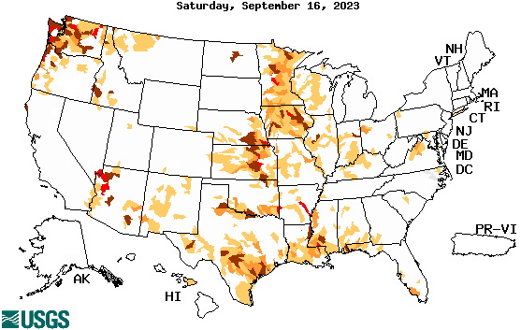
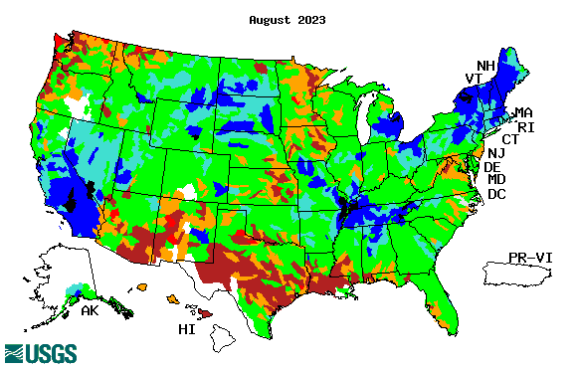
Streamflow (USGS)
Most US east droughts are relatively short lived (as compared to US west). However, if you recall, the drought over the New England states last year was a real surprise!!
Map shows only below normal 7-day average streamflow compared to historical streamflow for the day of year.
One month ago (left) &
Now (below)
Streamflow is only a partial indicator, as sometimes it is highly managed.
If sometimes, the various indicators are confusing, go back to % of rainfall deficit maps – to confirm/reinforce!!
22

Slide 23
EL NIÑO/SOUTHERN OSCILLATION (ENSO)
DIAGNOSTIC DISCUSSION
issued by CLIMATE PREDICTION CENTER/NCEP/NWS and the International Research Institute for Climate and Society
18 September 2023
ENSO Alert System Status: El Niño Advisory
Synopsis: El Niño conditions are observed.* Equatorial sea surface temperatures (SSTs) are above average across the central and eastern Pacific Ocean.
The tropical Pacific atmospheric anomalies are consistent with El Niño.
El Niño is anticipated to continue through the Northern Hemisphere winter (with greater than a 95% chance through December 2023-February 2024).*
CPC’s Oceanic Niño Index (ONI) [3 month running mean of ERSST.v5 SST anomalies in the Niño 3.4 region (5ºN-5ºS, 120º-170ºW)], based on centered 30-year base periods updated every 5 years.
For historical purposes, periods of below and above normal SSTs are colored in blue and red when the threshold is met for a minimum of 5 consecutive overlapping seasons.

Slide 24
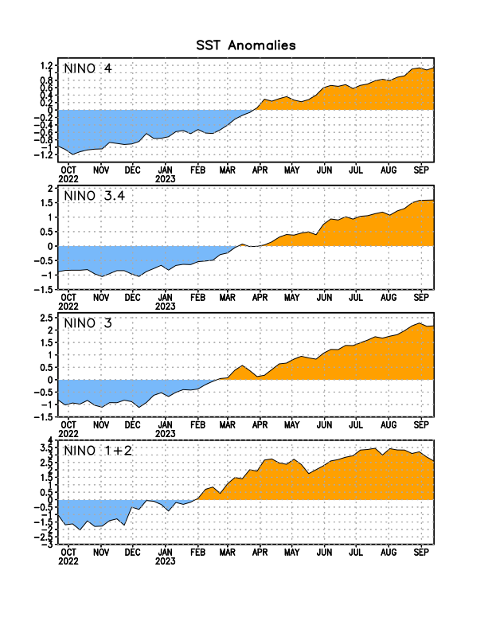
Latest values of SST indices in the various Nino Regions.
Rapidly decreasing Subsurface cold water reserv…

Slide 25
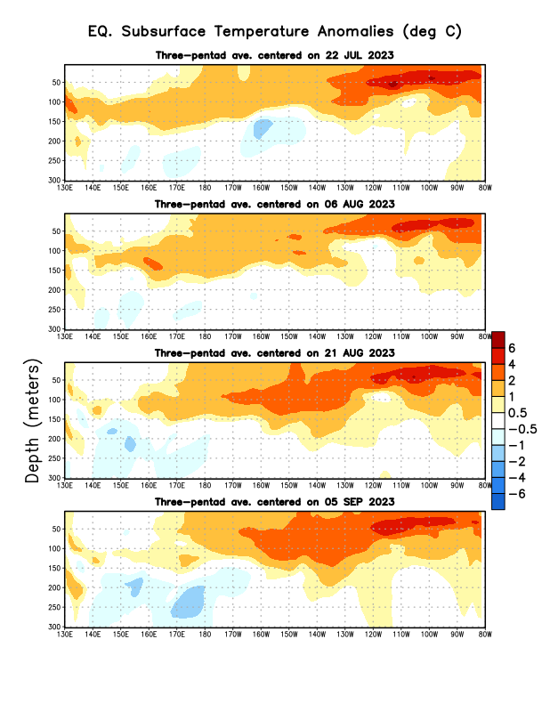
Sub-Surface Temperature Departures in the Equatorial Pacific
Most recent pentad analysis

Slide 26
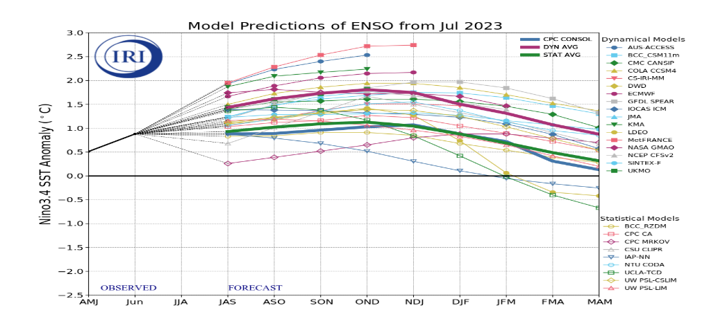
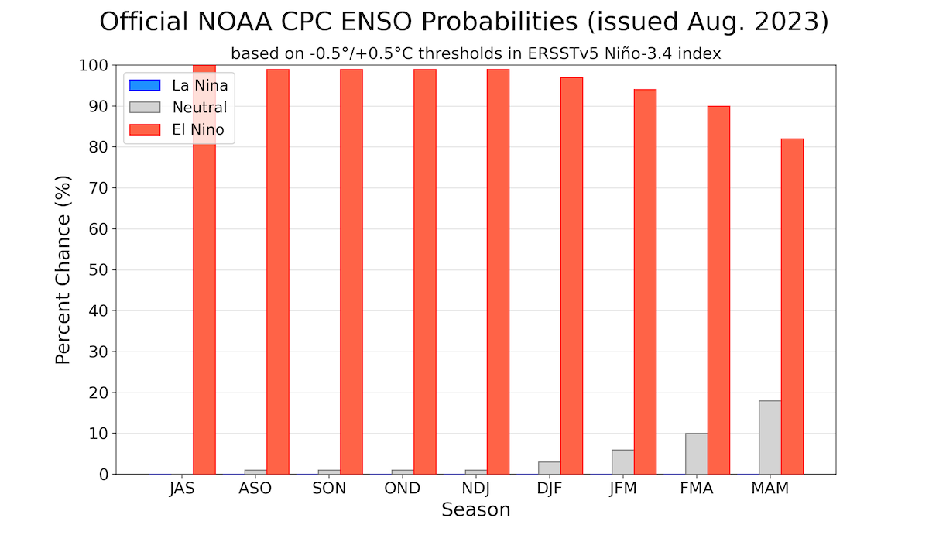
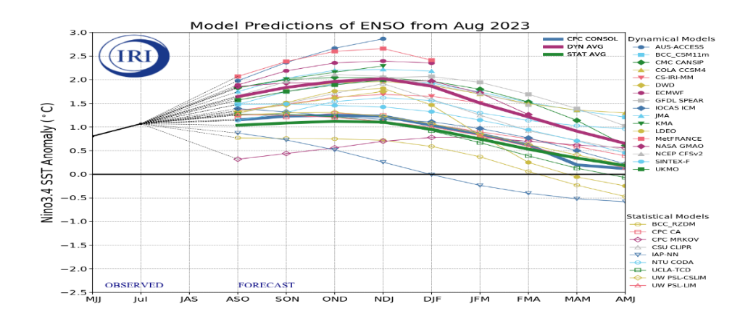
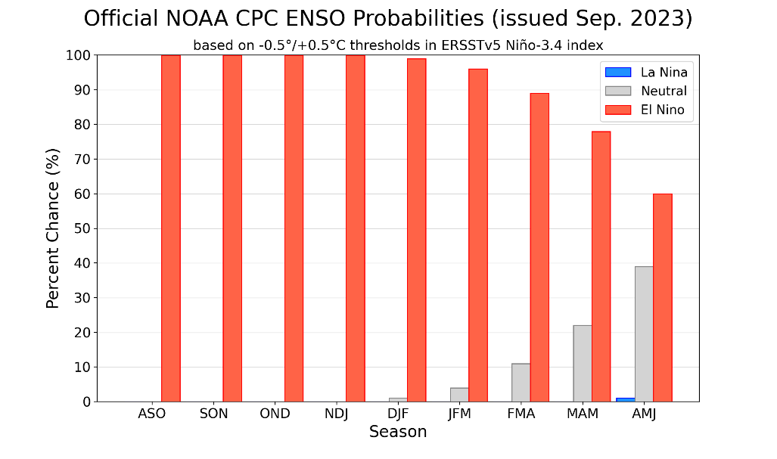
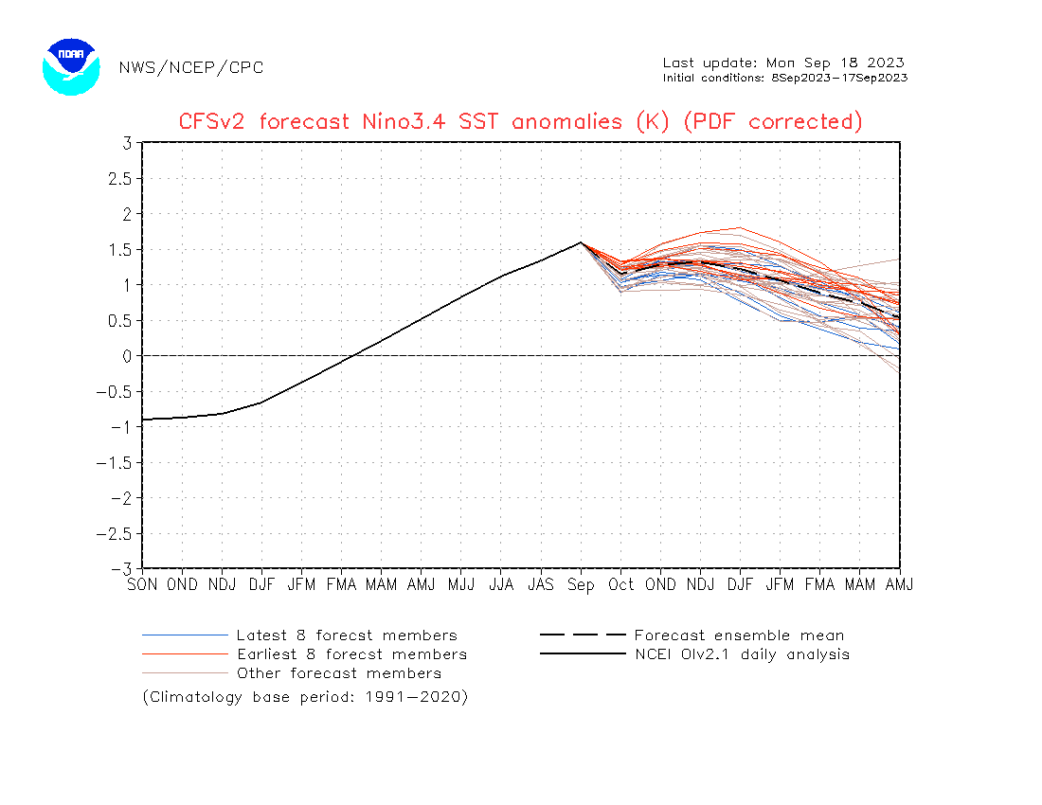
Official ENSO Forecasts
August CPC forecast
September CPC forecast
Latest ensemble members (blue!) show are less bullish

Slide 27
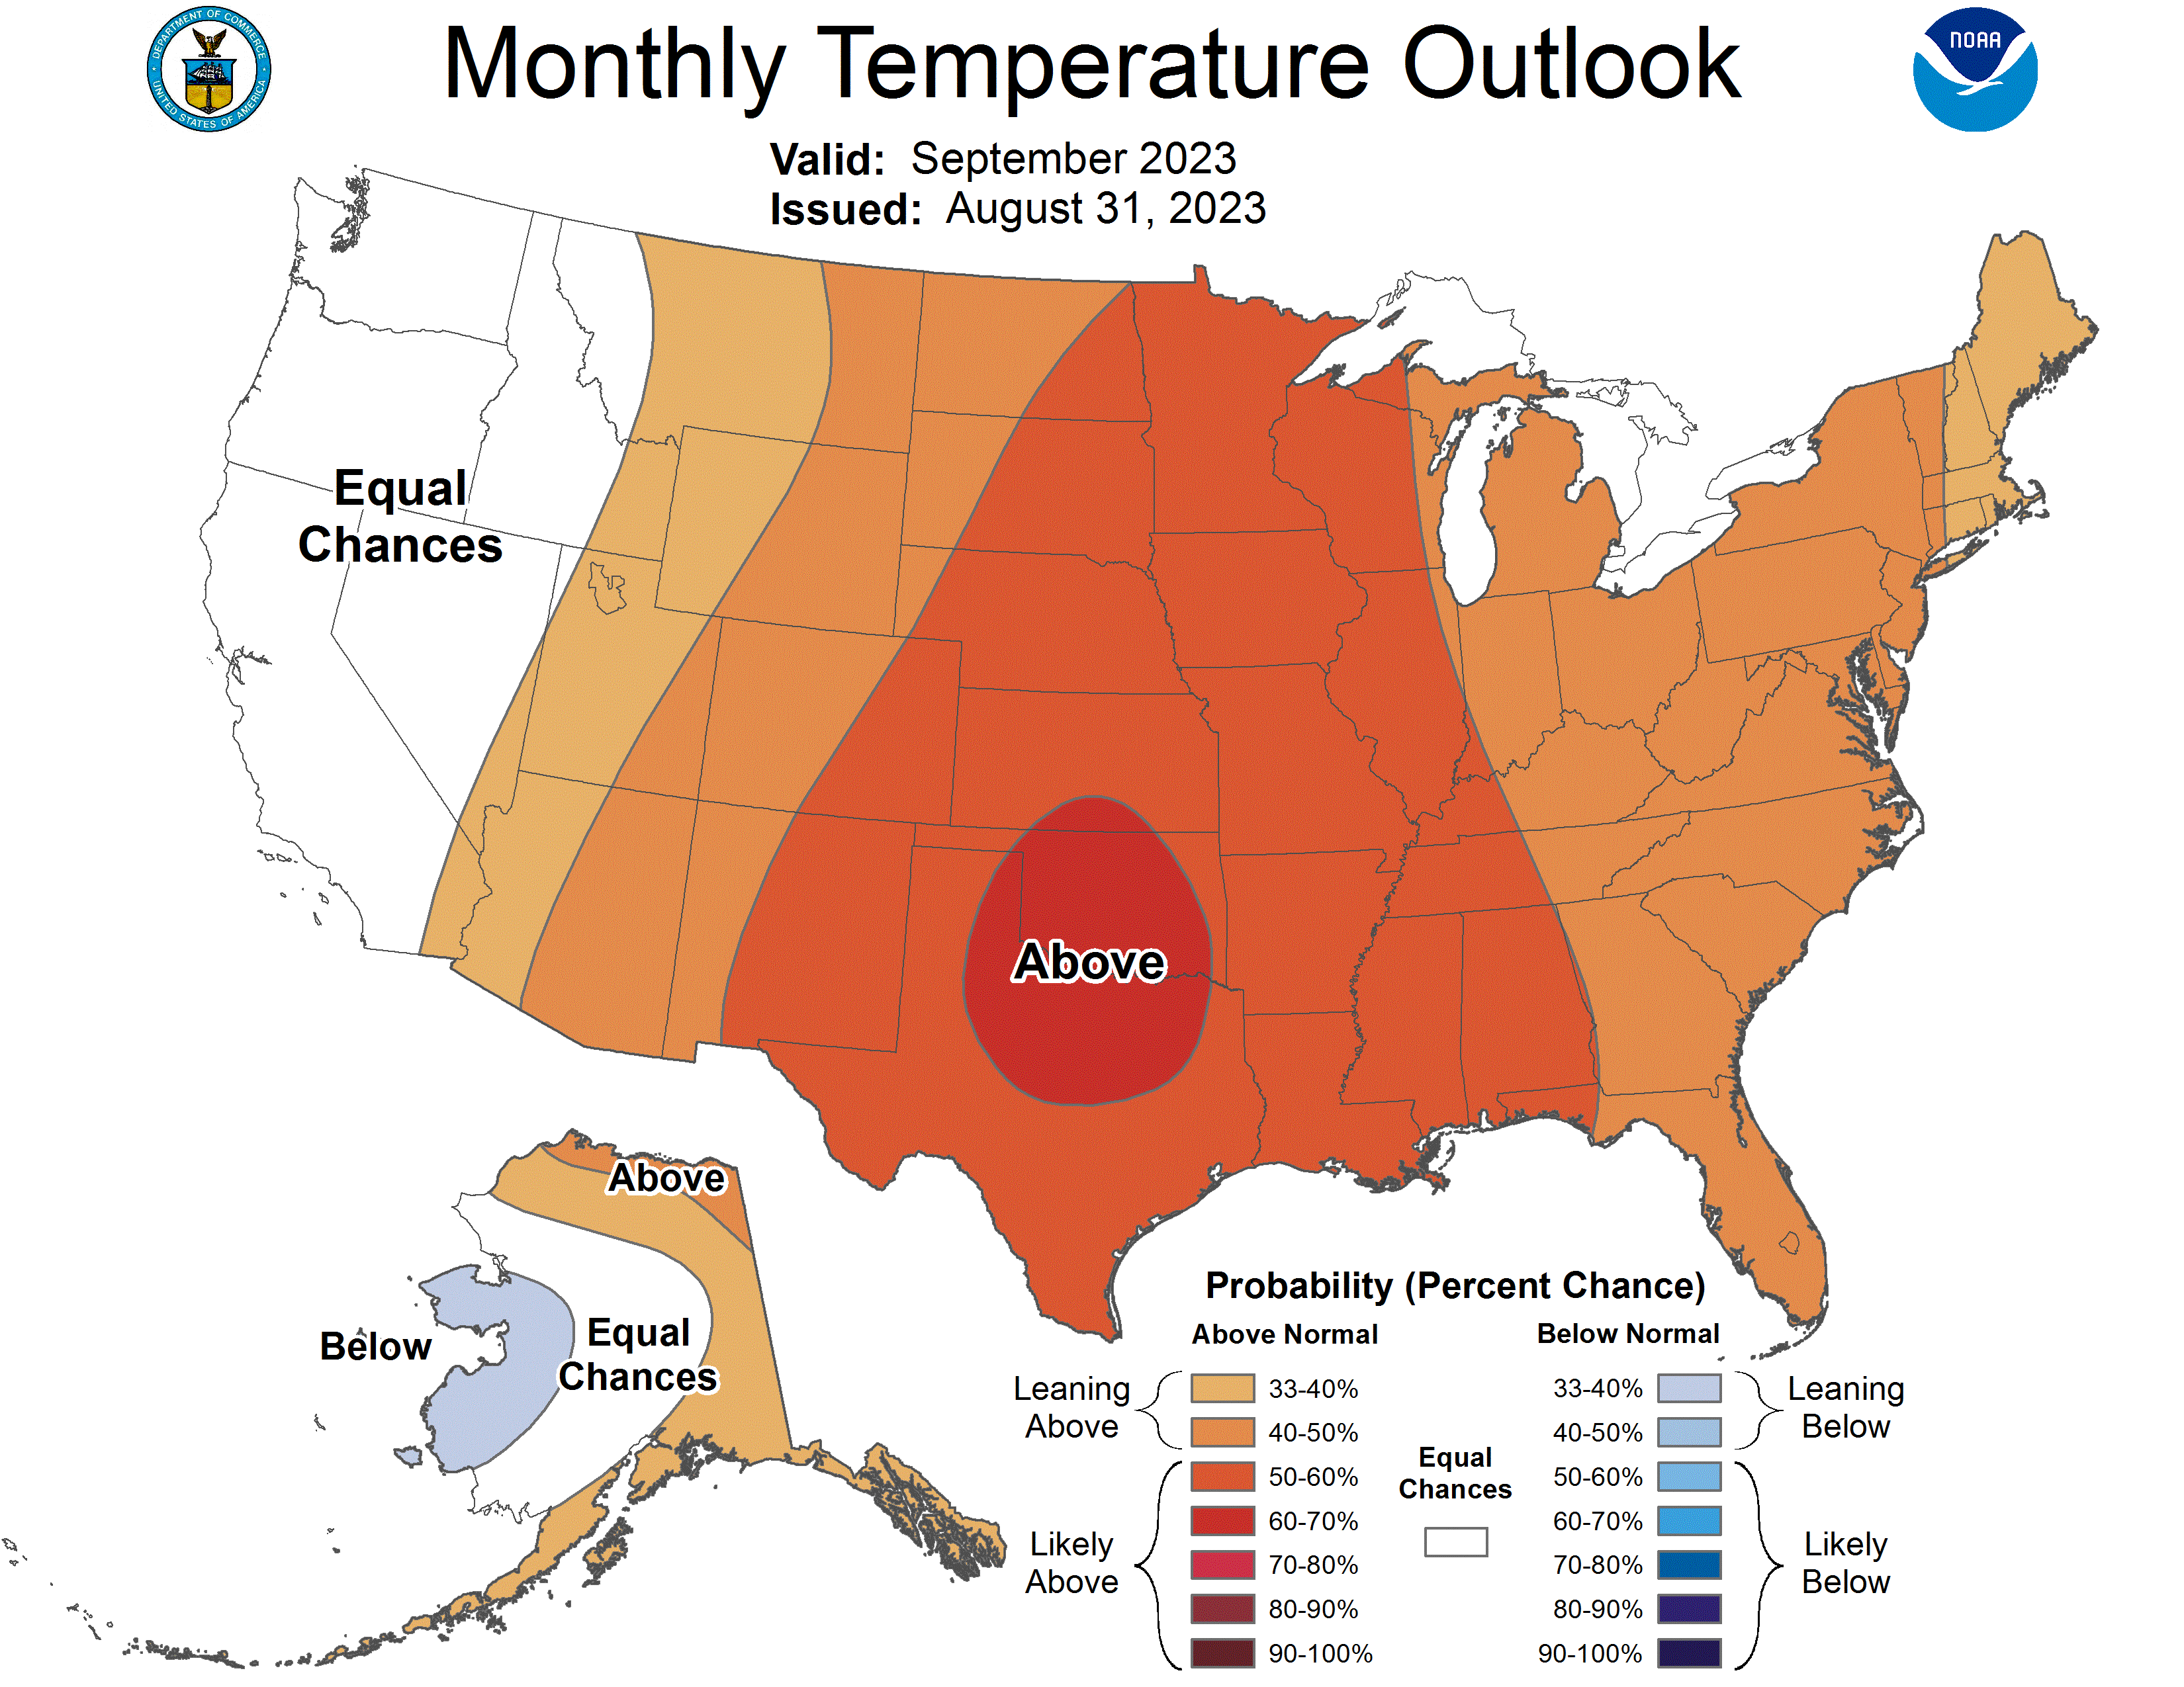
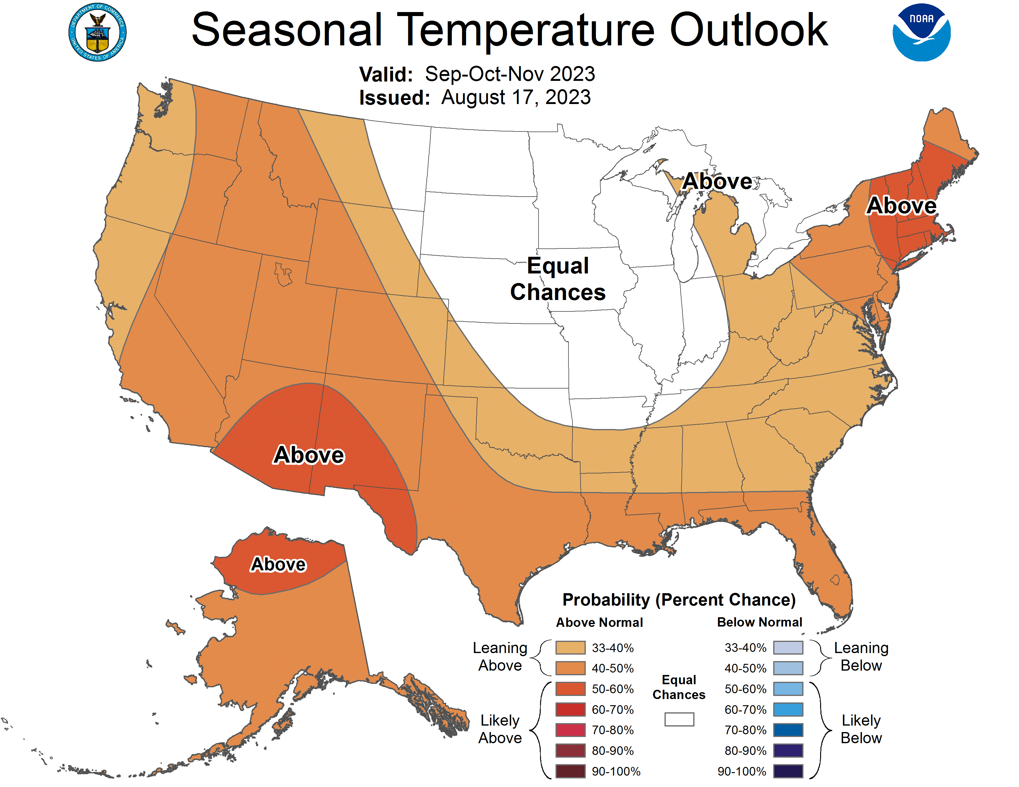
Previous (Last Month’s)
CPC’s official
Temperature OUTLOOK for Monthly (Sep)/Seasonal (SON)
Monthly P/T forecasts verified at mid-month are generally good! Becoz of good skill upto 2 wks.
Released Aug 17th
Observed so far this month!! ☹

Slide 28
Previous(Last month)
CPC’s official
Precipitation OUTLOOK for Monthly (Sep)/Seasonal (SON)
Monthly P/T forecasts verified at mid-month are generally good! (??) Becoz of good skill upto 2 wks.
Released Aug 17th
Observed so far this month!! ☺ ☹

Slide 29
WPC/NCEP’s Next 7 days QPF (Quantitative Precipitation Forecast)
GFS Model Guidance for the
next 16 days.

Slide 30
From 3 Models average Precip forecast (made 17/18 Sep) for next 30 days.
The 3Models are: CFSV2, GEFS, & EC

Slide 31
From 3 Models average Precip forecast (made 17/18 Sep) for next 30 days.
20
40

Slide 32
From 3 Models average Precip forecast (made yesterday 17/18 Sep) for next 30 days.

Slide 33
From 3 Models average Precip forecast (made yesterday 17/18 Sep) for next 30 days.

Slide 34
From 3 Models average Precip forecast (made yesterday 17/18 Sep) for next 30 days.

Slide 35
NMME* T (left) & P (right) Ens.Mean forecasts for
Oct
OND
NMME* : North American Multi Models Ensemble

Slide 36
Agreement/Disagreement among the various NMME models’ OND seasonal Precip. Forecast.
??

Slide 37
http://drought.geo.msu.edu/research/forecast/smi.monthly.php
Predicted Monthly Soil Moisture Percentile
Latest Initial Conditions:
DATA not available !
CPC’s soil moisture percentile – Leaky bucket Model
The inter quartile range suggest greater uncertainty about the forecast in these shaded regions in the ESP based forecast!

Slide 38
BONUS Topic: Discussion continues!! Explanation for the multiyear DROUGHT in the Southwest (CA/AZ/NM/NV/UT/CO & vicinity)!!
More La Nina’s lately ?
More frequent La Ninas lately ?
YES!! The stats in the table below (bottom left) are from the Official CPC ENSO declarations page/table!
(SKIP)
slide
Compared to other regions of the globe, the SST warming/trend in the central eq. Pacific (Nino 3.4) is relatively much small. (See Fig. above) – Why is this ?
Does nature try to compensate for the warming else/everywhere by producing more La Ninas in the equatorial Pacific? - Just my observation from data! Let’s check !!!
Since the 1997 monster El Nino (stronger than the famous 1982/83 event), just a quick count of CPC’s Nino 3.4 index++ values for the three month overlapping seasons, (Data at CPC site only available only from 1950!)
(27 years) (47 years) (74 years)
1997-2023 1950-1996 1950-2023
La Nina(DJF) 12 16 28
El Nino(DJF) 8 17 25
La Nina(all 3mos) 119 150 269
El Nino(all 3mos) 77 166 243
(Overlapping 3month seasons)
Look at Ratios of La Ninas (vs El Ninos) in the shorter
recent (27 yr) period vs the longer (47 yr) earlier period!!
Compare the ratios of La Nina to El Nino in the squared boxes.
***Analysis of CPC’s official Nino 3.4 index data over the last 70 years shows that the more frequent La Ninas in recent decades contributed to less rainfall in the southwest (See La Nina precip composites!, slide#13) and hence the ongoing long term drought in the Southwest!! Hence the long term southwest drought is unlikely to go away any time soon***
++ Barnston, Chelliah and Goldenberg (1997):Documentation of a highly ENSO‐related SST region in the equatorial pacific, Atmosphere-Ocean Volume 35, 1997. https://doi.org/10.1080/07055900.1997.9649597
*** The strong/weak annual monsoon rains in the southwest is a minor modulator riding on this bigger/longer-term signal. ***

Slide 39
Objective drought forecast
Support for Seasonal Drought Outlook (SDO)
NMME Standardized Prcp. Index (SPI) forecast
CONUS
AK regions
NMME Standardized Prcp. Evap. Index (SPEI) forecast (new development)
NMME_VIC Soil Moisture Percentile (SMP) forecast (coming soon)
NMME_VIC Standardized Runoff Index (SRI) forecast (coming soon)
Support for Monthly Drought forecast (MDO)/flash drought
Meteorological drought (SPI)
Agricultural drought (SMP)
Hydrological drought (SRI)
Towards Probabilistic drought outlook (in development!)
This and following few slides are new this month!

Slide 40
The North American Multi-Model Ensemble (NMME):
CFSv2,
NCAR_CCSM4
GFDL_SPEAR
CanCM4i
GEM_NEMO
NASA_GEOS5v2
Quantile-Mapping (BCSD) bias correction and downscaling
The Hatched area: Signal to Noise Ratio SNR < 1
Maximum likelihood to estimate the gamma distribution
Focus on the Meteorological drought
https://www.cpc.ncep.noaa.gov/products/Drought/Figures/SPI/Prediction/ENS_spi3-12_4x3_hatched.jpg

Slide 41
Focusses on Alaska
The same method as CONUS
Long-term drought
Observation in Alaska is poor!
Skill obviously is dependent on Model performance
https://www.cpc.ncep.noaa.gov/products/Drought/AK/nmme.shtml

Slide 42
Focusses on the climatic water balance: P - PET
Replace for the Palmer drought indices
The PET is estimated by Hargreaves (1985), FAO recommendation method without solar radiation, humidity and wind observation
Historical 1991-2020 base period
Rank-based non-parametric standardized indices (SI)
Good for the long-term drought and short-term drought

Slide 43
3-Month Standardized Precipitation Index
Based on CFSv2 Neural Network (NN) Forecast
Sub-seasonal Drought Forecast, support the monthly drought outlook (MDO)
The advanced Neural Network (NN) to bias correct and consolidate the forecast signal (developed by Dr. Yun Fan)
Focusses on the quickly developing Precipitation Deficiency
Weekly forecast, up to 35 days
Flash drought ( Rapid onset drought)
Two drought categories degradation (NoDrought->D1 and D0->D2)
Mostly happens in the warm season
https://ftp.cpc.ncep.noaa.gov/CPC/li.xu/Subseasonal_SPI/

Slide 44
ECMWF-extended forecast driven VIC model Soil Moisture Percentile (SMP) forecast
ECMWF 48r1 version extended forecast, up to 32 days
Possibly the best sub-seasonal forecast currently available
Forecasted meteorological Forcing to drive the VIC model
With realistic land initial from the VIC land analysis
Predictability: land initial + sub-seasonal forecast
SMP for agricultural drought
https://www.cpc.ncep.noaa.gov/products/people/lxu/flashd/flash_prediction.html#10

Slide 45
ECMWF-extended forecast driven VIC model Std. Runoff Index(SRI3) forecast
The same EC_VIC model forecast
Focusses on the runoff deficiency for hydrological drought
VIC is well known for the hydrological forecast
Important for the western US region
Future development is underway!

Slide 46
Summary
Current Drought conditions:
Towards the end of last year 2022, until December or so, severe drought conditions (both short and long term) remained in the west, mild drought conditions expanded in to portions of the eastern half of the US also, covering most of the country with very high % areas of the entire US affected by drought. The situation now is now drastically different due to the extraordinary winter season precipitation.
The past winter/early spring rainy season in CA and the west coast states, wiped out not only the S-term drought but also the L-term drought in most areas. Water levels in almost all CA reservoirs are now ABOVE their normal levels. However, the water storage levels in the huge Lakes Powell and Lake Mead in NV continue to be historically low, & decade(s) long hydrological drought still lingers..
S/L term droughts still remain in parts of northwestern states of WA/OR/ID/MT/ND/SD. Severe drought is entrenched in eastern and central areas of MN/WI/NE/KS/MO. Moderate/Severe drought in now entrenched in MN/WI/IA/IL/IN.
The relatively poor monsoon this year in the southwestern states has created short term drought conditions in AZ/NM and in parts of NV/UT/CO. Severe drought is fully established in most of TX, LA/MS
In spite of all these areas of drought noted above, about 50 % of the country drought free! And the remainder 50 % of the lower 48 states is in some kind of dryness/drought!
Recently we have introduced and show here, an exptl. version of an Objective US Drought Indicator based on AI/deep data methods, that runs daily at CPC. We introduce in this month’s briefing a new set of slides consolidating a few objectively made drought outlooks, produced experimentally at CPC.
Current ENSO status and forecast: El Niño conditions are observed. El Niño is anticipated to continue through the Northern Hemisphere winter (with greater than a 95% chance through December 2023-February 2024).
Prediction: Even though the Nino 3.4 SST index is officially in place finally with the expected air-sea coupling taking place. The official forecast for a moderate El Nino during the OND forecast season (and through the upcoming winter) is at near 100% probability. However, it is not totally clear if one can expect the same canonical ENSO impacts around the globe, and especially over the United States, if the more recent ENSO events (2015/16/17 and 2022/23 winters) and their rainfall impacts serve as any example.
The NMME models’ weak precip signal/guidance for the forecast season OND is not much helpful, in spite of the strong El Nino. In fact, the models suggests below normal rainfall for much of the Southwest. It is likely the drought in the SW will stay.
Besides the less than normal rainfall forecast for the next month in the Ohio valley, the overall rainfall climatology of the next three months (OND) is also NOT unfavorable to drought development. Potential exists for Flash Drought Development (lasting only temporarily ?) up and down the Ohio Valley (see slides!) extending north into western PA and NY during next month, but will go away by end of OND. While the Short term Drought in western TX may improve, along parts of eastern TX, LA, and MS will likely continue and may even worsen in the short term. Possible drought development at least in parts of FL, by end of season as well.
By the end of November, we expect that the drought in the Pacific Northwest will improve. ****

