Slide 1
Drought Outlook Support Briefing September 2024
Climate Prediction Center/NCEP/NOAA
http://www.cpc.ncep.noaa.gov/products/Drought
Points to ponder:
Often, there is a disconnect between the Short term (S) and Long term (L) drought in regions, and even with the short term (S) drought, the 3-month and 6-month signals are not quite consistent! With Long term (L) drought, it is even more trickier, as it is open ended from 6 months-onwards and beyond!!!
Places/regions experiencing Short term drought may (not) be ok in the Long term and vice versa!!
This duality is difficult to reconcile, to convey and even be clearly understood well by the public at large.
Public/Forecaster generally tends to focus more on the Short term Drought (for good reasons!!)
More importantly the very definitions and timescales associated with S/L term droughts and the declarations in the USDM are by themselves subjective!! Short term vs Long term drought need to be clearly distinguished and shown to the public!!
It may take a long time for drought to develop, but those conditions can end very quickly! as it happened in CA after DJF 2023 winter. Forecast models are yet to (seasonal) correctly forecast these changes in advance!
Subjective(delayed) USDM vs Objective (real time) map! A few days of more recent heavy precip can change the USDM a lot!
New (last several months):
Towards objective drought monitoring goals, we introduced, a new objective AI/Deep-Learning based Experimental ODI (objective drought indicator, updated daily, Slide # 3) compared with Official USDM (US Drought Monitor, produced weekly by USDM authors).
Towards prediction, we introduce a new section with few slides at the end, consolidating the various exptl. drought outlooks by purely objective methods developed here at CPC! All these in preparation of a broad general push towards Probabilistic Drought outlooks.
New issues/questions to ponder:
How much rainfall/Precip. deficient have to be, and after how long, do we actually declare Drought?
Do these have to vary by region?
i.e., When, what exact dry/rainfall-deficient conditions, trigger a Drought call?
Should there be minimum duration of Drought (conditions/criteria!) ? (We know there is no such maximum!)
i.e., Can a region quickly get into a Drought (say for a month or less, for a couple of weeks!) and get out of it?

Slide 2
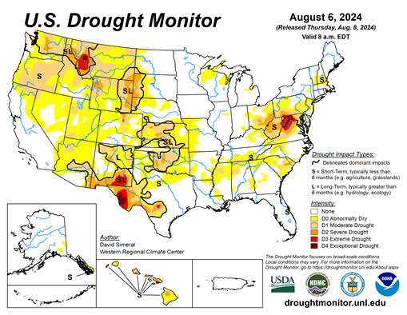
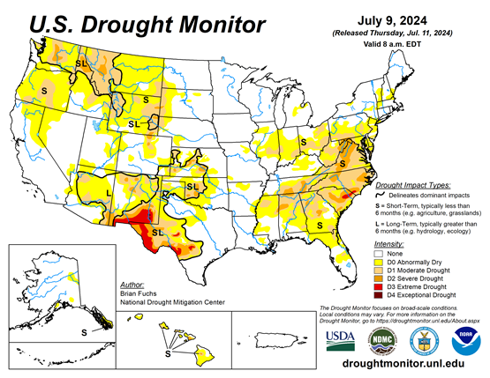
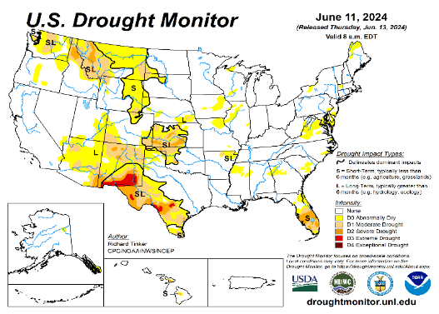
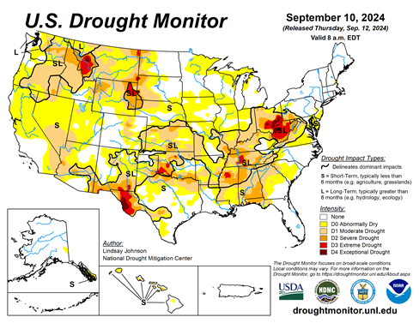
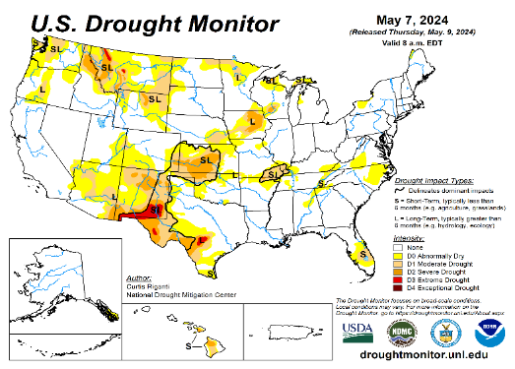
Drought Monitor
Monitoring is important because, unlike US T/P fcsts, for drought forecasts, we have to know where we are, before we can tell where we are going!! Drought forecasts are tendency forecasts as changes from the latest USDM.
August
California for the most part, has remained drought free for about twenty months now luckily due to above normal rainfall during both recent 2022/23 (La Nina, strange!) and 2023/24 (El Nino, canonical!) winter rainfall seasons.
Water levels in almost all CA reservoirs are now at or well above their normal levels. However, the water storage levels in the much bigger lakes, Lake Powell and Lake Mead in NV/AZ still continue to be very low, and have not recovered completely from the 2+ decades(since ~2000) long hydrological drought that existed in the region.
The S/L term drought in the interior Pacific Northwest and in parts of WA, OR, ID, MT & WY is still stubbornly persisting, or even worsened!. But drought in MN/IA/WI/ MO/NE is almost or nearly gone.
Earlier, five/six months ago, we had suggested/projected over the past few months that the overall drought situation across the entire US will improve slowly and steadily, and it actually happened. Having reached the “near bottom” for the % of US areas covered under drought three months ago, we again suggested a possible uptick/increase in drought area coverage over the next few months (mainly in the western US!) & it is slowly happening! However, the recent development drought in the eastern US up & down Ohio valley was quick! Is this temporary or will it last longer?
Since early summer, questions still remain about when the La Nina will actually develop and how strong it will be! Our mantra lately has been, that a lot depends on when the La Nina will finally develop and how strong will it be?
Large parts of NV/UT/AZ/NM and western TX are still dry or under drought due to long term/decadal drought in the SW, as well as the poor SW monsoon this past year (2023).
So far, the behavior of the monsoon in the US southwest is spatially very uncharacteristic. Another 2024 poor SW monsoon in the overall region even make the current dry conditions or drought in the region worse. We still postulate that the drought in the west/central US is a bit more ominous than the temporary flash dryness in the east.
The quick emergence of temporary dry conditions in southern VA, the Carolinas during July faded away as quickly as it appeared. However drought conditions in the western MD, western VA, WV and OH is staying stubborn.
July
June
September
(Recent/Latest)
May
Food for Thought: Are we (USDM) too quick to declare Drought and take it away?? Is lack of precip for just a few weeks or just 1 month call for drought?, especially in eastern US?

Slide 3
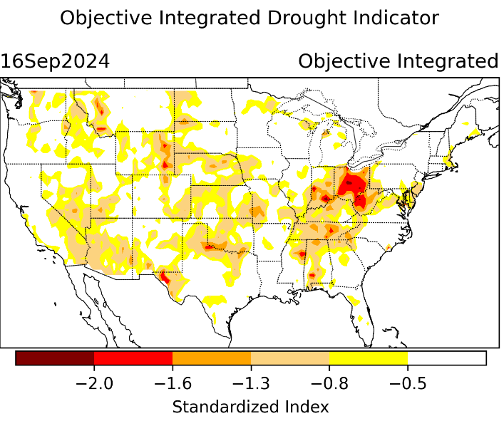
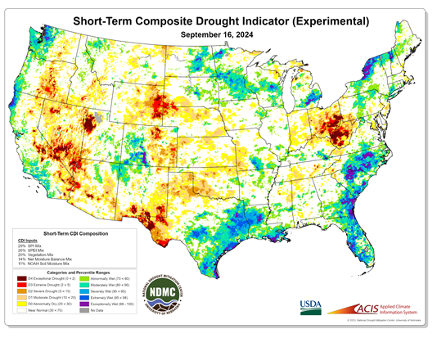
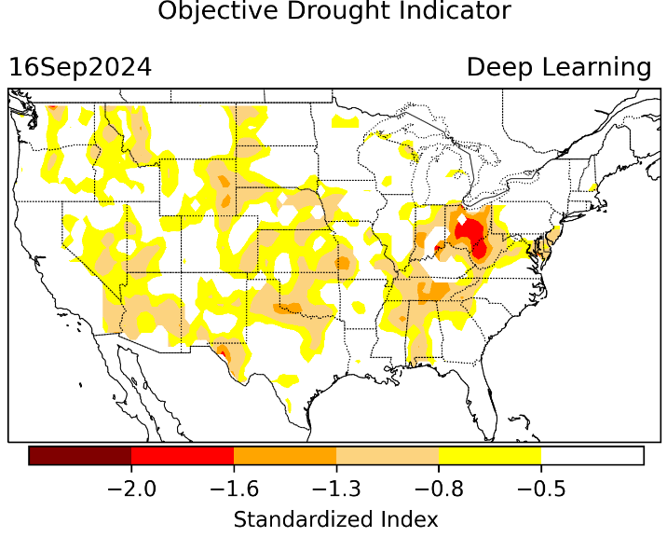
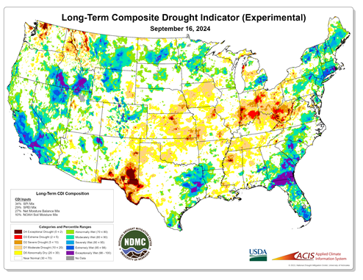
Exptl. Objective Drought Monitor (showing S/term & L/Term separately) from National Drought Mitigation Center (NDMC)
New slide now included recently in this briefing!
CPC’s own Experimental
Objective Drought Indicator (ODI)
using AI/Deep Learning ! – Updates daily !!
https://www.cpc.ncep.noaa.gov/products/people/lxu/odi/#deep-learning-increment-training
Based on the CPC P/analysis &
VIC (Princeton) NLDAS model assimilation:
Standardize Precipitation index (SPI)
Standardize Precipitation-Evapo –
transpiration index (SPEI)
Evapotranspiration Stress Index (ESI)
Soil Moisture Percentile (SMP)
Standardize Runoff Index (SRI)
-can be split into Short/Long Term Droughts!
https://droughtmonitor.unl.edu/ConditionsOutlooks/CurrentConditions.aspx
Objective
& Updates Daily!
Objectively Integrated
versus Deep Learning
Methods ~ gives |||r results. Both Objective!
Both update daily!
Objective, but
Runs Weekly!
On Mondays!
Objective
& Updates Daily!
* A manuscript (Xu & Chelliah) is under preparation.
Subjective &
Produced Manually!
Weekly!
Latest Official USDM (US Drought Monitor)
(about a week old!)
Objective, but
Runs Weekly!
On Mondays!
These two maps above, used to be produced at CPC (Rich Tinker!), every Monday but now recently officially moved to NDMC operations!
*Released every Thursday, for conditions as of Tuesday!

Slide 4
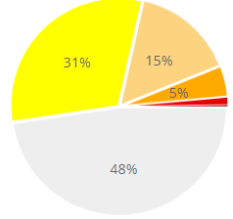
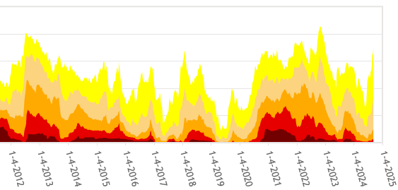
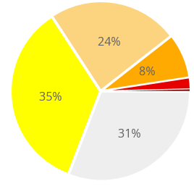
In general, The spatial details of every drought is different.! Every situation is different!!
Time series since 2000 spilt into 2 (above & below) panels.
last
month !
CONUS % Land Area
This month !
We said in this briefing a 2, 3 months ago, that the relative minimum in the %(percent) of US land coverage by Drought has reached its lower limit, and will likely increase from that low point onwards and it has been happening, as we suggested. We said it based on 2 factors: weak 2024 SW monsoon, ending of El Nino, possible trending La Nina development.

Slide 5
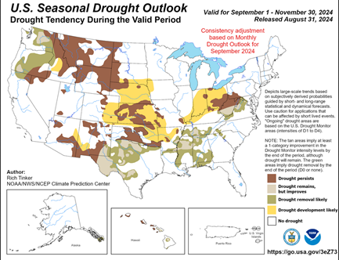
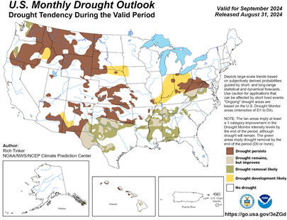
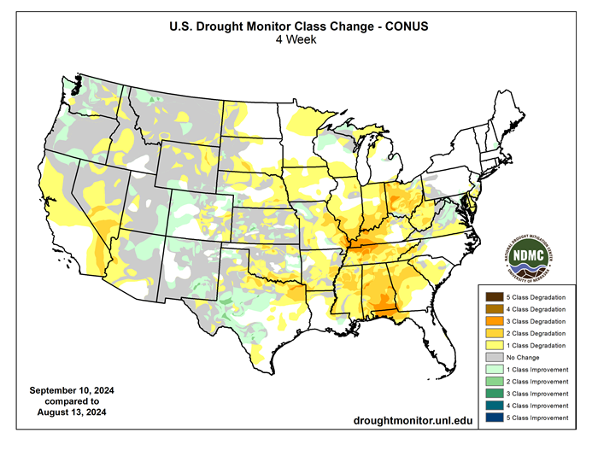
(Previous) Seasonal/Monthly Drought outlooks
New Seasonal+ Drought Outlook(SDO) to be released in 2 days!
(reissued again at end of month for consistency with MDO!)
New Monthly Drought Outlook (MDO) to be released at end of this month)
Updated Seasonal Outlook
( 1 Sep – 30 Nov 2024)
issued 8/31/24
Monthly outlook (for September 2024)
issued 8/31/24

Slide 6
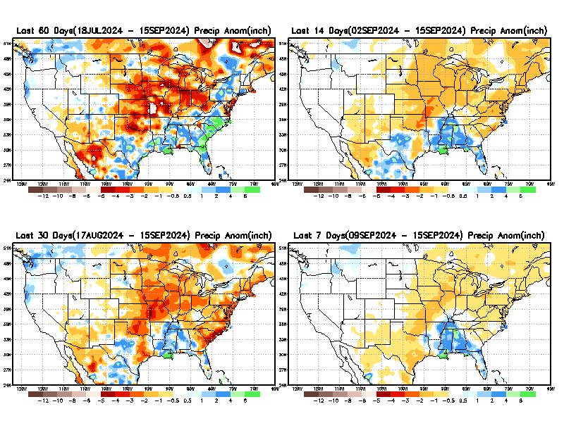
Precipitation ANOM during last 7, 14, 30, & 60 days.
This and next few slides show Precip deficit (excess).
Droughts, for the MOST part, begin and end with precip!! Lately, Temps are becoming (secondarily) important as well.
60 Days
14 Days
30 Days
7 Days
These maps in this and following slides, including a) Total,
b) Anom and
c) Percent of Normal precip. in these and other longer time ranges are now (routinely) daily updated at:
From: Recent Accum./Anom Precipitation https://www.cpc.ncep.noaa.gov/products/Drought/briefing_prcp.shtml

Slide 7
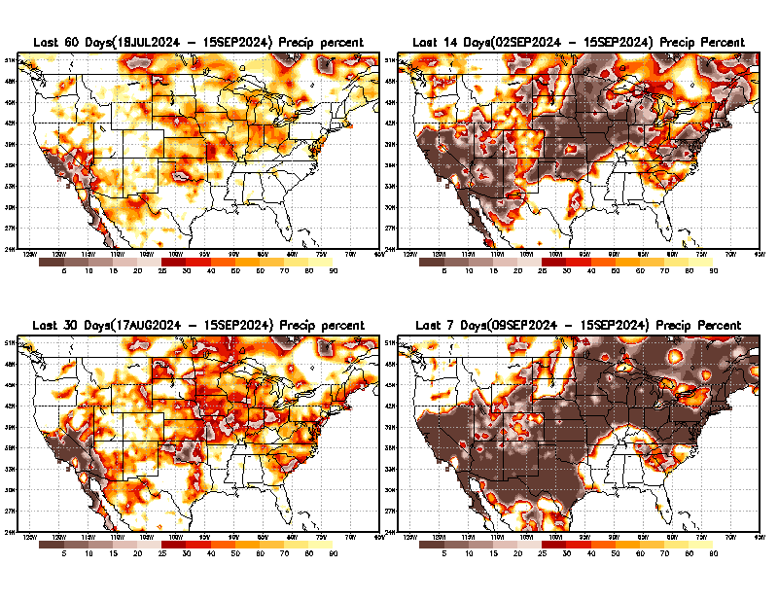
Precipitation Percent (of normal) during last 7, 14, 30, & 60 days - Only Deficit Areas <=90% shown !
60 Days
14 Days
This plot shows only the rainfall deficient regions <= 90% of normal.
-- This shows more clearly possible/likely drought developing region in the future unless there is above normal rainfall in these regions in the future, to offset these shortfalls.
30 days
7 days
From: Recent Anom/% of normal Precipitation https://www.cpc.ncep.noaa.gov/products/Drought/briefing_prcp.shtml

Slide 8
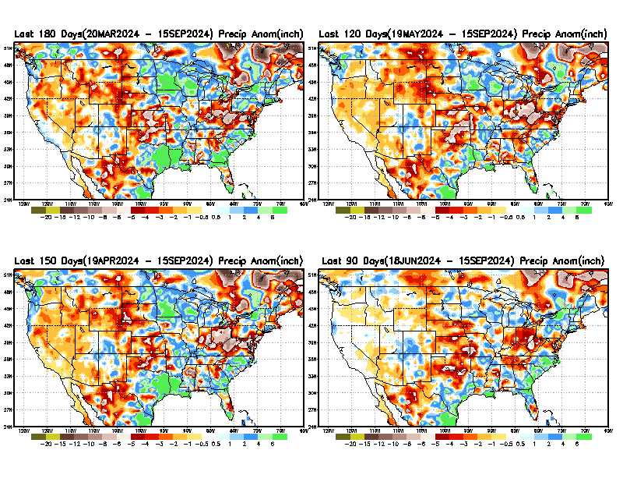
Total precipitation ANOM during last 3, 4, 5, and 6 months.
While the Precipitation anomalies deficit may seem large in some regions (compared to others),
it is the
% of normal precip (next slide) that matters more!!
6 M
4 M
5 M
3 M
From: Recent % of Normal Precipitation https://www.cpc.ncep.noaa.gov/products/Drought/briefing_prcp.shtml

Slide 9
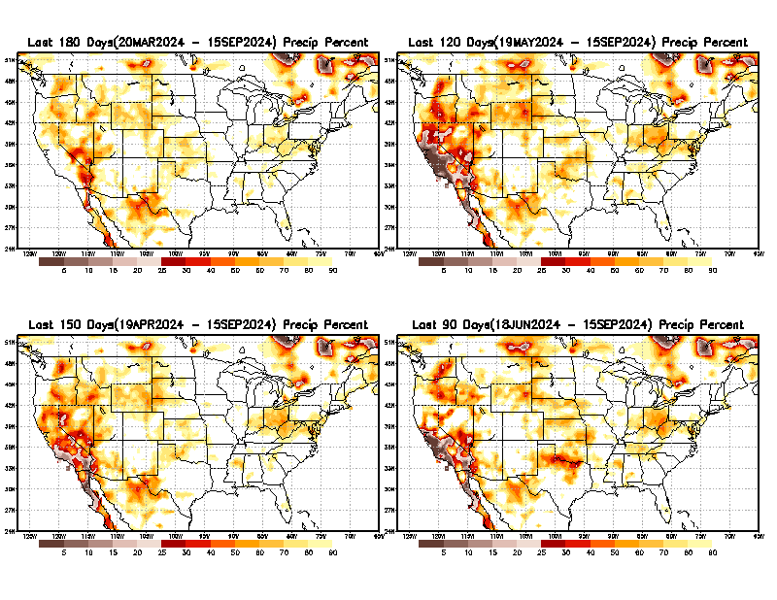
Total precipitation Percent (of normal) during last 3, 4, 5, and 6 months Only Deficit Areas <=90% shown!!
6 M
4 M
In these interim time scale 3-6 months, we need to pay attention to regions, which are dark brown, brown, dark red, & red (<40%).
While accrued precipitation deficits are real & objective,
droughts are subjective declarations!!
5 M
3 M
East vs West!
Broad vs Narrow
rainfall season.
In general, West US suffers more from frequent and lasting droughts. Droughts in East US are generally less and less lasting!
What about Center ?
More like West than East?
Short term(S) Drought is generally declared when large/severe rainfall deficits exist in the 3-6 months time range. {Long term deficits beyond 1 or 2 or more years is Long term L drought! }

Slide 10
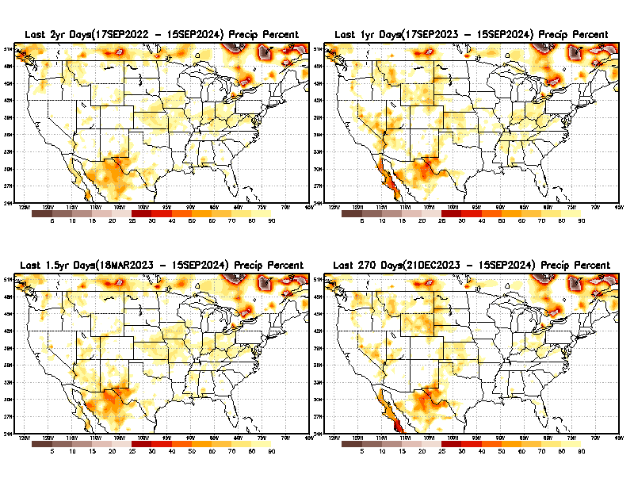
Total precipitation Percent during last 9 months, 1 yr, 1.5yrs, & 2 yrs. .–Only Deficit Areas shown!! <=90%
2 Y
1 Y
1.5 Y
9 M
The character and even location/spatial extent of the short/S and long/L –term droughts are different!!!
From: Recent Accumulated Precipitation https://www.cpc.ncep.noaa.gov/products/Drought/briefing_prcp.shtml

Slide 11
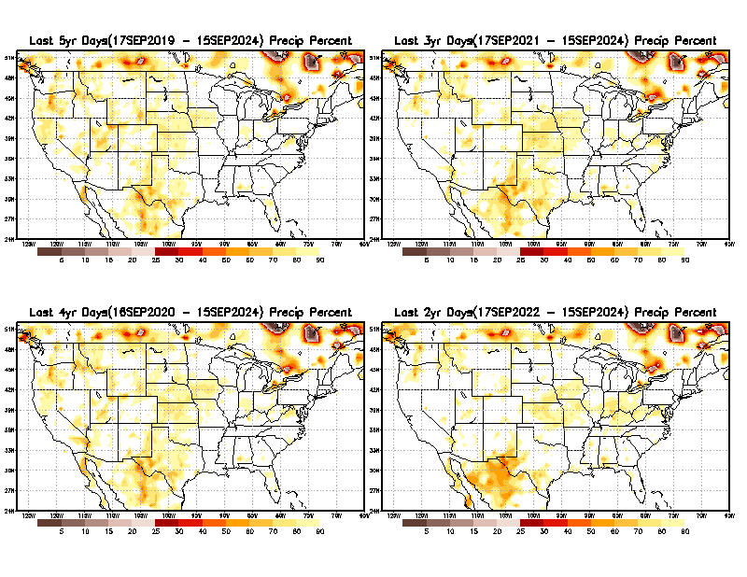
Total precipitation Percent (of normal) during last 2, 3, 4, & 5 yrs. .–Only Deficit Areas <=90% shown !!
5 Y
3 Y
Deficits are not much!
4 Y
2 Y
From: Recent Accumulated Precipitation https://www.cpc.ncep.noaa.gov/products/Drought/briefing_prcp.shtml

Slide 12
LEAST
MIXED
MOST
East vs West!
More darker colors in west/central => narrow rainy season (months)
Overall, more white space in the east => distributed rainfall season (except ~FL).

Slide 13
*********
EAST vs
CTR/WEST
Drought Behavior is loosely tied to rainfall climo!! And the limited rainy season in the west
*********
Adapted from Rich Tinker.

Slide 14
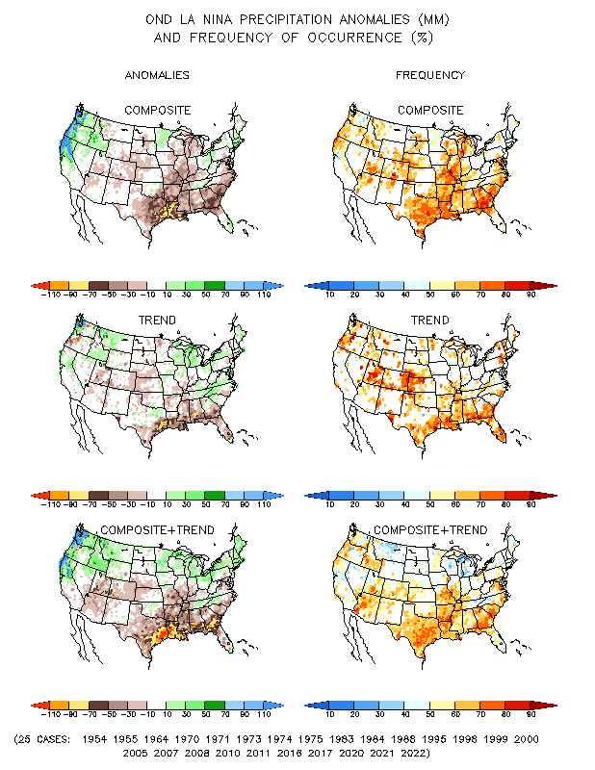
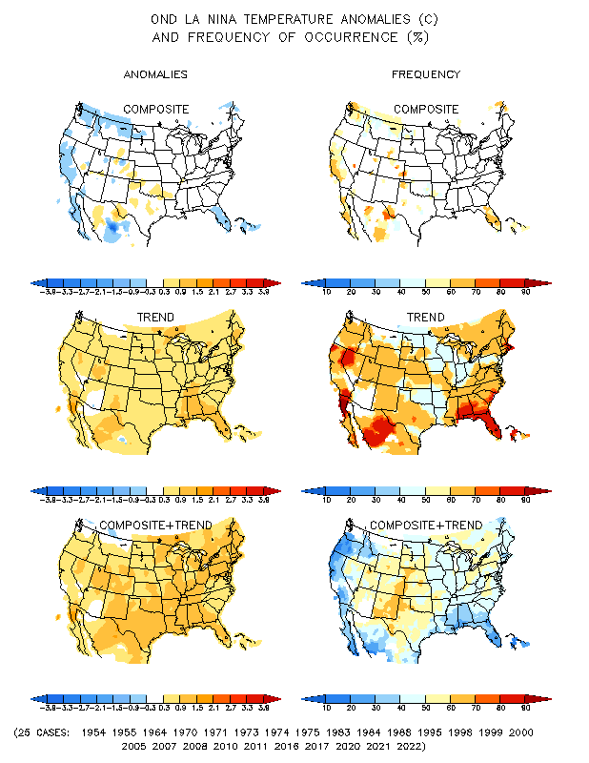
La Nina Precip/Temperature COMPOSITES & Trend map
OND
P
T
Opposing signals!

Slide 15
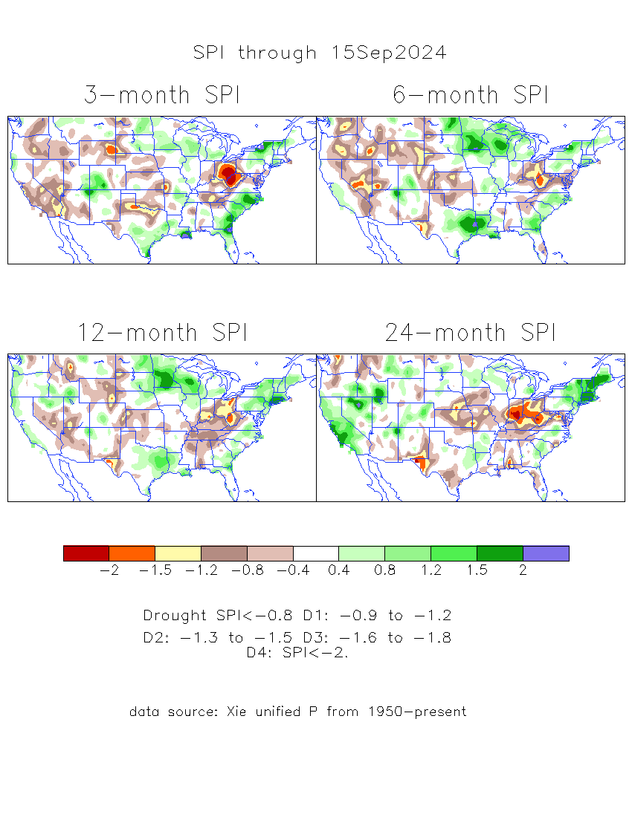
The Standardized Precipitation Index SPI (based on Observed P)
Compare with last month
----- NOW
Very interesting graphic & details for the drought across the US based on the more generalized precip deficit/excess, the Standardized Precipitation Index (SPI).
The dark brown and red colors, indicating standardized precipitation deficits, in the various time periods, approximately correspond to the appropriate short/long term drought monitor regions and their intensities
Short
Long
How does one negotiate and reconcile declaring short term vs long term drought when precip. deficiencies patterns differ on many different time scales locally!!
What is the cutoff delineating time between short VS long term drought!! Not so clear!!
At exactly where, does drought begin?
Based on this SPI indicator/measure,
The brown areas are various levels of DRY regions!
The yellow/red are more probably drought regions!

Slide 16
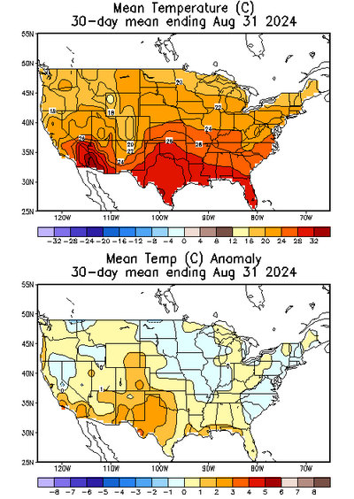
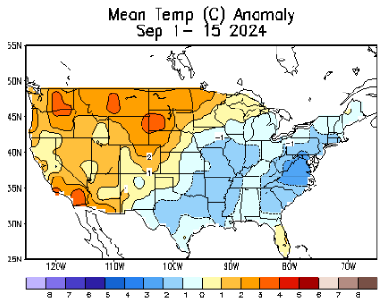
NOW
Recent US Temperatures
.
Last
month !!
So far this month !!

Slide 17
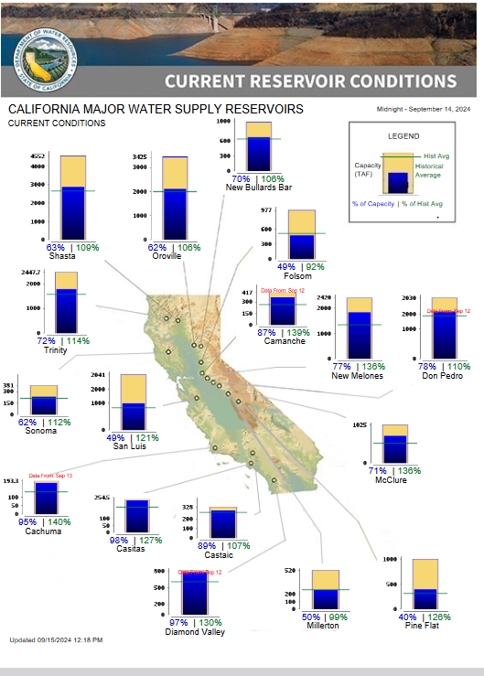
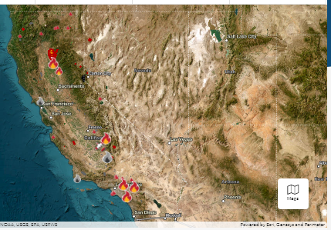
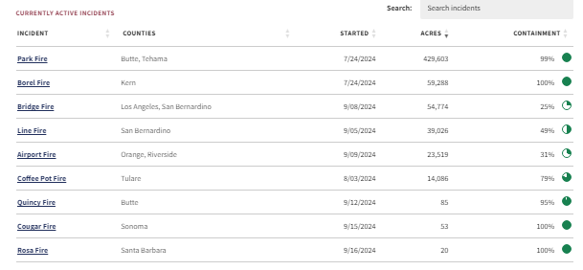
From Cal Fire
% of Capacity
% of Hist. Avg.
of Reservoirs.
Many CA water reservoirs are AT or ABOVE their historical average/ CAPACITY levels ! ☺
No up-to-date/current maps of Active Fires across the US! (except Cal Fire!) – If anybody has/knows a link, please email me!
Thanks!

Slide 18
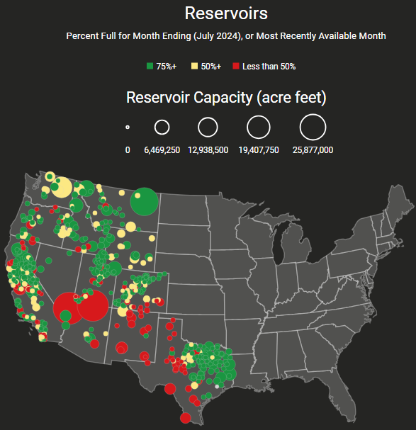
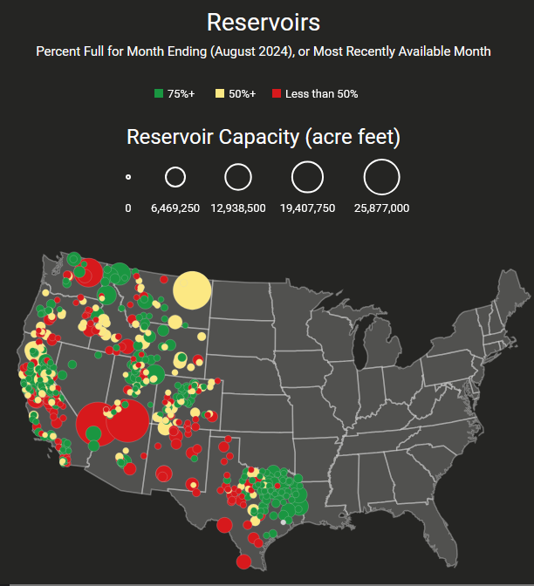
Western Water (2000-2024), from Dean Farr
Reservoirs
Percent Full for Month Ending (July 2024)
Month ending August 2024
https://www.deanfarr.com/western_water/
Lakes Mead, Powell in NV/AZ are at low levels! ☹ ☹ HUGE consequences for electric power for western states CA/NV/AZ/UT !! Slowly improving in recent months!
Big change in the western US in just 1 month!

Slide 19
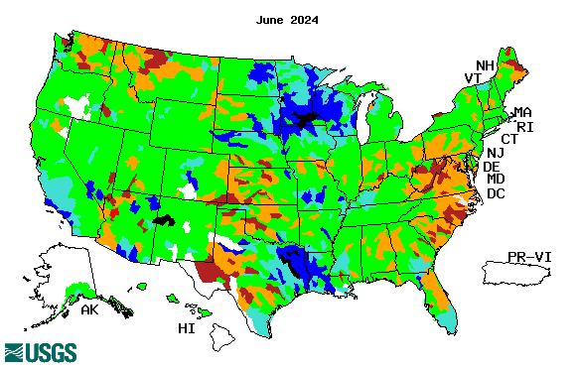
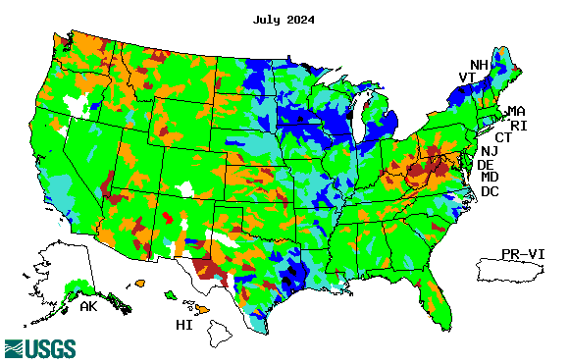
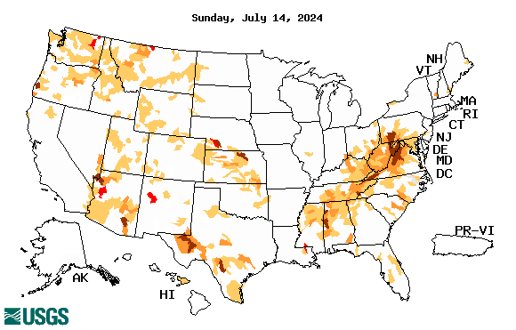
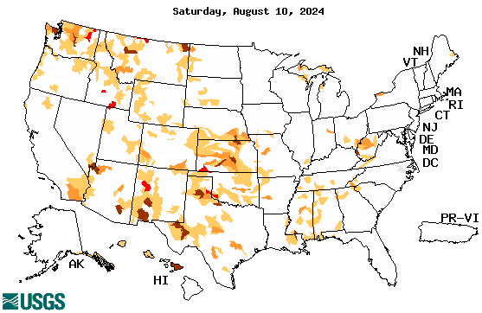
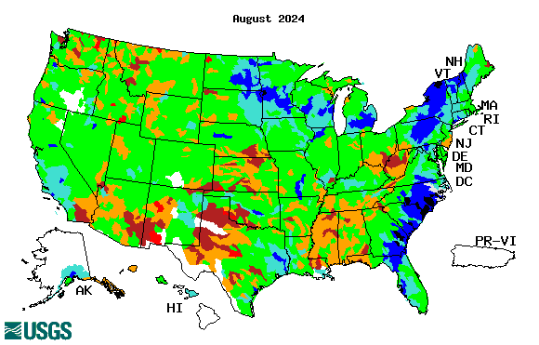
Streamflow (USGS)
Most US east droughts are relatively short lived (as compared to US west).
But in last 2 decades, recently in 2000, 2016, 2020, & 2022, New York and New England experienced historic drought conditions not seen since the 1960s.
Map shows only below normal 7-day average streamflow compared to historical streamflow for the day of year.
One month ago (left) &
Now (below)
Streamflow is only a partial indicator, as sometimes it is highly managed.
If sometimes, the various indicators are confusing, go back to % of rainfall deficit maps – to confirm/reinforce!!
https://waterwatch.usgs.gov/?m=nwc
19

Slide 20
EL NIÑO/SOUTHERN OSCILLATION (ENSO)
DIAGNOSTIC DISCUSSION
issued by CLIMATE PREDICTION CENTER/NCEP/NWS and the International Research Institute for Climate and Society
12 September 2024
ENSO Alert System Status: La Niña Watch
La Niña is favored to emerge in September-November (71% chance) and is expected to persist through January-March 2025.
(If you recall, back in June the forecast was for 65% chance of La Nina development during July-September!)
CPC’s Oceanic Niño Index (ONI) [3 month running mean of ERSST.v5 SST anomalies in the Niño 3.4 region (5ºN-5ºS, 120º-170ºW)], based on centered 30-year base periods updated every 5 years. For historical purposes, periods of below and above normal SSTs are colored in blue and red when the threshold (0.5) is met for a minimum of 5 consecutive 3-month overlapping seasons.

Slide 21
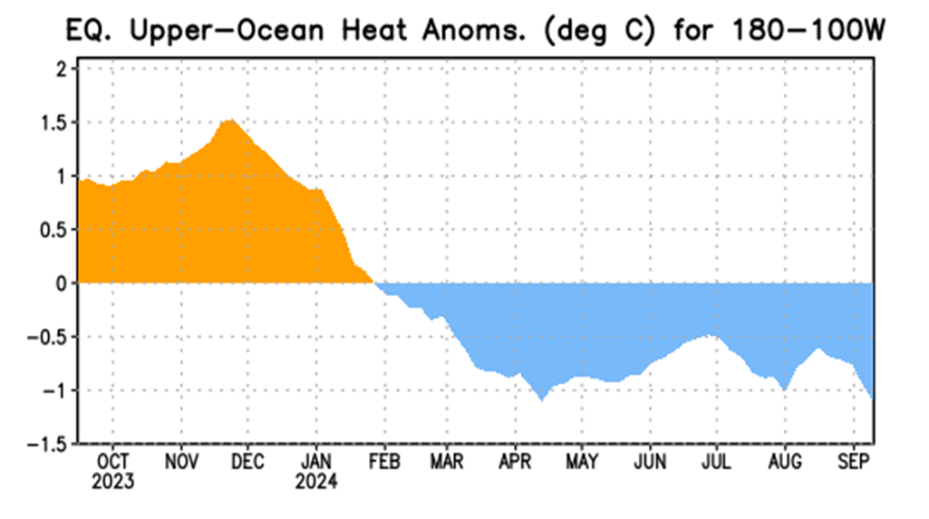
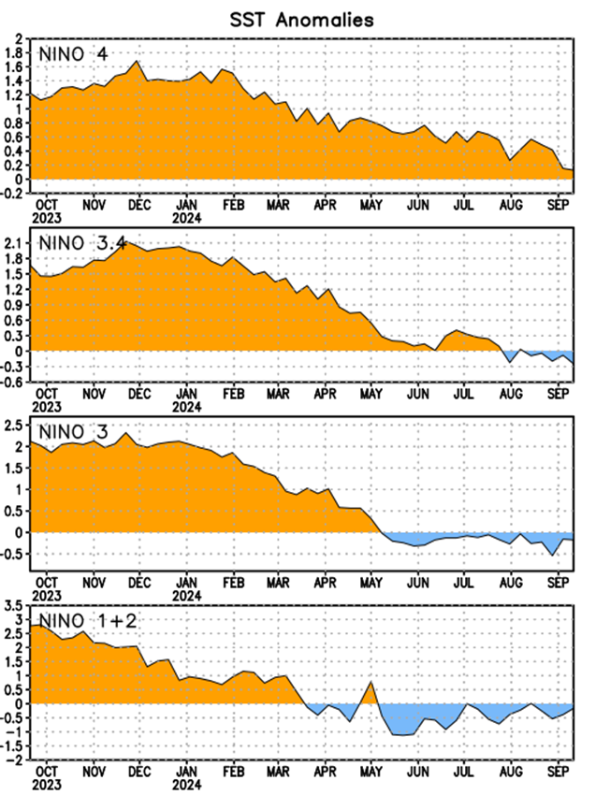
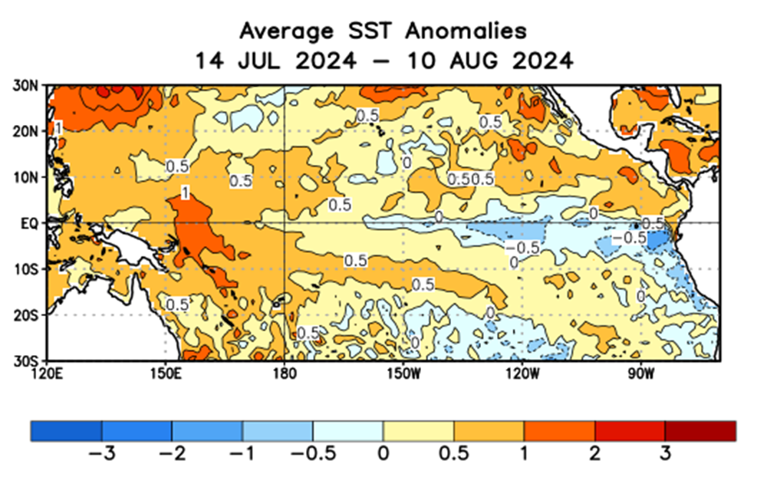
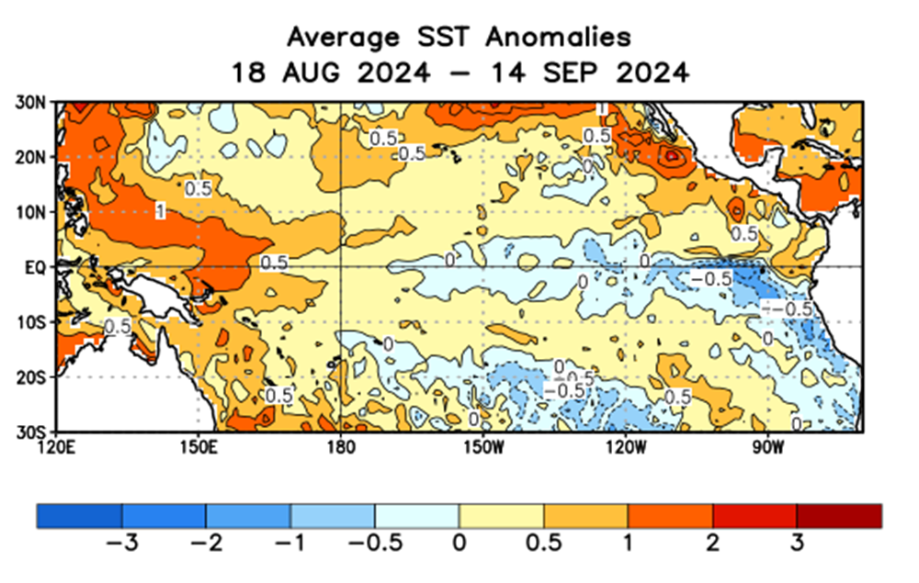
Latest values of SST indices in the various Nino Regions.
The recent El Nino came in a hurry after 3 back-to-back La Ninas has all but gone away in a great hurry to make room or ANOTHER La Nina which is on the way!!? ?

Slide 22
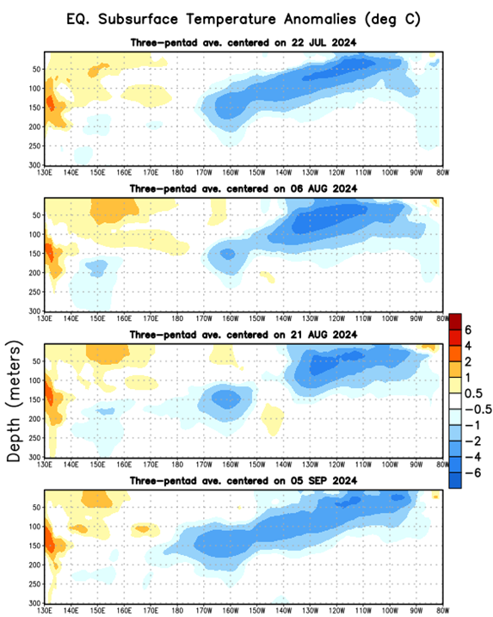
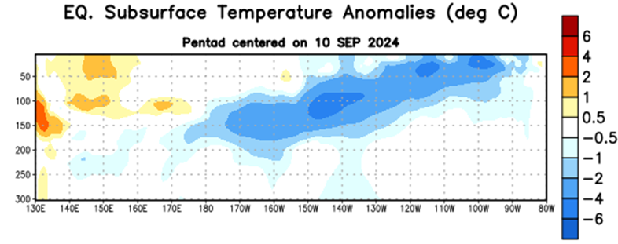
Sub-Surface Temperature Departures in the Equatorial Pacific
Most recent pentad analysis
Is the subsurface cold water content/volume increasing (toward a la Nina event) ?
Is prediction of ENSO event even in the next few months, becoming difficult?

Slide 23
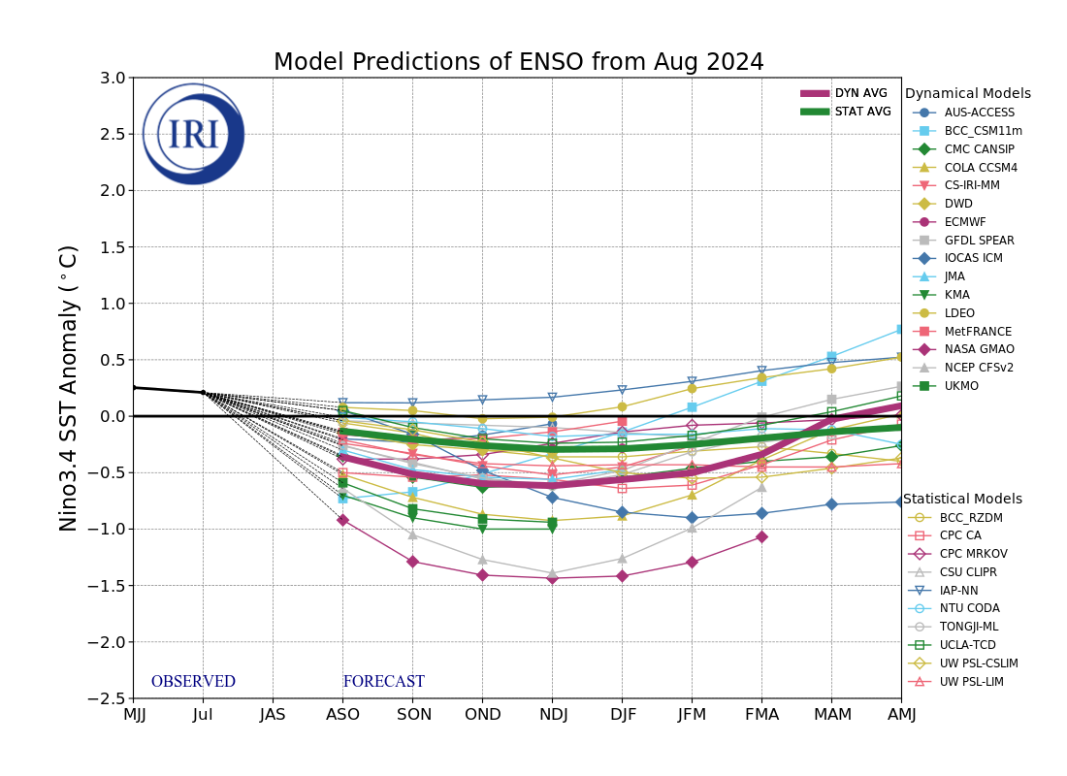
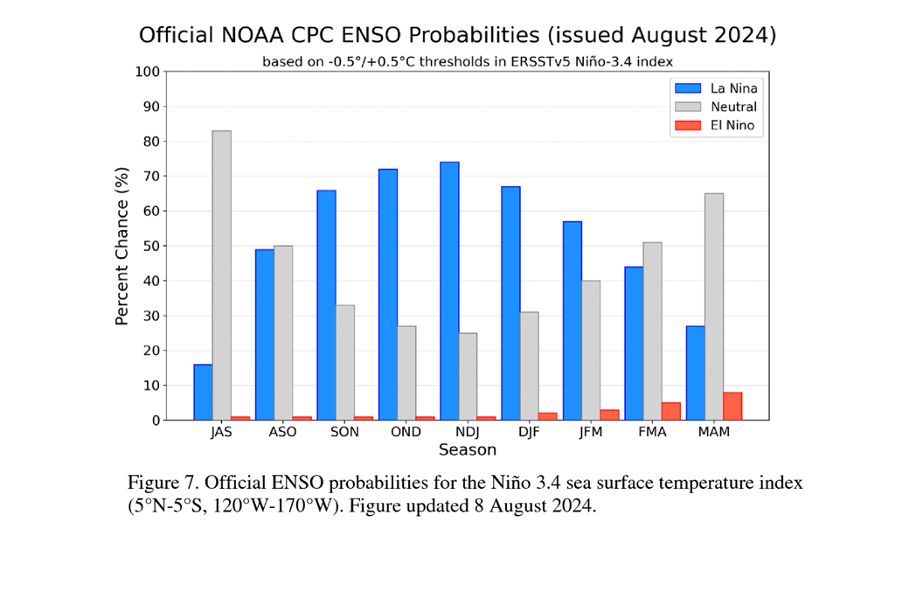
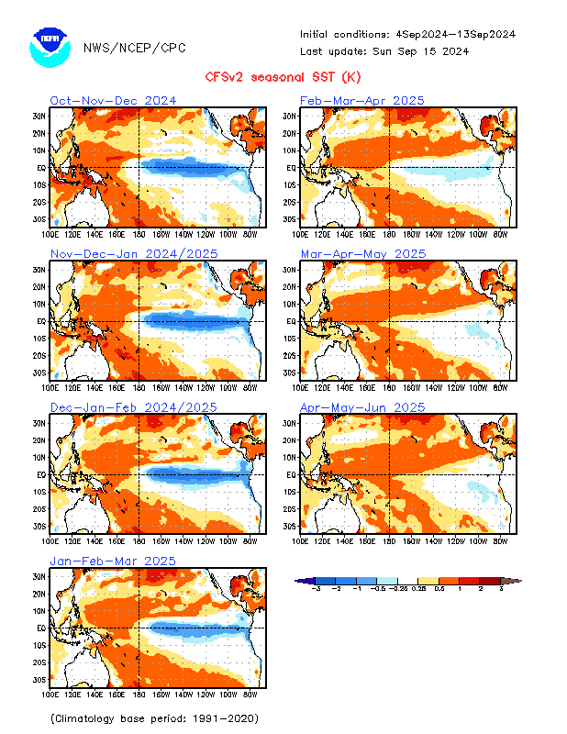
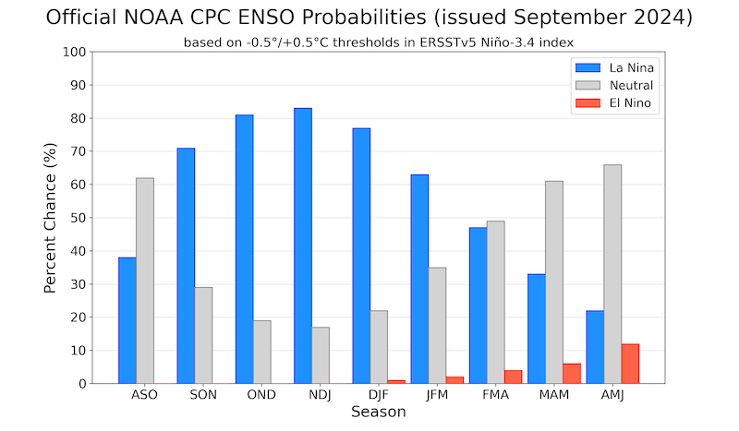
Official ENSO Forecasts
August CPC/NOAA forecast
The majority of models indicate ENSO-neutral will persist through July-September 2024. Thereafter, most models indicate a transition to La Niña around August-October 2024.
A slight pull back or slow down in the developing La Nina ??
September CPC/NOAA forecast
https://www.cpc.ncep.noaa.gov/products/people/wwang/cfsv2fcst/images3/PacSSTSeaadj.gif
Latest ensemble membrs (blue!)show are less bullish

Slide 24
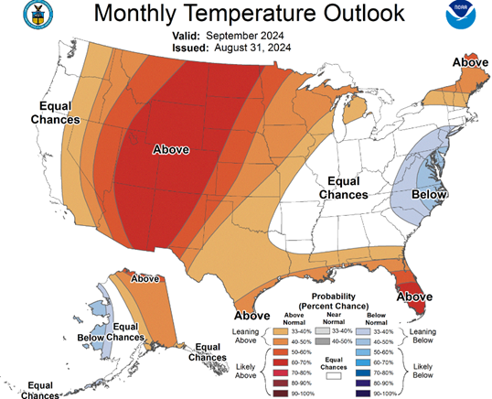
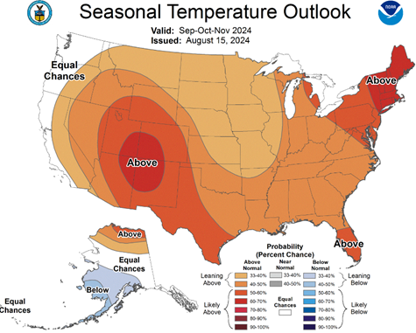
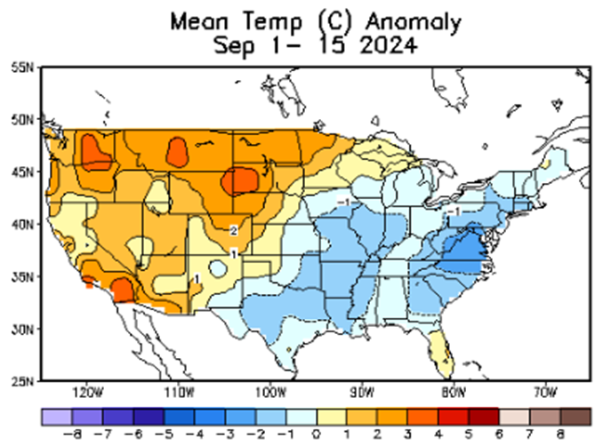
Previous (Last Month’s)
CPC’s official
Temperature OUTLOOK for Monthly (Sep)/Seasonal (SON)
Monthly P/T forecasts verified at mid-month are generally good! Becoz of good skill upto 2 wks.
Released August 15th
Observed so far this month!! ☺

Slide 25
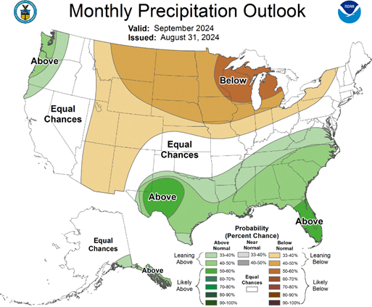
Previous(Last month)
CPC’s official
Precipitation OUTLOOK for Monthly (Sep)/Seasonal (SON)
Released August 15th
Monthly P/T forecasts verified at mid-month are generally good! (??) Becoz of good skill upto 2 wks.
Observed so far this month!! ☺
☹

Slide 26
GEFS
WPC/NCEP’s Next 7 days QPF (Quantitative Precipitation Forecast)
GEFS*/GFS Model Guidance for the next 15 days.
(*new)
GFS

Slide 27
From 3 Models average Precip forecast (made 15 & 16 Sep) for next 30 days.
The 3 Models are: CFSV2, GEFS, ERA5

Slide 28
From 3 Models average Precip forecast (made 15 & 16 Sep) for next 30 days.
20
40

Slide 29
From 3 Models average Precip forecasts (made 15 & 16 Sep) for next 30 days.

Slide 30
From 3 Models average Precip forecasts (made 15 & 16 Sep) for next 30 days.

Slide 31
From 3 Models average Precip forecasts (made 15 & 16 Sep) for next 30 days.

Slide 32
Even thru’ up to 5 years period, the country as a whole looks good, in terms of good rainfall!!! And lower drought coverage!!
From 3 Models average Precip forecasts (made 15 & 16 Sep) for next 30 days.

Slide 33
NMME* T (left) & P (right) Ens.Mean forecasts for
Oct
T
P
OND
Overall, across the US, less than normal rainfall (& above normal T) is forecast by NMME for both the month and season!
More HEAT in the SW!
NMME* : North American Multi Models Ensemble

Slide 34
Agreement/Disagreement among the various NMME models’ OND seasonal Precip. Forecast.
??

Slide 35
BONUS Topic: Discussion continues!! Explanation for the multiyear DROUGHT in the Southwest (CA/AZ/NM/NV/UT/CO & vicinity)!!
More La Nina’s lately ?
More frequent La Ninas lately ?
YES!! The stats in the table below (bottom left) are from the Official CPC ENSO declarations page/table!
(SKIP)
slide
Compared to other regions of the globe, the SST warming/trend in the central eq. Pacific (Nino 3.4) is relatively much small. (See Fig. above) – Why is this ?
Does nature try to compensate for the warming else/everywhere by producing more La Ninas in the equatorial Pacific? - Just my observation from data! Let’s check !!!
Since the 1997 monster El Nino (stronger than the famous 1982/83 event), just a quick count of CPC’s Nino 3.4 index++ values for the three month overlapping seasons, (Data at CPC site only available only from 1950!)
(27 years) (47 years) (74 years)
1997-2023 1950-1996 1950-2023
La Nina(DJF) 13 16 29
El Nino(DJF) 9 17 26
La Nina(all 3mos) 119 150 269
El Nino(all 3mos) 85 166 250
(Overlapping 3month seasons)
Look at Ratios of La Ninas (vs El Ninos) in the shorter
recent (27 yr) period vs the longer (47 yr) earlier period!!
Compare the ratios of La Nina to El Nino in the squared boxes.
***Analysis of CPC’s official Nino 3.4 index data over the last 70 years shows that the more frequent La Ninas in recent decades contributed to less rainfall in the southwest (See La Nina precip composites!, slide#13) and hence the ongoing long term drought in the Southwest!! Hence the long term southwest drought is unlikely to go away any time soon***
++ Barnston, Chelliah and Goldenberg (1997):Documentation of a highly ENSO‐related SST region in the equatorial pacific, Atmosphere-Ocean Volume 35, 1997. https://doi.org/10.1080/07055900.1997.9649597
*** The strong/weak annual monsoon rains in the southwest is a minor modulator riding on this bigger/longer-term signal. ***

Slide 36
Summary
Current Drought conditions:
California for the most part, has remained drought free for about twenty months now luckily due to above normal rainfall during both recent 2022/23 (La Nina, strange!) and 2023/24 (El Nino, canonical!) winter rainfall seasons. Water levels in almost all CA reservoirs are now at or well above their normal levels. However, the water storage levels in the much bigger lakes, Lake Powell and Lake Mead in NV/AZ still continue to be very low, and have not recovered completely from the 2+ decades(since ~2000) long hydrological drought.
The S/L term drought in the interior Pacific Northwest and in parts of WA, OR, ID, MT & WY is still stubbornly persisting, or even worsened!. But drought in MN/IA/WI/ MO/NE is almost or nearly gone.
Earlier, five/six months ago, we had suggested/projected over the past few months that the overall drought situation across the entire US will improve slowly and steadily, and it actually happened. Having reached the “near bottom” for the % of US areas covered under drought three months ago, we again suggested a possible uptick/increase in drought area coverage over the next few months (mainly in the western US!) & it is slowly happening! However, the recent development drought in the eastern US up & down Ohio valley was quick! Is this temporary or will it last longer?
Since early summer, questions still remain about when the La Nina will actually develop and how strong it will be! Our mantra lately has been, that a lot depends on when the La Nina will finally develop and how strong will it be?
Large parts of NV/UT/AZ/NM and western TX are still dry or under drought due to long term/decadal drought in the SW, as well as the poor SW monsoon this past year (2023).
So far, the behavior of the monsoon in the US southwest is spatially very uncharacteristic. Another 2024 poor SW monsoon in the overall region even make the current dry conditions or drought in the region worse. We still postulate that the drought in the west/central US is a bit more ominous than the temporary flash dryness in the east. The quick emergence of temporary dry conditions in southern VA, the Carolinas during July faded away as quickly as it appeared. However drought conditions in the western MD, western VA, WV and OH is staying stubborn.
Current ENSO status and forecast: La Niña is favored to emerge in September-November (71% chance) and is expected to persist through January-March 2025.
Prediction: The actual development of the expected La Nina keeps getting delayed since early summer. During the upcoming OND forecast season, La Nina is forecast to develop, again very tricky, in terms of possibly expecting any canonical La Nina impacts Nevertheless, the models, as if anticipating a La Nina, are somewhat consistent in forecasting generally below normal precip across much of the United States except possibly in the Pacific NW, in some coastal regions of CA, and in parts of OH, and vicinity.
The OND forecast season includes December, the beginning of the rainy winter season along the Pacific west coast states, and possible early winter rains in November. At least from the climatological perspective, this will help the existing drought in those northern regions and may act against any drought development or conditions getting any worse.
Existing Drought conditions in the southwestern US, particularly around the four corner states and western TX, KS and OK will likely persist. Both the climatology and the NMME forecast of T & P favor continued (existing) drought conditions in the region.
Again the key, is in the timing and development of La Nina, as well as its strength. Given the canonical La Nina impacts, and the NMME model forecasts, it is unlikely that the upcoming forecast season will see much improvement in the existing drought conditions except along the west coast. The southern tier states, and the Ohio valley is the challenge, where not much improvement is likely, if not the conditions possibly getting drought development. The coastal eastern US will likely remain drought free. We expect further uptick/increase in the overall % area of US covered by some level of drought by the end of the OND forecast season. *****

