Slide 1
The African Monsoon Recent Evolution and Current Status Include Week-1 and Week-2 Outlooks
Update prepared by
Climate Prediction Center / NCEP
29 April 2019
For more information, visit:
http://www.cpc.ncep.noaa.gov/products/Global_Monsoons/African_Monsoons/precip_monitoring.shtml

Slide 2
Outline
Highlights
Recent Evolution and Current Conditions
NCEP GEFS Forecasts
Summary

Slide 3
Highlights: Last 7 Days
Weekly rainfall surpluses, associated with tropical cyclone Kenneth, exceeded 200mm over parts of northeastern Mozambique.
Below-average rainfall prevailed over portions of Central Africa.
Week-1 outlooks call for an increased chance for above-average rainfall over parts DRC, Burundi, southeastern Tanzania, and parts of northern Mozambique. In contrast, there is an increased chance for below-average rainfall over southern Nigeria, portions of Ethiopia, southern Somalia and Kenya.

Slide 4
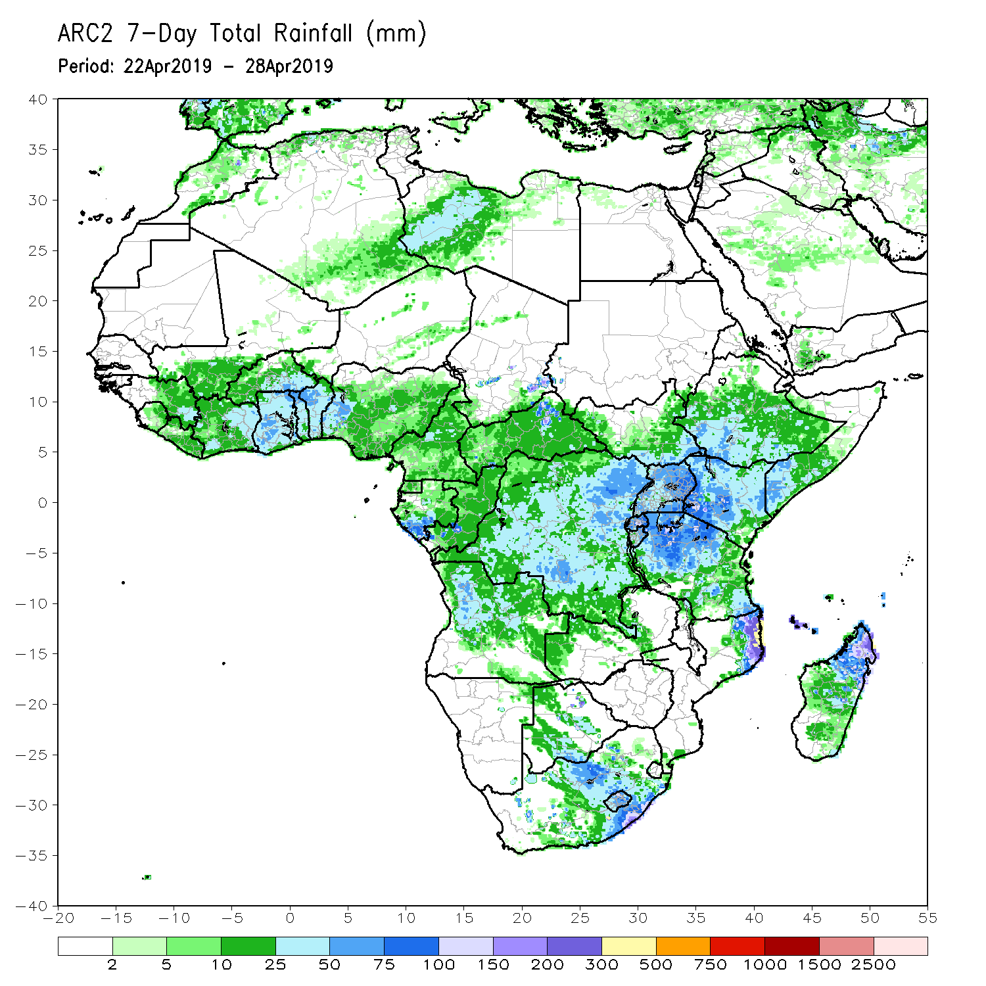
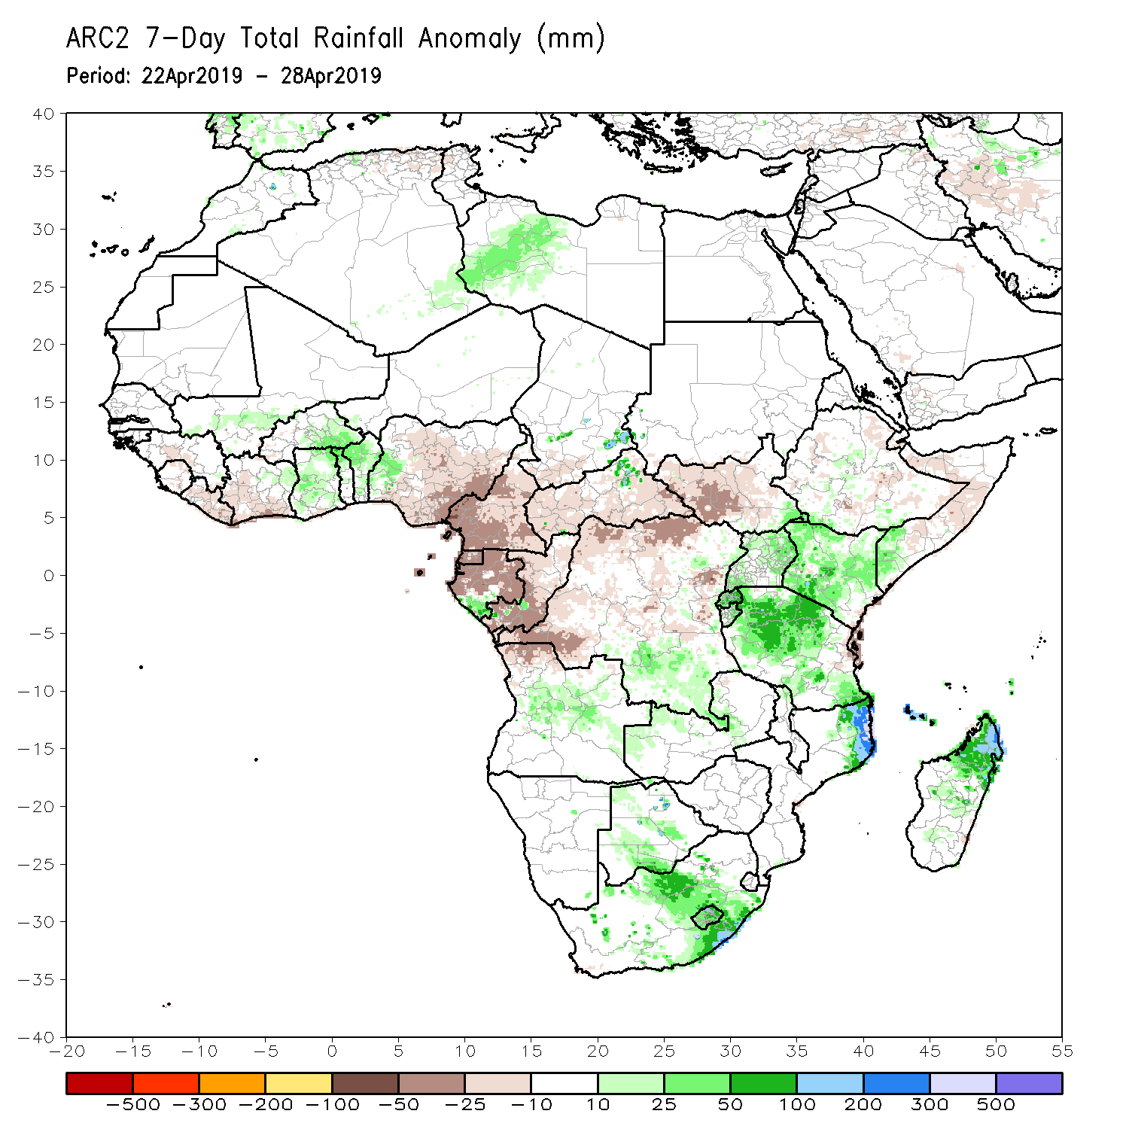
Rainfall Patterns: Last 7 Days
Weekly rainfall surpluses, associated with tropical cyclone Kenneth, exceeded 200mm over parts of northeastern Mozambique.
Rainfall was above-average over parts of Mali, Burkina Faso, Togo, Benin, western Nigeria, Angola, Uganda, Kenya, parts of southern Somalia, southern DRC, Tanzania, northeastern Mozambique, Botswana, South Africa, and northern Madagascar.
Below-average rainfall was observed over portions of Guinea, Sierra Leone, Liberia, Cote d’Ivoire, portions of Nigeria, Cameroon, Equatorial Guinea, Gabon, Congo-Brazzaville, portions of DRC, South Sudan, and local areas in Ethiopia and Somalia.

Slide 5
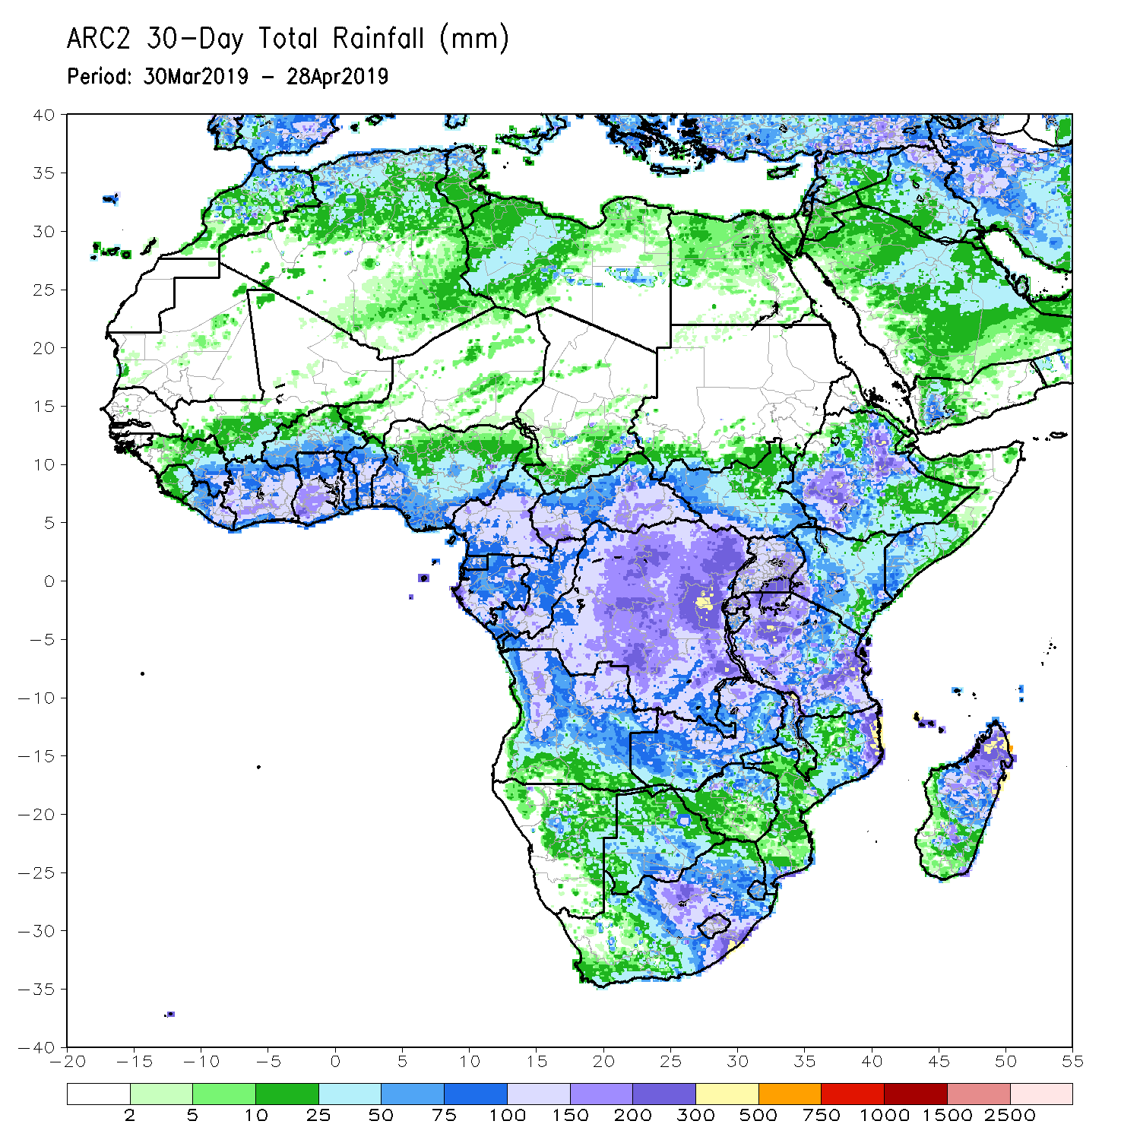
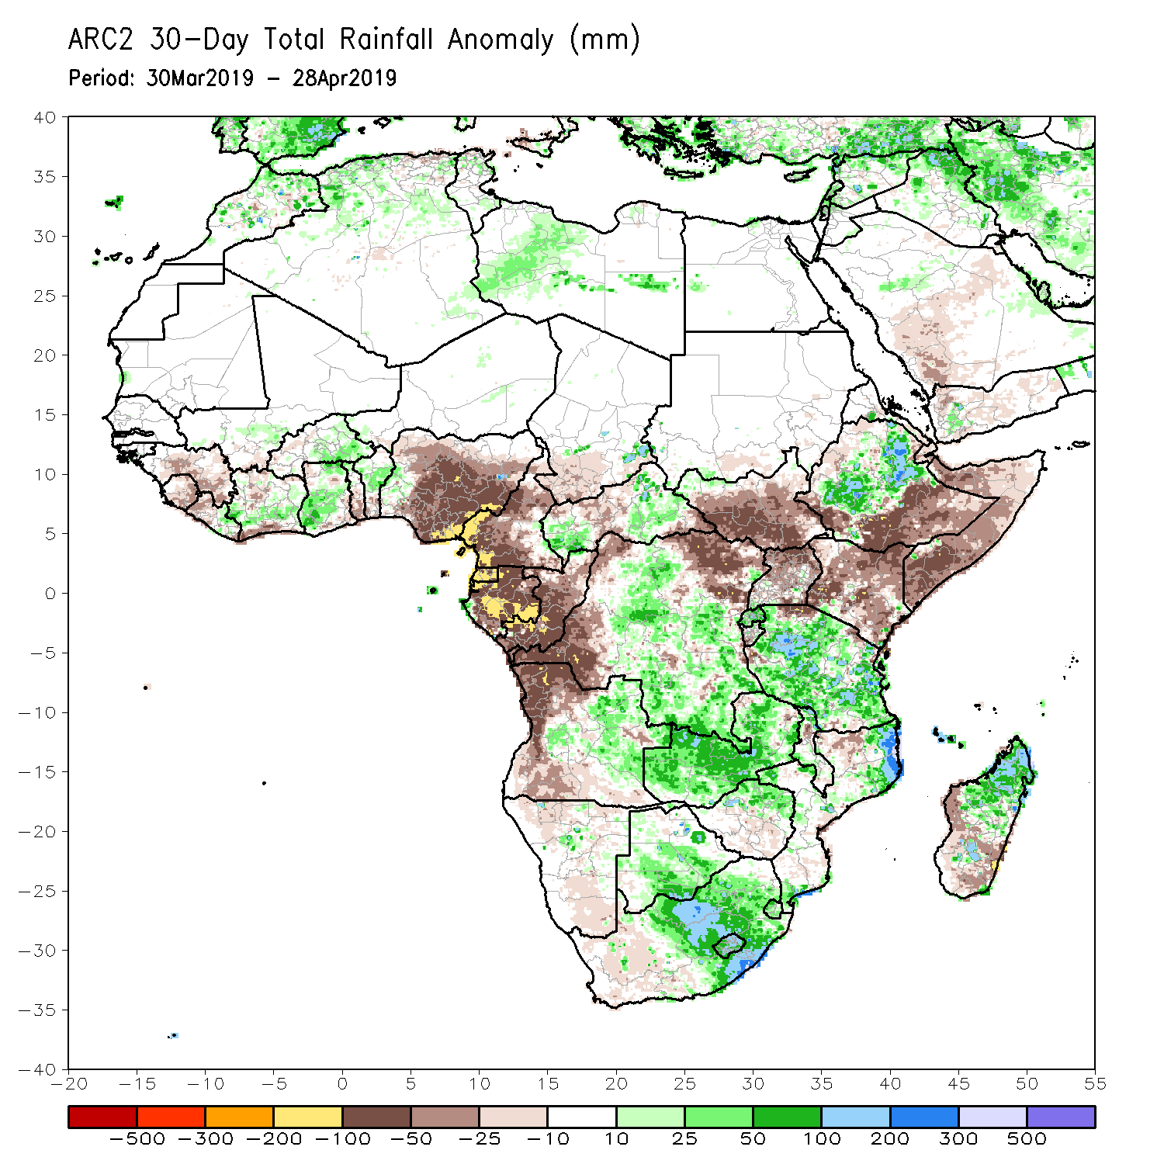
Rainfall Patterns: Last 30 Days
During the past 30 days, rainfall was above-average over parts of Cote d’Ivoire, Burkina Faso, Ghana, local areas in Nigeria, portions of CAR, DRC, central and northern Ethiopia, many parts of Tanzania, Zambia, northern Mozambique, portions of Angola, Botswana, northern Zimbabwe, South Africa, and portions of Madagascar.
Below-average rainfall was observed over Guinea, Sierra Leone, local areas in Cote d’Ivoire, Nigeria, Cameroon, Equatorial Guinea, Gabon, Congo, western and northern DRC, western and southern Angola, local areas in CAR, South Sudan, southern and southeastern Ethiopia, Somalia, and local areas in Mozambique and Madagascar.
Notes:
5

Slide 6
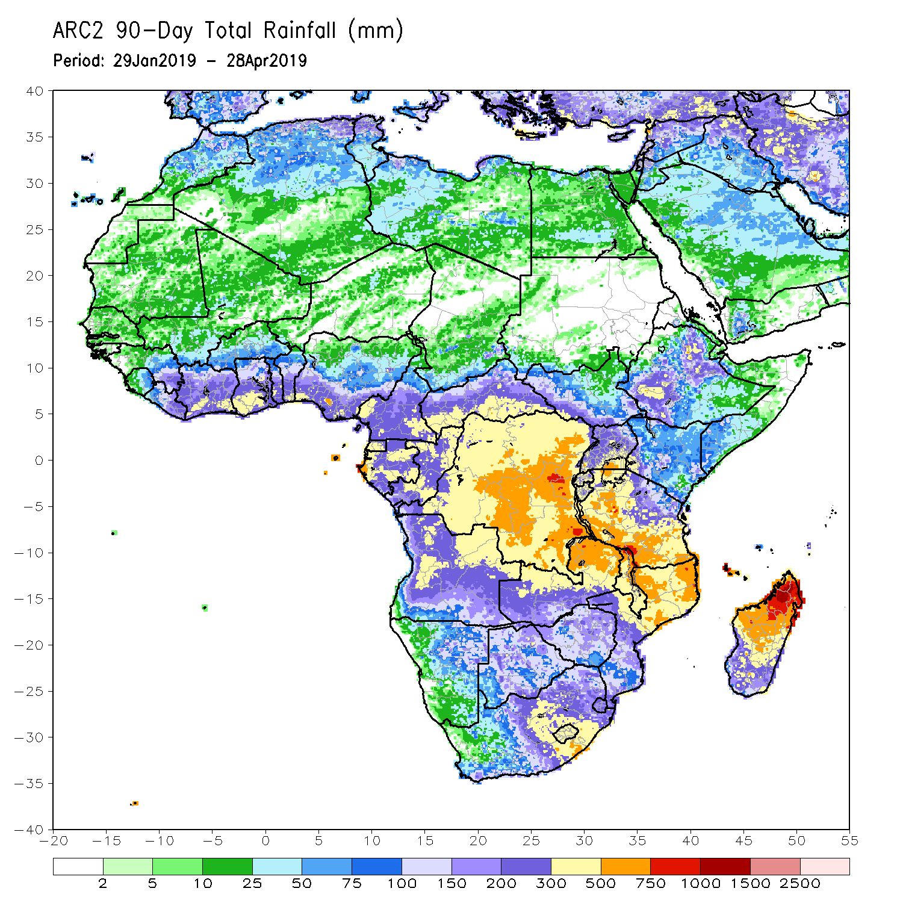
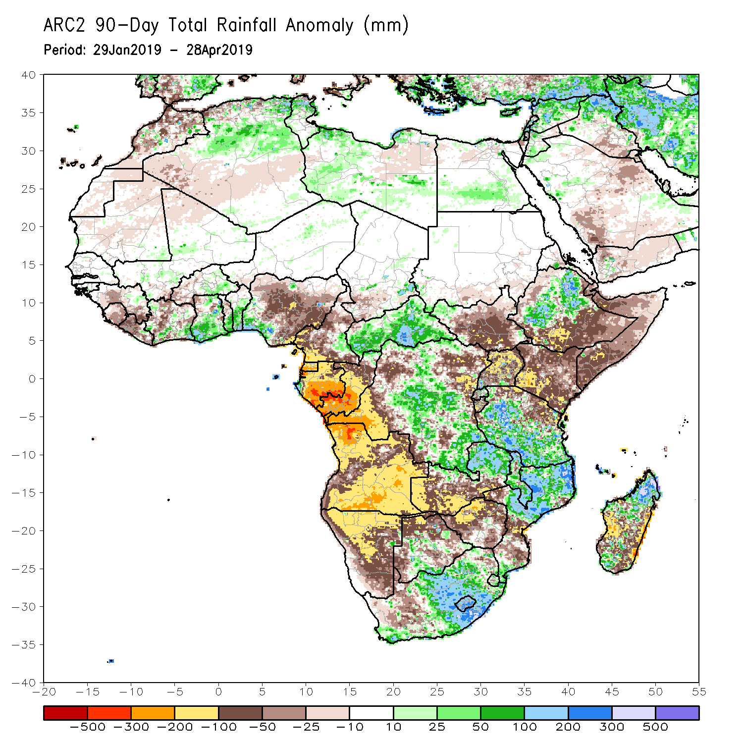
Rainfall Patterns: Last 90 Days
During the past 90 days, rainfall was above-average over local areas in Cote d’Ivoire, Ghana, Togo, Benin, eastern Cameroon, CAR, many parts of DRC, local areas in South Sudan, portions of Ethiopia, Tanzania, northern and eastern Zambia, Malawi, local areas in Botswana, portions of South Africa, Malawi, northern Mozambique, and portions of Madagascar.
Portions of Guinea, Sierra Leone, Liberia, parts of Cote d’Ivoire, Nigeria, Cameroon, Equatorial Guinea, Gabon, Congo, Angola, parts of DRC, Namibia, parts of Botswana, western South Africa, South Sudan, southeastern Ethiopia, Kenya, Somalia, western and southern Zambia, Zimbabwe, southern Mozambique, and parts of Madagascar had below-average rainfall.
Notes:
6

Slide 7
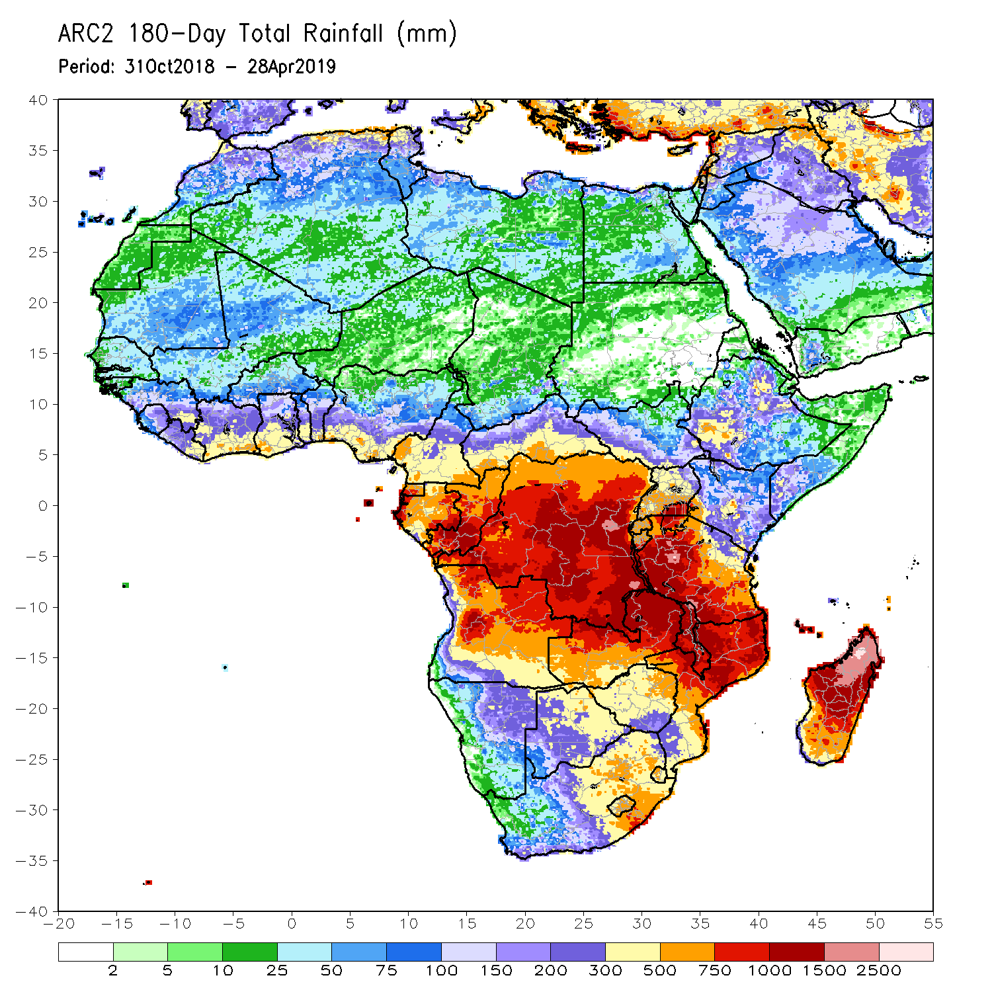
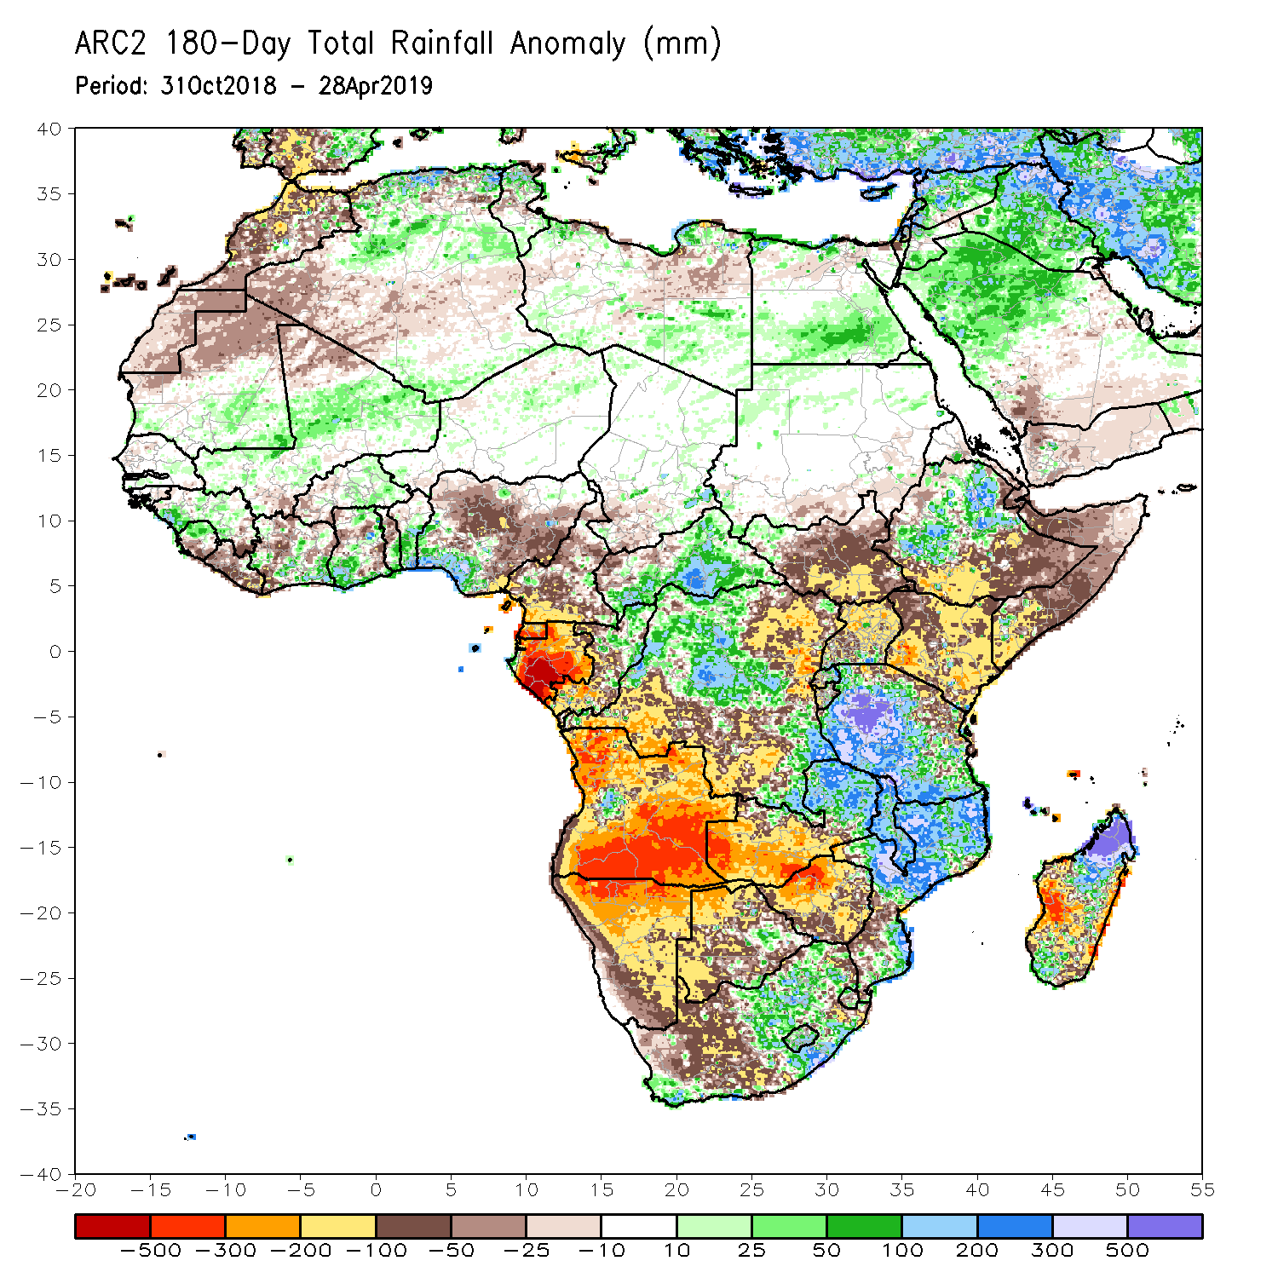
Rainfall Patterns: Last 180 Days
During the past 180 days, rainfall was above-average over parts of Mali, Guinea, Sierra Leone, parts of Cote d’Ivoire and Ghana, Burkina Faso, Togo, Benin, southern Nigeria, many parts of CAR, portions of DRC, local areas in western South Sudan, portions of Ethiopia, many parts of Tanzania, local areas in Congo-Brazzaville, parts of South Africa, eastern Zambia, Malawi, many parts of Mozambique, and portions of Madagascar.
Below-average rainfall was observed over much of Liberia, local areas in Cote d’Ivoire and Ghana, parts of Nigeria and Cameroon, Equatorial Guinea, Gabon, eastern and southern DRC, many parts of South Sudan, southern Ethiopia, Somalia, Uganda, Kenya, many parts of Angola and Namibia, western Zambia, many parts of Botswana, Zimbabwe, western South Africa, local areas in Mozambique, and portions of Madagascar.
Notes:
7

Slide 8
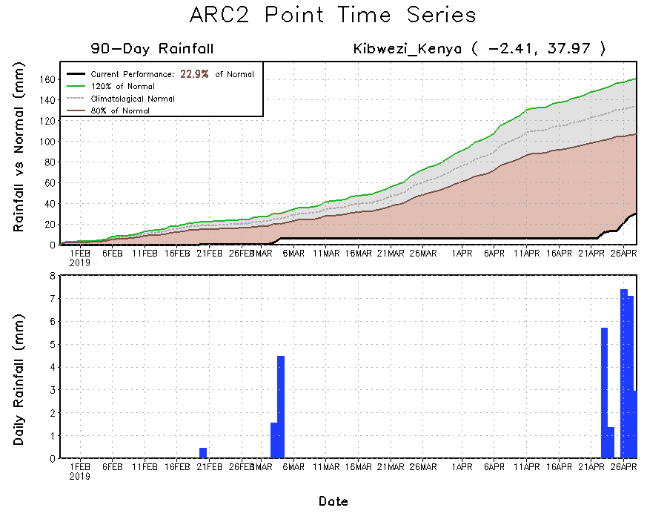
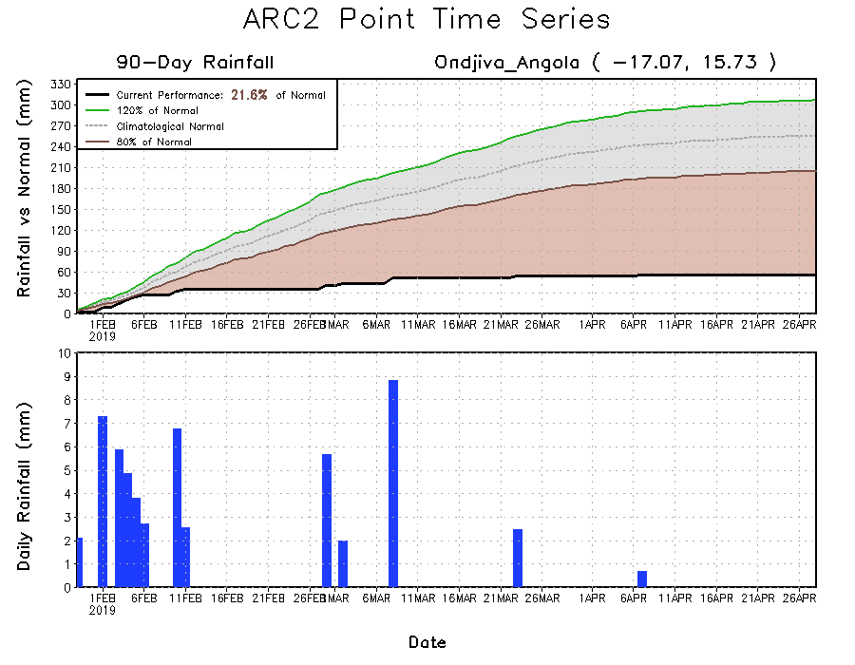
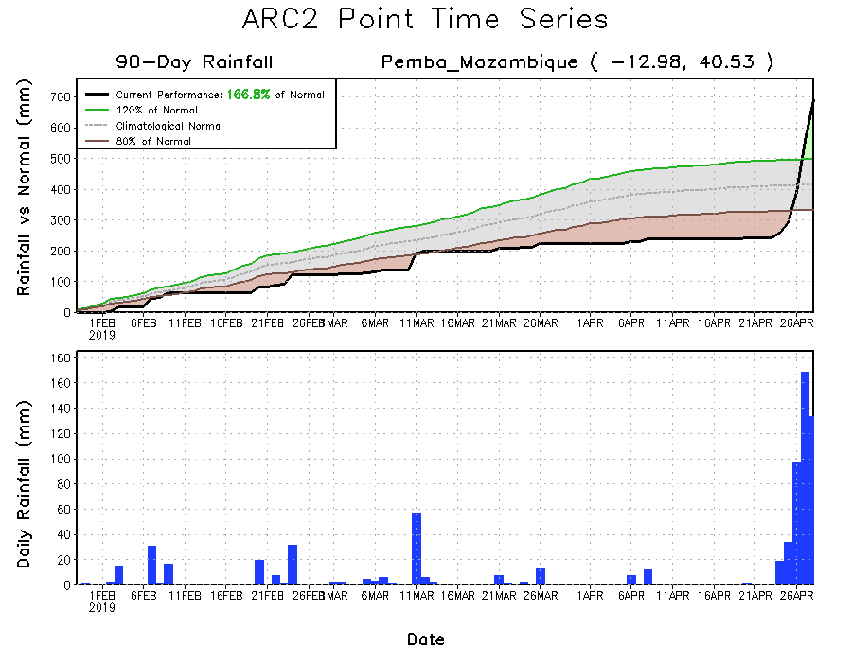
Recent Rainfall Evolution
Daily evolution of rainfall over the last 90 days at selected locations shows that seasonal total rainfall remained below-average over southern Angola (bottom left) and parts of Kenya (top right). In contrast, very heavy rainfall was observed over northeastern Mozambique due to landfall of tropical cyclone Kenneth (bottom right).

Slide 9
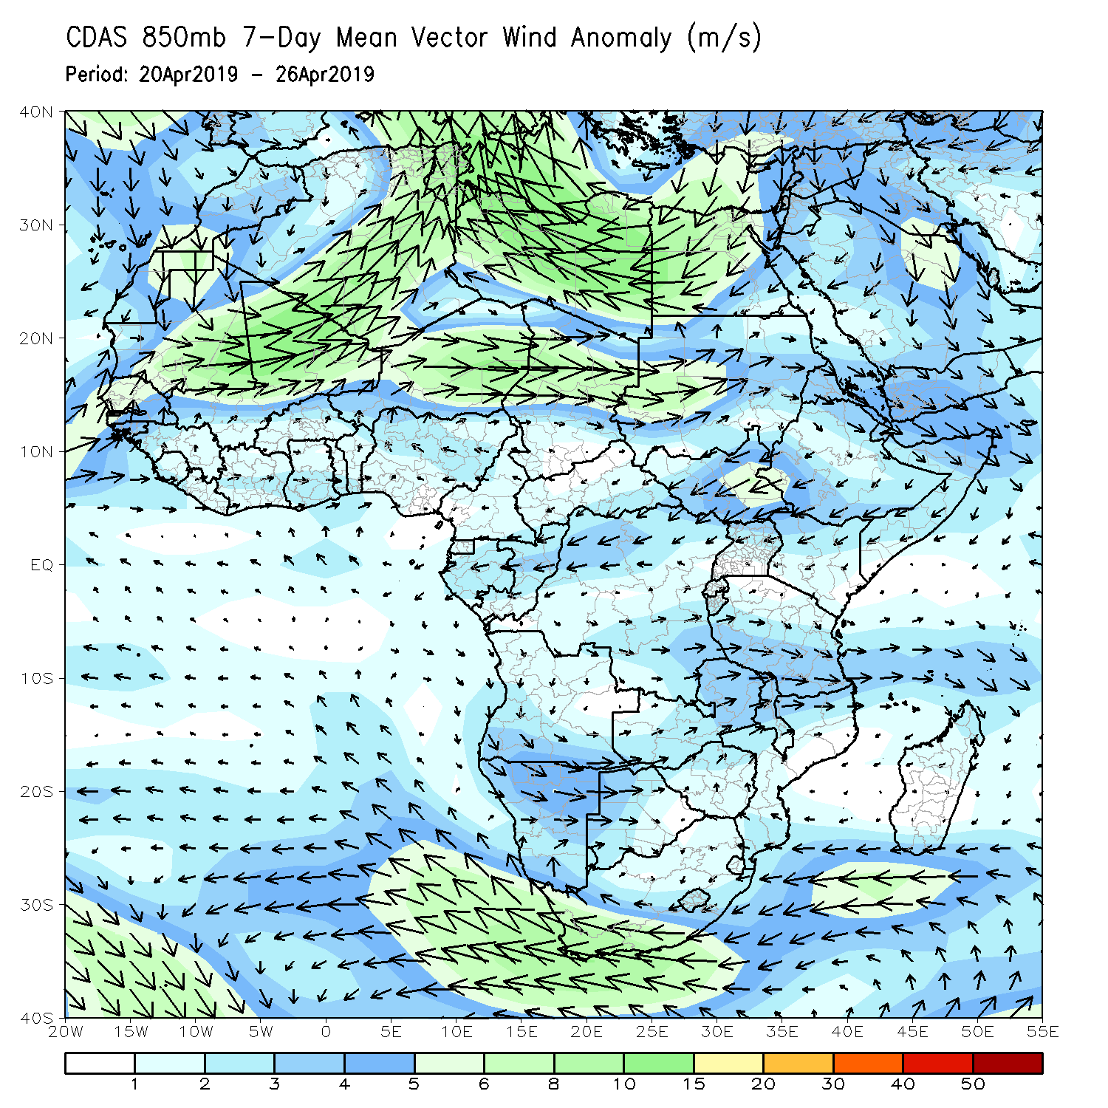
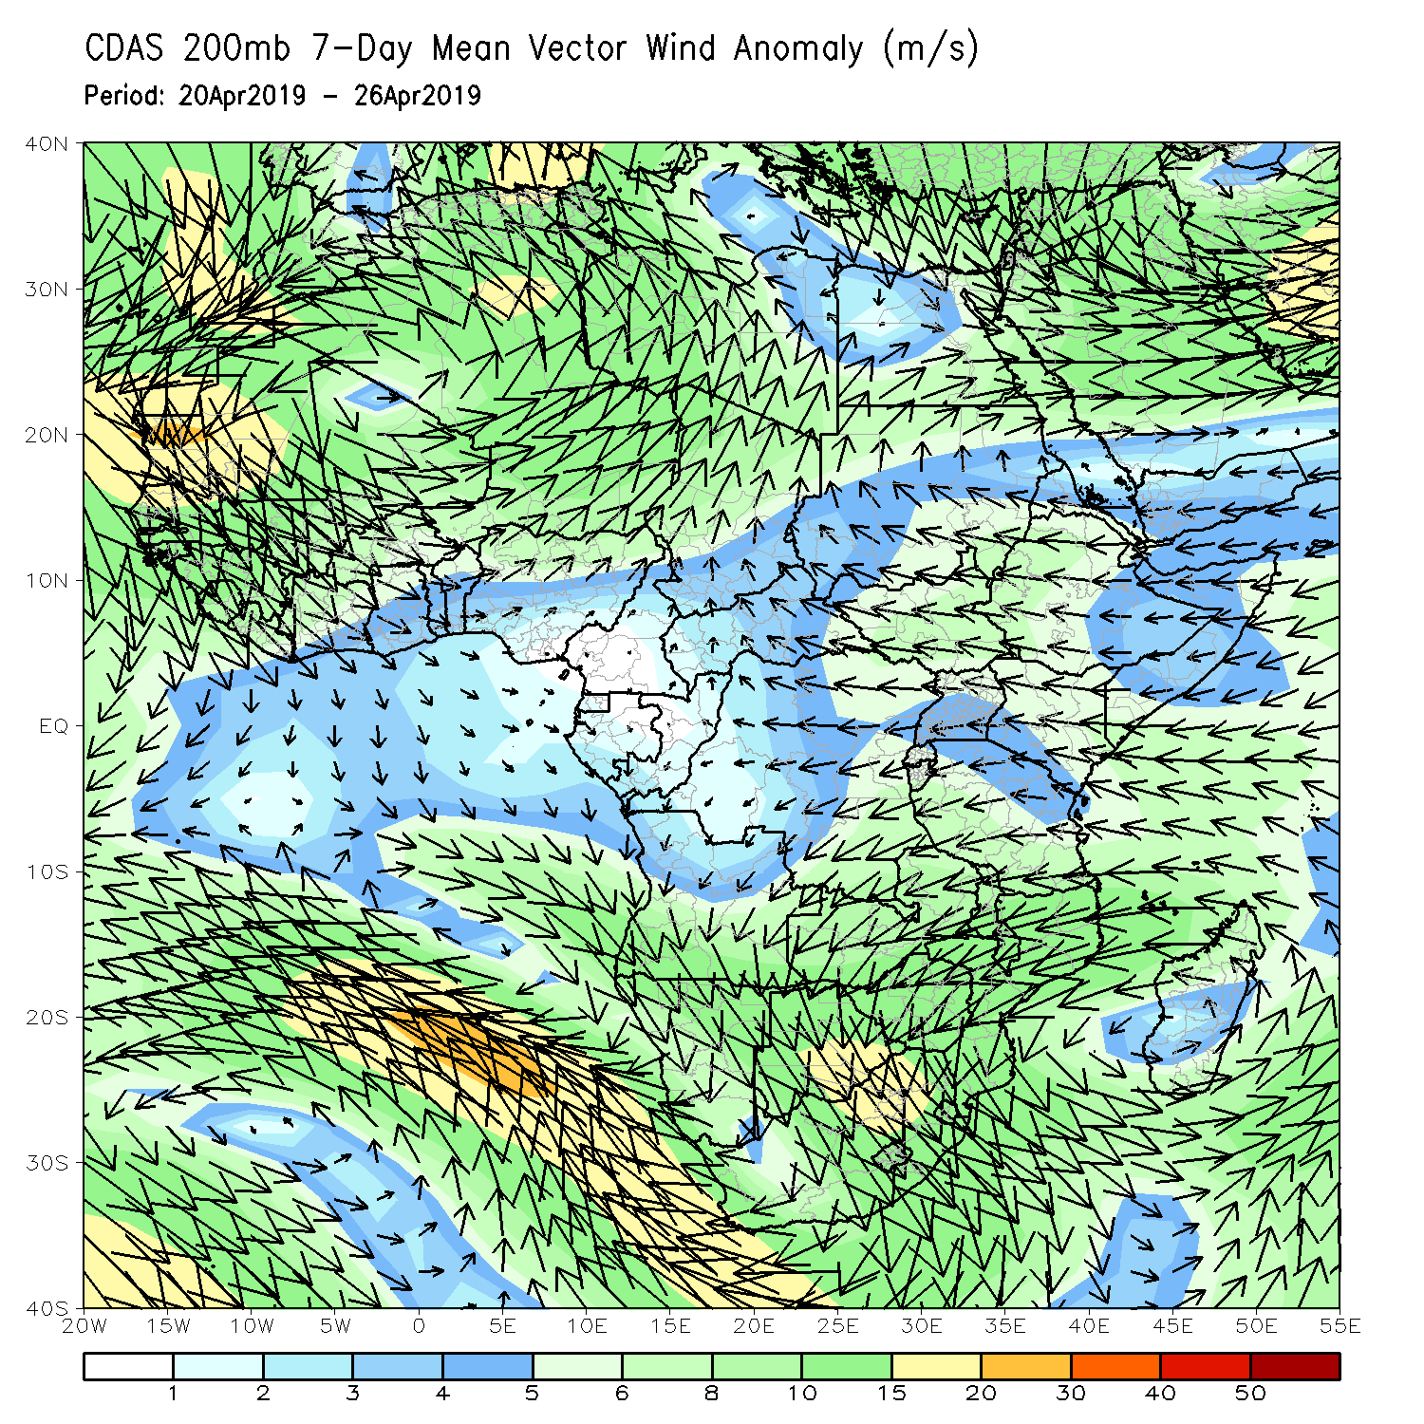
Atmospheric Circulation: Last 7 Days
An area of anomalous lower-level cyclonic and upper-level anti-cyclonic circulation was observed in the Mozambique Channel, associated with tropical cyclone Kenneth..

Slide 10
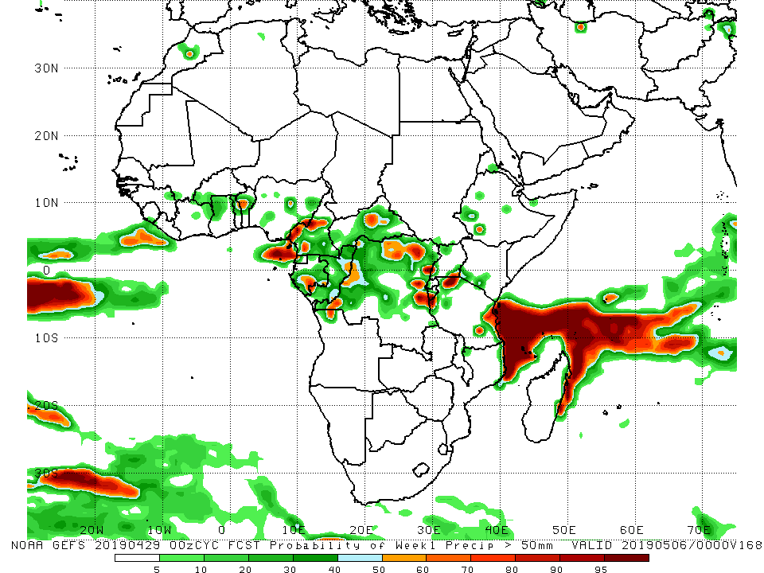
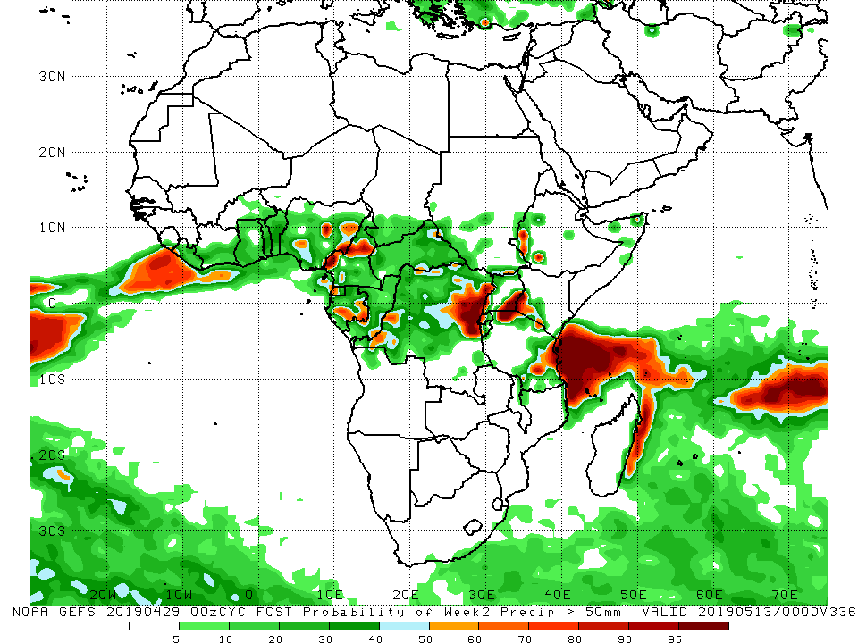
NCEP GEFS Model Forecasts Non-Bias Corrected Probability of precipitation exceedance
Week-1: Valid April 30 – May 6, 2019
Week-2: Valid 7 – 13 May, 2019
For week-1 (left panel), there is an increased chance for weekly rainfall totals to exceed 50 mm over local areas in Benin, Cameroon, CAR, Gabon, DRC, and Tanzania.
For week-2 (right panel), there is an increased chance for weekly rainfall totals to exceed 50 mm over Parts of Nigeria, Cameroon, Gabon, DRC, southwestern Ethiopia, southeastern Uganda, southwestern Kenya, and southeastern Tanzania.
Notes:
10

Slide 11
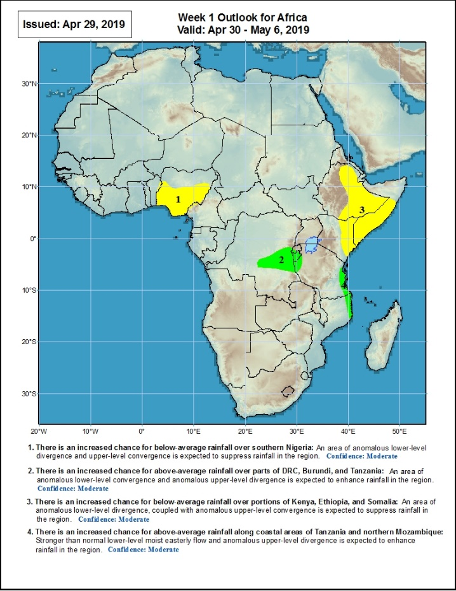
Week-1 Precipitation Outlooks
April 30 – May 6, 2019
There is an increased chance for below-average rainfall over southern Nigeria: An area of anomalous lower-level divergence and upper-level convergence is expected to suppress rainfall in the region. Confidence: Moderate
There is an increased chance for above-average rainfall over parts of DRC, Burundi, and Tanzania: An area of anomalous lower-level convergence and upper-level divergence is expected to enhance rainfall in the region. Confidence: Moderate
There is an increased chance for below-average rainfall over portions of Kenya, Ethiopia, and Somalia: An area of anomalous lower-level divergence and upper-level convergence is expected to suppress rainfall in the region. Confidence: Moderate
There is an increased chance for above-average rainfall along coastal areas of Tanzania and northern Mozambique: Anomalous lower-level onshore flow coupled with anomalous upper-level divergence is expected to enhance rainfall in the region.
Notes:
11

Slide 12
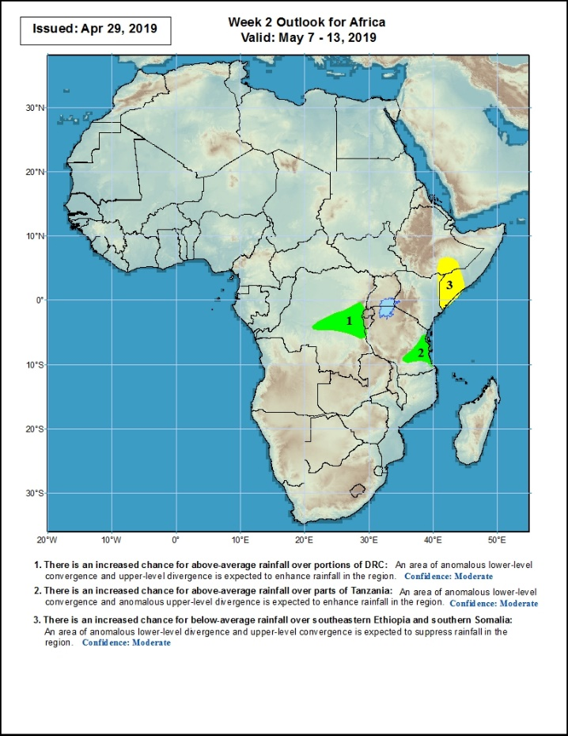
Week-2 Precipitation Outlooks
7 – 13 May, 2019
There is an increased chance for above-average rainfall over portions of DRC: An area of anomalous lower-level convergence and upper-level divergence is expected to enhance rainfall in the region. Confidence: Moderate
There is an increased chance for above-average rainfall over parts of Tanzania: An area of anomalous lower-level convergence and upper-level divergence is expected to enhance rainfall in the region. Confidence: Moderate
There is an increased chance for below-average rainfall over southeastern Ethiopia and southern Somalia: An area of anomalous lower-level divergence and upper-level convergence is expected to suppress rainfall in the region.
Notes:
12

Slide 13
Summary
Weekly rainfall surpluses, associated with tropical cyclone Kenneth, exceeded 200mm over parts of northeastern Mozambique. Rainfall was above-average over parts of Mali, Burkina Faso, Togo, Benin, western Nigeria, Angola, Uganda, Kenya, parts of southern Somalia, southern DRC, Tanzania, northeastern Mozambique, Botswana, South Africa, and northern Madagascar. Below-average rainfall was observed over portions of Guinea, Sierra Leone, Liberia, Cote d’Ivoire, portions of Nigeria, Cameroon, Equatorial Guinea, Gabon, Congo-Brazzaville, portions of DRC, South Sudan, and local areas in Ethiopia and Somalia.
During the past 30 days, rainfall was above-average over parts of Cote d’Ivoire, Burkina Faso, Ghana, local areas in Nigeria, portions of CAR, DRC, central and northern Ethiopia, many parts of Tanzania, Zambia, northern Mozambique, portions of Angola, Botswana, northern Zimbabwe, South Africa, and portions of Madagascar. Below-average rainfall was observed over Guinea, Sierra Leone, local areas in Cote d’Ivoire, Nigeria, Cameroon, Equatorial Guinea, Gabon, Congo, western and northern DRC, western and southern Angola, local areas in CAR, South Sudan, southern and southeastern Ethiopia, Somalia, and local areas in Mozambique and Madagascar.
During the past 90 days, rainfall was above-average over local areas in Cote d’Ivoire, Ghana, Togo, Benin, eastern Cameroon, CAR, many parts of DRC, local areas in South Sudan, portions of Ethiopia, Tanzania, northern and eastern Zambia, Malawi, local areas in Botswana, portions of South Africa, Malawi, northern Mozambique, and portions of Madagascar. Portions of Guinea, Sierra Leone, Liberia, parts of Cote d’Ivoire, Nigeria, Cameroon, Equatorial Guinea, Gabon, Congo, Angola, parts of DRC, Namibia, parts of Botswana, western South Africa, South Sudan, southeastern Ethiopia, Kenya, Somalia, western and southern Zambia, Zimbabwe, southern Mozambique, and parts of Madagascar had below-average rainfall.
Week-1 outlooks call for an increased chance for above-average rainfall over parts DRC, Burundi, southeastern Tanzania, and parts of northern Mozambique. In contrast, there is an increased chance for below-average rainfall over southern Nigeria, portions of Ethiopia, southern Somalia and Kenya.
Notes:
13

