Slide 1
The African Monsoon Recent Evolution and Current Status Include Week-1 and Week-2 Outlooks
Update prepared by
Climate Prediction Center / NCEP
26 August 2019
For more information, visit:
http://www.cpc.ncep.noaa.gov/products/Global_Monsoons/African_Monsoons/precip_monitoring.shtml

Slide 2
Outline
Highlights
Recent Evolution and Current Conditions
NCEP GEFS Forecasts
Summary

Slide 3
Highlights: Last 7 Days
Above-average rainfall was observed over many places in West and Central Africa, and portions of the Greater Horn of Africa.
Weekly rainfall totals exceeded 150mm over local areas in Senegal, Guinea, Mali, Burkina Faso, Cote d’Ivoire, Nigeria, Cameroon and Ethiopia.
Week-1 outlooks call for an increased chance for above-average rainfall over Senegal, Gambia, Guinea-Bissau, Guinea, Sierra Leone, western Liberia, southwestern Mali, eastern Chad, western Sudan, northeastern DRC, southern South Sudan and western Uganda. In contrast, there is an increased chance for below-average rainfall over parts of central and eastern Sudan.

Slide 4
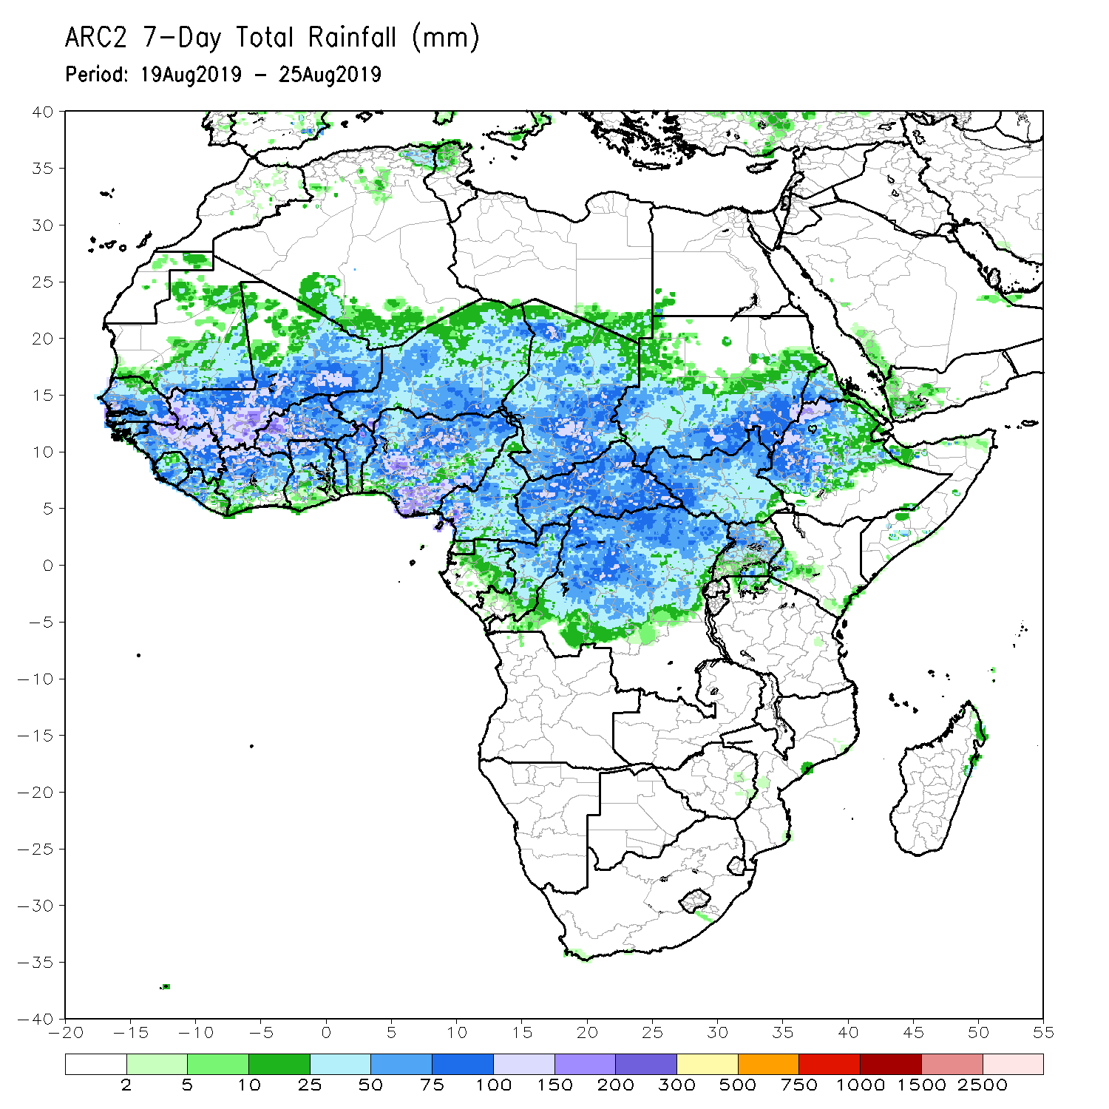
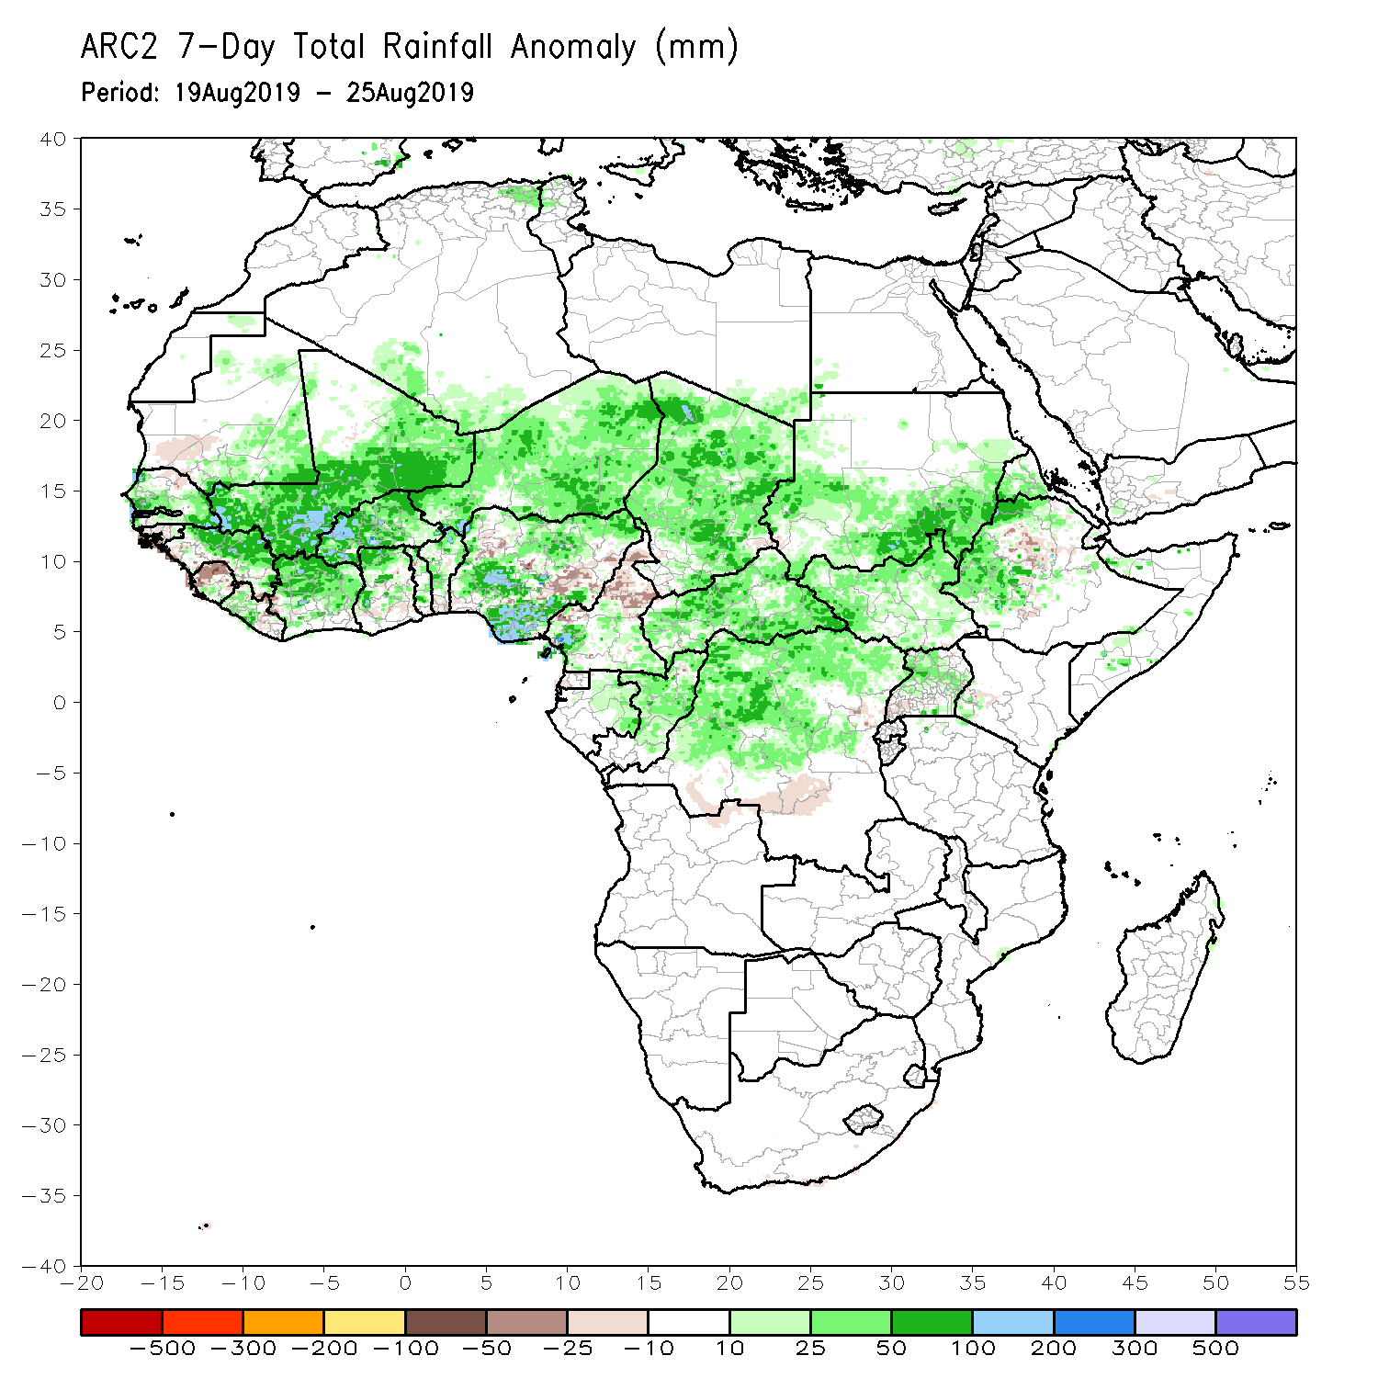
Rainfall Patterns: Last 7 Days
During the past 7 days, many places in West and Central Africa received above-average rainfall. Rainfall was also above-average over portions of Sudan and South Sudan, parts of Uganda and Ethiopia, and local areas in Kenya, and Somalia. Weekly rainfall totals exceeded 150mm over local areas in Senegal, Guinea, Mali, Burkina Faso, Cote d’Ivoire, Nigeria, Cameroon and Ethiopia.
Rainfall was below-average over southwestern Mauritania, parts of Sierra Leone, Nigeria, northern Cameroon, parts of southern Chad, and parts of DRC and Ethiopia.

Slide 5
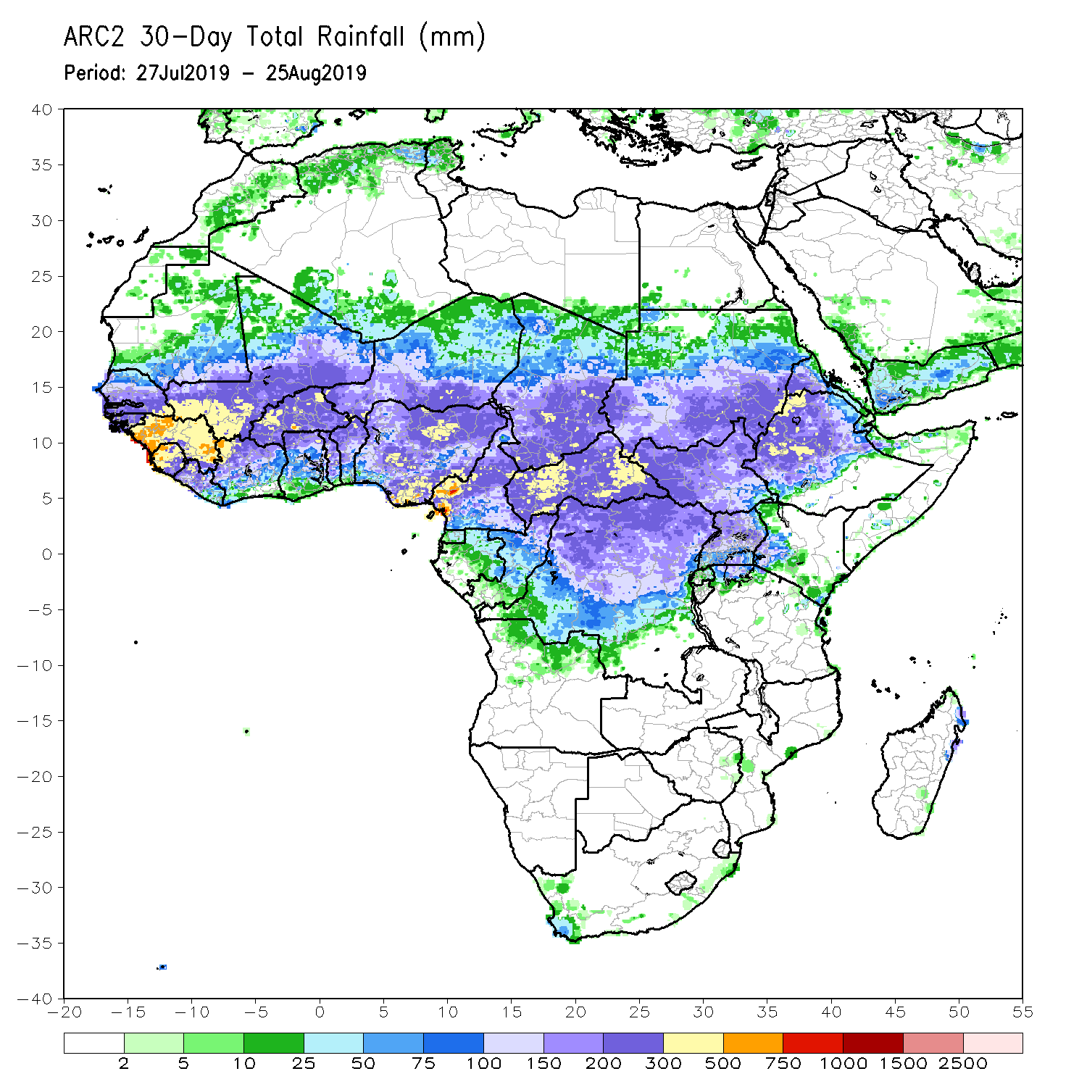
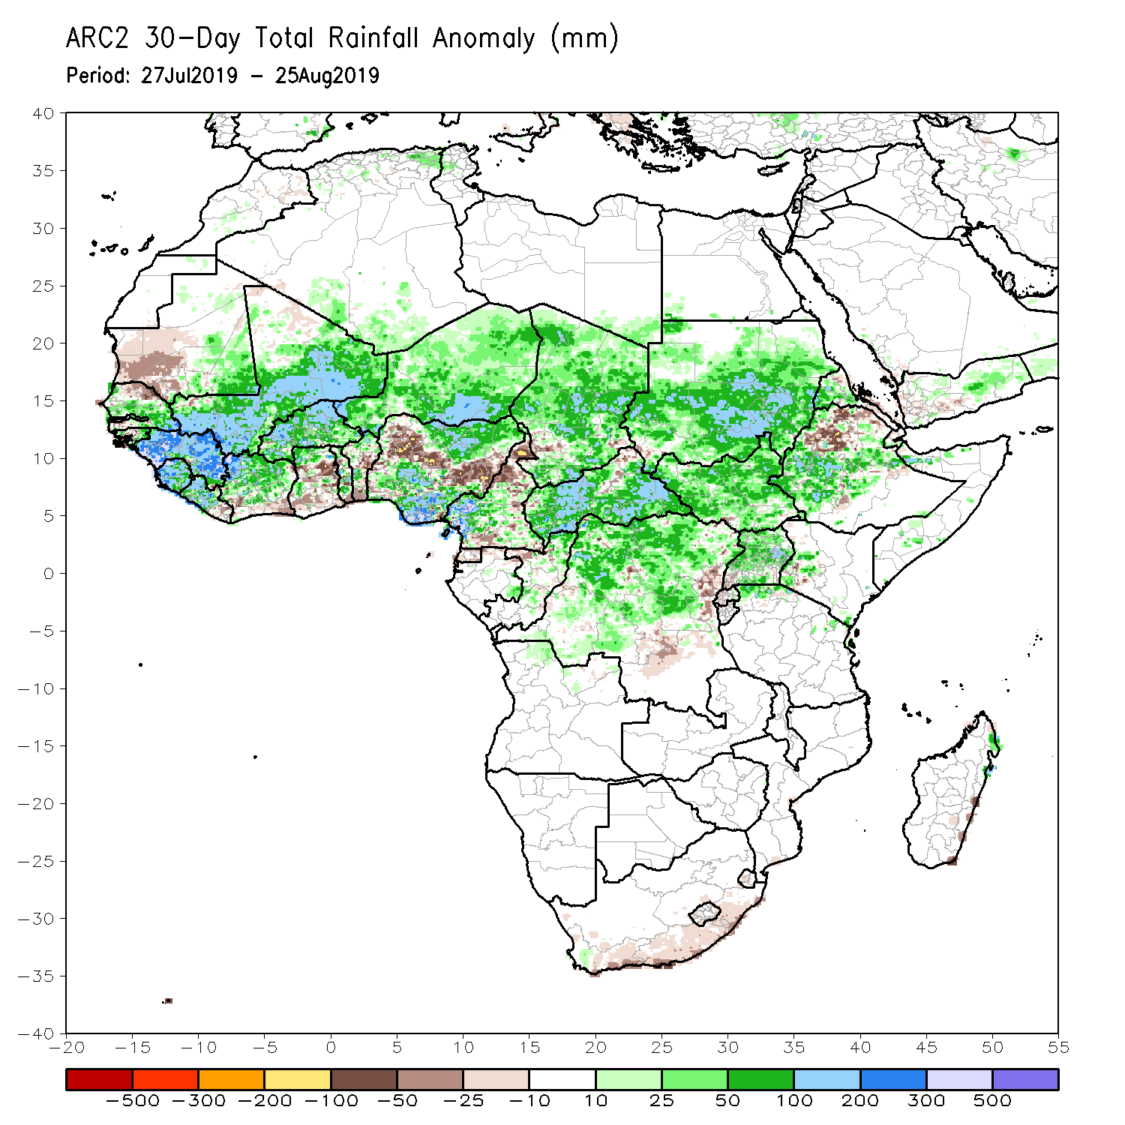
Rainfall Patterns: Last 30 Days
During the past 30 days, southwestern Mauritania, northern Senegal, parts of Guinea-Bissau, local areas in Mali, eastern Liberia, southern Cote d’Ivoire, parts of Ghana, local areas in Togo and Benin, portions of Nigeria and Cameroon, local areas in Niger and Chad, parts DRC, and portions of Ethiopia had below-average rainfall.
Rainfall was above-average over many parts of Senegal, much of Guinea, Sierra Leone, much of Liberia, Mali, Burkina Faso, central and northern Cote d’Ivoire, parts of Ghana, Togo and Benin, many parts of Niger, portions of Nigeria, Cameroon, much of Chad and CAR, northern Congo, many parts of DRC, Uganda, South Sudan, Sudan, and parts of Ethiopia and western Kenya.
Notes:
5

Slide 6
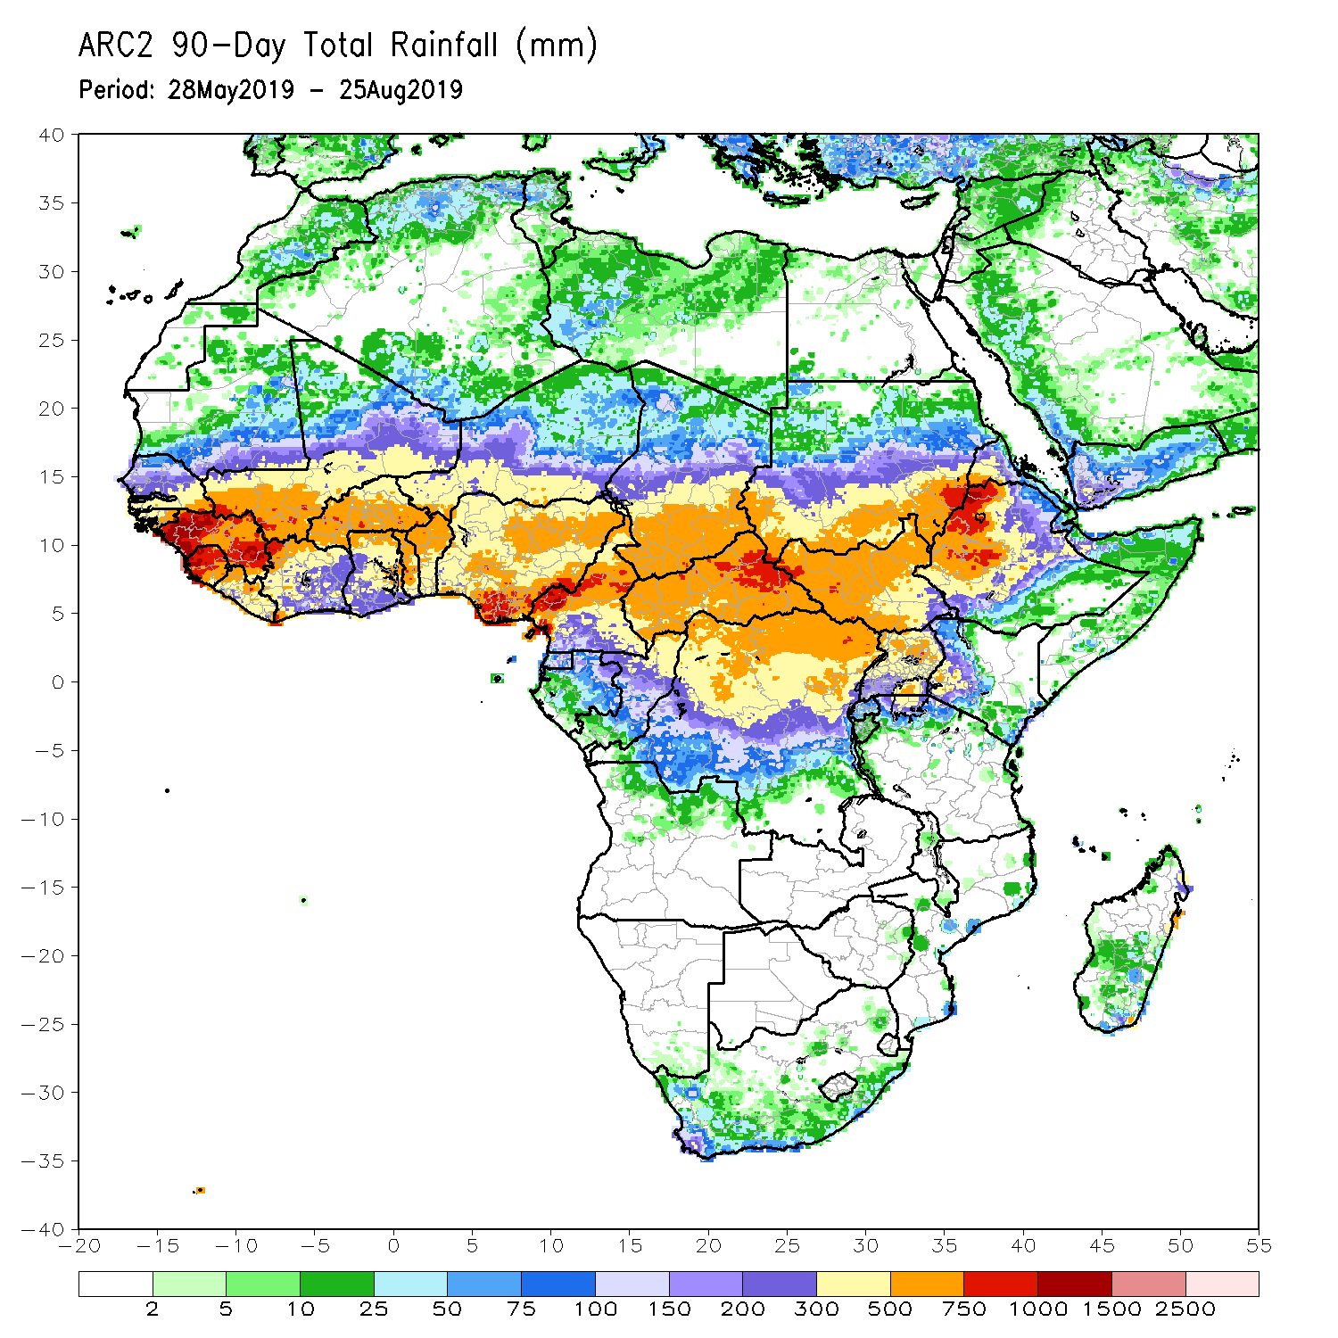
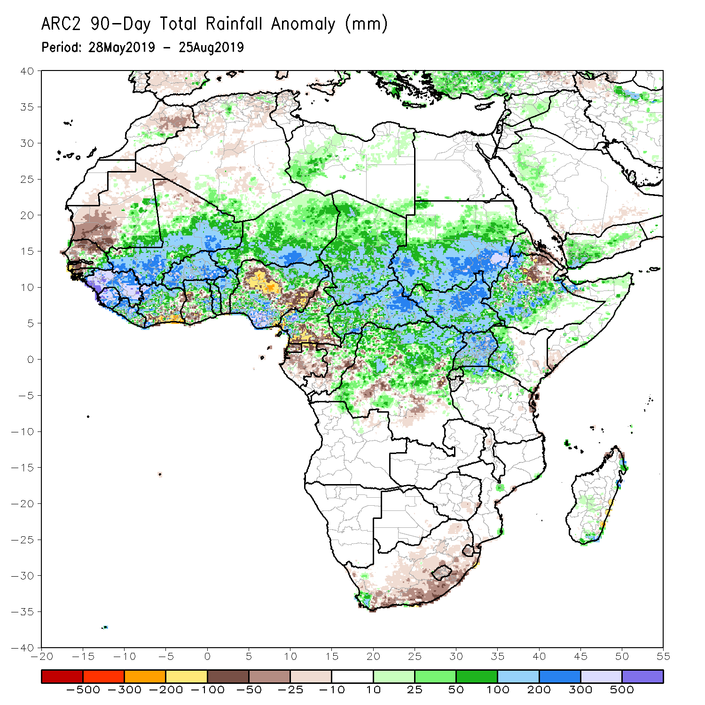
Rainfall Patterns: Last 90 Days
During the past 90 days, many parts of Senegal, Gambia, western Guinea-Bissau, portions of Mauritania, parts of Cote d’Ivoire and Ghana, portions of Nigeria and Cameroon, Equatorial Guinea, Gabon, parts of Congo, local areas in DRC, and parts of Ethiopia and South Africa had below-average rainfall.
Rainfall was above-average over much Guinea, Sierra Leone, Liberia, Mali, many parts of Cote d’Ivoire, Burkina Faso, Ghana, Togo, Benin, Niger, parts of Nigeria, Chad, parts of Cameroon, much of CAR, parts of DRC, South Sudan, Uganda, Sudan, portions of Ethiopia, and western Kenya and northern Tanzania.
Notes:
6

Slide 7
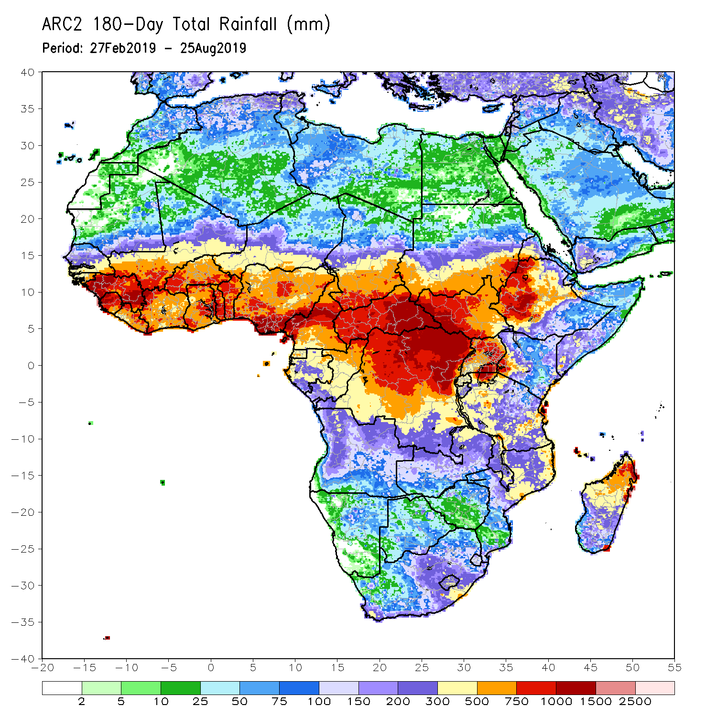
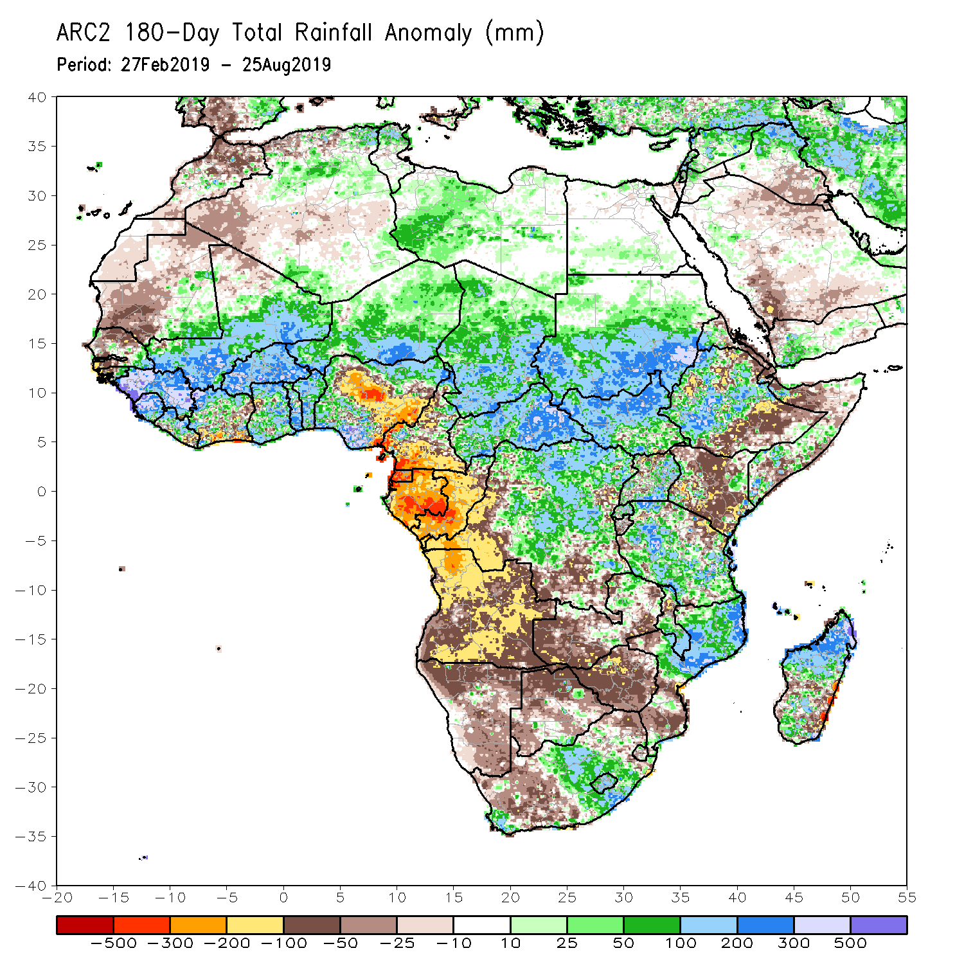
Rainfall Patterns: Last 180 Days
During the past 180 days, below-average rainfall was observed over many parts of Mauritania, Senegal, Guinea-Bissau, parts of Liberia and Cote d’Ivoire, local areas in Ghana, portions of Nigeria and Cameroon, Equatorial Guinea, Gabon, Congo, portions of DRC, Angola, Namibia, western and northeastern South Africa, western and southern Zambia, Botswana, Zimbabwe, southern Mozambique, parts of Madagascar, northern Tanzania, much of Kenya, portions of Ethiopia, and Somalia.
Much of Guinea, Sierra Leone, Mali, parts of Liberia and Cote d’Ivoire, Burkina Faso, Ghana, Togo, Benin, parts of Nigeria, Niger, Chad, CAR, many parts of DRC, South Sudan, Sudan, Uganda, many parts of Ethiopia, Tanzania, eastern Zambia, Malawi, northern Mozambique, and portions of South Africa and Madagascar had above-average rainfall.
Notes:
7

Slide 8
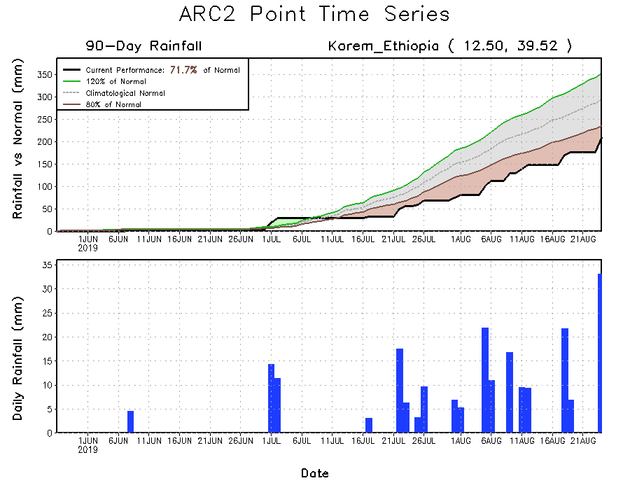
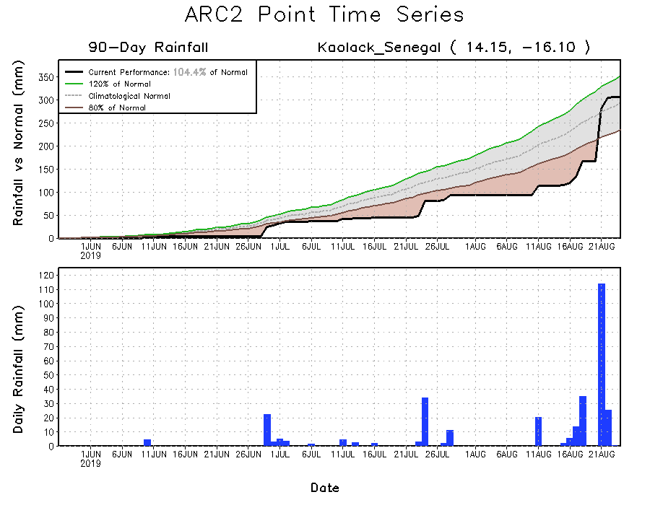
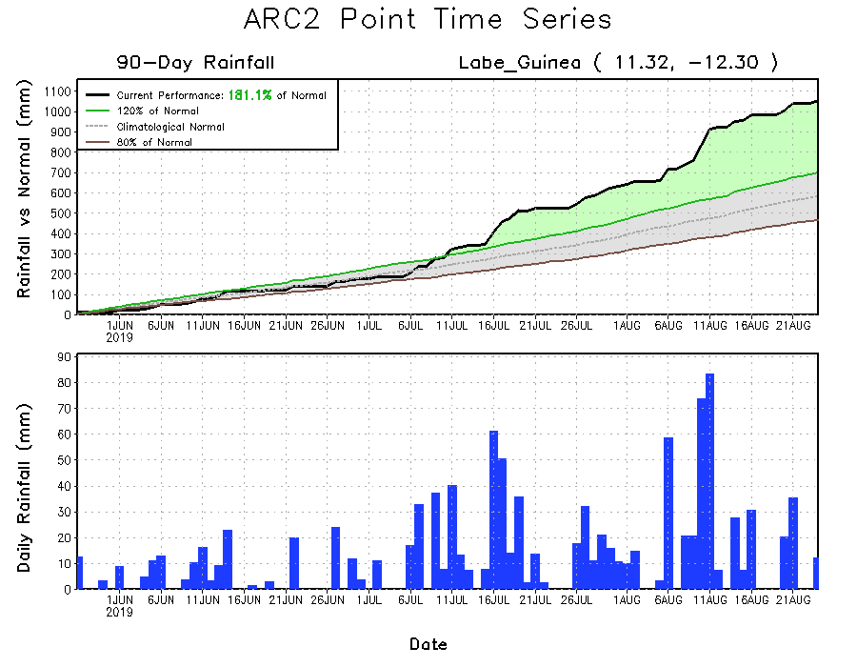
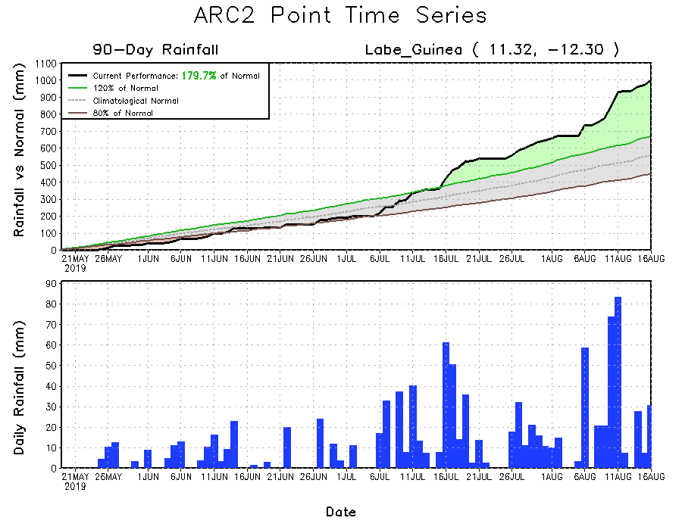
Recent Rainfall Evolution
Daily evolution of rainfall over the last 90 days at selected locations shows moderate to heavy rainfall helped to reduce accumulated moisture deficits over parts of Senegal (top right). Moderate to local heavy rainfall sustained moisture surpluses over parts of Guinea (bottom right). Seasonal total rainfall remained below-average over parts of Northeast Ethiopia (top right).

Slide 9
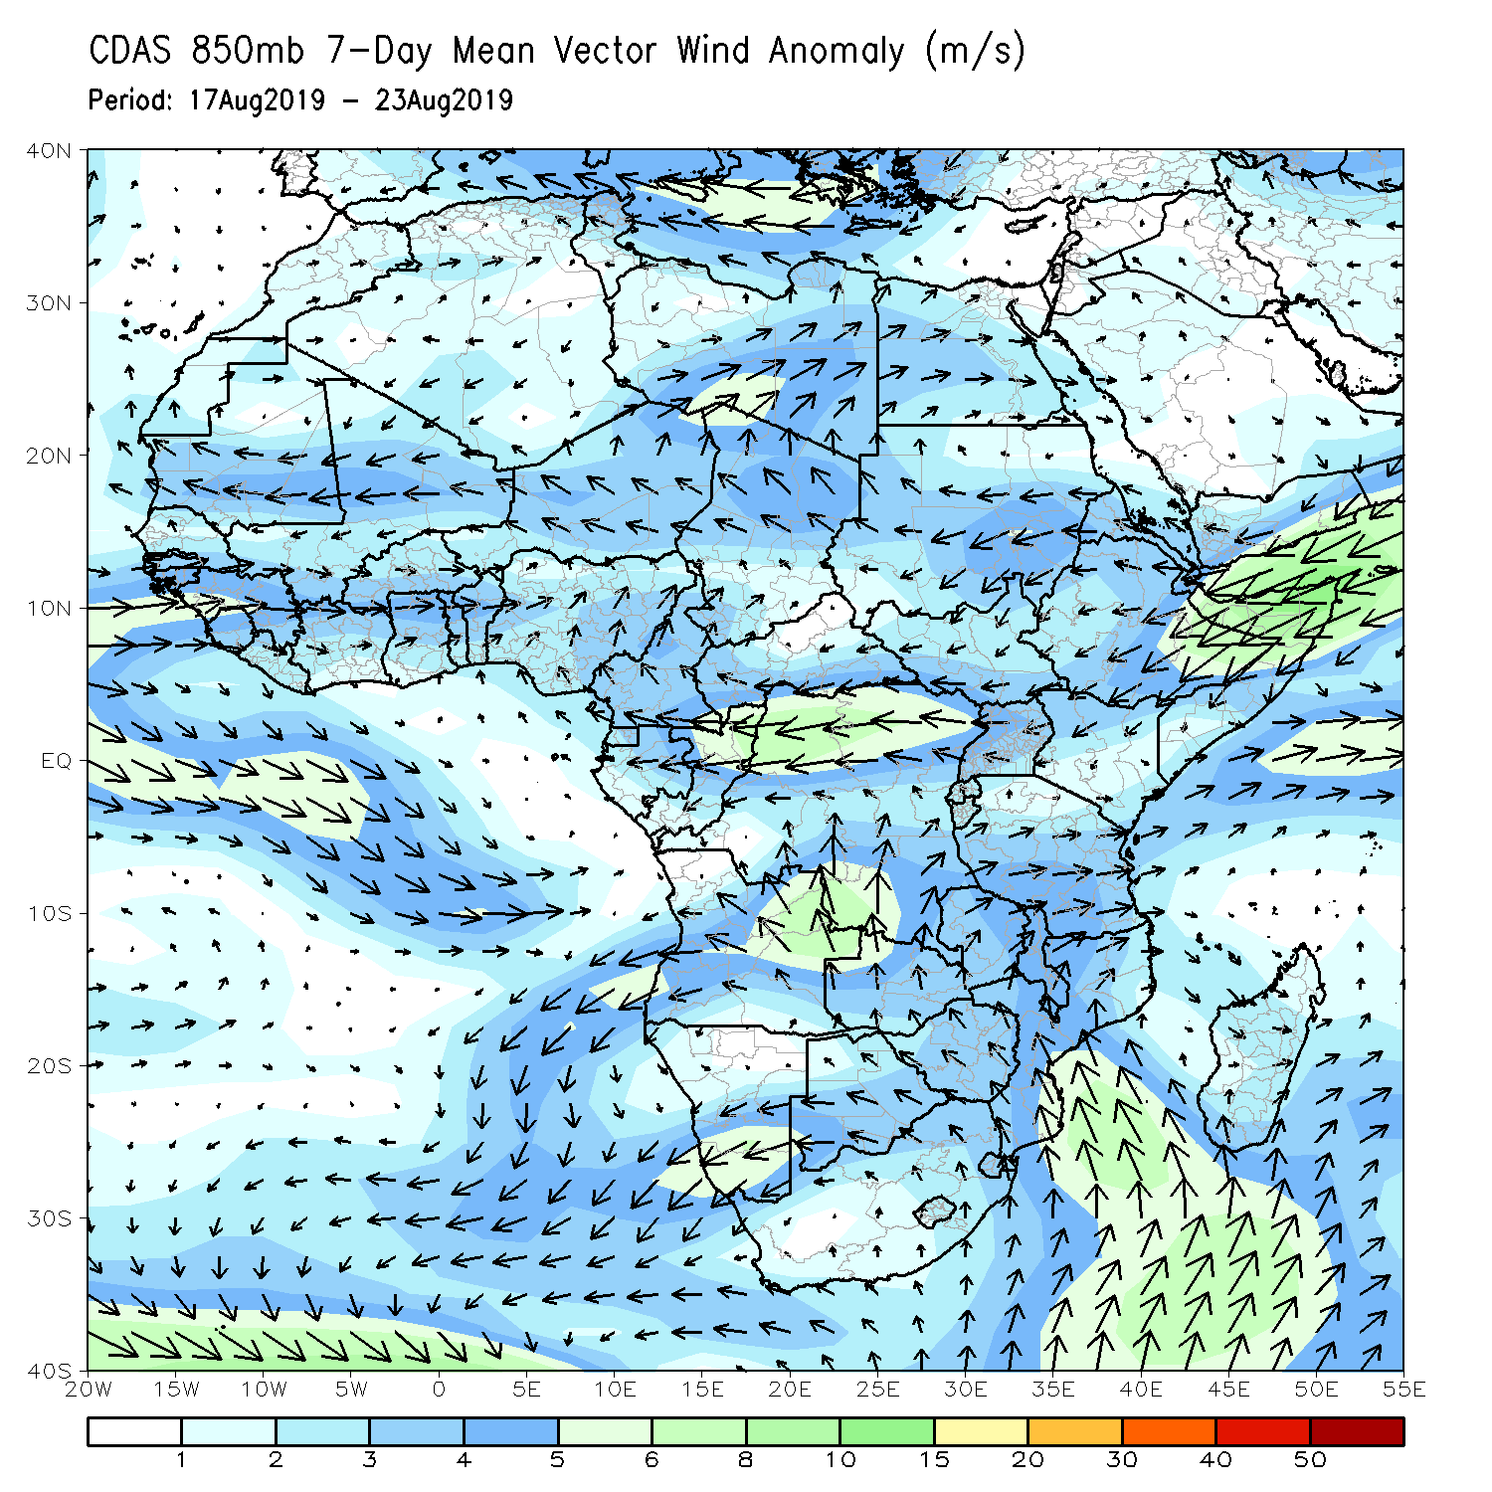
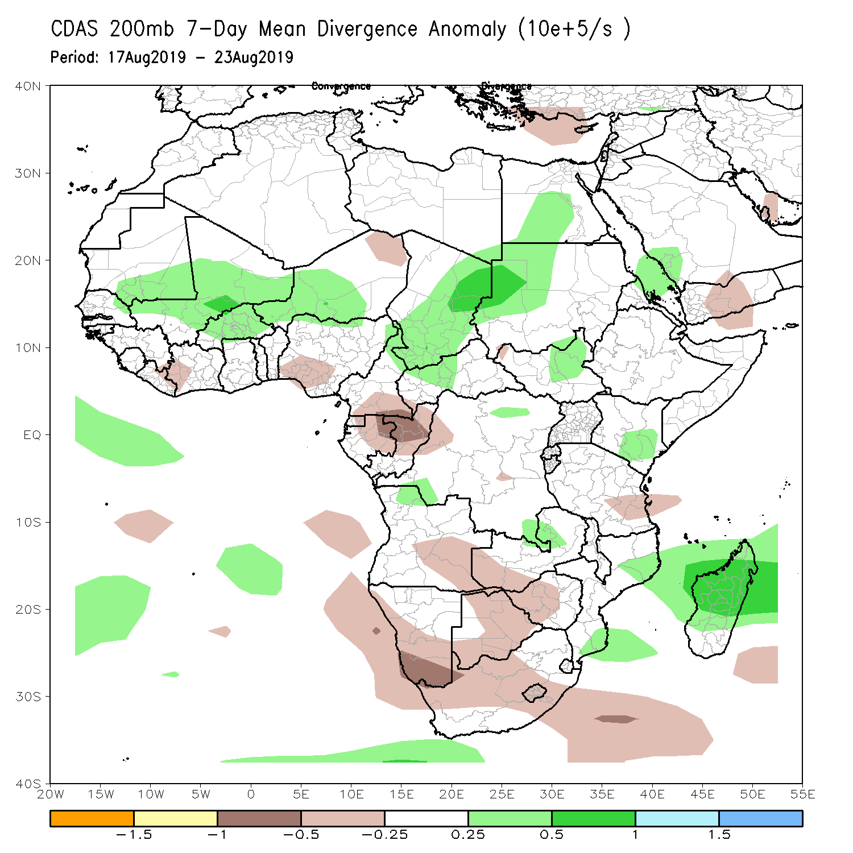
Atmospheric Circulation: Last 7 Days
Lower-level anomalous cyclonic shear (left) coupled with upper-level divergence (right) may have contributed to the observed above-average rainfall over many places in West and Central Africa.

Slide 10
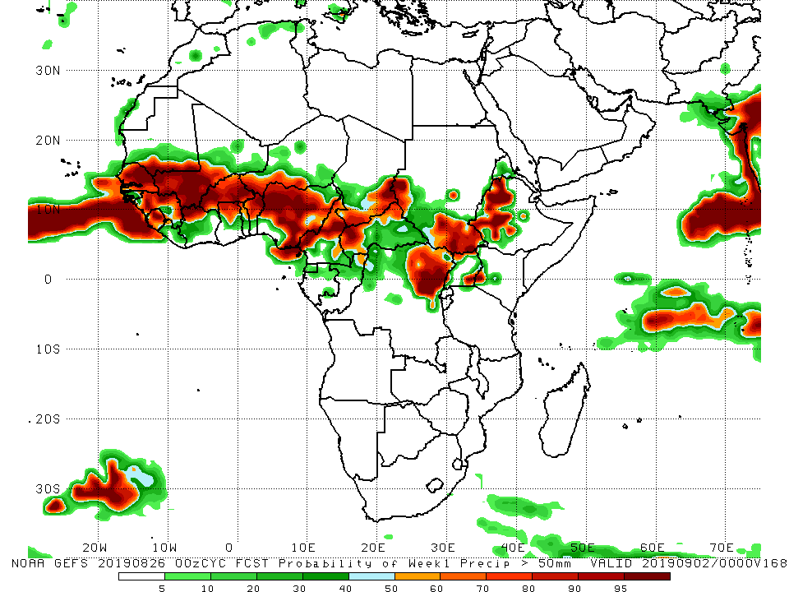
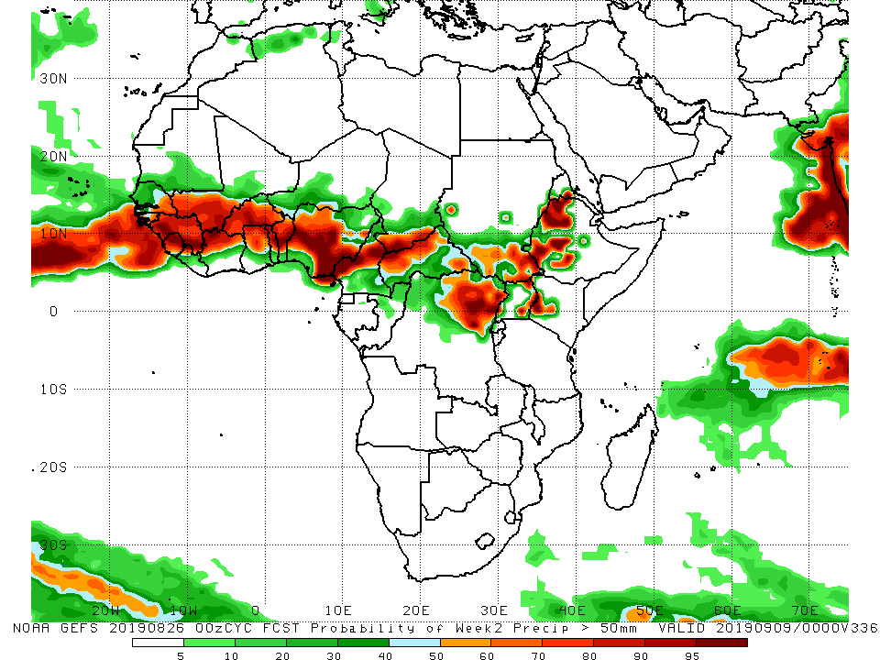
NCEP GEFS Model Forecasts Non-Bias Corrected Probability of precipitation exceedance
Week-1: Valid August 27 – September 2, 2019
Week-2: Valid 3 – 9 September, 2019
For week-1 (left panel) and week-2 (right panel), there is an increased chance for weekly rainfall totals to exceed 50mm over many places in West Africa, and eastern and southern Chad, northeastern DRC, South Sudan, western Kenya, and western Ethiopia.
Notes:
10

Slide 11
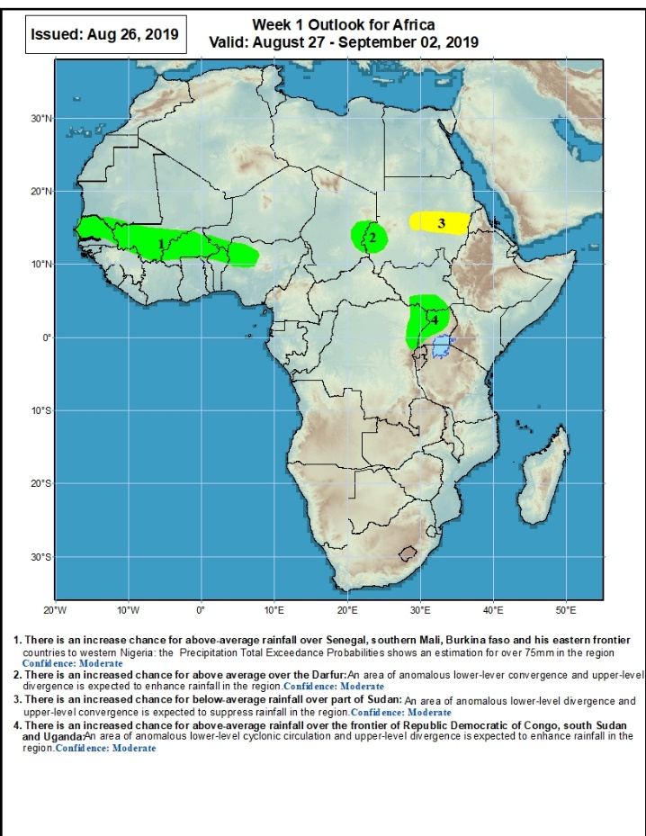
Week-1 Precipitation Outlooks
August 27 – September 2, 2019
There is an increased chance for above-average rainfall over central and northern Senegal, southern Mali, Burkina Faso, northern Benin, southwestern Niger and northwestern Nigeria: An area of anomalous lower-level convergence and upper-level divergence is expected to enhance rainfall in the region. Confidence: Moderate
There is an increased chance for above-average rainfall across eastern Chad and western Sudan: An area of anomalous lower-level convergence and upper-level divergence is expected to enhance rainfall in the region. Confidence: Moderate
There is an increased chance for below-average rainfall over portions of central and eastern Sudan: An area of anomalous lower-level divergence and upper-level convergence is expected to suppress rainfall in the region. Confidence: Moderate
There is an increased chance for above-average rainfall over northeastern DRC, southern South Sudan and western Uganda: An area of anomalous lower-level convergence and upper-level divergence is expected to enhance rainfall in the region. Confidence: Moderate
Notes:
11

Slide 12
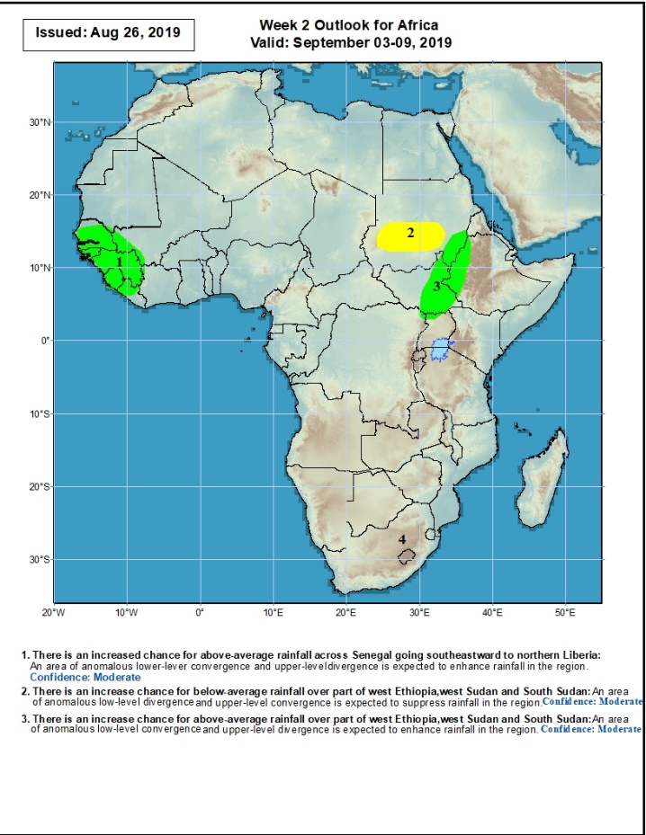
Week-2 Precipitation Outlooks
3 – 9 September, 2019
There is an increased chance for above-average rainfall over Senegal, Gambia, Guinea-Bissau, Guinea, Sierra Leone, western Liberia, southwestern Mali: An area of anomalous lower-level convergence and upper-level divergence is expected to enhance rainfall in the region. Confidence: Moderate
There is an increased chance for below-average rainfall central Sudan: An area of anomalous lower-level divergence and upper-level convergence is expected to suppress rainfall in the region. Confidence: Moderate
There is an increased chance for above-average rainfall eastern South Sudan, eastern Sudan and western Ethiopia: An area of anomalous lower-level convergence and upper-level divergence is expected to enhance rainfall in the region. Confidence: Moderate
Notes:
12

Slide 13
Summary
During the past 7 days, many places in West and Central Africa received above-average rainfall. Rainfall was also above-average over portions of Sudan and South Sudan, parts of Uganda and Ethiopia, and local areas in Kenya, and Somalia. Weekly rainfall totals exceeded 150mm over local areas in Senegal, Guinea, Mali, Burkina Faso, Cote d’Ivoire, Nigeria, Cameroon and Ethiopia. Rainfall was below-average over southwestern Mauritania, parts of Sierra Leone, Nigeria, northern Cameroon, parts of southern Chad, and parts of DRC and Ethiopia.
During the past 30 days, southwestern Mauritania, northern Senegal, parts of Guinea-Bissau, local areas in Mali, eastern Liberia, southern Cote d’Ivoire, parts of Ghana, local areas in Togo and Benin, portions of Nigeria and Cameroon, local areas in Niger and Chad, parts DRC, and portions of Ethiopia had below-average rainfall. Rainfall was above-average over many parts of Senegal, much of Guinea, Sierra Leone, much of Liberia, Mali, Burkina Faso, central and northern Cote d’Ivoire, parts of Ghana, Togo and Benin, many parts of Niger, portions of Nigeria, Cameroon, much of Chad and CAR, northern Congo, many parts of DRC, Uganda, South Sudan, Sudan, and parts of Ethiopia and western Kenya.
During the past 90 days, many parts of Senegal, Gambia, western Guinea-Bissau, portions of Mauritania, parts of Cote d’Ivoire and Ghana, portions of Nigeria and Cameroon, Equatorial Guinea, Gabon, parts of Congo, local areas in DRC, and parts of Ethiopia and South Africa had below-average rainfall. Rainfall was above-average over much Guinea, Sierra Leone, Liberia, Mali, many parts of Cote d’Ivoire, Burkina Faso, Ghana, Togo, Benin, Niger, parts of Nigeria, Chad, parts of Cameroon, much of CAR, parts of DRC, South Sudan, Uganda, Sudan, portions of Ethiopia, and western Kenya and northern Tanzania.
Week-1 outlooks call for an increased chance for above-average rainfall over Senegal, Gambia, Guinea-Bissau, Guinea, Sierra Leone, western Liberia, southwestern Mali, eastern Chad, western Sudan, northeastern DRC, southern South Sudan and western Uganda. In contrast, there is an increased chance for below-average rainfall over parts of central and eastern Sudan.
Notes:
13

