Slide 1
The African Monsoon Recent Evolution and Current Status Include Week-1 and Week-2 Outlooks
Update prepared by
Climate Prediction Center / NCEP
3 September 2019
For more information, visit:
http://www.cpc.ncep.noaa.gov/products/Global_Monsoons/African_Monsoons/precip_monitoring.shtml

Slide 2
Outline
Highlights
Recent Evolution and Current Conditions
NCEP GEFS Forecasts
Summary

Slide 3
Highlights: Last 7 Days
Weekly rainfall totals exceeded 100mm over parts of Senegal and southern Mauritania, central and eastern Guinea, Liberia, Cote d’Ivoire, local areas in Togo and Benin, southeastern Nigeria, western Cameroon, local areas in Sudan and Somalia, and many parts of Ethiopia.
Week-1 outlooks call for an increased chance for above-average rainfall over parts of Guinea- Bissau, Guinea, Sierra Leone, northern Cote d'Ivoire, northern Liberia, southern Nigeria, central Cameroon, eastern CAR, northeastern DRC, South Sudan, and parts of southwestern Ethiopia. In contrast, there is an increased chance for below-average rainfall over portions of central DRC and southern Sudan.

Slide 4
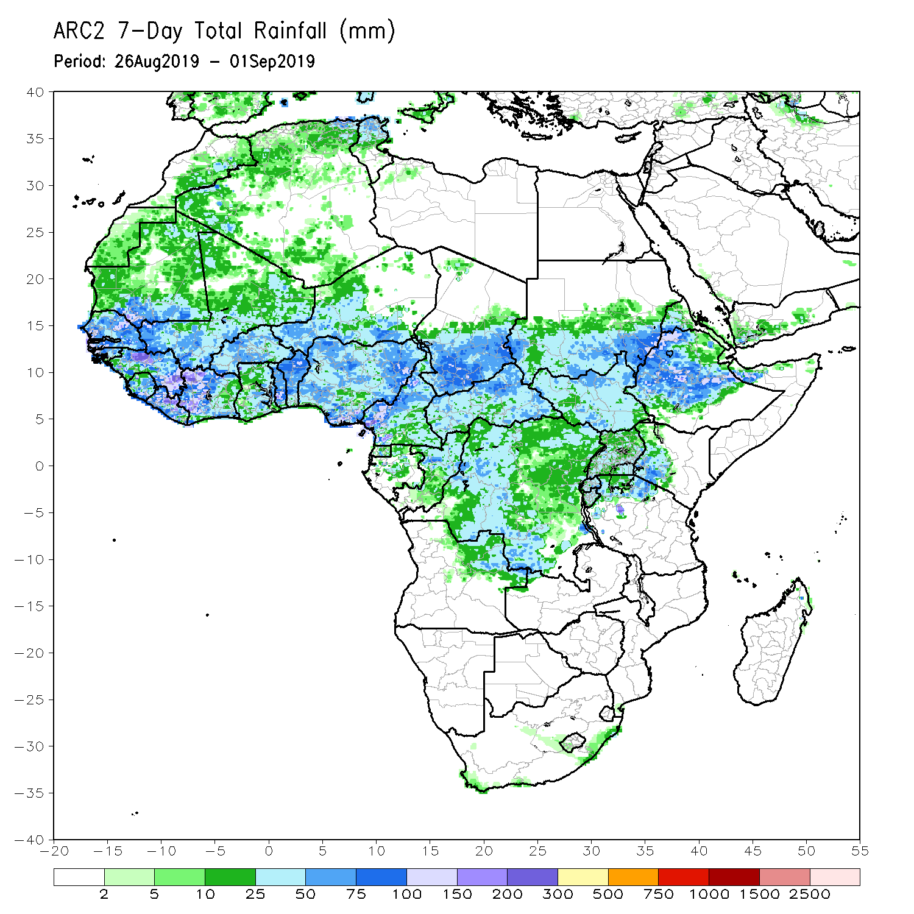
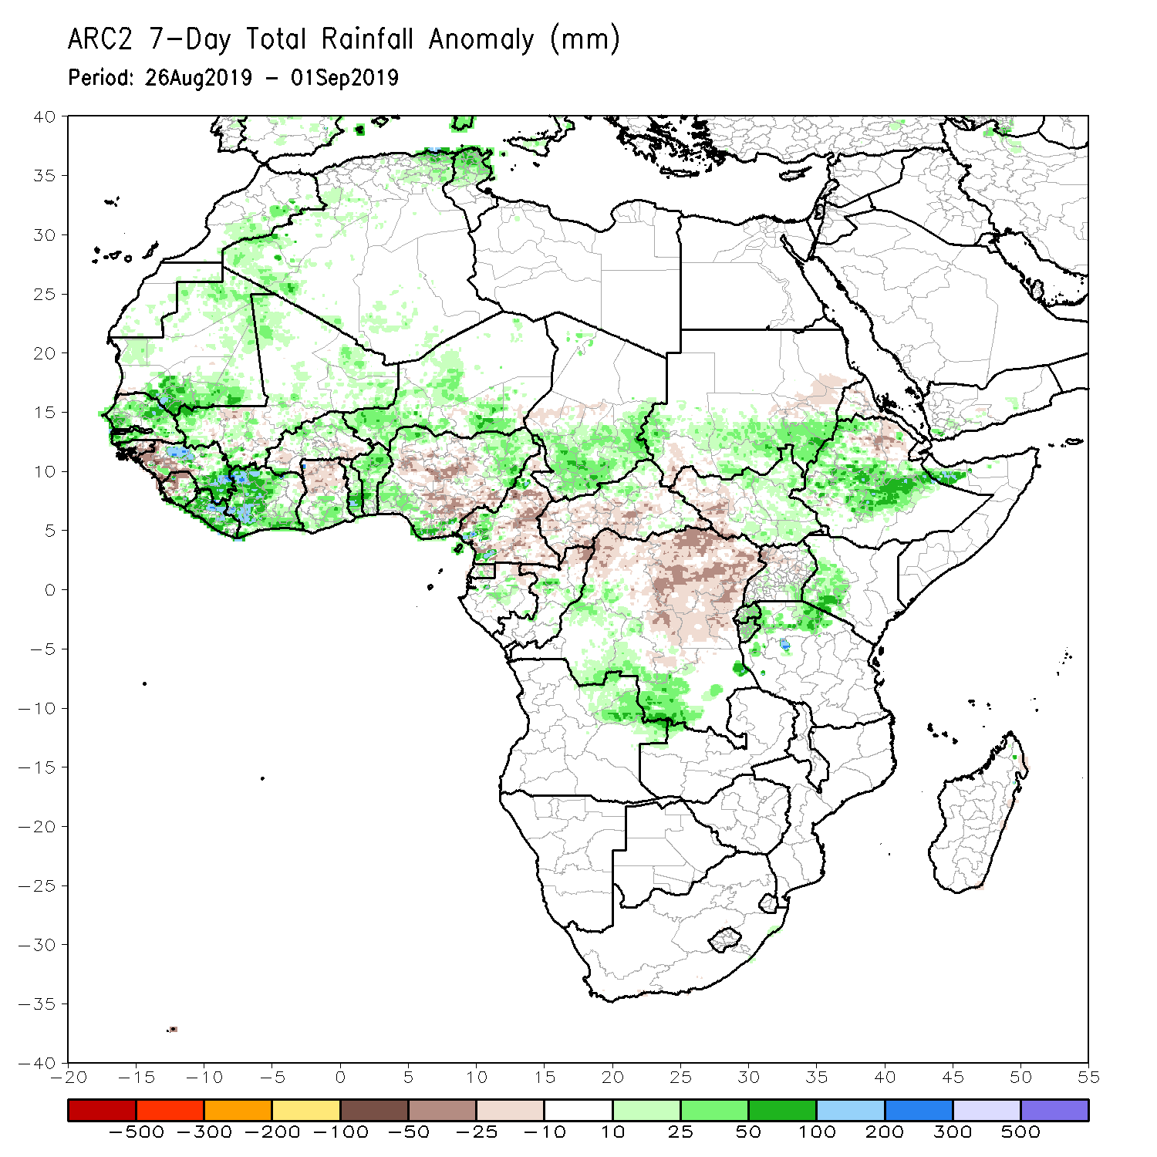
Rainfall Patterns: Last 7 Days
During the past 7 days, portions of Mauritania, much of Senegal, many parts of Guinea, local areas in Sierra Leone, much Liberia, and Cote d’Ivoire, local areas in Mali and Burkina Faso, southern Ghana, Togo, Benin, Niger, parts of Nigeria, southern Chad, local areas in Cameroon, Gabon and Congo, western and southern DRC, northeastern Angola, southern Sudan, eastern South Sudan, northern Tanzania, western Kenya, many parts of Ethiopia and northern Somalia had above-average rainfall. Weekly rainfall totals exceeded 100mm over parts of Senegal and southern Mauritania, central and eastern Guinea, Liberia, cote d’Ivoire, local areas in Togo and Benin, southeastern Nigeria, western Cameroon, local areas in Sudan and Somalia, and many parts of Ethiopia.
Rainfall was below-average over portions of Guinea-Bissau, western Guinea, western Sierra Leone, parts of Burkina Faso and northern Ghana, many parts of Nigeria and Cameroon, CAR, northern Congo, many parts of DRC, southwestern Sudan, western South Sudan, Uganda, and parts of northern Ethiopia.

Slide 5
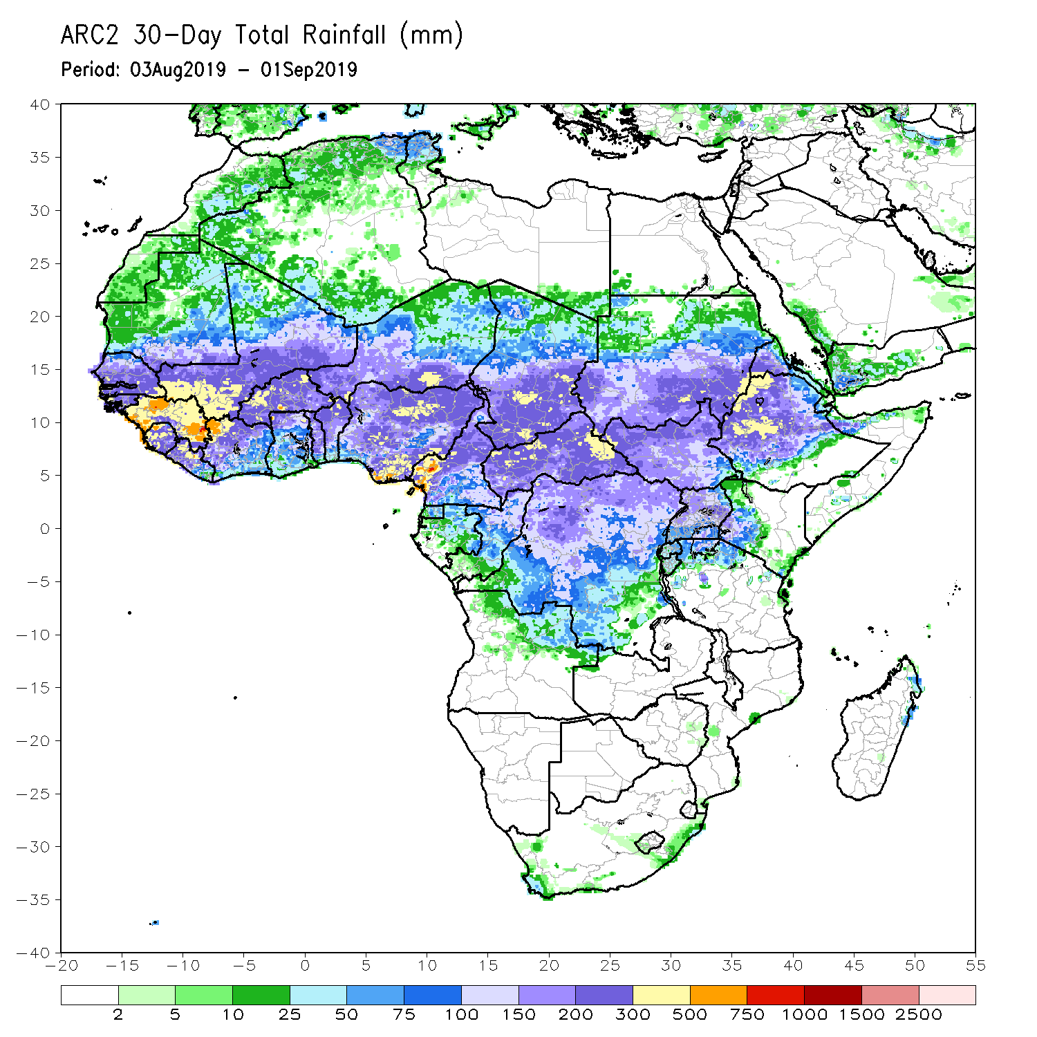
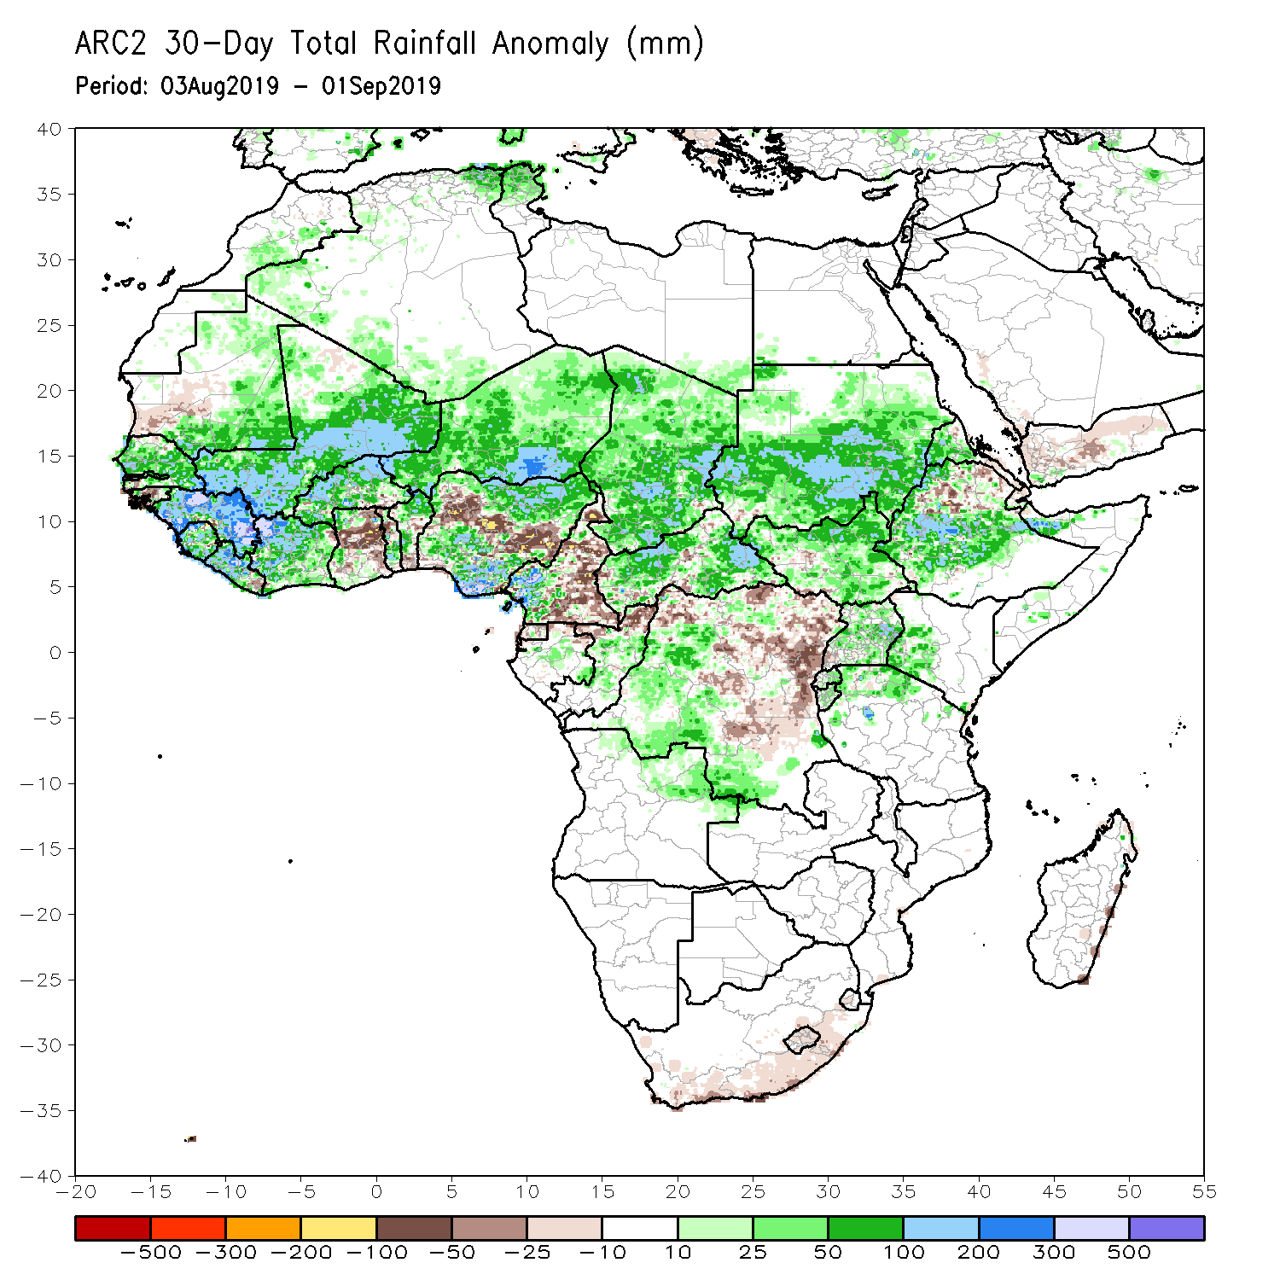
Rainfall Patterns: Last 30 Days
During the past 30 days, southwestern Mauritania, parts of Guinea-Bissau, local areas in eastern Liberia, parts of Ghana, local areas in Togo and Benin, portions of Nigeria and Cameroon, parts DRC, and local areas in South Sudan and Ethiopia had below-average rainfall.
Rainfall was above-average over much of Senegal, Guinea, Sierra Leone, much of Liberia, Mali, Burkina Faso, Cote d’Ivoire, local areas in Ghana, Togo and Benin, much of Niger, portions of Nigeria, western Cameroon, much of Chad and CAR, parts of Congo, western DRC, Uganda, South Sudan, Sudan, many parts of Ethiopia, northern Tanzania, Uganda and western Kenya.
Notes:
5

Slide 6
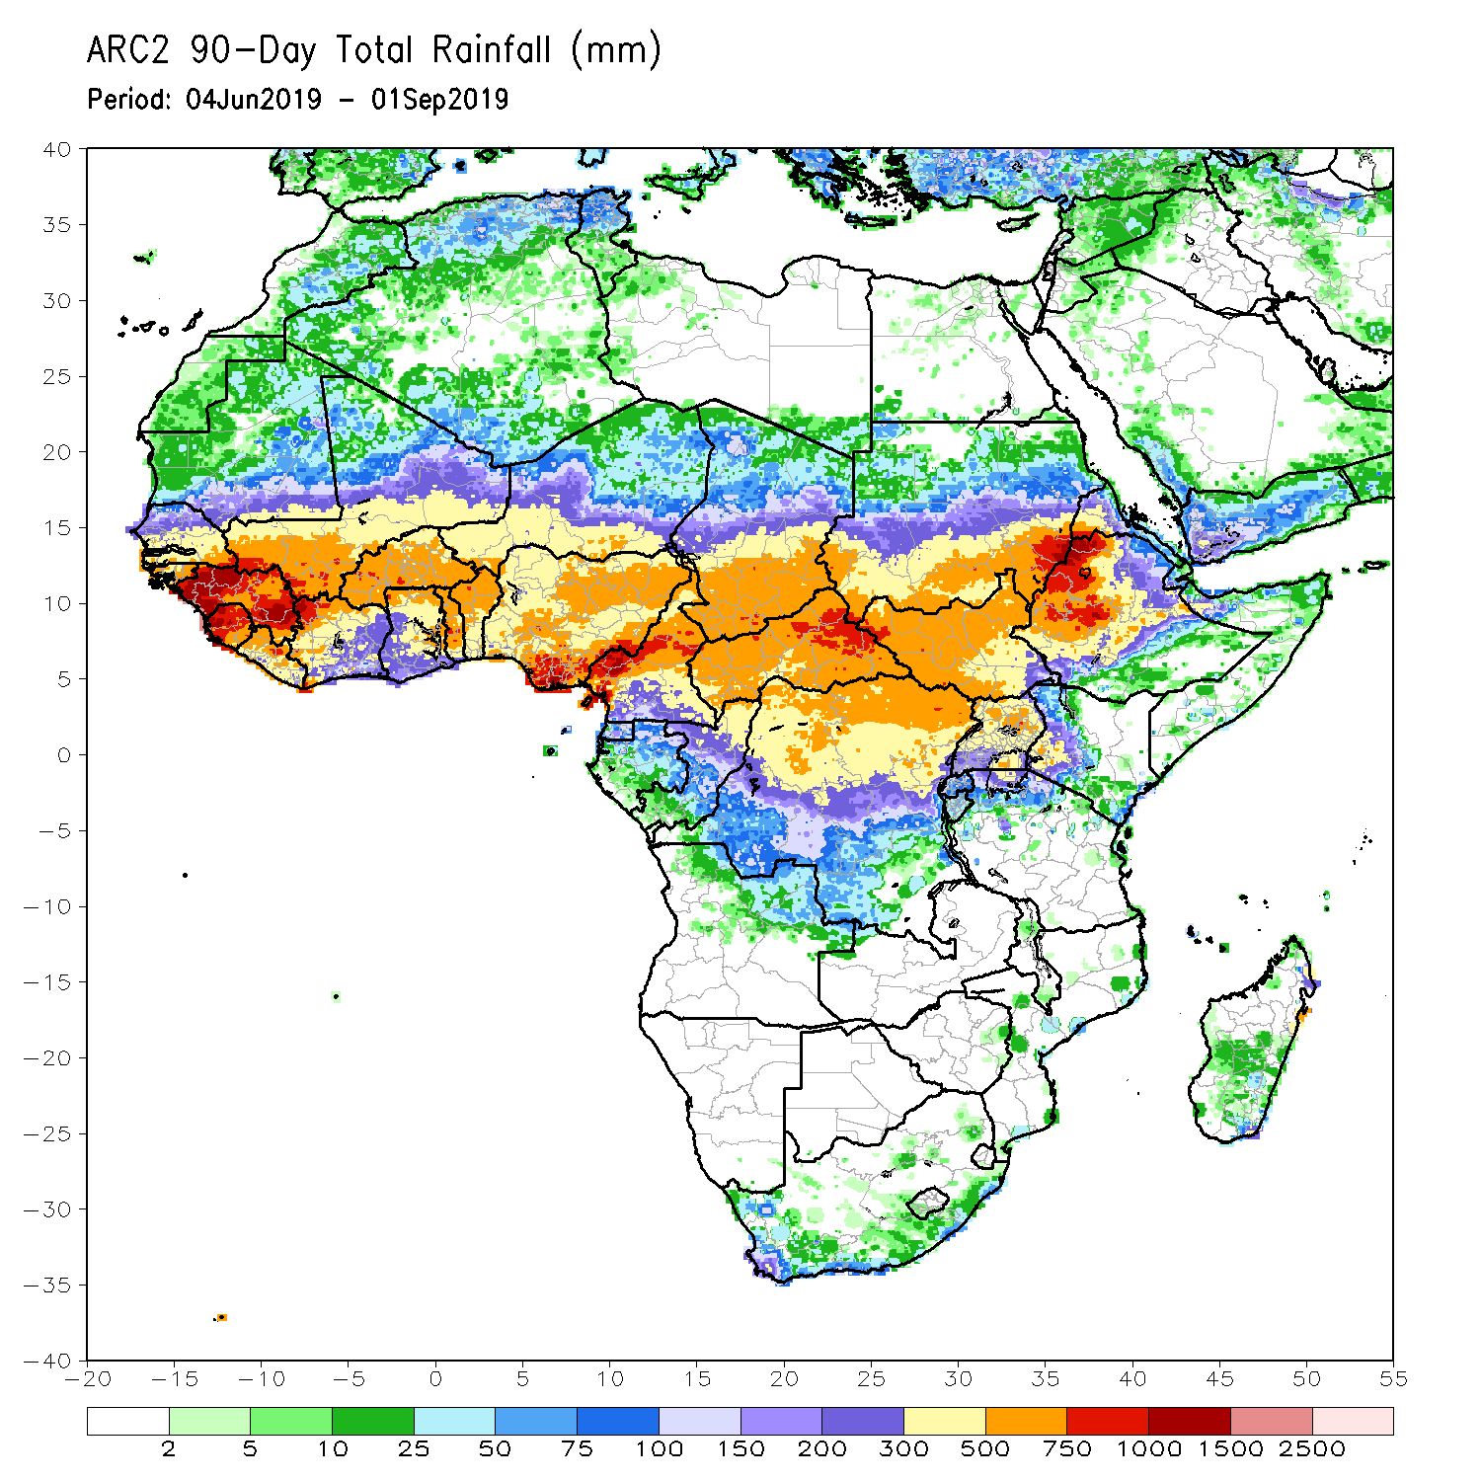
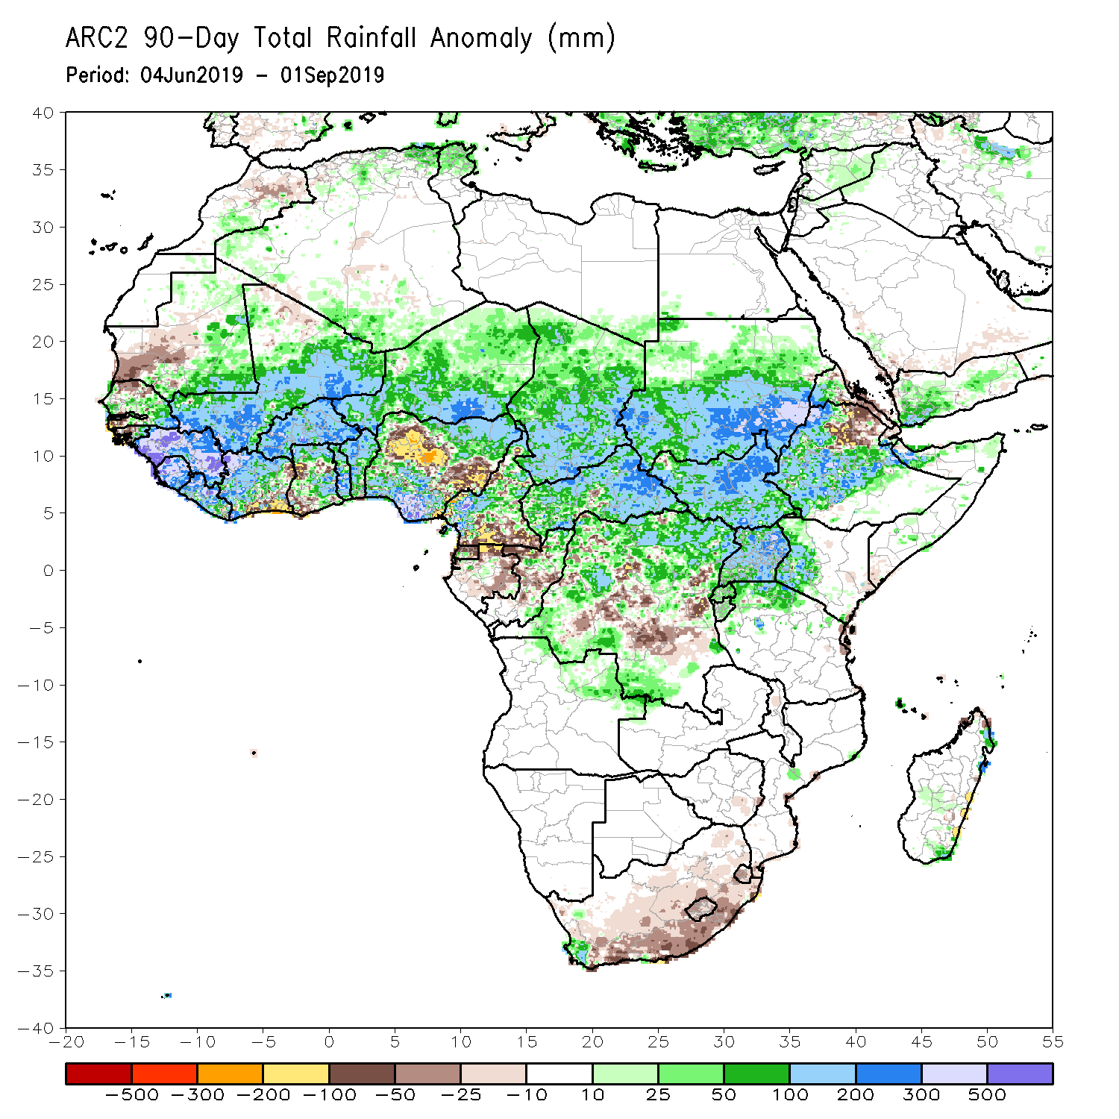
Rainfall Patterns: Last 90 Days
During the past 90 days, western Mauritania, northern Senegal, western Guinea-Bissau, parts of Cote d’Ivoire and Ghana, portions of Nigeria, southern Cameroon, parts of Gabon and Congo, portions of DRC, and northeastern Ethiopia and portions of South Africa had below-average rainfall.
Rainfall was above-average over portions of Senegal, much Guinea, southern Mauritania, Sierra Leone, Liberia, Mali, many parts of Cote d’Ivoire, Burkina Faso, Ghana, Togo, Benin, Niger, parts of Nigeria, Chad, many parts of Cameroon, much of CAR, parts of DRC, South Sudan, Uganda, Sudan, many parts of Ethiopia, and western Kenya and northern Tanzania.
Notes:
6

Slide 7
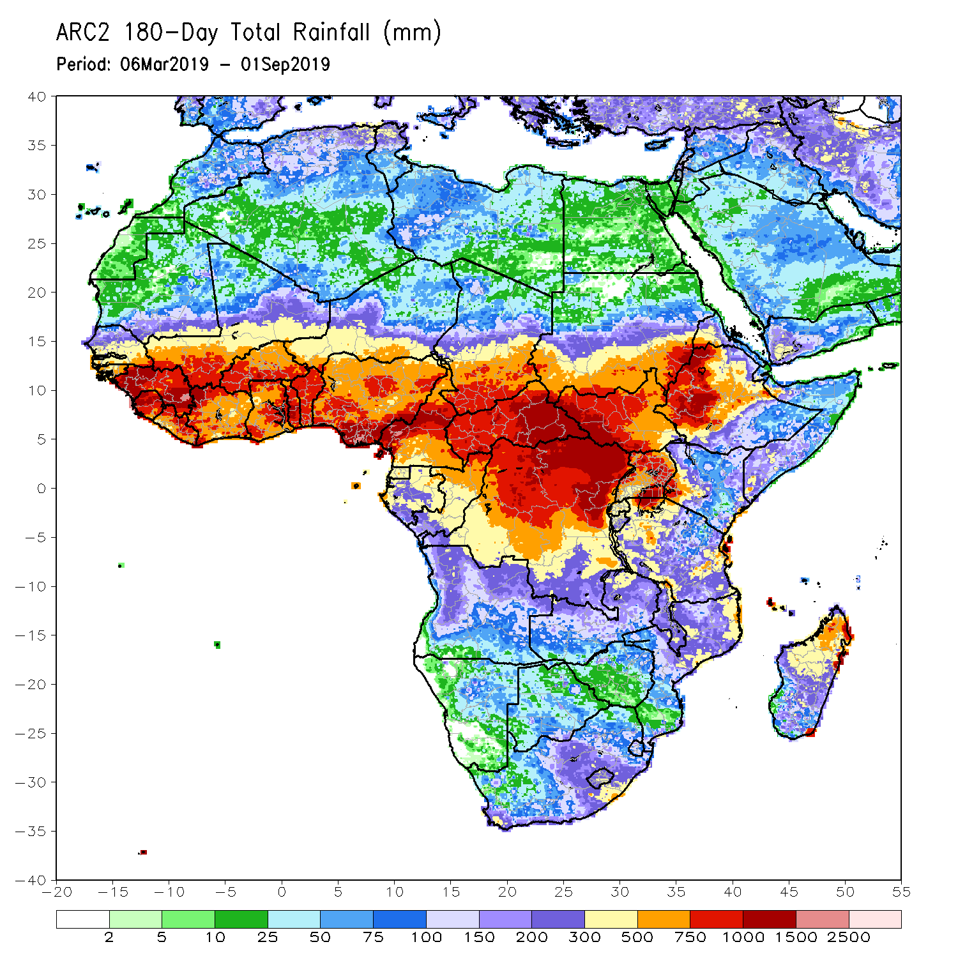
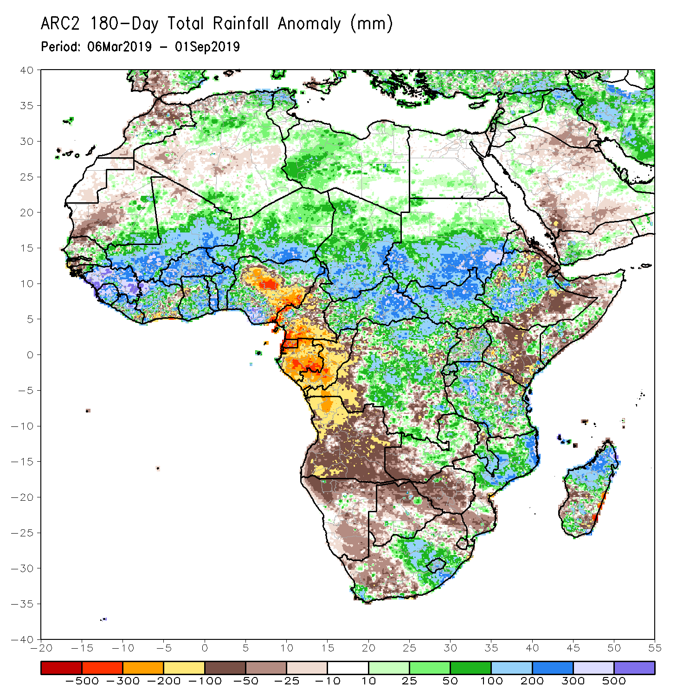
Rainfall Patterns: Last 180 Days
During the past 180 days, below-average rainfall was observed over western Mauritania, northern Senegal, parts of Guinea-Bissau, local areas in Liberia, parts of Cote d’Ivoire, local areas in Ghana, portions of Nigeria, many parts of Cameroon, Equatorial Guinea, Gabon, Congo, portions of DRC, Angola, Namibia, western and northeastern South Africa, portions of Zambia, Botswana, Zimbabwe, southern Mozambique, parts of Madagascar, northern Tanzania, much of Kenya, portions of Ethiopia, and Somalia.
Many parts of Senegal, parts of Guinea-Bissau, much of Guinea, Sierra Leone, Mali, much of Liberia and Cote d’Ivoire, Burkina Faso, Ghana, Togo, Benin, parts of Nigeria, Niger, Chad, CAR, many parts of DRC, South Sudan, Sudan, Uganda, many parts of Ethiopia, Tanzania, eastern Zambia, Malawi, northern Mozambique, and portions of South Africa and Madagascar had above-average rainfall.
Notes:
7

Slide 8
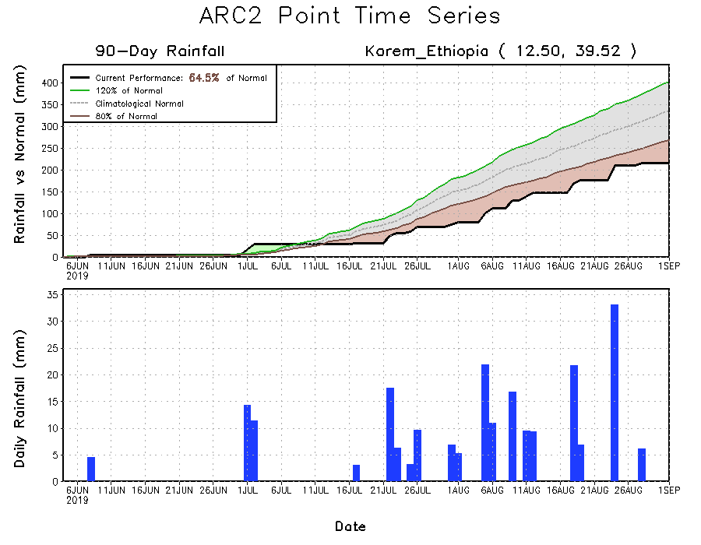
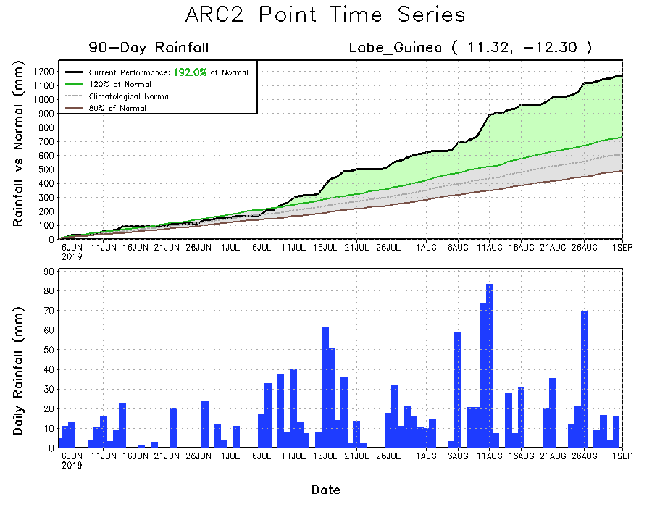
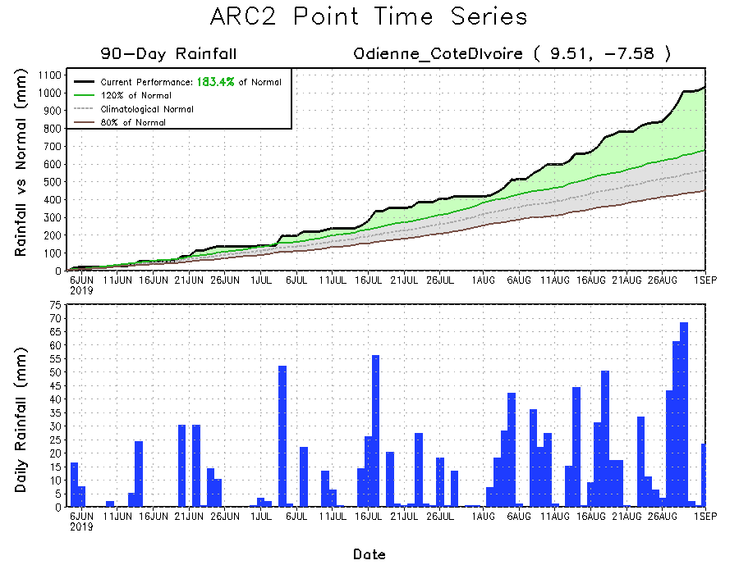
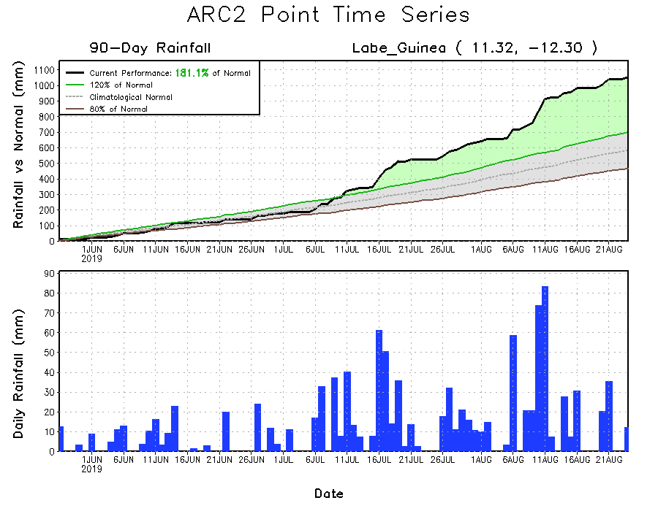
Recent Rainfall Evolution
Daily evolution of rainfall over the last 90 days at selected locations shows moderate to heavy rainfall sustained moisture surpluses over parts of Guinea (bottom left) and northwestern Cote d’Ivoire (bottom right). Seasonal total rainfall remained below-average over parts of Northeast Ethiopia (top right).

Slide 9
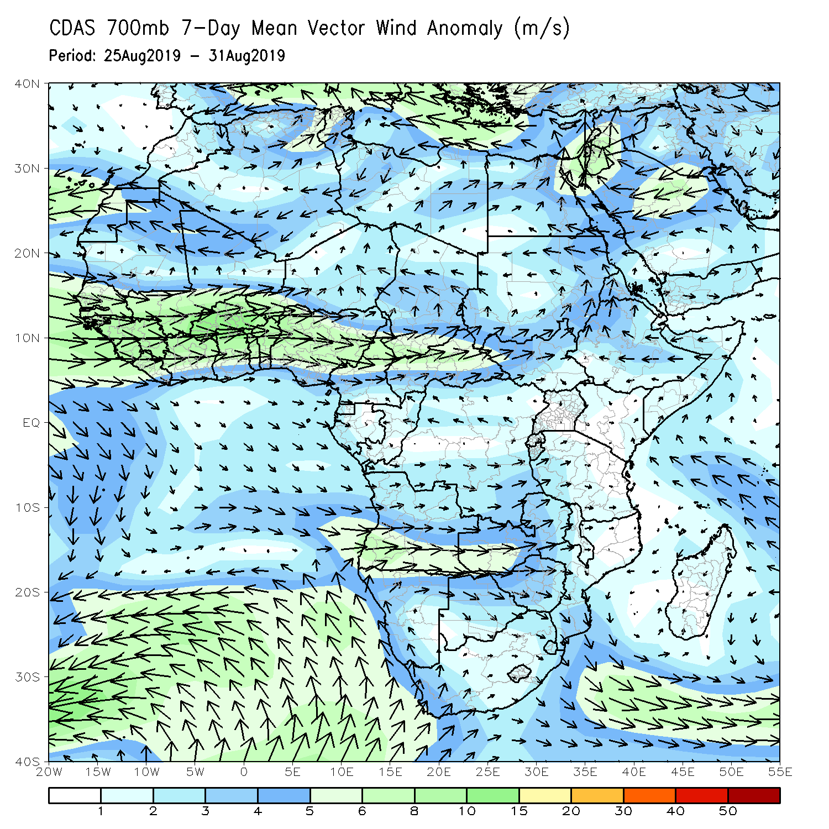
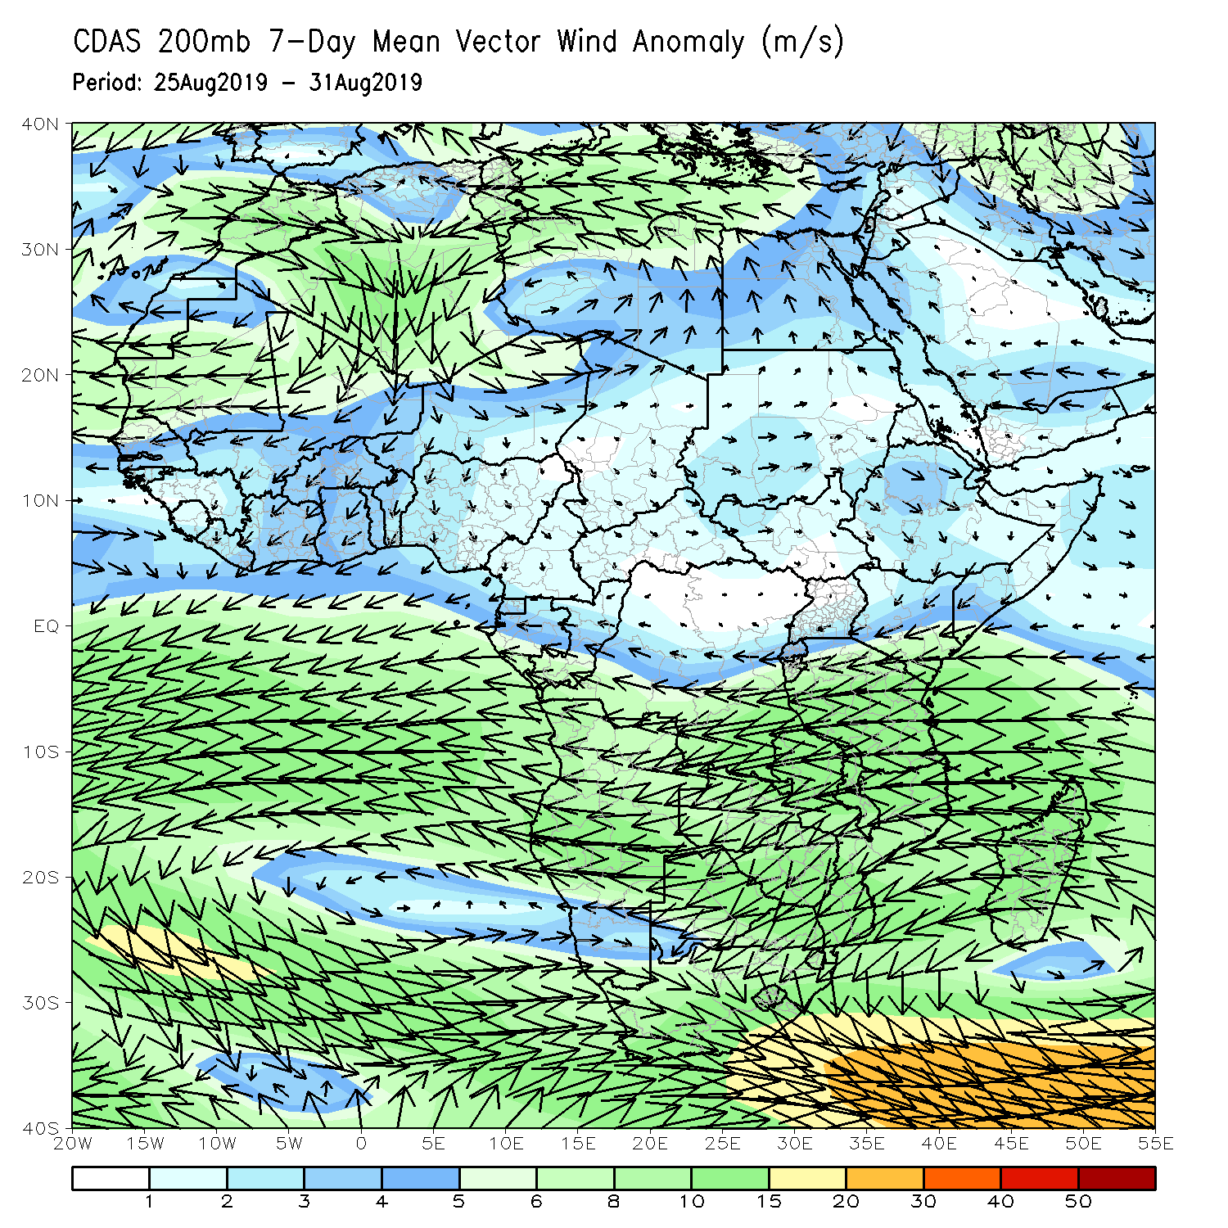
Atmospheric Circulation: Last 7 Days
A broad area of anomalous westerly flow with its associated cyclonic shear across West Africa (left) may have contributed to the observed above-average rainfall in the region.

Slide 10
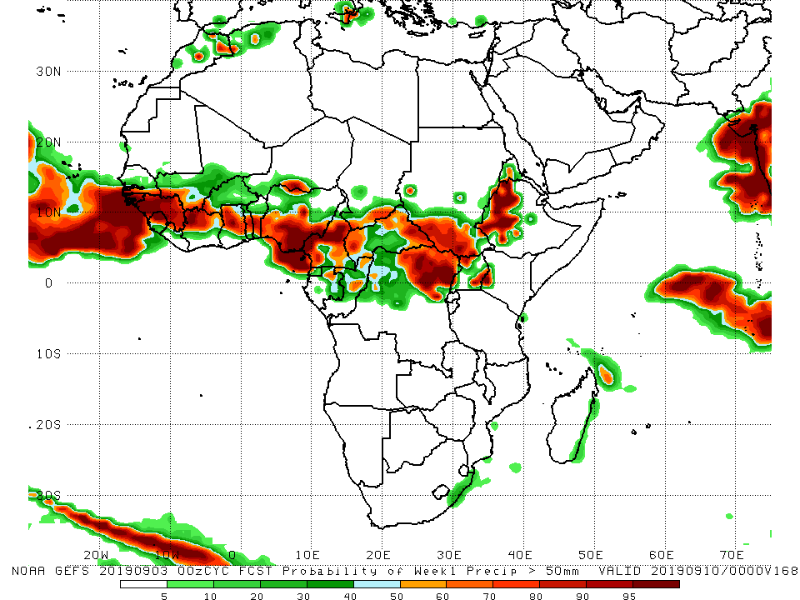
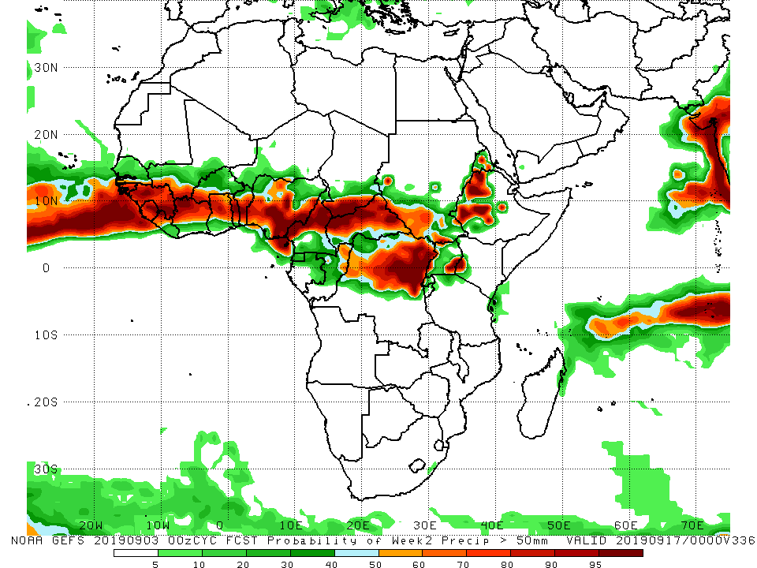
NCEP GEFS Model Forecasts Non-Bias Corrected Probability of precipitation exceedance
Week-1: Valid 4 – 10 September, 2019
Week-2: Valid 11 – 17 September, 2019
For week-1 (left panel) and week-2 (right panel), there is an increased chance for weekly rainfall totals to exceed 50mm over many places in the Gulf of Guinea and Central Africa, and western Ethiopia.
Notes:
10

Slide 11
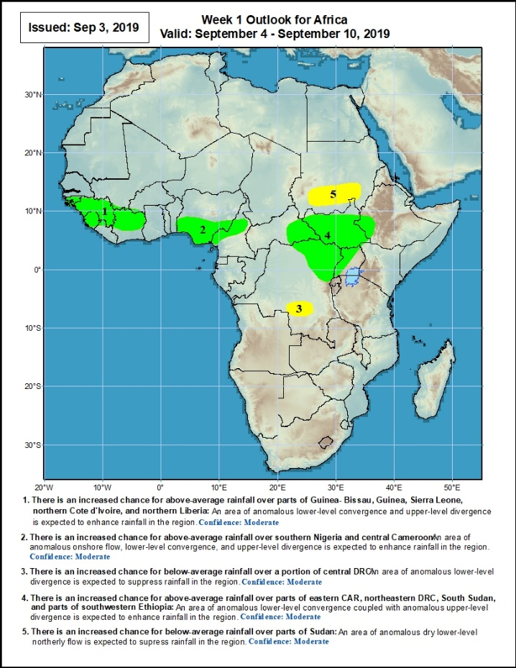
Week-1 Precipitation Outlooks
4 – 10 September, 2019
There is an increased chance for above-average rainfall over parts of Guinea- Bissau, Guinea, Sierra Leone, northern Cote d'Ivoire, and northern Liberia: An area of anomalous lower-level convergence and upper-level divergence is expected to enhance rainfall in the region. Confidence: Moderate
There is an increased chance for above-average rainfall over southern Nigeria and central Cameroon: An area of anomalous onshore flow, lower-level convergence and upper-level divergence is expected to enhance rainfall in the region. Confidence: Moderate
There is an increased chance for below-average rainfall over a portion of central DRC: An area of anomalous lower-level divergence is expected to suppress rainfall in the region. Confidence: Moderate
There is an increased chance for above-average rainfall over parts of eastern CAR, northeastern DRC, South Sudan, and parts of southwestern Ethiopia: An area of anomalous lower-level convergence couples with upper-level divergence is expected to enhance rainfall in the region. Confidence: Moderate
There is an increased chance for below-average rainfall over parts of Sudan: An area of anomalous lower-level northerly flow is expected to suppress rainfall in the region. Confidence: Moderate
Notes:
11

Slide 12
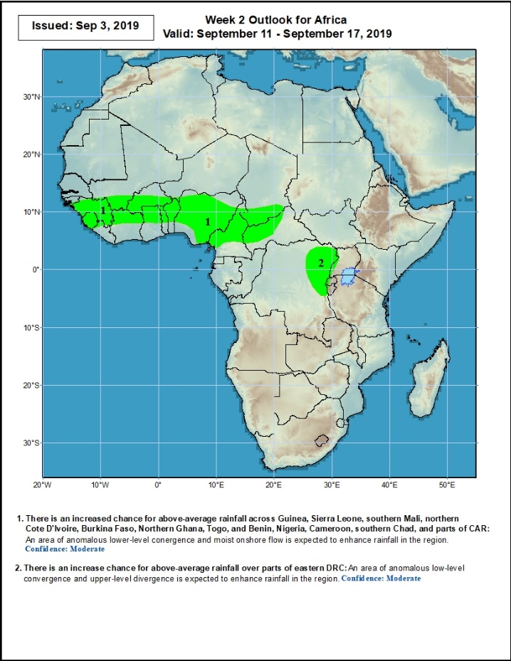
Week-2 Precipitation Outlooks
11 – 17 September, 2019
There is an increased chance for above-average rainfall across Guinea, Sierra Leone, southern Mali, northern Cote D'Ivoire, Burkina Faso, Northern Ghana, Togo, and Benin, Nigeria, Cameroon, southern Chad, and parts of CAR: An area of anomalous lower-level convergence is expected to enhance rainfall in the region. Confidence: Moderate
There is an increased chance for above-average rainfall over parts of eastern DRC: An area of anomalous lower-level convergence and upper-level divergence is expected to enhance rainfall in the region. Confidence: Moderate
Notes:
12

Slide 13
Summary
During the past 7 days, portions of Mauritania, much of Senegal, many parts of Guinea, local areas in Sierra Leone, much Liberia, and Cote d’Ivoire, local areas in Mali and Burkina Faso, southern Ghana, Togo, Benin, Niger, parts of Nigeria, southern Chad, local areas in Cameroon, Gabon and Congo, western and southern DRC, northeastern Angola, southern Sudan, eastern South Sudan, northern Tanzania, western Kenya, many parts of Ethiopia and northern Somalia had above-average rainfall. Weekly rainfall totals exceeded 100mm over parts of Senegal and southern Mauritania, central and eastern Guinea, Liberia, cote d’Ivoire, local areas in Togo and Benin, southeastern Nigeria, western Cameroon, local areas in Sudan and Somalia, and many parts of Ethiopia. Rainfall was below-average over portions of Guinea-Bissau, western Guinea, western Sierra Leone, parts of Burkina Faso and northern Ghana, many parts of Nigeria and Cameroon, CAR, northern Congo, many parts of DRC, southwestern Sudan, western South Sudan, Uganda, and parts of northern Ethiopia.
During the past 30 days, southwestern Mauritania, parts of Guinea-Bissau, local areas in eastern Liberia, parts of Ghana, local areas in Togo and Benin, portions of Nigeria and Cameroon, parts DRC, and local areas in South Sudan and Ethiopia had below-average rainfall. Rainfall was above-average over much of Senegal, Guinea, Sierra Leone, much of Liberia, Mali, Burkina Faso, Cote d’Ivoire, local areas in Ghana, Togo and Benin, much of Niger, portions of Nigeria, western Cameroon, much of Chad and CAR, parts of Congo, western DRC, Uganda, South Sudan, Sudan, many parts of Ethiopia, northern Tanzania, Uganda and western Kenya.
During the past 90 days, western Mauritania, northern Senegal, western Guinea-Bissau, parts of Cote d’Ivoire and Ghana, portions of Nigeria, southern Cameroon, parts of Gabon and Congo, portions of DRC, and northeastern Ethiopia and portions of South Africa had below-average rainfall. Rainfall was above-average over portions of Senegal, much Guinea, southern Mauritania, Sierra Leone, Liberia, Mali, many parts of Cote d’Ivoire, Burkina Faso, Ghana, Togo, Benin, Niger, parts of Nigeria, Chad, many parts of Cameroon, much of CAR, parts of DRC, South Sudan, Uganda, Sudan, many parts of Ethiopia, and western Kenya and northern Tanzania.
Week-1 outlooks call for an increased chance for above-average rainfall over parts of Guinea- Bissau, Guinea, Sierra Leone, northern Cote d'Ivoire, northern Liberia, southern Nigeria, central Cameroon, eastern CAR, northeastern DRC, South Sudan, and parts of southwestern Ethiopia. In contrast, there is an increased chance for below-average rainfall over portions of central DRC and southern Sudan.
Notes:
13

