Slide 1
The African Monsoon Recent Evolution and Current Status
Include Week-1 and Week-2 Outlooks
Update prepared by
Climate Prediction Center / NCEP
30 September 2019
For more information, visit:
http://www.cpc.ncep.noaa.gov/products/Global_Monsoons/African_Monsoons/precip_monitoring.shtml

Slide 2
Outline
Highlights
Recent Evolution and Current Conditions
NCEP GEFS Forecasts
Summary

Slide 3
Highlights:
Last 7 Days
Weekly rainfall surpluses exceeded 100mm over parts of southern Nigeria.
Week-1 outlooks call for an increased chance for below-average rainfall over much of Senegal, southwestern Mali and Guinea-Bissau. In contrast, there is an increased chance for above-average rainfall over many places in the Gulf of Guinea and Central Africa countries, and portions of Sudan and Ethiopia.

Slide 4
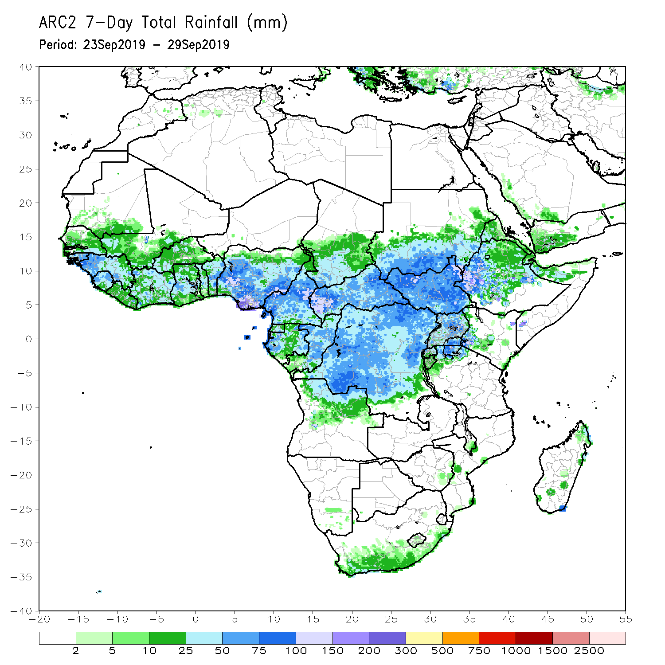
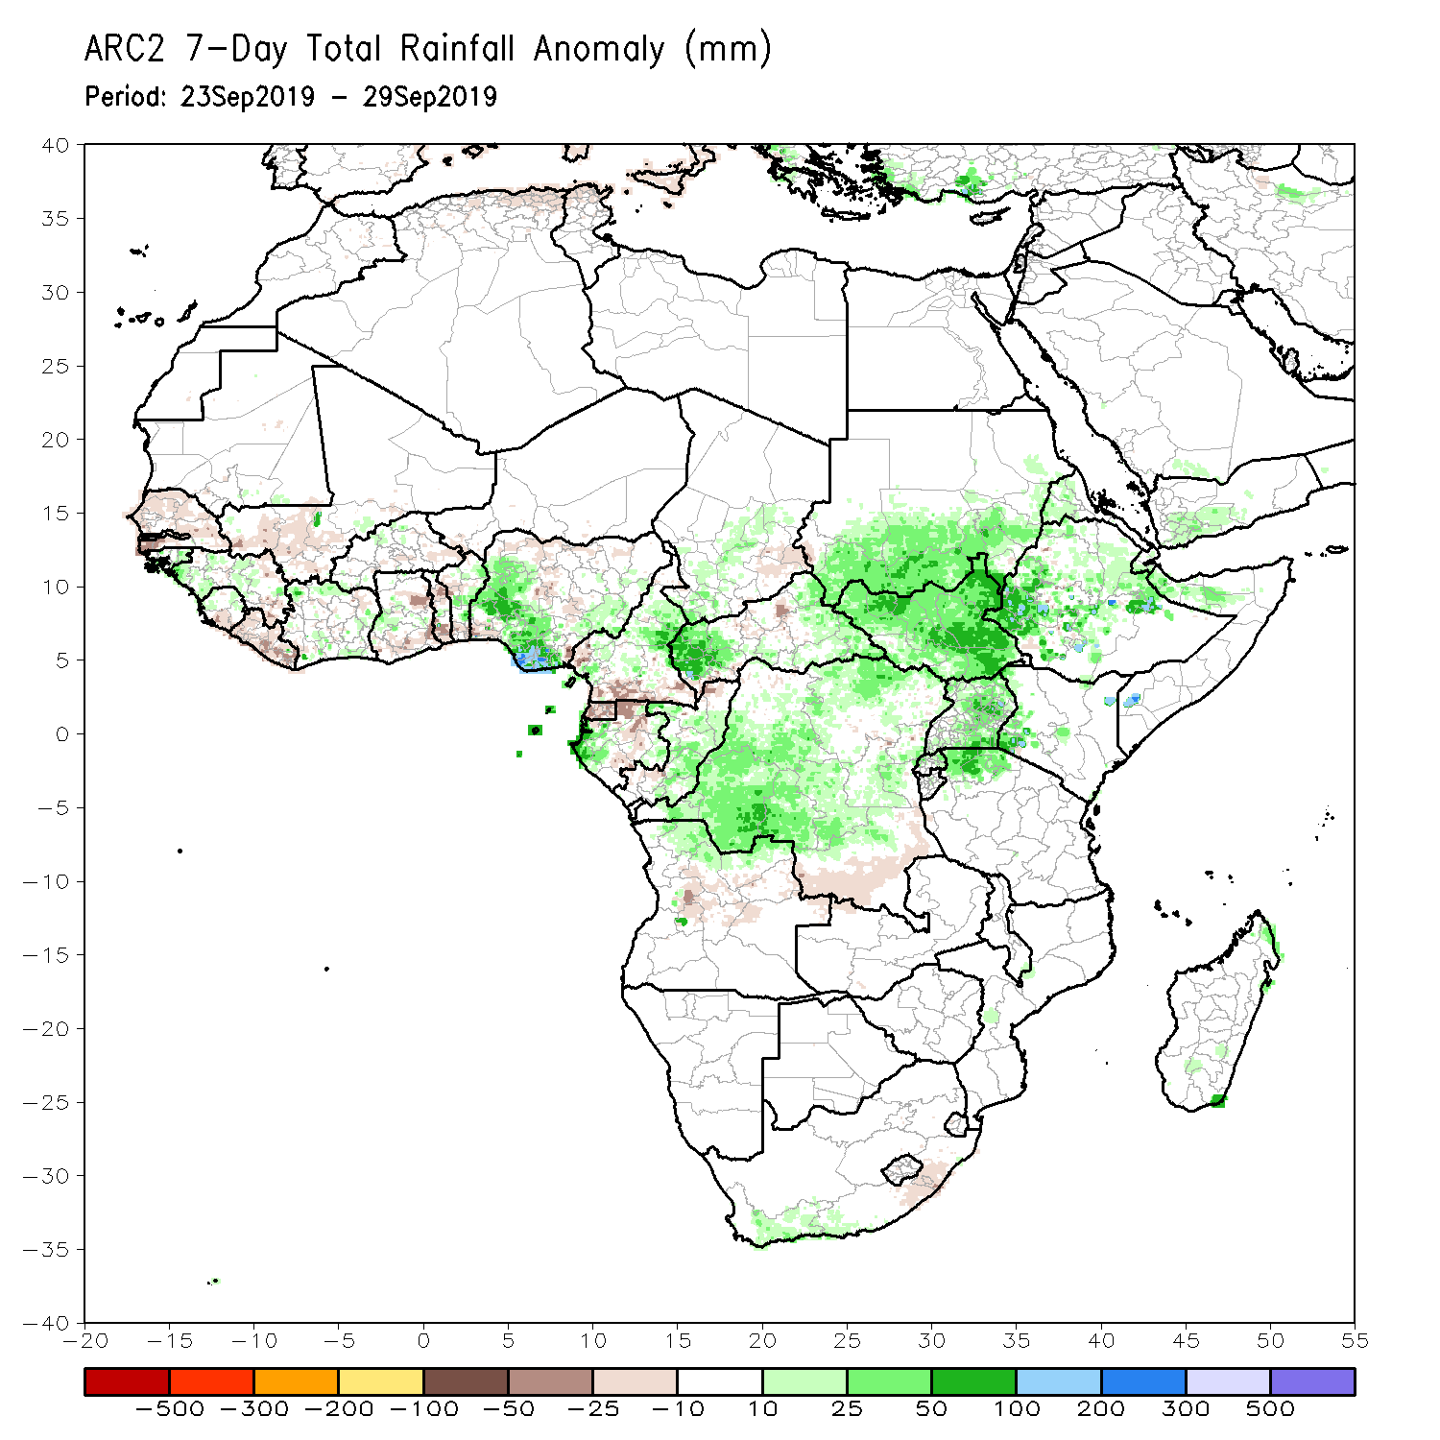
Rainfall Patterns: Last 7 Days
During the past 7 days, weekly rainfall totals exceeded 100mm over parts of Nigeria, local areas in Cameroon, western CAR, and parts of Ethiopia. Portions of Guinea, Sierra Leone, Cote d’Ivoire, parts of Ghana, Benin, western and southern Nigeria, portions of Cameroon, western Gabon, local areas in Chad, portions of CAR and Congo, many parts of DRC, southern Sudan, much South Sudan, portions of Ethiopia and Uganda, northern Tanzania, and local areas in Kenya and Somalia had above-average rainfall.
Rainfall was below-average over much of Senegal, parts of southern Mauritania, local areas in Guinea and Liberia, southern Mali, parts of Burkina Faso and Ghana, portions of Togo, southern Benin, parts of Nigeria, Equatorial Guinea, parts of Cameroon and Gabon, local areas in Congo and CAR, eastern Chad, parts of western Sudan, Angola, and parts of southern DRC and southeastern South Africa.

Slide 5
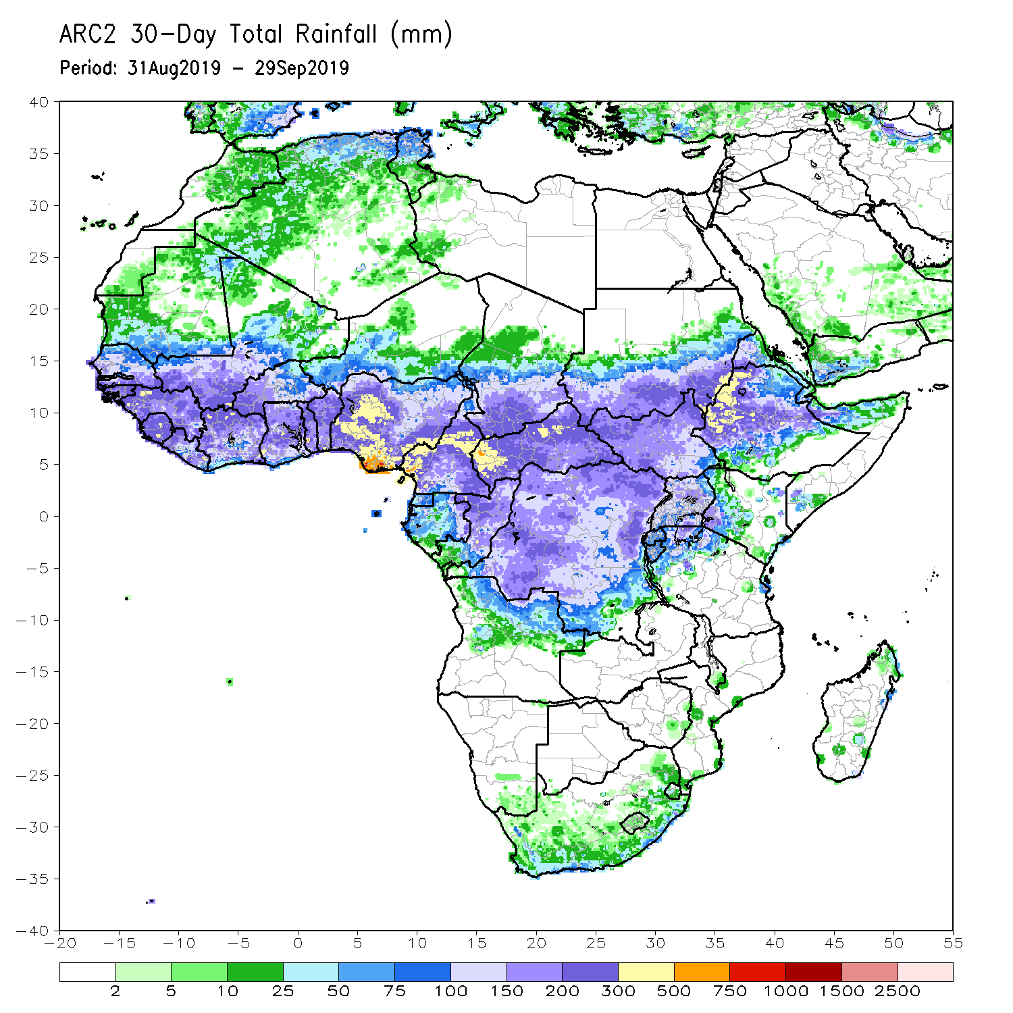
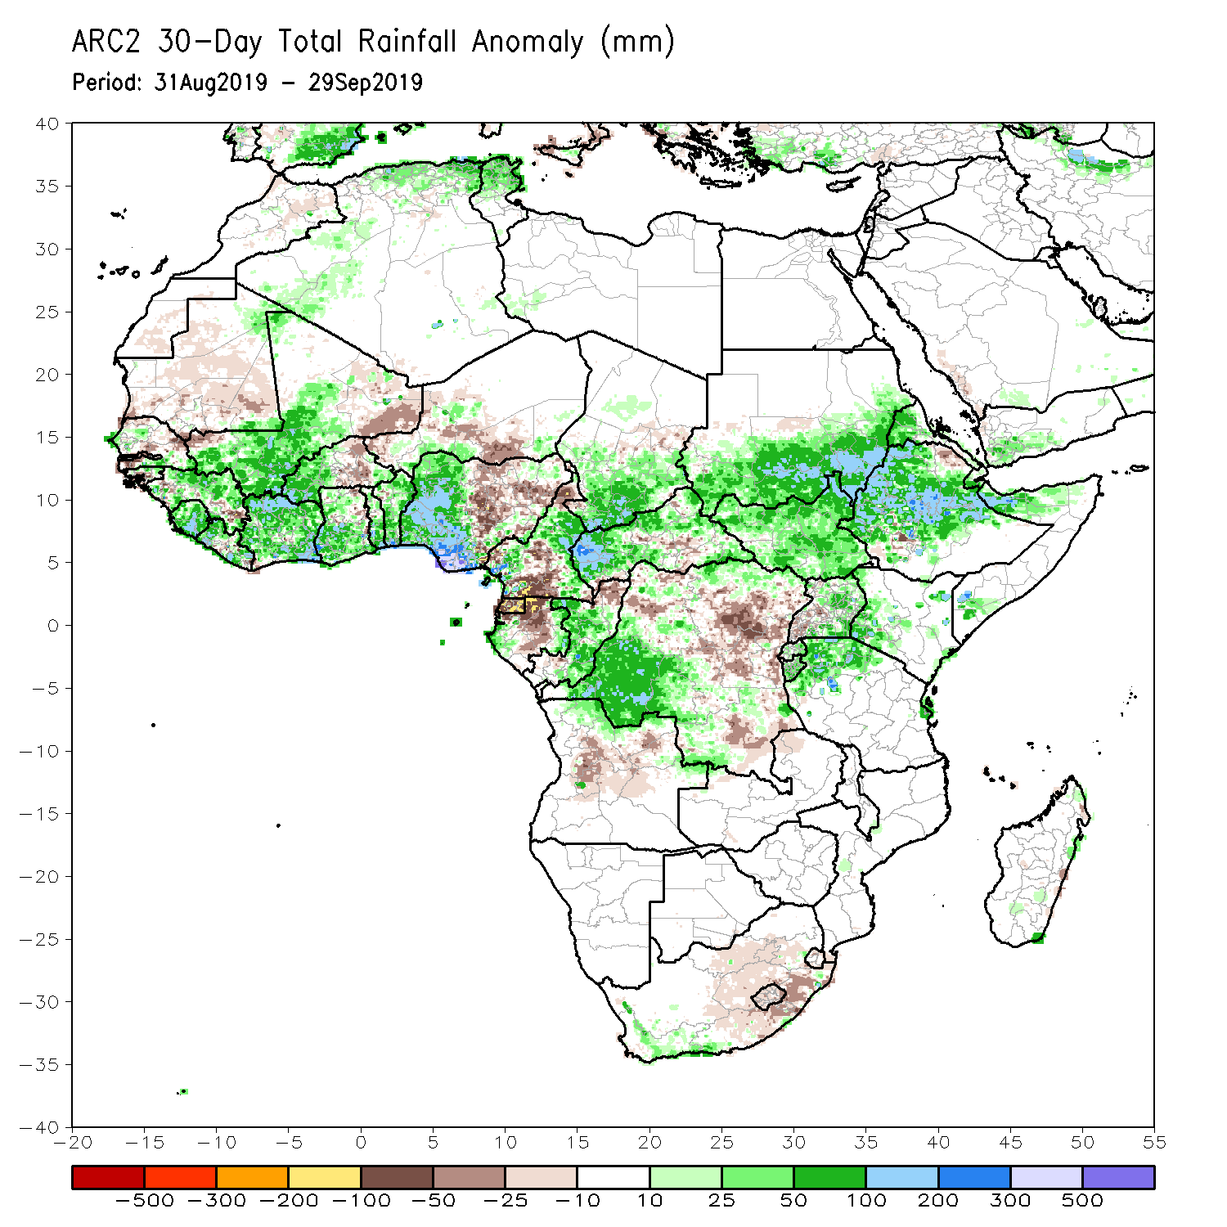
Rainfall Patterns: Last 30 Days
During the past 30 days, rainfall was above-average over local areas in Senegal, much of Guinea, Sierra Leone, Liberia, Mali, western Burkina Faso, many parts of Ghana, Cote d’Ivoire, Togo, Benin, portions of Nigeria and Cameroon, southern Chad, portions of CAR, much of Congo, western DRC, much of South Sudan, southern and eastern Sudan, many parts of Ethiopia, Eritrea, northern Tanzania, and parts of Somalia and Kenya.
Portions of Mauritania, Senegal, Guinea-Bissau, local areas in Guinea, parts of northeastern Ghana, eastern Burkina Faso, portions of Nigeria and Cameroon, northern and eastern DRC, southern CAR, parts of Uganda and South Africa had below-average rainfall.
Notes:
5

Slide 6
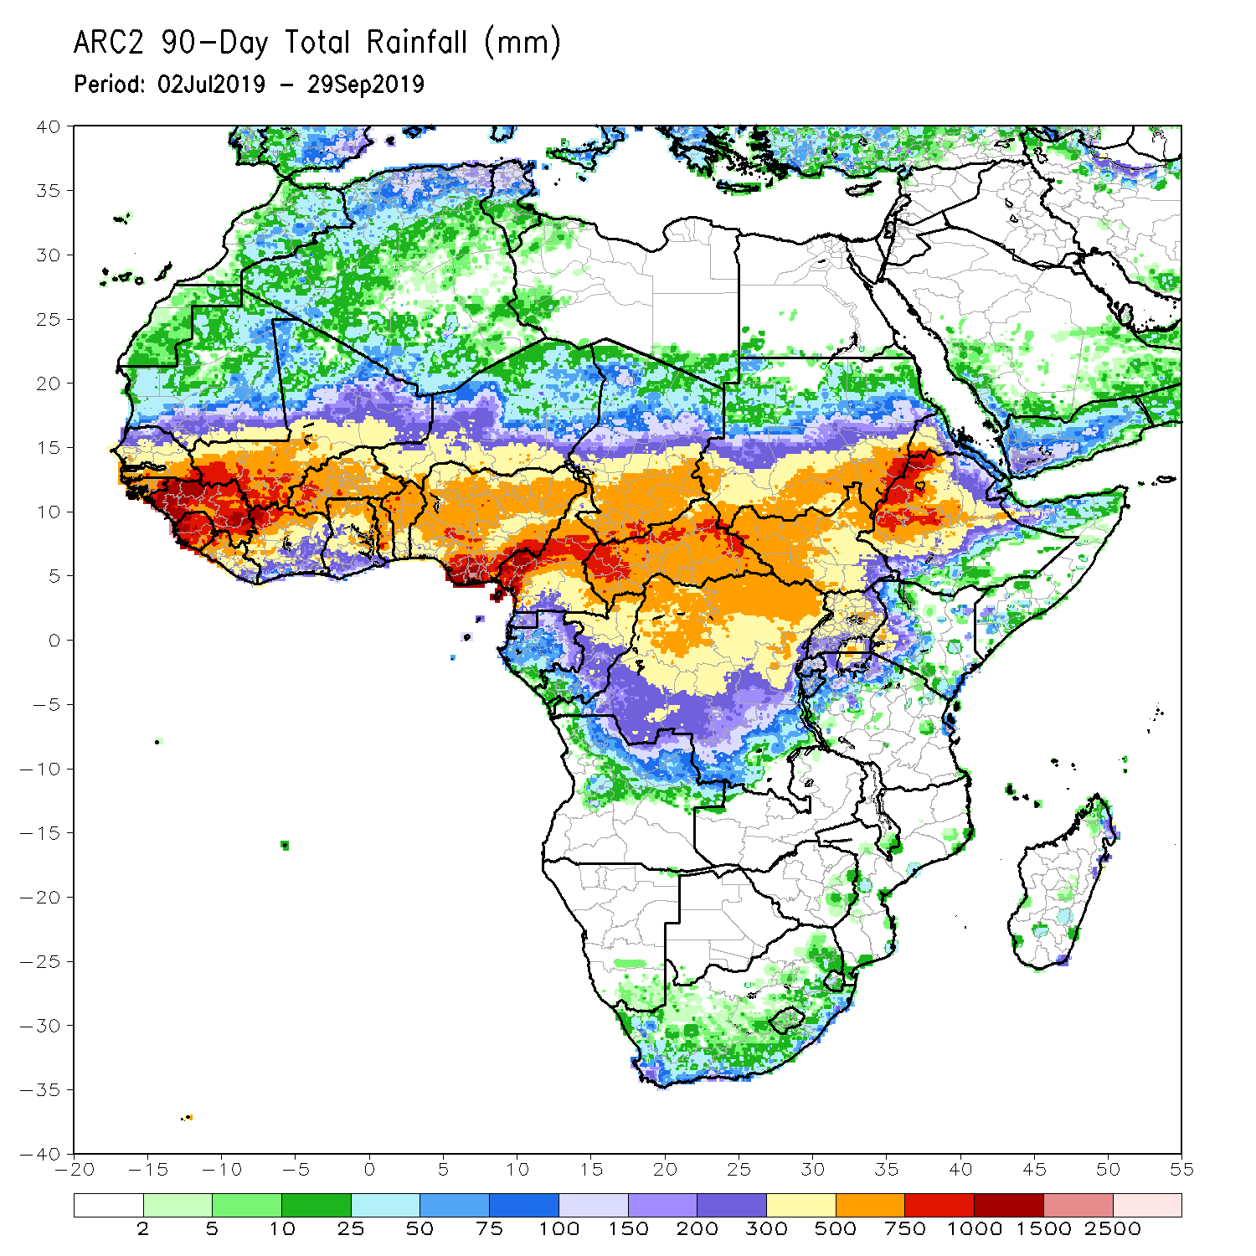
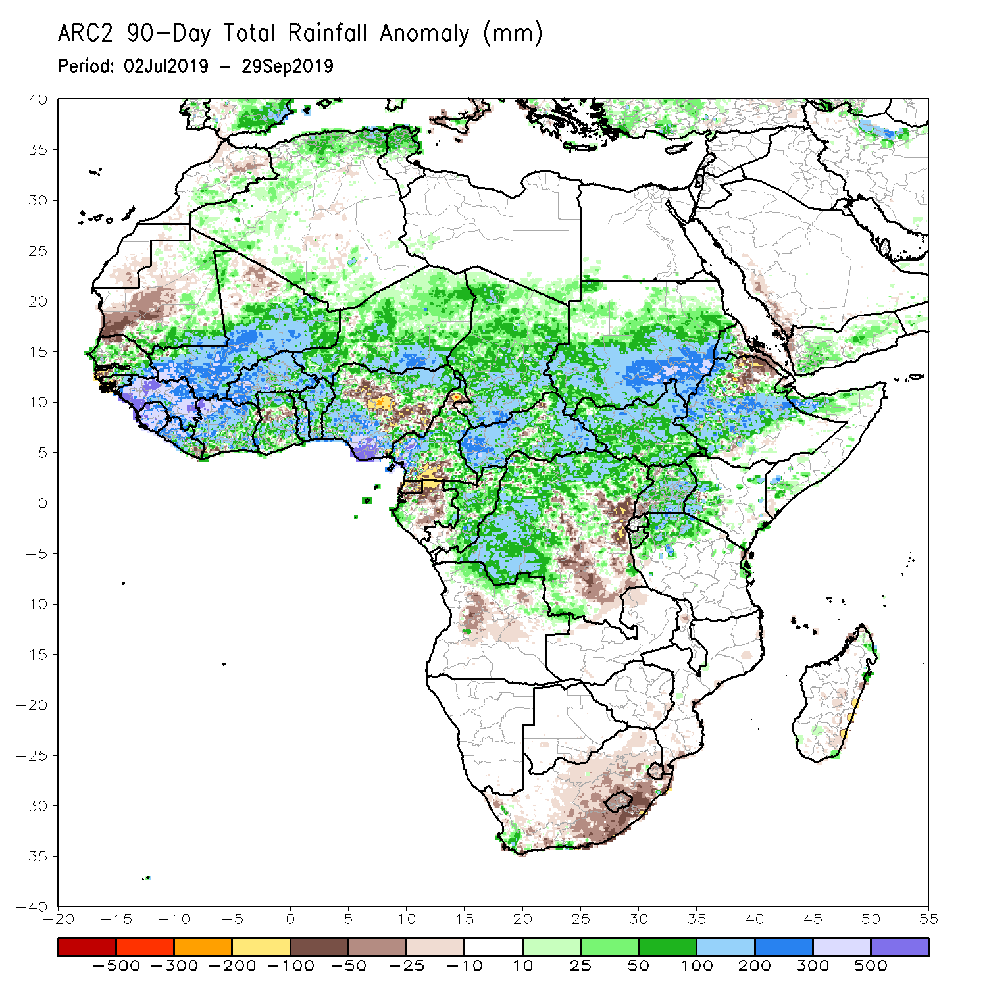
Rainfall Patterns: Last 90 Days
During the past 90 days, western and central Mauritania, local areas in Senegal, western Guinea-Bissau, local areas in Ghana, portions of Nigeria and Cameroon, Gabon, local areas in Congo, portions of DRC, and northeastern Ethiopia and many parts of South Africa had below-average rainfall.
Rainfall was above-average over many parts of Senegal, much Guinea, southern and eastern Mauritania, Sierra Leone, Liberia, Mali, much of Cote d’Ivoire, Burkina Faso, Ghana, Togo, Benin, Niger, portions of Nigeria, much of Chad, many parts of Cameroon, CAR, many parts of DRC, South Sudan, Uganda, Sudan, many parts of Ethiopia, and western Kenya, parts of Somalia and northern Tanzania.
Notes:
6

Slide 7
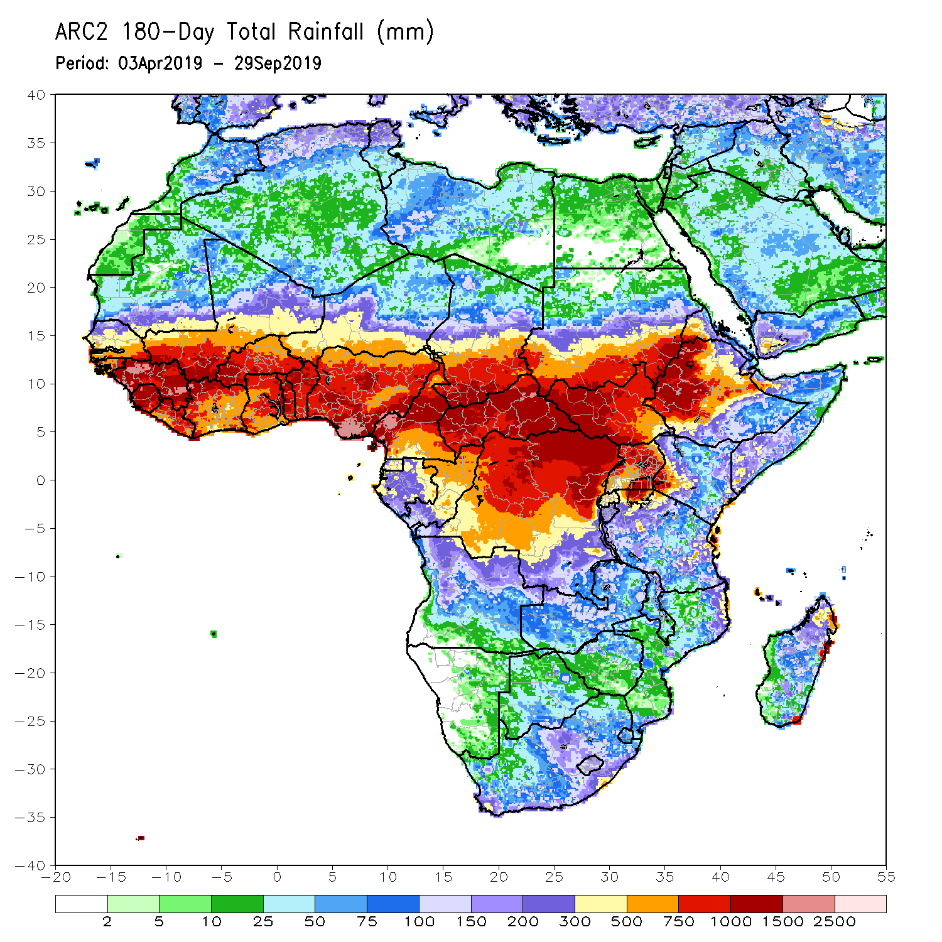
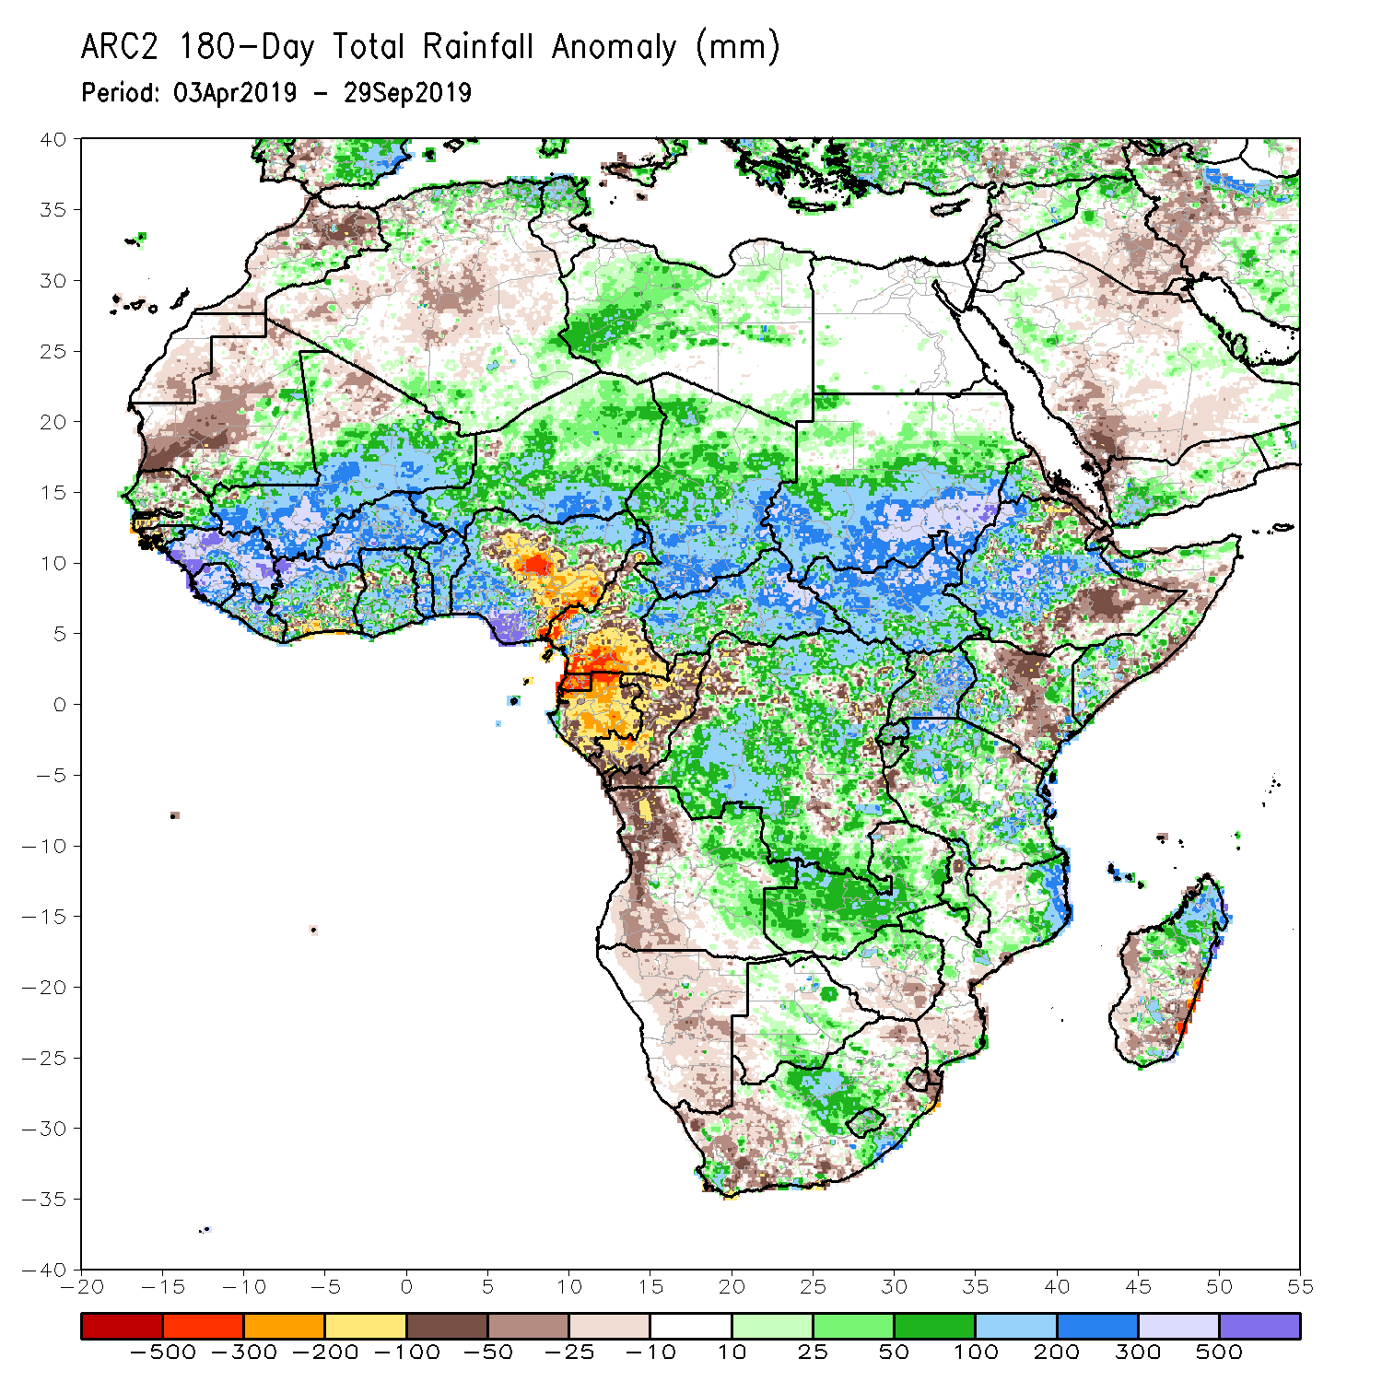
Rainfall Patterns: Last 180 Days
During the past 180 days, below-average rainfall was observed over western and central Mauritania, local areas in Senegal, western Guinea-Bissau, local areas in Liberia, Cote d’Ivoire and Ghana, portions of Nigeria, many parts of Cameroon, Equatorial Guinea, Gabon, Congo, portions of DRC, much of Angola, Namibia, western and northeastern South Africa, eastern Zambia, parts of Botswana, Zimbabwe, many parts of Mozambique, parts of Madagascar, local areas in Tanzania, many parts of Kenya, and portions of Ethiopia and Somalia.
Many parts of Senegal, eastern Guinea-Bissau, much of Guinea, Sierra Leone, Mali, much of Liberia and Cote d’Ivoire, Burkina Faso, Ghana, Togo, Benin, parts of Nigeria, Niger, Chad, CAR, many parts of DRC, South Sudan, Sudan, Uganda, many parts of Ethiopia and Tanzania, Zambia, local areas in Malawi, northern Mozambique, and portions of South Africa and Madagascar had above-average rainfall.
Notes:
7

Slide 8
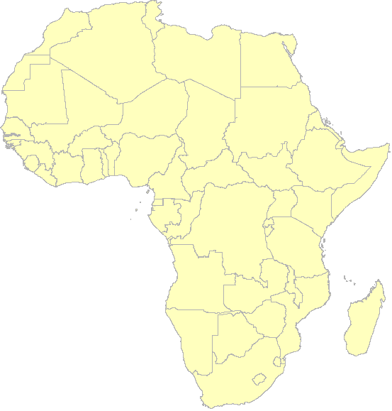
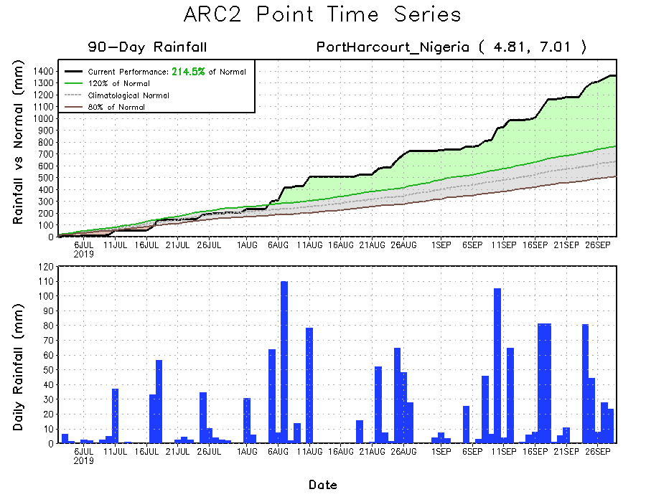
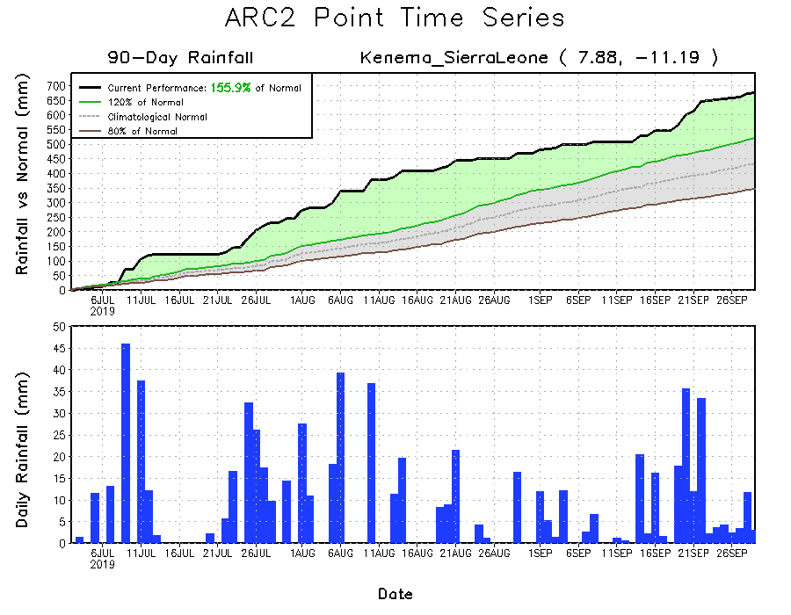
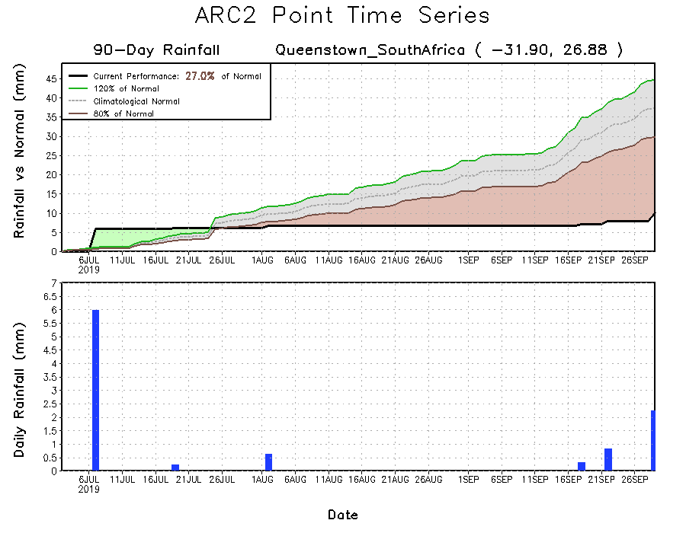
Recent Rainfall Evolution
Daily evolution of rainfall over the last 90 days at selected locations shows that moderate to locally heavy rainfall sustained moisture surpluses over parts of southwestern Sierra Leone (bottom left) and southern Nigeria (top right). Early season dryness was observed across southern South Africa (bottom right).

Slide 9
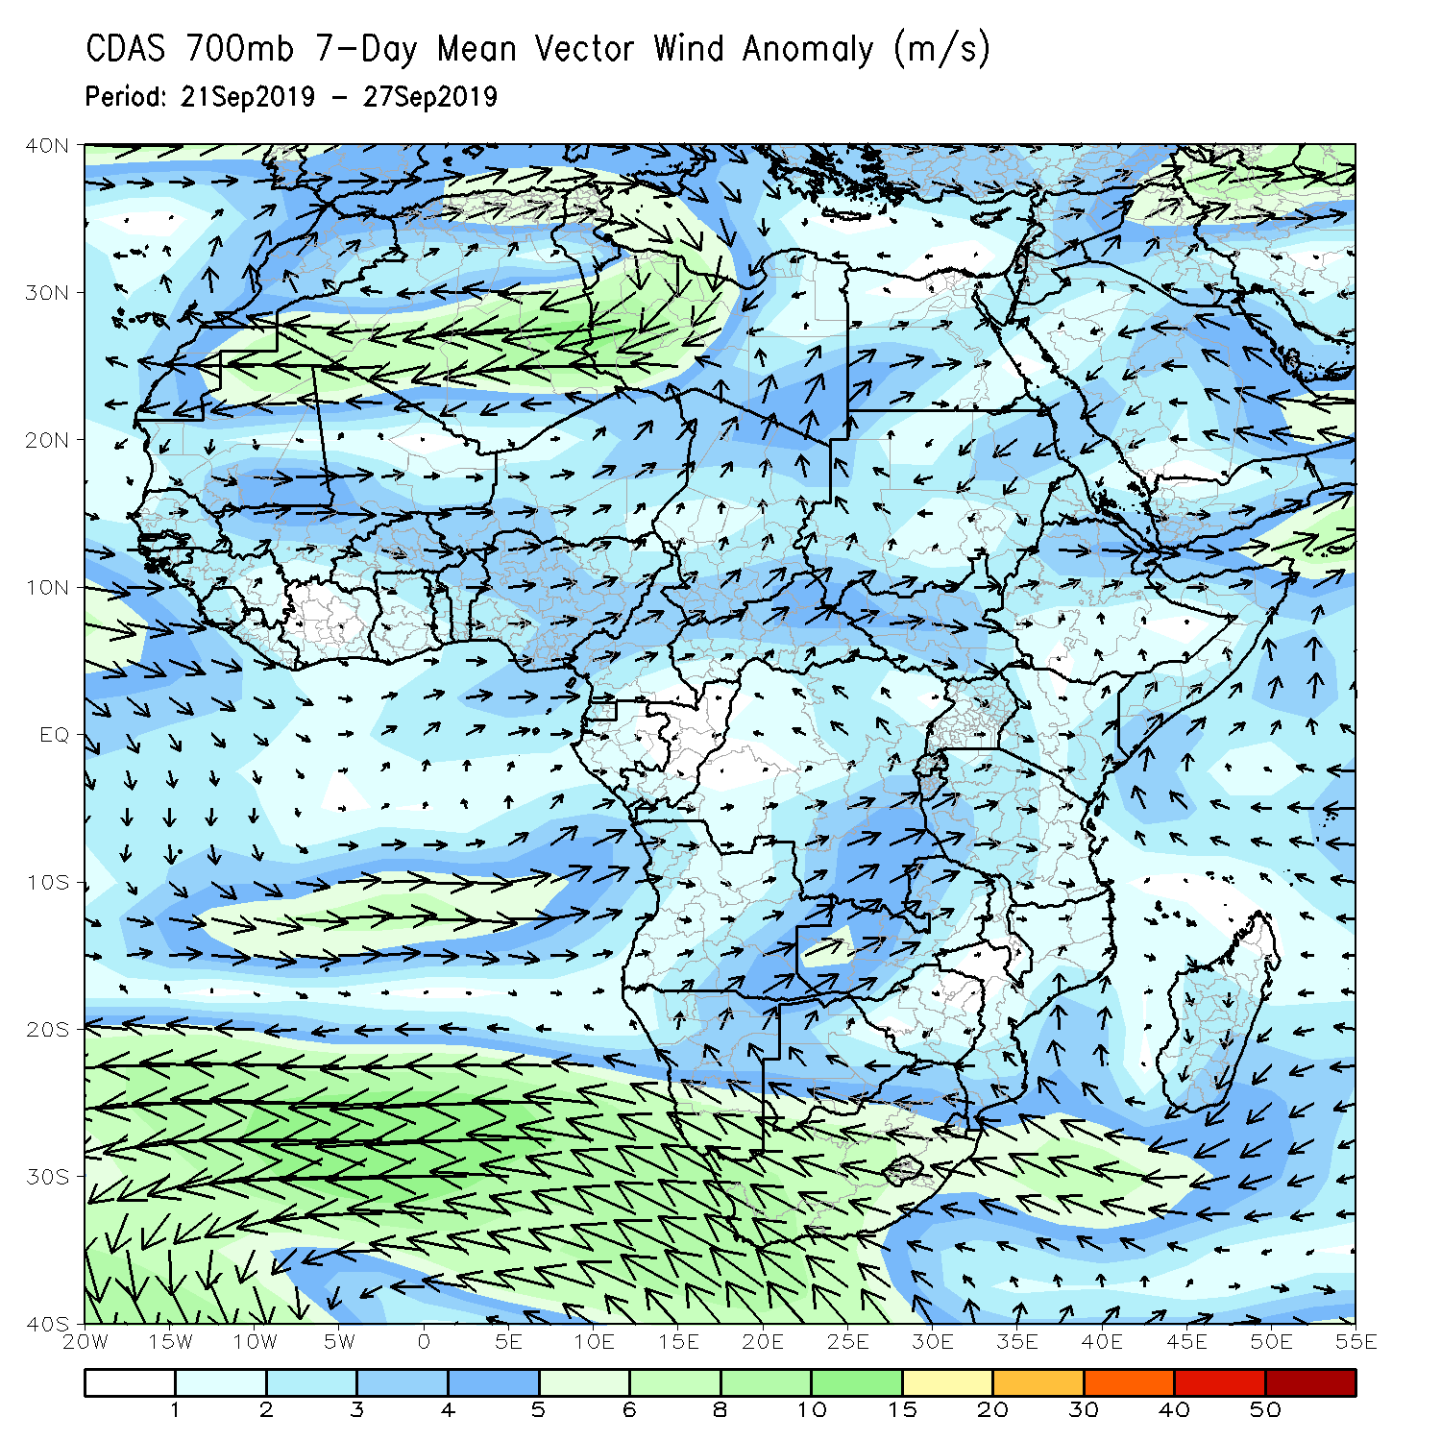
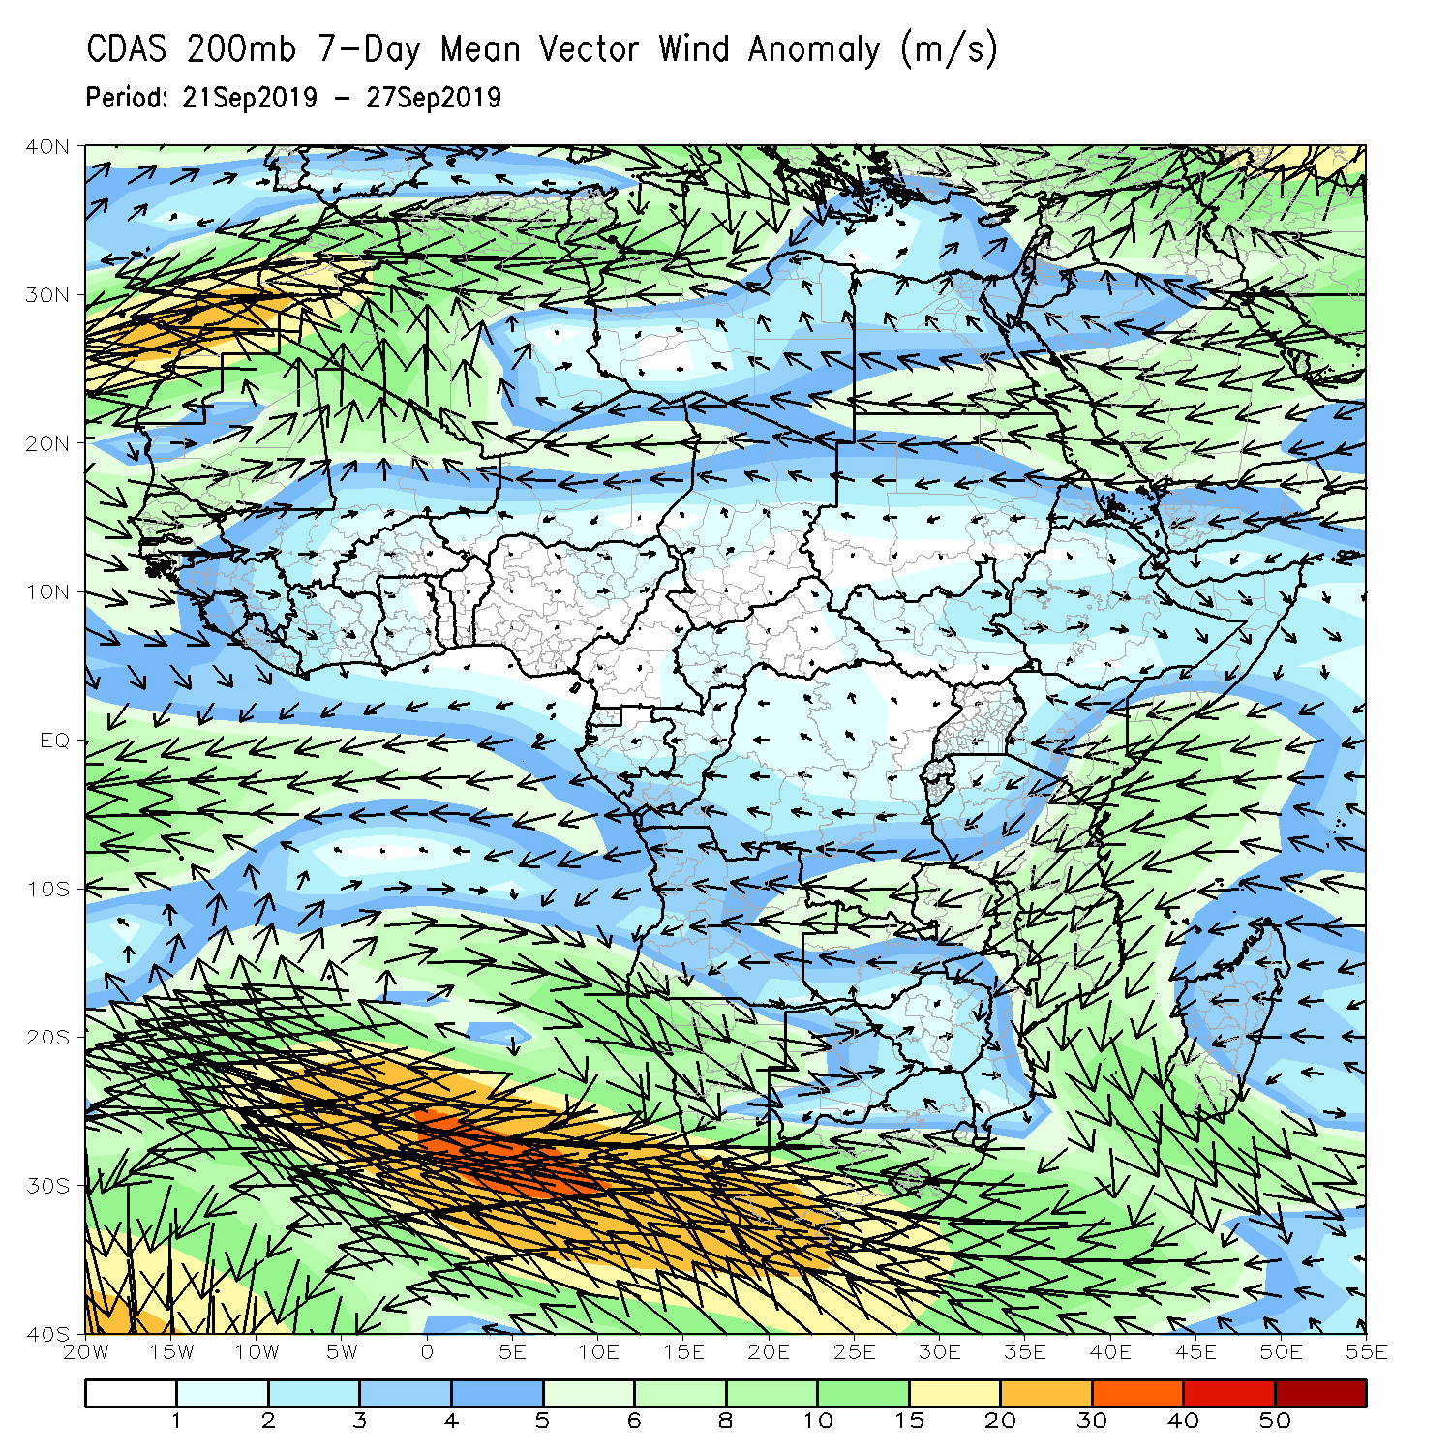
Atmospheric Circulation:
Last 7 Days
Anomalous lower-level westerly to southwesterly flow was observed across eastern Gulf of Guinea and the neighboring areas of central Africa (left).

Slide 10
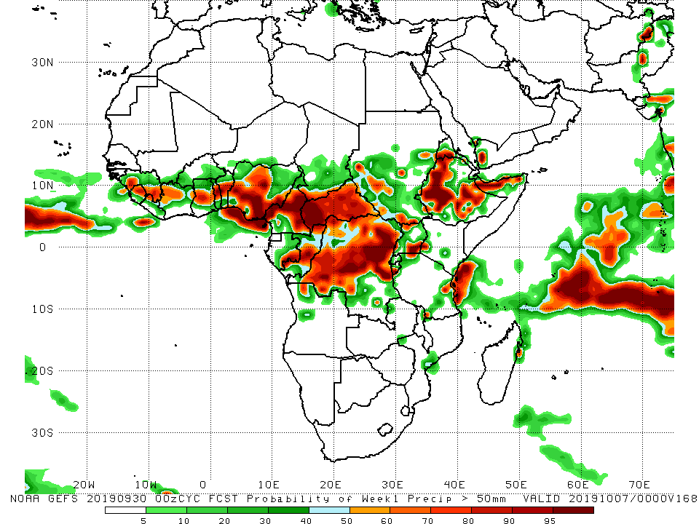
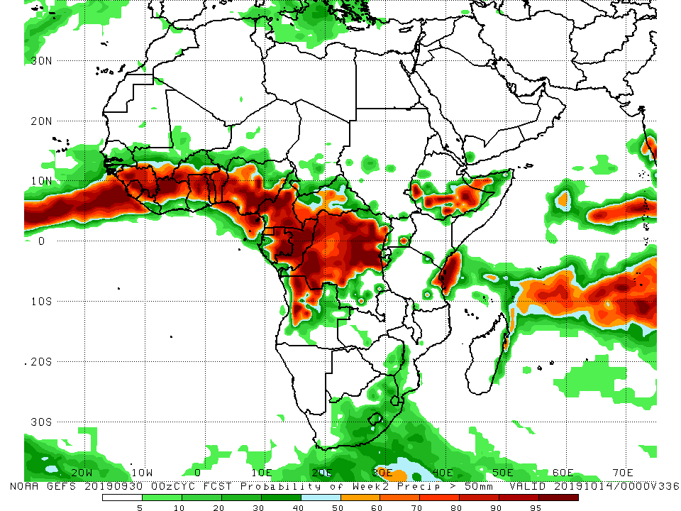
NCEP GEFS Model Forecasts
Non-Bias Corrected Probability of
precipitation exceedance
Week-1: Valid 1 – 7 October, 2019
Week-2: Valid 8 – 14 October, 2019
For week-1 (left panel) and week-2 (right panel), there is an increased chance for weekly rainfall totals to exceed 50mm across Gulf of Guinea and Central Africa counties, portions of Ethiopia, and coastal Tanzania.
Notes:
10

Slide 11
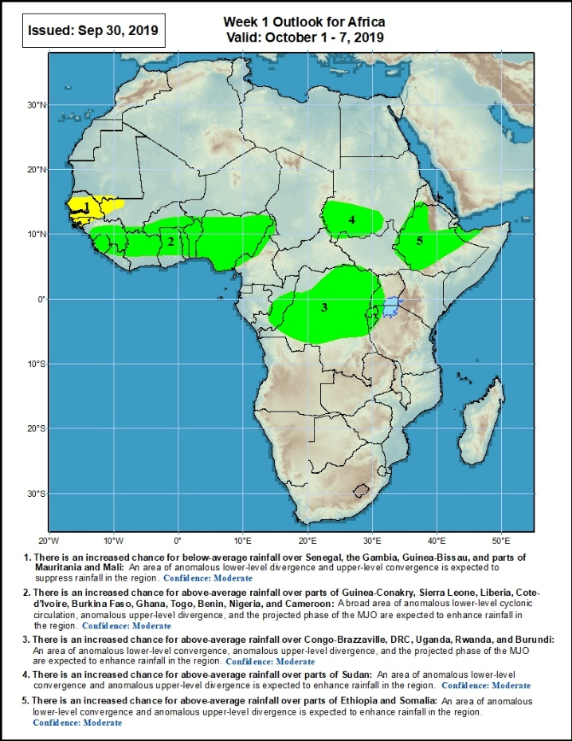
Week-1 Precipitation Outlooks
1 – 7 October, 2019
There is an increased chance for below-average rainfall over Senegal, Gambia, Guinea-Bissau, and parts of Mauritania and Mali: An area of anomalous lower-level divergence and upper-level convergence is expected to suppress rainfall in the region. Confidence: Moderate
There is an increased chance for above-average rainfall over parts of Guinea-Conakry, Sierra Leone, Liberia, Cote-d’Ivoire, Burkina Faso, Ghana, Togo, Benin, Nigeria, and Cameroon: A broad area of anomalous lower-level cyclonic circulation, anomalous upper-level divergence, and the projected phase of the MJO are expected to enhance rainfall in the region. Confidence: Moderate
There is an increased chance for above-average rainfall over Congo-Brazzaville, DRC, Uganda, Rwanda, and Burundi: An area of upper-level divergence along with the projected phase of the MJO is expected to enhance rainfall in the region. Confidence: Moderate
There is an increased chance for above-average rainfall over parts of Sudan: An area of anomalous lower-level convergence and upper-level divergence is expected to enhance rainfall in the region. Confidence: Moderate
There is an increased chance for above-average rainfall over parts of Ethiopia and Somalia: An area of anomalous lower-level convergence and upper-level divergence is expected to enhance rainfall in the region. Confidence: Moderate
Notes:
11

Slide 12
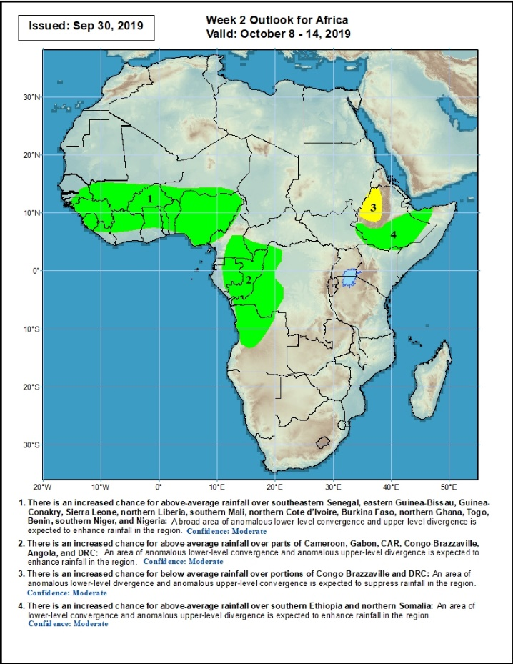
Week-2 Precipitation Outlooks
8 – 14 October, 2019
There is an increased chance for above-average rainfall over southeastern Senegal, eastern Guinea-Bissau, Guinea-Conakry, Sierra Leone, northern Liberia, southern Mali, northern Cote d’Ivoire, Burkina Faso, northern Ghana, Togo, Benin, southern Niger, and Nigeria: A broad area of anomalous lower-level convergence and upper-level divergence is expected to enhance rainfall in the region. Confidence: Moderate
There is an increased chance for above-average rainfall over parts of Cameroon, Gabon, CAR, Congo-Brazzaville, Angola, and DRC: An area of anomalous lower-level convergence and upper-level divergence is expected to enhance rainfall in the region. Confidence: Moderate
There is an increased chance for below-average rainfall over portions of Congo-Brazzaville and DRC: An area of anomalous lower-level divergence and upper-level convergence is expected to suppress rainfall in the region. Confidence: Moderate
There is an increased chance for above-average rainfall over southern Ethiopia and northern Somalia: An area of anomalous lower-level convergence and upper-level divergence is expected to enhance rainfall in the region. Confidence: Moderate
Notes:
12

Slide 13
Summary
During the past 7 days, weekly rainfall totals exceeded 100mm over parts of Nigeria, local areas in Cameroon, western CAR, and parts of Ethiopia. Portions of Guinea, Sierra Leone, Cote d’Ivoire, parts of Ghana, Benin, western and southern Nigeria, portions of Cameroon, western Gabon, local areas in Chad, portions of CAR and Congo, many parts of DRC, southern Sudan, much South Sudan, portions of Ethiopia and Uganda, northern Tanzania, and local areas in Kenya and Somalia had above-average rainfall. Rainfall was below-average over much of Senegal, parts of southern Mauritania, local areas in Guinea and Liberia, southern Mali, parts of Burkina Faso and Ghana, portions of Togo, southern Benin, parts of Nigeria, Equatorial Guinea, parts of Cameroon and Gabon, local areas in Congo and CAR, eastern Chad, parts of western Sudan, Angola, and parts of southern DRC and southeastern South Africa.
During the past 30 days, rainfall was above-average over local areas in Senegal, much of Guinea, Sierra Leone, Liberia, Mali, western Burkina Faso, many parts of Ghana, Cote d’Ivoire, Togo, Benin, portions of Nigeria and Cameroon, southern Chad, portions of CAR, much of Congo, western DRC, much of South Sudan, southern and eastern Sudan, many parts of Ethiopia, Eritrea, northern Tanzania, and parts of Somalia and Kenya. Portions of Mauritania, Senegal, Guinea-Bissau, local areas in Guinea, parts of northeastern Ghana, eastern Burkina Faso, portions of Nigeria and Cameroon, northern and eastern DRC, southern CAR, parts of Uganda and South Africa had below-average rainfall.
During the past 90 days, western and central Mauritania, local areas in Senegal, western Guinea-Bissau, local areas in Ghana, portions of Nigeria and Cameroon, Gabon, local areas in Congo, portions of DRC, and northeastern Ethiopia and many parts of South Africa had below-average rainfall. Rainfall was above-average over many parts of Senegal, much Guinea, southern and eastern Mauritania, Sierra Leone, Liberia, Mali, much of Cote d’Ivoire, Burkina Faso, Ghana, Togo, Benin, Niger, portions of Nigeria, much of Chad, many parts of Cameroon, CAR, many parts of DRC, South Sudan, Uganda, Sudan, many parts of Ethiopia, and western Kenya, parts of Somalia and northern Tanzania.
Week-1 outlooks call for an increased chance for below-average rainfall over much of Senegal, southwestern Mali and Guinea-Bissau. In contrast, there is an increased chance for above-average rainfall over many places in the Gulf of Guinea and Central Africa countries, and portions of Sudan and Ethiopia.
Notes:
13

