Slide 1
The African Monsoon Recent Evolution and Current Status Include Week-1 and Week-2 Outlooks
Update prepared by
Climate Prediction Center / NCEP
09 December 2019
For more information, visit:
http://www.cpc.ncep.noaa.gov/products/Global_Monsoons/African_Monsoons/precip_monitoring.shtml

Slide 2
Outline
Highlights
Recent Evolution and Current Conditions
NCEP GEFS Forecasts
Summary

Slide 3
Highlights: Last 7 Days
Weekly rainfall surpluses exceeded 100mm over local areas in Kenya and Tanzania.
Week-1 outlooks call for an increased chance for above-average rainfall over northeastern Angola, southern and eastern DRC, Uganda, Kenya, Ethiopia, central and eastern Zambia, Malawi, eastern Zimbabwe, Mozambique and Madagascar. In contrast, there is an increased chance for below-average rainfall over southern Angola, northern Namibia, southwestern Zambia, Botswana, western Zimbabwe, and parts of northern South Africa.

Slide 4
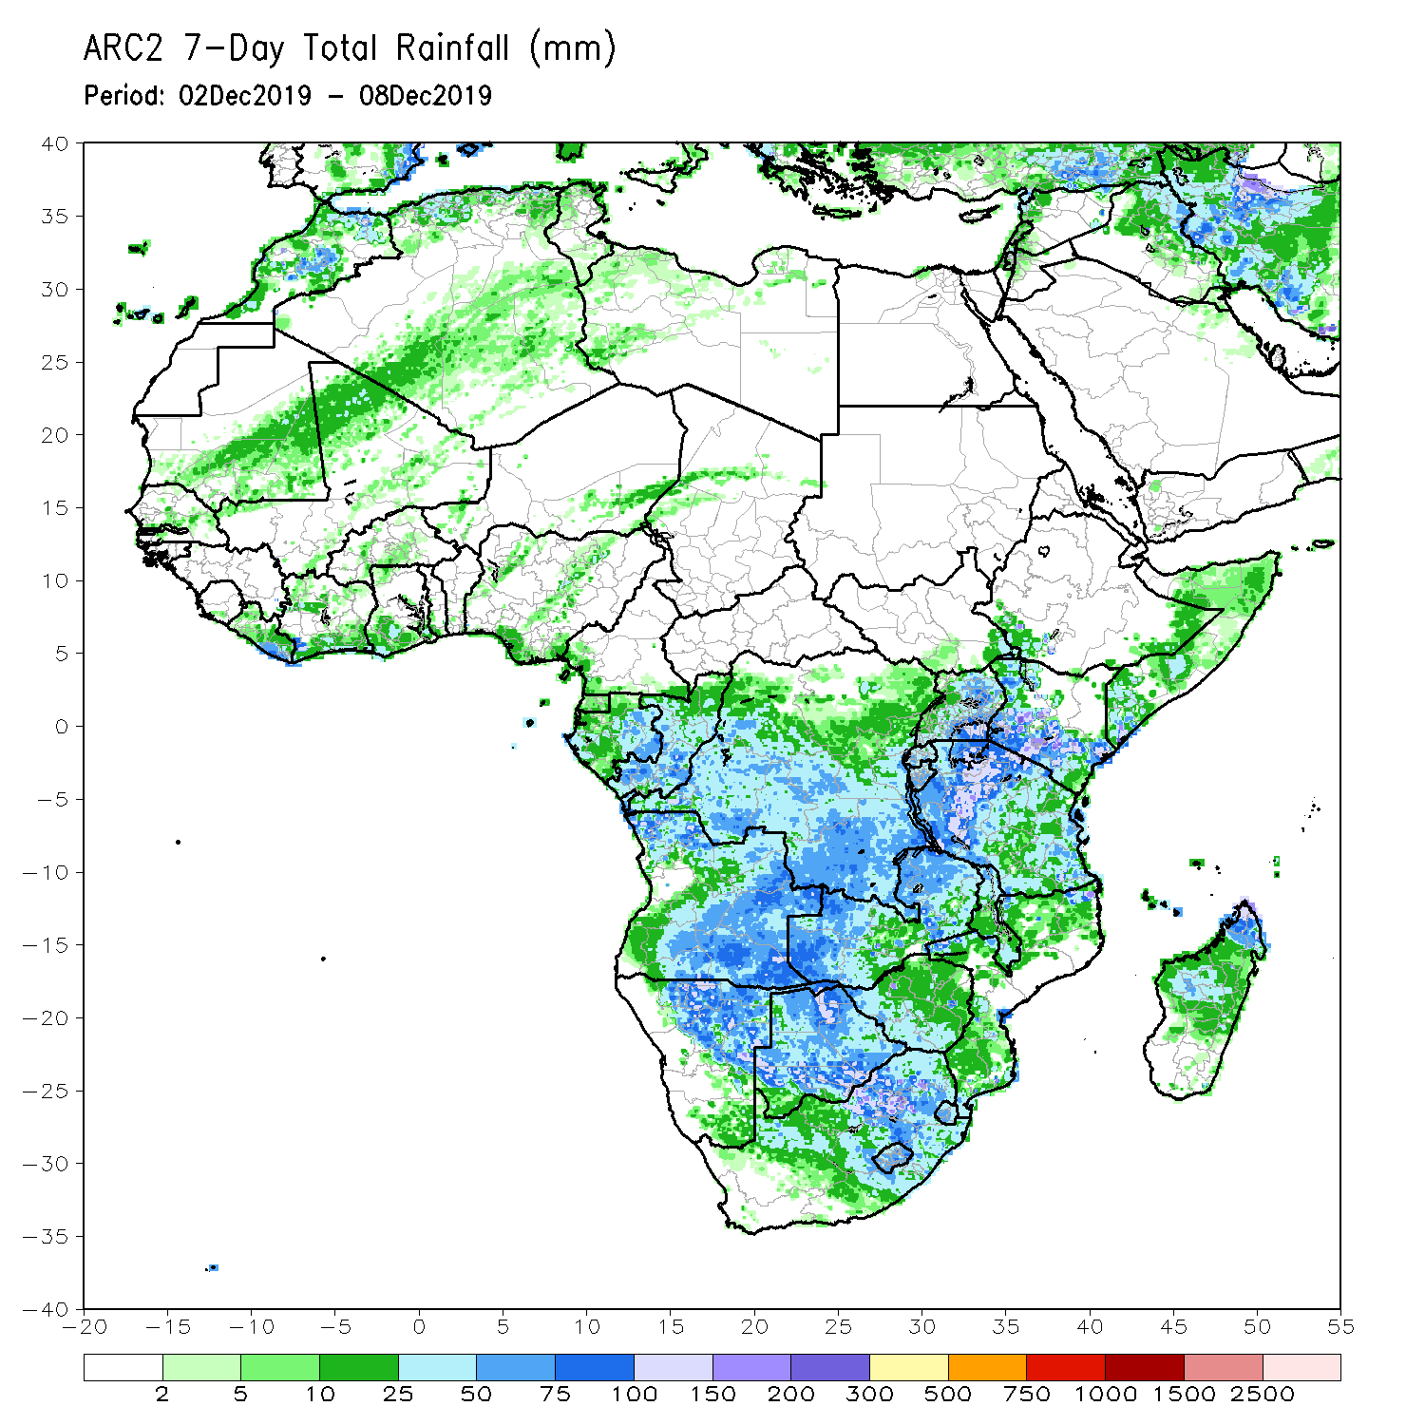
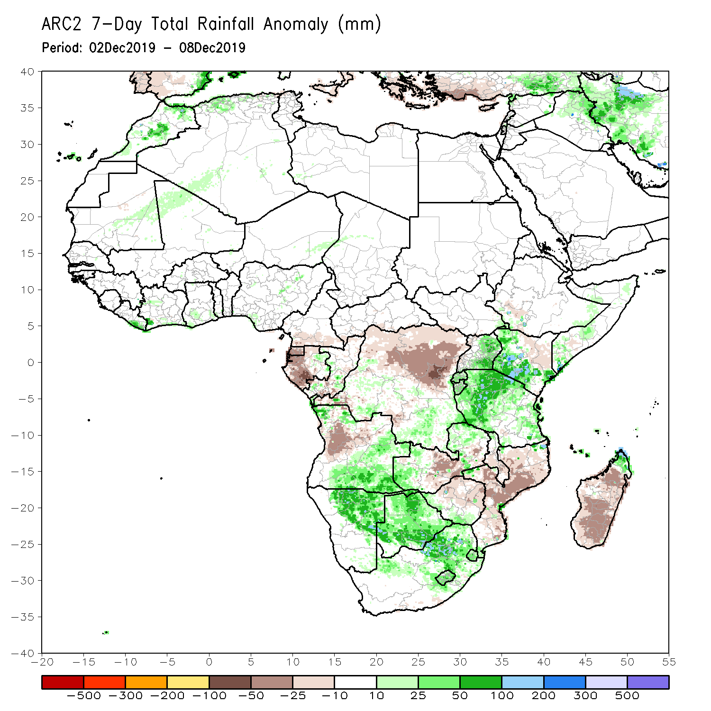
Rainfall Patterns: Last 7 Days
During the past 7 days, rainfall was below-average over Equatorial Guinea, western Gabon, many parts of DRC, western and central Angola, central Zambia, much of Zimbabwe, Malawi, Mozambique, and many parts of Madagascar.
Local areas in Congo, northwestern, southern and eastern Angola, parts of southern DRC, Namibia, Botswana, parts of South Africa, parts of western and eastern Zambia, Rwanda, Burundi, Uganda, portions of Kenya, Tanzania, and the far northern Madagascar had above-average rainfall.

Slide 5
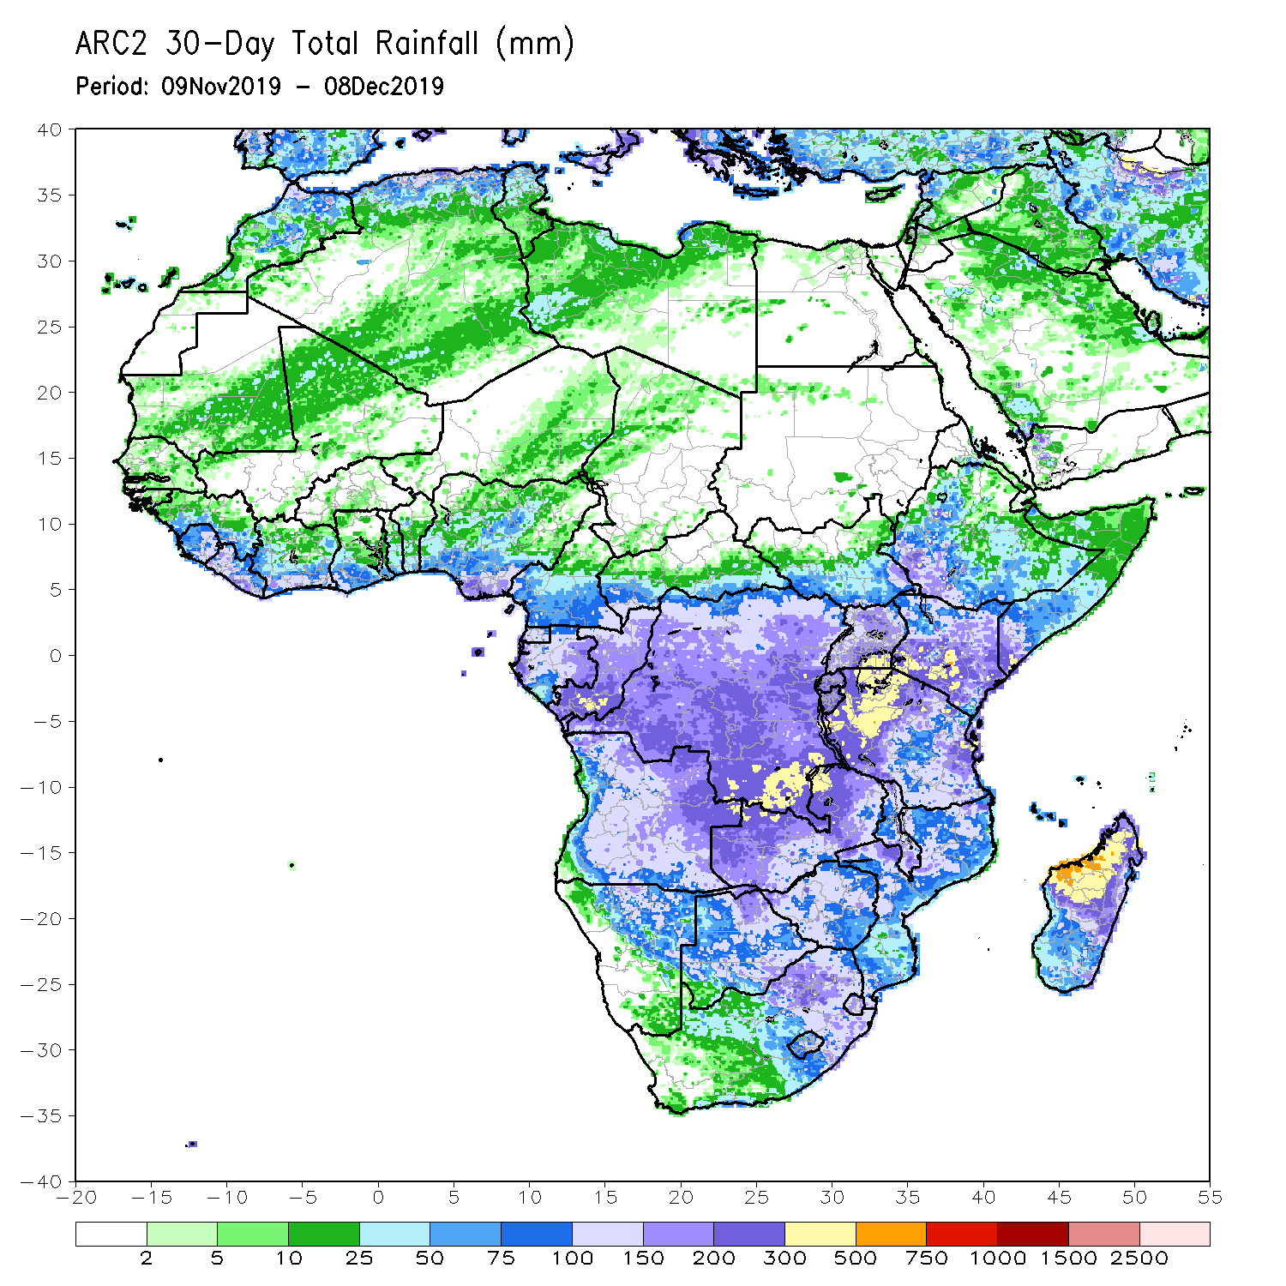
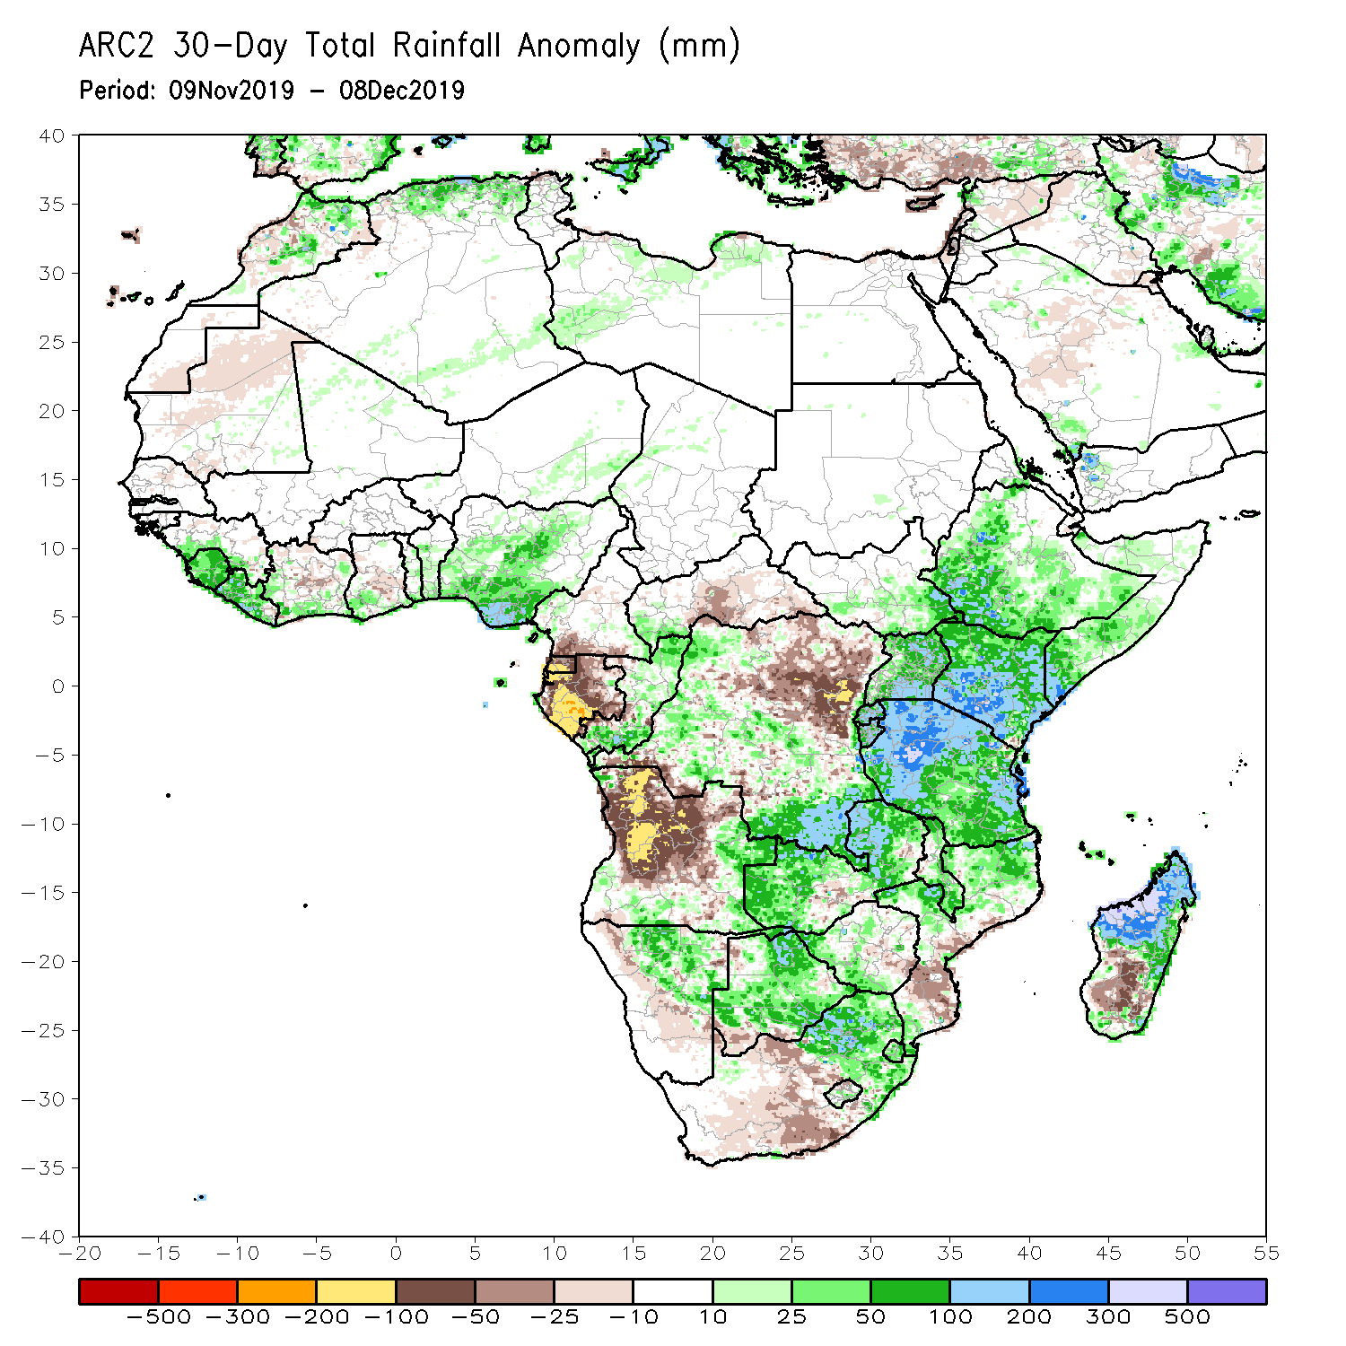
Rainfall Patterns: Last 30 Days
During the past 30 days, rainfall was above-average over local areas in Guinea, Sierra Leone, Liberia, parts of southern Cote d’Ivoire, local areas in Ghana, portions of Nigeria, northern and southern Congo, parts of DRC, local areas in South Sudan, Ethiopia, Rwanda, Burundi, Uganda, Kenya, Tanzania, southern Somalia, local areas in Angola, Namibia, Botswana, much of Zambia, Zimbabwe, eastern South Africa, Malawi, northern Mozambique, and many parts of Madagascar.
Local areas in Cote d’Ivoire and Ghana, parts of southern Cameroon, Equatorial Guinea, Gabon, much of Angola, parts of DRC, parts of southern Zambia, Zimbabwe, parts of southern Mozambique, western and southern South Africa and parts of southern Madagascar had below-average rainfall.
Notes:
5

Slide 6
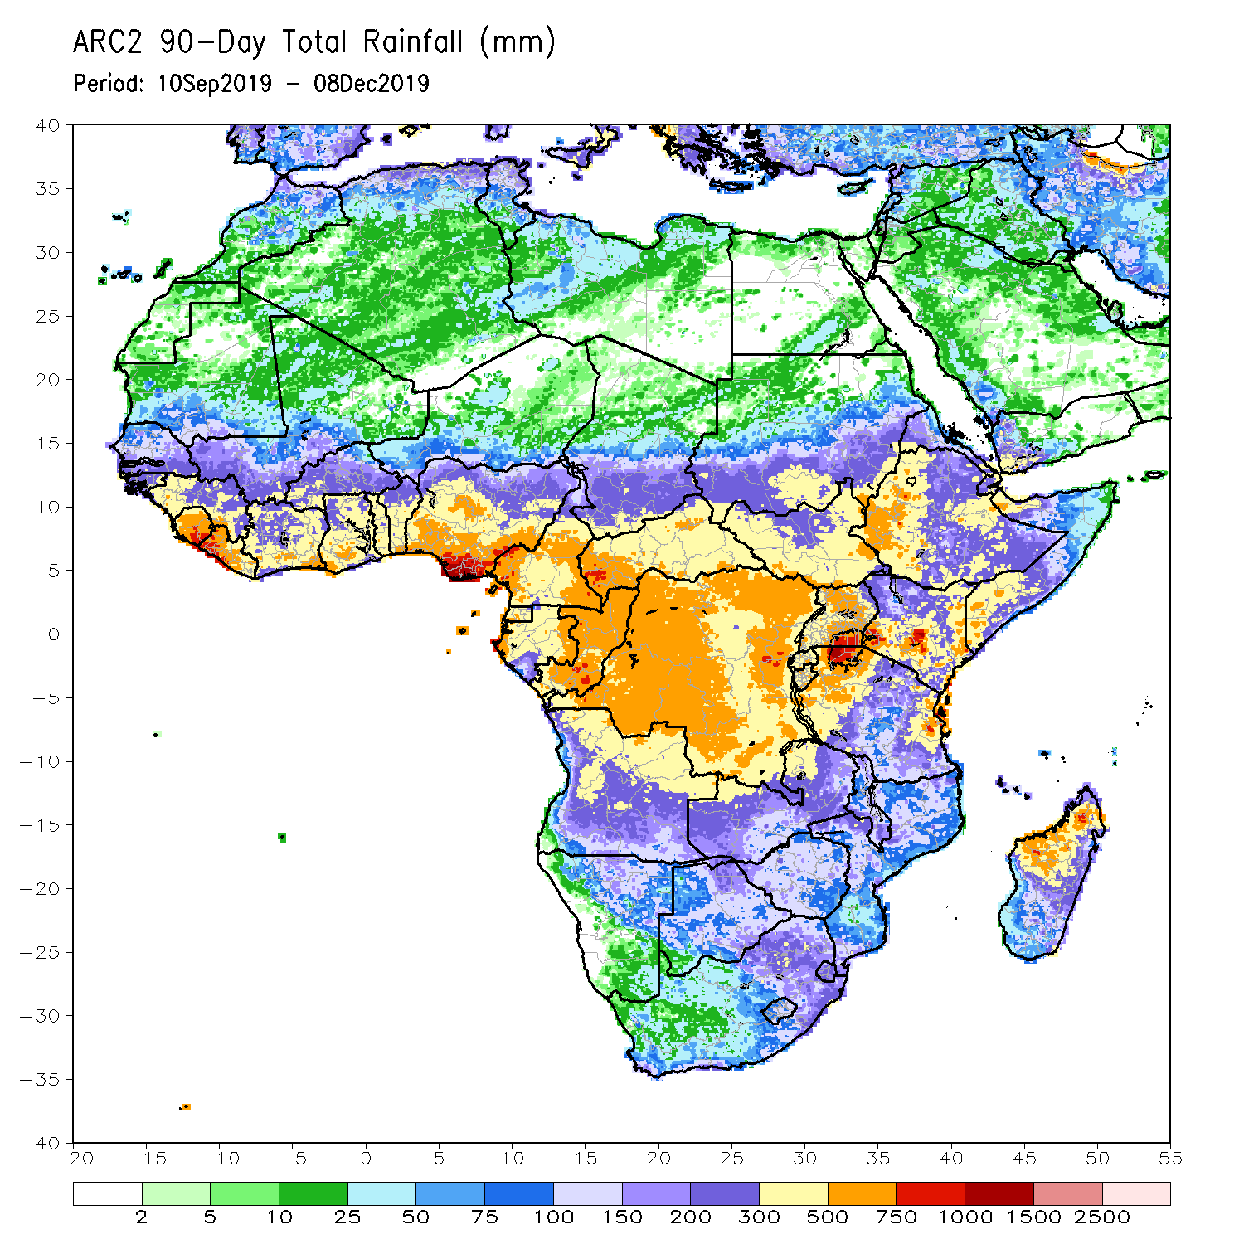
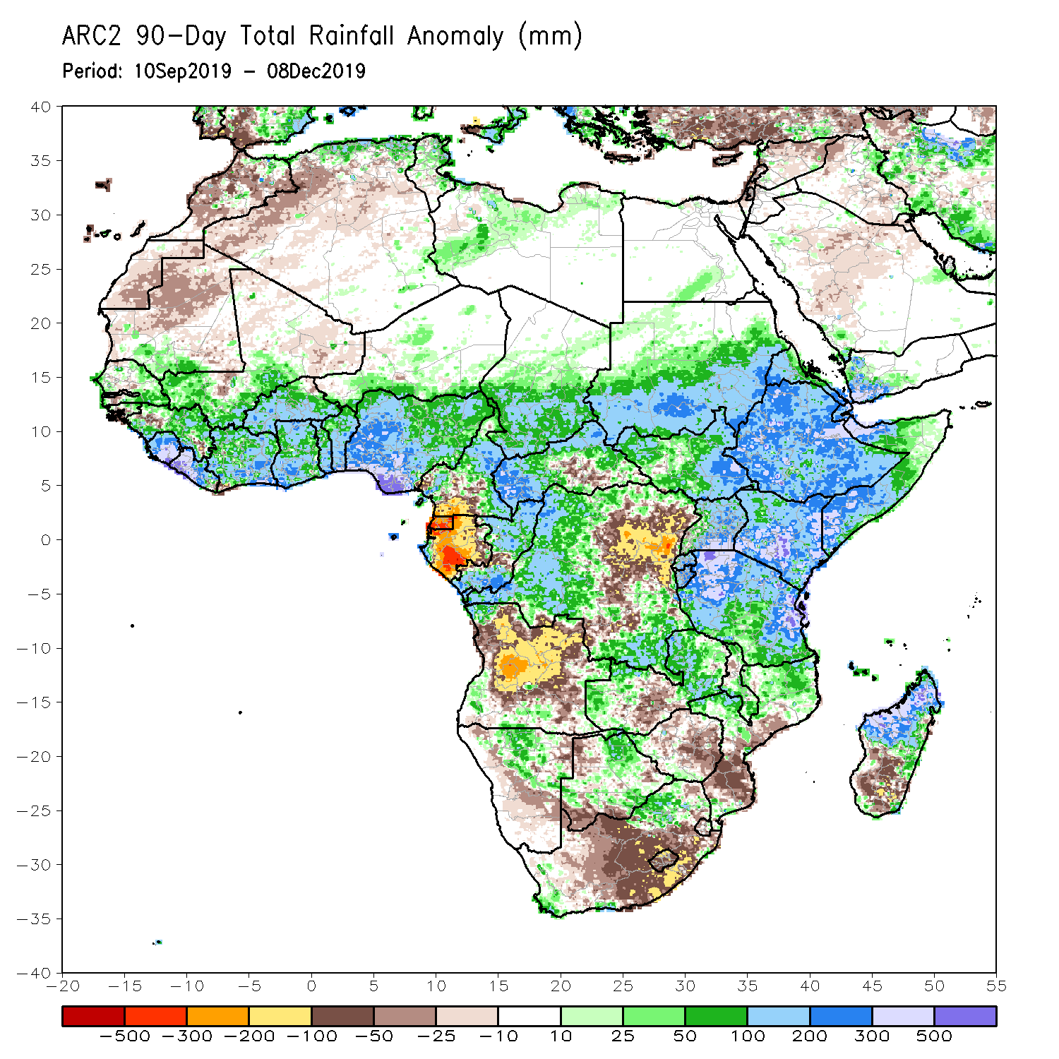
Rainfall Patterns: Last 90 Days
During the past 90 days, rainfall was above-average over parts of southern Mauritania, Senegal, Guinea-Bissau, Guinea, Sierra Leone, eastern Liberia, central and southern Mali, Cote d’Ivoire, Burkina Faso, Ghana, Togo, Benin, Niger, many parts of Nigeria, Chad, portions of Cameroon, CAR, portions of DRC, South Sudan, Uganda, southern and eastern Sudan, Eritrea, Ethiopia, Kenya, Somalia, many parts of Tanzania, local areas in Angola, many parts of Zambia, parts of Namibia and Botswana, Malawi, northern Mozambique, and many parts of Madagascar.
Local areas in Guinea, parts of southern Cameroon, Gabon, parts of CAR, portions of central and eastern DRC, many parts of Angola, parts of western Zambia, Zimbabwe, parts of Namibia and Botswana, southern Mozambique, southern Madagascar and many parts of South Africa had below-average rainfall.
Notes:
6

Slide 7
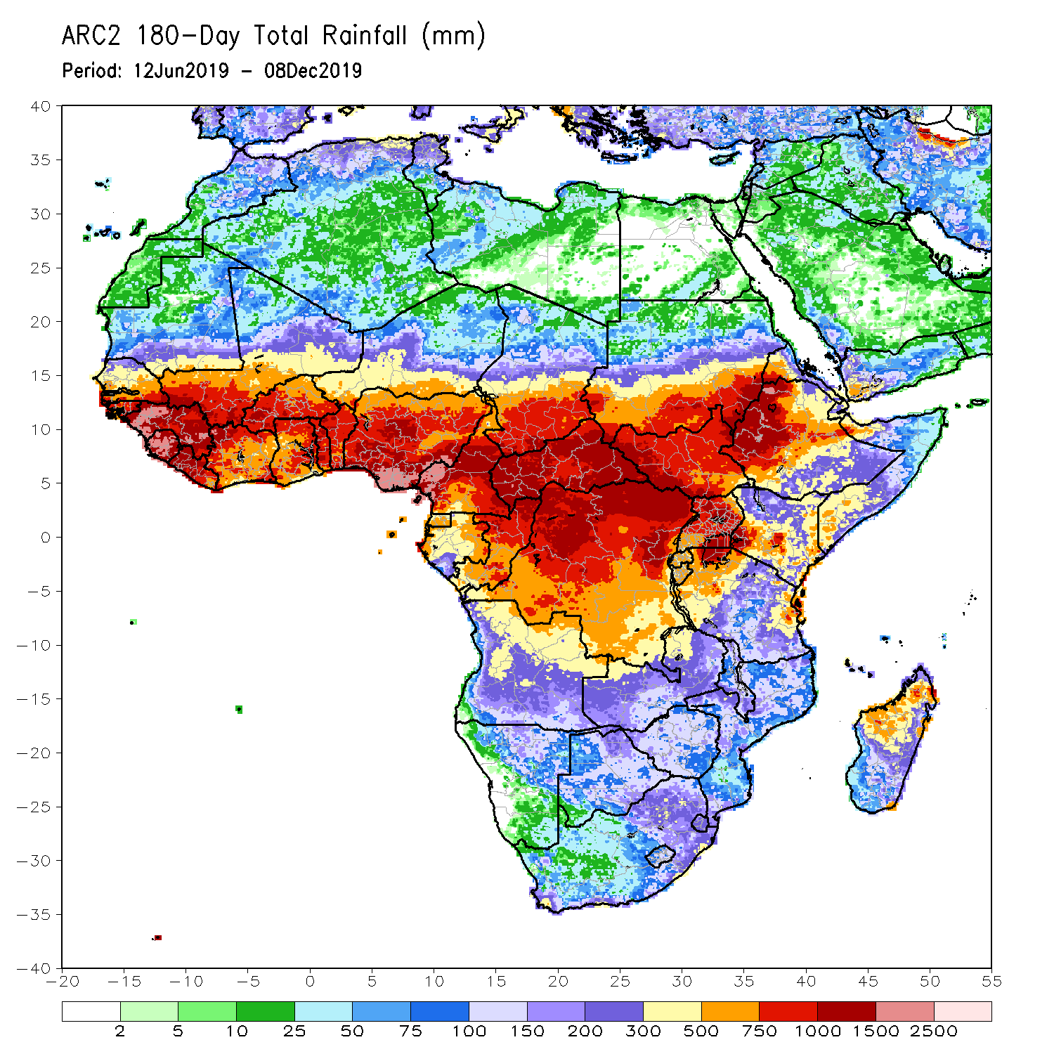
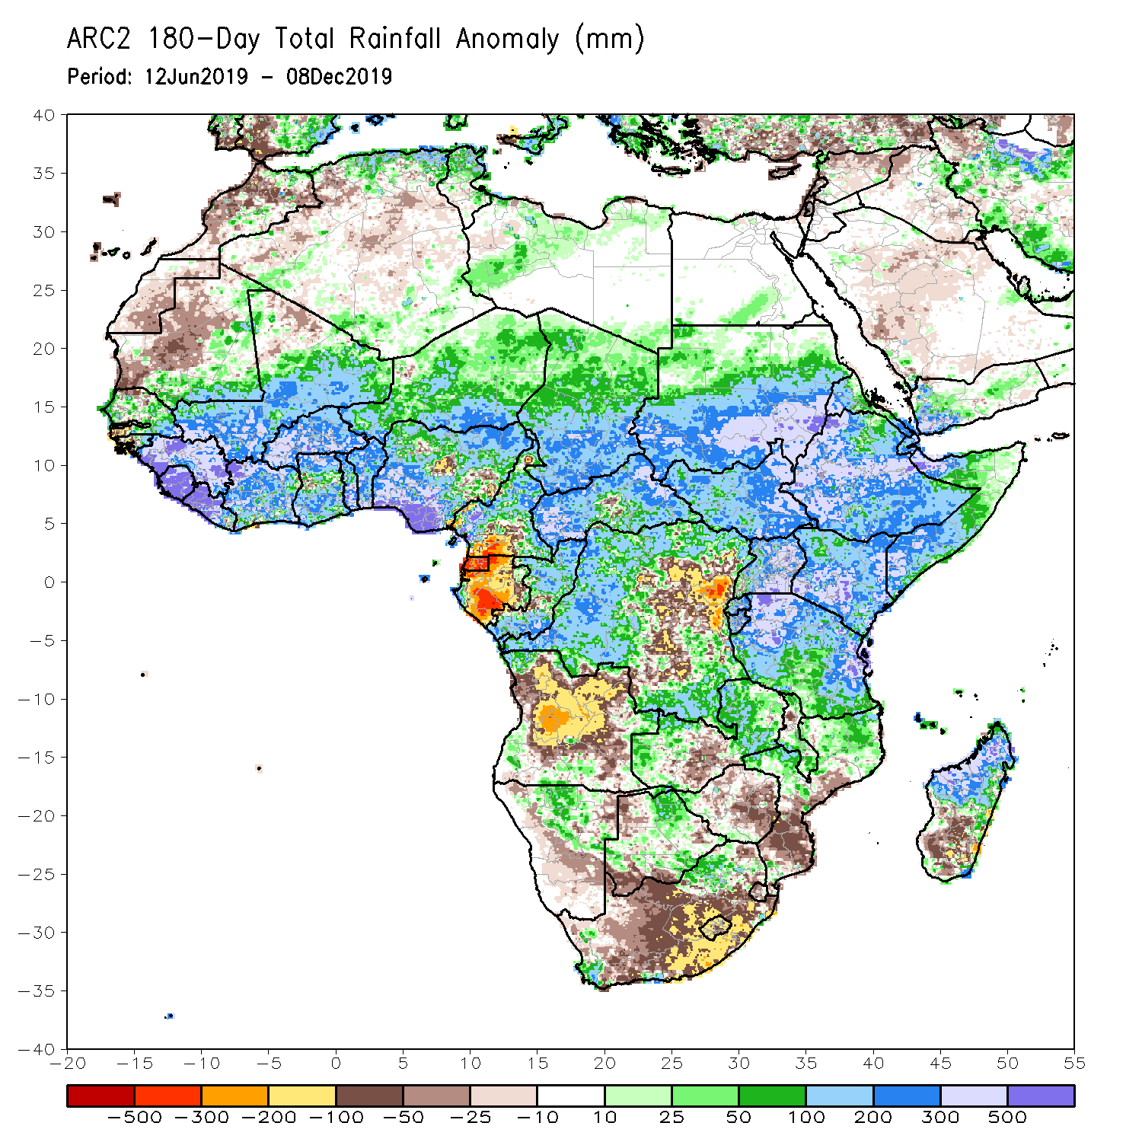
Rainfall Patterns: Last 180 Days
During the past 180 days, below-average rainfall was observed over portions of southern Cameroon, Equatorial Guinea, Gabon, parts of central and eastern DRC, many parts of Angola, parts of Namibia and Botswana, much of South Africa, western Zambia, Zimbabwe, and southern Mozambique and southern Madagascar.
Parts of Southern and eastern Mauritania, much of Senegal, Guinea-Bissau, Guinea, Sierra Leone, Mali, Liberia, Cote d’Ivoire, Burkina Faso, Ghana, Togo, Benin, Nigeria, much of Cameroon, Niger, Chad, CAR, many parts of DRC, South Sudan, Sudan, Uganda, Eritrea, Ethiopia, Somalia, Kenya, Tanzania, local areas in Angola, portions of Zambia, Namibia and Botswana, much of Malawi, northern Mozambique and many parts of Madagascar had above-average rainfall.
Notes:
7

Slide 8
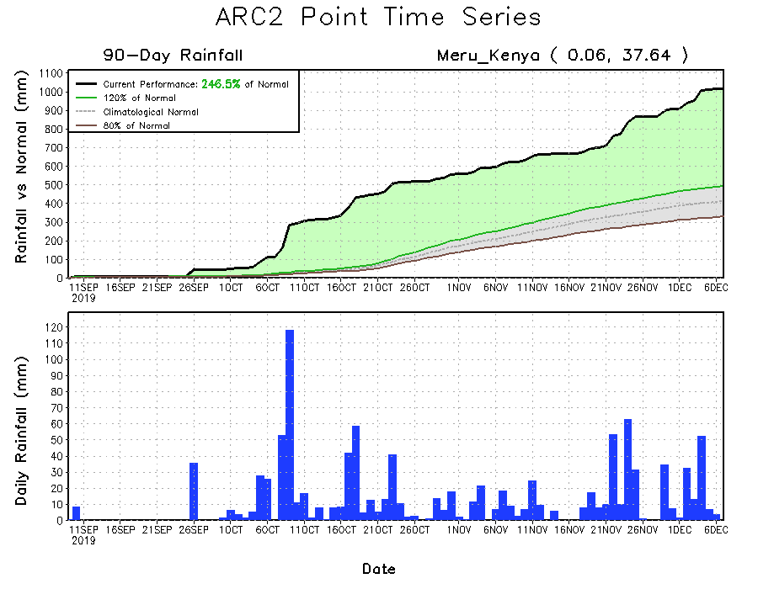
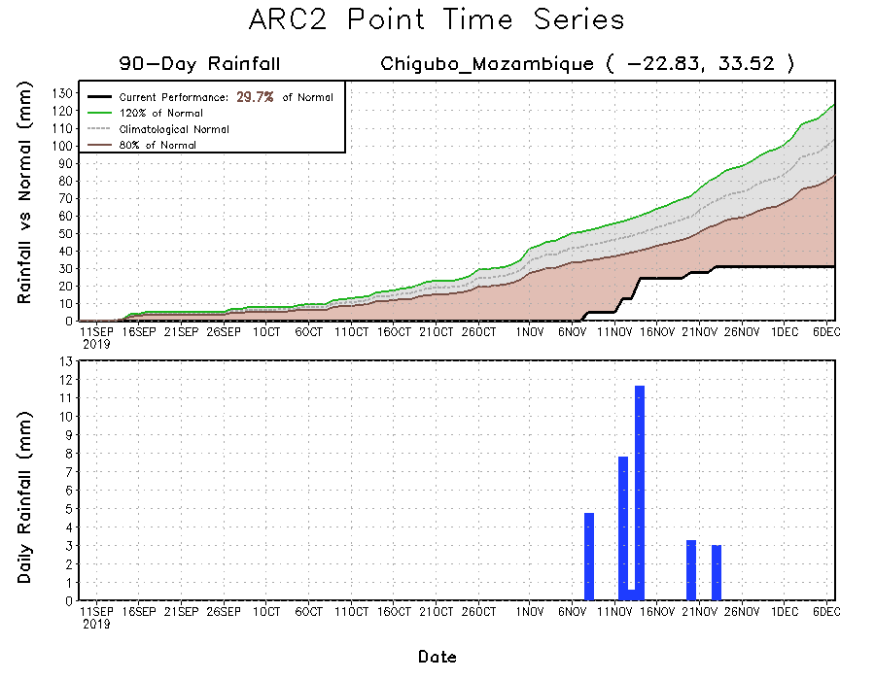
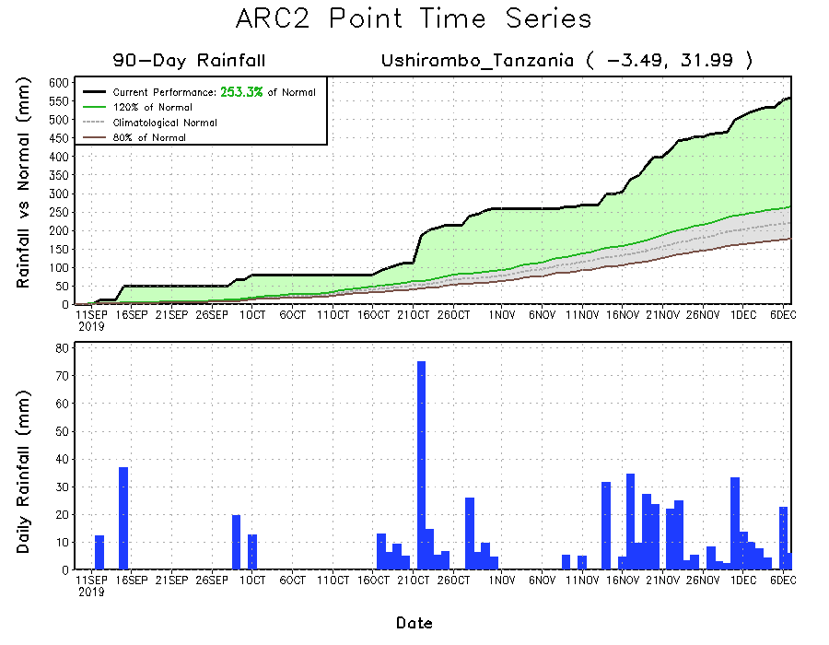
Recent Rainfall Evolution
Daily evolution of rainfall over the last 90 days at selected locations shows that moderate to locally heavy rainfall sustained moisture surpluses over parts of Tanzania (bottom right) and Kenya (top right). Seasonal total rainfall remained below-average over many parts of Southern Mozambique (bottom left).

Slide 9
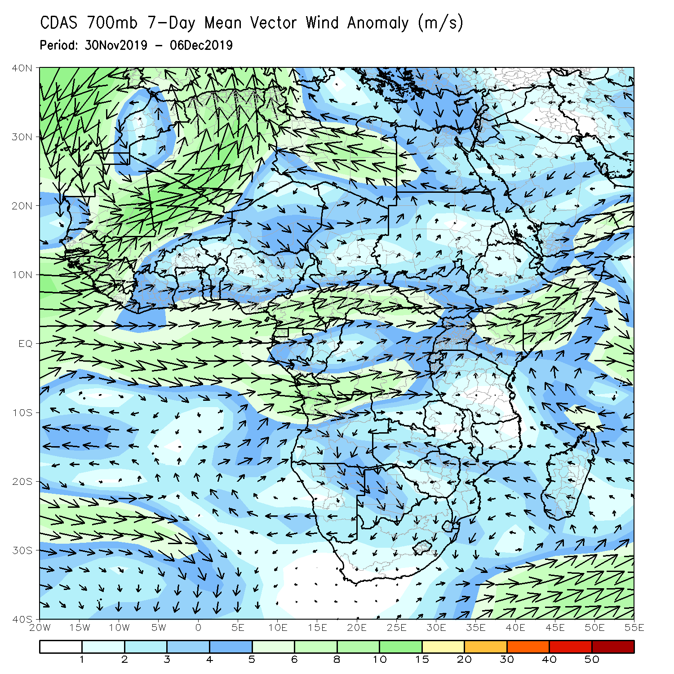
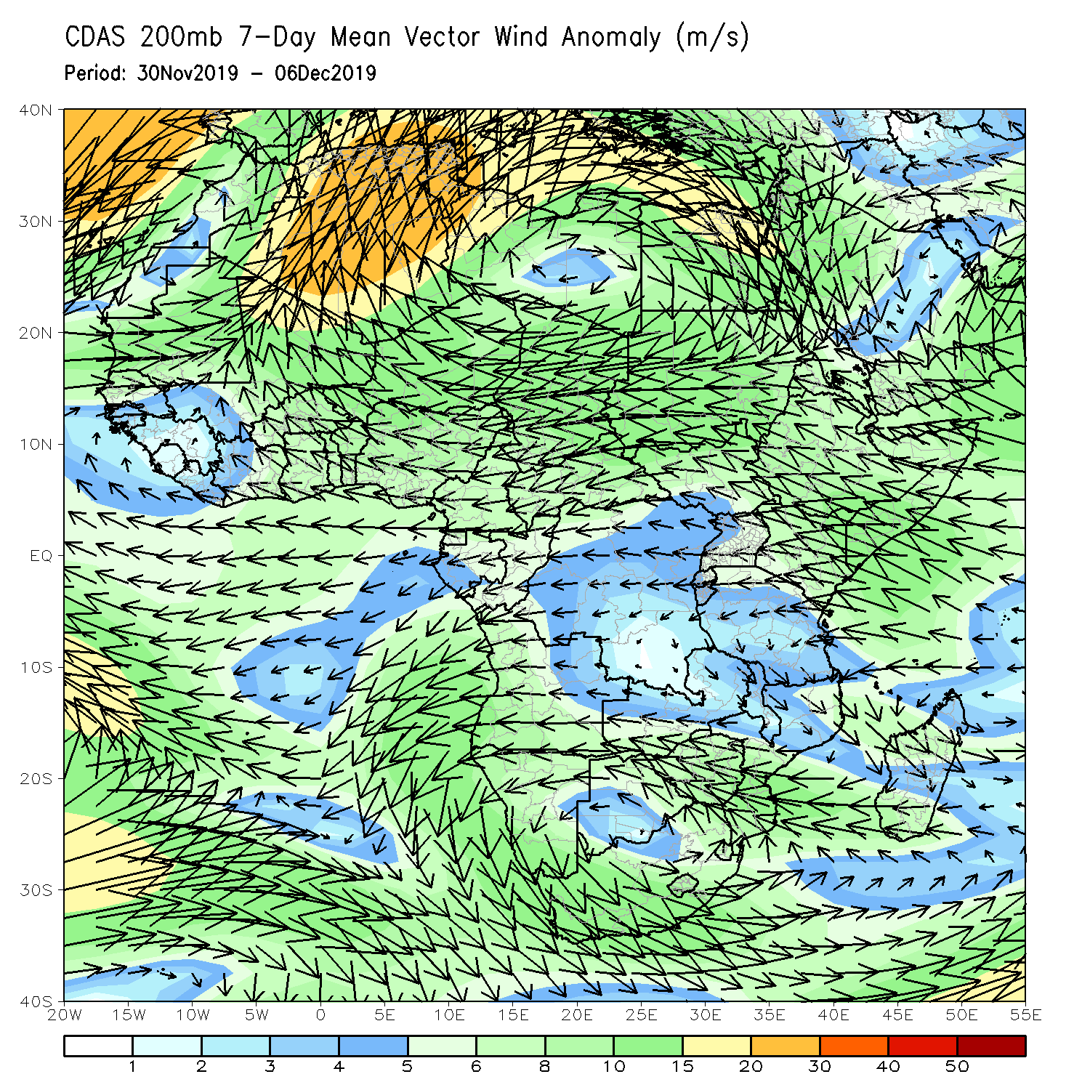
Atmospheric Circulation: Last 7 Days
Lower-level wind anomalies were westerly over many places of equatorial Africa (left panel).

Slide 10
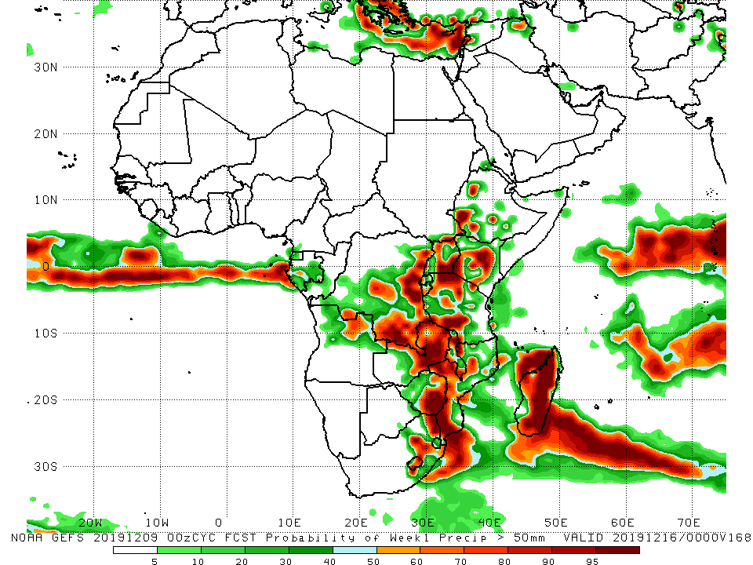
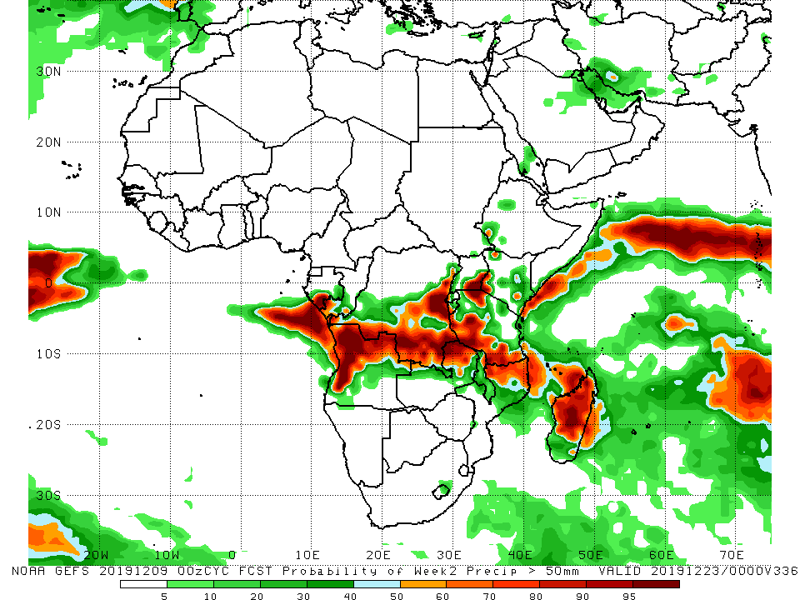
NCEP GEFS Model Forecasts Non-Bias Corrected Probability of precipitation exceedance
Week-1: Valid 10 – 16 December, 2019
Week-2: Valid 17 – 23 December, 2019
For week-1 (left panel) there is an increased chance for weekly rainfall totals to exceed 50mm over parts of central, southern and eastern DRC, Uganda, parts of Ethiopia and Kenya, Tanzania, eastern Zambia, eastern Zimbabwe, Mozambique, eastern South Africa and much of Madagascar. For week-2 (right panel), there is an increased chance for weekly rainfall totals to exceed 50mm southern and eastern DRC, western and northern Angola, eastern Zambia, southeastern Uganda, Tanzania, northern Mozambique, and Madagascar.
Notes:
10

Slide 11
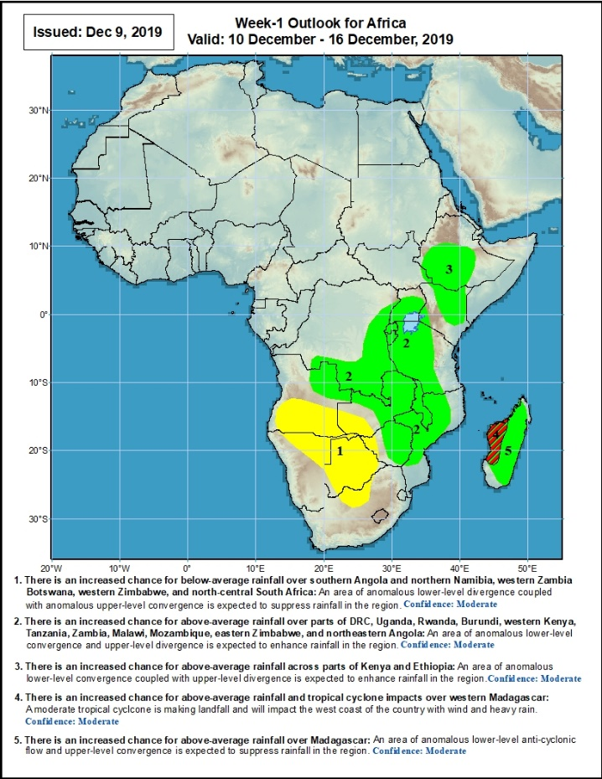
Week-1 Precipitation Outlooks
10 – 16 December, 2019
There is an increased chance for below-average rainfall over southern Angola and northern Namibia, western Zambia Botswana, western Zimbabwe, and north-central South Africa: An area of anomalous lower-level divergence and upper-level convergence is expected to suppress rainfall in the region. Confidence: Moderate
There is an increased chance for above-average rainfall over parts of DRC, Uganda, Rwanda, Burundi, western Kenya, Tanzania, Zambia, Malawi, Mozambique, eastern Zimbabwe, and northeastern Angola: An area of anomalous lower-level convergence and upper-level divergence is expected to enhance rainfall in the region. Confidence: Moderate
There is an increased chance for above-average rainfall across parts of Kenya and Ethiopia: An area anomalous lower-level convergence and upper-level divergence is expected to enhance rainfall in the region. Confidence: Moderate
There is an increased chance for above-average rainfall over western Madagascar: Tropical cyclone activity near the Mozambique Channel is expected to enhance rainfall in the region. Confidence: Moderate
Notes:
11

Slide 12
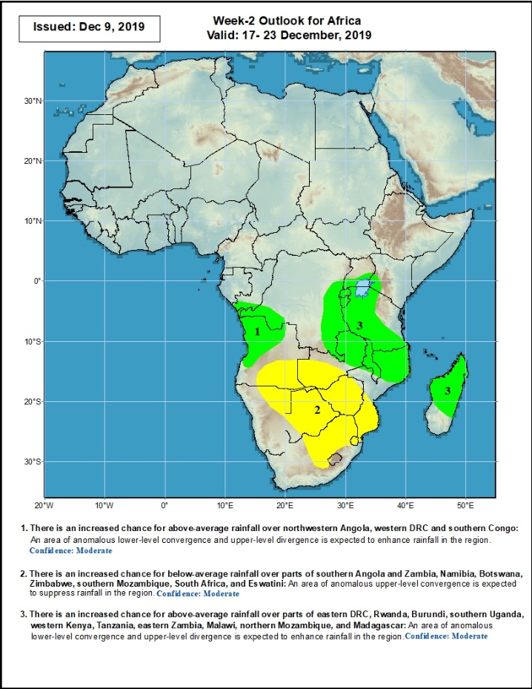
Week-2 Precipitation Outlooks
17 – 23 December, 2019
There is an increased chance for above-average rainfall over northwestern Angola, western DRC and southern Congo: An area of anomalous lower-level convergence and upper-level divergence is expected to enhance rainfall in the region. Confidence: Moderate
There is an increased chance for below-average rainfall over parts of southern Angola and Zambia, Namibia, Botswana, Zimbabwe, southern Mozambique, South Africa, and Eswatini: An area of anomalous upper-level divergence is expected to enhance rainfall in the region. Confidence: Moderate
here is an increased chance for above-average rainfall over parts of eastern DRC, Rwanda, Burundi, southern Uganda, western Kenya, Tanzania, eastern Zambia, Malawi, northern Mozambique, and Madagascar: An area of anomalous lower-level convergence and upper-level divergence is expected to enhance rainfall in the region. Confidence: Moderate
Notes:
12

Slide 13
Summary
During the past 7 days, rainfall was below-average over Equatorial Guinea, western Gabon, many parts of DRC, western and central Angola, central Zambia, much of Zimbabwe, Malawi, Mozambique, and many parts of Madagascar. Local areas in Congo, northwestern, southern and eastern Angola, parts of southern DRC, Namibia, Botswana, parts of South Africa, parts of western and eastern Zambia, Rwanda, Burundi, Uganda, portions of Kenya, Tanzania, and the far northern Madagascar had above-average rainfall.
During the past 30 days, rainfall was above-average over local areas in Guinea, Sierra Leone, Liberia, parts of southern Cote d’Ivoire, local areas in Ghana, portions of Nigeria, northern and southern Congo, parts of DRC, local areas in South Sudan, Ethiopia, Rwanda, Burundi, Uganda, Kenya, Tanzania, southern Somalia, local areas in Angola, Namibia, Botswana, much of Zambia, Zimbabwe, eastern South Africa, Malawi, northern Mozambique, and many parts of Madagascar. Local areas in Cote d’Ivoire and Ghana, parts of southern Cameroon, Equatorial Guinea, Gabon, much of Angola, parts of DRC, parts of southern Zambia, Zimbabwe, parts of southern Mozambique, western and southern South Africa and parts of southern Madagascar had below-average rainfall.
During the past 90 days, rainfall was above-average over parts of southern Mauritania, Senegal, Guinea-Bissau, Guinea, Sierra Leone, eastern Liberia, central and southern Mali, Cote d’Ivoire, Burkina Faso, Ghana, Togo, Benin, Niger, many parts of Nigeria, Chad, portions of Cameroon, CAR, portions of DRC, South Sudan, Uganda, southern and eastern Sudan, Eritrea, Ethiopia, Kenya, Somalia, many parts of Tanzania, local areas in Angola, many parts of Zambia, parts of Namibia and Botswana, Malawi, northern Mozambique, and many parts of Madagascar. Local areas in Guinea, parts of southern Cameroon, Gabon, parts of CAR, portions of central and eastern DRC, many parts of Angola, parts of western Zambia, Zimbabwe, parts of Namibia and Botswana, southern Mozambique, southern Madagascar and many parts of South Africa had below-average rainfall.
Week-1 outlooks call for an increased chance for above-average rainfall over northeastern Angola, southern and eastern DRC, Uganda, Kenya, Ethiopia, central and eastern Zambia, Malawi, eastern Zimbabwe, Mozambique and Madagascar. In contrast, there is an increased chance for below-average rainfall over southern Angola, northern Namibia, southwestern Zambia, Botswana, western Zimbabwe, and parts of northern South Africa.
Notes:
13

