Slide 1
The African Monsoon Recent Evolution and Current Status Include Week-1 and Week-2 Outlooks
Update prepared by
Climate Prediction Center / NCEP
13 January 2020
For more information, visit:
http://www.cpc.ncep.noaa.gov/products/Global_Monsoons/African_Monsoons/precip_monitoring.shtml

Slide 2
Outline
Highlights
Recent Evolution and Current Conditions
NCEP GEFS Forecasts
Summary

Slide 3
Highlights: Last 7 Days
Above-average rainfall was observed over portions of Southern and East Africa.
Week-1 outlooks call for an increased chance for below-average rainfall over northern Angola, parts of southwestern DRC, eastern Namibia, Botswana and part of South Africa. In contrast, there is an increased chance for above-average rainfall over Malawi, Northern Mozambique, parts of Zambia and Zimbabwe and southern Madagascar.

Slide 4
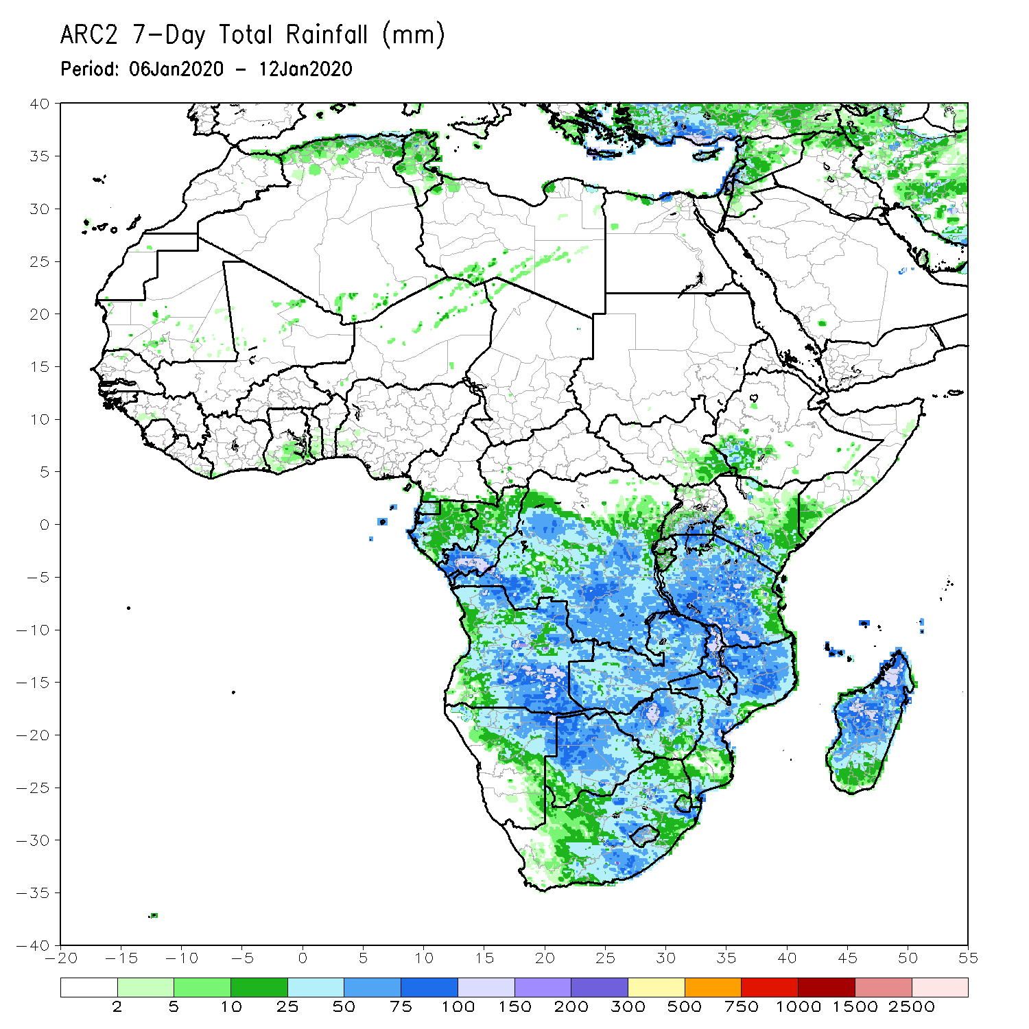
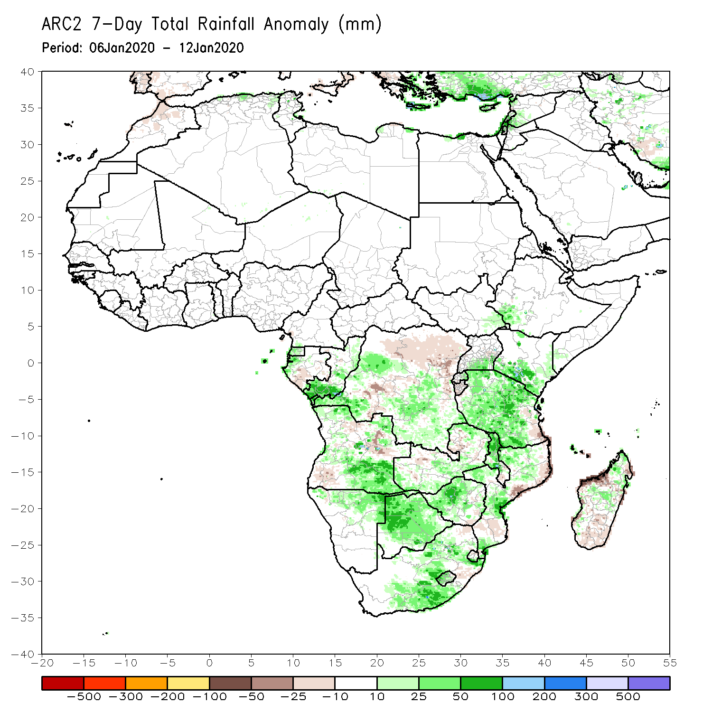
Rainfall Patterns: Last 7 Days
During the past 7 days, rainfall was above-average over local areas in Gabon and Equatorial Guinea, portions of Angola and DRC, northern Namibia, local areas in Zambia, Botswana, Zimbabwe, South Africa, Malawi, parts of Mozambique, much of Tanzania, parts of Kenya, southwestern Ethiopia and northern Madagascar.
Northern DRC, parts of Angola and Zambia, southeastern Tanzania, and parts of Mozambique and Madagascar had below-average rainfall.

Slide 5
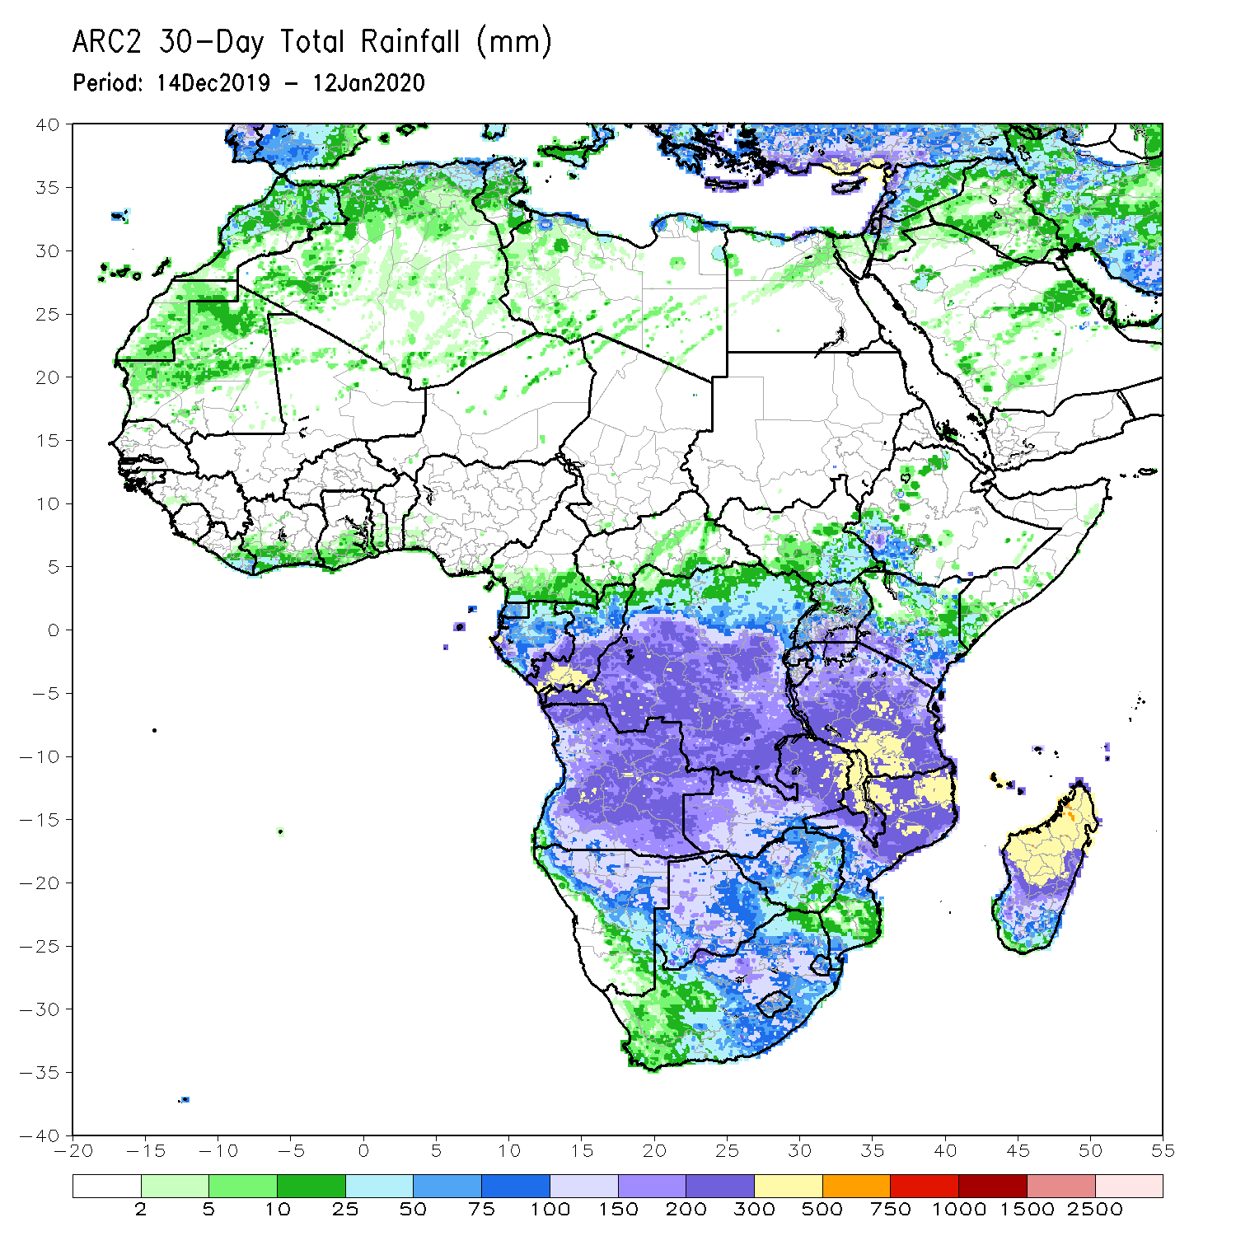
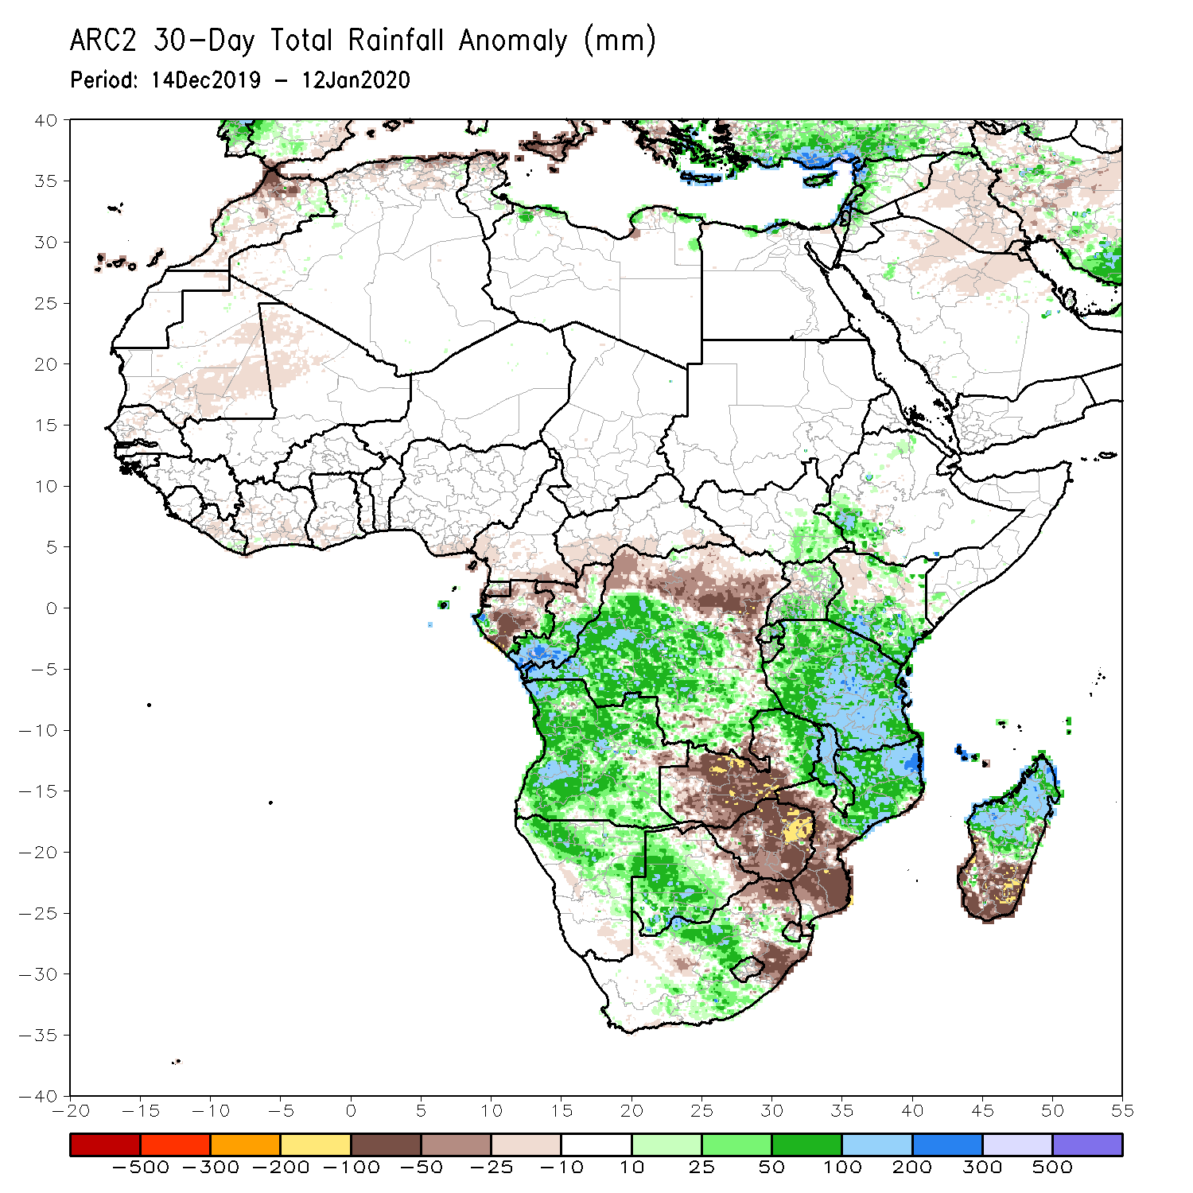
Rainfall Patterns: Last 30 Days
During the past 30 days, rainfall was above-average over central and southern Congo, western and central DRC, parts of South Sudan and Ethiopia, Rwanda, Burundi, Uganda, parts of Kenya, Tanzania, Angola, northern Namibia, Botswana, parts of eastern Zambia, Malawi, northern Mozambique, central South Africa and southern Madagascar.
Equatorial Guinea, Gabon, northern Congo, local areas in Angola, northern and eastern DRC, western and central Zambia, Zimbabwe, northeastern Botswana, eastern South Africa, southern Mozambique and southern Madagascar had below-average rainfall.
Notes:
5

Slide 6
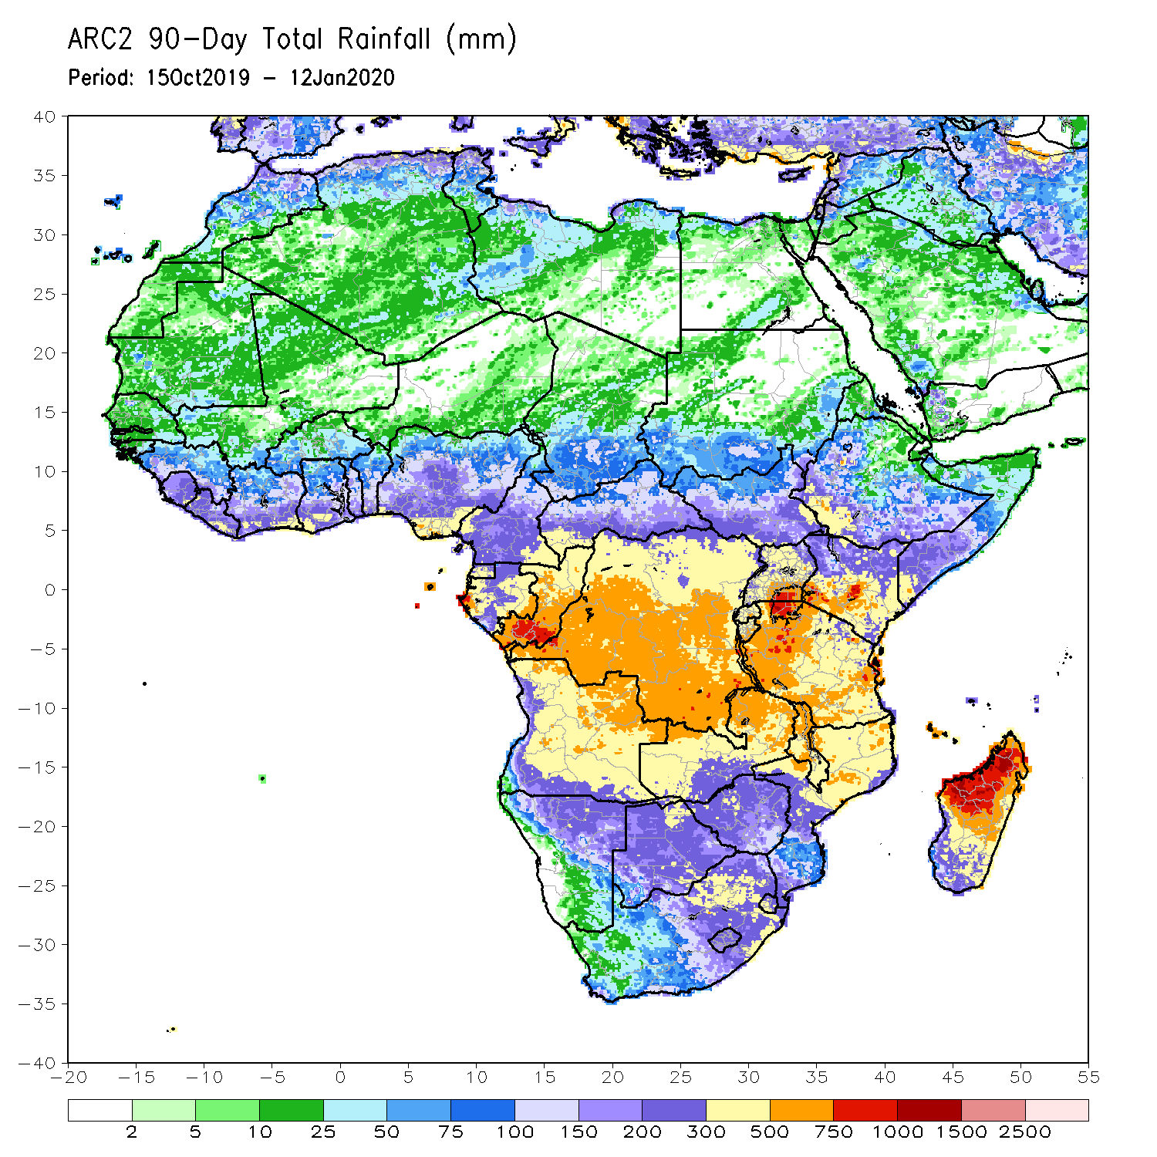
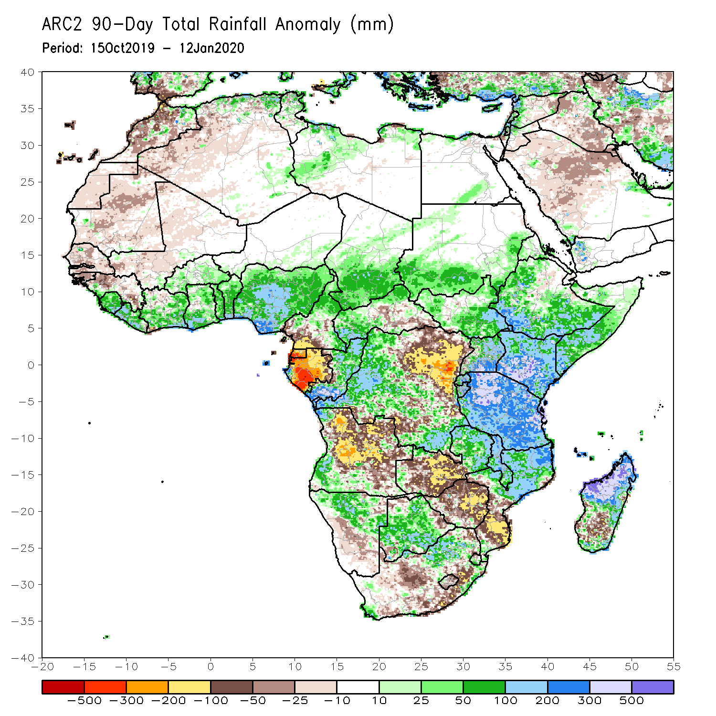
Rainfall Patterns: Last 90 Days
During the past 90 days, rainfall was above-average over local areas in Guinea, Sierra Leone, Liberia, Cote d’Ivoire, Burkina Faso, Ghana, Togo, Benin, parts of Niger, Nigeria, Chad, portions of Cameroon and CAR, portions of DRC, South Sudan, Uganda, southern and eastern Sudan, Eritrea, Ethiopia, Kenya, Somalia, many parts of Tanzania, western Angola, eastern Zambia, parts of Namibia and Botswana, Malawi, northeastern South Africa, northern Mozambique, and central and northern Madagascar.
Much of Guinea, southern Cameroon, Equatorial Guinea, Gabon, eastern CAR, portions of central and eastern DRC, many parts of Angola, western Zambia, Zimbabwe, parts of Namibia and Botswana, southern Mozambique, parts of southern Madagascar and many parts of South Africa had below-average rainfall.
Notes:
6

Slide 7
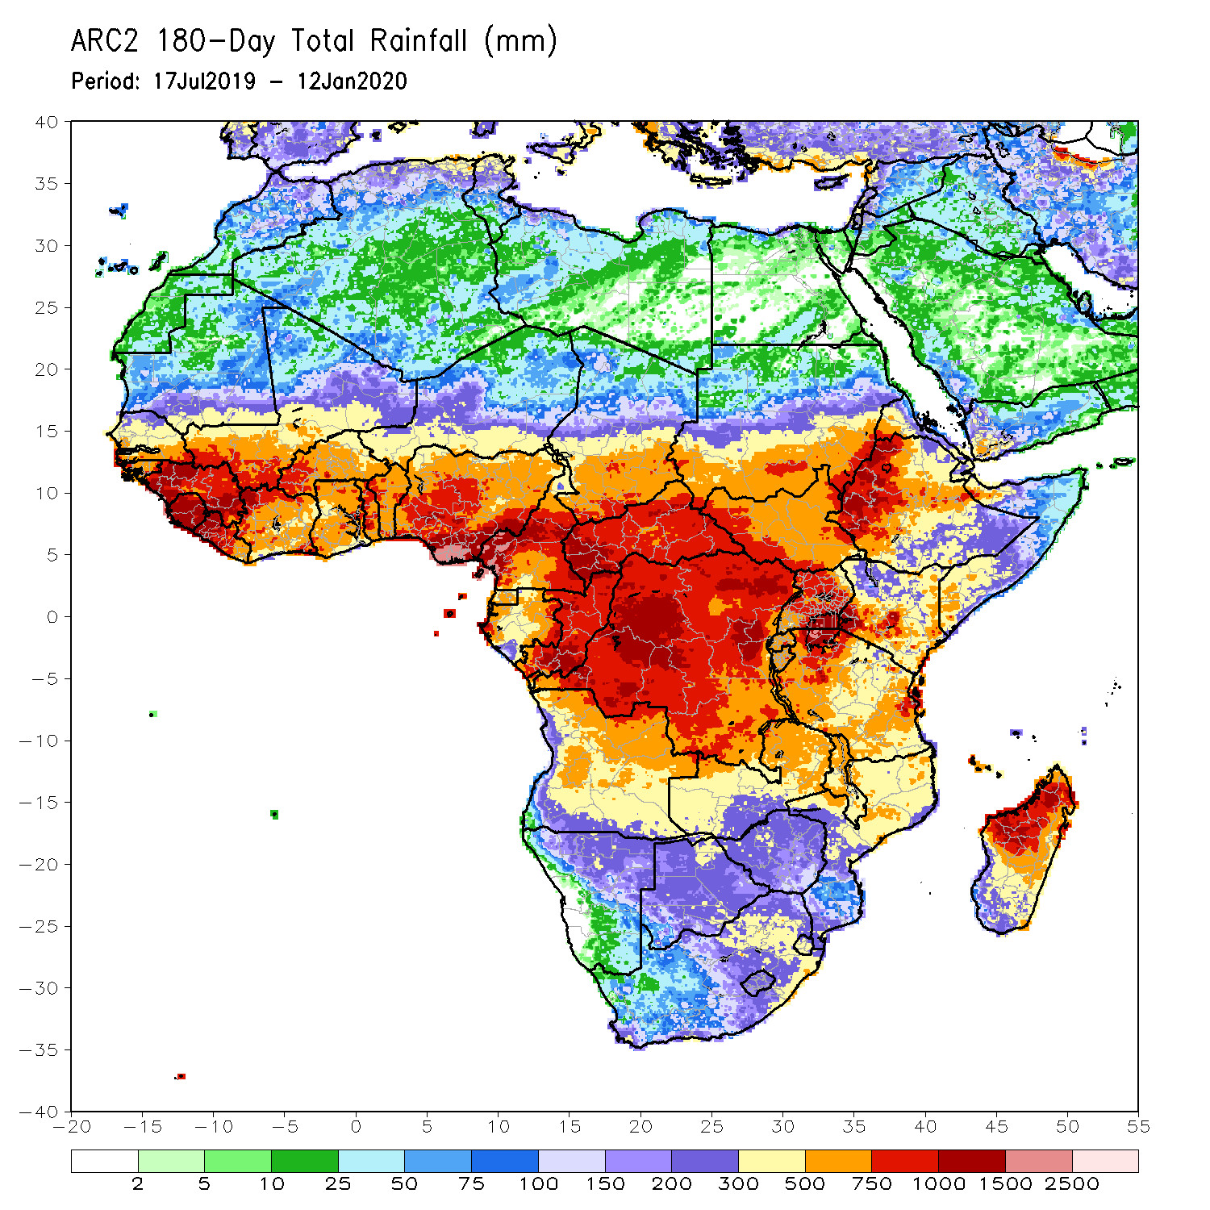
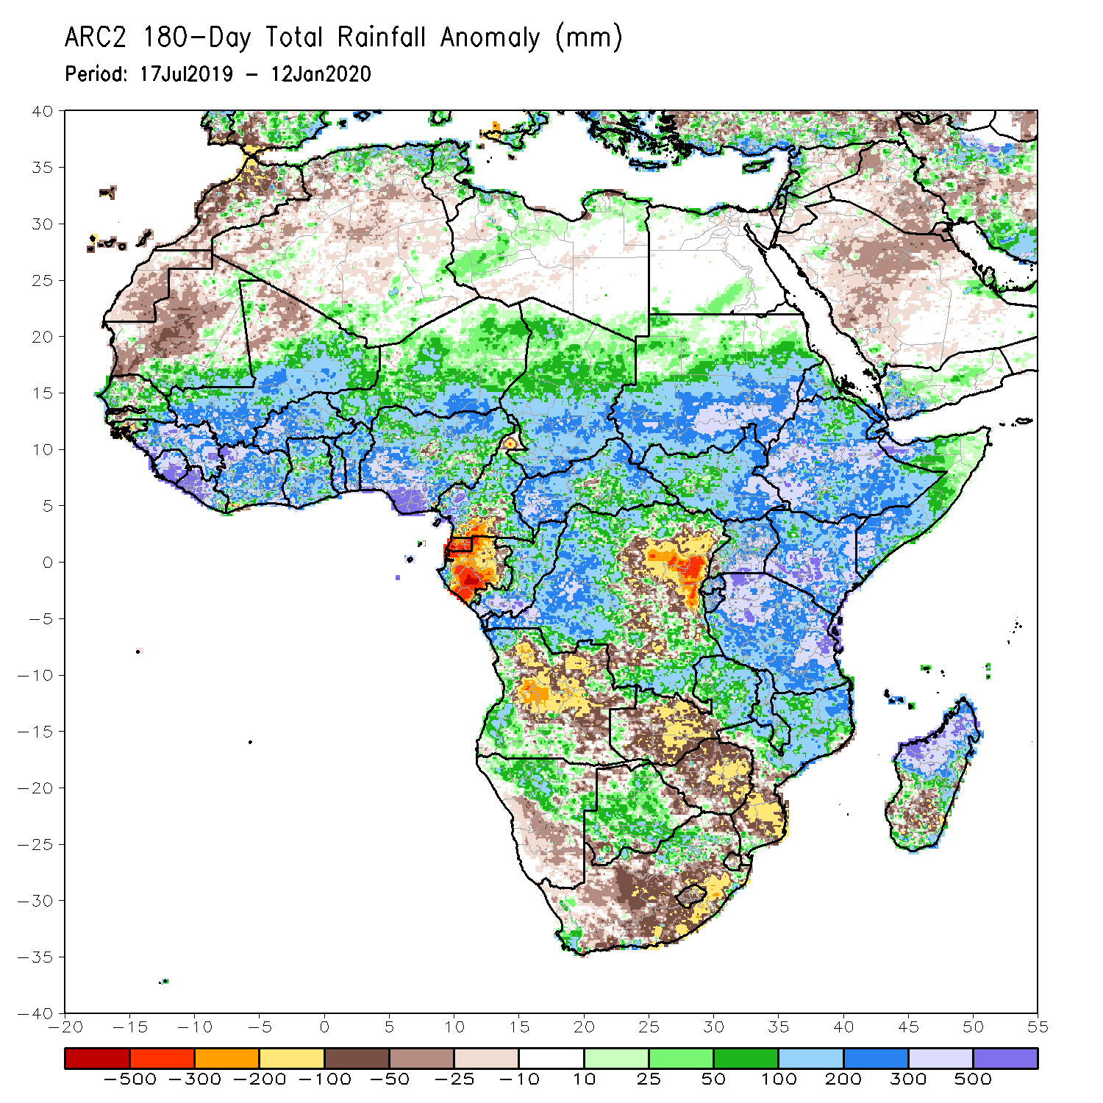
Rainfall Patterns: Last 180 Days
During the past 180 days, below-average rainfall was observed over portions of southern Cameroon, Equatorial Guinea, Gabon, parts of central and eastern DRC, many parts of Angola, parts of Namibia, many parts of South Africa, western Zambia, Zimbabwe, and southern Mozambique and southern Madagascar.
Parts of Southern Mauritania, much of Senegal, Guinea-Bissau, Guinea, Sierra Leone, Mali, Liberia, Cote d’Ivoire, Burkina Faso, Ghana, Togo, Benin, Nigeria, much of Cameroon, Niger, Chad, CAR, portions of DRC, South Sudan, Sudan, Uganda, Eritrea, Ethiopia, Somalia, Kenya, Tanzania, local areas in Angola, portions of Zambia, Namibia and Botswana, much of Malawi, northern Mozambique and many parts of Madagascar had above-average rainfall.
Notes:
7

Slide 8
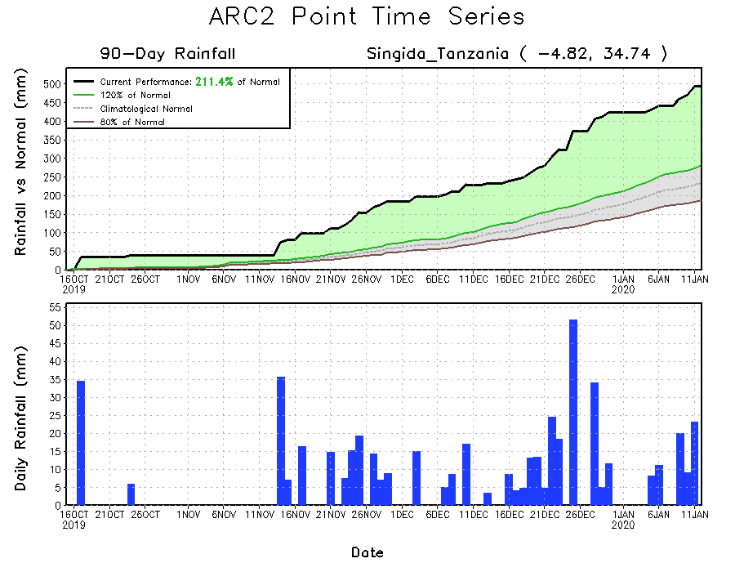
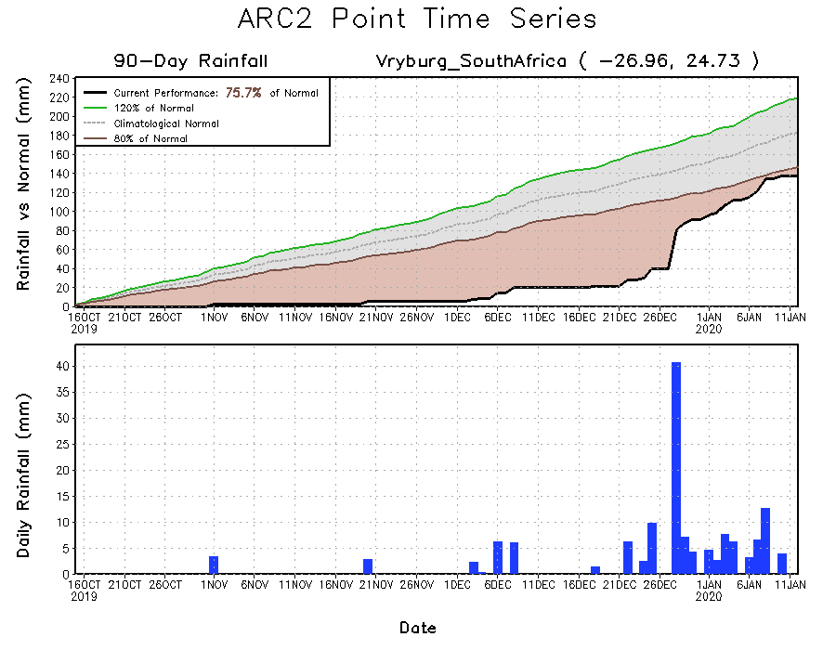
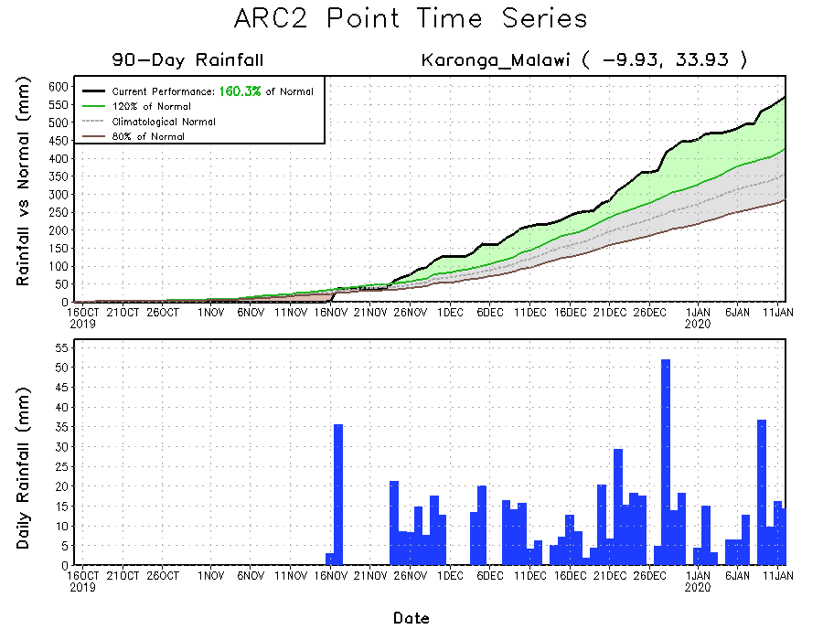
Recent Rainfall Evolution
Daily evolution of rainfall over the last 90 days at selected locations shows that moderate to locally heavy rainfall sustained moisture surpluses over man parts of Tanzania (top right) and Malawi (bottom right). Moderate to locally heavy rainfall was also helped to reduce accumulated rainfall deficits over parts of South Africa (bottom left).

Slide 9
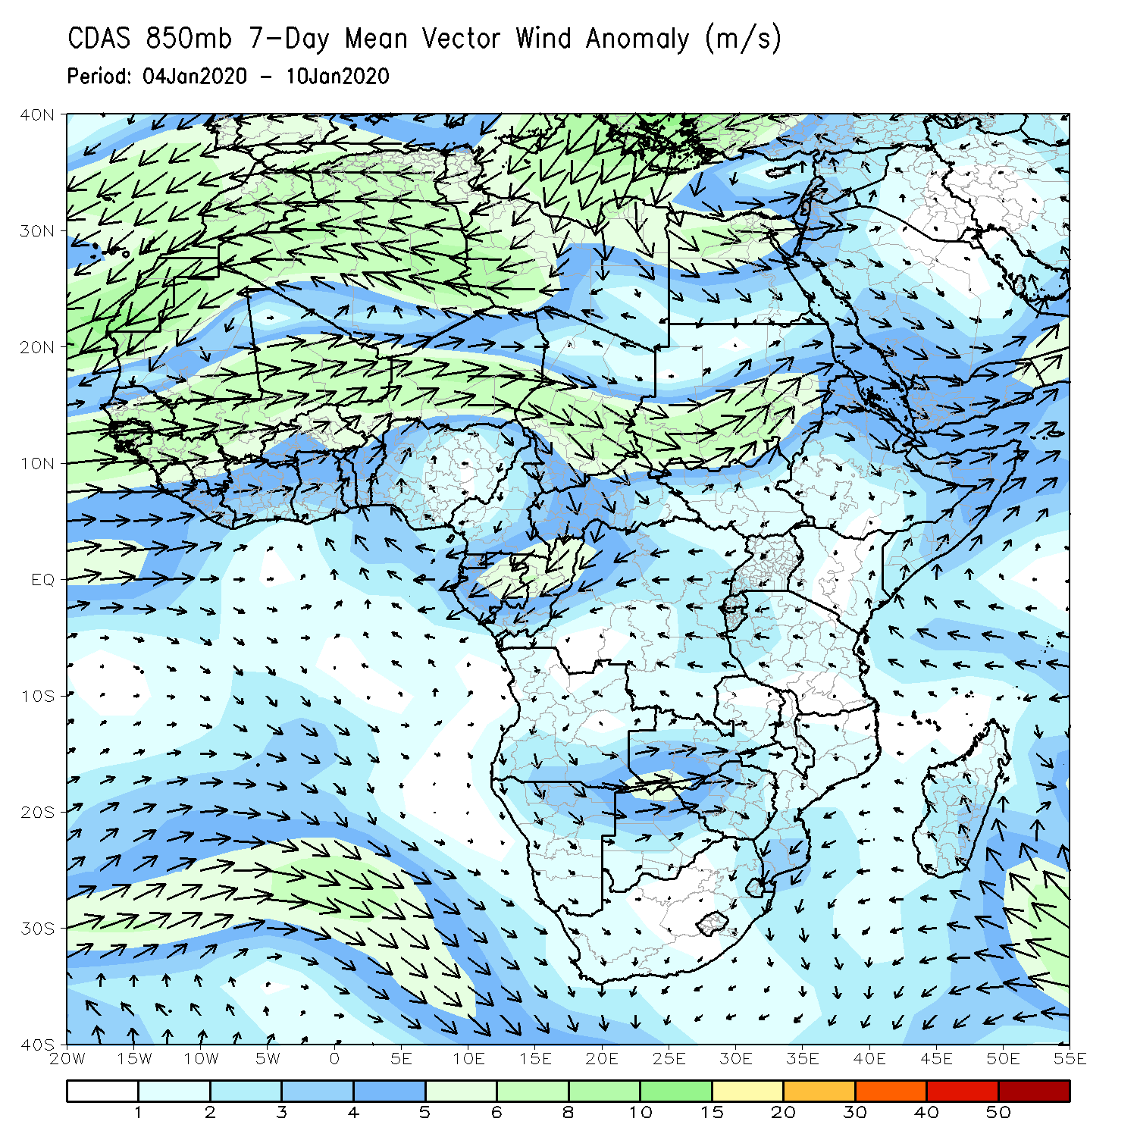
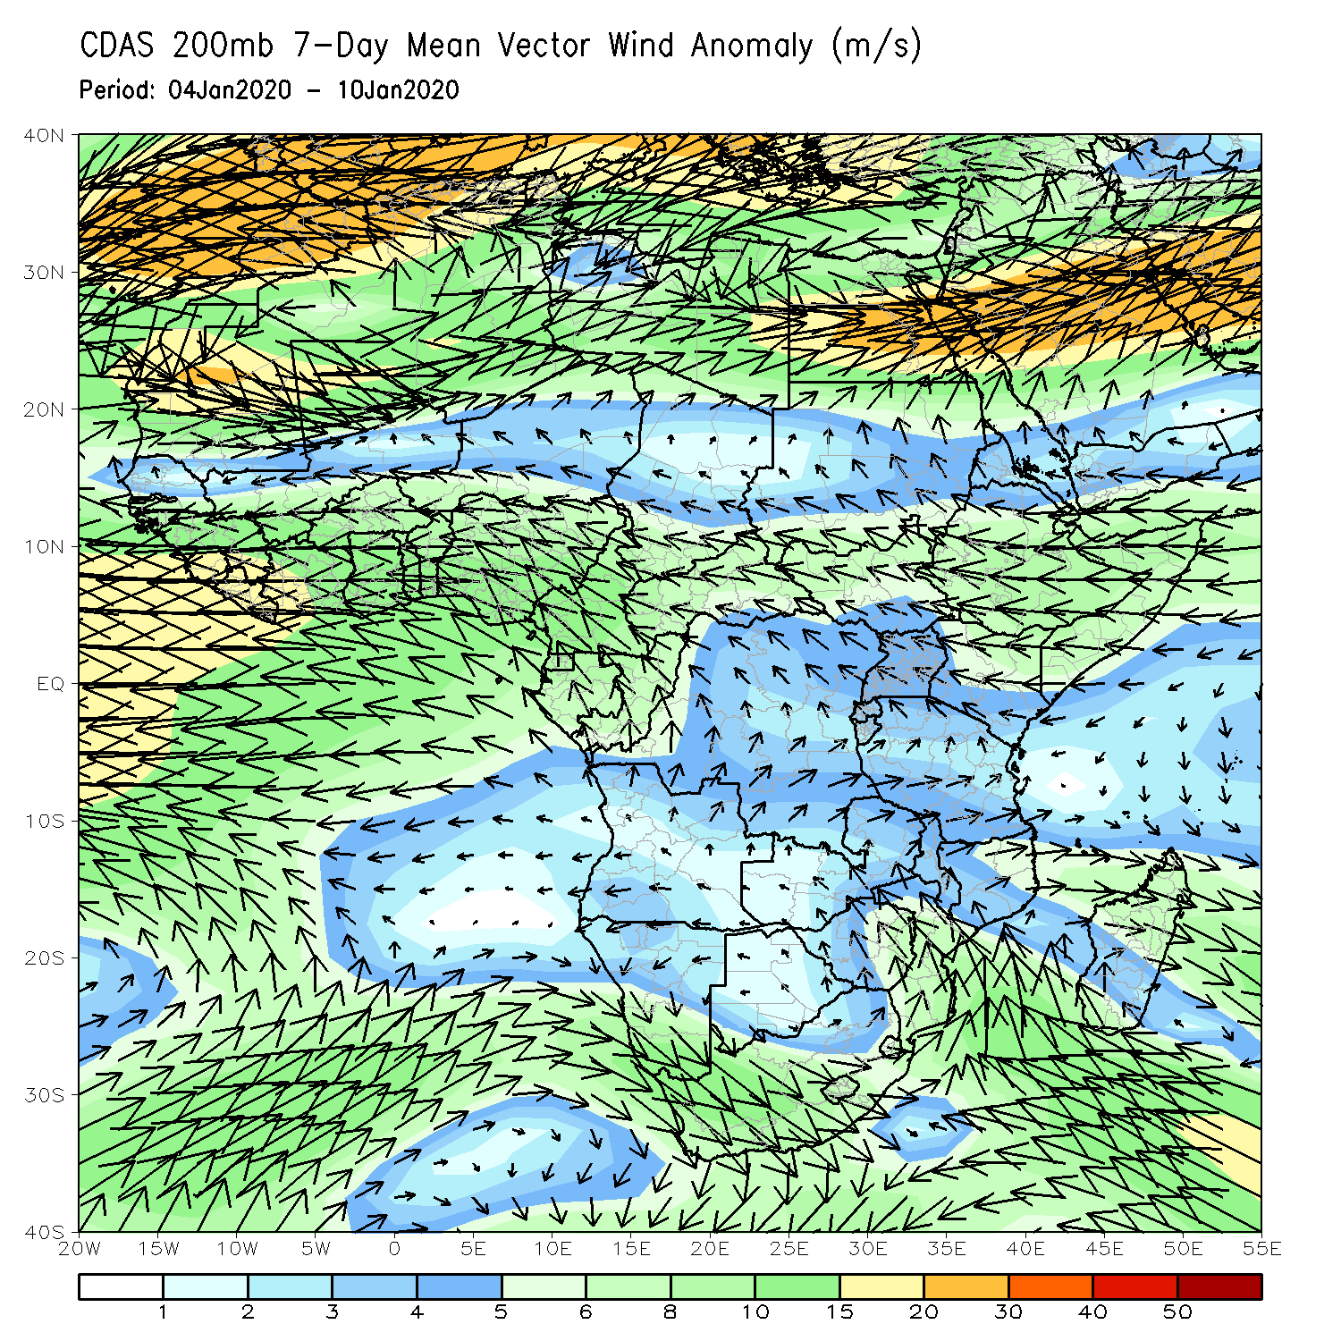
Atmospheric Circulation: Last 7 Days
An area of anomalous lower-level cyclonic flow and upper-level anti-cyclonic circulation was observed across portions of Southern Africa.

Slide 10
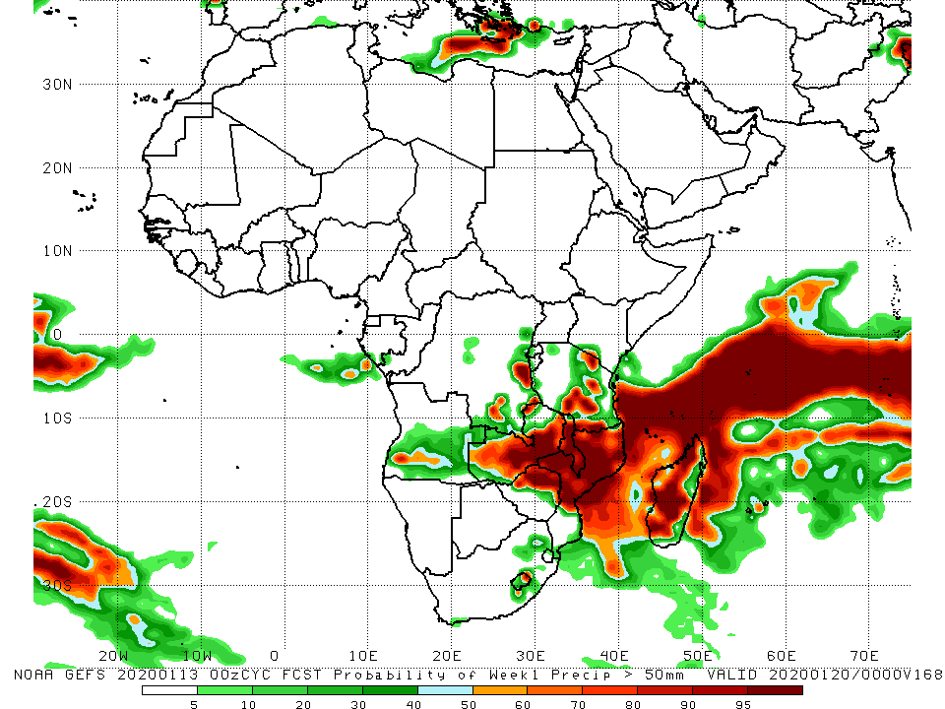
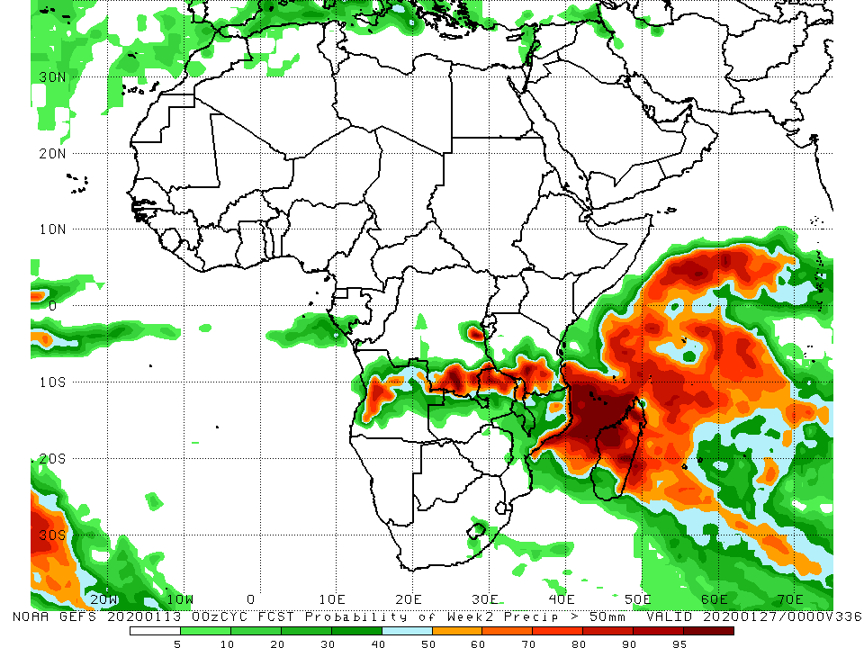
NCEP GEFS Model Forecasts Non-Bias Corrected Probability of precipitation exceedance
Week-1: Valid 14 – 20 January, 2020
Week-2: Valid 21 – 27 January, 2020
For week-1 (left panel) and week-2 (right panel), there is an increased chance for weekly rainfall totals to exceed 50mm over the northern portions of Southern Africa, including Madagascar.
Notes:
10

Slide 11
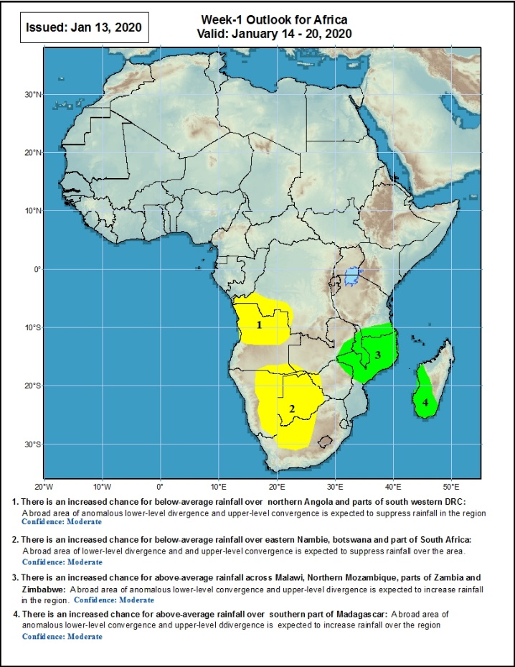
Week-1 Precipitation Outlooks
14 - 20 January, 2020
There is an increased chance for below-average rainfall over northern Angola and parts of southwestern DRC: An area of anomalous lower-level divergence and upper-level convergence is expected to suppress rainfall in the region. Confidence: Moderate
There is an increased chance for below-average rainfall over eastern Namibia, Botswana and part of South Africa: A broad area of anomalous lower-level divergence and upper-level convergence is expected to suppress rainfall in the region. Confidence: Moderate
There is an increased chance for above-average rainfall across Malawi, northern Mozambique, parts of Zambia and Zimbabwe: An area of anomalous lower-level convergence and upper-level divergence is expected to enhance rainfall in the region. Confidence: Moderate
There is an increased chance for above-average rainfall over southern Madagascar: An area of anomalous lower-level convergence and upper-level divergence is expected to enhance rainfall in the region. Confidence: Moderate
Notes:
11

Slide 12
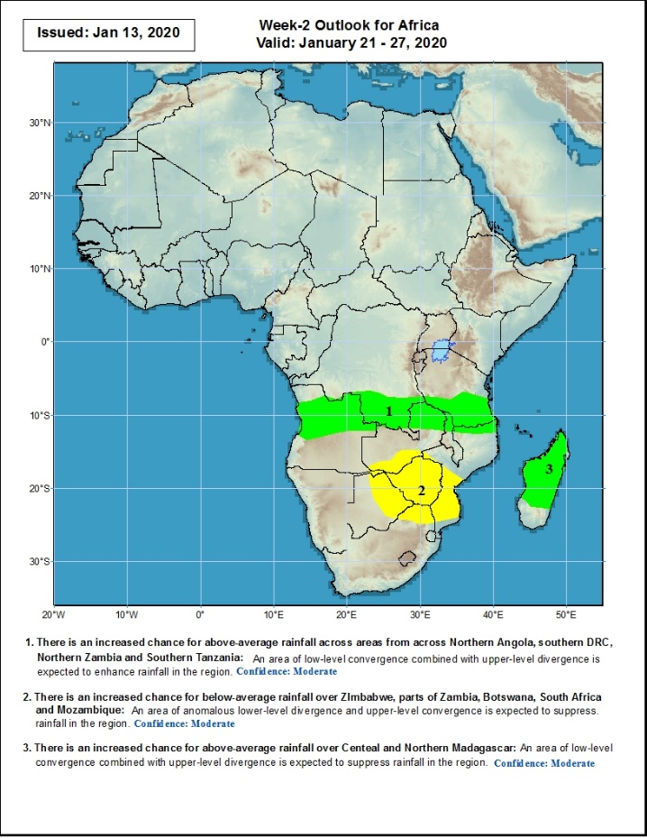
Week-2 Precipitation Outlooks
21 - 27 January, 2020
There is an increased chance for above-average rainfall across northern Angola, southern DRC, eastern Zambia and Southern Tanzania: An area of anomalous lower-level convergence and upper-level divergence is expected to enhance rainfall in the region. Confidence: Moderate
There is an increased chance for below-average rainfall over eastern Botswana, parts of southern Zambia, Zimbabwe, northeastern South Africa and southern Mozambique: An area of anomalous lower-level divergence and upper-level convergence is expected to suppress rainfall in the region. Confidence: Moderate
There is an increased chance for above-average rainfall over central and northern Madagascar: An area of anomalous lower-level convergence and upper-level divergence is expected to enhance rainfall in the region. Confidence: Moderate
Notes:
12

Slide 13
Summary
During the past 7 days, rainfall was above-average over local areas in Gabon and Equatorial Guinea, portions of Angola and DRC, northern Namibia, local areas in Zambia, Botswana, Zimbabwe, South Africa, Malawi, parts of Mozambique, much of Tanzania, parts of Kenya, southwestern Ethiopia and northern Madagascar. Northern DRC, parts of Angola and Zambia, southeastern Tanzania, and parts of Mozambique and Madagascar had below-average rainfall.
During the past 30 days, rainfall was above-average over central and southern Congo, western and central DRC, parts of South Sudan and Ethiopia, Rwanda, Burundi, Uganda, parts of Kenya, Tanzania, Angola, northern Namibia, Botswana, parts of eastern Zambia, Malawi, northern Mozambique, central South Africa and southern Madagascar. Equatorial Guinea, Gabon, northern Congo, local areas in Angola, northern and eastern DRC, western and central Zambia, Zimbabwe, northeastern Botswana, eastern South Africa, southern Mozambique and southern Madagascar had below-average rainfall.
During the past 90 days, rainfall was above-average over local areas in Guinea, Sierra Leone, Liberia, Cote d’Ivoire, Burkina Faso, Ghana, Togo, Benin, parts of Niger, Nigeria, Chad, portions of Cameroon and CAR, portions of DRC, South Sudan, Uganda, southern and eastern Sudan, Eritrea, Ethiopia, Kenya, Somalia, many parts of Tanzania, western Angola, eastern Zambia, parts of Namibia and Botswana, Malawi, northeastern South Africa, northern Mozambique, and central and northern Madagascar. Much of Guinea, southern Cameroon, Equatorial Guinea, Gabon, eastern CAR, portions of central and eastern DRC, many parts of Angola, western Zambia, Zimbabwe, parts of Namibia and Botswana, southern Mozambique, parts of southern Madagascar and many parts of South Africa had below-average rainfall.
Week-1 outlooks call for an increased chance for below-average rainfall over northern Angola, parts of southwestern DRC, eastern Namibia, Botswana and part of South Africa. In contrast, there is an increased chance for above-average rainfall over Malawi, Northern Mozambique, parts of Zambia and Zimbabwe and southern Madagascar.
Notes:
13

