Slide 1
The African Monsoon Recent Evolution and Current Status Include Week-1 and Week-2 Outlooks
Update prepared by
Climate Prediction Center / NCEP
23 March 2020
For more information, visit:
http://www.cpc.ncep.noaa.gov/products/Global_Monsoons/African_Monsoons/precip_monitoring.shtml

Slide 2
Outline
Highlights
Recent Evolution and Current Conditions
NCEP GEFS Forecasts
Summary

Slide 3
Highlights: Last 7 Days
Weekly rainfall totals exceeded 150mm over local areas in Angola, DRC, and eastern Zambia.
Week-1 outlooks call for an increased chance for above-average rainfall over many places in the Gulf of Guinea region, parts of Angola, southern DRC, northern Zambia, much of Kenya, eastern and southeastern Ethiopia and Somalia. In contrast, there is an increased chance for below-average rainfall over parts of Botswana, Zimbabwe, and central and southern Mozambique.

Slide 4
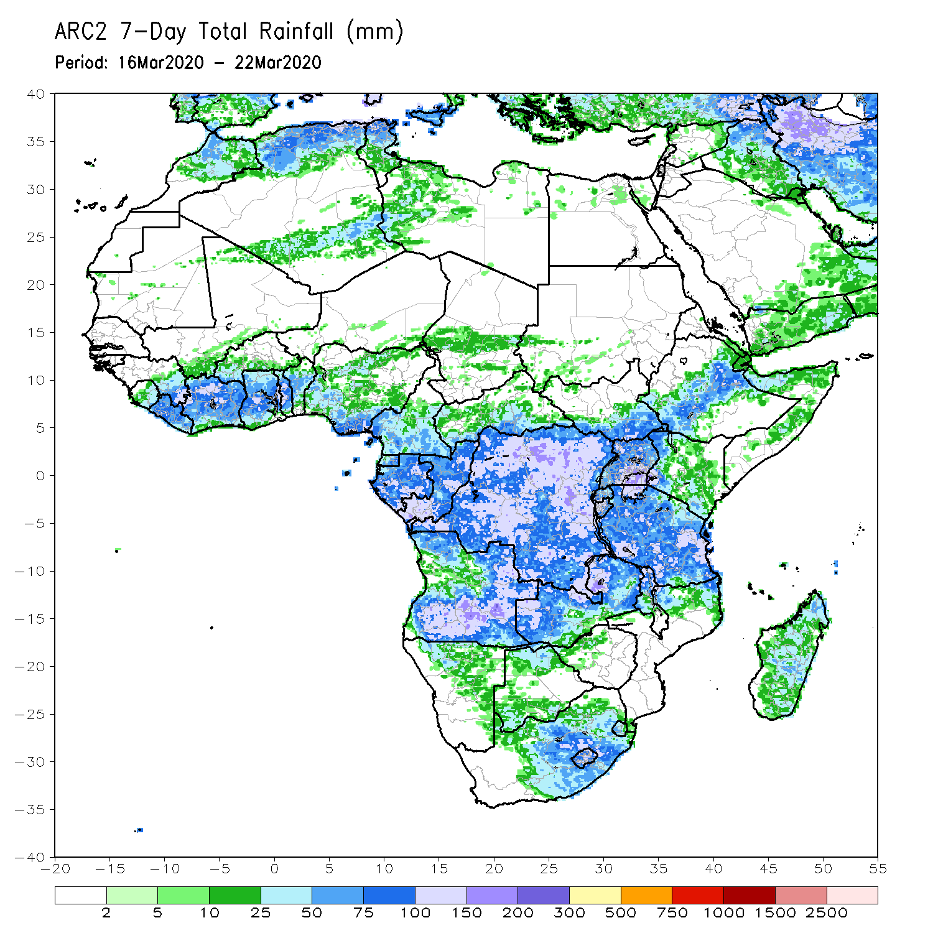
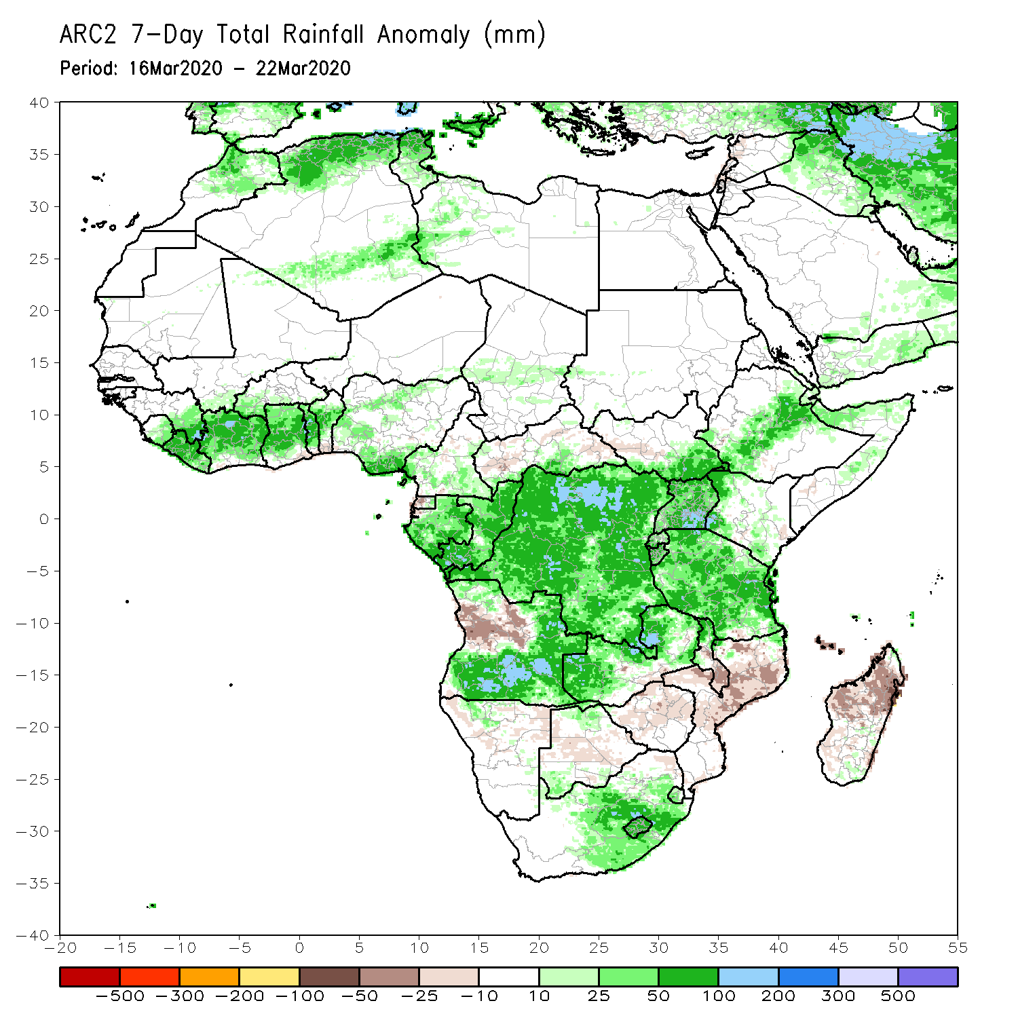
Rainfall Patterns: Last 7 Days
During the past 7 days, weekly rainfall totals exceeded 100mm over northern Cote d’Ivoire, local areas in Ghana and Togo, parts of Gabon, Congo, portions of Angola, many parts of DRC, eastern Zambia, and local areas in Tanzania and South Africa, with rainfall amount in excess of 150mm recorded over local areas in Angola, DRC, and eastern Zambia. Rainfall was above-average over many places in the Gulf of Guinea region, Gabon, Congo, DRC, Uganda, eastern South Sudan, portion of Ethiopia and Somalia, much of Tanzania, parts of Angola, Zambia, northern Malawi, parts of South Africa, and Lesotho. Rainfall surpluses exceeded 100mm over local areas in Angola, DRC, Uganda, eastern Zambia.
Rainfall was below-average over parts of Angola, Botswana, Zimbabwe, southern Malawi, Mozambique and Madagascar.

Slide 5
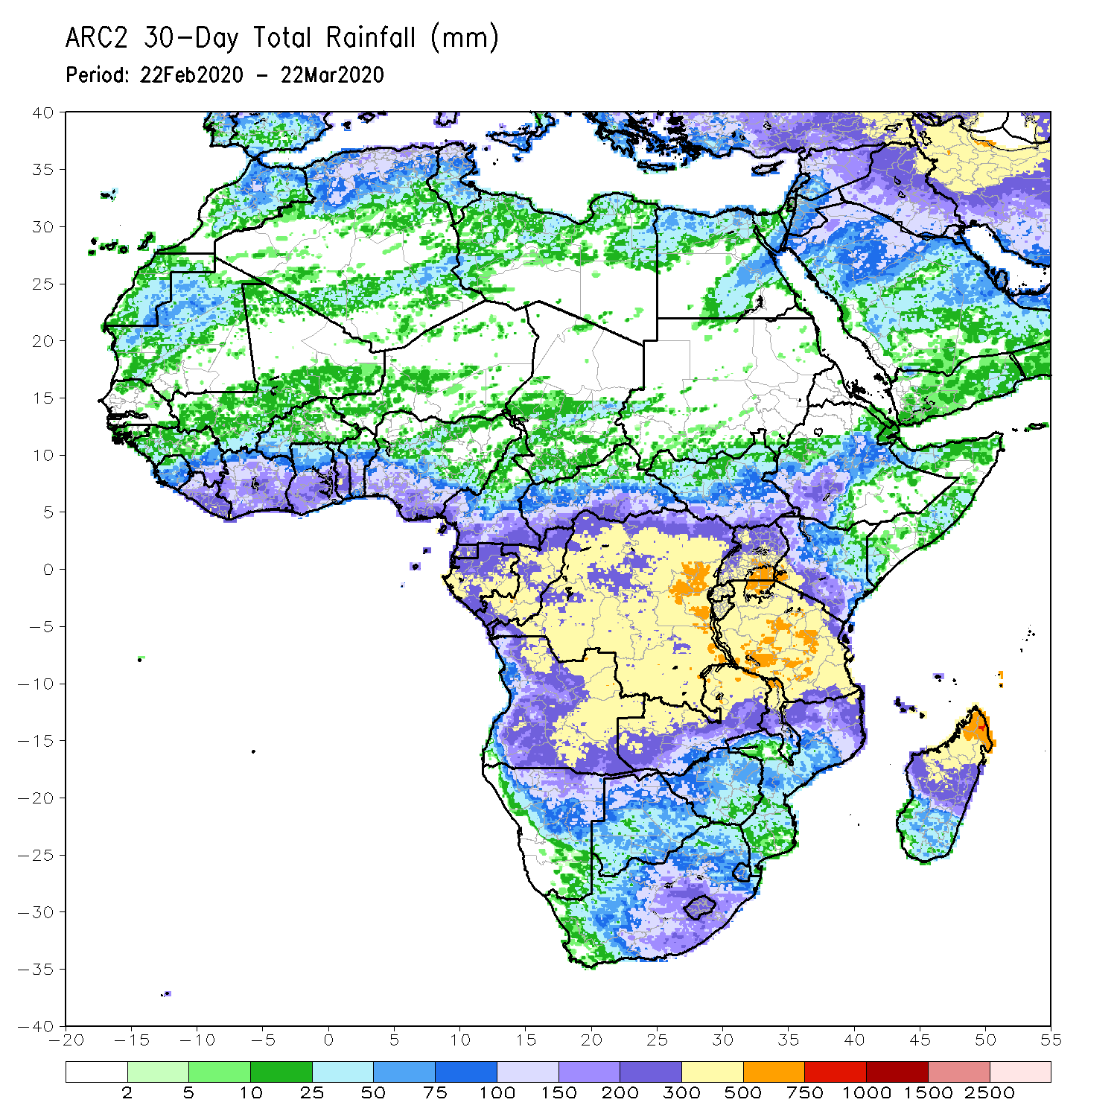
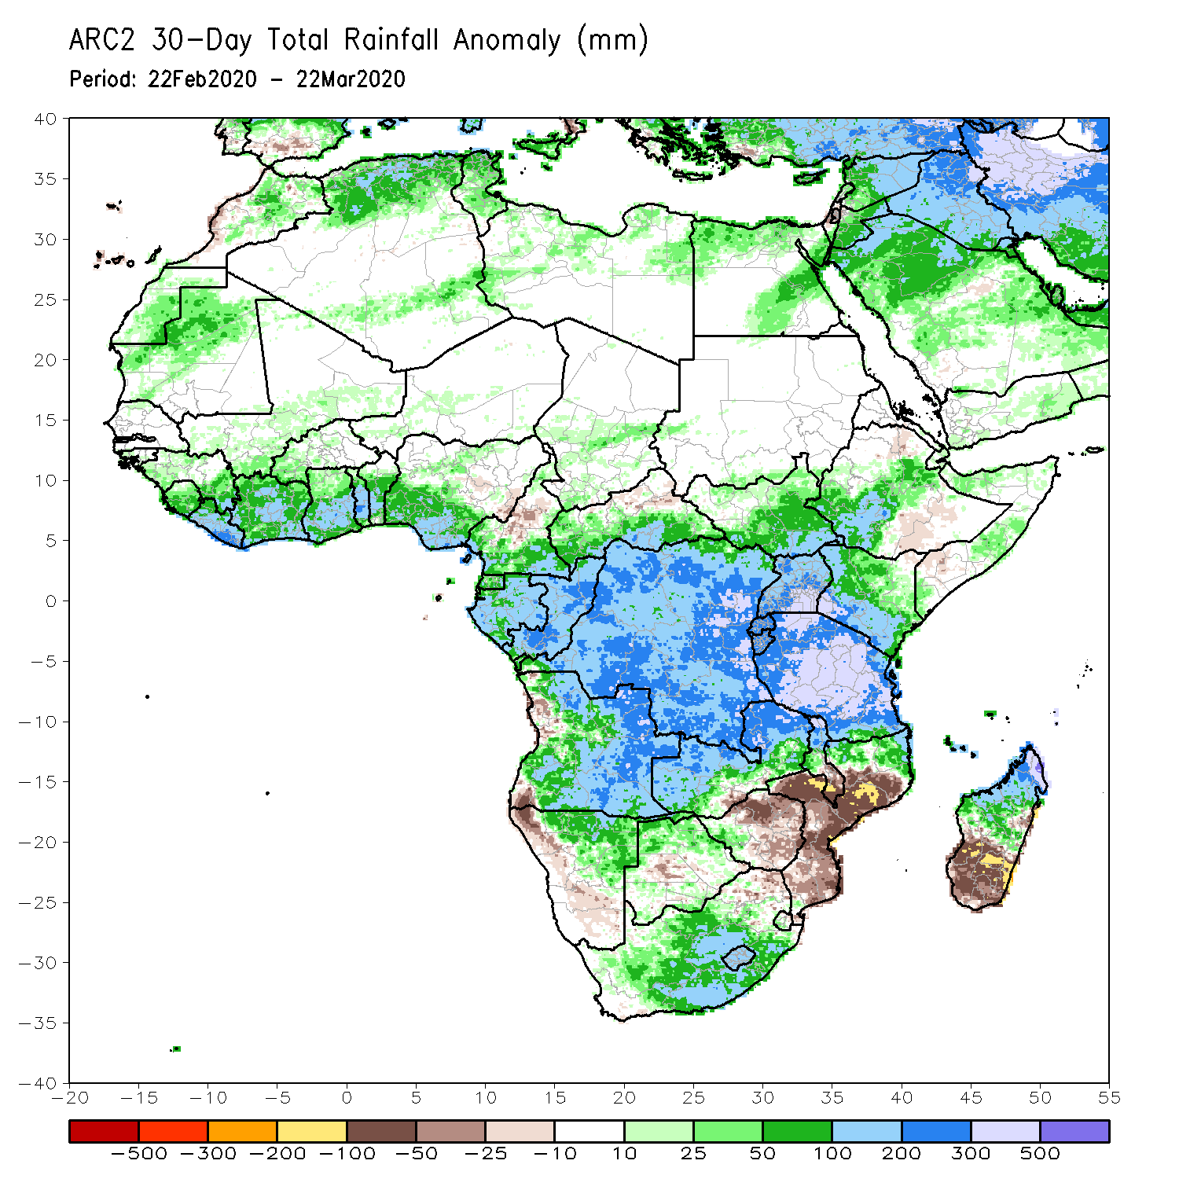
Rainfall Patterns: Last 30 Days
During the past 30 days, rainfall totals exceeded 300mm over parts of Gabon and Congo, DRC, parts of eastern Angola, many parts of Tanzania, northern Zambia, northern Malawi, and northern Madagascar, with rainfall totals in excess of 500mm observed over local areas in eastern DRC and central Tanzania, and northern Madagascar. Rainfall was above-average over many places in the Gulf of Guinea region, Gabon, Congo, southern CAR, much of DRC, South Sudan, Uganda, parts of Ethiopia, much of Kenya, Tanzania, Zambia, many parts of Angola, Namibia, Malawi, northern Mozambique, western and central South Africa, Lesotho, and central and northern Madagascar. Rainfall surpluses exceeded 300mm over parts of Tanzania and northern Madagascar.
Rainfall was below-average over western Angola, central and southern Mozambique, local areas in Namibia and Botswana, and eastern South Africa, much of Eswatini, and southern Madagascar.
Notes:
5

Slide 6
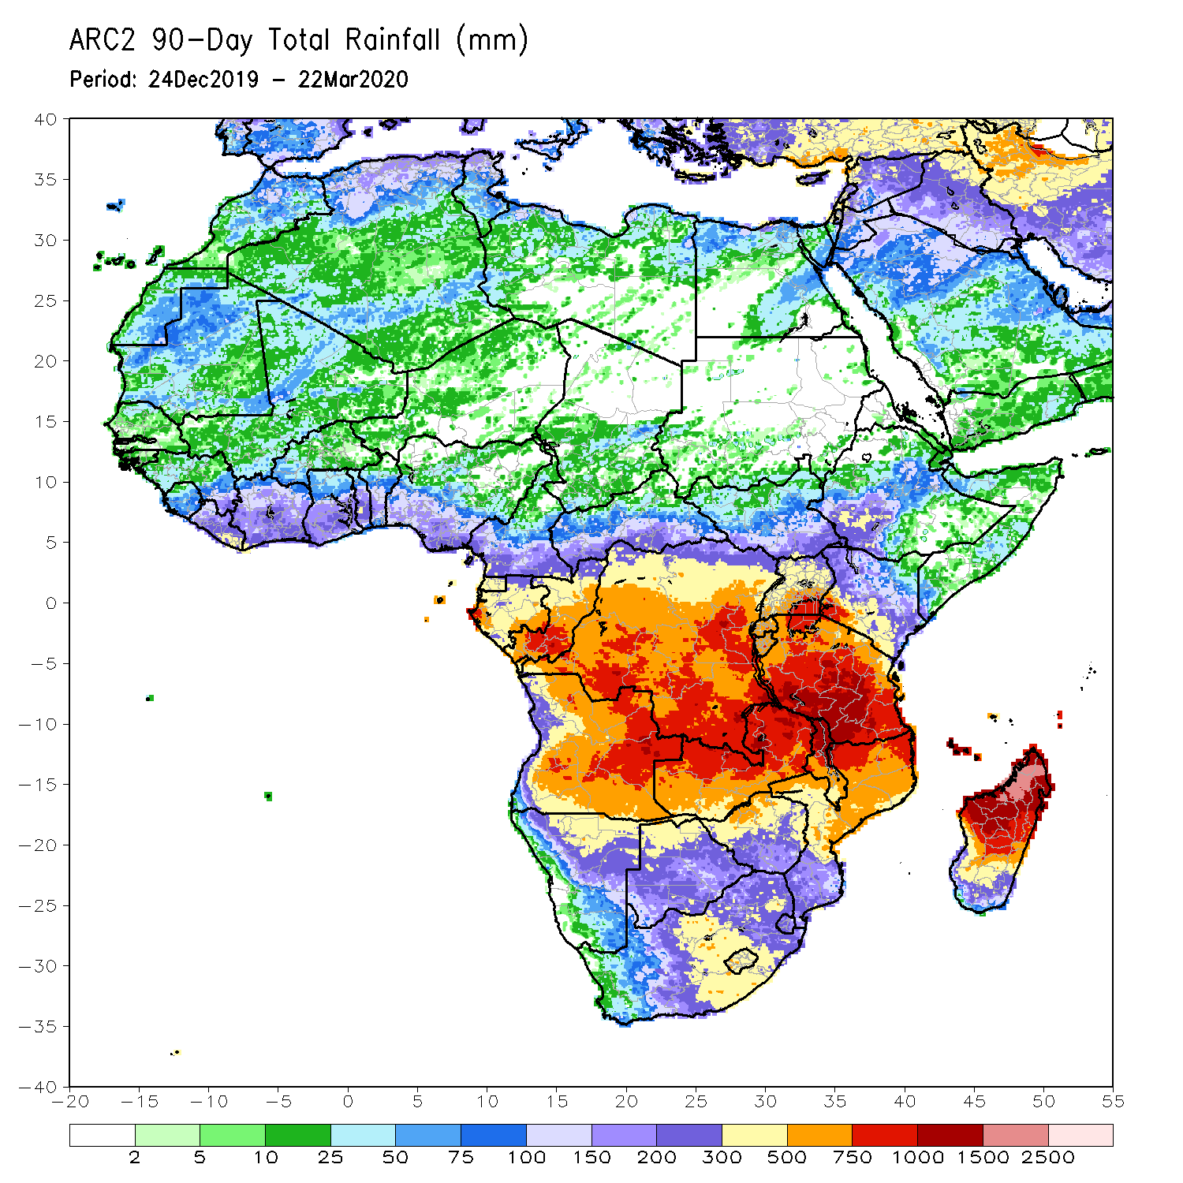
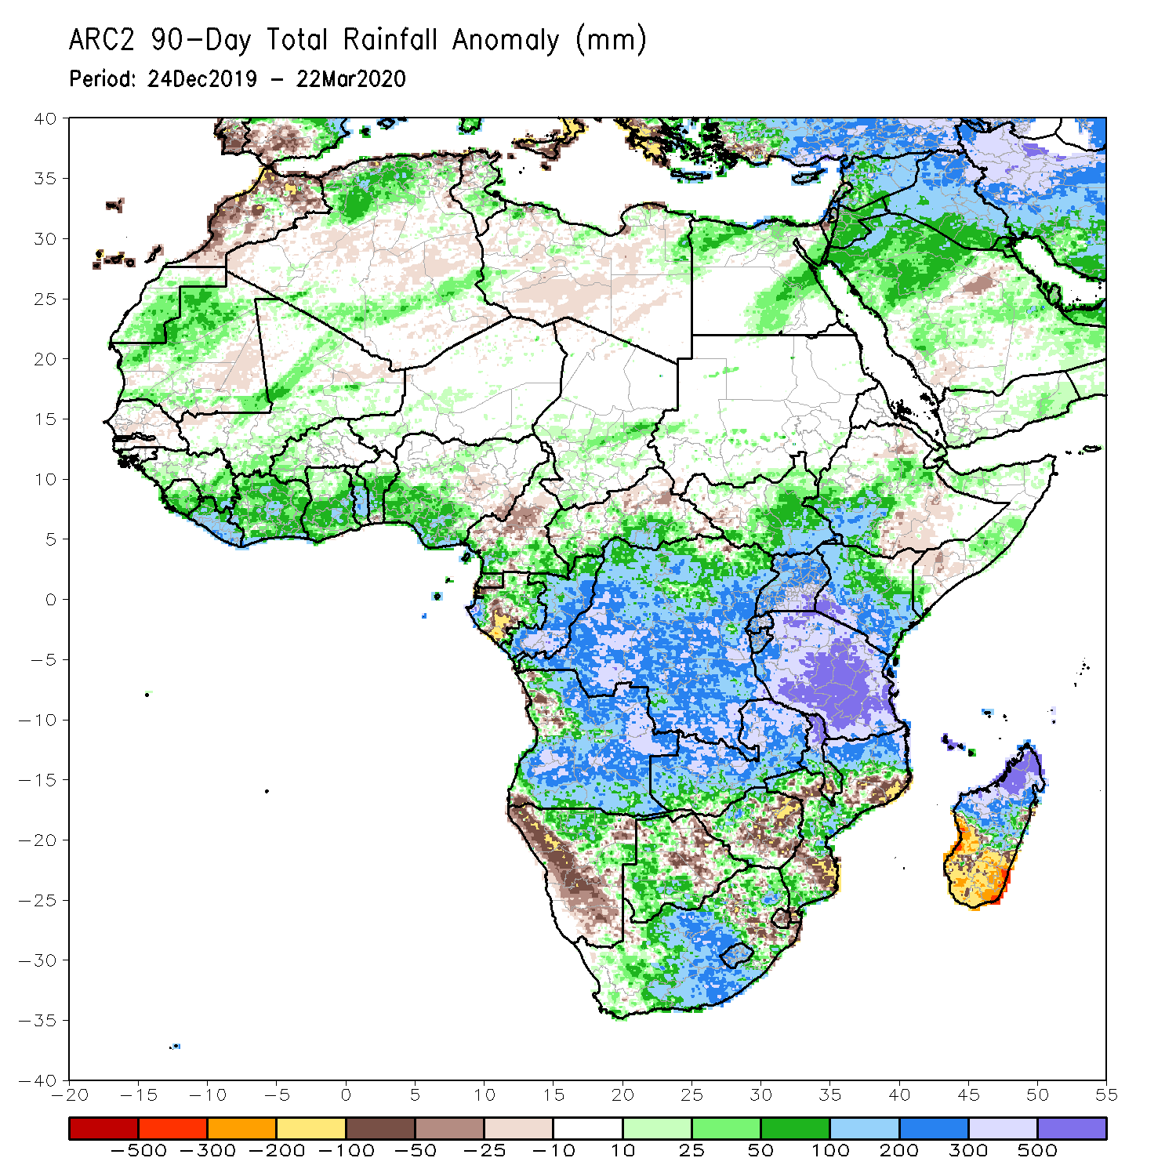
Rainfall Patterns: Last 90 Days
During the past 90 days, rainfall totals exceeded 750mm over parts of southern Congo and portions of DRC, eastern Angola, Tanzania, northern Zambia, northern Malawi, northern Mozambique, and central and northern Madagascar. Rainfall was above-average over portions of the Gulf of Guinea region, parts of CAR, South Sudan, much of Congo and DRC, Rwanda, Burundi, Uganda, Kenya, parts of Ethiopia, much of Tanzania, many parts of Angola and Zambia, northern Malawi, parts of Namibia, western Botswana, central South Africa, many parts of Mozambique, and northern Madagascar. Rainfall surpluses exceeded 500mm over local areas in central Tanzania and northern Madagascar.
Northern Cameroon, western Namibia, parts of Zimbabwe and northeastern Botswana, local areas in Mozambique, Eswatini and local areas in eastern South Africa, and southern Madagascar had below-average rainfall.
Notes:
6

Slide 7
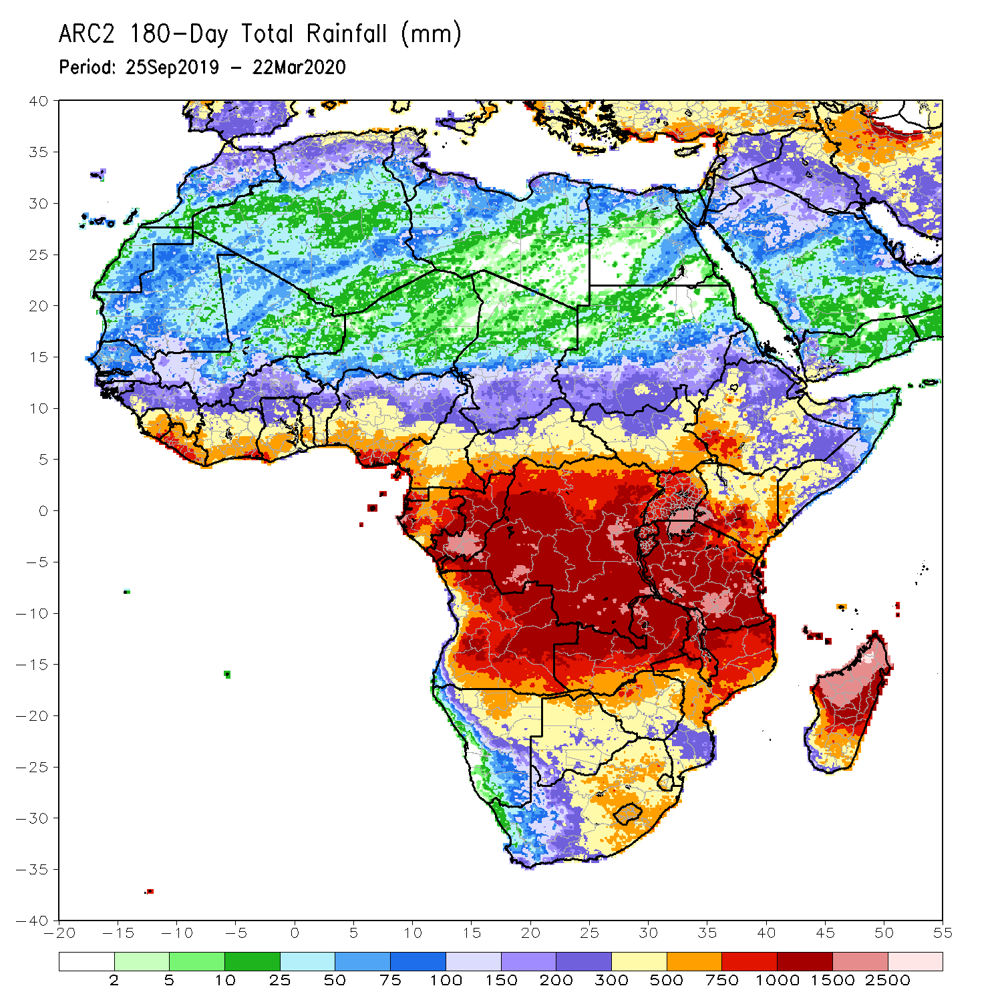
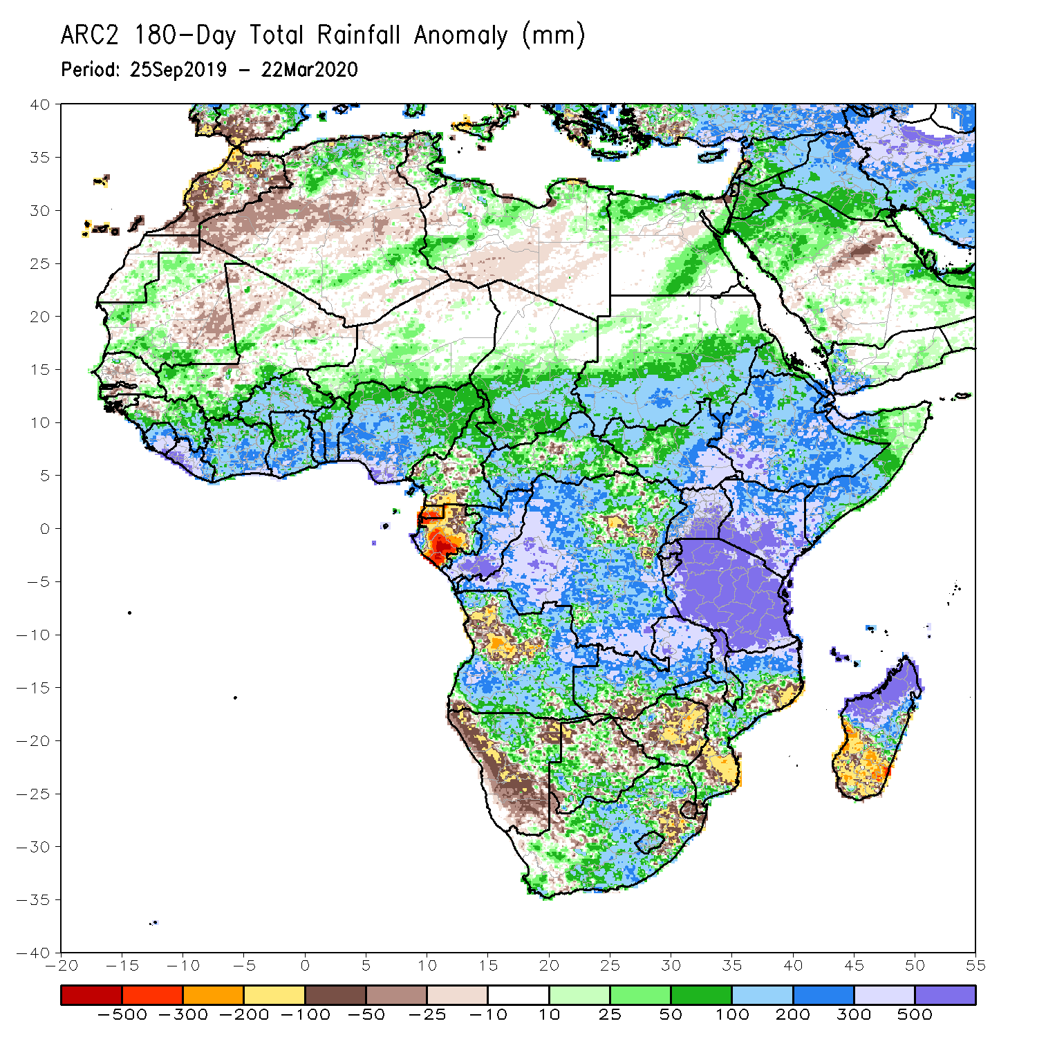
Rainfall Patterns: Last 180 Days
During the past 180 days, rainfall totals in excess of 1500mm were observed over southern Congo, local areas in DRC, Zambia and Tanzania, and parts of northern Madagascar. Parts of Southern Mauritania, eastern Guinea, Sierra Leone, portions of southern Mali, Liberia, Cote d’Ivoire, Burkina Faso, Ghana, Togo, Benin, Nigeria, portions of Cameroon, Niger, Chad, portions of CAR and DRC, South Sudan, Sudan, Uganda, Eritrea, Ethiopia, Somalia, Kenya, Tanzania, parts of Angola, parts of northern Namibia, many parts of Zambia, parts of Namibia, Malawi and South Africa, many parts of Mozambique and northern Madagascar had above-average rainfall. Rainfall surpluses exceeded 500mm over parts of southern Nigeria, local areas in Congo, Kenya, Tanzania, and northern Madagascar.
Below-average rainfall was observed over portions of southern Cameroon, Equatorial Guinea, Gabon, parts of northeastern DRC, parts of Angola, western Namibia, southeastern South Africa, local areas in western Zambia, parts of Botswana and Zimbabwe, parts of southern Mozambique and southern Madagascar. Rainfall deficits exceeded 500mm over parts of Gabon and Equatorial Guinea.
Notes:
7

Slide 8
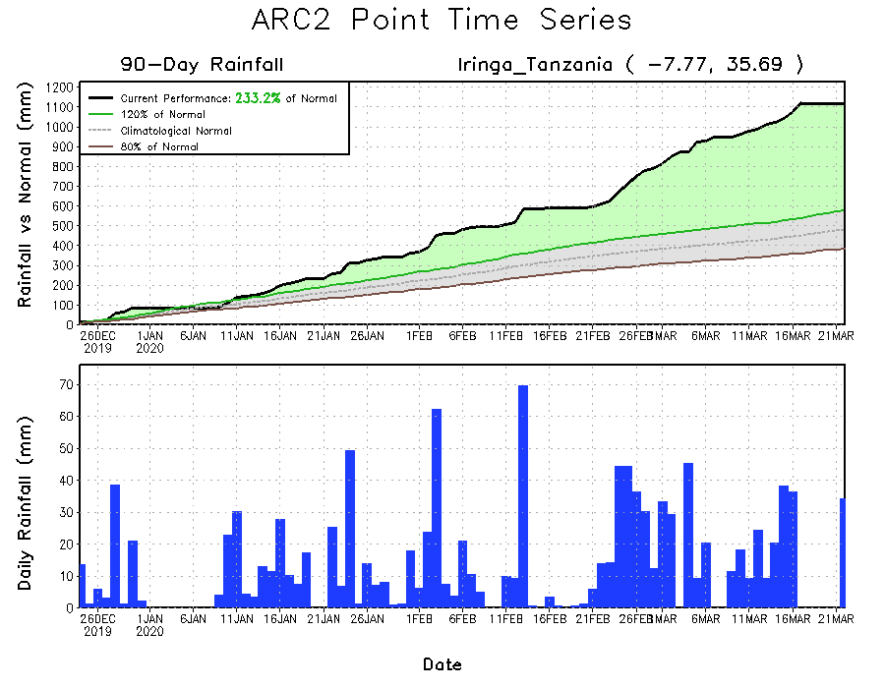
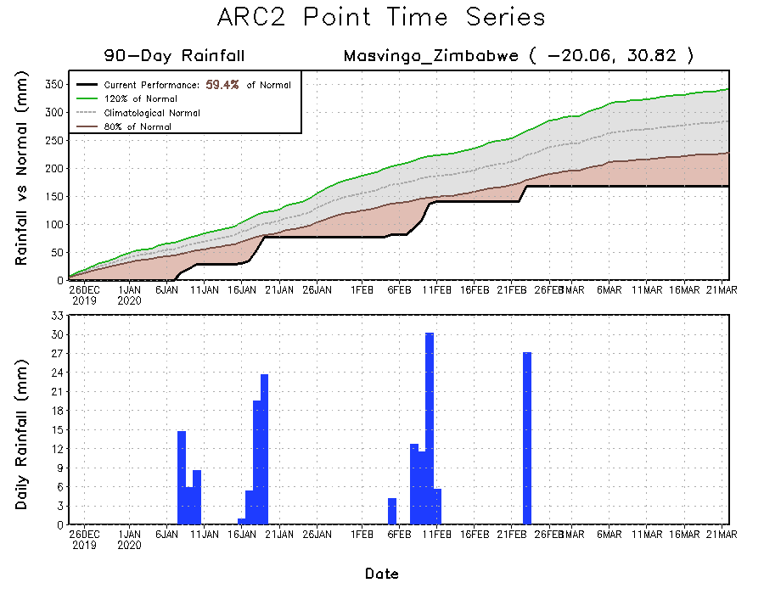
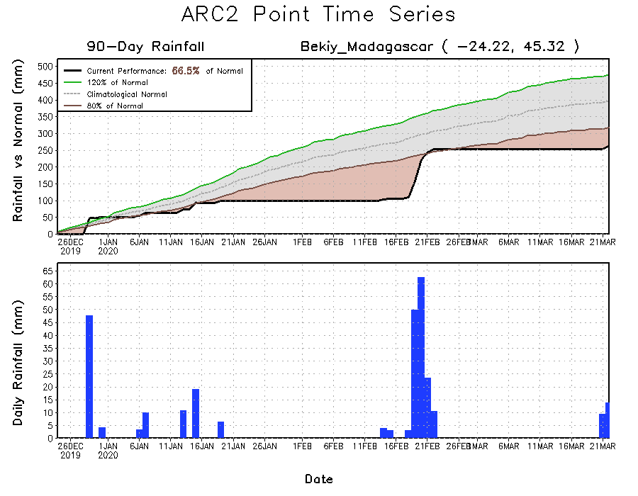
Recent Rainfall Evolution
Daily evolution of rainfall over the last 90 days at selected locations shows that moderate to locally heavy rainfall sustained moisture surpluses over portions of Tanzania (top right). Seasonal total rainfall remained below-average over parts of Zimbabwe (bottom left) and southern Madagascar(bottom right).

Slide 9
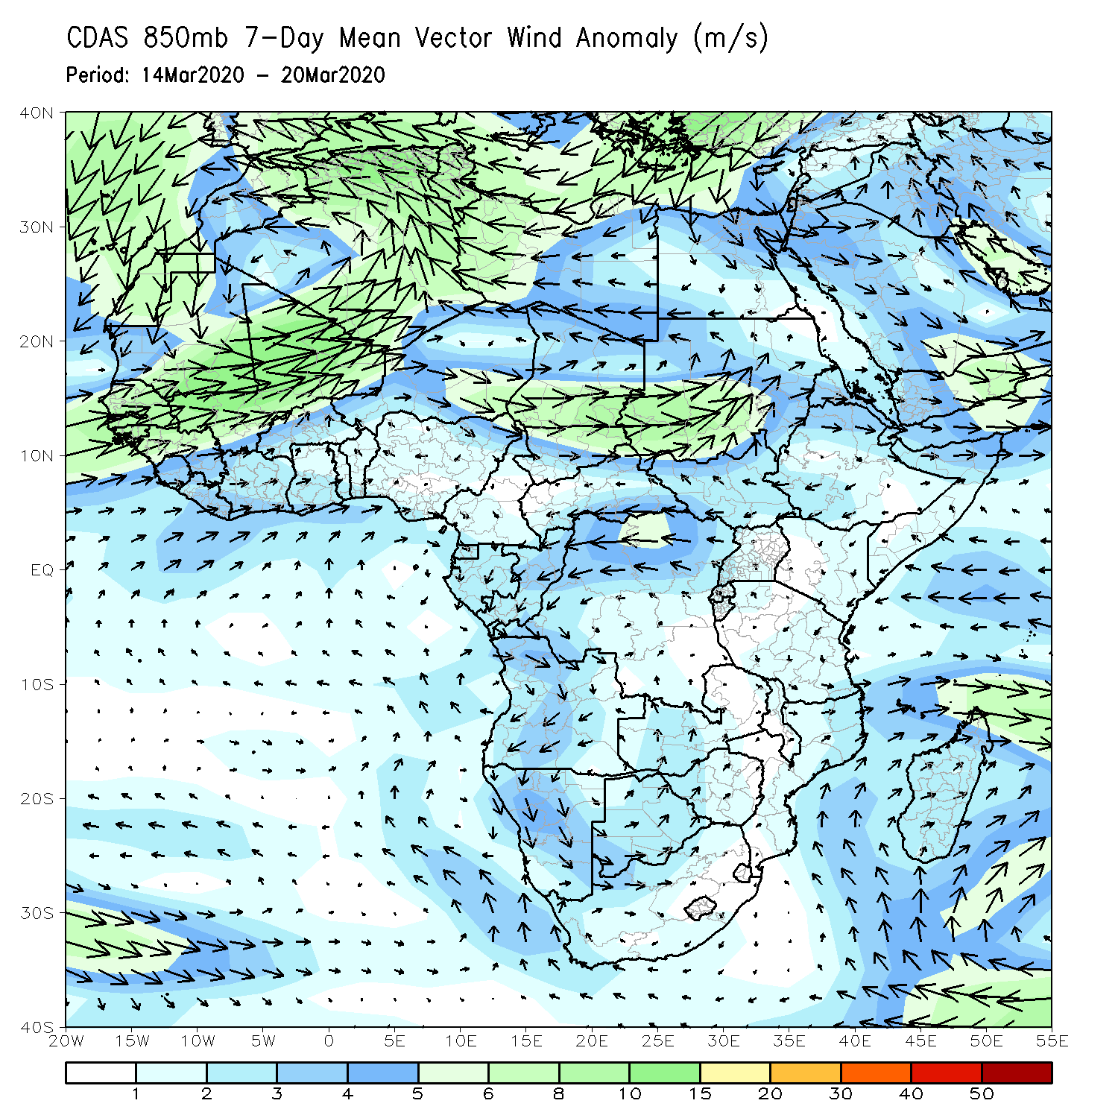
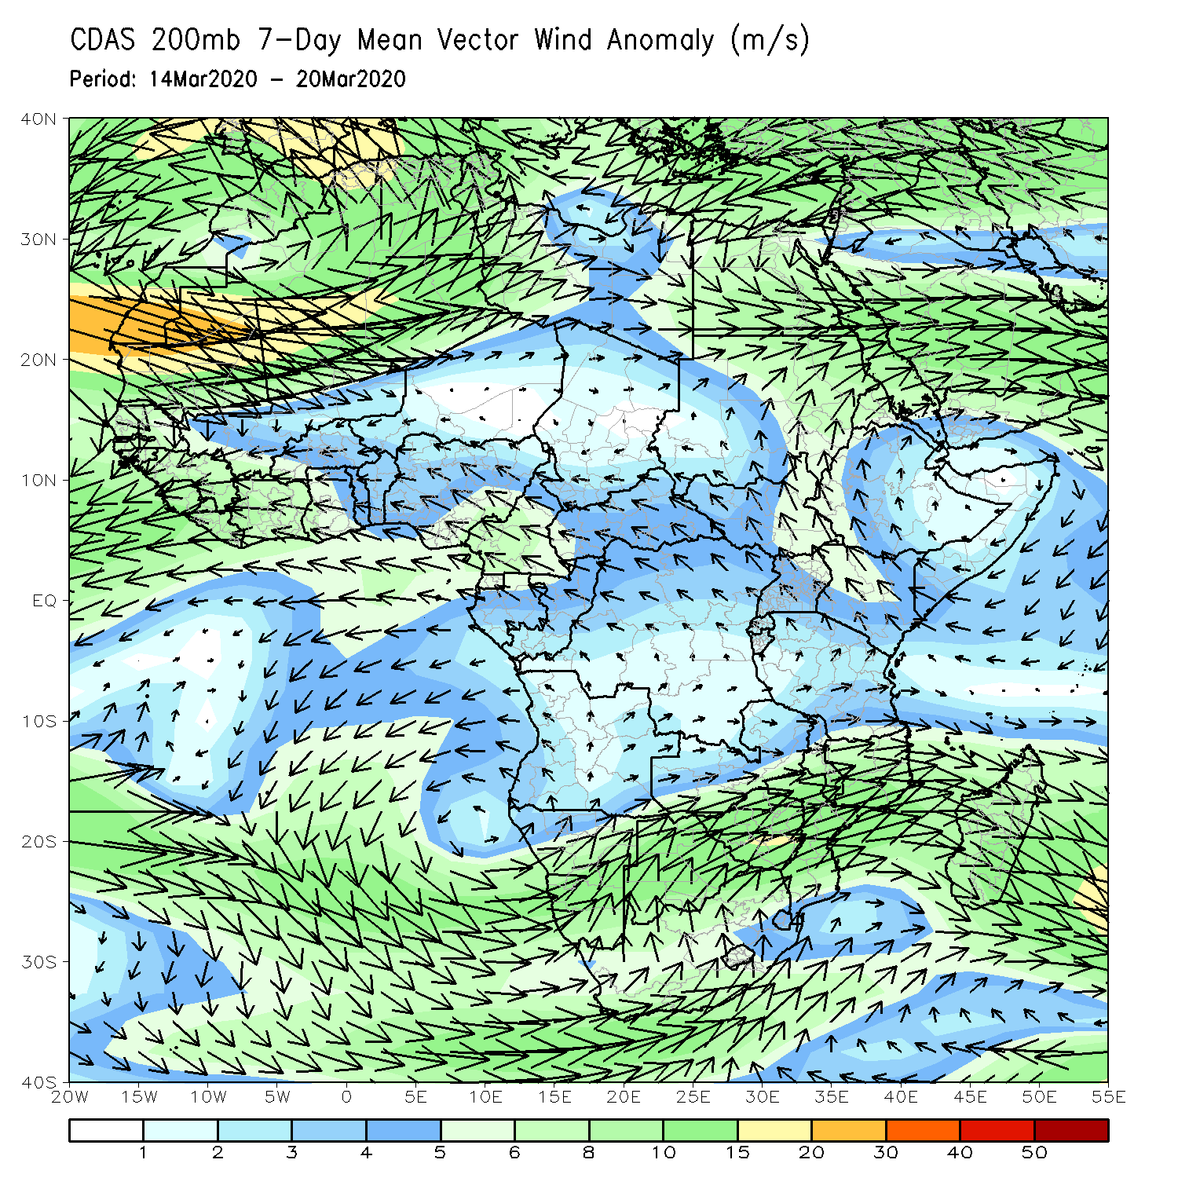
Atmospheric Circulation: Last 7 Days
Lower-level wind anomalies were anti-cyclonic across the western portions of Southern Africa (left panel).

Slide 10
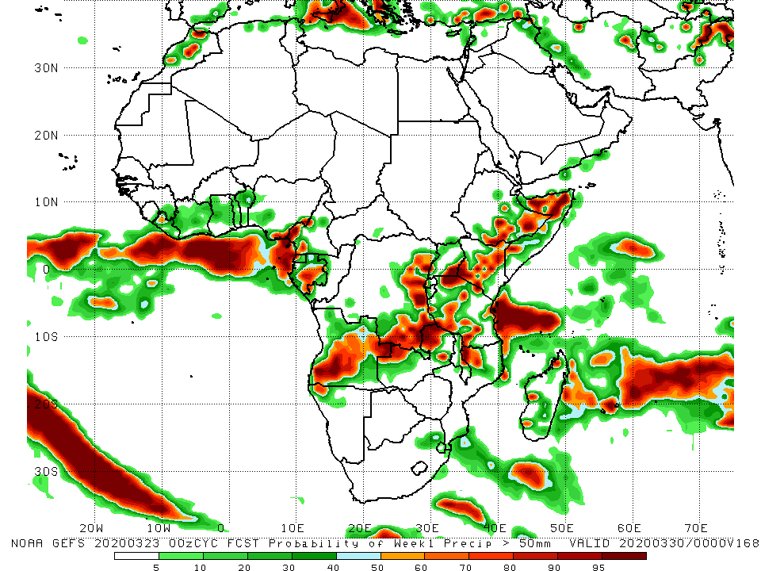
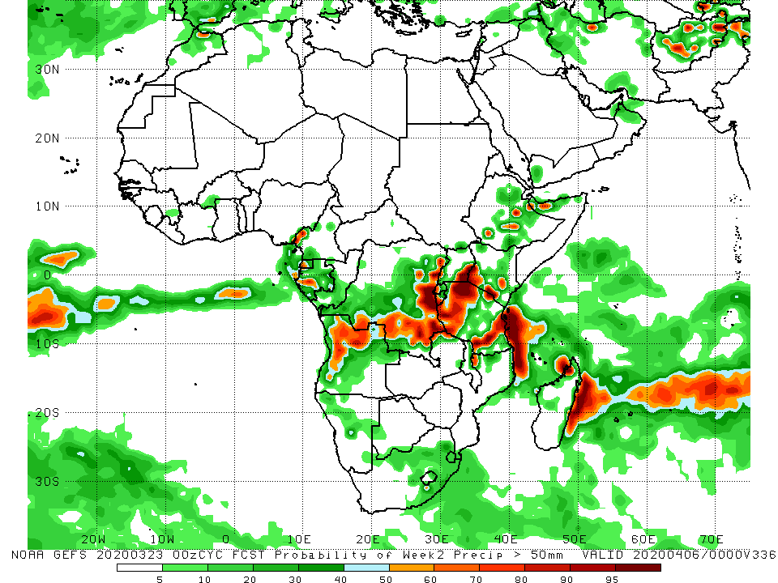
NCEP GEFS Model Forecasts Non-Bias Corrected Probability of precipitation exceedance
Week-1: Valid 24 - 30 March, 2020
Week-2: Valid 31 March - 6 April, 2020
For week-1 (left panel), there is an increased chance for weekly rainfall totals to exceed 50mm over southeastern Nigeria, western Cameroon, Equatorial Guinea, Gabon, Angola, southern and eastern DRC, eastern Zambia, parts of Uganda and Tanzania, Kenya, southeastern Ethiopia, Somalia, northern Mozambique and local areas n Madagascar. For week-2 (right panel), there is an increased chance for weekly rainfall totals to exceed 50mm over local areas in Cameroon and Gabon, Angola, southern and eastern DRC, southeastern Uganda, parts of Tanzania, and local areas in Kenya and Ethiopia.
Notes:
10

Slide 11
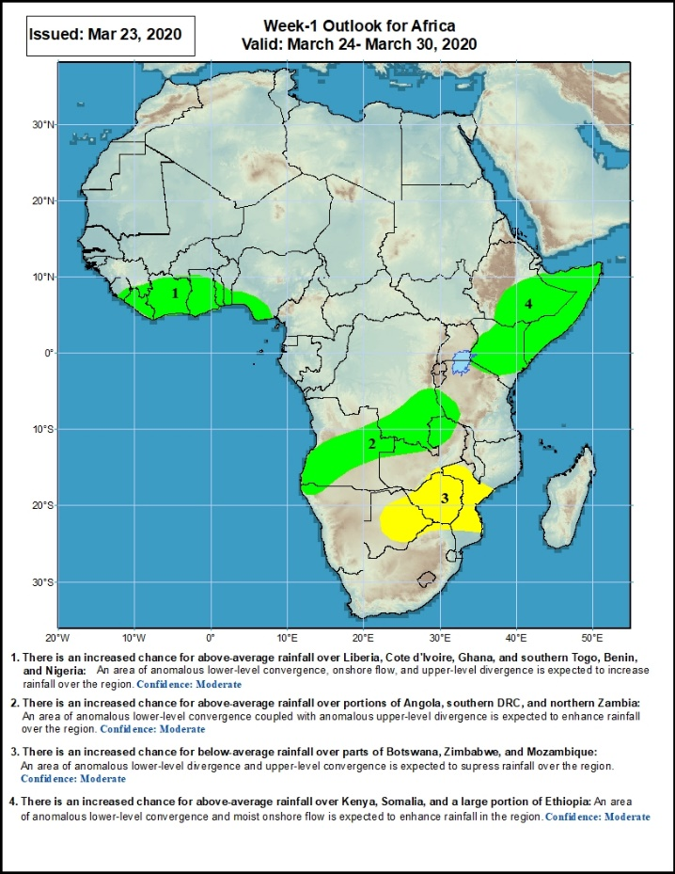
Week-1 Precipitation Outlooks
24– 30 March, 2020
There is an increased chance for above-average rainfall over Liberia, Cote d'Ivoire, Ghana, and southern Togo, Benin, and Nigeria: An area of anomalous lower-level convergence, onshore flow and upper-level divergence is expected to enhance rainfall in the region. Confidence: Moderate
There is an increased chance for above-average rainfall over portions of Angola, southern DRC, and northern Zambia: An area of anomalous lower-level convergence and upper-level divergence is expected to enhance rainfall over the region. Confidence: Moderate
There is an increased chance for below-average rainfall over parts of Botswana, Zimbabwe, and Mozambique: An area of anomalous lower-level divergence and upper-level convergence is expected to suppress rainfall over the region. Confidence: Moderate
There is an increased chance for above-average rainfall over Kenya, Somalia, and eastern and southeastern Ethiopia: An area of anomalous lower-level convergence and moist onshore flow is expected to enhance rainfall over the region. Confidence: Moderate
Notes:
11

Slide 12
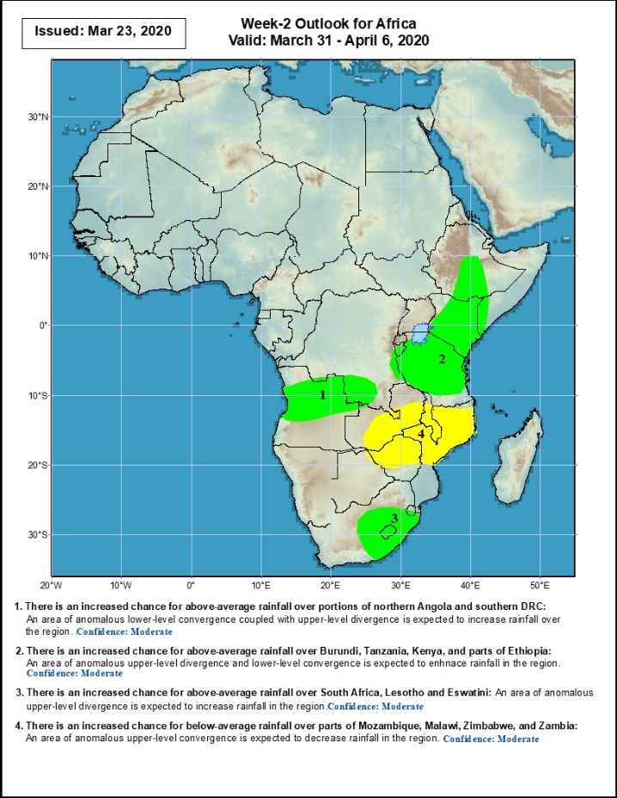
Week-2 Precipitation Outlooks
31 March – 6 April, 2020
There is an increased chance for above-average rainfall over portions of northern Angola and southern DRC: An area of anomalous lower level convergence and upper-level divergence is expected to enhance rainfall in the region. Confidence: Moderate
There is an increased chance for above-average rainfall over Burundi, Tanzania, Kenya, and parts of Ethiopia: An area of anomalous lower-level convergence and upper-level divergence is expected to enhance rainfall in the region. Confidence: Moderate
There is an increased chance for above-average rainfall over eastern South Africa, Lesotho and Eswatini: An area of anomalous upper-level divergence is expected to enhance rainfall in the region.. Confidence: Moderate
There is an increased chance for below-average rainfall over southern Zambia, Zimbabwe, Malawi, and central and northern Mozambique: An area of anomalous lower-level divergence is expected to suppress rainfall in the region. Confidence: Moderate
Notes:
12

Slide 13
Summary
During the past 7 days, weekly rainfall totals exceeded 100mm over northern Cote d’Ivoire, local areas in Ghana and Togo, parts of Gabon, Congo, portions of Angola, many parts of DRC, eastern Zambia, and local areas in Tanzania and South Africa, with rainfall amount in excess of 150mm recorded over local areas in Angola, DRC, and eastern Zambia. Rainfall was above-average over many places in the Gulf of Guinea region, Gabon, Congo, DRC, Uganda, eastern South Sudan, portion of Ethiopia and Somalia, much of Tanzania, parts of Angola, Zambia, northern Malawi, parts of South Africa, and Lesotho. Rainfall surpluses exceeded 100mm over local areas in Angola, DRC, Uganda, eastern Zambia. Rainfall was below-average over parts of of Angola, Botswana, Zimbabwe, southern Malawi, Mozambique and Madagascar.
During the past 30 days, rainfall totals exceeded 300mm over parts of Gabon and Congo, DRC, parts of eastern Angola, many parts of Tanzania, northern Zambia, northern Malawi, and northern Madagascar, with rainfall totals in excess of 500mm observed over local areas in eastern DRC and central Tanzania, and northern Madagascar. Rainfall was above-average over many places in the Gulf of Guinea region, Gabon, Congo, southern CAR, much of DRC, South Sudan, Uganda, parts of Ethiopia, much of Kenya, Tanzania, Zambia, many parts of Angola, Namibia, Malawi, northern Mozambique, western and central South Africa, Lesotho, and central and northern Madagascar. Rainfall surpluses exceeded 300mm over parts of Tanzania and northern Madagascar. Rainfall was below-average over western Angola, central and southern Mozambique, local areas in Namibia and Botswana, and eastern South Africa, much of Eswatini, and southern Madagascar.
During the past 90 days, rainfall totals exceeded 750mm over parts of southern Congo and portions of DRC, eastern Angola, Tanzania, northern Zambia, northern Malawi, northern Mozambique, and central and northern Madagascar. Rainfall was above-average over portions of the Gulf of Guinea region, parts of CAR, South Sudan, much of Congo and DRC, Rwanda, Burundi, Uganda, Kenya, parts of Ethiopia, much of Tanzania, many parts of Angola and Zambia, northern Malawi, parts of Namibia, western Botswana, central South Africa, many parts of Mozambique, and northern Madagascar. Rainfall surpluses exceeded 500mm over local areas in central Tanzania and northern Madagascar. Northern Cameroon, western Namibia, parts of Zimbabwe and northeastern Botswana, local areas in Mozambique, Eswatini and local areas in eastern South Africa, and southern Madagascar had below-average rainfall.
Week-1 outlooks call for an increased chance for above-average rainfall over many places in the Gulf of Guinea region, parts of Angola, southern DRC, northern Zambia, much of Kenya, eastern and southeastern Ethiopia and Somalia. In contrast, there is an increased chance for below-average rainfall over parts of Botswana, Zimbabwe, and central and southern Mozambique.
Notes:
13

