Slide 1
The African Monsoon Recent Evolution and Current Status Include Week-1 and Week-2 Outlooks
Update prepared by
Climate Prediction Center / NCEP
6 April 2020
For more information, visit:
http://www.cpc.ncep.noaa.gov/products/Global_Monsoons/African_Monsoons/precip_monitoring.shtml

Slide 2
Outline
Highlights
Recent Evolution and Current Conditions
NCEP GEFS Forecasts
Summary

Slide 3
Highlights: Last 7 Days
Rainfall was above-average along the Gulf of Guinea coast and many places in Central Africa, while below-average rainfall was observed over many places in East and Southeast Africa.
Week-1 outlooks call for an increased chance for above-average rainfall over eastern Guinea, Sierra Leone, Liberia, central Ghana, southern Togo, Benin, southern Nigeria, southeastern DRC, eastern Zambia, western Tanzania, and western Ethiopia. In contrast, there is an increased chance for below-average rainfall over southeastern Angola, eastern Namibia, southwestern Zambia, Botswana, western Zimbabwe, Uganda, parts of southern South Sudan, and western Kenya.

Slide 4
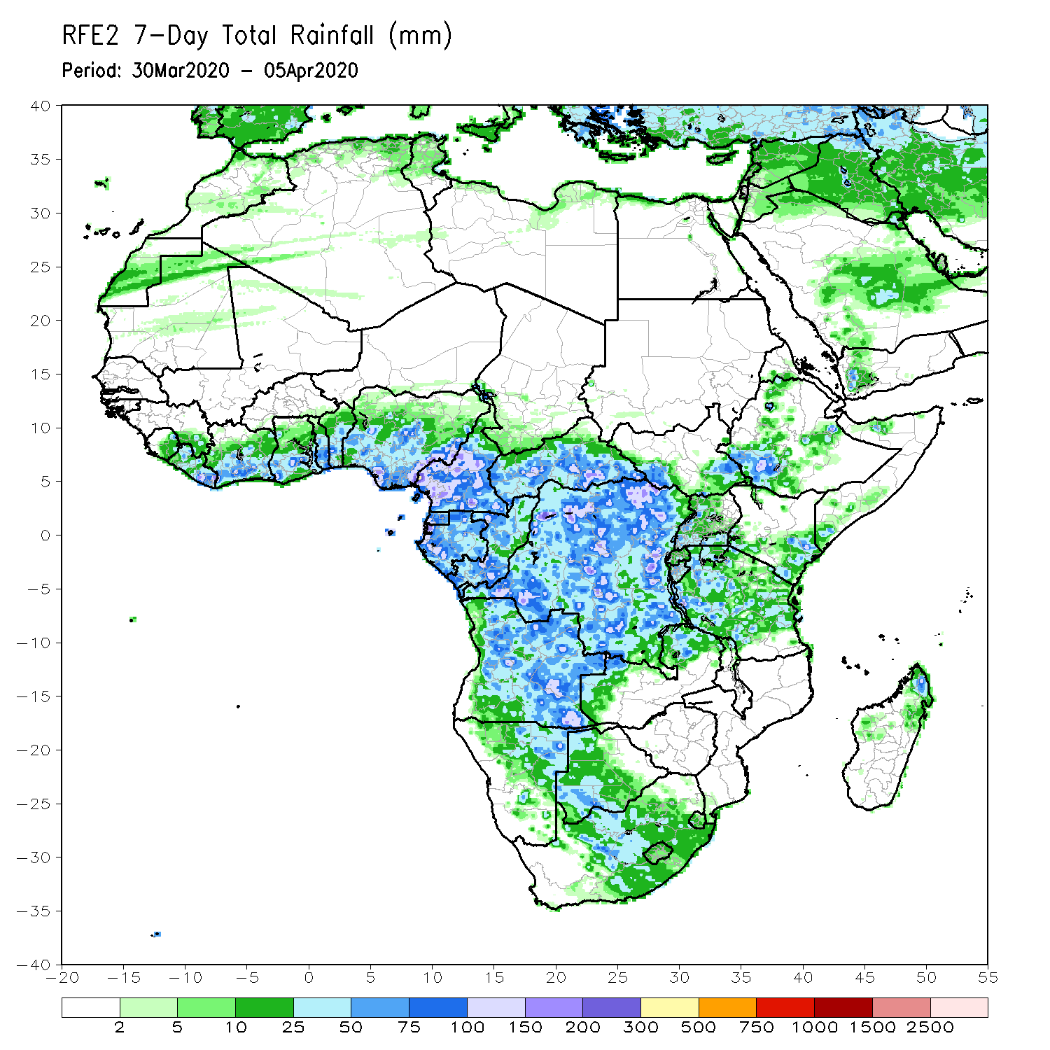
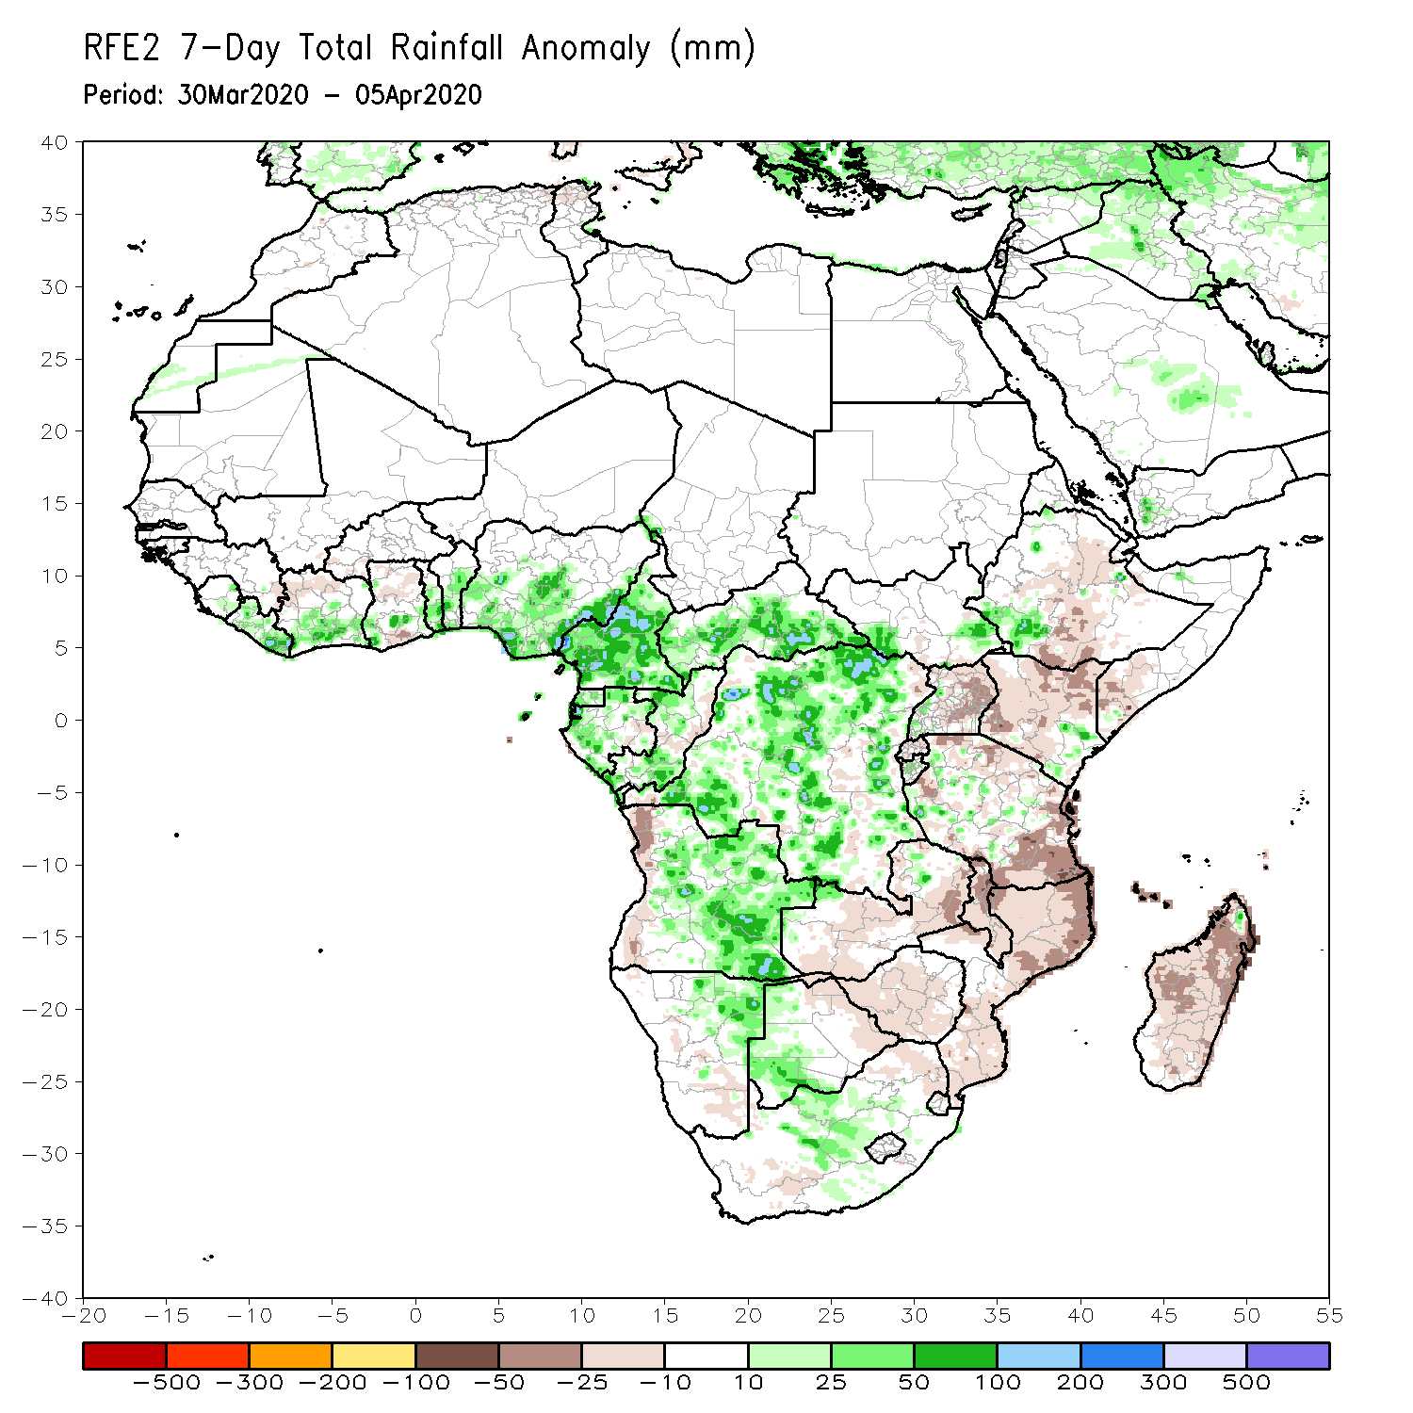
Rainfall Patterns: Last 7 Days
During the past 7 days, rainfall was above-average over across Liberia, southern Cote d’Ivoire, southern Ghana, Togo, Benin, Nigeria, Cameroon, CAR, parts of Gabon and Congo, many parts of DRC and Angola, eastern Angola, western Botswana, central South Africa, and local area sin Southwestern Ethiopia.
Below-average rainfall was observed over portions of Ethiopia, Uganda, Kenya, Tanzania, coastal Angola, western Namibia, Zambia, Malawi, Mozambique and Madagascar.

Slide 5
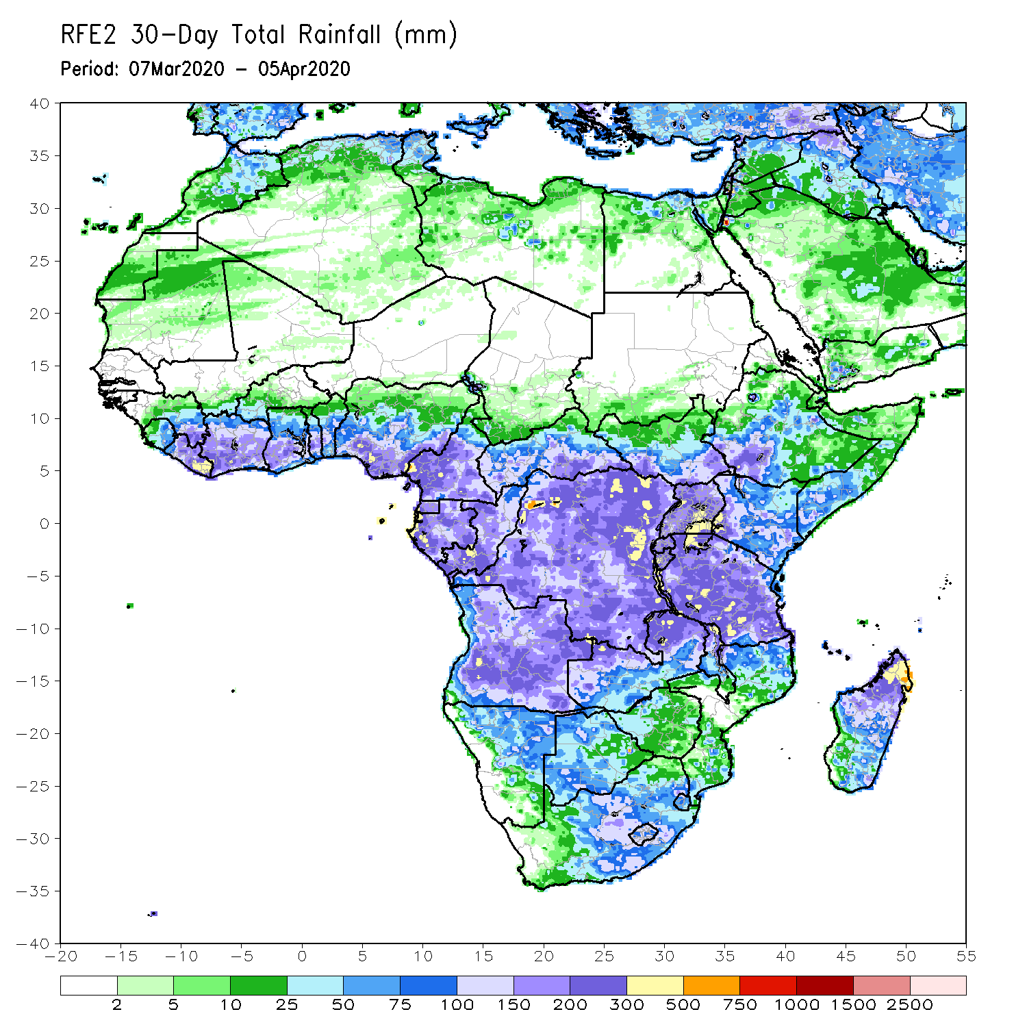
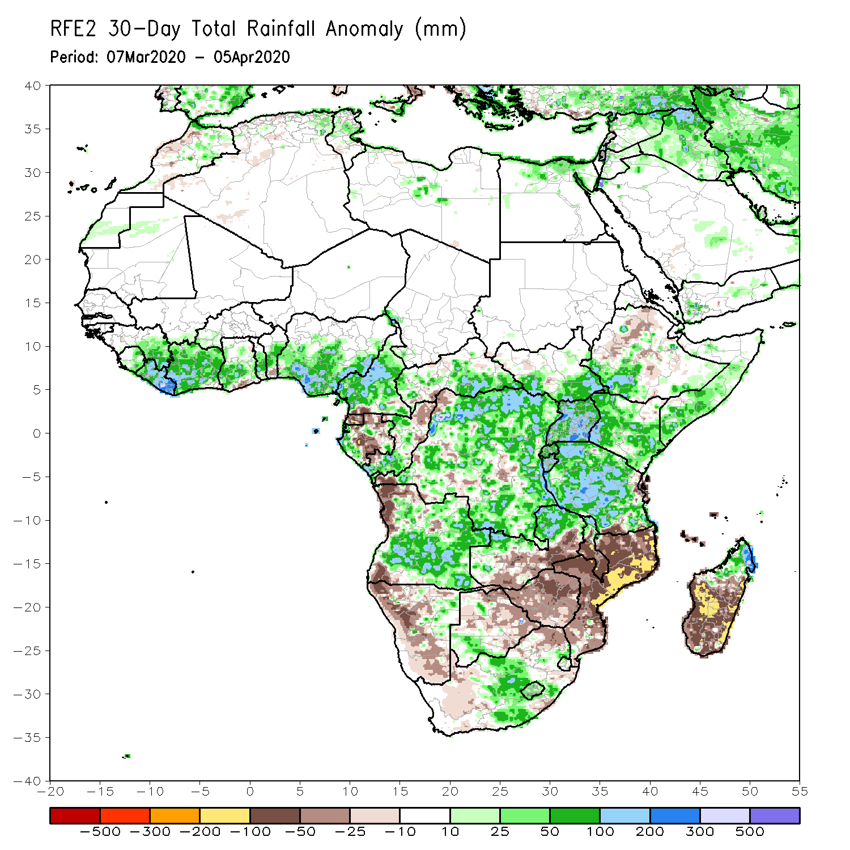
Rainfall Patterns: Last 30 Days
During the past 30 days, rainfall was above-average over many places in the Gulf of Guinea region, including much of Cameroon, parts of Gabon and Congo, CAR, much of DRC, South Sudan, Uganda, parts of Ethiopia, much of Kenya, southern Somalia, Tanzania, northern Zambia, many parts of Angola, central South Africa, Lesotho, and central and northern Madagascar.
Rainfall was below-average over parts of Gabon and Congo, western Angola, local areas in DRC, parts of Ethiopia, Namibia, Botswana, Zimbabwe, Malawi, Mozambique, parts of South Africa, and central and southern Madagascar.
Notes:
5

Slide 6
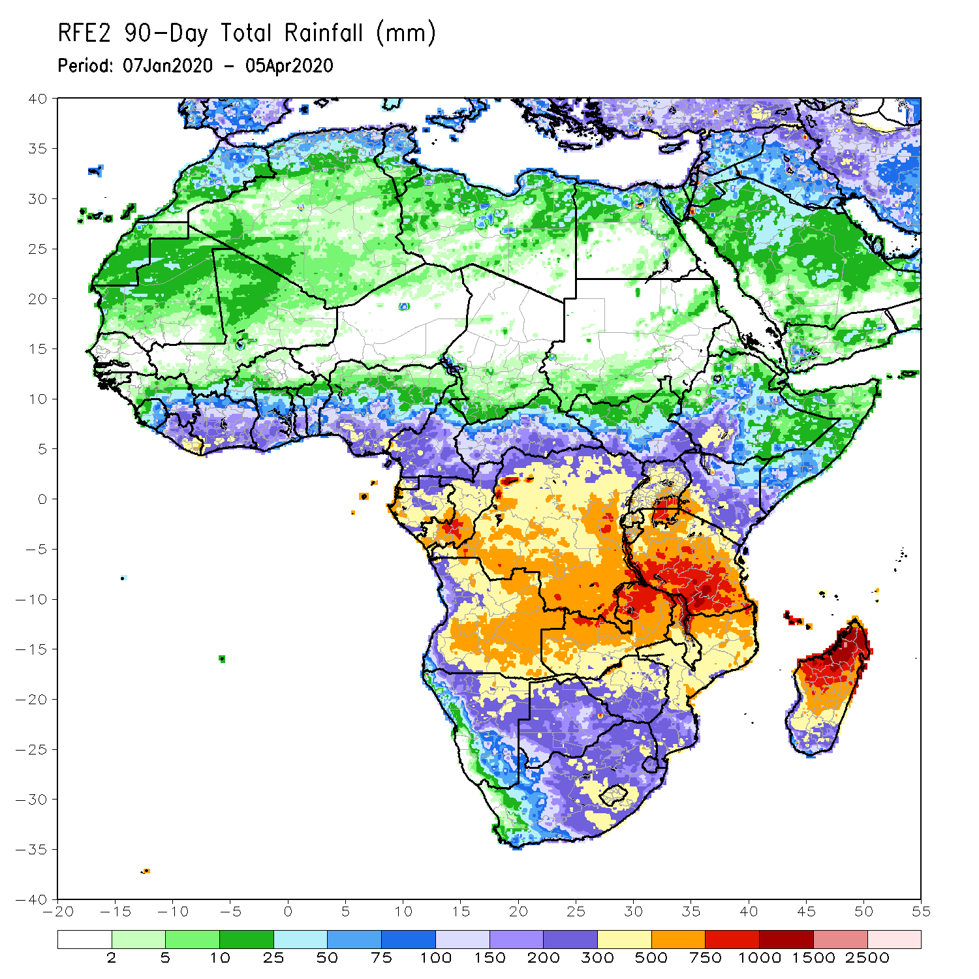
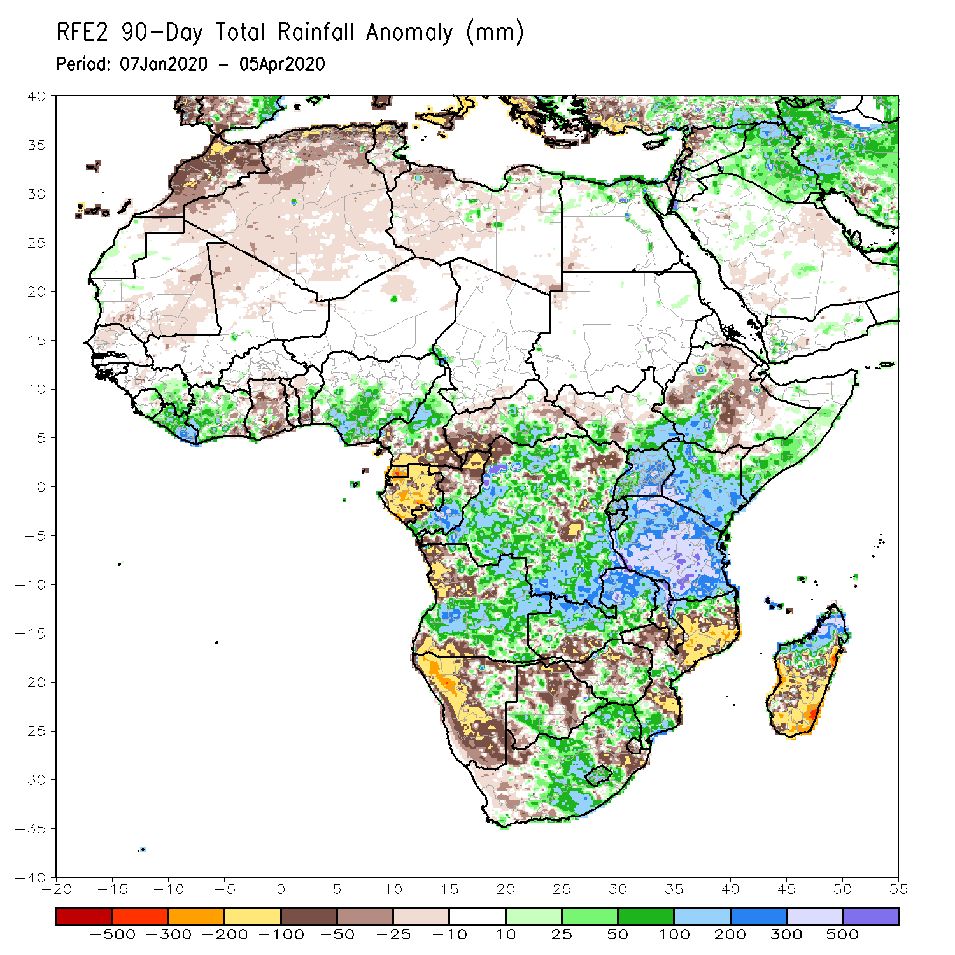
Rainfall Patterns: Last 90 Days
During the past 90 days, rainfall was above-average over portions of the Gulf of Guinea region, including northern Cameroon, eastern CAR, southeastern South Sudan, southern Congo, many parts of DRC, Rwanda, Burundi, Uganda, Kenya, parts of Ethiopia, Somalia, much of Tanzania, many parts of Angola and Zambia, Malawi, local areas in Namibia and Botswana, portions of South Africa, Zimbabwe, northern Malawi, local areas in Mozambique, and northern Madagascar.
Much of Ghana, Togo, Benin, southern Cameroon, Equatorial Guinea, Gabon, western CAR, parts of Angola and DRC, local areas in South Sudan, parts of Ethiopia, Namibia, parts of Botswana and Zimbabwe, southern Zambia, eastern South Arica, parts of Mozambique and Madagascar.
Notes:
6

Slide 7
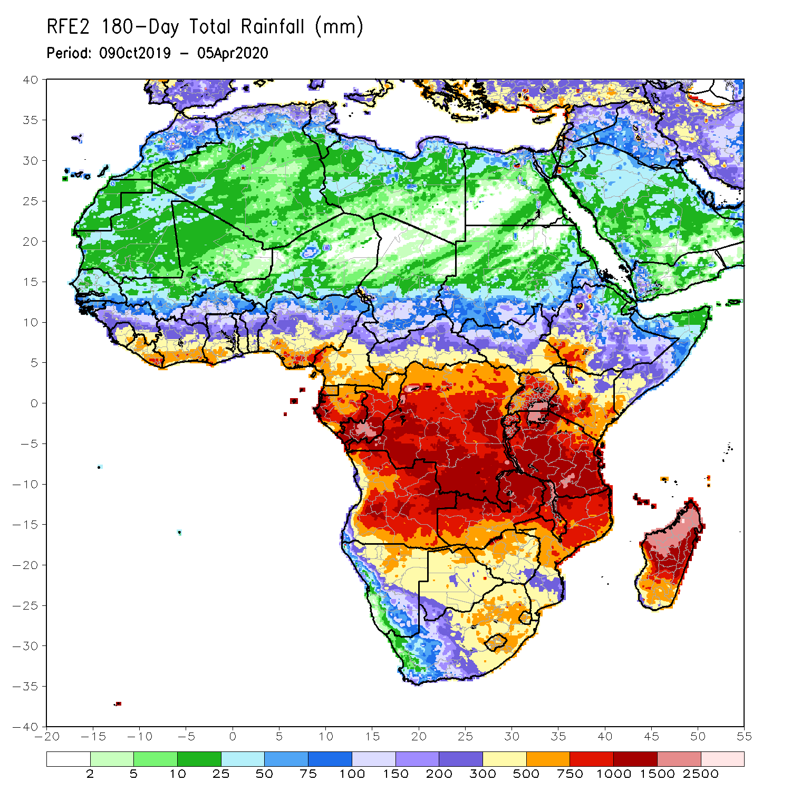
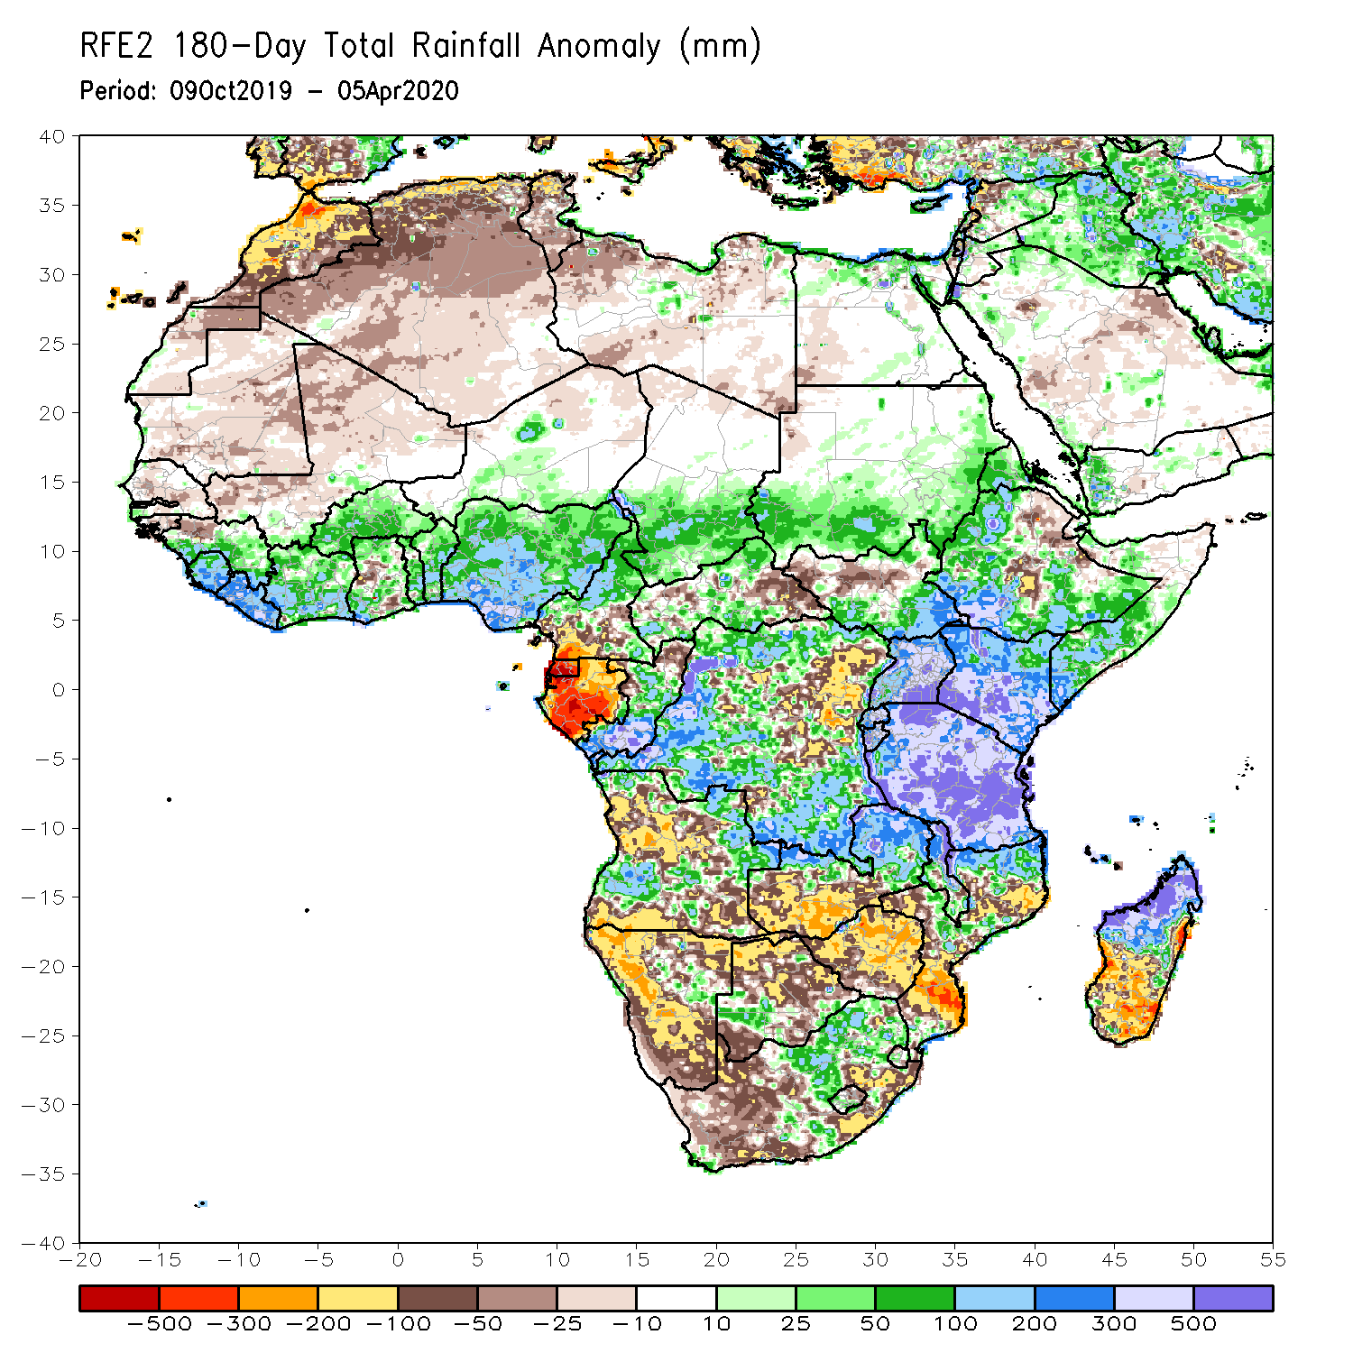
Rainfall Patterns: Last 180 Days
During the past 180 days, eastern Guinea, Sierra Leone, Liberia, Cote d’Ivoire, Burkina Faso, Ghana, Togo, Benin, Nigeria, portions of Cameroon, southern Chad, portions of CAR and DRC, local areas in South Sudan, southern Sudan, Uganda, Eritrea, Ethiopia, southern Somalia, Kenya, Tanzania, parts of Angola, local areas in Namibia, parts of Zambia, Malawi and parts of South Africa, portions of Mozambique and northern Madagascar had above-average rainfall.
Below-average rainfall was observed over portions of southern Cameroon, Equatorial Guinea, Gabon, parts of northeastern DRC, parts of Angola, Namibia, South Africa, western Zambia, many parts of Botswana and Zimbabwe, parts of southern Mozambique and southern Madagascar.
Notes:
7

Slide 8
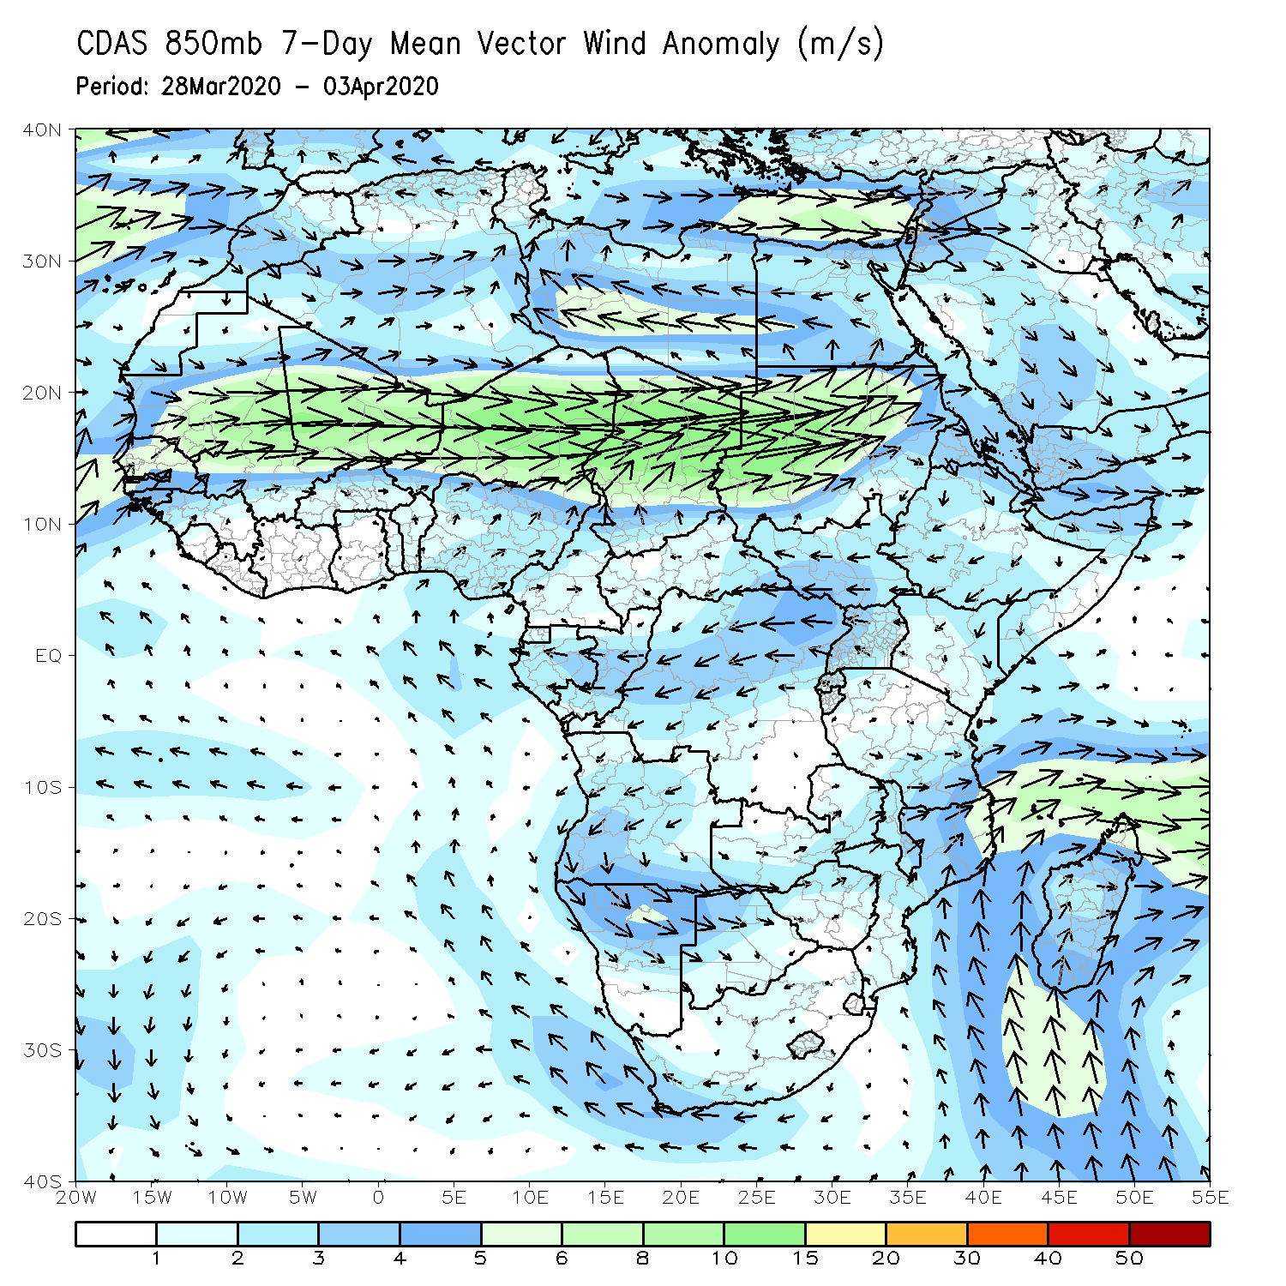
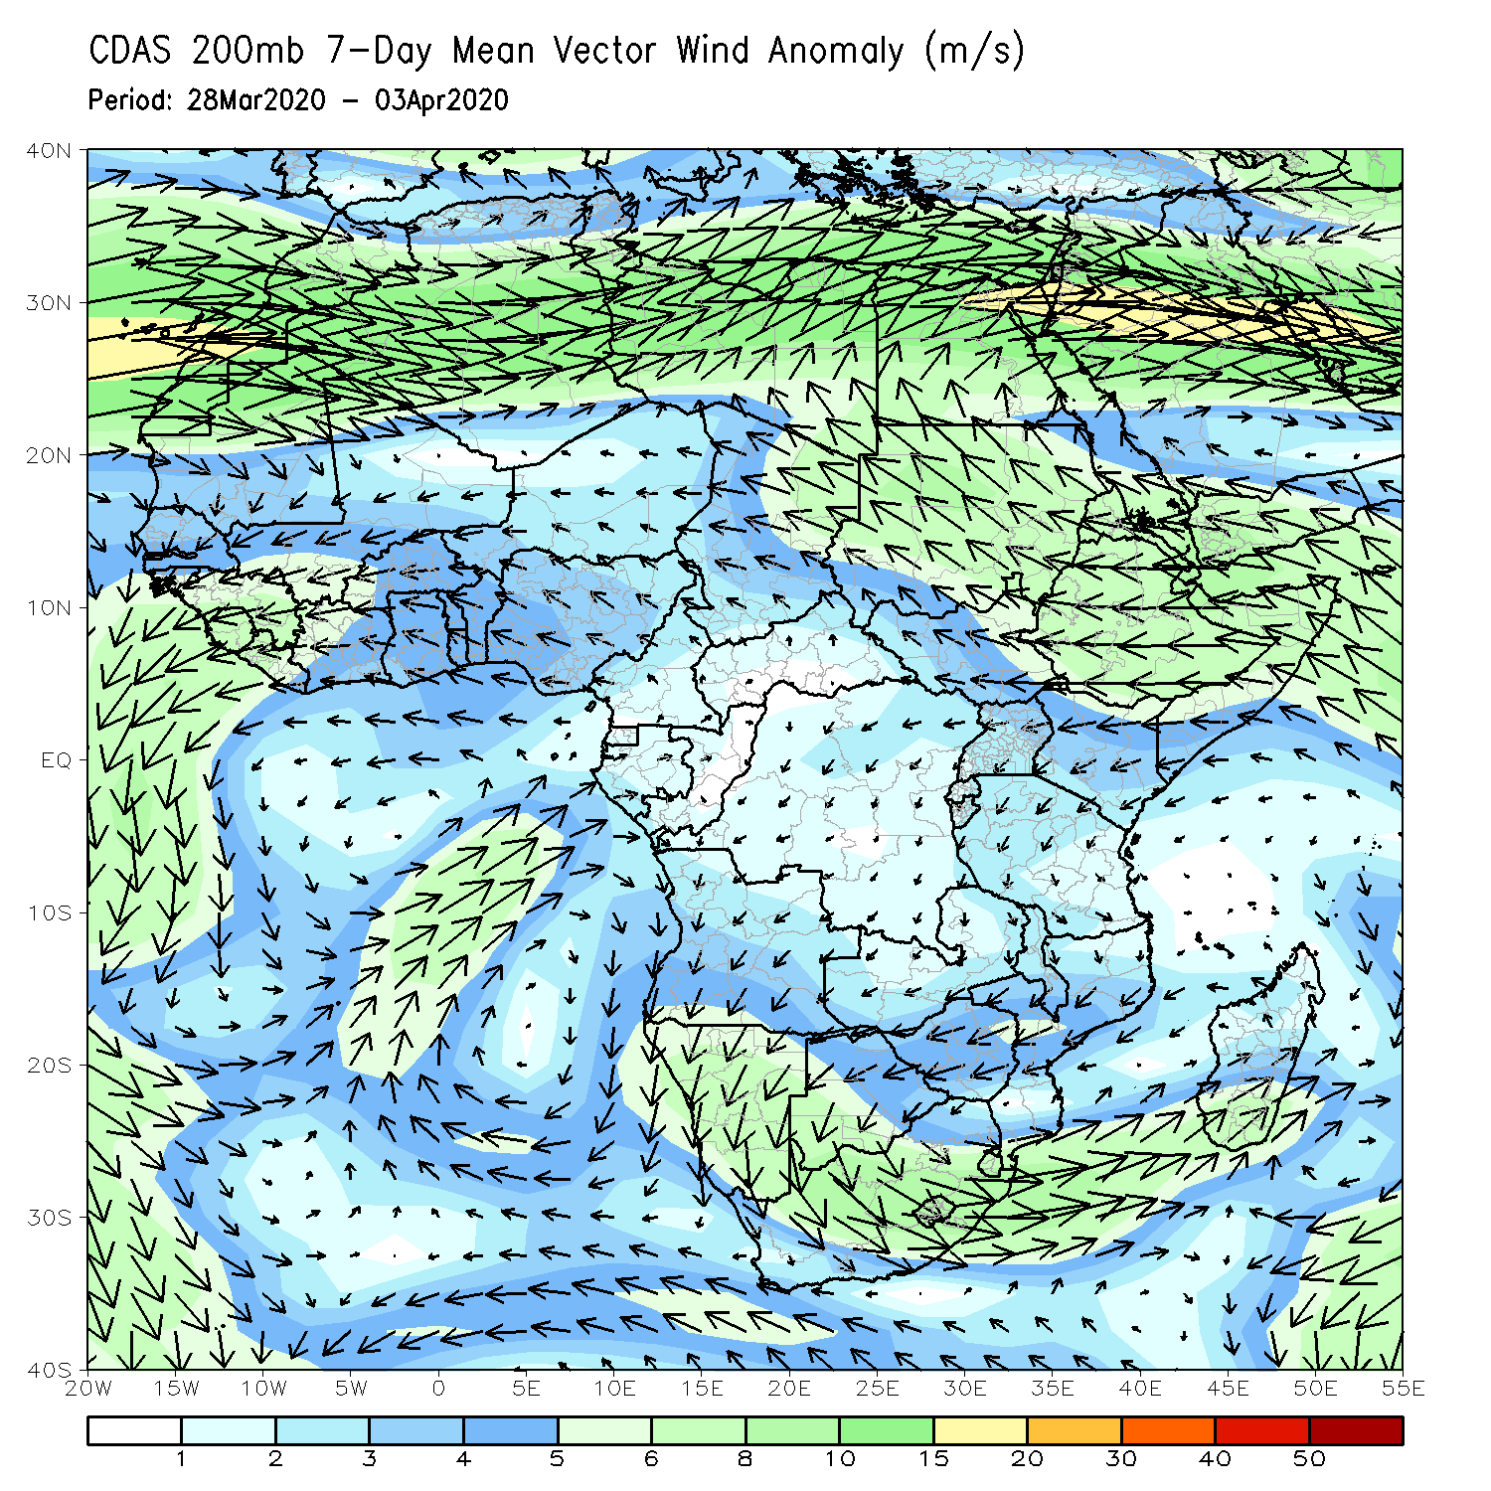
Atmospheric Circulation: Last 7 Days
Anomalous lower-level anti-cyclonic circulation was evident across portions of Southern Africa (left panel).

Slide 9
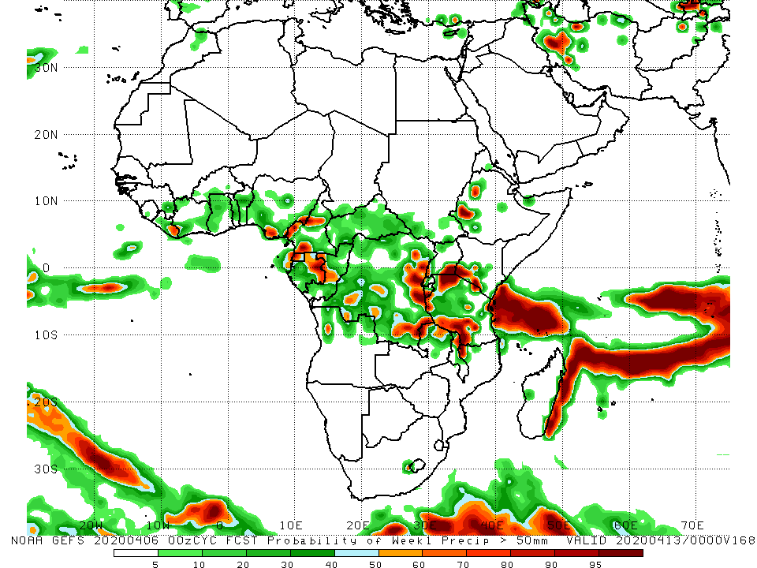
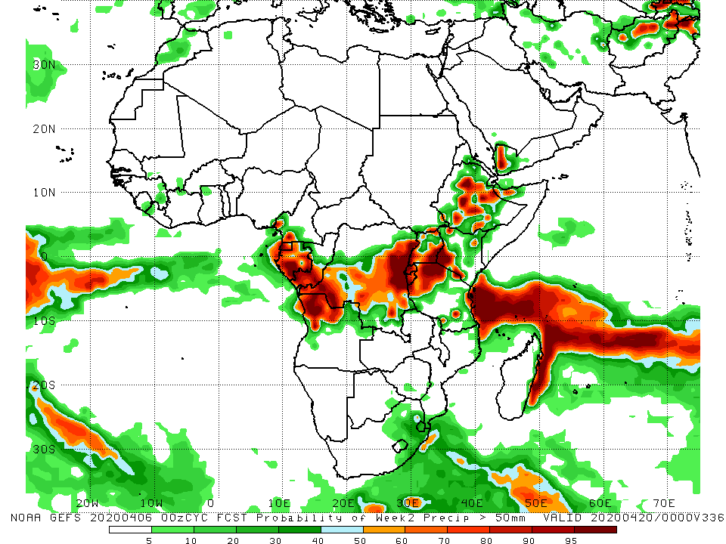
NCEP GEFS Model Forecasts Non-Bias Corrected Probability of precipitation exceedance
Week-2: Valid 7 - 13 April, 2020
Week-2: Valid 14 - 20 April, 2020
For week-1 (left panel), there is an increased chance for weekly rainfall totals to exceed 50mm over local areas in Nigeria and Cameroon, parts of Gabon and DRC, western Ethiopia, southern Kenya, and portions of Tanzania and northern Malawi. For week-2 (right panel), there is an increased chance for weekly rainfall totals to exceed 50mm over parts of southern Cameroon, Gabon, Congo, northern Angola, DRC, parts of Uganda and Kenya, Ethiopia, and portions of Tanzania..
Notes:
9

Slide 10
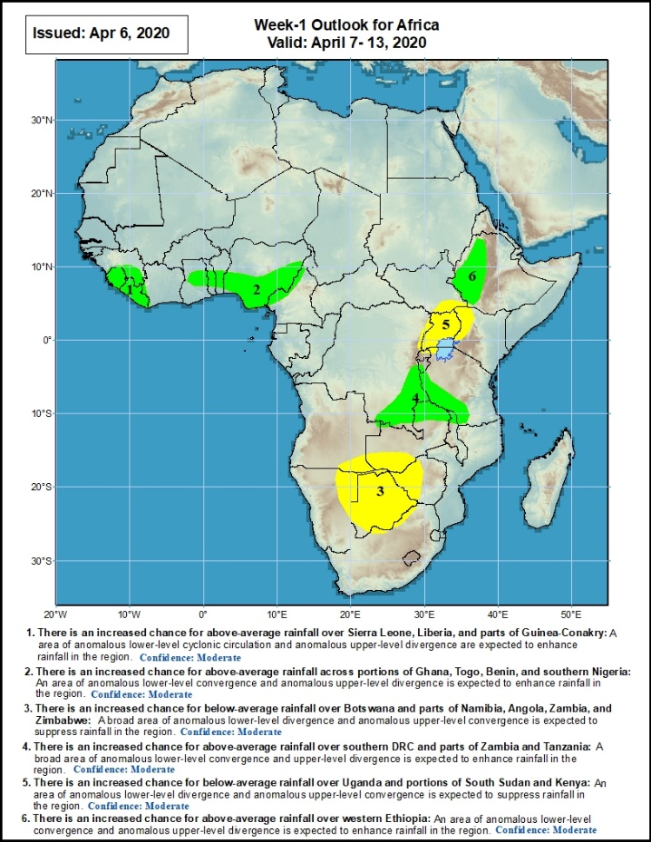
Week-1 Precipitation Outlooks
There is an increased chance for above-average rainfall over Sierra Leone, Liberia, and parts of Guinea-Conakry: An area of anomalous lower-level cyclonic circulation and upper-level divergence is expected to enhance rainfall in the region. Confidence: Moderate
There is an increased chance for above-average rainfall across portions of Ghana, Togo, Benin, and southern Nigeria: An area of anomalous lower-level convergence and upper-level divergence is expected to enhance rainfall in the region. Confidence: Moderate
There is an increased chance for below-average rainfall over Botswana and parts of Namibia, Angola, Zambia, and Zimbabwe: An area of anomalous lower-level divergence and upper-level convergence is expected to suppress rainfall in the region. Confidence: Moderate
There is an increased chance for above-average rainfall over southern DRC and parts of Zambia and Tanzania: A broad area of anomalous lower-level convergence and upper-level divergence is expected to enhance rainfall in the region. Confidence: Moderate
There is an increased chance for below-average rainfall over Uganda and portions of South Sudan and Kenya: An area of anomalous lower-level divergence and upper-level convergence is expected to suppress rainfall in the region. Confidence: Moderate
There is an increased chance for above-average rainfall over western Ethiopia: An area of anomalous lower-level convergence and upper-level divergence is expected to enhance rainfall in the region. Confidence: Moderate
7 – 13 April, 2020
Notes:
10

Slide 11
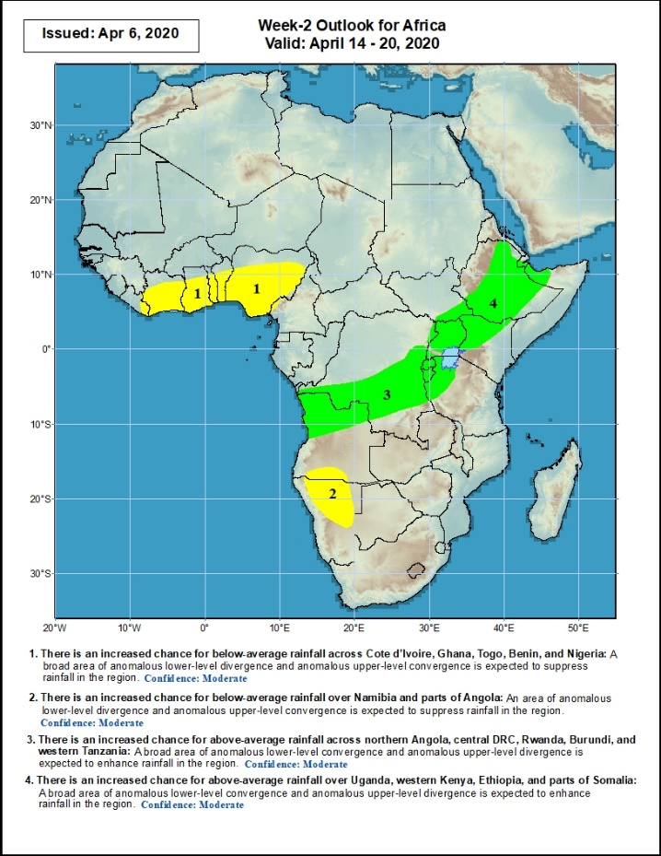
Week-2 Precipitation Outlooks
14 – 20 April, 2020
There is an increased chance for below-average rainfall across Cote d’Ivoire, Ghana, Togo, Benin, and Nigeria: An area of anomalous lower level divergence and upper-level convergence is expected to suppress rainfall in the region. Confidence: Moderate
There is an increased chance for below-average rainfall over Namibia and parts of Angola: An area of anomalous lower level divergence and upper-level convergence is expected to suppress rainfall in the region. Confidence: Moderate
There is an increased chance for above-average rainfall across northern Angola, central DRC, Rwanda, Burundi, and western Tanzania: A broad area of anomalous lower-level convergence and upper-level divergence is expected to enhance rainfall in the region. Confidence: Moderate
There is an increased chance for above-average rainfall over Uganda, western Kenya, Ethiopia, and parts of Somalia: A broad area of anomalous lower-level convergence and upper-level divergence is expected to enhance rainfall in the region. Confidence: Moderate
Notes:
11

Slide 12
Summary
During the past 7 days, rainfall was above-average over across Liberia, southern Cote d’Ivoire, southern Ghana, Togo, Benin, Nigeria, Cameroon, CAR, parts of Gabon and Congo, many parts of DRC and Angola, eastern Angola, western Botswana, central South Africa, and local area sin Southwestern Ethiopia. Below-average rainfall was observed over portions of Ethiopia, Uganda, Kenya, Tanzania, coastal Angola, western Namibia, Zambia, Malawi, Mozambique and Madagascar.
During the past 30 days, rainfall was above-average over many places in the Gulf of Guinea region, including much of Cameroon, parts of Gabon and Congo, CAR, much of DRC, South Sudan, Uganda, parts of Ethiopia, much of Kenya, southern Somalia, Tanzania, northern Zambia, many parts of Angola, central South Africa, Lesotho, and central and northern Madagascar. Rainfall was below-average over parts of Gabon and Congo, western Angola, local areas in DRC, parts of Ethiopia, Namibia, Botswana, Zimbabwe, Malawi, Mozambique, parts of South Africa, and central and southern Madagascar.
During the past 90 days, rainfall was above-average over portions of the Gulf of Guinea region, including northern Cameroon, eastern CAR, southeastern South Sudan, southern Congo, many parts of DRC, Rwanda, Burundi, Uganda, Kenya, parts of Ethiopia, Somalia, much of Tanzania, many parts of Angola and Zambia, Malawi, local areas in Namibia and Botswana, portions of South Africa, Zimbabwe, northern Malawi, local areas in Mozambique, and northern Madagascar. Much of Ghana, Togo, Benin, southern Cameroon, Equatorial Guinea, Gabon, western CAR, parts of Angola and DRC, local areas in South Sudan, parts of Ethiopia, Namibia, parts of Botswana and Zimbabwe, southern Zambia, eastern South Arica, parts of Mozambique and Madagascar.
Week-1 outlooks call for an increased chance for above-average rainfall over eastern Guinea, Sierra Leone, Liberia, central Ghana, southern Togo, Benin, southern Nigeria, southeastern DRC, eastern Zambia, western Tanzania, and western Ethiopia. In contrast, there is an increased chance for below-average rainfall over southeastern Angola, eastern Namibia, southwestern Zambia, Botswana, western Zimbabwe, Uganda, parts of southern South Sudan, and western Kenya.
Notes:
12

