Slide 1
The African Monsoon Recent Evolution and Current Status Include Week-1 and Week-2 Outlooks
Update prepared by
Climate Prediction Center / NCEP
13 April 2020
For more information, visit:
http://www.cpc.ncep.noaa.gov/products/Global_Monsoons/African_Monsoons/precip_monitoring.shtml

Slide 2
Outline
Highlights
Recent Evolution and Current Conditions
NCEP GEFS Forecasts
Summary

Slide 3
Highlights: Last 7 Days
Rainfall was above-average across much of the Gulf of Guinea countries and many places in Central Africa, while below-average rainfall was observed over many places in East and Southeast Africa.
Week-1 outlooks call for an increased chance for above-average rainfall over northern Angola, southern DRC, Rwanda, Burundi, western Tanzania, eastern South Africa, Uganda, western Kenya, Ethiopia, Djibouti, and northern Somalia. In contrast, there is an increased chance for below-average rainfall over many places in the Gulf of Guinea region, and parts of Madagascar.

Slide 4
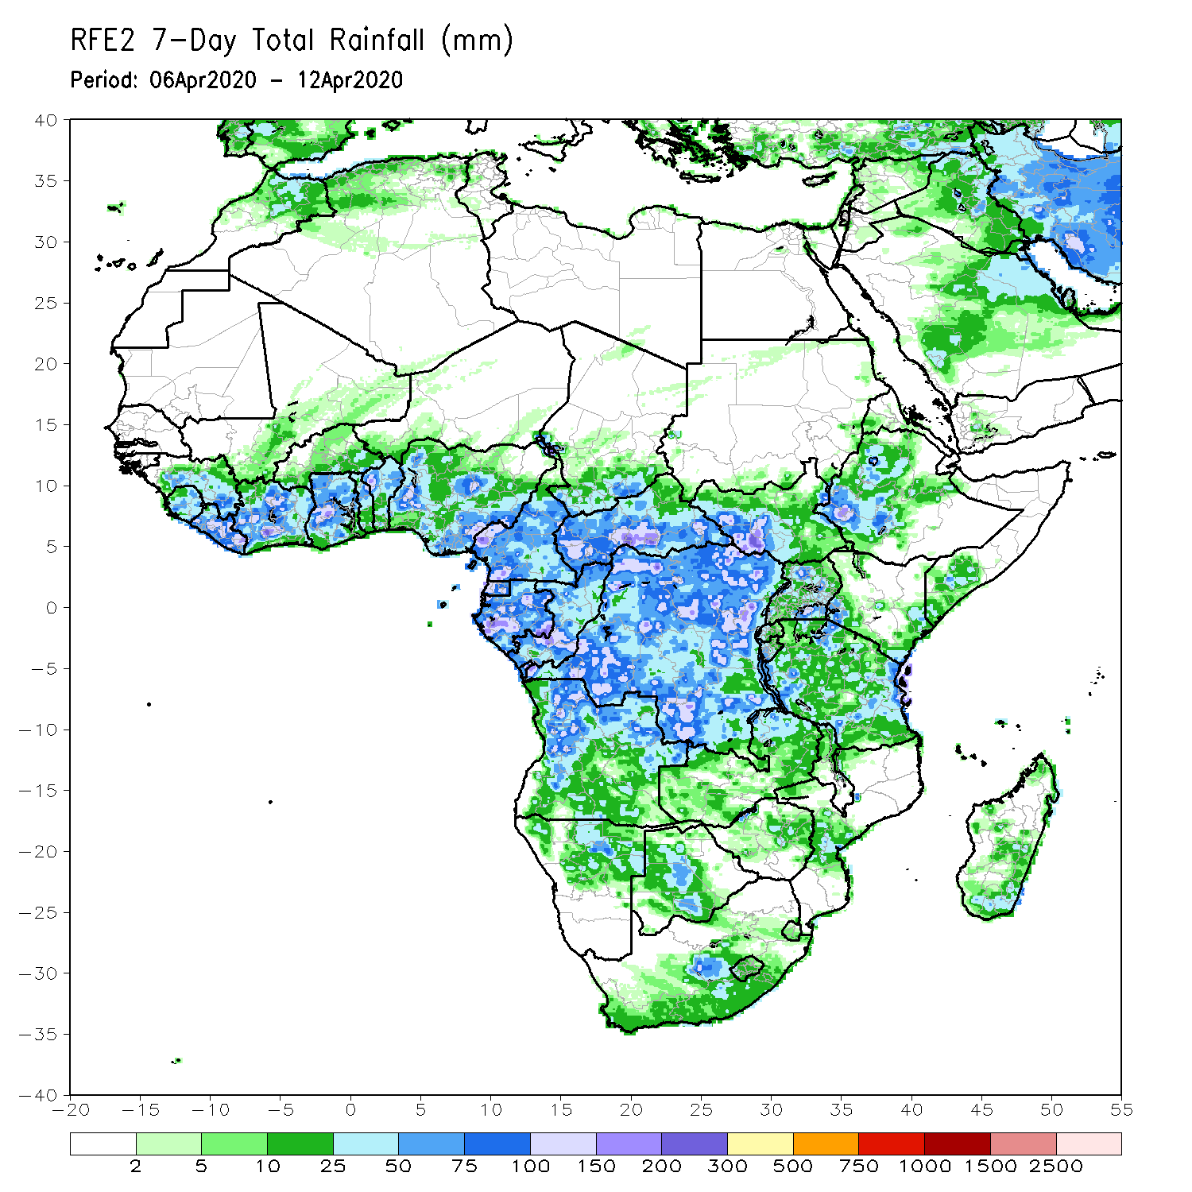
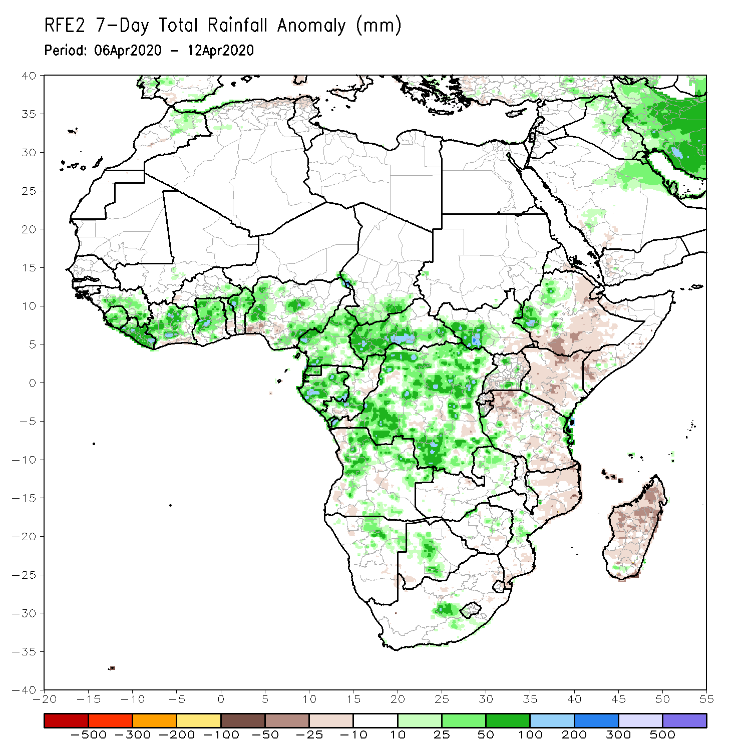
Rainfall Patterns: Last 7 Days
During the past 7 days, rainfall was above-average across portions of Guinea, Liberia, Sierra Leone, Cote d’Ivoire, Ghana, Togo, Benin, portions of Nigeria, Cameroon, CAR, Gabon, Congo, many parts of DRC, portions of Angola, local area in Namibia, Botswana and South Africa. Rainfall was also above-average over local areas in South Sudan, western Ethiopia and coastal Tanzania.
Below-average rainfall was observed over portions of Ethiopia, Uganda, Kenya, Tanzania, local area in Angola, Malawi, Mozambique and Madagascar.

Slide 5
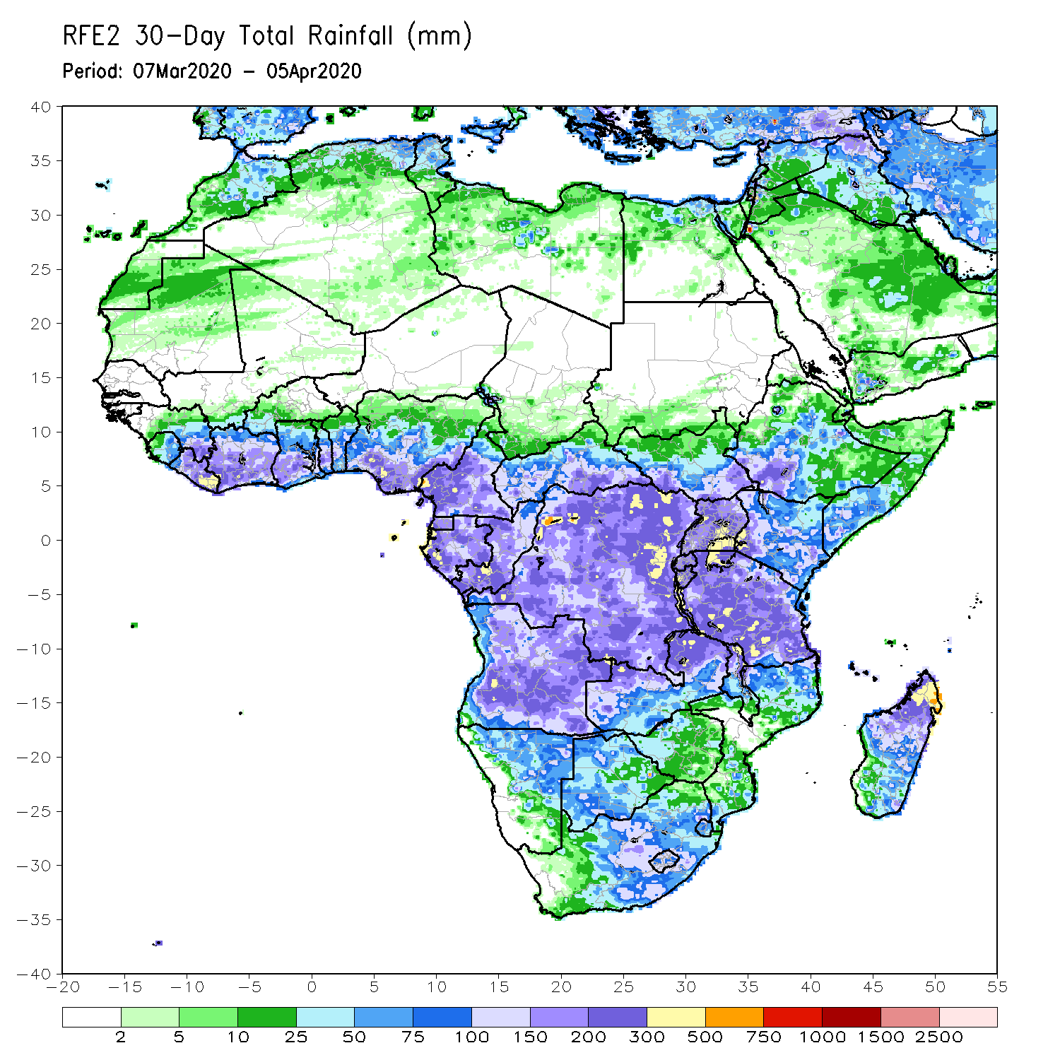
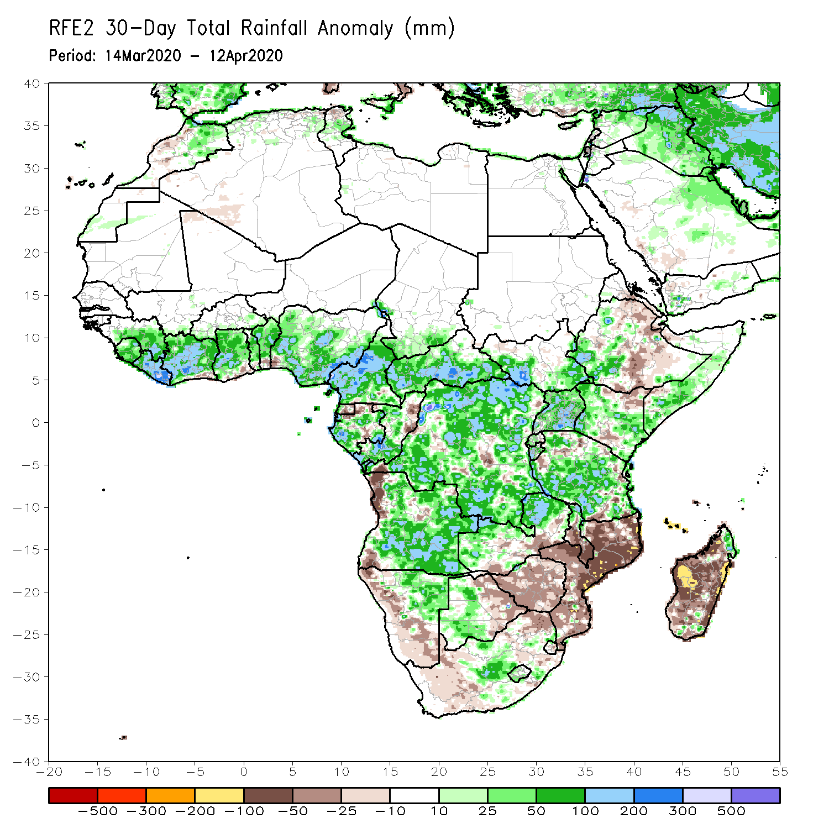
Rainfall Patterns: Last 30 Days
During the past 30 days, rainfall was above-average over many places in the Gulf of Guinea region, including much of Cameroon, parts of Gabon and Congo, CAR, much of DRC, parts of South Sudan, Uganda, parts of Ethiopia, much of Kenya, southern Somalia, Tanzania, Angola, northern Zambia, central South Africa, Lesotho, and northern Madagascar.
Rainfall was below-average over local areas in Gabon and Congo, parts of western Angola, local areas in DRC, parts of Ethiopia, western Namibia, eastern Botswana, Zimbabwe, Malawi, Mozambique, parts of South Africa, and central and southern Madagascar.
Notes:
5

Slide 6
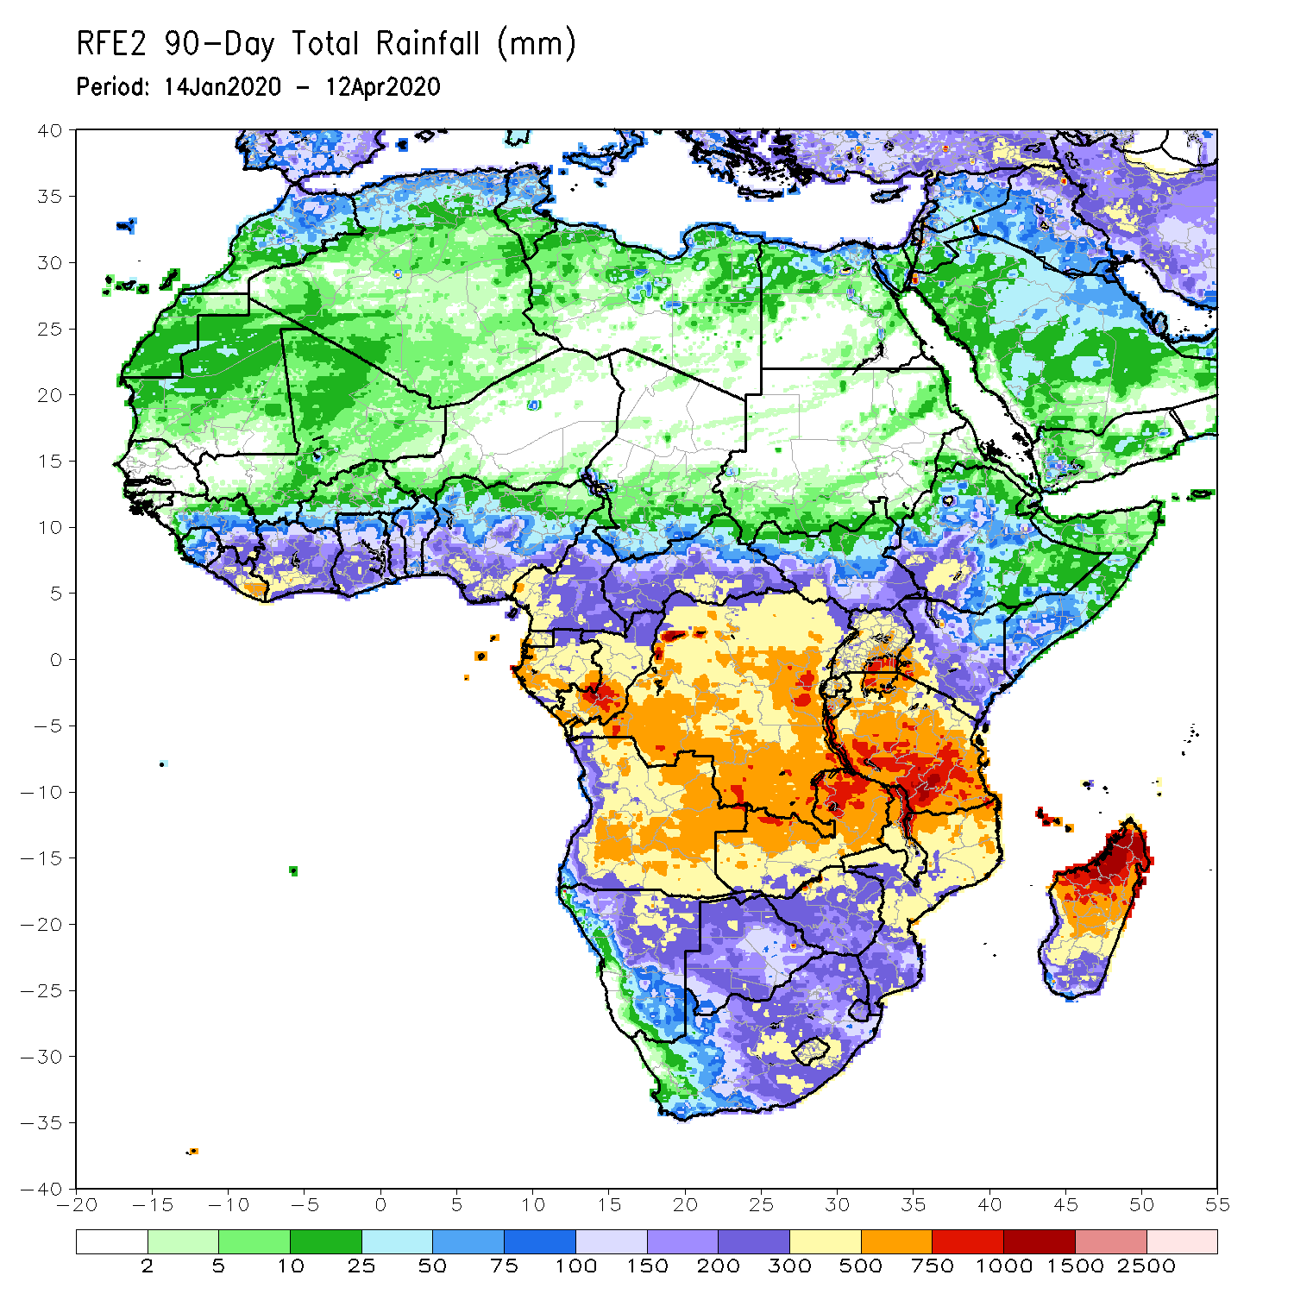
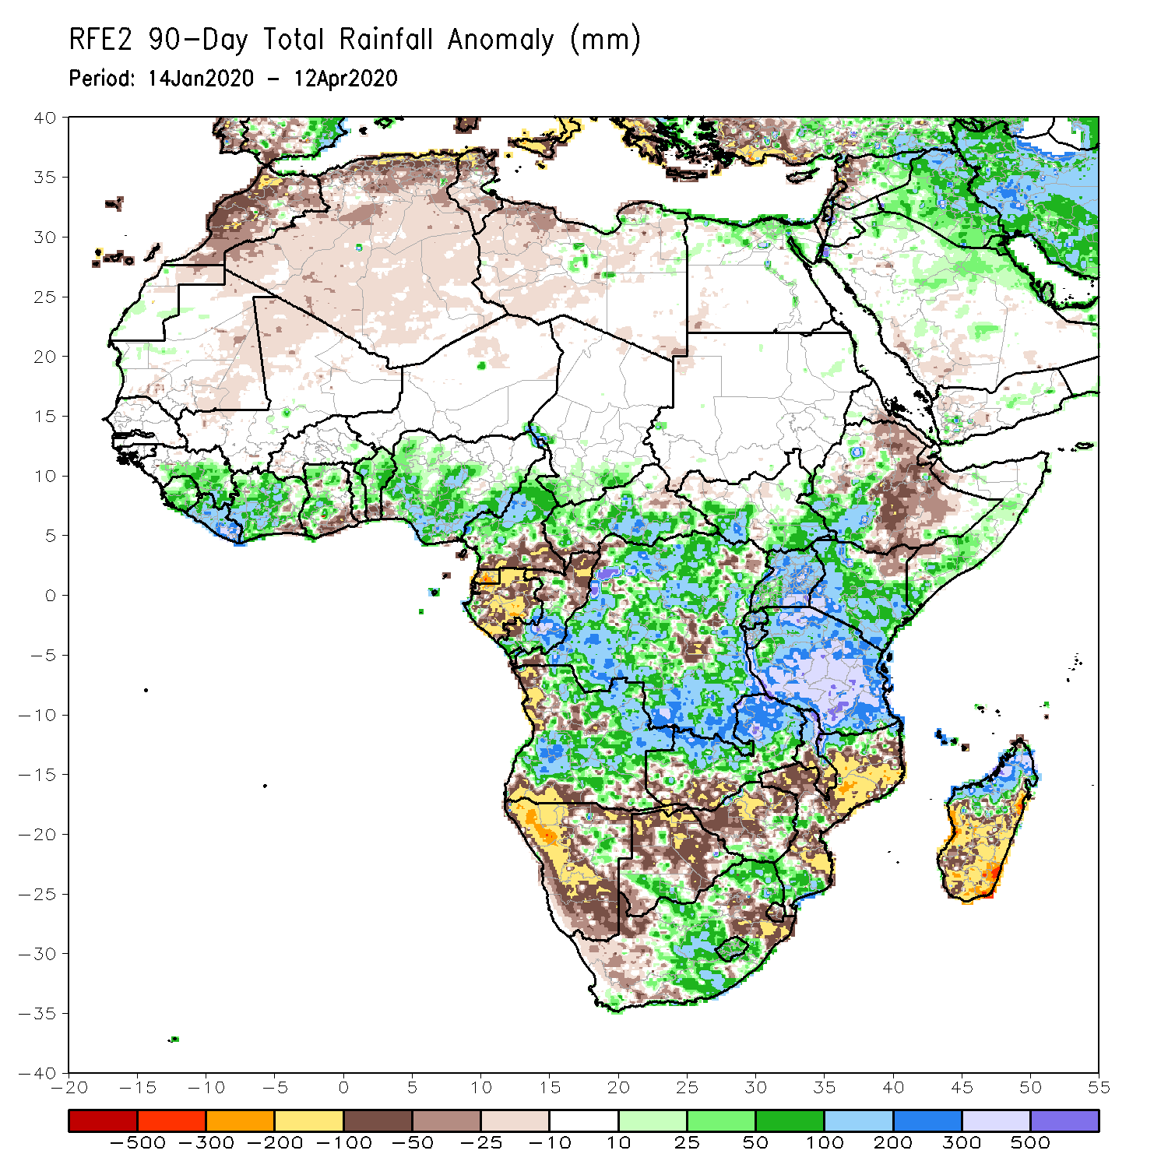
Rainfall Patterns: Last 90 Days
During the past 90 days, rainfall was above-average over many places in the Gulf of Guinea region, including central and northern Cameroon, CAR, parts of South Sudan, southern Congo, many parts of DRC, Rwanda, Burundi, Uganda, Kenya, parts of Ethiopia, Somalia, much of Tanzania, many parts of Angola and northern Zambia, northern Malawi, local areas in Namibia and Botswana, portions of South Africa, local areas in Zimbabwe, local areas in Mozambique, and northern Madagascar.
The coastal areas of Ghana, Togo and Benin, southern Cameroon, Equatorial Guinea, Gabon, local areas in CAR, Angola and DRC, parts of Ethiopia, Namibia, parts of Botswana and Zimbabwe, southern Zambia, eastern South Arica, parts of Mozambique and Madagascar.
Notes:
6

Slide 7
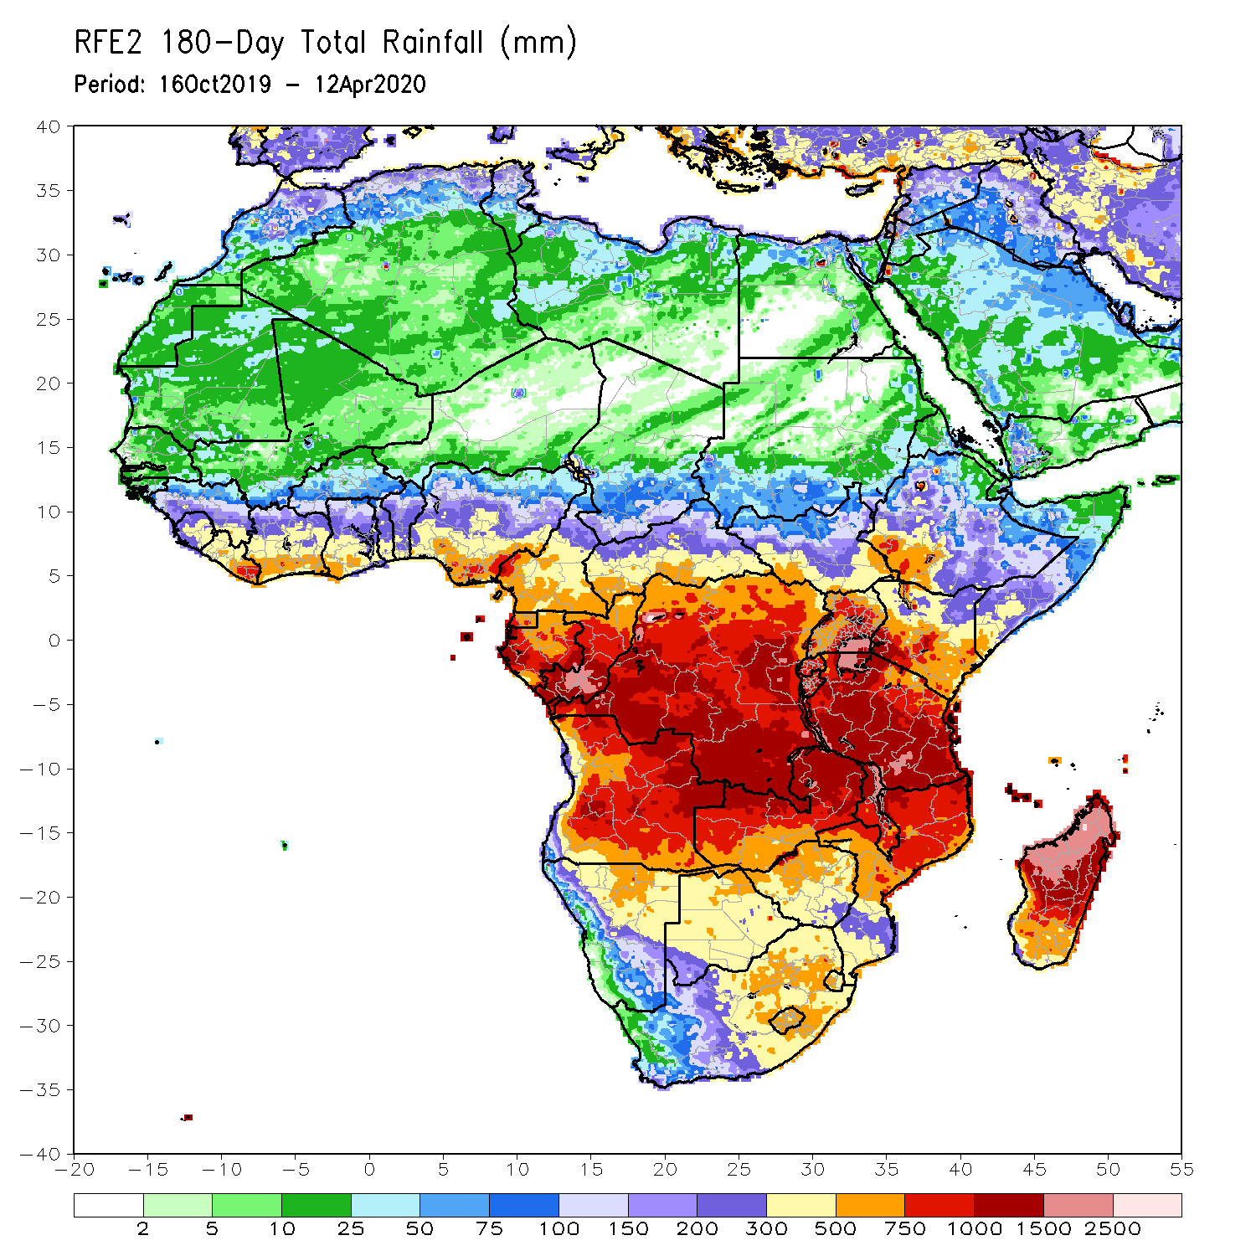
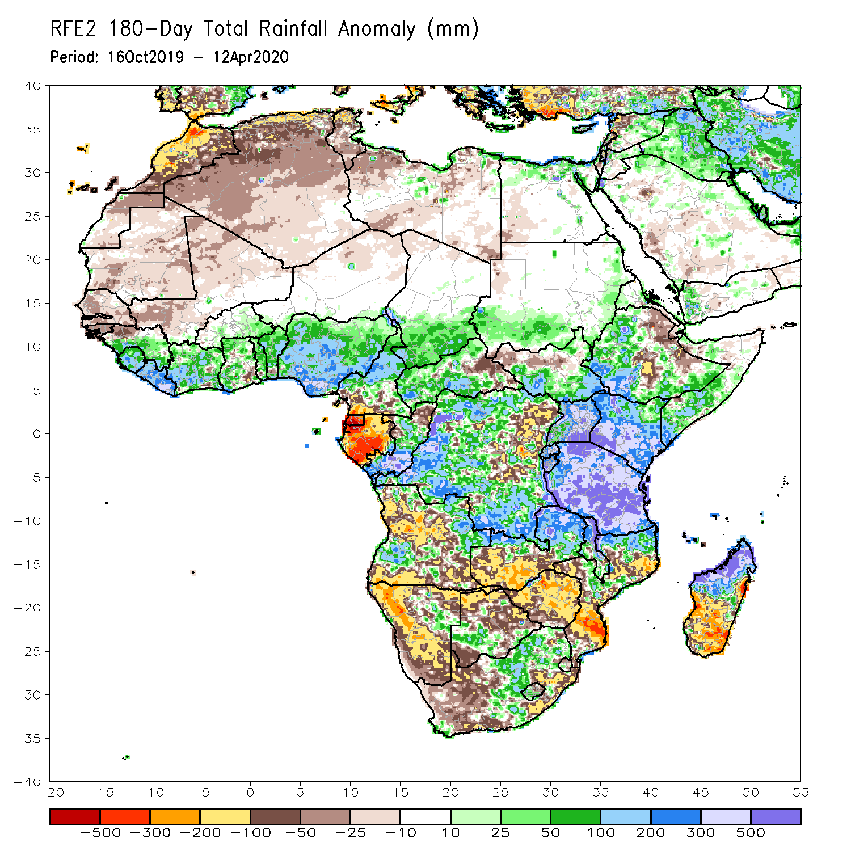
Rainfall Patterns: Last 180 Days
During the past 180 days, eastern Guinea, Sierra Leone, Liberia, Cote d’Ivoire, Burkina Faso, Ghana, Togo, Benin, Nigeria, portions of Cameroon, southern Chad, portions of CAR and DRC, local areas in South Sudan, southern Sudan, Uganda, Eritrea, portions of Ethiopia, southern Somalia, Kenya, Tanzania, parts of Angola, local areas in Namibia, parts of Zambia, Malawi and parts of South Africa, portions of Mozambique and northern Madagascar had above-average rainfall.
Below-average rainfall was observed over portions of Senegal, Guinea-Bissau, western Mali,, Equatorial Guinea, Gabon, parts of northeastern DRC, parts of Angola, Namibia, South Africa, western Zambia, many parts of Botswana and Zimbabwe, parts of southern Mozambique and southern Madagascar.
Notes:
7

Slide 8
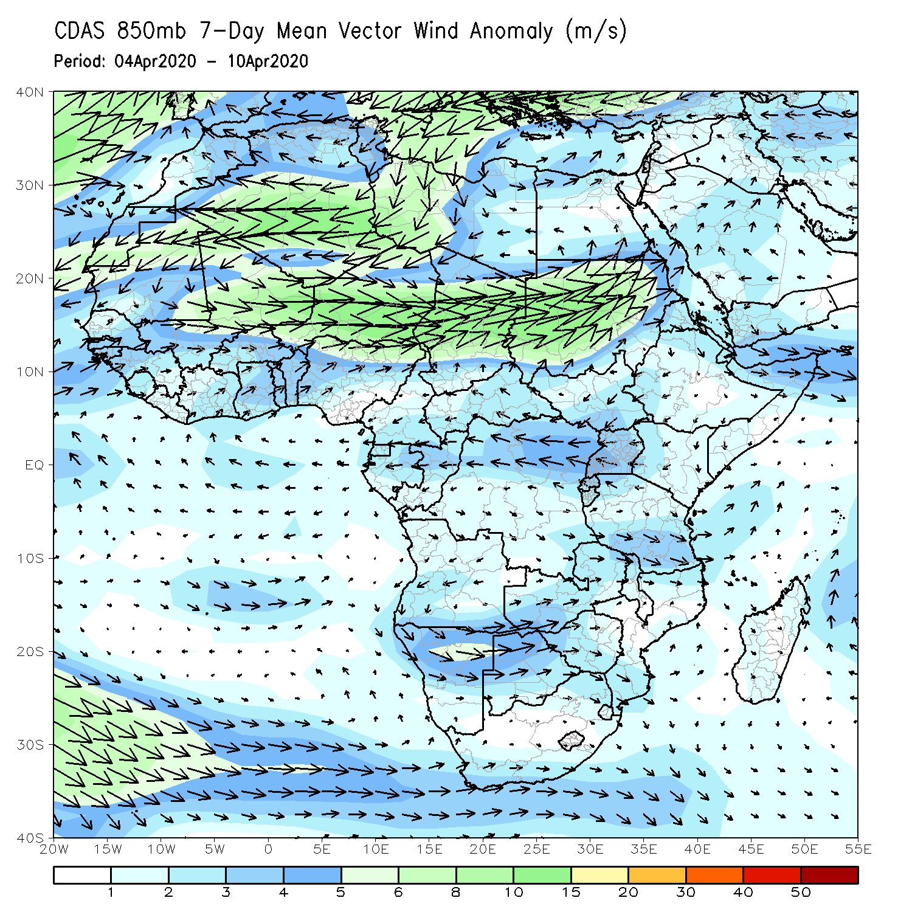
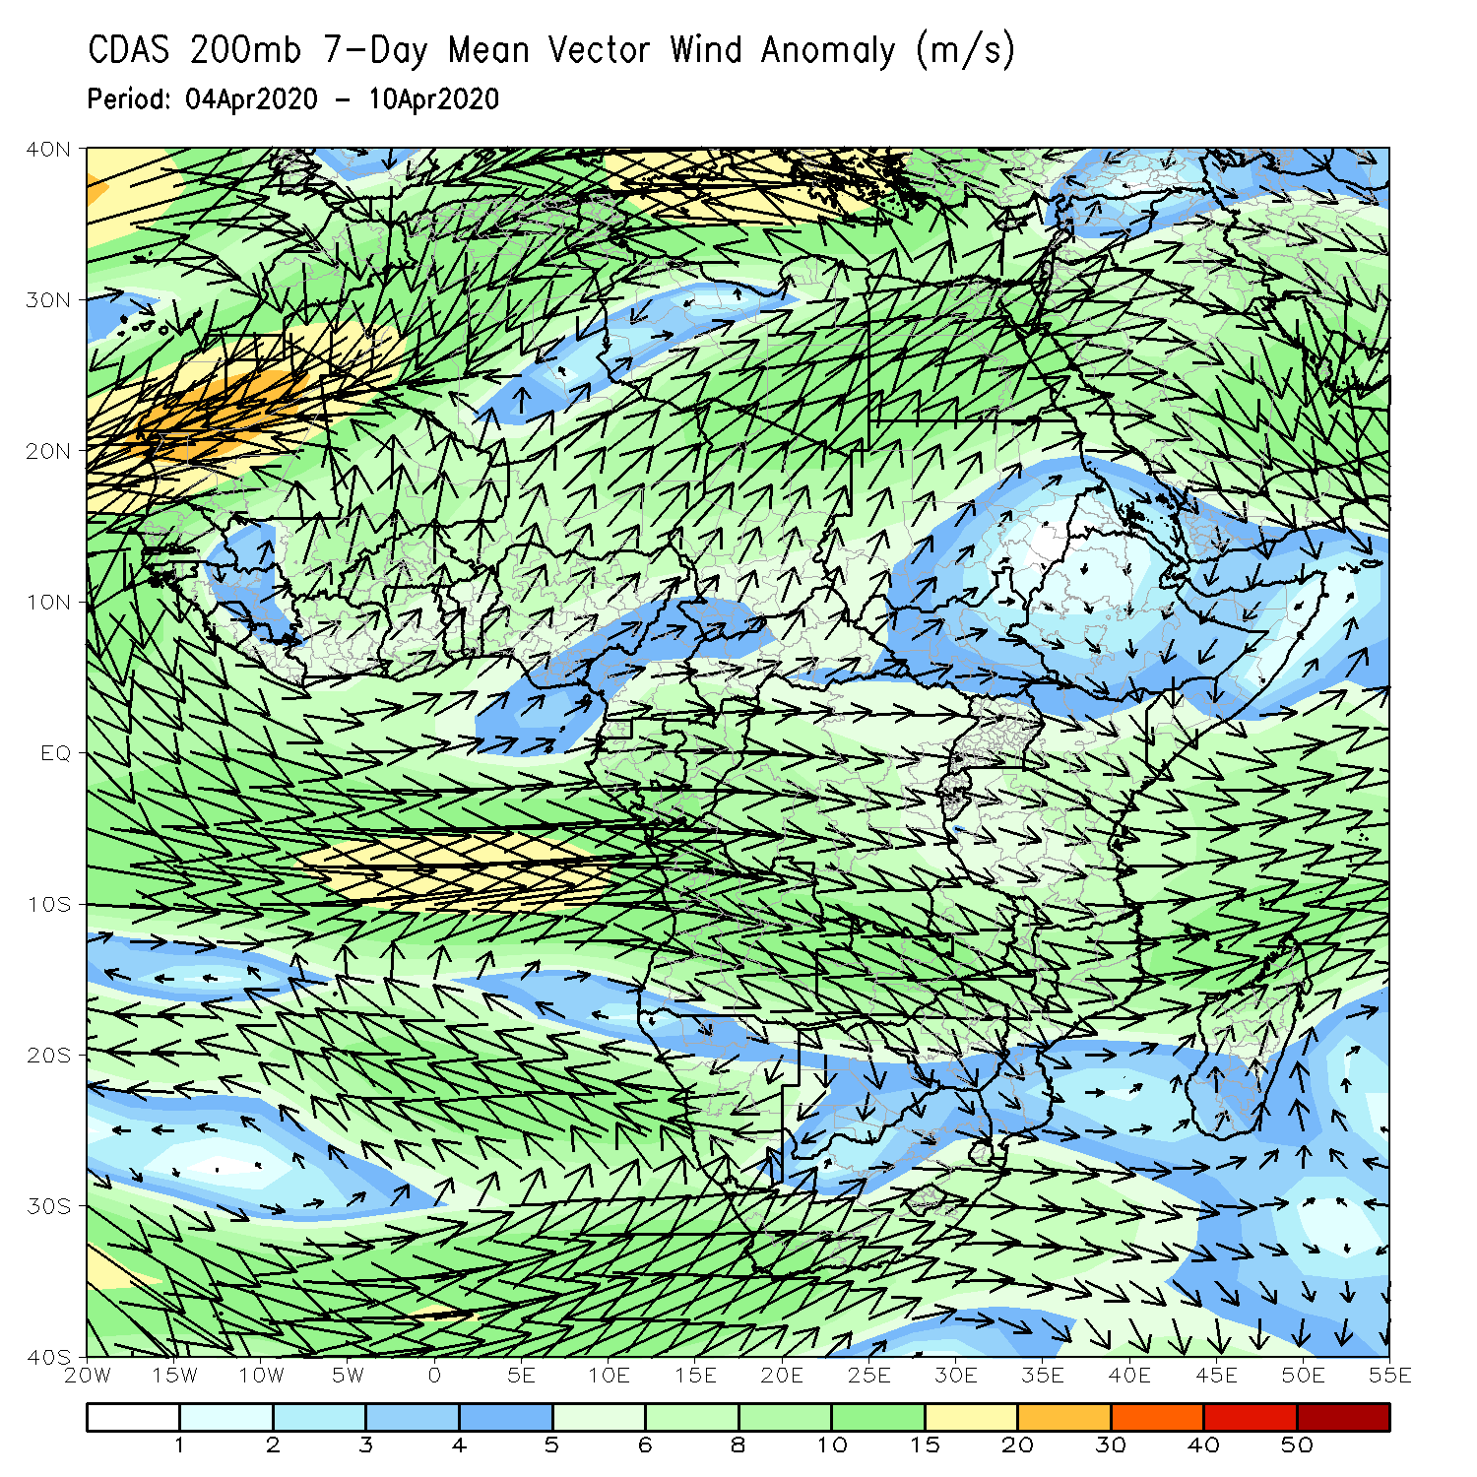
Atmospheric Circulation: Last 7 Days
Lower-level wind anomalies were easterly across much of equatorial Africa (left panel).

Slide 9
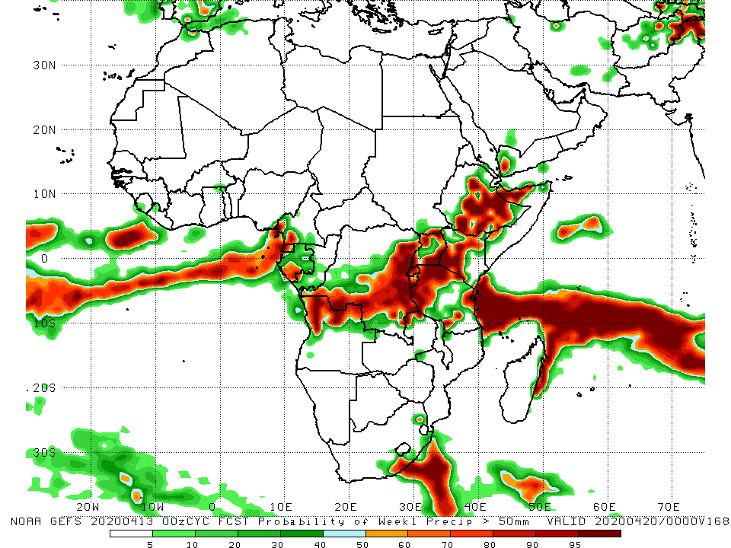
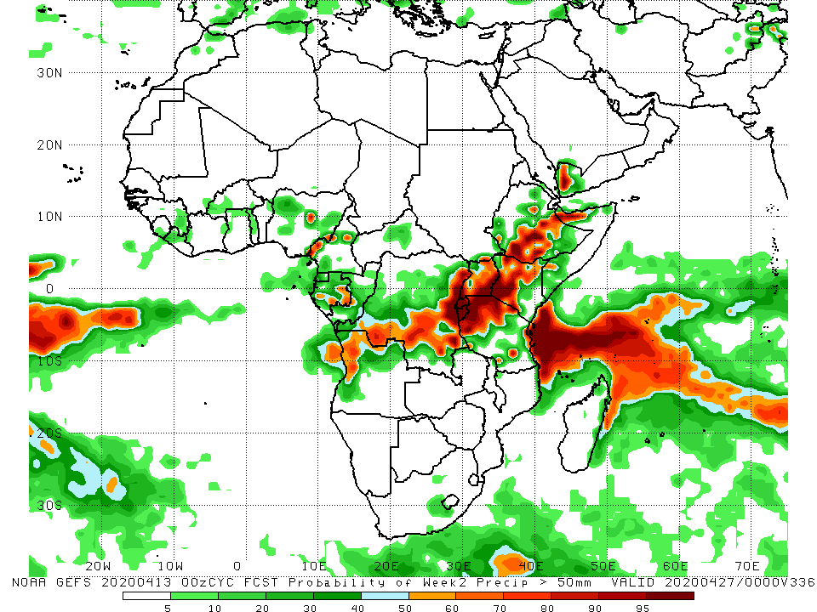
NCEP GEFS Model Forecasts Non-Bias Corrected Probability of precipitation exceedance
Week-2: Valid 14 - 20 April, 2020
Week-2: Valid 21 - 27 April, 2020
For week-1 (left panel) and weeke-2 (right panel), there is an increased chance for weekly rainfall totals to exceed 50mm over local areas in Cameroon and Gabon, northern Angola, southern and eastern DRC, Rwanda, Burundi, Kenya, and parts of Tanzania and Ethiopia.
Notes:
9

Slide 10
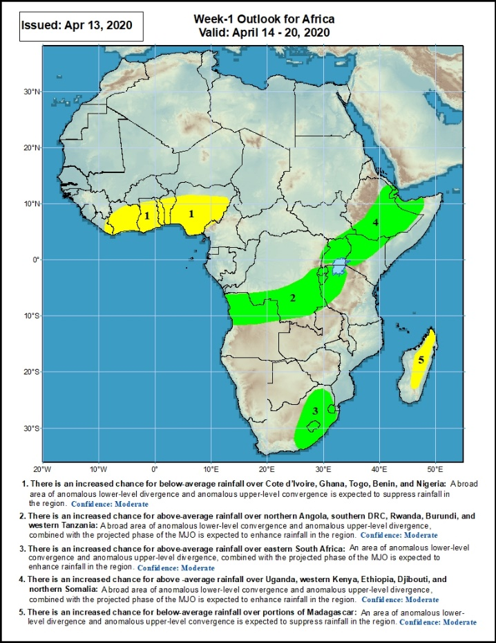
Week-1 Precipitation Outlooks
14 – 20 April, 2020
There is an increased chance for below-average rainfall over Cote d’Ivoire, Ghana, Togo, Benin, and Nigeria: A broad area of anomalous lower-level divergence and upper-level convergence is expected to suppress rainfall in the region. Confidence: Moderate
There is an increased chance for above-average rainfall over northern Angola, southern DRC, Rwanda, Burundi, and western Tanzania: An area of anomalous lower-level convergence and upper-level divergence, combined with the projected phase of the MJO is expected to enhance rainfall in the region. Confidence: Moderate
There is an increased chance for above-average rainfall over eastern South Africa: An area of anomalous lower-level convergence and upper-level divergence is expected to enhance rainfall in the region. Confidence: Moderate
There is an increased chance for above-average rainfall over Uganda, western Kenya, Ethiopia, Djibouti, and northern Somalia: A broad area of anomalous lower-level convergence and upper-level divergence, combined with the projected phase of the MJO is expected to enhance rainfall in the region. Confidence: Moderate
There is an increased chance for below-average rainfall over portions of Madagascar: An area of anomalous lower-level divergence and upper-level convergence is expected to suppress rainfall in the region. Confidence: Moderate
Notes:
10

Slide 11
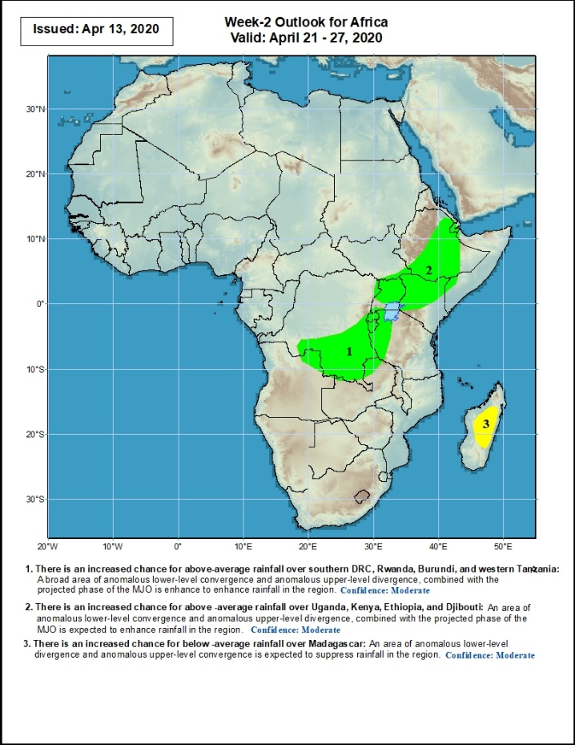
Week-2 Precipitation Outlooks
21 – 27 April, 2020
There is an increased chance for above-average rainfall over southern DRC, Rwanda, Burundi, and western Tanzania: An area of anomalous lower-level convergence and upper-level divergence, combined with the projected phase of the MJO is expected to enhance rainfall in the region. Confidence: Moderate
There is an increased chance for above -average rainfall over Uganda, Kenya, Ethiopia, and Djibouti: An area of anomalous lower-level convergence and upper-level divergence, combined with the projected phase of the MJO is expected to enhance rainfall in the region. Confidence: Moderate
There is an increased chance for below -average rainfall over Madagascar: An area of anomalous lower-level divergence and upper-level convergence is expected to suppress rainfall in the region. Confidence: Moderate
Notes:
11

Slide 12
Summary
During the past 7 days, rainfall was above-average across portions of Guinea, Liberia, Sierra Leone, Cote d’Ivoire, Ghana, Togo, Benin, portions of Nigeria, Cameroon, CAR, Gabon, Congo, many parts of DRC, portions of Angola, local area in Namibia, Botswana and South Africa. Rainfall was also above-average over local areas in South Sudan, western Ethiopia and coastal Tanzania. Below-average rainfall was observed over portions of Ethiopia, Uganda, Kenya, Tanzania, local area in Angola, Malawi, Mozambique and Madagascar.
During the past 30 days, rainfall was above-average over many places in the Gulf of Guinea region, including much of Cameroon, parts of Gabon and Congo, CAR, much of DRC, parts of South Sudan, Uganda, parts of Ethiopia, much of Kenya, southern Somalia, Tanzania, Angola, northern Zambia, central South Africa, Lesotho, and northern Madagascar. Rainfall was below-average over local areas in Gabon and Congo, parts of western Angola, local areas in DRC, parts of Ethiopia, western Namibia, eastern Botswana, Zimbabwe, Malawi, Mozambique, parts of South Africa, and central and southern Madagascar.
During the past 90 days, rainfall was above-average over many places in the Gulf of Guinea region, including central and northern Cameroon, CAR, parts of South Sudan, southern Congo, many parts of DRC, Rwanda, Burundi, Uganda, Kenya, parts of Ethiopia, Somalia, much of Tanzania, many parts of Angola and northern Zambia, northern Malawi, local areas in Namibia and Botswana, portions of South Africa, local areas in Zimbabwe, local areas in Mozambique, and northern Madagascar. The coastal areas of Ghana, Togo and Benin, southern Cameroon, Equatorial Guinea, Gabon, local areas in CAR, Angola and DRC, parts of Ethiopia, Namibia, parts of Botswana and Zimbabwe, southern Zambia, eastern South Arica, parts of Mozambique and Madagascar.
Rainfall was above-average across much of the Gulf of Guinea countries and many places in Central Africa, while below-average rainfall was observed over many places in East and Southeast Africa. Week-1 outlooks call for an increased chance for above-average rainfall over northern Angola, southern DRC, Rwanda, Burundi, western Tanzania, eastern South Africa, Uganda, western Kenya, Ethiopia, Djibouti, and northern Somalia. In contrast, there is an increased chance for below-average rainfall over many places in the Gulf of Guinea region, and parts of Madagascar.
Notes:
12

