Slide 1
The African Monsoon Recent Evolution and Current Status Include Week-1 and Week-2 Outlooks
Update prepared by
Climate Prediction Center / NCEP
01 June 2020
For more information, visit:
http://www.cpc.ncep.noaa.gov/products/Global_Monsoons/African_Monsoons/precip_monitoring.shtml

Slide 2
Outline
Highlights
Recent Evolution and Current Conditions
NCEP GEFS Forecasts
Summary

Slide 3
Highlights: Last 7 Days
Weekly rainfall total was above-average over many places in the Gulf of Guinea and Central Africa countries.
Week-1 outlooks call for an increased chance for above-average rainfall over many places in the Sahel region and northern Somalia. In contrast, there is an increased chance for below-average rainfall across much of the Gulf of Guinea region, CAR and western South Sudan.

Slide 4
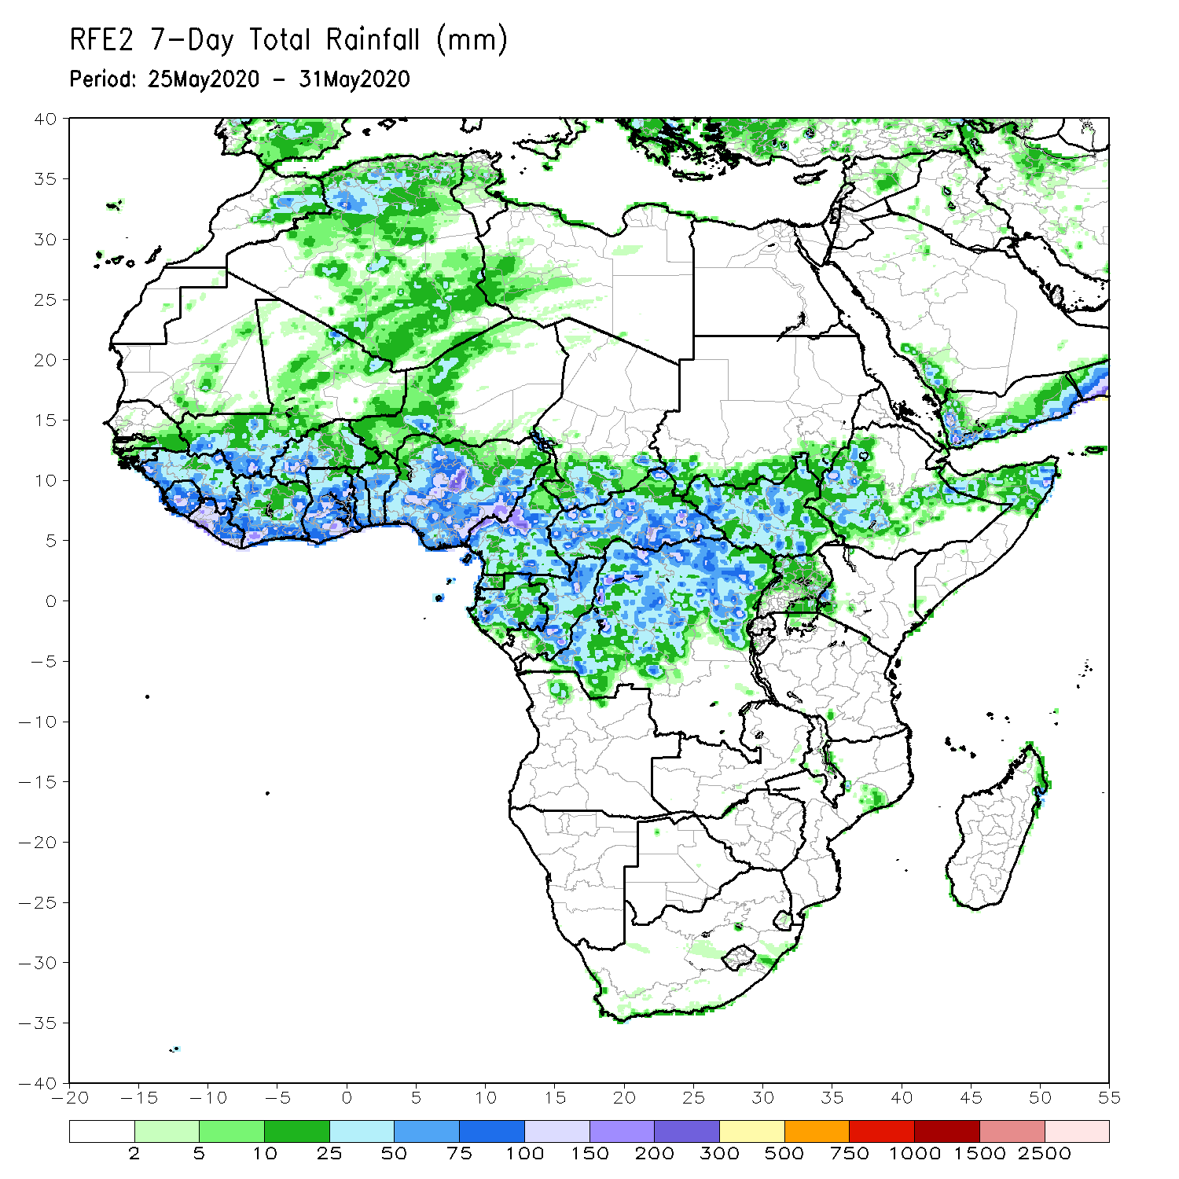
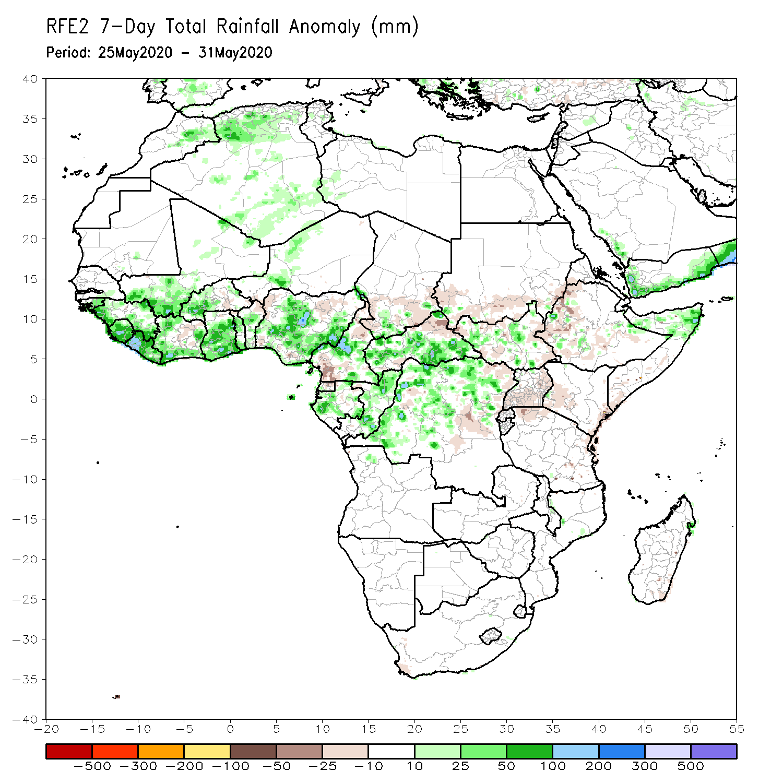
Rainfall Patterns: Last 7 Days
During the past 7 days, rainfall was above-average over parts of Mali, Sierra Leone, Liberia, local areas in Cote d’Ivoire, Burkina Faso, Ghana, local areas in Niger, Nigeria, Cameroon, Gabon, CAR, Congo, portions of DRC, northern Angola, and local areas in South Sudan, Ethiopia and northern Somalia.
Below-average rainfall was observed over local areas in Cote d’Ivoire, Nigeria, Cameroon, eastern CAR, southern Sudan, local areas in DRC, Uganda, and parts of western Kenya and western Ethiopia.

Slide 5
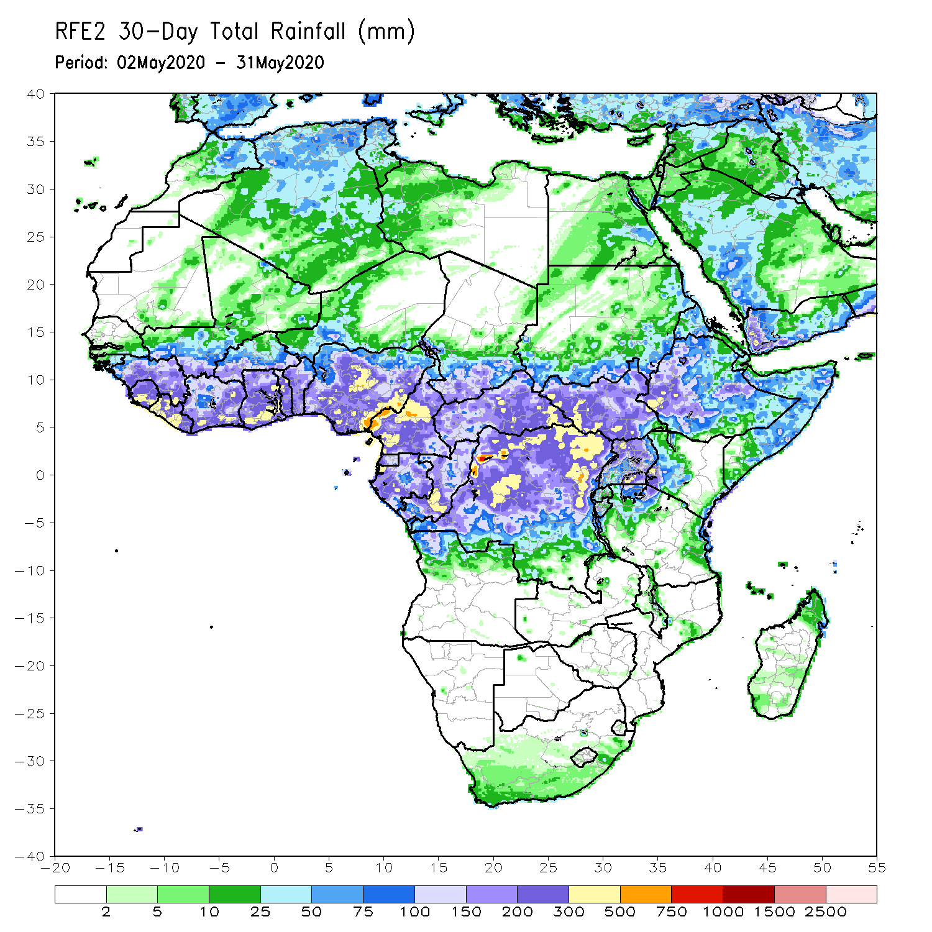
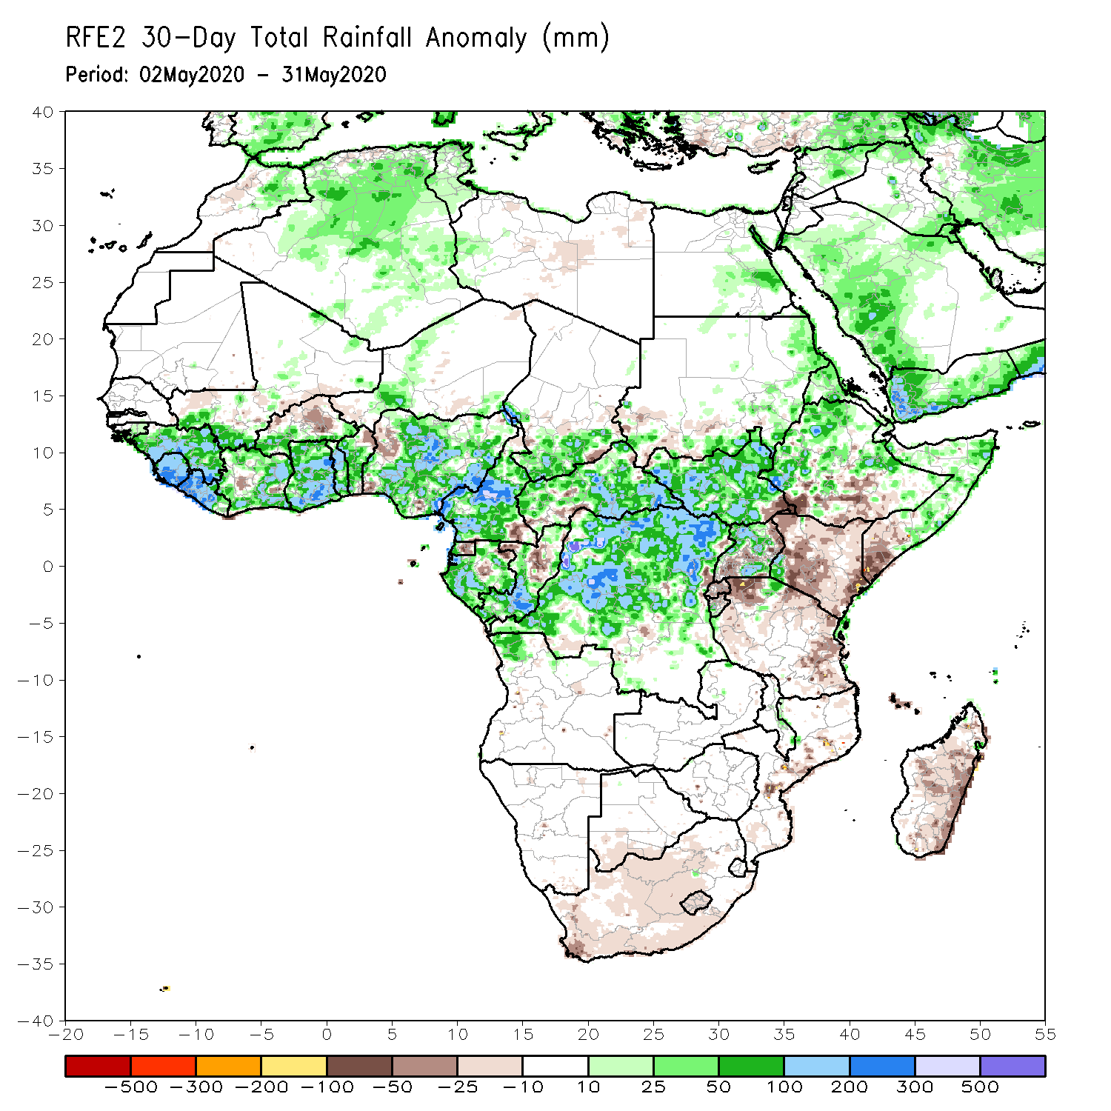
Rainfall Patterns: Last 30 Days
During the past 30 days, rainfall was above-average over many places in the Gulf of Guinea region, including much of Cameroon, Gabon and Congo, southern Chad, eastern CAR, much of DRC, South Sudan, parts of eastern Sudan, Uganda, Eritrea, Ethiopia, parts western Kenya, central and northern Somalia, Burundi, local areas in Tanzania, northern Angola, and local areas in South Africa.
Rainfall was below-average over parts of southern Mali, Burkina Faso, local areas in Nigeria, western CAR, northern Congo, central and eastern Kenya, parts of southern Somalia, local area in Mozambique, and much of Madagascar.
Notes:
5

Slide 6
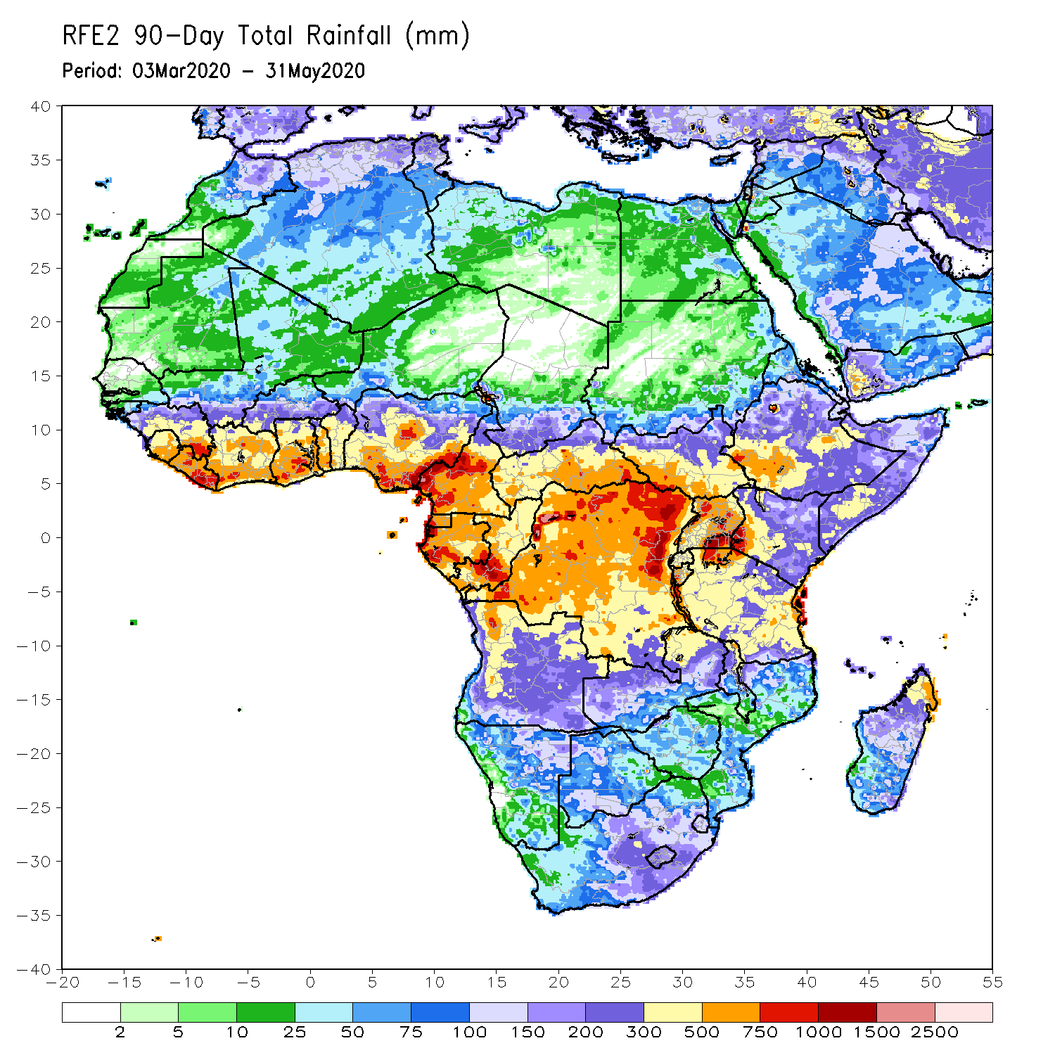
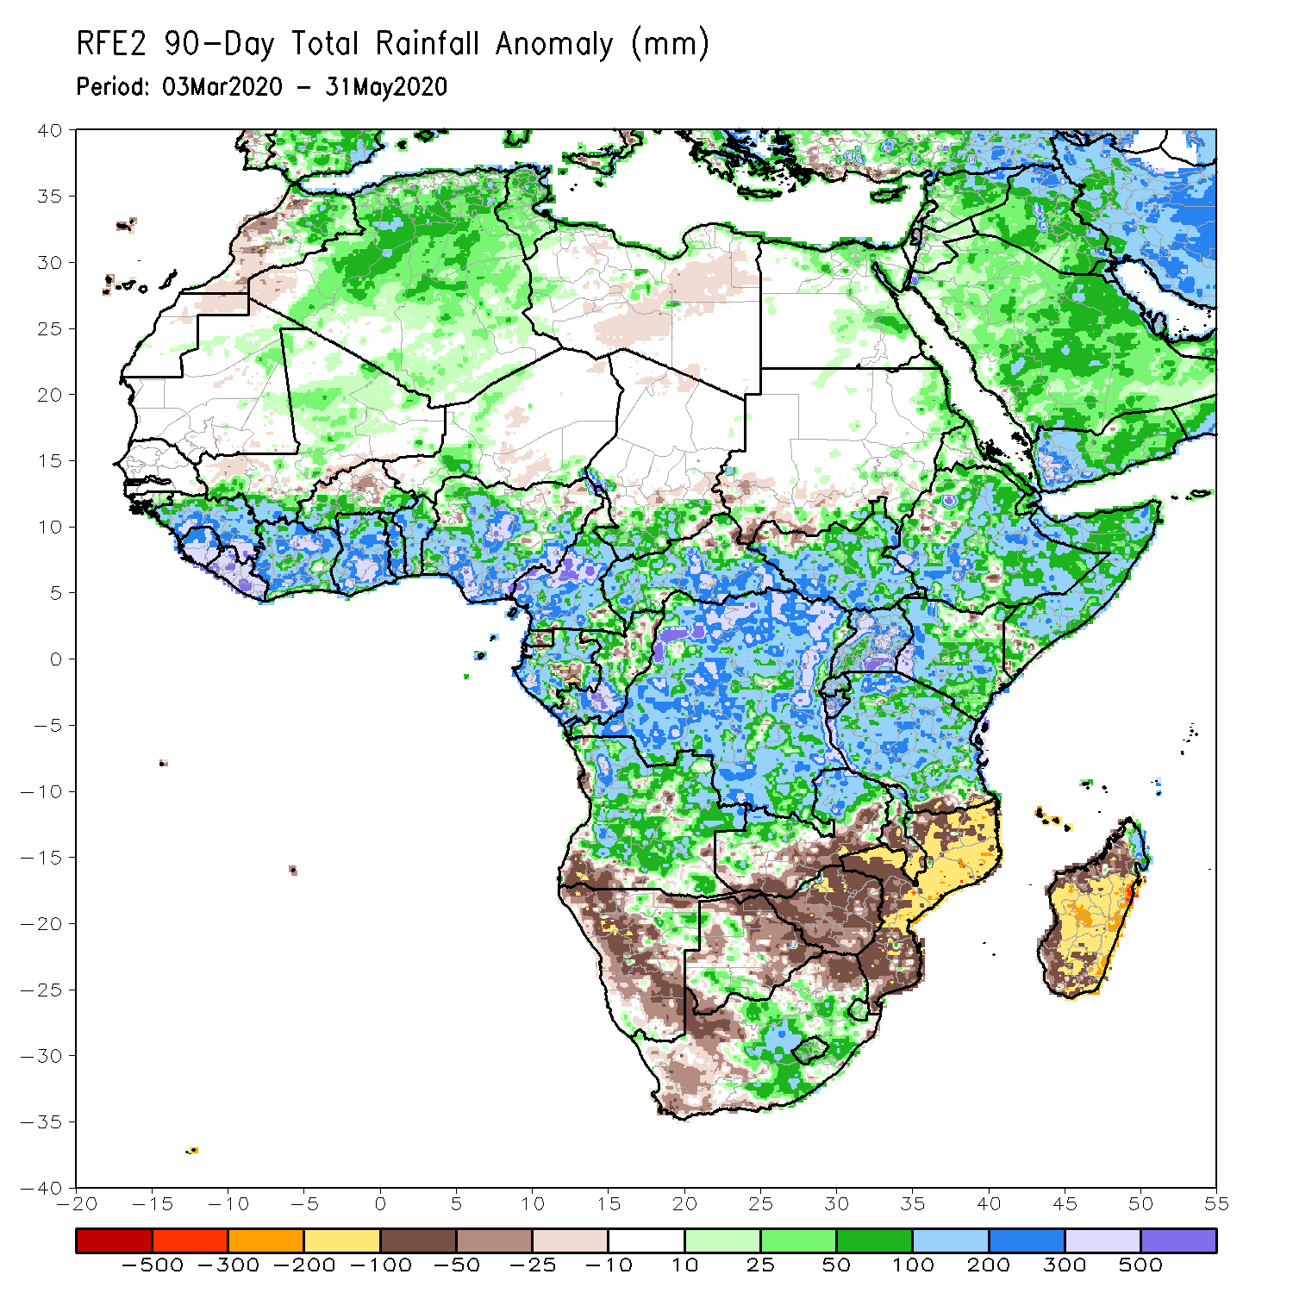
Rainfall Patterns: Last 90 Days
During the past 90 days, rainfall was above-average over many places in the Gulf of Guinea and the neighboring areas of Sahel region, Cameroon, and southern Chad, much of CAR, South Sudan, Gabon, Congo, DRC, Rwanda, Burundi, Uganda, Kenya, Eritrea, Ethiopia, Somalia, much of Tanzania, many parts of Angola and northern Zambia, northern Malawi, northeastern Namibia, western Botswana, portions of South Africa, and northern Madagascar.
Parts of southern Mali and Burkina Faso, southwestern Angola, western and southern Namibia, eastern Botswana, much of Zimbabwe, parts of southern Zambia, western South Arica, much of Mozambique, and central and southern Madagascar had below-average rainfall.
Notes:
6

Slide 7
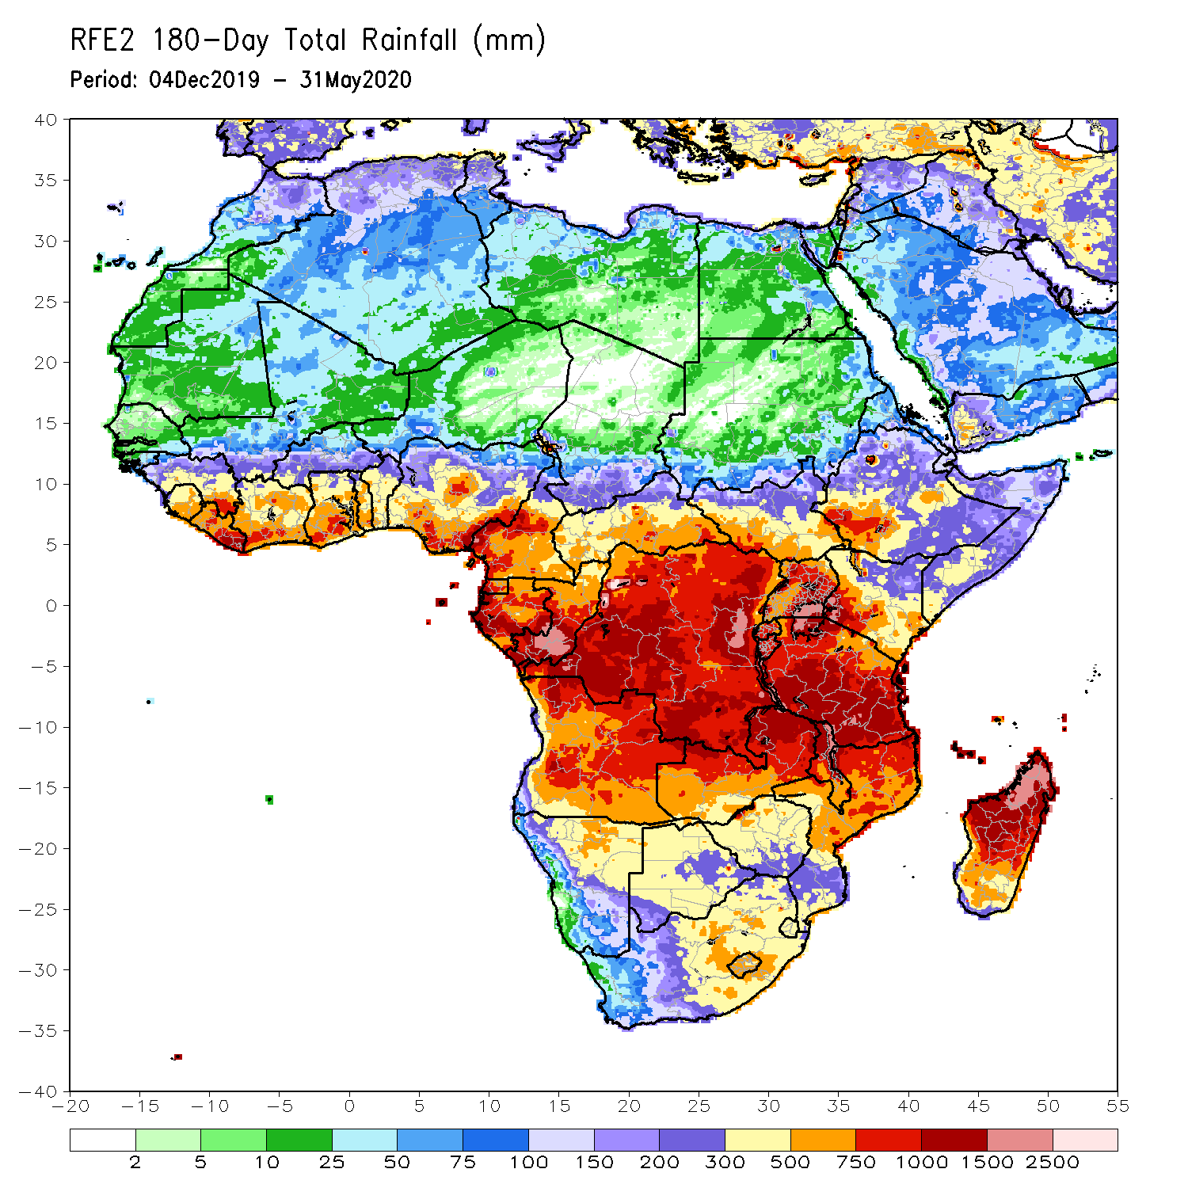
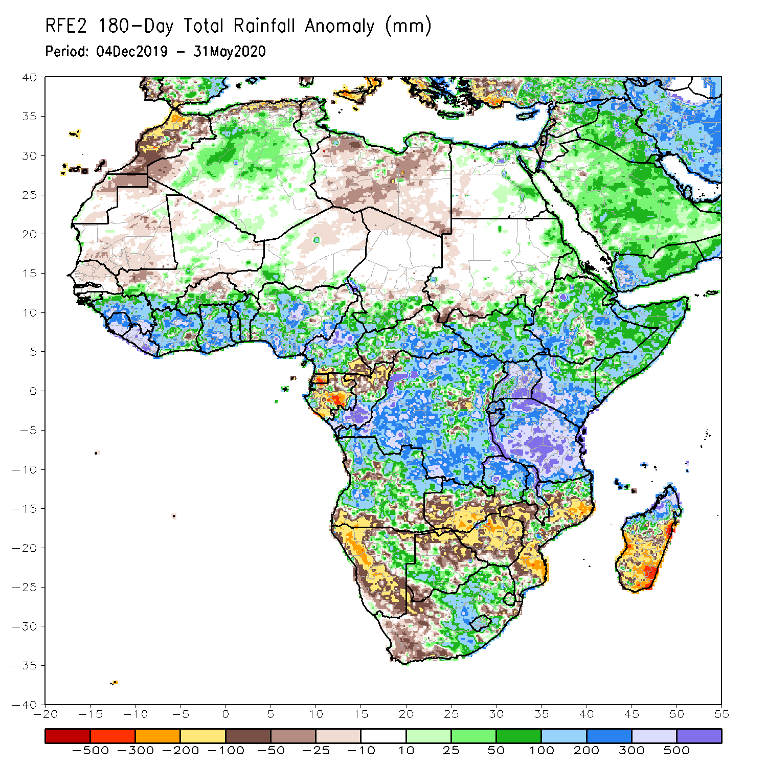
Rainfall Patterns: Last 180 Days
During the past 180 days, many places in the Gulf of Guinea and the neighboring areas of the Sahel region, Cameroon, southern Chad, much of CAR, DRC and South Sudan, Uganda, Eritrea, Ethiopia, much Somalia, Kenya, Tanzania, many parts of Angola, northeastern Namibia, northern Zambia, Malawi, parts of South Africa, portions of Mozambique and northern Madagascar had above-average rainfall.
Below-average rainfall was observed over Equatorial Guinea, Gabon, northern Congo, local areas in CAR and DRC, parts of Angola, western and southern Namibia, western South Africa, southern Zambia, northern and eastern Botswana, much of Zimbabwe, parts of Mozambique and southern Madagascar.
Notes:
7

Slide 8
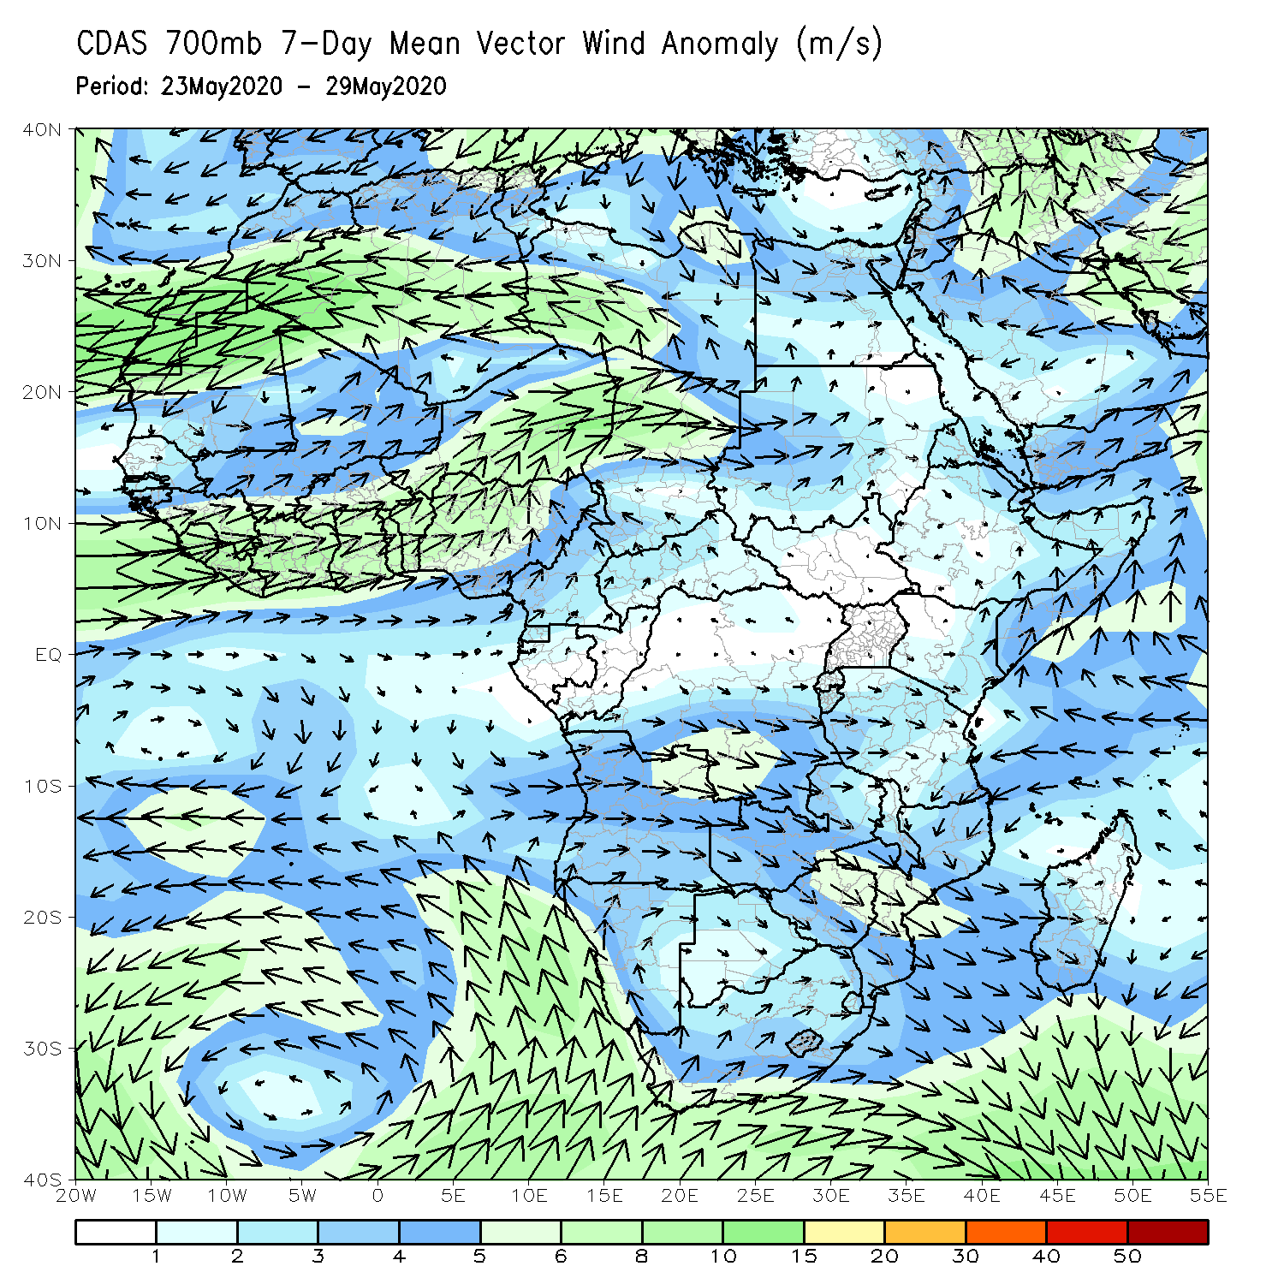
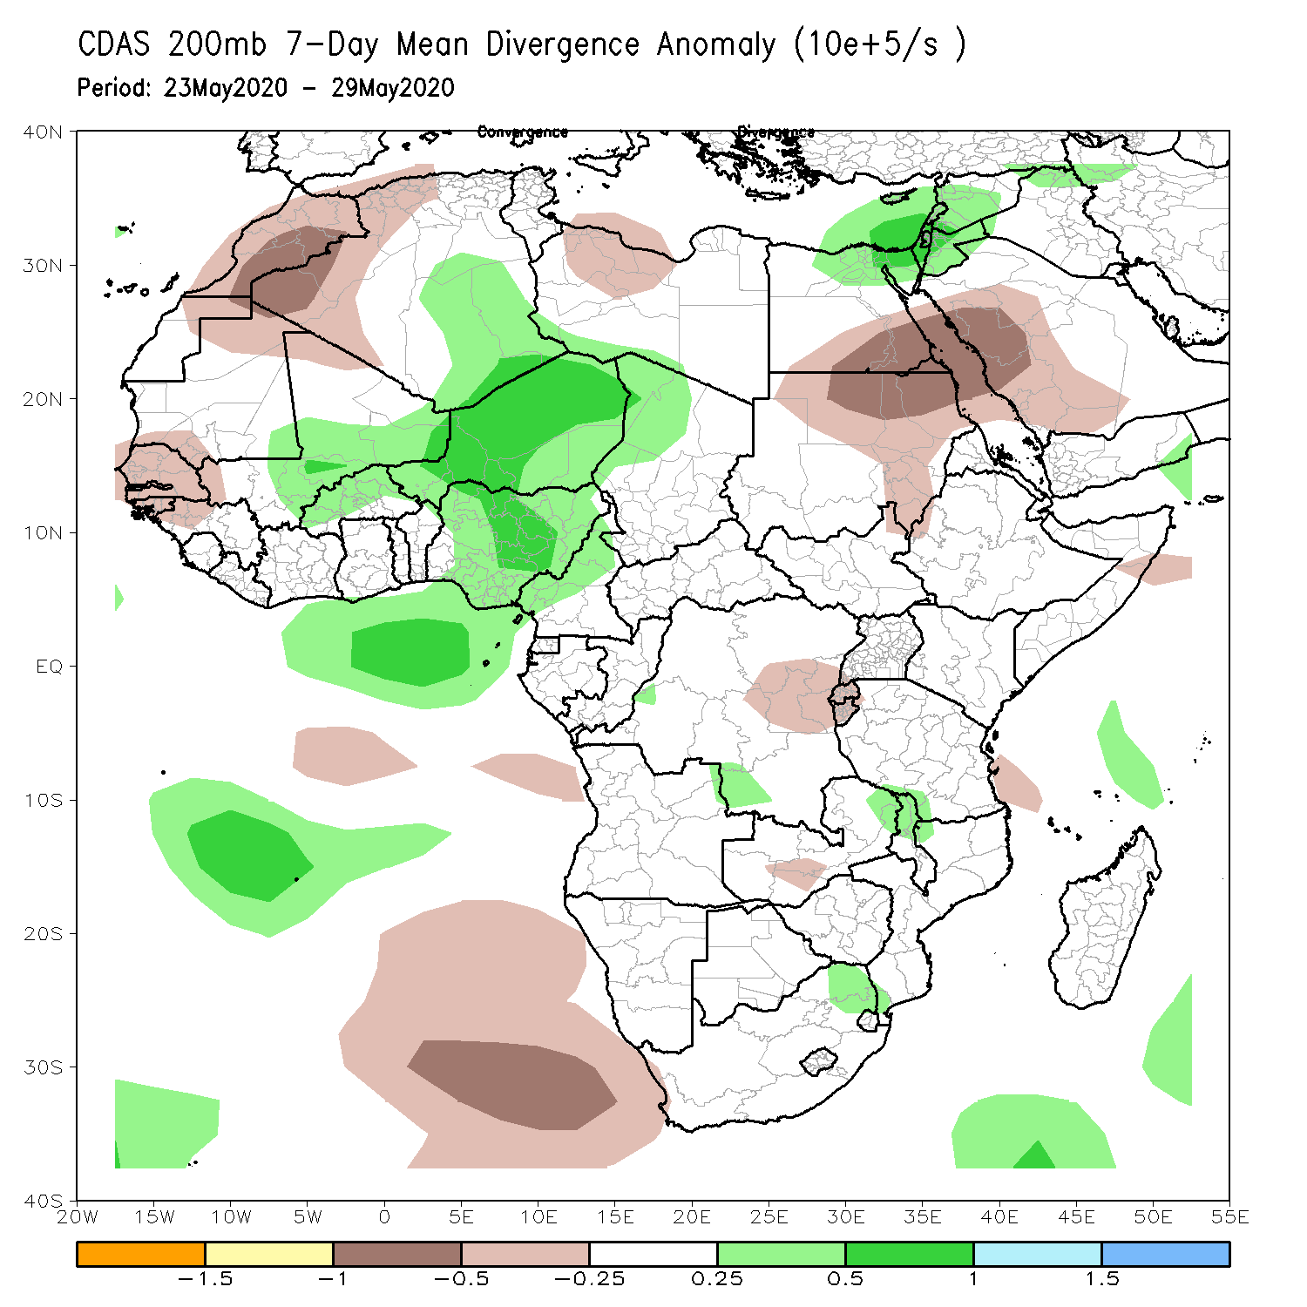
Atmospheric Circulation: Last 7 Days
Stronger than normal onshore flow, coupled with anomalous upper-level divergence may have contributed to the observed above-average rainfall over portions of West Africa.

Slide 9
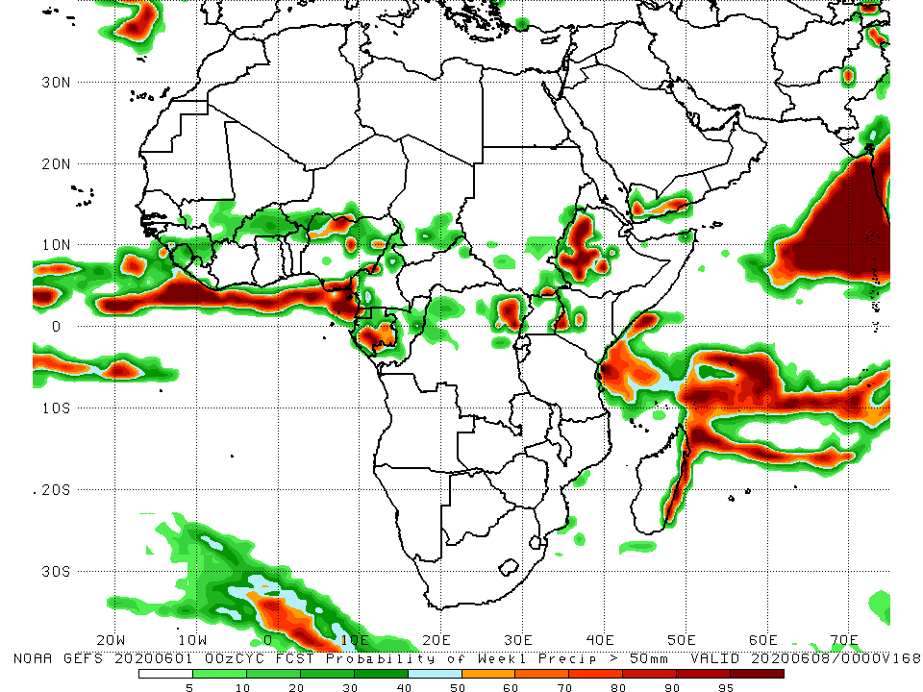
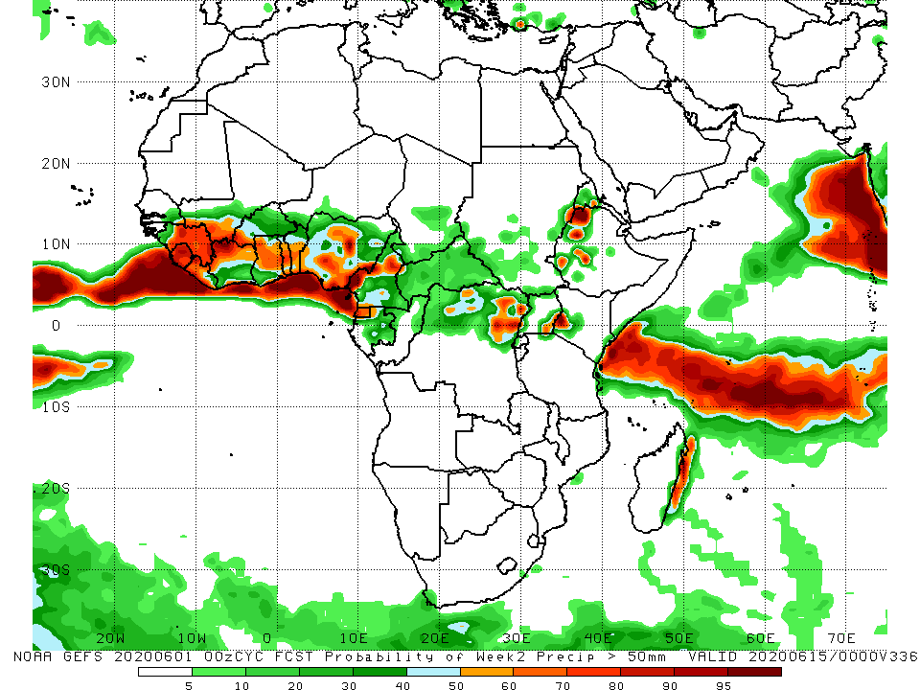
NCEP GEFS Model Forecasts Non-Bias Corrected Probability of precipitation exceedance
Week-1: 2 – 8 June, 2020
Week-2: Valid 9 – 15 June, 2020
For week-1 (left panel), there is an increased chance for weekly rainfall totals to exceed 50mm over local areas in Nigeria, Cameroon, Gabon, DRC, western Ethiopia and Kenya.
For week-2 (right panel), there is an increased chance for weekly rainfall totals to exceed 50mm over many places in the Gulf of Guinea region, northern DRC, local areas in Uganda and Kenya, and western Ethiopia.
Notes:
9

Slide 10
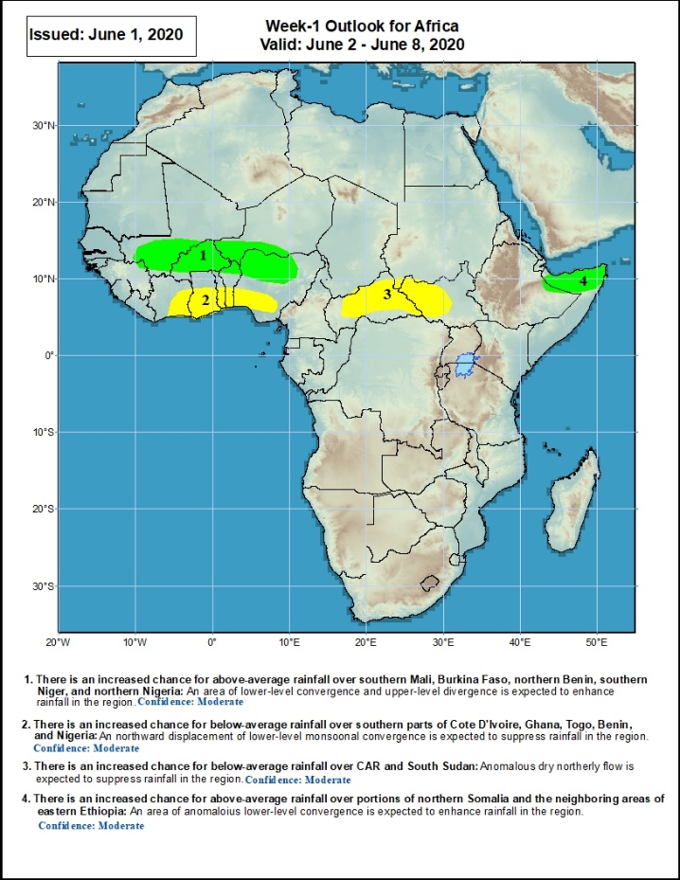
Week-1 Precipitation Outlooks
2 – 8 June, 2020
There is an increased chance for above-average rainfall over southern Mali, Burkina Faso, northern Benin, southern Niger, and northern Nigeria: An area of anomalous lower-level convergence and upper-level divergence is expected to enhance rainfall in the region. Confidence: Moderate
There is an increased chance for below-average rainfall over southern parts of Cote d'Ivoire, Ghana, Togo, Benin, and southern Nigeria: An area anomalous lower-level divergence and upper-level convergence is expected to suppress rainfall in the region. Confidence: Moderate
There is an increased chance for below-average rainfall over portions of CAR and South Sudan: An area anomalous lower-level divergence and upper-level convergence is expected to suppress rainfall in the region. Confidence: Moderate
There is an increased chance for above-average rainfall over portions of northern Somalia and the neighboring areas of eastern Ethiopia: An area of anomalous lower-level convergence and upper-level divergence is expected to enhance rainfall in the region. Confidence: Moderate
Notes:
10

Slide 11
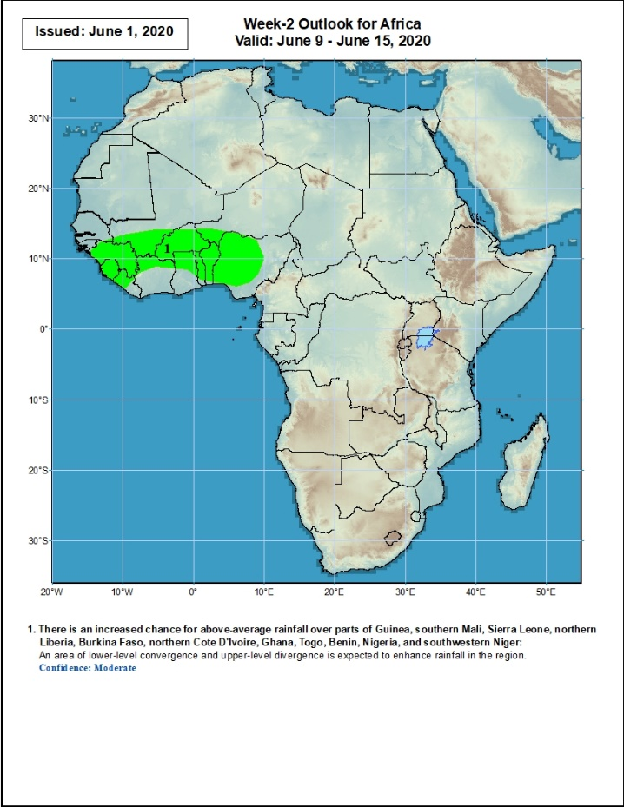
Week-2 Precipitation Outlooks
9 – 15 June, 2020
There is an increased chance for above-average rainfall over parts of Guinea, southern Mali, Sierra Leone, northern Liberia, Burkina Faso, northern Cote D'Ivoire, Ghana, Togo, Benin, Nigeria, and southwestern Niger: An area of lower-level convergence and upper-level divergence is expected to enhance rainfall in the region. Confidence: Moderate
Notes:
11

Slide 12
Summary
During the past 7 days, rainfall was above-average over parts of Mali, Sierra Leone, Liberia, local areas in Cote d’Ivoire, Burkina Faso, Ghana, local areas in Niger, Nigeria, Cameroon, Gabon, CAR, Congo, portions of DRC, northern Angola, and local areas in South Sudan, Ethiopia and northern Somalia. Below-average rainfall was observed over local areas in Cote d’Ivoire, Nigeria, Cameroon, eastern CAR, southern Sudan, local areas in DRC, Uganda, and parts of western Kenya and western Ethiopia.
During the past 30 days, rainfall was above-average over many places in the Gulf of Guinea region, including much of Cameroon, Gabon and Congo, southern Chad, eastern CAR, much of DRC, South Sudan, parts of eastern Sudan, Uganda, Eritrea, Ethiopia, parts western Kenya, central and northern Somalia, Burundi, local areas in Tanzania, northern Angola, and local areas in South Africa. Rainfall was below-average over parts of southern Mali, Burkina Faso, local areas in Nigeria, western CAR, northern Congo, central and eastern Kenya, parts of southern Somalia, local area in Mozambique, and much of Madagascar.
During the past 90 days, rainfall was above-average over many places in the Gulf of Guinea and the neighboring areas of Sahel region, Cameroon, and southern Chad, much of CAR, South Sudan, Gabon, Congo, DRC, Rwanda, Burundi, Uganda, Kenya, Eritrea, Ethiopia, Somalia, much of Tanzania, many parts of Angola and northern Zambia, northern Malawi, northeastern Namibia, western Botswana, portions of South Africa, and northern Madagascar. Parts of southern Mali and Burkina Faso, southwestern Angola, western and southern Namibia, eastern Botswana, much of Zimbabwe, parts of southern Zambia, western South Arica, much of Mozambique, and central and southern Madagascar had below-average rainfall.
Week-1 outlooks call for an increased chance for above-average rainfall over many places in the Sahel region and northern Somalia. In contrast, there is an increased chance for below-average rainfall across much of the Gulf of Guinea region, CAR and western South Sudan
Notes:
12

