Slide 1
The African Monsoon Recent Evolution and Current Status Include Week-1 and Week-2 Outlooks
Update prepared by
Climate Prediction Center / NCEP
10 August 2020
For more information, visit:
http://www.cpc.ncep.noaa.gov/products/Global_Monsoons/African_Monsoons/precip_monitoring.shtml

Slide 2
Outline
Highlights
Recent Evolution and Current Conditions
NCEP GEFS Forecasts
Summary

Slide 3
Highlights: Last 7 Days
Rainfall was below average over much of the Gulf of Guinea region, while many places in the Sahel region continued to receive above-average rainfall.
Week-1 outlooks call for an increased chance for above-average rainfall over portions of Senegal, Guinea-Bissau, Guinea, Sierra Leone, southwestern Mali, western Burkina Faso, southern Niger, northern Nigeria, northern Cameroon, southern Chad, Sudan, northern South Sudan, western Ethiopia and Eritrea. In contrast, there is an increased chance for below-average rainfall along the Gulf of Guinea coast.
Week-2 outlooks call for an increased chance for above-average rainfall over northern Nigeria, southern Niger, northern Cameroon, southern Chad, northern CAR, portions of Sudan, South Sudan, western Ethiopia and Eritrea. In contrast, there is an increased chance for below-average rainfall over much of Senegal, parts of southern Mauritania, southwestern Mali, Guinea-Bissau, Guinea, Sierra Leone, Liberia, d'Ivoire Ghana, southern Togo and southern Benin.

Slide 4
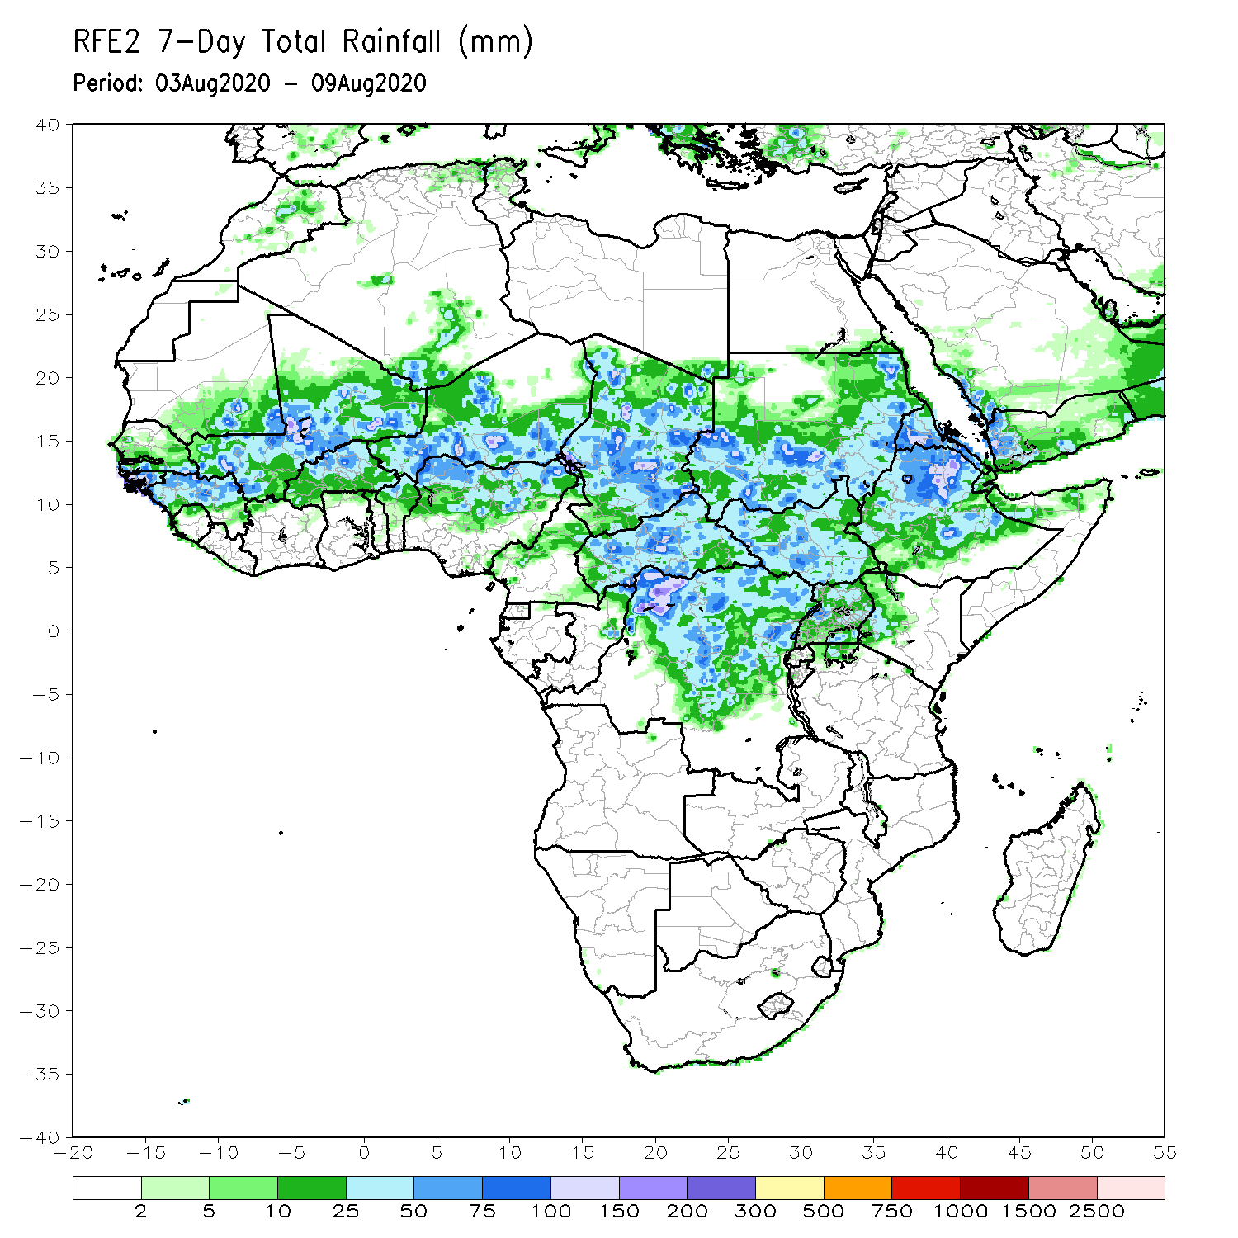
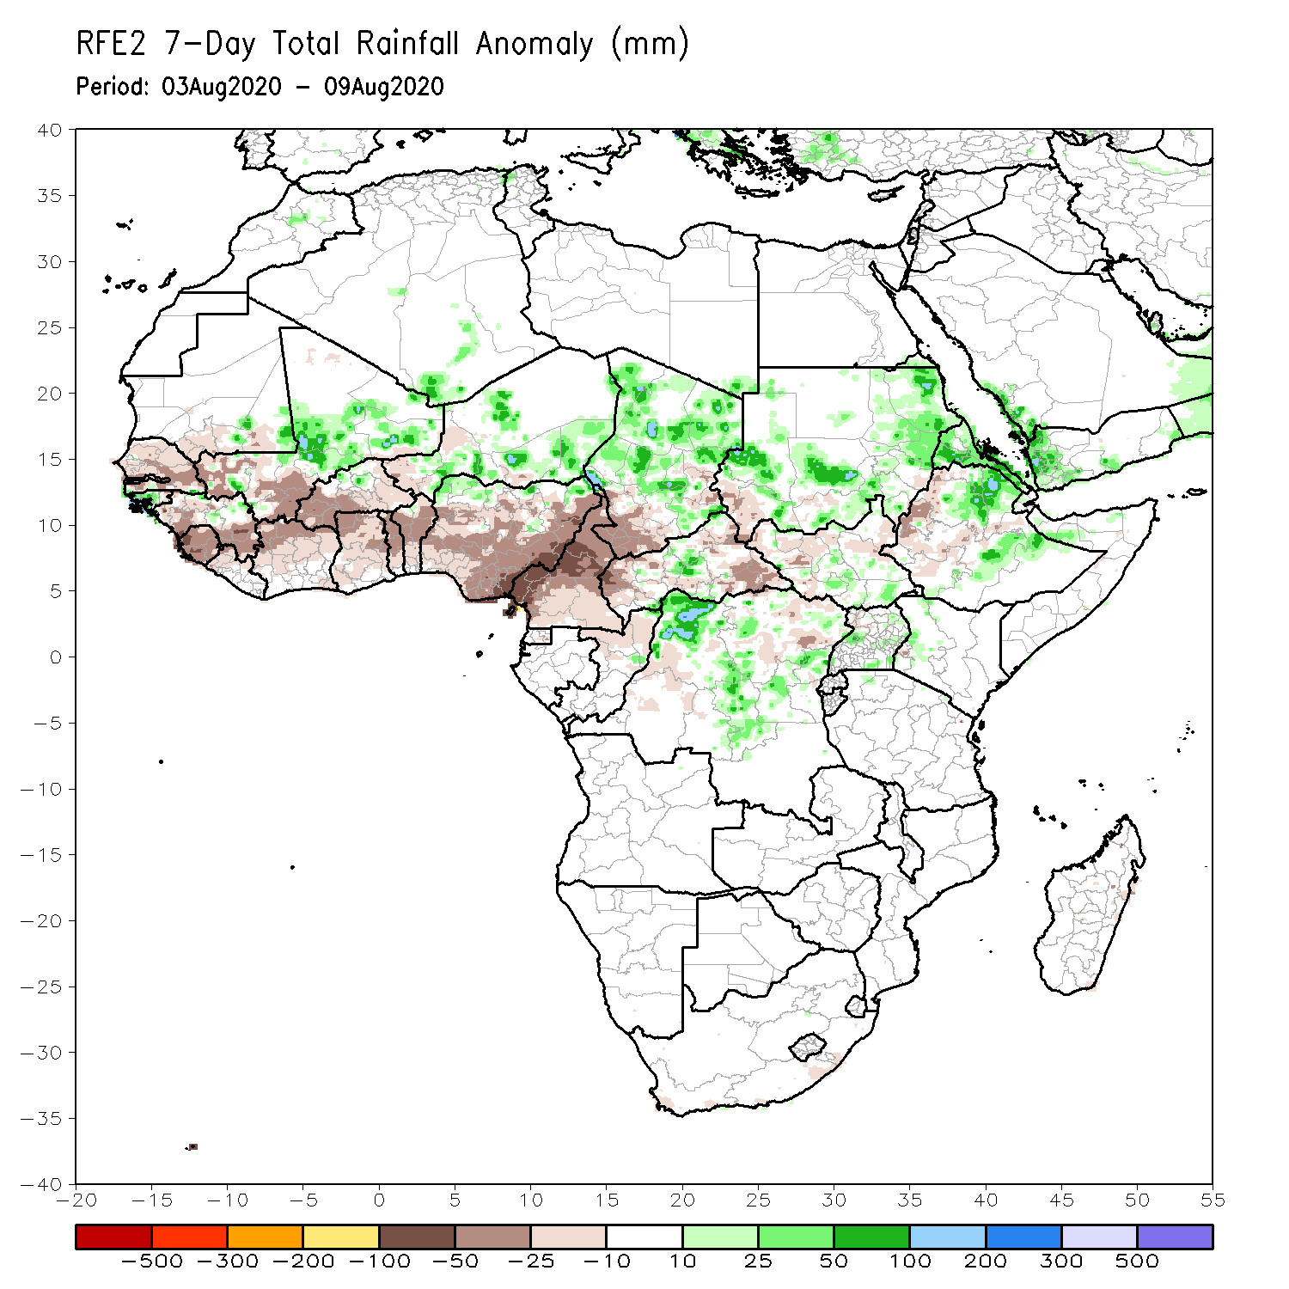
Rainfall Patterns: Last 7 Days
During the past 7 days, rainfall was above-average over local areas in Mauritania, central and eastern Mali, parts of Niger, central and northern Chad, and portions of Sudan and DRC, and Eritrea and eastern Ethiopia.
Below-average rainfall was observed over Senegal, southwestern Mali, Guinea, Sierra Leone, Liberia, Cote d’Ivoire, much of Burkina Faso, Ghana, Togo Benin, Nigeria, Cameroon, southern Chad, local areas in car and South Sudan, and southwestern Ethiopia.

Slide 5
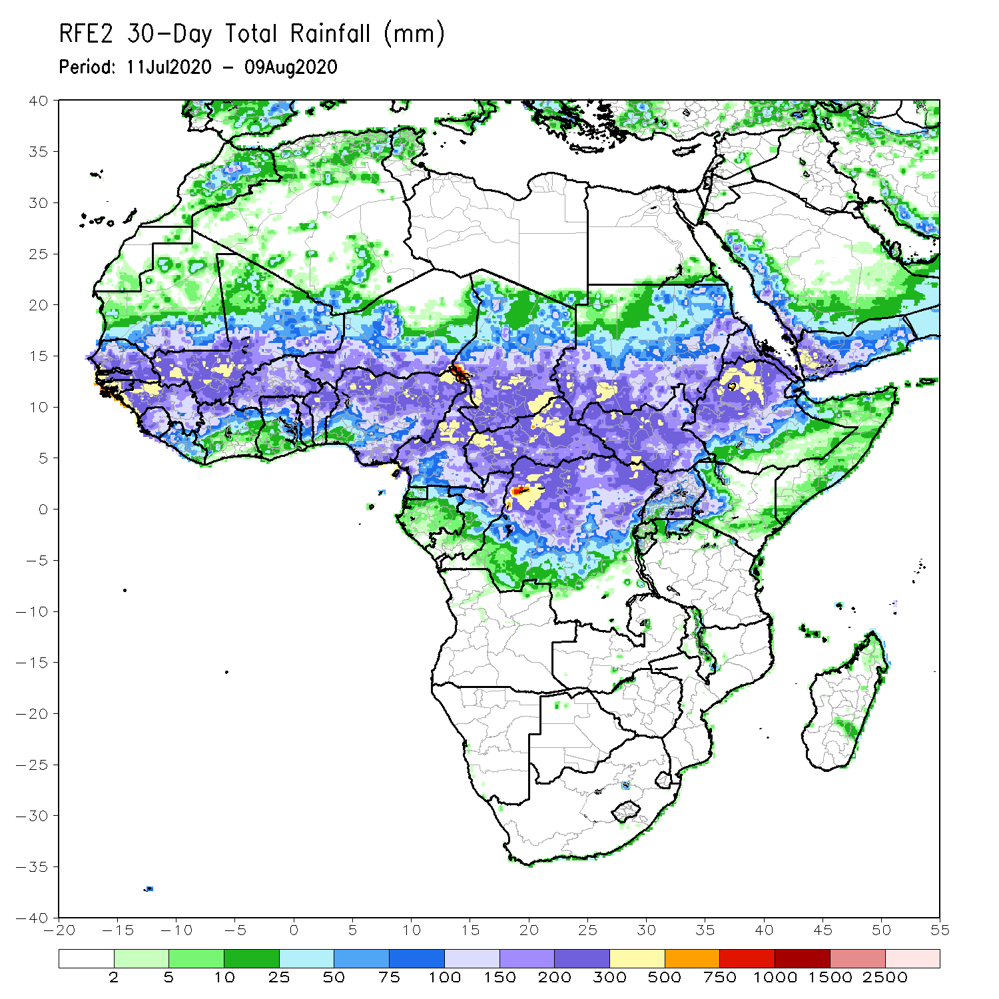
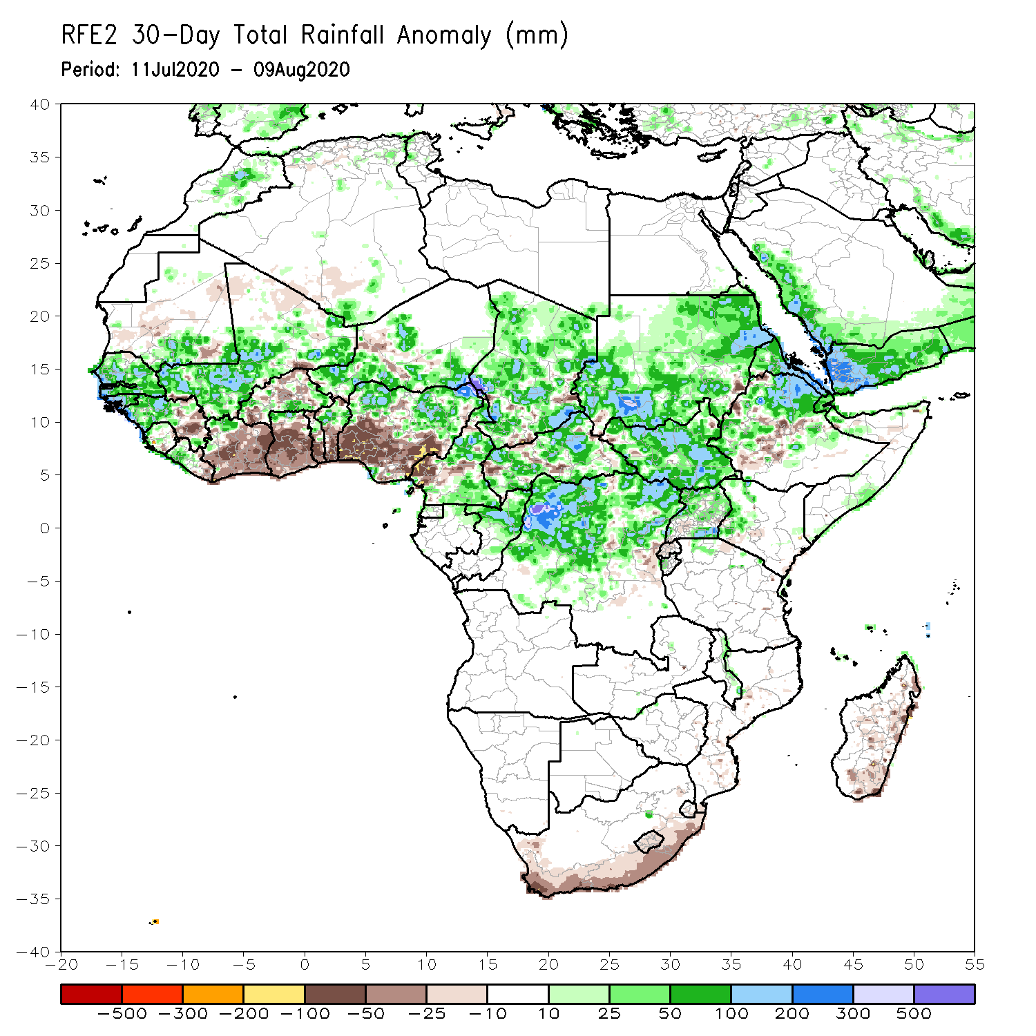
Rainfall Patterns: Last 30 Days
During the past 30 days, rainfall was above-average over many places in the Sahel region, the far western and eastern Gulf of Guinea, and Central Africa countries. Above-average rainfall was also observed over South Sudan, much of Sudan, Uganda, Eritrea, portions of Ethiopia, and local areas in western Kenya.
Rainfall was below-average over eastern Liberia, eastern Guinea, Cote d’Ivoire, Ghana, local areas in Burkina Faso, southern Togo, southern Benin, southern Nigeria, local areas in Ethiopia, and coastal South Africa and Madagascar.
Notes:
5

Slide 6
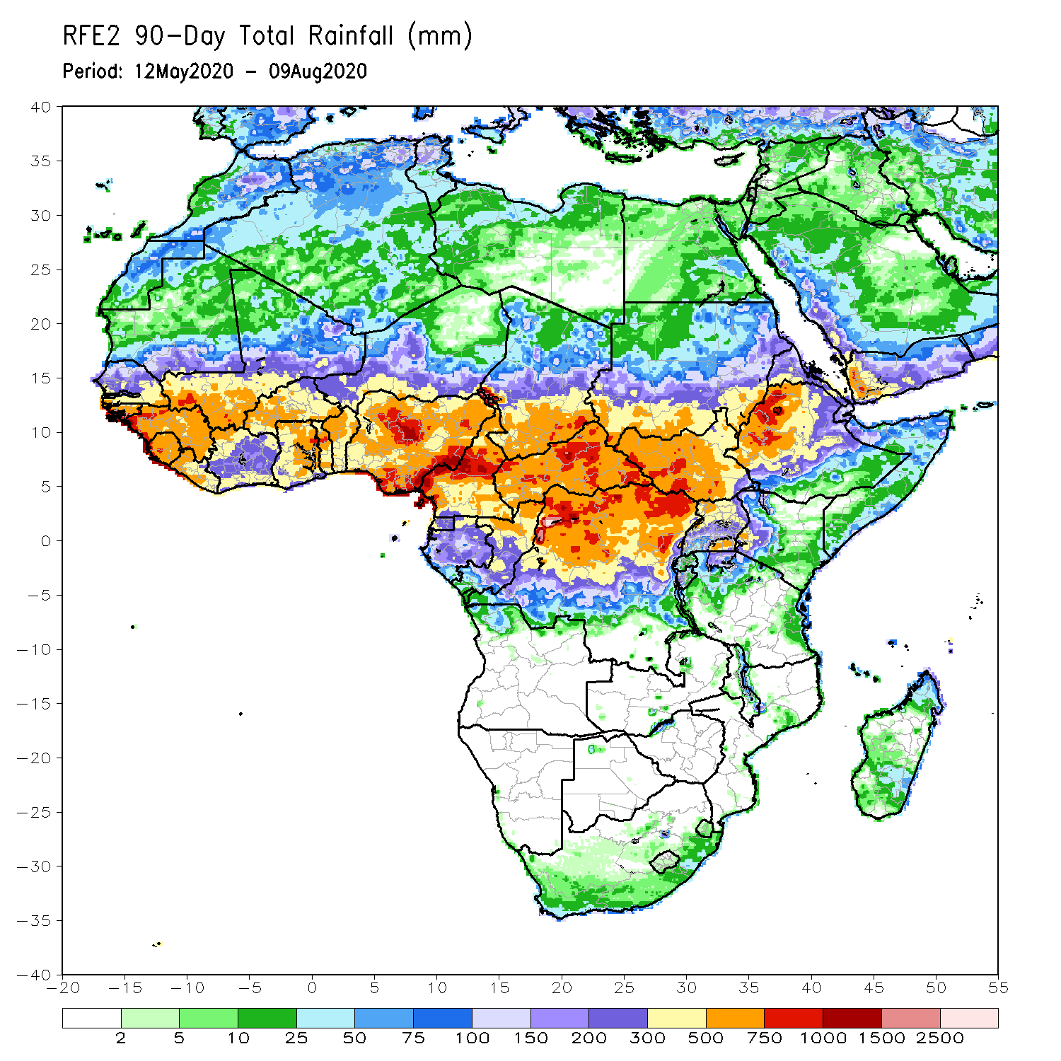
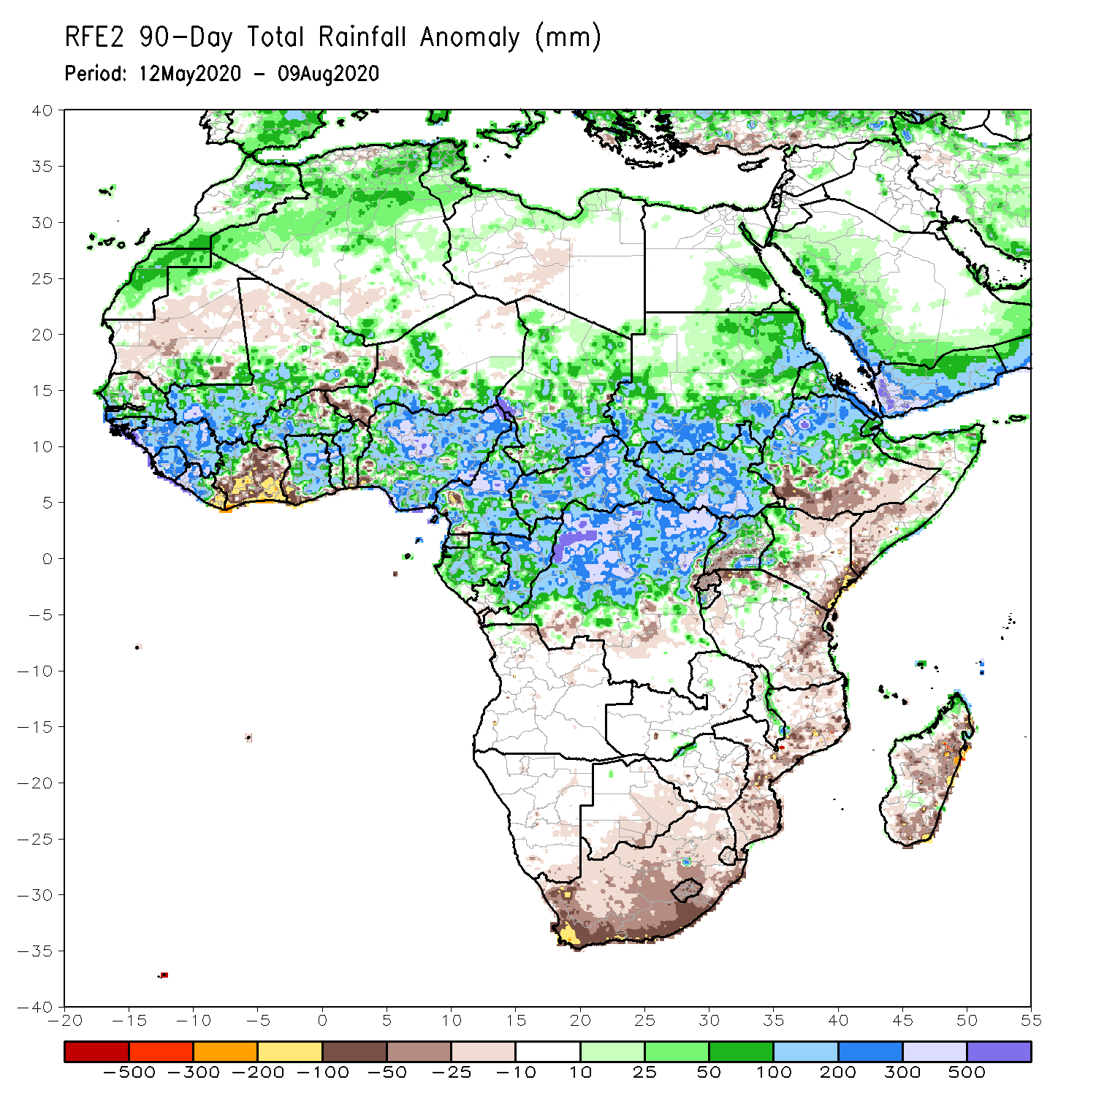
Rainfall Patterns: Last 90 Days
During the past 90 days, rainfall was above-average over much of West, Central and the Greater Horn of Africa.
Below-average rainfall was observed over parts of Cote d’Ivoire, local areas in Niger, southern Ethiopia, Kenya, southern Somalia, parts of Tanzania, South Africa, Mozambique and Madagascar.
Notes:
6

Slide 7
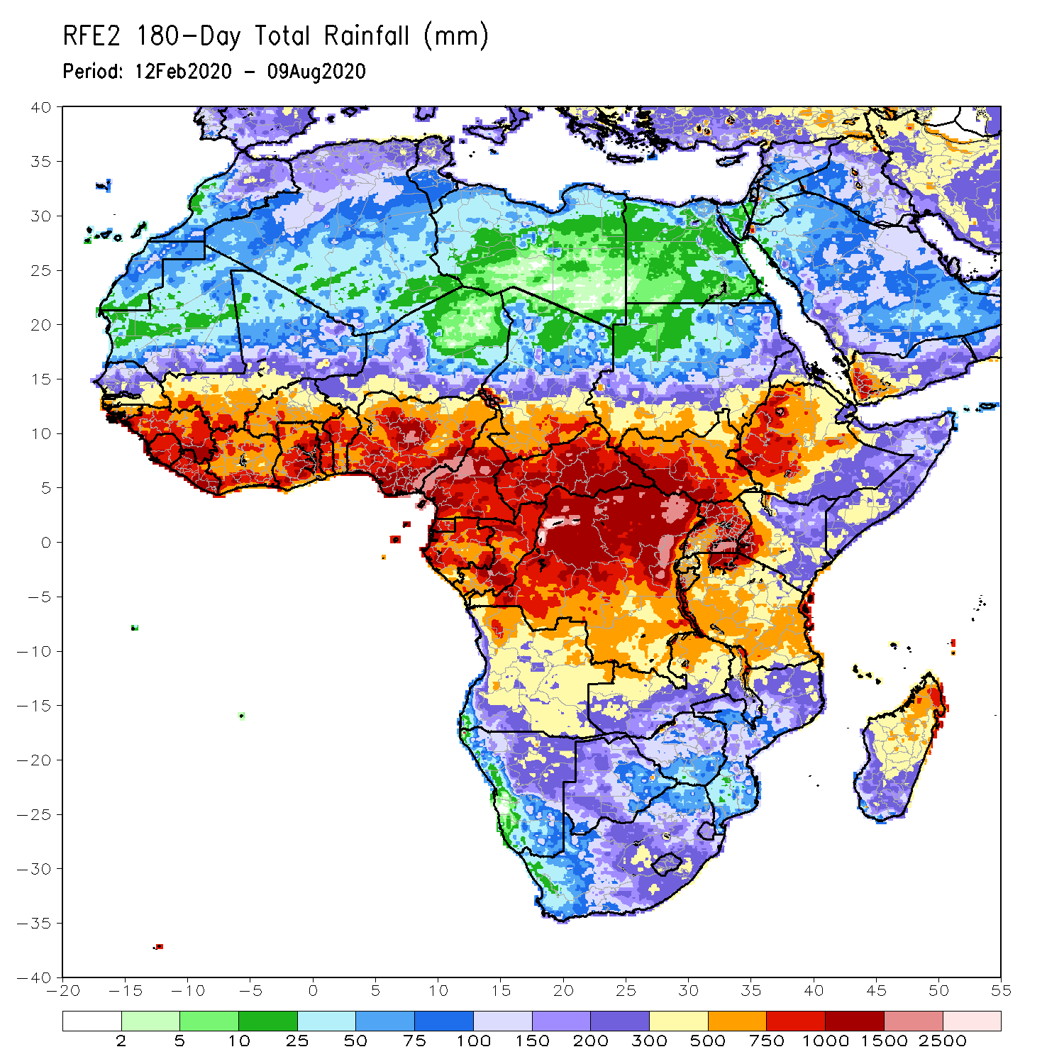
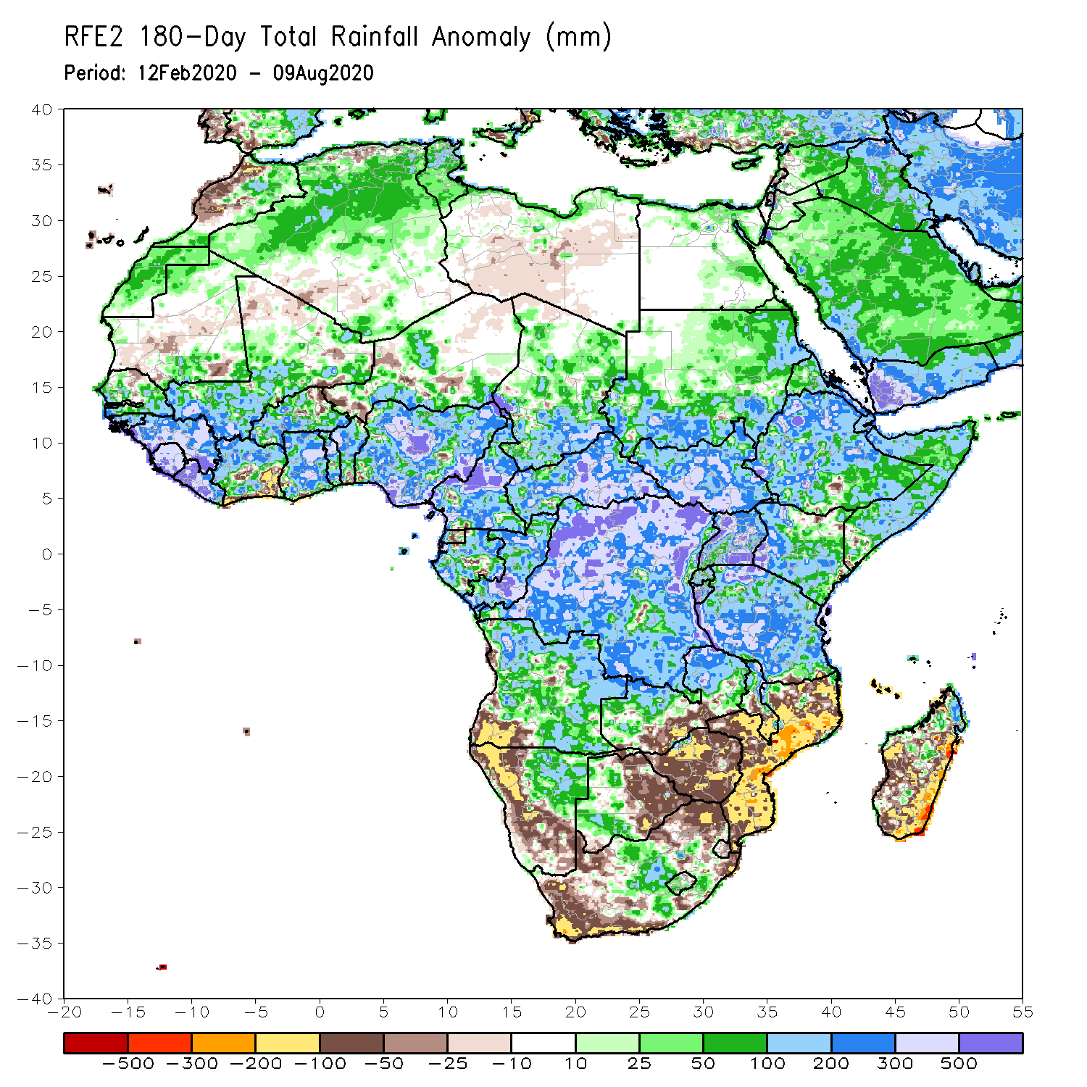
Rainfall Patterns: Last 180 Days
During the past 180 days, rainfall was above-average over much of West, Central and the Greater Horn of Africa, including the northern portions of Southern Africa. Rainfall was also above-average over northeastern Namibia, western Botswana, portions of South Africa, and northern Madagascar.
Below-average rainfall was observed over portions of southwestern Angola, western and southern Namibia, western South Africa, local areas in southern Zambia, eastern Botswana, Zimbabwe, many parts of Mozambique, and central and southern Madagascar.
Notes:
7

Slide 8
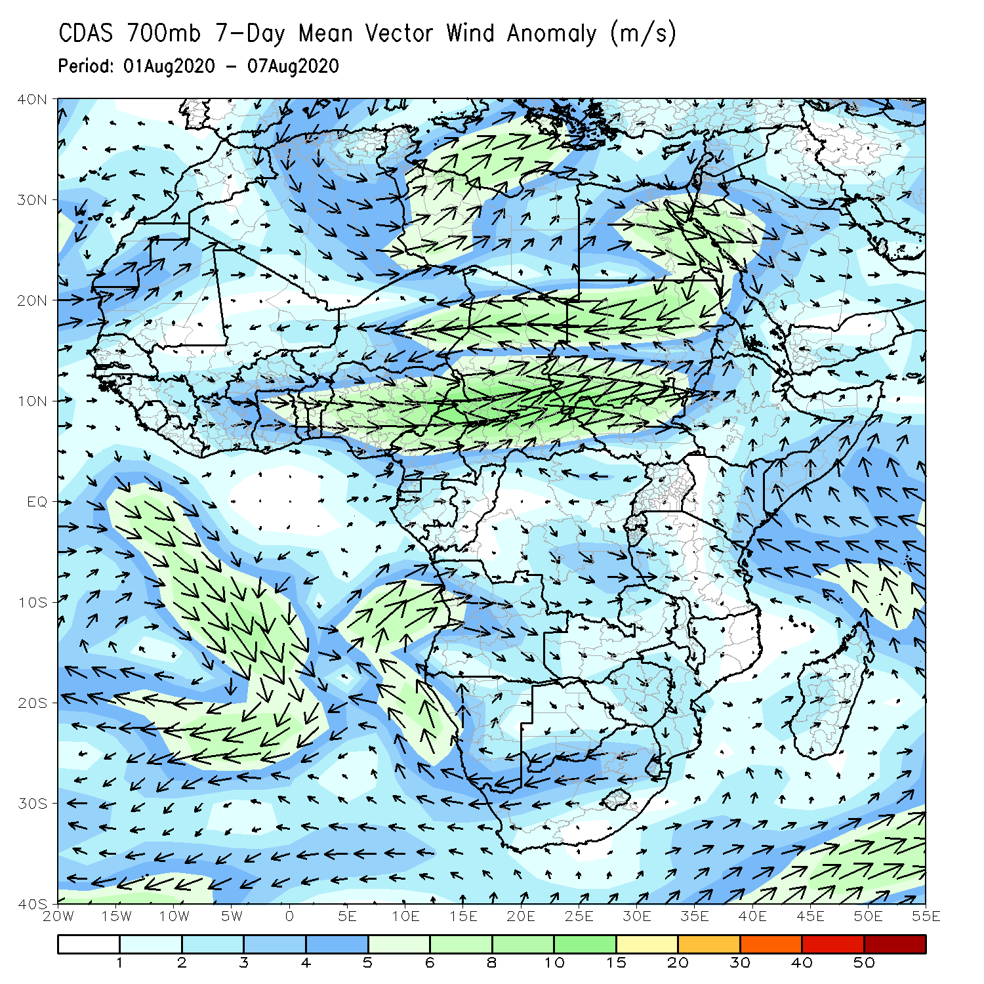
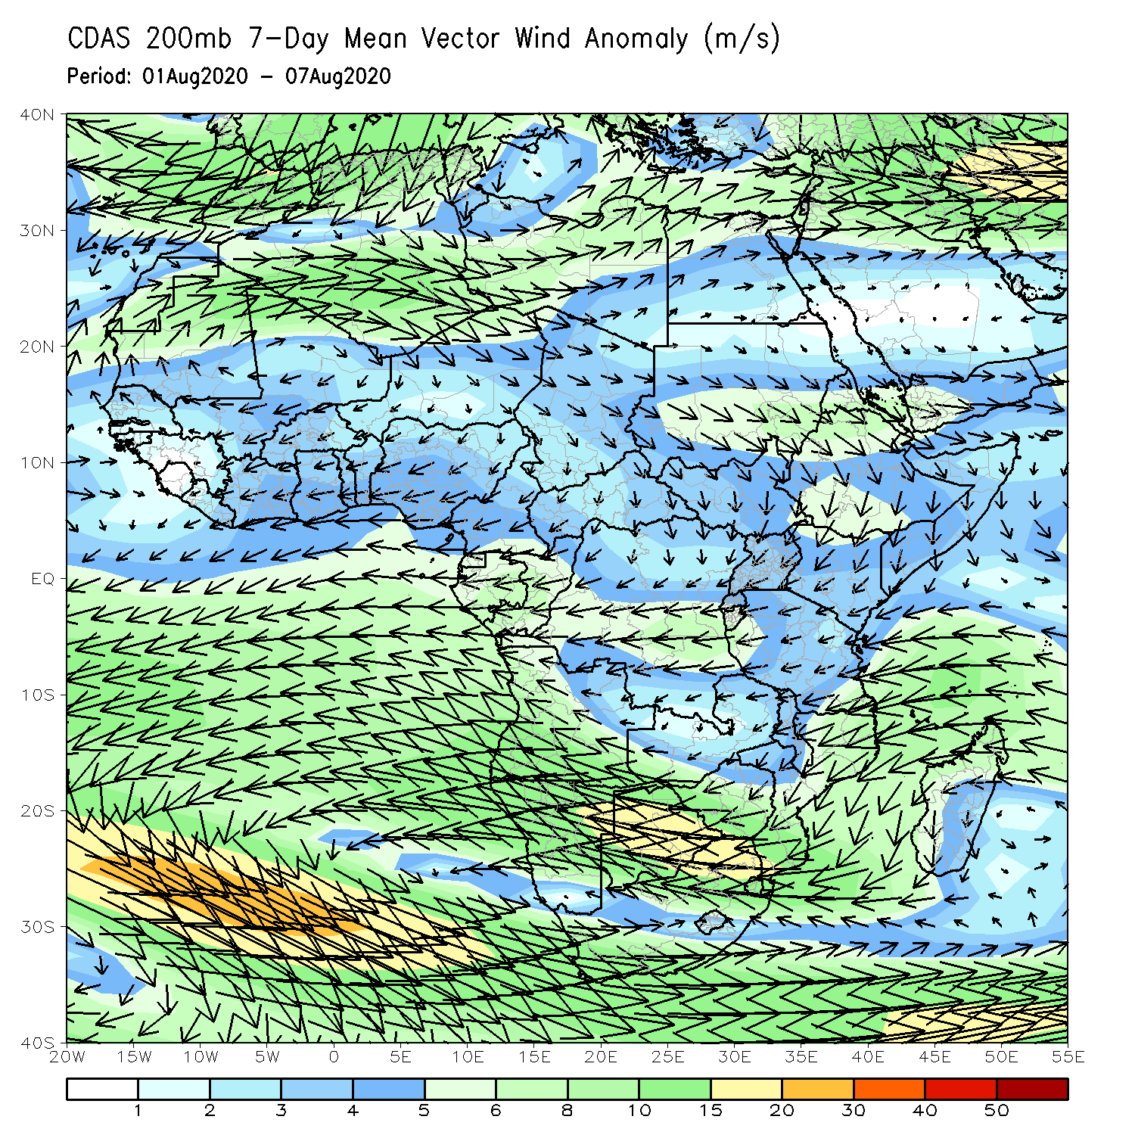
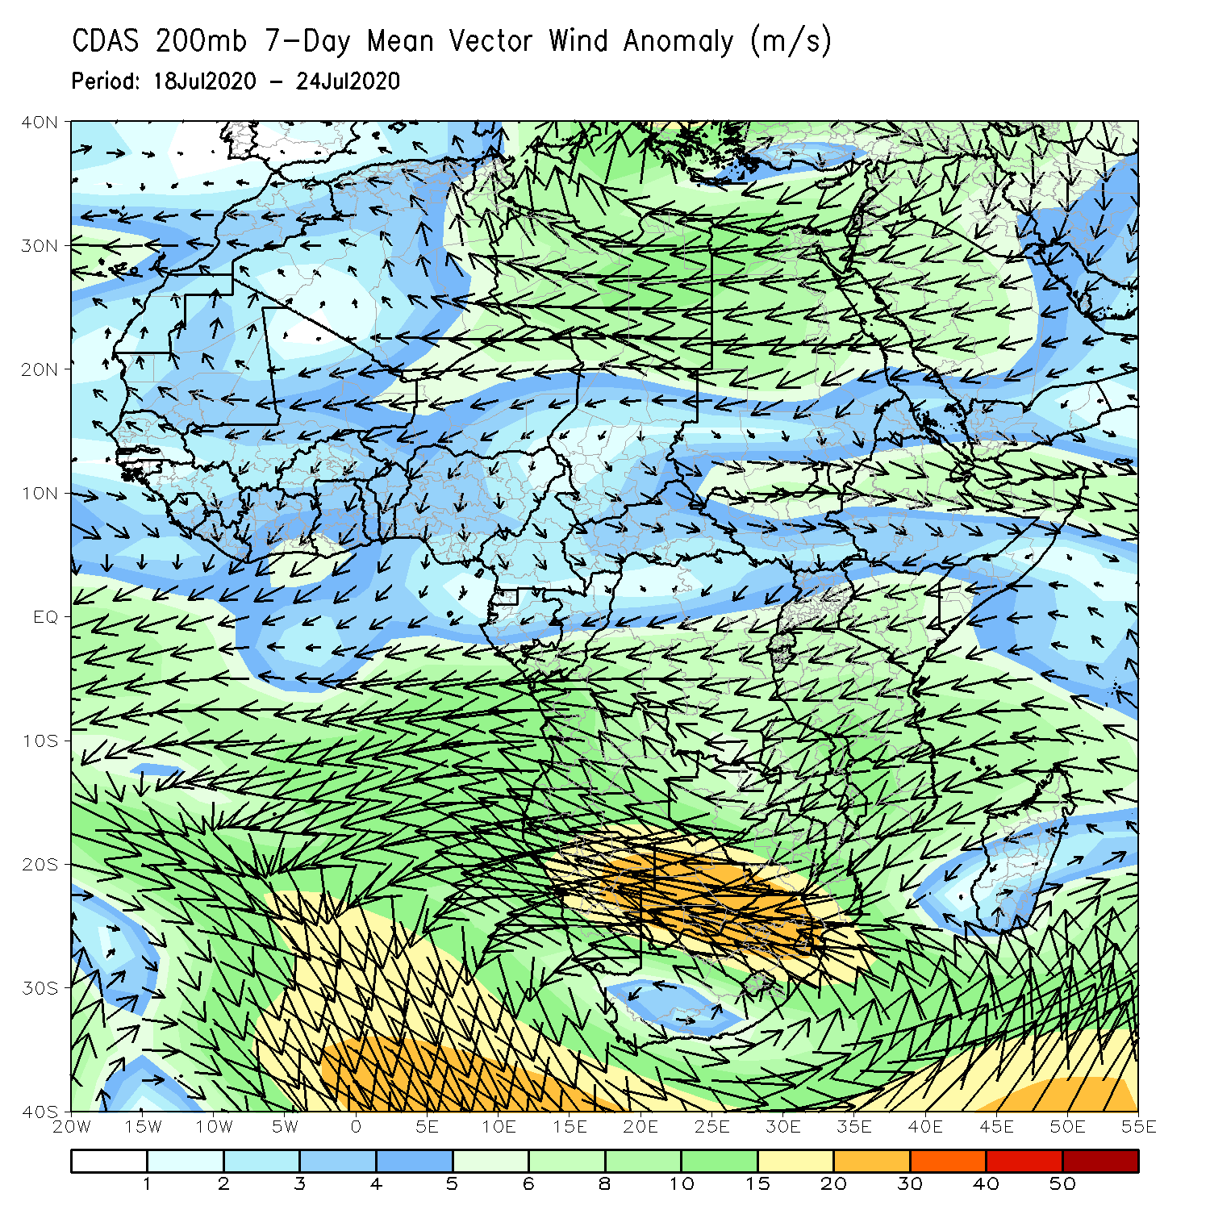
Atmospheric Circulation: Last 7 Days
An area of anomalous lower-level cyclonic shear was observed across central and eastern Sahel (left panel).

Slide 9
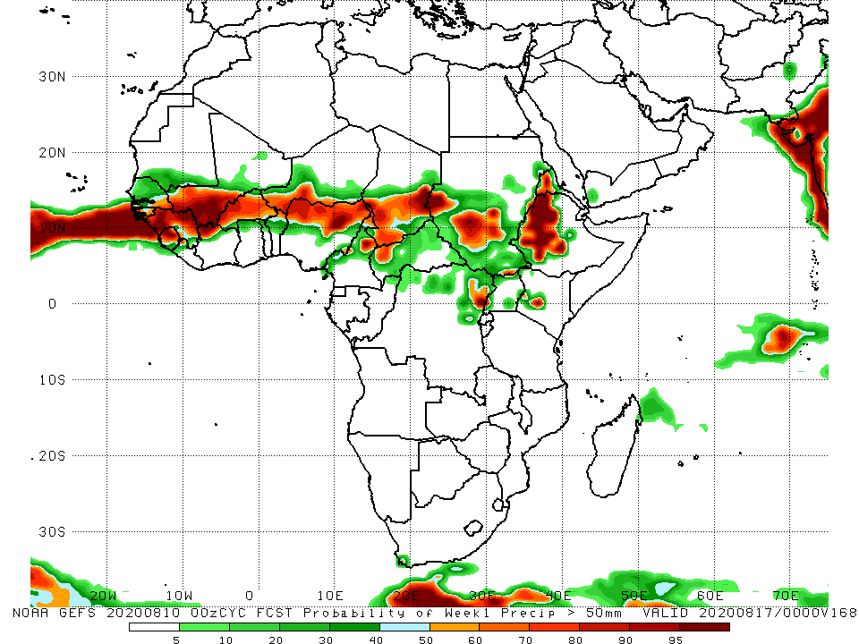
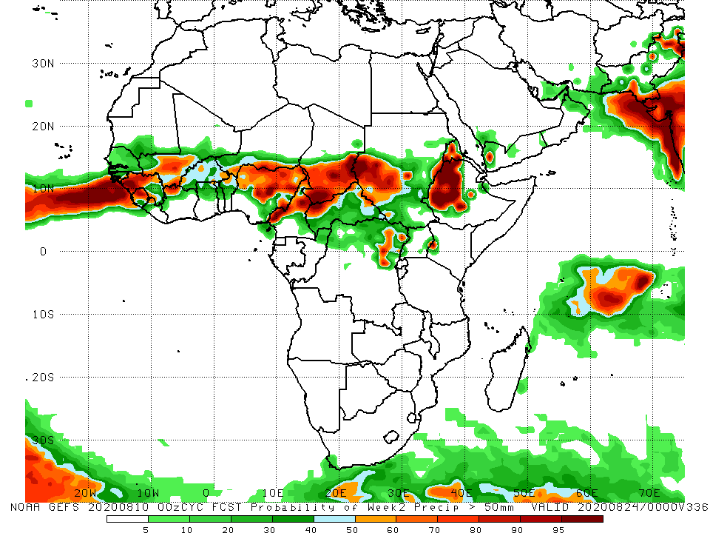
NCEP GEFS Model Forecasts Non-Bias Corrected Probability of precipitation exceedance
Week-1 Valid 11 – 17 August, 2020
Week-2: Valid 18 – 24 August, 2020
For week-1 (left panel) and Week-2 (right panel), there is an increased chance for weekly rainfall totals to exceed 50mm over many places in the Sahel region, and portions of the Greater Horn of Africa.
Notes:
9

Slide 10
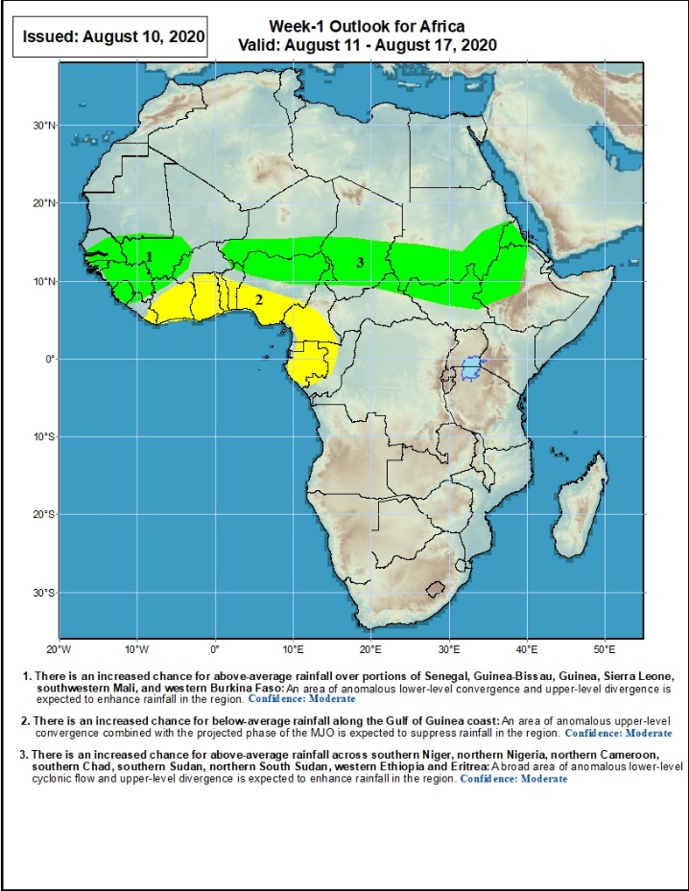
Week-1 Precipitation Outlooks
11 – 17 August, 2020
There is an increased chance for above-average rainfall over portions of Senegal, Guinea-Bissau, Guinea, Sierra Leone, southwestern Mali, and western Burkina Faso: An area of anomalous lower-level convergence and upper-level divergence is expected to enhance rainfall in the region. Confidence: Moderate
There is an increased chance for below-average rainfall along the Gulf of Guinea coast: An area of anomalous lower-level divergence and upper-level convergence is expected to suppress rainfall in the region. Confidence: Moderate
There is an increased chance for above-average rainfall across southern Niger, northern Nigeria, northern Cameroon, southern Chad, Sudan, northern South Sudan, western Ethiopia and Eritrea: A broad area of anomalous lower-level cyclonic flow and upper-level divergence is expected to enhance rainfall in the region. Confidence: Moderate
Notes:
10

Slide 11
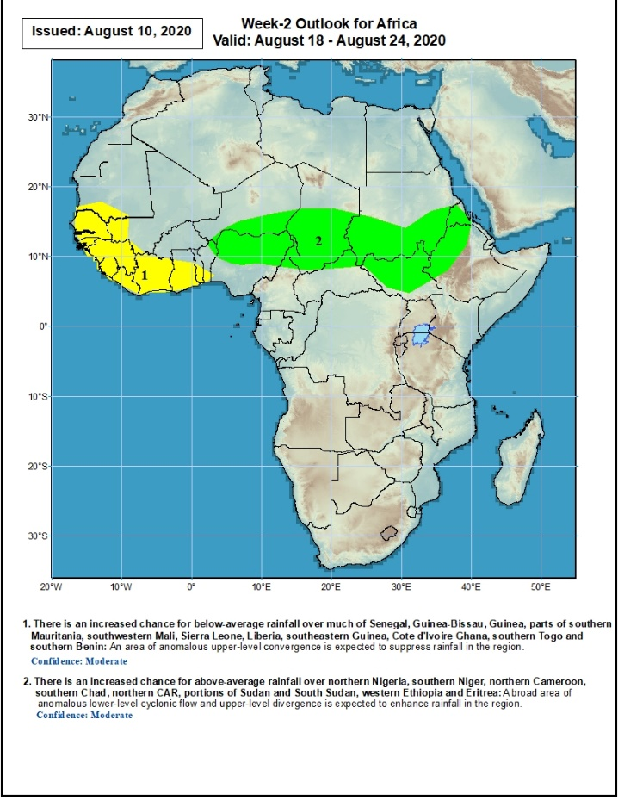
Week-2 Precipitation Outlooks
18 – 24 August, 2020
There is an increased chance for below-average rainfall over much of Senegal, Guinea-Bissau, Guinea, parts of southern Mauritania, southwestern Mali, Sierra Leone, Liberia, Cote d'Ivoire Ghana, southern Togo and southern Benin: An area of anomalous upper-level convergence is expected to suppress rainfall in the region. Confidence: Moderate
There is an increased chance for above-average rainfall over northern Nigeria, southern Niger, northern Cameroon, southern Chad, northern CAR, southern Chad, northern CAR, portions of Sudan and South Sudan, western Ethiopia and Eritrea: A broad area of anomalous lower-level cyclonic flow and upper-level divergence is expected to enhance rainfall in the region. Confidence: Moderate
Notes:
11

Slide 12
Summary
During the past 7 days, rainfall was above-average over eastern Senegal, parts of Mali, local areas in Niger, northern Nigeria, northern During the past 7 days, rainfall was above-average over local areas in Mauritania, central and eastern Mali, parts of Niger, central and northern Chad, and portions of Sudan and DRC, and Eritrea and eastern Ethiopia. Below-average rainfall was observed over Senegal, southwestern Mali, Guinea, Sierra Leone, Liberia, Cote d’Ivoire, much of Burkina Faso, Ghana, Togo Benin, Nigeria, Cameroon, southern Chad, local areas in car and South Sudan, and southwestern Ethiopia.
Cameroon, Chad, much of CAR, northern DRC, Sudan, South Sudan, Eritrea and northeastern Ethiopia. Below-average rainfall was observed over much of the Gulf of Guinea region, local areas in Senegal, Mali Burkina Faso and Niger, local areas in CAR, local area sin eastern Sudan, and western Ethiopia.
During the past 30 days, rainfall was above-average over many places in the Sahel region, the far western and eastern Gulf of Guinea, and Central Africa countries. Above-average rainfall was also observed over South Sudan, much of Sudan, Uganda, Eritrea, portions of Ethiopia, and local areas in western Kenya. Rainfall was below-average over eastern Liberia, eastern Guinea, Cote d’Ivoire, Ghana, local areas in Burkina Faso, southern Togo, southern Benin, southern Nigeria, local areas in Ethiopia, and coastal South Africa and Madagascar.
During the past 90 days, rainfall was above-average over much of West, Central and the Greater Horn of Africa. Below-average rainfall was observed over parts of Cote d’Ivoire, local areas in Niger, southern Ethiopia, Kenya, southern Somalia, parts of Tanzania, South Africa, Mozambique and Madagascar.
Week-1 outlooks call for an increased chance for above-average rainfall over portions of Senegal, Guinea-Bissau, Guinea, Sierra Leone, southwestern Mali, western Burkina Faso, southern Niger, northern Nigeria, northern Cameroon, southern Chad, Sudan, northern South Sudan, western Ethiopia and Eritrea. In contrast, there is an increased chance for below-average rainfall along the Gulf of Guinea coast.
Week-2 outlooks call for an increased chance for above-average rainfall over northern Nigeria, southern Niger, northern Cameroon, southern Chad, northern CAR, portions of Sudan, South Sudan, western Ethiopia and Eritrea. In contrast, there is an increased chance for below-average rainfall over much of Senegal, parts of southern Mauritania, southwestern Mali, Guinea-Bissau, Guinea, Sierra Leone, Liberia, d'Ivoire Ghana, southern Togo and southern Benin.
Notes:
12

