Slide 1
The African Monsoon Recent Evolution and Current Status Include Week-1 and Week-2 Outlooks
Update prepared by
Climate Prediction Center / NCEP
14 September 2020
For more information, visit:
http://www.cpc.ncep.noaa.gov/products/Global_Monsoons/African_Monsoons/precip_monitoring.shtml

Slide 2
Outline
Highlights
Recent Evolution and Current Conditions
NCEP GEFS Forecasts
Summary

Slide 3
Highlights: Last 7 Days
The West African Monsoon remained extremely active and the Sahel continued to register above average rainfall. Moisture surpluses approached 100 mm in many areas resulting in widespread flooding. In contrast drier than normal conditions prevailed in parts of the Gulf of Guinea region. Extremely heavy rains also fell along the western border of Ethiopia and in northern Democratic Republic of Congo (DRC).
The week-1 outlooks indicate a high chance for above average-rainfall along the Guinean coast and over portions of Central Africa. At week-2, the Gulf of Guinea region and portions of central Africa are likely to receive above average rainfall.

Slide 4
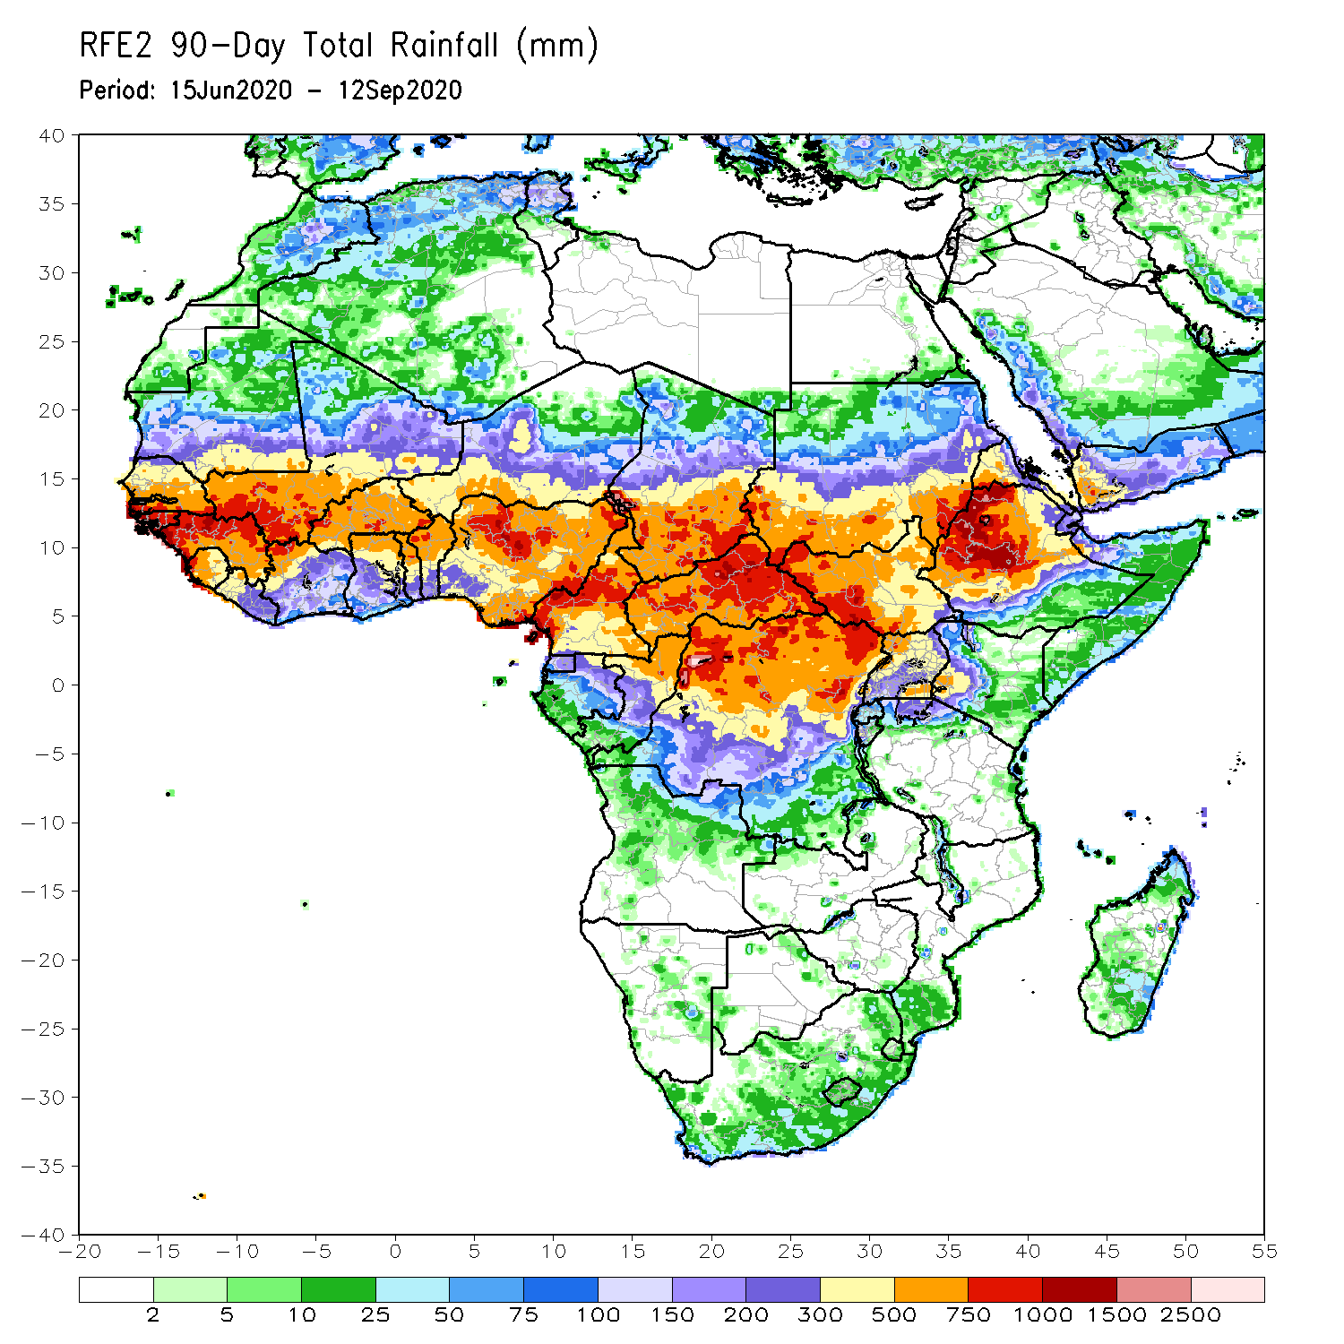
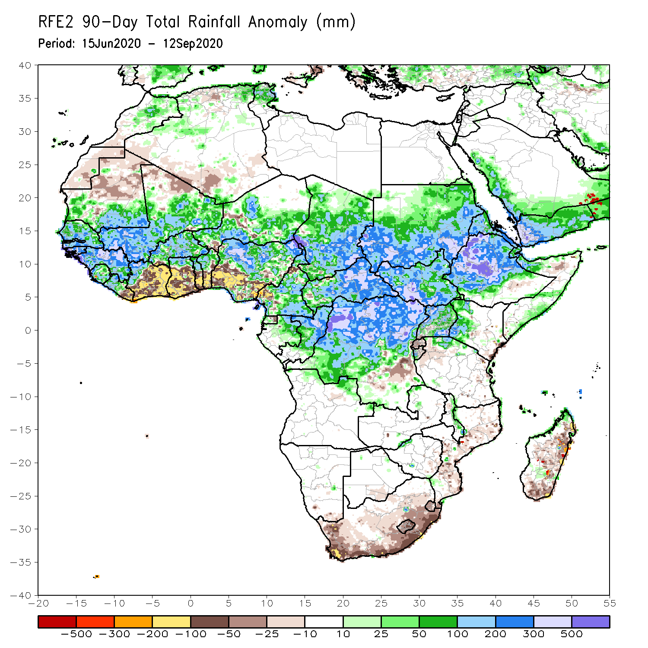
Rainfall Patterns: Last 90 Days
Over the past 90 days, rainfall was above-average along the Sahel band from Senegal to Ethiopia. Rainfall amounts approached 1000 mm along the border between Guinea and Mali and in many areas in Central Africa. The highest rainfall amounts fell over the western Ethiopian highlands with totals approaching 1500 mm, more than 500 mm above the mean. However, moisture deficits prevailed over the southern Gulf of Guinea region in the areas from Cote d’Ivoire eastward to western Nigeria. Seasonably dry conditions occurred in equatorial East Africa and southern Africa.
Notes:
4

Slide 5
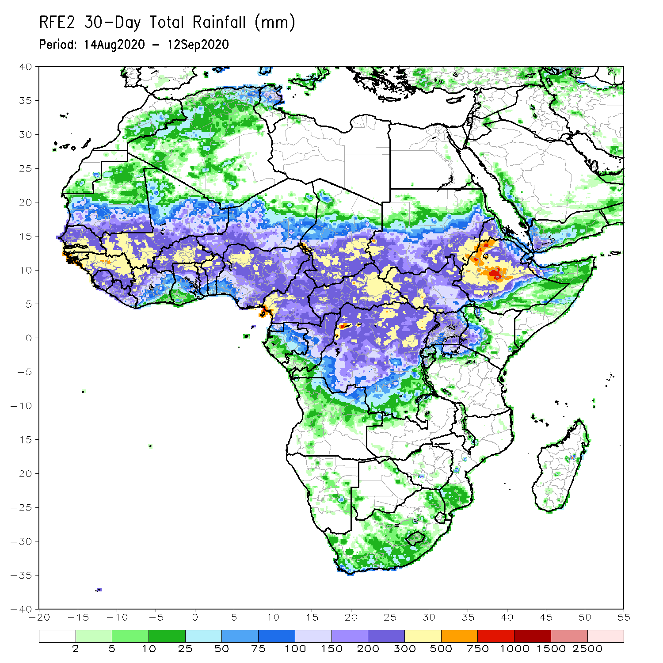
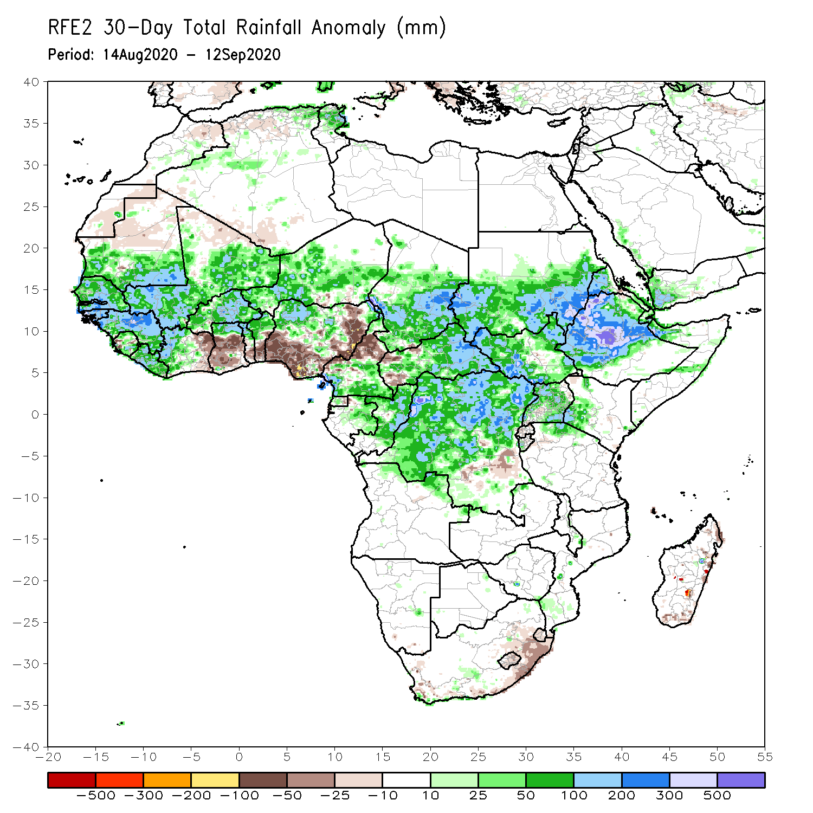
Rainfall Patterns: Last 30 Days
Over the past 30 days, persistent rains resulted in above-average rainfall across the Sahel from Senegal eastward to Niger. In contrast, rainfall was below-average over in the southern areas of the Gulf of Guinea region, including Ghana, Togo, Benin, and Nigeria. Rainfall was also below-average over northeastern Nigeria. Rainfall was above-average over much of Central Africa and the northern areas of the Greater Horn of Africa. Totals approached 1000 mm about 500 mm above the mean locally over the Ethiopian Highlands. Seasonably dry conditions occurred in equatorial East Africa and southern Africa.
Notes:
5

Slide 6
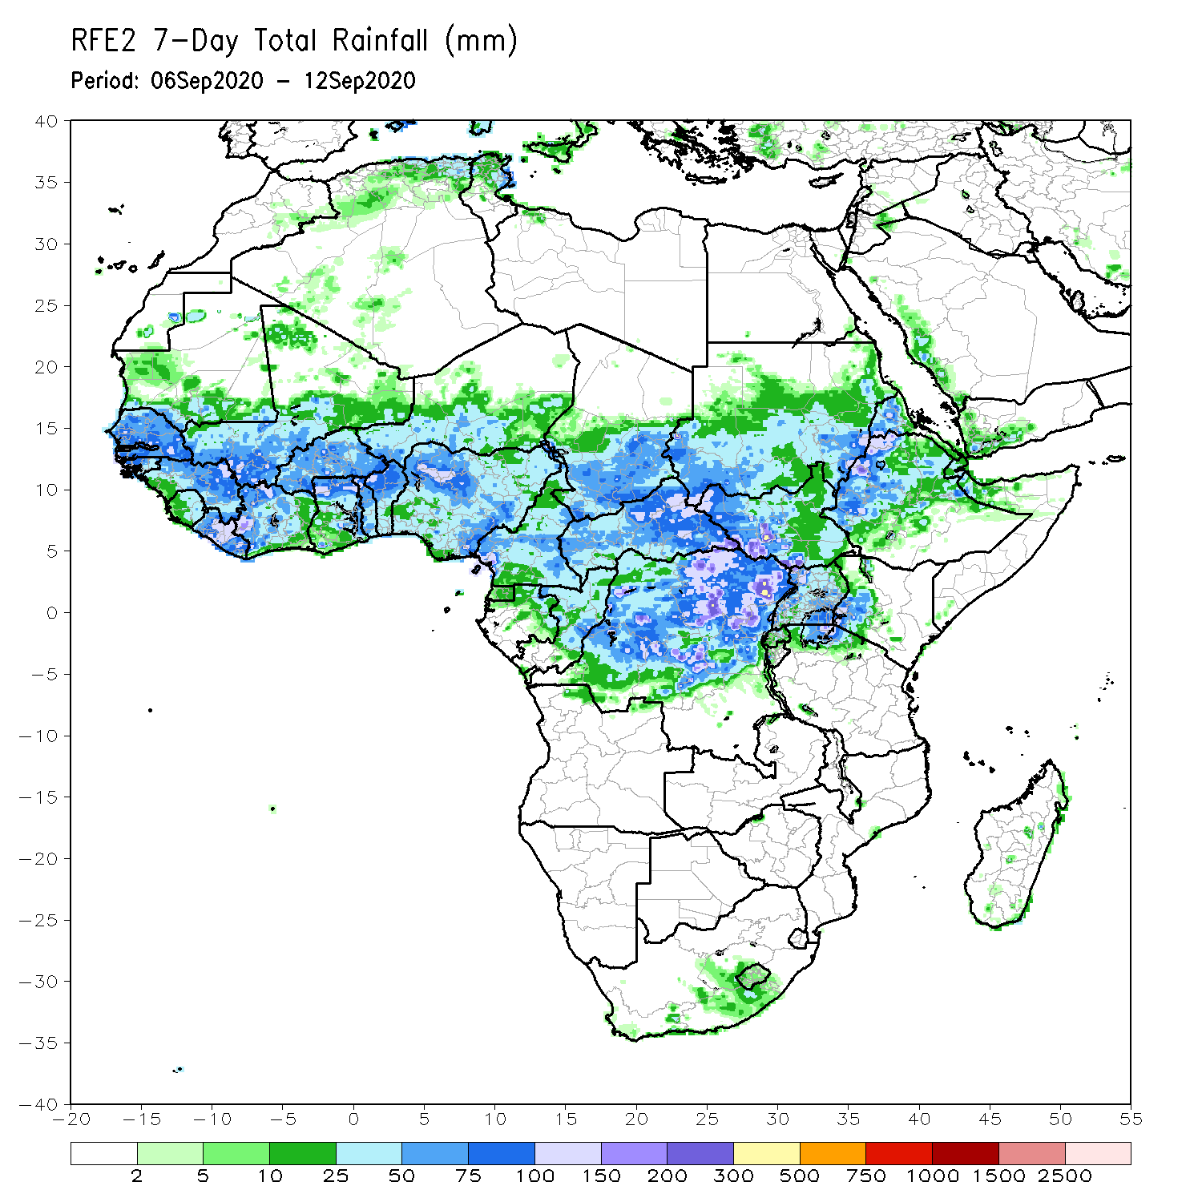
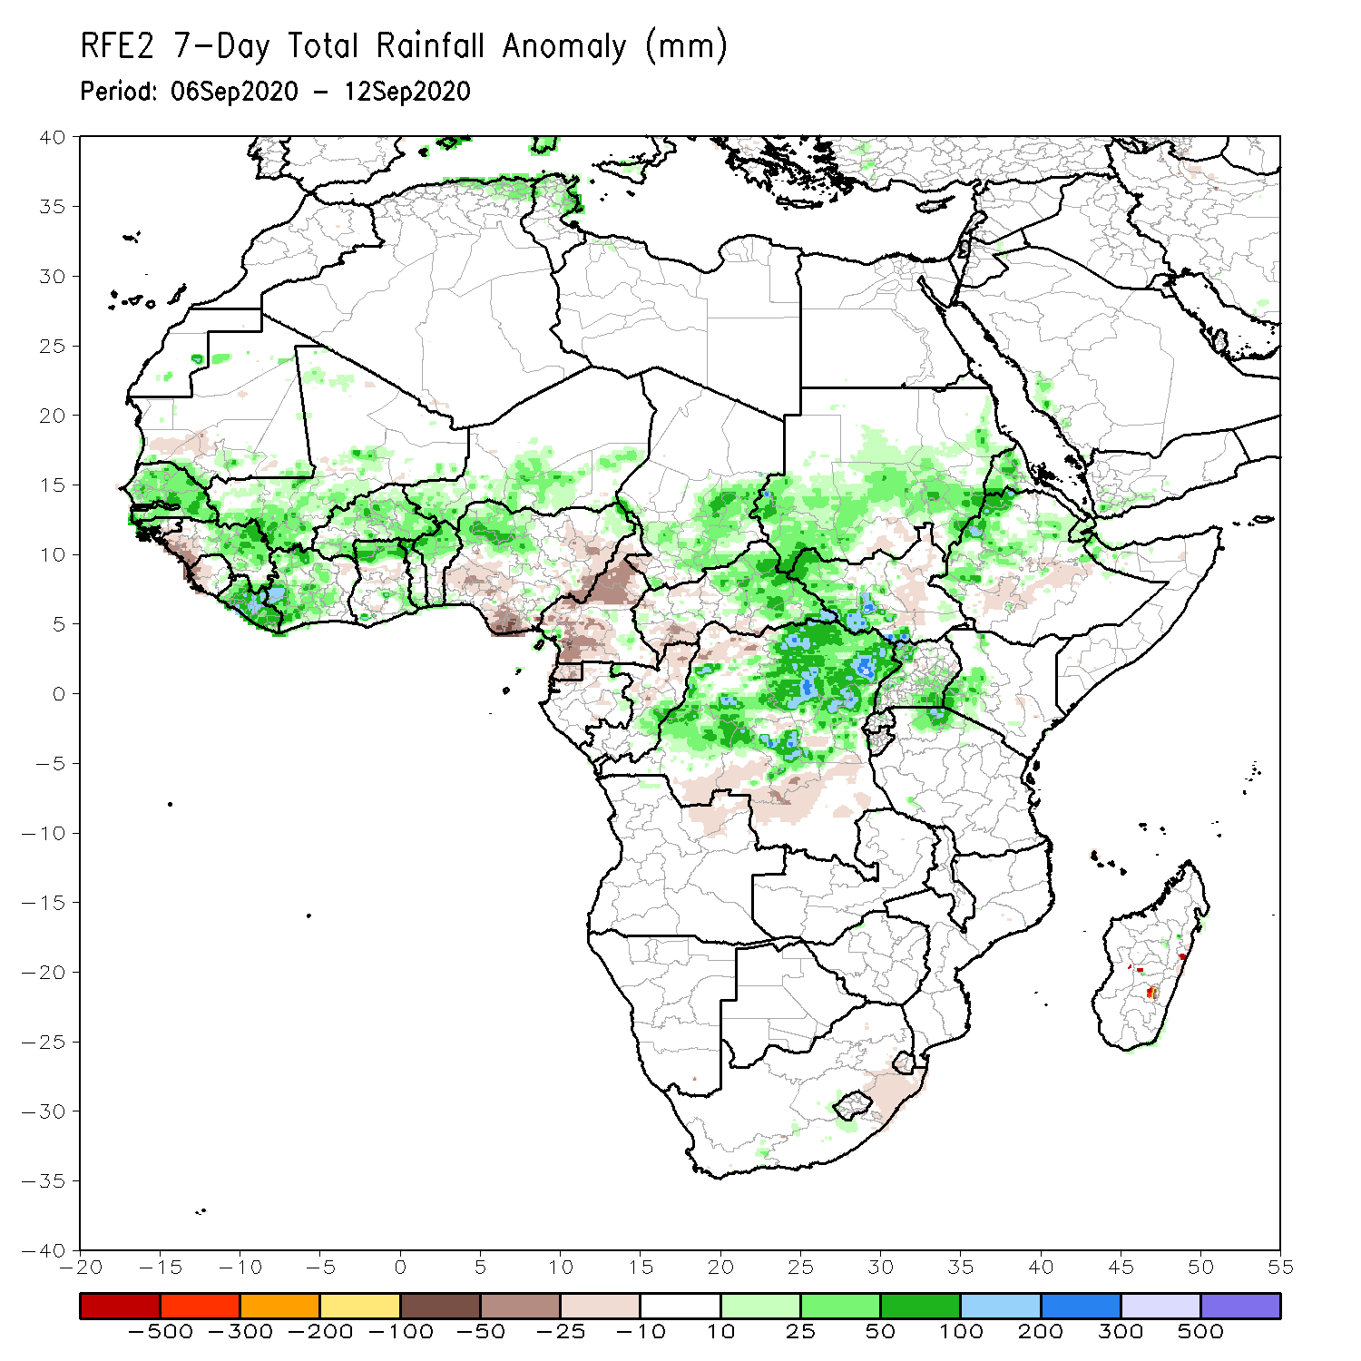
Rainfall Patterns: Last 7 Days
During the past 7 days, heavy downpours ranging between 50 and 100 mm soaked much of West Africa resulting in above-average rainfall in most areas, except for western Guinea and portions of southern and northeastern Nigeria. Rainfall was also below-average in the western areas of central Africa. In contrast, excessive rainfall locally approaching 300 mm prevailed over eastern Central Africa and the northern half of DRC with moisture surpluses exceeding 100 mm. In the Greater Horn of Africa, rainfall was above average in southern Sudan, western South Sudan, and along the western border of Ethiopia and Eritrea. Seasonably dry weather prevailed over southern Africa.

Slide 7
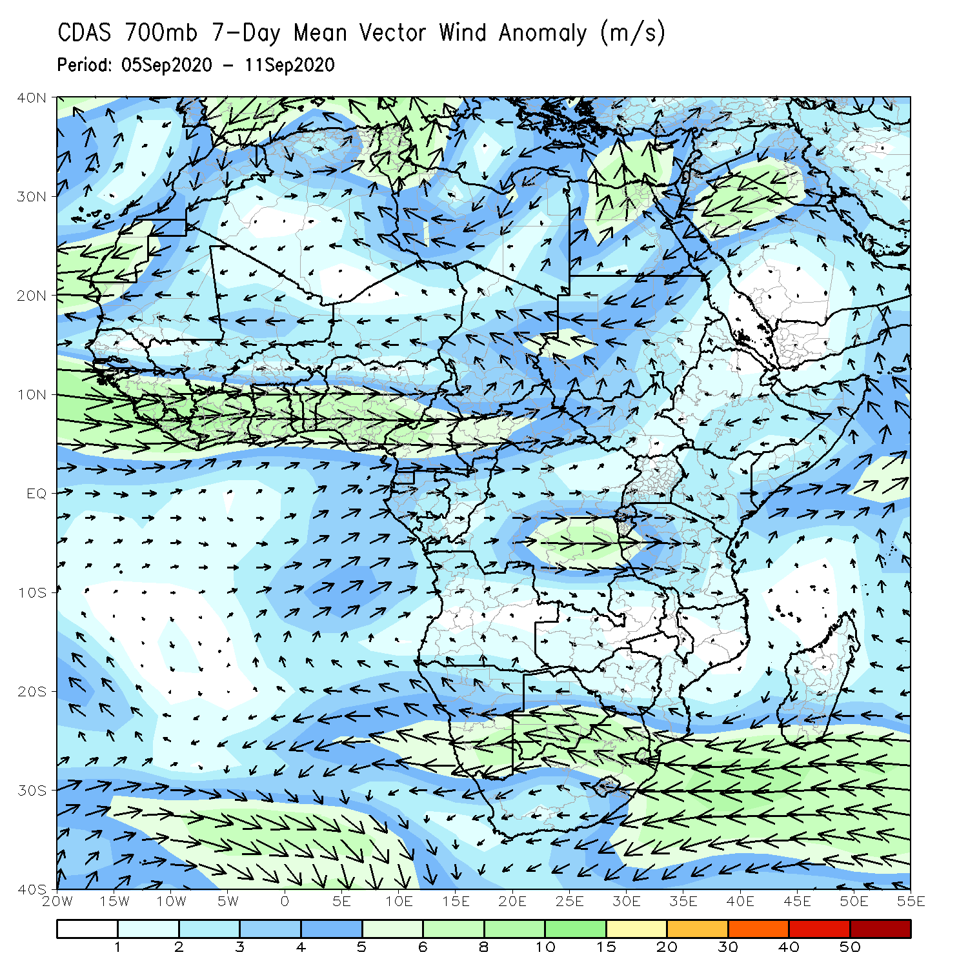
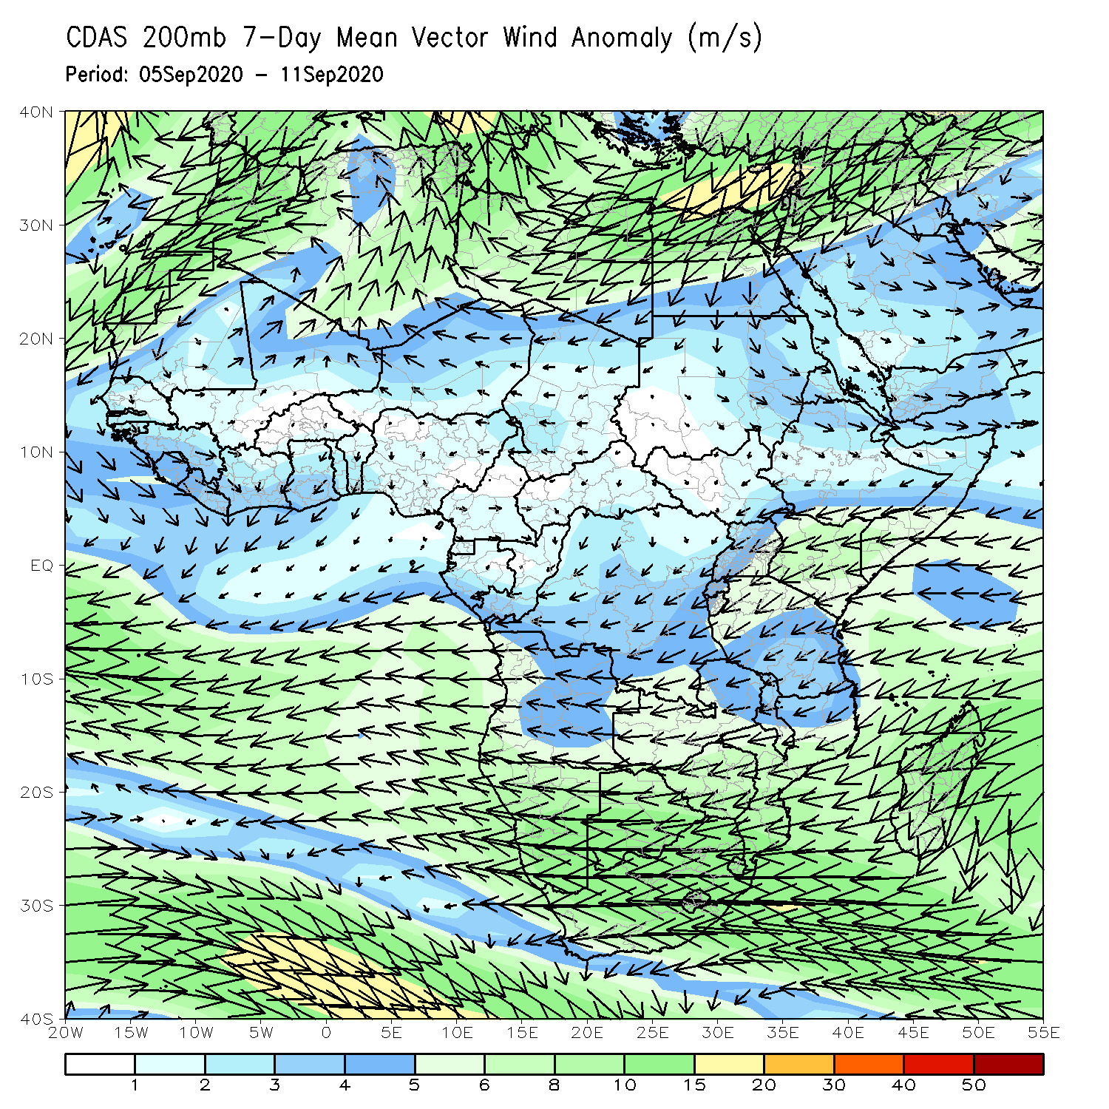
Atmospheric Circulation: Last 7 Days
The circulation anomaly over the past 7 days revealed a prominent mid-level anomalous westerly jet associated with upper level divergence and the observed rainfall surpluses.

Slide 8
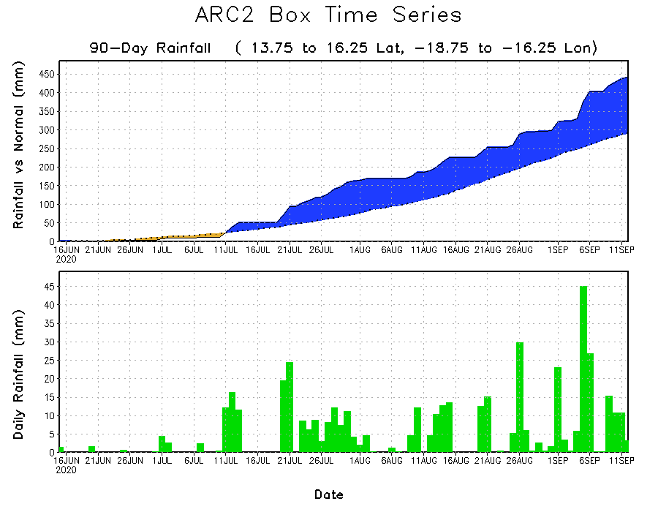
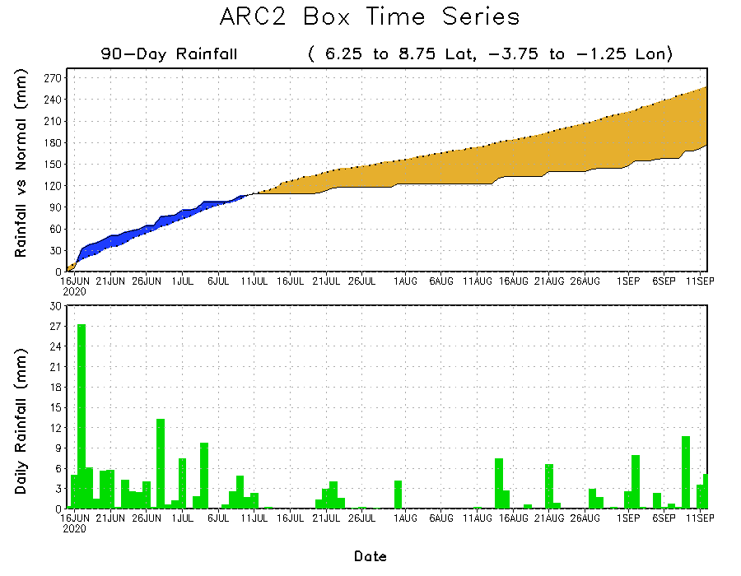
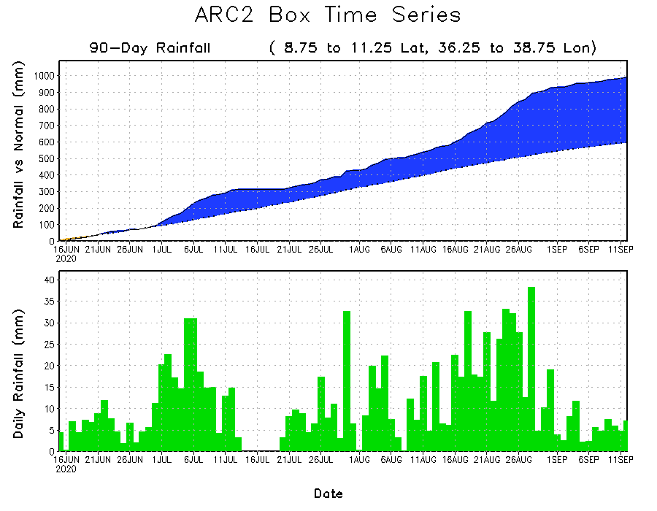
Rainfall Evolution over 5x5 lat-lon boxes
The rainfall time series revealed the frequent rains that fell over West Africa and the Ethiopian highlands over the past 90 days, while frequent dry spells occured in the Gulf of Guinea region.

Slide 9
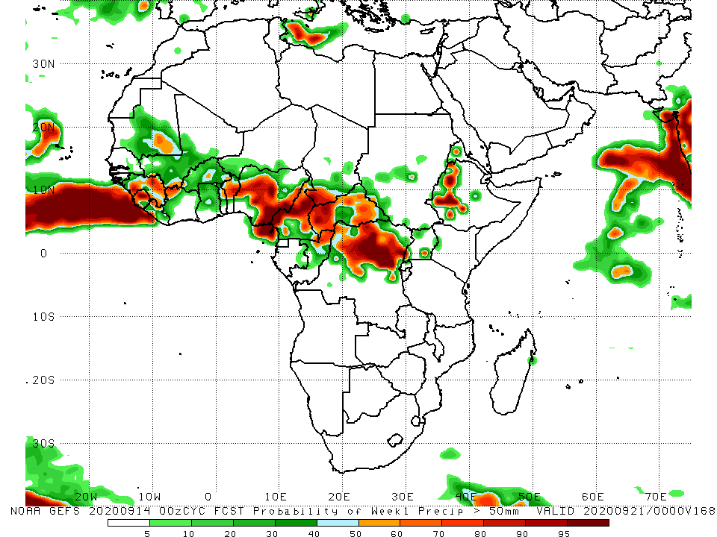
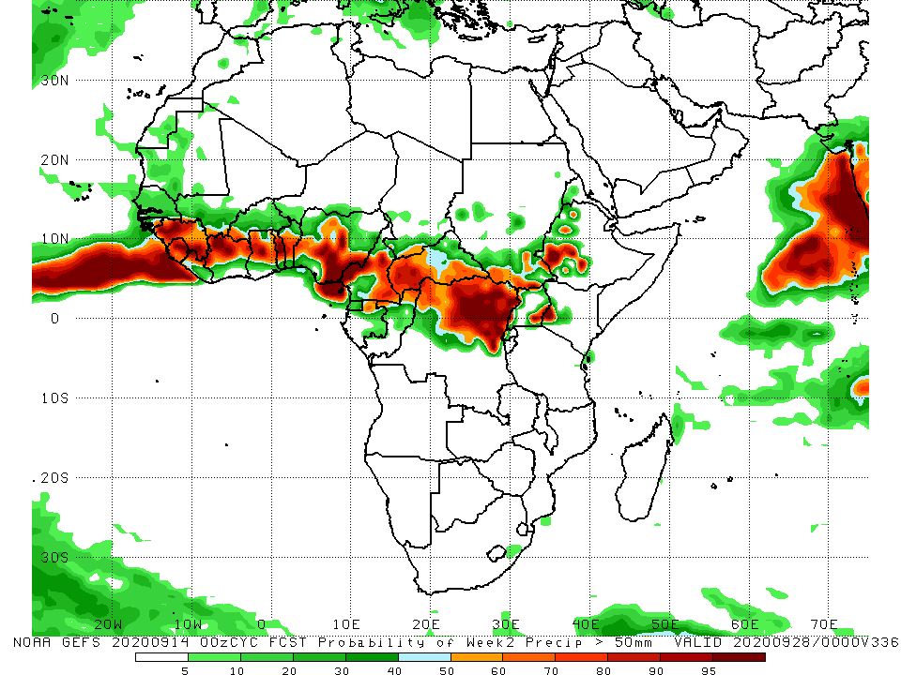
NCEP GEFS Model Forecasts Non-Bias Corrected Probability of precipitation exceedance
Week-1 Valid 15 – 21 September, 2020
Week-2: Valid 22 – 28 September, 2020
The NCEP GEFS indicates a high chance (> 70% probability) for above average-rainfall along the Guinean coast and over portions of Central Africa at week-1. At week-2, the Gulf of Guinea region and portions of central Africa are likely to receive above average rainfall.
Notes:
9

Slide 10
Summary
Over the past 90 days, rainfall was above-average along the Sahel band from Senegal to Ethiopia. However, moisture deficits prevailed over the southern Gulf of Guinea region in the areas from Cote d’Ivoire eastward to western Nigeria. The same rainfall pattern continued over the past 30 days.
During the past 7 days, the heavy rains persisted over in the Sahel resulting in widespread flooding, while portions of the Gulf of Guinea region continued to register moisture deficits. High amounts of rains fell over Central Africa Republic and over the Democratic Republic of Congo.
Forecasts suggest a high chance for above-average rainfall over parts of the Gulf of Guinea region and DRC at week-1 and week-2.

