Slide 1
The African Monsoon Recent Evolution and Current Status Include Week-1 and Week-2 Outlooks
Update prepared by
Climate Prediction Center / NCEP
26 October 2020
For more information, visit:
http://www.cpc.ncep.noaa.gov/products/Global_Monsoons/African_Monsoons/precip_monitoring.shtml

Slide 2
Outline
Highlights
Recent Evolution and Current Conditions
NCEP GEFS Forecasts
Summary

Slide 3
Highlights: Last 7 Days
Heavy downpours sustained moisture surpluses and flooding in Western Ethiopian Highlands. The Short Rains (October – December rainfall season) in Equatorial East Africa are off to a slow start as dry conditions over southern Somalia and northeastern Kenya.
The week-1 outlooks indicate a moderate to high chance for rainfall to exceed 50 mm over Central Africa and pockets in equatorial East Africa. For week-2, the chance for rainfall to exceed 50 mm is limited to Gabon, Congo, and eastern DRC.

Slide 4
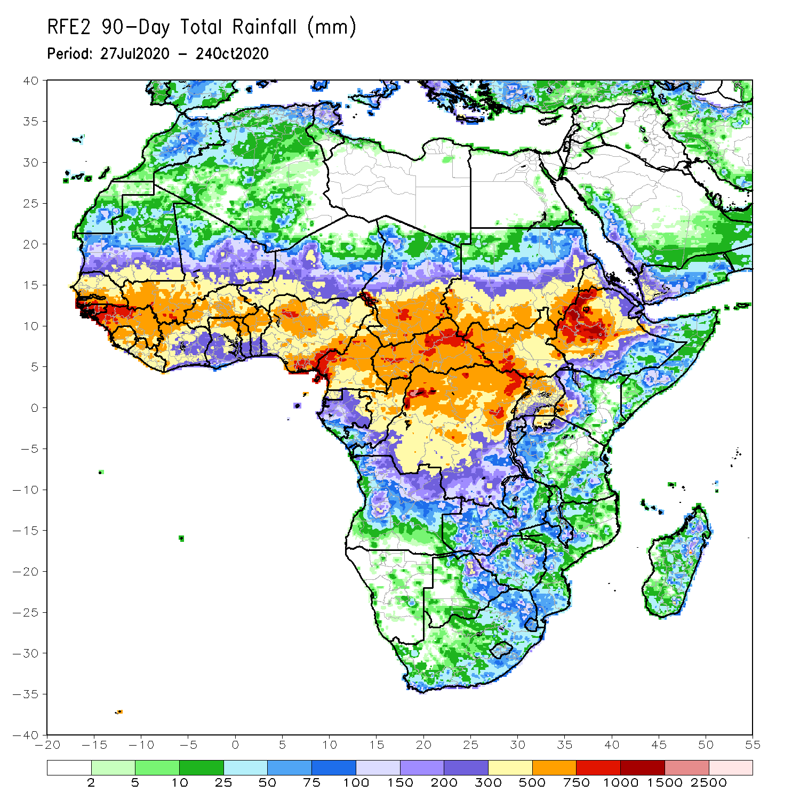
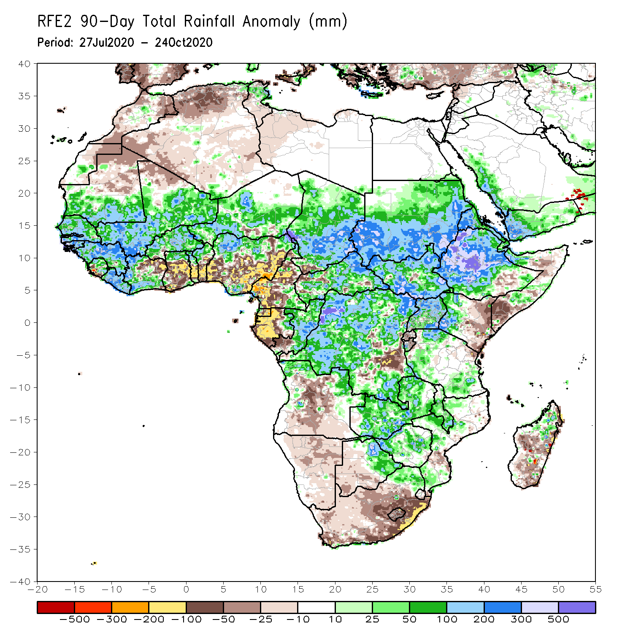
Rainfall Patterns: Last 90 Days
Over the past 90 days, in West Africa, above-average rainfall was observed across much of the Sahel from Senegal eastward to Chad. In contrast, rainfall was below-average over the southern areas of the Gulf of Guinea region with totals ranging between 100 and 300 mm (50 to 200 mm below the mean). The moisture deficits extended to western Central Africa in the area encompassing Cameroon, Gabon and southeastern Congo. Rainfall was much above-average in the remainder of Central Africa from southern Chad to the northern two third of DRC. Rainfall was locally below average in southeastern DRC. In East Africa, the heaviest amounts 500 to 1500 mm (200 – 500 mm above the mean) occurred over the Ethiopian Highlands and locally over southern Sudan. Well above-average rainfall (over 300 mm above the mean) was also observed over south Sudan and Uganda. Rainfall was below-average over eastern Kenya and southern Somalia. In southern Africa, moisture surpluses prevailed over Zambia, Zimbabwe, and the northern tip of Madagascar. Rainfall was below-average in eastern South Africa.
Notes:
4

Slide 5
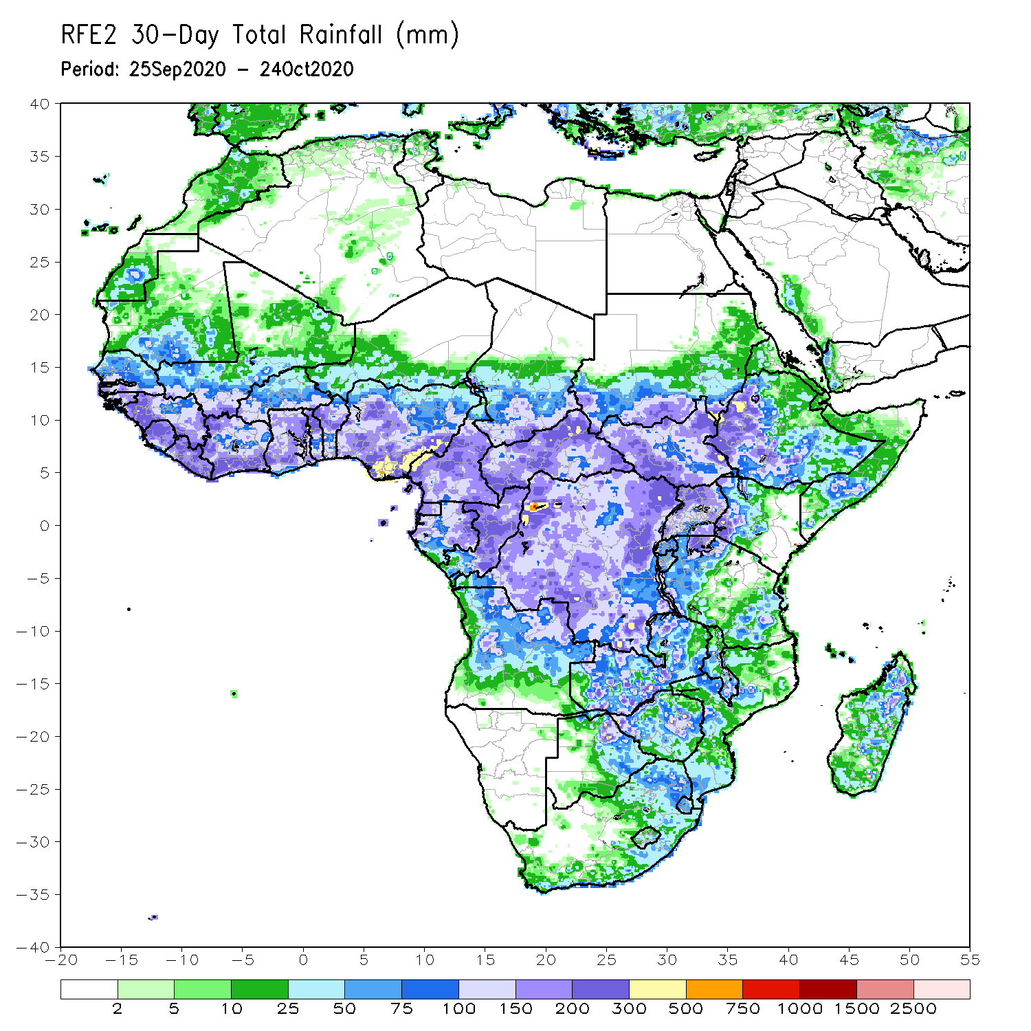
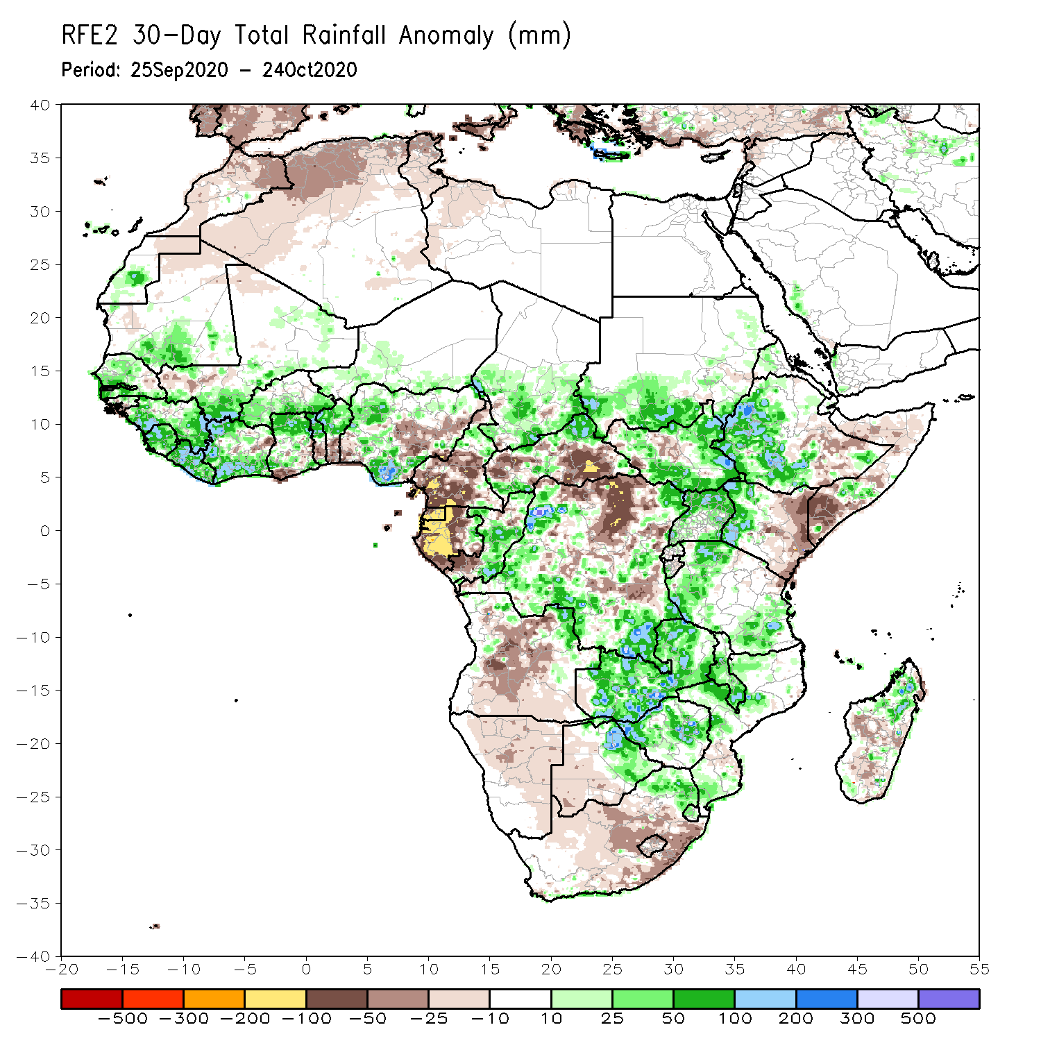
Rainfall Patterns: Last 30 Days
During the past 30 days, rainfall totals diminished over West Africa as the West African Monsoon has been retreating over the past several weeks. However, rainfall was above-average over portions of the Sahel and across much of the Gulf of Guinea region. The exceptions were pockets along coastal Benin and eastern Nigeria. In Central Africa, rainfall was below average along the coastal areas and along the border between DRC and CAR. Rainfall was above average over much of Congo and western DRC, and southern Chad. In East Africa, moisture surpluses prevailed over the Ethiopian Highlands and southern Sudan. Above average rainfall was also observed over much of South Sudan, Uganda, and western Kenya. In contrast, rainfall was below average over eastern Kenya and southern Somalia. In Southern Africa, rainfall was above average over Zambia, Zimbabwe, and Malawi. Rainfall was below average over eastern South Africa.
Notes:
5

Slide 6
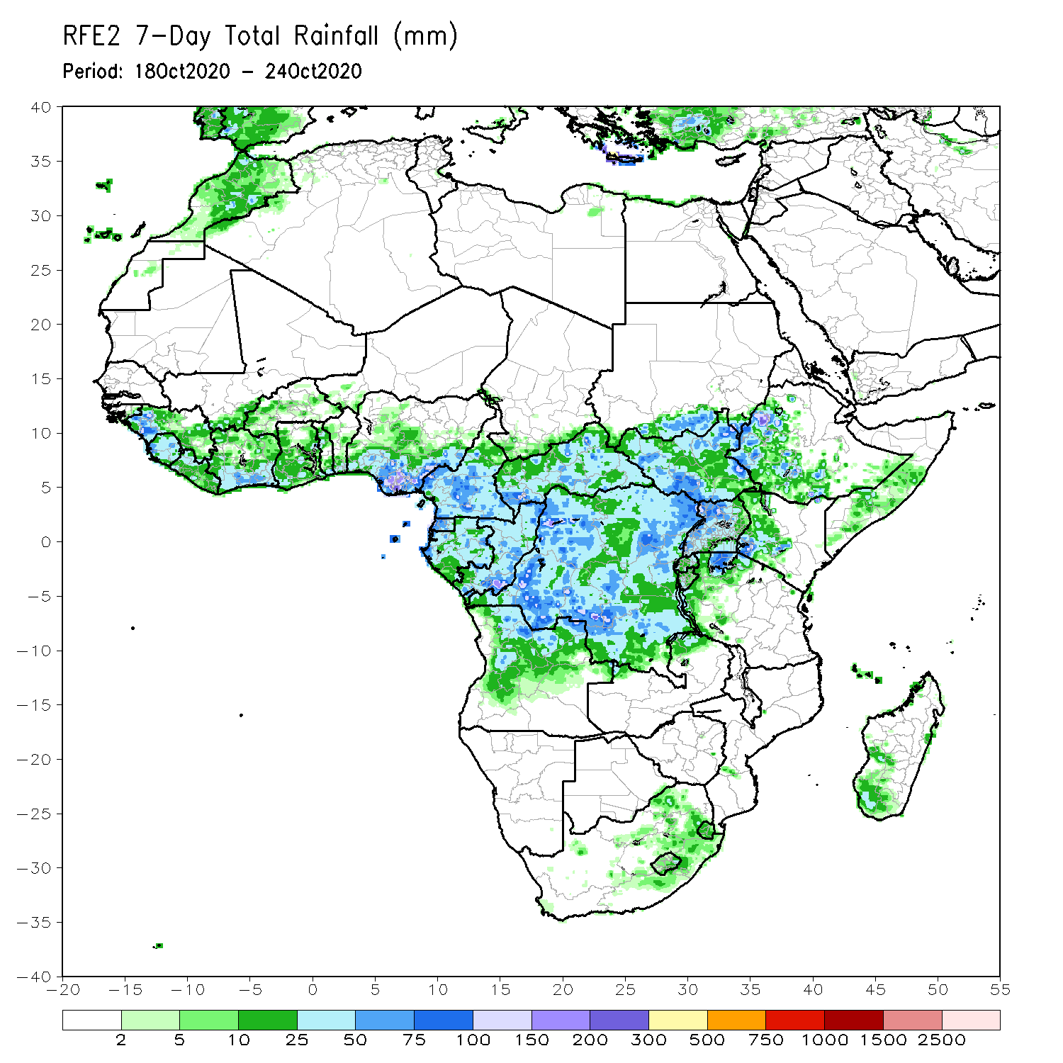
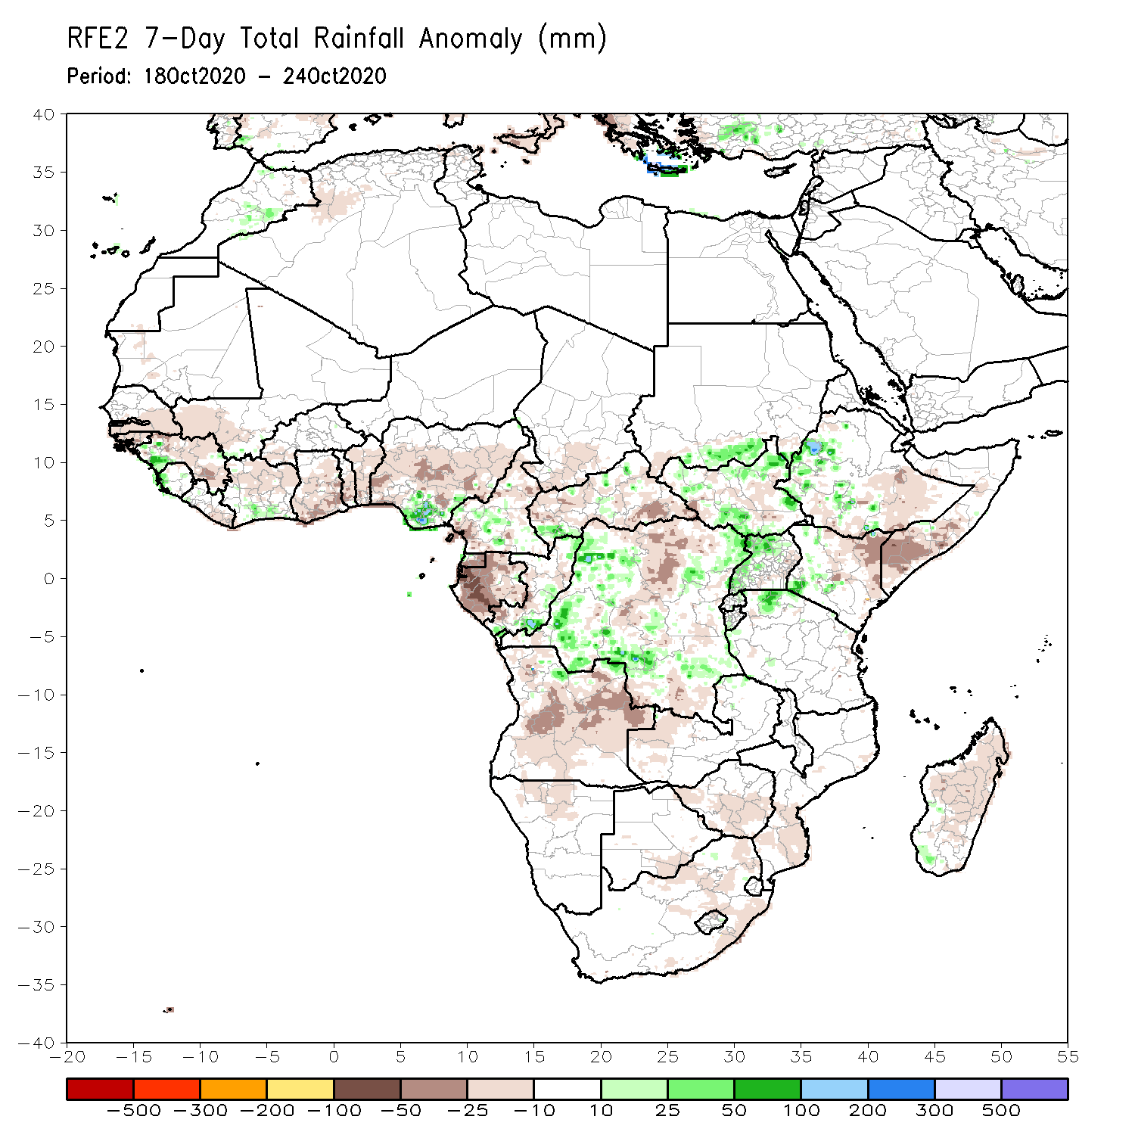
Rainfall Patterns: Last 7 Days
During the past 7 days, in West Africa, the West African monsoon continued its southward retreat as dry conditions prevailed across much of the Sahel. Rainfall was also below average across much of the Gulf of Guinea Region, except for pockets along the coastal areas of Guinea, Cote d’Ivoire, and Nigeria, where totals ranged between 50 and 100 mm (10-50 mm above the mean). In Central Africa, excessive rainfall locally approaching 300 mm prevailed over western DRC with moisture surpluses exceeding 100 mm. In contrast, rainfall was much below average along the coast of Gabon, where totals were in the amounts between 25 and 50 mm (25-50 mm below the mean). In the Greater Horn of Africa, heavy downpours exceeding 100 mm (25 – 50 mm) above the mean) sustained moisture surpluses in Western Ethiopia. Rainfall was also above average in portions of South Sudan, western Uganda. In contrast southern Somalia and northeastern Kenya registered significant moisture deficits as dry conditions prevailed. In Southern Africa, dry conditions prevailed across the region, except for eastern South Africa, where rainfall was in the near average range about 10 – 50 mm.

Slide 7
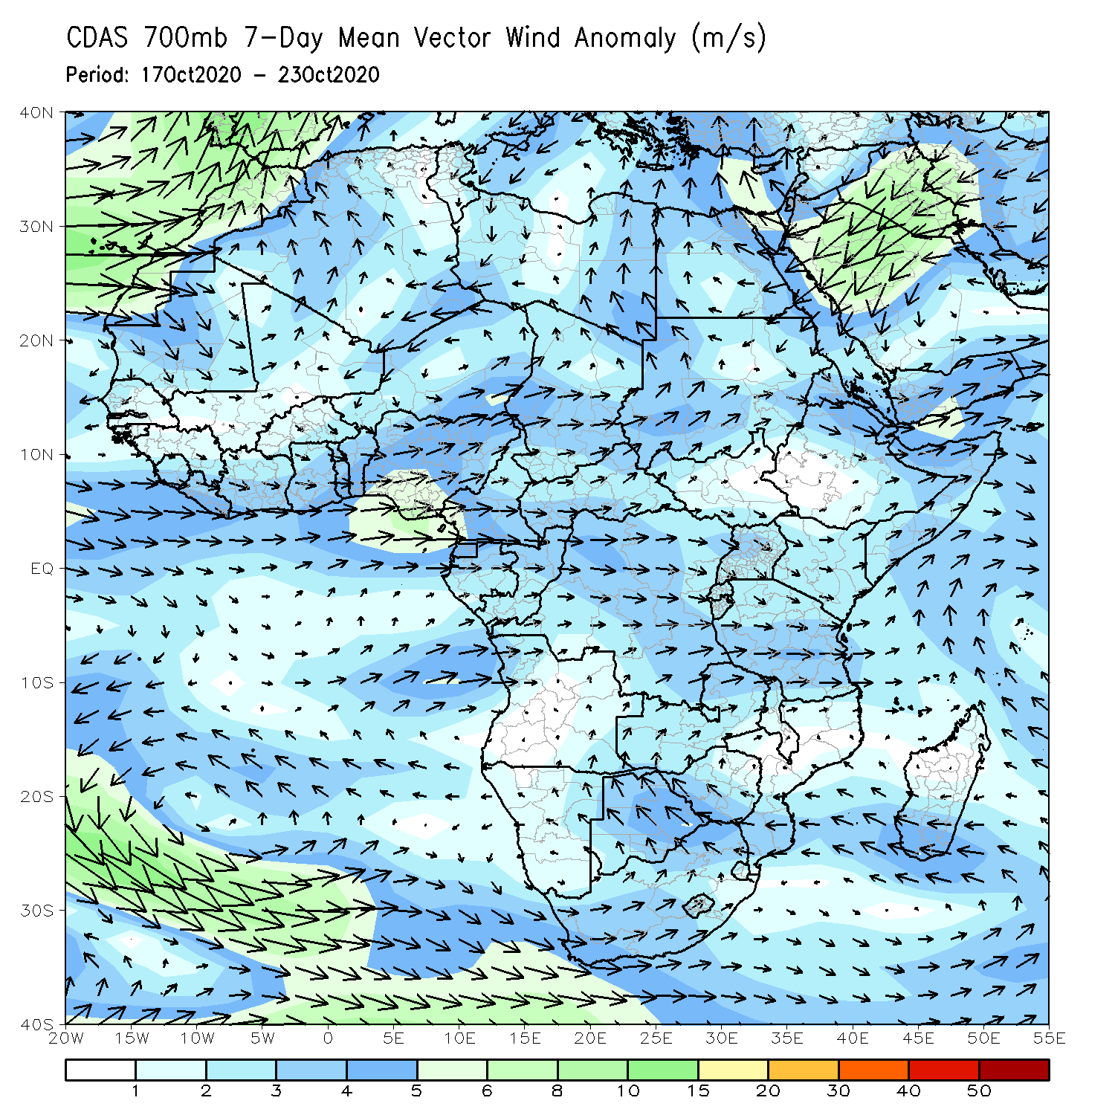
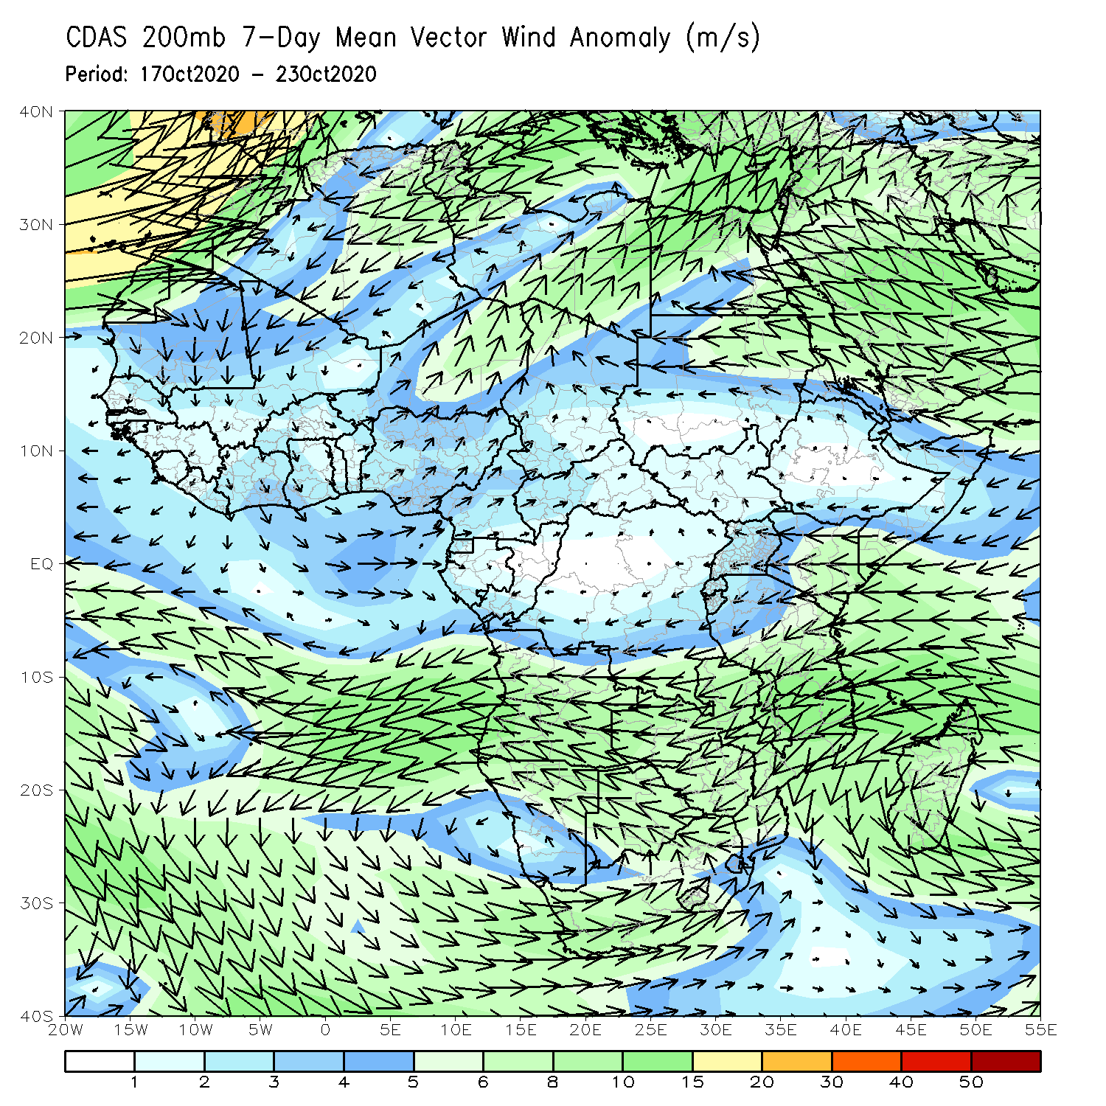
Atmospheric Circulation: Last 7 Days
An anomalous lower-level westerly flow (left panel) was observed along the Gulf of Guinea coast into Central Africa. At upper level (right panel), an anomalous anticyclonic flow prevailed across southern Africa, while an anomalous southeasterly flow dominated north of the Greater Horn of Africa in the Arabian Peninsula.

Slide 8
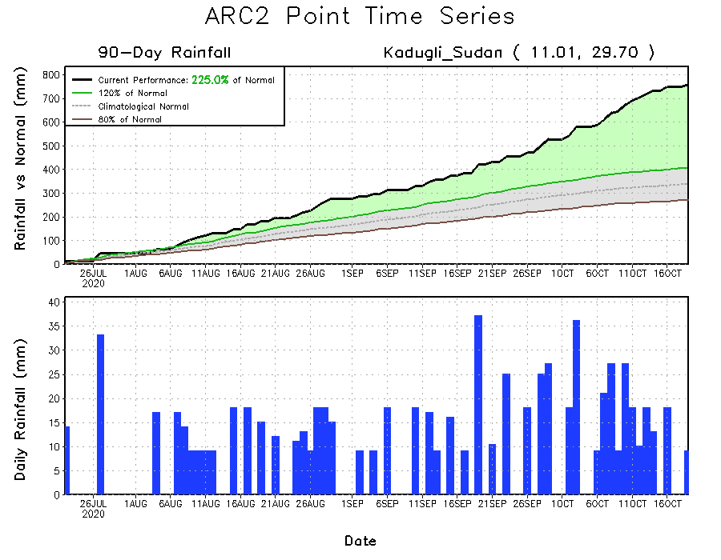
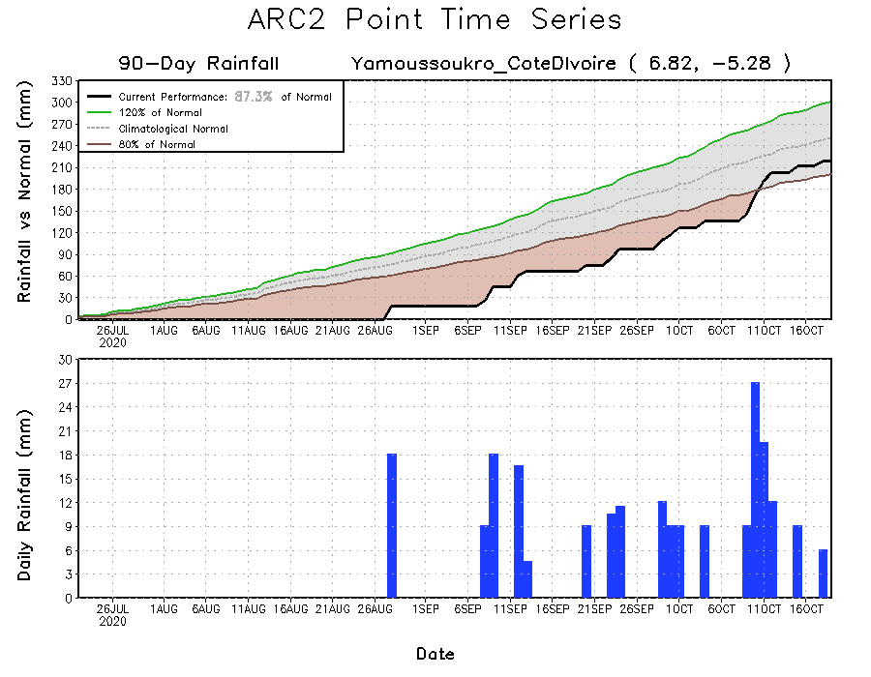
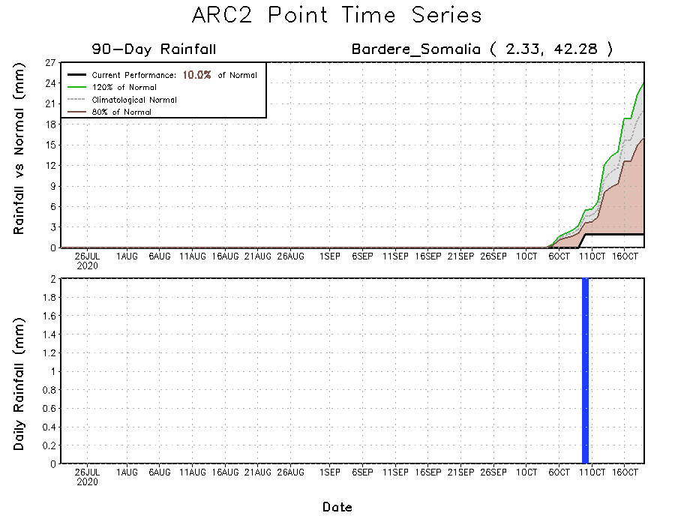
Rainfall Evolution
Daily evolution of rainfall over the last 90 days at selected locations shows that moderate to locally heavy rainfall helped to reduce accumulated rainfall deficits over southern Cote d’Ivoire (bottom left). Moisture surpluses continued over southern Sudan (top right), while southern Somalia is off to a slow start to the short rainfall season (bottom right).

Slide 9
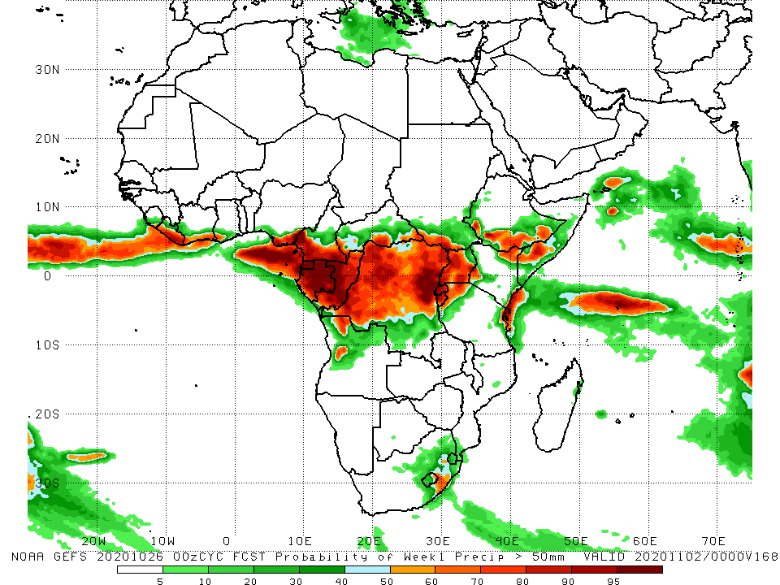
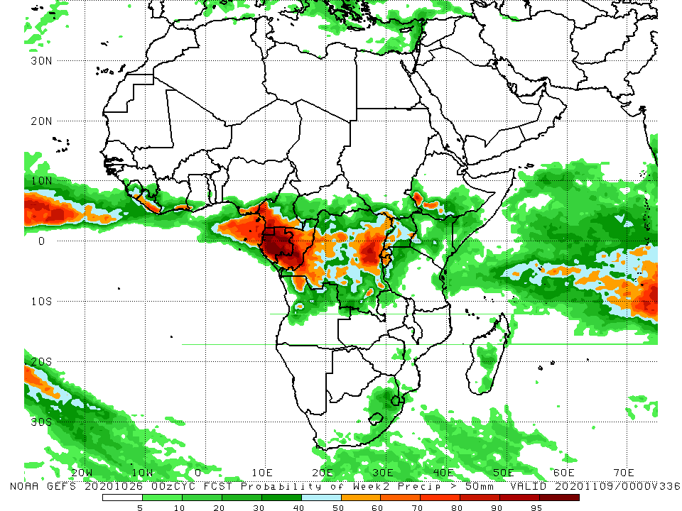
NCEP GEFS Model Forecasts Non-Bias Corrected Probability of precipitation exceedance
Week-1 Valid 27 October–02 November, 2020
Week-2: Valid 03 – 09 October, 2020
For week-1 (left panel), the NCEP GEFS indicates a moderate to high chance (over 70%) for rainfall to exceed 50 mm over Central Africa and pockets in equatorial East Africa. For week-2 (right panel), the chance for rainfall to exceed 50 mm is confined to Gabon, Congo, and eastern DRC.
Notes:
9

Slide 10
Summary
During the past 30 to 90 days, in West Africa, above-average rainfall was observed across much of the Sahel. In contrast, rainfall was below-average over the southern areas of the Gulf of Guinea region. In Central Africa, rainfall was below average along the coast and above average in interior Central Africa. In East Africa, rainfall was above average in much of the Greater Horn of Africa, except for eastern Kenya and southern Somalia. Rainfall was above average in parts of southern Africa.
Over the past 7 days the West African monsoon continued its southward retreat as dry conditions prevailed across much of the Sahel. Rainfall was also below average across much of the Gulf of Guinea Region. In Central Africa, above average rainfall was observed over western DRC. Rainfall was much below average along the coast of Gabon. In the Greater Horn of Africa, heavy downpours sustained moisture surpluses in Western Ethiopia. Southern Somalia and northeastern Kenya registered significant moisture deficits. In Southern Africa, dry conditions prevailed across the region.
The GEFS indicates a moderate to high chance for rainfall to exceed 50 mm over parts of Central Africa and pockets in equatorial East Africa.

