Slide 1
The African Monsoon Recent Evolution and Current Status Include Week-1 and Week-2 Outlooks
Update prepared by
Climate Prediction Center / NCEP
30 November 2020
For more information, visit:
http://www.cpc.ncep.noaa.gov/products/Global_Monsoons/African_Monsoons/precip_monitoring.shtml

Slide 2
Outline
Highlights
Recent Evolution and Current Conditions
NCEP GEFS Forecasts
Summary

Slide 3
Highlights: Last 7 Days
During the past 7 days, moderate to locally heavy rainfall was observed over parts of northern Somalia and eastern Ethiopia, following the landfall of Tropical Cyclone Gati. Above-average rainfall was also observed across Congo, southern DRC, much of Angola, western Zambia, eastern Botswana and southern Zimbabwe.
The week-1 and week-2 outlooks indicate a moderate to high chance for rainfall to exceed 50 mm across portions of Gabon, southern Congo, southern and eastern DRC, Rwanda, Burundi, western Kenya, portions of Angola, much of Zambia, Zimbabwe, central Mozambique, pocket areas in South Africa, and many parts of Madagascar.

Slide 4
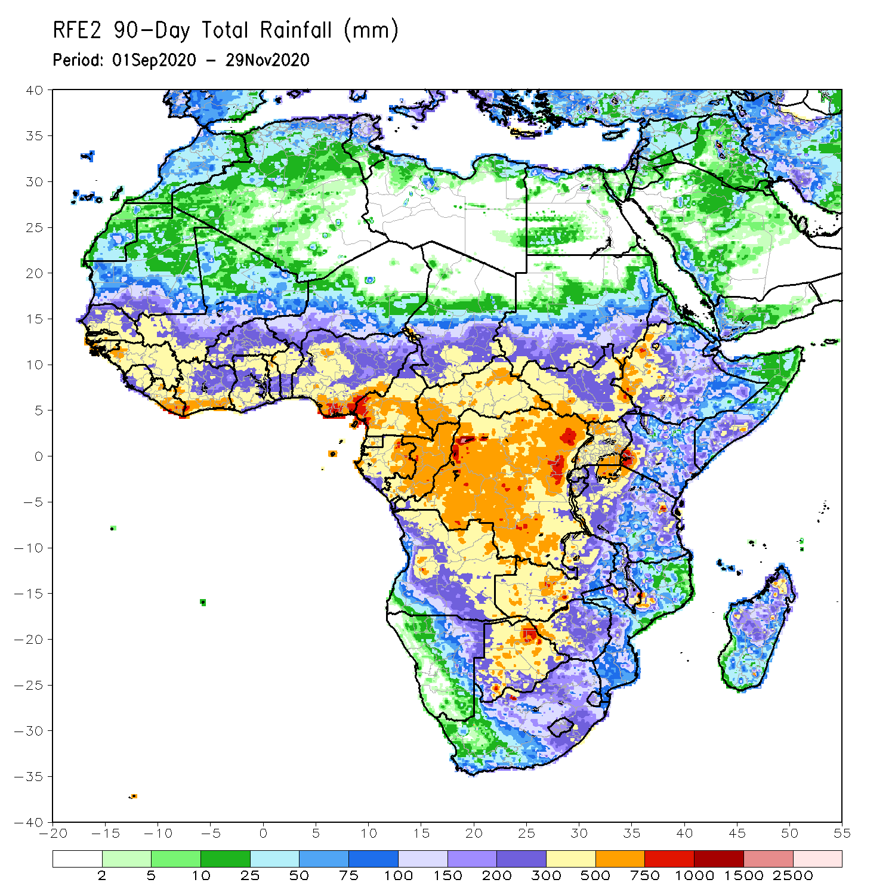
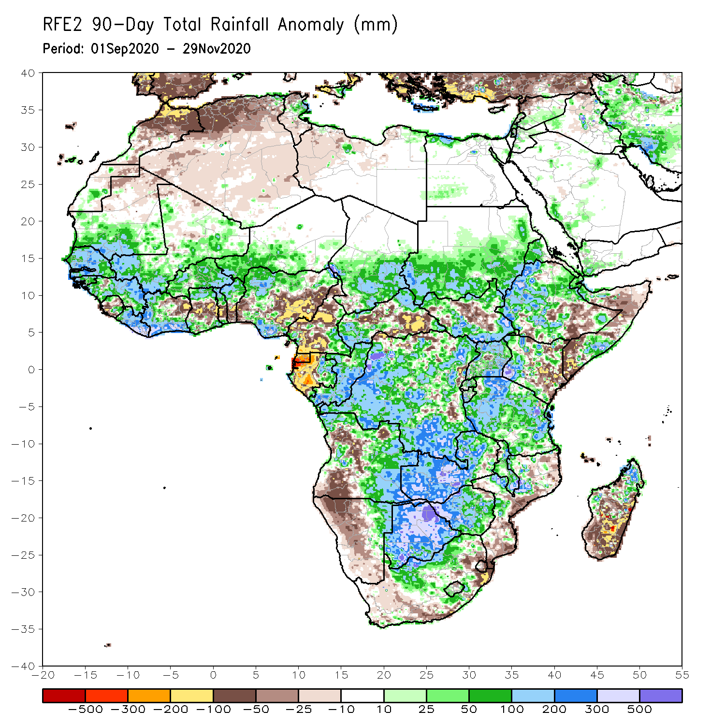
Rainfall Patterns: Last 90 Days
Over the past 90 days, in West Africa, above-average rainfall was observed across much of the Sahel from Senegal eastward to Chad. Rainfall was also above-average from Guinea to much of Cote D’Ivoire. In contrast, rainfall was below-average over the southern areas of the Gulf of Guinea region from northeastern Cote d’Ivoire eastward to Nigeria. The moisture deficits extended to eastern Nigeria, the western areas of Cameroon, Equatorial Guinea and Gabon. Rainfall was also below average over pockets in CAR and southeastern DRC. Rainfall was much above-average in the remainder of Central Africa from southern Chad to much of DRC. In East Africa, the heaviest amounts 500 to 1500 mm (200 – 500 mm above the mean) occurred over the Ethiopian Highlands. Well above-average rainfall (over 300 mm above the mean) was also observed over portions of South Sudan, southwestern Kenya, Tanzania and Uganda. Rainfall was below-average over southeastern Ethiopia, southeastern Kenya and southern Somalia. In southern Africa, moisture surpluses prevailed over Zambia, Zimbabwe, Botswana, and the northern areas of Madagascar. Rainfall was below-average over central and southern Angola into Namibia and South Africa. The southern areas of Mozambique and Madagascar also registered below average rainfall.
Notes:
4

Slide 5
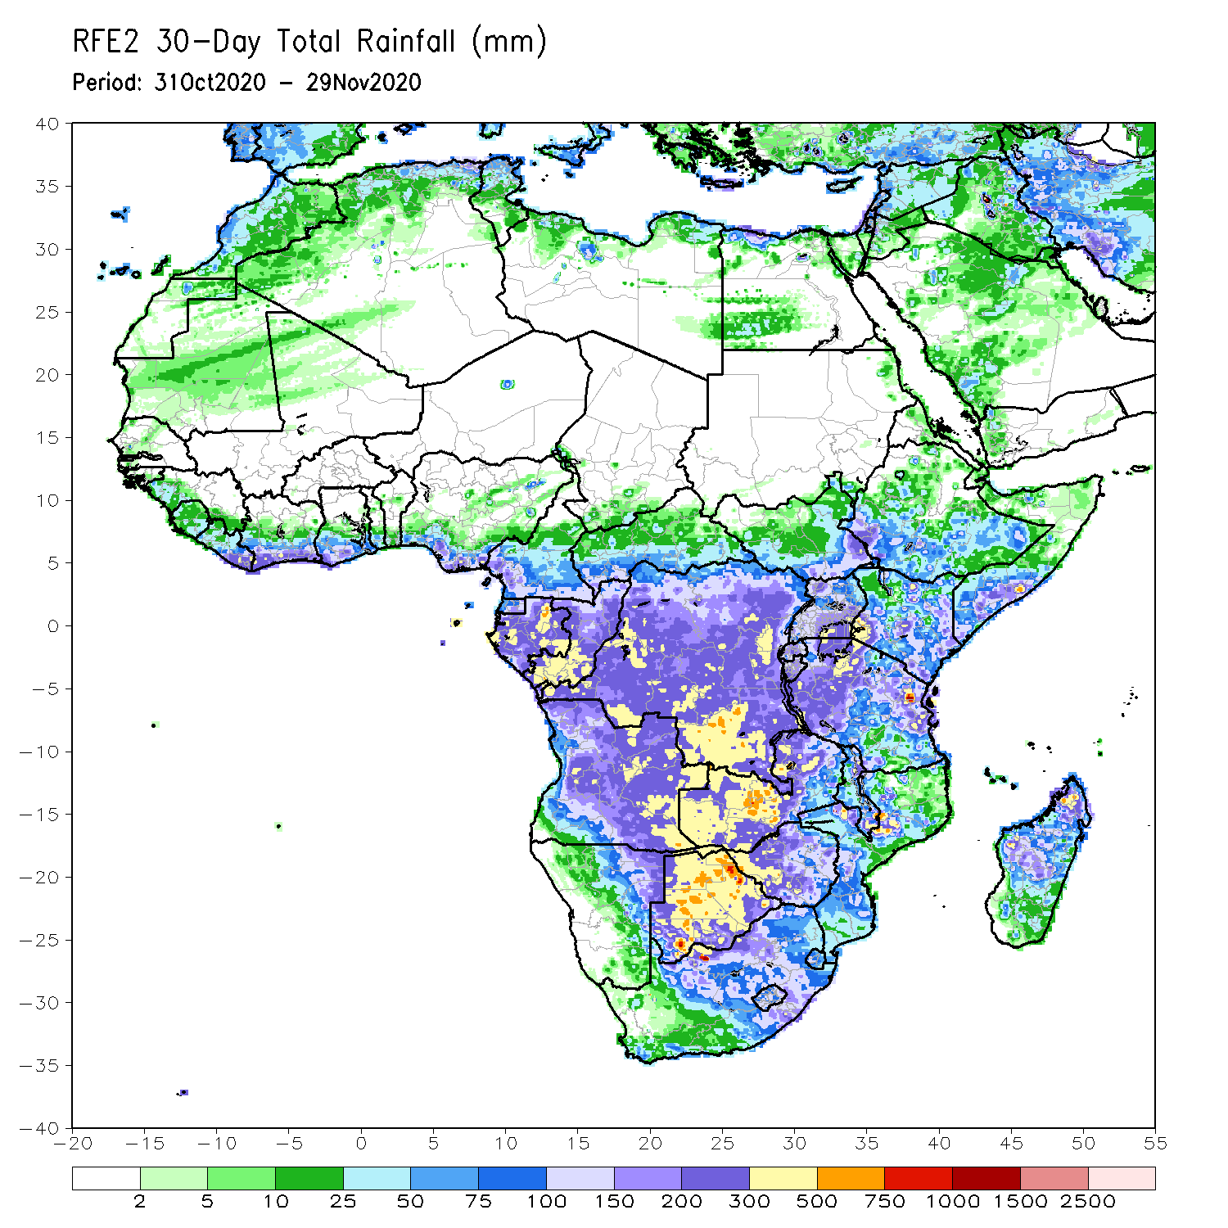
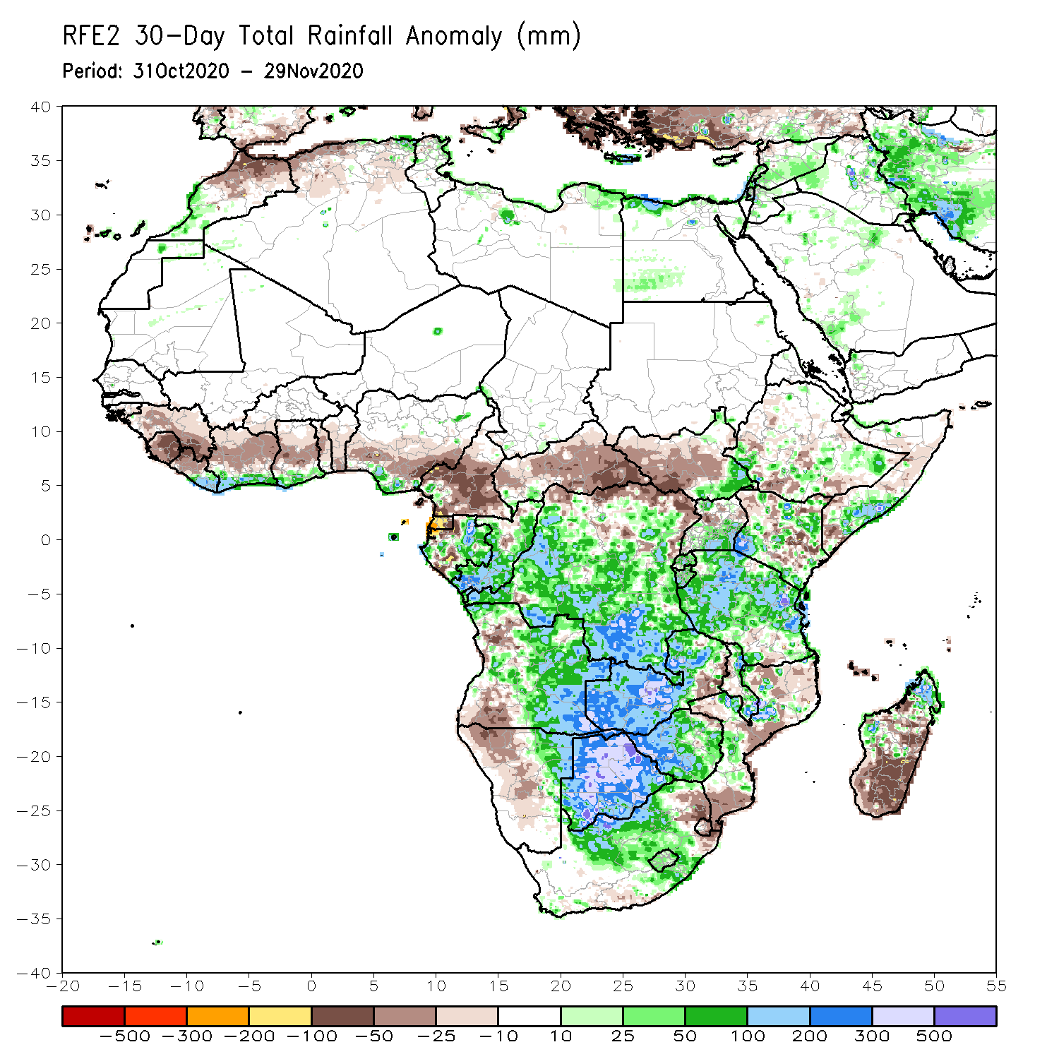
Rainfall Patterns: Last 30 Days
During the past 30 days, rainfall totals continued to diminish over West Africa as the West African Monsoon retreated over the past several weeks. Rainfall was below-average over much of the northern areas of the Gulf of Guinea region, while the coastal areas received above average rains. In Central Africa, rainfall was below average over much of Cameroon and Equatorial Guinea, and much of CAR. Rainfall was also below-average over pockets in DRC. Rainfall was above-average over much of Congo and DRC. In East Africa, moisture surpluses prevailed over local areas in Ethiopia, southern Uganda and Kenya. Rainfall was also above average over much of Tanzania. Below average rainfall was observed over parts of Ethiopia and Somalia. In Southern Africa, rainfall was much above average over Zambia, Botswana and Zimbabwe. Moisture surpluses were also registered over the central areas of South Africa, including portions of the Maize Triangle, and the northern areas of Madagascar. Rainfall was below average over the southern areas of Mozambique, northeastern South Africa and Madagascar.
Notes:
5

Slide 6
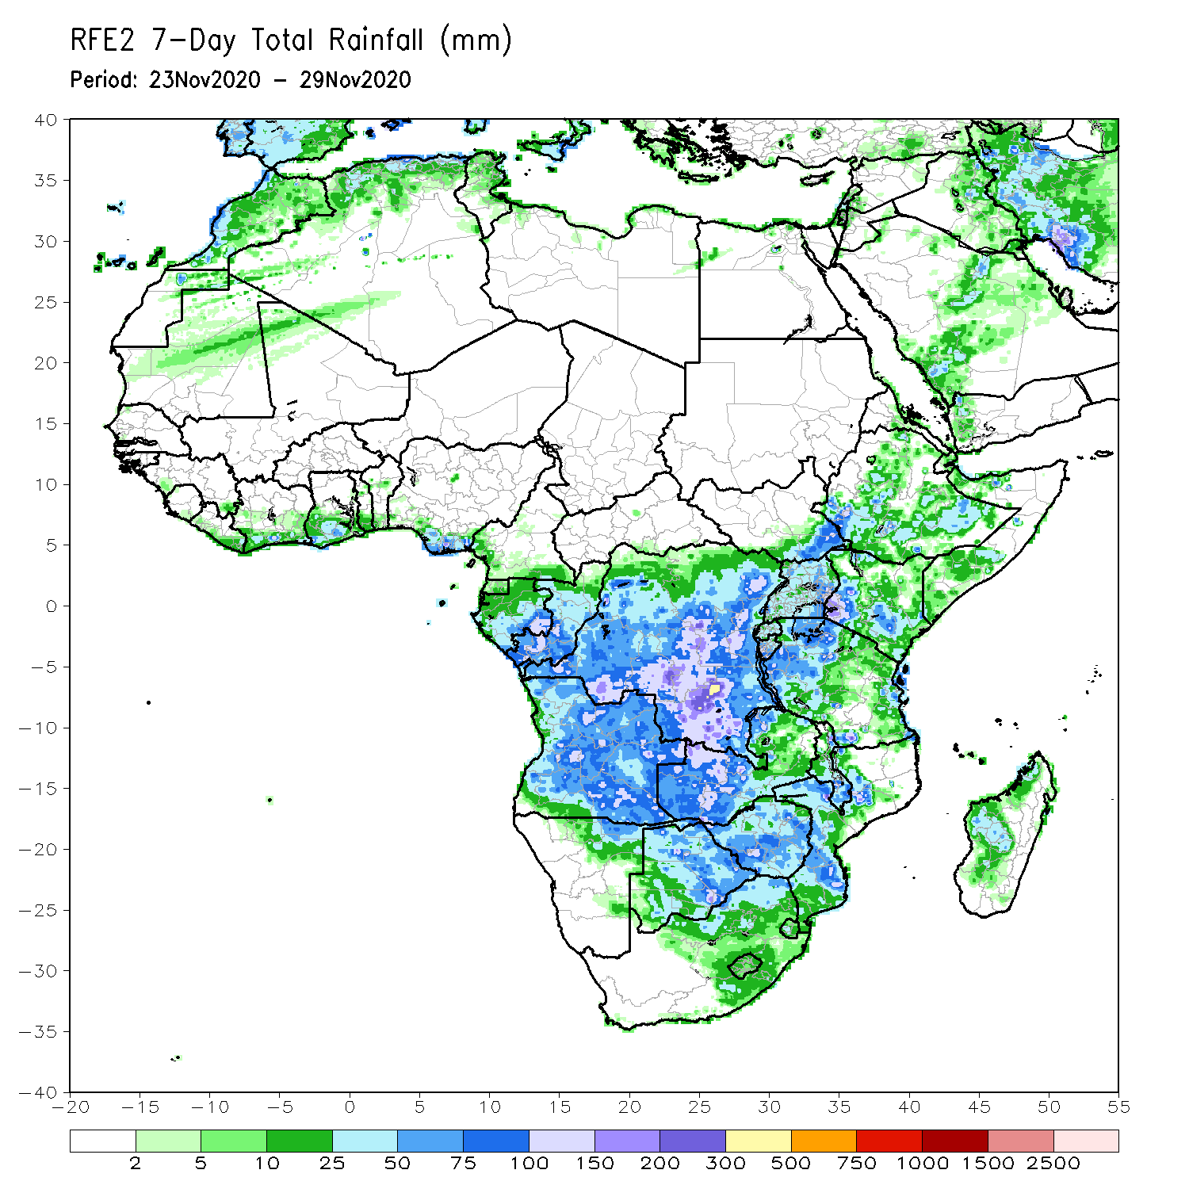
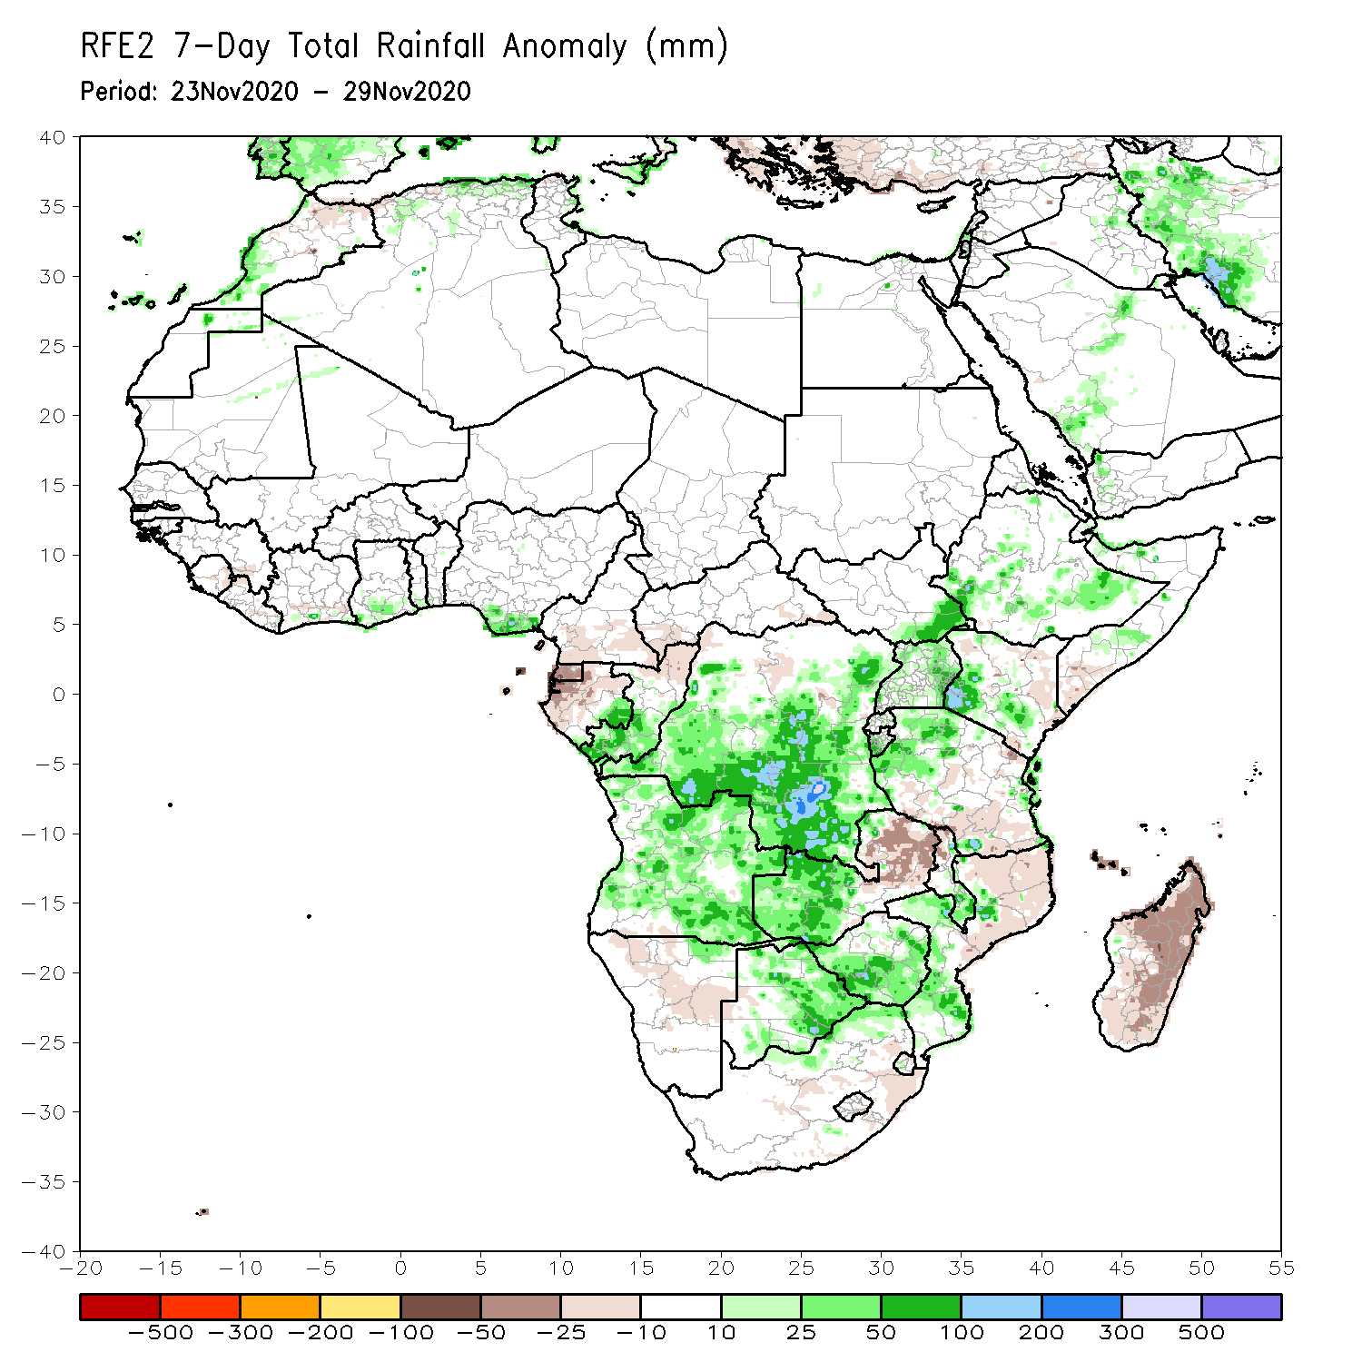
Rainfall Patterns: Last 7 Days
During the past 7 days, in East Africa, rainfall was above-average over pocket areas in southern Ethiopia, western and southern Kenya, Uganda and Tanzania, while rainfall totals remained below-average over parts of eastern Kenya and southern Somalia. Rainfall was below-average over central and southern Tanzania. In Southern Africa, another week of heavy rains (75-300 mm; 50-200 mm above the mean) sustained moisture surpluses in western Zambia and eastern Botswana. Above-average rainfall was observed over much of Angola, while below average rains (-10-25 mm) fell over much of Namibia, western Botswana, eastern South Africa, eastern Zambia and Mozambique. Rainfall was also below-average over much of Madagascar. In Central Africa, rainfall was above average over portions of northern and southern DRC, Congo, while below-average rainfall was registered over Equatorial Guinea. Weekly rainfall totals remained below-average over parts of Cameroon, CAR and the far northern DRC. Light to Moderate rains continued to fall along coastal Ghana and Nigeria, while seasonable dry weather prevailed across the Sahel.

Slide 7
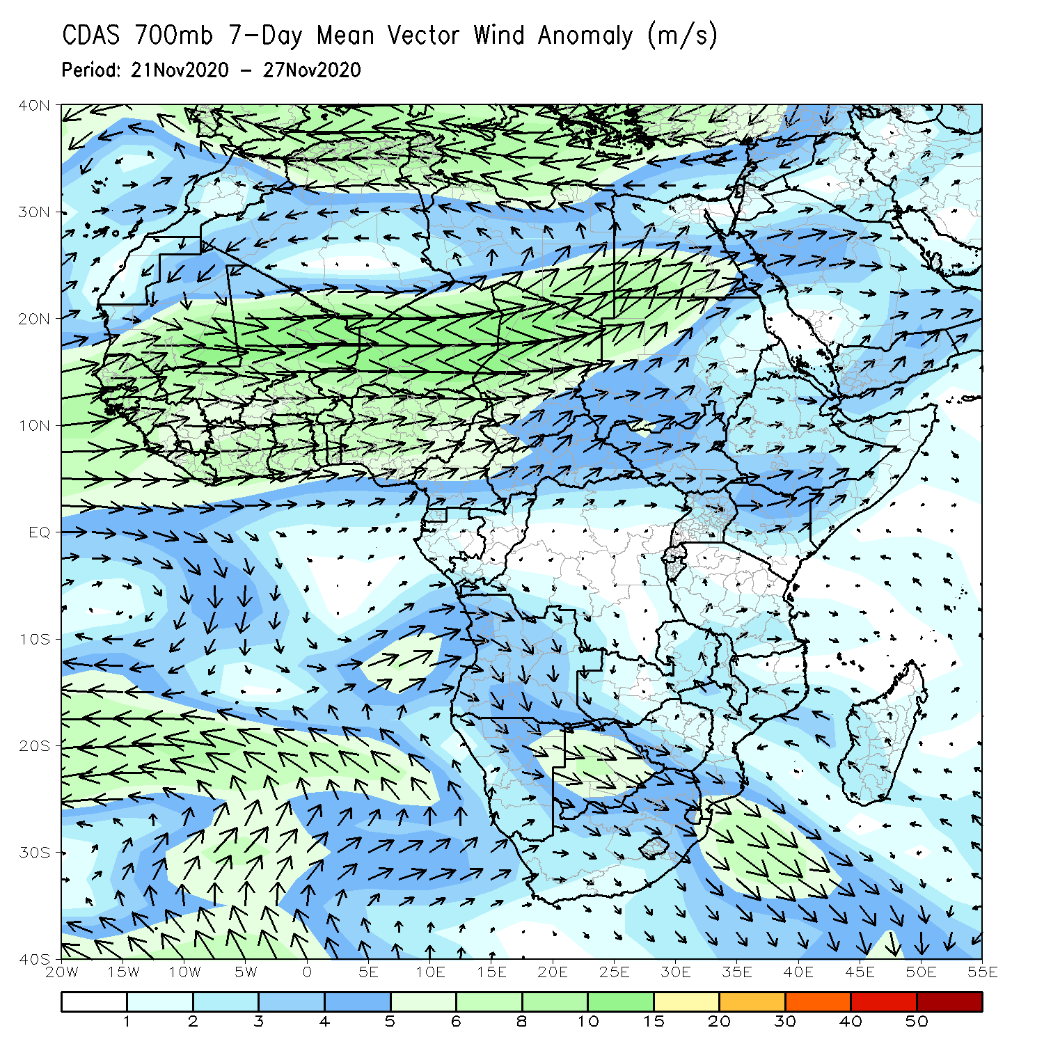
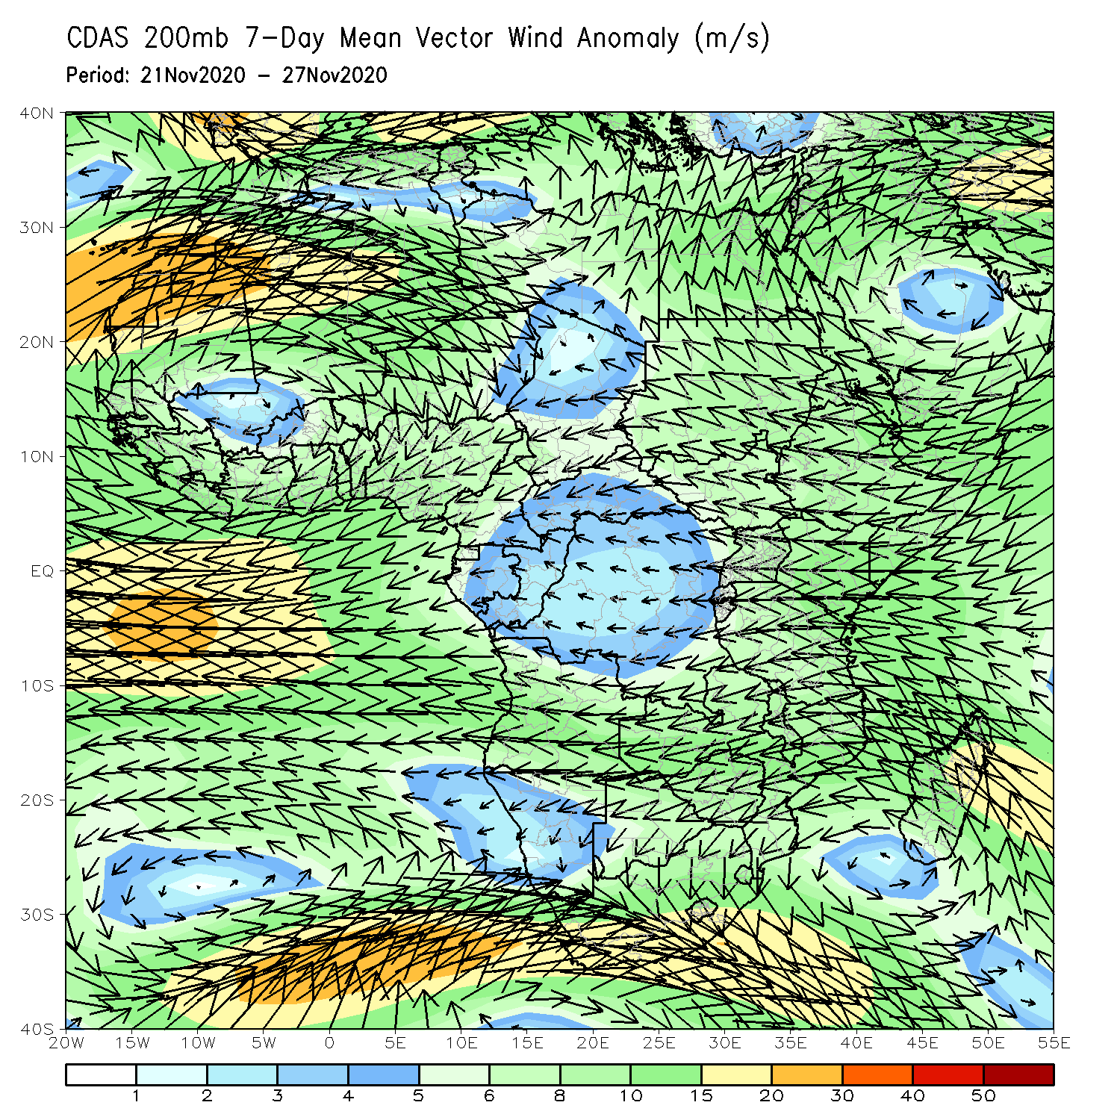
Atmospheric Circulation: Last 7 Days
An anomalous lower-level westerly flow from the Atlantic Ocean with its associated cyclonic turning across Angola and the neighboring areas may have contributed to the observed above-average rainfall in the region (left panel).

Slide 8
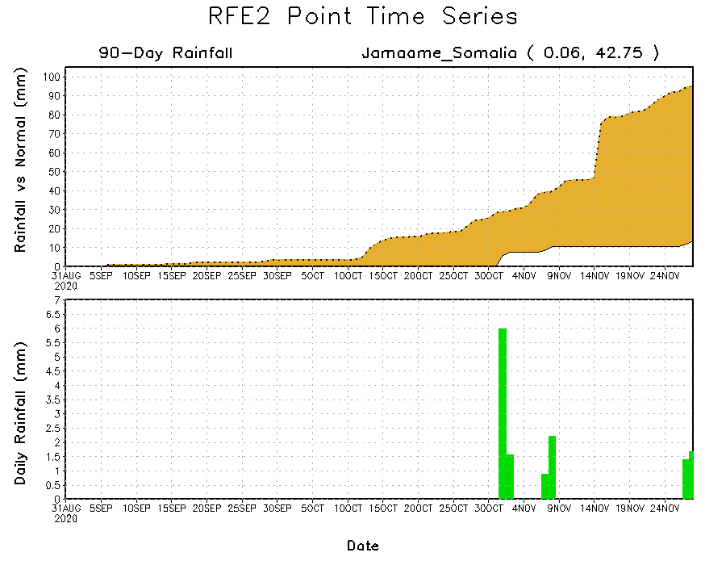
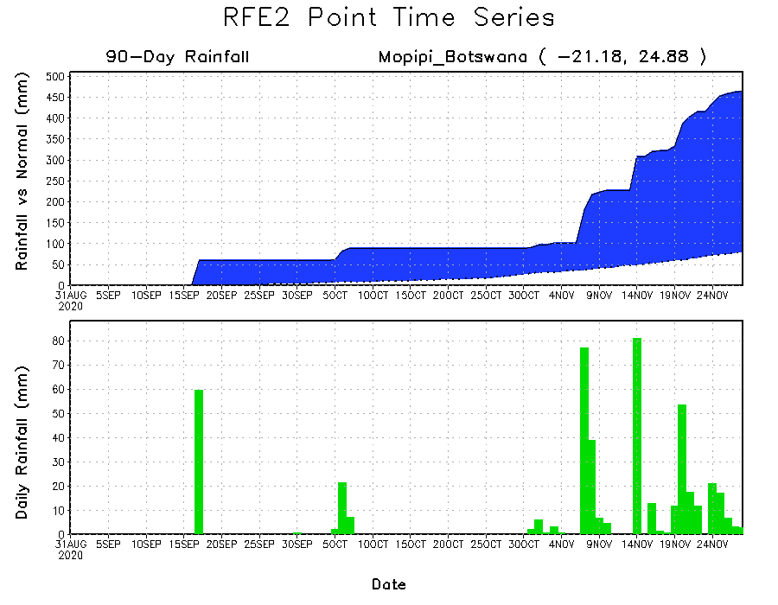
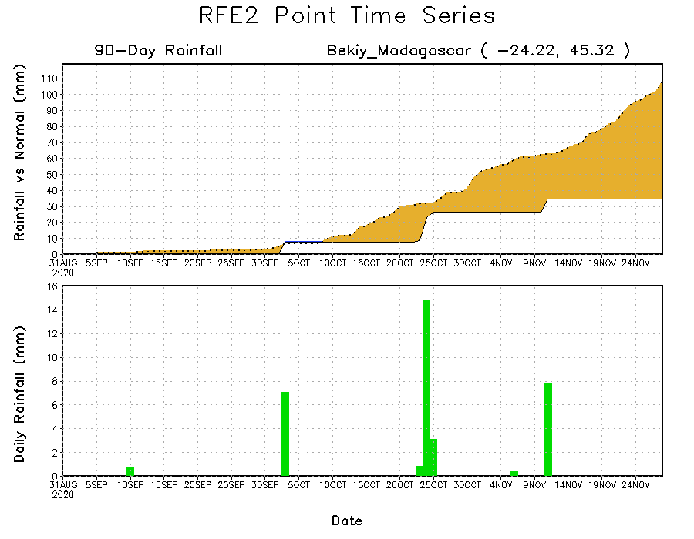
Rainfall Evolution
Daily evolution of rainfall over the last 90 days at selected locations shows that moderate to locally heavy rainfall sustained moisture surpluses over many parts of Botswana (bottom left). Moisture deficits continued to prevail over southern Somalia (top right) and southern Madagascar (bottom right).

Slide 9
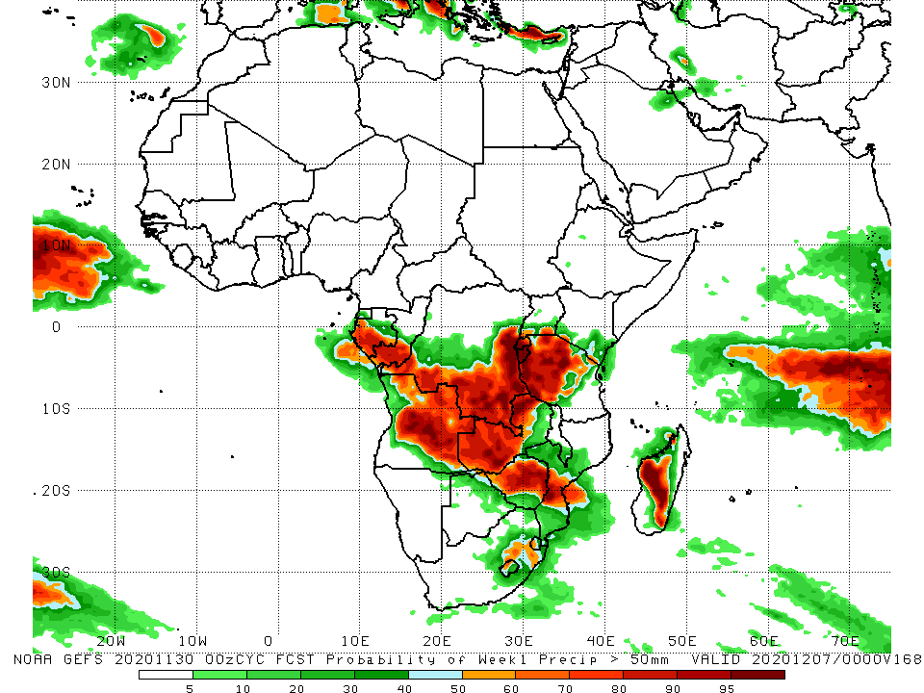
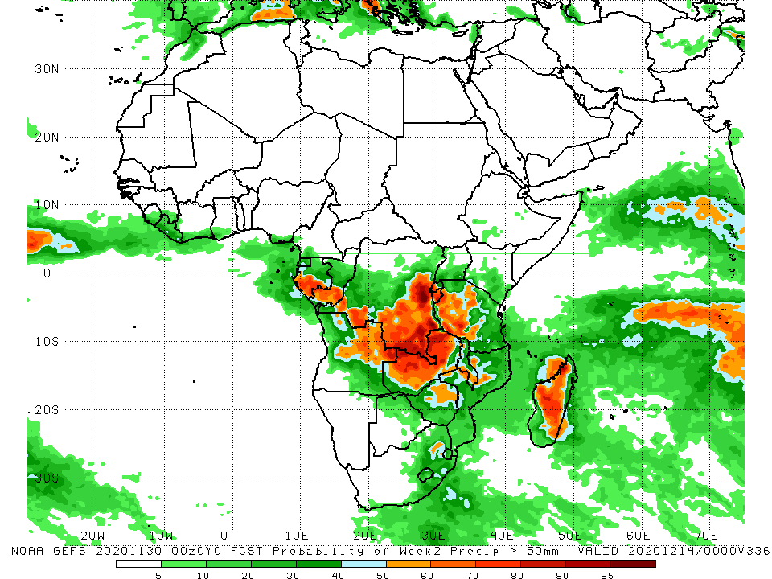
NCEP GEFS Model Forecasts Non-Bias Corrected Probability of precipitation exceedance
Week-1, Valid: 1 – 7 December, 2020
Week-2, Valid: 8 – 14 December, 2020
For week-1 (left panel and week-2 (right panel), the NCEP GEFS indicates a moderate to high chance (over 70%) for rainfall to exceed 50 mm across portions of Gabon, southern Congo, southern and eastern DRC, Rwanda, Burundi, western Kenya, portions of Angola, much of Zambia, Zimbabwe, central Mozambique, pocket areas in South Africa, and many parts of Madagascar.
Notes:
9

Slide 10
Summary
During the past 30 to 90 days, in West Africa, rainfall was above average over much of the Sahel, but as the West African monsoon retreated, seasonable dry weather prevailed over the Sahel during the past several weeks, while rainfall was below average over the northern areas of the Gulf of Guinea region. However, rainfall was above average over pocket areas along the coast. In Central Africa, rainfall was above average across much of the region, except for the western areas, which continued to register below average rainfall over the past several weeks. In East Africa, rainfall was above average over portions of equatorial East Africa, including Tanzania, while suppressed rainfall continued to prevail over southern Somalia and eastern Kenya. Rainfall was much above average over the northern areas of southern Africa, but below average over the southern areas of Mozambique and Madagascar.
During the past 7 days, moderate to locally heavy rainfall was observed over parts of northern Somalia and southeastern Ethiopia, following the landfall of Tropical Cyclone Gati. Above-average rainfall was also observed across Congo, southern DRC, much of Angola, western Zambia, eastern Botswana and southern Zimbabwe.
The week-1 and week-2 outlooks indicate a moderate to high chance for rainfall to exceed 50 mm across portions of Gabon, southern Congo, southern and eastern DRC, Rwanda, Burundi, western Kenya, portions of Angola, much of Zambia, Zimbabwe, central Mozambique, pocket areas in South Africa, and many parts of Madagascar.

