Slide 1
The African Monsoon Recent Evolution and Current Status Include Week-1 and Week-2 Outlooks
Update prepared by
09 August 2021
For more information, visit:
http://www.cpc.ncep.noaa.gov/products/Global_Monsoons/African_Monsoons/precip_monitoring.shtml

Slide 2
Outline
Highlights
Recent Evolution and Current Conditions
NCEP GEFS Forecasts
Summary

Slide 3
Highlights: Last 7 Days
During the past 7 days, weekly rainfall totals exceeded 150 mm in northern Nigeria, western Sudan, and northern Eritrea (moisture surpluses of over 100 mm).
Week-1 outlooks call for an increased chance for above-average rainfall over southern Senegal, Guinea-Bissau, Guinea, Sierra Leone, western Liberia, southwestern Mali, southern Burkina Faso, northern Côte D'Ivoire, northern Ghana, Togo, Benin, southwestern Niger, Nigeria, northern Cameroon, eastern Chad, southern Sudan, and parts of northern South Sudan and western Ethiopia. In contrast, the outlooks call for an increased chance for below-average rainfall over northern Senegal, southern Mauritania, central Mali and northern Burkina Faso.
Week-2 outlooks call for an increased chance for above-average rainfall across much of Senegal, Guinea-Bissau, Guinea, Sierra Leone, western Liberia, northern Cote d'Ivoire, southern Mali, Burkina Faso, northern Ghana, western Niger, northern Togo, northern Benin, northwestern Nigeria, parts of northeastern Nigeria, northern Cameroon, southern Chad, northern CAR and western Sudan.

Slide 4
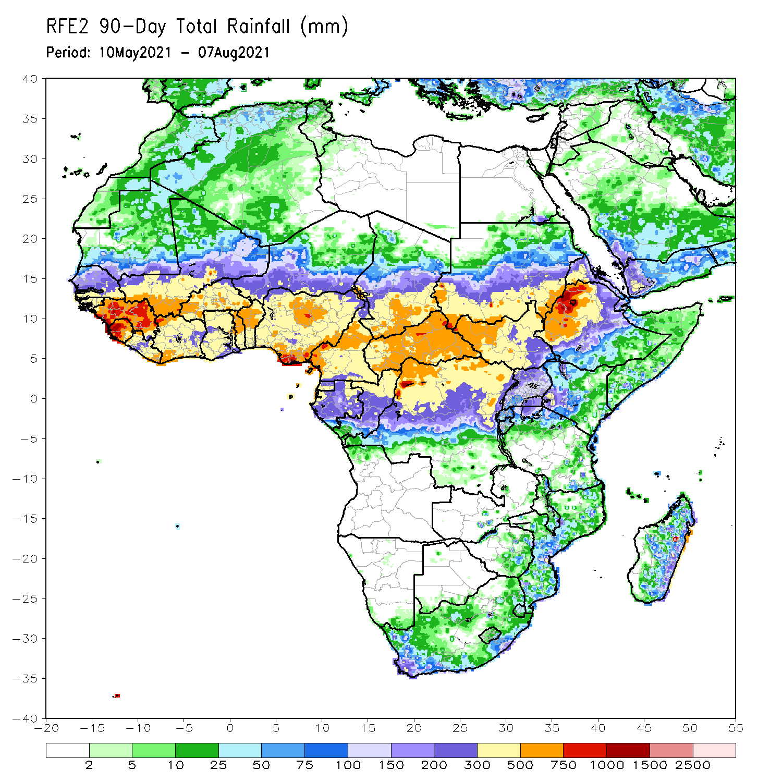
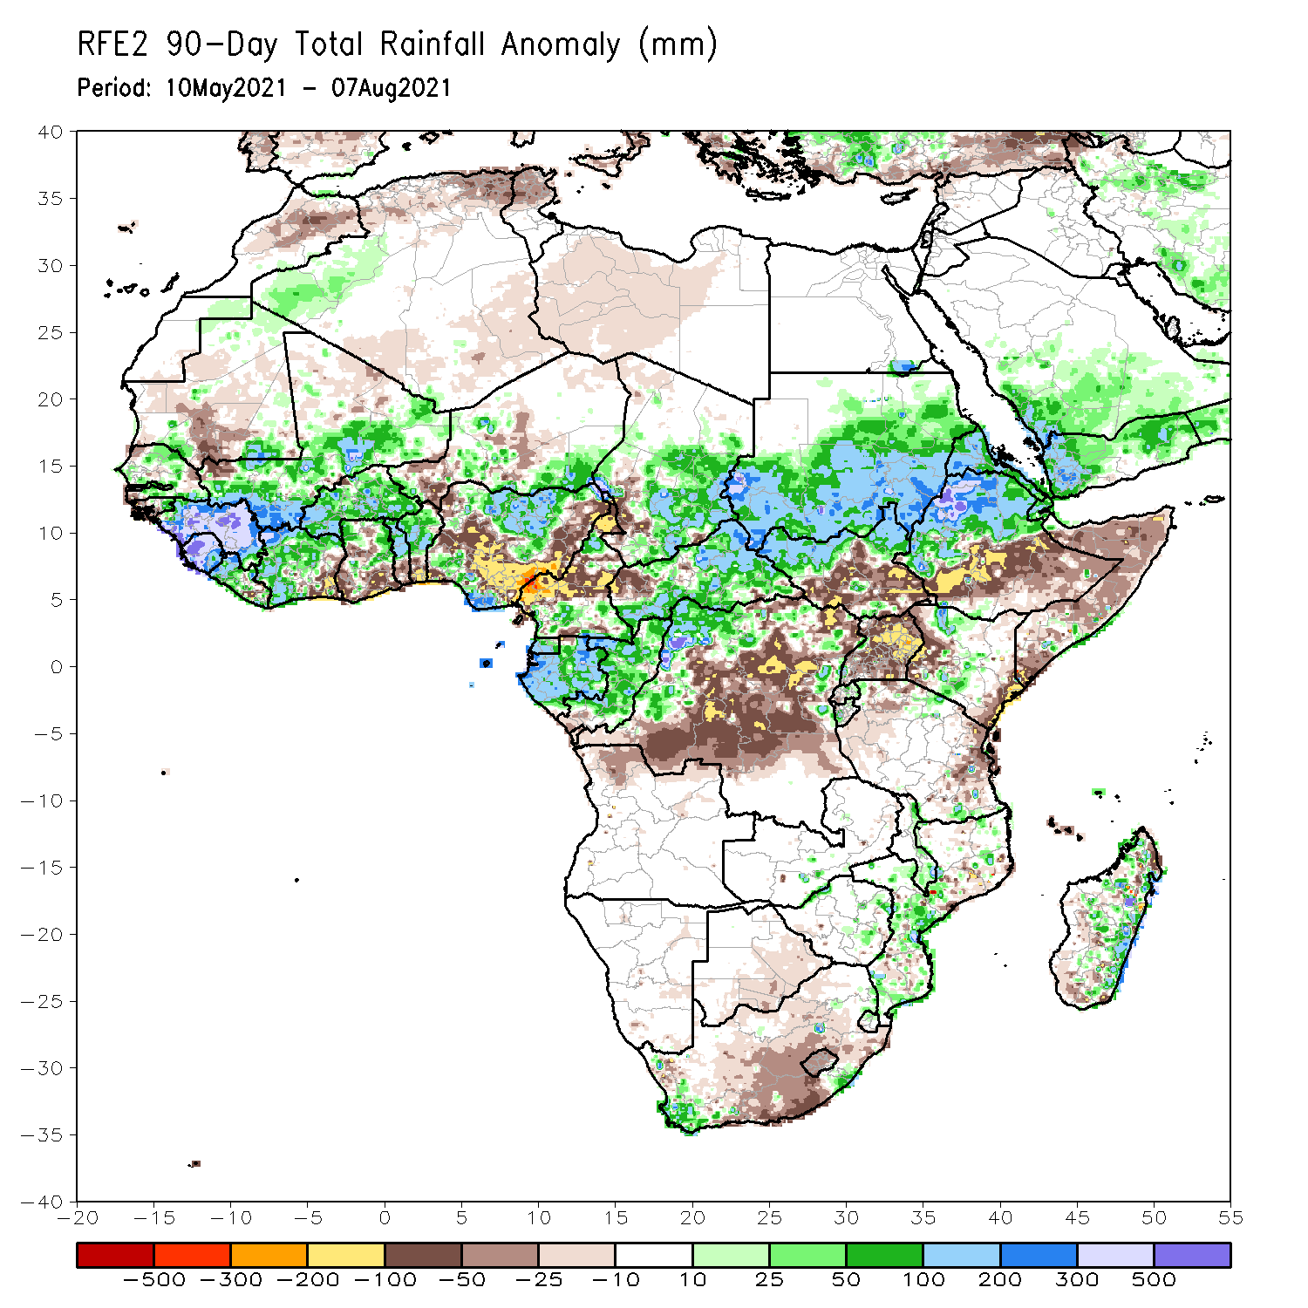
Rainfall Patterns: Last 90 Days
Over the past 90 days, in East Africa, rainfall was well above-average over southern Sudan, northern South Sudan, Eritrea, northern Ethiopia, pocket areas in northern and southern Kenya. Below-average rainfall was observed central and southern South Sudan, southern Ethiopia, Somalia, Uganda, western and eastern Kenya, and western and eastern Tanzania.
In southern Africa, above-average rainfall was observed over local areas in the southern part of South Africa, and many parts in Mozambique and Madagascar. Light moisture deficits were observed over Botswana, much of South Africa, and portions of western and northern Madagascar.
In Central Africa, positive precipitation anomalies were found over southern Chad, much of CAR, southern Cameroon, Equatorial Guinea, Gabon, Congo, and portions of northern DRC. Negative precipitation anomalies occurred in portions Chad, much of Cameroon, western CAR, and northeastern and central DRC.
In West Africa, moisture surpluses were observed over much of Senegal, eastern Guinea-Bissau, Guinea, Sierra Leone, Liberia, much of Côte d’Ivoire, Mali, Burkina Faso, northern Ghana, northern Togo, northern Benin, parts of Niger, and northern and southern Nigeria. Portions of Senegal, western Guinea-Bissau, northern and western Mali, southeastern Côte d’Ivoire, Ghana, southern Togo, southern Benin, and portions of Niger and Nigeria experienced moisture deficits.
Notes:
4

Slide 5
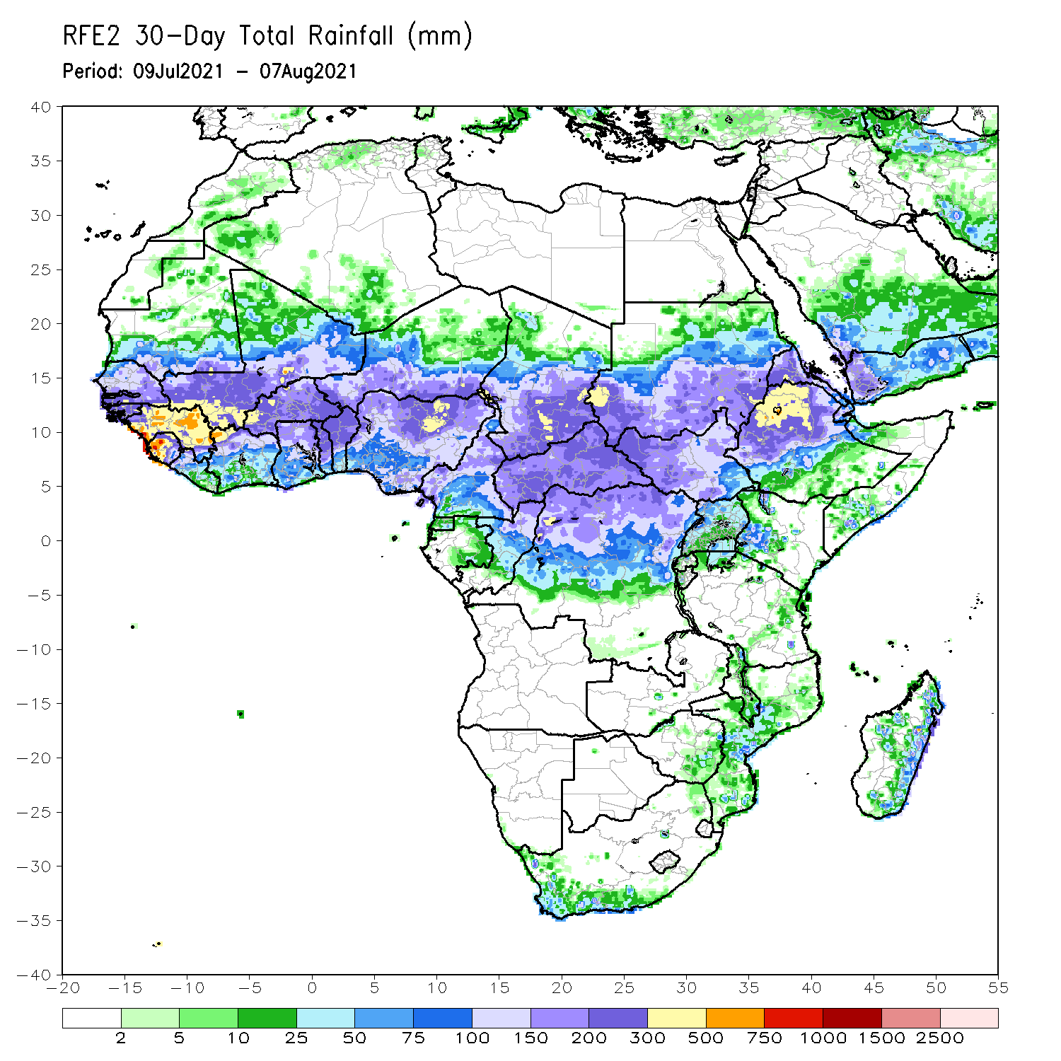
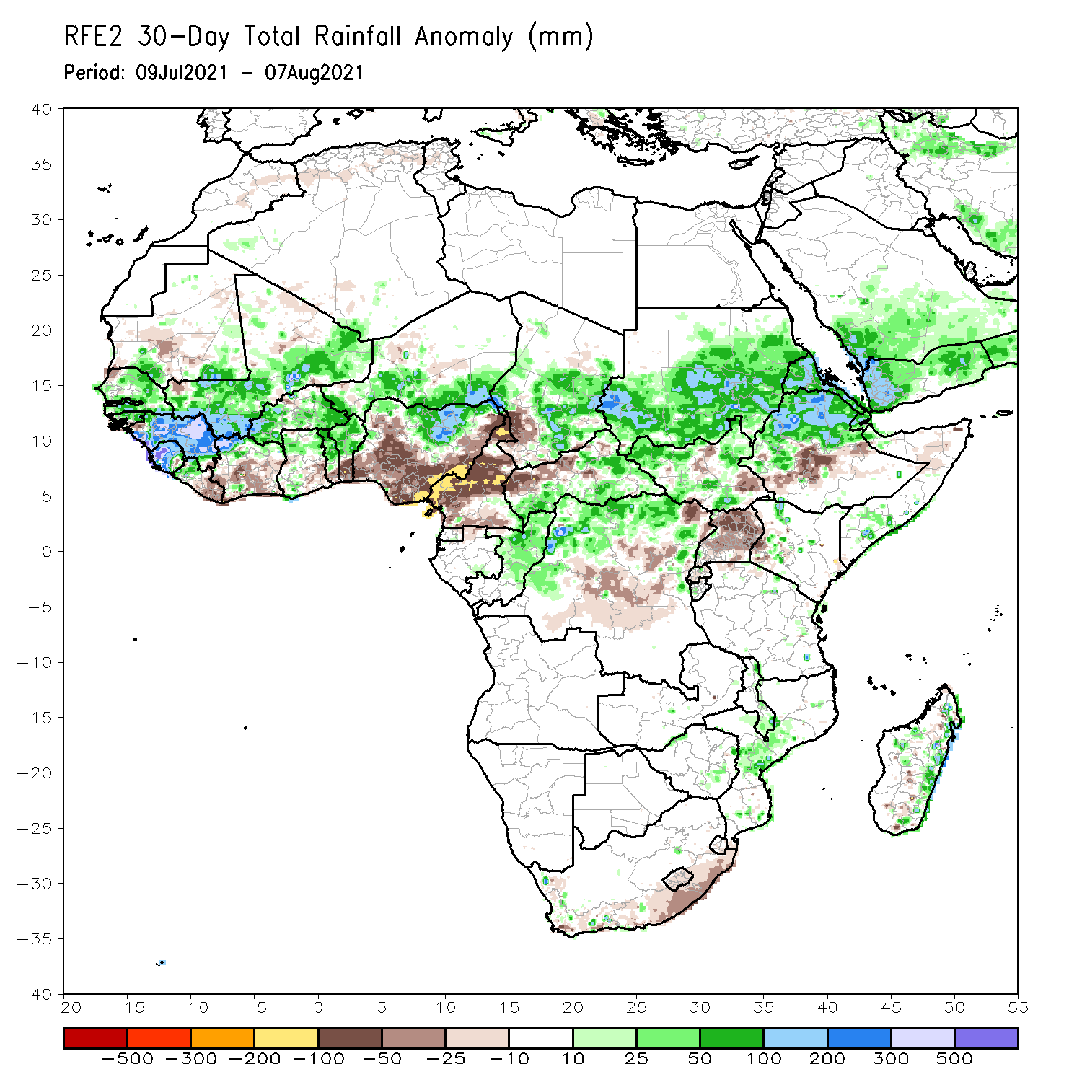
Rainfall Patterns: Last 30 Days
During the past 30 days, in East Africa, above-average rainfall was observed over Sudan, many parts in South Sudan, Eritrea, northern Ethiopia, and local areas in western Kenya and northern and southern Somalia. Rainfall was below-average over central Ethiopia, parts of South Sudan, southwestern Kenya, and Uganda.
In southern Africa, many parts of Mozambique and eastern Madagascar experienced positive rainfall anomalies. Negative rainfall anomalies were observed over the southern part of South Africa.
In Central Africa, rainfall was well above-average over much of Chad, eastern and southern CAR, northern DRC, and northern Congo. Conversely, below-average conditions were found over Cameroon, southwestern Chad, western CAR, and central DRC.
In West Africa, rainfall was above-average over Senegal, Guinea-Bissau, Guinea, Sierra Leone, northern Liberia, northern Côte d’Ivoire, much of Mali, Burkina Faso, northern Ghana, northern Togo, northern Benin, southern Niger and northern Nigeria. Moisture deficits were observed over southern Liberia, southern Côte d’Ivoire, southern Ghana, southern Togo, southern Benin, and many parts of Nigeria.
Notes:
5

Slide 6
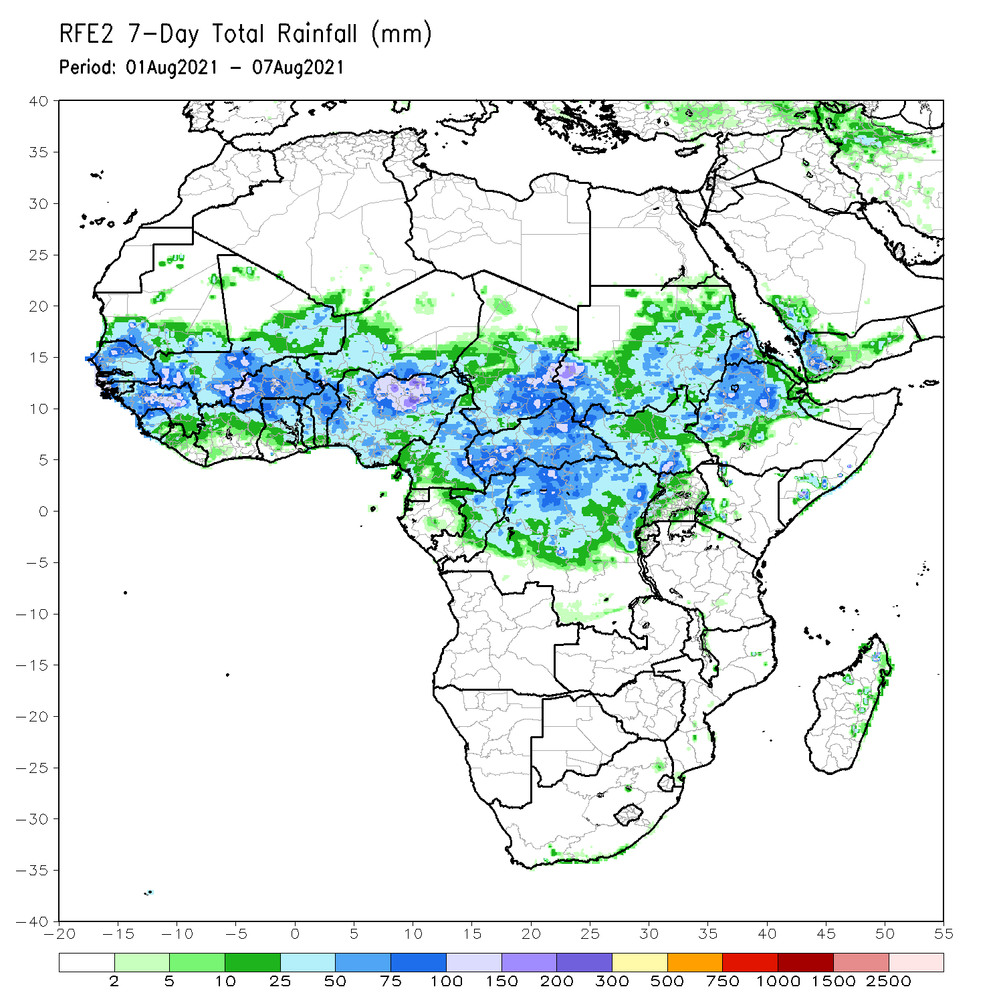
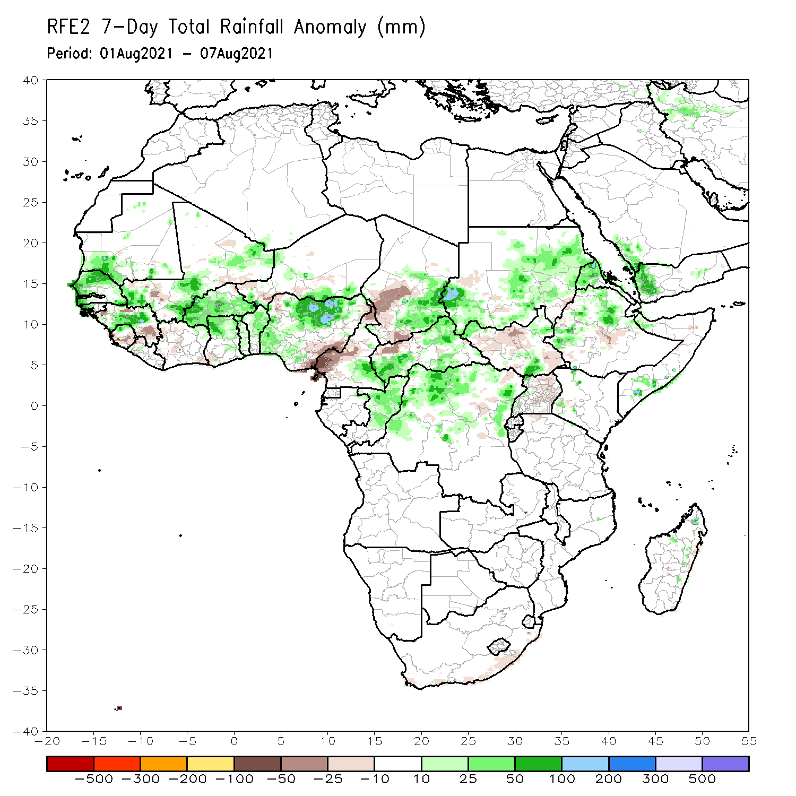
Rainfall Patterns: Last 7 Days
During the past 7 days, in East Africa, rainfall was above-average over southwestern and eastern Sudan, parts of South Sudan, Eritrea, northern Ethiopia, and northern and southern Somalia. Precipitation was slightly below-average over portions of South Sudan, central Ethiopia, and Uganda.
In Central Africa, rainfall was above-average over southeastern Chad, southeastern Cameroon, much of CAR, Congo, and northern DRC. Northern and southwestern Cameroon, southwestern Chad, and northwestern CAR experienced below-average rainfall.
In West Africa, Senegal, Guinea-Bissau, central Guinea, northern Sierra Leone, parts of Mali, Burkina Faso, northern Ghana, Togo, Benin, southern Niger and much of Nigeria observed above-average rainfall. Northern and southern Guinea, southern Sierra Leone, and southeastern Nigeria experienced below-average rainfall conditions.

Slide 7
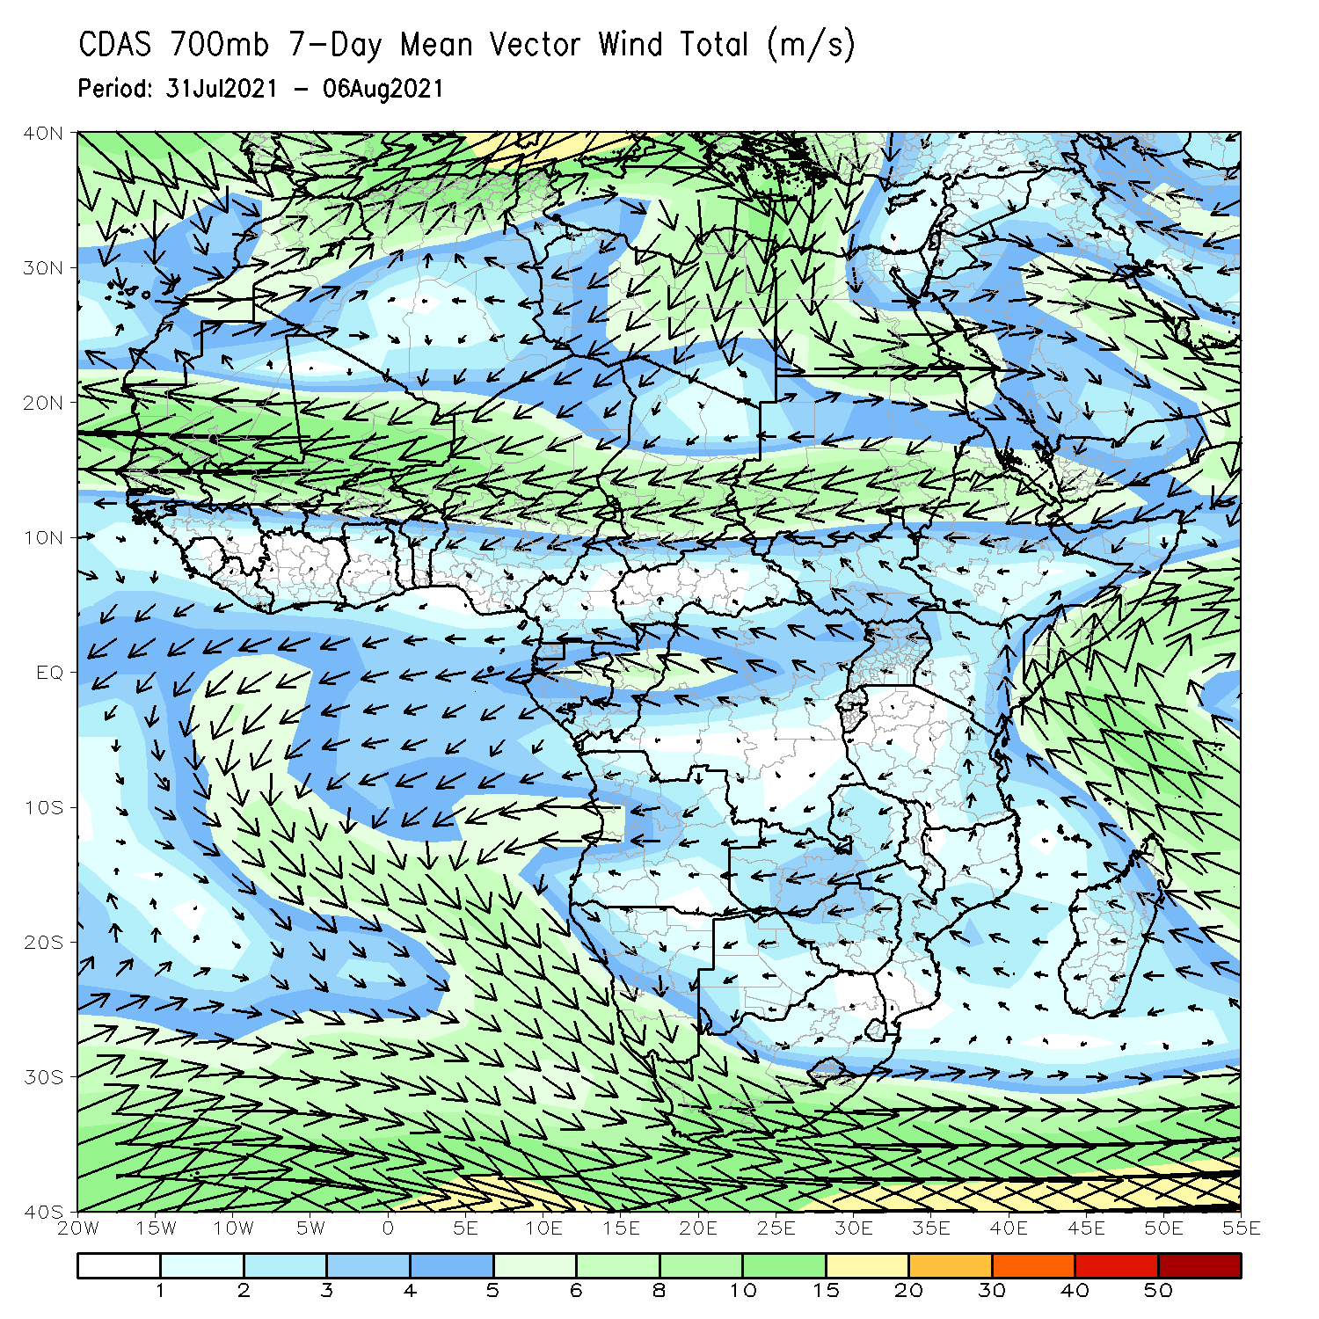
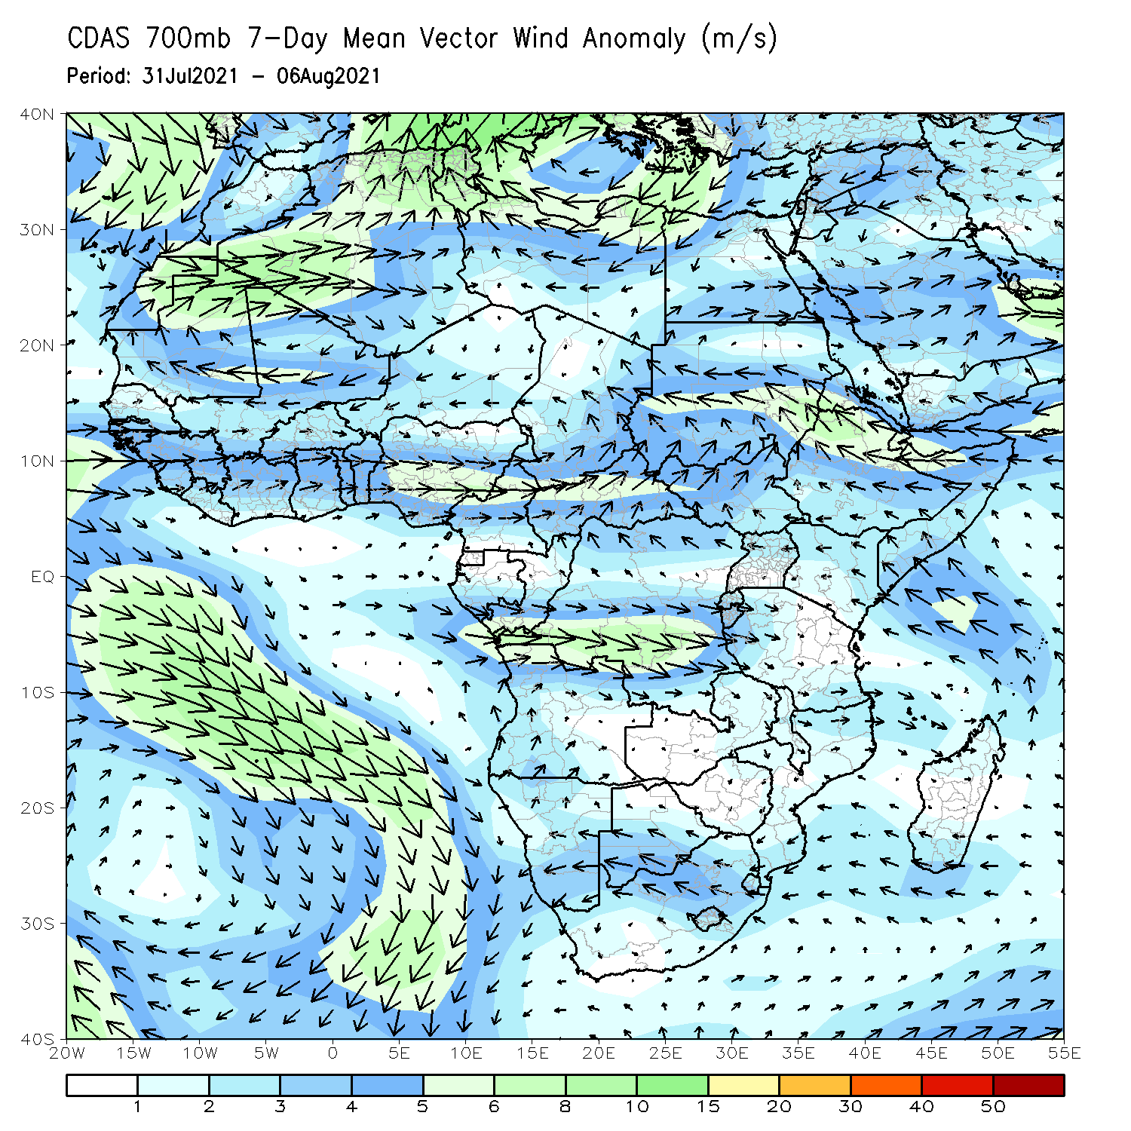
Atmospheric Circulation: Last 7 Days
The 700-hPa atmospheric circulation pattern features easterly flow stretching from Eritrea to Senegal (left panel).
The anomalous cyclonic circulation located over the western part of the Sahel and Central Africa may have contributed to enhanced rainfall in those areas. An anticyclonic circulation was observed over the northern part of Mauritania and Mali (right panel).

Slide 8
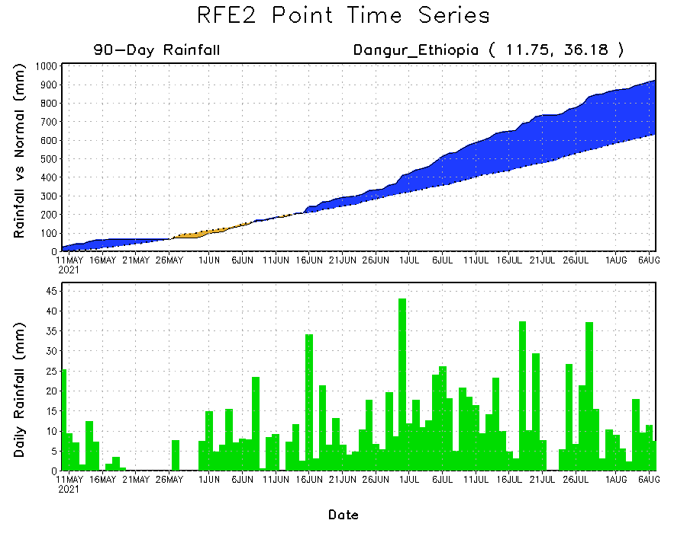
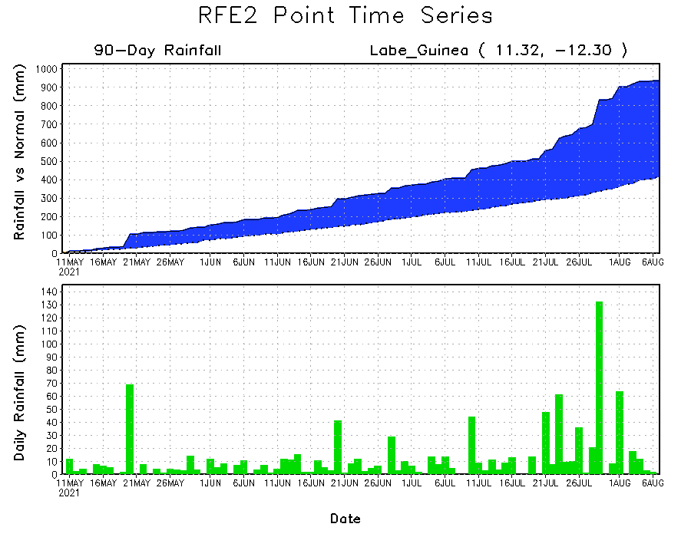
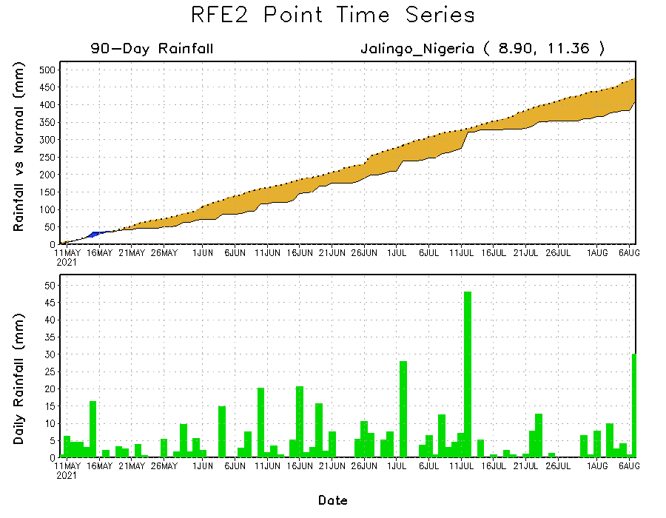
Rainfall Evolution
Daily evolution of rainfall over the last 90 days at selected locations shows moderate to heavy rainfall sustained moisture surpluses over parts of Guinea (bottom left) and western Ethiopia (top right). In contrast, seasonal total rainfall remained below-average over eastern Nigeria (bottom right).

Slide 9
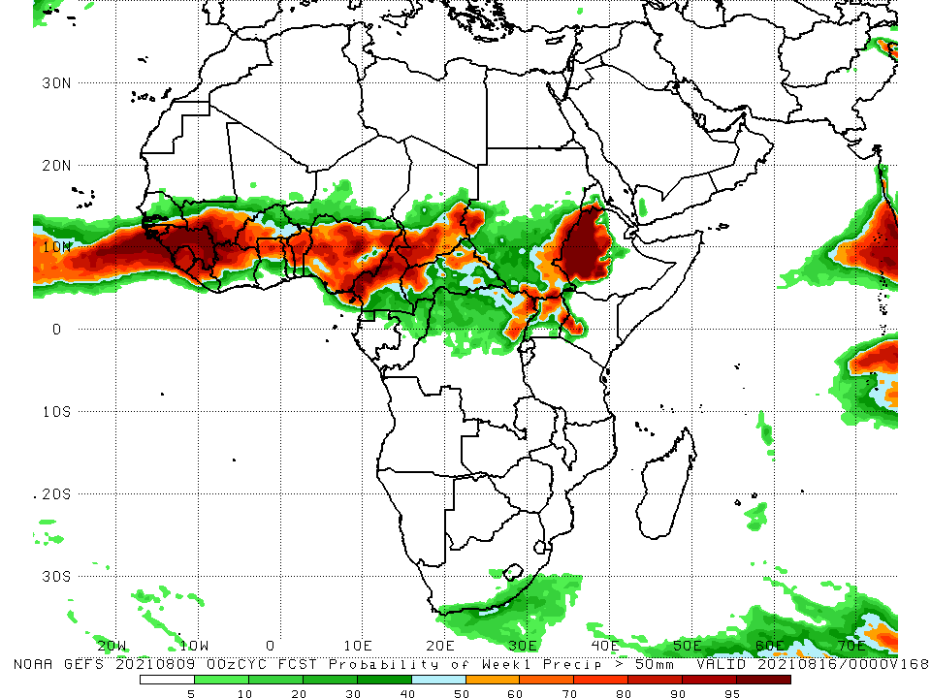
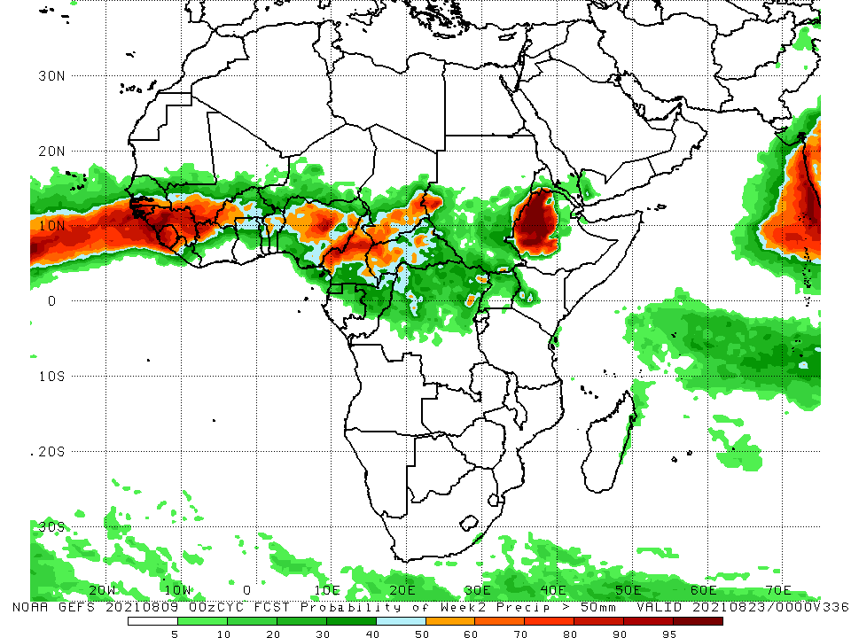
NCEP GEFS Model Forecasts Non-Bias Corrected Probability of precipitation exceedance
Week-1, Valid: 10 – 16 August, 2021
Week-2, Valid: 17 – 23 August, 2021
For week-1 (left panel) and week-2 (right panel), the NCEP GEFS indicates a moderate to high chance (over 70%) for rainfall to exceed 50 mm over southern Senegal, Guinea-Bissau, Guinea, Sierra Leone, northern Liberia, southern Mali, western Burkina Faso, northern Côte d’Ivoire, northern Togo, northern Benin, Nigeria, much of Cameroon, southern Chad, parts of CAR, western and southeastern Sudan, parts of northern DRC, western Ethiopia, and southwestern Eritrea.
In addition, week-1 forecast depicts an increased chance for weekly rainfall to exceed 50 mm over eastern South Sudan, northern Uganda, and southwestern Kenya.
Notes:
9

Slide 10
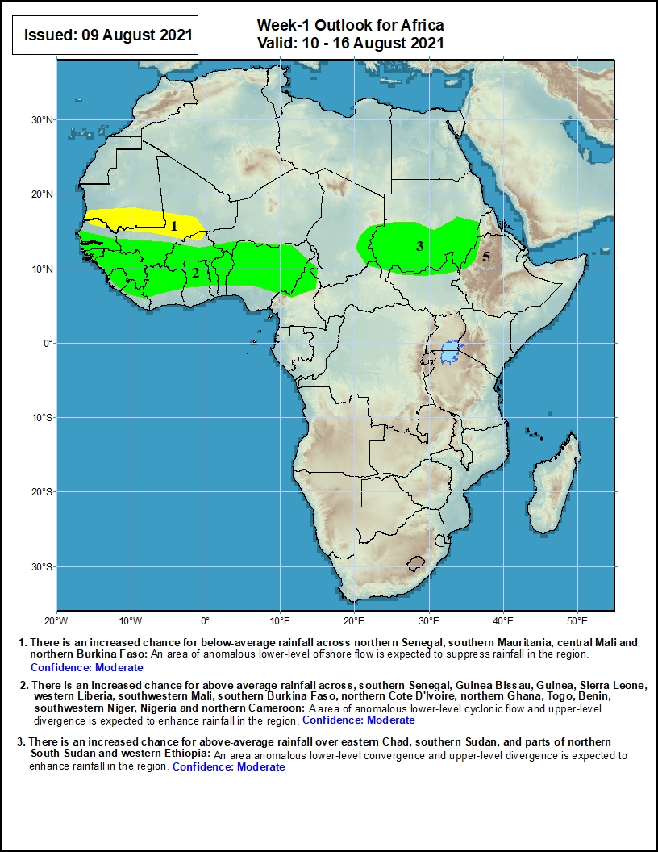
Week-1 Precipitation Outlooks
10 – 16 August, 2021
There is an increased chance for below-average rainfall across northern Senegal, southern Mauritania, central Mali and northern Burkina Faso: An area of anomalous lower-level offshore flow is expected to suppress rainfall in the region.
There is an increased chance for above-average rainfall across, southern Senegal, Guinea-Bissau, Guinea, Sierra Leone, western Liberia, southwestern Mali, southern Burkina Faso, northern Cote D'Ivoire, northern Ghana, Togo, Benin, southwestern Niger, Nigeria and northern Cameroon: A broad area of anomalous lower-level cyclonic flow and upper-level divergence is expected to enhance rainfall in the region.
There is an increased chance for above-average rainfall over eastern Chad, southern Sudan, and parts of northern South Sudan and western Ethiopia: An area anomalous lower-level convergence and upper-level divergence is expected to enhance rainfall in the region.
Notes:
10

Slide 11
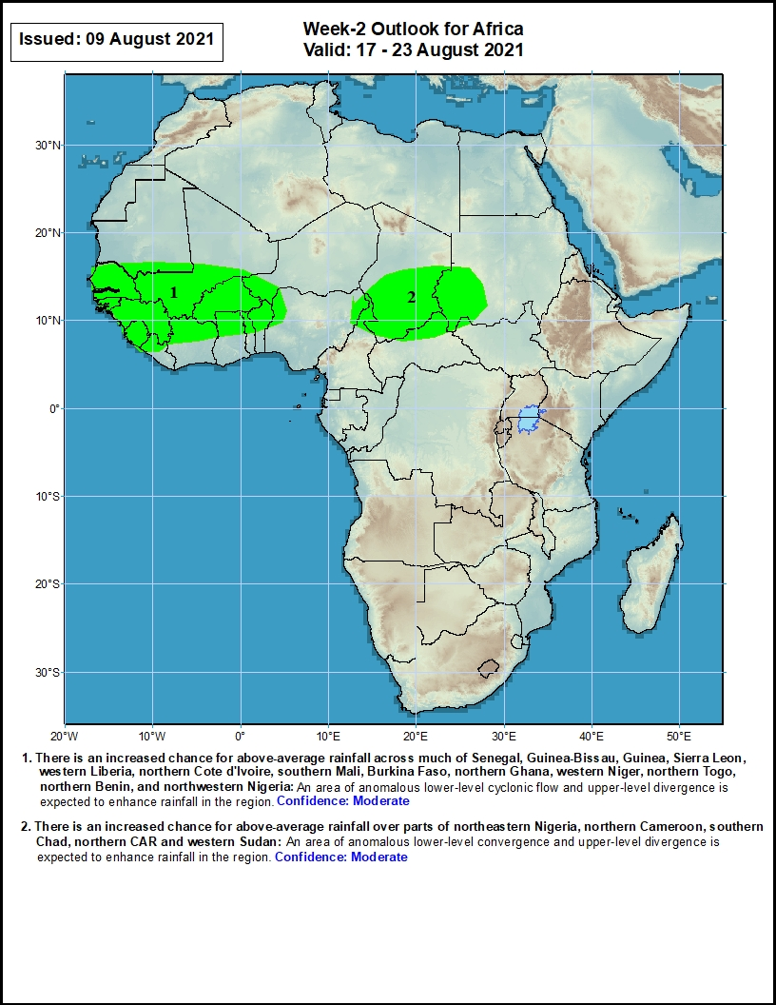
Week-2 Precipitation Outlooks
17 – 23 August, 2021
There is an increased chance for above-average rainfall across much of Senegal, Guinea-Bissau, Guinea, Sierra Leon, western Liberia, northern Cote d'Ivoire, southern Mali, Burkina Faso, northern Ghana, western Niger, northern Togo, northern Benin, and northwestern Nigeria: An area of anomalous lower-level cyclonic flow and upper-level divergence is expected to enhance rainfall in the region.
There is an increased chance for above-average rainfall over parts of northeastern Nigeria, northern Cameroon, southern Chad, northern CAR and western Sudan: An area of anomalous lower-level convergence and upper-level divergence is expected to enhance rainfall in the region.
Notes:
11

Slide 12
Summary
During the past 30 to 90 days, in East Africa, above-average rainfall was observed over southern Sudan, parts of South Sudan Republic, Eritrea, and northern Ethiopia. Rainfall was below-average over portions of South Sudan, central Ethiopia, and Uganda. In Central Africa, rainfall was below-average over parts of central DRC, Cameroon, southwestern Chad, and western CAR. Rainfall was above-average over southern Chad, much of CAR, Equatorial Guinea, Gabon, Congo, much of CAR, and pockets of DRC. In West Africa, rainfall was above-average over Senegal, Guinea, Sierra Leone, northern Liberia, much of Mali, Burkina Faso, northern Côte d’Ivoire, northern Togo, northern Benin, parts of Niger, and portions of Nigeria. Below-average rainfall was observed over southern Ghana, southern Togo, southern Benin, and portions of Nigeria and Niger.
During the past 7 days, in East Africa, rainfall was above-average over much of Sudan, parts of South Sudan, Eritrea, and northern Ethiopia. Light moisture deficits were observed over central South Sudan, central Ethiopia, and Uganda. In Central Africa, rainfall was above-average over eastern Chad, much of CAR, Congo, and northern DRC. Below-average rainfall was observed over southwestern Chad, northern and central Cameroon, and northwestern CAR. In West Africa, above-average rainfall was observed over Senegal, western Guinea-Bissau, central Guinea, portions of Mali, much of Burkina Faso, northern Ghana, northern Togo, northern Benin, and much of Nigeria. Below-average rainfall was observed over southeastern Nigeria. Rainfall was slightly below-average over local areas in Guinea, southern Sierra Leone, and parts of Mali and Nigeria.
Week-1 outlooks call for an increased chance for above-average rainfall over southern Senegal, Guinea-Bissau, Guinea, Sierra Leone, western Liberia, southwestern Mali, southern Burkina Faso, northern Côte D'Ivoire, northern Ghana, Togo, Benin, southwestern Niger, Nigeria, northern Cameroon, eastern Chad, southern Sudan, and parts of northern South Sudan and western Ethiopia. In contrast, the outlooks call for an increased chance for below-average rainfall over northern Senegal, southern Mauritania, central Mali and northern Burkina Faso.
Week-2 outlooks call for an increased chance for above-average rainfall across much of Senegal, Guinea-Bissau, Guinea, Sierra Leone, western Liberia, northern Cote d'Ivoire, southern Mali, Burkina Faso, northern Ghana, western Niger, northern Togo, northern Benin, northwestern Nigeria, parts of northeastern Nigeria, northern Cameroon, southern Chad, northern CAR and western Sudan.

