Slide 1
The African Monsoon Recent Evolution and Current Status Include Week-1 and Week-2 Outlooks
Update prepared by
7 September 2021
For more information, visit:
http://www.cpc.ncep.noaa.gov/products/Global_Monsoons/African_Monsoons/precip_monitoring.shtml

Slide 2
Outline
Highlights
Recent Evolution and Current Conditions
NCEP GEFS Forecasts
Summary

Slide 3
Highlights: Last 7 Days
During the past 7 days, southern Nigeria and southwestern Cameroon received heavy rainfall of over 150 mm (moisture surpluses of over 100 mm). Pocket areas in southeastern Liberia, western Côte d’Ivoire, southwestern Sudan, northern Ethiopia, and western Eritrea also registered precipitation amounts of over 150 mm (moisture surpluses of over 100 mm).
The week-1 outlooks depict an increased chance for above-average rainfall across southern Senegal, Guinea-Bissau, Guinea, Sierra Leone, Liberia, southwestern Mali, Côte d’Ivoire, parts of Burkina Faso, much of South Sudan, northeastern DRC, northern Uganda, and western Ethiopia. Conversely, there is an increased chance for below-average rainfall across parts of southern Mauritania, central Mali, central and eastern Burkina Faso, western Niger, and northern Benin.
The week-2 outlooks call for an increased chance for above-average rainfall across much of Guinea, Sierra Leone, Liberia, Côte d’Ivoire, eastern South Sudan, northeastern DRC, northern Uganda, and southwestern Ethiopia. In contrast, there is an increased chance for below-average rainfall across much of Senegal, southern Mauritania, southern and central Mali, Burkina Faso, and western Niger.

Slide 4
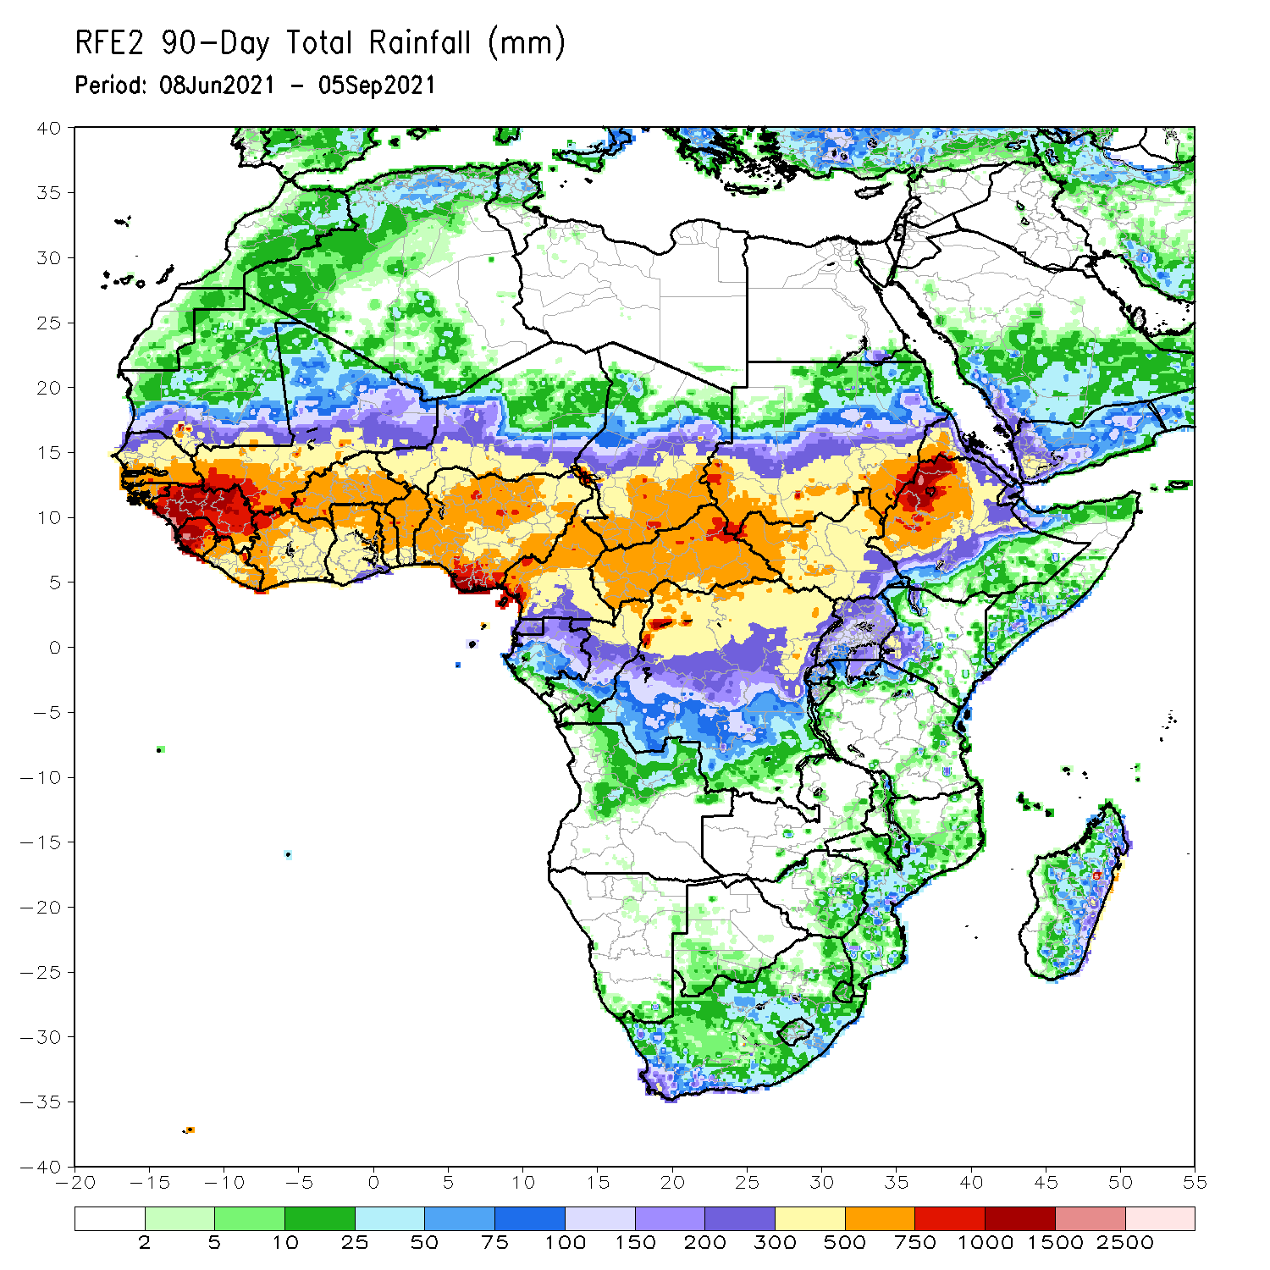
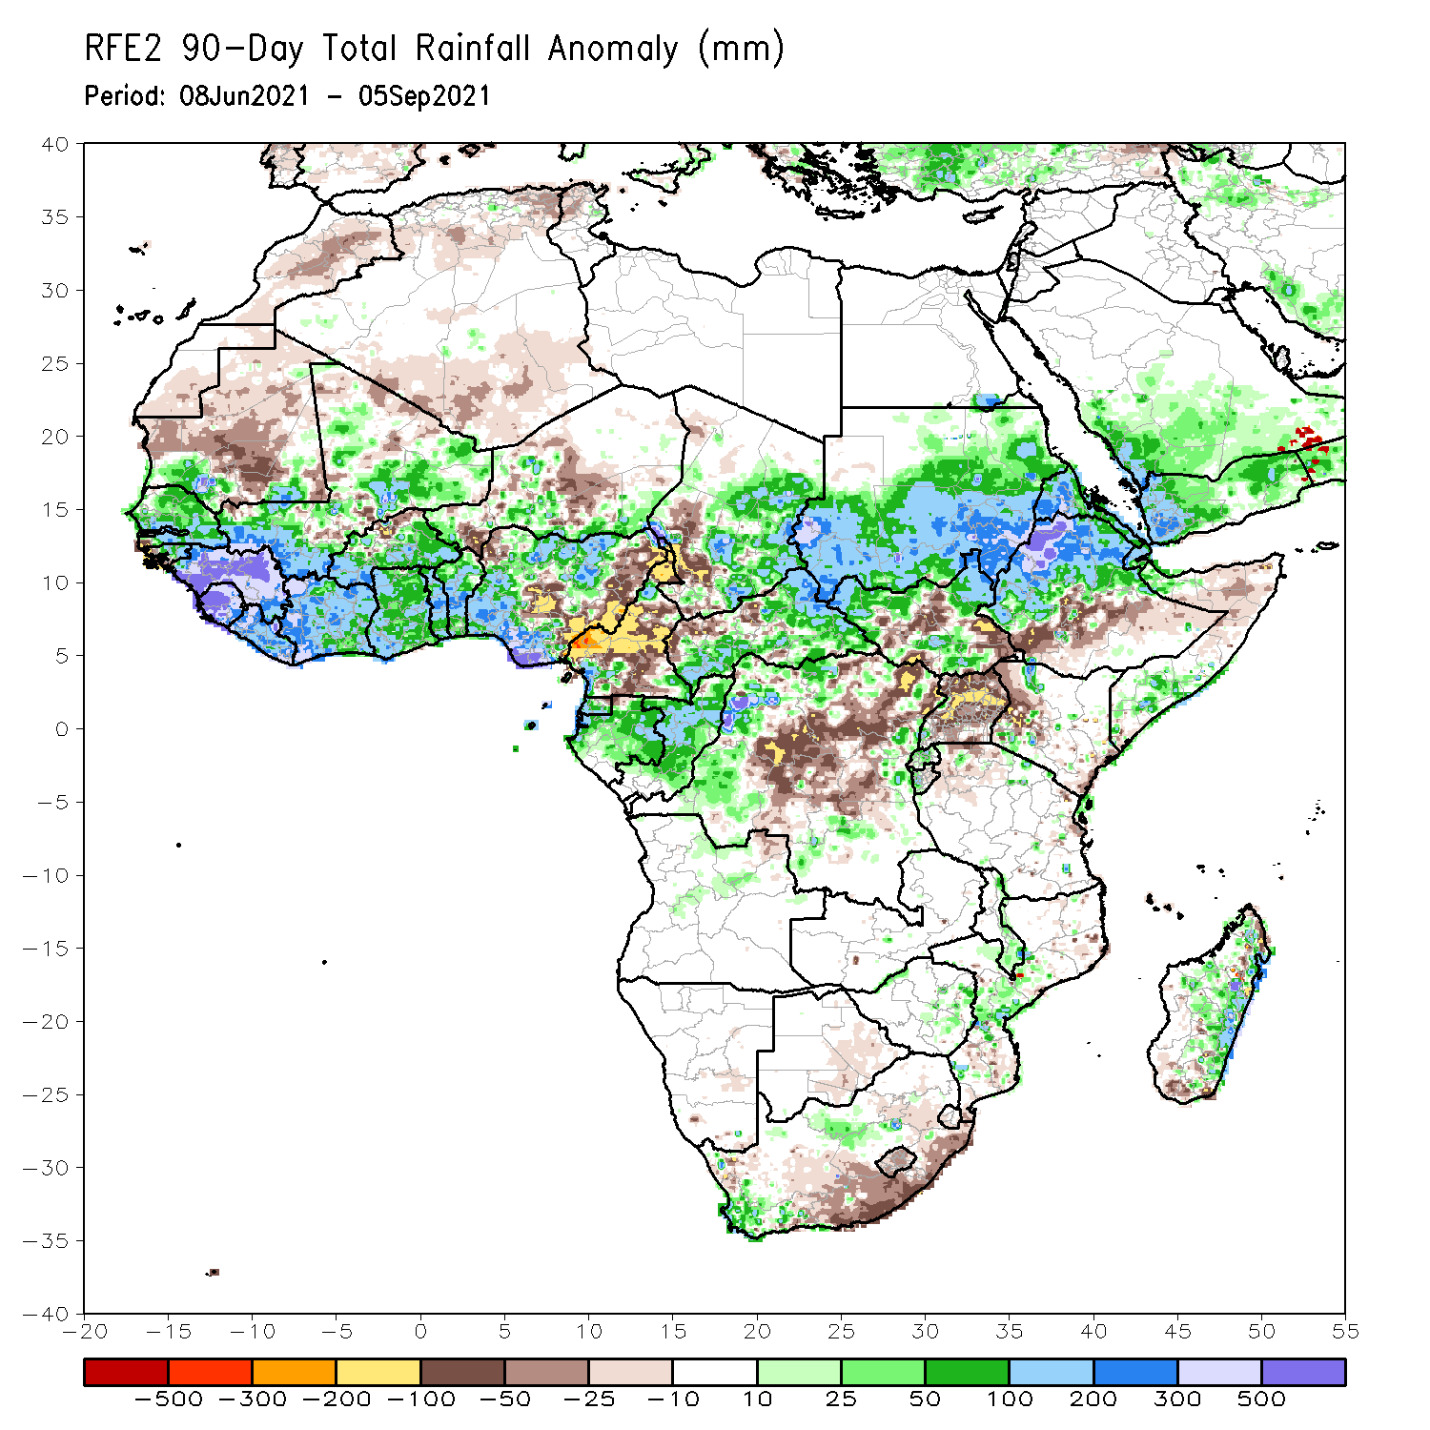
Rainfall Patterns: Last 90 Days
Over the past 90 days, in East Africa, above-average rainfall was observed over Sudan, northern and southern South Sudan, Eritrea, northern Ethiopia, and local areas in northern and southern Somalia. Rainfall was below-average over central and southeastern South Sudan, southern Ethiopia, western Kenya, and Uganda.
In southern Africa, local areas in the southern part of South Africa, Zimbabwe, central Mozambique and eastern Madagascar experienced moisture surpluses. Light moisture deficits were present in eastern Botswana, much of South Africa and Lesotho, and portions of Madagascar.
In Central Africa, positive precipitation anomalies were found over eastern Chad, much of CAR, Equatorial Guinea, Gabon, Congo, and local areas in northwestern DRC. Negative precipitation anomalies occurred in southwestern Chad, much of Cameroon, and much of DRC.
In West Africa, southwestern Mauritania, much of Senegal, eastern Guinea-Bissau, Guinea, Sierra Leone, Liberia, Côte d’Ivoire, much of Mali and Burkina Faso, Ghana, Togo, Benin, and northern and southern Nigeria observed moisture surpluses. Southwestern Senegal, western Guinea-Bissau, northern Burkina Faso, southwestern and central Niger, and eastern Nigeria experienced moisture deficits.
Notes:
4

Slide 5
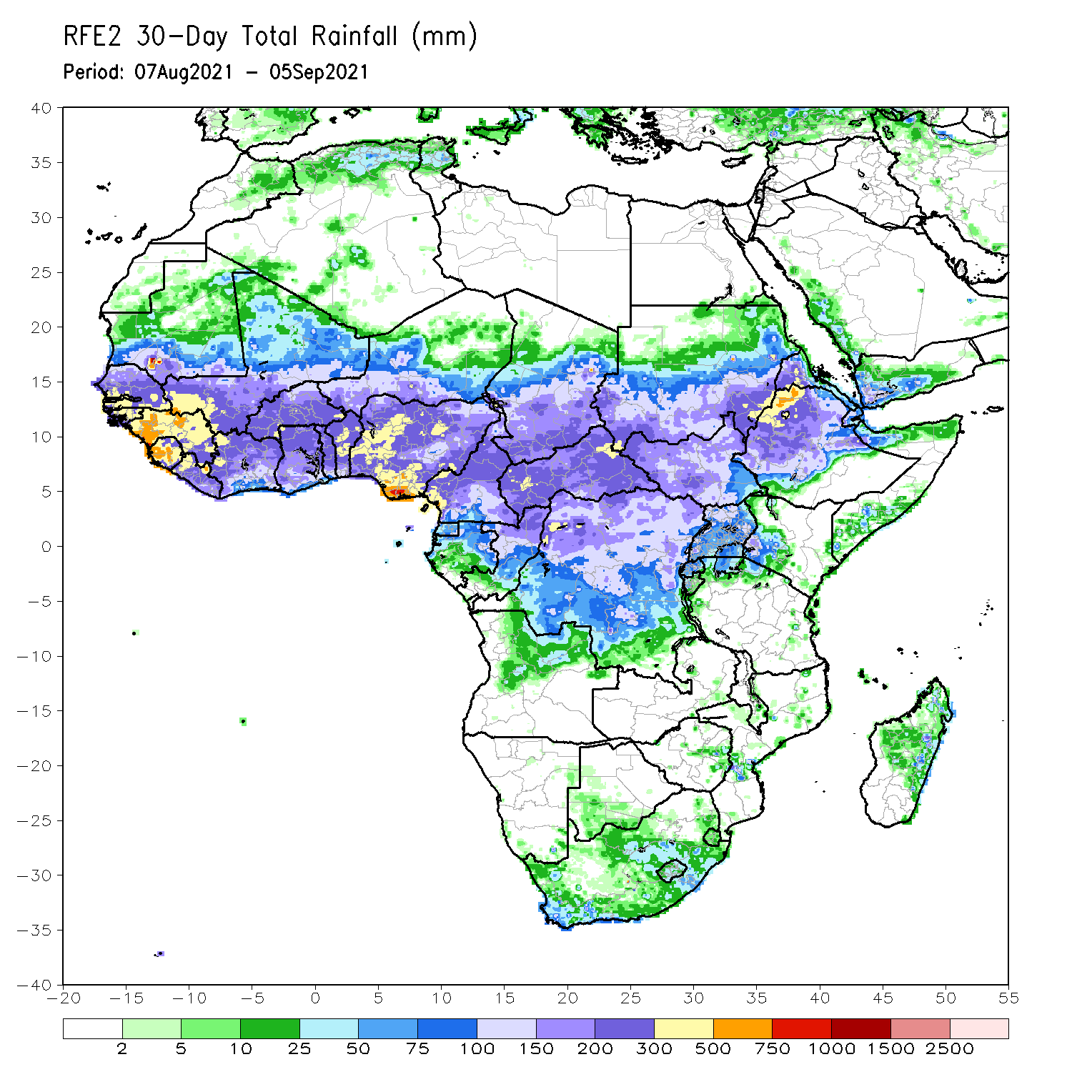
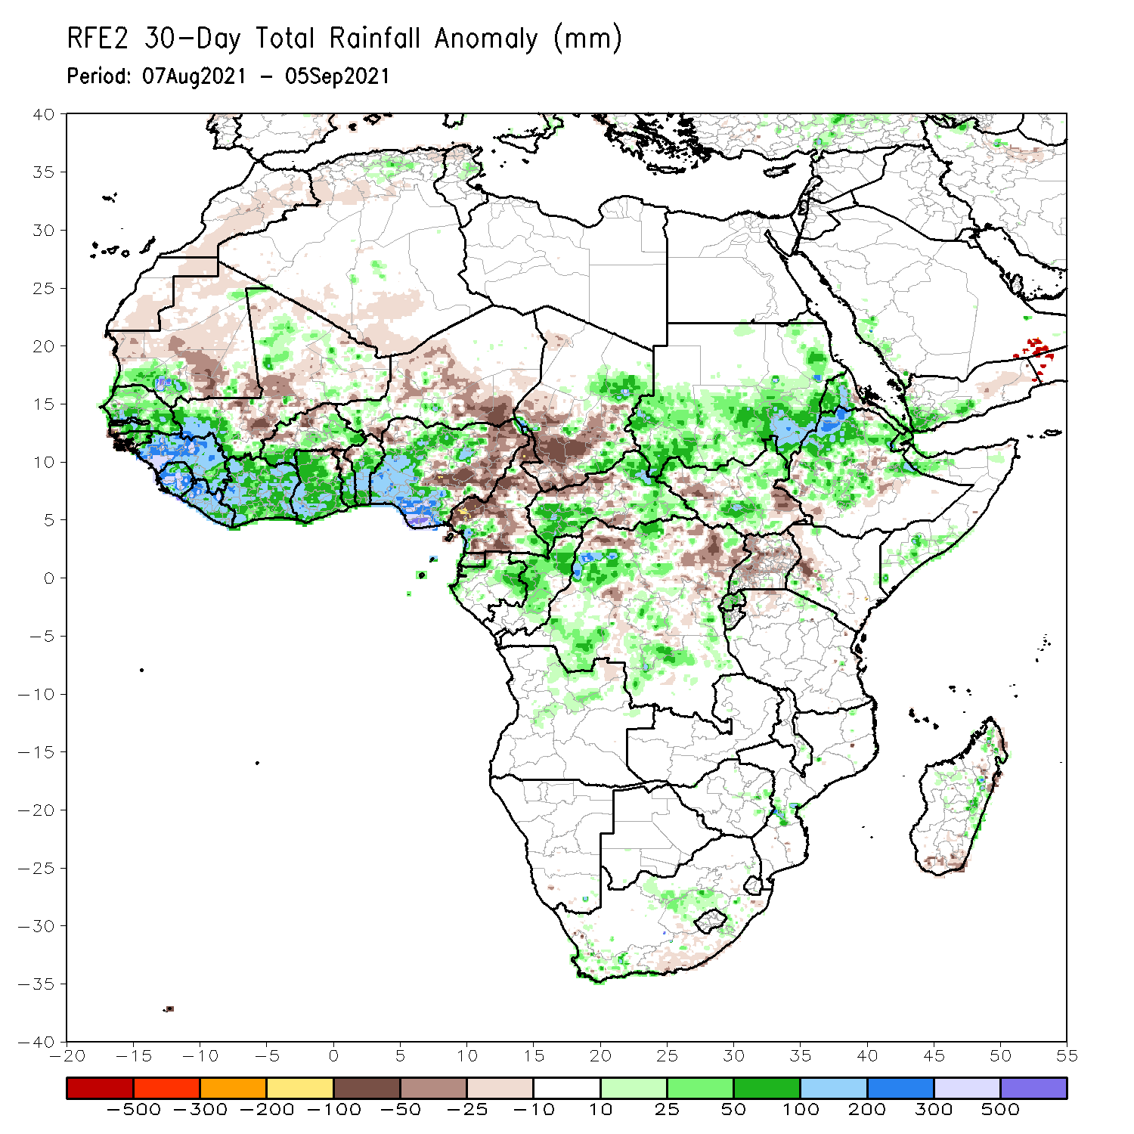
Rainfall Patterns: Last 30 Days
During the past 30 days, in East Africa, above-average rainfall was observed over Sudan, Eritrea, portions of South Sudan, Ethiopia, western Eritrea, and local areas in northern and southern Somalia. Rainfall was below-average over western and eastern South Sudan, Uganda, and western Kenya.
In Central Africa, eastern Chad, southwestern and eastern CAR, Gabon, Congo, and many parts of DRC experienced positive rainfall anomalies. Conversely, central and western Chad, much of Cameroon, portions of CAR and northeastern DRC experienced negative rainfall anomalies.
In West Africa, moisture surpluses were present across southern Mauritania, Senegal, Guinea-Bissau, Guinea, Sierra Leone, southwestern Mali, southern Burkina Faso, Liberia, Côte d’Ivoire, Ghana, southern Togo, Benin, and southern and western Nigeria. Eastern Nigeria, central Mali, northern Burkina Faso, and much of Niger observed moisture deficits.
Notes:
5

Slide 6
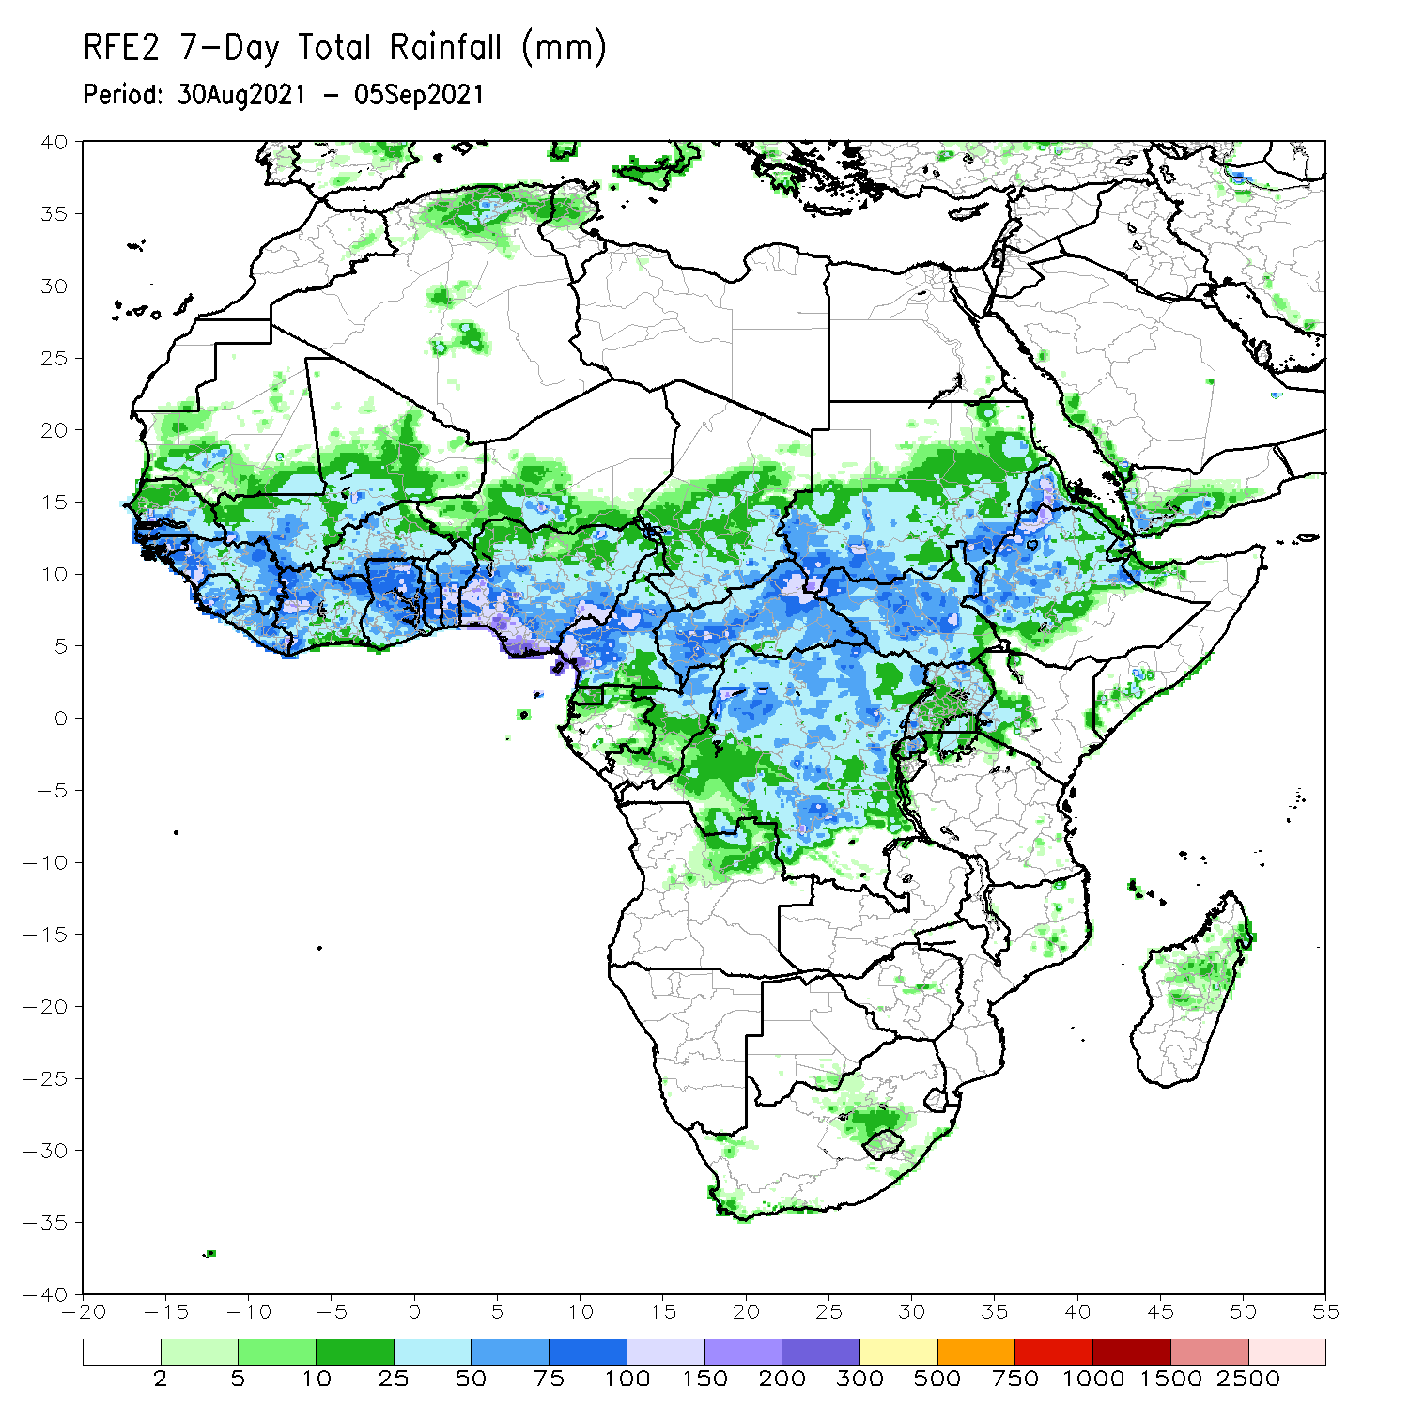
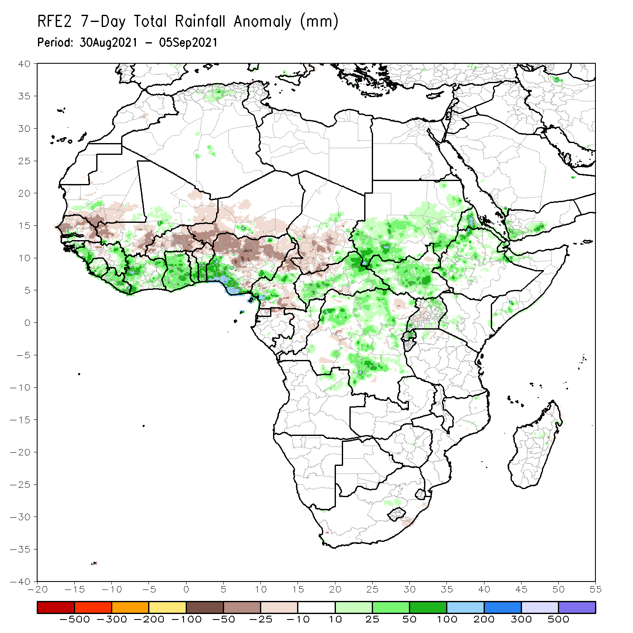
Rainfall Patterns: Last 7 Days
During the past 7 days, East African region observed above-average rainfall.
In Central Africa, moisture surpluses were present over central and southeastern Cameroon, and much of CAR and DRC. Conversely, Chad, northern and southern Cameroon, and northern Gabon experienced moisture deficits.
In West Africa, southern Senegal, Guinea-Bissau, western and eastern Guinea, Sierra Leone, Liberia, Côte d’Ivoire, Ghana, southern Togo, southern Benin, and southern Nigeria observed above-average rainfall. Southern Mauritania, much of Senegal, central Guinea, much of Mali, Burkina Faso, Niger, northern Togo, northern Benin, and northern Nigeria experienced below-average rainfall conditions.

Slide 7
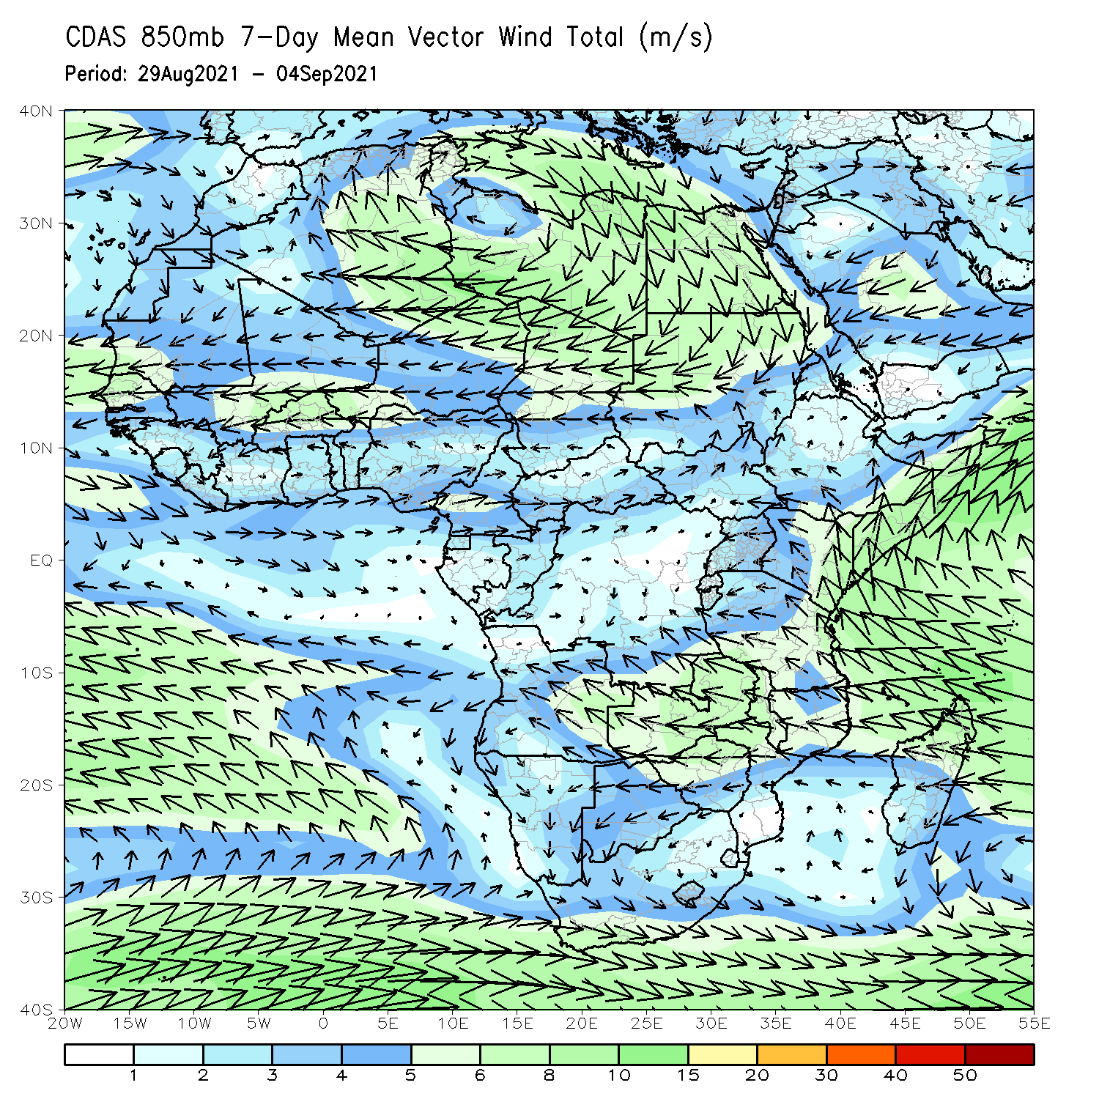
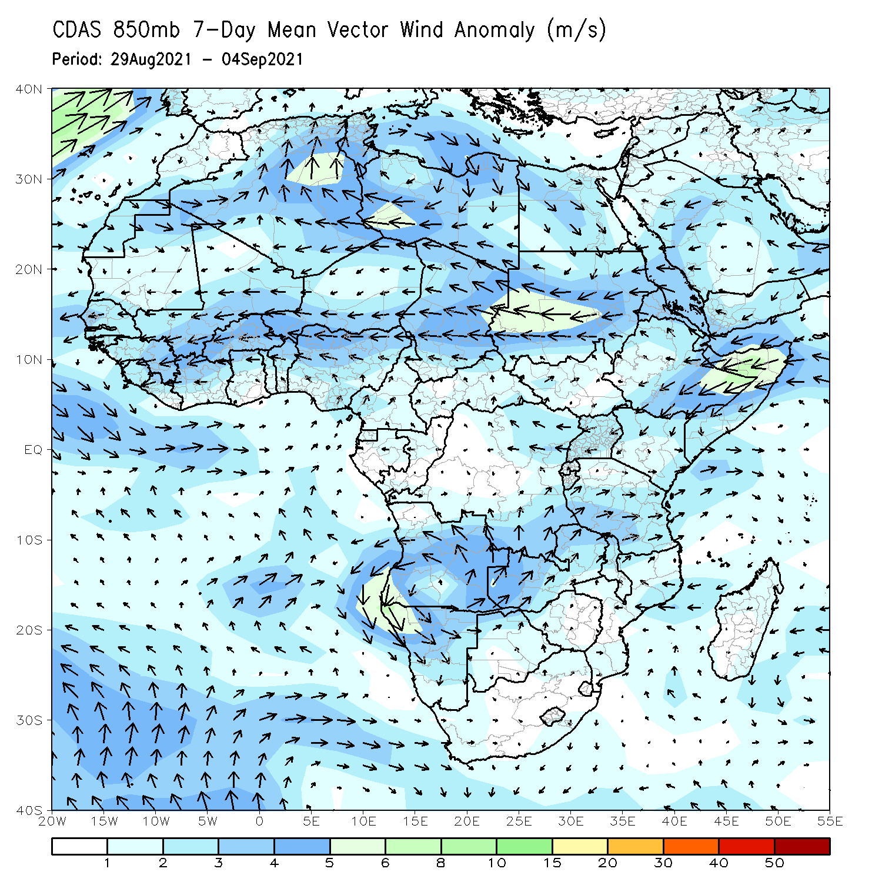
Atmospheric Circulation: Last 7 Days
The 850-hPa atmospheric circulation pattern features a cyclonic circulation over the Gulf of Guinea region. This pattern may have contributed to enhanced rainfall in the Gulf of Guinea countries (right panel).
The moisture-laden westerly wind over the Gulf of Guinea likely contributed to bring heavy rainfall across coastal areas of Nigeria and Cameroon (left panel).

Slide 8
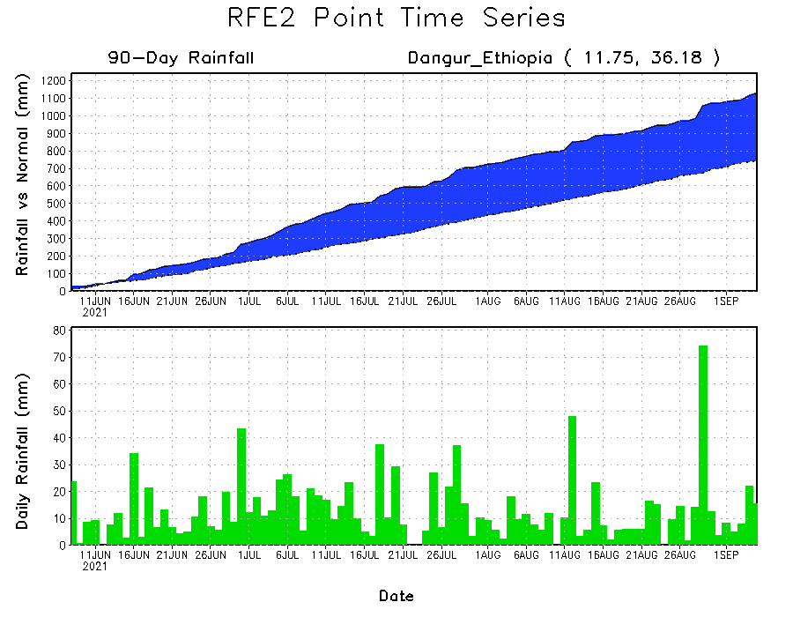
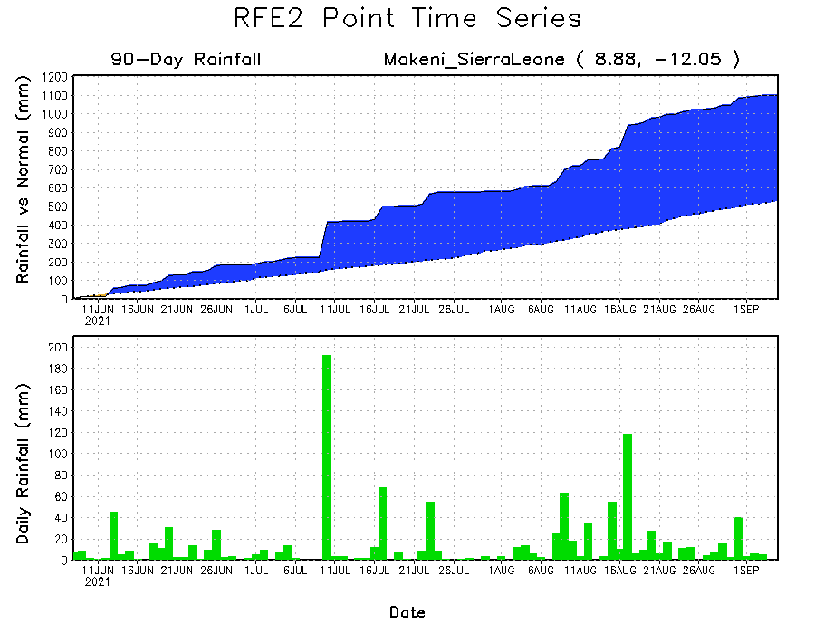
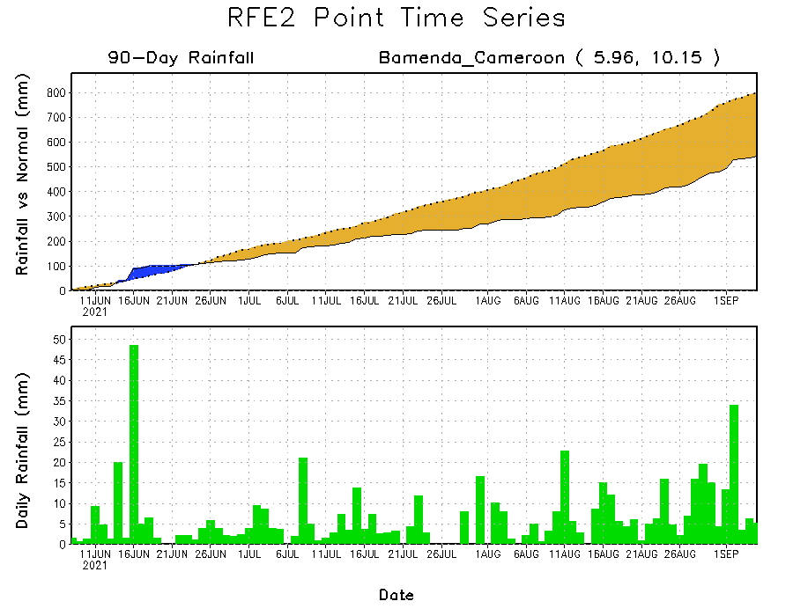
Rainfall Evolution
Daily evolution of rainfall over the last 90 days at selected locations shows moderate to heavy rainfall sustained moisture surpluses over Sierra Leone (bottom left) and northwestern Ethiopia (top right). In contrast, seasonal total rainfall remained below-average over southwestern Cameroon (bottom right).

Slide 9
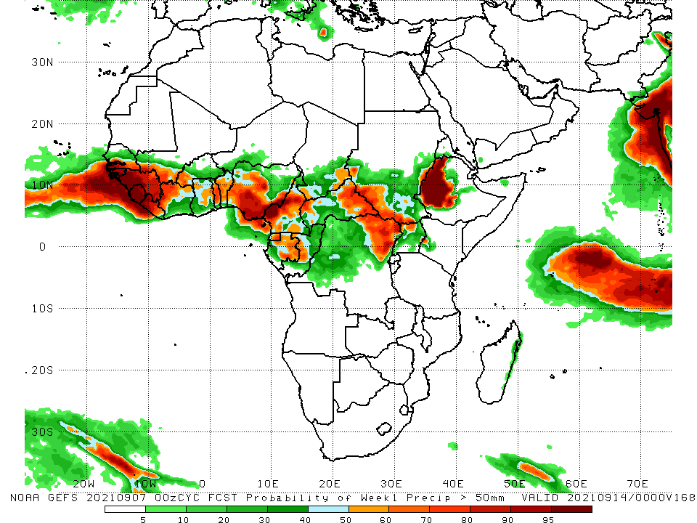
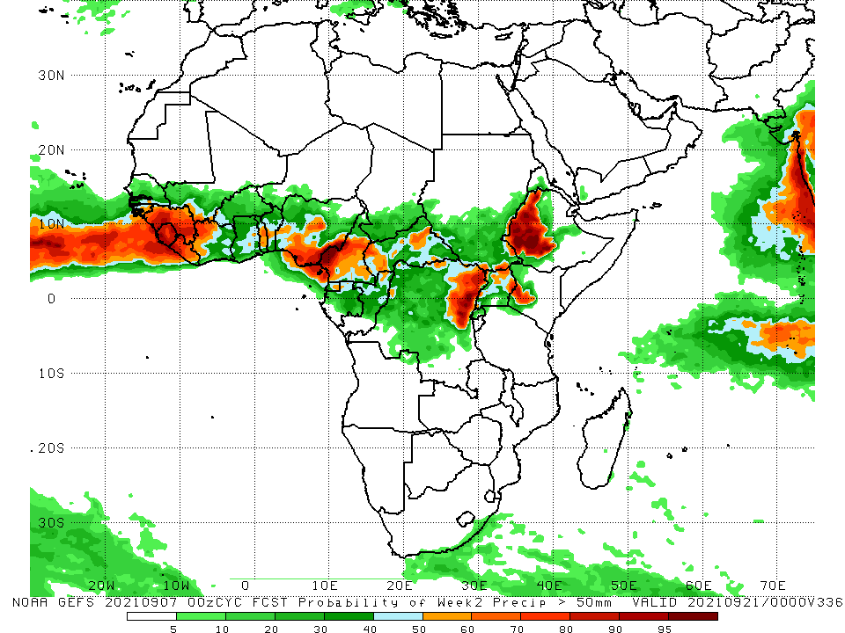
NCEP GEFS Model Forecasts Non-Bias Corrected Probability of precipitation exceedance
Week-1, Valid: 8 – 14 September 2021
Week-2, Valid: 15 – 21 September 2021
For week-1 and week-2 (left panel), the NCEP GEFS forecasts indicate a moderate to high chance (over 70%) for rainfall to exceed 50 mm over southern Senegal, Guinea-Bissau, Guinea, Sierra Leone, Liberia, southwestern Mali, western Burkina Faso, Côte d’Ivoire, Togo, Benin, portions of Nigeria, Cameroon, Equatorial Guinea, southern Chad, parts of CAR, northeastern DRC, northern Uganda, western Kenya, and western Ethiopia.
In addition, week-1 forecast depicts an increased chance for weekly rainfall to exceed 50 mm across parts of Ghana, Gabon, western Congo, and western South Sudan.
Notes:
9

Slide 10
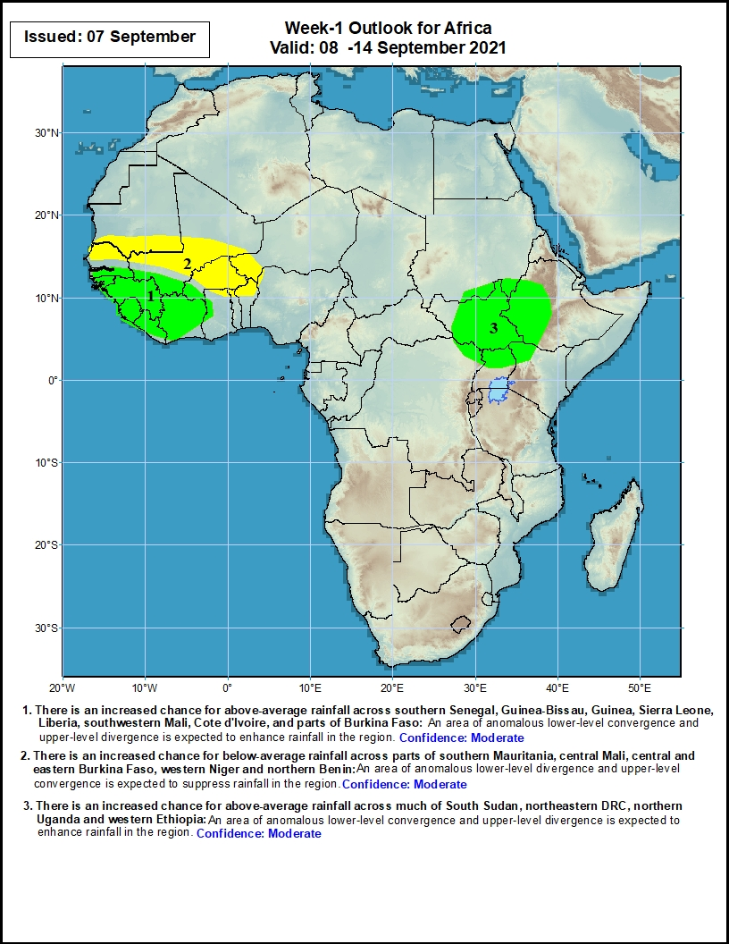
Week-1 Precipitation Outlooks
8 – 14 September 2021
There is an increased chance for above-average rainfall across southern Senegal, Guinea-Bissau, Guinea, Sierra Leone, Liberia, southwestern Mali, Côte d’Ivoire, and parts of Burkina Faso: An area of anomalous lower-level convergence and upper-level divergence is expected to enhance rainfall in the region. Confidence: Moderate
There is an increased chance for below-average rainfall across parts of southern Mauritania, central Mali, central and eastern Burkina Faso, western Niger, and northern Benin: An area of anomalous lower-level divergence and upper-level convergence is expected to suppress rainfall in the region. Confidence: Moderate
There is an increased chance for above-average rainfall across much of South Sudan, northeastern DRC, northern Uganda, and western Ethiopia: An area of anomalous lower-level divergence is expected to enhance rainfall in the region. Confidence: Moderate
Notes:
10

Slide 11
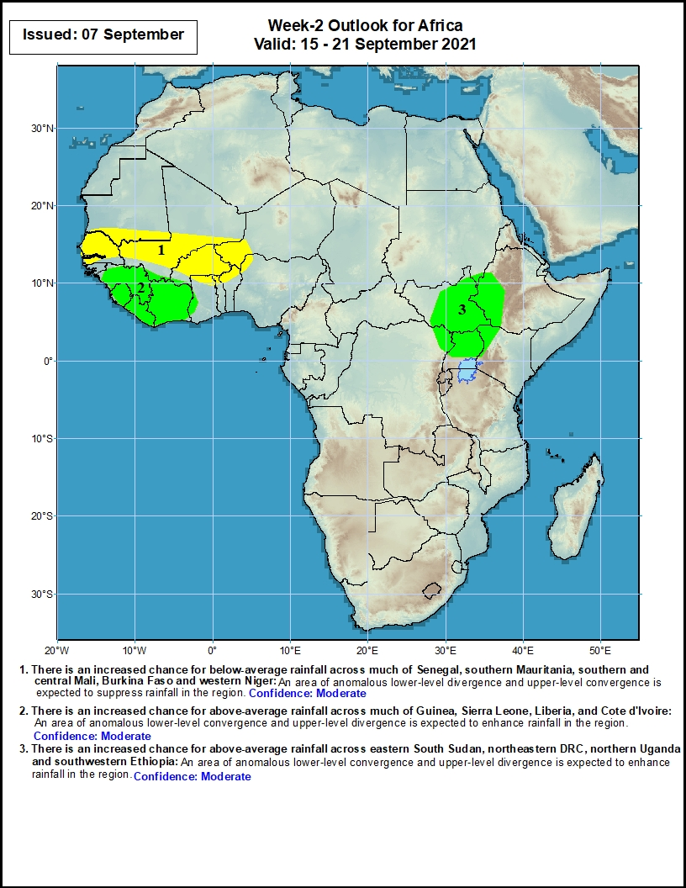
Week-2 Precipitation Outlooks
15 – 21 September 2021
There is an increased chance for below-average rainfall across much of Senegal, southern Mauritania, southern and central Mali, Burkina Faso, and western Niger: An area of anomalous lower-level divergence and upper-level convergence is expected to suppress rainfall in the region. Confidence: Moderate
There is an increased chance for above-average rainfall across much of Guinea, Sierra Leone, Liberia, and Côte d’Ivoire: An area of anomalous lower-level convergence and upper-level divergence is expected to suppress rainfall in the region. Confidence: Moderate
There is an increased chance for above-average rainfall across eastern South Sudan, northeastern DRC, northern Uganda, and southwestern Ethiopia: An area of anomalous lower-level convergence and upper-level divergence is expected to suppress rainfall in the region. Confidence: Moderate
Notes:
11

Slide 12
Summary
During the past 30 to 90 days, in East Africa, above-average rainfall was observed over Sudan, many parts of South Sudan, Eritrea, northern Ethiopia, and local areas over northern and southern Somalia. Rainfall was below-average over southeastern South Sudan, Uganda, and western Kenya. In Central Africa, moisture surpluses were found in eastern Chad, portions of CAR, Gabon, Congo, and parts DRC. Moisture deficits occurred in Cameroon, western Chad, northwestern CAR, and portions of DRC. Southern Mauritania, Senegal, Guinea-Bissau, Guinea, Sierra Leone, Liberia, southern Burkina Faso, and much of the Gulf of Guinea countries observed above-average rainfall. Eastern Nigeria continued to experience drier than normal conditions.
During the past 7 days, the East African region observed above-normal rainfall conditions. In Central Africa, rainfall was above-average over central and southwestern Cameroon, and much of CAR and DRC. Chad, and northern and southern Cameroon observed light moisture deficits. Moisture deficits were present over the Sahel region. Western and eastern Guinea, Sierra Leone, Liberia, and much of the Gulf of Guinea countries experienced moisture surpluses. Northern Nigeria experienced below-normal rainfall, while the southern part of the country experienced above-normal precipitation.
The week-1 outlooks depict an increased chance for above-average rainfall across southern Senegal, Guinea-Bissau, Guinea, Sierra Leone, Liberia, southwestern Mali, Côte d’Ivoire, parts of Burkina Faso, much of South Sudan, northeastern DRC, northern Uganda, and western Ethiopia. Conversely, there is an increased chance for below-average rainfall across parts of southern Mauritania, central Mali, central and eastern Burkina Faso, western Niger, and northern Benin.
The week-2 outlooks call for an increased chance for above-average rainfall across much of Guinea, Sierra Leone, Liberia, Côte d’Ivoire, eastern South Sudan, northeastern DRC, northern Uganda, and southwestern Ethiopia. In contrast, there is an increased chance for below-average rainfall across much of Senegal, southern Mauritania, southern and central Mali, Burkina Faso, and western Niger.

