Slide 1
The African Monsoon Recent Evolution and Current Status Include Week-1 and Week-2 Outlooks
Update prepared by
12 October 2021
For more information, visit:
http://www.cpc.ncep.noaa.gov/products/Global_Monsoons/African_Monsoons/precip_monitoring.shtml

Slide 2
Outline
Highlights
Recent Evolution and Current Conditions
NCEP GEFS Forecasts
Summary

Slide 3
Highlights: Last 7 Days
During the past 7 days, local areas in Nigeria, western Cameroon, eastern Sudan, Ethiopia, and northern Somalia received precipitation totals of over 100 mm (moisture surpluses of over 100 mm).
The week-1 outlooks depict an increased chance for above-average rainfall across southern Guinea, Sierra Leone, Liberia, southeastern Sudan, western South Sudan and western Ethiopia. Conversely, there is an increased chance for below-average rainfall across southern Burkina Faso, northeastern Cote d’Ivoire, Ghana, Togo, Benin, Central African Republic, southeastern Cameroon, northern Congo, northern DR Congo and eastern South Sudan.
The week-2 outlooks call for an increased chance for above-average rainfall across southern Guinea, Sierra Leone, Liberia, eastern South Sudan and southwestern Ethiopia. In contrast, there is an increased chance for below-average rainfall across southern Burkina Faso, eastern Cote d’Ivoire, Ghana, Togo, Benin, eastern Nigeria, Central African Republic, northern DR Congo and eastern South Sudan.

Slide 4
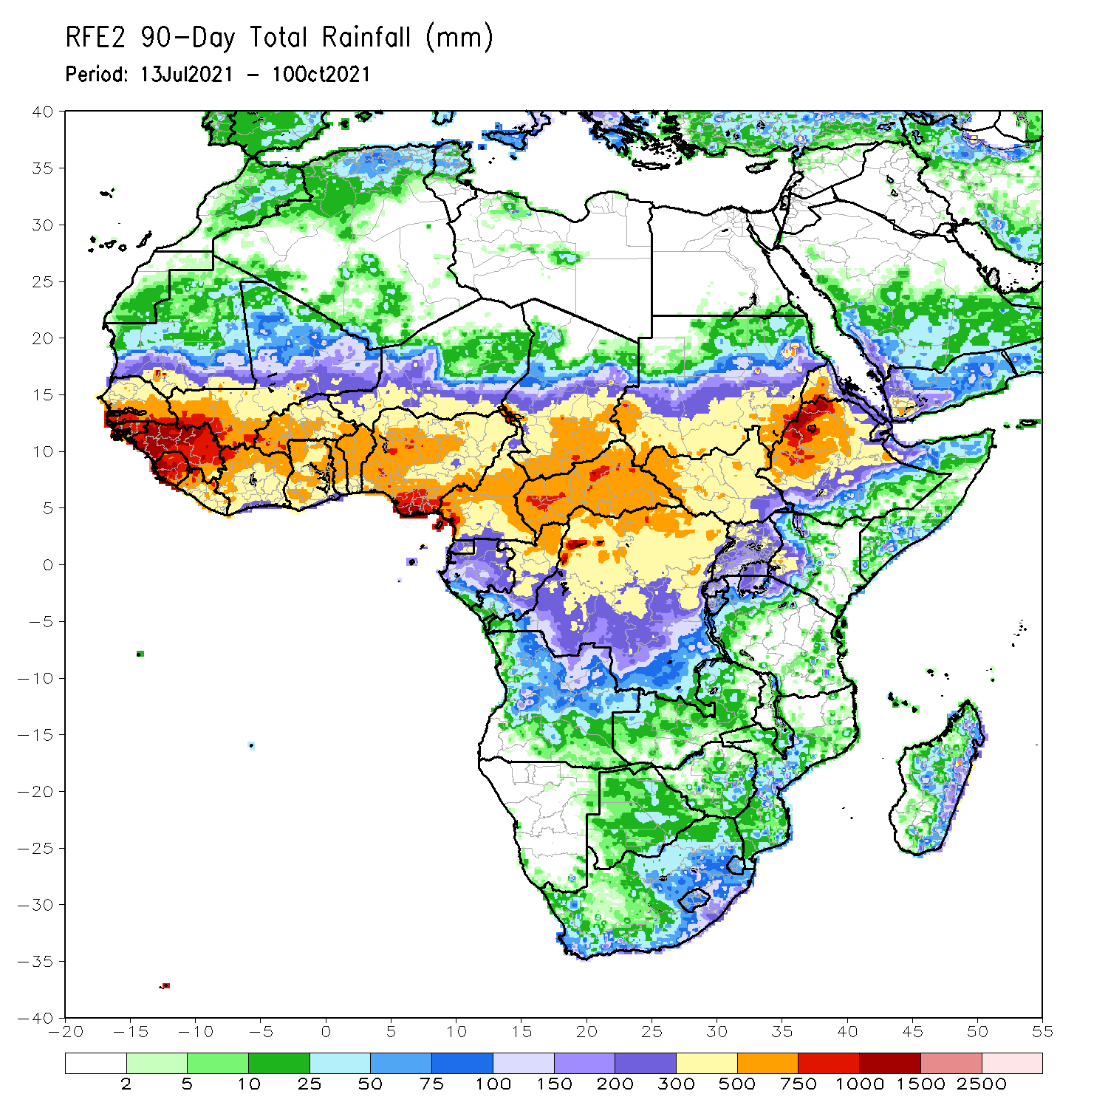
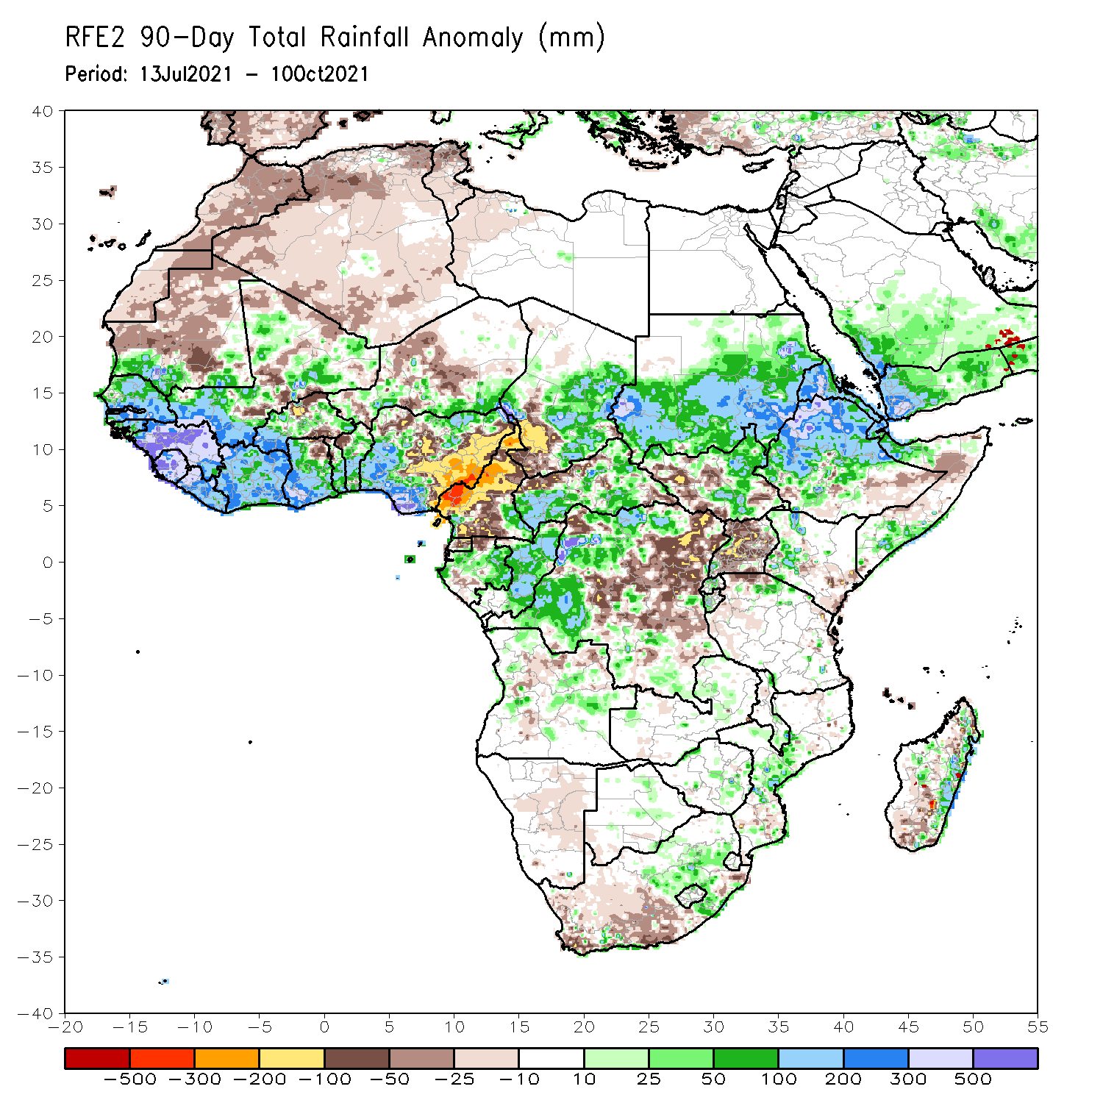
Rainfall Patterns: Last 90 Days
Over the past 90 days, in West Africa, rainfall totals exceeded 1000 mm across Guinea, Sierra Leone, and coastline of Nigeria (moisture surpluses of over 500 mm). Precipitation was in excess of 200 mm across southern Senegal, southwestern Mali, Liberia, southwestern Burkina Faso, portions of Côte d’Ivoire, southwestern Ghana, and southwestern Nigeria. Conversely, local areas in northern Burkina Faso and central and eastern Nigeria experienced moisture deficits of over 100 mm.
In Central Africa, positive precipitation anomalies of 100-200 mm were found over the western border of Chad and Cameroon, eastern Chad, portions of CAR, eastern Gabon, Congo, and local areas in western DRC. Large negative precipitation anomalies of over 100 mm were observed in Cameroon, southwestern Chad, and local areas in northwestern CAR and eastern DRC. In particular, southwestern Cameroon experienced moisture deficits of 300-500 mm.
In East Africa, northwestern Ethiopia received heavy rainfall amounts of over 1000 mm (more than 300 mm above the mean). Precipitation was in excess of 200 mm in western and eastern Sudan, western Eritrea, and northern Ethiopia. Uganda continued to experience sustained negative precipitation anomalies of over 50 mm.
In southern Africa, the central part of Mozambique and the eastern coast of Madagascar registered rainfall amounts of over 200 mm (moisture surpluses of over 100 mm). Precipitation was above-average across the northeastern part of South Africa. Light moisture deficits of 10-50 mm were present across much of western South Africa, and portions of Madagascar.
Notes:
4

Slide 5
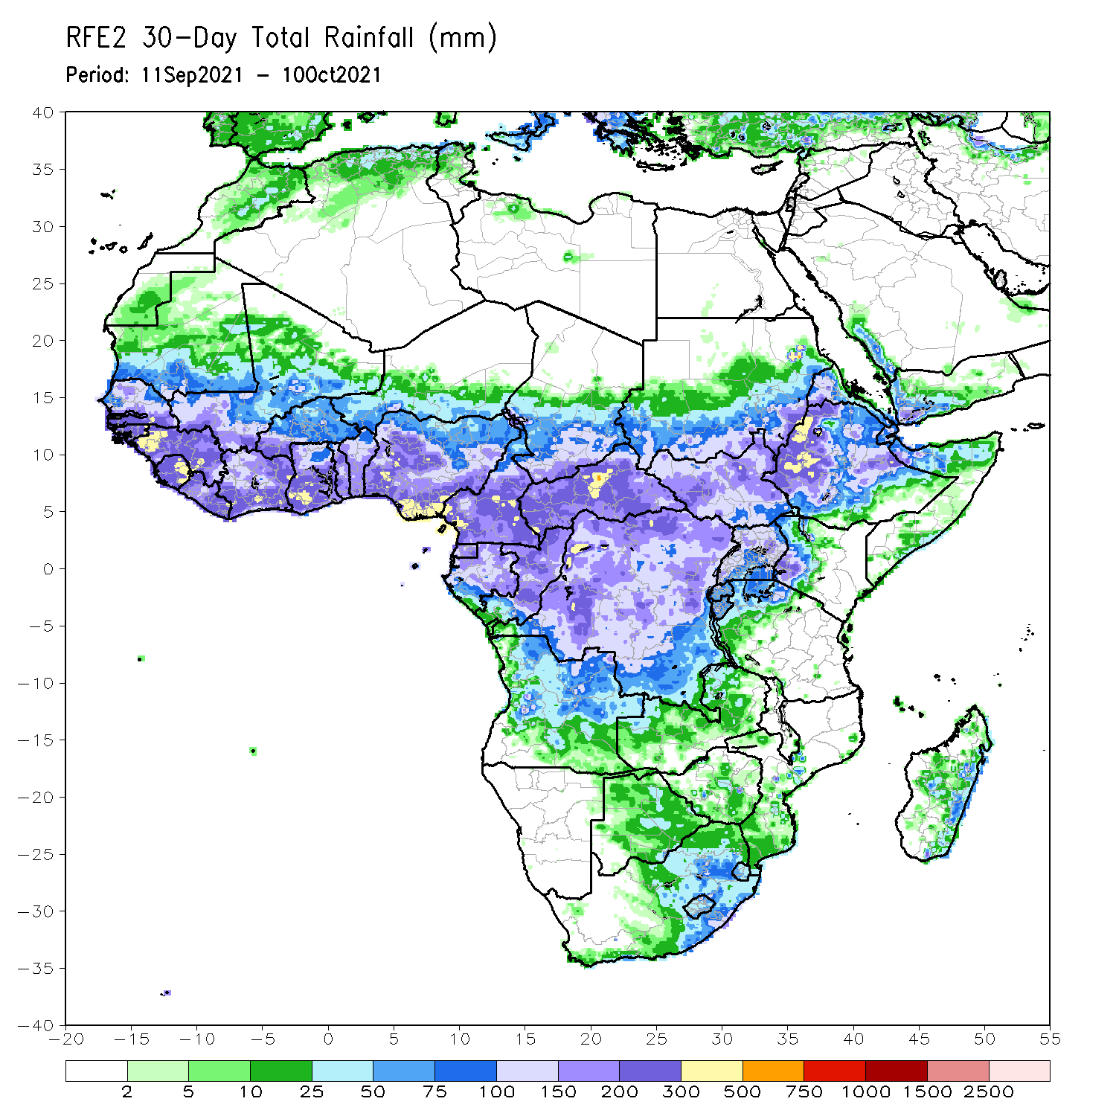
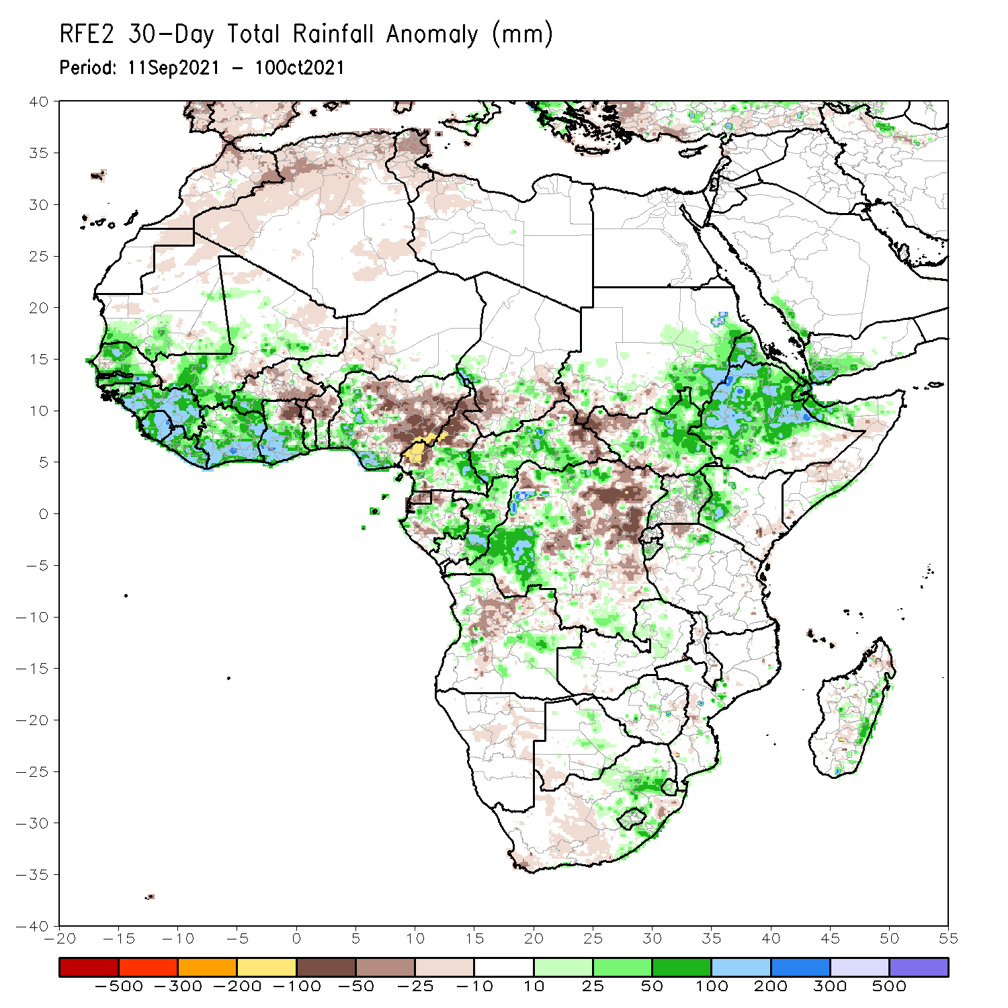
Rainfall Patterns: Last 30 Days
During the past 30 days, in West Africa, above-average rainfall was observed across much of Senegal, Guinea-Bissau, Guinea, Sierra Leone, portions of Mali, southwestern Burkina Faso, Côte d’Ivoire, much of Ghana, southern Togo, southern Benin, and western and southern Nigeria (more than 50 mm above the mean). Portions of Burkina Faso, northeastern Ghana, northern Togo, northern Benin, and much of Nigeria, experienced below-average rainfall (more than 25 mm below the mean). Eastern Nigeria observed negative precipitation anomalies of over 100 mm.
In Central Africa, precipitation was 100 mm above the mean across local areas in western Chad, southeastern Cameroon, CAR, southern Togo, and western and northern DRC. Southwestern and southeastern Chad, northern Cameroon, Equatorial Guinea, eastern CAR, and northeastern of DRC received below-average rainfall (more than 50 mm below the mean). In particular, western Cameroon observed negative precipitation anomalies of 100-200 mm.
In East Africa, rainfall amounts reached 300-500 mm in northwestern Ethiopia. Moisture surpluses of over 100 mm were found across eastern Sudan, local areas in eastern CAR, western Eritrea, Ethiopia, and northern Somalia. Moisture deficits of over 25 mm were observed over southwestern Sudan, and northwestern South Sudan.
In Southern Africa, the eastern part of South Africa and eastern coastline of Madagascar observed above-average rainfall (more than 50 mm above the mean).
Notes:
5

Slide 6
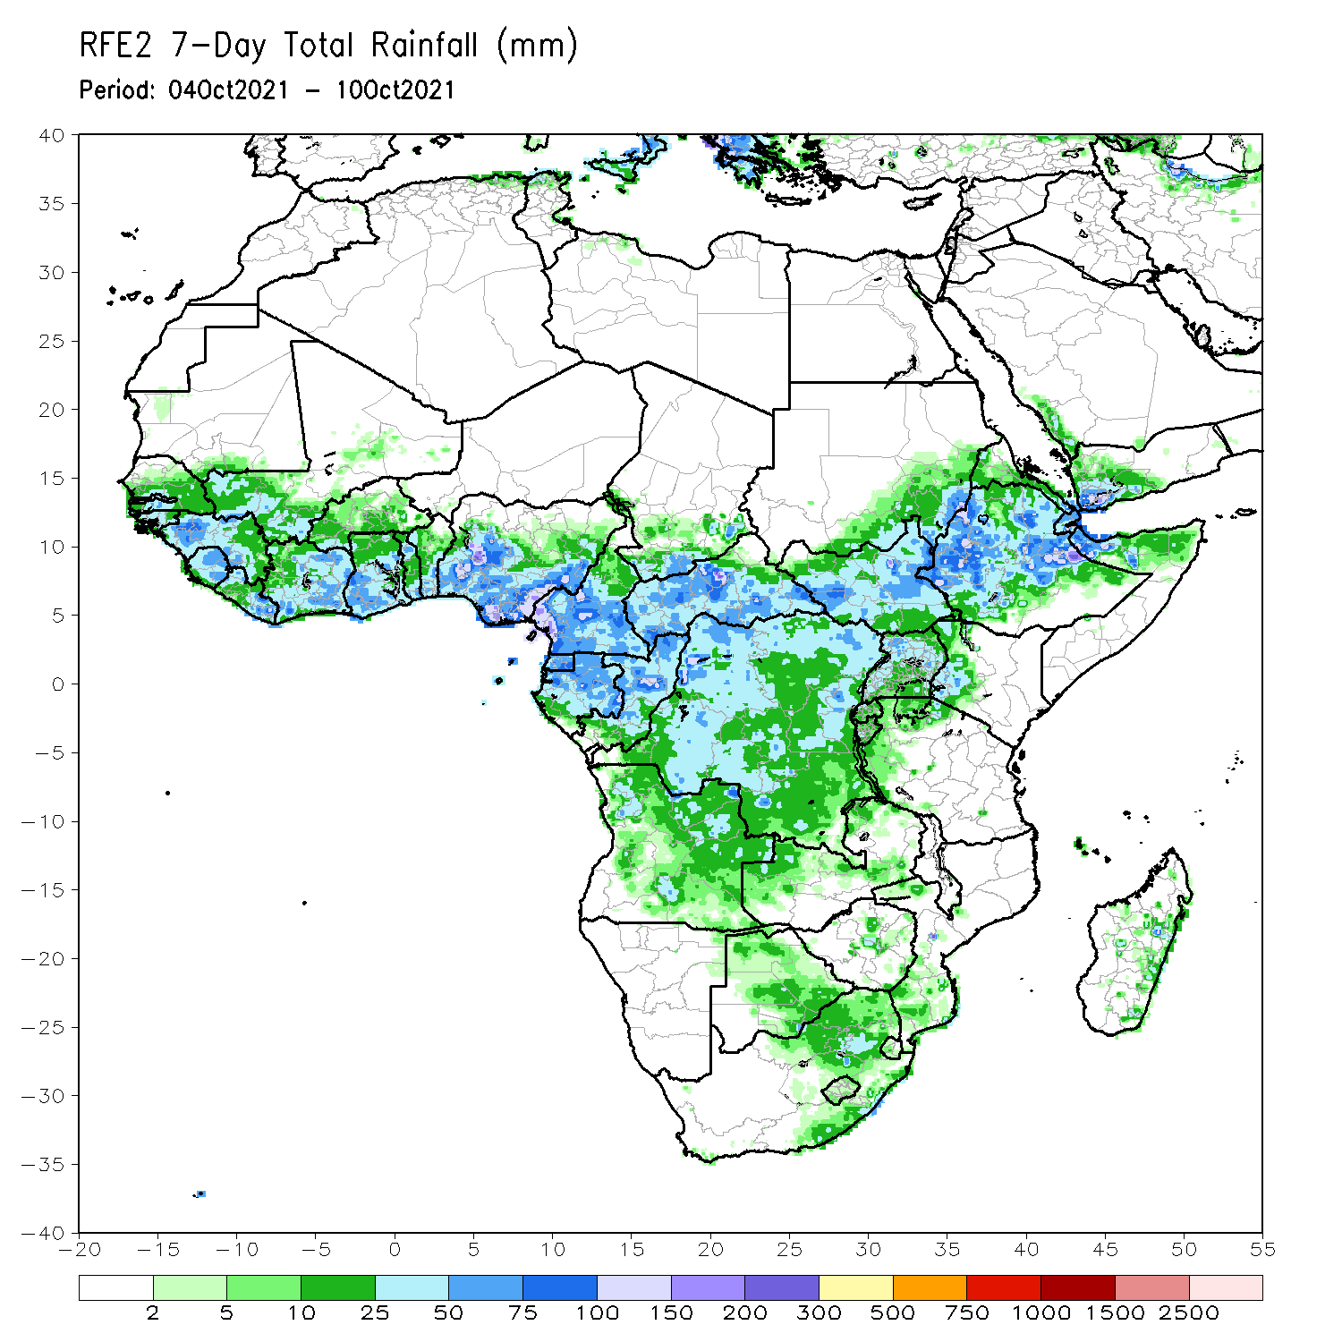
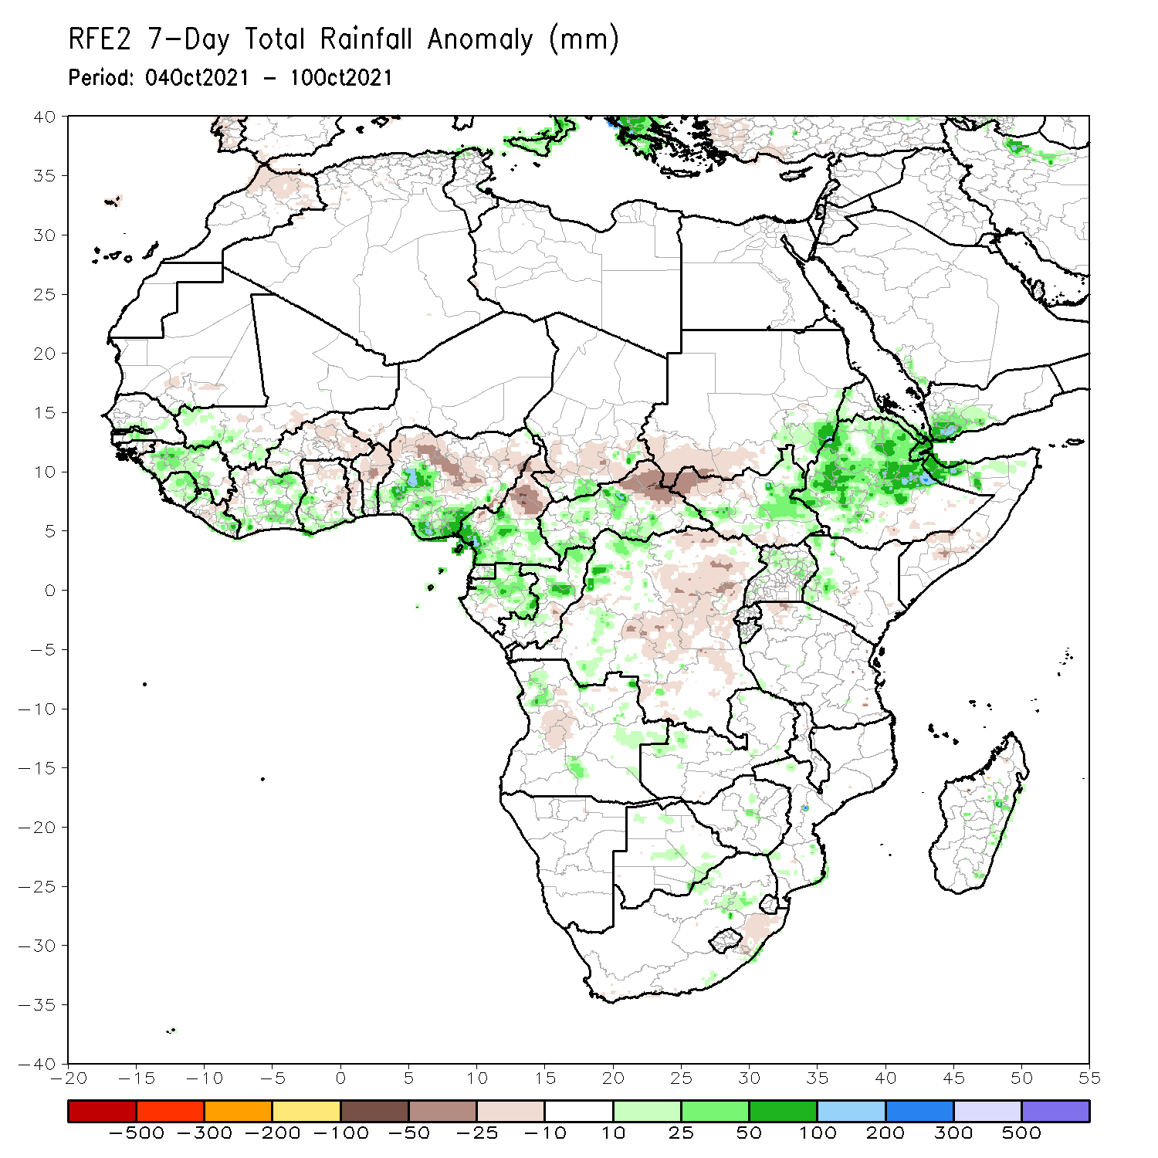
Rainfall Patterns: Last 7 Days
During the past 7 days, in West Africa, precipitation was slightly above-average across Senegal, southwestern Mali, Guinea, Sierra Leone, Liberia, Côte d’Ivoire, southern Ghana. The southern part of Nigeria observed above-average rainfall (more than 50 mm above the mean), while the northern part of the country observed below-average rainfall (more than 10 mm below the mean).
In Central Africa, southern Cameroon, Gabon, Congo, much of CAR, and western DRC experienced above-average rainfall. Conversely, southern Chad, northern Cameroon, northern CAR, and eastern DRC experienced below-average rainfall.
East Africa, moisture surpluses of over 50 mm were observed across eastern Sudan, parts of South Sudan, Ethiopia,, Eritrea, and northern Somalia. Moisture deficits of 10-25 mm were found across southern Sudan and northern and southern South Sudan.

Slide 7
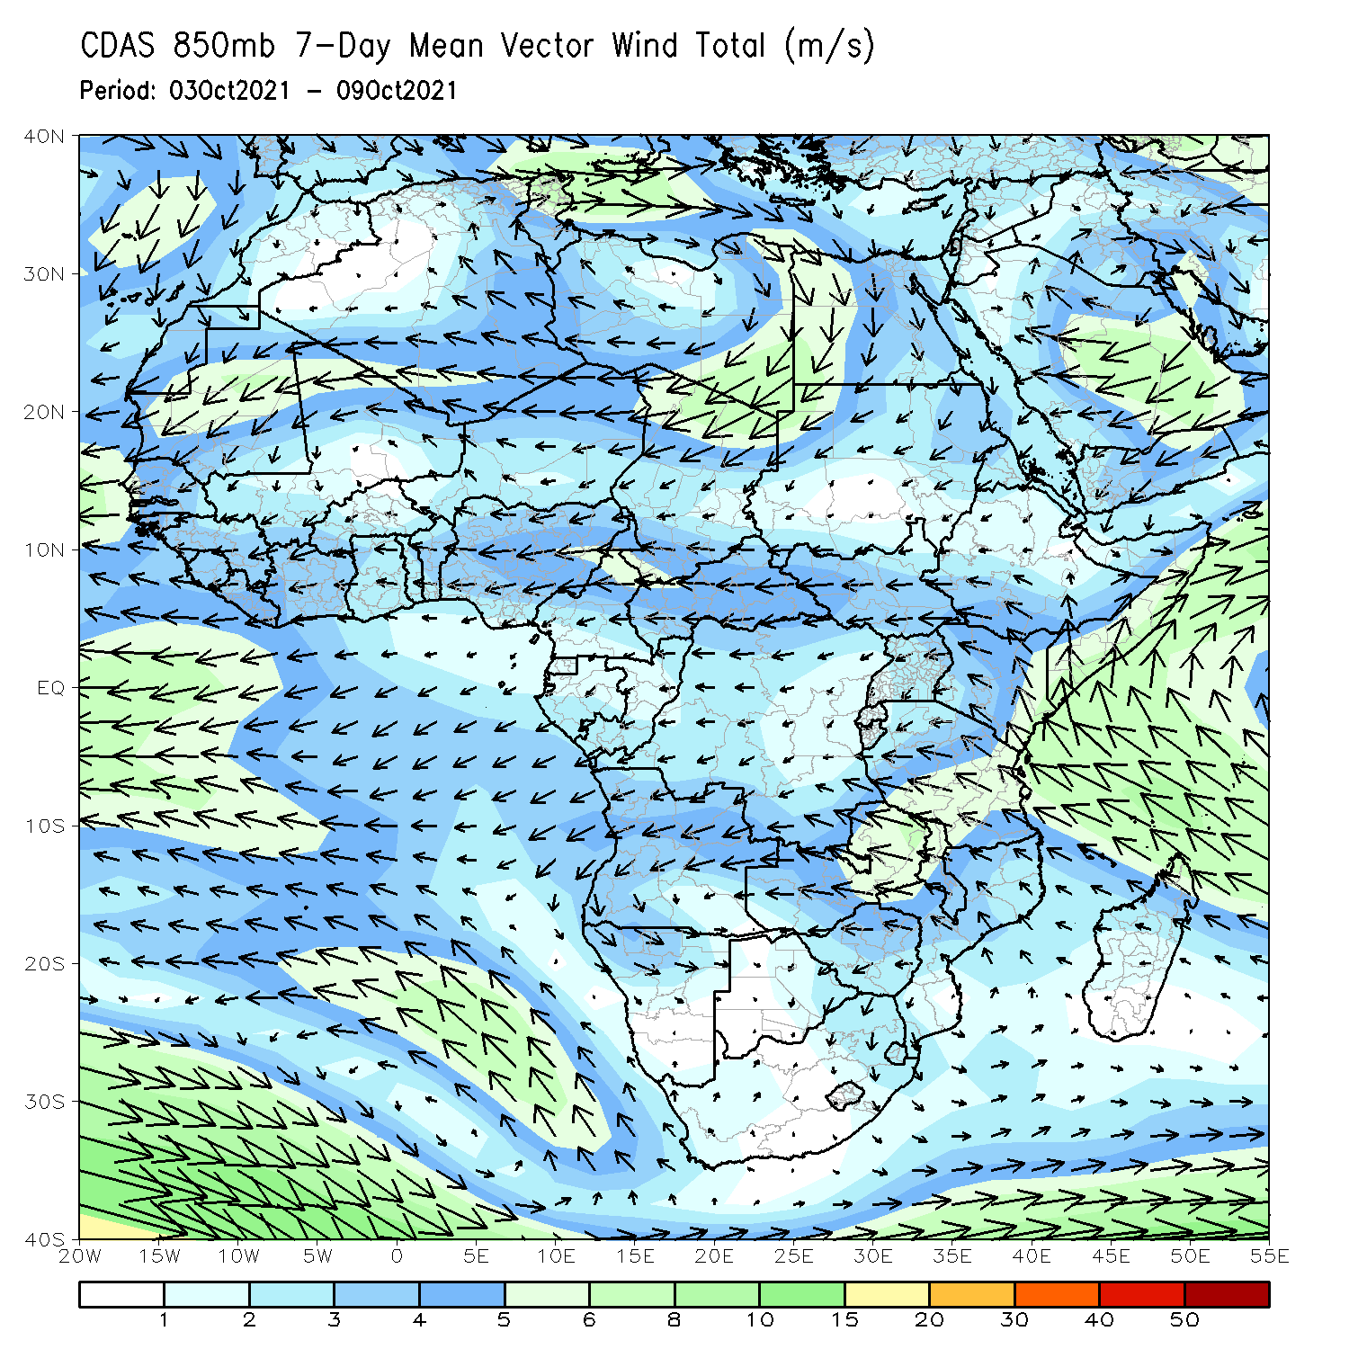
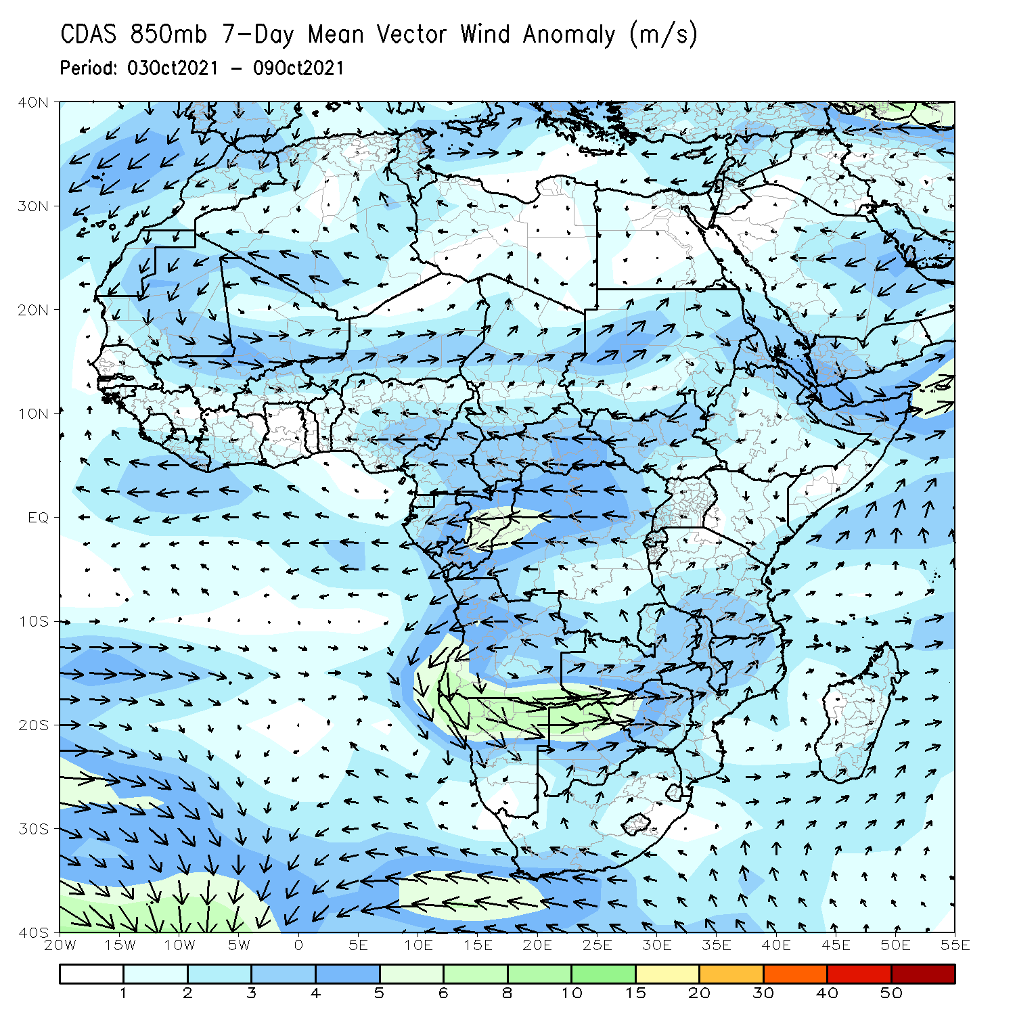
Atmospheric Circulation: Last 7 Days
The 850-hPa atmospheric circulation pattern features an anomalous anticyclonic circulation over Sudan and an cyclonic circulation over Angola.
A strong anomalous easterly flow was present over DRC, Congo, and Gabon.

Slide 8
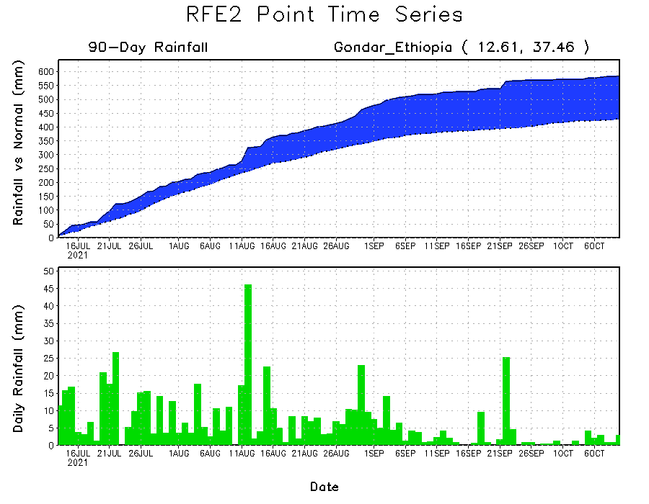
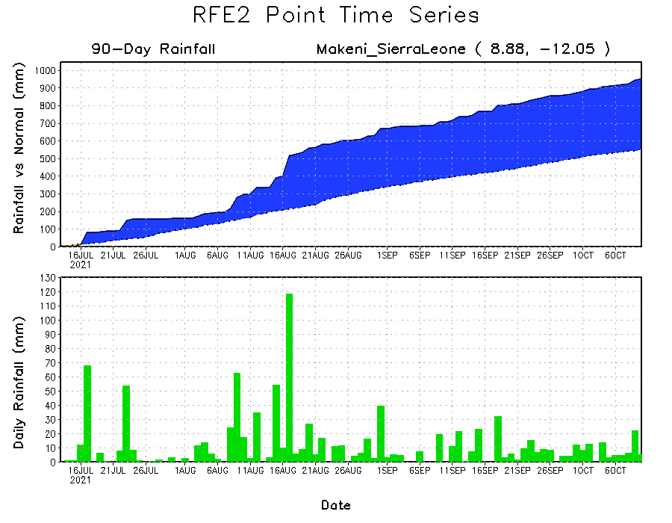
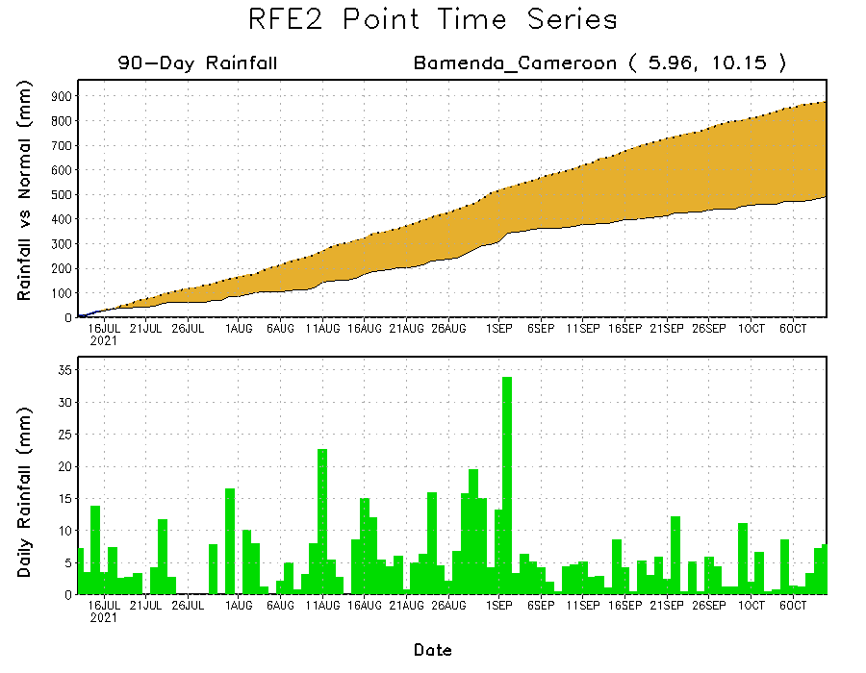
Rainfall Evolution
Daily evolution of rainfall over the last 90 days at selected locations shows moderate to heavy rainfall sustained moisture surpluses over Sierra Leone (bottom left) and northwestern Ethiopia (top right). In contrast, seasonal total rainfall remained below-average over southwestern Cameroon despite recent rainfall (bottom right).

Slide 9
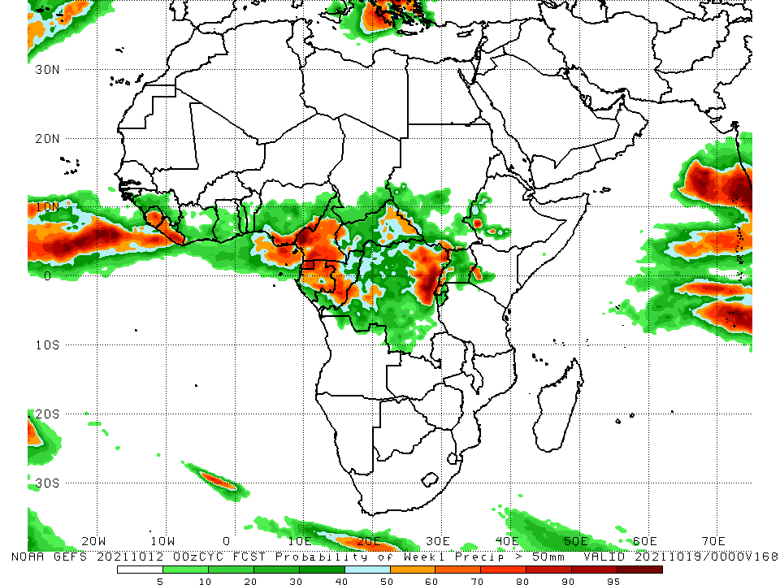
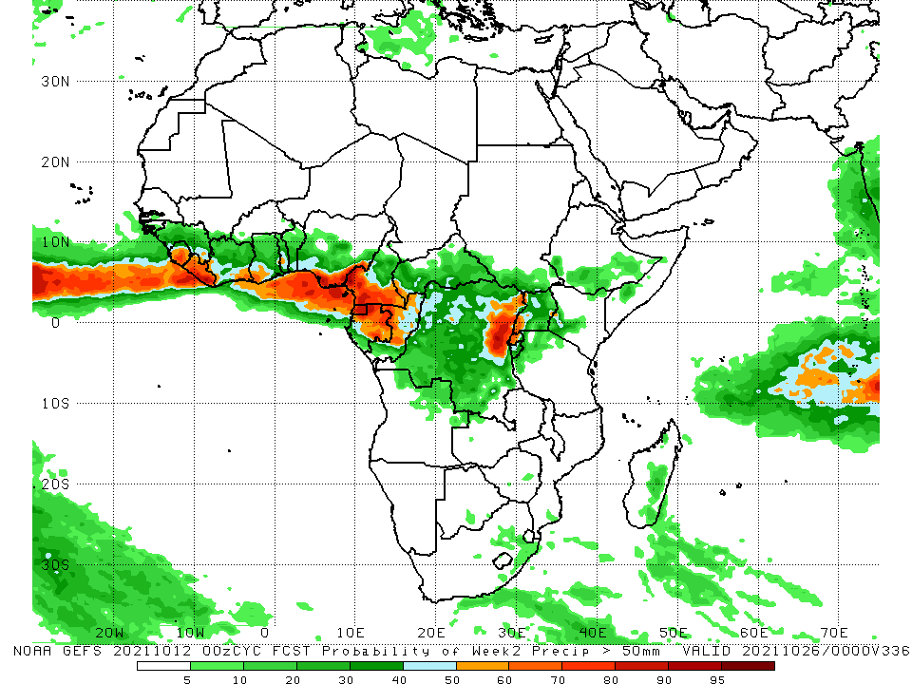
NCEP GEFS Model Forecasts Non-Bias Corrected Probability of precipitation exceedance
Week-1, Valid: 13 – 19 October 2021
Week-2, Valid: 20 – 26 October 2021
For week-1 (left panel), the NCEP GEFS forecasts indicate a moderate to high chance (over 70%) for rainfall to exceed 50 mm over Sierra Leone, Liberia, southern Nigeria, much of Cameroon, Equatorial Guinea, Gabon, Congo, parts of DRC, western and eastern CAR, Rwanda, and local areas in South Sudan, western Uganda, western Kenya, and western Ethiopia.
week-2 forecast (right panel) depicts an increased chance for weekly rainfall to exceed 50 mm across Sierra Leone, Liberia, southern Côte d’Ivoire, southern Togo, southern Nigeria, southern Cameroon, southwestern CAR, Equatorial Guinea, Gabon, Congo, northeastern DRC, Rwanda, and western Uganda.
Notes:
9

Slide 10
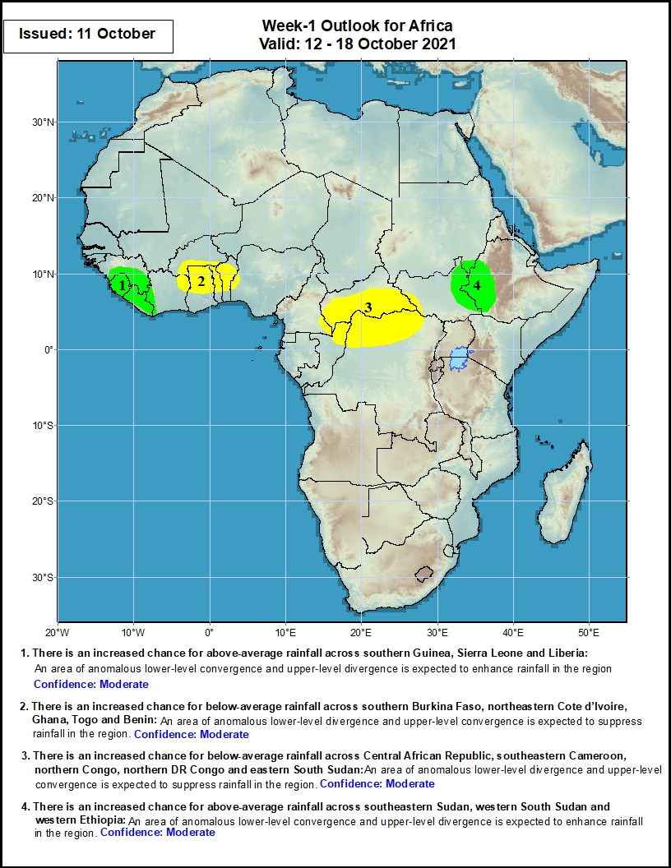
Week-1 Precipitation Outlooks
12 – 18 October 2021
There is an increased chance for above-average rainfall across southern Guinea, Sierra Leone and Liberia: An area of anomalous lower-level convergence and upper-level divergence is expected to enhance rainfall in the region. Confidence: Moderate
There is an increased chance for below-average rainfall across southern Burkina Faso, northeastern Cote d’Ivoire, Ghana, Togo and Benin: An area of anomalous lower-level divergence and upper-level convergence is expected to suppress rainfall in the region. Confidence: Moderate
There is an increased chance for below-average rainfall across Central African Republic, southeastern Cameroon, northern Congo, northern DR Congo and eastern South Sudan: An area of anomalous lower-level divergence and upper-level convergence is expected to suppress rainfall in the region. Confidence: Moderate
There is an increased chance for above-average rainfall across southeastern Sudan, western South Sudan and western Ethiopia: An area of anomalous lower-level convergence and upper-level divergence is expected to enhance rainfall in the region. Confidence: Moderate
Notes:
10

Slide 11
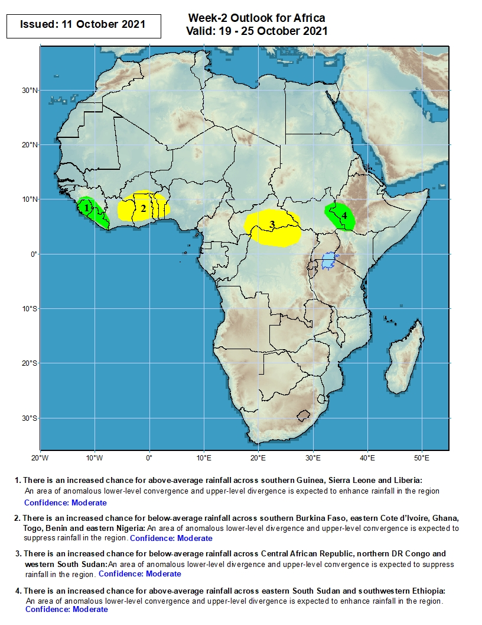
Week-2 Precipitation Outlooks
19 – 25 October 2021
There is an increased chance for above-average rainfall across southern Guinea, Sierra Leone and Liberia: An area of anomalous lower-level convergence and upper-level divergence is expected to enhance rainfall in the region. Confidence: Moderate
There is an increased chance for below-average rainfall across southern Burkina Faso, eastern Cote d’Ivoire, Ghana, Togo, Benin and eastern Nigeria: An area of anomalous lower-level divergence and upper-level convergence is expected to suppress rainfall in the region. Confidence: Moderate
There is an increased chance for below-average rainfall across Central African Republic, northern DR Congo and eastern South Sudan: An area of anomalous lower-level divergence and upper-level convergence is expected to suppress rainfall in the region. Confidence: Moderate
There is an increased chance for above-average rainfall across eastern South Sudan and southwestern Ethiopia: An area of anomalous lower-level convergence and upper-level divergence is expected to enhance rainfall in the region. Confidence: Moderate
Notes:
11

Slide 12
Summary
During the past 30 to 90 days, in West Africa, southern Mauritania, much of Senegal, portions of Mali, southwestern Burkina Faso, Guinea-Bissau, Guinea, Sierra Leone, Liberia, Côte d’Ivoire, much of Ghana, southern Togo, southern Benin, and western and southern Nigeria observed above-average rainfall. Central and eastern Nigeria continued to experience large negative precipitation anomalies. In Central Africa, moisture surpluses were found across much of CAR, Congo, and parts DRC. Moisture deficits occurred in Cameroon, Equatorial Guinea, northern Gabon, and portions of DRC. In East Africa, above-average rainfall prevailed in Sudan, parts of South Sudan, Eritrea, and Ethiopia. The eastern part of South Africa and the eastern coastline of Madagascar experienced above-average rainfall.
During the past 7 days, in West Africa, southern Nigeria received well above-average rainfall, while the northern part of the country observed below-average rainfall. In Central Africa, western Cameroon experienced moisture surpluses of over 100 mm. Northeastern CAR and northern Cameroon observed moisture deficits of 25-50 mm. In East Africa, local areas in eastern South Sudan, many parts of South Sudan, Eritrea, Ethiopia, and northern Somalia received above-average rainfall. Southern Sudan and northern and southern South Sudan experienced light negative precipitation anomalies.
The week-1 outlooks depict an increased chance for above-average rainfall across southern Guinea, Sierra Leone, Liberia, southeastern Sudan, western South Sudan and western Ethiopia. Conversely, there is an increased chance for below-average rainfall across southern Burkina Faso, northeastern Cote d’Ivoire, Ghana, Togo, Benin, Central African Republic, southeastern Cameroon, northern Congo, northern DR Congo and eastern South Sudan.
The week-2 outlooks call for an increased chance for above-average rainfall across southern Guinea, Sierra Leone, Liberia, eastern South Sudan and southwestern Ethiopia. In contrast, there is an increased chance for below-average rainfall across southern Burkina Faso, eastern Cote d’Ivoire, Ghana, Togo, Benin, eastern Nigeria, Central African Republic, northern DR Congo and eastern South Sudan.

