Slide 1
The African Monsoon Recent Evolution and Current Status Include Week-1 and Week-2 Outlooks
Update prepared by
31 January 2022
For more information, visit:
http://www.cpc.ncep.noaa.gov/products/Global_Monsoons/African_Monsoons/precip_monitoring.shtml

Slide 2
Outline
Highlights
Recent Evolution and Current Conditions
NCEP GEFS Forecasts
Summary

Slide 3
Highlights: Last 7 Days
During the past 7 days, in East Africa, rainfall was above-average over parts of Tanzania. Below-average rainfall was observed over parts of southwestern Ethiopia and the far southern Tanzania. In central Africa, rainfall was above-average over portions of DRC. Rainfall was below-average over Equatorial Guinea, Gabon and much of Congo. In Southern Africa, rainfall was above-average over western and southern Angola, southern Zambia, eastern Zimbabwe, Malawi, much of Mozambique, and parts of northeastern South Africa. Below-average rainfall was observed over eastern Angola, Namibia, western Zambia, and much of Madagascar.
Week-1 and week-2 outlooks call for an increased chance for above-average rainfall across the northern portions of Southern Africa, Tanzania and Madagascar. In contrast, there is an increased chance for below-average rainfall over the southern portions of Southern Africa, and equatorial Central Africa.

Slide 4
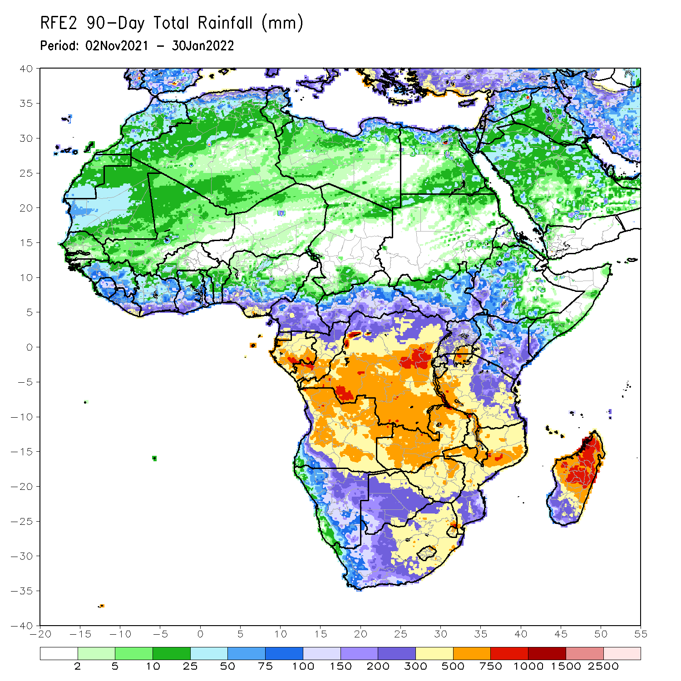
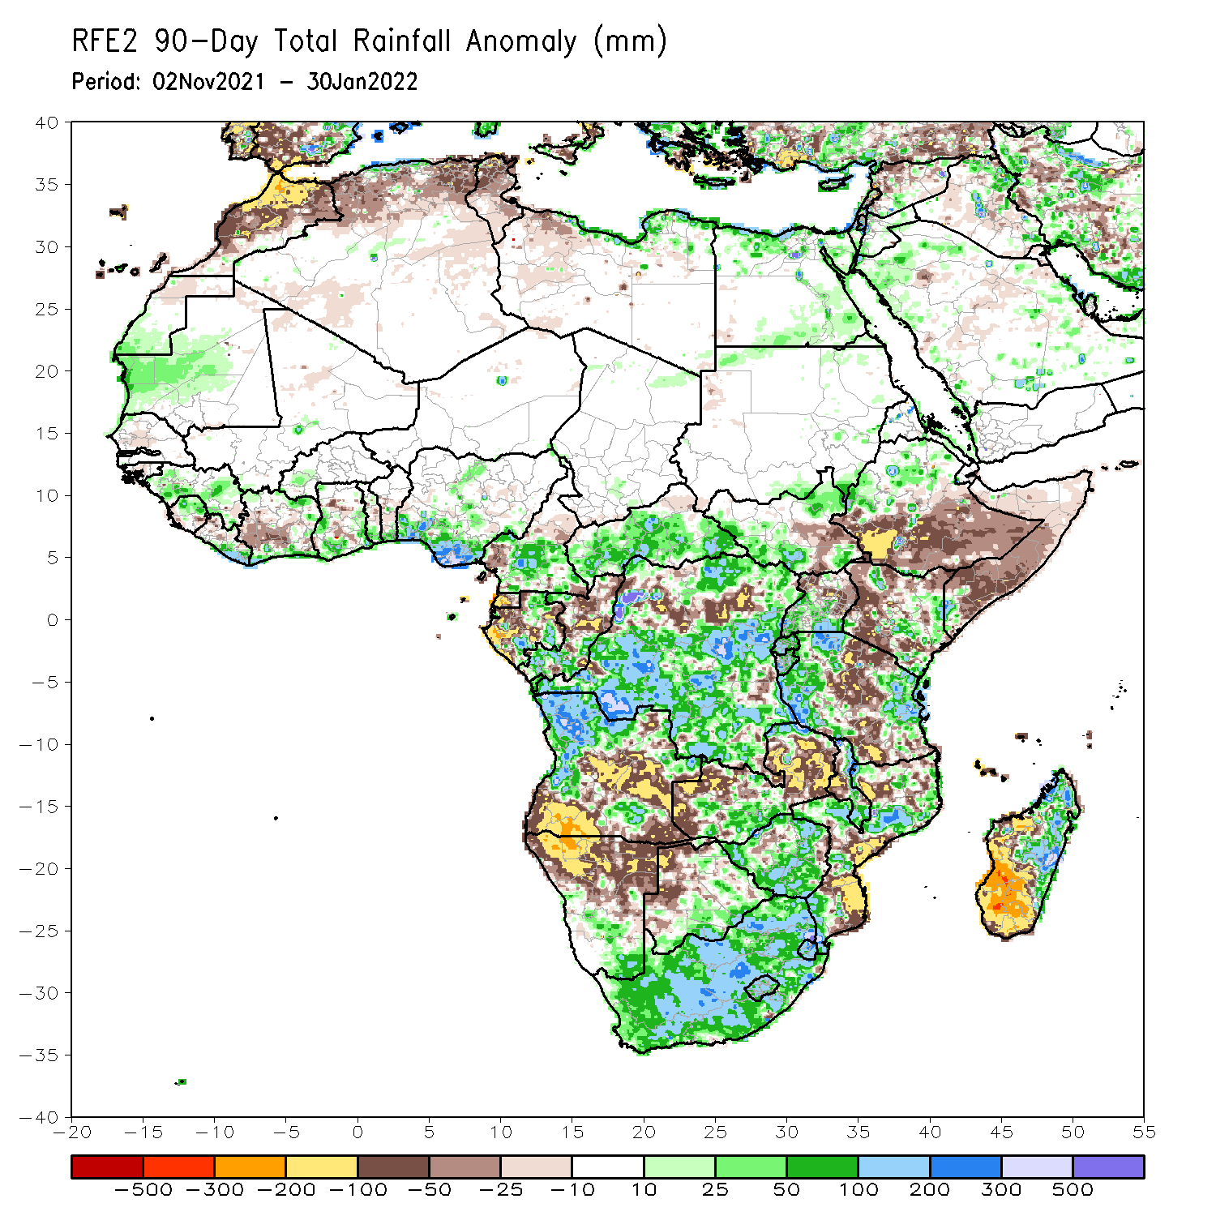
Rainfall Patterns: Last 90 Days
Over the past 90 days, in East Africa, above-average rainfall was observed over parts of northern Ethiopia, South Sudan, Rwanda, Burundi, southern Uganda, eastern Kenya, and parts of western and eastern Tanzania. Rainfall was below-average over southern Ethiopia, much of Somalia, western Kenya, northern Uganda, and the central portions of Tanzania. In southern Africa, above-average rainfall was observed over northern Angola, eastern Botswana, much of Zimbabwe, parts of western Zambia, northern Mozambique, eastern and northern Madagascar and much of South Africa. Below-average rainfall was observed over central and southern Angola, eastern northern and eastern Zambia, much of Namibia, western Botswana, pockets of northern Zimbabwe, parts of Mozambique and western and southern Madagascar. In Central Africa, rainfall was above-average over much of DRC, Gabon, Congo, and CAR Rainfall was below-average over pockets of DRC and northern Congo. In West Africa, rainfall was above-average over pockets of Guinea and southern Nigeria. Below-average rainfall was observed over southern Cote d’Ivoire, and pocket areas of Ghana Nigeria.
Notes:
4

Slide 5
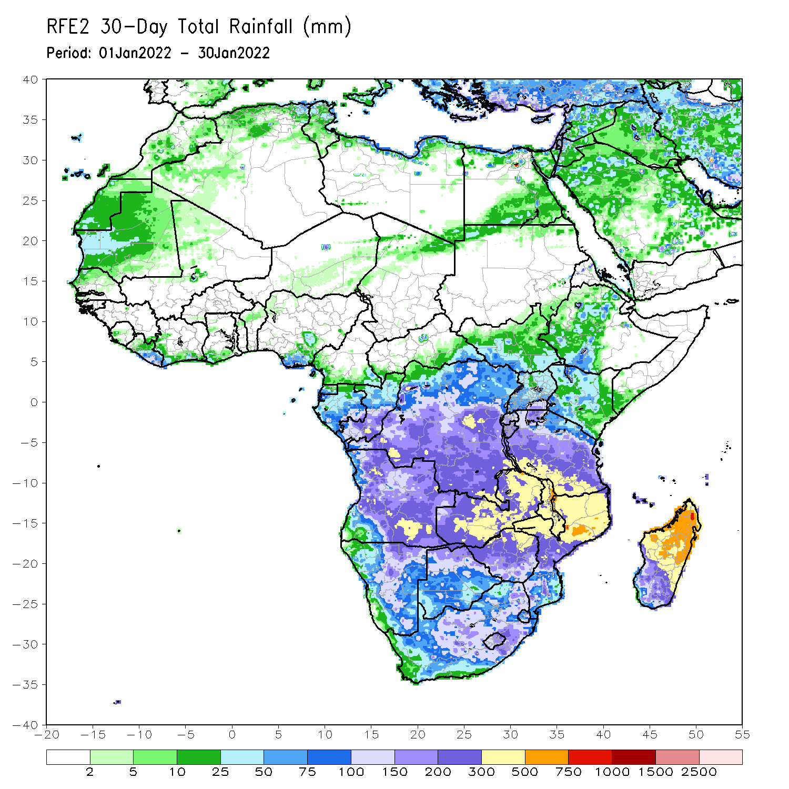
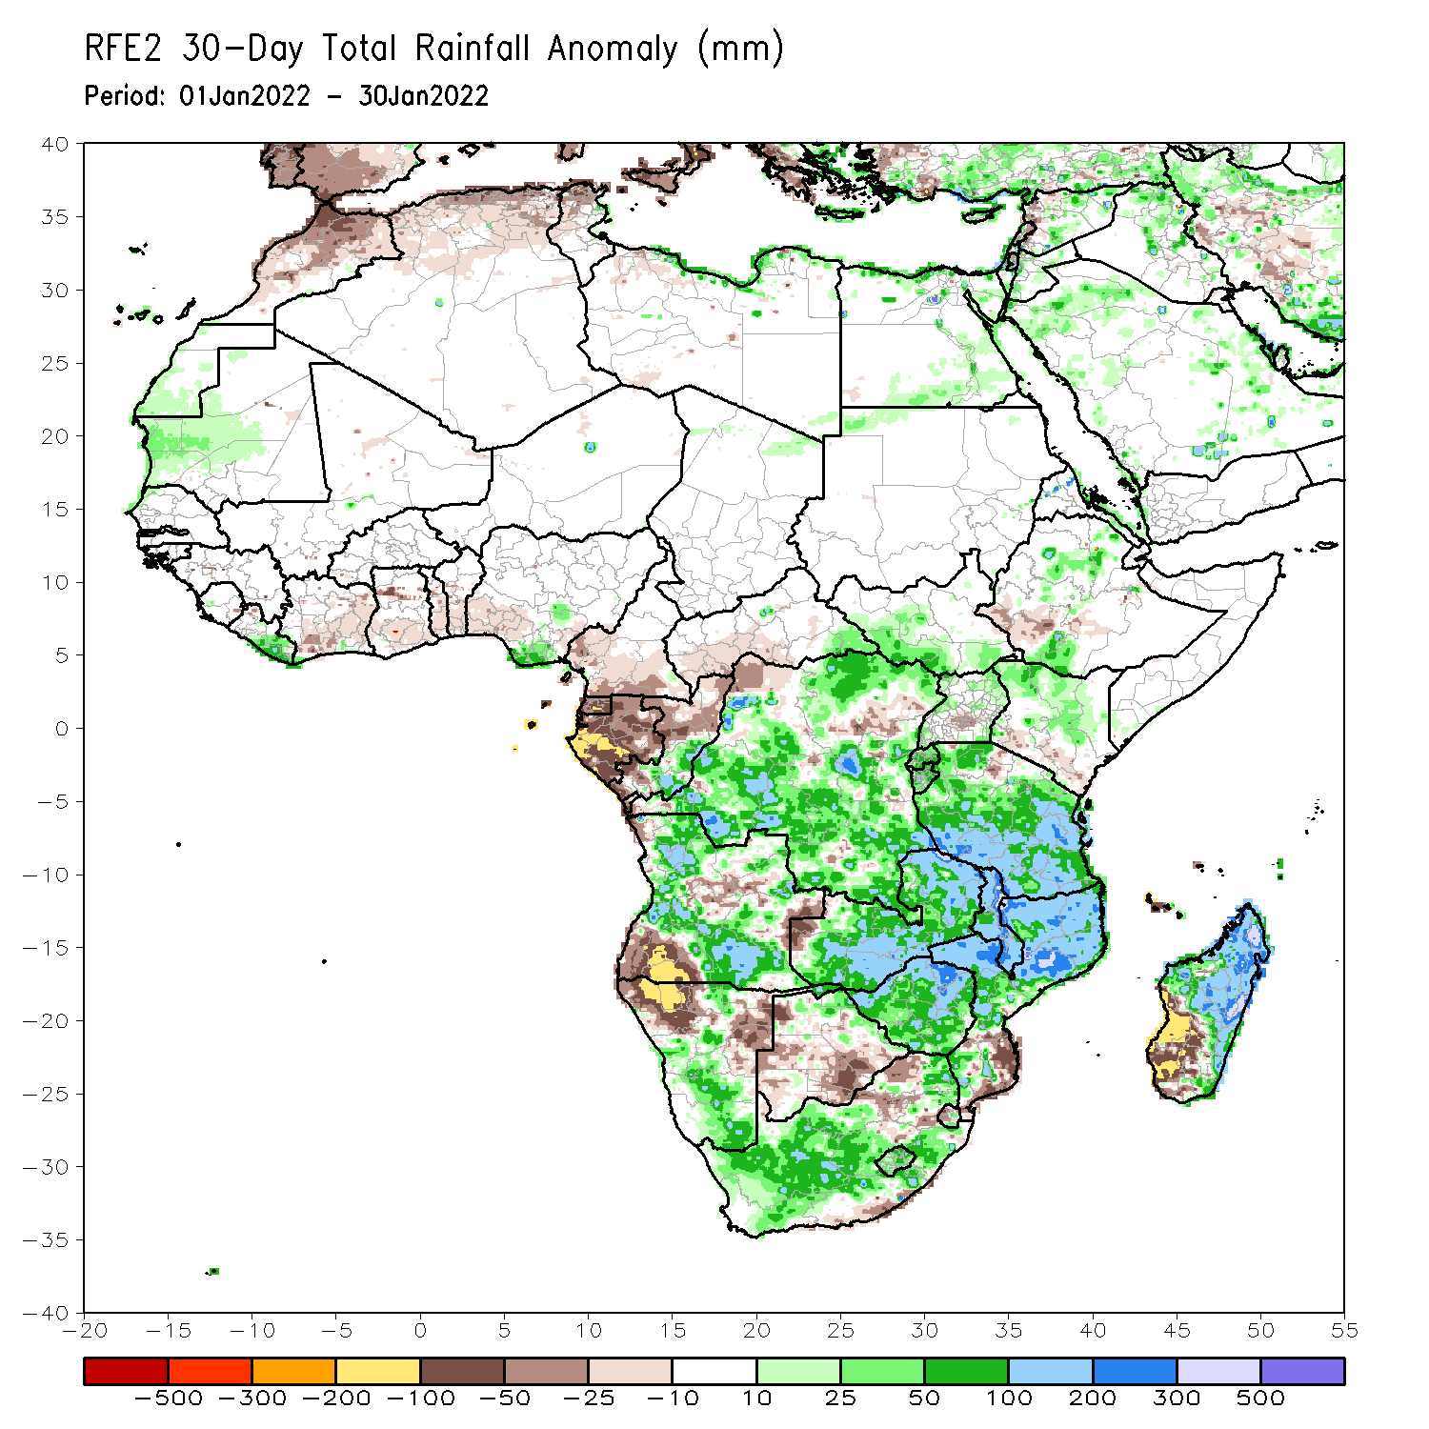
Rainfall Patterns: Last 30 Days
During the past 30 days, in East Africa, above-average rainfall was observed over pocket areas of southern and northern Ethiopia, Uganda, Rwanda, Burundi, central and eastern Kenya, and much of Tanzania. Rainfall was below-average over parts of southwestern Ethiopia, and near Kenya/Tanzania border. In Central Africa, rainfall was below-average over Equatorial Guinea, Gabon and northern Congo. Rainfall was above-average over southern Congo and much of DRC. In Southern Africa, above-average rainfall was observed over many parts of Angola, western and southern Namibia, Zimbabwe, Zambia, Malawi, central and northern Mozambique, northern and eastern Madagascar and much of South Africa. Below-average rainfall was observed over southwestern Angola, the far western Zambia, northern Namibia, Botswana, the far southern Mozambique, and southwestern Madagascar.
Notes:
5

Slide 6
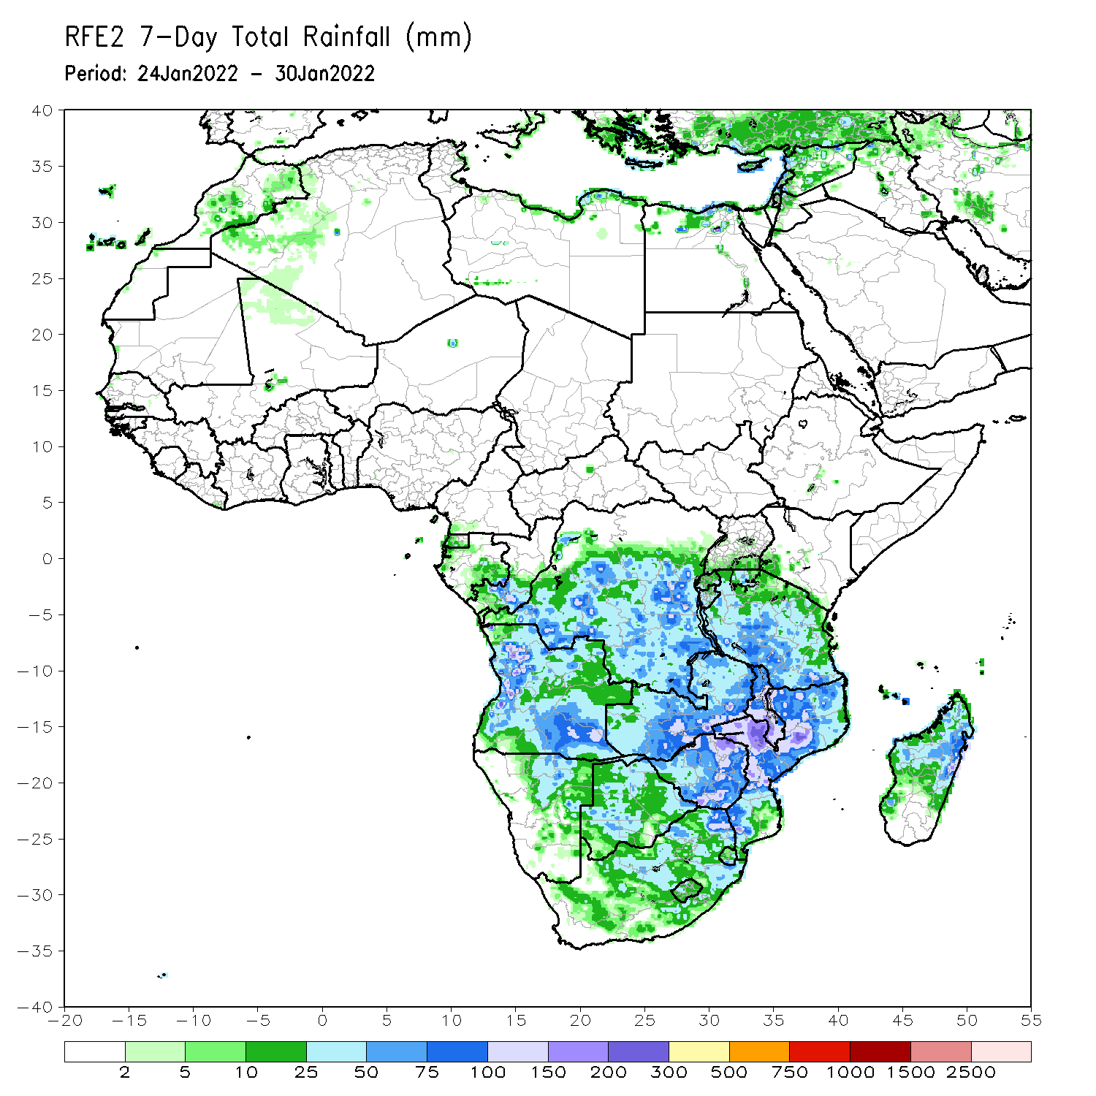
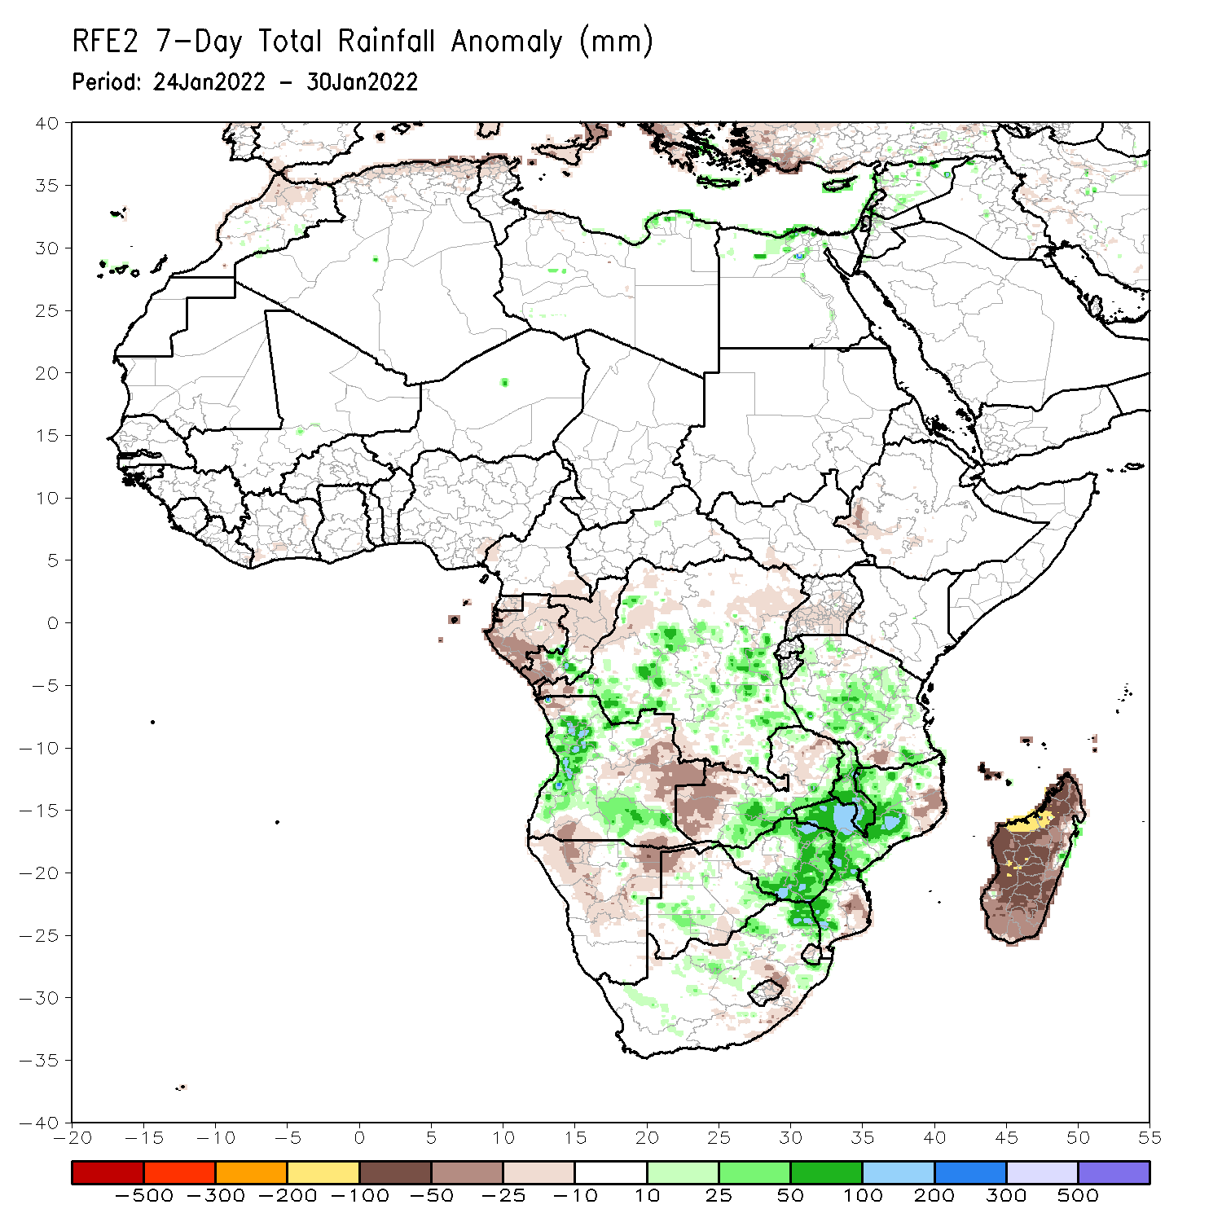
Rainfall Patterns: Last 7 Days
During the past 7 days, in East Africa, rainfall was above-average over parts of Tanzania. Below-average rainfall was observed over parts of southwestern Ethiopia and the far southern Tanzania. In central Africa, rainfall was above-average over portions of DRC. Rainfall was below-average over Equatorial Guinea, Gabon and much of Congo. In Southern Africa, rainfall was above-average over western and southern Angola, southern Zambia, eastern Zimbabwe, Malawi, much of Mozambique, and parts of northeastern South Africa. Below-average rainfall was observed over eastern Angola, Namibia, western Zambia, and much of Madagascar.

Slide 7
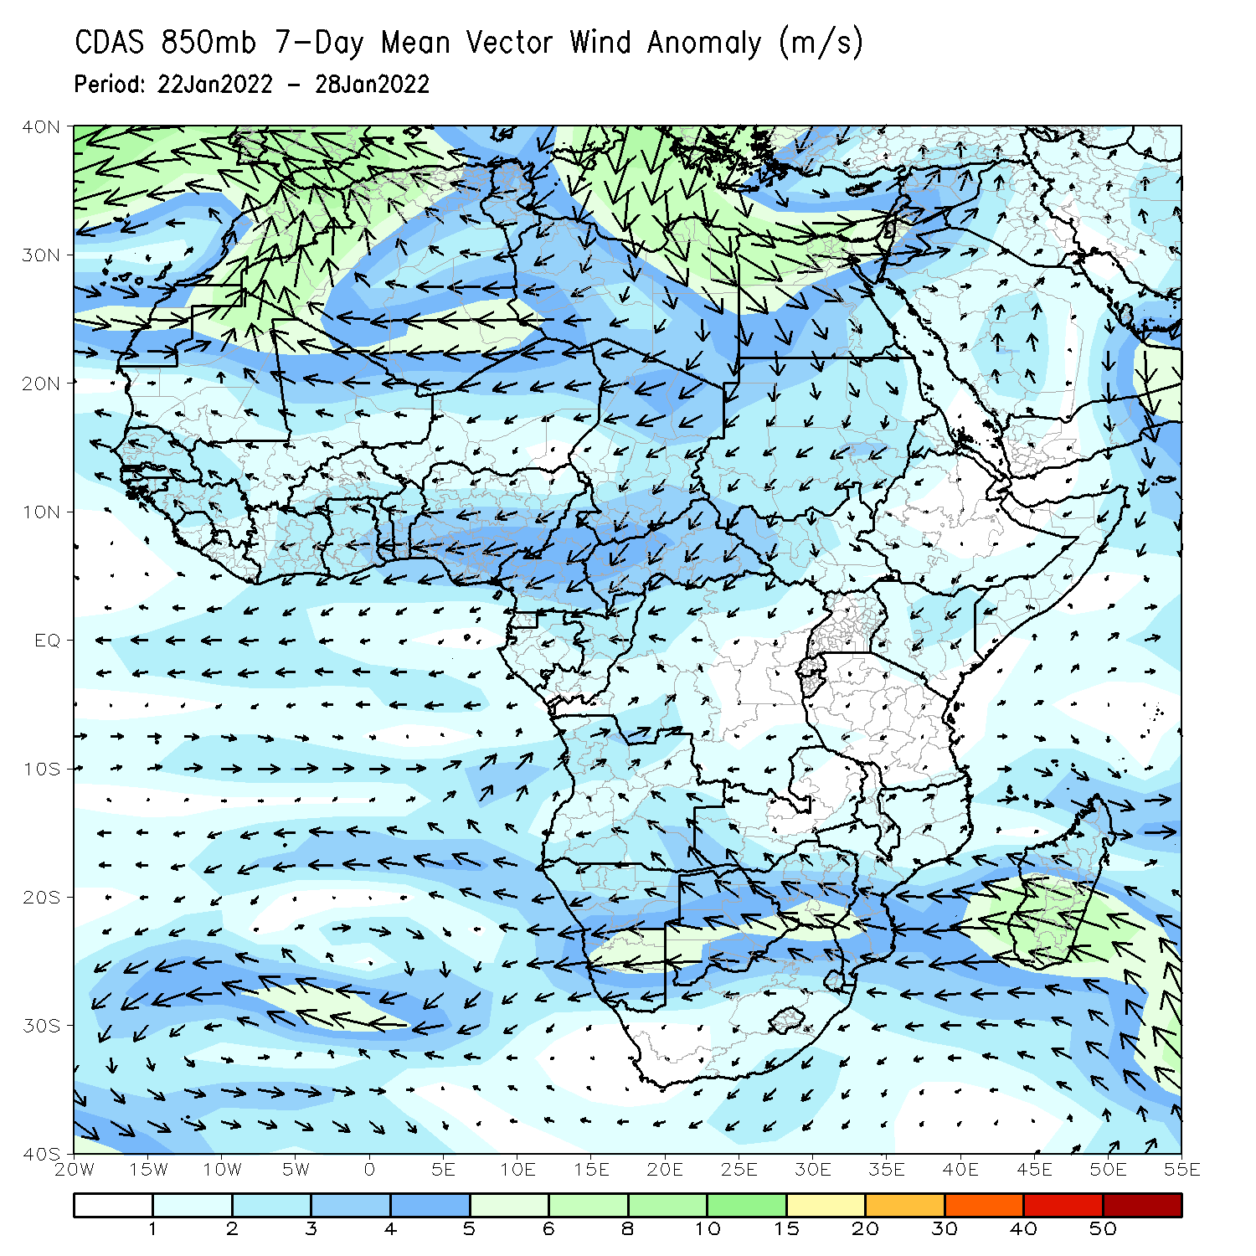
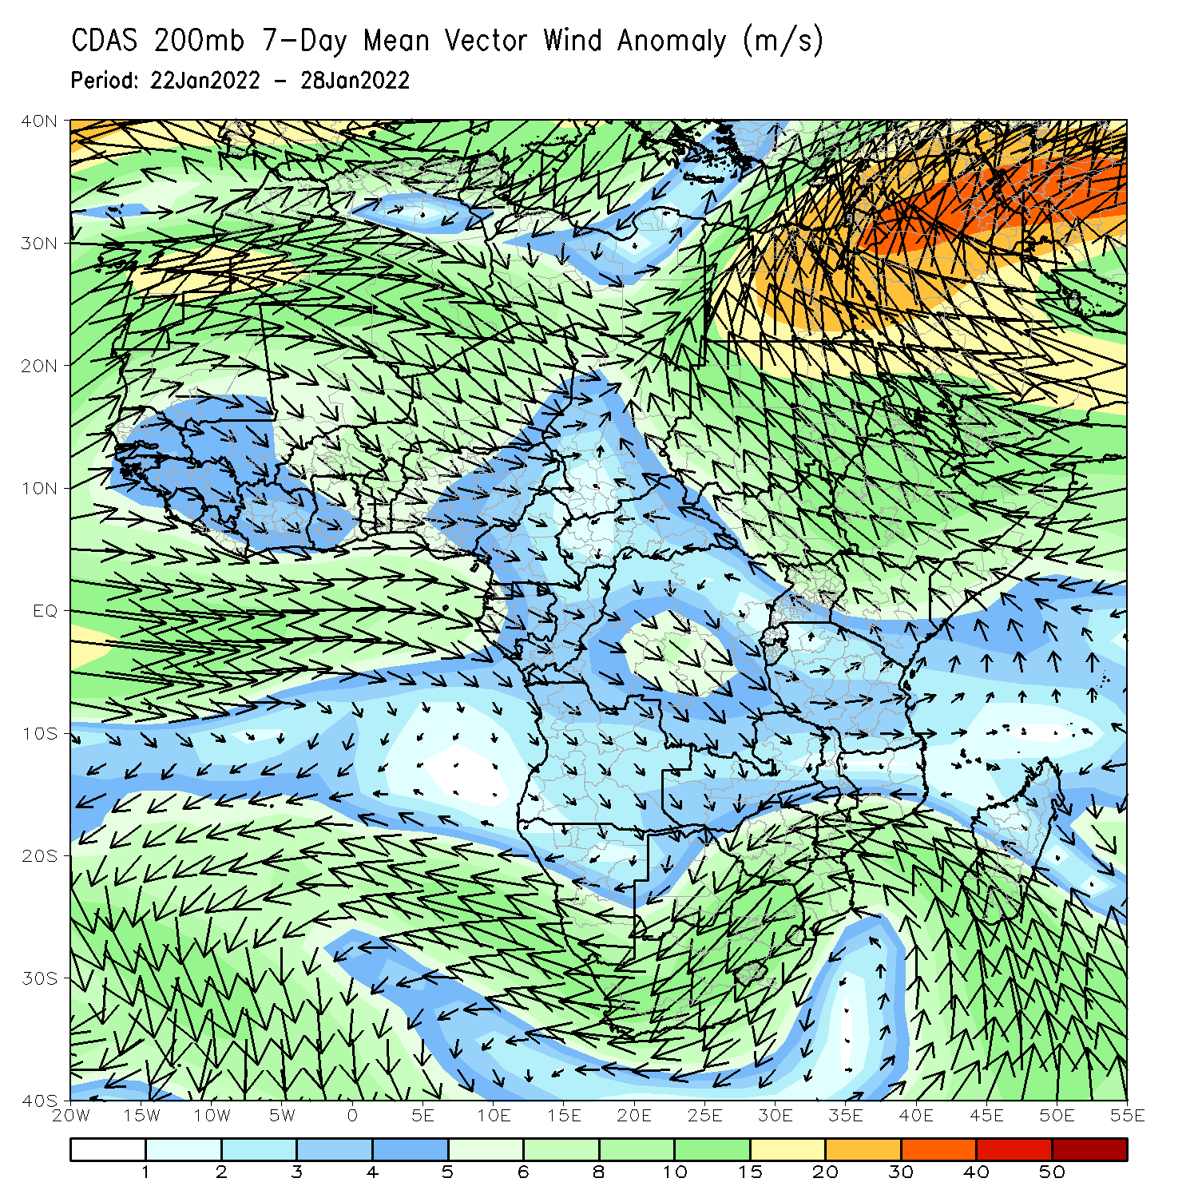
Atmospheric Circulation: Last 7 Days
At 850-hPa level (left panel), a broad area of anomalous easterly flow was observed across Southern Africa.

Slide 8
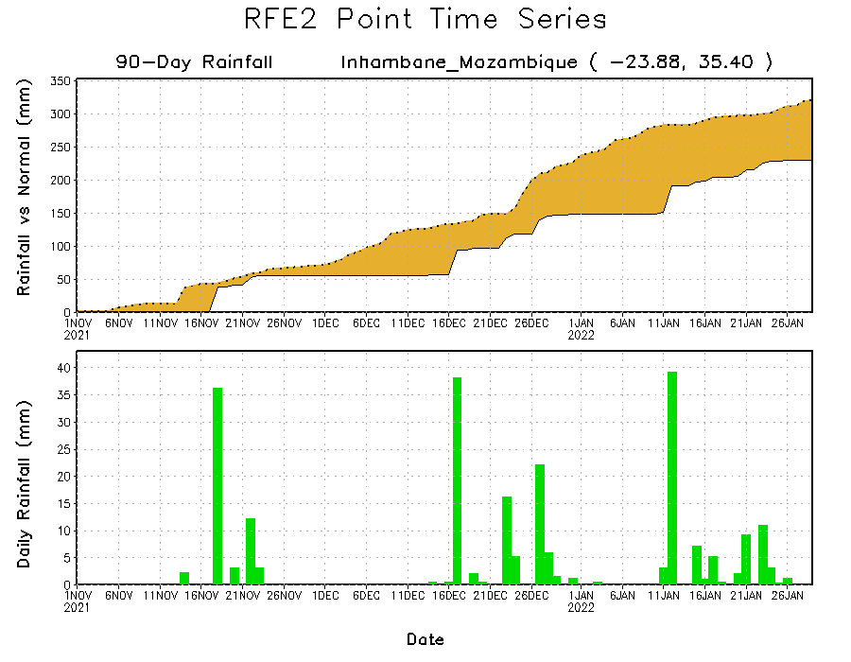
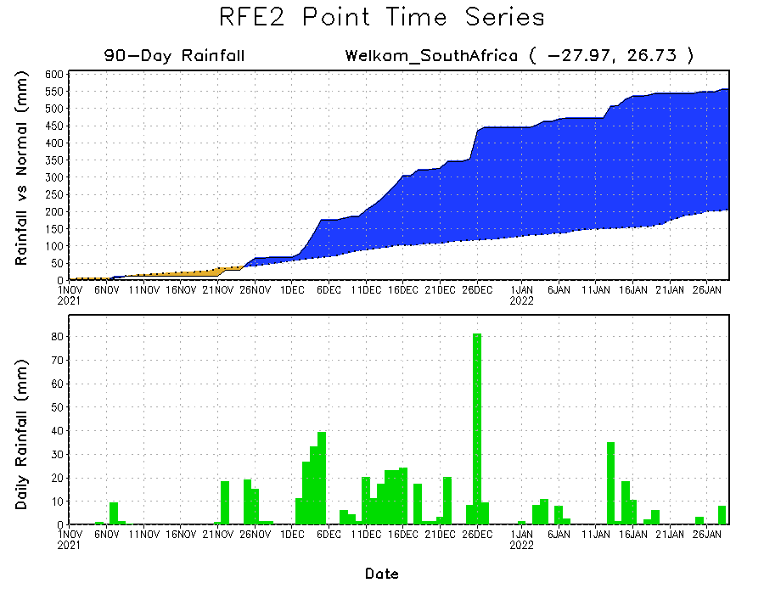
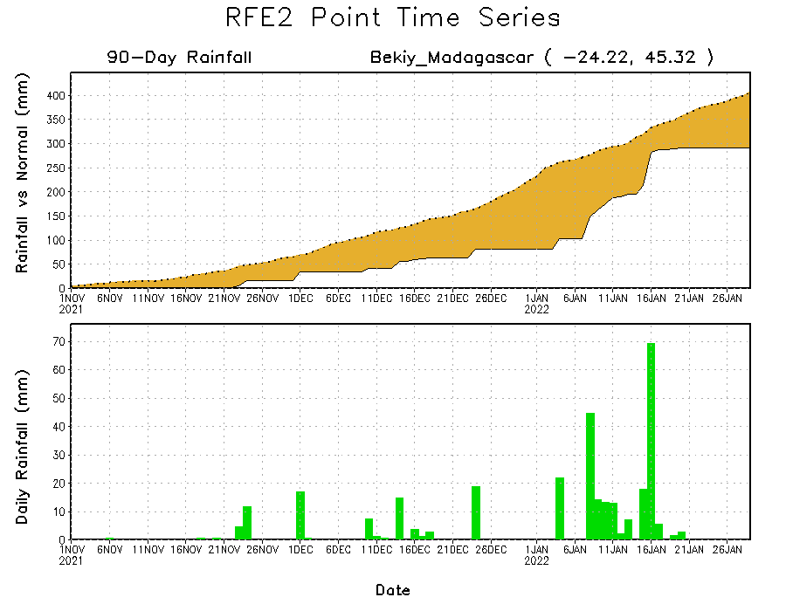
Rainfall Evolution
Daily evolution of rainfall over the last 90 days at selected locations shows moderate sustained moisture surpluses over parts of South Africa (bottom left). The seasonal total rainfall remained below-average over southern Mozambique (top right) and southwestern Madagascar (bottom right).

Slide 9
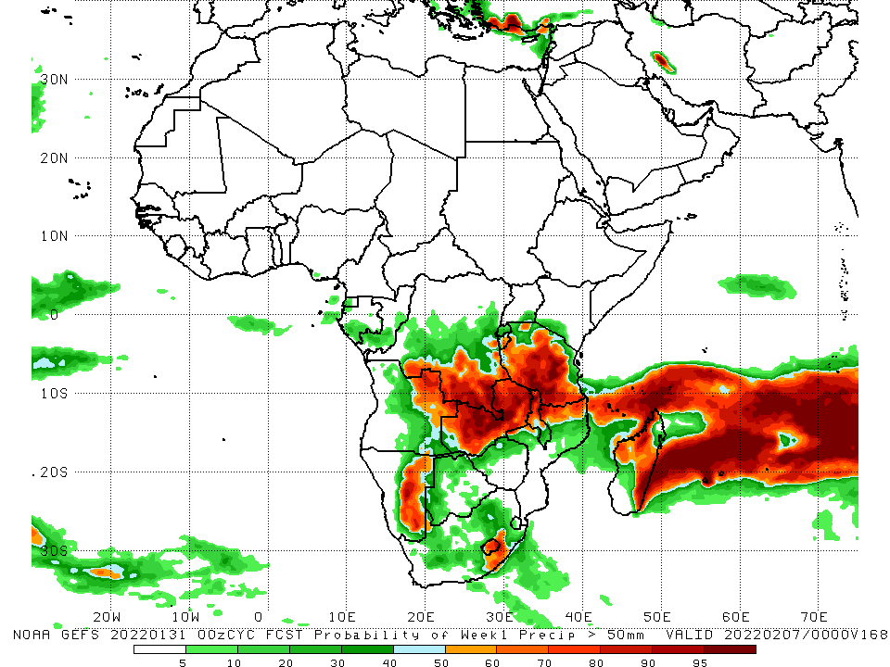
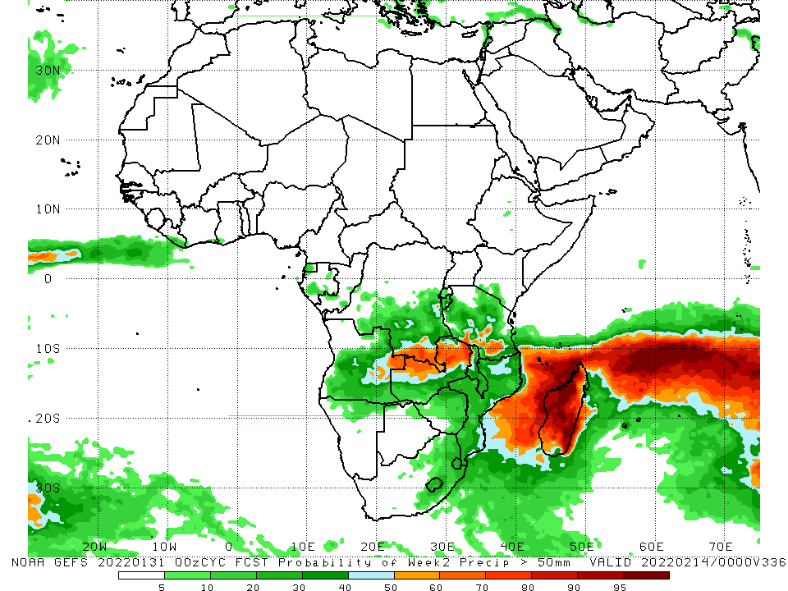
NCEP GEFS Model Forecasts Non-Bias Corrected Probability of precipitation exceedance
Week-1, Valid: 01 – 07 Feb, 2022
Week-2, Valid: 08 – 14 Feb, 2022
For week-1 (left panel), the NCEP GEFS indicates a moderate to high chance (over 70%) for rainfall to exceed 50 mm over eastern Angola, eastern Namibia, southern DRC, much of Zambia, Tanzania, northern Malawi, northern Mozambique, and portions of Madagascar. For week-2 (right panel), there is an increased chance for weekly rainfall totals to exceed 50mm across the far southern DRC and northern Zambia, and much of Madagascar.
Notes:
9

Slide 10
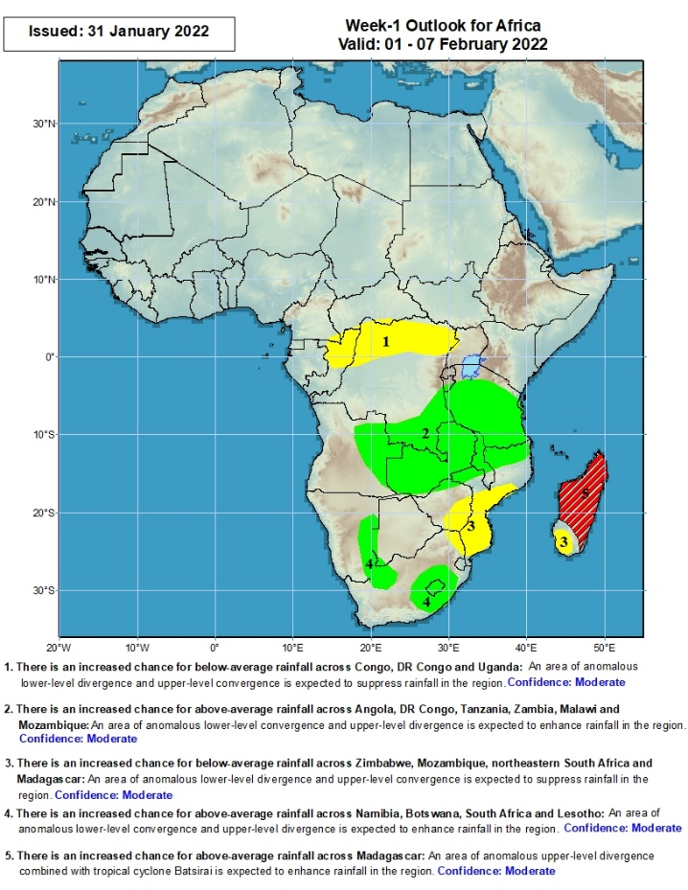
Week-1 Precipitation Outlooks
1 – 7 Feb, 2022
There is an increased chance for below-average rainfall across northern Congo and northern DR Congo: An area of anomalous lower-level divergence and upper-level convergence is expected to suppress rainfall in the region. Confidence: Moderate
There is an increased chance for above-average rainfall across eastern Angola, southern DR Congo, Tanzania, Zambia, Malawi and northern Mozambique: An area of anomalous lower-level convergence and upper-level divergence is expected to enhance rainfall in the region. Confidence: Moderate
There is an increased chance for below-average rainfall across eastern Zimbabwe, central and southern Mozambique, northeastern South Africa and southern Madagascar: An area of anomalous lower-level divergence and upper-level convergence is expected to suppress rainfall in the region. Confidence: Moderate
There is an increased chance for above-average rainfall across eastern Namibia, eastern South Africa and Lesotho: An area of anomalous lower-level convergence and upper-level divergence is expected to enhance rainfall in the region. Confidence: Moderate
There is an increased chance for above-average rainfall across central and northern Madagascar: An area of anomalous upper-level divergence associated with tropical cyclone Batsirai is expected to enhance rainfall in the region. Confidence: Moderate
Notes:
10

Slide 11
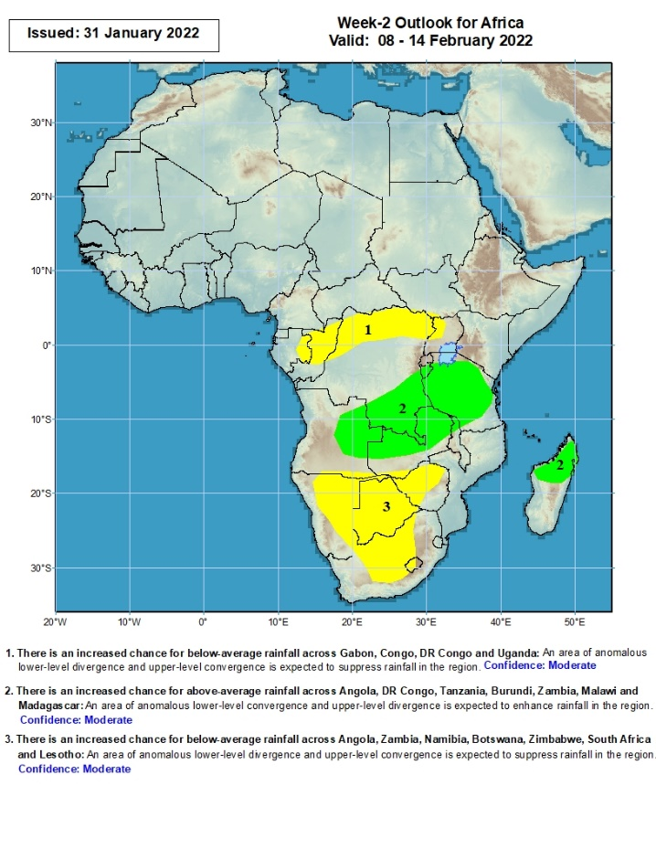
Week-2 Precipitation Outlooks
8 – 14 Feb, 2022
There is an increased chance for below-average rainfall across eastern Gabon, Congo, northern DR Congo and western Uganda: An area of anomalous lower-level divergence and upper-level convergence is expected to suppress rainfall in the region. Confidence: Moderate
There is an increased chance for above-average rainfall across eastern Angola, southern DR Congo, Tanzania, Burundi, Zambia, Malawi and northern Madagascar: An area of anomalous lower-level convergence and upper-level divergence is expected to enhance rainfall in the region. Confidence: Moderate
There is an increased chance for below-average rainfall across Namibia, Botswana, Zimbabwe, South Africa and Lesotho: An area of anomalous lower-level divergence and upper-level convergence is expected to suppress rainfall in the region. Confidence: Moderate
Notes:
11

Slide 12
Summary
During the past 30 days, in East Africa, above-average rainfall was observed over pocket areas of southern and northern Ethiopia, Uganda, Rwanda, Burundi, central and eastern Kenya, and much of Tanzania. Rainfall was below-average over parts of southwestern Ethiopia, and near Kenya/Tanzania border. In Central Africa, rainfall was below-average over Equatorial Guinea, Gabon and northern Congo. Rainfall was above-average over southern Congo and much of DRC. In Southern Africa, above-average rainfall was observed over many parts of Angola, western and southern Namibia, Zimbabwe, Zambia, Malawi, central and northern Mozambique, northern and eastern Madagascar and much of South Africa. Below-average rainfall was observed over southwestern Angola, the far western Zambia, northern Namibia, Botswana, the far southern Mozambique, and southwestern Madagascar.
During the past 7 days, in East Africa, rainfall was above-average over parts of Tanzania. Below-average rainfall was observed over parts of southwestern Ethiopia and the far southern Tanzania. In central Africa, rainfall was above-average over portions of DRC. Rainfall was below-average over Equatorial Guinea, Gabon and much of Congo. In Southern Africa, rainfall was above-average over western and southern Angola, southern Zambia, eastern Zimbabwe, Malawi, much of Mozambique, and parts of northeastern South Africa. Below-average rainfall was observed over eastern Angola, Namibia, western Zambia, and much of Madagascar.
Week-1 and week-2 outlooks call for an increased chance for above-average rainfall across the northern portions of Southern Africa, Tanzania and Madagascar. In contrast, there is an increased chance for below-average rainfall over the southern portions of Southern Africa, and equatorial Central Africa.

