Slide 1
The African Monsoon Recent Evolution and Current Status Include Week-1 and Week-2 Outlooks
Update prepared by
07 February 2022
For more information, visit:
http://www.cpc.ncep.noaa.gov/products/Global_Monsoons/African_Monsoons/precip_monitoring.shtml

Slide 2
Outline
Highlights
Recent Evolution and Current Conditions
NCEP GEFS Forecasts
Summary

Slide 3
Highlights: Last 7 Days
During the past 7 days, in East Africa, rainfall was above-average over much of Tanzania, and Rwanda and Burundi. In central Africa, rainfall was above-average over central and southern DRC. Rainfall was below-average over Equatorial Guinea, Gabon, northern DRC and northern Congo. In Southern Africa, rainfall was above-average over southern Angola, central and eastern Namibia, central and northern Zambia, pockets of Zimbabwe, northern Malawi, much of South Africa, and pockets of Madagascar. Below-average rainfall was observed over western and the far eastern Angola, northwestern Namibia, parts of western Zambia, and much of Madagascar.
Week-1 and week-2 outlooks call for an increased chance for above-average rainfall across the northern portions of Southern Africa, and Tanzania. In contrast, there is an increased chance for below-average rainfall over the southern portions of Southern Africa, and equatorial Central Africa.

Slide 4
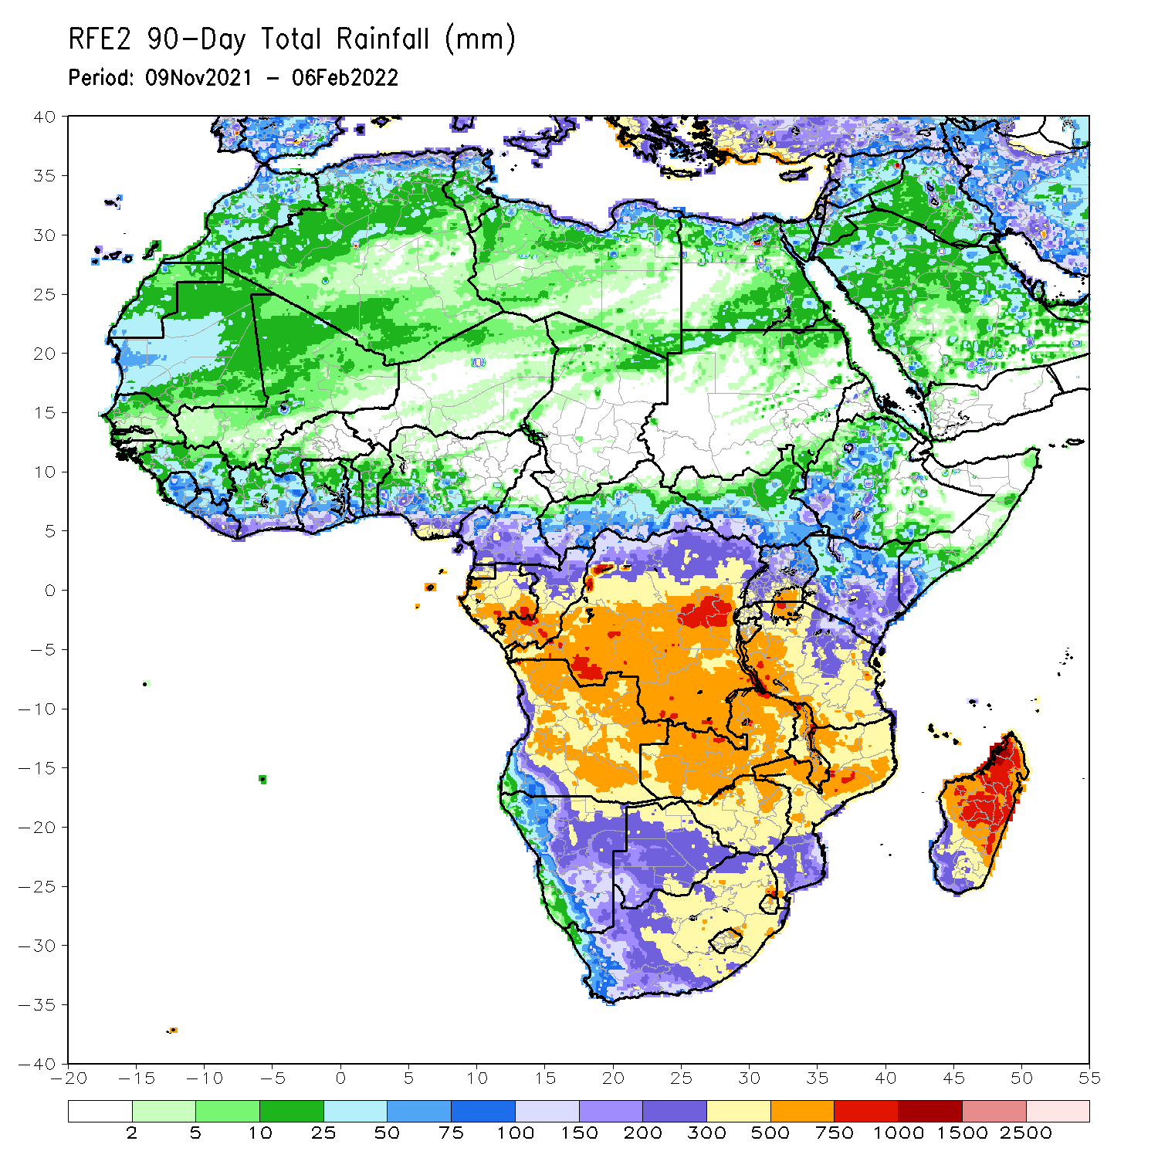
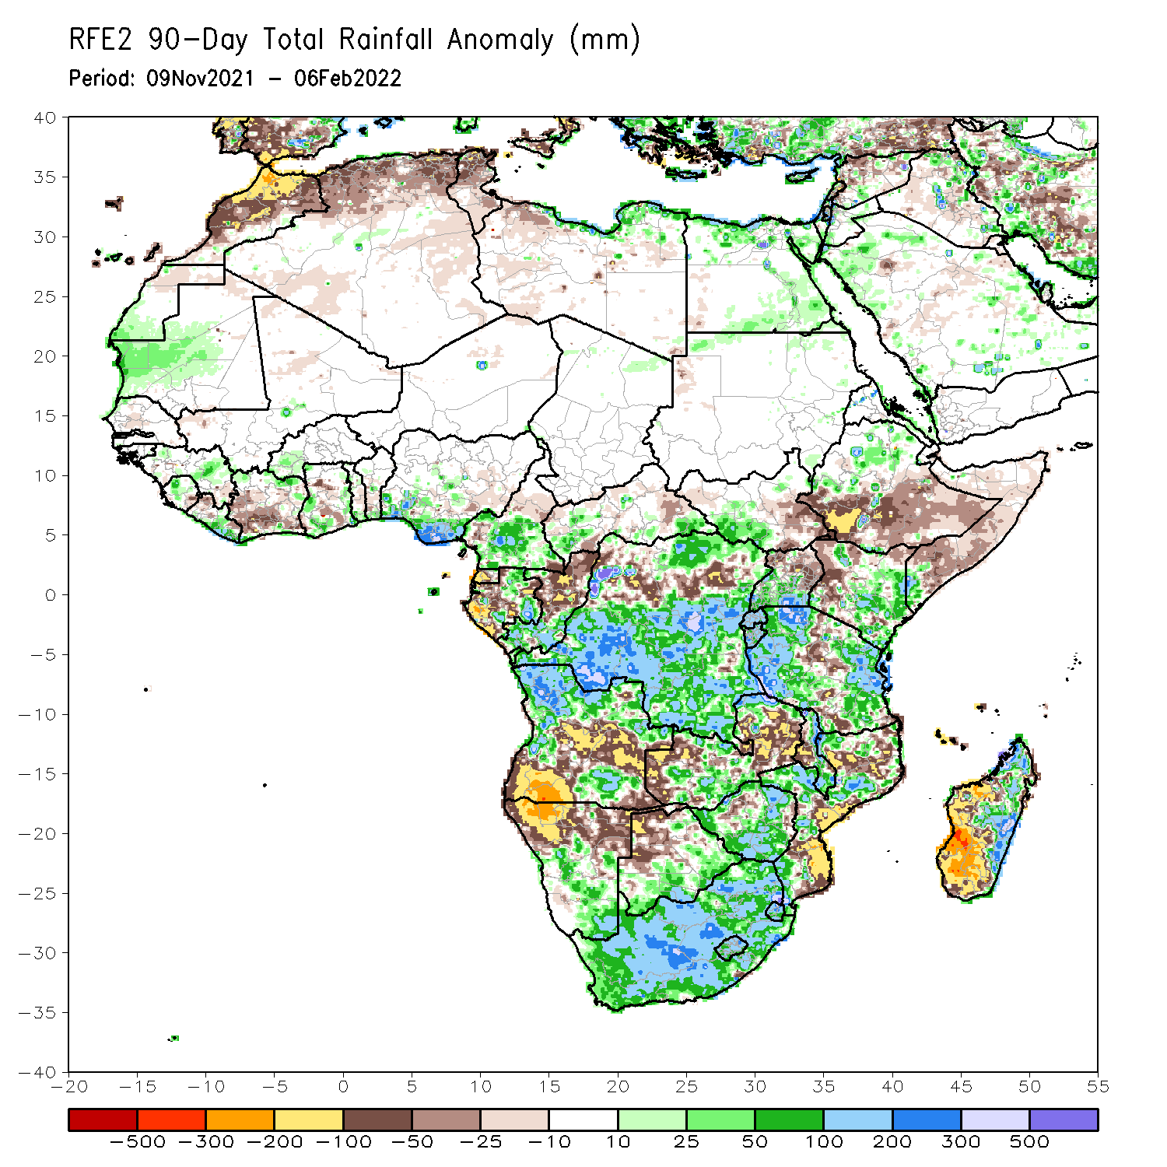
Rainfall Patterns: Last 90 Days
Over the past 90 days, in East Africa, above-average rainfall was observed over parts of northern Ethiopia, the far southern South Sudan, Rwanda, Burundi, southern Uganda, eastern Kenya, southwestern Somalia, and many parts of Tanzania. Rainfall was below-average over southern Ethiopia, eastern South Sudan, much of Somalia, western Kenya, northern Uganda, and the central portions of Tanzania. In southern Africa, above-average rainfall was observed over northern Angola, eastern and southern Botswana, much of Zimbabwe, parts of western Zambia, parts of northern Mozambique, eastern and northern Madagascar and much of South Africa. Below-average rainfall was observed over central and southern Angola, the far western and eastern Zambia, northern Namibia, northwestern Botswana, pockets of northern Zimbabwe, parts of Mozambique and western and southern Madagascar. In Central Africa, rainfall was above-average over many parts of DRC, pockets of Gabon, southern Congo, and pockets of western CAR. Rainfall was below-average over parts of northern DRC, Gabon, and northern Congo. In West Africa, rainfall was above-average over pockets of Guinea and southern Nigeria. Below-average rainfall was observed over southern Cote d’Ivoire, and pocket areas of Ghana.
Notes:
4

Slide 5
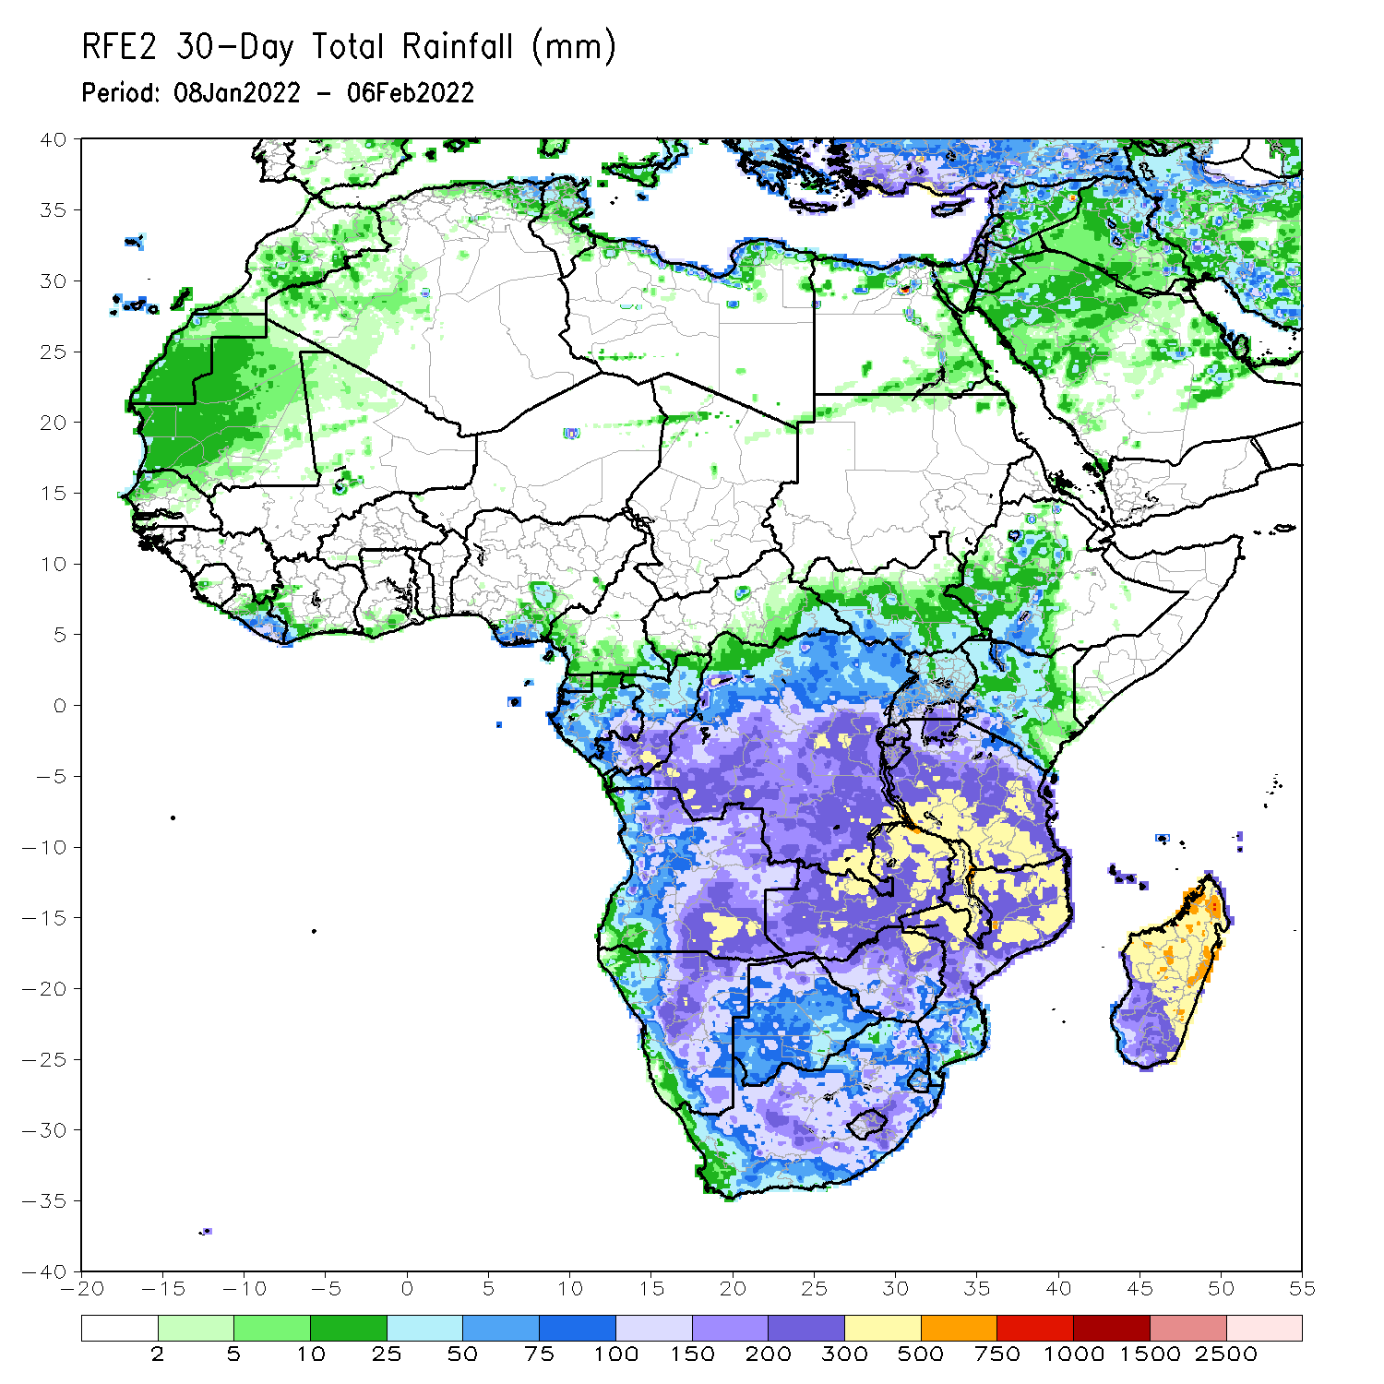
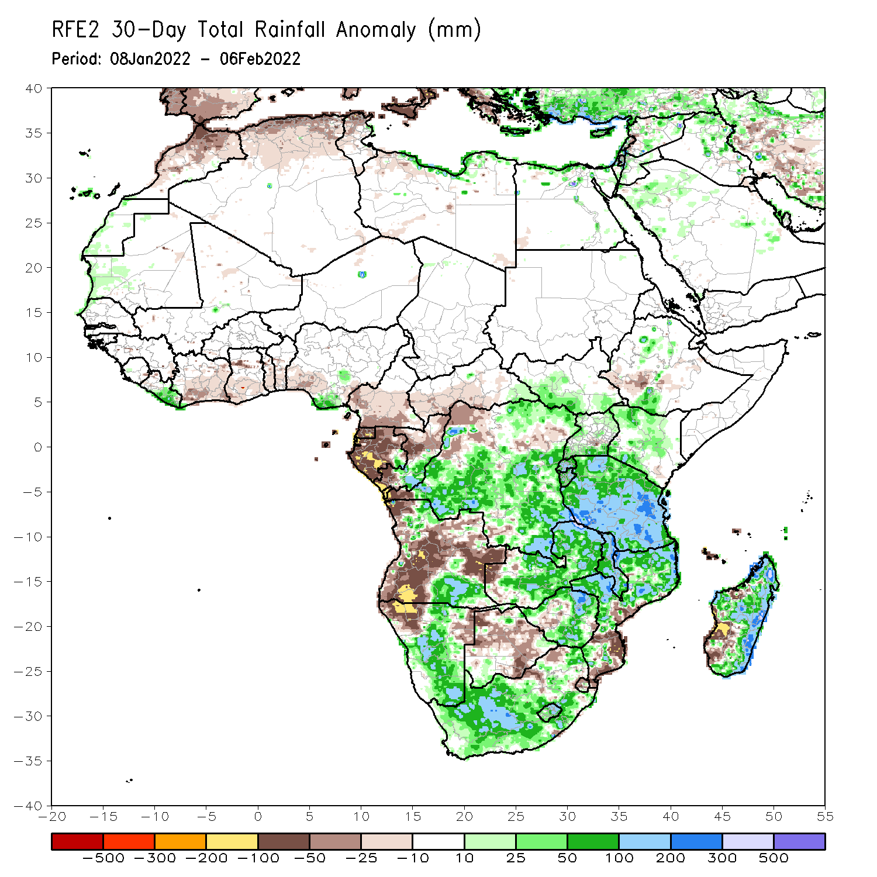
Rainfall Patterns: Last 30 Days
During the past 30 days, in East Africa, above-average rainfall was observed over pocket of southern and northern Ethiopia, parts of Uganda, Rwanda, Burundi, portions of Kenya, and much of Tanzania. Rainfall was below-average over pockets of southwestern Ethiopia, In Central Africa, rainfall was below-average over Equatorial Guinea, Gabon, northern Congo, and parts of northern DRC. Rainfall was above-average over southern Congo and many parts of DRC. In Southern Africa, above-average rainfall was observed over the far northern and southern Angola, many parts of Namibia, Zimbabwe, much of Zambia, Malawi, central and much of Mozambique, northern and eastern Madagascar and much of South Africa. Below-average rainfall was observed over western and eastern Angola, the far western Zambia, northwestern Namibia, Botswana, the far southern Mozambique, and southwestern Madagascar.
Notes:
5

Slide 6
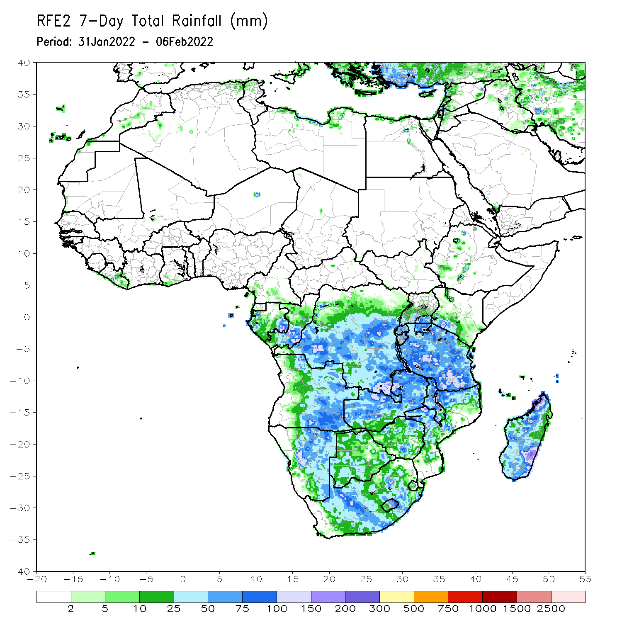
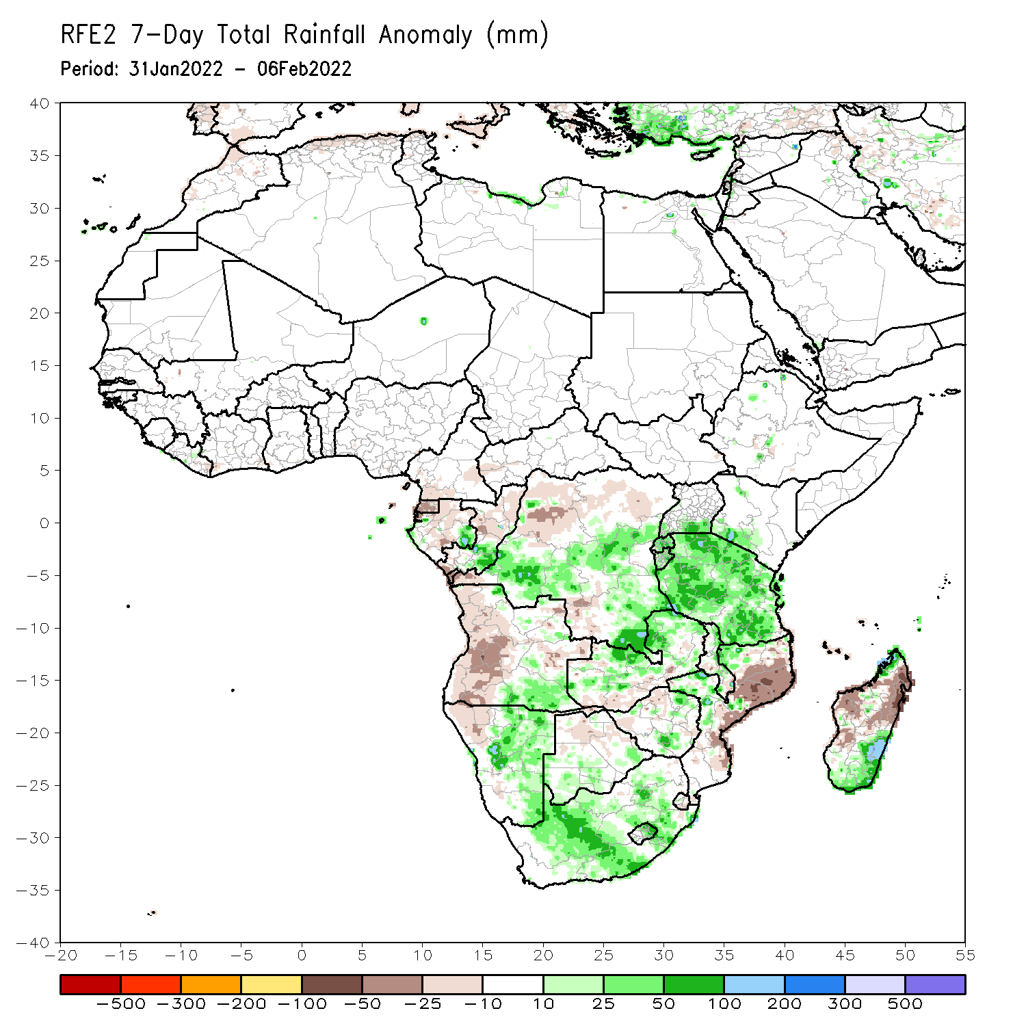
Rainfall Patterns: Last 7 Days
During the past 7 days, in East Africa, rainfall was above-average over much of Tanzania, and Rwanda and Burundi. In central Africa, rainfall was above-average over central and southern DRC. Rainfall was below-average over Equatorial Guinea, Gabon, northern DRC and northern Congo. In Southern Africa, rainfall was above-average over southern Angola, central and eastern Namibia, central and northern Zambia, pockets of Zimbabwe, northern Malawi, much of South Africa, and pockets of Madagascar. Below-average rainfall was observed over western and the far eastern Angola, northwestern Namibia, parts of western Zambia, and much of Madagascar.

Slide 7
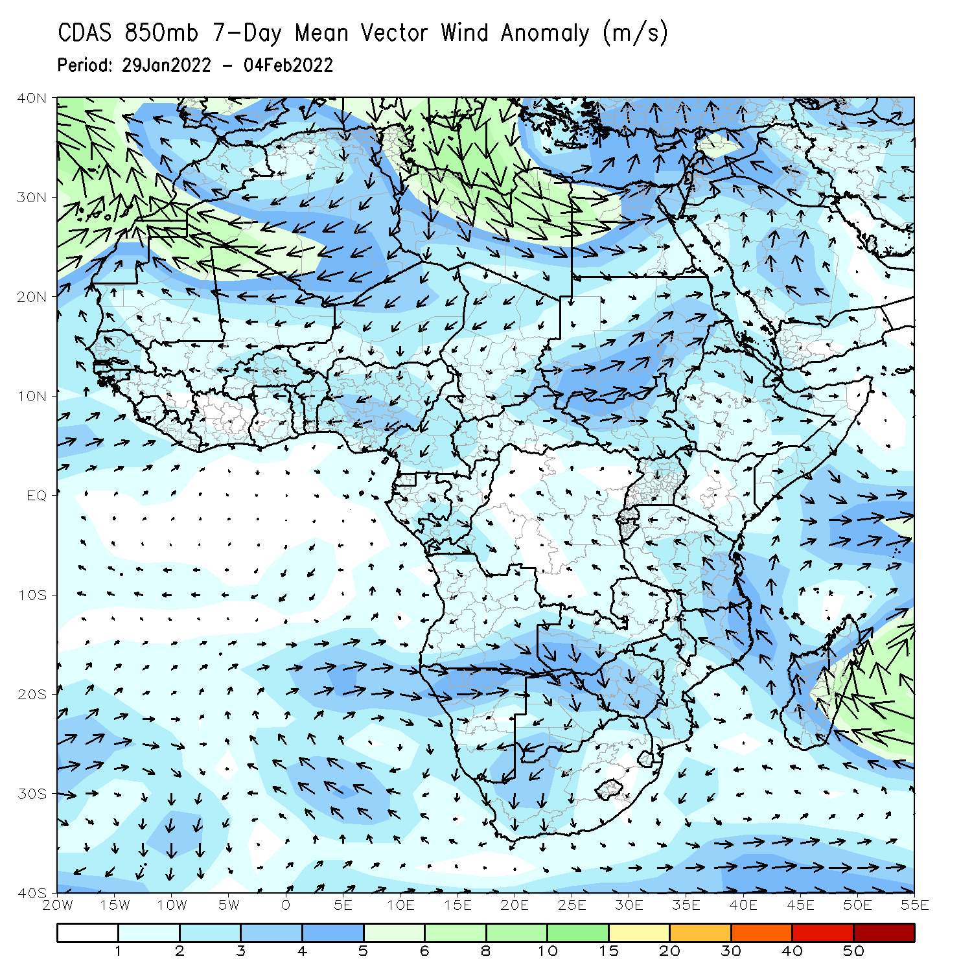
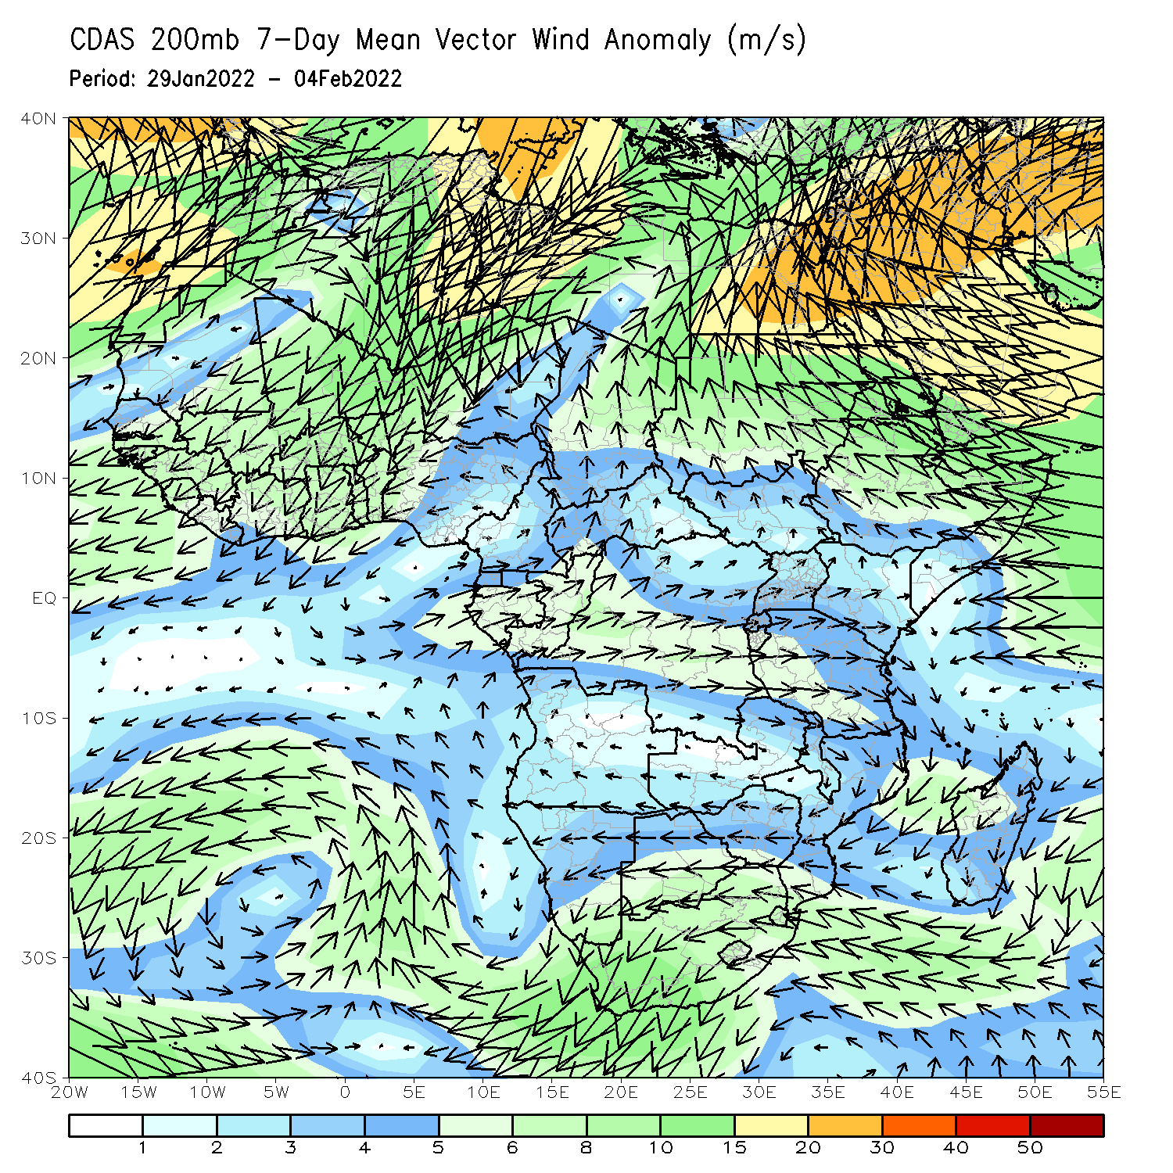
Atmospheric Circulation: Last 7 Days
At 850-hPa level (left panel), an area of cyclonic trough was observed across southwestern Africa and the neighboring areas of the Atlantic Ocean.

Slide 8
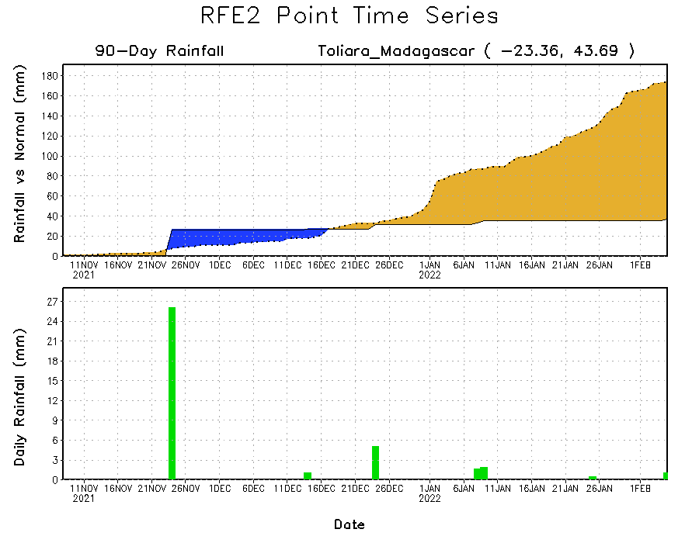
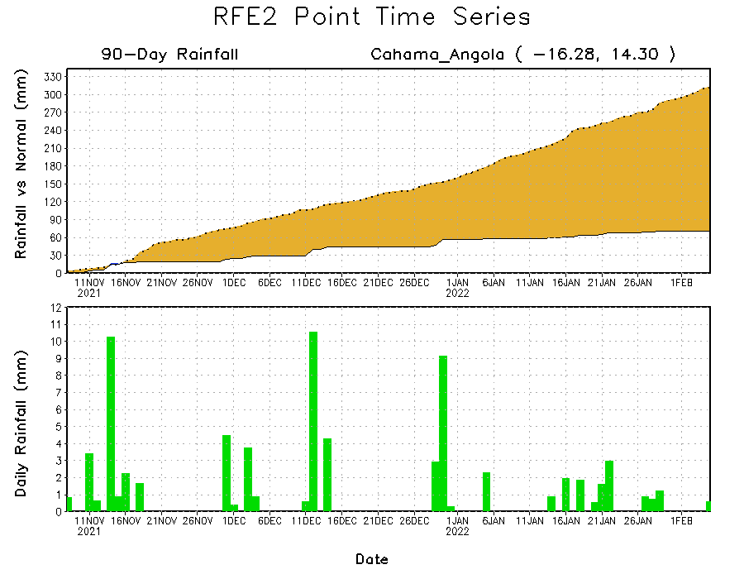
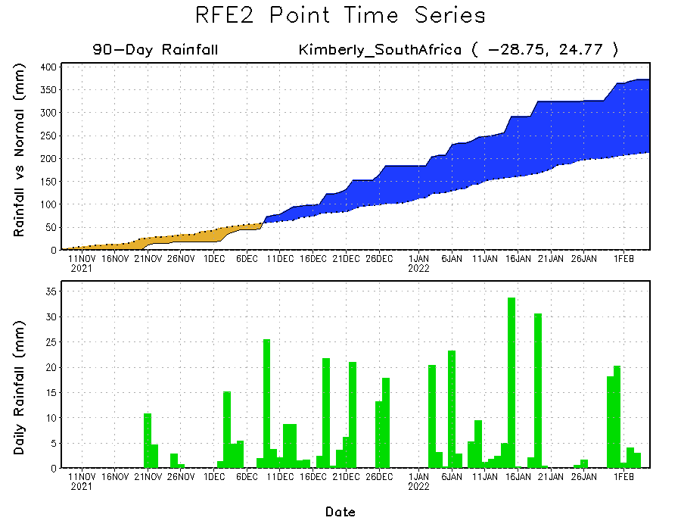
Rainfall Evolution
Daily evolution of rainfall over the last 90 days at selected locations shows moderate sustained moisture surpluses over parts of South Africa (bottom right). The seasonal total rainfall remained below-average over southern Madagascar (top right) and southern Angola (bottom left).

Slide 9
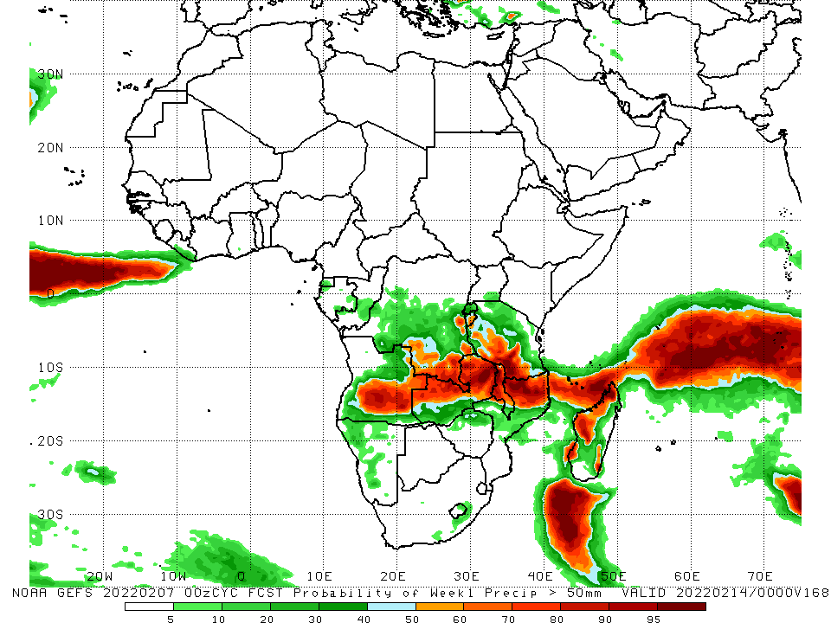
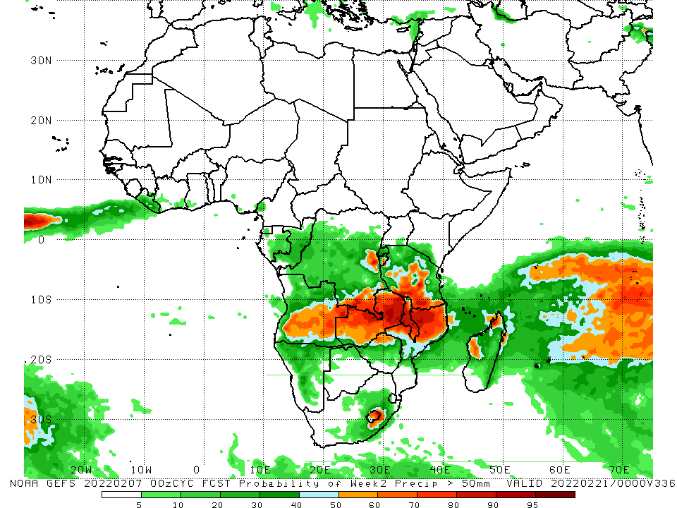
NCEP GEFS Model Forecasts Non-Bias Corrected Probability of precipitation exceedance
Week-1, Valid: 08 – 14 Feb, 2022
Week-2, Valid: 15 – 21 Feb, 2022
For week-1 (left panel), and week-2 (right panel), the NCEP GEFS indicates a moderate to high chance (over 70%) for rainfall to exceed 50 mm over the northern portions of Southern Africa.
Notes:
9

Slide 10
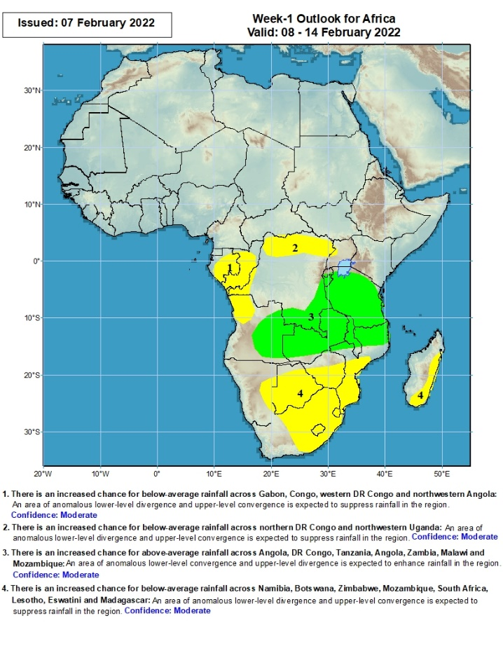
Week-1 Precipitation Outlooks
8 – 14 Feb, 2022
There is an increased chance for below-average rainfall across Gabon, Congo, parts of western DR Congo and northwestern Angola: An area of anomalous lower-level divergence and upper-level convergence is expected to suppress rainfall in the region. Confidence: Moderate
There is an increased chance for below-average rainfall across northern DR Congo and northwestern Uganda: An area of anomalous lower-level divergence and upper-level convergence is expected to suppress rainfall in the region. Confidence: Moderate
There is an increased chance for above-average rainfall across eastern Angola, southern DR Congo, Tanzania, Angola, Zambia, Malawi and northern Mozambique: An area of anomalous lower-level convergence and upper-level divergence is expected to enhance rainfall in the region. Confidence: Moderate
There is an increased chance for below-average rainfall across eastern Namibia, Botswana, Zimbabwe, Mozambique, South Africa, Lesotho, Eswatini and Madagascar: An area of anomalous lower-level divergence and upper-level convergence is expected to suppress rainfall in the region. Confidence: Moderate
Notes:
10

Slide 11
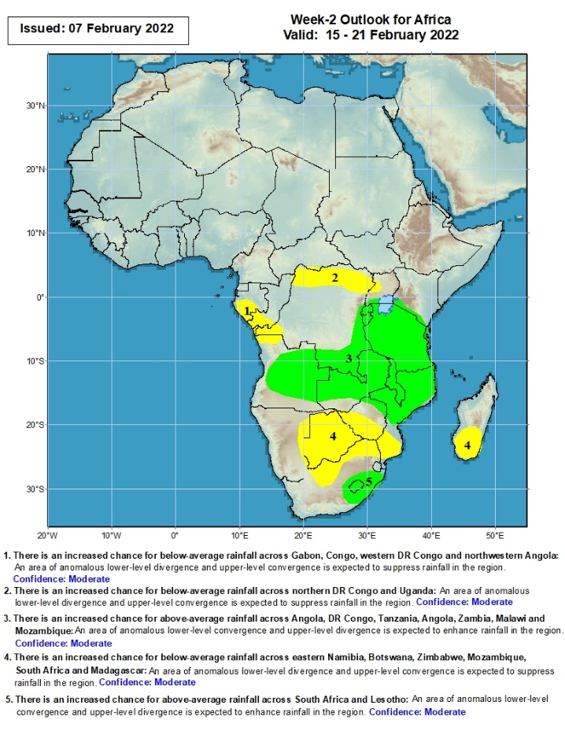
Week-2 Precipitation Outlooks
15 – 21 Feb, 2022
There is an increased chance for below-average rainfall across southern Gabon, southern Congo, parts of western DR Congo and northwestern Angola: An area of anomalous lower-level divergence and upper-level convergence is expected to suppress rainfall in the region. Confidence: Moderate
There is an increased chance for below-average rainfall across northern DR Congo and Uganda: An area of anomalous lower-level divergence and upper-level convergence is expected to suppress rainfall in the region. Confidence: Moderate
There is an increased chance for above-average rainfall across much of Angola, southern DR Congo, Tanzania, Angola, Zambia, Malawi and Mozambique: An area of anomalous lower-level convergence and upper-level divergence is expected to enhance rainfall in the region. Confidence: Moderate
There is an increased chance for below-average rainfall across eastern Namibia, Botswana, southern Zimbabwe, southern Mozambique, northern South Africa and southern Madagascar: An area of anomalous lower-level divergence and upper-level convergence is expected to suppress rainfall in the region. Confidence: Moderate
There is an increased chance for above-average rainfall across eastern South Africa and Lesotho: An area of anomalous lower-level convergence and upper-level divergence is expected to enhance rainfall in the region. Confidence: Moderate
Notes:
11

Slide 12
Summary
During the past 30 days, in East Africa, above-average rainfall was observed over pocket of southern and northern Ethiopia, parts of Uganda, Rwanda, Burundi, portions of Kenya, and much of Tanzania. Rainfall was below-average over pockets of southwestern Ethiopia, In Central Africa, rainfall was below-average over Equatorial Guinea, Gabon, northern Congo, and parts of northern DRC. Rainfall was above-average over southern Congo and many parts of DRC. In Southern Africa, above-average rainfall was observed over the far northern and southern Angola, many parts of Namibia, Zimbabwe, much of Zambia, Malawi, central and much of Mozambique, northern and eastern Madagascar and much of South Africa. Below-average rainfall was observed over western and eastern Angola, the far western Zambia, northwestern Namibia, Botswana, the far southern Mozambique, and southwestern Madagascar.
During the past 7 days, in East Africa, rainfall was above-average over much of Tanzania, and Rwanda and Burundi. In central Africa, rainfall was above-average over central and southern DRC. Rainfall was below-average over Equatorial Guinea, Gabon, northern DRC and northern Congo. In Southern Africa, rainfall was above-average over southern Angola, central and eastern Namibia, central and northern Zambia, pockets of Zimbabwe, northern Malawi, much of South Africa, and pockets of Madagascar. Below-average rainfall was observed over western and the far eastern Angola, northwestern Namibia, parts of western Zambia, and much of Madagascar.
Week-1 and week-2 outlooks call for an increased chance for above-average rainfall across the northern portions of Southern Africa, and Tanzania. In contrast, there is an increased chance for below-average rainfall over the southern portions of Southern Africa, and equatorial Central Africa.

