Slide 1
The African Monsoon Recent Evolution and Current Status Include Week-1 and Week-2 Outlooks
Update prepared by
14 February 2022
For more information, visit:
http://www.cpc.ncep.noaa.gov/products/Global_Monsoons/African_Monsoons/precip_monitoring.shtml

Slide 2
Outline
Highlights
Recent Evolution and Current Conditions
NCEP GEFS Forecasts
Summary

Slide 3
Highlights: Last 7 Days
During the past 7 days, in East Africa, rainfall was above-average over much of Tanzania, and southern Uganda. In central Africa, rainfall was above-average over central and southern DRC. Rainfall was below-average over parts of Equatorial Guinea, Gabon, northern and eastern DRC and much of Congo. In Southern Africa, rainfall was above-average over southern Angola, portions of Namibia, northern Zambia, northern Malawi, northern Mozambique, and the far northern Madagascar. Below-average rainfall was observed over central and northern Angola, parts of southern Zambia, Botswana, South Africa, Zimbabwe, southern Mozambique and much of Madagascar.
Week-1 and week-2 outlooks call for an increased chance for above-average rainfall across the northern portions of Southern Africa, and Tanzania. In contrast, there is an increased chance for below-average rainfall over equatorial Central Africa, southwestern Ethiopia, and the southern portions of Southern Africa.

Slide 4
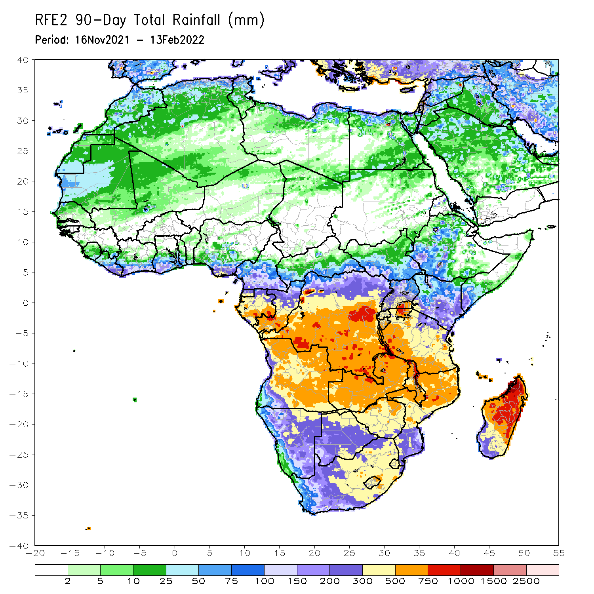
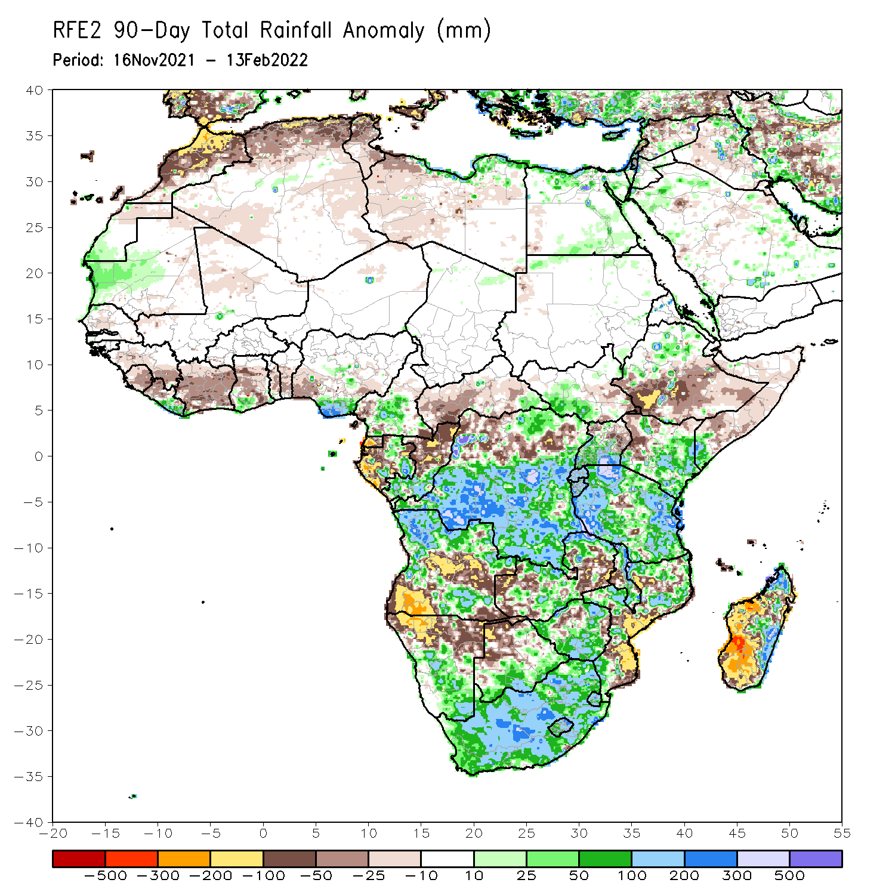
Rainfall Patterns: Last 90 Days
Over the past 90 days, in East Africa, above-average rainfall was observed over parts of northern Ethiopia, the far southern South Sudan, Rwanda, Burundi, southern Uganda, eastern and southern Kenya, southwestern Somalia, and many parts of Tanzania. Rainfall was below-average over southern Ethiopia, eastern South Sudan, parts of Somalia, western Kenya, northern Uganda, and pockets of central Tanzania. In southern Africa, above-average rainfall was observed over northern and southeastern Angola, eastern and southern Botswana, central and southern Namibia, much of Zimbabwe, western and northern Zambia, parts of northern Mozambique, eastern Madagascar and much of South Africa. Below-average rainfall was observed over central and southwestern Angola, northern Namibia, the far western and eastern Zambia, northwestern Botswana, pockets of northern Zimbabwe, parts of Mozambique and western and southern Madagascar. In Central Africa, rainfall was above-average over many parts of DRC, pockets of Gabon, southern Congo, and pockets of southeastern CAR. Rainfall was below-average over parts of northern DRC, Gabon, western and central CAR, and northern Congo. In West Africa, rainfall was above-average over eastern Liberia, southwestern Ghana and southern Nigeria. Below-average rainfall was observed over Guinea, Sierra Leone, Cote d’Ivoire, parts of Ghana, Togo and Benin.
Notes:
4

Slide 5
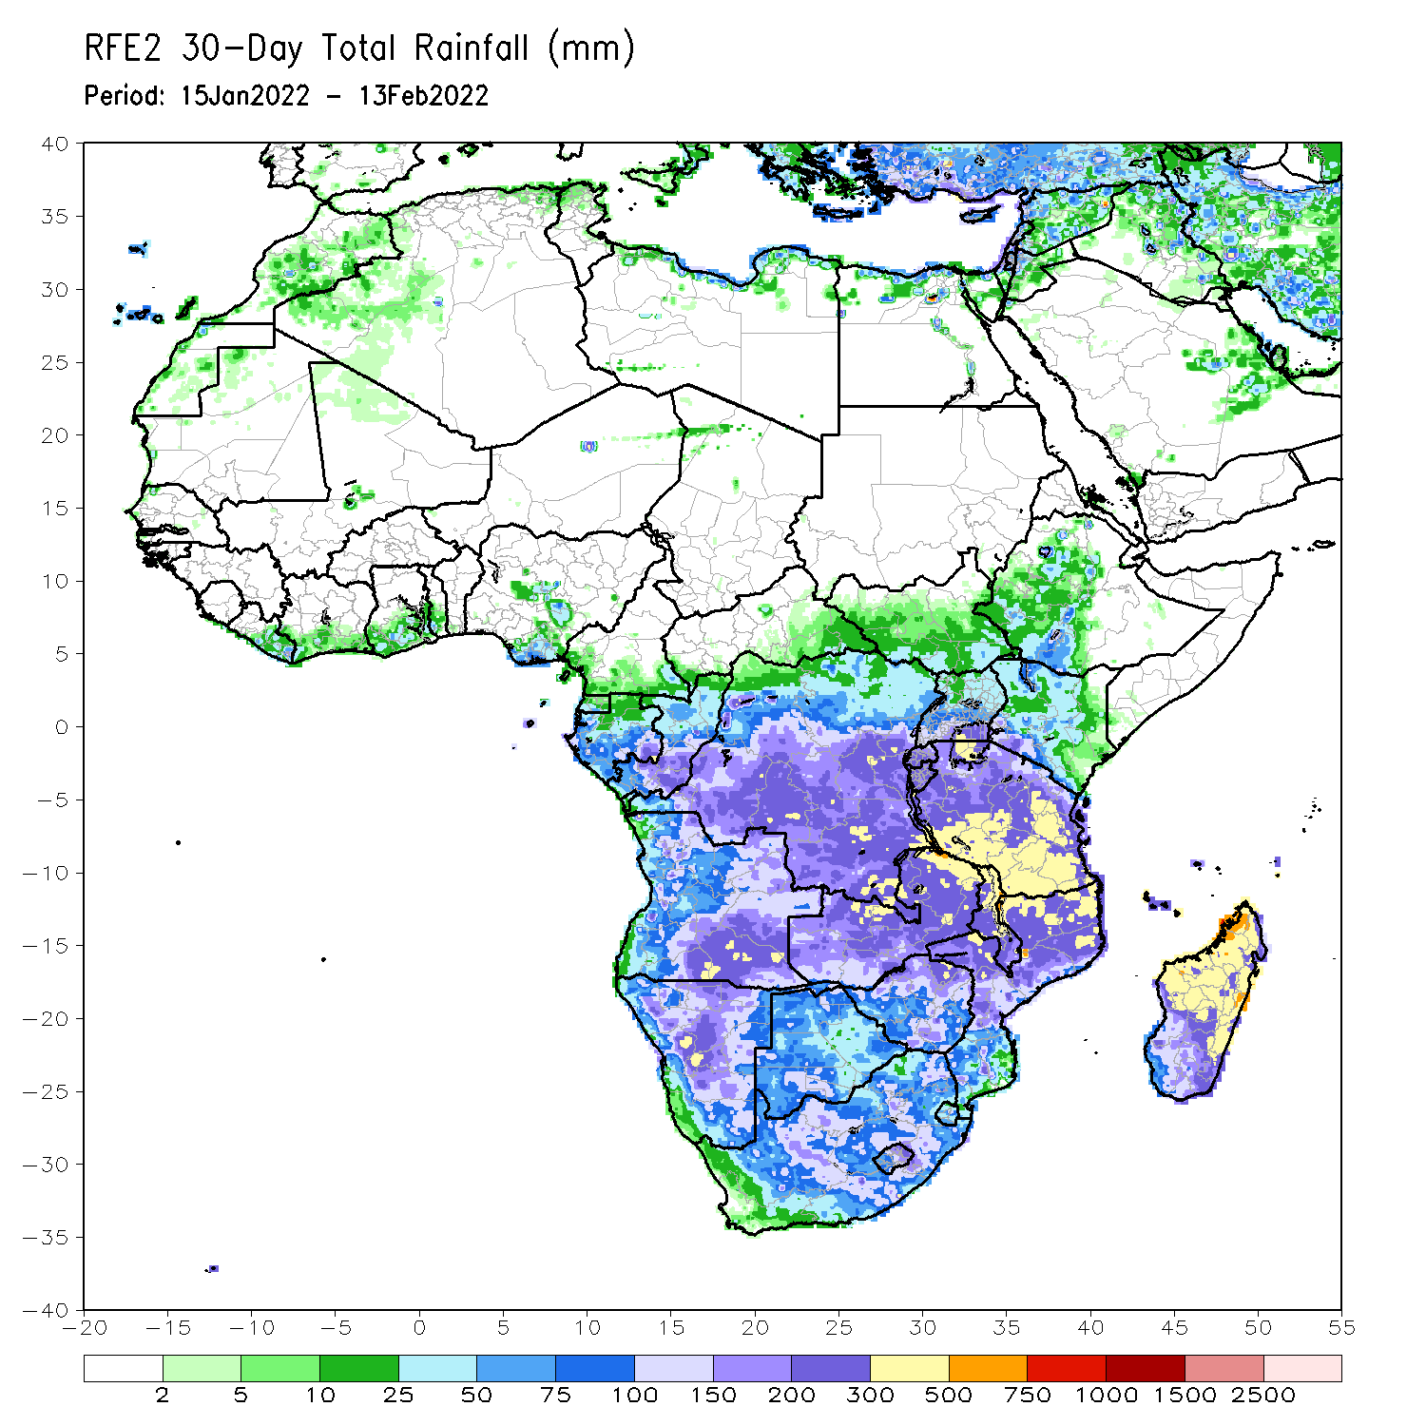
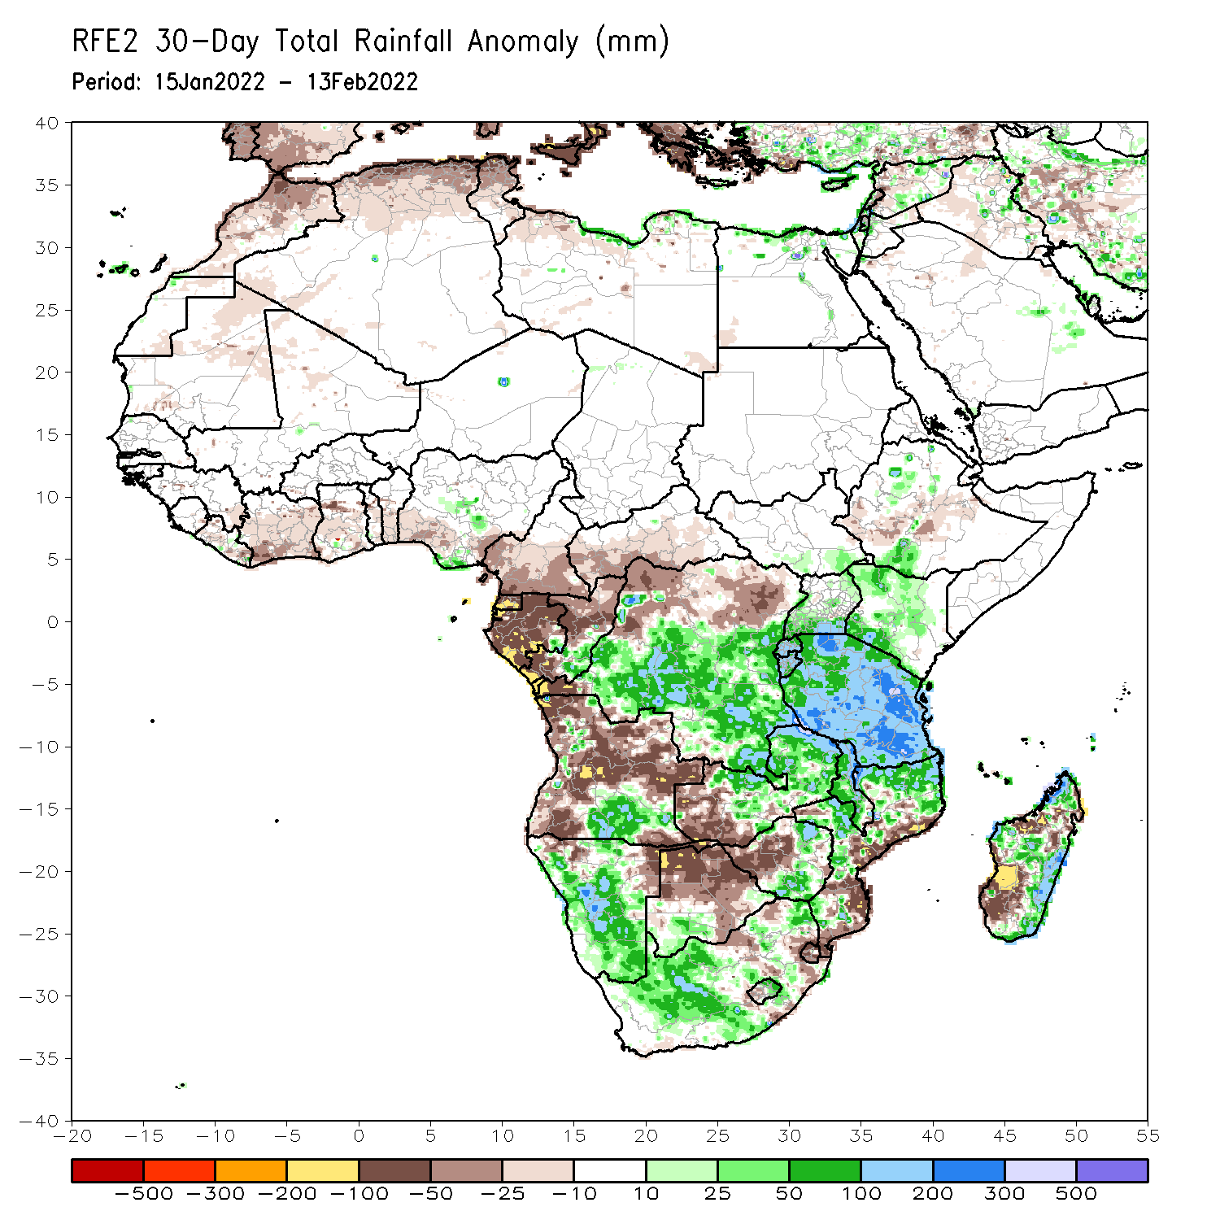
Rainfall Patterns: Last 30 Days
During the past 30 days, in East Africa, above-average rainfall was observed over pocket of southern and northern Ethiopia, parts of Uganda, Rwanda, Burundi, portions of Kenya, and much of Tanzania. Rainfall was below-average over pockets of southwestern Ethiopia. In Central Africa, rainfall was below-average over southern Cameroon, Equatorial Guinea, Gabon, northern Congo, and parts of northern DRC. Rainfall was above-average over southern Congo and many parts of DRC. In Southern Africa, above-average rainfall was observed over southern Angola, many parts of Namibia, eastern Zimbabwe, central and eastern Zambia, Malawi, central and much of Mozambique, northern and eastern Madagascar and much of South Africa. Below-average rainfall was observed over western and northern Angola, the far western Zambia, northwestern Namibia, Botswana, southern Mozambique, and southwestern Madagascar.
Notes:
5

Slide 6
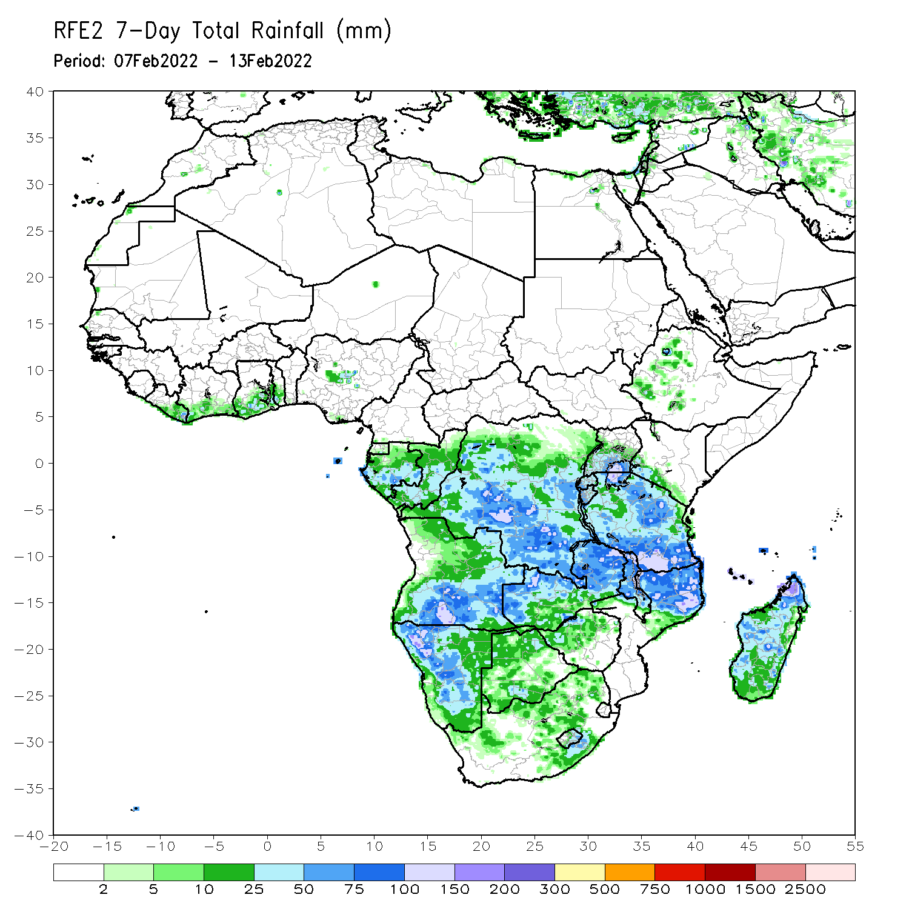
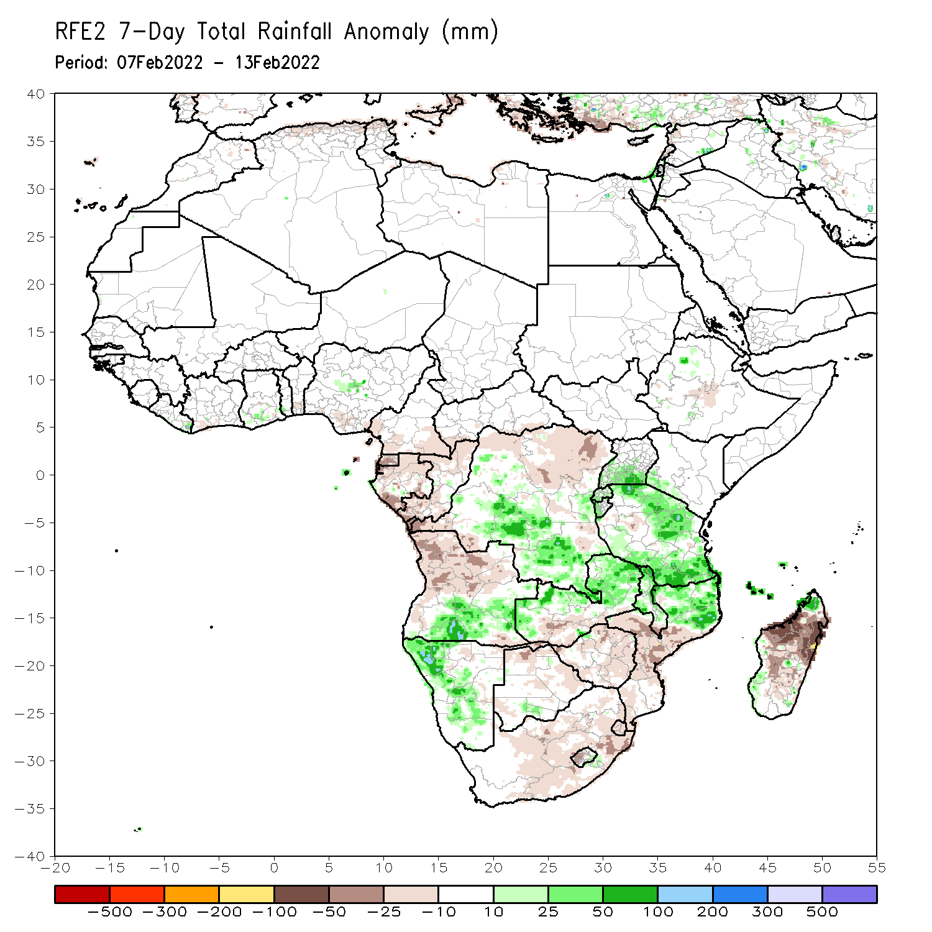
Rainfall Patterns: Last 7 Days
During the past 7 days, in East Africa, rainfall was above-average over much of Tanzania, and southern Uganda. In central Africa, rainfall was above-average over central and southern DRC. Rainfall was below-average over parts of Equatorial Guinea, Gabon, northern and eastern DRC and much of Congo. In Southern Africa, rainfall was above-average over southern Angola, portions of Namibia, northern Zambia, northern Malawi, northern Mozambique, and the far northern Madagascar. Below-average rainfall was observed over central and northern Angola, parts of southern Zambia, Botswana, South Africa, Zimbabwe, southern Mozambique and much of Madagascar.

Slide 7
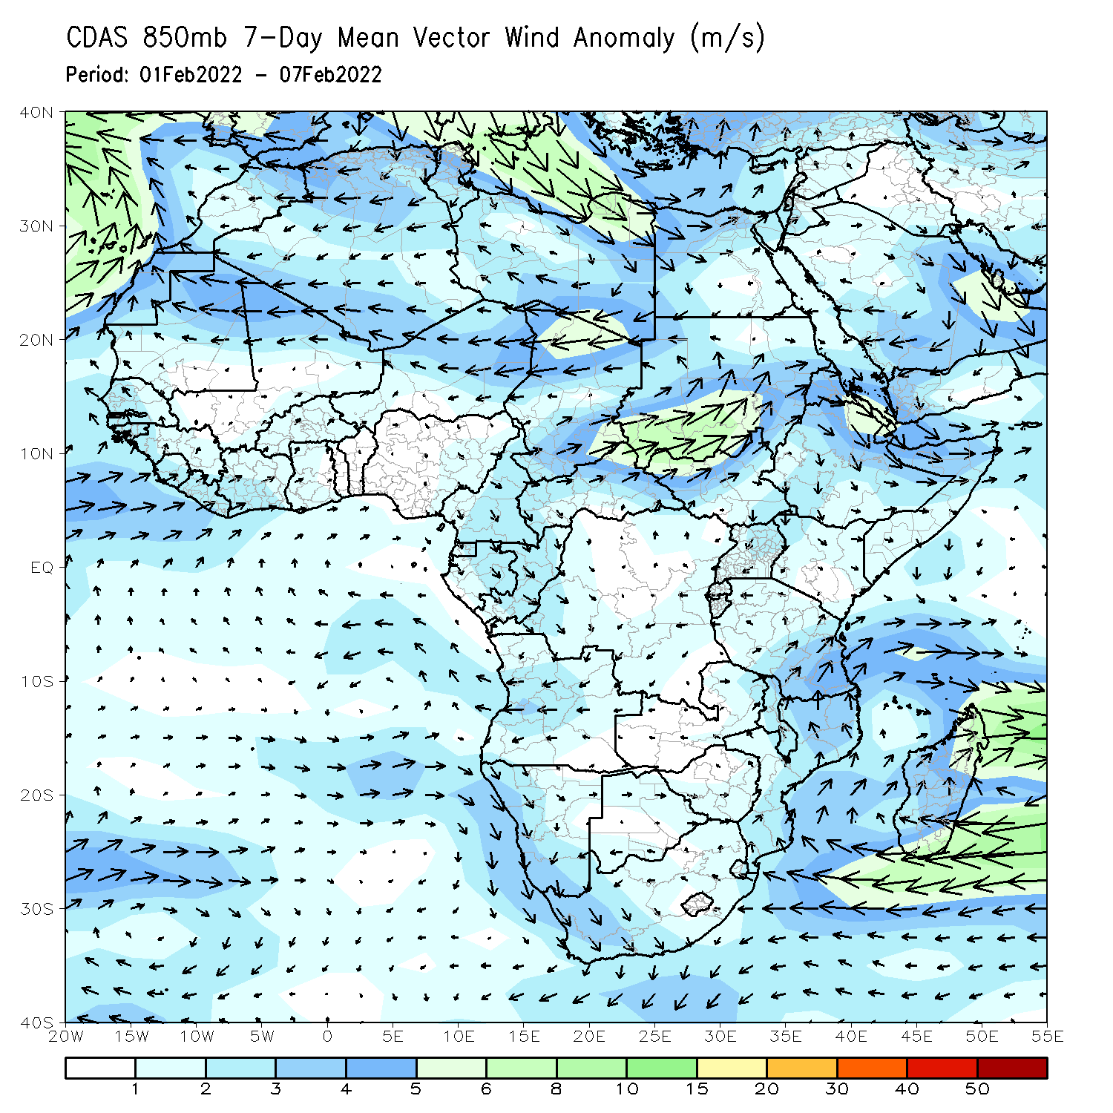
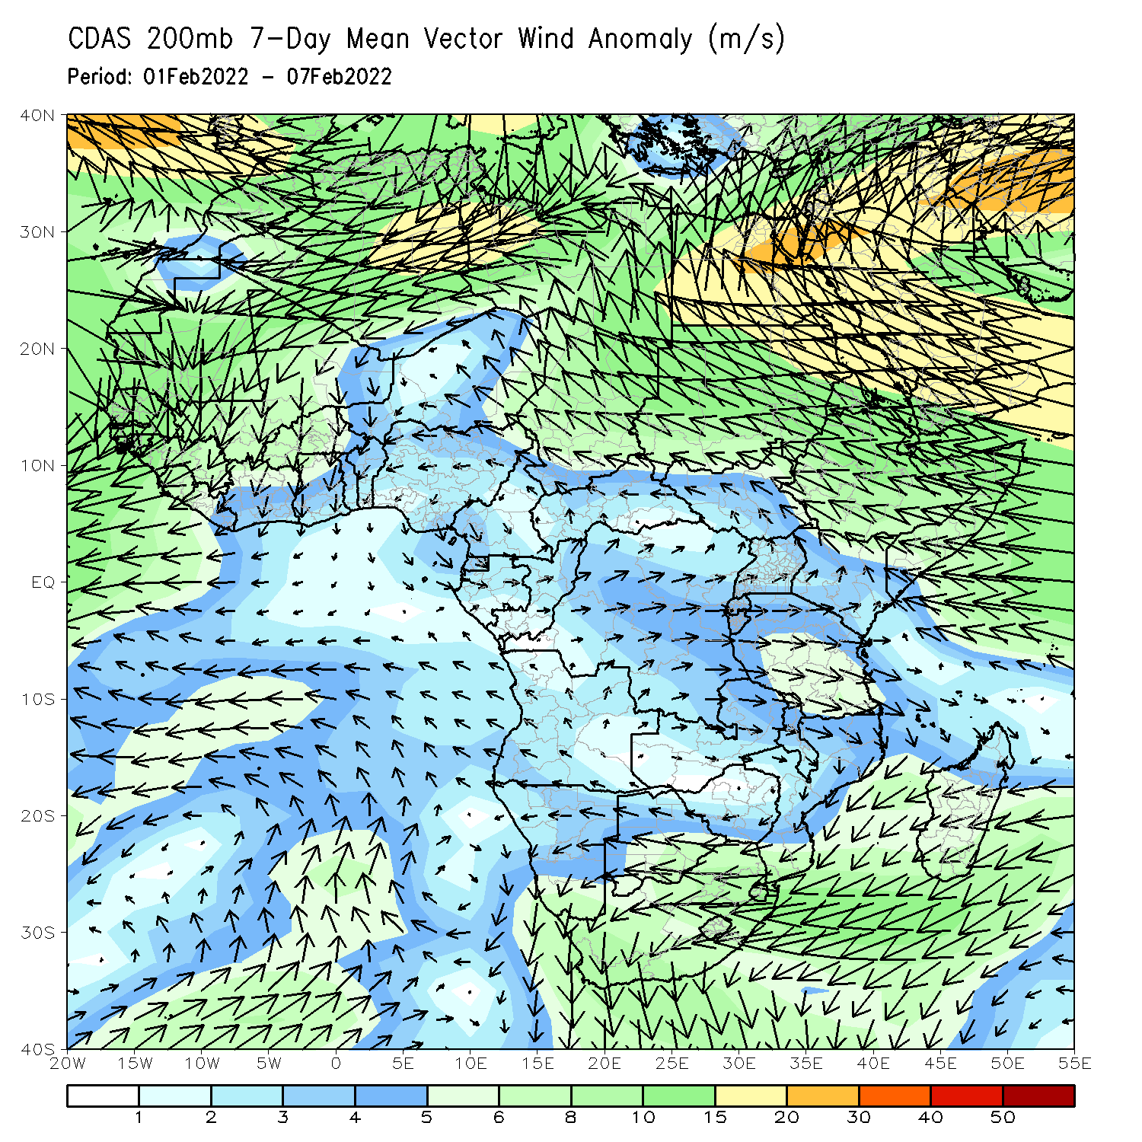
Atmospheric Circulation: Last 7 Days
At 850-hPa level (left panel), an area of cyclonic trough was observed across Madagascar and the neighboring areas of the Mozambique Channel.

Slide 8
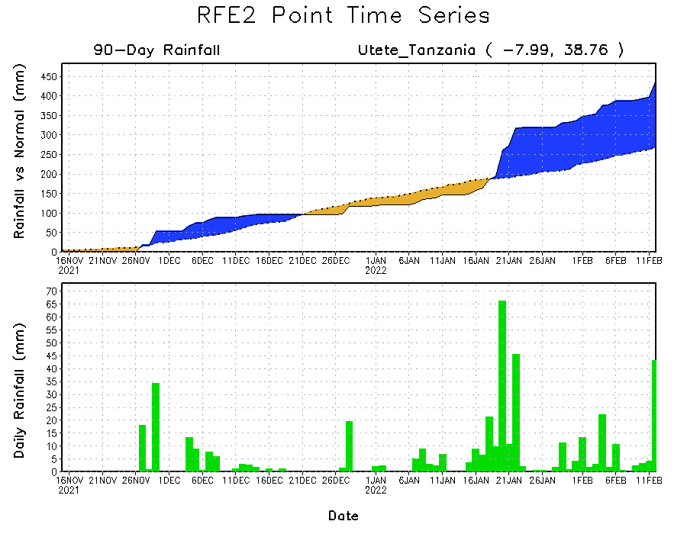
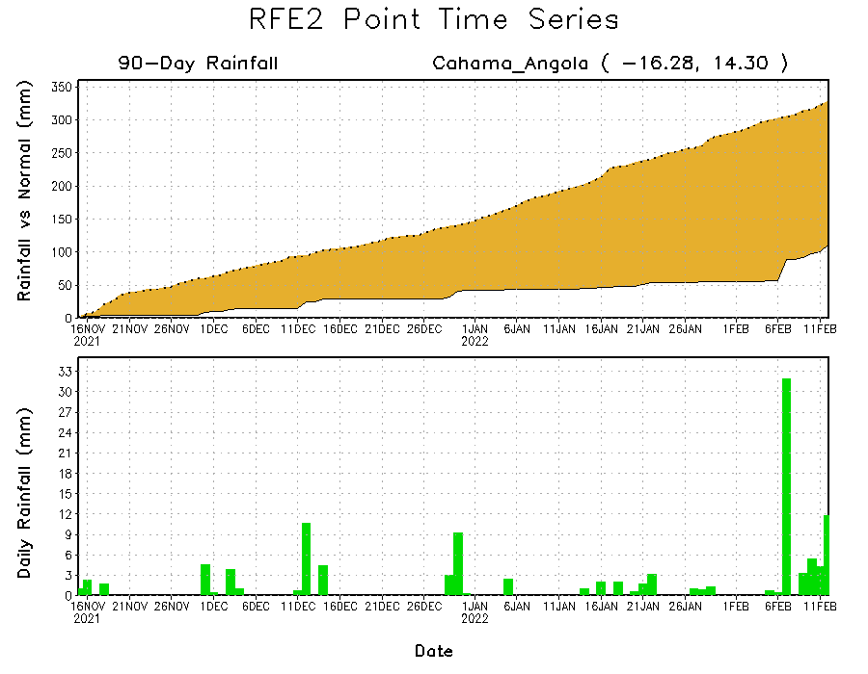
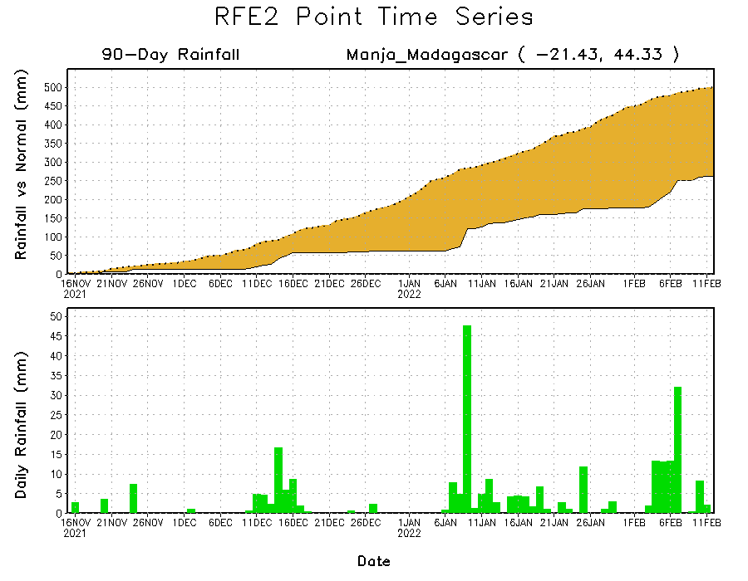
Rainfall Evolution
Daily evolution of rainfall over the last 90 days at selected locations shows moderate sustained moisture surpluses over parts of Tanzania (top right). The seasonal total rainfall remained below-average over southern Madagascar (bottom right) and southern Angola (bottom left).

Slide 9
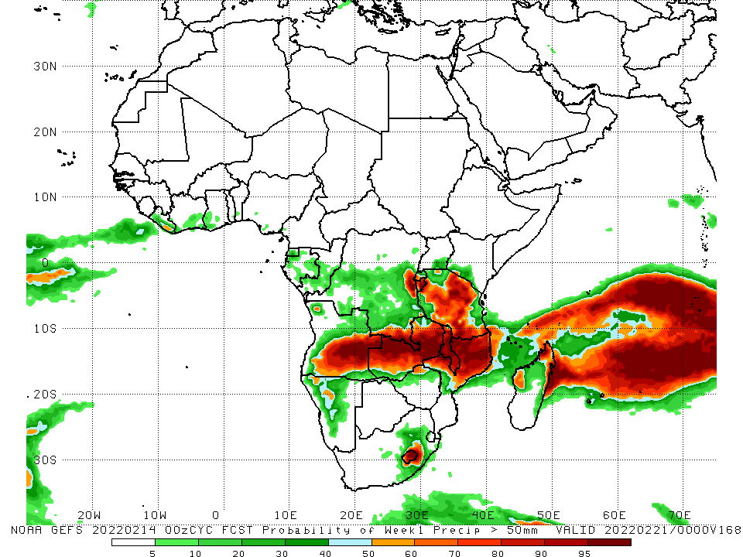
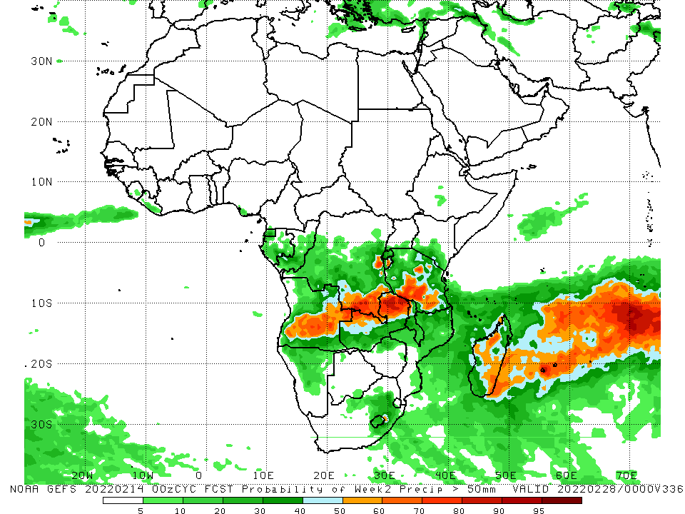
NCEP GEFS Model Forecasts Non-Bias Corrected Probability of precipitation exceedance
Week-1, Valid: 15 – 21 Feb, 2022
Week-2, Valid: 22 – 28 Feb, 2022
For week-1 (left panel), and week-2 (right panel), the NCEP GEFS indicates a moderate to high chance (over 70%) for rainfall to exceed 50 mm over the northern portions of Southern Africa, and Tanzania and parts of Madagascar..
Notes:
9

Slide 10
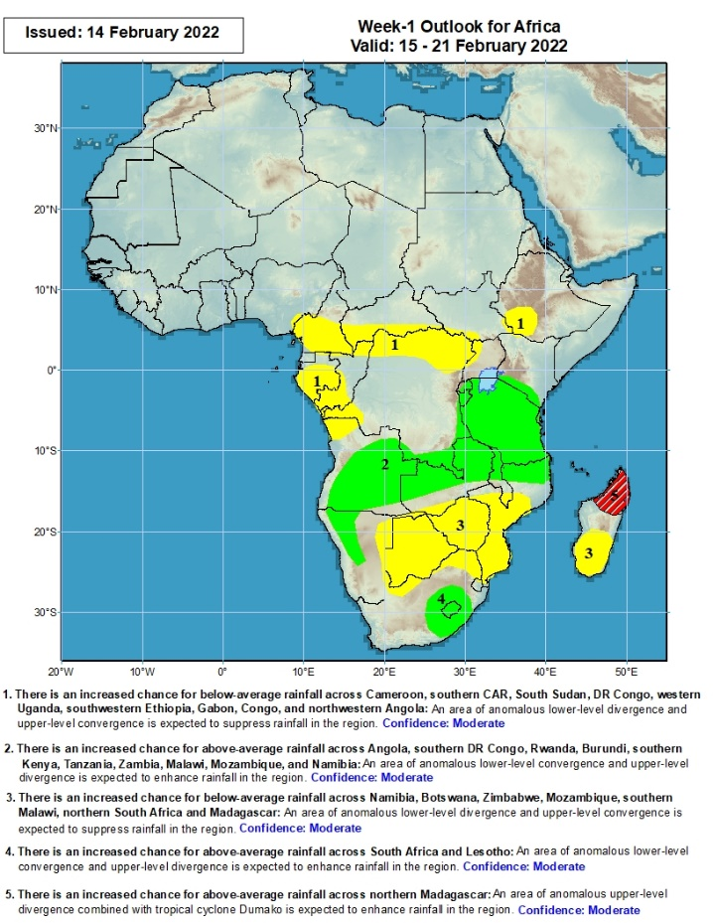
Week-1 Precipitation Outlooks
15 – 21 Feb, 2022,
There is an increased chance for below-average rainfall across southern Cameroon, southern CAR, South Sudan, northern DR Congo, southwestern Ethiopia, Gabon, Congo, and northwestern Angola: An area of anomalous lower-level divergence and upper-level convergence is expected to suppress rainfall in the region. Confidence: Moderate
There is an increased chance for above-average rainfall across portions of Angola, southern DR Congo, Rwanda, Burundi, southern Kenya, Tanzania, Zambia, Malawi, northern Mozambique, and western Namibia: An area of anomalous lower-level convergence and upper-level divergence is expected to enhance rainfall in the region. Confidence: Moderate
There is an increased chance for below-average rainfall across eastern Namibia, much of Botswana, Zimbabwe, central and southern Mozambique, southern Malawi, northern South Africa and southern Madagascar: An area of anomalous lower-level divergence and upper-level convergence is expected to suppress rainfall in the region. Confidence: Moderate
There is an increased chance for above-average rainfall across eastern South Africa and Lesotho: An area of anomalous lower-level convergence and upper-level divergence is expected to enhance rainfall in the region. Confidence: Moderate
There is an increased chance for above-average rainfall across northern Madagascar: An area of anomalous upper-level divergence combined with tropical cyclone Dumako is expected to enhance rainfall in the region. Confidence: Moderate
Notes:
10

Slide 11
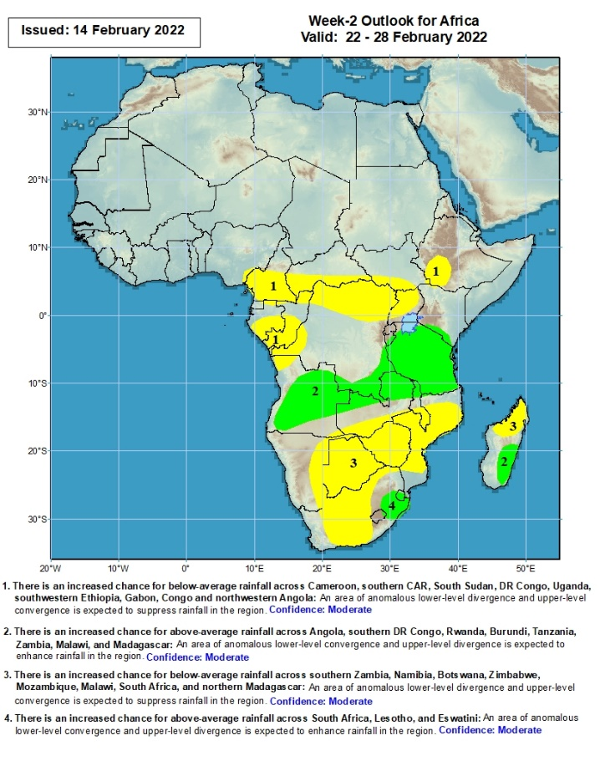
Week-2 Precipitation Outlooks
22 – 28 Feb, 2022
There is an increased chance for below-average rainfall across southern Cameroon, southern CAR, parts of South Sudan, northern DR Congo, Uganda, southwestern Ethiopia, Gabon, southern Congo and northwestern Angola: An area of anomalous lower-level divergence and upper-level convergence is expected to suppress rainfall in the region. Confidence: Moderate
There is an increased chance for above-average rainfall across portions of Angola, southern DR Congo, Rwanda, Burundi, Tanzania, northern Zambia, northern Malawi, and southern Madagascar: An area of anomalous lower-level convergence and upper-level divergence is expected to enhance rainfall in the region. Confidence: Moderate
There is an increased chance for below-average rainfall across southern Zambia, eastern Namibia, Botswana, Zimbabwe, Mozambique, southern Malawi, South Africa and northern Madagascar: An area of anomalous lower-level divergence and upper-level convergence is expected to suppress rainfall in the region. Confidence: Moderate
There is an increased chance for above-average rainfall across South parts of eastern Africa, Lesotho and Eswatini: An area of anomalous lower-level convergence and upper-level divergence is expected to enhance rainfall in the region. Confidence: Moderate
Notes:
11

Slide 12
Summary
During the past 30 days, in East Africa, above-average rainfall was observed over pocket of southern and northern Ethiopia, parts of Uganda, Rwanda, Burundi, portions of Kenya, and much of Tanzania. Rainfall was below-average over pockets of southwestern Ethiopia. In Central Africa, rainfall was below-average over southern Cameroon, Equatorial Guinea, Gabon, northern Congo, and parts of northern DRC. Rainfall was above-average over southern Congo and many parts of DRC. In Southern Africa, above-average rainfall was observed over southern Angola, many parts of Namibia, eastern Zimbabwe, central and eastern Zambia, Malawi, central and much of Mozambique, northern and eastern Madagascar and much of South Africa. Below-average rainfall was observed over western and northern Angola, the far western Zambia, northwestern Namibia, Botswana, southern Mozambique, and southwestern Madagascar.
During the past 7 days, in East Africa, rainfall was above-average over much of Tanzania, and southern Uganda. In central Africa, rainfall was above-average over central and southern DRC. Rainfall was below-average over parts of Equatorial Guinea, Gabon, northern and eastern DRC and much of Congo. In Southern Africa, rainfall was above-average over southern Angola, portions of Namibia, northern Zambia, northern Malawi, northern Mozambique, and the far northern Madagascar. Below-average rainfall was observed over central and northern Angola, parts of southern Zambia, Botswana, South Africa, Zimbabwe, southern Mozambique and much of Madagascar.
Week-1 and week-2 outlooks call for an increased chance for above-average rainfall across the northern portions of Southern Africa, and Tanzania. In contrast, there is an increased chance for below-average rainfall over equatorial Central Africa, southwestern Ethiopia, and the southern portions of Southern Africa.

