Slide 1
The African Monsoon Recent Evolution and Current Status Include Week-1 and Week-2 Outlooks
Update prepared by
21 February 2022
For more information, visit:
http://www.cpc.ncep.noaa.gov/products/Global_Monsoons/African_Monsoons/precip_monitoring.shtml

Slide 2
Outline
Highlights
Recent Evolution and Current Conditions
NCEP GEFS Forecasts
Summary

Slide 3
Highlights: Last 7 Days
During the past 7 days, in East Africa, rainfall was above-average over much of Tanzania. In central Africa, rainfall was above-average over parts of northern and southern DRC. Rainfall was below-average over parts of Equatorial Guinea, Gabon, parts of western and eastern DRC the far southern Congo. In Southern Africa, rainfall was above-average over parts of Angola and Namibia, northern and eastern Zambia, Malawi, northern Mozambique, and pockets of eastern Madagascar. Below-average rainfall was observed over parts of southern Zambia, Botswana, South Africa, Zimbabwe, southern Mozambique and much of Madagascar.
Week-1 and week-2 outlooks call for an increased chance for above-average rainfall across the northern portions of Southern Africa, and Tanzania. In contrast, there is an increased chance for below-average rainfall along equatorial Central Africa, southwestern Ethiopia, and the southern portions of Southern Africa.

Slide 4
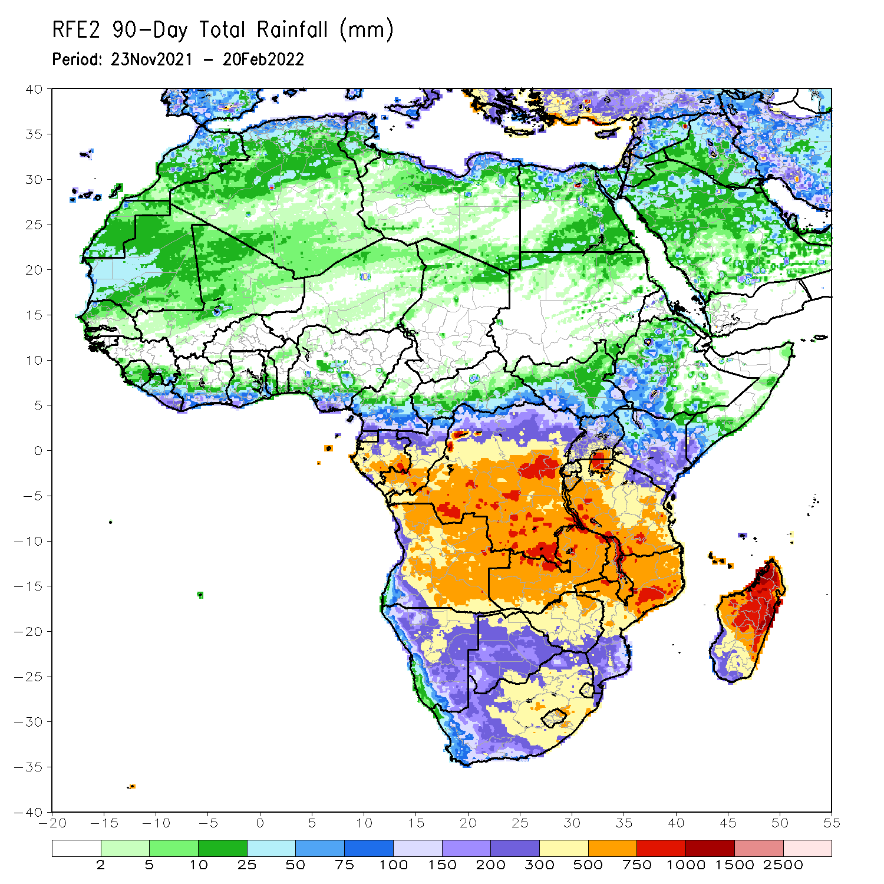
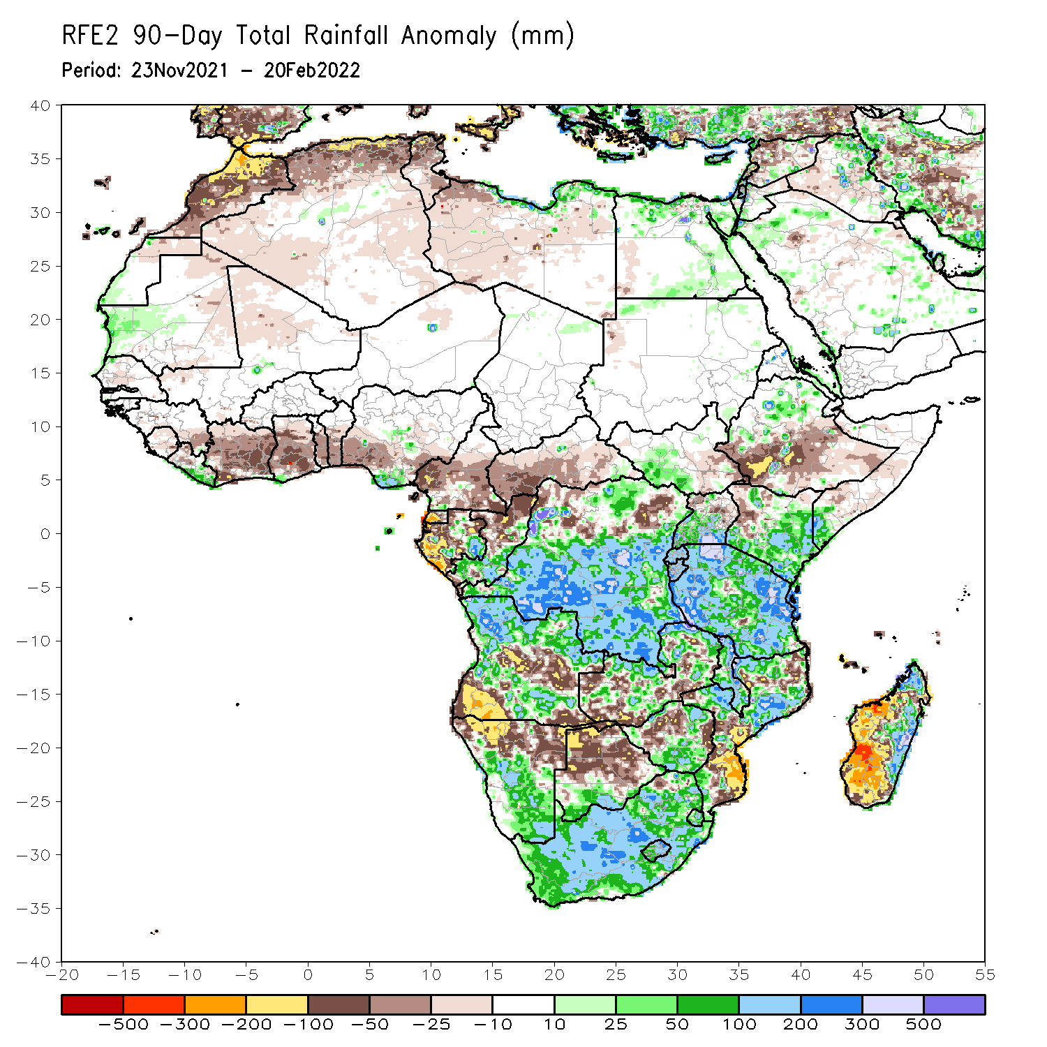
Rainfall Patterns: Last 90 Days
Over the past 90 days, in East Africa, above-average rainfall was observed over parts of northern Ethiopia, the far southern South Sudan, Rwanda, Burundi, southern Uganda, eastern and southern Kenya, southwestern Somalia, and many parts of Tanzania. Rainfall was below-average over southern Ethiopia, eastern South Sudan, parts of Somalia, western Kenya, and northern Uganda. In southern Africa, above-average rainfall was observed over northern and southeastern Angola, southern Botswana, central and southern Namibia, portions of Zimbabwe and Zambia, northern Mozambique, eastern Madagascar and much of South Africa. Below-average rainfall was observed over central and southwestern Angola, northern Namibia, pockets of Zambia, central and northern Botswana, pockets of northern Zimbabwe, parts of Mozambique and western and southern Madagascar. In Central Africa, rainfall was above-average over many parts of DRC, pockets of Gabon, and southern Congo. Rainfall was below-average over southern Cameroon, parts of northern DRC, Gabon, much of CAR, and northern Congo. In West Africa, rainfall was below-average over many places in the Gulf of Guinea region.
Notes:
4

Slide 5
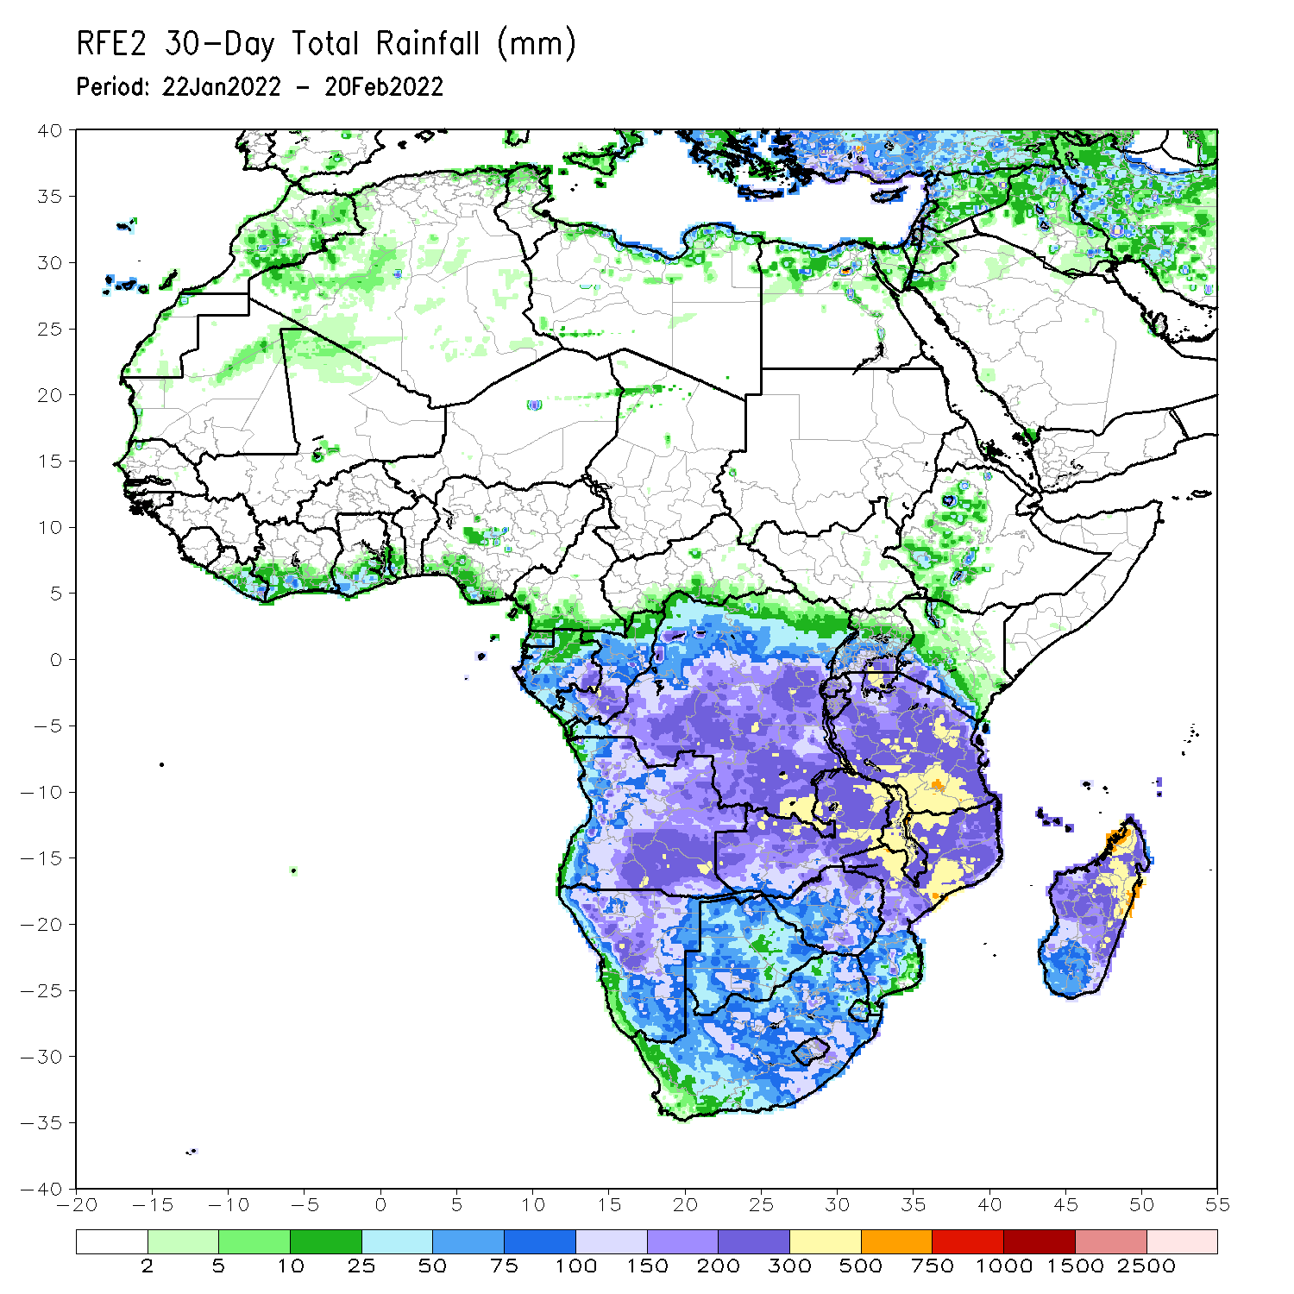
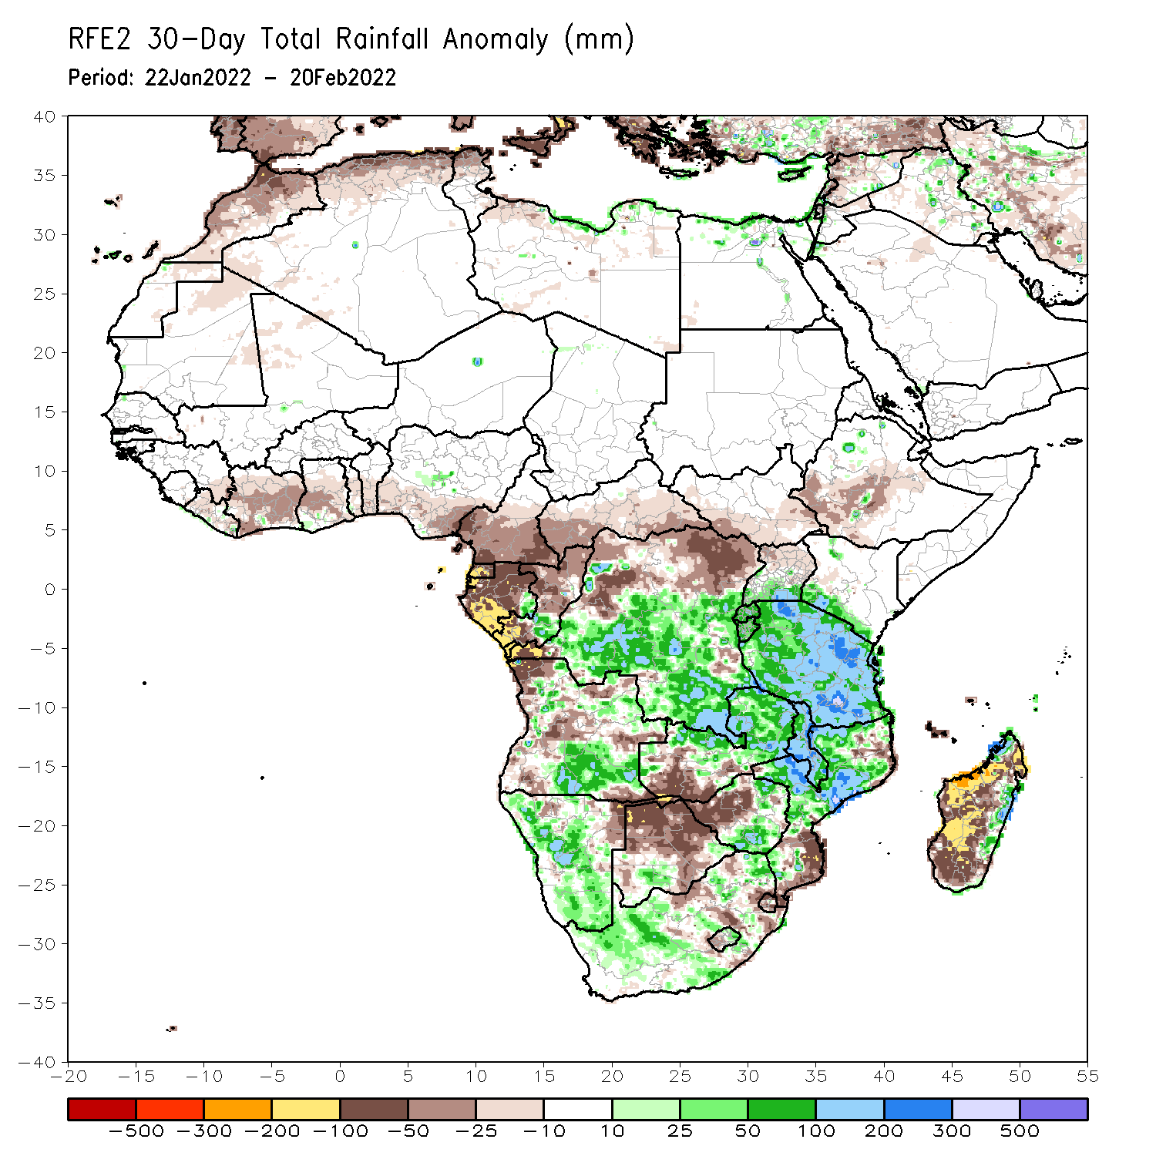
Rainfall Patterns: Last 30 Days
During the past 30 days, in East Africa, above-average rainfall was observed over pocket of southern and northern Ethiopia, parts of Uganda, Rwanda, Burundi, southwestern Kenya, and much of Tanzania. Rainfall was below-average over southern and southwestern Ethiopia. In Central Africa, rainfall was below-average over southern Cameroon, Equatorial Guinea, Gabon, northern Congo, and parts of northern DRC. Rainfall was above-average over southern Congo, and central and southern DRC. In Southern Africa, above-average rainfall was observed over southern Angola, many parts of Namibia, eastern Zimbabwe, northern and eastern Zambia, Malawi, much of Mozambique, eastern Madagascar, and much of South Africa. Below-average rainfall was observed over parts of western and northern Angola, southwestern Zambia, pockets of northern Namibia, Botswana, southern Mozambique, and western Madagascar.
Notes:
5

Slide 6
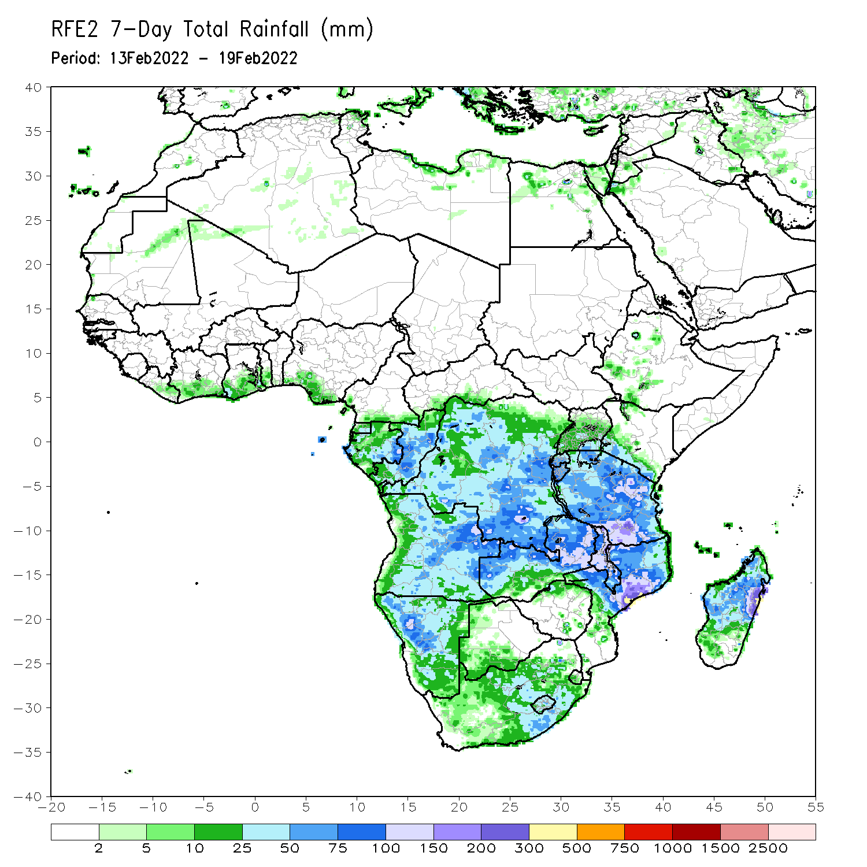
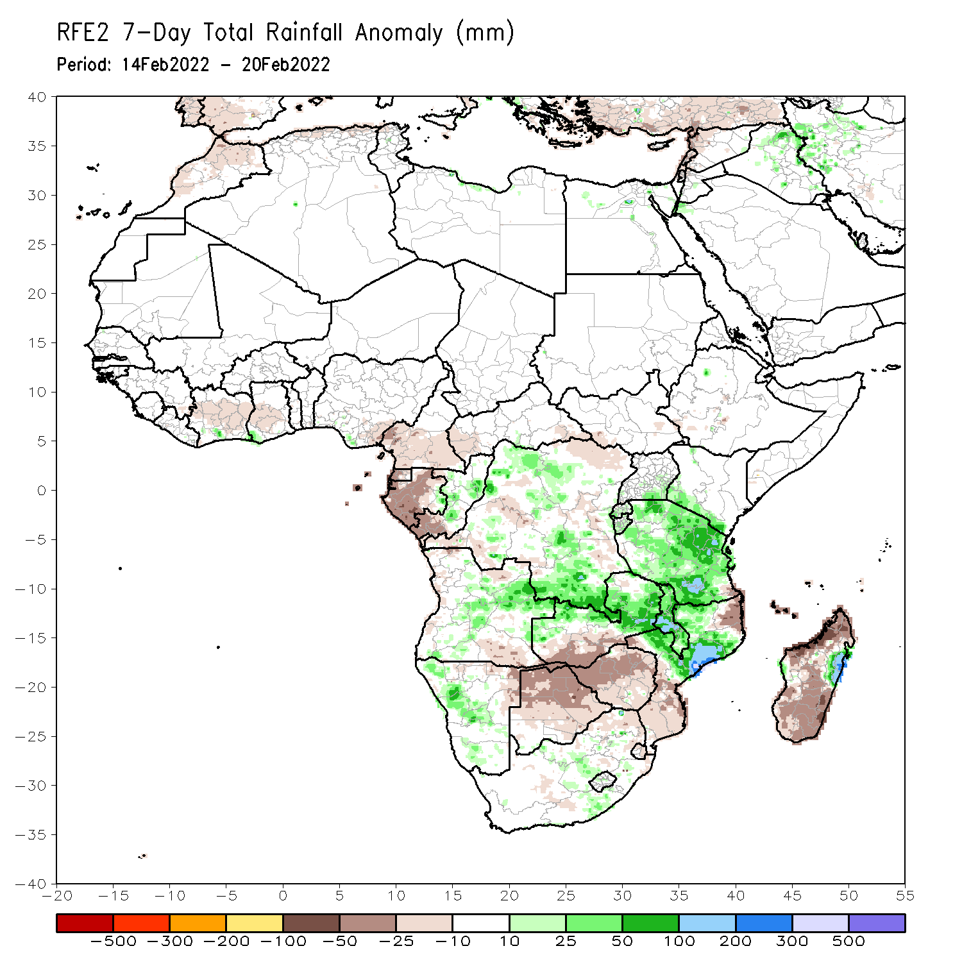
Rainfall Patterns: Last 7 Days
During the past 7 days, in East Africa, rainfall was above-average over much of Tanzania. In central Africa, rainfall was above-average over parts of northern and southern DRC. Rainfall was below-average over parts of Equatorial Guinea, Gabon, parts of western and eastern DRC the far southern Congo. In Southern Africa, rainfall was above-average over parts of Angola and Namibia, northern and eastern Zambia, Malawi, northern Mozambique, and pockets of eastern Madagascar. Below-average rainfall was observed over parts of southern Zambia, Botswana, South Africa, Zimbabwe, southern Mozambique and much of Madagascar.

Slide 7
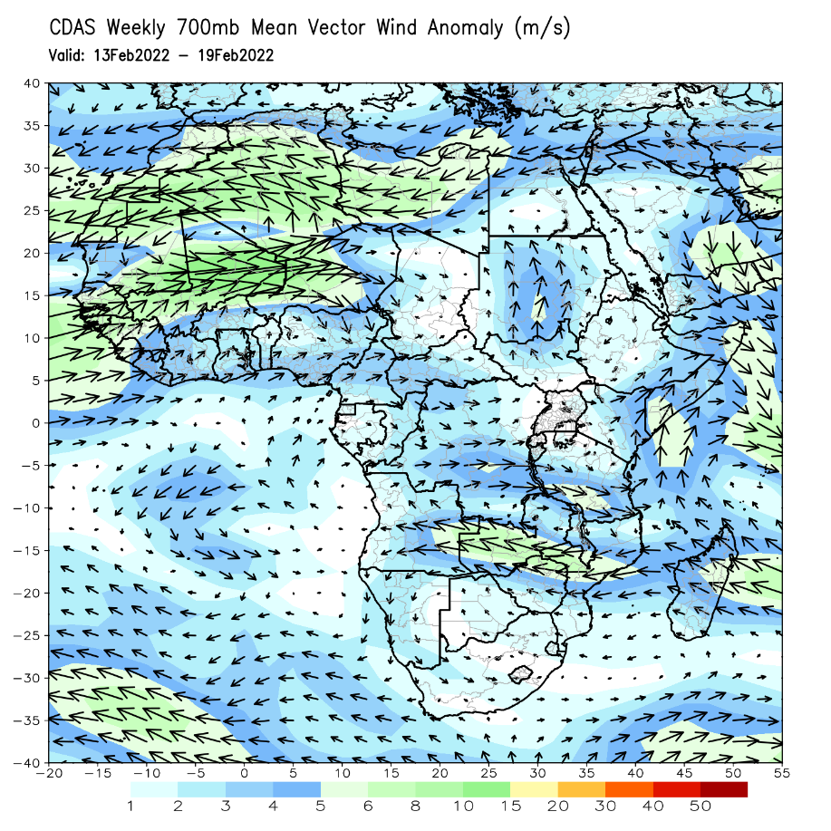
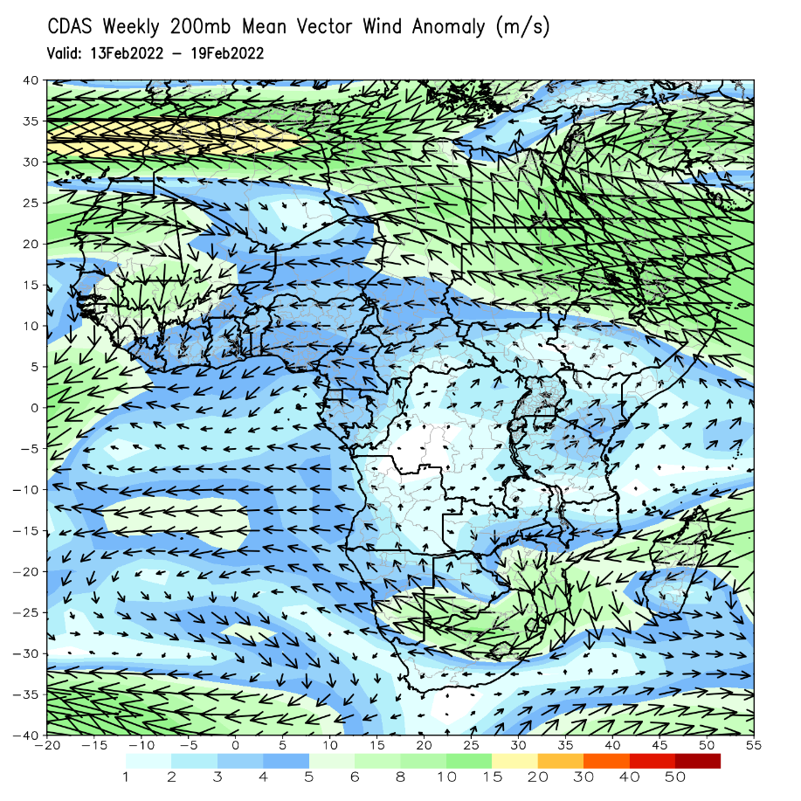
Atmospheric Circulation: Last 7 Days
At 700-hPa level (left panel), an area of cyclonic trough was observed across the northern portions of Southern Africa.

Slide 8
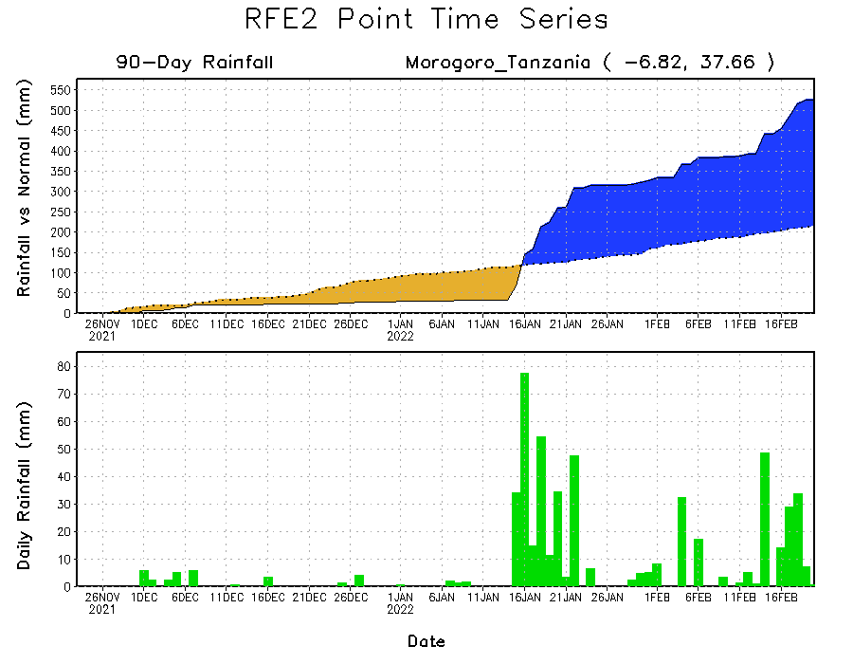
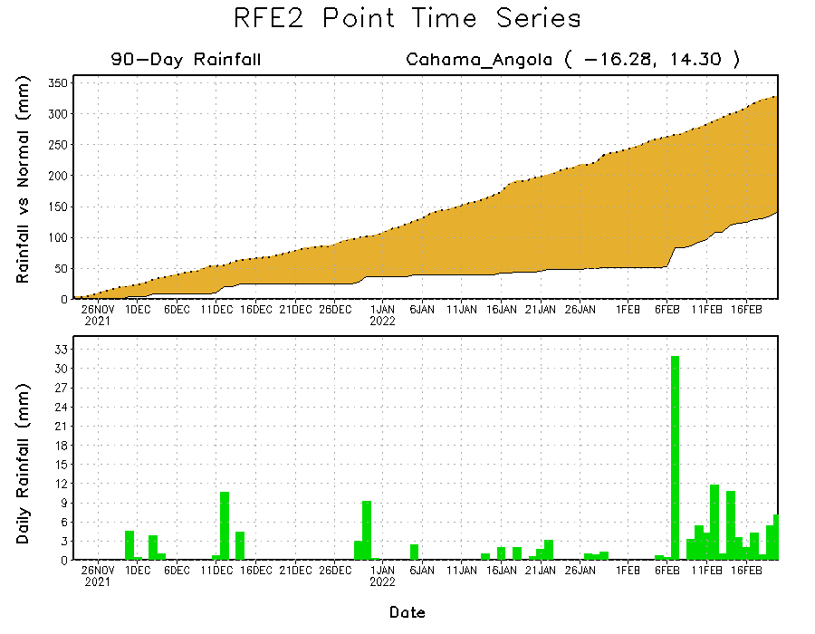
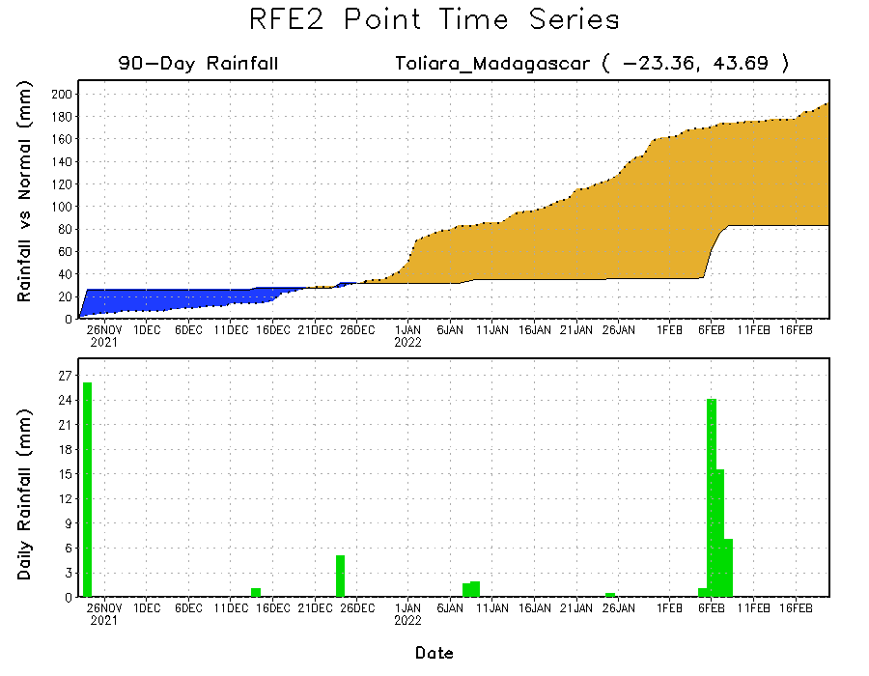
Rainfall Evolution
Daily evolution of rainfall over the last 90 days at selected locations shows moderate sustained moisture surpluses over parts of Tanzania (top right). The seasonal total rainfall remained below-average over southern Madagascar (bottom right) and southern Angola (bottom left).

Slide 9
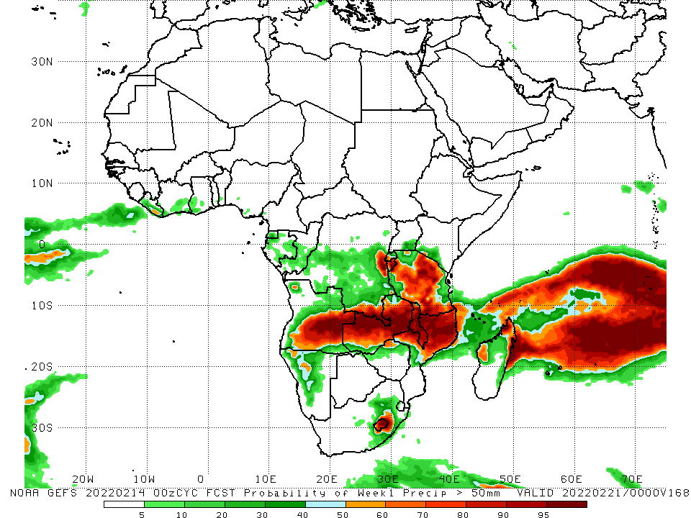
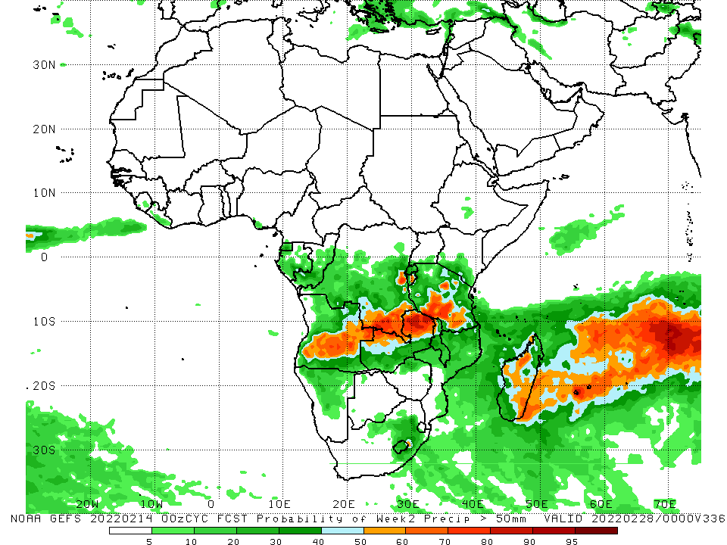
NCEP GEFS Model Forecasts Non-Bias Corrected Probability of precipitation exceedance
Week-1, Valid: 22 – 28 Feb, 2022
Week-2, Valid: 01 – 07 Mar, 2022
For week-1 (left panel), and week-2 (right panel), the NCEP GEFS indicates a moderate to high chance (over 70%) for rainfall to exceed 50 mm over the northern portions of Southern Africa, and Tanzania and parts of Madagascar..
Notes:
9

Slide 10
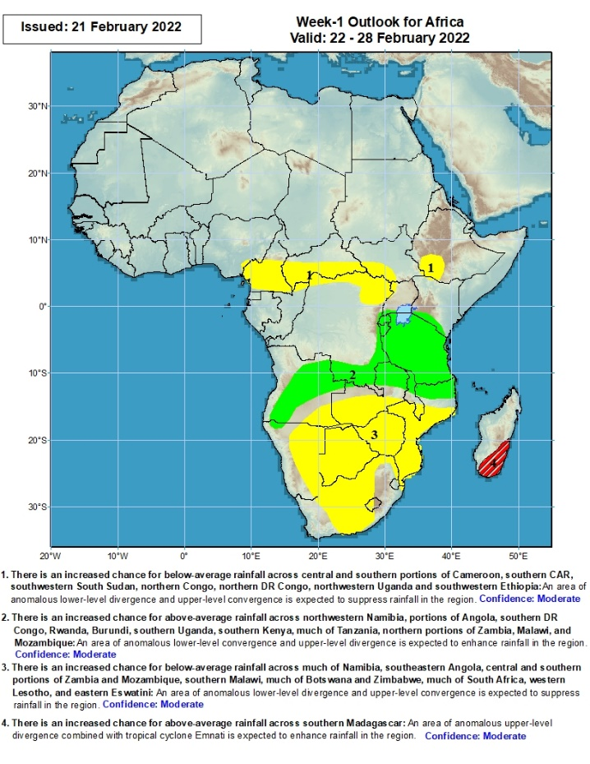
Week-1 Precipitation Outlooks
22 – 28 Feb, 2022
There is an increased chance for below-average rainfall across central and southern portions of Cameroon, southern CAR, southwestern South Sudan, northern Congo, northern DR Congo, northwestern Uganda, and southwestern Ethiopia: An area of anomalous lower-level divergence and upper-level convergence is expected to suppress rainfall in the region. Confidence: Moderate
There is an increased chance for above-average rainfall across northwestern Namibia, portions of Angola, southern DR Congo, Rwanda, Burundi, southern Uganda, southern Kenya, much of Tanzania, northern portions of Zambia, Malawi, and Mozambique: An area of anomalous lower-level convergence and upper-level divergence is expected to enhance rainfall in the region. Confidence: Moderate
There is an increased chance for below-average rainfall across much of Namibia, southeastern Angola, central and southern portions of Zambia and Mozambique, southern Malawi, much of Botswana and Zimbabwe, much of South Africa, western Lesotho, and eastern Eswatini: An area of anomalous lower-level divergence and upper-level convergence is expected to suppress rainfall in the region. Confidence: Moderate
There is an increased chance for above-average rainfall across southern Madagascar: An area of anomalous upper-level divergence combined with tropical cyclone Emnati is expected to enhance rainfall in the region. Confidence: Moderate
Notes:
10

Slide 11
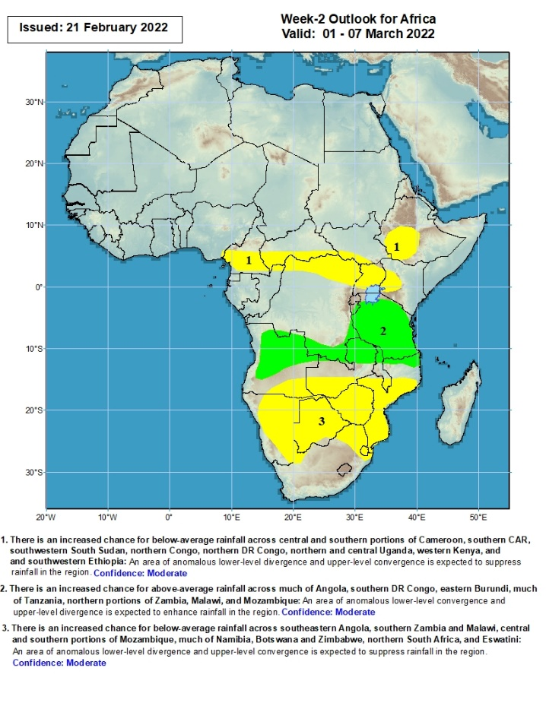
Week-2 Precipitation Outlooks
01 – 07 Mar, 2022
There is an increased chance for below-average rainfall across central and southern portions of Cameroon, southern CAR, southwestern South Sudan, northern Congo, northern DR Congo, northern and central Uganda, western Kenya, and southwestern Ethiopia: An area of anomalous lower-level divergence and upper-level convergence is expected to suppress rainfall in the region. Confidence: Moderate
There is an increased chance for above-average rainfall across much of Angola, southern DR Congo, eastern Burundi, much of Tanzania, northern portions of Zambia, Malawi, and Mozambique: An area of anomalous lower-level convergence and upper-level divergence is expected to enhance rainfall in the region. Confidence: Moderate
There is an increased chance for below-average rainfall across southeastern Angola, southern Zambia and Malawi, central and southern portions of Mozambique, much of Namibia, Botswana and Zimbabwe, northern South Africa, and Eswatini: An area of anomalous lower-level divergence and upper-level convergence is expected to suppress rainfall in the region. Confidence: Moderate
Notes:
11

Slide 12
Summary
During the past 30 days, in East Africa, above-average rainfall was observed over pocket of southern and northern Ethiopia, parts of Uganda, Rwanda, Burundi, southwestern Kenya, and much of Tanzania. Rainfall was below-average over southern and southwestern Ethiopia. In Central Africa, rainfall was below-average over southern Cameroon, Equatorial Guinea, Gabon, northern Congo, and parts of northern DRC. Rainfall was above-average over southern Congo, and central and southern DRC. In Southern Africa, above-average rainfall was observed over southern Angola, many parts of Namibia, eastern Zimbabwe, northern and eastern Zambia, Malawi, much of Mozambique, eastern Madagascar, and much of South Africa. Below-average rainfall was observed over parts of western and northern Angola, southwestern Zambia, pockets of northern Namibia, Botswana, southern Mozambique, and western Madagascar.
During the past 7 days, in East Africa, rainfall was above-average over much of Tanzania. In central Africa, rainfall was above-average over parts of northern and southern DRC. Rainfall was below-average over parts of Equatorial Guinea, Gabon, parts of western and eastern DRC the far southern Congo. In Southern Africa, rainfall was above-average over parts of Angola and Namibia, northern and eastern Zambia, Malawi, northern Mozambique, and pockets of eastern Madagascar. Below-average rainfall was observed over parts of southern Zambia, Botswana, South Africa, Zimbabwe, southern Mozambique and much of Madagascar.
Week-1 and week-2 outlooks call for an increased chance for above-average rainfall across the northern portions of Southern Africa, and Tanzania. In contrast, there is an increased chance for below-average rainfall along equatorial Central Africa, southwestern Ethiopia, and the southern portions of Southern Africa.

