Slide 1
The African Monsoon Recent Evolution and Current Status Include Week-1 and Week-2 Outlooks
Update prepared by
04 April 2022
For more information, visit:
http://www.cpc.ncep.noaa.gov/products/Global_Monsoons/African_Monsoons/precip_monitoring.shtml

Slide 2
Outline
Highlights
Recent Evolution and Current Conditions
NCEP GEFS Forecasts
Summary

Slide 3
Highlights: Last 7 Days
During the past 7 days, in East Africa, rainfall was above-average over parts of Uganda, Kenya and Tanzania, while below-average rainfall was observed over parts of South Sudan, southern Ethiopia, and parts of central Kenya and central Tanzania. In central Africa, rainfall was above-average much of DRC, pockets of northern Gabon, and southern Congo, while below-average rainfall was observed over southern Cameroon, Equatorial Guinea, western Gabon and parts of CAR. In Southern Africa, rainfall was above-average over much of Angola, parts of Namibia, western Botswana, and central South Africa, northern Malawi, and pockets of Mozambique and Madagascar. Rainfall was below-average over portions of Botswana, Zambia, Zimbabwe, northeastern South Africa, parts of Mozambique, and, pockets of Madagascar. In West Africa, above average rainfall was observed over pockets of eastern Guinea, while below-average rainfall was observed over southern Nigeria.
Week-1 and Week-2 outlooks call for an increased chance for below-average rainfall over much of East Africa. In contrast, the forecasts call for an increased chance for above-average rainfall across central and eastern Angola, Zambia, northern Zimbabwe, Malawi, northern Mozambique, and central South Africa.

Slide 4
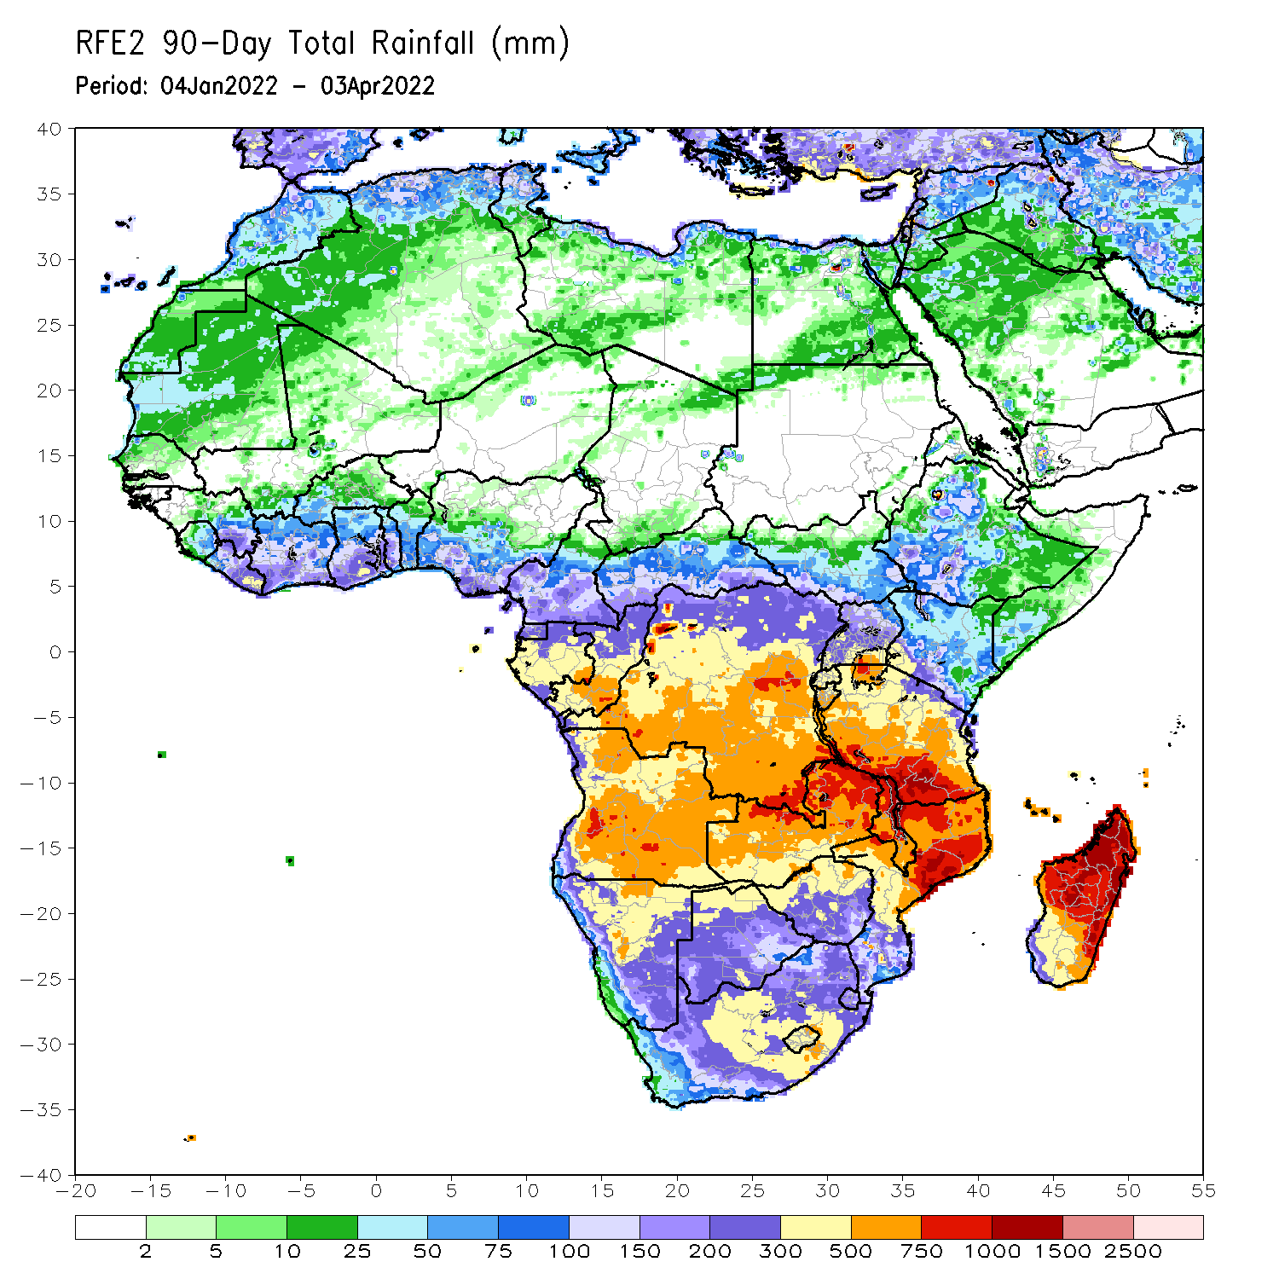
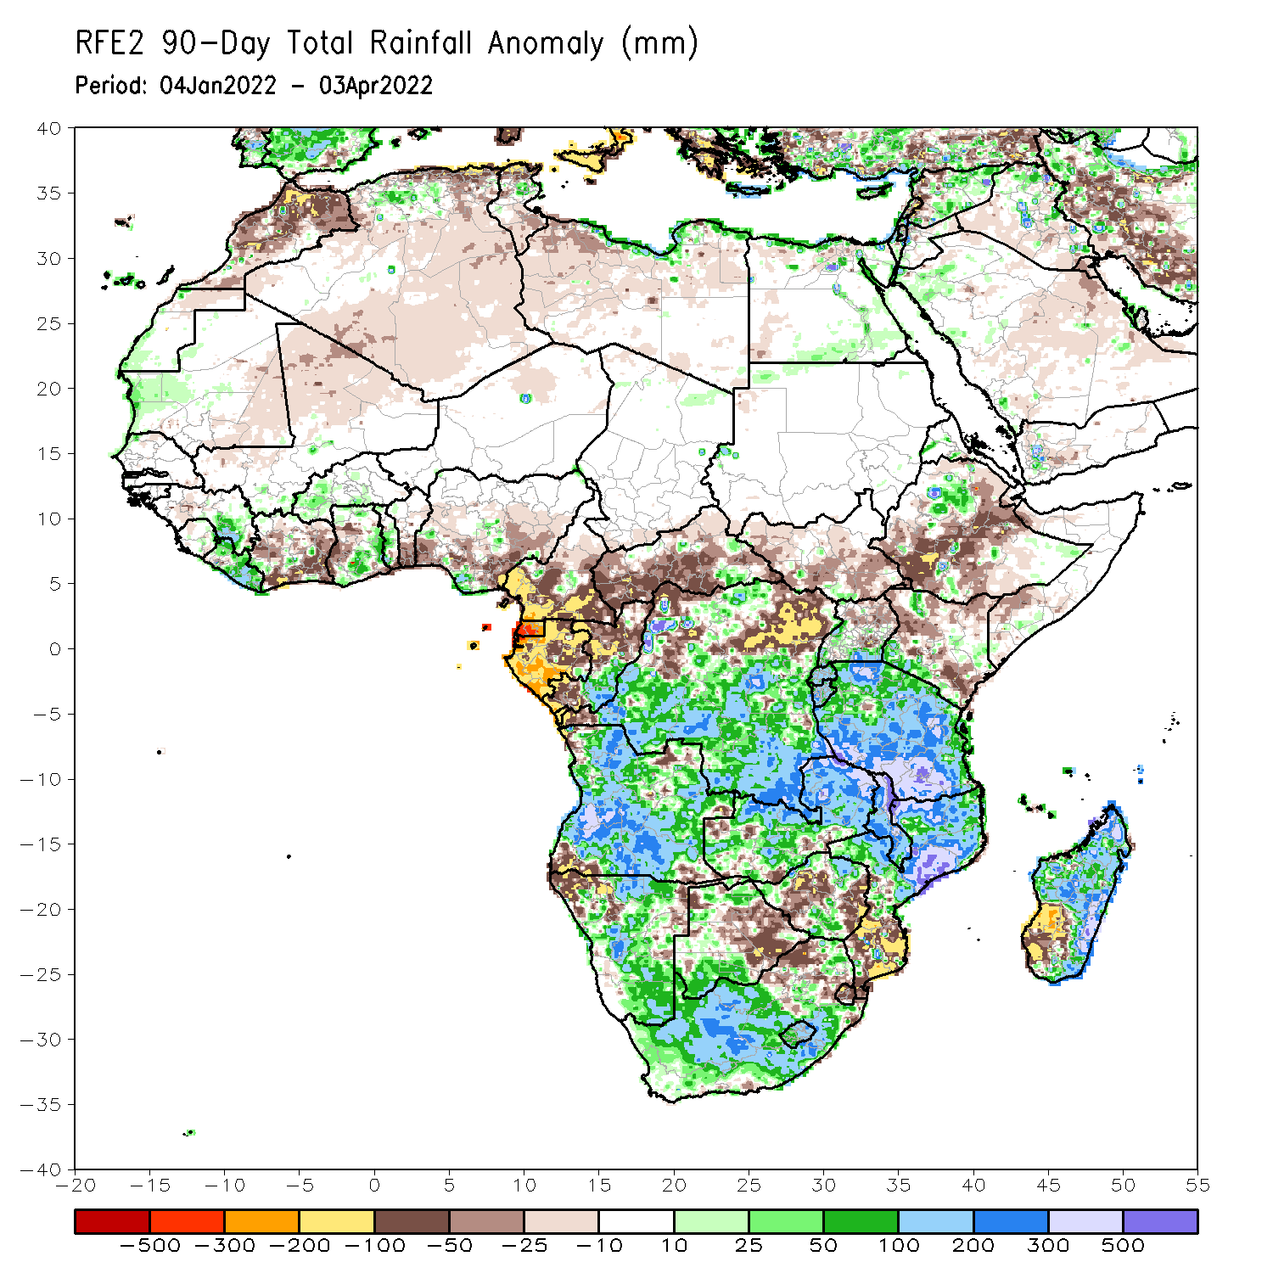
Rainfall Patterns: Last 90 Days
Over the past 90 days, in East Africa, above-average rainfall was observed over parts of northern Ethiopia, Rwanda, Burundi, southern Uganda, pockets of Kenya, and much of Tanzania. Rainfall was below-average over central, southwestern and eastern Ethiopia, parts of western and southern Kenya, and northern Uganda. In southern Africa, above-average rainfall was observed over much of Angola, parts of northern and western Botswana, much of Namibia, portions of Zimbabwe, much of Zambia, Malawi, central and northern Mozambique, northern and eastern Madagascar, and much of South Africa. Below-average rainfall was observed over pockets of northeastern and southwestern Angola, northwestern and eastern Namibia, pockets of western Zambia, eastern Botswana, parts of Zimbabwe, southern Mozambique and southwestern Madagascar. In Central Africa, rainfall was above-average over many parts of DRC and southern Congo. Rainfall was below-average over southern Cameroon, parts of northern DRC, Equatorial Guinea, much of Gabon, CAR, and northern Congo. In West Africa, rainfall was below-average over portions of Cote d’Ivoire and Nigeria, while above-average rainfall was observed over pockets of eastern Guinea, much of Liberia, parts of Ghana and pockets of Burkina Faso.
Notes:
4

Slide 5
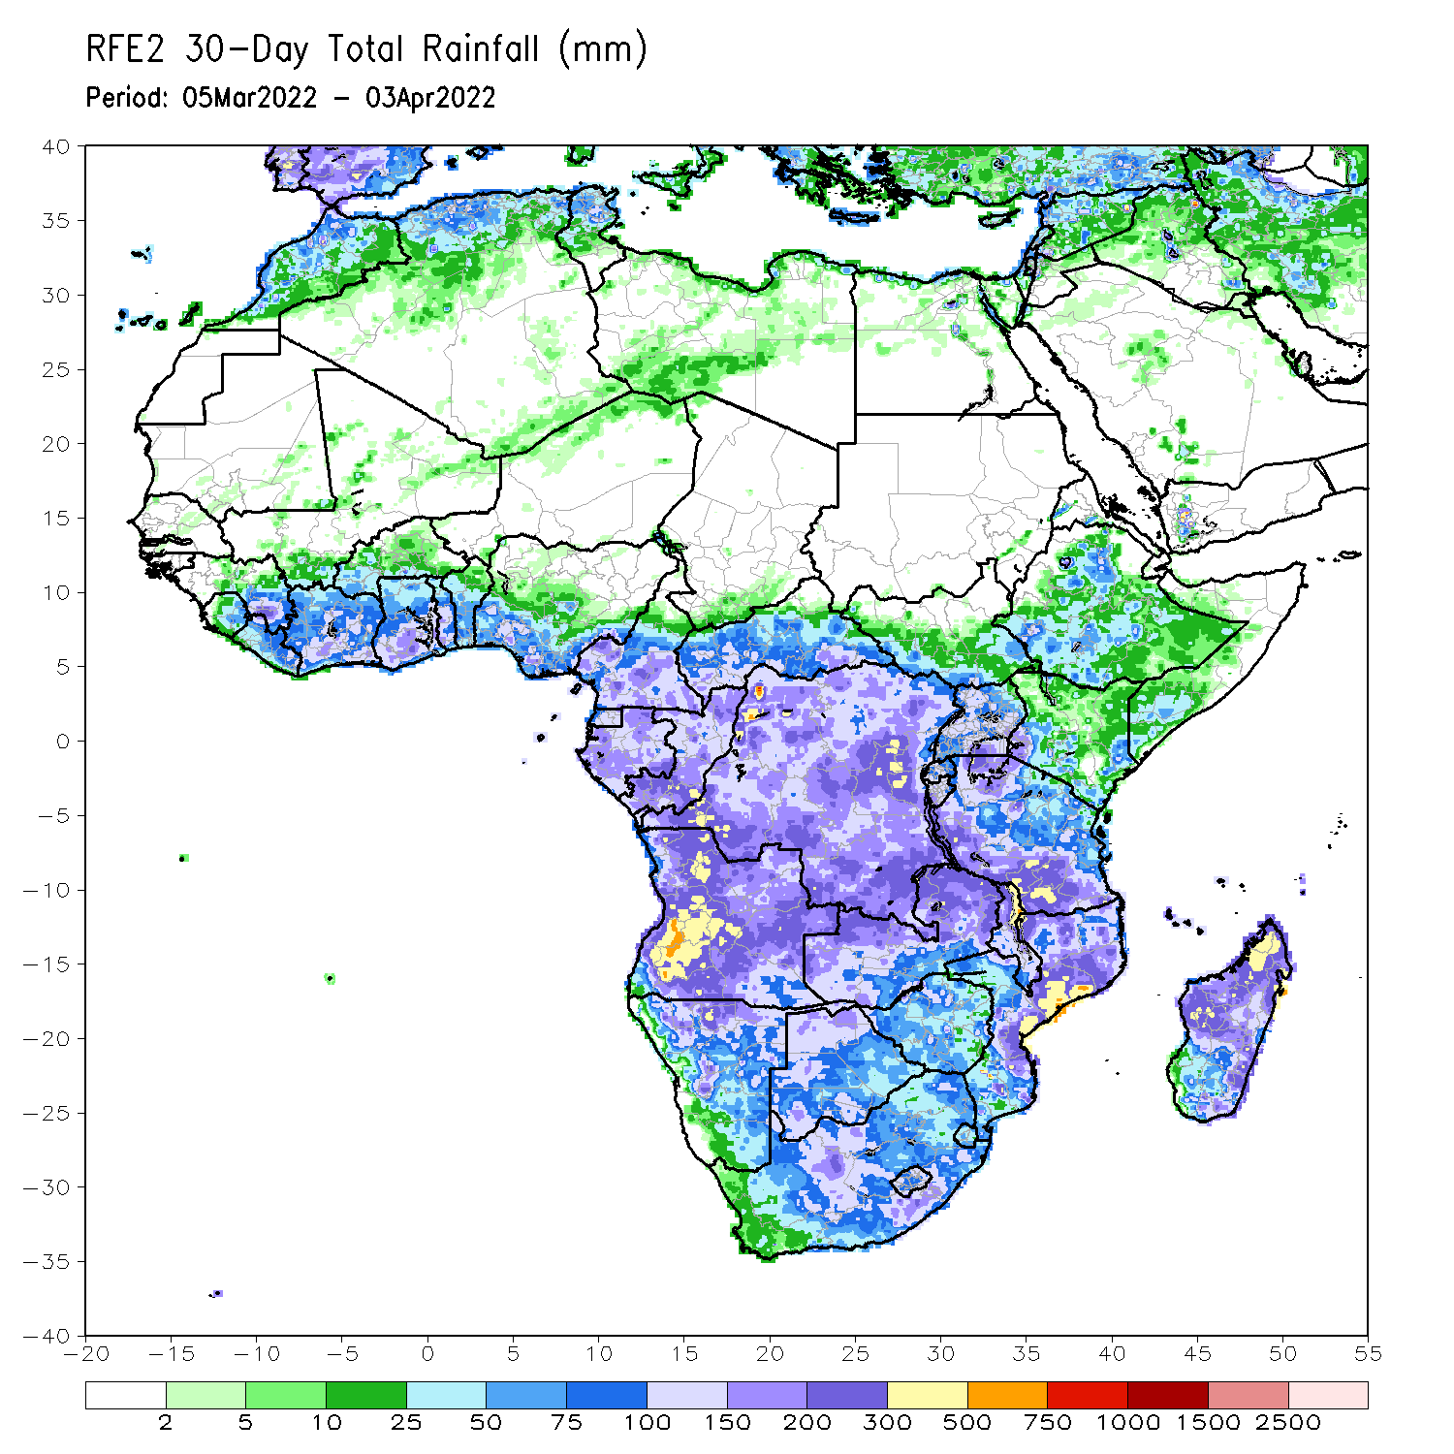
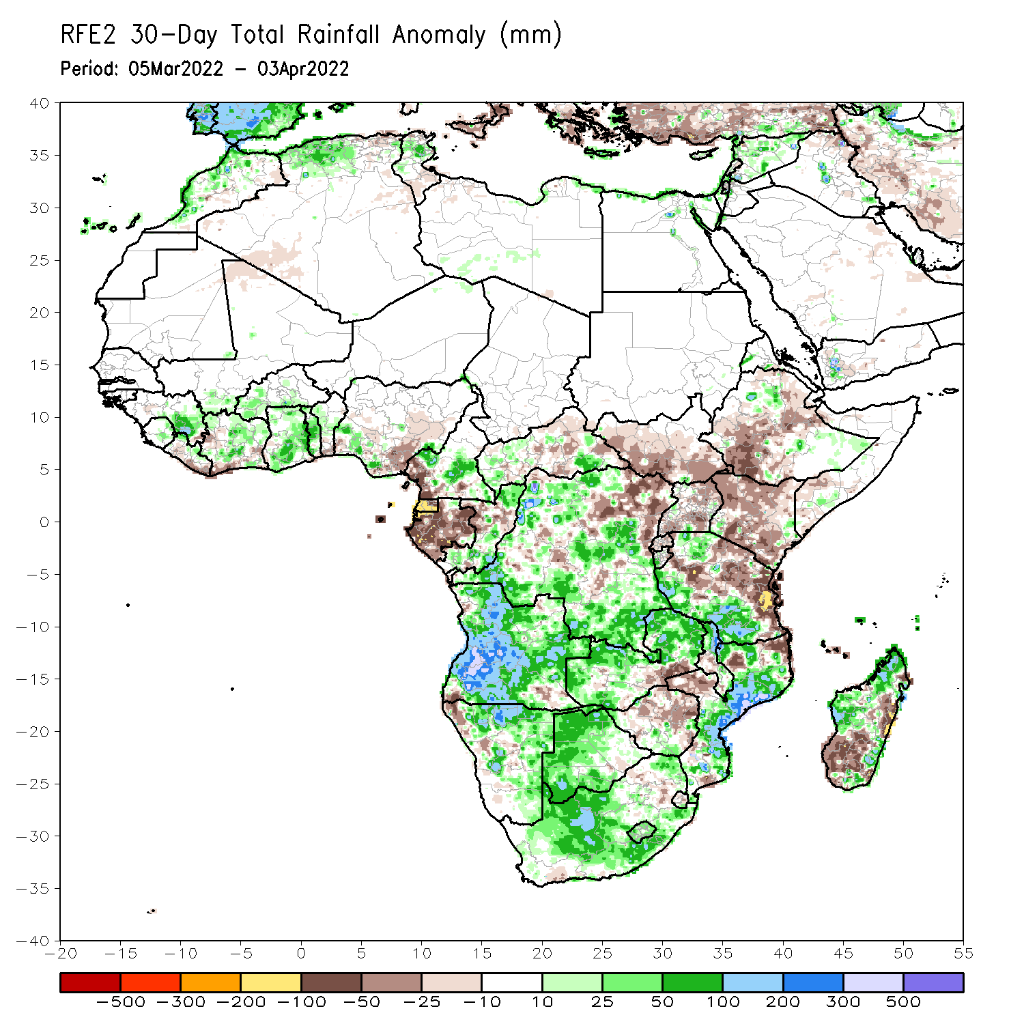
Rainfall Patterns: Last 30 Days
During the past 30 days, in East Africa, above-average rainfall was observed over pockets of northern southeastern Ethiopia, and western and southern Tanzania. Rainfall was below-average over southwestern and eastern Ethiopia, southern South Sudan, Kenya, northern and eastern Tanzania, and much of and Uganda. In Central Africa, rainfall was below-average over Equatorial Guinea, Gabon, parts of CAR and northeastern DRC. Rainfall was above-average over southern Cameroon, Congo, and much of DRC. In Southern Africa, above-average rainfall was observed over much of Angola, Namibia, much of Zambia, northern Malawi, much of Mozambique, portions of Madagascar, and much of Botswana and South Africa. Below-average rainfall was observed over pockets of southwestern and southeastern Angola, southern Zambia, much of Zimbabwe, parts of northeastern South Africa, and southern and the far eastern Madagascar. In West Africa, rainfall was above-average over parts of the Gulf of Guinea region.
Notes:
5

Slide 6
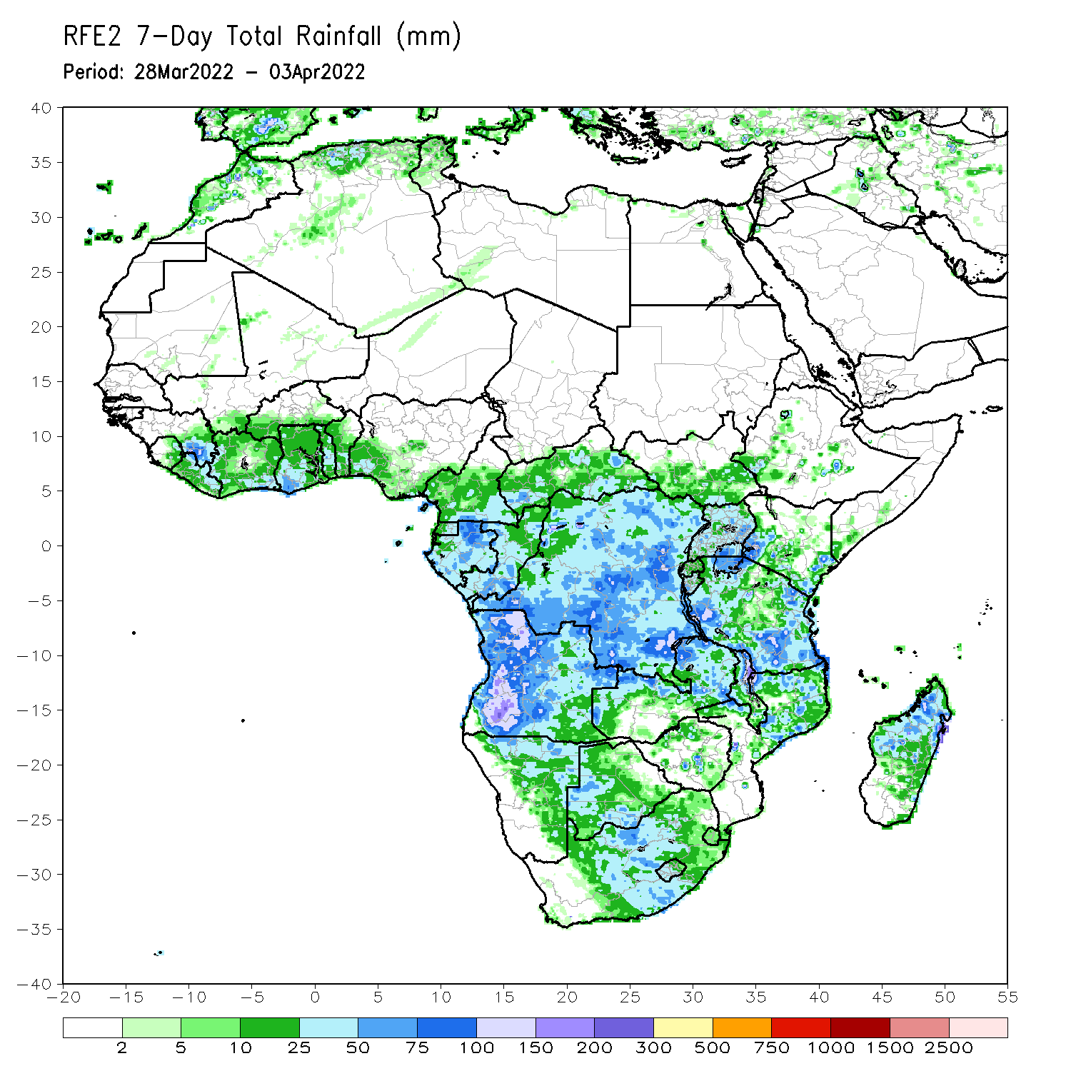
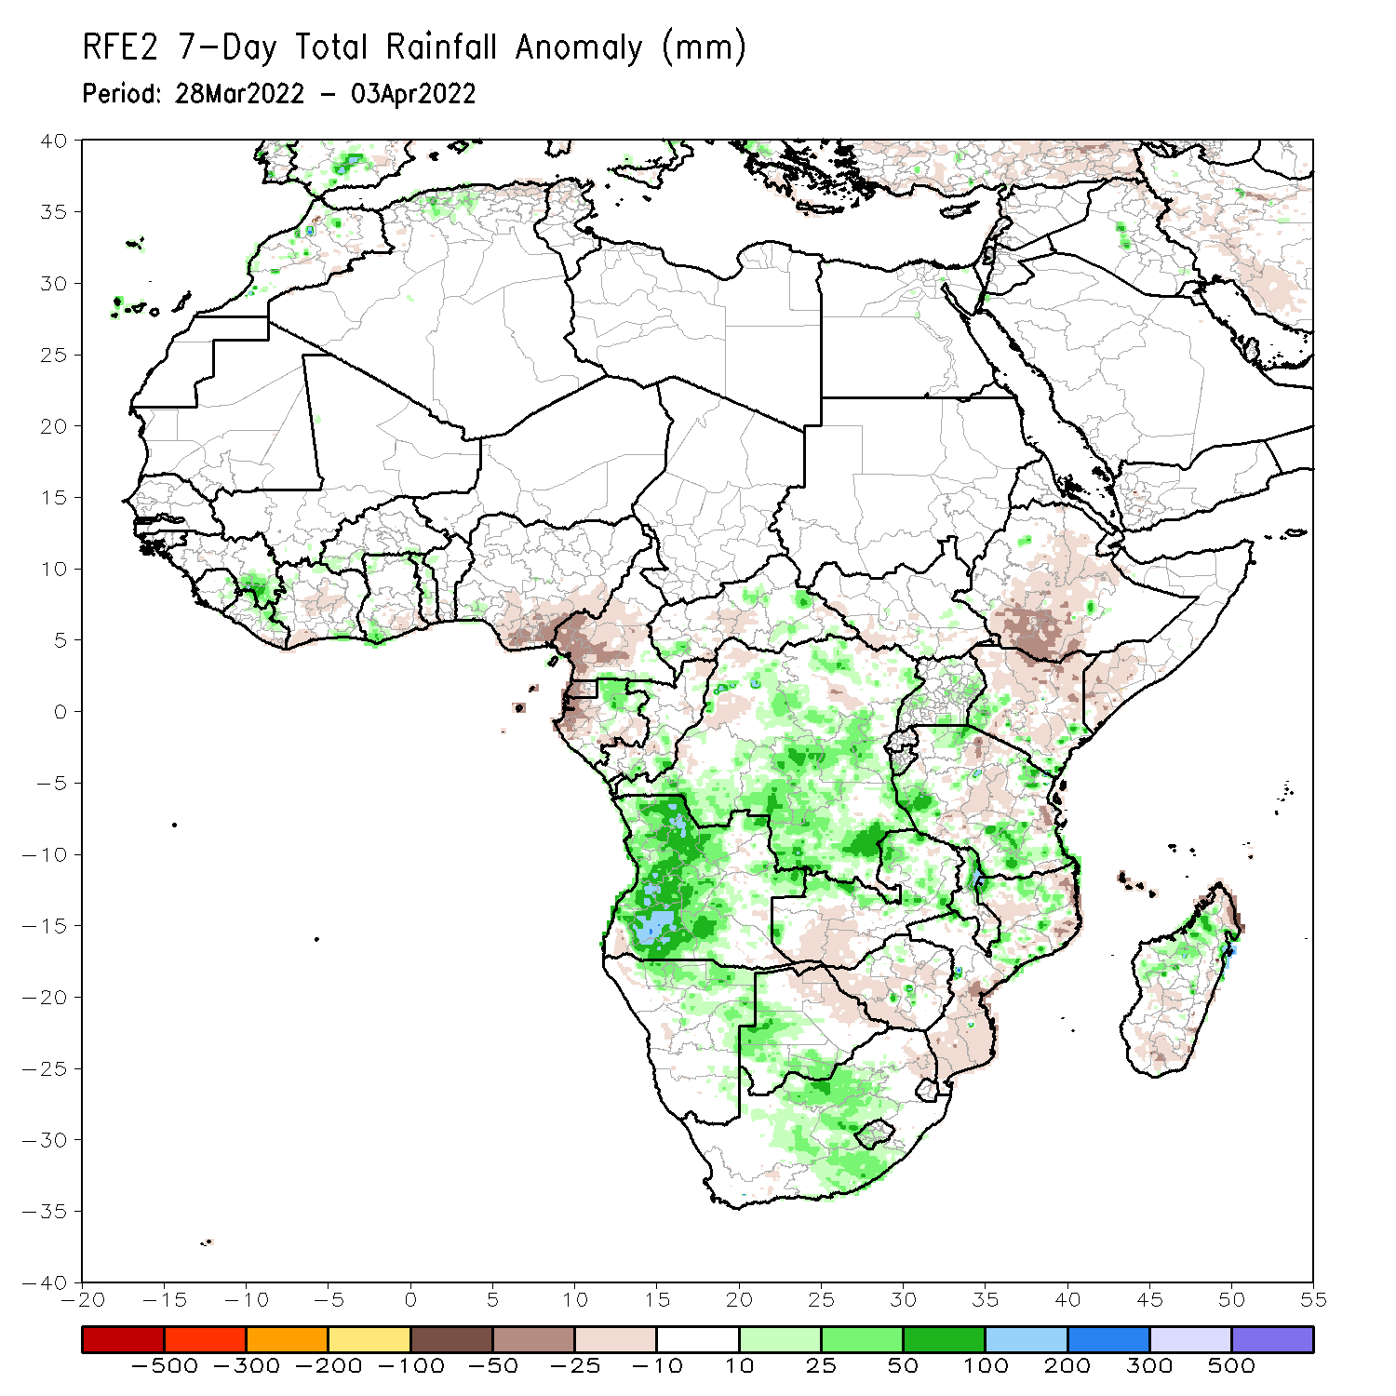
Rainfall Patterns: Last 7 Days
During the past 7 days, in East Africa, rainfall was above-average over parts of Uganda, Kenya and Tanzania, while below-average rainfall was observed over parts of South Sudan, southern Ethiopia, and parts of central Kenya and central Tanzania. In central Africa, rainfall was above-average much of DRC, pockets of northern Gabon, and southern Congo, while below-average rainfall was observed over southern Cameroon, Equatorial guinea, western Gabon and parts of CAR. In Southern Africa, rainfall was above-average over much of of Angola, parts of Namibia, western Botswana, and central South Africa, northern Malawi, and pockets of Mozambique and Madagascar. Rainfall was below-average over portions of Botswana, Zambia, Zimbabwe, northeastern South Africa, parts of Mozambique, and, pockets of Madagascar. In West Africa, above average rainfall was observed over pockets of eastern Guinea, while below-average rainfall was observed over southern Nigeria.

Slide 7
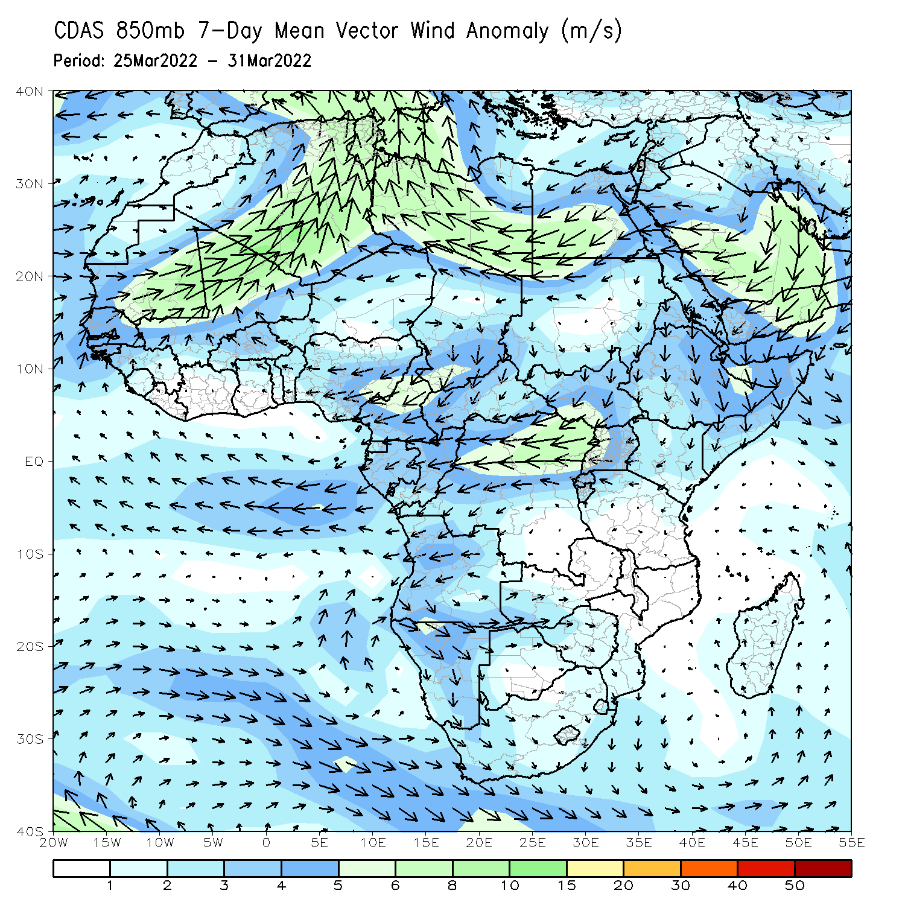
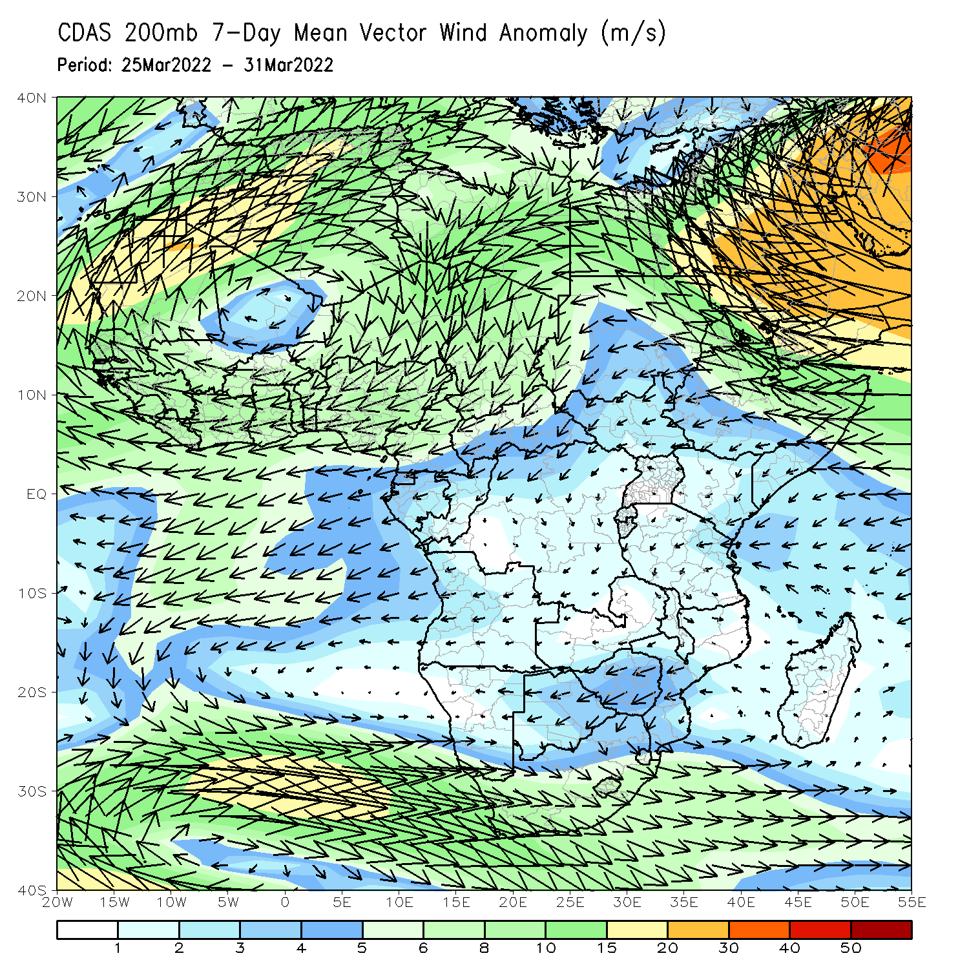
Atmospheric Circulation: Last 7 Days
At 850-hPa level (left panel), anomalous norther flow and its associated lower-level divergence may have contributed to the observed below-average rainfall across East Africa.

Slide 8
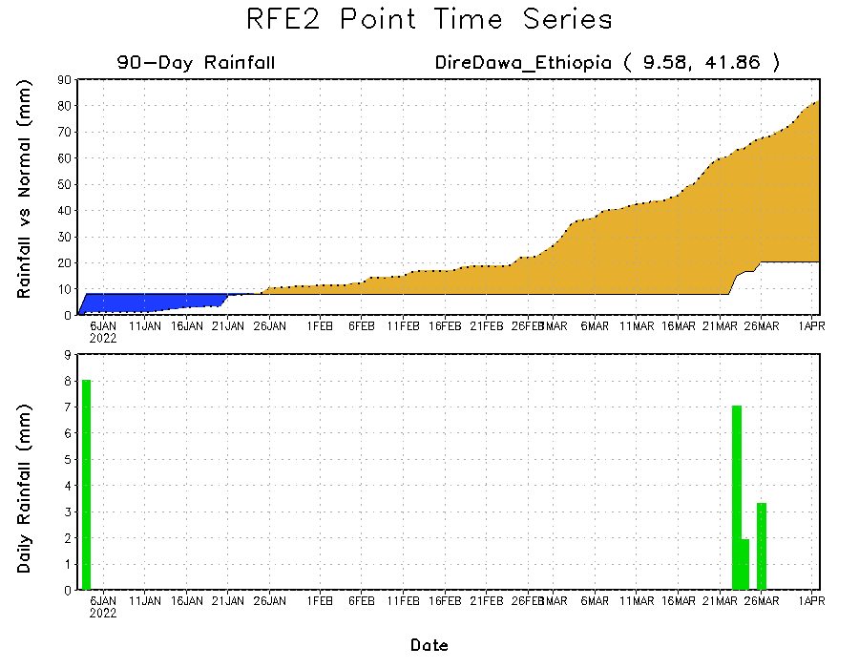
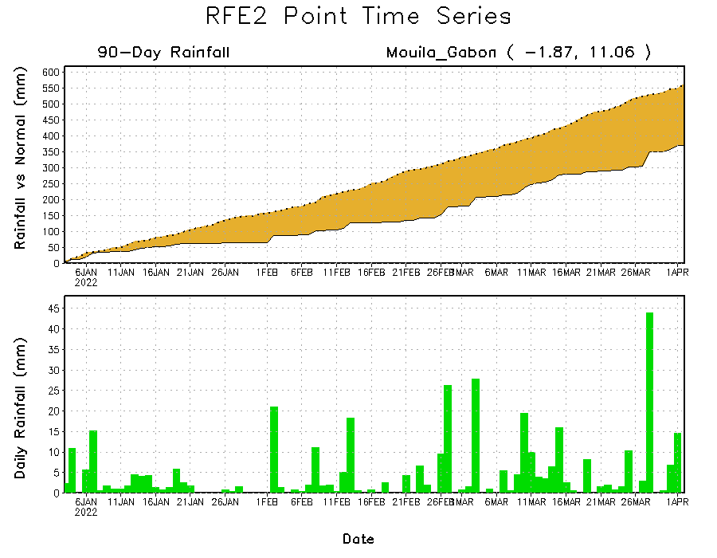
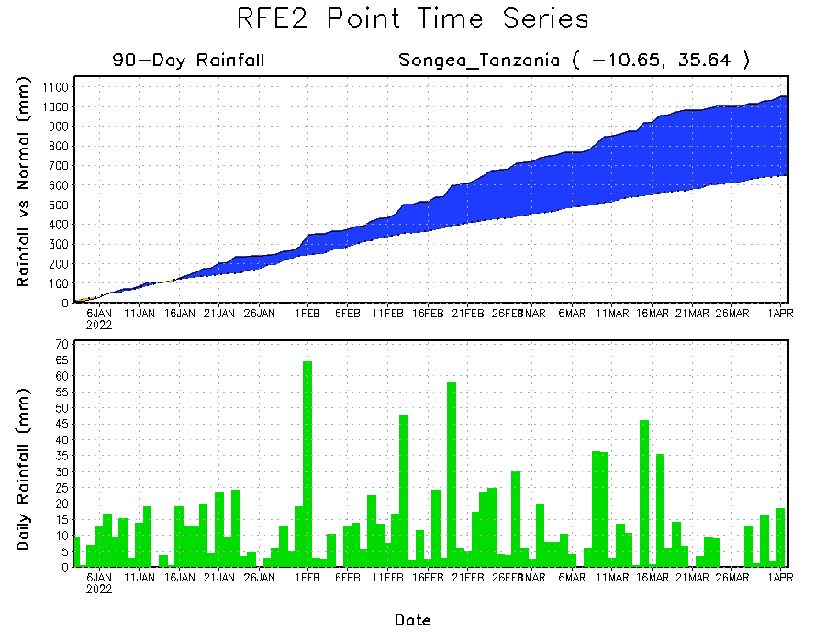
Rainfall Evolution
Daily evolution of rainfall over the last 90 days at selected locations shows moderate sustained moisture surpluses over parts of Tanzania (bottom right). The seasonal total rainfall remained below-average over parts of Ethiopia (top right) and Gabon (bottom left).

Slide 9
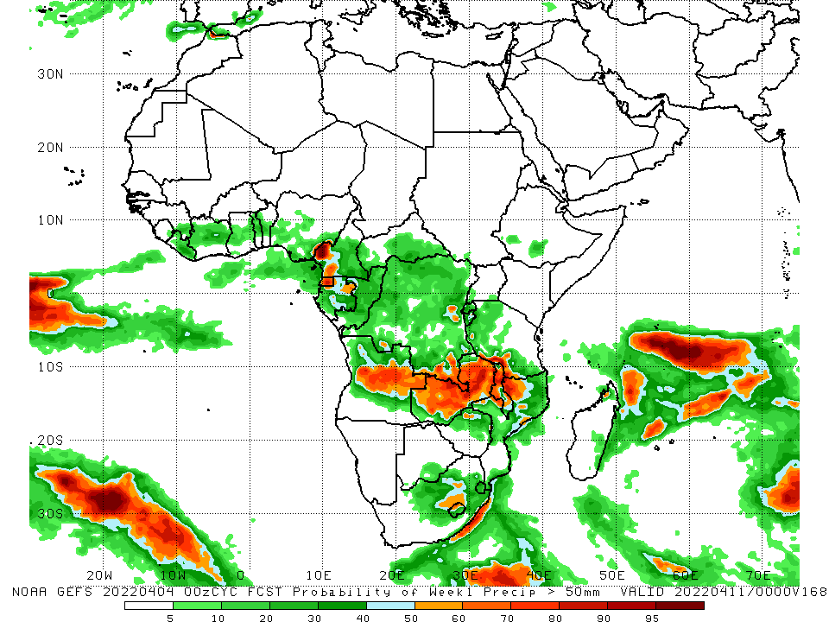
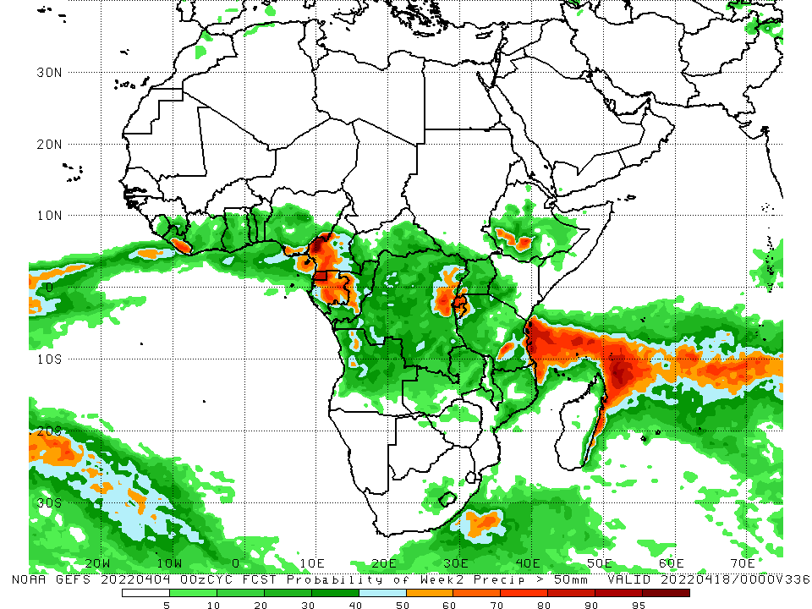
NCEP GEFS Model Forecasts Non-Bias Corrected Probability of precipitation exceedance
Week-1, Valid: 05 – 11 Apr, 2022
Week-2, Valid: 05 – 11 Apr, 2022
For week-1 (left panel), the NCEP GEFS indicates a moderate to high chance (over 70%) for rainfall to exceed 50 mm over the northern portion of Southern Africa, and pockets of Cameroon, Gabon and South Africa.
Notes:
9

Slide 10
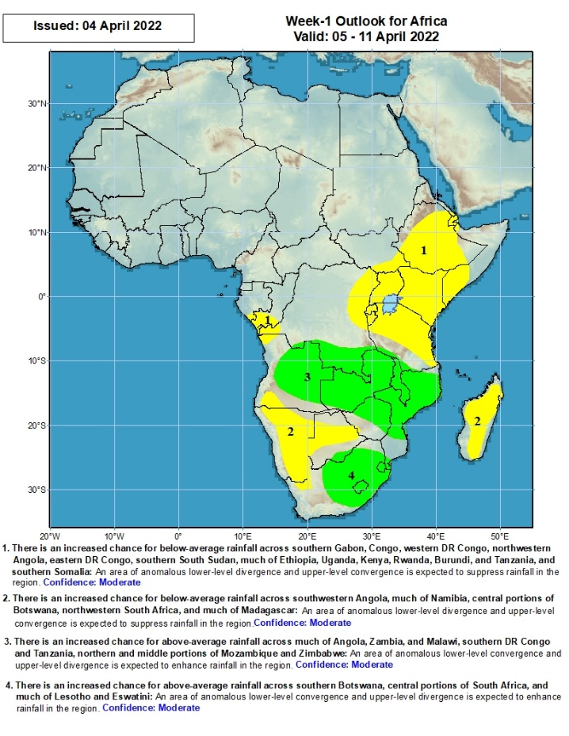
Week-1 Precipitation Outlooks
There is an increased chance for below-average rainfall across southern Gabon, Congo, western DR Congo, northwestern Angola, eastern DR Congo, southern South Sudan, much of Ethiopia, Uganda, Kenya, Rwanda, Burundi, and Tanzania, and southern Somalia: An area of anomalous lower-level divergence and upper-level convergence is expected to suppress rainfall in the region. Confidence: Moderate
There is an increased chance for below-average rainfall across southwestern Angola, much of Namibia, central portions of Botswana, northwestern South Africa, and much of Madagascar: An area of anomalous lower-level divergence and upper-level convergence is expected to suppress rainfall in the region. Confidence: Moderate
There is an increased chance for above-average rainfall across much of Angola, Zambia, and Malawi, southern DR Congo and Tanzania, northern and middle portions of Mozambique and Zimbabwe: An area of anomalous lower-level convergence and upper-level divergence is expected to enhance rainfall in the region. Confidence: Moderate
There is an increased chance for above-average rainfall across southern Botswana, central portions of South Africa, and much of Lesotho and Eswatini: An area of anomalous lower-level convergence and upper-level divergence is expected to enhance rainfall in the region. Confidence: Moderate
05 – 11 Apr, 2022
Notes:
10

Slide 11
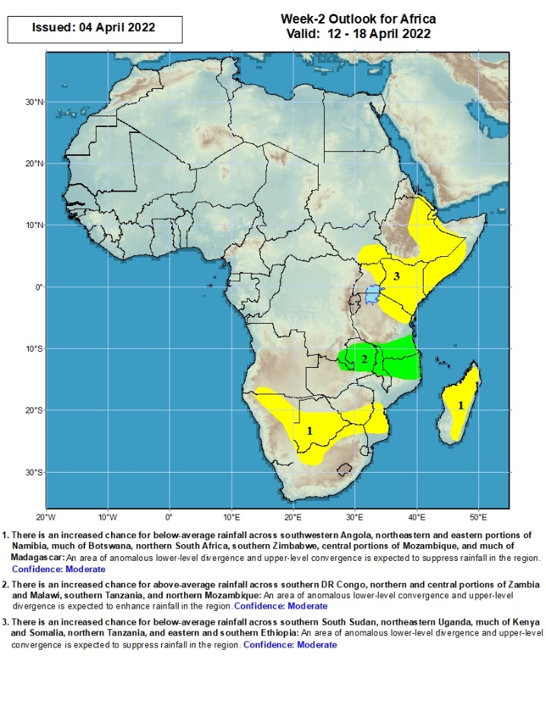
Week-2 Precipitation Outlooks
12 – 18 Apr, 2022
There is an increased chance for below-average rainfall across southwestern Angola, northeastern and eastern portions of Namibia, much of Botswana, northern South Africa, southern Zimbabwe, central portions of Mozambique, and much of Madagascar: An area of anomalous lower-level divergence and upper-level convergence is expected to suppress rainfall in the region. Confidence: Moderate
There is an increased chance for above-average rainfall across southern DR Congo, northern and central portions of Zambia and Malawi, southern Tanzania, and northern Mozambique: An area of anomalous lower-level convergence and upper-level divergence is expected to enhance rainfall in the region. Confidence: Moderate
There is an increased chance for below-average rainfall across southern South Sudan, northeastern Uganda, much of Kenya and Somalia, northern Tanzania, and eastern and southern Ethiopia: An area of anomalous lower-level divergence and upper-level convergence is expected to suppress rainfall in the region. Confidence: Moderate
Notes:
11

Slide 12
Summary
During the past 30 days, in East Africa, above-average rainfall was observed over pockets of northern southeastern Ethiopia, and western and southern Tanzania. Rainfall was below-average over southwestern and eastern Ethiopia, southern South Sudan, Kenya, northern and eastern Tanzania, and much of and Uganda. In Central Africa, rainfall was below-average over Equatorial Guinea, Gabon, parts of CAR and northeastern DRC. Rainfall was above-average over southern Cameroon, Congo, and much of DRC. In Southern Africa, above-average rainfall was observed over much of Angola, Namibia, much of Zambia, northern Malawi, much of Mozambique, portions of Madagascar, and much of Botswana and South Africa. Below-average rainfall was observed over pockets of southwestern and southeastern Angola, southern Zambia, much of Zimbabwe, parts of northeastern South Africa, and southern and the far eastern Madagascar. In West Africa, rainfall was above-average over parts of the Gulf of Guinea region.
During the past 7 days, in East Africa, rainfall was above-average over parts of Uganda, Kenya and Tanzania, while below-average rainfall was observed over parts of South Sudan, southern Ethiopia, and parts of central Kenya and central Tanzania. In central Africa, rainfall was above-average much of DRC, pockets of northern Gabon, and southern Congo, while below-average rainfall was observed over southern Cameroon, Equatorial Guinea, western Gabon and parts of CAR. In Southern Africa, rainfall was above-average over much of Angola, parts of Namibia, western Botswana, and central South Africa, northern Malawi, and pockets of Mozambique and Madagascar. Rainfall was below-average over portions of Botswana, Zambia, Zimbabwe, northeastern South Africa, parts of Mozambique, and, pockets of Madagascar. In West Africa, above average rainfall was observed over pockets of eastern Guinea, while below-average rainfall was observed over southern Nigeria.
Week-1 and Week-2 outlooks call for an increased chance for below-average rainfall over much of East Africa. In contrast, the forecasts call for an increased chance for above-average rainfall across central and eastern Angola, Zambia, northern Zimbabwe, Malawi, northern Mozambique, and central South Africa.

