Slide 1
The African Monsoon Recent Evolution and Current Status Include Week-1 and Week-2 Outlooks
Update prepared by
23 May 2022
For more information, visit:
http://www.cpc.ncep.noaa.gov/products/Global_Monsoons/African_Monsoons/precip_monitoring.shtml

Slide 2
Outline
Highlights
Recent Evolution and Current Conditions
NCEP GEFS Forecasts
Summary

Slide 3
Highlights: Last 7 Days
During the past 7 days, in East Africa, rainfall was above-average over the far southern Sudan and the neighboring areas of South Sudan, and pockets of southwestern Ethiopia, while below-average rainfall was observed over the southern portion of southern Sudan, and many parts of Ethiopia and Uganda. In Central Africa, rainfall was above-average over eastern Gabon, central Congo, western and central DRC, and southern Chad. Below-average rainfall was observed over pockets of CAR and northeastern DRC. In West Africa, above-average rainfall was observed over the eastern portion of Gulf of Guinea, while rainfall was below-average over the western portion of the Gulf of Guinea region. In southern Africa, above-average rainfall was observed over portions of South Africa and southern Mozambique.
Week-1 and Week-2 outlooks call for an increased chance for below-average rainfall over the eastern portion of the Gulf of Guinea region, and parts of Central and the Greater Horn of Africa. In contrast, there is an increased chance for above-average rainfall in the Lake Victoria region, including northeastern DRC during week-1, and over southern Cameroon, Equatorial Guinea, Gabon and Congo during week-2.

Slide 4
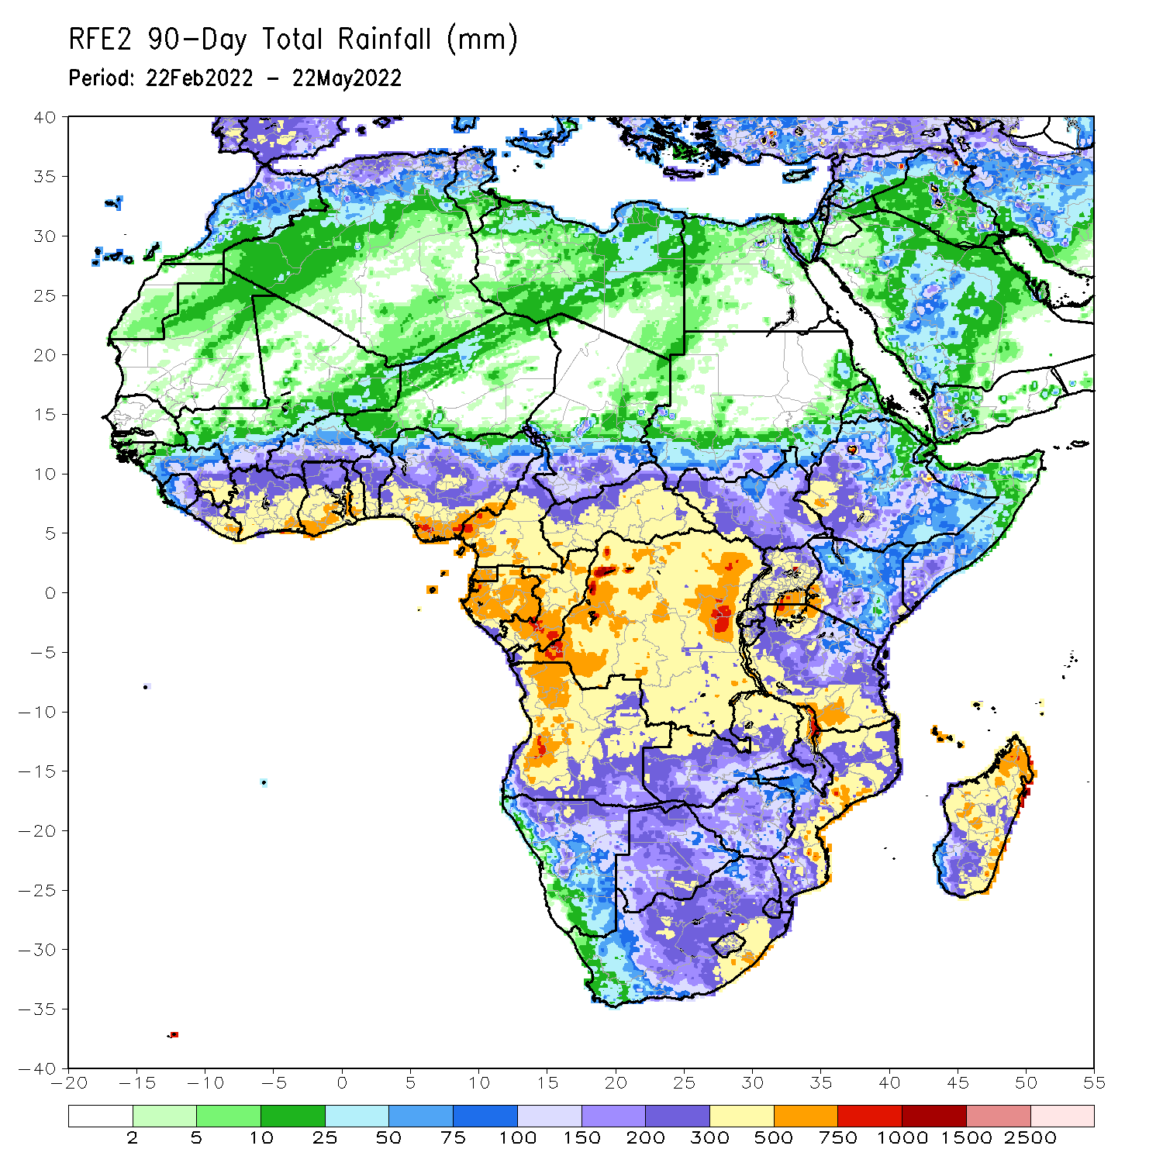
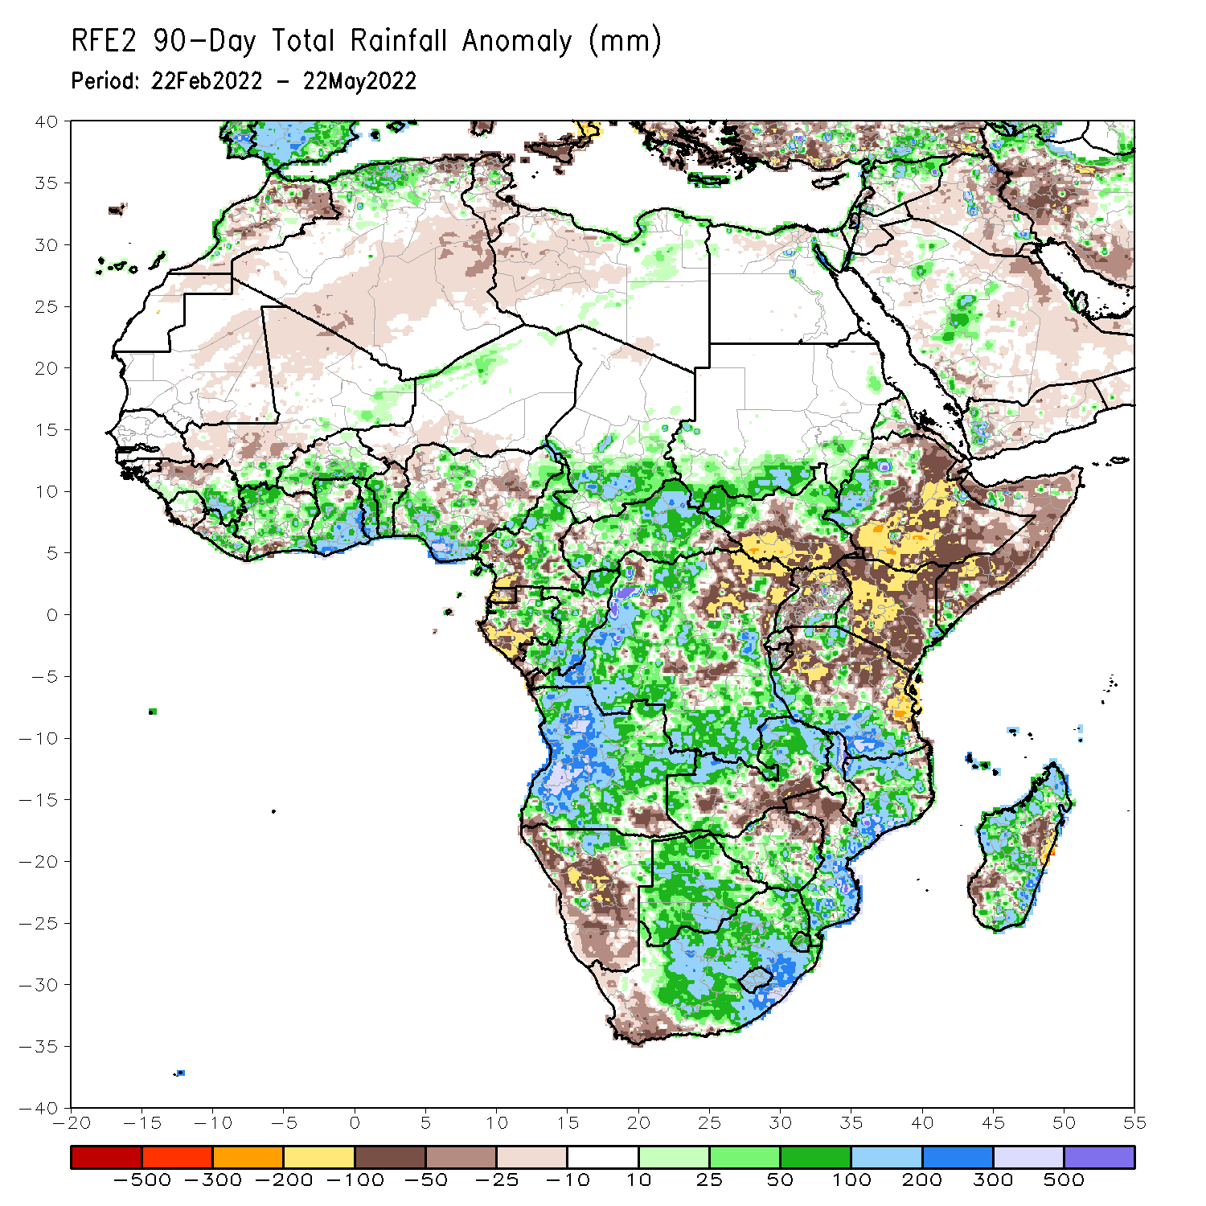
Rainfall Patterns: Last 90 Days
Over the past 90 days, in East Africa, above-average rainfall was observed over parts of southern Sudan, the western and eastern portions of South Sudan, western Ethiopia, pockets of Eritrea and southern Uganda, and southern Tanzania. Rainfall was below-average over central, southern and eastern Ethiopia, central and southern South Sudan, much of Kenya, Somalia, and northern Uganda and northern Tanzania. In southern Africa, above-average rainfall was observed over much of Angola, Botswana, northern Namibia, northern Zambia, Malawi, much of Mozambique, many parts of Madagascar and South Africa. Below-average rainfall was observed over pockets of Angola, western and southern Namibia, southern Zambia, northern Zimbabwe, and pockets of Madagascar. In Central Africa, rainfall was above-average over much of CAR, many parts of DRC and Congo. Rainfall was below-average over parts of Cameroon, parts of central and eastern DRC, Equatorial Guinea, southern Gabon, and pockets of western CAR. In West Africa, rainfall was above-average over much of the Gulf of Guinea region, while below-average rainfall was observed over pockets of Nigeria.
Notes:
4

Slide 5
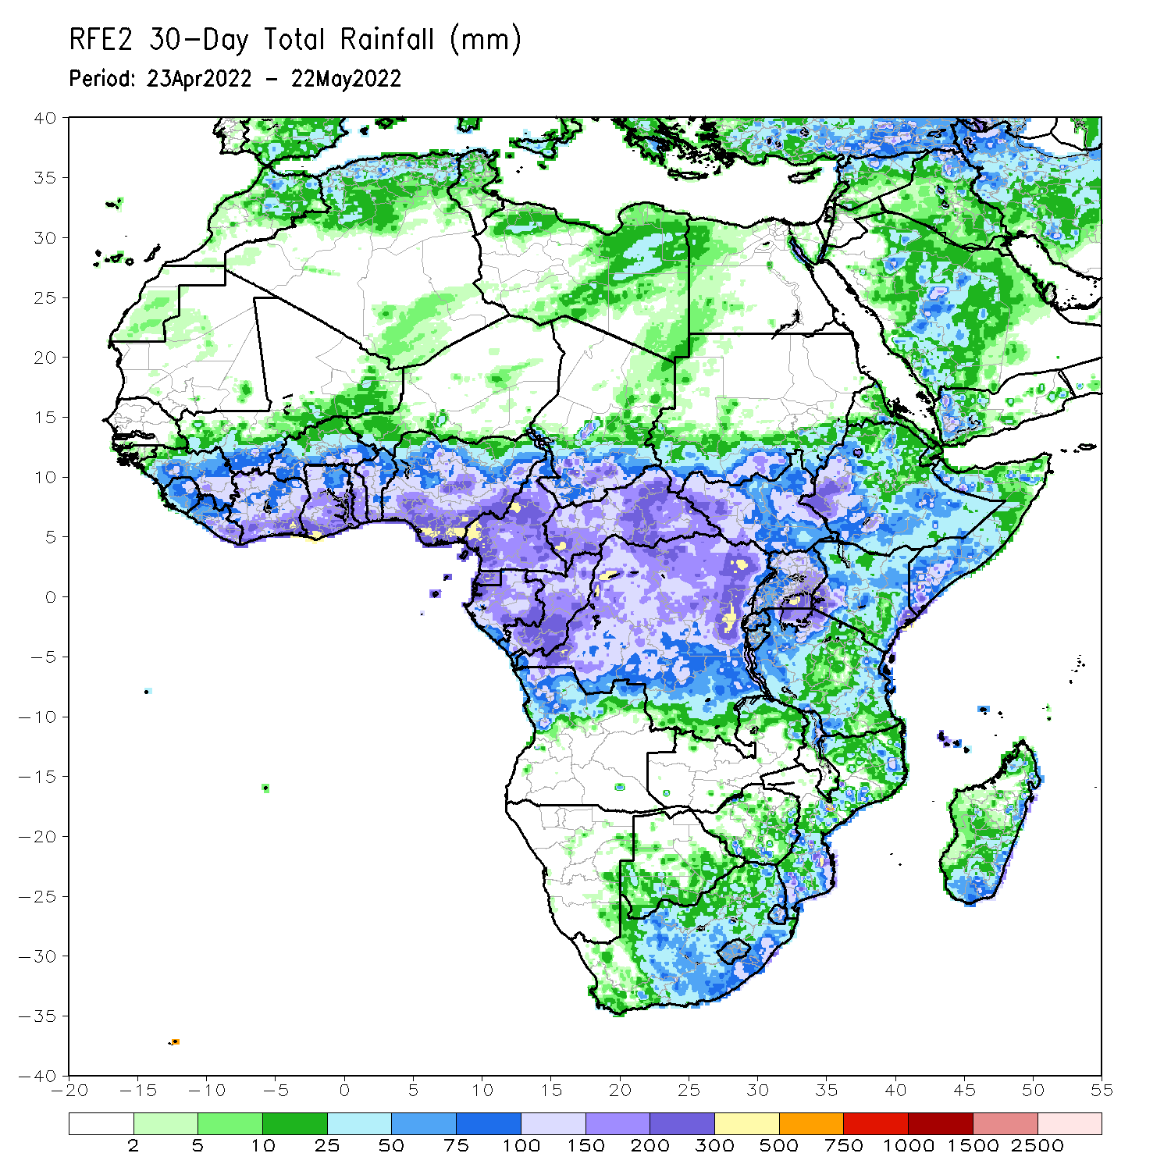
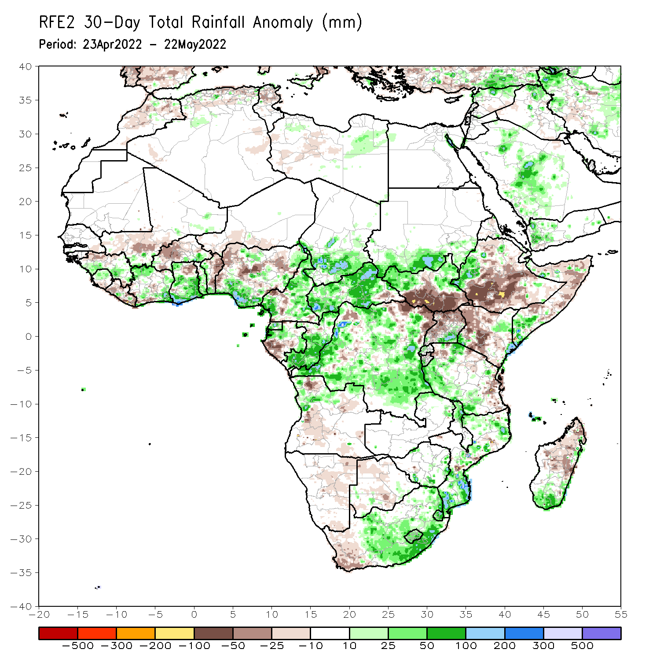
Rainfall Patterns: Last 30 Days
During the past 30 days, in East Africa, above-average rainfall was observed over western Ethiopia, southern Sudan, western northern and eastern South Sudan, southeastern Uganda, and parts of Tanzania. Rainfall was below-average over eastern and southern Ethiopia, the central and southern parts of South Sudan, western and central Kenya, and Somalia. In Central Africa, rainfall was above-average over Cameroon, Equatorial Guinea, northern and eastern Gabon, Congo, much of CAR, and much of DRC. Rainfall was below-average over pockets of Gabon and northeastern DRC. In Southern Africa, above-average rainfall was observed over portions of Mozambique, central and eastern South Africa. Below-average rainfall was observed over parts of Angola, Namibia, western South Africa, and pockets of Madagascar. In West Africa, rainfall was above-average over parts of Guinea, Cote d’Ivoire, Ghana and Nigeria. In contrast, portions of Liberia and Cote d’Ivoire, Burkina Faso, Benin and northern Nigeria received below-average rainfall.
Notes:
5

Slide 6
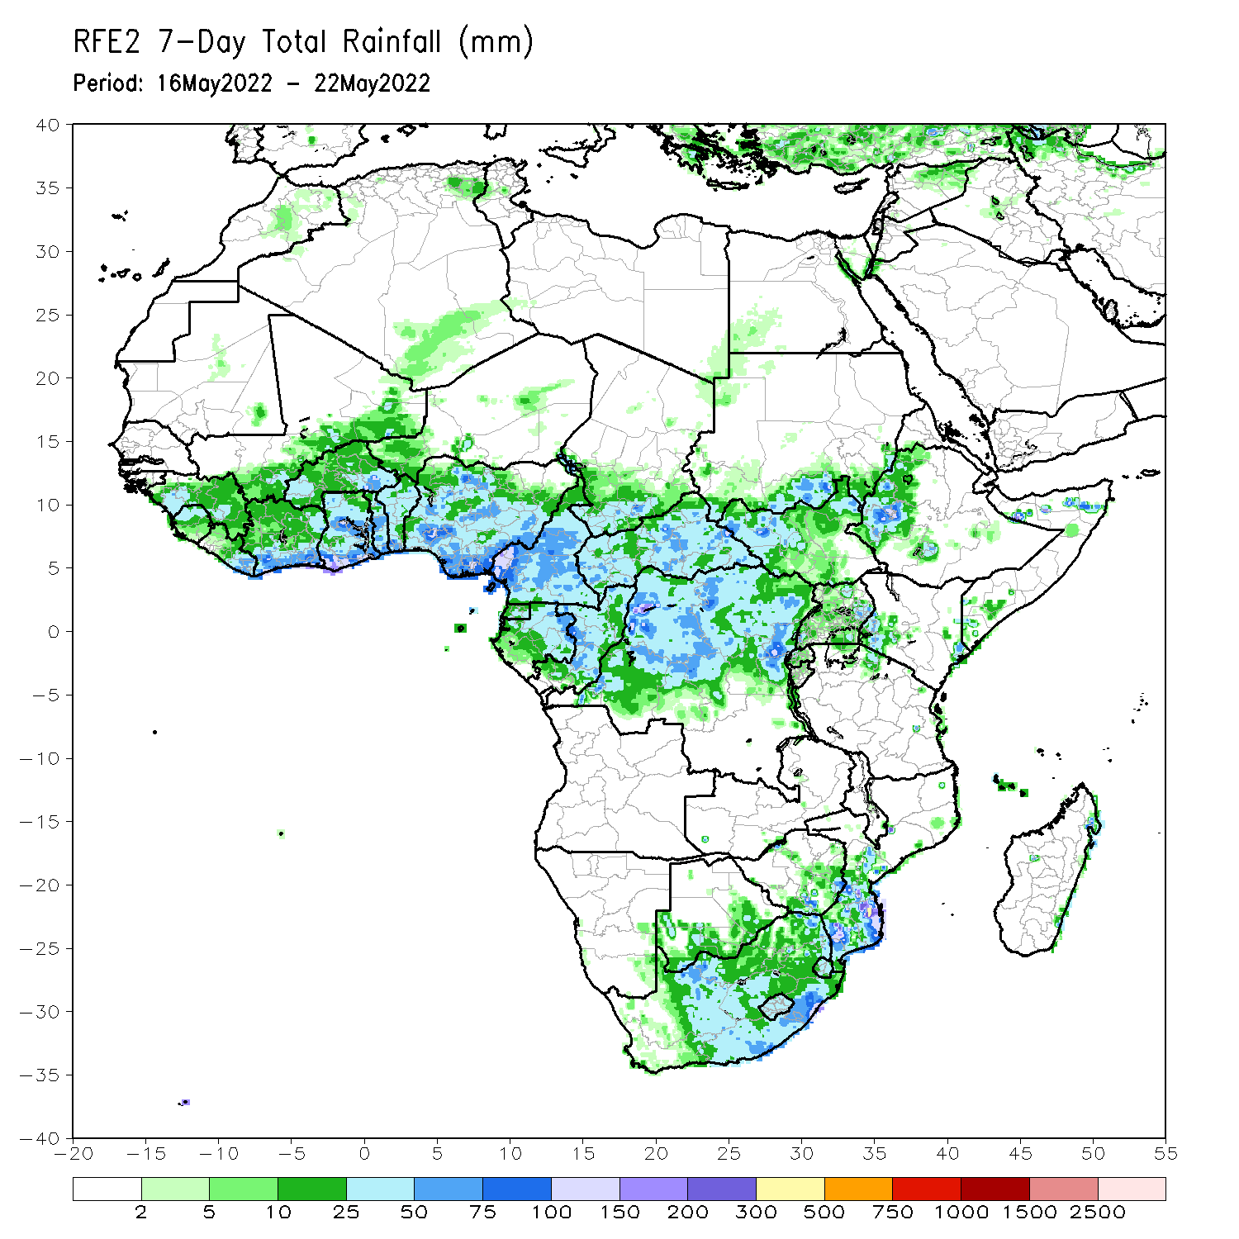
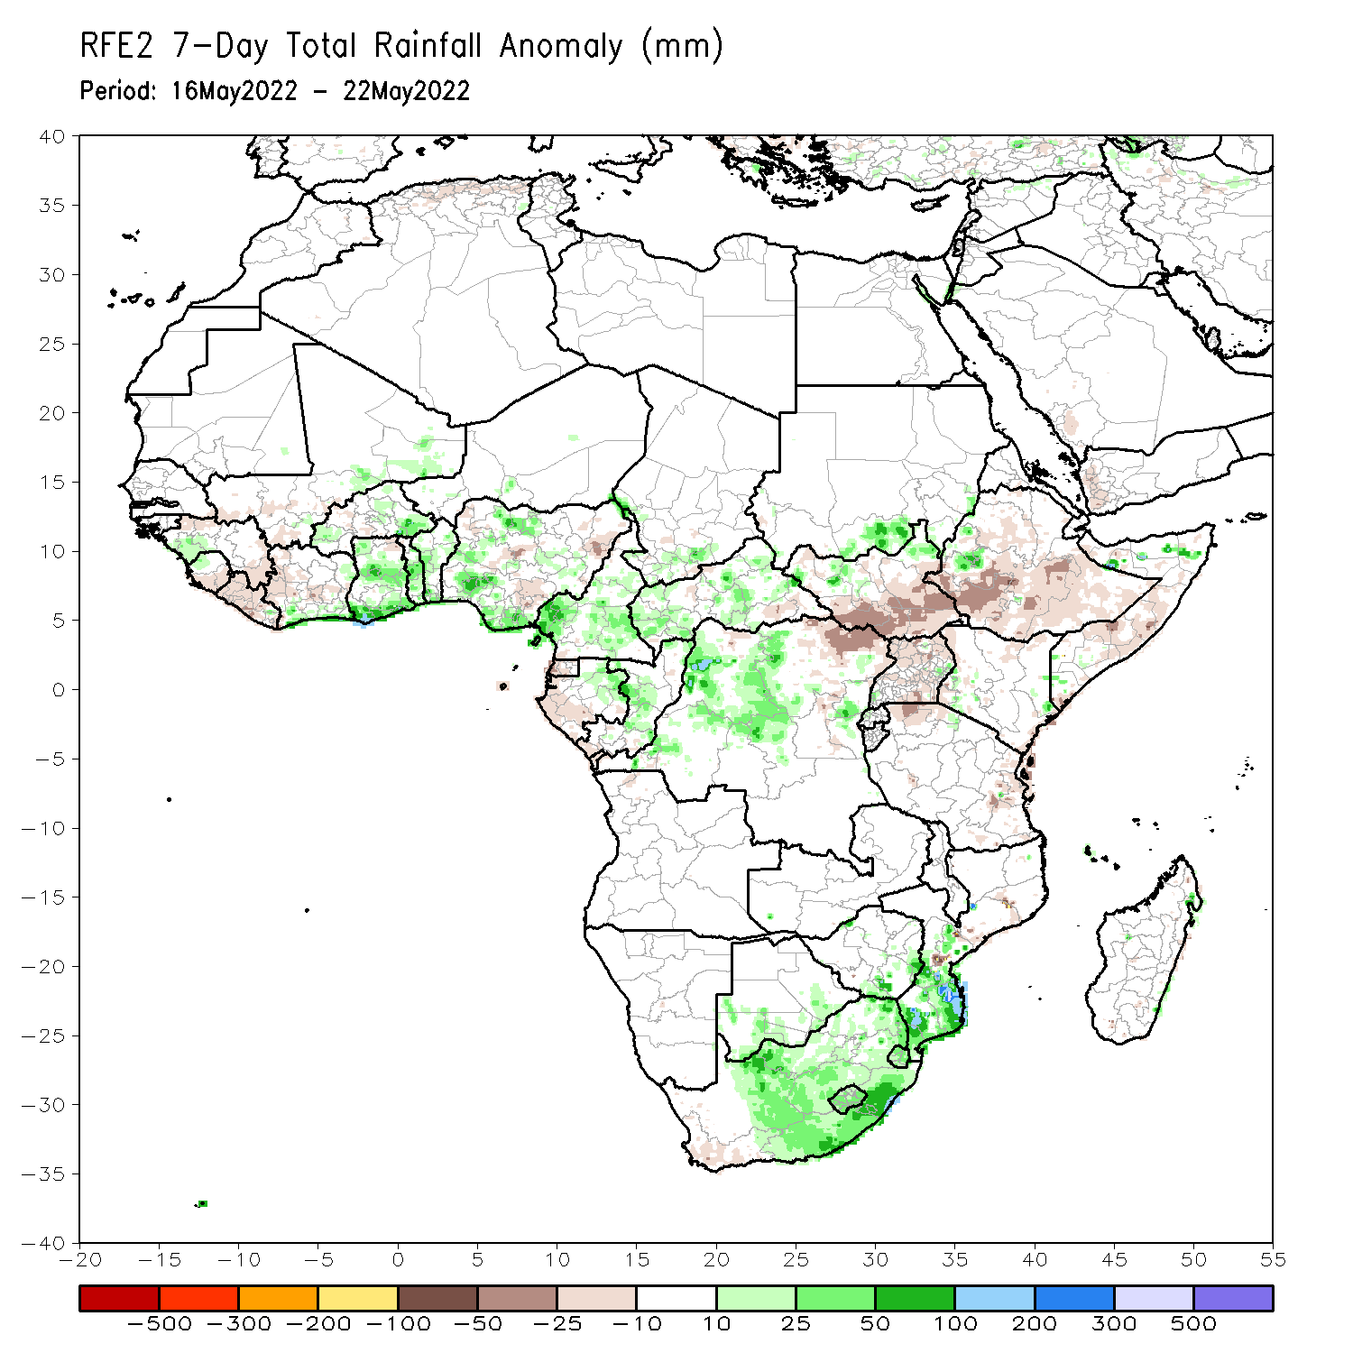
Rainfall Patterns: Last 7 Days
During the past 7 days, in East Africa, rainfall was above-average over the far southern Sudan and the neighboring areas of South Sudan, and pockets of southwestern Ethiopia, while below-average rainfall was observed over the southern portion of southern Sudan, and many parts of Ethiopia and Uganda. In Central Africa, rainfall was above-average over eastern Gabon, central Congo, western and central DRC, and southern Chad. Below-average rainfall was observed over pockets of CAR and northeastern DRC. In West Africa, above-average rainfall was observed over the eastern portion of Gulf of Guinea, while rainfall was below-average over the western portion of the Gulf of Guinea region. In southern Africa, above-average rainfall was observed over portions of South Africa and southern Mozambique.

Slide 7
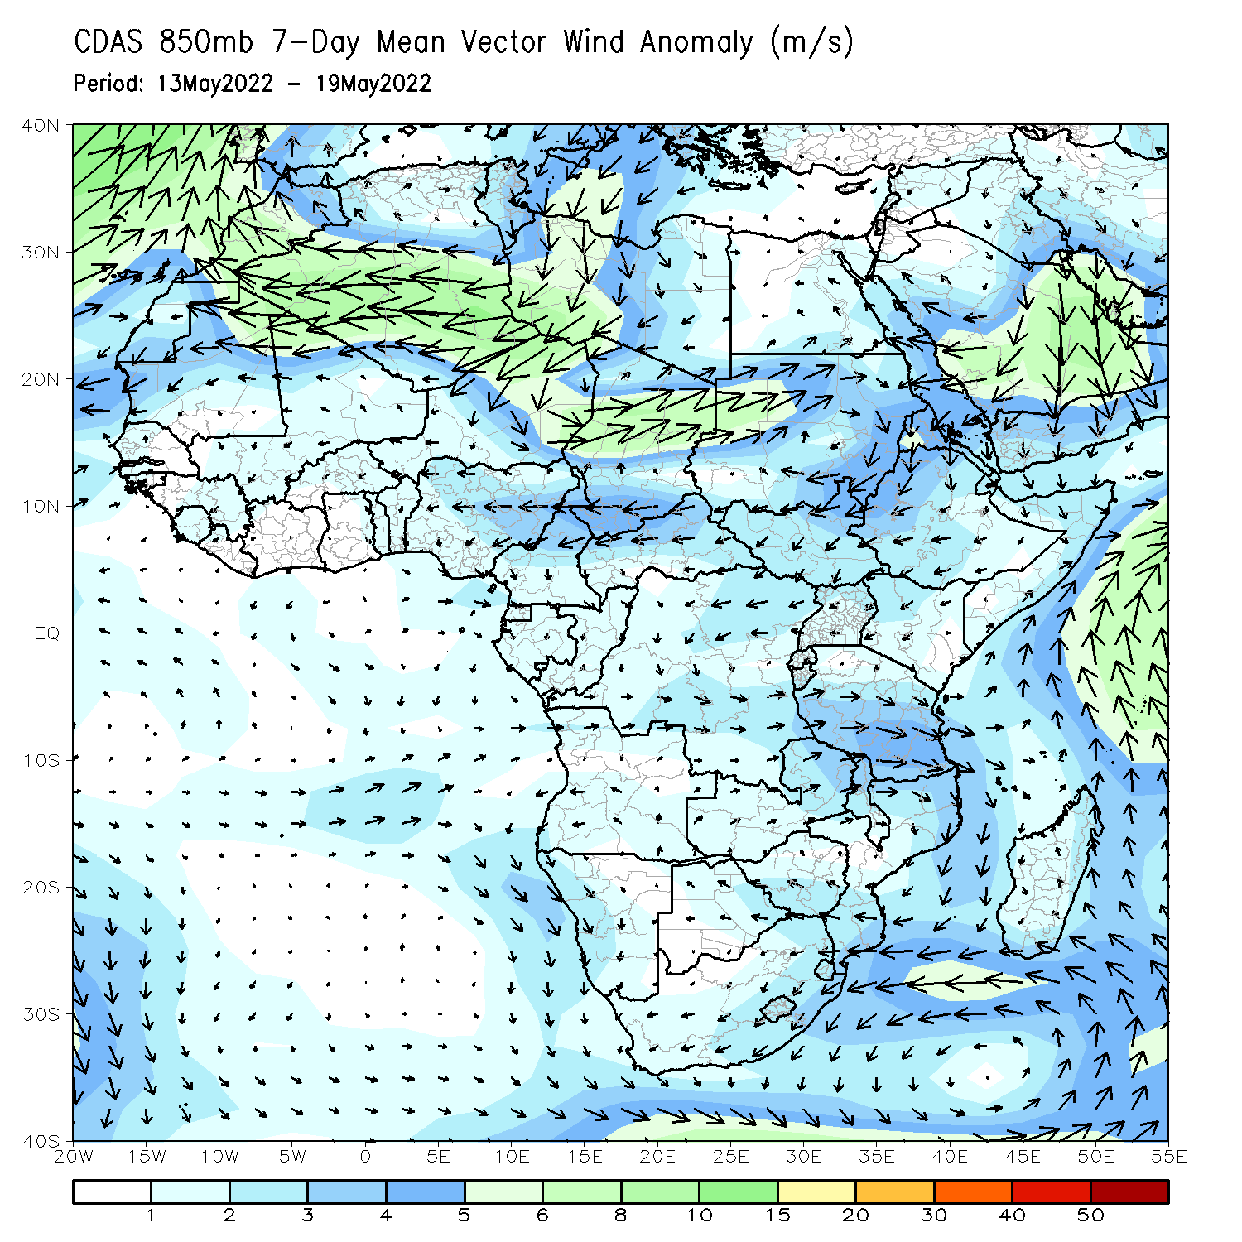
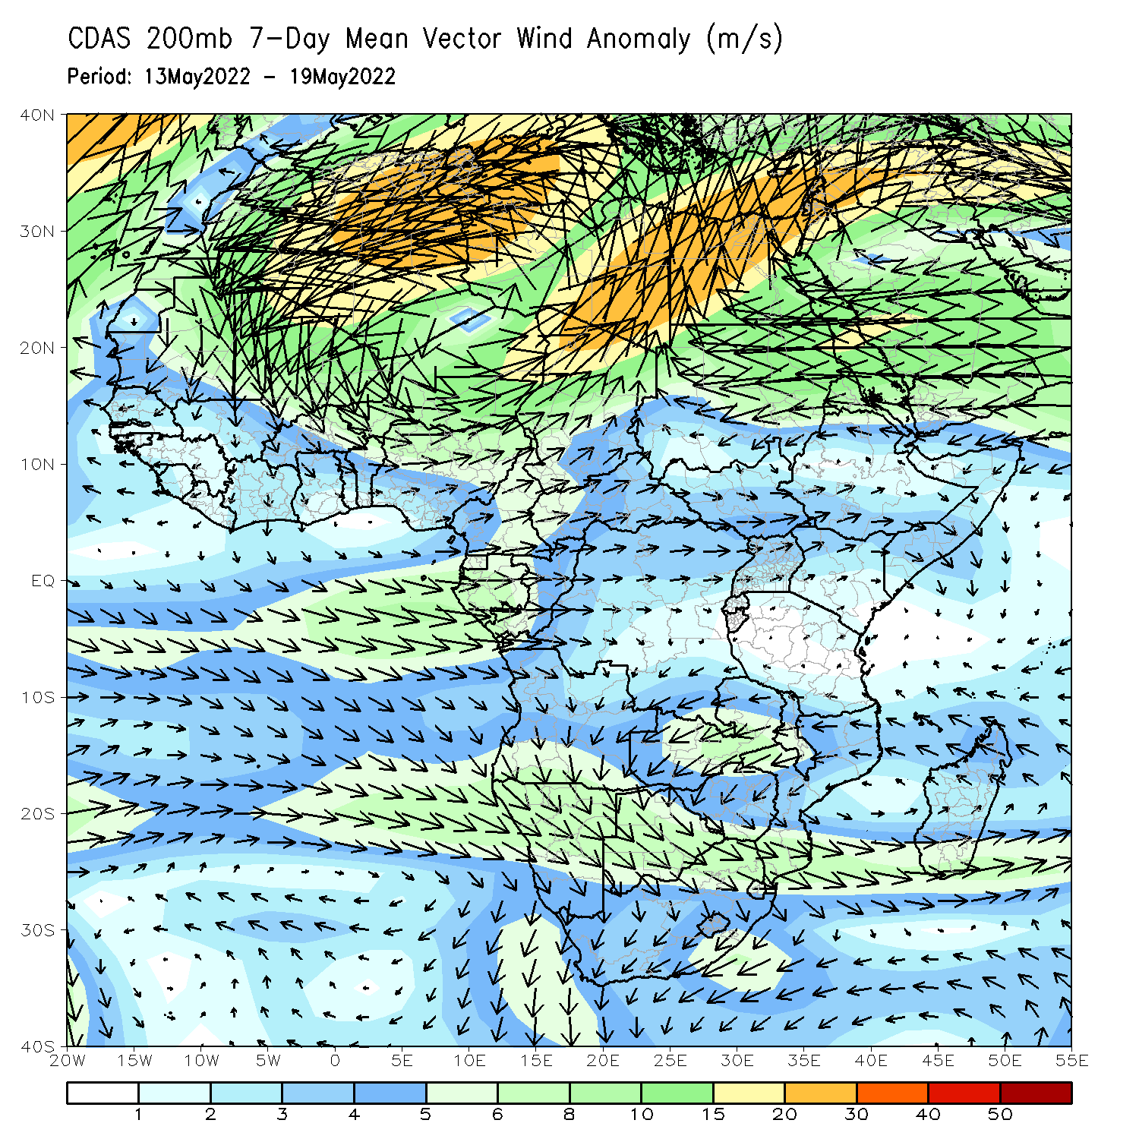
Atmospheric Circulation: Last 7 Days
At 850-hPa level (left panel), anomalous easterly flow was observed across Central and East Africa (left panel).

Slide 8
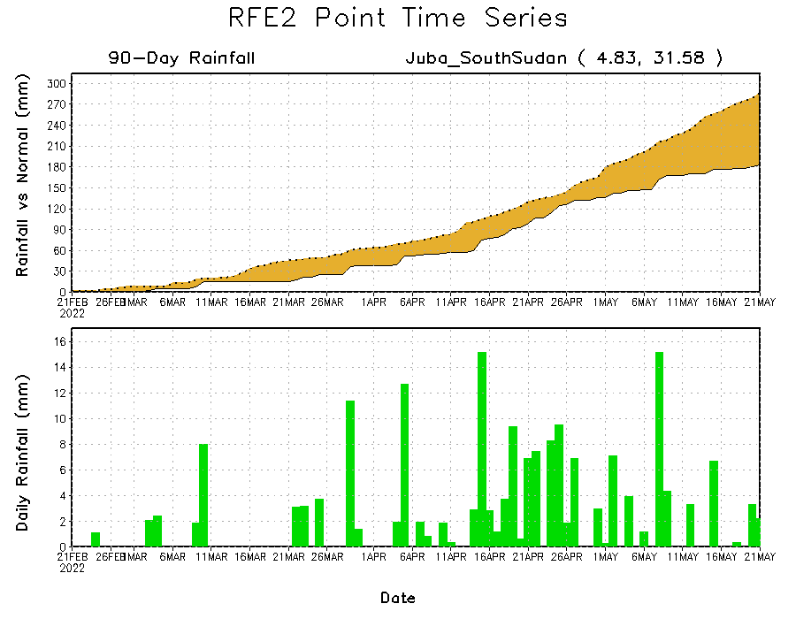
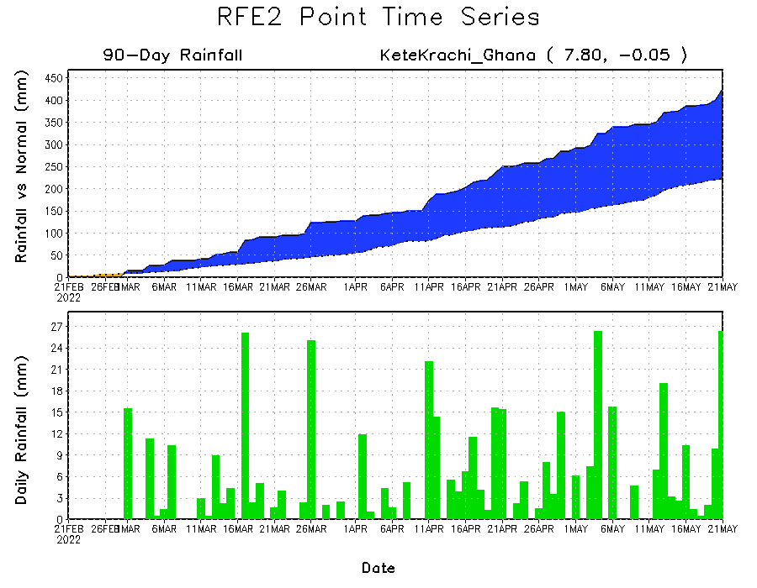
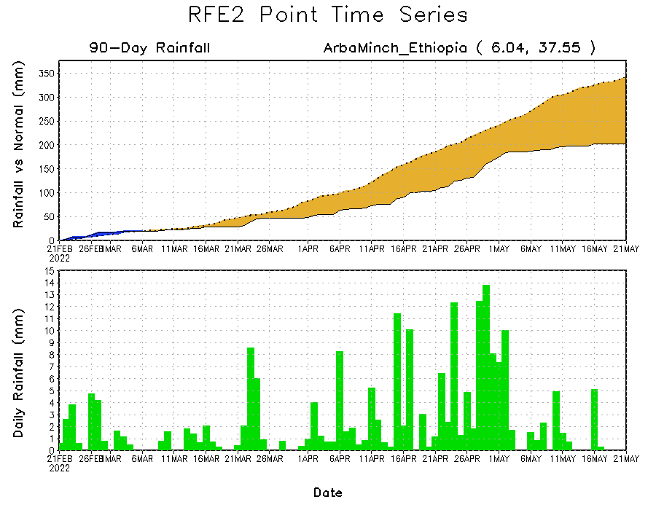
Rainfall Evolution
Daily evolution of rainfall over the last 90 days at selected locations shows moderate to heavy rainfall sustained moisture surpluses over parts of southern Ghana (bottom left). Seasonal total rainfall remained below-average over parts of southern South Sudan (top right) and southern Ethiopia (bottom right).

Slide 9
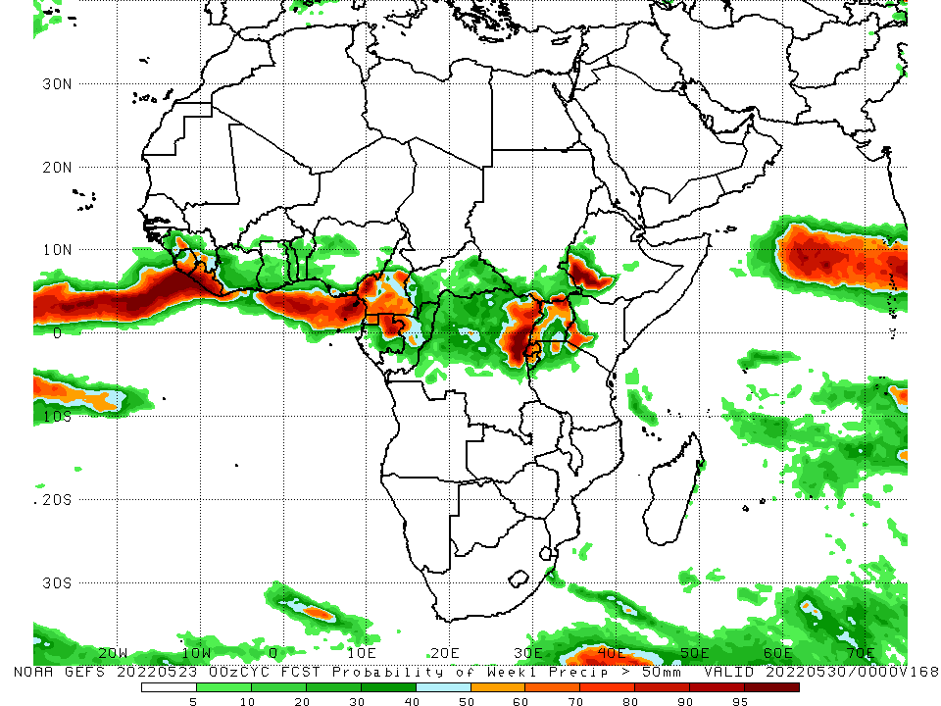
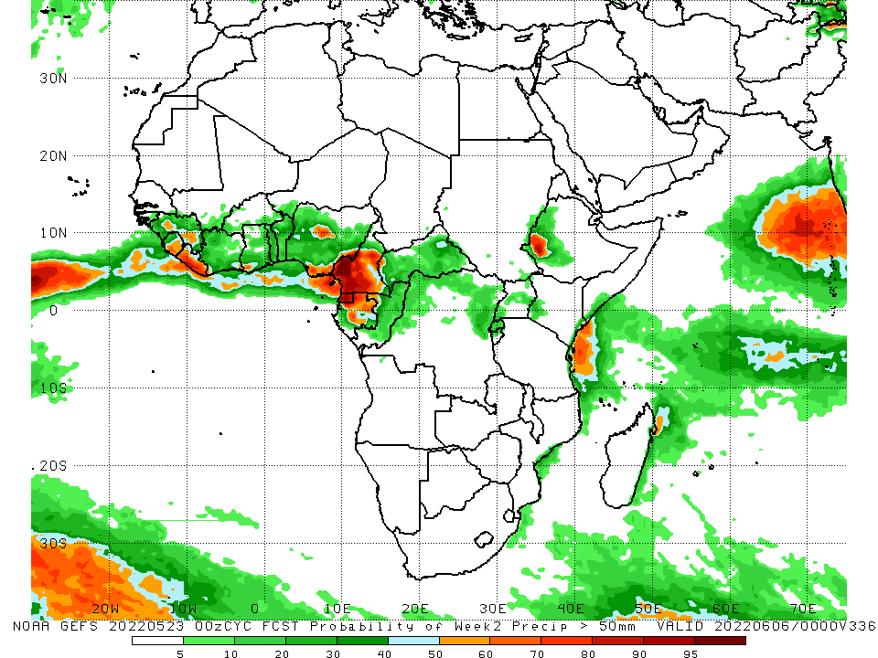
NCEP GEFS Model Forecasts Non-Bias Corrected Probability of precipitation exceedance
Week-1, Valid: 24 – 30 May, 2022
Week-2, Valid: 31 May – 06 June, 2022
For week-1 (left panel) and week-2 (right panel), the NCEP GEFS indicates a moderate to high chance (over 70%) for rainfall to exceed 50 mm over Sierra Leone, Liberia, Cameroon, northern Gabon, Equatorial Guinea, the Lake Victoria region, and southwestern Ethiopia.
Notes:
9

Slide 10
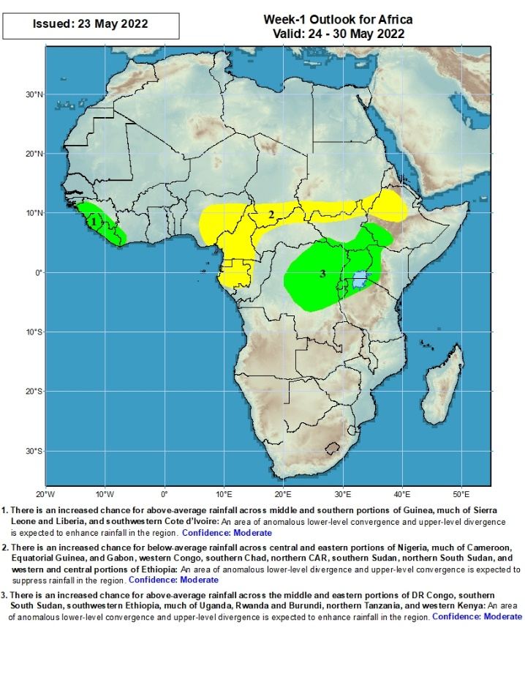
Week-1 Precipitation Outlooks
24 – 30 May, 2022
There is an increased chance for above-average rainfall across the middle and southern portions of Guinea, much of Sierra Leone and Liberia, and southwestern Cote d’Ivoire: An area of anomalous lower-level convergence and upper-level divergence is expected to enhance rainfall in the region. Confidence: Moderate
There is an increased chance for below-average rainfall across central and eastern portions of Nigeria, much of Cameroon, Equatorial Guinea, and Gabon, western Congo, southern Chad, northern CAR, southern Sudan, northern South Sudan, and western and central portions of Ethiopia: An area of anomalous lower-level divergence and upper-level convergence is expected to suppress rainfall in the region. Confidence: Moderate
There is an increased chance for above-average rainfall across the middle and eastern portions of DR Congo, southern South Sudan, southwestern Ethiopia, much of Uganda, Rwanda and Burundi, northern Tanzania, and western Kenya: An area of anomalous lower-level convergence and upper-level divergence is expected to enhance rainfall in the region. Confidence: Moderate
Notes:
10

Slide 11
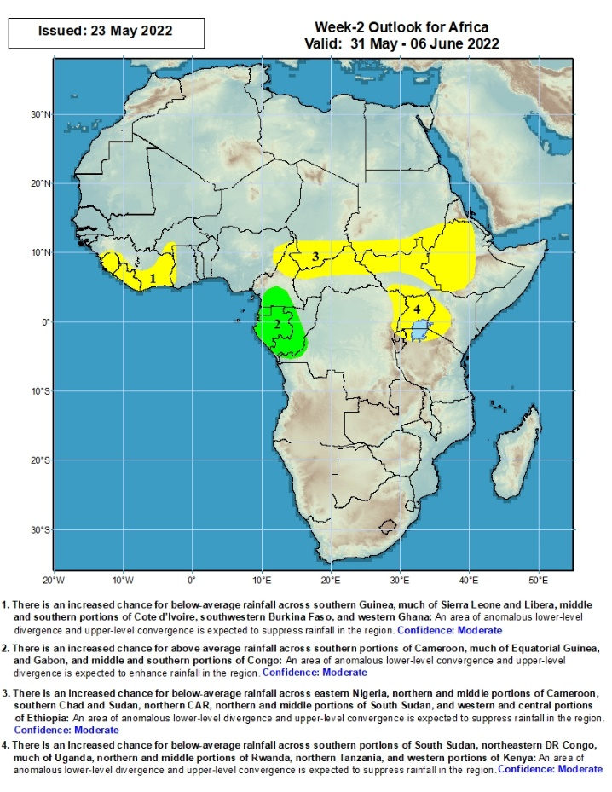
Week-2 Precipitation Outlooks
31 May – 06 Jun, 2022
There is an increased chance for below-average rainfall across southern Guinea, much of Sierra Leone and Liberia, middle and southern portions of Cote d’Ivoire, southwestern Burkina Faso, and western Ghana: An area of anomalous lower-level divergence and upper-level convergence is expected to suppress rainfall in the region. Confidence: Moderate
There is an increased chance for above-average rainfall across southern portions of Cameroon, much of Equatorial Guinea, and Gabon, and middle and southern portions of Congo: An area of anomalous lower-level convergence and upper-level divergence is expected to enhance rainfall in the region. Confidence: Moderate
There is an increased chance for below-average rainfall across eastern Nigeria, northern and middle portions of Cameroon, southern Chad and Sudan, northern CAR, northern and middle portions of South Sudan, and western and central portions of Ethiopia: An area of anomalous lower-level divergence and upper-level convergence is expected to suppress rainfall in the region. Confidence: Moderate
There is an increased chance for below-average rainfall across southern portions of South Sudan, northeastern DR Congo, much of Uganda, northern and middle portions of Rwanda, northern Tanzania, and western portions of Kenya: An area of anomalous lower-level divergence and upper-level convergence is expected to suppress rainfall in the region. Confidence: Moderate
Notes:
11

Slide 12
Summary
During the past 30 days, in East Africa, above-average rainfall was observed over western Ethiopia, southern Sudan, western northern and eastern South Sudan, southeastern Uganda, and parts of Tanzania. Rainfall was below-average over eastern and southern Ethiopia, the central and southern parts of South Sudan, western and central Kenya, and Somalia. In Central Africa, rainfall was above-average over Cameroon, Equatorial Guinea, northern and eastern Gabon, Congo, much of CAR, and much of DRC. Rainfall was below-average over pockets of Gabon and northeastern DRC. In Southern Africa, above-average rainfall was observed over portions of Mozambique, central and eastern South Africa. Below-average rainfall was observed over parts of Angola, Namibia, western South Africa, and pockets of Madagascar. In West Africa, rainfall was above-average over parts of Guinea, Cote d’Ivoire, Ghana and Nigeria. In contrast, portions of Liberia and Cote d’Ivoire, Burkina Faso, Benin and northern Nigeria received below-average rainfall.
During the past 7 days, in East Africa, rainfall was above-average over the far southern Sudan and the neighboring areas of South Sudan, and pockets of southwestern Ethiopia, while below-average rainfall was observed over the southern portion of southern Sudan, and many parts of Ethiopia and Uganda. In Central Africa, rainfall was above-average over eastern Gabon, central Congo, western and central DRC, and southern Chad. Below-average rainfall was observed over pockets of CAR and northeastern DRC. In West Africa, above-average rainfall was observed over the eastern portion of Gulf of Guinea, while rainfall was below-average over the western portion of the Gulf of Guinea region. In southern Africa, above-average rainfall was observed over portions of South Africa and southern Mozambique.
Week-1 and Week-2 outlooks call for an increased chance for below-average rainfall over the eastern portion of the Gulf of Guinea region, and parts of Central and the Greater Horn of Africa. In contrast, there is an increased chance for above-average rainfall in the Lake Victoria region, including northeastern DRC during week-1, and over southern Cameroon, Equatorial Guinea, Gabon and Congo during week-2.

